Slide 1



YEAR 12
LAUNCH EVENT
14 September 2026

Slide 2
Year 12 Launch Event
The key dates and assessments points throughout the two years
An overview of independent study at KS5
Information and strategies to support with revision
Strategies to support with positive mental health and wellbeing
Key reminders about the importance of attendance and punctuality
SEND support and Access Arrangements
An introduction to how we incorporate next steps planning into Personal Development sessions
Sixth Form Enrichment

Slide 3
Meet the team
Mrs Sweeney – Head of Sixth Form Miss Plimmer – Assistant Head of Sixth Form Mrs Dennison – Sixth Form Academic Mentor
12HEN | 12PGE | 12ROL | 12SMT
Mr Henson Humanities | Mr Page CAPA | Mr Rollo Maths | Mrs Smith MFL

Slide 4
KEY DATES AND ASSESSMENT POINTS

Slide 5
The key dates and assessments points throughout the two years
 | Semester 1 exams | Semester 2 exams | Final exams
Year 12 | Thurs 19 – Fri 27 November 2026 | Thurs 25 Feb – Fri 5 March 2027 | Progress Exams* Tues 22 June – Wed 30 June 2027 Core/Further Maths Exams EPQ submission
Sixth Form Parents Evening Tuesday 5th January 2027
Year 13 | Thurs 18 - Fri 26 November 2027 | Thurs 2 March – Fri 10 March 2028 | May – June 2028 Final exams
*To continue with A-Level courses a student must have achieved a grade E in their Year 12 progress exam
*To continue with an applied course, a student must be in line to achieve at least their target for that subject
January and May/June - External exams for applied courses (Human & Biomedical Science and Sport Studies)

Slide 6
INDEPENDENCE
AT KEY STAGE FIVE

Slide 7
Attendance to all lessons is compulsory. This includes Personal Development.
Period 6 lessons finish at 4.00pm
 | Tutorial | Period 1 | Period 2 | Period 3 | Period 4 | Period 5 | Period 6
A Mon |  | Chem |  | Psy |  | Bio
A Tues |  |  | Chem | Psy
A Wed |  | Chem |  | Bio |  | Psy
A Thurs |  |  |  | Bio | Chem | PD | Bio
A Fri |  | Psy | Chem
B Mon |  | Chem | Bio | Psy
B Tues |  |  |  | Chem |  | Psy
B Wed |  | Bio |  | Psy | Psy
B Thurs |  | Psy | Bio | Chem
B Fri |  | PD | Chem |  | Bio | Bio
Student must attend one tutorial session with their tutor each week.
Students do not have to sign in until break time if they do not have a period 1 or period 2 lesson.
All students stay on site until 3.00pm. Can leave and return at lunchtime if they wish.

Slide 8
Attendance to all lessons is compulsory. This includes Personal Development.
Period 6 lessons finish at 4.00pm
 | Tutorial | Period 1 | Period 2 | Period 3 | Period 4 | Period 5 | Period 6
A Mon |  | Chem |  | Psy |  | Bio
A Tues |  |  | Chem | Psy
A Wed | Tutorial | Chem |  | Bio |  | Psy
A Thurs |  |  |  | Bio | Chem | PD | Bio
A Fri |  | Psy | Chem
B Mon | Tutorial | Chem | Bio | Psy
B Tues |  |  |  | Chem |  | Psy
B Wed | Tutorial | Bio |  | Psy | Psy
B Thurs |  | Psy | Bio | Chem
B Fri |  | PD | Chem |  | Bio | Bio
Student must attend three tutorials per fortnight
Students do not have to sign in until break time if they do not have a period 1 or period 2 lesson.
All students stay on site until 3.00pm. Can leave and return at lunchtime if they wish.

Slide 9
Attendance to all lessons is compulsory. This includes Personal Development.
Period 6 lessons finish at 4.00pm
 | Tutorial | Period 1 | Period 2 | Period 3 | Period 4 | Period 5 | Period 6
A Mon |  | Chem |  | Psy |  | Bio
A Tues |  |  | Chem | Psy
A Wed | Tutorial | Chem |  | Bio |  | Psy
A Thurs |  |  |  | Bio | Chem | PD | Bio
A Fri |  | Psy | Chem
B Mon | Tutorial | Chem | Bio | Psy
B Tues |  |  |  | Chem |  | Psy
B Wed | Tutorial | Bio |  | Psy | Psy
B Thurs |  | Psy | Bio | Chem
B Fri |  | PD | Chem |  | Bio | Bio
Student must attend three tutorials per fortnight
Students do not have to sign in until break time if they do not have a tutorial, period 1 or period 2 lesson.
Everyone must sign in by 11.15am
All students stay on site until 3.00pm. Can leave and return at lunchtime if they wish. they wish.

Slide 10

Personal Development Curriculum
A coherent, planned curriculum
Tutorial sessions and Personal Development lessons ensure we deliver all aspects of the KS5 Personal Development Curriculum
OFSTED: Achieve, Belong & Thrive
TTCT Mission: Enhancing Life Choices

Slide 11

 | Tutorial | Period 1 | Period 2 | Period 3 | Period 4 | Period 5 | Period 6
A Mon |  | Chem |  | Psy |  | Bio
A Tues |  |  | Chem | Psy
A Wed | Tutorial | Chem |  | Bio |  | Psy
A Thurs |  |  |  | Bio | Chem | PD | Bio
A Fri |  | Psy | Chem
B Mon | Tutorial | Chem | Bio | Psy
B Tues |  |  |  | Chem |  | Psy
B Wed | Tutorial | Bio |  | Psy | Psy
B Thurs |  | Psy | Bio | Chem
B Fri |  | PD | Chem |  | Bio | Bio
‘What you achieve at GCSE is due to your work in lessons. How you achieve at A-level is due to your work outside of lessons’.

Slide 12
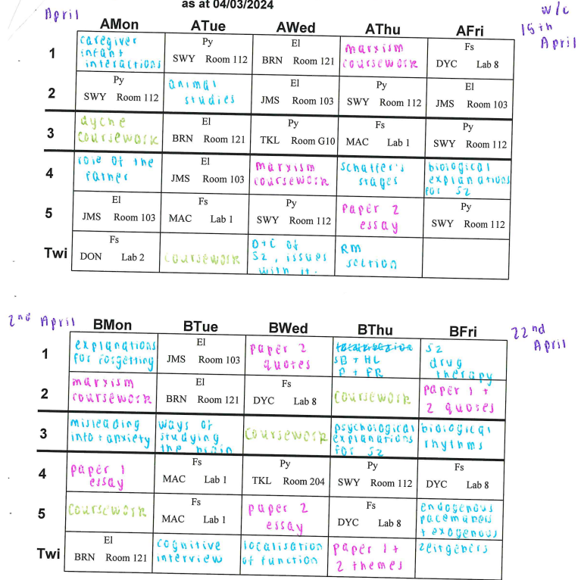





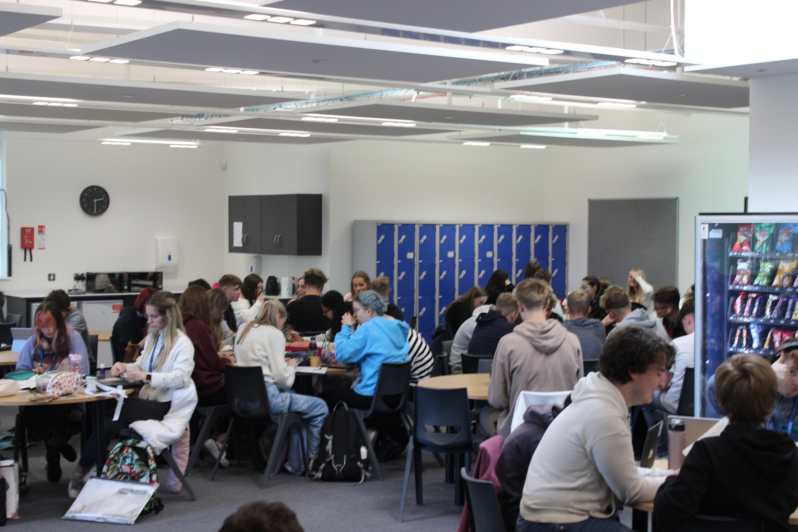
Independent study at KS5

Slide 13
INFORMATION AND STRATEGIES TO SUPPORT WITH REVISION

Slide 14
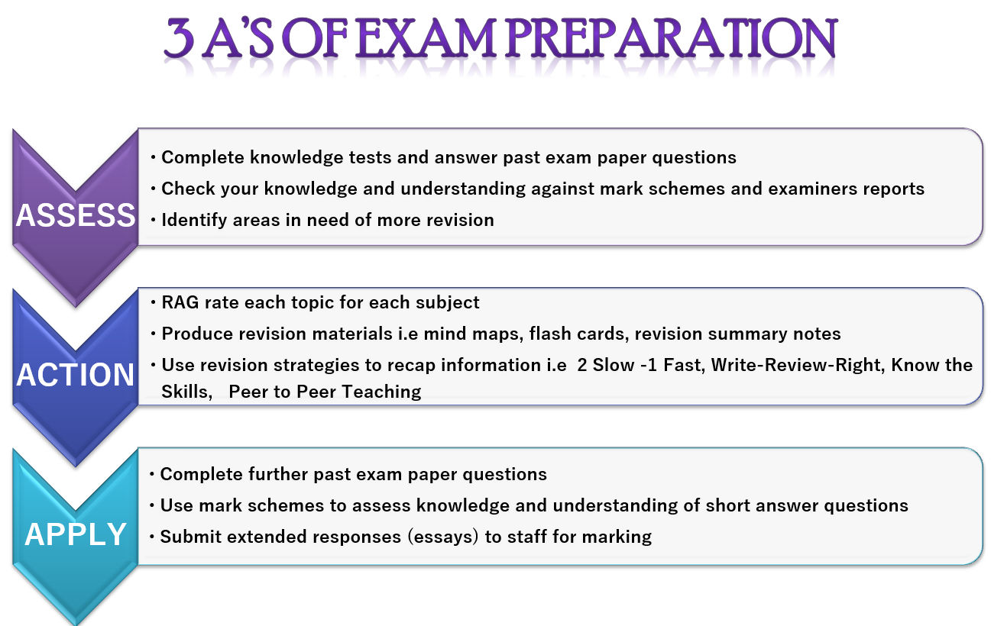
Information and strategies to support with revision

Slide 15
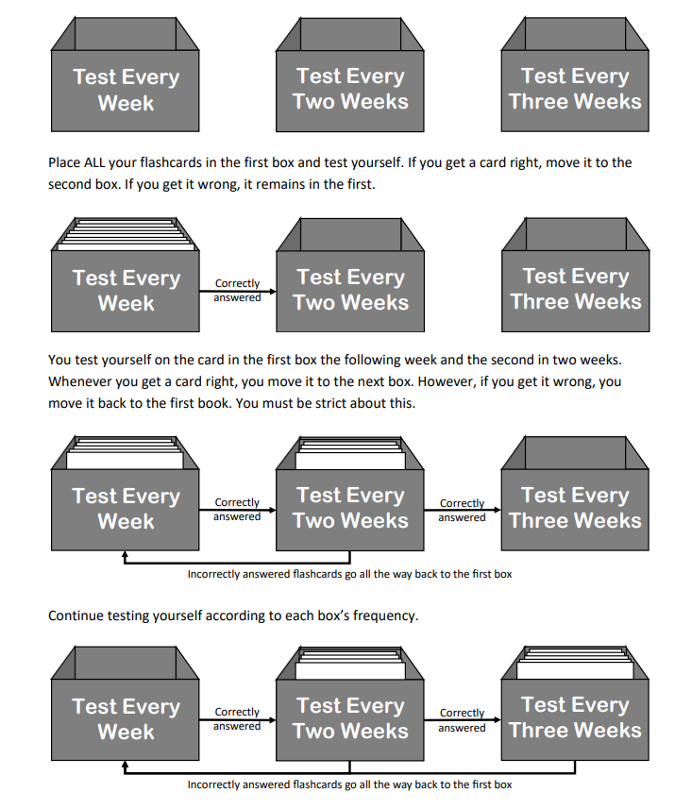
The Leitner Box System
Effective use of flashcards

Slide 16



Two Slow, One fast
This is a technique that is designed to take away all the chaos and uncertainty of answering a question in an exam.
It focuses on skill development by asking students to repeat a tricky process 3 times….
Write an answer slowly (no time limit) using notes, mark schemes and examiners reports
Write the answer out again slowly (no time limit) but this time from memory so no notes or mark schemes
Write the answer out again but this time in exam conditions (timed and with no notes etc) HAND THIS ONE INTO CLASS TEACHER FOR FEEDBACK
This technique works well with subjects that require extended writing or mathematical problem solving and it helps to support students with exam timings

Slide 17
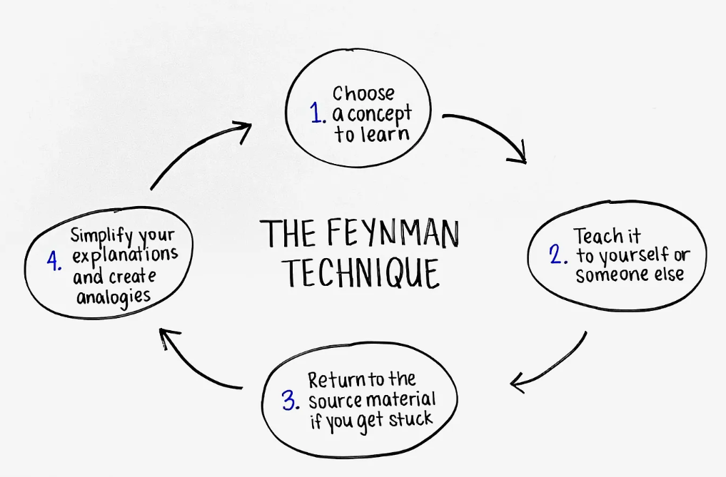

Slide 18

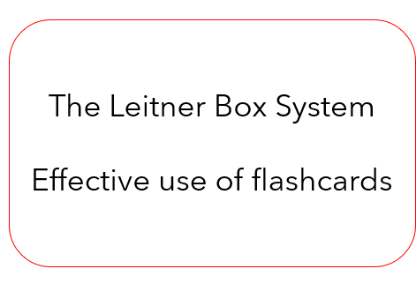

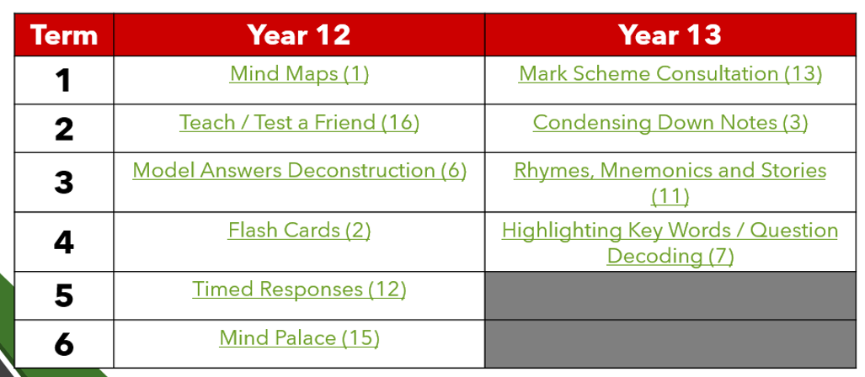

INFORMATION AND STRATEGIES TO SUPPORT WITH REVISION
1:1 Academic Mentor Support

Slide 19

‘Excessive use of AI can lead to pupils avoiding looking up information themselves, a process called cognitive off-loading’.
The 2025 Programme for International Student Assessment (PISA)
PISA: Programme for International Student Assessment | OECD

Slide 20
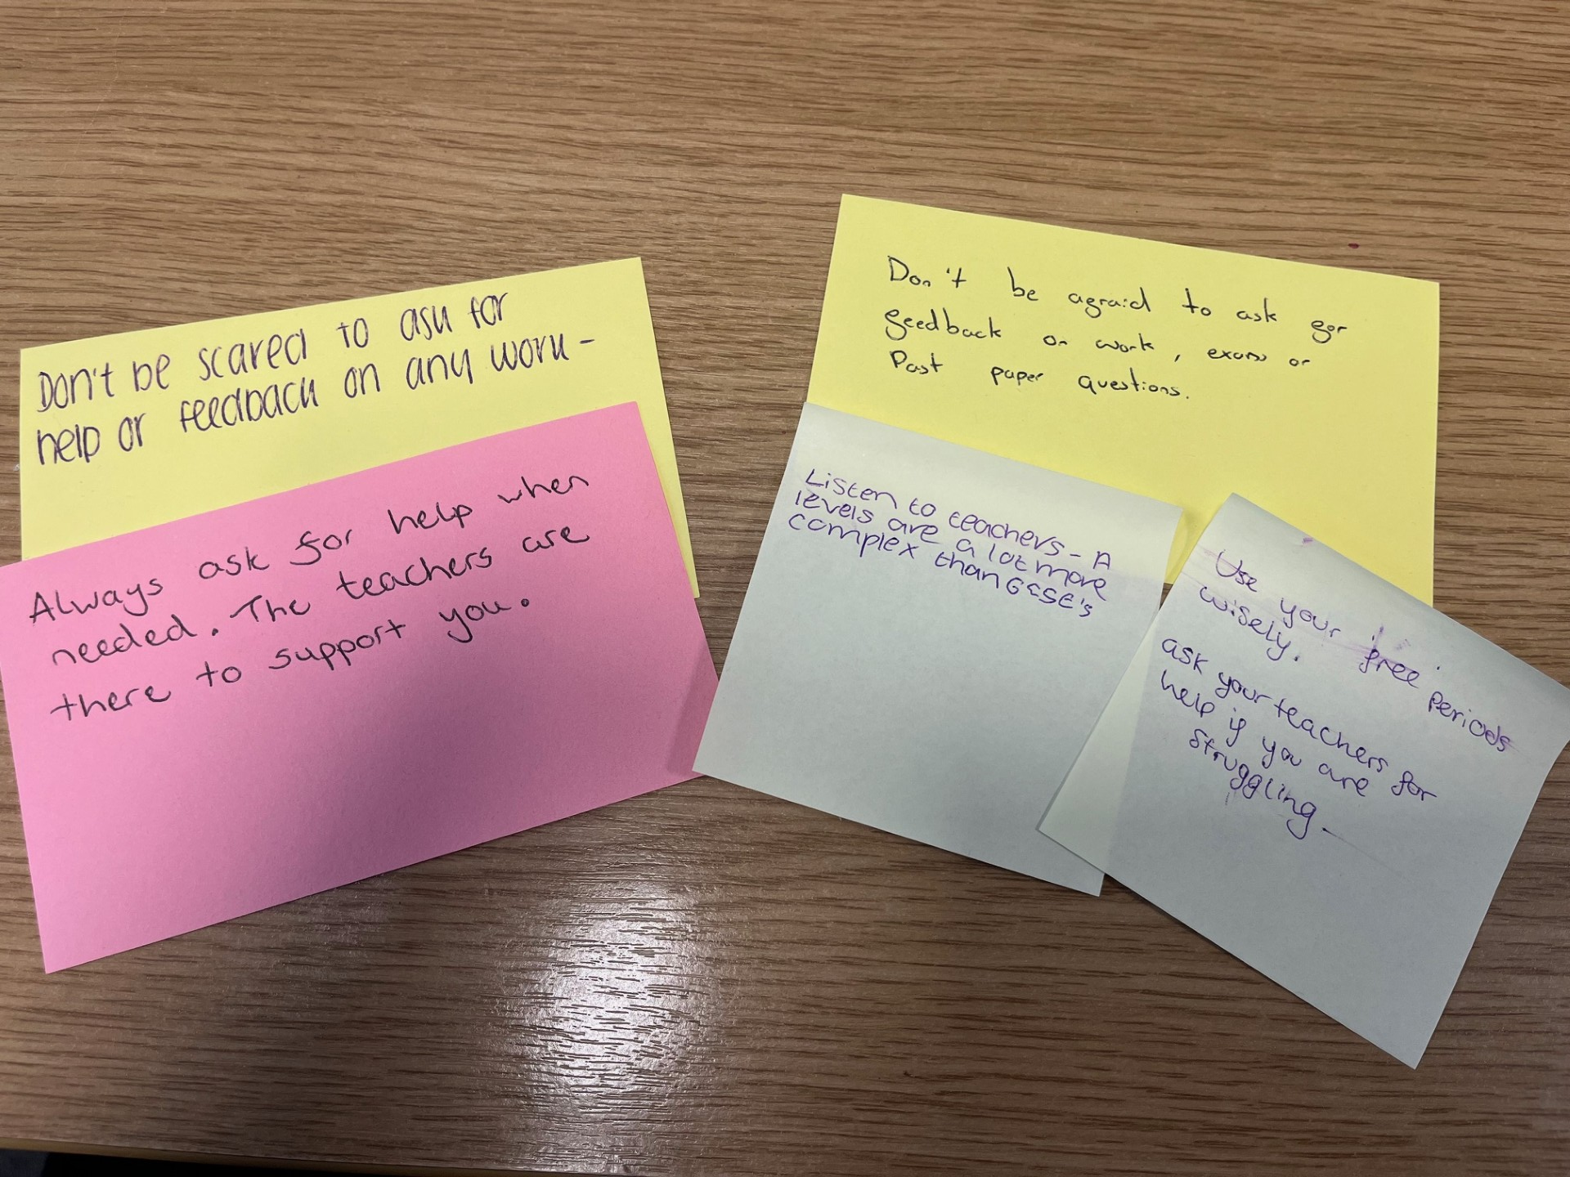

Slide 21
ATTENDANCE, PUNCTUALITY AND EMPLOYABILITY

Slide 22
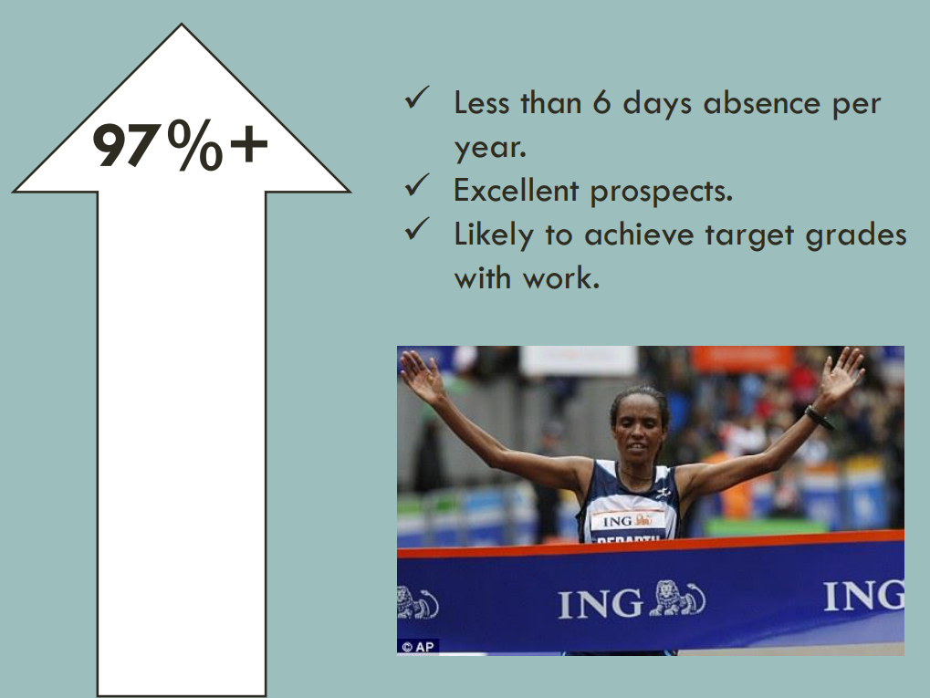
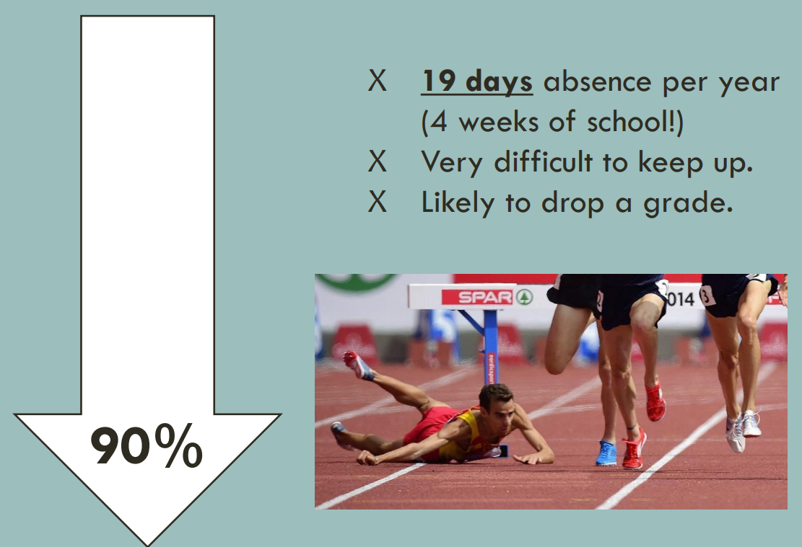
Employability standards
Attendance

Slide 23
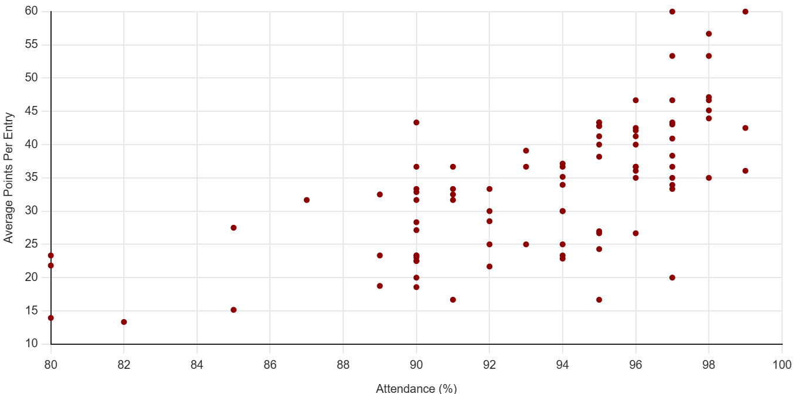
Employability standards
Attendance
Average grades
'Points' per entry:
A* = 60
A = 50
B = 40
C = 30
D = 20
E = 10
Dist* = 50
Dist = 35
Merit = 25
Pass = 15

Slide 24
Employability standards
Dress code, positive role modelling and student accountability
Casual
Mature
Suitable for school environment
Lanyards and ID badges at all times
Students can communicate absences
Students can communicate planned appointments(with supporting evidence)
attendance@wilsthorpe.ttct.co.uk
Students are able to plan their driving lessons during independent study time
Proof of driving lesson must be shown as confirmation

Slide 25
Employability standards
Work Experience Week
12 – 15 July 2027*
At least one day of work experience is beneficial
Work experience can be taken at alternative points during the year
*This is the same week as Geography fieldwork

Slide 26



Communication home
MyEd
ParentPay
Communication was shared last week explaining how to sign up to these apps.
Please let us or your child's form tutor know if you have not had this information.

Slide 27
SEND, Learning Support
Mrs Robinson
Deputy SENCO
Mrs Dennison
Sixth Form Academic Mentor
Access Arrangements
Any exam access arrangements in place for GCSE are closely reviewed and applied throughout Sixth Form
Referrals can be during Year 12/13

Slide 28
STRATEGIES TO SUPPORT WITH POSITIVE MENTAL HEALTH AND WELL BEING

Slide 29

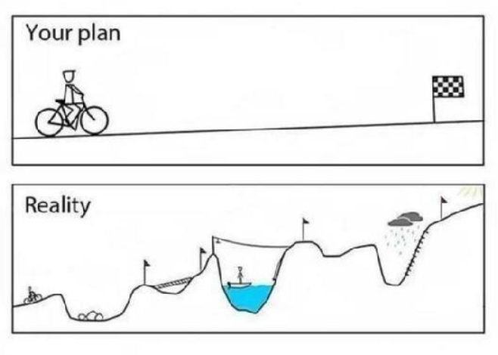





Strategies to support with positive mental health and wellbeing

Slide 30
NEXT STEPS AND
CAREERS PLANNING

Slide 31
Post 18 Pathways
UCAS
Apprenticeships
Careers/Jobs/Gap years
*Oxbridge, Medicine, Dentistry, Veterinary Science*
Students who are looking to apply for these courses will experience a dedicated support program from our experienced team;
Oxford outreach
Support with admissions tests
Personal statement writing
Super curricular opportunites

Slide 32





An introduction to how we incorporate next steps planning into Personal Development sessions
Work Experience

Slide 33
Medicine
Maths
Cyber Security
Law
History
Politics and International Relations
Forensic Science
Chemical Engineering
Education with Psychology and Counselling
Primary Education
Veterinary Nursing
University of Nottingham
University of Leeds
University of Leicester
Nottingham Trent University
University of Derby
University of Liverpool
University of Brighton
University of York
University of Swansea
RAF Weapons Engineer
Rolls Royce Nuclear Engineering
Magnum
Laing O’Rourke Quantity Surveying
Bridgeway Railway Engineering

Slide 34










SIXTH FORM ENRICHMENT
We want students to leave Wilsthorpe Sixth Form with a set of grades they are proud of, alongside a memorable and purposeful student experience
1:1
Reading
KS3 and KS4 Mentoring
COOKING SKILLS
Visiting speakers
Sixth Form Society(s)
MOOCs
Ambition Nottingham
Supporting in the Hub or with lunchtime/after school clubs for younger students
Work Experience

Slide 35
Year 12 Launch Event
Thank you very much for listening
Any questions?
(Please come down and speak to us if you have any questions relating specifically to your child)

