Slide 1









Geography
Edexcel A GCSE
Knowledge Cards
How to use your Knowledge Cards:
Each card gives you the key knowledge you need for each key point in the exam specification.
Using the knowledge on each card, you can create revision resources to help you learn what is on them
Examples of revision resources and techniques may include:
Mind Maps – put the spec key point in the middle of a page and branch off with the key knowledge you need to remember, building on it each time!
Flash Cards – great for key terms and definitions, or Q+A!
Name:
Class:
Teacher:
Look, Cover, Write, Check – look at the card, then cover it up, write what you can remember, then check. Then repeat until you can remember more!
Poems and Songs – turn what you are trying to remember into a poem or song to make it stick!
Revision Clocks – take a topic, divide it into 12 sections for sub-topics, and spend just 5 minutes on each to write down what you can remember before checking!

Slide 2
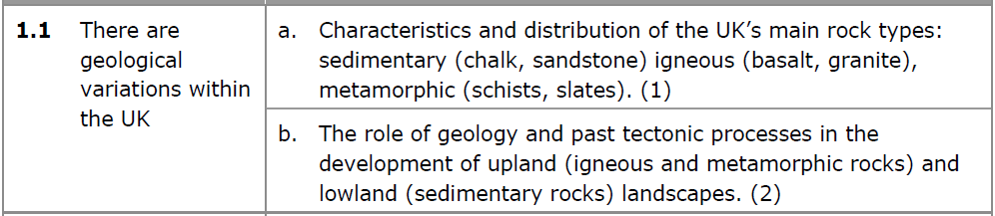
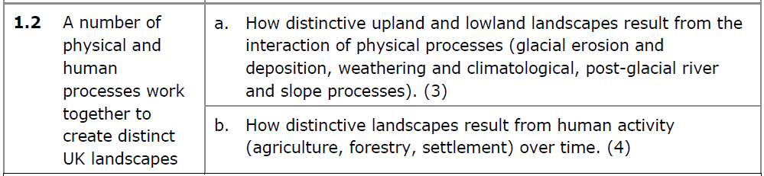
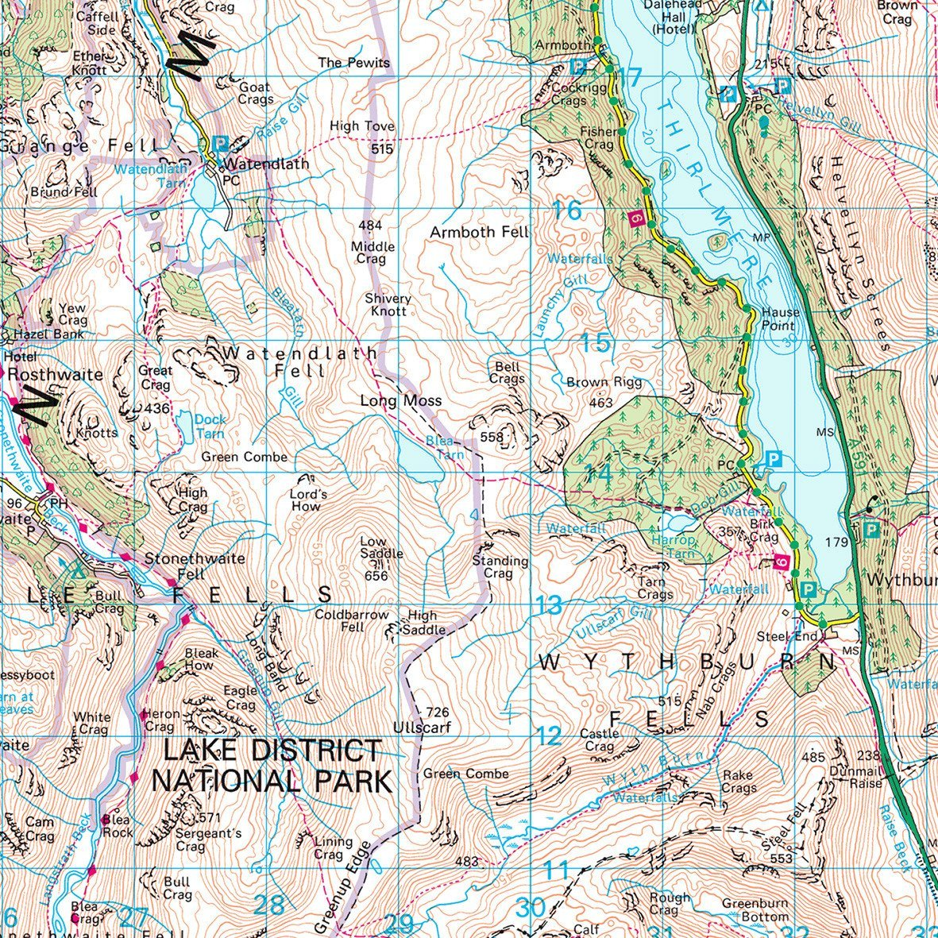
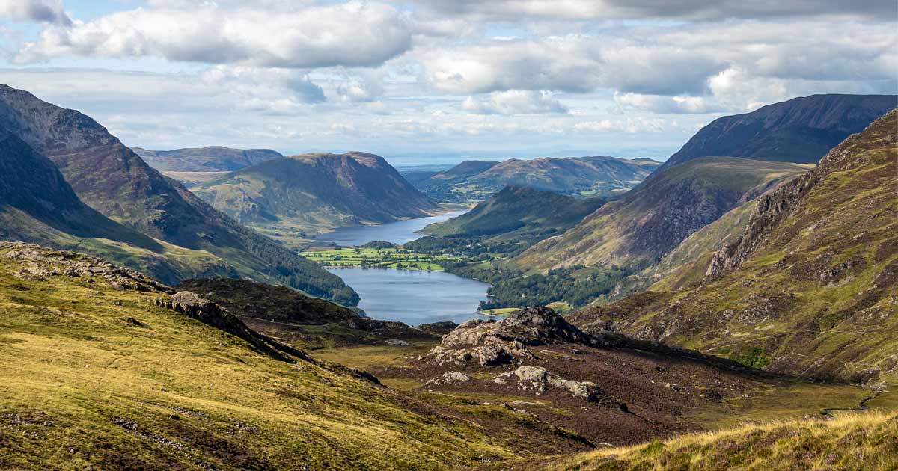
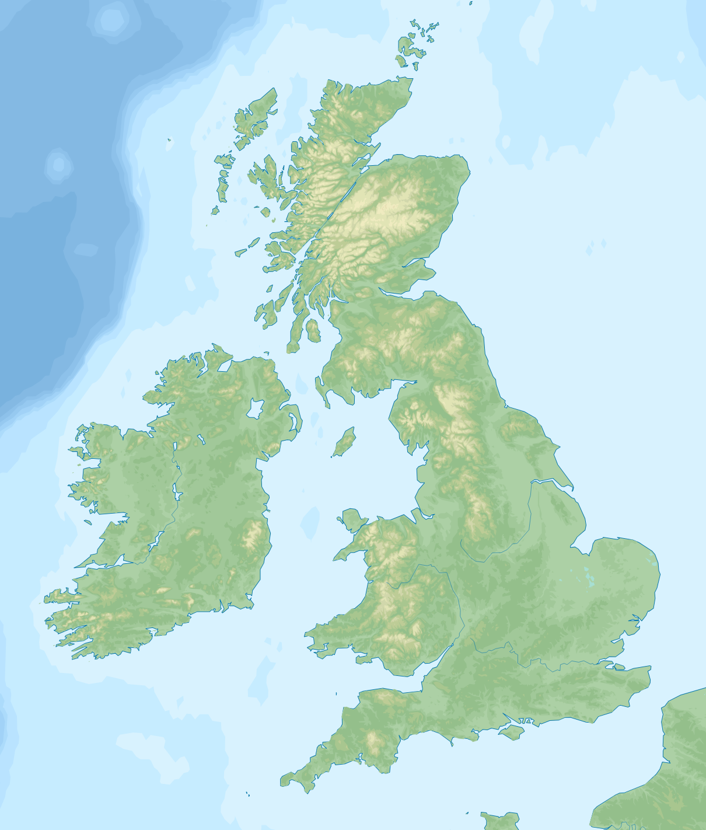
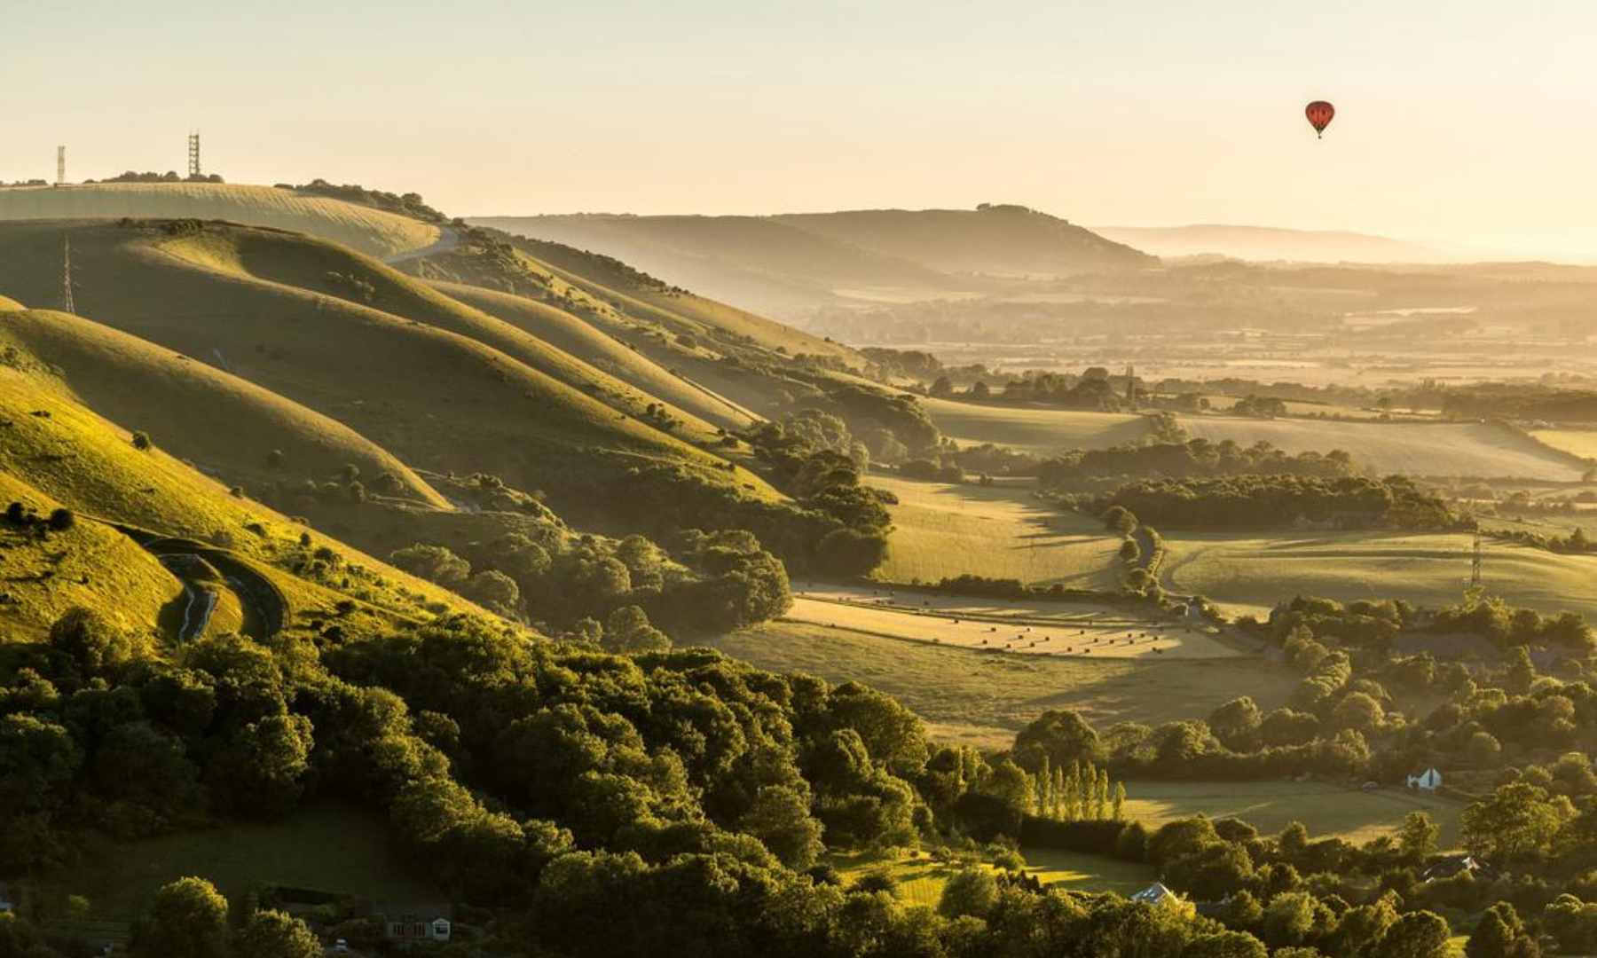
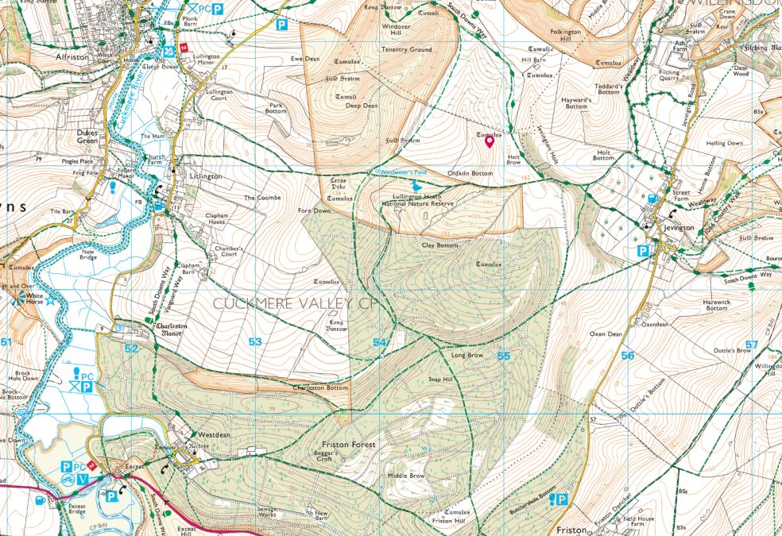
Type | Examples | Formation | Characteristics
Igneous | Granite Basalt | Cooling magma from volcanoes | Hard Crystals
Sedimentary | Limestone Sandstone | Sediment that has been compacted together | Hard or Soft Layers Fossils
Metamorphic | Marble Slate | Rocks changed by heat and pressure | Hard Colourful
Upland Landscape
Glaciers during the last ice age eroded U-shaped valleys
Freeze-thaw weathering creates steep valley sides with scree (broken rock) at bottom
Farming of livestock on the hillsides
Not many large settlements here as it is difficult to build on steep land
Upland = Igneous Rock
Old volcanoes that have not eroded away as quickly
Lowland Landscape
Lowland = Sedimentary Rock
More easily eroded to create more gentle or flat land
Landscape shaped by river erosion and deposition of sediments
Escarpments created by past tectonic uplift, with rivers running off these hills.
Flatter land allows for more settlements to be built and for more crop farming.

Slide 3
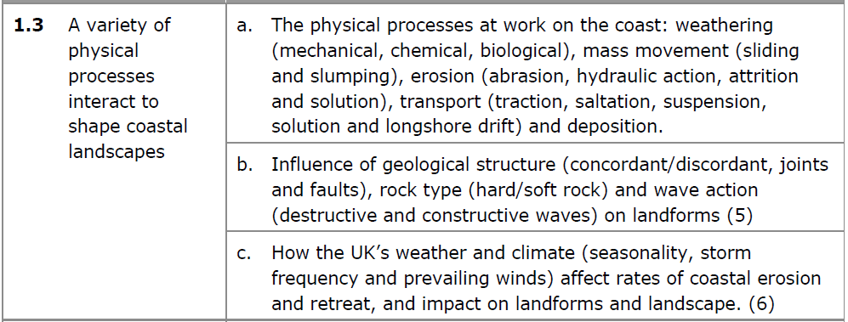
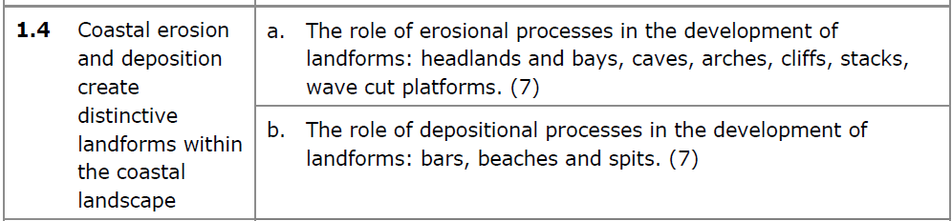
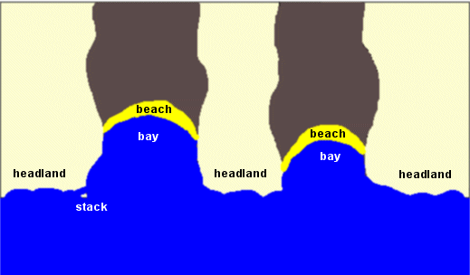
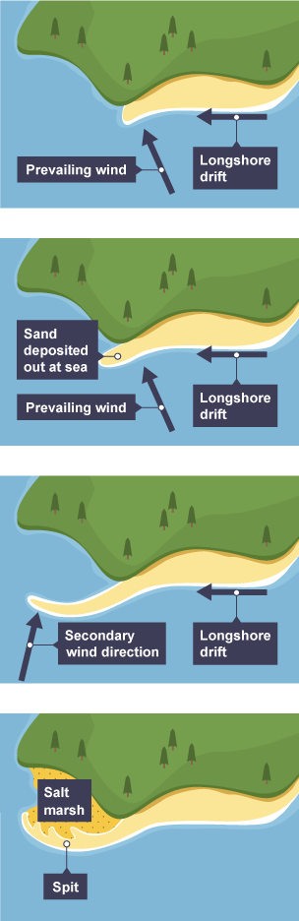
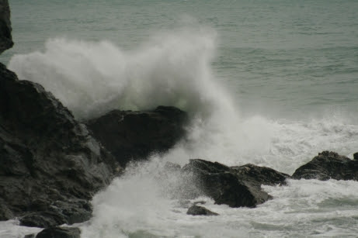
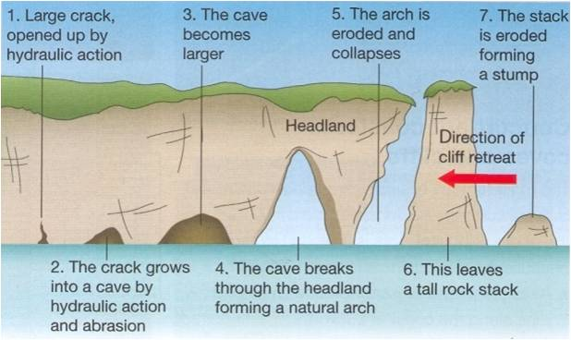
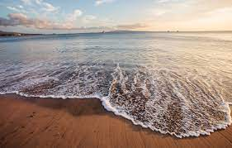
Headlands and Bays
Hard rock is more resistant to erosion than soft rock.
Soft rock erodes backwards, whilst the hard rock does not.
This leaves hard rock sticking out as headlands, with bays in between.
Erosion | The wearing away of the coast
Hydraulic Action | Water and air forced into cracks in the cliff, breaking chunks off.
Abrasion | Rocks scrape against the coastline.
Attrition | Rocks collide together becoming smaller and smoother.
Solution | Rocks dissolved by the sea water.
Spits
Longshore drift carries sediment along the coastline, driven by the prevailing wind.
When the coastline changes direction, longshore drift loses energy and deposits sediment at the end of the coast.
This builds up over time, extending the beach out into the sea.
Longshore drift can then begin again, continuing to extend the beach. This forms a spit.
A salt marsh forms behind the spit in a low energy zone.
Transportation | Movement of sediment
Traction | Rolling along the seabed.
Saltation | Bouncing along the seabed.
Suspension | Carried by the waves.
Solution | Dissolved within the waves.
Longshore Drift | Movement of sediment along the coastline, driven by prevailing winds.
Destructive Waves
Weak swash, strong backwash = more erosion
Cave, Arch, Stack
Constructive Waves
Weathering | Breakdown of the coast in-situ
Mechanical | Physical breakdown by weather.
Chemical | Rocks worn down by acid rain.
Biological | Plants/animals breaking down rocks through roots and burrows.
Strong swash, weak backwash = more deposition

Slide 4
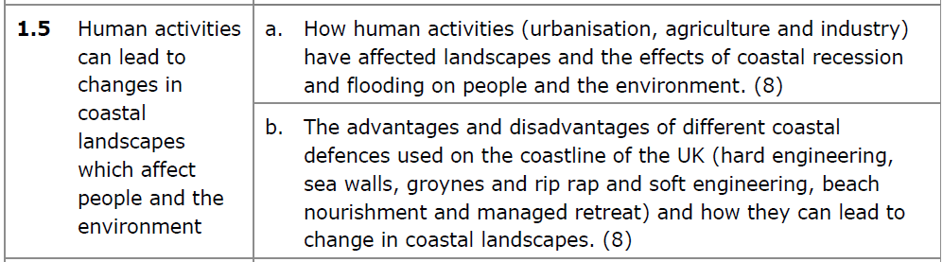
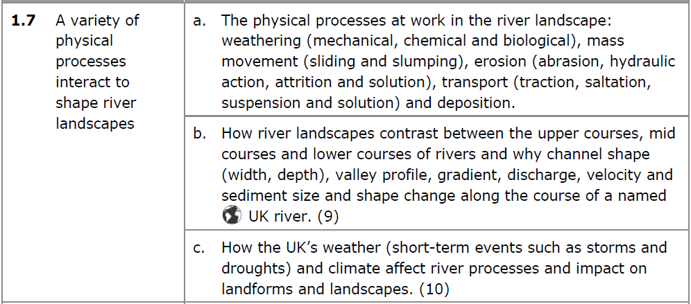
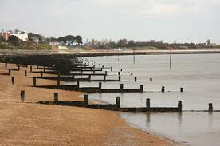
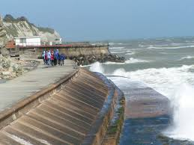
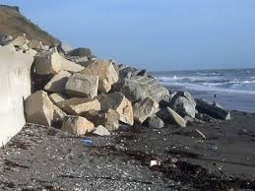
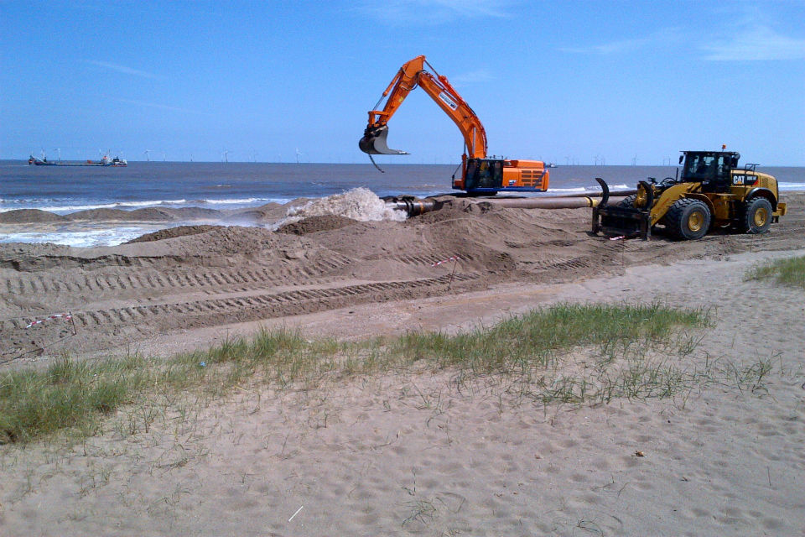
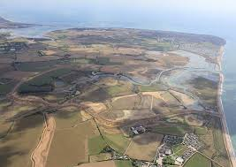
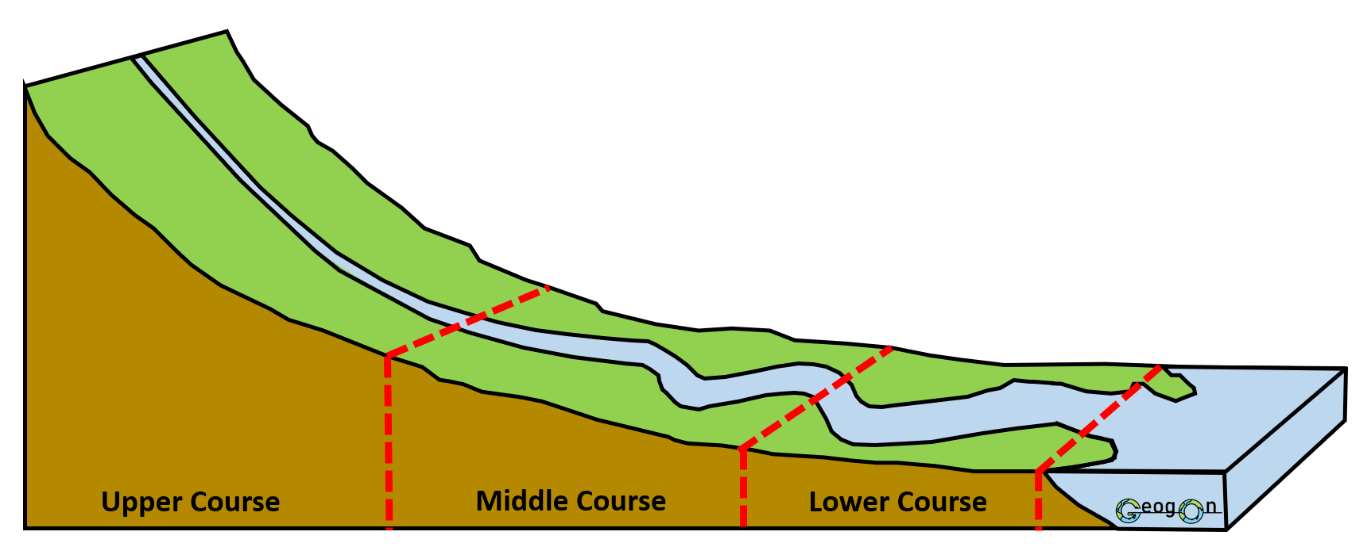
Effects on People | Effects on the Environment
Homes destroyed and collapsed Loss of jobs in farming as farmland is lost Tourism industry suffers | Loss of animal habitats More sediment carried along the coast Pollution from fallen buildings
Erosion | The wearing away of the riverbed and banks
Hydraulic Action | Water and air forced into cracks in the banks, breaking chunks off.
Abrasion | Rocks scrape against the bed and banks.
Attrition | Rocks collide together becoming smaller and smoother.
Solution | Rocks dissolved by the river water.
Strategy | Picture | Positive | Negative
Groynes |  | Stops longshore drift and helps build up the beach | Needs maintaining regularly so can be expensive
Sea Wall |  | Protects the coastline from destructive waves | Very expensive to put in place
Rip-Rap |  | Absorbs wave energy, reducing erosion rates | Not very attractive to look at
Beach Nourishment |  | Builds up the beach for natural protection | Sediment can be carried away by longshore drift
Managed Retreat |  | Allows more valuable land to be invested in | People and farmers lose land in this process still
Transportation | Movement of sediment
Traction | Rolling along the riverbed.
Saltation | Bouncing along the riverbed.
Suspension | Carried by the river water.
Solution | Dissolved within the water.
As the river flows downstream…
Width increases
Depth increases
Velocity increases
Discharge increases
Sediment Size decreases
Gradient (steepness) decreases
Weathering | Breakdown of the coast in-situ
Mechanical | Physical breakdown by weather.
Chemical | Rocks worn down by acid rain.
Biological | Plants/animals breaking down rocks through roots and burrows.

Slide 5
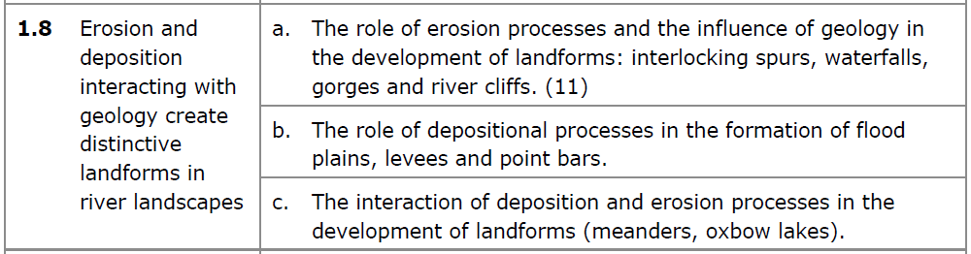
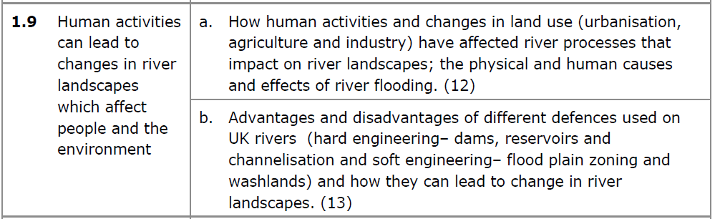
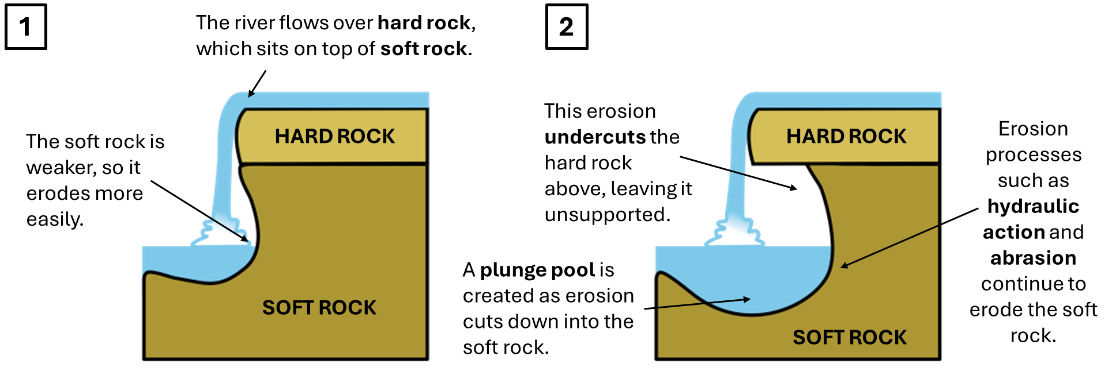
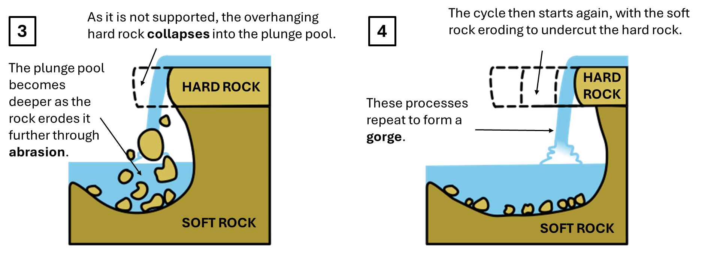
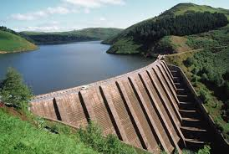
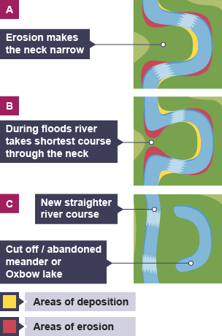
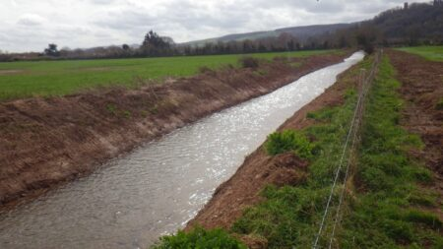
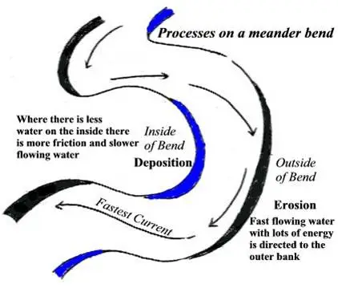
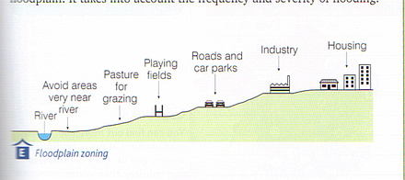
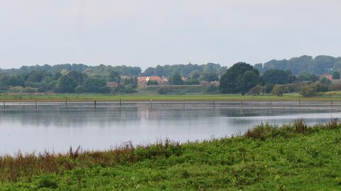
Waterfalls and Gorges
Causes of Flooding
Physical | Human
Impermeable rock, so water cannot infiltrate through. Heavy, prolonged rainfall creating saturated ground (full of water) | Deforestation, so there are no trees to intercept rainfall, and water reaches the river quicker. Urbanisation, as people create impermeable surfaces like roads with tarmac, no water infiltrates.
Strategy | Picture | Positive | Negative
Dams and Reservoirs |  | Holds water upstream, limiting flooding downstream | Upstream areas are flooded, and it is very expensive
Channel Straightening |  | Moves water more quickly downstream | The river floods the next time it hits a meander bend
Floodplain Zoning |  | Protects more valuable land from flooding | Does not prevent flooding from happening
Washlands |  | Creates an area where flood waters can go | Means that land cannot be used for other purposes
Meanders and Ox-Bow Lakes

Slide 6
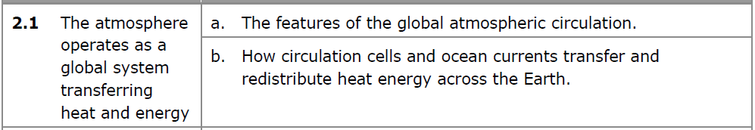
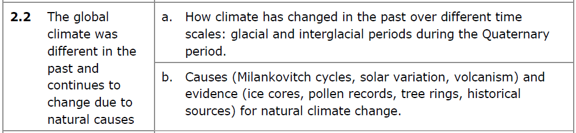
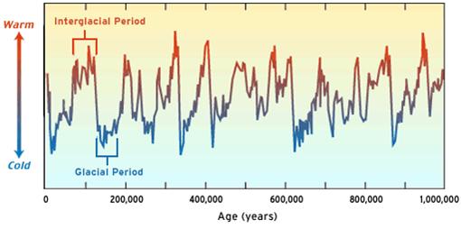
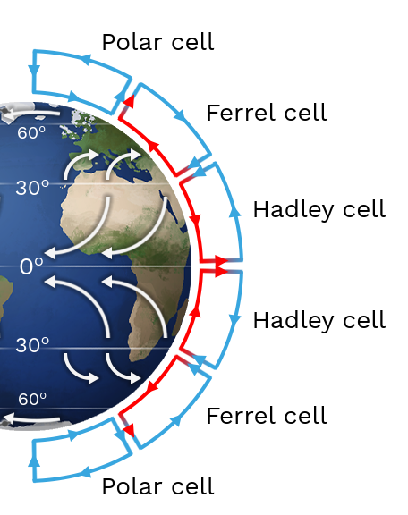
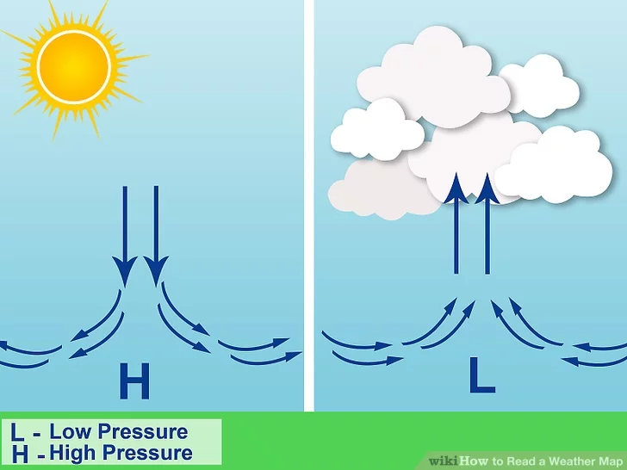
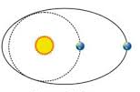
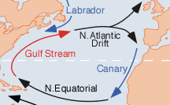
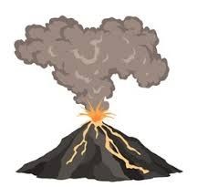
Equator is less curved, so solar energy is more concentrated, increasing temperatures.
Poles are more curved, so solar energy is less concentrated, decreasing temperatures.
The Earth’s climate changes from being in a glacial (cold period) to an interglacial (warm period) every 100,000 years.
Deserts at 30°N/S:
High pressure
Air Sinking
Dry/Arid Conditions
Tropical Rainforests at 0°:
Low pressure
Air Rising, Cools and Condenses
Rainfall and Wet
Conditions
When the Earth’s orbit is more circle-shaped, the Earth is closer to the sun for more of the year = warmer temperatures (interglacial).
Milankovitch Cycles (Eccentricity)
When the Earth’s orbit is more oval-shaped, the Earth is further away from the sun for more of the year = colder temperatures (glacial).
North Atlantic Drift = brings this warm water from the Atlantic Ocean towards the UK and Europe.
Gulf Stream = warm current bringing warm waters from the Gulf of Mexico into the Atlantic Ocean.
Volcanism
Canary Current = cold current bringing cooler waters back to the Equator.
Evidence for Past Climate Change
Ice Cores Tree Rings Pollen Analysis Paintings/Diaries Glacier Retreat
Large volcanic eruptions release gases which block out solar energy from coming into the atmosphere, cooling temperatures for a few years.
Circulation cells and ocean currents take heat energy from an area of surplus (the Equator) to an area of deficit (the Poles).

Slide 7
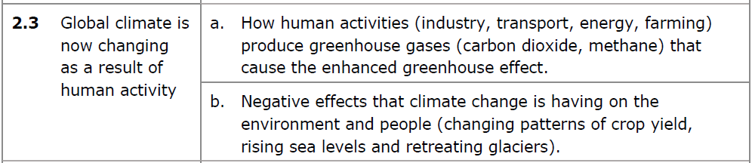
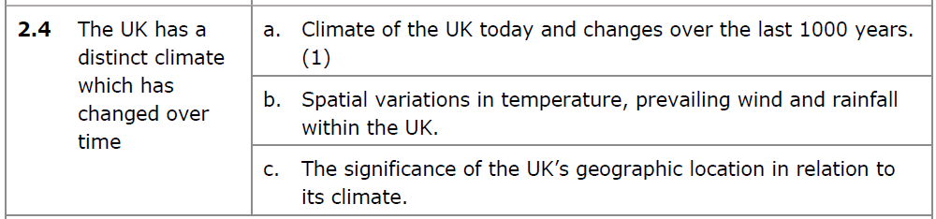
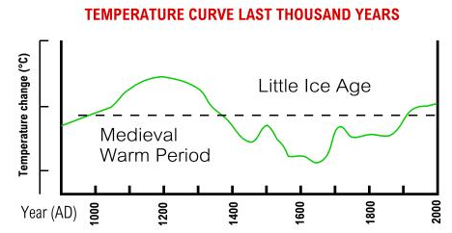
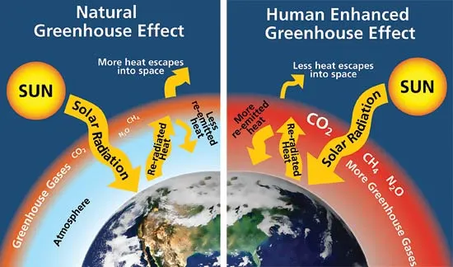
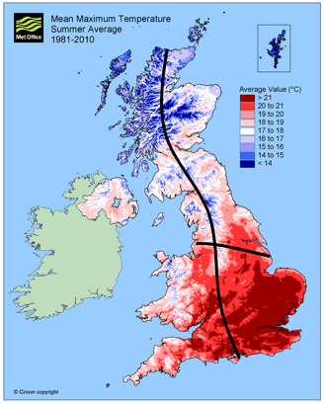
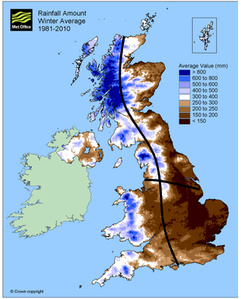
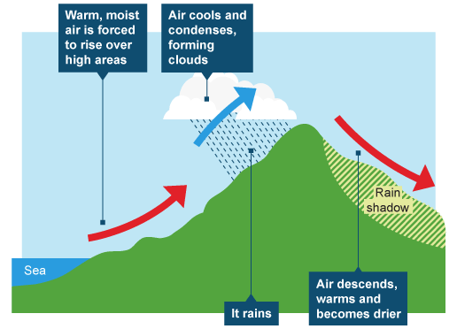
Human Activities:
Energy Production = burning fossil fuels creates carbon dioxide.
Farming = cattle farming (cows) produces methane, and machinery needs fuel which produces carbon dioxide.
Transport = cars need petrol and diesel, which are burned producing carbon dioxide.
Greenhouse Gases
Carbon Dioxide (CO₂) Methane (CH₄)
Medieval Warm Period = temperatures were 1°c warmer than average.
Little Ice Age = temperatures were 1°c colder than average.
North is colder as it has a higher latitude (further from the equator)
Human activity involves burning fossil fuels.
This creates more greenhouse gases.
These greenhouse gases trap solar energy in the atmosphere.
Temperatures rise.
West is wetter as prevailing winds bring moisture off the Atlantic Ocean
East is drier as hills (e.g. the Pennines) block rainfall from reaching this side of the UK (relief rainfall)
Impact of Climate Change | This leads to… | Impact on People
Drought | Reduced crop yields (farmers struggle to grow crops) | People lack food and become malnourished
Rising Sea Levels | Coastal flooding | Homes damaged by flood water
Retreating Glaciers | More meltwater into rivers causing flooding | Loss of homes and jobs
Prevailing wind comes from the south-west (off the Atlantic Ocean)
South is warmer as it has a lower latitude (closer to the equator)
Relief Rainfall
Word | Definition
Prevailing Wind | The strongest, most common wind
Latitude | Distance from the Equator
Relief | Changes in the height of the land

Slide 8
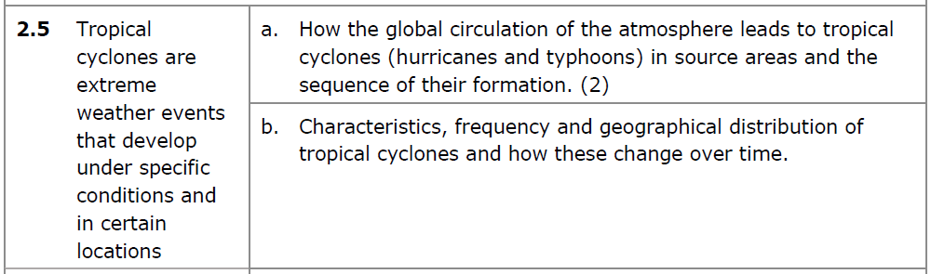
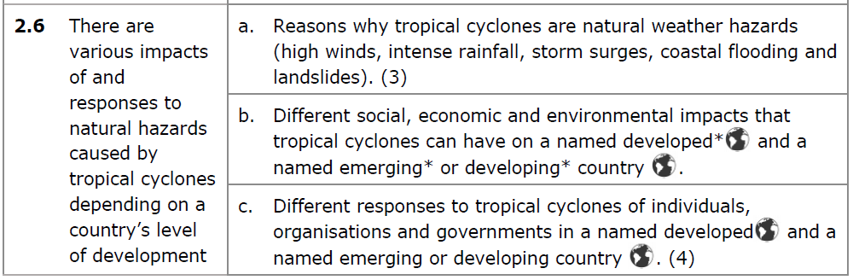
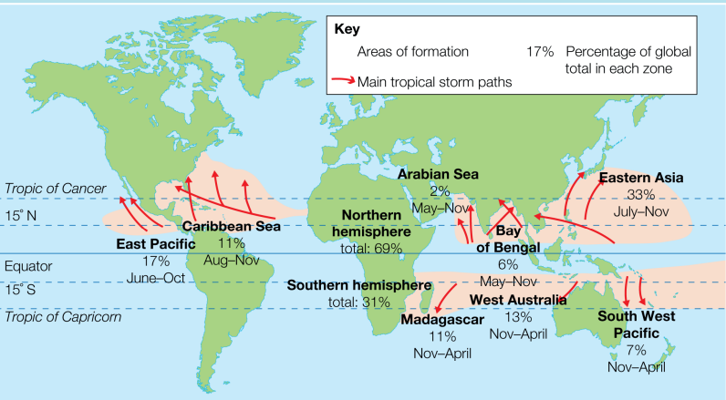



Tropical cyclones form in the tropics (10-30°N/S of the Equator). This is because there is more solar energy concentrated here to warm the oceans.
Intense rainfall = leads to river flooding and damage to homes
Storm surges = strong winds blows waves onto the coast
Hazards from Tropical Cyclones
Landslides = hillsides become full of water and slide down, destroying buildings
High winds = blow roofs off buildings and uproot trees
Tropical cyclones need ocean surface temperatures of around 26-27°c to form!
Case Study | Impacts | Responses
Developing or Emerging Country: Mozambique (Cyclone Idai) | Social: 846 people died Economic: $2 billion worth of damages Environmental: Landslides happened after heavy rain fell | Individuals: Local citizens had to help rescue people as roads were destroyed and aid struggled to get in Organisations: UN appealed for donations Governments: Mozambique government raised $18 million to help those affected
Developed Country: Japan (Typhoon Hagibis) | Social: 31 people died Economic: $15 billion worth of damages Environmental: Severe flooding occurred as rivers burst their banks | Individuals: Citizens followed warnings and emergency plans Organisations: Businesses halted production, to resume once the storm had passed Governments: Deployed the military to help evacuate and rescue people
Eye = centre of the storm, calm conditions
Eye Wall = highest strength winds
High-speed rotating winds = cause damage to buildings and infrastructure
Number of tropical storms (frequency) is increasing over time as climate change increases ocean surface temperatures!

Slide 9



Wildfires = dry conditions mean that trees and wood can ignite more easily
Malnutrition = loss of crops means there is a lack of food
Hazards from Droughts
Loss of Jobs = farming jobs are lost, meaning less income for families
Dehydration = lack of drinking water to keep people alive
Case Study | Impacts | Responses
Developing or Emerging Country: Namibia | People: 1 in 3 people were at risk of malnutrition Ecosystems: Loss of savannah grassland which was used for grazing livestock | Individuals: Farmers had to sell their livestock to make money Organisations: UNICEF appealed for $7 million for children and families Governments: Declared a state of emergency and requested over $1 million in aid
Developed Country: USA (California) | People: 17,000 jobs in farming were lost Ecosystems: Increased risk of wildfires each year destroying natural habitats | Individuals: Farmers turned to planting smaller crops which use less water Organisations: NASA developing new advanced forecasting models for future droughts Governments: New laws brought in, fining people for using water for unnecessary reasons (e.g., watering gardens).
Arid areas (deserts) are found at around 30°N/S of the Equator – high pressure creates dry conditions. This is permanent.
Drought = prolonged period with little rainfall.
This is temporary, but the risk of drought is increasing with climate change.
Physical Causes | Human Causes
Hydrological = lack of rainfall reduces water supply to rivers, lakes and groundwater. Meteorological Causes = more high pressure than low pressure, meaning drier conditions and less rainfall. Global warming means the atmosphere can hold more water, not raining as often. | Deforestation reduces the amount of water held in the soil by roots and reduces transpiration from tree leaves, reducing the amount of moisture added to the atmosphere. Population growth means that more water is extracted from rivers, lakes and groundwater. Dams hold water back upstream, limiting supply of water downstream.

Slide 10



Biosphere = all the living things on Earth (plants and animals)
Biodiversity = the variety of living things
Goods = physical products the biosphere gives us
Service = something the biosphere does to support life
Temperate Forests:
Around 50-60°N/S
Mild temperatures, 1000mm rainfall/year
Boreal Forests:
Around 60-70°N/S
Low-mild temperatures, 500mm rainfall/year
Tundra:
Around 70-80°N/S
Low temperatures, low rainfall
Goods | Services
Timber for building materials Medicines from tropical plants Meat, fish and vegetables for food supply Freshwater for drinking Wood for fuel | Oxygen from photosynthesis to help people breathe Removal of carbon dioxide to regulate the climate Job opportunities in resource exploitation Places for leisure and recreation (e.g. walking and cycling)
Tropical Rainforests:
Along the Equator (0°)
High rainfall, warm temperatures
Deserts:
Around 30°N/S
High temperatures, low rainfall
Temperate Grassland:
Around 40-50°N/S)
Mild temperatures, 500mm rainfall/year
Tropical Grassland:
Around 15-20°N/S
Warm temperatures with wet and dry seasons
Minerals = large areas of ecosystems are cleared to make way for mining of minerals
Farming = land is deforested to make way for farmland to grow crops and breed livestock
Factors | How does it influence the distribution of biomes?
Climate (Latitude) | The further a location is away from the Equator, the colder it gets. More solar energy at the Equator = low pressure, meaning high rainfall, creating tropical rainforests. As air moves away from the Equator, it loses moisture and sinks = high pressure and less rainfall, creating deserts.
Local Factors (Altitude) | High mountains force air to rise and cool as it passes over them = more rainfall on the mountain, creating temperate grasslands/forests. When air has passes over the mountains, it has lost moisture. This means there is less rainfall on the other side of the mountain = deserts.
Energy = forests are cut down to gather wood as a biofuel. Ecosystems are also cleared to make way for the mining of fossil fuels for energy resources
Water = rivers, lakes and groundwater are used up to supply freshwater for farming and to be used in homes
How do humans exploit the biosphere?
Overfishing = fish are taken out of the ocean in large numbers to supply food for people

Slide 11




UK Ecosystem | Distribution | Characteristics
Moorland | Highland areas with heavy rainfall. | Created by people by grazing sheep. Soils are acidic and peaty, so only bracken and some grasses are found there.
Heathland | Found in much of the lowland areas of the UK. | Dry and sandy soils with lower areas that are peaty and boggy. Shrubs like heather, and some trees like birch are found there.
Woodland | Deciduous forests found across much of England, Coniferous found in some parts of England and Scotland. | Trees dominate the landscape.
Wetland | Across the UK as ponds, rivers and lakes. | Waterlogged soils alongside ponds, rivers and lakes. Vegetation includes reeds and are home to otters and mallards.
Biotic = living things in an ecosystem (e.g. plants and animals)
Abiotic = non-living things in an ecosystem (e.g. sunlight, rainfall, temperature and soils)
Interdependence = how living and non-living things depend on each other (e.g. plants need sunlight and rainfall to photosynthesise)
Litter = any leaf litter that falls is quickly decomposed by micro-organisms or lost through leaching (due to the warm and wet conditions).
Biomass = lots of plants in a constant growing season means that most nutrients are stored in biomass.
Soil = These are thin and lack nutrients as they are rapidly taken up by plants and trees into the biomass store.
Tropical rainforests have very high biodiversity due them having the ideal conditions for plants to grow (e.g. high rainfall, more sunlight, high temperatures)!
Why is the Marine Ecosystem important?
Overfishing – removes large amounts of fish from the ocean, disrupting food chains
Tourism = people visiting the UK seaside creates money and jobs for the economy.
Fishing = creates job for people on the coast and provides people with food resources.
Energy = the UK has built off-shore wind farms to create clean energy for homes and businesses.
Plant Adaptations | Animal Adaptations
Large buttress roots that give tall trees stability to reach sunlight. Leaves have drip-tips to allow water to drip off, stopping them from breaking. | Most live in the canopy layer where most food grows. Some animals camouflage to avoid predators.
Trawling – fish nets scraping the bottom of the ocean destroys habitats
Impact of Human Activities
Pollution – plastic pollution in the ocean is eaten by fish, killing them and disrupting food chains

Slide 12



Biotic = living things in an ecosystem (e.g. plants and animals)
Abiotic = non-living things in an ecosystem (e.g. sunlight, rainfall, seasonal temperatures and soils)
Interdependence = how living and non-living things depend on each other (e.g. plants need sunlight and rainfall to photosynthesise)
Feature | How does climate change threaten this?
Structure | Less rainfall in the future could slow down decomposition, reducing the biomass store.
Functioning | Longer drier periods reduces the amount of water provided, meaning that plants and trees will struggle to grow. As a result, trees cannot photosynthesise as well, with less carbon dioxide being removed from the atmosphere.
Biodiversity | Species will struggle to adapt to drier conditions with less rainfall, increasing the risk of extinction.
Litter = deciduous trees shed their leaves, adding to the litter store (mainly in Autumn). Decomposition is also slower here as conditions are not as humid.
Biomass = smaller than the tropical rainforest store as there is less biodiversity. This is due to there not being a constant growing season here as temperatures and sunlight change between summer and winter.
Cattle Farming – as demand for food and meat increases, more land is needed to farm cattle.
Causes of Deforestation
Resource Extraction – wood from trees is used as a biofuel, whilst trees can be cleared to mine for minerals underneath, which can be sold to help the economy grow.
Soil = These are larger and deeper here as trees do not uptake nutrients all year round and less nutrients are lost through leaching due to the lower rainfall.
Population Growth – more people are needing homes, so forests are cleared to make way for homes to be built.
Deciduous woodlands have moderate biodiversity because they have seasons – in the winter, there is less sunlight to photosynthesis, meaning less trees can grow!
Costa Rica: Sustainable Management of the Tropical Rainforest
Governance = the Costa Rica government have made it illegal to deforest in any land protected by law. Ecotourism = the Pacuare Lodge allows small groups to visit and learn about rainforest conservation. It is run on 100% renewable energy and was built using naturally fallen timber from the rainforest. Local people are employed. Commodity Value = companies are encouraged to use timber that has naturally fallen, rather than cut down standing trees.
Plant Adaptations | Animal Adaptations
Trees shed leaves in autumn and winter to conserve water and energy. Broad, thin leaves to maximise the amount of sunlight they take in during the summer. | Animals (e.g. hedgehogs) hibernate during winter. Some birds migrate to warmer climates in the winter.

Slide 13



Urbanisation = the growth in the population of cities and towns
The rate of urbanisation has been slower in Europe, North America and Oceania over the last 50 years. This is because most of the growth of these cities occurred during the industrial revolution in the 1800’s when people moved from the countryside into cities and towns for work.
The rate of urbanisation has been faster in Asia, Africa and South America over the last 50 years. This is because cities in these continents have industrialised more recently and have seen rapid developments in healthcare over the last 50 years, leading to more babies being born than people dying.
Feature | How does climate change threaten this?
Structure | Trees may struggle to survive in drier summers with more drought, reducing the canopy cover.
Functioning | A loss of trees through drought will reduce the amount of carbon that can stored and can also increase soil erosion.
Biodiversity | Migration patterns of birds will change, and some animals may end hibernation early, posing a risk of harm to them.
Population Growth – more people are needing homes, so forests are cleared to make way for homes to be built.
Causes of Deforestation
Agricultural Change – more land is needed for farming crops.
Timber Extraction – timber wood is needed as a building material in construction, so therefore is taken from deciduous woodlands.
Key Word | Definition
Rural to Urban Migration | The movement of people from the countryside into cities and towns.
Natural Increase | Where birth rates are higher than death rates – meaning, more babies are born than people dying.
Effects of Urbanisation on Developed and Emerging Countries
The New Forest: Sustainable Management of the Deciduous Woodland
National Park Authority protect The New Forest, making it illegal to deforest any land under their protection without permission. They also create leaflets giving the public information about looking after the forest. New trees are planted to replace any cut down. Private landowners are funded to plant native trees by the National Park Authority. The Green Leaf Scheme promotes local sustainable businesses and encourages visitors to walk/cycle through rather than drive.

Slide 14




Scotland – much of this land is hilly/mountainous so it is difficult to build on, meaning fewer cities.
Newcastle – has a coastline on the North Sea, meaning people invest there to trade, attracting people into the city with jobs.
Key Word | Definition
Site | The actual location of a settlement and the physical characteristics of the landscape specific to the area.
Situation | The location of a place relative to its surroundings and other places.
Manchester and Leeds – close to natural resources (e.g. coal) so there were once plenty of jobs in these cities.
Nottingham – lace industry grew during the industrial revolution, attracting people into the city looking for work.
Site:
On the banks of the River Trent (for water resources)
Flat land (floodplain – easy to build on)
Fertile land (for farming)
Near coal resources and Sherwood Forest (for timber)
London – capital city and where the government is based. Close to Europe so lots of investment by TNC’s helps the city grow.
Situation:
45 miles south of Sheffield and 130 miles north of London – connected by the M1 motorway.
15 miles east of Derby – connected by the A52.
Has a train station that has routes to Birmingham, London, Leeds and Liverpool.
East Midlands Airport is around 10 miles to the south-west, connecting Nottingham internationally.
Factors that affect the rate and degree of urbanisation:
Rural to urban migration – people moving from the countryside into cities and towns in search of work. The amount of investment from TNCs into cities, providing jobs. The landscape – cities and towns are easier to build and grow on flatter land. Natural increase – if the population is made up of younger adults, more children are likely to be born, which will be higher than the number of people dying. Natural resources – areas close to natural resources like coal were able to grow rapidly during the industrial revolution. Cities that did not have these resources urbanised and grew more recently.
Central Business District (CBD) | Oldest buildings, with modern shops and offices. Well-connected by transport routes.
Inner City | Old industrial buildings, terraced houses.
Suburbs | Semi-detached/detached houses, housing estates.
Urban-Rural Fringe | Large houses, surrounded by farmland and fields.

Slide 15





4) Most of Nottingham City Centre has been regenerated by turning old lace factories into apartments, restaurants and bars. The NET trams have helped reconnect people to the city.
1) Nottingham grew during the industrial revolution as the lace industry provided jobs, so people moved in.
Population of the city grows as people move back in
Population of the city grows
Nottingham
Population is growing due to migration (mainly aged 18-30) and natural increase (young people are more likely to have children).
Population of the city decreases as people and industry move away
People move from the city centre into the suburbs
3) As deindustrialisation happened, the lace industry moved out of Nottingham, leaving much of it derelict and abandoned. Crime and anti-social behaviour increased.
2) As people became wealthier, they moved out of the crowded city centre into the suburbs, with more space.
Migration in Nottingham
Deindustrialisation and Deprivation
Causes | Impacts
To study at the University of Nottingham or Nottingham Trent University. Jobs in major companies such as Boots. | More younger people (aged 18-30) Greater ethnic diversity. Pressure on housing, healthcare and education.
Deindustrialisation happens (factories close) due to globalisation – industry moves abroad for cheaper labour.
People are made redundant in secondary jobs and become unemployed.
More people are on low or no income.
Higher crime rates and loss of community.
Less investment into services like healthcare, education and transport.
Those who can migrate out of the city.
Fewer people paying taxes.

Slide 16



Site:
On a plateau 820m above sea level.
On the banks of the River Tiete (for water supply)
Situation:
70km in land from the Atlantic coast – connected to the Port of Santos by the motorway (Rodovia dos Imigrantes)
1,000km south of Brazil’s capital city, Brasilia.
Two international airports.
Decentralisation: The movement of activity out of city centres. This includes offices and retail.
Reasons for Decentralisation
Increase in online shopping due to greater internet access (e.g. Amazon) More out-of-town shopping centres as these are often more accessible to people in the suburbs, people can park more easily, and stores can be larger.
Central Business District (CBD):
Most buildings were built during the 19th century, but high-rise buildings developed during rapid industrialisation in the 20th century.
Financial centre (Centro Velho)
Retail centre (Centro Nov)
Expensive apartment blocks
Suburbs:
Mainly residential
Huge inequality between rich and poor.
Morumbi – good quality housing with access to services (e.g. hospitals)
Large number of favelas.
Impact of the CBD of Nottingham
More people shop online or in out-of-town shopping centres
Less people visit and shop in the CBD
Shops lose money and income
Shops close and people lose their jobs
Other businesses suffer due to lower footfall in the CBD.
Sustainable Urban Living in Nottingham
Green Heart Regeneration Scheme – government funded project to regenerate the Island Quarter, Broadmarsh, Nottingham College the Nottingham Science Park. Aims to create open, green space in the city, bring in jobs in skilled industries and improve education standards. Will cost almost £1 billion. NET Trams and NCT Buses running on renewable energy, providing efficient transport across the whole city. Helps to improve air quality. Hockerton Housing Project – developing homes that consume fewer natural resources and run on 100% renewable energy. Very small scale.
Inner City:
Corticos – abandoned industrial buildings where people live.
Bela Vista – home to Italian migrants.
Liberdade – home to Japanese migrants.
Some favelas here (e.g. Paraisoplis, home to 43,000 people).
Urban-Rural Fringe:
Favelas grew in the 1980’s as more people moved into Sao Paulo in search of work.
Gated communities (e.g. Alphaville) were created for wealthy residents wanting more space away from the city centre.

Slide 17





Why has the population of Sao Paulo increased rapidly over time?
Natural Increase = healthcare is improving, so death rate falls and more babies survive.
Air pollution – leading to respiratory problems and death.
Increased pressure on healthcare and education – schools and hospitals become crowded.
Housing Shortages – people are forced to live in Favelas and Corticos.
Rural to Urban Migration = people leaving rural areas and moving into cities as there are more job opportunities and better healthcare and education.
Rich and poor are forced to live next to each other, the rich in gated communities, the poor in favelas. This can cause unrest and crime.
Challenges of Rapid Urbanisation in Sao Paulo
Increased traffic and congestion – more than 6 million cars on the roads!
International Migration = Sao Paulo has a significant Japanese and Italian population that moved to fill gaps in the job market. Families have then moved over to be closer to them.
Rise in informal employment (cash in hand jobs), particularly in favelas. These often do not pay as well.
Underemployment – skilled people are forced to take low-skilled work that they are overqualified for as there is a shortage of jobs available after large numbers moved into the city.
Wealthier people mainly live towards the city centre – close to where TNCs have invested so there are higher paying jobs
Impacts of Migration in Sao Paulo
Younger age structure. Increased birth rate. Pressure on housing and healthcare. 20% of residents live in favelas or corticos.
The poorest in Sao Paulo tend to live on the outskirts of the CDB in the inner city, where there are favelas and corticos (poor quality housing). There is often more traffic and air pollution here.
Project | Advantages | Disadvantages
Top-Down: Cingapura Housing Project | Planned to build 100,000 homes with clean water and sanitation, replacing favelas. | Only 14,000 were built, and large areas of favelas were knocked down, making more people homeless.
Bottom-Up: Santo Andre Self-Help Scheme | Charities and NGOs working together to upgrade favelas and provide literacy support. | Often too many people working on the project for decisions to be made quickly.

Slide 18




Countries in Europe and North America are more developed than those in Africa, Asia and South America.
Development is where a country improves in terms of the quality of life of its people. We can look at development in different ways:
Economically – factors around money (e.g. wealth and jobs)
Socially – factors around people lives (e.g. health and education)
Politically – factors around governments (e.g. corruption)
Physical: Countries such as Afghanistan are landlocked, meaning they are unable to trade by sea.
Measure | What does it tell us?
Gross Domestic Product (GDP) per capita | How much money a country earns from trading good and services each year, divided by its population. This tells us about the wealth of the country and how much it interacts with other countries around the world.
Corruption Perception Index | How corrupt each country is perceived to be (e.g. do they invest money and support where the public need it, or do they invest in their own interests?). This tells us about political corruption.
Human Development Index (HDI) | A composite measure that looks at wealth, health and education to give an overall view of a country’s development.
Historical: European countries had previously colonised African countries, exploiting their resources and allow corrupt governments to take over once independence was gained.
Economic: Countries such as the USA, Japan and those in Europe are globalised, meaning they are connected to the global economy through trade and investment.
In the UK, the south is more developed than the north.
Historical | London is the historic capital of the UK, so receives more investment. Areas of the north has seen deindustrialisation in the past, reducing incomes.
Physical | The land is flatter in the south, making it easier to construct buildings and infrastructure.
Economic | London and the south-east is closer and well-connected to mainland Europe for trade and investment.
Gross National Income (GNI) per capita
Changed by Trade and FDI
Human Development Index (HDI)
Life Expectancy
Changed by standards of healthcare
Average Years of Schooling
Changed by standards of education
Expected Years of Schooling

Slide 19


Impact | Developed Countries | Developing Countries
Housing | Homes are well built with mains water and electricity access. | Some homes may be well built, but many may live in slums on the edge of cities, made from scrap materials.
Health | People can get to hospitals and doctor’s surgeries easily. They have access to medication and treatments. | Hospitals are found in urban areas, but rural areas are often left out. Hospitals may lack the technology and resources.
Education | Both public and private schools are available. Lots of qualified teachers. Funding for resources. | Fewer schools available with fewer qualified teachers. Many families cannot afford to send their child to school.
Employment | More high-paying jobs available. Lots of investment from companies creates high-skilled jobs too. | Jobs are mainly in the primary sector in rural areas, or secondary in the urban areas.
Technology | People have access to advanced technology (e.g. smartphones, computers, AI). Technology is widely used in the health and education industry. | Most people rely on appropriate technology to support their development (e.g. a water pump in a rural village).
Food and Water Security | Higher food and water security as food can either be grown or imported. Water can be treated and provided to people’s homes. | Rely on their own food supply, so changes in farming (e.g. drought) can risk malnutrition. Water is often contaminated and they lack funds to treat it.
International Aid: Money and/or resources given to another country to help them develop.
Foreign Direct Investment (FDI): Trans-National Corporations (TNCs) invest in a country, setting up factories and HQs. This creates jobs.
Remittances: Migrants in a more developed country sending money they earn back to their home country. This helps provide money to families back home.
Trade: Countries can sell goods and services to each other, increasing wealth.
Strategies to Reduce Uneven Development
Fairtrade: An organisation that ensures that producers in developing countries get a fair price for the goods they produce.
Debt Relief: Where one country wipes the debt that another country owes them so that country can put more money towards its development.
Strategy | What is it? | Advantages | Disadvantages
Top-Down | Large Scale Funded by Governments and TNCS | Helps a larger number of people | Can be very expensive to put into place
Bottom-Up | Small Scale Led by Charities and NGOs Works closely with locals | Local people have a say in decision making and is often cheaper | Does not help large numbers of people or over a large area

Slide 20



India is located in the continent of Asia. It is the south-east of Pakistan, south of China and Nepal, and north-west of Sri Lanka. It is to the north of the Indian Ocean.
Political Context | Once a colony of the British Empire. Now it is independent and is the world’s largest democracy.
Social Context | India has a ‘caste system’ – a social hierarchy influenced by a person’s parents' status when they were born.
Cultural Context | 80% of the population are Hindu. 13% of people are Muslim.
Environmental Context | Himalayan mountains are in the north. Monsoon rains provide a wet season which farmers rely on.
Primary Sector | Extracting raw materials (e.g. farming)
Secondary Sector | Manufacturing products
Tertiary Sector | Services (e.g. teaching, healthcare, retail, banks)
Quaternary Sector | Research and development jobs
Before industrialisation, most people lived in rural areas and worked in primary jobs (e.g. farming).
Mechanisation of farming in rural areas, and TNC investment into urban areas means more rural-urban migration.
More people employed in secondary jobs (manufacturing) or tertiary jobs (call centres) in core regions like Mumbai
Key Terms
Core Region = an economically active area. Periphery Region = less economically developed area outside of the core region.
Core Region: Mumbai
Coastal – able to trade and bring in money.
TNCs are more likely to invest, which creates jobs.
More rural-urban migration, which can lead to overpopulation. Housing shortages mean that people result in living in slums (e.g. Dharavi).
Periphery Region: Bihar
In land – cannot trade by sea so income is small.
TNCs are less likely to invest due to smaller population for workforce.
Mainly rural so people rely on farming for jobs.
Rural-urban migration reduces population here, so less funding from government.
Economic Change Impacts
Positive: Core regions develop quickly. More people have access to education and healthcare in cities. More people can pay tax to help fund government-led development projects. Greater gender equality as more women are gaining jobs. Negative: Overpopulation in core regions leading to people living in slums. Greater pressure on existing education and healthcare. Growing inequality between core and periphery regions, as well as within core regions.

Slide 21


Positive Relationship:
United Kingdom:
Despite once being colonised by the UK, India is now part of the Commonwealth alongside the UK. This means that India and the UK can establish strong trade links, helping to boost India’s economy.
Negative Relationship: Pakistan:
Conflict over the Kashmir region means that India is spending more money on military needs, taking money away from other key services such as education and healthcare.
Trade | India’s trade has grown rapidly as it has become more connected globally.
Aid | India once received aid to help fund development projects across the country. It now receives less aid than it donates to other countries.
Private Investment (FDI) | TNCs such as Apple, Microsoft and Vodafone have invested into India, creating jobs and paying taxes.
Public Investment (Tax) | The Indian government has been selling off public services to private companies to reduce the amount of money the government needs to invest.
4. Business and Trade
Small businesses can now sell goods online, use digital payments, and reach customers across India and the world. This has helped entrepreneurs and farmers earn more money.
1. Jobs and the Economy
Better internet and mobile technology have helped India grow big industries like IT, software, and call centres. This has created millions of jobs and brought money into the country from overseas companies.
Growth of Technology and Connectivity
Demographic Changes:
Fewer young dependents - due to falling birth rates. This is caused by:
Families wanting fewer children as more are likely to survive.
The rights of women improving meaning that they can access better education and jobs.
Better access to contraception.
More elderly dependents – due to an increase in life expectancy. This is caused by:
Better healthcare meaning people live for longer.
Larger working population – this is caused by:
More people surviving into working age.
More international migration into India.
2. Education
Technology allows students to learn online through videos, apps, and virtual classes. Even in rural areas, mobile phones and the internet help young people access education and learn new skills.
3. Healthcare
Connectivity has improved healthcare through online doctor appointments (telemedicine), health apps, and faster sharing of medical information. This is especially helpful for people living far from hospitals.

Slide 22


Biotic | A resource obtained from living things in the biosphere
Abiotic | A resource obtained from non-living things
Renewable | It will not run out and can be replenished very easily
Non-Renewable | It is finite (it will run out) and could take a long time to replenish
Impacts of India’s Rapid Development | Positive | Negative
Social | People have better access to healthcare and education. Increasing gender equality. | More traffic and congestion on roads. Overpopulation in urban areas leading to slums developing.
Economic | More high-skilled and high paying jobs due to TNC investment. More investment in infrastructure. | Greater wealth inequality between the rich ‘core’ regions and less developed ‘periphery’ regions.
Environmental | More money to invest in renewable energy production. | Increase in air and water pollution. More deforestation to clear land for cities to develop on.
Deforestation:
Why?: Trees are cut down for timber resources or biofuel. Land cleared for farming and mining.
What impact?: If trees are cut down, less rainfall can be intercepted, meaning that soil will be washed away, causing soil erosion.
Farming:
Why?: As populations grow, demand for food increases. More farmland is created to grow crops and breed livestock.
What impact?: If the land is used for cattle farming, grazing cows can expose the soils. Wind can then cause drier soils to blow away, causing soil erosion.
Exploiting Environments
Extraction of Fossil Fuels:
Why?: As populations grow, demand for energy increases. Countries turn to fossil fuels to supply this energy.
What impact?: If fossil fuels are burned, more greenhouse gases and pollutants enter the atmosphere, causing reduced air quality.
Overfishing:
Why?: As food demand increases, so does demand for fish. Fleets of boats then go to catch large fish numbers to sell as food.
What impact?: If too many fish are caught, the ocean food chain is disrupted, meaning that other fish species die, causing reduced biodiversity.
Smart Cities Initiative: The government wants to create 100 smart cities that will use technology to manage congestion, water supply, sanitation and create jobs.
Swasthya Slate: A device which can run routine medical checks without the need to go to visit a hospital or doctor. Needs electricity access to be used regularly.
Managing India’s Rapid Development
Gujarat Solar Park: A government funded solar energy project. Will provide clean energy to homes in Gujarat and beyond.

Slide 23







Global resource distribution depends on the climate, soils, relief and geology of a place!
Where is there a surplus and deficit of water?
UK Resources: Water: More water is found in the north and west of the UK where rainfall is higher, but this is where fewer people live. Food: Arable farming (e.g. wheat) is easier on flatter, more fertile land, typically in the Midlands and East Anglia. Hill farming of sheep mainly takes place in the north of England and Scotland. Energy: The UK has offshore oil and gas in the North Sea
Countries at high latitudes (e.g. Canada, Russia and Iceland) have a surplus of water due to the seasonal melting of ice and glaciers.
Countries along the Equator (e.g. Brazil and the DRC) have a surplus of water as they have high rainfall. This is due to low pressure creating a tropical climate.
Countries around 30°N/S of the Equator (e.g. Algeria, Libya and Saudi Arabia) have a deficit of water as they have very low rainfall. This is due to high pressure creating an arid climate.
Key Terms Surplus = lots of a resource Deficit = lack of a resource
Supply of water is changing due to climate change – patterns of rainfall are changing with some places becoming wetter, and some becoming drier.
Water Stress = a situation where there is not enough water to meet people’s needs, below 1,700m³ per person per year in a country/region.
Water Scarcity = when water supplies fall below 1,000m³ per person per year in a country/region.
Demand for water is increasing due to rapid global population growth and economic development!

Slide 24









Problems in the UK:
Ageing infrastructure: The UK was one of the first countries to develop piped water systems – but these systems are now old and leaking. It is estimated that 3.28 billion litres of water are lost through leaks every day. It would cost around £100 million to repair all these pipes!
Seasonal imbalance: In the UK, areas receive more rainfall in the summer than the winter. In the South, the UK has severely reduced rainfall in the summer months which often leads to hosepipe bans.
Rainfall imbalance: the West of the UK has more rainfall than the East due to relief rainfall. Areas with higher population densities are in the East.
Groundwater – amount of water stored in aquifers
Climate – humid (wet) climates have higher supply than arid (dry) climates
Precipitation Levels – higher rainfall = higher supply
Glacial Melt – freshwater from melting ice
What affects the supply of water?
Population growth – more people = increased demand
Industry – greater demand for products uses water
Air Masses – maritime vs continental
Domestic – increased use of appliances that require water
What affects the demand for water?
Energy – growing use of hydropower
Problems in Developing/Emerging Countries:
Unsafe water: An estimated 650 million people do not have access to drinking safe water. This is because of a lack of water treatment systems in the country. Diseases such as cholera and typhoid are water-borne.
Pollution: water supplies can be polluted by human waste or faming and industry. 2.3 billion people across the world lack access to sanitation systems that make water safe.
Low annual rainfall: Areas between 20-40 degrees North and South of the equator have arid or semi-arid climates, which lack rainfall. These areas have persistent high pressure, meaning clouds cannot form and therefore precipitation levels are low.
Agriculture – more irrigation needed to sustain demand for food
 | Developed | Developing/Emerging
Agriculture | Better technology (e.g. sprinklers) to avoid wasting water | Farmers flood fields as they don’t have access to high-tech irrigation equipment
Industry | Water is used in industry, though this is more efficient due to technology. | Growing investment from TNCs means more water is used in industry
Domestic | Water is piped into homes for use in a range of appliances | Many homes do not have piped water access, and do not use as many appliances

Slide 25



Desalination: The process of removing salt from seawater.
Individuals: Residents will be concerned about have a clean domestic supply of water. Farmers will want to have a secure water supply to ensure they can continue to grow crops and make money.
Organisations: TNCs need water for industry so they can continue to make profit and provide jobs for people. Water companies want to provide a good, affordable service to people but also want to fix leaks from ageing infrastructure.
Governments: Will decide how water resources are managed in their country. Laws and restrictions may be brought in to conserve water, or they may invest in technology and schemes to access and redistribute water.
Advantages | Disadvantages
The technology is used in over 100 countries to create water for drinking, washing, agriculture and industry. It has the ability to use the vast water source of the ocean, without depleting freshwater reserves further. The process is becoming more efficient as technology and practices improve. | Currently not very efficient. In older desalination plants, only 10% of the water that is input becomes usable water (50% in newer plants). Creating the high pressure for the process uses a lot of energy, resulting in higher carbon emissions. Desalination plants are too expensive for developing countries to afford (e.g. a plant in Sydney, Australia cost $2bn).
Efficient Agriculture (e.g. sprinklers, drip feeds)
Reduce domestic consumption
Reduce meat consumption
Sustainable Management
Water Recycling
“The desalination plant has provided me and my family with jobs locally, as well as helping to give us clean water”
Desalination
Farm crops that are less water-intensive
Local Resident
Developed: UK | Developing/Emerging: India
Water transfer schemes (e.g. Tyne-Tees Pipeline) redistributes water from areas of water surplus to areas of water deficit. Government hosepipe bans during the summer months when reservoir levels fall. Household water saving schemes to reduce domestic consumption. | Water transfer schemes (e.g. The River Interlinking Project) redistributes water from areas of surplus to deficit, though this is on a much larger scale and more expensive than in the UK. Desalination – low energy desalination is beginning to be used but is still too expensive. Rainwater harvesting.
“Through our investment in desalination projects, we have been able to grow our business and influence in multiple countries across the world”
CEO of a TNC
“Many marine creatures are killed through the desalination process, with further environmental impacts of wastewater output still unknown”
Environmental Activist

