Slide 1

GCSE
French
Boss your tenses!
Part 1

Slide 2
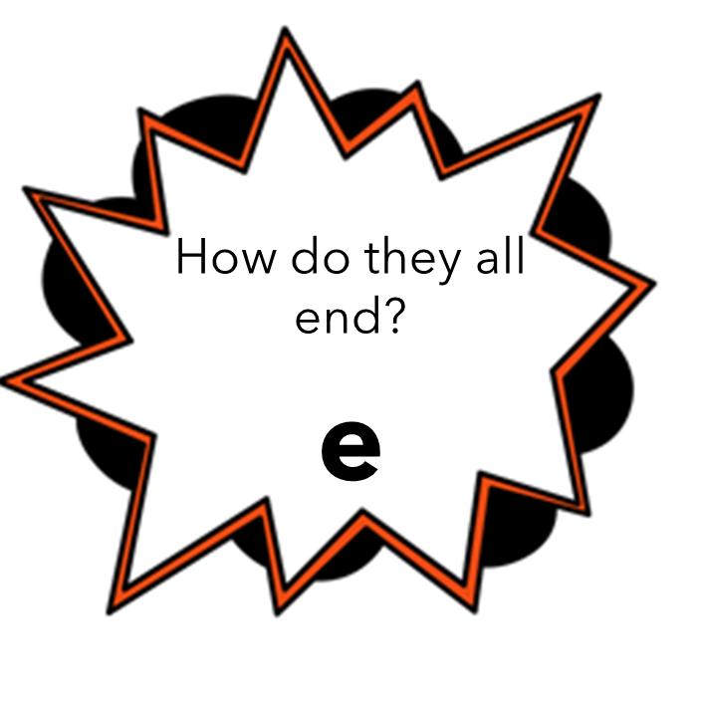
Present tense – Essential irregulars
Je fais | I do
Je suis | I am
J’ai | I have
Je vais | I go
Present tense – Regular (-er verbs)
Je mange | I eat
Je regarde | I watch
Je joue | I play
Je voyage | I travel
Je visite | I visit
J’aime | I like
J’écoute | I listen
Je travaille | I work
J’aide | I help
Je donne | I give
Je fête | I celebrate
Je préfère | I prefer
J’achète | I buy
Je nage | I swim
J’utilise | I use
Je recycle | I recyle
Je pratique | I practice
J’envoie | I send
Je porte | I wear
J’étudie | I study
Je trouve | I find
J’habite | I live
Je déteste | I hate

Slide 3
Present tense – Reflexive
Je m’appelle | I am called
Je me lave | I wash myself
Je me lève | I get myself up
Je me dispute | I argue with
Je m’entends avec | I get on with
Je m’amuse | I have fun
Je me baigne | I swim (paddle)
Present tense other irregulars
Je vois | I see
Je bois | I drink
Je peux | I can
Je dois | I must/ have to
Je dis | I say
Je veux | I want
J’écris | I write
Je lis | I read
Je dors | I sleep
Je prends | I take
J’apprends | I learn
Je sors | I go out
Je viens | I come

Slide 4
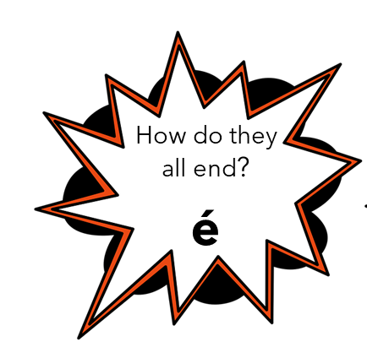
Past tense – Essential irregulars
J’ai fait | I did
Je suis allé (e) | I went
Past tense – Regular (-er verbs)
J’ai mangé | I ate
J’ai regardé | I watched
J’ai joué | I played
J’ai voyagé | I traveled
J’ai visité | I visited
J’ai écouté | I listened
J’ai travaillé | I worked
J’ai aidé | I helped
J’ai donné | I gave
J’ai fêté | I celebrated
J’ai acheté | I bought
J’ai nagé | I swam
J’ai utilisé | I used
J’ai recyclé | I recyled
J’ai envoyé | I sent
J’ai porté | I wore
J’ai trouvé | I found

Slide 5
Past tense – we
On a regardé | We watched
On a fait | We did
On a joué | We played
Past tense – Reflexive
Je me suis disputé (e) | I argue with
Je me suis amusé (e) | I had fun
Je me suis baigné (e) | I swam (paddle)
Past tense – être verbs
Je suis allé (e) | I went
Je suis resté (e) | I stayed
Je suis arrivé (e) | I arrived
Je suis parti (e) | I left
Je suis venu (e) | I came
Je suis sorti (e) | I went out
Past tense other irregulars
J’ai vu | I saw
J’ai bu | I drank
J’ai du | I had to
J’ai dit | I said
J’ai écrit | I wrote
J’ai lu | I read
J’ai dormi | I slept
J’ai pris | I took
J’ai appris | I learnt

Slide 6
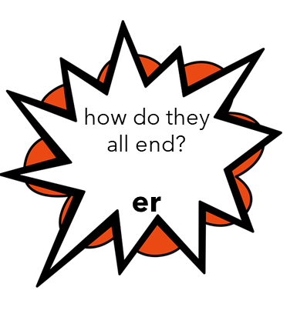
Future tense – Essential irregulars
Je vais faire | I am going to do
Je vais être | I am going to be
Je vais avoir | I am going to have
Je vais aller | I am going to go
Future tense – Regular (-er verbs)
Je vais manger | I am going to eat
Je vais regarder | I am going to watch
Je vais jouer | I am going to play
Je vais voyager | I am going to travel
Je vais visiter | I am going to visit
Je vais travailler | I am going to work
Je vais aider | I am going to help
Je vais donner | I am going to give
Je vais fêter | I am going to celebrate
Je vais acheter | I am going to buy
Je vais envoyer | I am going to send
Je vais porter | I am going to wear
Je vais habiter | I am going to live
Future tense – we
On va manger | We are going to eat
On va boire | We are going to drink
On va prendre | We are going to take
On va chanter | We are going to siing
On va danser | We are going to dance

Slide 7
Tense essentials
Present | Il y a | There is
 | C’est | It is
 | Ils sont | They are
Past | Il y avait | There was
 | C’était | It was
Future | Il y aura | There will be
 | Ce sera | It will be
Tense essentials
Present | Souvent | Often
 | Quelquefois | Sometimes
 | Normalement | Normally
 | Le week-end | At the weekend
Past | Le week-end dernier | Last weekend
 | Hier | Yesterday
 | Récemment | Recently
Future | Le week-end prochain | Next weekend
 | Demain | Tomorrow
 | À l’avenir | In the future
Notes:
fanc

Slide 8

QUIZ!
Present tense – Essential verbs
I travel
I eat
I give
I do
I buy
I prefer
I wear
I am
I live
I like
I have
I play
I watch
I go
I play football with my friends in the park
I watch comedies sometimes
I listen to pop music because it is fun
Normally I travel to France
I eat some chicken, rice and vegetables
I go to the shops at the weekend
I am nice and I like
I study French but I prefer art

Slide 9
QUIZ!
Past tense – Essential verbs
I worked
I played
I went
I bought
I visited
I helped
I ate
I celebrated
I watched
I gave
I did
I used
I played tennis after school
I watched an action film yesterday
I went to the stadium with my dad
Last week-end I visited Paris
I ate at a restaurant recently
I gave money to charity
I did some dance
I worked in a café it was boring

Slide 10
QUIZ!
Future tense – Essential verbs
I am going to help
I am going to watch
I am going to go
I am going to eat
I am going to celebrate
I am going to live
I am going to do
I am going to visit
I am going to travel
I am going to work
I am going to buy
In the future I am going to live in the countryside
I am going to visit the museum
I am going to buy a souvenir
I am going to eat an ice-cream
Next weekend I am going to do some skating
I am going to celebrate with my friends it will be great
I am going to work as a doctor
Tomorrow I am going to go to the ice-rink

Slide 11
QUIZ!
Present tense irregular verbs
I drink
I must
I want
I read
I sleep
I can
I take
I write
I learn
I come
I go out
Present tense – Reflexive
I have fun
I wash myself
I am called
I argue with
I get on with
I swim
I get myself up

Slide 12
QUIZ!
Past tense – we
We did
We played
We watched
Past tense – Reflexive
I argued with
I had fun with
Past tense – être verbs
I left
I arrived
I came
I went out
I went
I stayed
Past tense other irregulars
I took
I wrote
I saw
I drank
I learnt

Slide 13
QUIZ!
Future tense - we
We are going to do
We are going to eat
We are going to take
We are going to sing
We are going to watch
It will be fun
Yesterday I went to the park
Tomorrow i am going to eat a pizza
Normally I travel to Spain
It was interesting
I am going to go to university
There are a lot of shops
We played basketball last weekend
In the future I will work as a teacher
I went to the cinema and I watched a horror film
At the weekend I read and I use my phone
We are going to take the train

