Slide 1


Year 10 GCSE Launch Evening
How to support your child through their GCSE exams

Slide 2
The Aim of this Session:
To provide you with information, advice and resources to help you support your child in their GCSE revision.
Structure of the session:
The key dates and assessments points throughout the two years
Information and strategies to support with GCSE revision
Curriculum Area Leaders talk about the core content and expectations within their subject areas
An overview of homework in KS4
Strategies to support with positive mental health and wellbeing
Key reminders about the importance of good attendance, punctuality and behaviour
An introduction to the Year 10 work experience and employability standards

Slide 3

What does a good attitude look like?
Punctual – Being on time
Good Attendance
97.5%
Being equipped
Wearing the correct uniform smartly
Speaking politely and positively
Being on task
These are “The Basics” that we expect from every student in Year 10.
No ifs! No buts!
Doing these basic things every day will help you to maximise every learning opportunities leading towards the end of Year 11 to bring YOU success.

Slide 4
What is the biggest mistake that Year 10 make?
They think it doesn’t count!

Slide 5
Key Dates & Assessment Points during Year 10
Monday 15th September 2025 | Year 10 Launch Event
W/C Monday 12th January 2026 | Year 10 Tracker 1 - ATL
W/C Monday 9th February 2026 | Year 10 Drama Exams
W/C Monday 23rd March 2026 | Year 10 Mock Exams
W/C Monday 24th April 2026 | Year 10 Tracker 2 – ATL & Grades
Tuesday 5th May 2026 | Year 10 Parents’ Evening
Tuesday 2nd June 2026 | GCSE Statistics Exam 1
Tuesday 12th June 2026 | GCSE Statistics Exam 2
Monday 22nd June - Tuesday 23rd June 2026 | Year 10 Art Mock Exams
Tuesday 30th June – Wednesday 1st July 2026 | Year 10 Geography Field Trip
Monday 13th July – Friday 17th July 2026 | Year 10 Work Experience
+ Coursework Deadlines
throughout Year 10

Slide 6
Key Dates & Assessment Points during Year 11*
College/Sixth Form Applications:
Open Days will be scheduled around October 2026 onwards
Careers Programme to support all learners e.g. Careers interviews and skills
Wilsthorpe Sixth Form applications deadline -
Mock exams:
Nov 2026*
February 2027*
Exams:
May/June 2027
Exam results day/Sixth Form enrolment:
August 2026
*To be confirmed

Slide 7
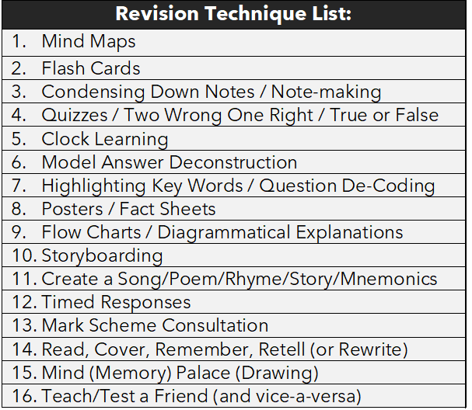
Form time support: Revision
Everybody learns and remembers in a different way - it is about finding the method(s) that work for your child.

Slide 8
Of the 16 methods the following are particularly useful for GCSE Students:
Method 1 - Mind Maps
Method 2 - Flash Cards
Method 3 - Condensing Down Notes
Method 4 - Two Wrong, One Right
Method 5 - Clock Learning
Method 6 - Model Answer Deconstruction
Method 7 - Highlighting
Method 12 - Timed Responses
Method 13 - Mark Scheme Consultation

Slide 9
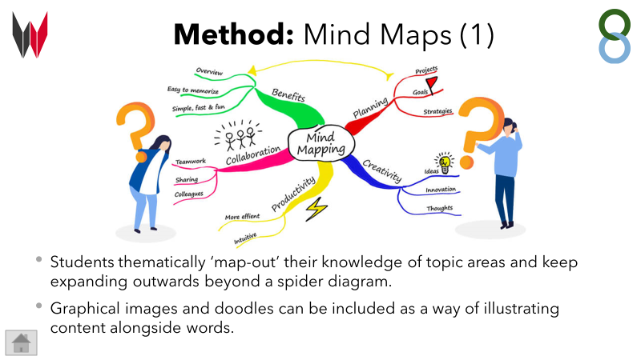

Slide 10
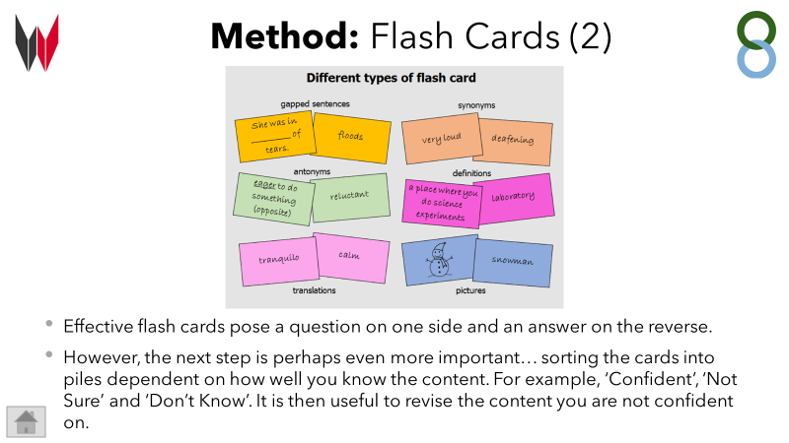

Slide 11
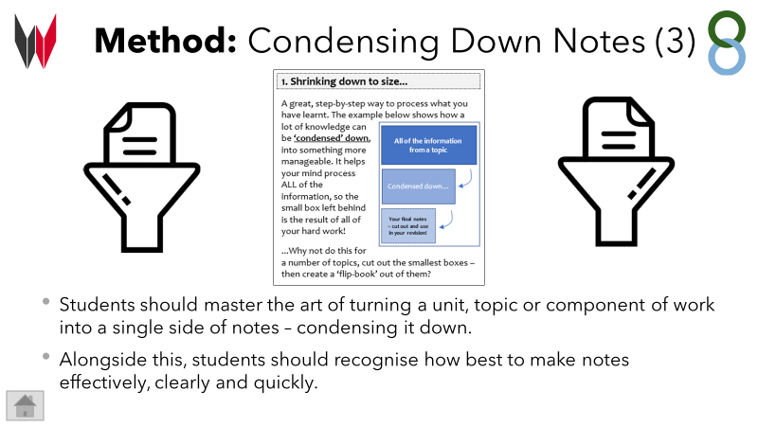

Slide 12
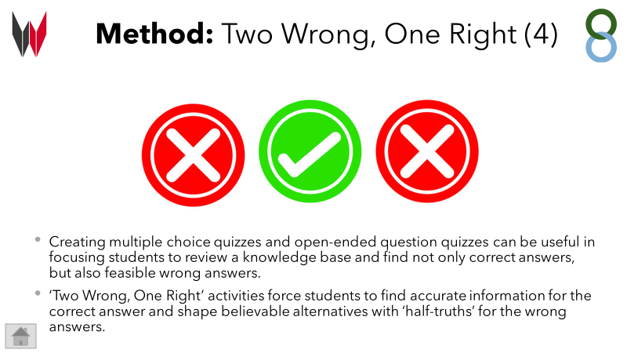

Slide 13
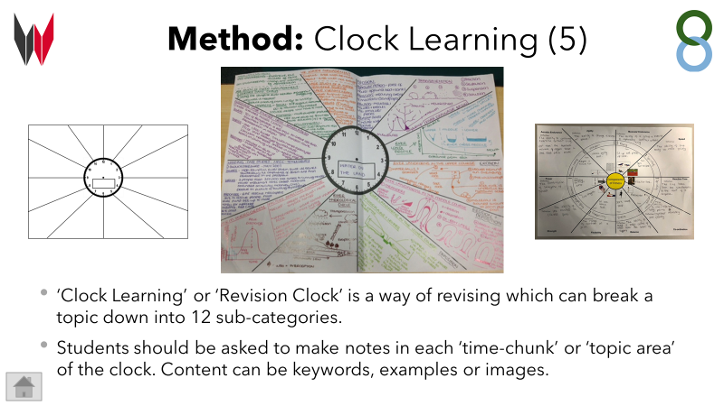

Slide 14
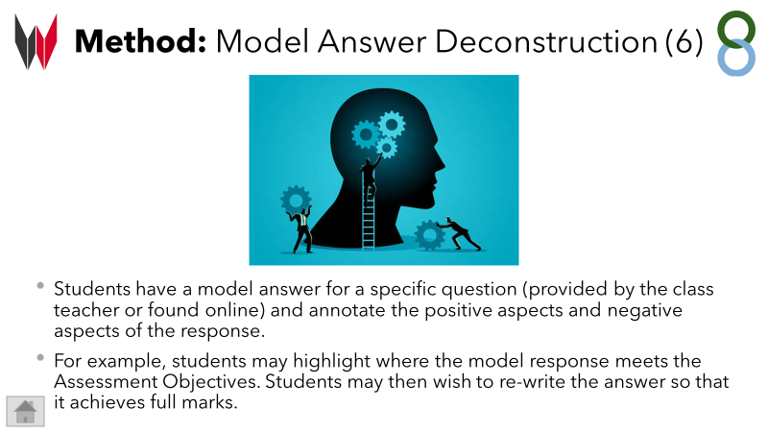

Slide 15
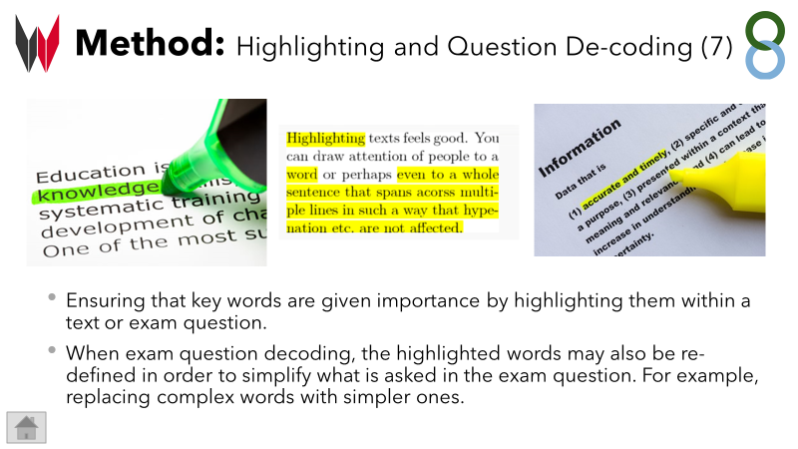

Slide 16
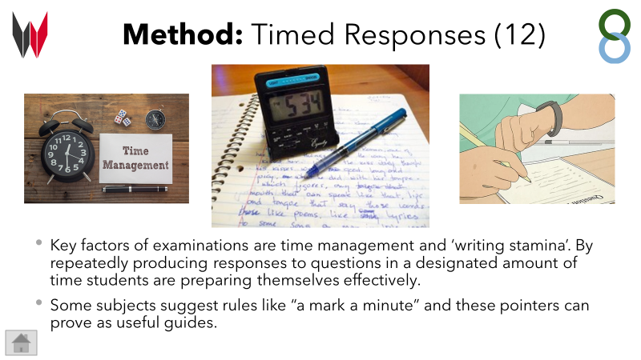

Slide 17
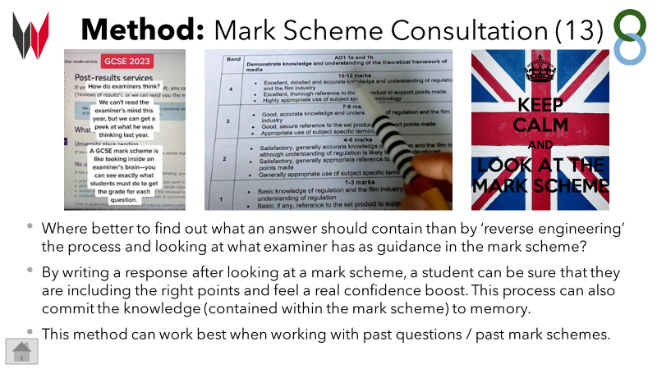

Slide 18
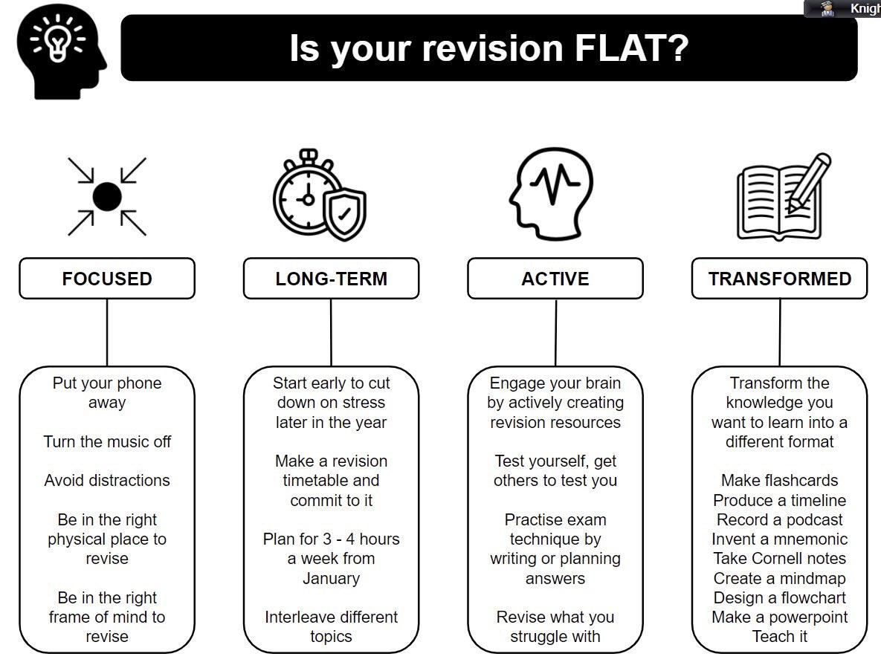
Further form time
support:
Form tutors will also be pushing the students to consider if their revision is ‘flat’ and how to tackle this.

Slide 19
What past students have said helps…
“Turn the internet off.”
“I do feel stressed, especially when I have to do loads of jobs too.”
“Buy me resources – revision books, note books, flashcards.”
“Quiz me on work I have read/ask questions.”
“Make a timetable together and help me stick to it.”
“Trust me.”

Slide 20

Homework at KS4

Slide 21


Year 10 and 11:
You will be set a minimum of 1 piece of homework each week for every subject you study.
You are also expected to complete a minimum of 15 minutes reading every night using your reading book. This should be logged on the reading log in the student handbook. This will be checked by your tutor.
Staff will record all of your homework tasks and
dates for submission under the ‘Assignments’ tab
on Microsoft Teams.

Slide 22
Science

Slide 23


All separate exams are 1hr45 long
Biology Paper 1 1hr15 70 marks Cell Biology; Organisation; Infection and response; and Bioenergetics. | Chemistry Paper 1 1hr15 70 marks Atomic structure and the periodic table; Bonding, structure, and the properties of matter; Quantitative chemistry; Chemical changes; and Energy changes. | Physics Paper 1 1hr15 70 marks Energy; Electricity; Particle model of matter; and Atomic structure.
Biology Paper 2 1hr15 70 marks Homeostasis and response; Inheritance, variation and evolution; and Ecology. | Chemistry Paper 2 1hr15 70 marks The rate and extent of chemical change; Organic chemistry; Chemical analysis; Chemistry of the atmosphere; and Using resources. | Physics Paper 2 1hr15 70 marks Forces; Waves; and Magnetism and electromagnetism

Slide 24
Year 10 Mock Exams
3 Papers - 1hr15 (1hr45 for Separates!)
Students will only be tested on topics they have covered in year 9 and 10.
Students are expected to revise fully for these so we can prepare for year 11 support and interventions.

Slide 25
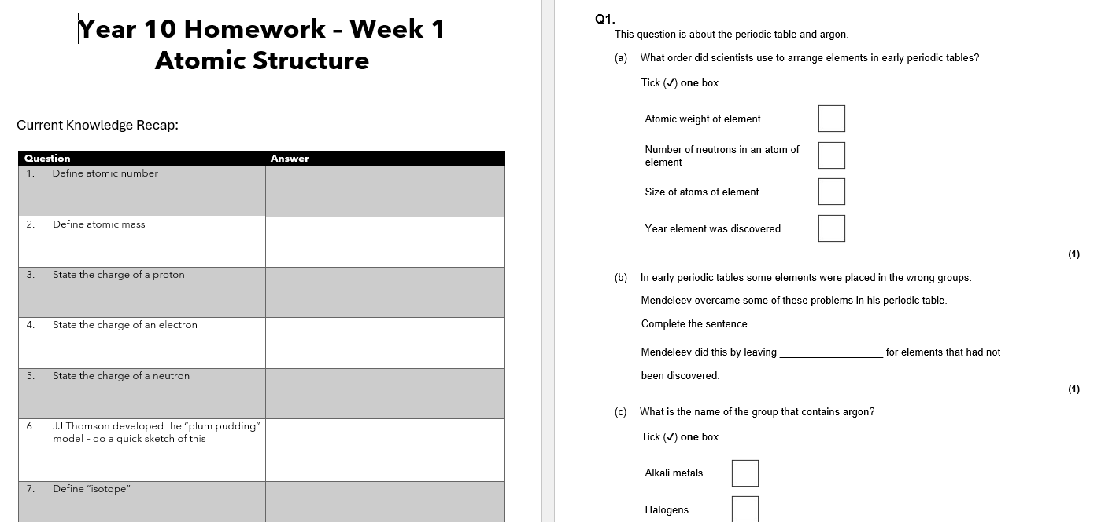
Homework as revision
The weekly 1 hour homework from science will be set each Tuesday and submitted the following Tuesday.
It will be formed of two elements- a written piece and Sparx science.

Slide 26
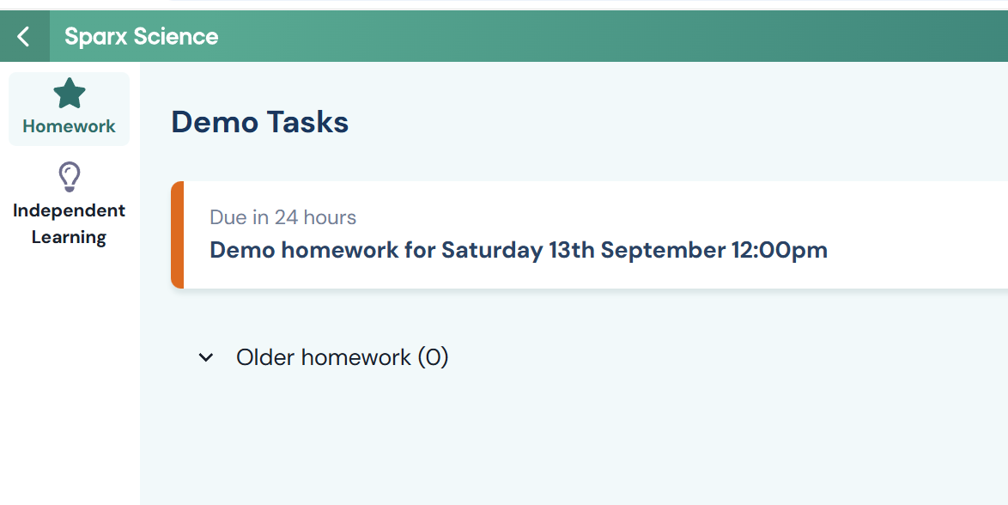

Slide 27

Key knowledge- from revision guides or online
Sparx Science- homework is set on here but students can also do independent study
Exam practice- past papers on AQA website
Seneca- quick knowledge checks
Practicals- video demonstrations on youtube

Slide 28
Maths

Slide 29
You don’t need to be good at maths to be able to help your child with their maths revision!
There are lots of things you can do to support them.
Provide an appropriate work space
Help with designing a revision plan
Reward if revision is taking place
Don’t forget to talk about the Maths!

Slide 30
SPARX MATHS
Will form part of the weekly homework for Year 10 in Maths.
Set and due every Wednesday (at 4pm and 8am respectively) with 100% completion required.
Retrieval topics from the previous term.
Link with regular Do Now tasks completed in lessons.
Weekly quizzes in class to confirm understanding.
Levels will be automatically adapted based on speed of work and ability.
Should be completed independently without the use of AI

Slide 31
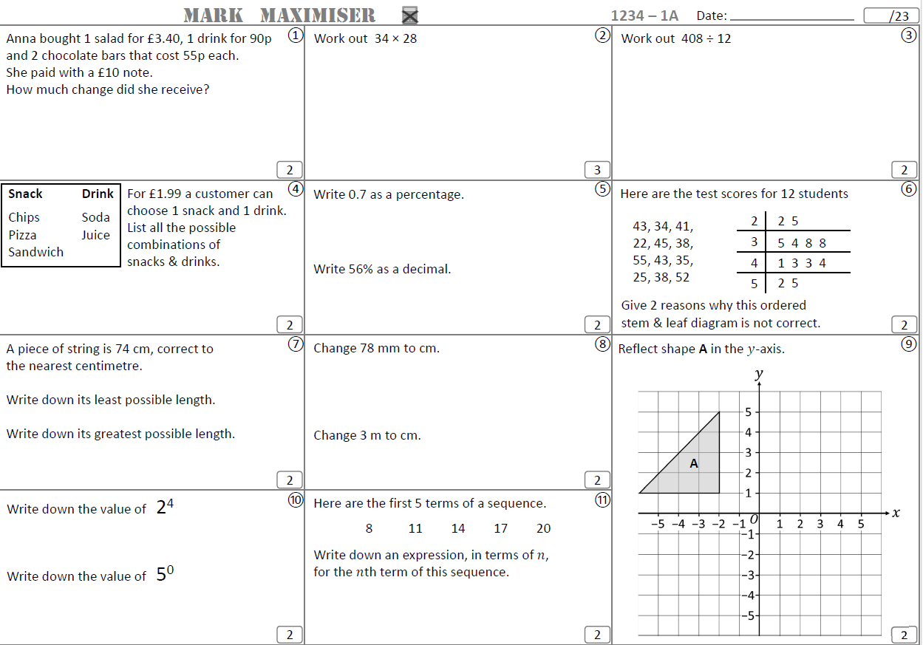
EXAM PRACTICE
Will form the second part of the weekly homework for Year 10 in Maths.
Set and due every Wednesday and completion with full working out is required.
Levelled based on ability.
A variety of topics to aid retrieval
and application of knowledge.
To ensure all students get regular
exam practice and support with
exam technique.

Slide 32
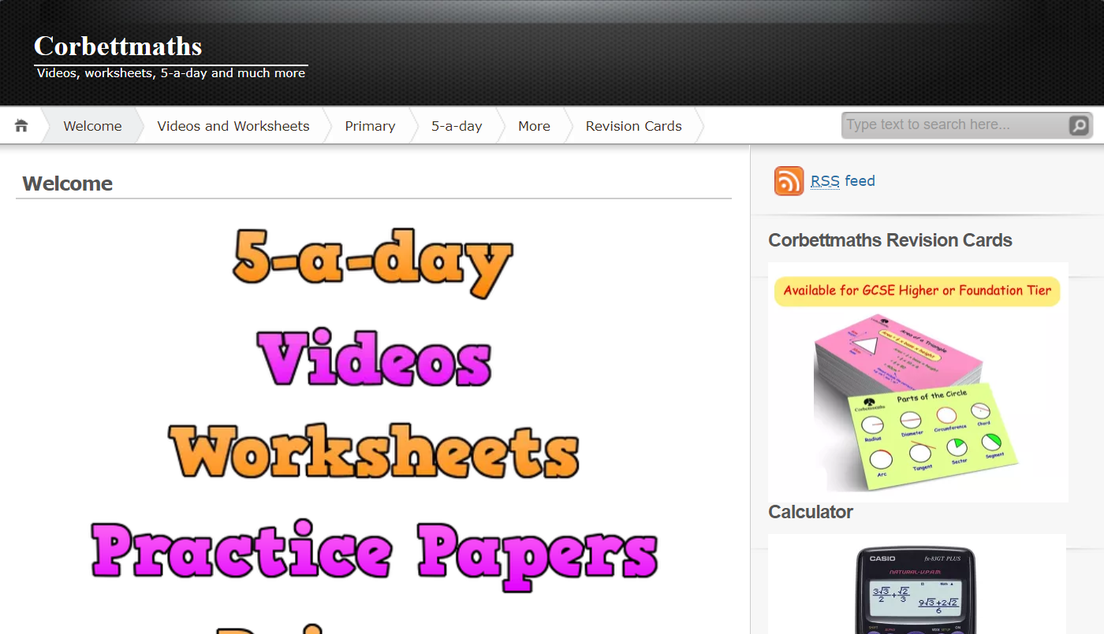
Corbett Maths – can be used to practice specific topics
There are support videos, practice questions and exam questions on every topic.

Slide 33
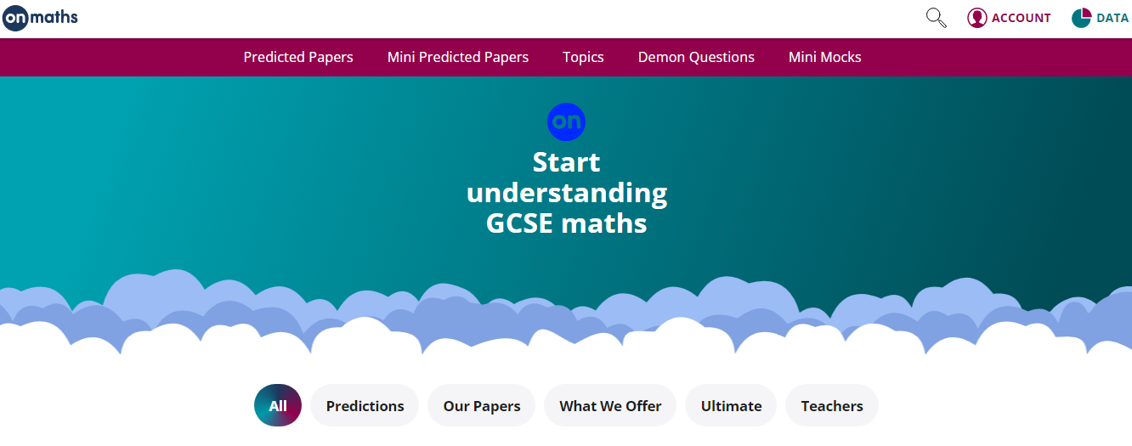
OnMaths – can be used to practice specific topics (no need to login or create an account).
There are mini mocks (assorted topics), demon questions (the hardest questions from each paper) or predicted papers as we approach exams.

Slide 34
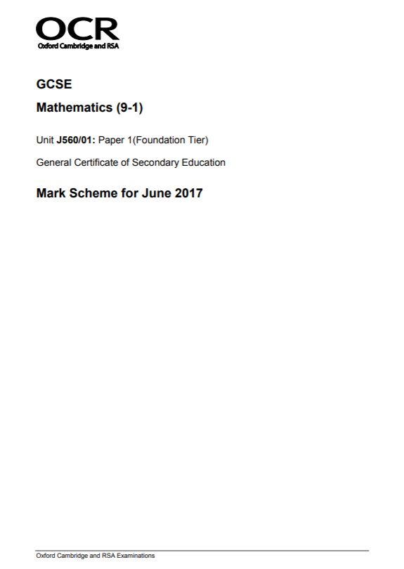
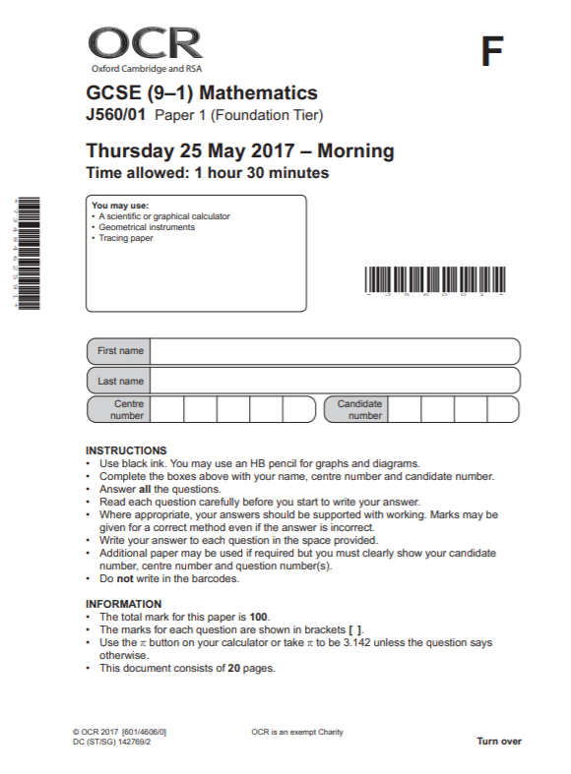
Past Exam Papers - the most important thing to work on and to use are past exam papers.
They inform students where they are (using official grade boundaries).
They inform students which topics they need to revise.
Students need to know the average grade boundaries for their target grade and be working towards achieving that score.
These will be used for the mock exams
in Year 10 and key questions will be
used throughout the year.

Slide 35

PinPoint Learning - targeted questions on students’ weakest topics.
Students will upload their scores per question from full papers they complete and this will tell them their 5 weakest topics per paper to work on.
They will receive a booklet of questions (which they can print off) with questions of increasing difficulty on these topics.

Slide 36
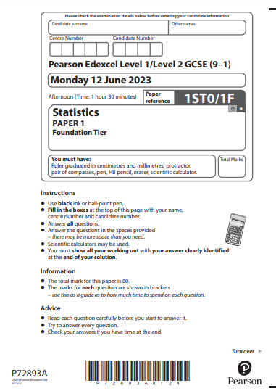
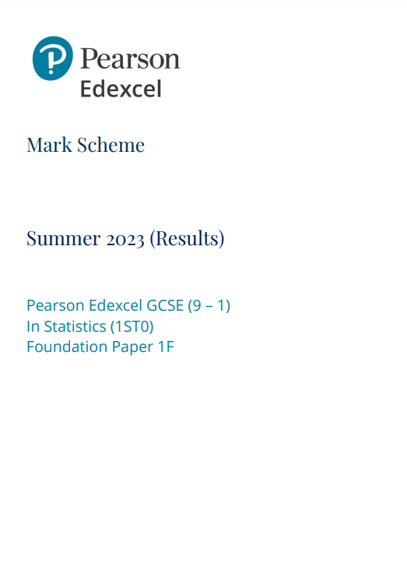
GCSE Statistics
All content for the foundation level GCSE Statistics has been taught at Key Stage 3 and will be revisited this year.
The exam for this will be sat by all Year 10 students at the end of this academic year.
Set 1 and 2 (opt in) - Higher GCSE, can achieve up to Grade 9.
All other students - Foundation GCSE, can achieve up to Grade 5.
Supports with other subjects requiring statistics,
at both GCSE and A Level.
Supports with the Statistics required in GCSE
Maths
Builds confidence for success in GCSE Maths
at the end of Year 11.

Slide 37
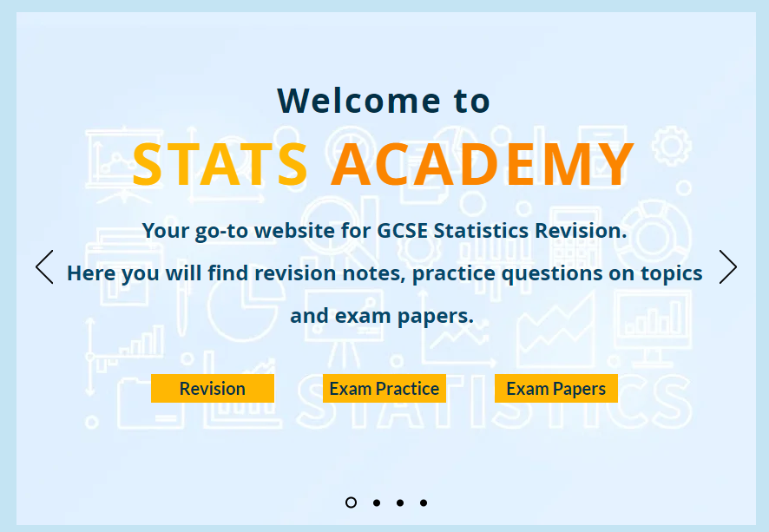
Stats Academy – a website with lots of Statistics resources.
This is great for revision for the statistics exam and has revision notes, questions by topic and full past papers.

Slide 38



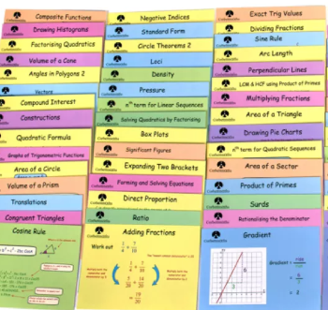
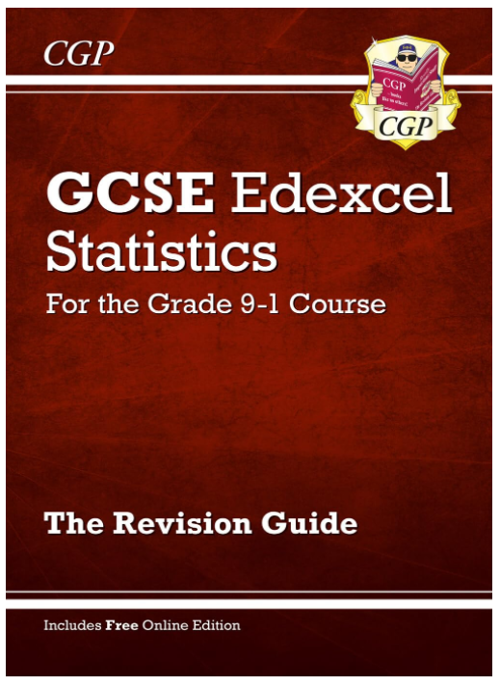



Revision cards/revision books and workbooks – teachers will be able to give more information on these to their classes.

Slide 39
Year 10 Statistics Mock (w/c 20th October)
1 x 1.5hr Calculator Paper
Year 10 Maths Mocks (w/c 23rd March)
2 x 1.5hr Calculator Paper
1 x 1.5hr Non-Calculator Paper
Year 10 Statistics Mock (w/c 23rd March)
2 x 1.5hr Calculator Paper
Year 10 GCSE Statistics Exam (Tues 2nd & Fri 12th June)
2 x 1.5hr Calculator Papers

Slide 40
English

Slide 41


English: Language AND Literature
Paper 1 | Paper 2
Section A Reading a Fiction Extract | Section A Reading 2 Non Fiction Extracts
Section B Creative Writing | Section B Viewpoint Writing
Year 10 Mock Exam is a full Language Paper 1

Slide 42

English Language: ways to revise
Practice makes perfect!
Writing is 50% of the Language GCSE.
Get your child to choose an image off the internet to describe or give them a topic to write persuasively about.
Time your child for 45 minutes.
Read through what they have done. Is it interesting? Have they structured their writing? Have they used ambitious vocabulary?

Slide 43

English Language: ways to revise
Read!
With all this revision reading will just seem like something extra to do…
However, exposing your child to short stories or articles online will really help with their Language GCSE.
And could be a stress relief too!
Your child can get practice Language exams
online or from their English teacher.

Slide 44




Literature
English Revision: Monday
Romeo and Juliet | Animal Farm
Frankenstein | Power and Conflict Poetry
 | Unseen Poetry

Slide 45

Flash Cards
For each text your child needs to know:
Characters
Plot
Themes
Context
With the use of flashcard you can easily test them on these.
Information
Questions
Quotations
Students have lots of ‘notes’ or information. It is now time to start condensing these notes – active revision!
Bonus Revision:
Your child can plan (and even write) and exam answer. Again exam questions can be found online or from the classroom teacher.

Slide 46




Embrace their phone…
Youtube Poetry Mr Bruff
SENECA
BBC Bitesize
York/Spark Notes
Flash card apps

Slide 47
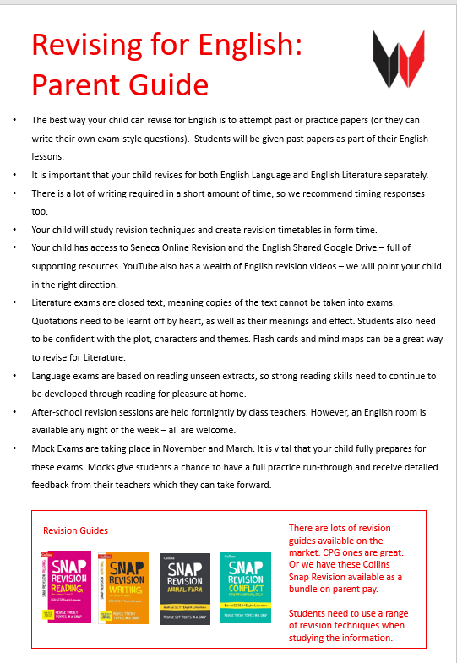

Slide 48

Revision page on the school website

Slide 49
Mental Health & Wellbeing
It is normal to feel stressed and anxious during exams. Managing those feelings, thought and the behaviours that it causes can be difficult. There are lots of charities and groups that provides tips on managing exams stress, as well as more bespoke services that students can contact if they are feeling overwhelmed.
Looking after yourself during exam period | Looking after yourself while preparing for an exam | Looking after yourself on the day of your exam | Looking after yourself after your exam
Make time for things you enjoy Talk to others about how you feel Try to find balance Take care of your physical health Focus on yourself | Find a study group Make a revision timetable Work in the best way for you Revise in the best place for you | Prepare your items the night before Start your day the best you can Try to ground yourself with a breathing exercise Take your time Remind yourself that it'll be over soon | Try not to compare your answers to others Reward yourself Focus on next steps Relax before your next exam

Slide 50



Mental Health & Wellbeing
Hints and tips on managing exam stress
https://www.mind.org.uk/for-young-people/feelings-and-experiences/exam-stress/
Help for parents and students about support with mental health and exam stress
https://www.youngminds.org.uk/parent/blog/how-to-help-your-child-manage-exam-stress/
Students can chat online about their worries, as well access articles and discussions
https://www.kooth.com/

Slide 51

Mental Health & Wellbeing

Slide 52
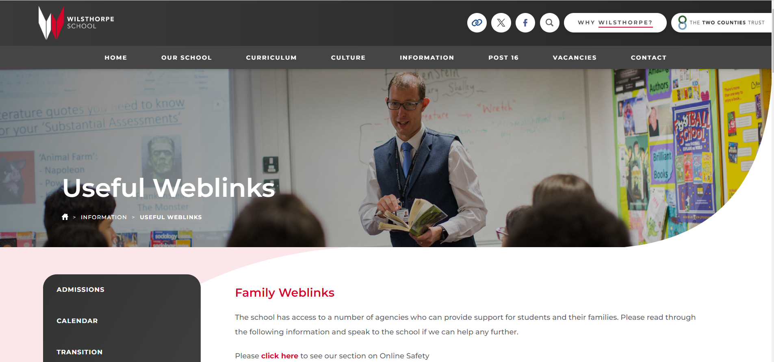
Mental Health & Wellbeing
https://www.wilsthorpe.ttct.co.uk/information/useful-weblinks/#1623761629243-70b2bc50-86fd

Slide 53
Work Experience
Monday 13th July 2026 – Friday 17th July 2026
Work experience is a fantastic opportunity for Year 10 students to gain experience of working in sectors they are potentially interested in for future careers.
Help to make decisions about future education and careers
Gives an understanding of the world of work and employability standards
Need to be already thinking about where they would like to do work experience and contacting employers.
Both Friesland and TLES are on work experience at the same time as us – get in early!
Support during form time with applying and contacting employers.

Slide 54




