Slide 1
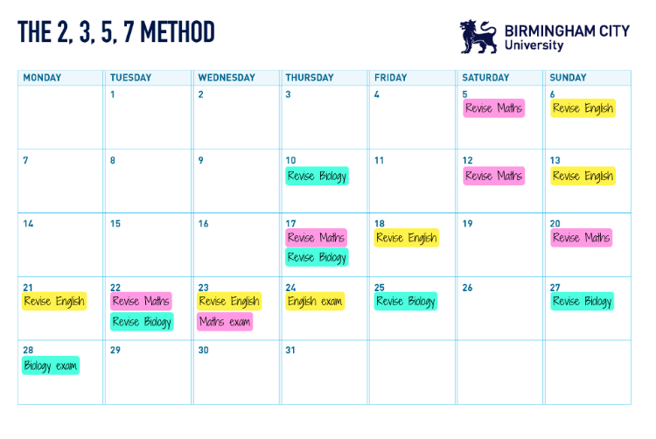
Revision Timetable
Spaced Retrieval Method + 2,3,5,7 method
I have done the core subject exams for you. Add your option subjects.
Write the exam date onto your revision timetable.
Add a revision session for that exam the day before.
Add a revision session 2 days before that.
Add a revision session 3 days before that one.
Add a revision session 5 days before that one.
Then add a revision session every 7 days after that.
Repeat this for every exam.
Ext: If you know which topics appear in each exam, or you know the topics that you struggle with, you can add these to the timetable too.
6.
5.
4.
3.
2.
1.
.
Remember you don’t need to be spending hours each day revising. This is just a guide.
If there are lots of subjects on one day, you can move it to the day before or day after to spread it out.
Breaking it up into 20 – 30-minute sessions per subject that day is enough.
This is flexible and personal to you, add in time to relax, play sport, attend clubs etc.

Slide 2
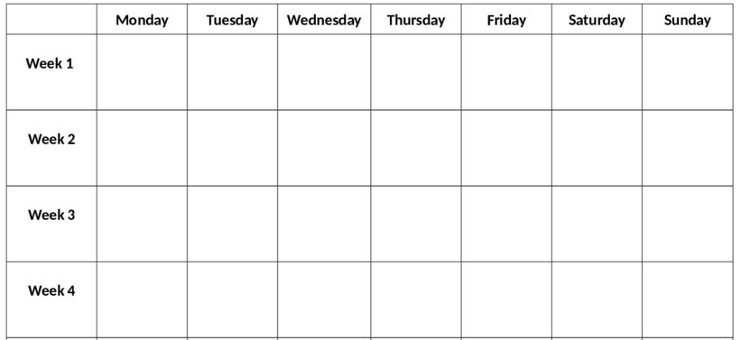
Revision and Exam Timetable
E – Exam
R - Revision
Spaced retrieval
31
1
2
3
4
5
6
R – Eng Lang P1
R – Chemistry P2
R – Eng Lang P2
R – Eng Lit P1
R- Physics P2
R – Chemistry P1
R – Biology P2
R – Biology P1
R – Eng Lit P2
R - Maths P2
R – Maths P3
R – Maths P1
R – Physics P1
31st March
7
8
9
10
11
12
13
R – Eng Lang P1
R – Chemistry P2
R – Eng Lang P2
R – Eng Lit P1
R- Physics P2
R – Chemistry P1
R – Biology P2
R – Biology P1
R – Eng Lit P2
R - Maths P2
R – Maths P3
R – Maths P1
R – Physics P1
7th April
EASTER
14
15
16
17
18
19
20
R – Eng Lang P1
R – Chemistry P2
R – Eng Lang P2
R – Eng Lit P1
R- Physics P2
R – Chemistry P1
R – Biology P2
R – Biology P1
R – Eng Lit P2
R - Maths P2
R – Maths P3
R – Maths P1
R – Physics P1
14th April EASTER
21
22
23
24
25
26
27
R – Eng Lang P1
R – Chemistry P2
R – Eng Lang P2
R – Eng Lit P1
R- Physics P2
R – Chemistry P1
R – Biology P2
R – Biology P1
R – Eng Lit P2
R - Maths P2
R – Maths P3
R – Maths P1
R – Physics P1
21st April

Slide 3
Revision and Exam Timetable
E – Exam
R - Revision
Spaced retrieval
28
29
30
1
2
3
4
R – Eng Lang P1
R – Chemistry P2
R – Eng Lang P2
R – Eng Lit P1
R- Physics P2
R – Chemistry P1
R – Biology P2
R – Biology P1
R – Eng Lit P2
R - Maths P2
R – Maths P3
R – Maths P1
R – Physics P1
28th April
5
6
7
8
9
10
11
R – Eng Lang P1
R – Chemistry P2
R – Eng Lit P1
R – Biology P1
R – Eng Lang P2
R - Physics P2
R – Chemistry P1
R – Biology P2
R – Eng Lit P1
R – Maths P1
R – Eng Lit P2
R – Biology P1
R - Maths P2
R – Maths P3
R – Eng Lit P1
R – Physics P1
5th May
12
13
14
15
16
17
18
E – Eng Lit P1
R- Biology P1
R – Maths P1
R – Eng Lang P1
R – Chemistry P2
E – Biology P1
R – Chemistry P1
R – Maths P1
R – Eng Lit P2
R – Eng Lang P2
E – Maths P1
R - Physics P2
R – Biology P2
R – Chemistry P1
R – Physics P1
R – Eng Lit P2
R – Eng Lang P1
R - Maths P2
R – Maths P3
R – Chemistry P1
12th May
19
20
21
22
23
24
25
E – Chemistry P1
R –Eng Lit P2
R – Physics P1
R – Chemistry P2
E – Eng Lit P2
R – Eng Lang P1
R – Physics P1
R – Eng Lang P2
E – Physics P1
R – Physics P2
R – Eng Lang P1
R – Biology P2
E – Eng Lang P1
R - Maths P2
R – Maths P3
19th May

Slide 4
Revision and Exam Timetable
E – Exam
R - Revision
Spaced retrieval
26
27
28
29
30
31
1
R – Eng Lang P2
R – Chemistry P2
R – Physics P2
R - Maths P2
R – Biology P2
R – Eng Lang P2
R – Maths P3
R - Maths P2
26th May
HALF TERM
2
3
4
5
6
7
8
R – Chemistry P2
R - Maths P2
R – Eng Lang P2
R – Biology P2
E - Maths P2
R – Physics
R – Eng Lang P2
R – Maths P3
E – Eng Lang P2
R – Biology P2
R – Chemistry P2
R – Biology P2
R – Maths P3
2nd June
9
10
11
12
13
14
15
E – Biology P2
R – Maths P3
R – Chemistry P2
E – Maths P3
R – Chemistry P2
E – Chemistry P2
R – Physics P2
R – Physics P2
9th June
16
17
18
19
20
21
22
E – Physics P2
16th June

