Slide 1
Revision Support
How to support your child through their GCSE exams Year 10

Slide 2
The Aim of this Session:
To provide you with information, advice and resources to help you support your child in their GCSE revision.
Structure of the session:
General Advice
Maths
English
Science

Slide 3
But before we start…
Can I reiterate my thanks for all of your ongoing support
Welcome to an important 12 months
Work experience updates

Slide 4
General Advice
Quiet space to work in.
Have resources ready and easily available.
20-30 minute chunks with 5 minute breaks 3 times a evening.
Have a revision timetable (tutors have been supporting with this via a revision booklet, more to follow on this) – so that you can be fair to all your subjects, especially your weaker ones.
Consider their work/life balance – don’t burn out.
Well-being – sleep, eat well, talk to an adult if they are stressed.
Celebrate successes to maintain motivation.

Slide 5
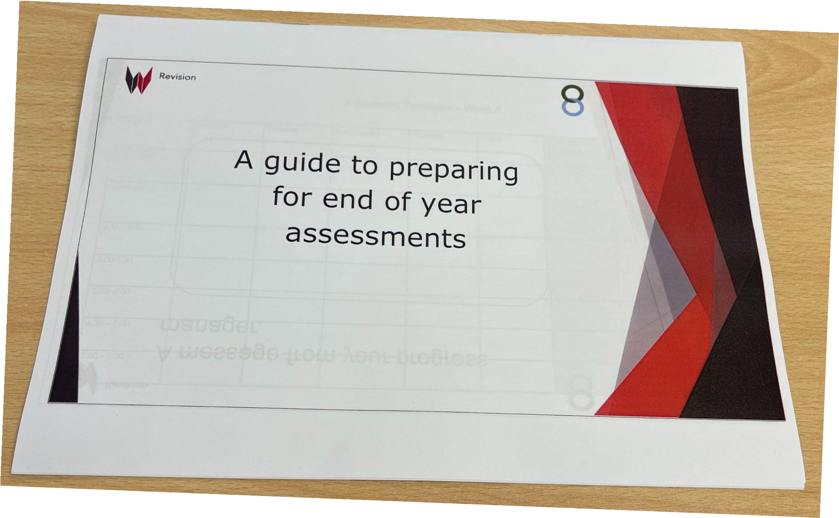
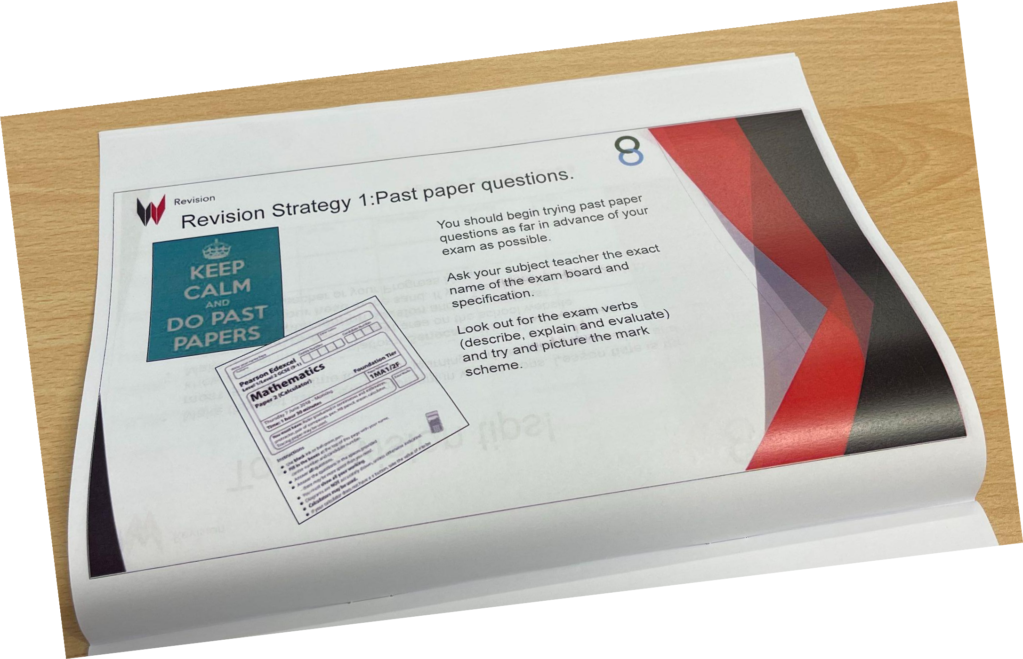
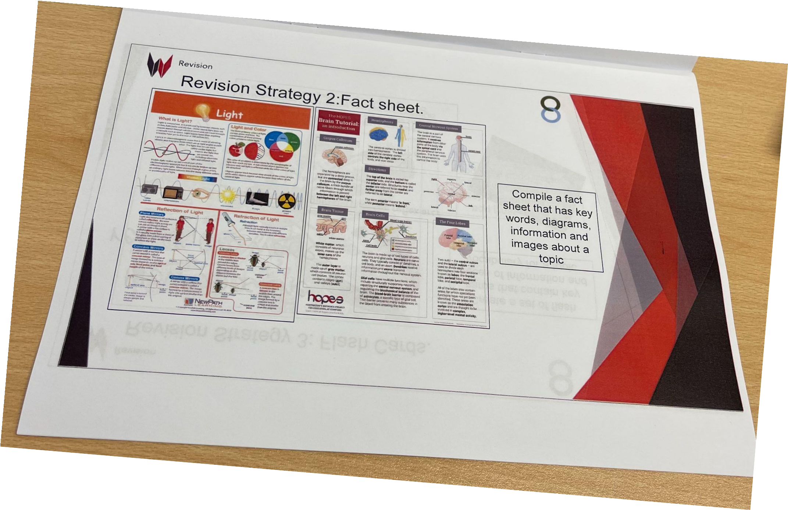
Form time support: Revision Booklet
During form time this term, form tutors will be going through a revision booklet which covers the following:
A Revision timetable
Revision top tips
Different types of revision strategies
Different revision websites for their subjects
Students will be sent home with this revision booklet in the coming weeks. Please continue to encourage them to use it for revision in the weeks leading up to their Y10 mock exams.

Slide 6
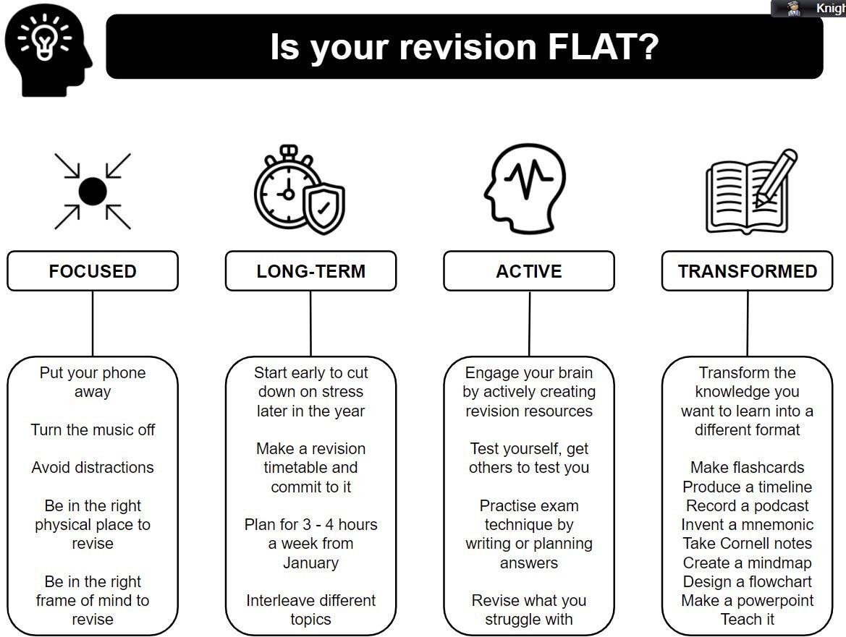
Further form time support:
Form tutors will also be pushing the students to consider if their revision is ‘flat’ and how to tackle this.

Slide 7
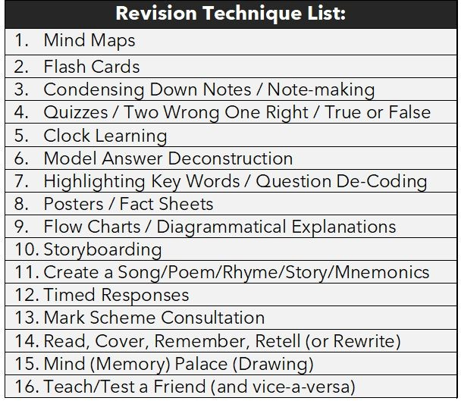
Introduction of Revision Curriculum - 16 Supportive Methods
Everybody learns and remembers in a different way - it is about finding the method(s) that work for your child.
“The right horses for the right courses” approach.

Slide 8
Of the 16 methods the following are particularly useful for GCSE Students:
Method 1 - Mind Maps Method 2 - Flash Cards
Method 3 - Condensing Down Notes Method 4 - Two Wrong, One Right Method 5 - Clock Learning
Method 6 - Model Answer Deconstruction Method 7 - Highlighting
Method 12 - Timed Responses
Method 13 - Mark Scheme Consultation

Slide 18
What past students have said helps…
“I do feel stressed, especially when I have to do loads of jobs too.”
“Turn the internet off.”
“Buy me resources – revision books, note books, flashcards.”
“Quiz me on work I have read/ask questions.”
“Make a timetable together and help me stick to it.”
“Trust me.”

Slide 19
Science

Slide 20
All separate exams are 1hr45 long
Biology Paper 1 1hr15 70 marks Cell Biology; Organisation; Infection and response; and Bioenergetics. | Chemistry Paper 1 1hr15 70 marks Atomic structure and the periodic table; Bonding, structure, and the properties of matter; Quantitative chemistry; Chemical changes; and Energy changes. | Physics Paper 1 1hr15 70 marks Energy; Electricity; Particle model of matter; and Atomic structure.
Biology Paper 2 1hr15 70 marks | Chemistry Paper 2 1hr15 70 marks | Physics Paper 2 1hr15 70 marks
Homeostasis and response; | The rate and extent of | Forces; Waves; and
Inheritance, variation and | chemical change; Organic | Magnetism and
evolution; and Ecology. | chemistry; Chemical analysis; | electromagnetism
 | Chemistry of the
 | atmosphere; and Using
 | resources.

Slide 21
Equations….
By the end of Yr11 students will need to learn 21 equations (23 if in separate sciences).
You can help by quizzing students on the equations.
What equation links charge, current & time?
All equations are found in student planners.

Slide 22
Year 10 Mock Exams
3 Papers - 1hr15 (1hr45 for Separates!)
Biology - Tuesday 27th June Chemistry - Thursday 29th June Physics - Friday 30th June

Slide 24
How you can help:
Key knowledge Exam practice Seneca Practicals

Slide 25
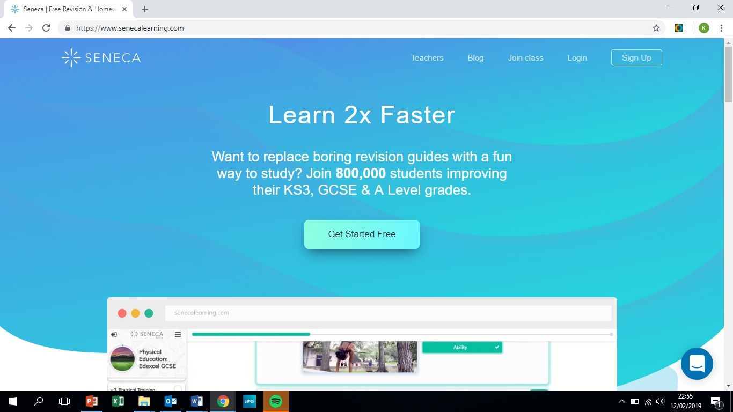

Slide 26
Other online bits….
Free Science Lessons https://www.youtube.com/channel/UCqbOeHaAUXw9Il7sBVG3_bw
Primrose Kitten https://www.youtube.com/c/primrosekittenscience

Slide 27
Maths

Slide 28
You don’t need to be good at maths to be able to help your child with their maths revision!
There are lots of things you can do to support them.
Provide an appropriate work space
Help with designing a revision plan
Reward if revision is taking place
Don’t forget to talk about the Maths!

Slide 29
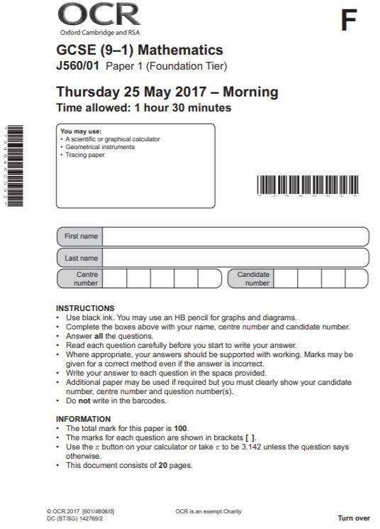
The most important thing to work on and to use are past exam papers:
They inform students where they are (using official grade boundaries)
They inform students which topics they need to revise
If students can get a grade 5 regularly on these then they will in the exam

Slide 30
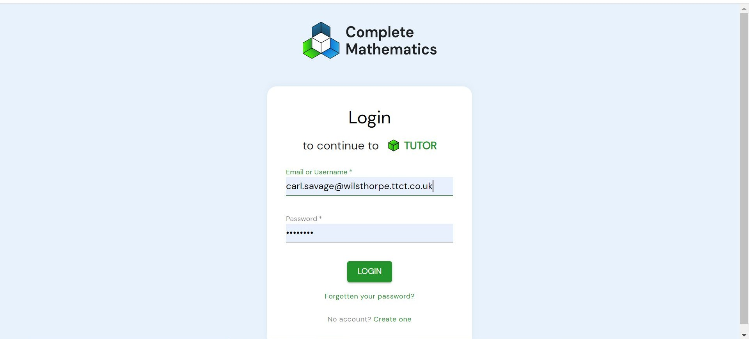
1. TUTOR - work on gaps in knowledge and/or target a particular grade

Slide 31
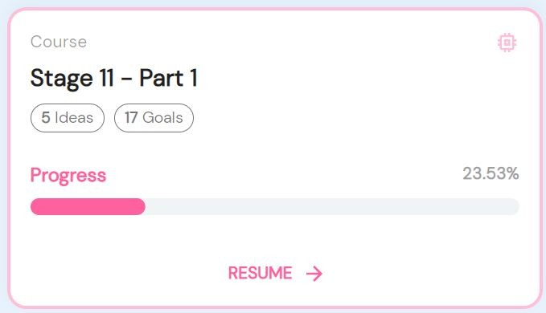
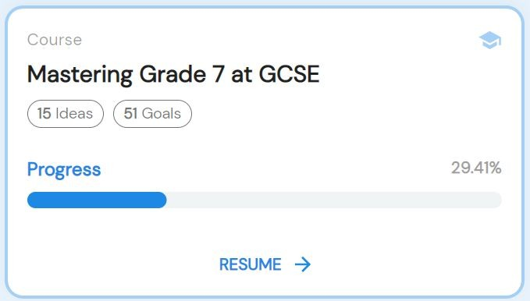
1. TUTOR - work on gaps in knowledge and/or target a particular grade
Work on your gaps
Target a grade

Slide 32
2. Corbett Maths - videos explaining topics plus questions and answers

Slide 33
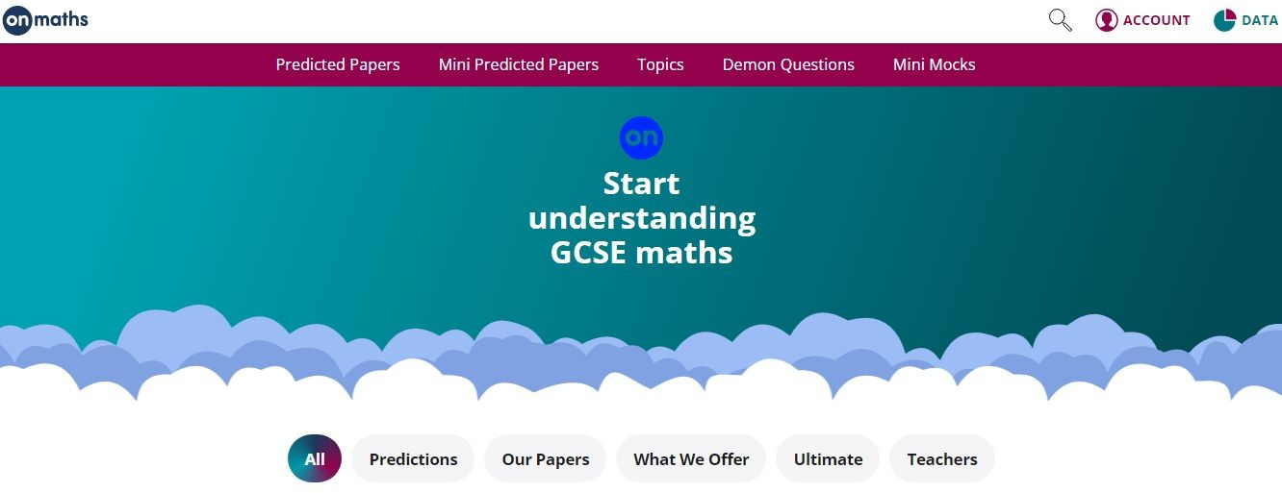
3. OnMaths - topic revision with increasingly difficult question plus predicted papers

Slide 34
4. PinPoint Learning - targeted questions on students’ weakest topics

Slide 35
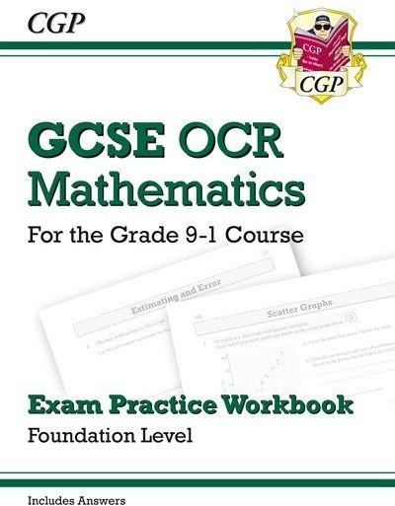
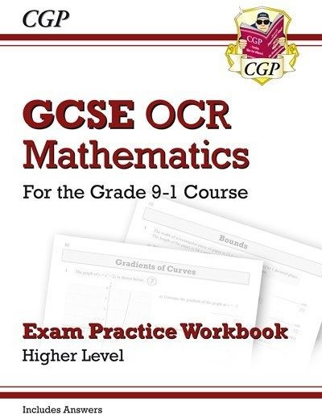
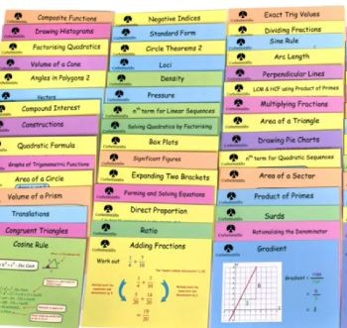
5. Revision cards/revision books and workbooks
£2.50
per set
£6.25

Slide 36
English

Slide 37
English: Language AND Literature
Paper 1 | Paper 2
Section A Reading a Fiction Extract | Section A Reading 2 Non Fiction Extracts
Section B Creative Writing | Section B Viewpoint Writing
Year 10 Mock Exam is a full Paper 1

Slide 38
English Language: Ways to revise
Practice makes perfect!
Writing is 50% of the Language GCSE.
Get your child to choose an image off the internet to describe or give them a topic to write persuasively about.
Time your child for 45 minutes.
Read through what they have done. Is it interesting? Have they structured their writing? Have they used ambitious vocabulary?

Slide 39
English Language: Ways to revise
Read!
With all this revision reading will just seem like something extra to do…
However, exposing your child to short stories or articles online will really help with their Language GCSE.
And could be a stress relief too!
Your child can get practice Language exams online or from their English teacher.

Slide 40
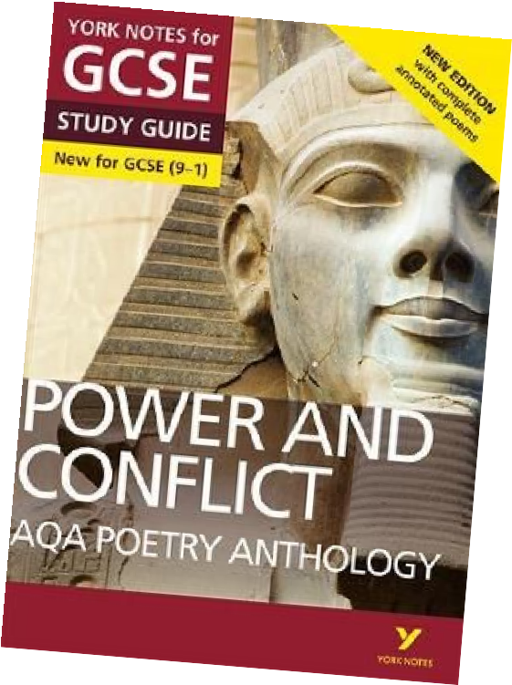
Literature
Romeo and Juliet | Animal Farm
Frankenstein | Power and Conflict Poetry
 | Unseen Poetry

Slide 41
Flash Cards
For each text your child needs to know:
Characters Plot Themes Context
With the use of flashcard you can easily test them on these.
Information
Questions
Quotations
Students have lots of ‘notes’ or information. It is now time to start condensing these notes – active revision!
Bonus Revision:
Your child can plan (and even write)
and exam answer. Again exam
questions can be found online or
from the classroom teacher.

Slide 42
Embrace their phone…
Youtube
SENECA
BBC Bitesize
York/Spark Notes
Flash card apps
Poetry Mr Bruff

Slide 43
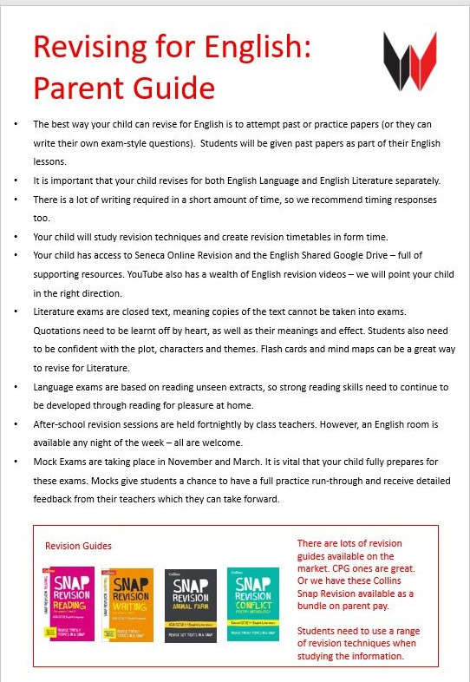
Summer Reading…
Frankenstein

Slide 44
Revision page on the school website

Slide 45
Please come and ask us any questions…

