Slide 1
“Education is the most powerful weapon which you can use to change the world.”
Nelson Mandela (Anti-apartheid activist and former President of South Africa)
Preparation for Learning - Knowledge Organisers
Year 9 Summer Term

Slide 2
What is a knowledge organiser and why do we use them?
Here at Wilsthorpe School, all subject leaders produce knowledge organisers to support you whilst you are in Years 7, 8 and 9, but what is a knowledge organiser?
Knowledge organisers present the key knowledge and skills for a particular topic. We call this the most ‘powerful’ knowledge.
They contain the key vocabulary for the topic that you need to understand and use.
We know that if we do not regularly revisit this powerful knowledge, we forget some or most of what we have learned. Our lessons are designed so that we regularly revisit prior learning but knowledge organisers allow you to also revisit this knowledge at home.
Using this booklet at home will help you to understand and remember all of the knowledge you will be taught each term. This will allow you to connect and strengthen your learning, allowing you to thrive in your lessons and beyond.

Slide 3
How to use a knowledge organiser (1)
Using your knowledge organiser at school
You will be given a knowledge organiser at the start of each term (September, January and April). You need to bring your knowledge organiser and exercise book with you every day to school. This will be a key piece of equipment and will be regularly referred to in lesson.
In lessons, there will be fortnightly low-stakes retrieval quizzes based on the knowledge contained in the knowledge organiser. Your knowledge organiser and exercise book will be checked regularly during tutor time.
Using your knowledge organiser at home
You should spend 40 minutes per evening completing your knowledge organiser work. On Monday, Tuesday, Wednesday and Thursday evenings, you should be studying two sections of your knowledge organiser. On Friday you should study one section.
The timetable on the following pages tells you which subjects you should be studying on which days. Your subject teacher will explain which Design and Technology page to study and which Languages page to study.
You should use your exercise book to show the work you have done. Each evening you should start a new page and put the date clearly at the top.
Every night you should also read for 15 minutes as a minimum and fill in your ‘Reading Log’. Parents should sign your reading log by initialling the relevant column.

Slide 4
How to use a knowledge organiser (2)
There are many different methods you can use to revise the information in the knowledge organiser and to test yourself. Here are some ideas of things you can do:
Clocks - divide a page into 12 sections (like a clock) and add information about a topic in each section
Spelling tests - write a spelling test for yourself based on the key vocabulary
Fact sheets - produce a fact sheet that contains key words, diagrams and information about a topic
Posters - produce of poster that contains the key images in a topic
Flowcharts – produce a diagram that sequences the key steps in a process or key events in a time period
Quizzes - write a quiz based on what you have learnt about a topic and get others to test you
Mind maps - produce a mind map to logically organise key concepts
Flash cards - create a set of flash cards that contain key pieces of information and vocabulary for a topic
Read, cover, say, write and check – read 3 pieces of information, cover it over, say it aloud, write it down correctly then check it against your knowledge organiser. Repeat until to you say and write it perfectly

Slide 5
How to use a knowledge organiser (3)
There are many different methods you can use to revise the information in the knowledge organiser and to test yourself. Here are some ideas of things you can do:
Mnemonics - take the first letter of each key word to be remembered and write it in to a down in to a memorable word or sentence i.e to remember the planets you could use My Very Educated Mother Just Served Us Nuts (Mercury, Venus, Earth, Mars, Jupiter, Saturn, Uranus, Neptune.)
3D models - make a 3D model (with labels) relating to a topic
Comic strip/storyboard – produce a visual representation of a topic or concept in a storyboard or comic
Poem/song - create a poem or song about a topic you’ve studied, remember to include key terms
Creative writing – write a fictional story that contains the key terms from a topic
For more details on each of these methods and how to use them, visit the following page on the school website:
https://www.wilsthorpe.ttct.co.uk/wp-content/uploads/sites/6/2021/10/Using-the-Knowledge-Organiser.pdf
You will also be taught how to use each of these methods during our revision sessions in tutor time.

Slide 6
Knowledge organiser timetable
Week A
Week B
Day | Subject 1 | Subject 2 | Reading
Monday | English | Design Technology | 15 minutes minimum
Tuesday | Maths | Physical Education | 15 minutes minimum
Wednesday | Science | Geography | 15 minutes minimum
Thursday | Grammar | Music | 15 minutes minimum
Friday | Drama |  | 15 minutes minimum
Day | Subject 1 | Subject 2 | Reading
Monday | English | History | 15 minutes minimum
Tuesday | Maths | MFL | 15 minutes minimum
Wednesday | Science | Computing | 15 minutes minimum
Thursday | Grammar | Art | 15 minutes minimum
Friday | Maths |  | 15 minutes minimum

Slide 7
Reading log
Fifteen is fantastic! Remember to read for at least 15 minutes everyday.
Week Beginning | M | T | W | T | F | S | S | Book(s) Read | Pages Read | Parent Initials | Librarian Initials
 | Record the number of minutes you read for each day
15th April
22nd April
29th April
6th May
13th May
20th May
Half term
3rd June
10th June
17th June
24th June
1st July
8th July
15th July

Slide 8
Year 9 reading list
Fifteen is fantastic! Remember to read for at least 15 minutes everyday.
Alternative ‘Super Readable Reads’ are available in the library
Subject Wider Reading Lists for every subject are available on the school website subject pages at: https://www.wilsthorpe.ttct.co.uk/curriculum/subjects/

Slide 9
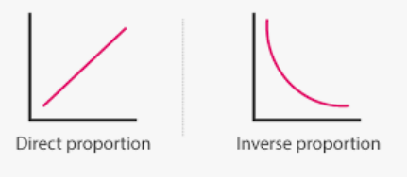
Maths
Enlargement and Similarity Similar shapes have corresponding sides that are in the same ratio. Similar shapes have exactly the same size angles. Enlargements require a scale factor of enlargement and a centre of enlargement Scale factors between 0 and 1 will reduce the size of the shape Negative scale factors change the size of the shape and rotate by 180 degrees The hypotenuse is the longest side in a right-angled triangle | 2. Solving Ratio and Proportion · Directly Proportional relationships have equations y=kx Inversely Proportional relationships have equations y=k/x Recognise graphs of direct and inverse proportion To solve best buy problems I find the price of one product, This is the unitary method. | 3. Rates · Speed = Distance/Time Density = Mass/Volume To convert minutes to hours I must divide by 60 The gradient of a Distance-Time Graph gives the velocity. The gradient of a Velocity-Time Graph gives the acceleration. 1m³ = 1 000 000cm³ 1 km = 1000m 8km = 5miles

Slide 10
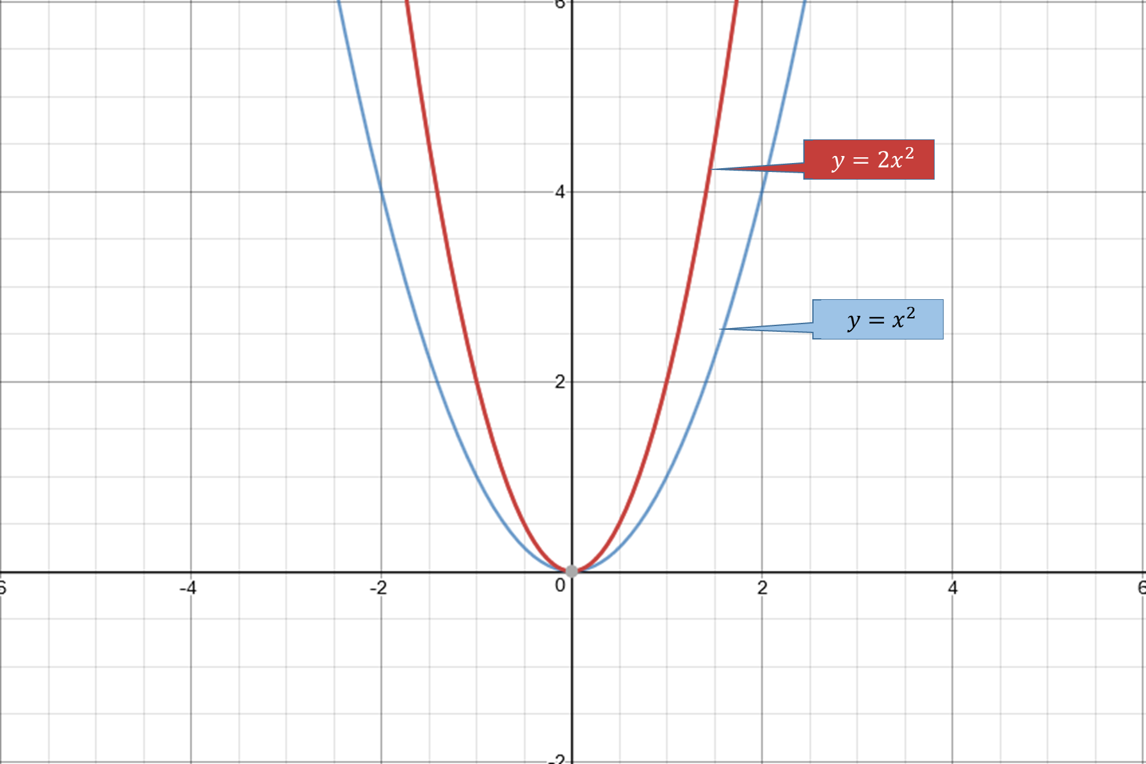
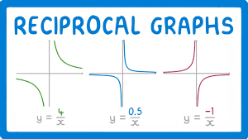
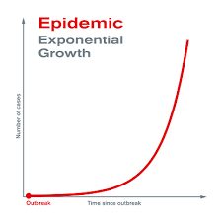
Maths
4. Maths and Money Simple Interest is the same interest applied every term · Compound interest calculates interest on the new total at the end of every term · Understand Value Added Tax (VAT) as a government tax applied to goods · Understand income as the money earned by an individual or company · Understand overtime as work completed on top of normal hours · Understand salary as the yearly wage · Understand income tax as the money paid to the government from your wages | 5, Probability · Probability can be expressed as a Fraction, Decimal or a Percentage Relative Frequency is an estimation of probability obtained from an experiment Know that the more trials completed the more accurately relative frequency reflects the true probability Expected outcomes = probability x total trials Independent events do not affect each other’s probability Sample spaces list the outcomes of two event | 3. Algebra · Recognise a quadratic graph as a parabola Recognise reciprocal and exponential graphs

Slide 11
English
To Kill a Mockingbird by Harper Lee
Fifteen is fantastic! Remember to read for at least 15 minutes everyday.

Slide 12
English
To Kill a Mockingbird by Harper Lee
Fifteen is fantastic! Remember to read for at least 15 minutes everyday.

Slide 13
Grammar
Your Grammar teacher will tell you when you will be tested on each list.

Slide 14
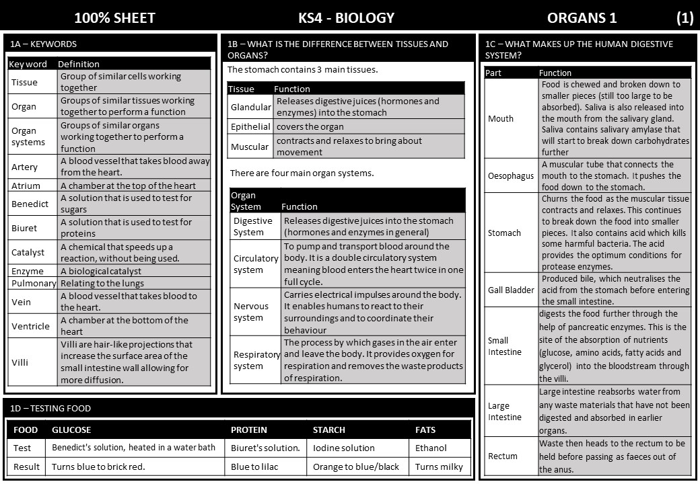
Science

Slide 15
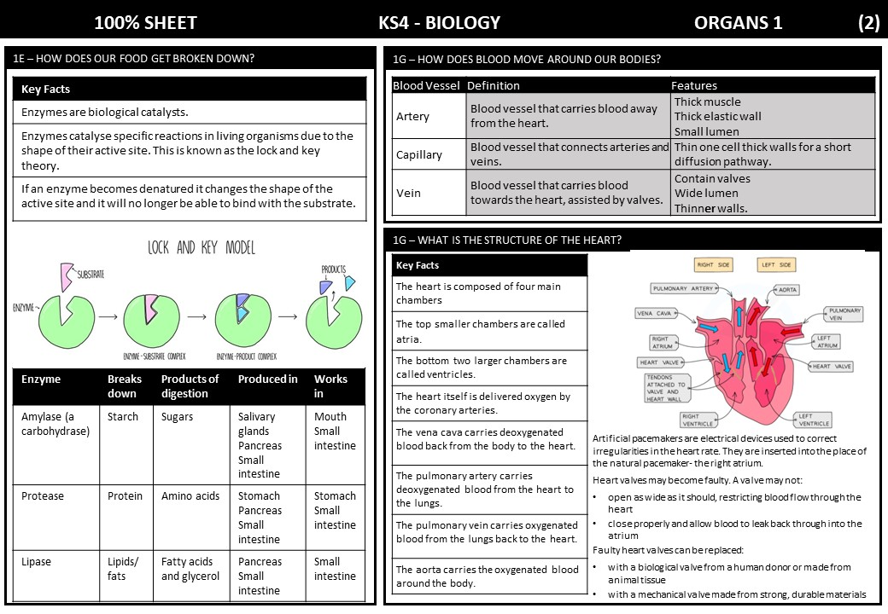
Science

Slide 16
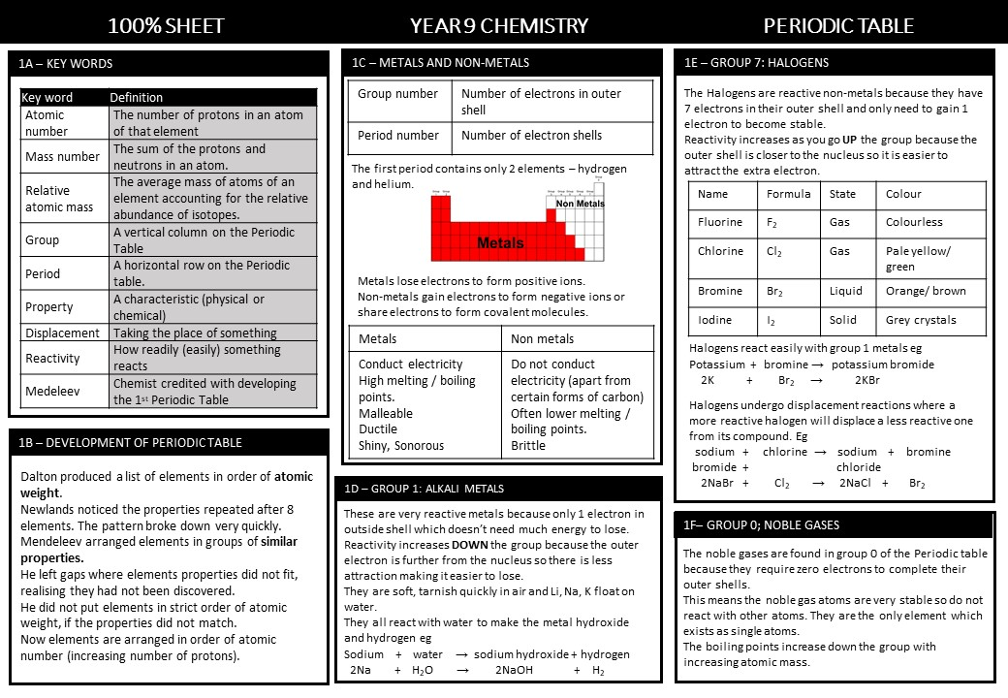
Science

Slide 17
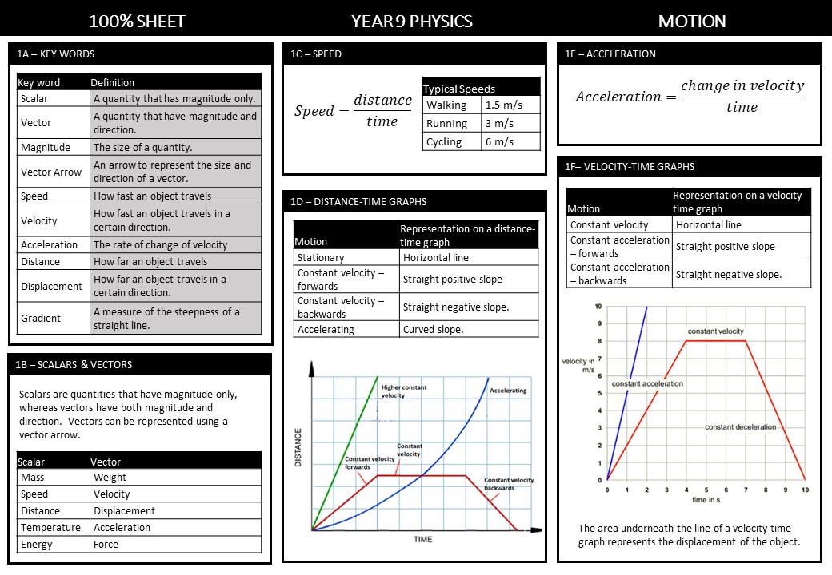
Science

Slide 18
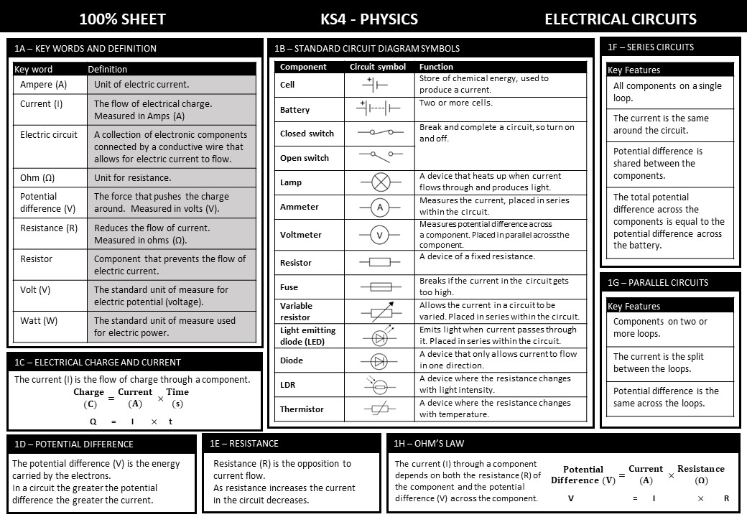
Science

Slide 19
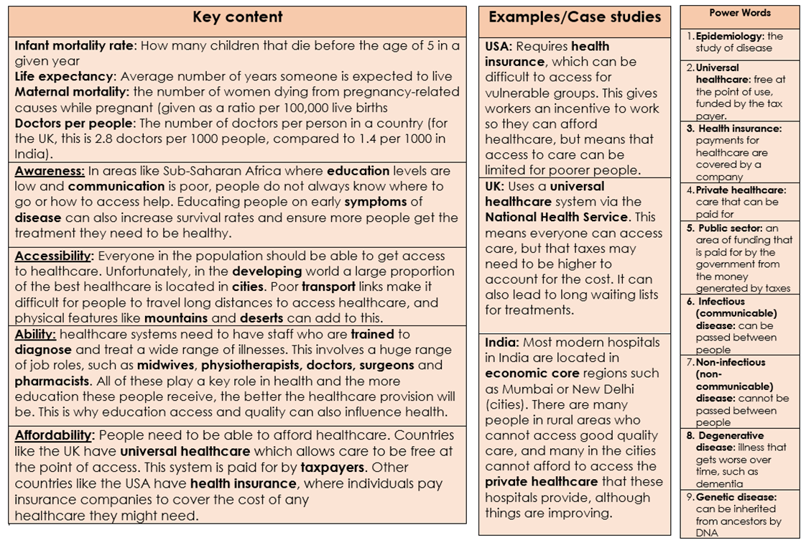
Geography

Slide 20
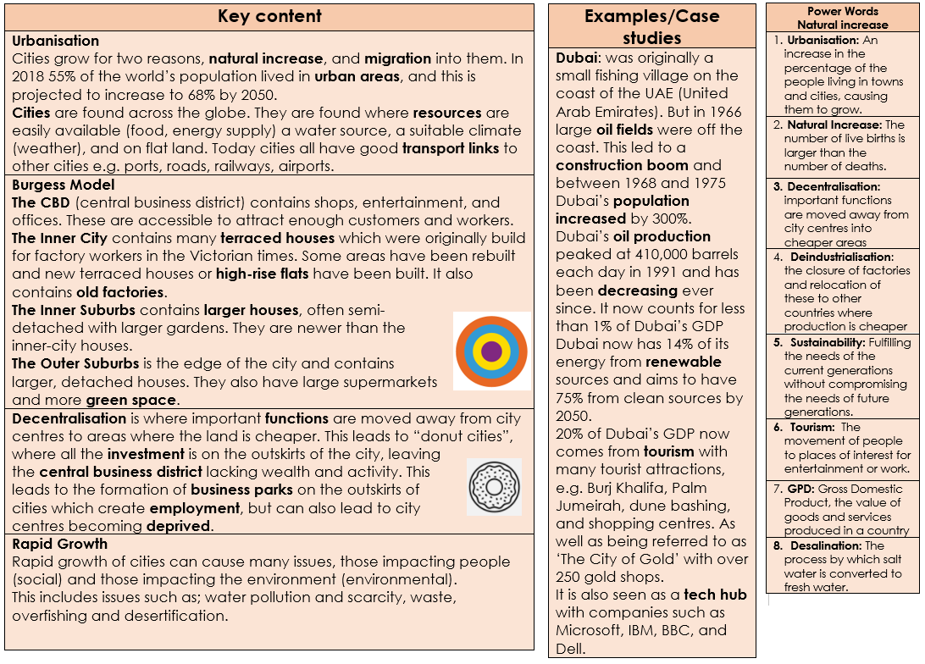
Geography

Slide 21
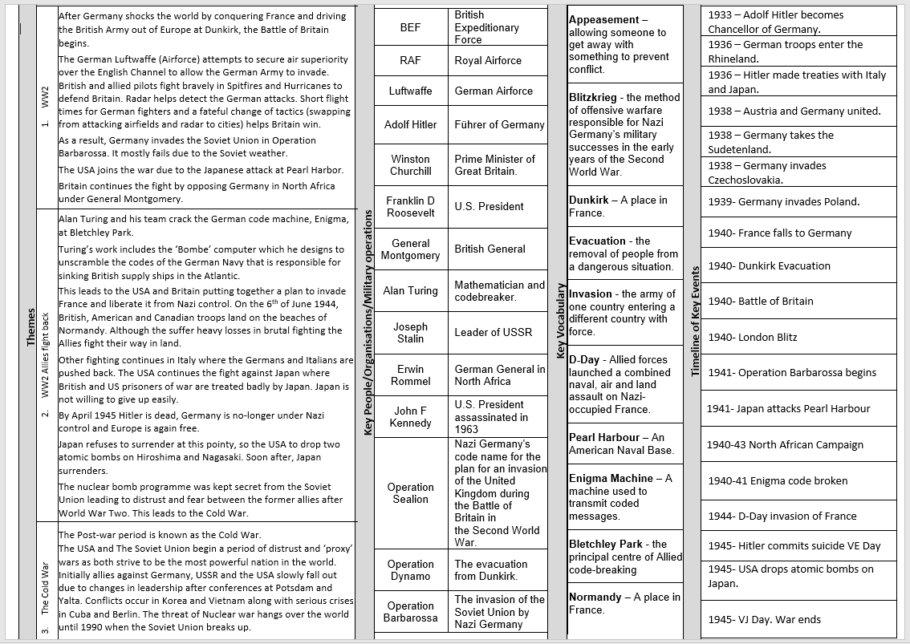
HISTORY
HISTORY

Slide 22
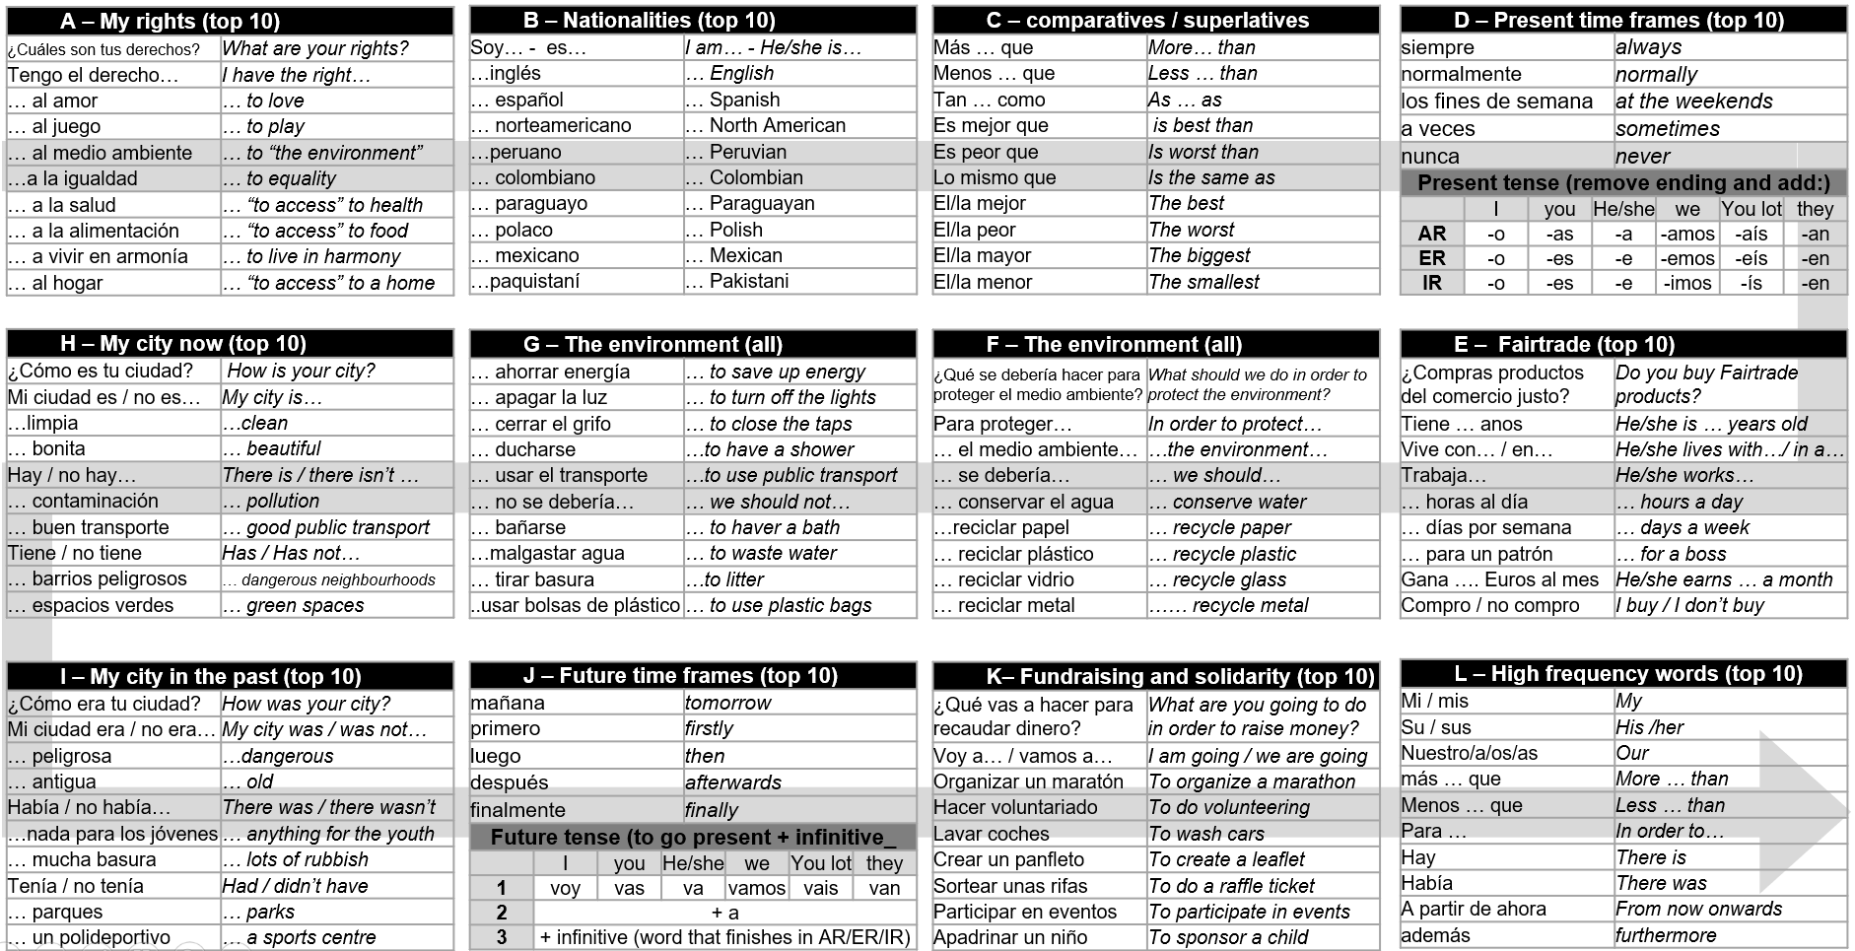
Spanish

Slide 23
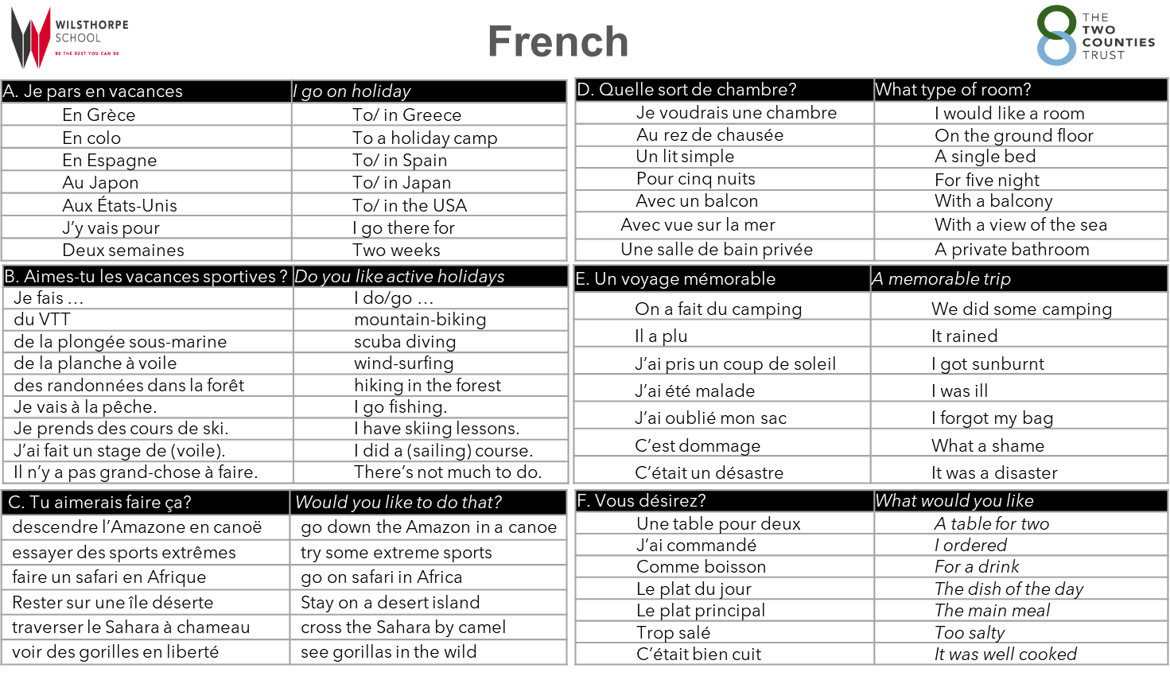

Slide 24
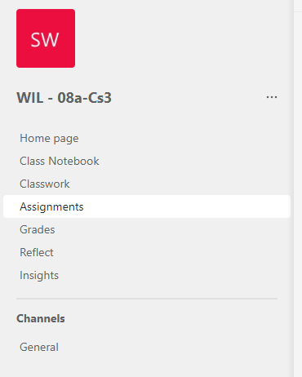
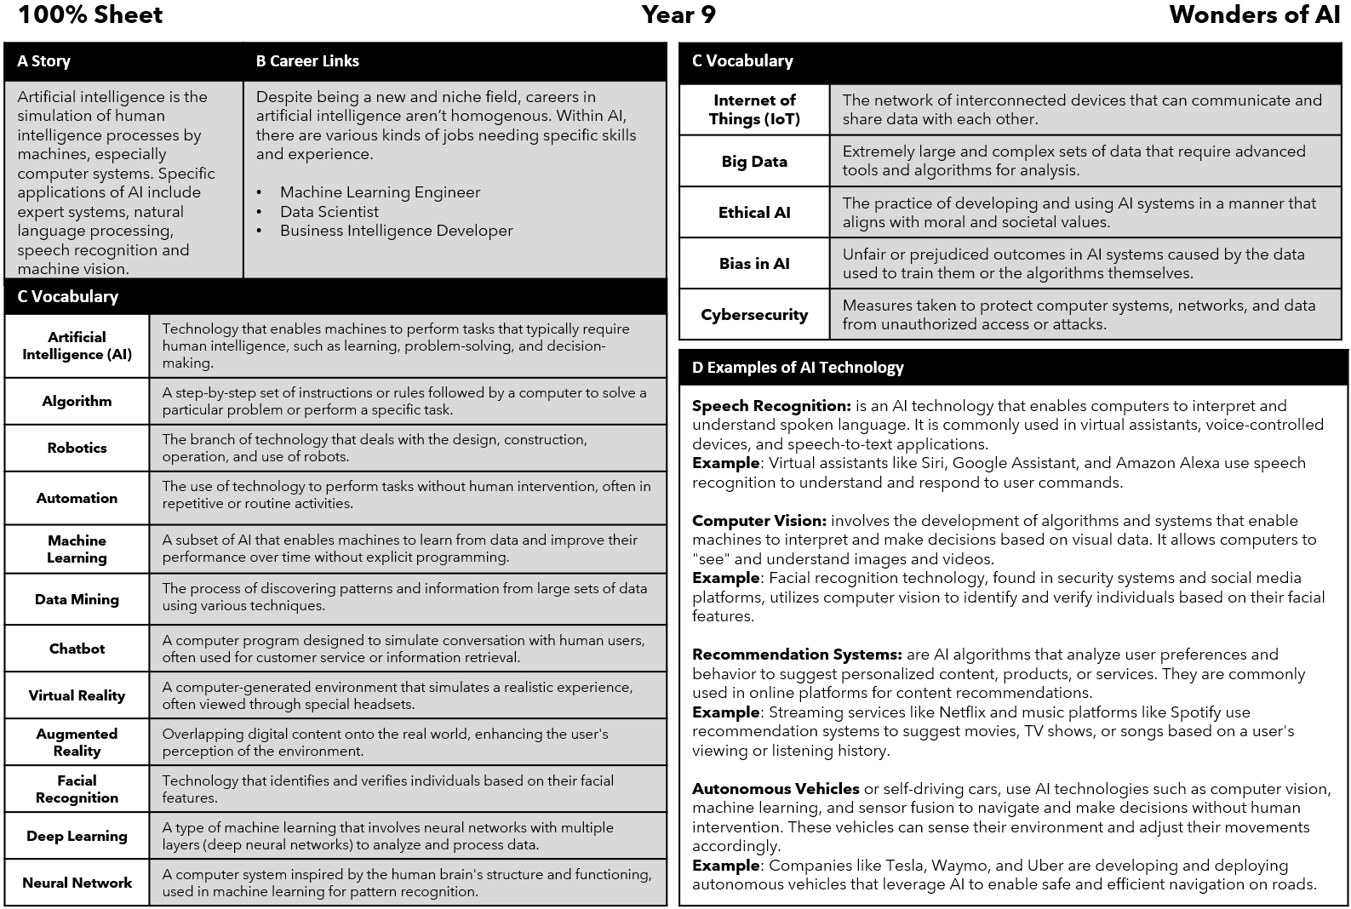
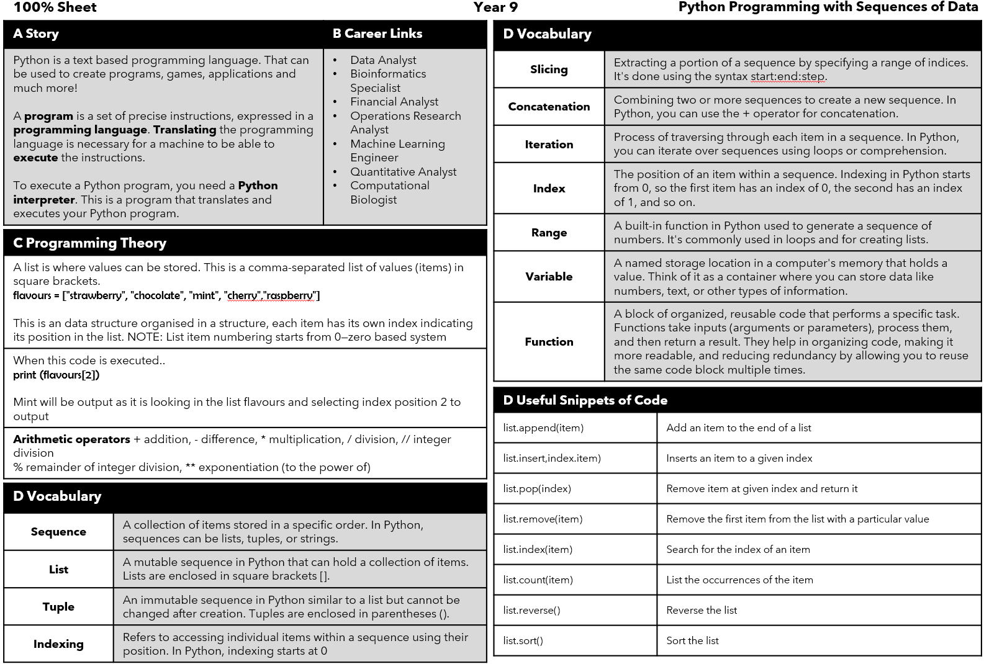
Accessing Teams
Computing
All Computer Science Lessons, Resources and Homework can be found on our Teams Platform. (This does not affect other subjects). To access the web platform for Teams - type into google the following link: https://www.microsoft.com/en-gb/microsoft-teams/log-in
You may not always get homework through teams. Revise the information below if you don't receive any from your teacher on the platform.
Then click on the top right and login using your school email and password.
You can also download the platform but this is optional.
On the Teams platform find your classroom and open it.
In your classroom go to assignments and scroll through until you find your homework posted by your teacher.
Term 5
Term 6

Slide 25
Art

Slide 26
Drama
Drama Key words
Dialogue | A conversation between two or more people
Devising | When a group of performers work together to create an original piece of drama
Hot-seating | When a character is questioned by the group about his or her background, behaviour and motivation.
Backstory | An event that happened in a character’s past that has shaped how they are today
Stimulus | Starting point for a piece of drama
Narration | Adding a spoken commentary for the audience about the action onstage
Mime | A wordless form of entertainment, in which movement and gesture are used to communicate rather than speech.
Multi-roling | Playing more than one character on stage
Slow motion | An effect where actors move more slowly than in real life, this could be used to highlight a certain moment
Split stage | Two different pieces of action seen alongside each other on stage
Flashback / flash forward | Moving the narrative back or forward in time
Monologue | An extended speech by one actor
Cross-cutting | Mixing different scenes up in to different orders so it is non-linear.
Thought-Tracking | Speaking inner thoughts out loud to an audience
Intention | Aim / goal
Movement sequences | Communicating meaning through movement
Writing-in-role | Writing from a character's perspective
Camera & Editing Techniques
Key Word | Definition
Pan | Where the camera pivots left or right while its base remains in a fixed location
Close up | Taken at close range intended to show greater detail to the viewer
Zoom | The illusion of moving closer or further away
Shot | A continuous view through a single camera without interruption
Fade | Slowly disappear
Transition | The process of moving from one scene or set to the next
Cut | The end of a take and a call to stop the action
Trim | Taking off either part of the beginning or end of a video clip
Split | Breaking a film clip in two

Slide 27
Music

Slide 28
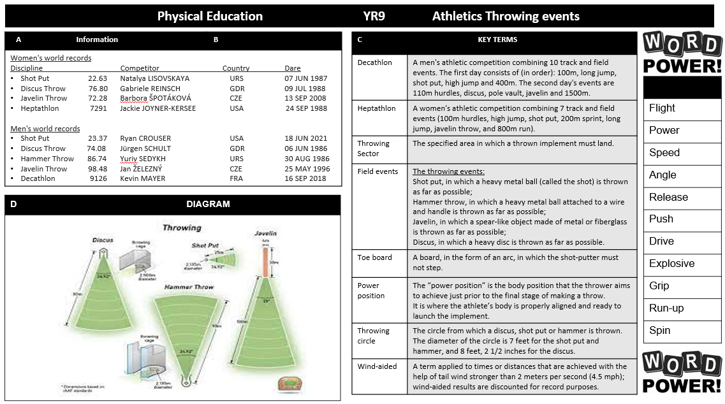
Physical Education

Slide 29
Physical Education

Slide 30
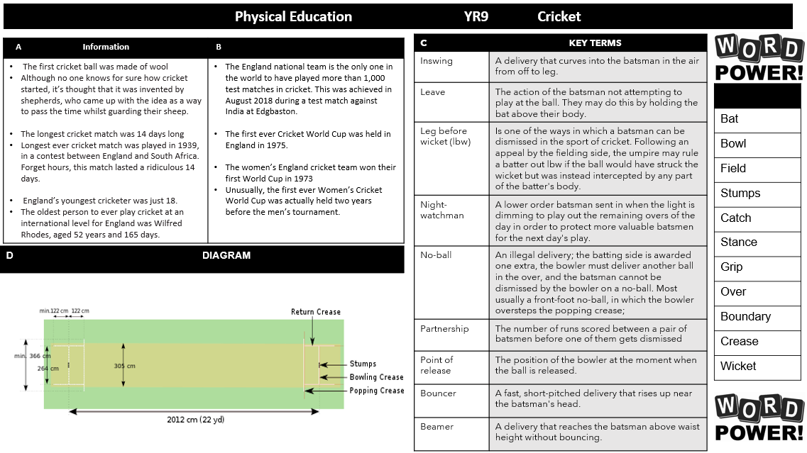
Physical Education

Slide 31
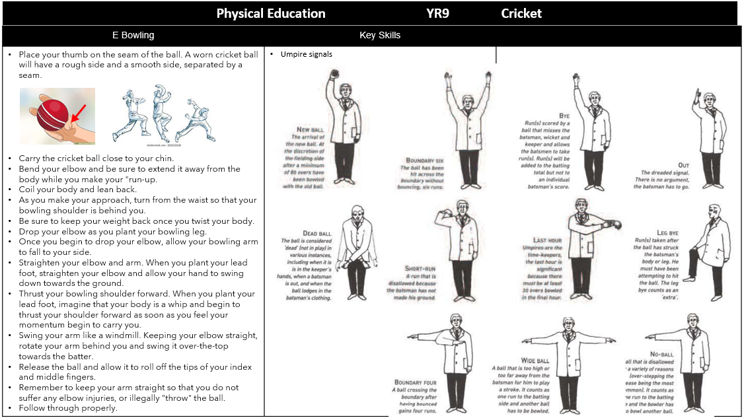
Physical Education

Slide 32
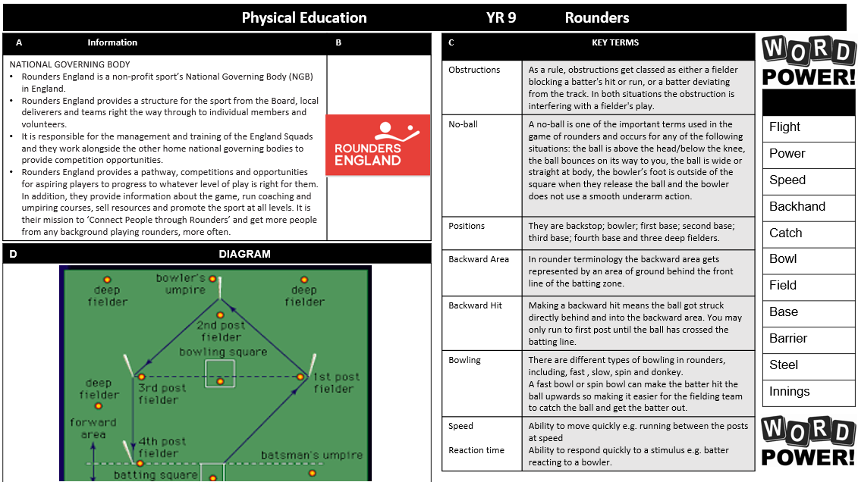
Physical Education

Slide 33
Physical Education

Slide 34
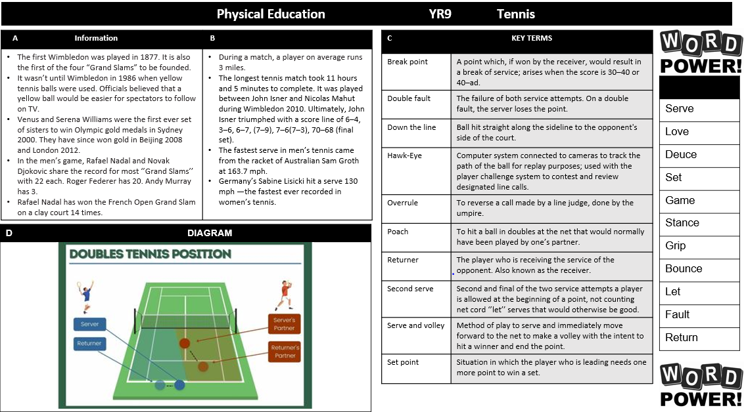
Physical Education

Slide 35
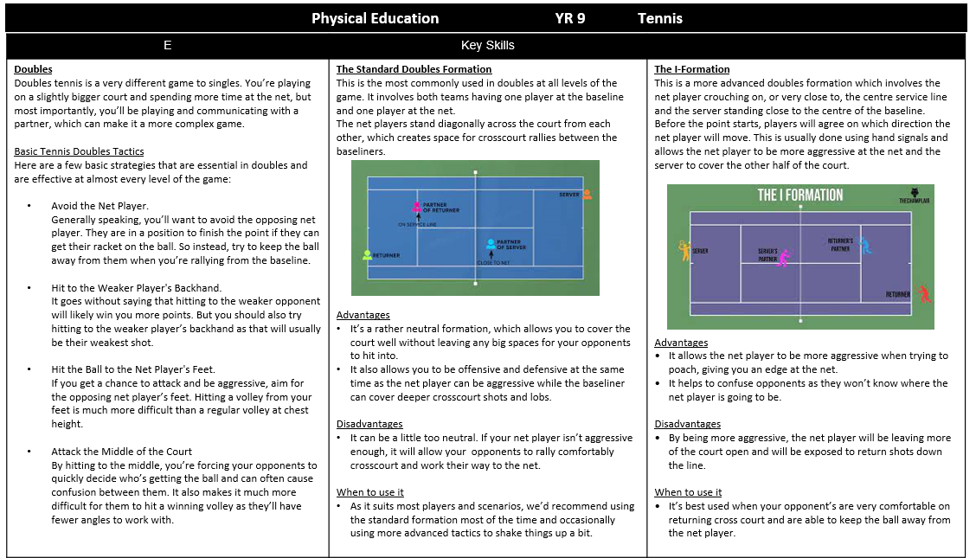
Physical Education

Slide 36
Engineering

Slide 37
Product Design

Slide 38
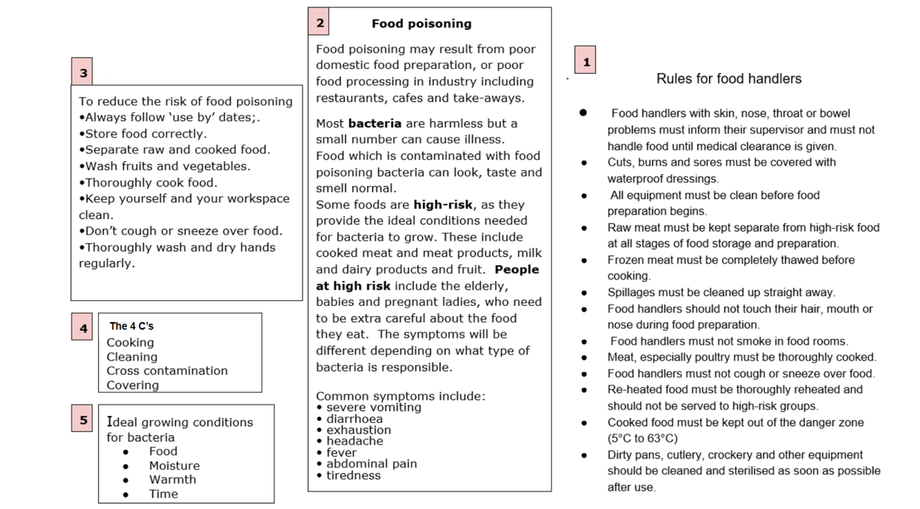
Food Technology

Slide 39
Textiles

Slide 40
Graphic Design

Slide 41
Numeracy

Slide 42
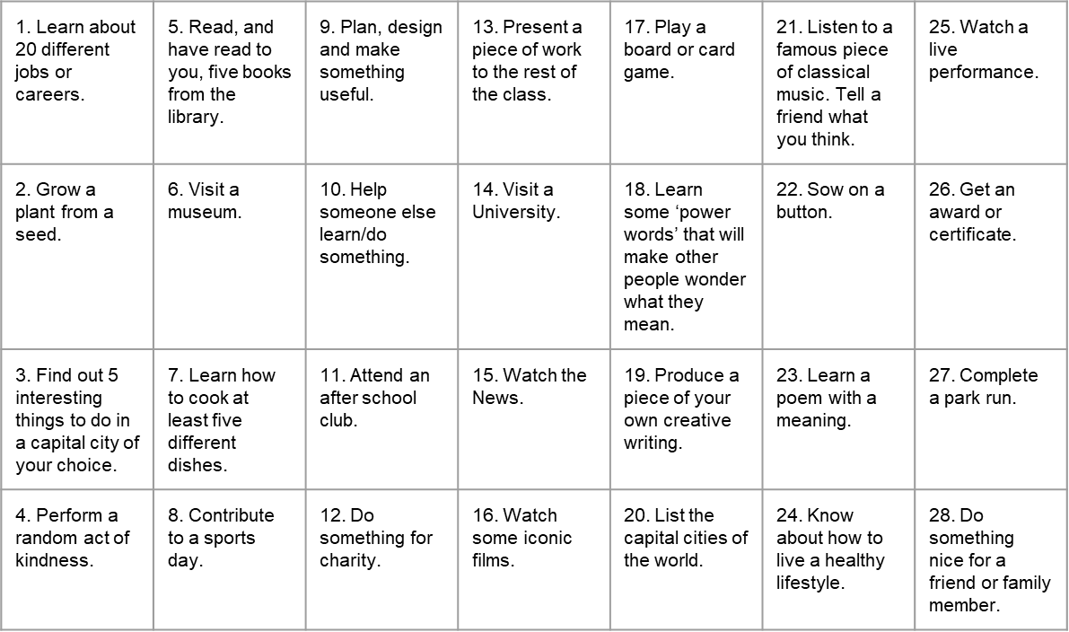
Things to do whilst at Wilsthorpe

Slide 43
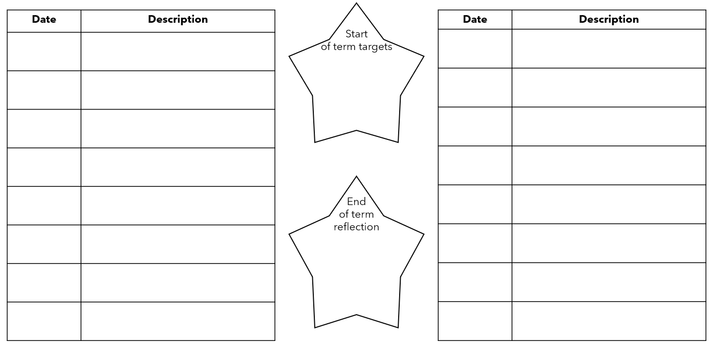
Out of lesson opportunities

Slide 44
Notes and Reminders

Slide 45
Notes and Reminders

Slide 46
Notes and Reminders

Slide 47
Notes and Reminders

