Slide 1
“No thief, however skilful, can rob one of knowledge, and that is why knowledge is the best and safest treasure to acquire”.
L. Frank Baum
Preparation for Learning - Knowledge Organisers
Year 9 Autumn Term

Slide 2
What is a knowledge organiser and why do we use them?
Here at Wilsthorpe School, all subject leaders produce knowledge organisers to support you whilst you are in Years 7, 8 and 9, but what is a knowledge organiser?
Knowledge organisers present the key knowledge and skills for a particular topic. We call this the most ‘powerful’ knowledge.
They contain the key vocabulary for the topic that you need to understand and use.
We know that if we do not regularly revisit this powerful knowledge, we forget some or most of what we have learned. Our lessons are designed so that we regularly revisit prior learning but knowledge organisers allow you to also revisit this knowledge at home.
Using this booklet at home will help you to understand and remember all of the knowledge you will be taught each term. This will allow you to connect and strengthen your learning, allowing you to thrive in your lessons and beyond.

Slide 3
How to use a knowledge organiser (1)
Using your knowledge organiser at school
You will be given a knowledge organiser at the start of each term (September, January and April). You need to bring your knowledge organiser and exercise book with you every day to school. This will be a key piece of equipment and will be regularly referred to in lesson.
In lessons, there will be fortnightly low-stakes retrieval quizzes based on the knowledge contained in the knowledge organiser. Your knowledge organiser and exercise book will be checked regularly during tutor time.
Using your knowledge organiser at home
You should spend 40 minutes per evening completing your knowledge organiser work. On Monday, Tuesday, Wednesday and Thursday evenings, you should be studying two sections of your knowledge organiser. On Friday you should study one section.
The timetable on the following pages tells you which subjects you should be studying on which days. Your subject teacher will explain which Design and Technology page to study and which Languages page to study.
You should use your exercise book to show the work you have done. Each evening you should start a new page and put the date clearly at the top.
Every night you should also read for 15 minutes as a minimum and fill in your ‘Reading Log’. Parents should sign your reading log by initialling the relevant column.

Slide 4
How to use a knowledge organiser (2)
There are many different methods you can use to revise the information in the knowledge organiser and to test yourself. Here are some ideas of things you can do:
Clocks - divide a page into 12 sections (like a clock) and add information about a topic in each section
Spelling tests - write a spelling test for yourself based on the key vocabulary
Fact sheets - produce a fact sheet that contains key words, diagrams and information about a topic
Posters - produce of poster that contains the key images in a topic
Flowcharts – produce a diagram that sequences the key steps in a process or key events in a time period
Quizzes - write a quiz based on what you have learnt about a topic and get others to test you
Mind maps - produce a mind map to logically organise key concepts
Flash cards - create a set of flash cards that contain key pieces of information and vocabulary for a topic
Read, cover, say, write and check – read 3 pieces of information, cover it over, say it aloud, write it down correctly then check it against your knowledge organiser. Repeat until to you say and write it perfectly

Slide 5
How to use a knowledge organiser (3)
There are many different methods you can use to revise the information in the knowledge organiser and to test yourself. Here are some ideas of things you can do:
Mnemonics - take the first letter of each key word to be remembered and write it in to a down in to a memorable word or sentence i.e to remember the planets you could use My Very Educated Mother Just Served Us Nuts (Mercury, Venus, Earth, Mars, Jupiter, Saturn, Uranus, Neptune.)
3D models - make a 3D model (with labels) relating to a topic
Comic strip/storyboard – produce a visual representation of a topic or concept in a storyboard or comic
Poem/song - create a poem or song about a topic you’ve studied, remember to include key terms
Creative writing – write a fictional story that contains the key terms from a topic
For more details on each of these methods and how to use them, visit the following page on the school website:
https://www.wilsthorpe.ttct.co.uk/wp-content/uploads/sites/6/2021/10/Using-the-Knowledge-Organiser.pdf
You will also be taught how to use each of these methods during our revision sessions in tutor time.

Slide 6
Knowledge organiser timetable
Week A
Week B
Day | Subject 1 | Subject 2 | Reading
Monday | English | Design Technology | 15 minutes minimum
Tuesday | Maths | Physical Education | 15 minutes minimum
Wednesday | Science | Geography | 15 minutes minimum
Thursday | Grammar | Music | 15 minutes minimum
Friday | Drama |  | 15 minutes minimum
Day | Subject 1 | Subject 2 | Reading
Monday | English | History | 15 minutes minimum
Tuesday | Maths | MFL | 15 minutes minimum
Wednesday | Science | Computing | 15 minutes minimum
Thursday | Grammar | Art | 15 minutes minimum
Friday | Maths |  | 15 minutes minimum

Slide 7
Reading log
Week Beginning | M | T | W | T | F | S | S | Book(s) Read | Pages Read | Parent Initials | Librarian Initials
 | Record the number of minutes you read for each day

Slide 8
Year 9 reading list
Subject Wider Reading Lists for every subject are available on the school website subject pages at: https://www.wilsthorpe.ttct.co.uk/curriculum/subjects/

Slide 9
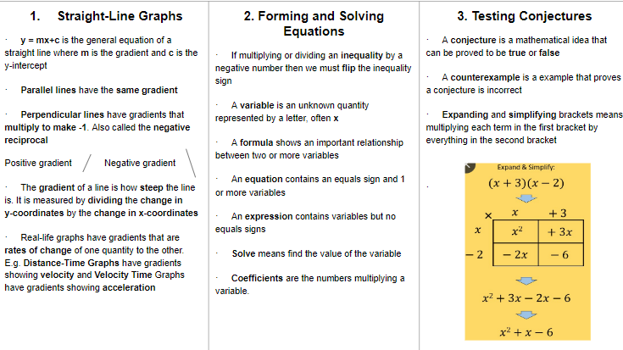
Maths

Slide 10
Maths

Slide 11
English

Slide 12
Grammar

Slide 13
Science

Slide 14
Science

Slide 15
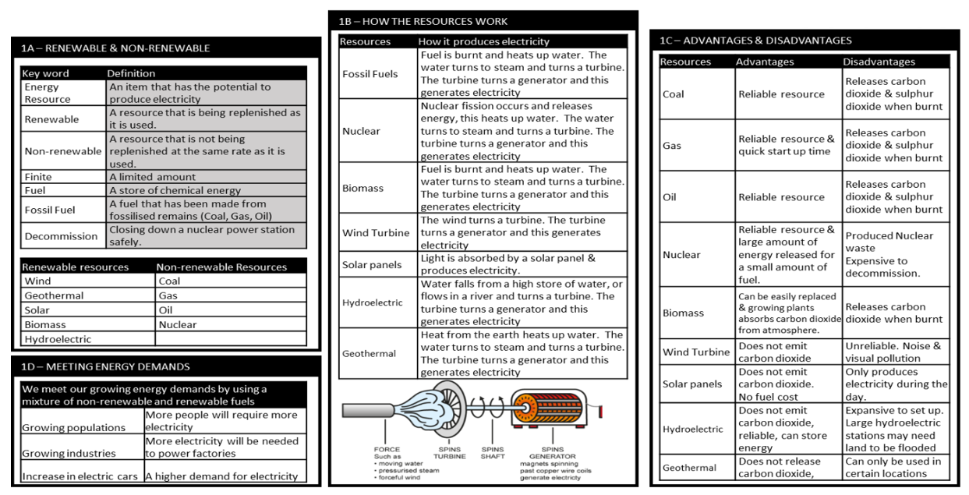
Science

Slide 16
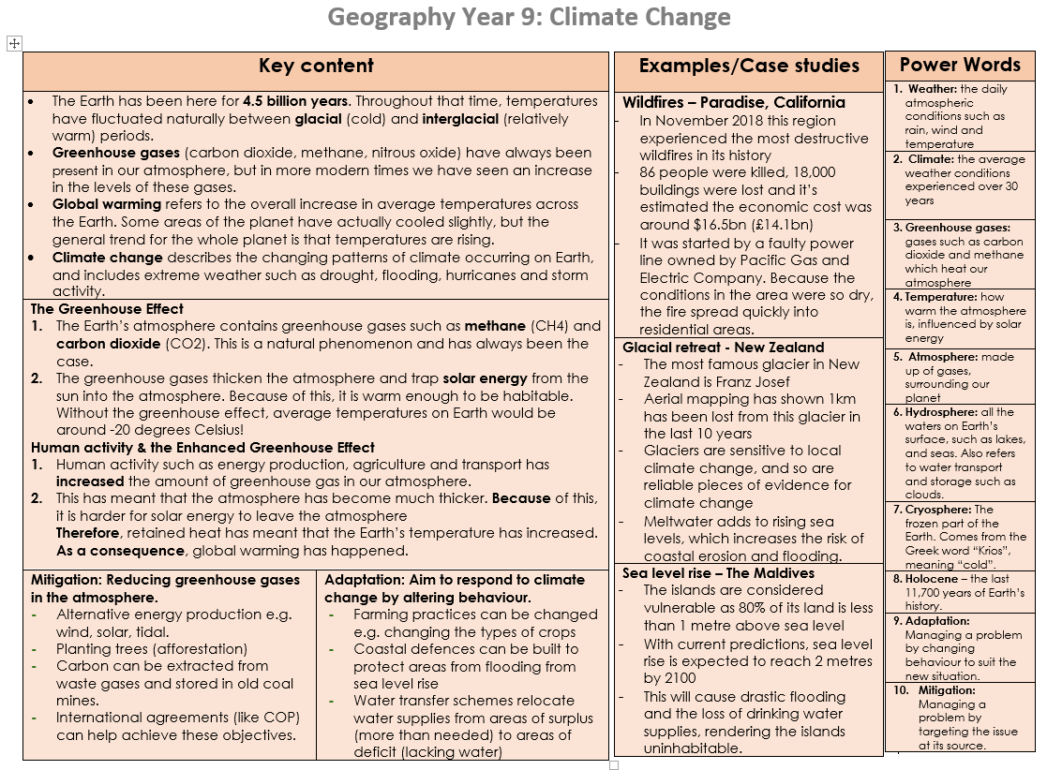
Geography

Slide 17
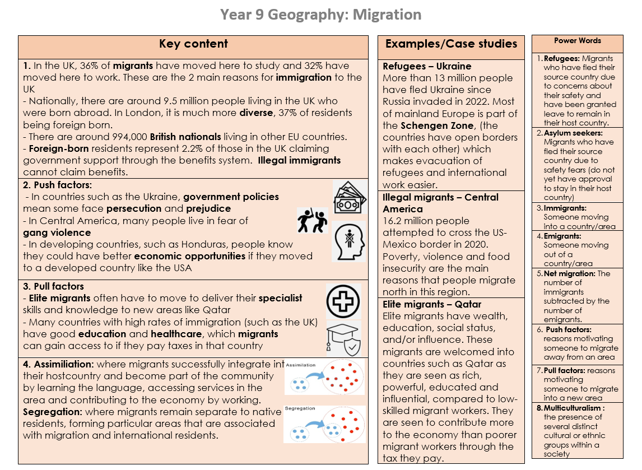
Geography

Slide 18
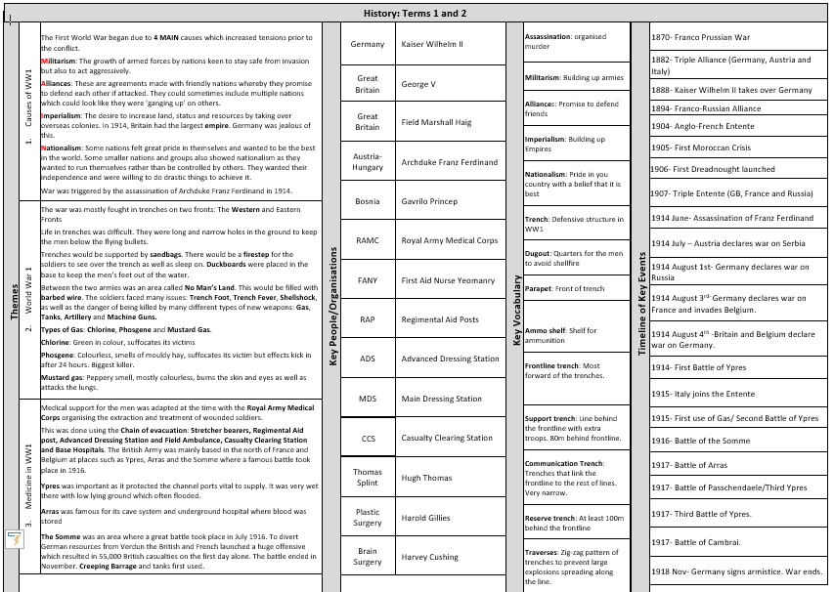
History

Slide 19
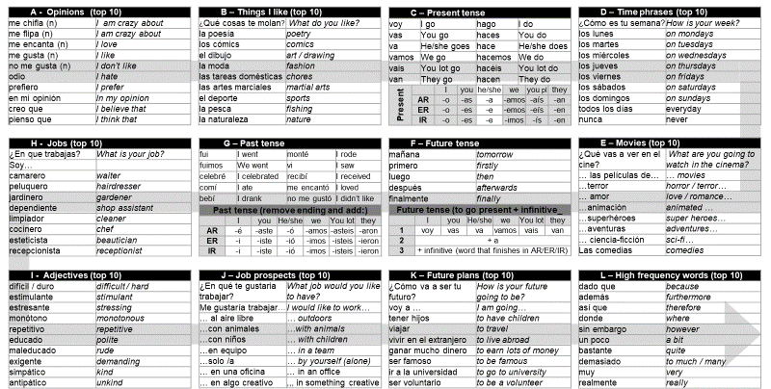
Spanish

Slide 20
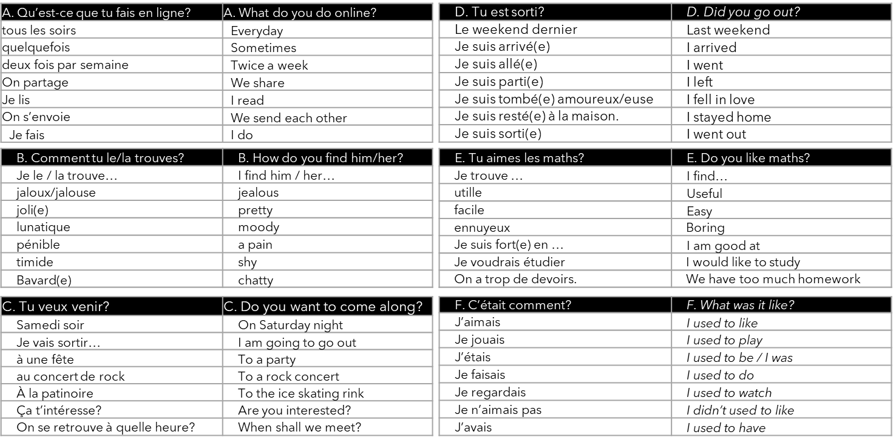
French

Slide 21
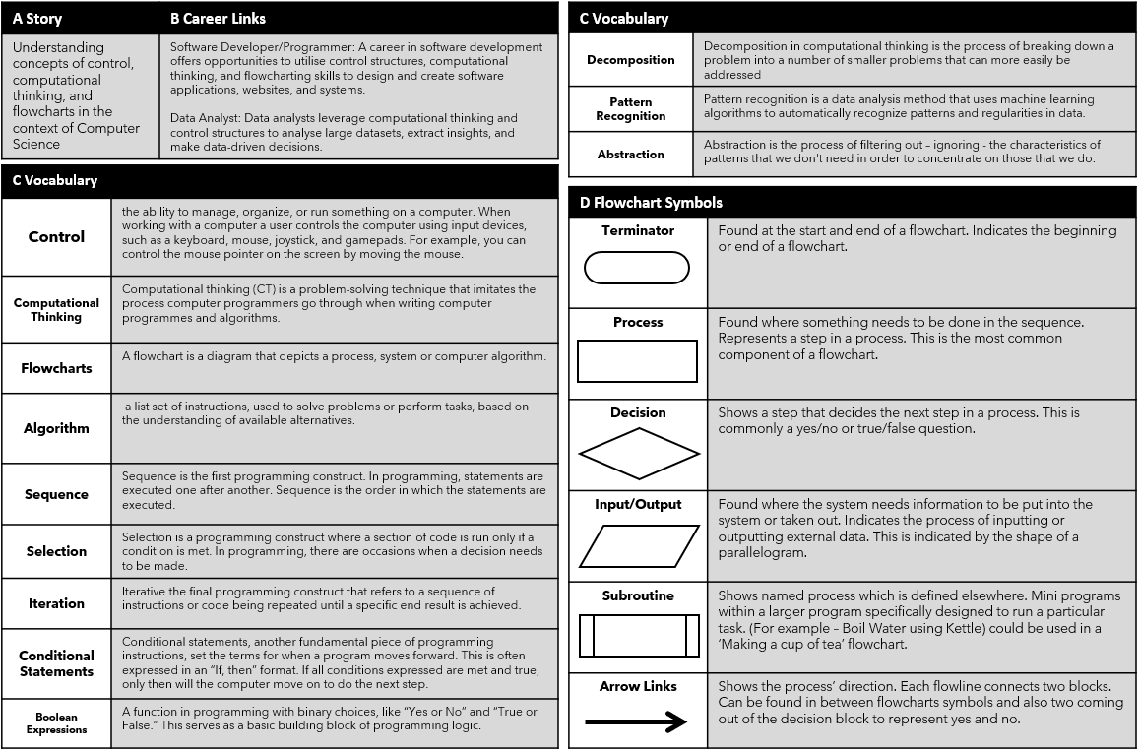
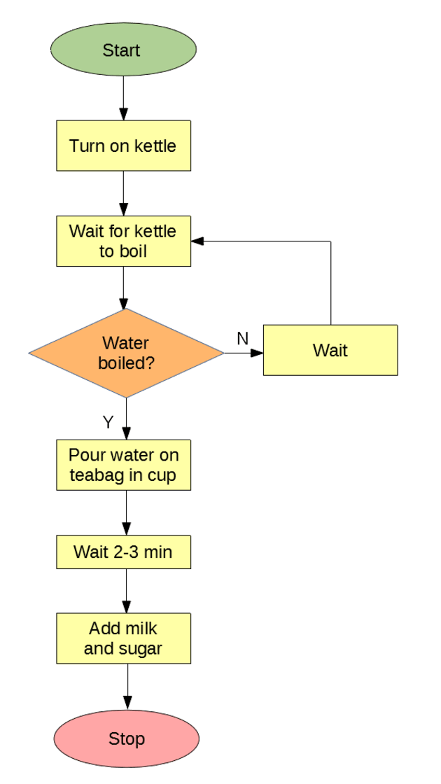
Computing

Slide 22
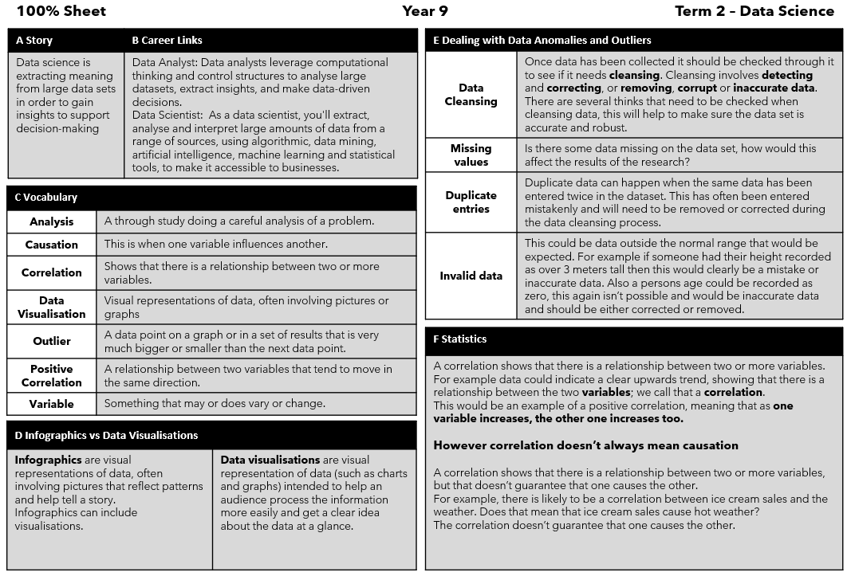
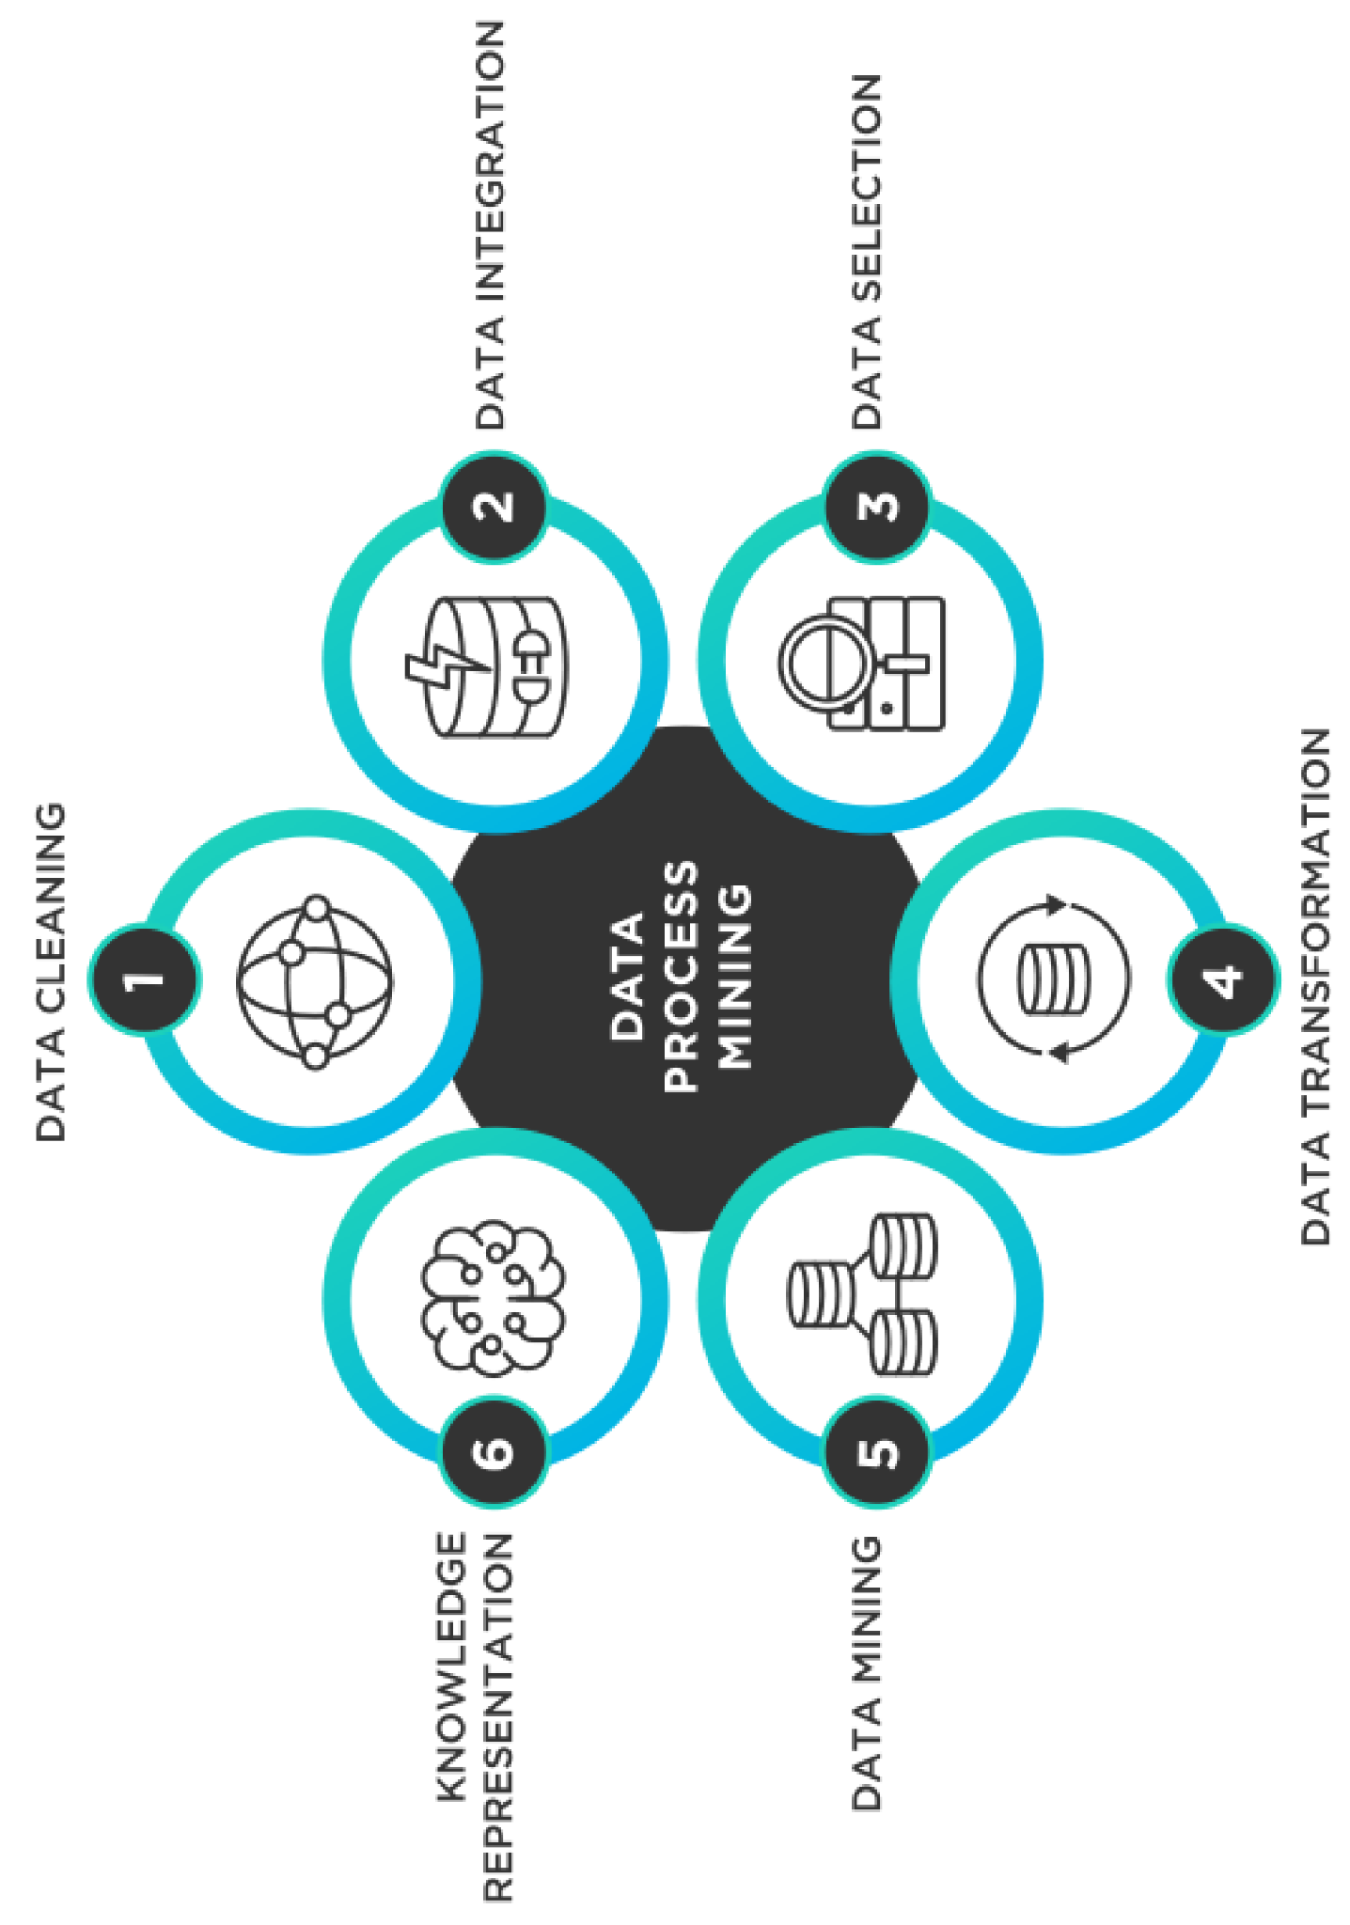
Computing

Slide 23
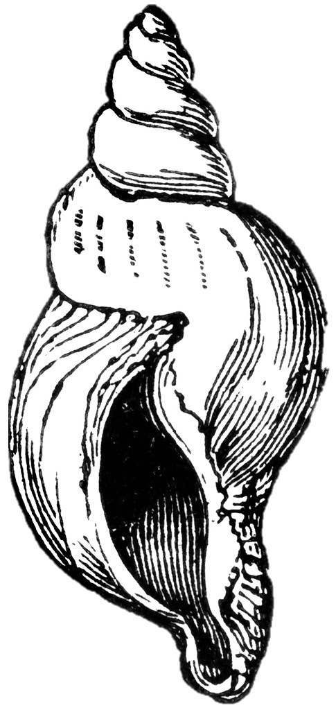
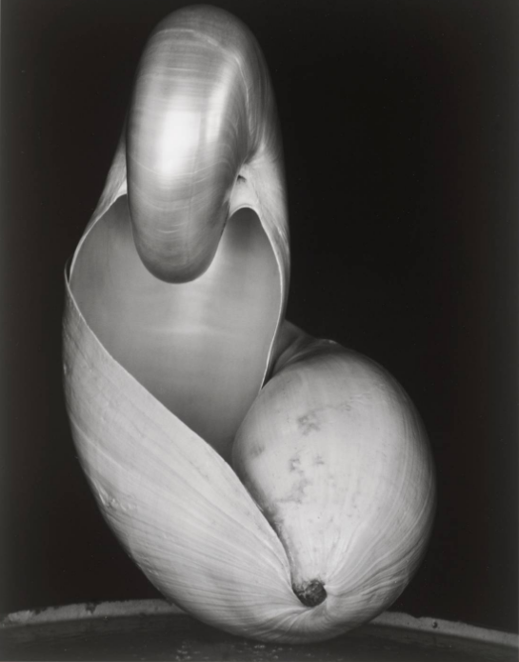
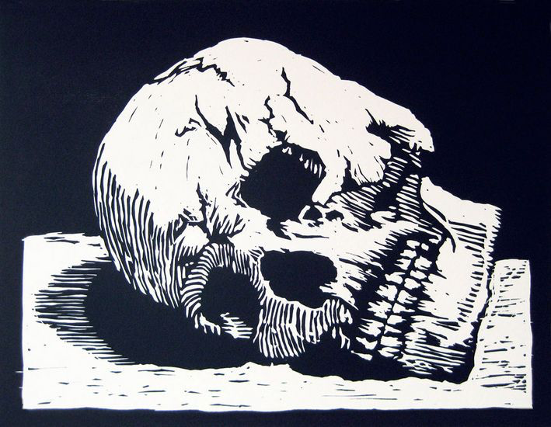
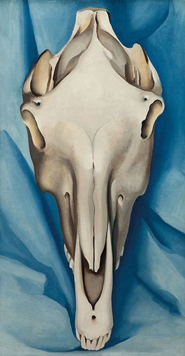
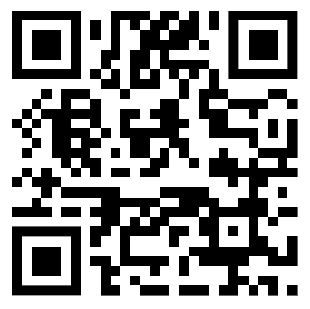
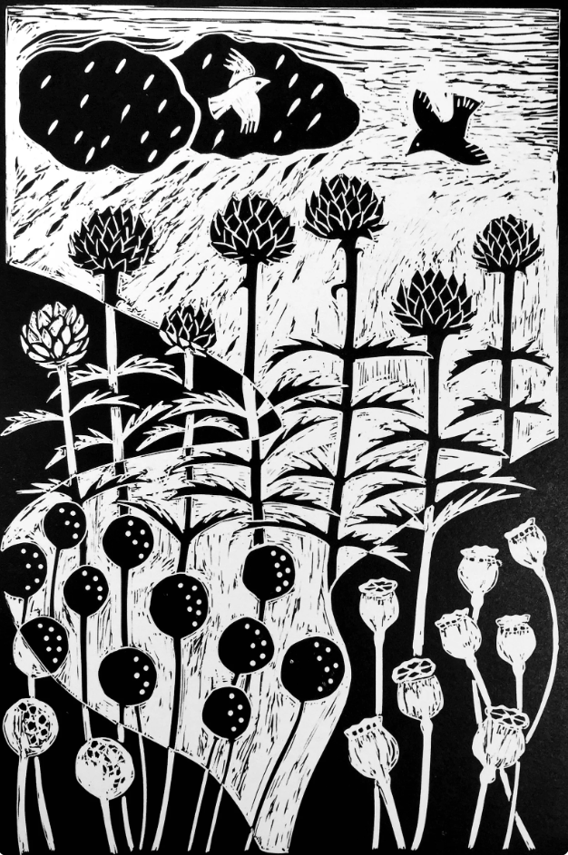
Art
Artist research
Key Words – Growth and Decay
Tone | The darkness or lightness of a colour
Relief print | Any print in which the image is printed from the raised portions of a carved or etched surface e.g. a rubber stamp. Woodcuts are the most common relief
Lino print | Is a form of relief printing. It is done by carving a design into a piece of linoleum. The sheet is inked with a roller (called a brayer), and then impressed onto paper or fabric. The actual printing can be done by hand or with a press.
Reduction print | Use of more than one colour over the existing colour. In each printing interval more of the print surface is removed.
Positive space | Refers to the subject, or areas of interest in an artwork. Negative space refers to the background or area that surrounds the subject.
Composition | How an artwork is arranged.
Pinch pot | A simple form of handmade pottery, using gentle pinching motions to create a pot from a ball of clay.
Score & slip | Score means to make scratches on the surfaces A liquid clay, can be used as a glue to join pieces together after scoring.
media | The type of art (painting, print, sculpture) and the materials it has been made out of.
Texture/Pattern
Task 2
Task 1
Artists:
Damien Hirst,
Van Gogh
Claud Monet,
Andy Warhol, Hiroshige,
James Ensor, Marc Quinn, Salvador Dali, Judith Leyster, Designers: Versace, McQueen
Flowers have historical importance in Japanese culture, they can be used to create ornate floral arrangements or included in woodblock prints. Flowers are given as a social custom meant to greet visitors.
Edward Weston, Shells, 1927 is a photograph. Of a nautilus shell balanced within an abalone shell. Using a long exposure time of several hours, creating an intense contrast between light and shadow
3D – Cast shadow/core shadow
Hibiscus by Hiroshige (c. 1845)
Task 4
Pablo Picasso, Black jug and skull, 1946
The main ideas behind Vanitas Art were as a reminder of the certainty of death, the shortness of life and the passing of earthly things. The book alludes to excessive pride through learning and the wine jug to the shortness of worldly pleasures. The skull is a memento mori, a reminder
Task 3
LINE DRAWING
Lines can show the subject's physical appearance: the outline of shapes and objects; details of features and patterns; surfaces and texture; tone, light and shade.
of the inevitable approach of death. Picasso was superstitious about death and kept a skull in his studio and often included human or animal skulls in his work.
Georgia O'Keeffe: Horse's Skull on Blue, 1930
Positive/negative space
Remember to check google classroom for more handouts and guidance for each task.
W/B 4 Sept: Task 1 Write up the key words for Growth & Decay in your book.
W/B 18 Sept: Task 2 Artist Research Choose an artwork by one of the artists above, Use the Art writing framework to discuss the work.
W/B 2 Oct: Task 3 Create an observational drawing using LINE, write up the description of LINE in your book.
W/B 16 Oct: Task 4 Scan the QR code to learn more about careers in art. Put this together as a power point slide or poster.
W/B 6 Nov: Task 5 Create an observational drawing using colour or tone, annotate your artwork using the Art writing framework.
W/B 20 Nov: Task 6 Compare the Edward Weston Shell with the Texture/Pattern shell. Give your opinion using the Art writing framework.
W/B 4 Dec Task 7 Watch the ‘Tate short’ on Damien Hirst discussing his artwork https://youtu.be/YWSb9QMlLoQ scan the QR code
Task 7

Slide 24
Drama
Term 1 - Page to Stage Key Words
Emphasis | Stress given to a word or words when speaking to indicate particular importance
Thought- tracking | When a character speaks out loud their inner feelings or emotions
Stereotype | A popular but simplified characterisation of people often made according to how they visually appear or behave.
Status / Shift in Status | The power difference in the relationship between two or more characters. A shift in status is when one character switches from one status to another during the same scene.
Stage Directions | These are written in to a script and usually are in italics or in (brackets)
Character Intentions | This is what the character wants to achieve. These are generated by finding clues (given circumstances) in the script by both the director and the actor.
Clarity | how clearly words are pronounced
Multi-roling | Multi-roling is when an actor plays more than one character on stage.
Term 2 - Devising Key Words
Cross-cutting | When the action cuts from one time/place to another time/place.
Split-stage | When two different scenes / locations are performed side by side on stage
Empathy | The ability to understand and relate to another person's thoughts and feelings
Flashback | A transition in a story to an earlier time, that interrupts the normal chronological order of events
Hot-seating | When you are questioned as a character
Marking the Moment | A dramatic technique used to highlight a key moment in a scene or improvisation. This can be done in a number of different ways: through slow-motion, a freeze-frame, narration, thought-tracking or music.
Stimulus | A starting point for a piece of drama
Proxemics | The use of space on stage to communicate a characters relationship and feelings towards another character.
Tempo- rhythm | Defines the character’s pace and beat and has an effect on movement, emotions, motivations, and thought processes. Essentially it is like a character’s heartbeat.
Dialogue | The exchange of spoken words between two or more characters in a book, play, or other written work.
Stylised Movement | A very visual series of movements where all actors face the front and perform similar movements that represent the words they are speaking.

Slide 25
Music

Slide 26
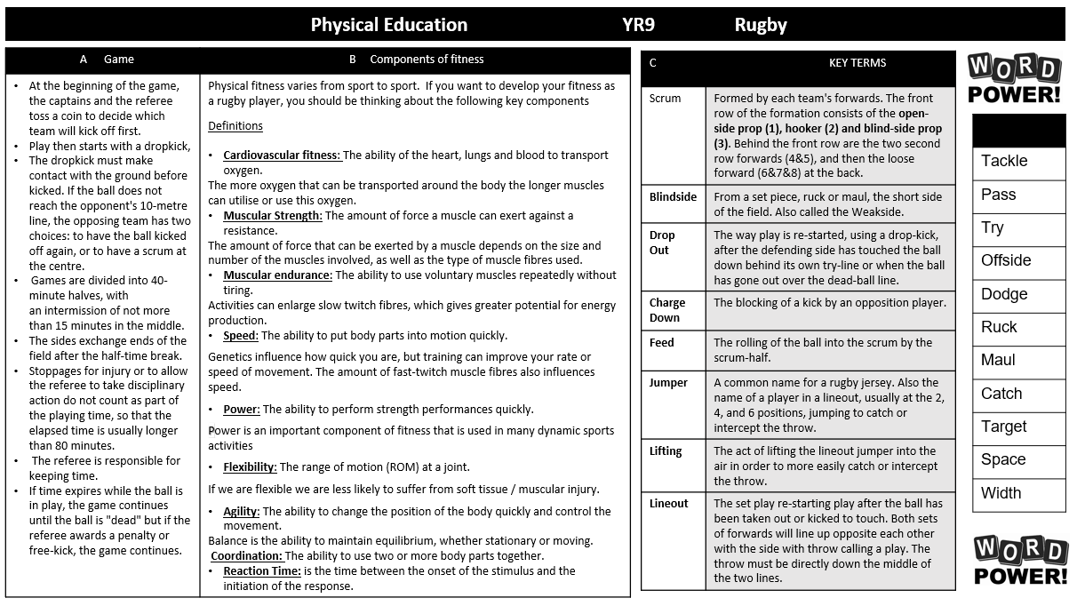
Physical Education

Slide 27
Physical Education

Slide 28
Physical Education

Slide 29
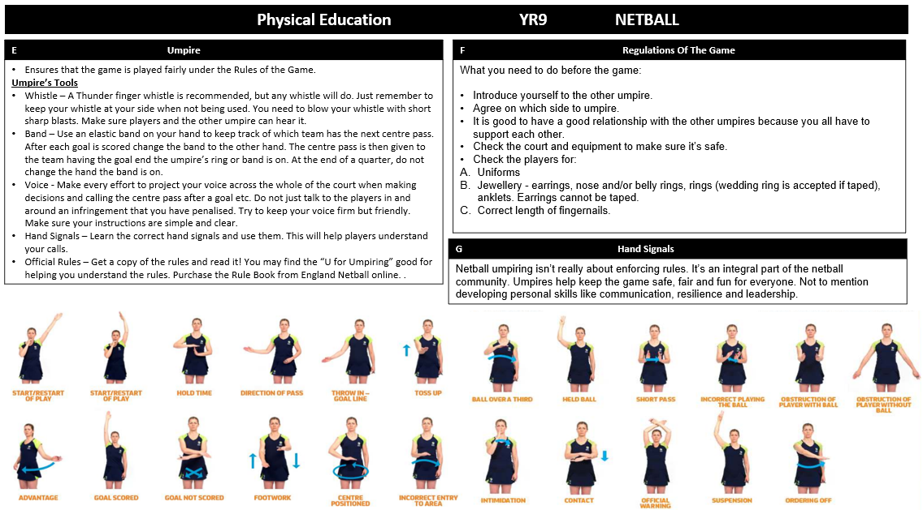
Physical Education

Slide 30
Physical Education

Slide 31
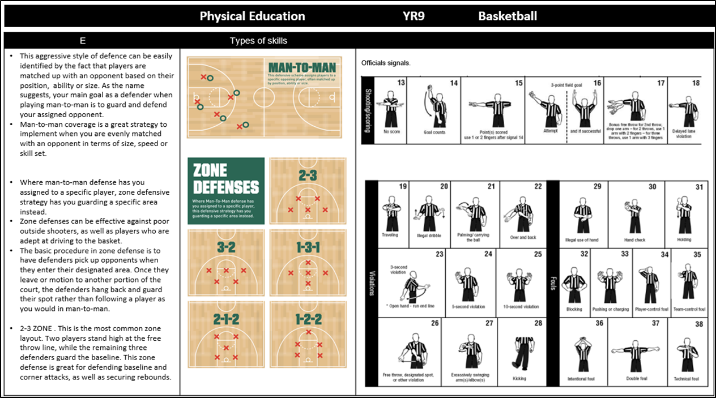
Physical Education

Slide 32
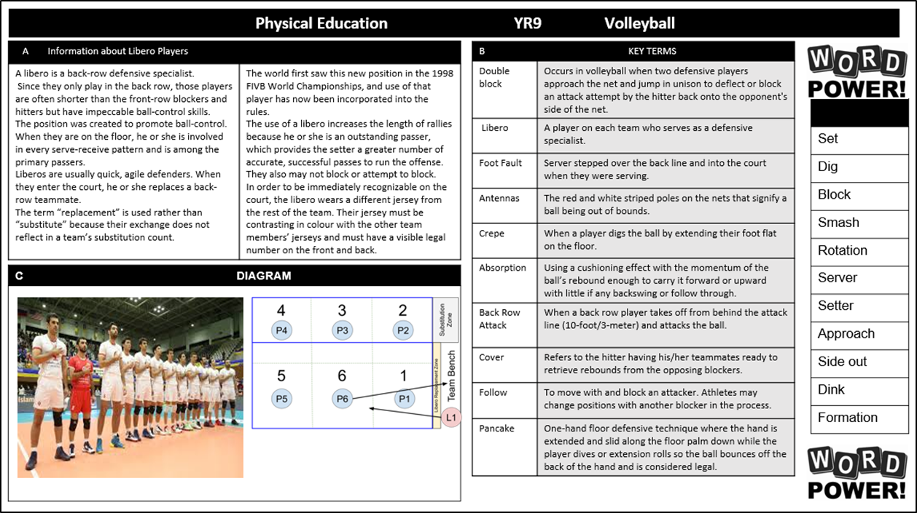
Physical Education

Slide 33
Physical Education

Slide 34
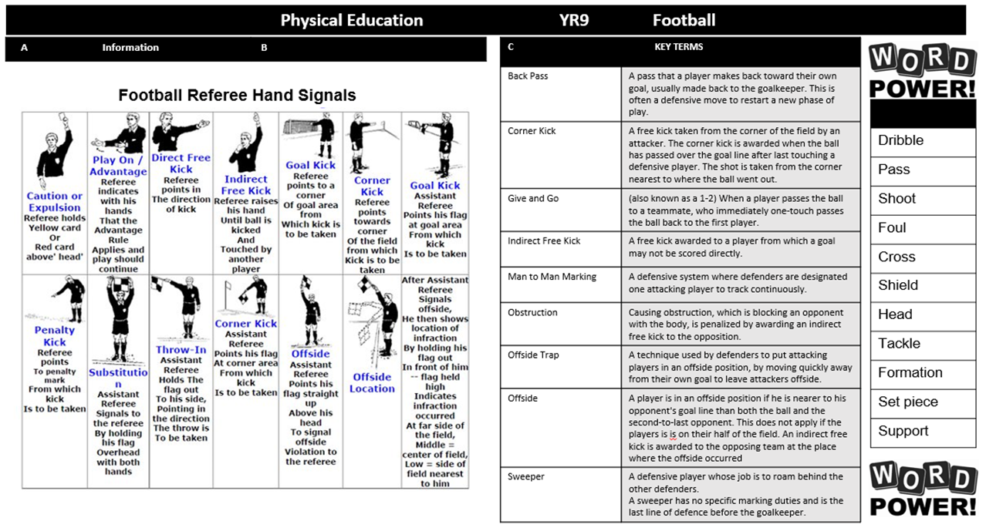
Physical Education

Slide 35
Physical Education

Slide 36
Engineering

Slide 37
Product Design

Slide 38
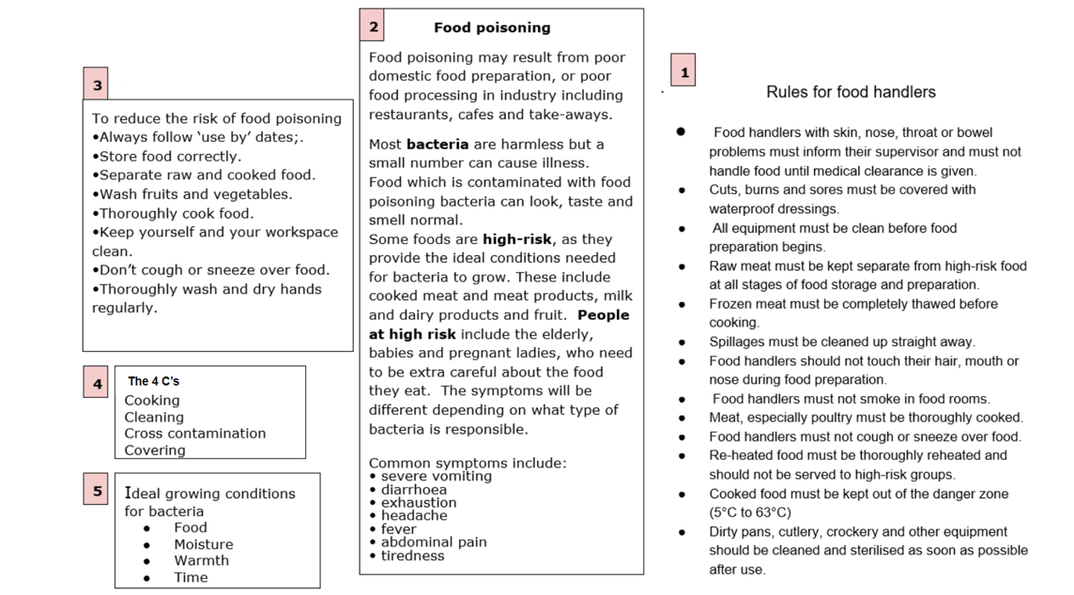
Food Technology

Slide 39
Textiles

Slide 40
Graphic Design

Slide 41
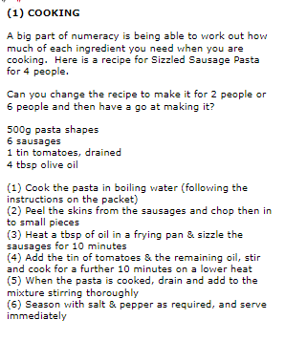
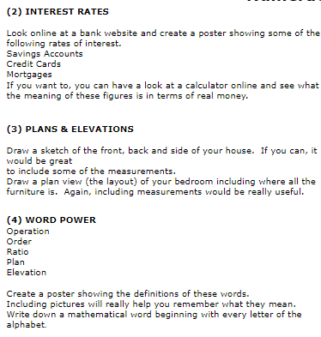
Numeracy

Slide 42
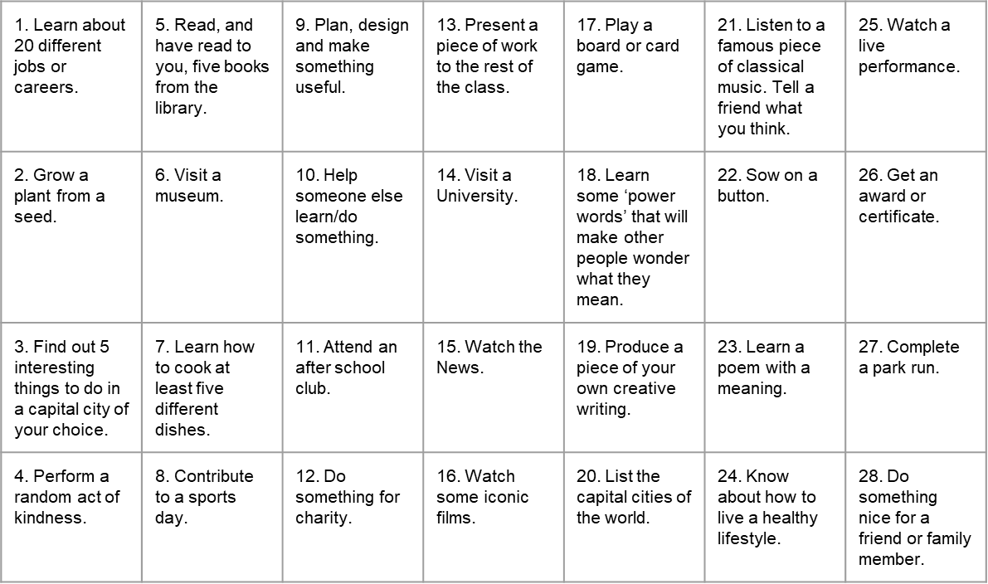
Things to do whilst at Wilsthorpe

Slide 43
Notes and Reminders

Slide 44
Notes and Reminders

Slide 45
Notes and Reminders

Slide 46
Notes and Reminders

