Slide 1
“Education is the most powerful weapon which you can use to change the world.”
Nelson Mandela (Anti-apartheid activist and former President of South Africa)
Preparation for Learning - Knowledge Organisers
Year 8 Summer Term

Slide 2
What is a knowledge organiser and why do we use them?
Here at Wilsthorpe School, all subject leaders produce knowledge organisers to support you whilst you are in Years 7, 8 and 9, but what is a knowledge organiser?
Knowledge organisers present the key knowledge and skills for a particular topic. We call this the most ‘powerful’ knowledge.
They contain the key vocabulary for the topic that you need to understand and use.
We know that if we do not regularly revisit this powerful knowledge, we forget some or most of what we have learned. Our lessons are designed so that we regularly revisit prior learning but knowledge organisers allow you to also revisit this knowledge at home.
Using this booklet at home will help you to understand and remember all of the knowledge you will be taught each term. This will allow you to connect and strengthen your learning, allowing you to thrive in your lessons and beyond.

Slide 3
How to use a knowledge organiser (1)
Using your knowledge organiser at school
You will be given a knowledge organiser at the start of each term (September, January and April). You need to bring your knowledge organiser and exercise book with you every day to school. This will be a key piece of equipment and will be regularly referred to in lesson.
In lessons, there will be fortnightly low-stakes retrieval quizzes based on the knowledge contained in the knowledge organiser. Your knowledge organiser and exercise book will be checked regularly during tutor time.
Using your knowledge organiser at home
You should spend 40 minutes per evening completing your knowledge organiser work. On Monday, Tuesday, Wednesday and Thursday evenings, you should be studying two sections of your knowledge organiser. On Friday you should study one section.
The timetable on the following pages tells you which subjects you should be studying on which days. Your subject teacher will explain which Design and Technology page to study and which Languages page to study.
You should use your exercise book to show the work you have done. Each evening you should start a new page and put the date clearly at the top.
Every night you should also read for 15 minutes as a minimum and fill in your ‘Reading Log’. Parents should sign your reading log by initialling the relevant column.

Slide 4
How to use a knowledge organiser (2)
There are many different methods you can use to revise the information in the knowledge organiser and to test yourself. Here are some ideas of things you can do:
Clocks - divide a page into 12 sections (like a clock) and add information about a topic in each section
Spelling tests - write a spelling test for yourself based on the key vocabulary
Fact sheets - produce a fact sheet that contains key words, diagrams and information about a topic
Posters - produce of poster that contains the key images in a topic
Flowcharts – produce a diagram that sequences the key steps in a process or key events in a time period
Quizzes - write a quiz based on what you have learnt about a topic and get others to test you
Mind maps - produce a mind map to logically organise key concepts
Flash cards - create a set of flash cards that contain key pieces of information and vocabulary for a topic
Read, cover, say, write and check – read 3 pieces of information, cover it over, say it aloud, write it down correctly then check it against your knowledge organiser. Repeat until to you say and write it perfectly

Slide 5
How to use a knowledge organiser (3)
There are many different methods you can use to revise the information in the knowledge organiser and to test yourself. Here are some ideas of things you can do:
Mnemonics - take the first letter of each key word to be remembered and write it in to a down in to a memorable word or sentence i.e to remember the planets you could use My Very Educated Mother Just Served Us Nuts (Mercury, Venus, Earth, Mars, Jupiter, Saturn, Uranus, Neptune.)
3D models - make a 3D model (with labels) relating to a topic
Comic strip/storyboard – produce a visual representation of a topic or concept in a storyboard or comic
Poem/song - create a poem or song about a topic you’ve studied, remember to include key terms
Creative writing – write a fictional story that contains the key terms from a topic
For more details on each of these methods and how to use them, visit the following page on the school website:
https://www.wilsthorpe.ttct.co.uk/wp-content/uploads/sites/6/2021/10/Using-the-Knowledge-Organiser.pdf
You will also be taught how to use each of these methods during our revision sessions in tutor time.

Slide 6
Knowledge organiser timetable
Week A
Week B
Day | Subject 1 | Subject 2 | Reading
Monday | English | Design Technology | 15 minutes minimum
Tuesday | Maths | Physical Education | 15 minutes minimum
Wednesday | Science | Geography | 15 minutes minimum
Thursday | Grammar | Music | 15 minutes minimum
Friday | Drama |  | 15 minutes minimum
Day | Subject 1 | Subject 2 | Reading
Monday | English | History | 15 minutes minimum
Tuesday | Maths | MFL | 15 minutes minimum
Wednesday | Science | Computing | 15 minutes minimum
Thursday | Grammar | Art | 15 minutes minimum
Friday | Maths |  | 15 minutes minimum

Slide 7
Reading log
Fifteen is fantastic! Remember to read for at least 15 minutes everyday.
Week Beginning | M | T | W | T | F | S | S | Book(s) Read | Pages Read | Parent Initials | Librarian Initials
 | Record the number of minutes you read for each day
15th April
22nd April
29th April
6th May
13th May
20th May
Half term
3rd June
10th June
17th June
24th June
1st July
8th July
15th July

Slide 8
Year 8 reading list
Fifteen is fantastic! Remember to read for at least 15 minutes everyday.
Alternative ‘Super Readable Reads’ are available in the library
Subject Wider Reading Lists for every subject are available on the school website subject pages at: https://www.wilsthorpe.ttct.co.uk/curriculum/subjects/

Slide 9
Maths

Slide 10
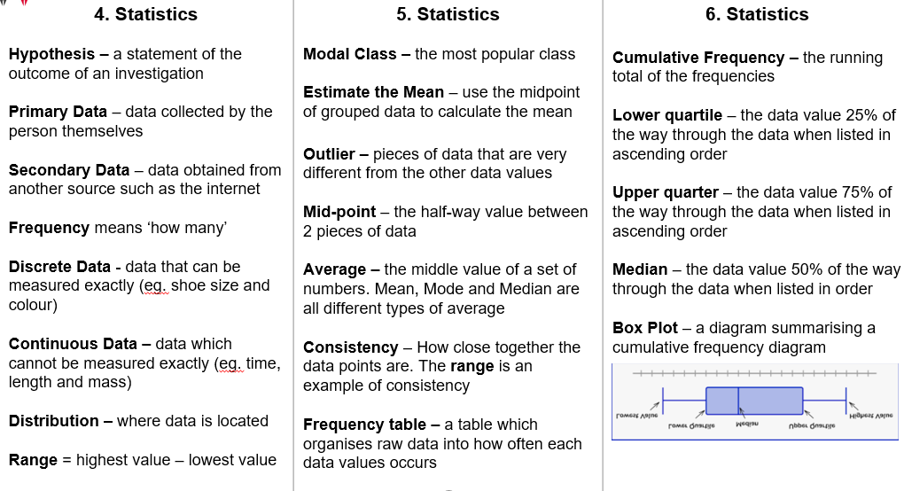
Maths

Slide 11
English
The Gothic
Fifteen is fantastic! Remember to read for at least 15 minutes everyday.

Slide 12
Grammar
Vocabulary Test - when you are tested on these words, you will be asked to write the word - spelt correctly - within a sentence that makes sense.
Your Grammar teacher will tell you which list to learn and when.

Slide 13
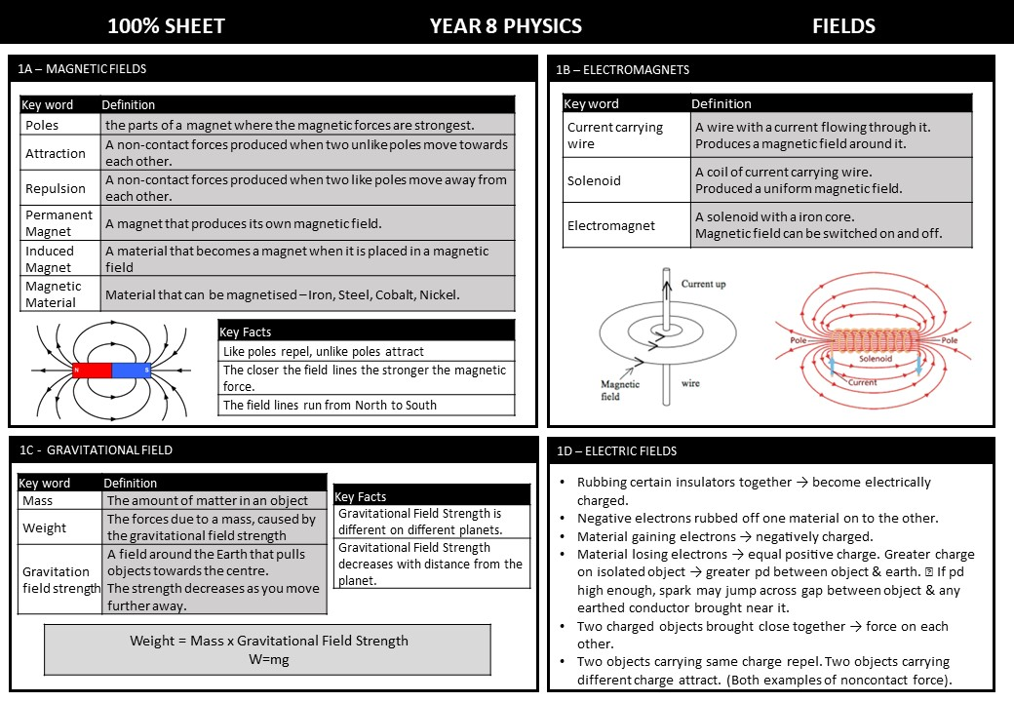
Science

Slide 14
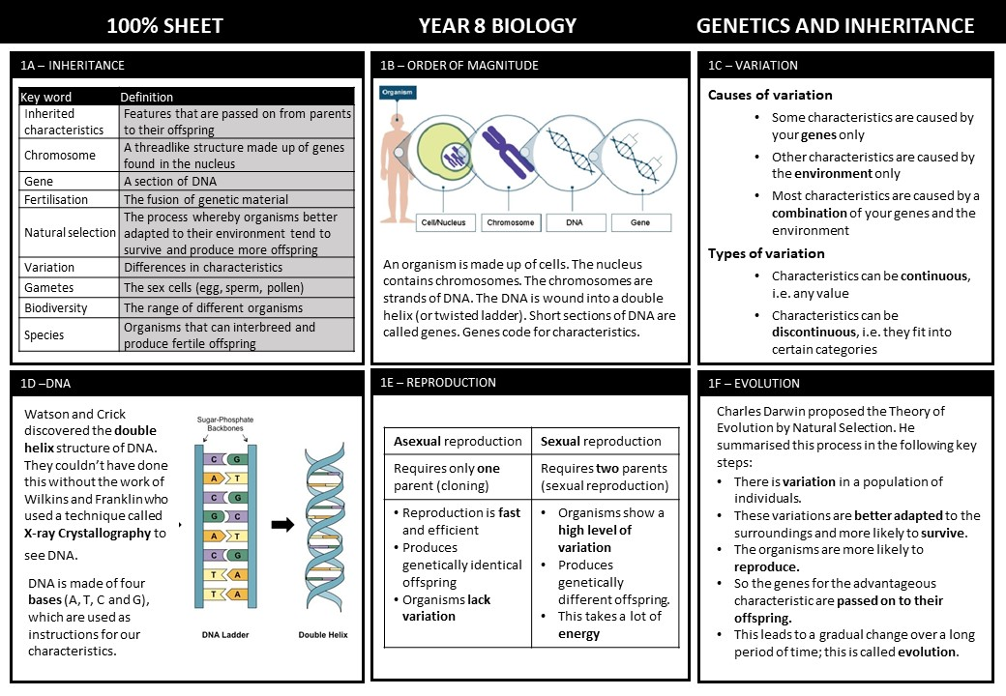
Science

Slide 15
Science

Slide 16
Science

Slide 17
Science

Slide 18
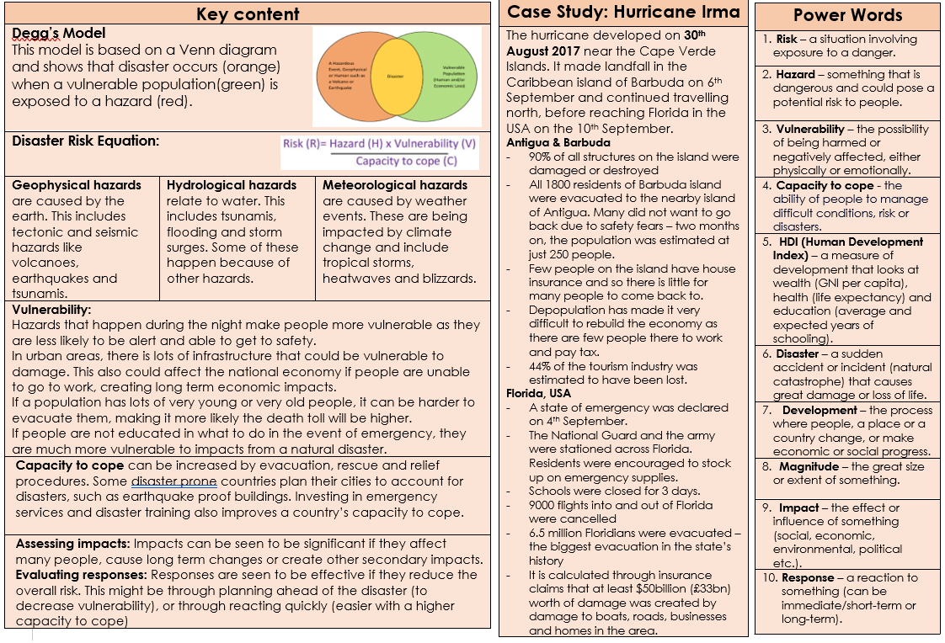
Geography

Slide 19
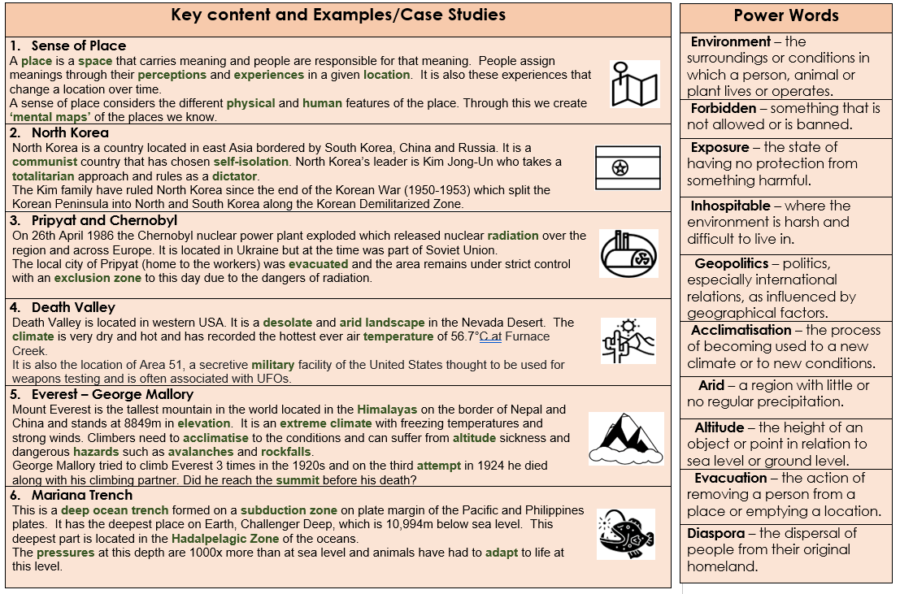
Geography

Slide 20
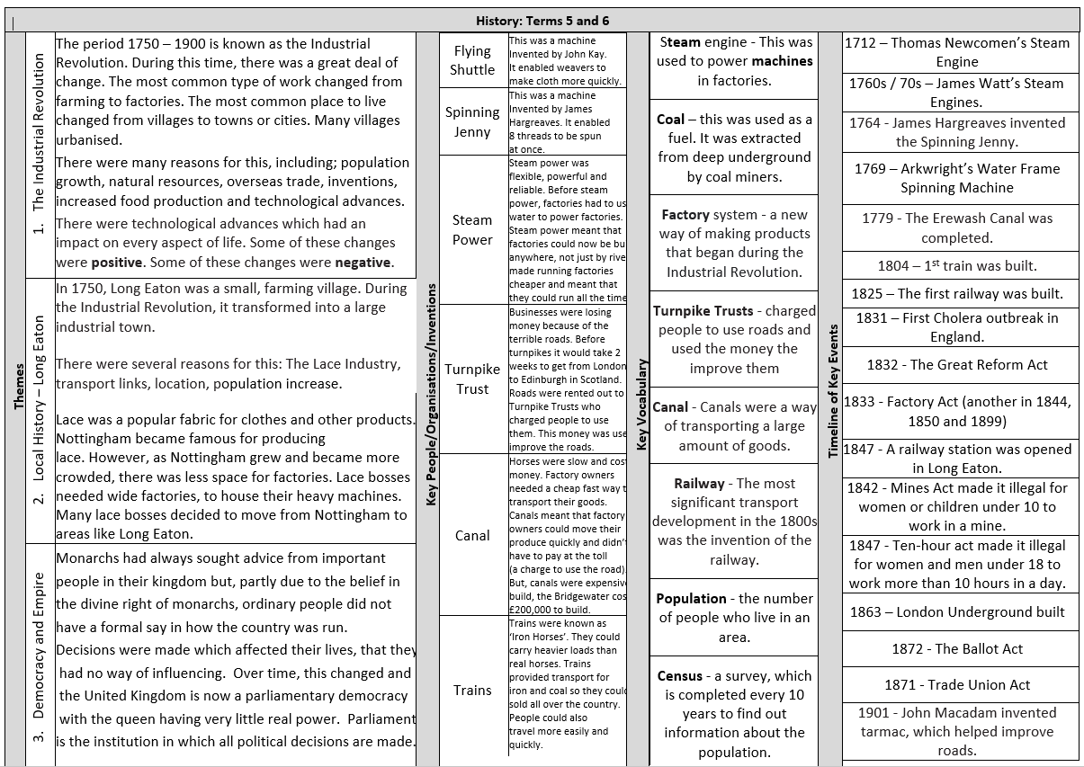
HISTORY
HISTORY

Slide 21
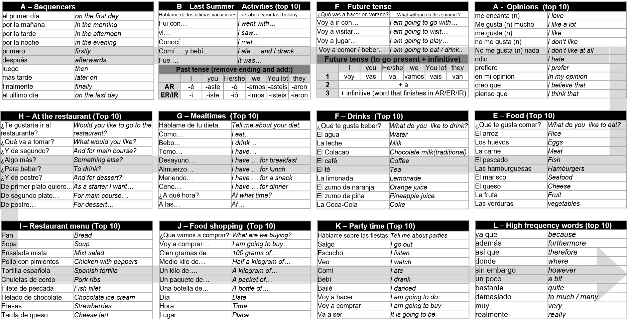
Spanish

Slide 22
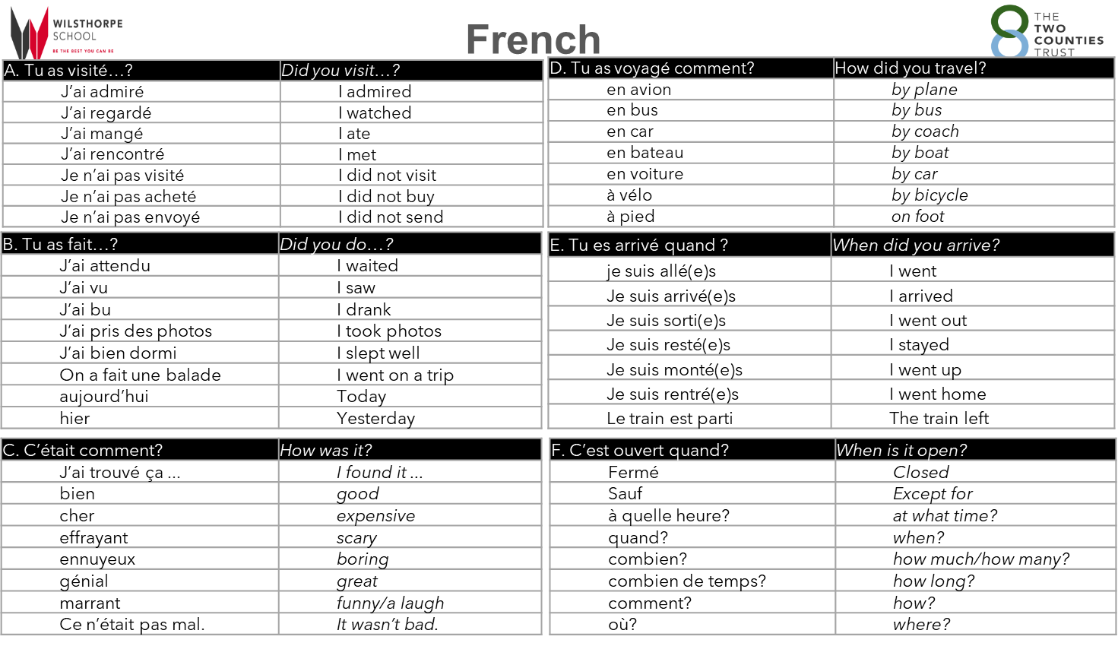

Slide 23
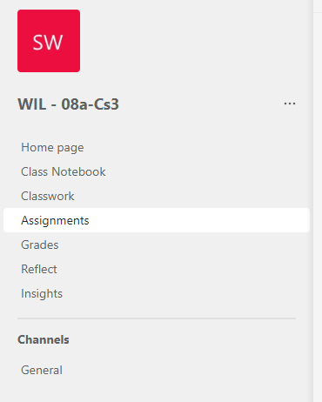
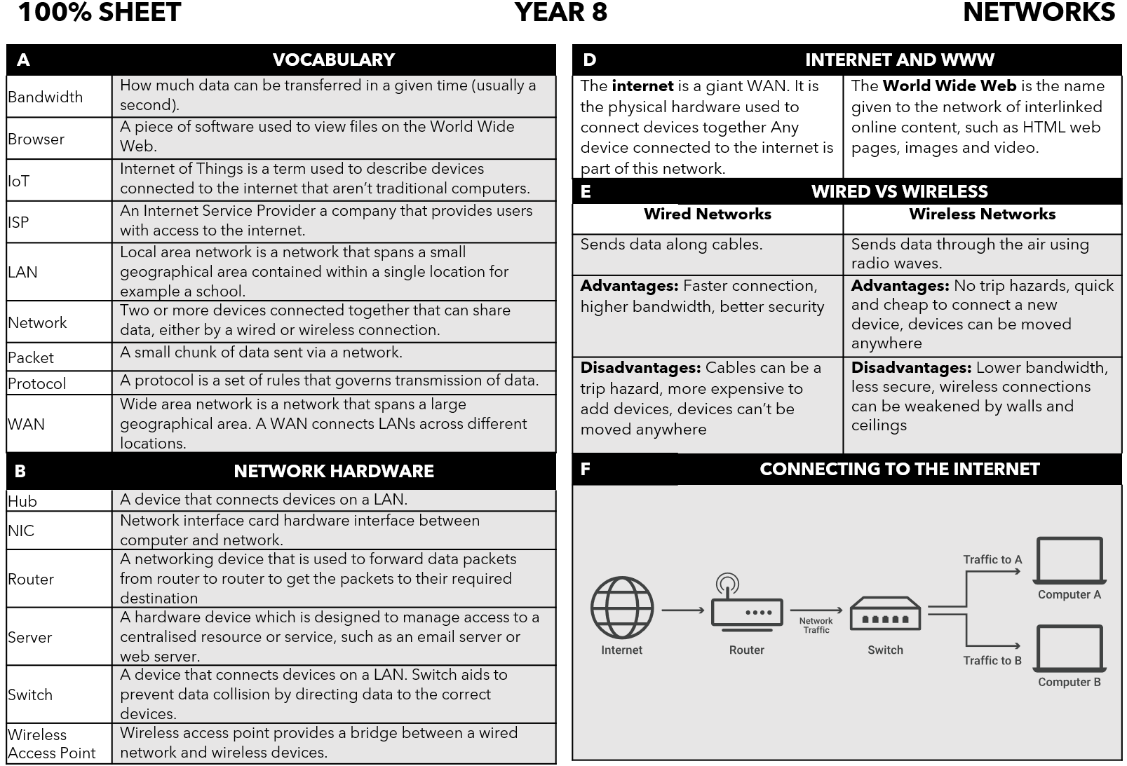
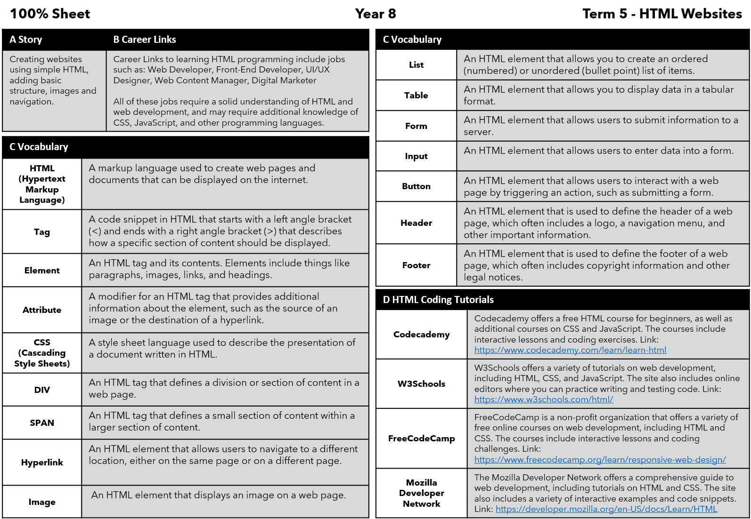
Accessing Teams
Computing
All Computer Science Lessons, Resources and Homework can be found on our Teams Platform. (This does not affect other subjects). To access the web platform for Teams - type into google the following link: https://www.microsoft.com/en-gb/microsoft-teams/log-in
You may not always get homework through teams. Revise the information below if you don't receive any from your teacher on the platform.
Then click on the top right and login using your school email and password.
You can also download the platform but this is optional.
On the Teams platform find your classroom and open it.
In your classroom go to assignments and scroll through until you find your homework posted by your teacher.
Term 5
Term 6

Slide 24
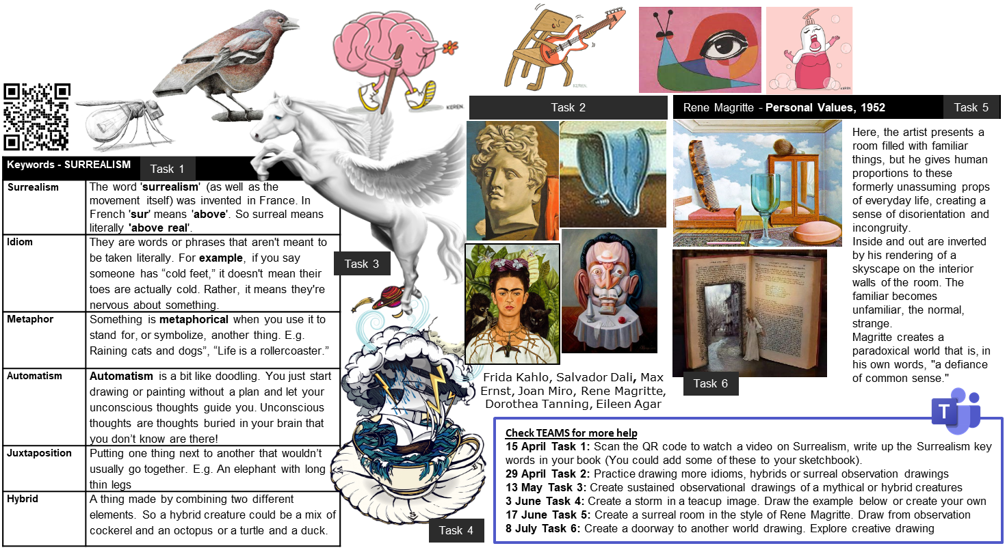
Art

Slide 25
Drama
Devising Drama Key words
Protagonist | A character at the centre of the story
Cross-cutting | When the action cuts from one time/place to another time/place.
Split-stage | When two different scenes / locations are performed side by side on stage
Narration | When you speak directly to the audience, explaining what is happening in the scene
Empathy | The ability to understand and relate to another person's thoughts and feelings
Flashback | A transition in a story to an earlier time, that interrupts the normal chronological order of events
Thought-tracking | When a character speaks out loud their inner feelings or emotions
Still Image | When all the actors on stage are still to highlight an important moment or message
Accent | Accent refers to a particular way of talking and pronouncing words, and is associated with a geographical area or social class
Marking the Moment | Used to highlight a key moment in a scene or improvisation. This can be done in a number of different ways: through slow-motion, a freeze-frame, narration, thought-tracking or music)
Physical Theatre Key words
Physical Theatre | A style of theatre where the actor uses their body as the primary tool for performance (creating shapes, images, movement sequences through the body)
Transition | The process of moving from one scene or freeze to the next.
Flexibility | The abiility to reach, stretch and move joints
Tension | The condition where one or more muscles remains tensed for an extended period.
Fluent Movement | The ability for movement to flow freely
Safety | The state of being safe; freedom from the occurrence or risk of injury.
Teamwork | Working together towards achieving a goal
Timing | How quickly or slowly you perform physical theatre movements to communicate meaning to an audience.
Exaggerated Movement | Movement that is over the top
Control | Focused and purposeful movement which is rehearsed and planned.

Slide 26
Music

Slide 27
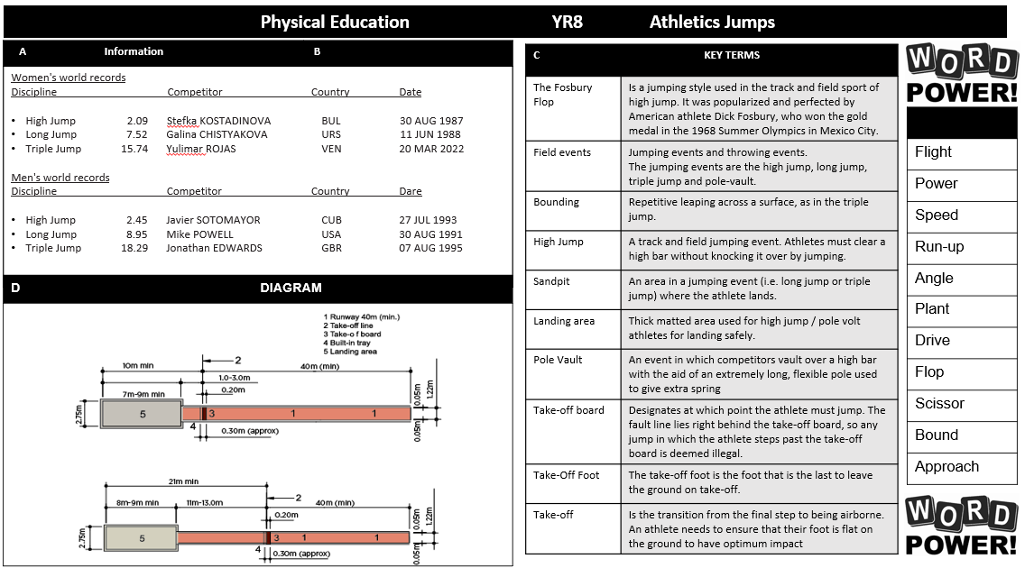
Physical Education

Slide 28
Physical Education

Slide 29
Physical Education

Slide 30
Physical Education

Slide 31
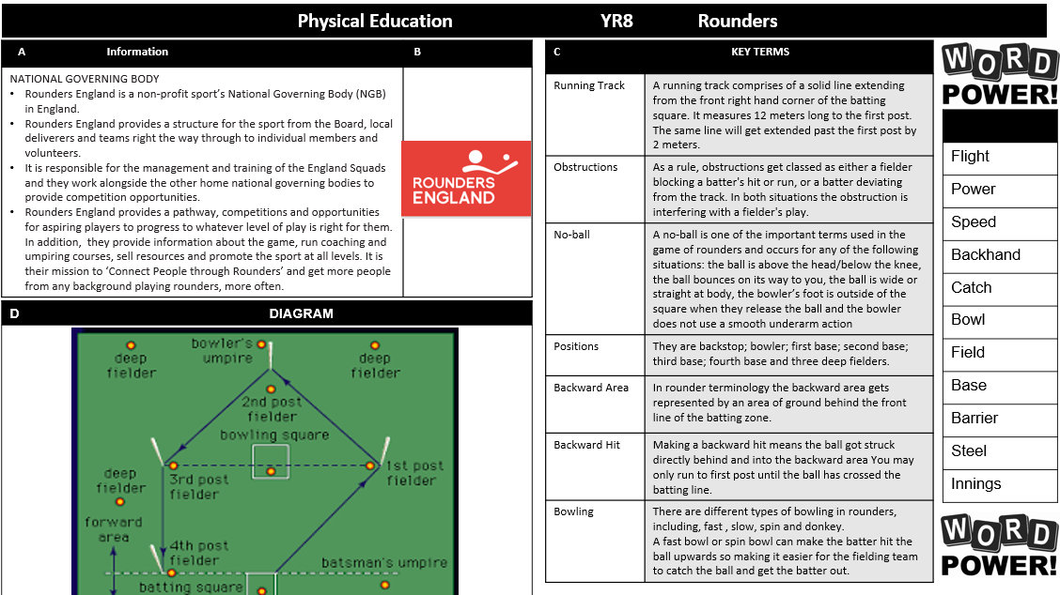
Physical Education

Slide 32
Physical Education

Slide 33
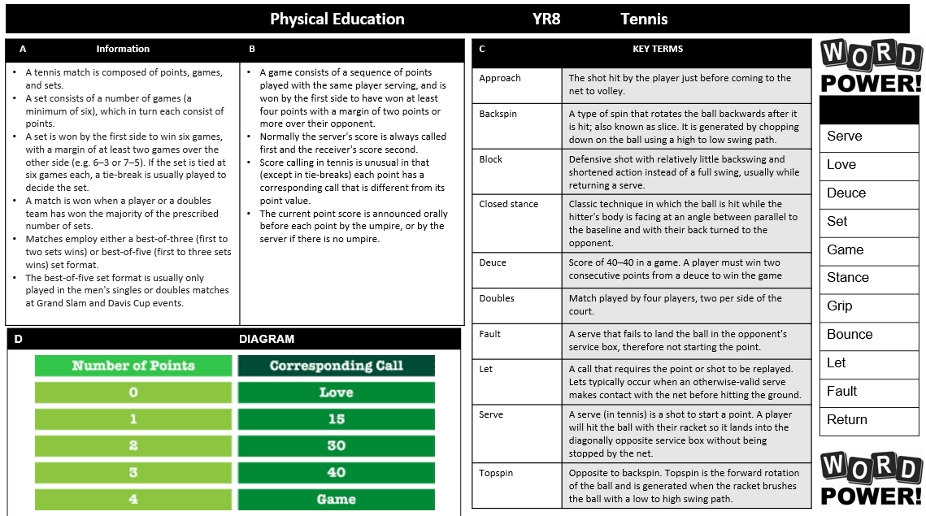
Physical Education

Slide 34
Physical Education

Slide 35
Engineering

Slide 36
Product Design

Slide 37
Food Technology

Slide 38
Textiles

Slide 39
Graphic Design

Slide 40
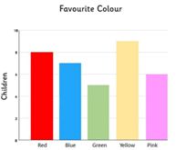
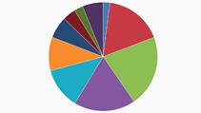
Numeracy
ESTIMATION
Go round each room in your house and think about the size of it. Write down an estimate for the following: The length of the room The height of the room The width of the room Using this information see if you can work out the area of each room (remember area of a rectangle is length multiplied by width) If you have a tape measure (and maybe some help if you aren’t tall enough) you can check and see how close your estimates were.
RESEARCH TASK
Think about something you would like to find out about your friends and family. It could be their favourite colour, their favourite TV show, what they eat for breakfast, their worst subject at school ………. or anything at all. Decide on some questions you need to ask to find out this information and ask at least 10 people. Draw a table to display all your information. Decide what sort of graph would work best to display the information. Create a poster which includes your original questionnaire, a copy of the table, and all the graphs you decided to draw. Write down what you have found out. Did you answer your question? Were the responses what you would have expected?
Volume
Surface Area
Vertex
Edge
Create a poster showing the definitions of these words.
Including pictures will really help you remember what they mean.
FINDING SHAPES
Look around your house and garden and see how many things you can find which are regular 3D shapes. Draw pictures of the shapes and see if you can work out the volume of them. Try drawing the plan view and front & side elevations too.

Slide 41
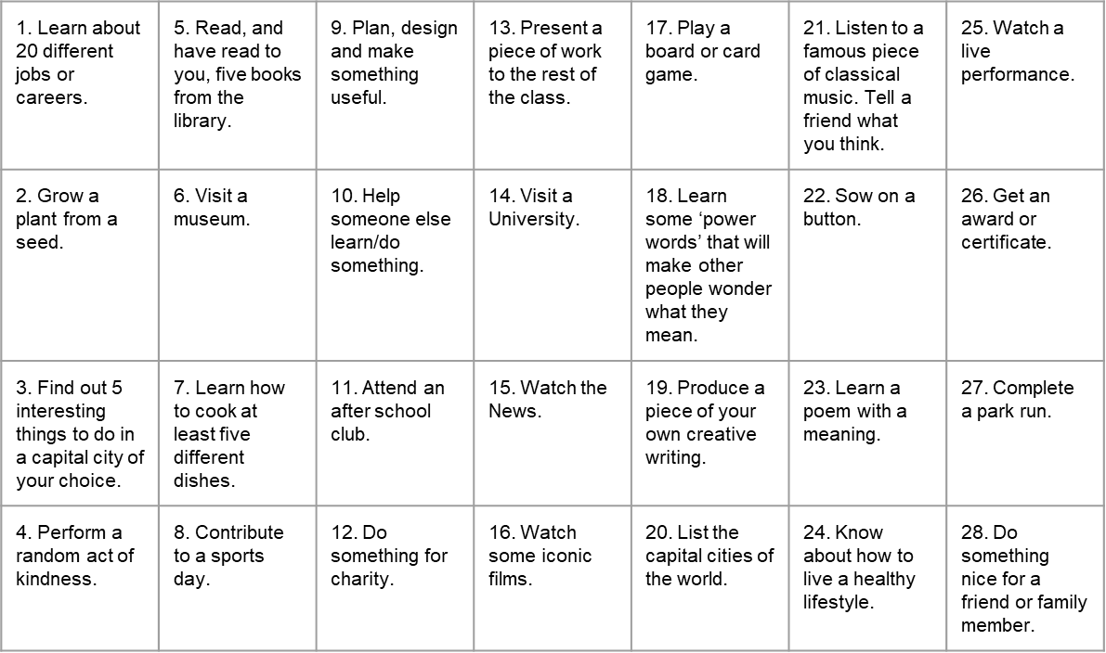
Things to do whilst at Wilsthorpe

Slide 42
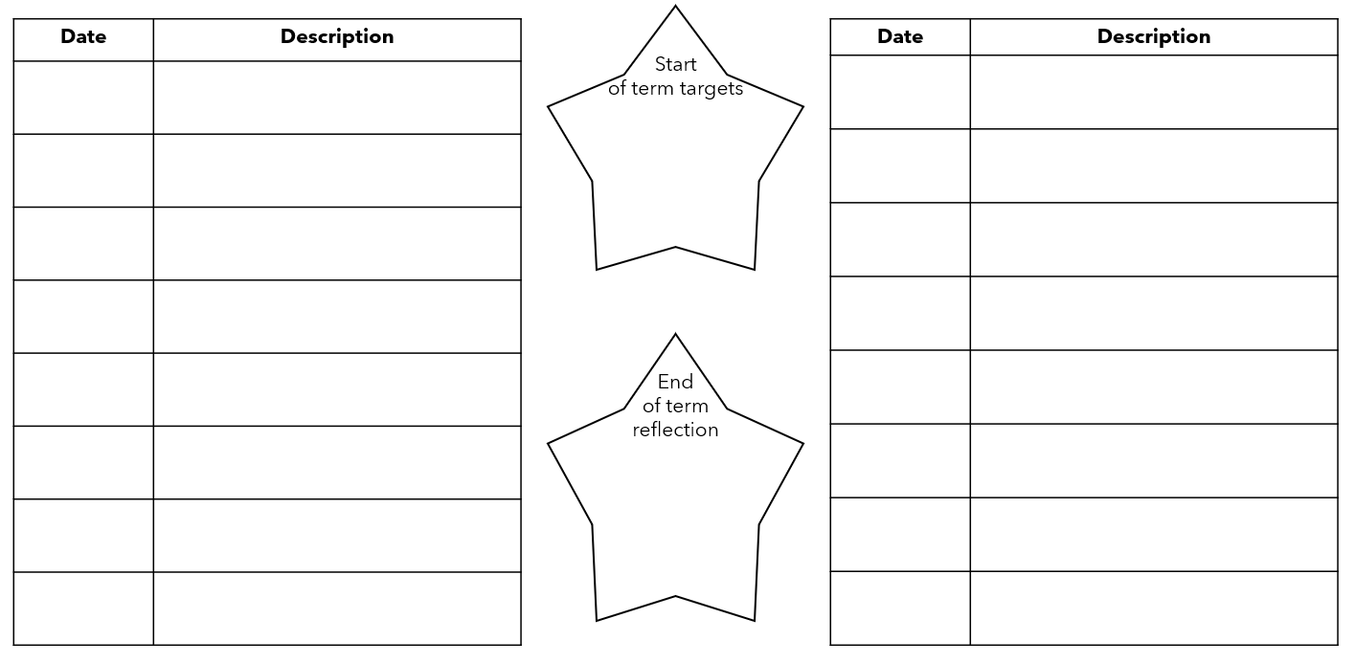
Out of lesson opportunities

Slide 43
Notes and Reminders

Slide 44
Notes and Reminders

Slide 45
Notes and Reminders

Slide 46
Notes and Reminders

