Slide 1
“If you are committed to doing what it takes, everything is possible. It is up to you.”
Michelle Obama (Lawyer and Writer)
Preparation for Learning - Knowledge Organisers
Year 8 Spring Term

Slide 2
What is a knowledge organiser and why do we use them?
Here at Wilsthorpe School, all subject leaders produce knowledge organisers to support you whilst you are in Years 7, 8 and 9, but what is a knowledge organiser?
Knowledge organisers present the key knowledge and skills for a particular topic. We call this the most ‘powerful’ knowledge.
They contain the key vocabulary for the topic that you need to understand and use.
We know that if we do not regularly revisit this powerful knowledge, we forget some or most of what we have learned. Our lessons are designed so that we regularly revisit prior learning but knowledge organisers allow you to also revisit this knowledge at home.
Using this booklet at home will help you to understand and remember all of the knowledge you will be taught each term. This will allow you to connect and strengthen your learning, allowing you to thrive in your lessons and beyond.

Slide 3
How to use a knowledge organiser (1)
Using your knowledge organiser at school
You will be given a knowledge organiser at the start of each term (September, January and April). You need to bring your knowledge organiser and exercise book with you every day to school. This will be a key piece of equipment and will be regularly referred to in lesson.
In lessons, there will be fortnightly low-stakes retrieval quizzes based on the knowledge contained in the knowledge organiser. Your knowledge organiser and exercise book will be checked regularly during tutor time.
Using your knowledge organiser at home
You should spend 40 minutes per evening completing your knowledge organiser work. On Monday, Tuesday, Wednesday and Thursday evenings, you should be studying two sections of your knowledge organiser. On Friday you should study one section.
The timetable on the following pages tells you which subjects you should be studying on which days. Your subject teacher will explain which Design and Technology page to study and which Languages page to study.
You should use your exercise book to show the work you have done. Each evening you should start a new page and put the date clearly at the top.
Every night you should also read for 15 minutes as a minimum and fill in your ‘Reading Log’. Parents should sign your reading log by initialling the relevant column.

Slide 4
How to use a knowledge organiser (2)
There are many different methods you can use to revise the information in the knowledge organiser and to test yourself. Here are some ideas of things you can do:
Clocks - divide a page into 12 sections (like a clock) and add information about a topic in each section
Spelling tests - write a spelling test for yourself based on the key vocabulary
Fact sheets - produce a fact sheet that contains key words, diagrams and information about a topic
Posters - produce of poster that contains the key images in a topic
Flowcharts – produce a diagram that sequences the key steps in a process or key events in a time period
Quizzes - write a quiz based on what you have learnt about a topic and get others to test you
Mind maps - produce a mind map to logically organise key concepts
Flash cards - create a set of flash cards that contain key pieces of information and vocabulary for a topic
Read, cover, say, write and check – read 3 pieces of information, cover it over, say it aloud, write it down correctly then check it against your knowledge organiser. Repeat until to you say and write it perfectly

Slide 5
How to use a knowledge organiser (3)
There are many different methods you can use to revise the information in the knowledge organiser and to test yourself. Here are some ideas of things you can do:
Mnemonics - take the first letter of each key word to be remembered and write it in to a down in to a memorable word or sentence i.e to remember the planets you could use My Very Educated Mother Just Served Us Nuts (Mercury, Venus, Earth, Mars, Jupiter, Saturn, Uranus, Neptune.)
3D models - make a 3D model (with labels) relating to a topic
Comic strip/storyboard – produce a visual representation of a topic or concept in a storyboard or comic
Poem/song - create a poem or song about a topic you’ve studied, remember to include key terms
Creative writing – write a fictional story that contains the key terms from a topic
For more details on each of these methods and how to use them, visit the following page on the school website:
https://www.wilsthorpe.ttct.co.uk/wp-content/uploads/sites/6/2021/10/Using-the-Knowledge-Organiser.pdf
You will also be taught how to use each of these methods during our revision sessions in tutor time.

Slide 6
Knowledge organiser timetable
Week A
Week B
Day | Subject 1 | Subject 2 | Reading
Monday | English | Design Technology | 15 minutes minimum
Tuesday | Maths | Physical Education | 15 minutes minimum
Wednesday | Science | Geography | 15 minutes minimum
Thursday | Grammar | Music | 15 minutes minimum
Friday | Drama |  | 15 minutes minimum
Day | Subject 1 | Subject 2 | Reading
Monday | English | History | 15 minutes minimum
Tuesday | Maths | MFL | 15 minutes minimum
Wednesday | Science | Computing | 15 minutes minimum
Thursday | Grammar | Art | 15 minutes minimum
Friday | Maths |  | 15 minutes minimum

Slide 7
Reading log
Week Beginning | M | T | W | T | F | S | S | Book(s) Read | Pages Read | Parent Initials | Librarian Initials
 | Record the number of minutes you read for each day
8th Jan
15th Jan
22nd Jan
29th Jan
5th Feb
12th Feb
Half term
26th Feb
4th March
11th March
18th March
25th March

Slide 8
Year 8 reading list
Subject Wider Reading Lists for every subject are available on the school website subject pages at: https://www.wilsthorpe.ttct.co.uk/curriculum/subjects/

Slide 9
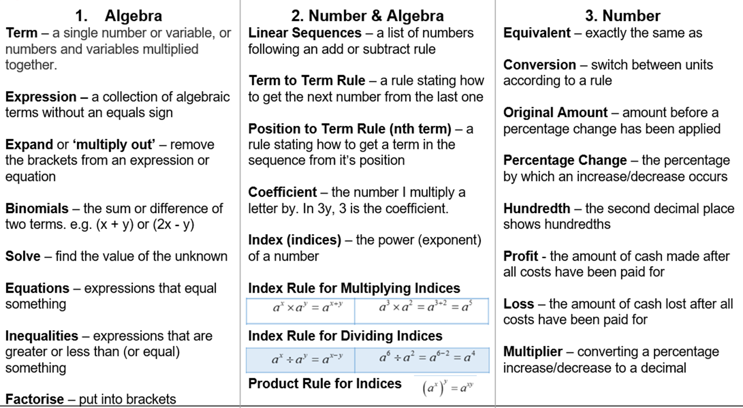
Maths

Slide 10
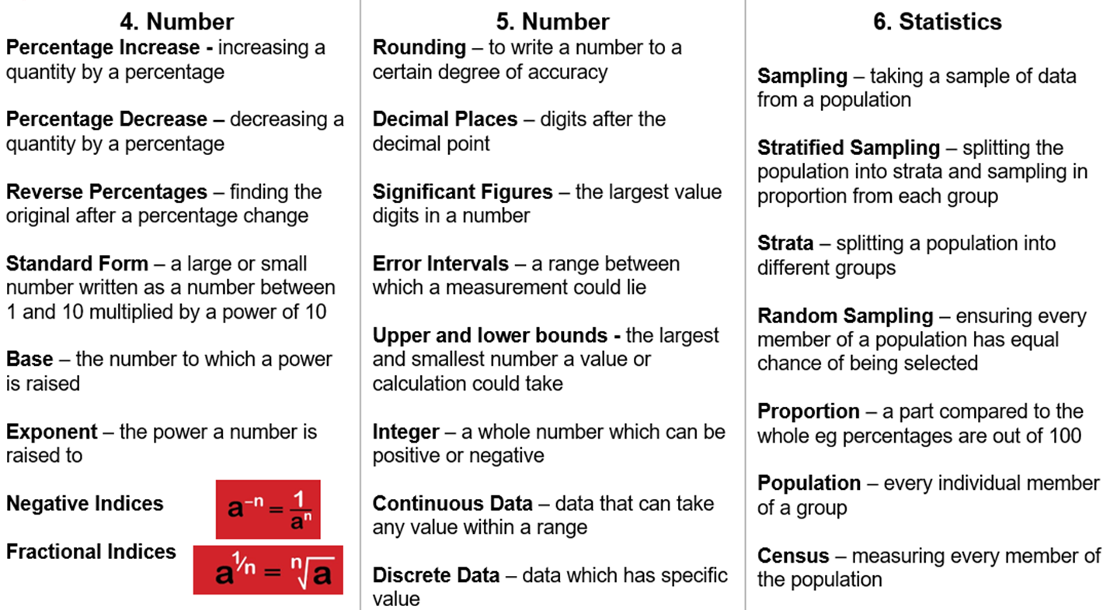
Maths

Slide 11
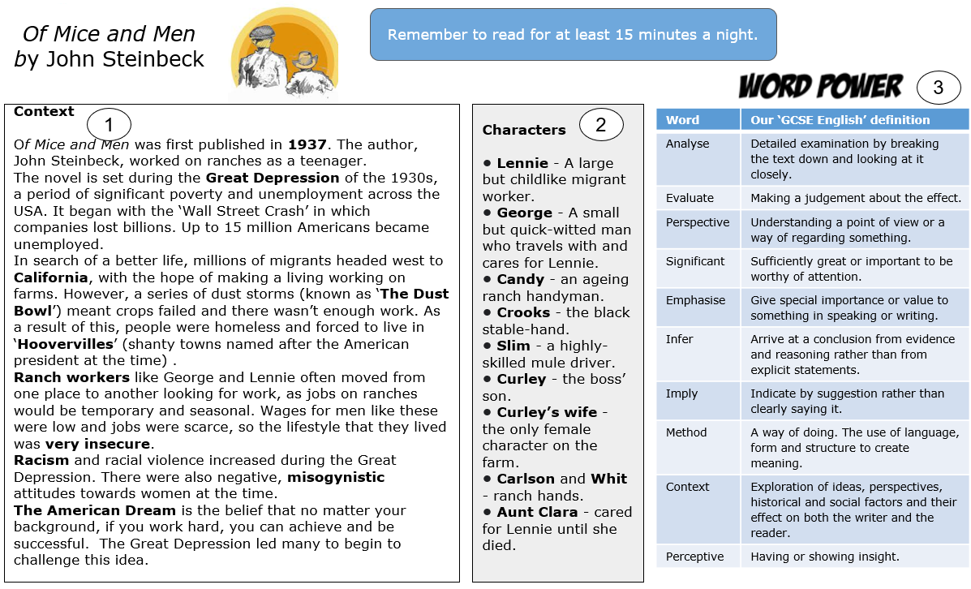
English

Slide 12
Grammar

Slide 13
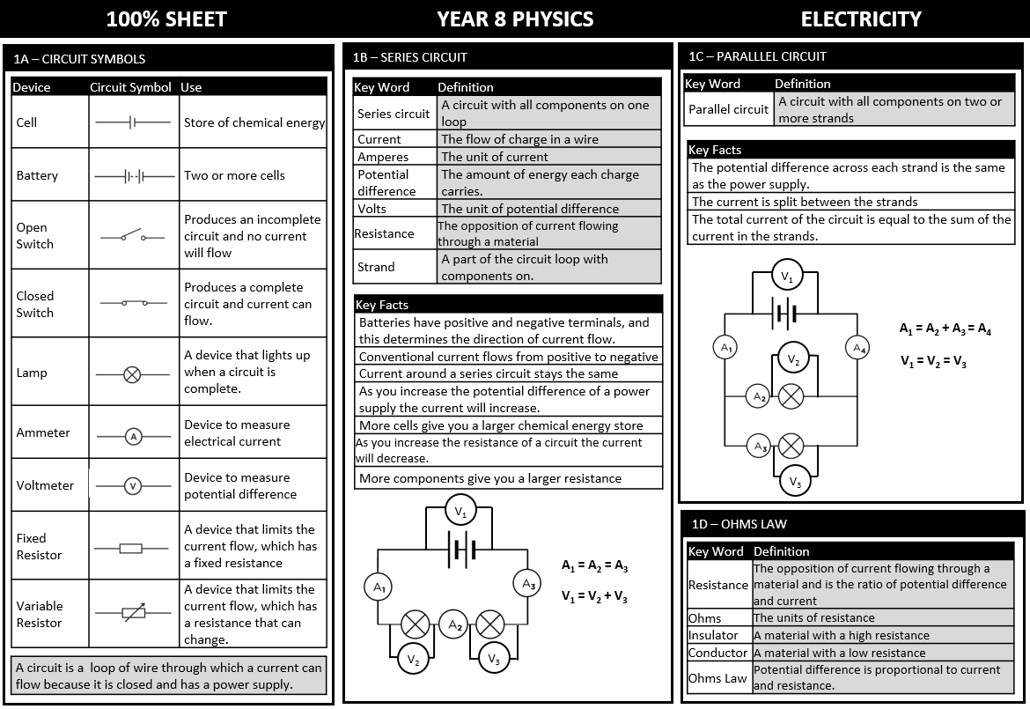
Science

Slide 14
Science

Slide 15
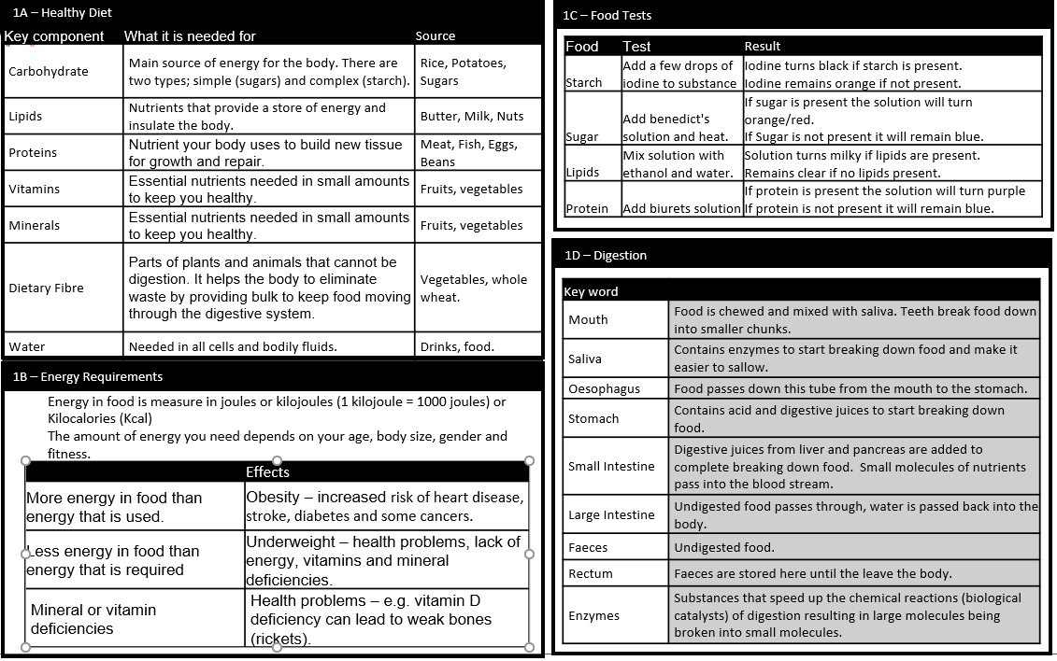
Science

Slide 16
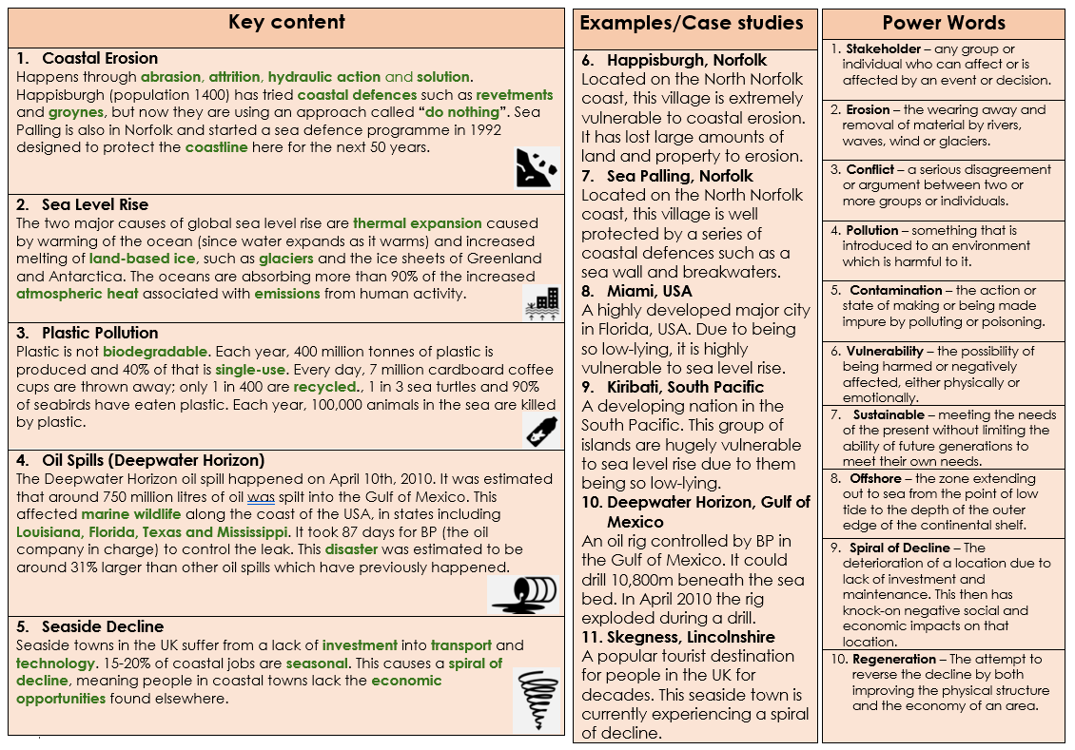
Geography

Slide 17
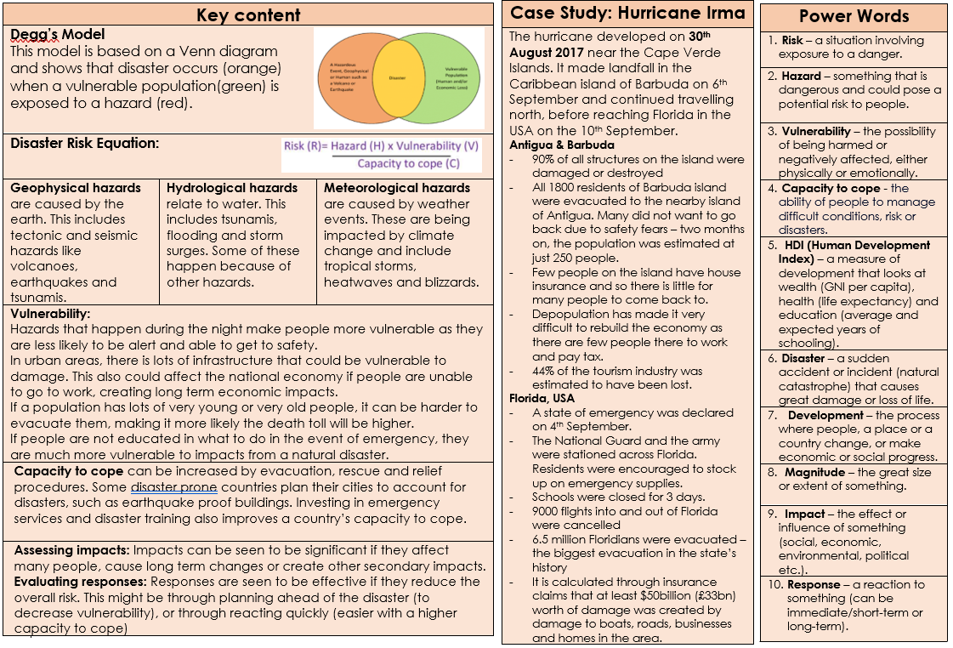
Geography

Slide 18
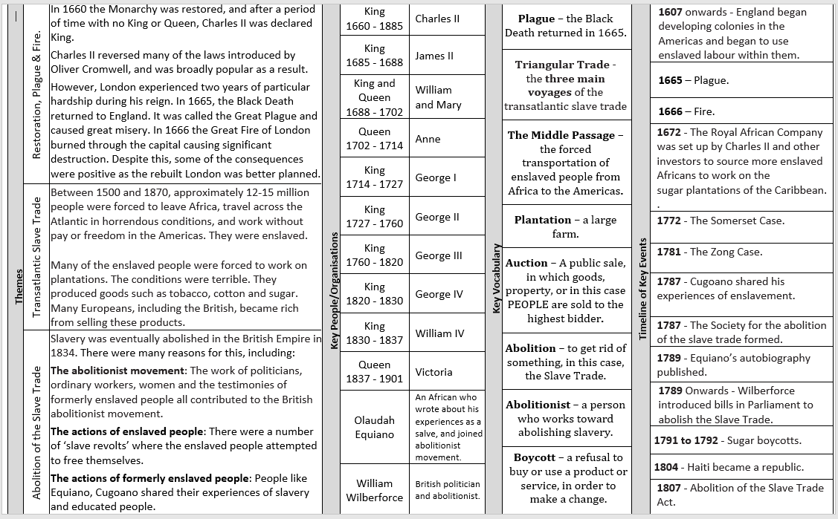
HISTORY

Slide 19
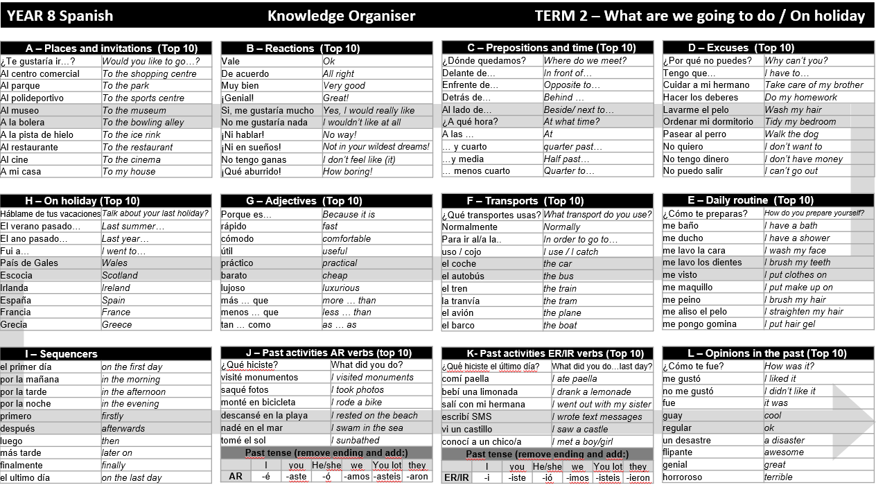
Spanish

Slide 20
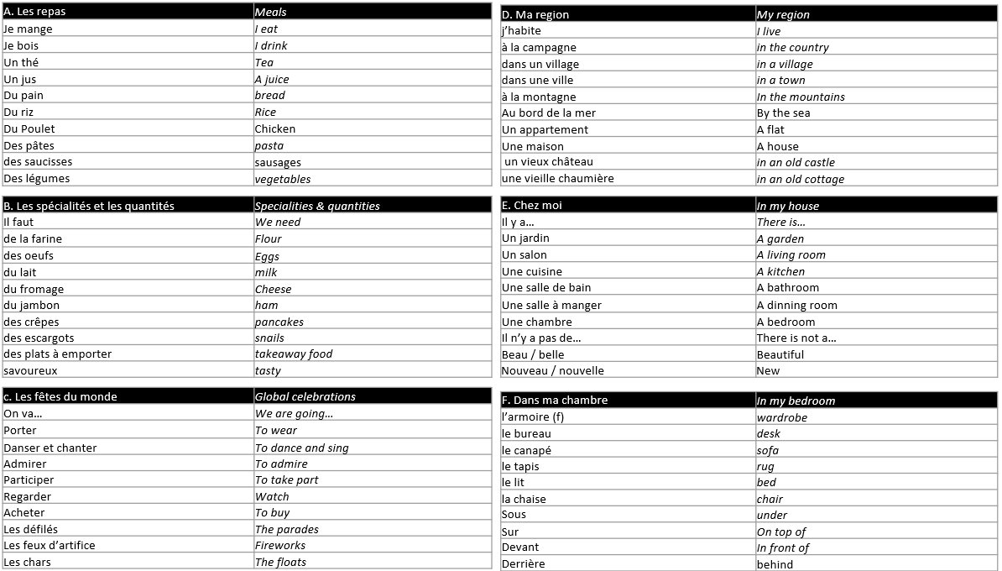
French

Slide 21
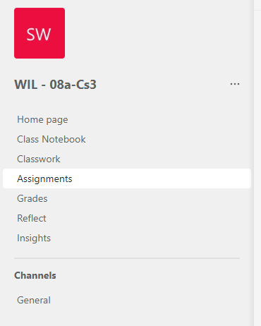
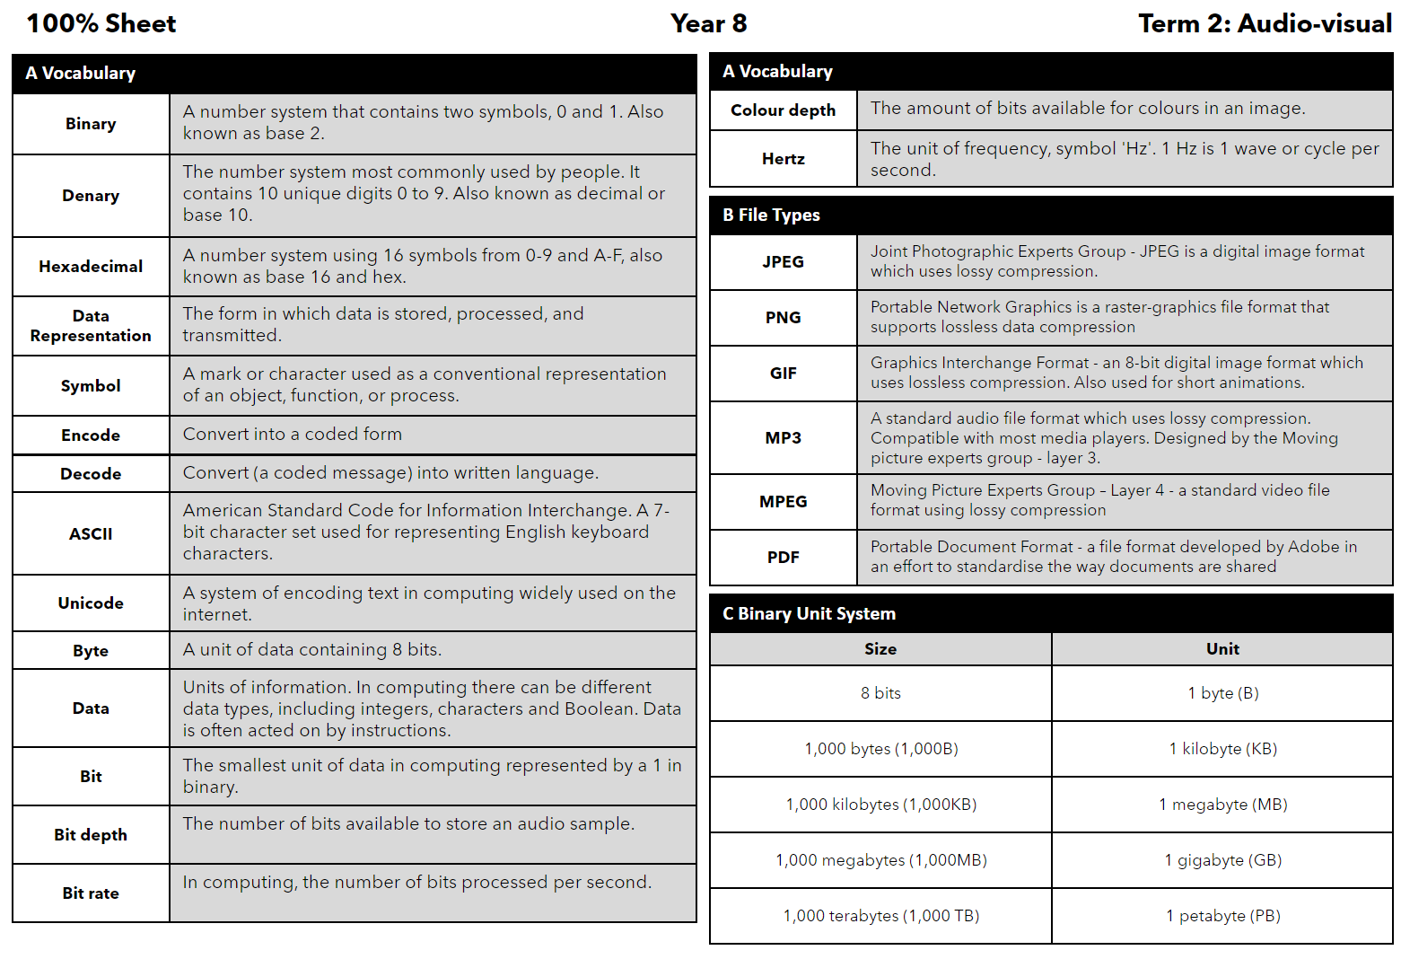
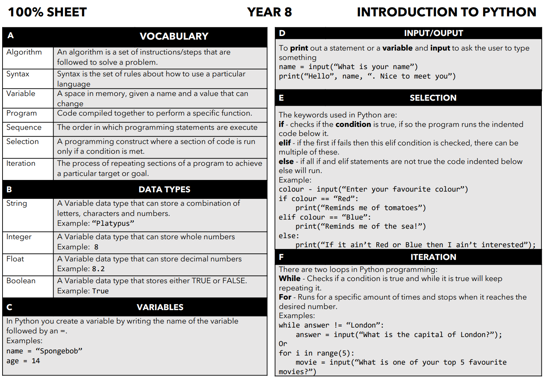
Accessing Teams
Computing
All Computer Science Lessons, Resources and Homework can be found on our Teams Platform. (This does not affect other subjects). To access the web platform for Teams - type into google the following link: https://www.microsoft.com/en-gb/microsoft-teams/log-in
You may not always get homework through teams. Revise the information below if you don't receive any from your teacher on the platform.
Then click on the top right and login using your school email and password.
You can also download the platform but this is optional.
On the Teams platform find your classroom and open it.
In your classroom go to assignments and scroll through until you find your homework posted by your teacher.
Term 3
Term 4

Slide 22
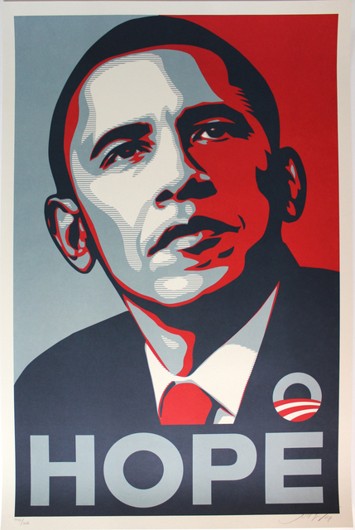
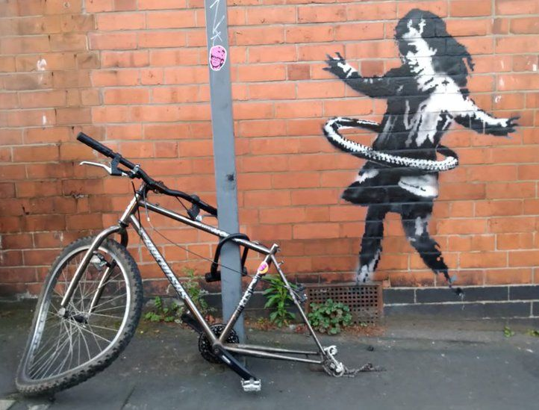
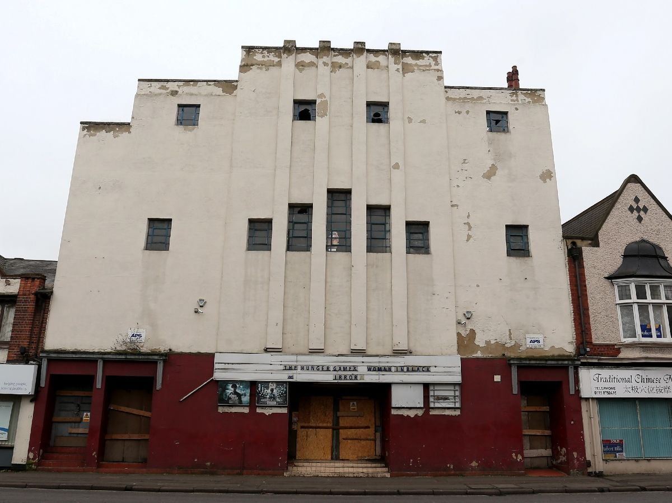
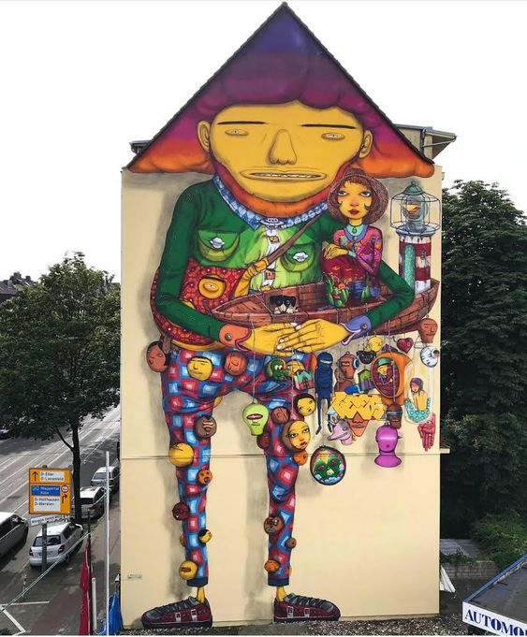
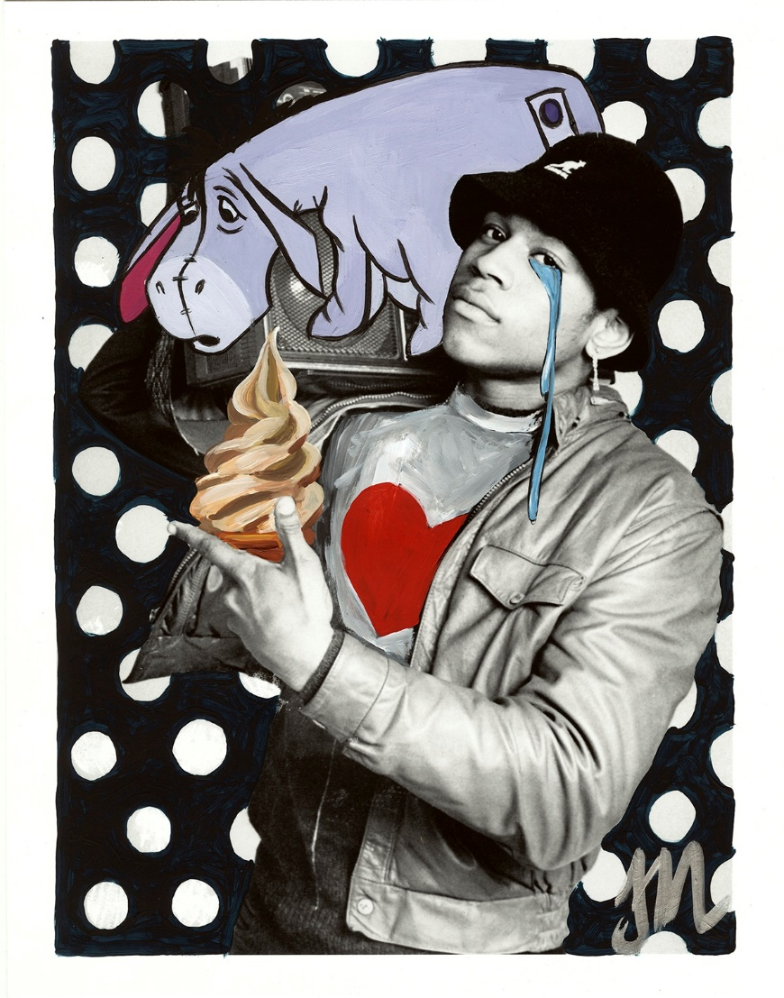
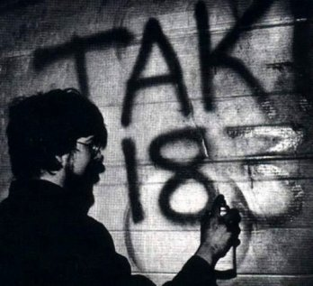
Art
Fairey Artist study
Task 4
BANKSY Artist research
Task 2
Shepard Fairey created this portrait of Barack Obama called ‘Hope’ in 2008 as a form of activism to support Obama’s first presidential campaign. It was inspired by the graphics of Soviet Socialist Realism
GRAFFITI - Keywords
Graffiti | Graffiti is art that is written, painted or drawn on a wall or other surface within public view. It ranges from simple written words to elaborate wall paintings, and has existed since ancient times, with examples dating back to ancient Egypt, ancient Greece, and the Roman Empire.
Piece | Short of ‘masterpiece’, is used to describe a large, complex, time-consuming graffiti painting. It must have at least 3 colours and incorporate colour transitions, shadows and three-dimensional effects.
Throw-Up | Most commonly used to describe tag-like drawings of bubble letters of graffiti words, it usually consisting of artist's name and two colours.
Tag | Usually written with marker or spray paint in one colour. Tag is a stylised personal signature and contains graffiti writer's name, also known as a moniker. Graffiti writers often tag their pieces, similar to how an artists signs their artwork.
Stencil Graffiti | Stencils made out of paper, cardboard, or other media to create an image or text that is easily reproducible.
Black Book | Is a graffiti writers' sketch book in which they draw and plan out potential graffiti works. Graffiti writers use their black books to perfect their style and save their ideas.
Keith Haring Artist research
Task 1
Task 3
Radiant Baby was one of the most symbolic graphics of Keith Haring’s work. It first started appearing in his subway art in the early ’80s, becoming a signature hallmark in Haring’s murals. In his youth, Haring was greatly influenced by Christianity and religion, themes that would continue to appear in his artwork throughout his life. Radiant Baby is a Christ-child like image: pure, innocent, vulnerable, but radiating positive energy. The rays surrounding the figure are a nod to the rays surrounding religious figures in Renaissance art, particularly of the Virgin Mary.
This Banksy mural, which depicts a girl hula-hooping with a bicycle tyre, appeared on a Nottingham street in 2020. The artwork was removed in 2021, it was sold for a 6 figure sum to a gallery owner. He claimed he had saved the Nottingham artwork "in time" before damp could cause damage under the plastic cover put on by Nottingham City Council.
Add graffiti art
Task 5
Tag
Piece
Throw-Up
Task 6
Check TEAMS for more help
W/B 8 Jan: Task 1 Write up the key Art terminology for this project in your book.
W/B 22 Jan: Task 2 Create an artwork inspired by Banksy, add 5 facts about the artist and his work, give your opinion.
W/B 5 Feb: Task 3 Create a study page of on Keith Haring’s work to include: Artist study, 10 facts, give your opinion.
W/B 26 Feb: Task 4 Create a large A4 Colour Study of the ‘Hope’ artwork by Shepard Fairey, give your opinion on the artwork.
W/B 11 Mar: Task 5 Reclaim your city, Draw the outlines of the Galaxy Cinema in Long Eaton (above) to decorate using your own unique artwork in graffiti style.
W/B 25 Mar: Task 6 Download a picture of your favourite music artist and add graffiti text and illustrations to ‘Mash it up!’

Slide 23
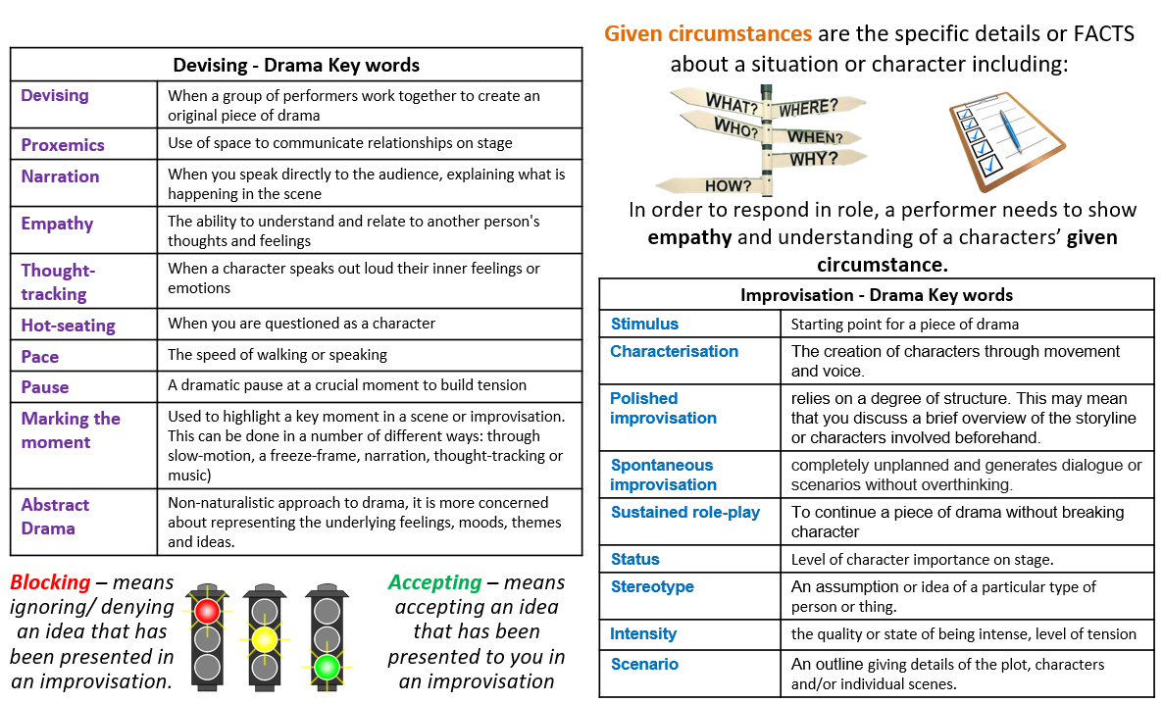
Drama

Slide 24
Music

Slide 25
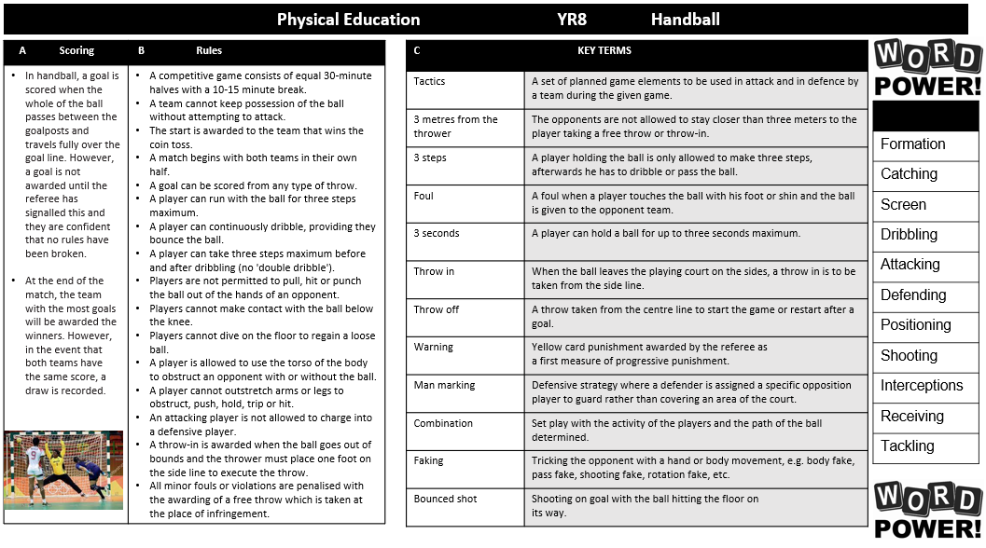
Physical Education

Slide 26
Physical Education

Slide 27
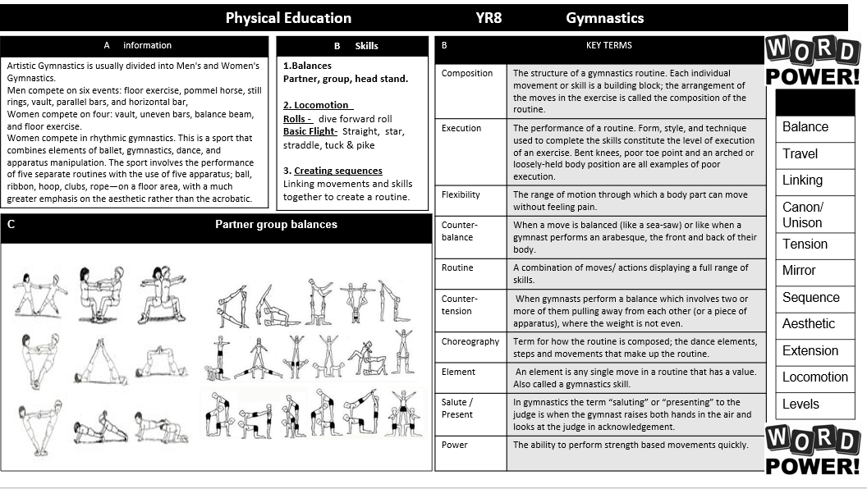
Physical Education

Slide 28
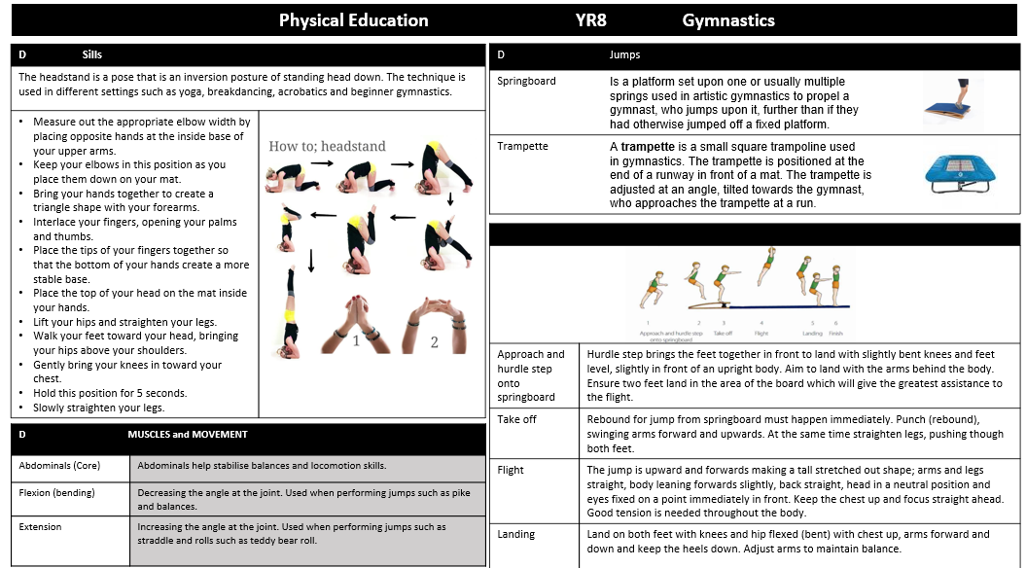
Physical Education

Slide 29
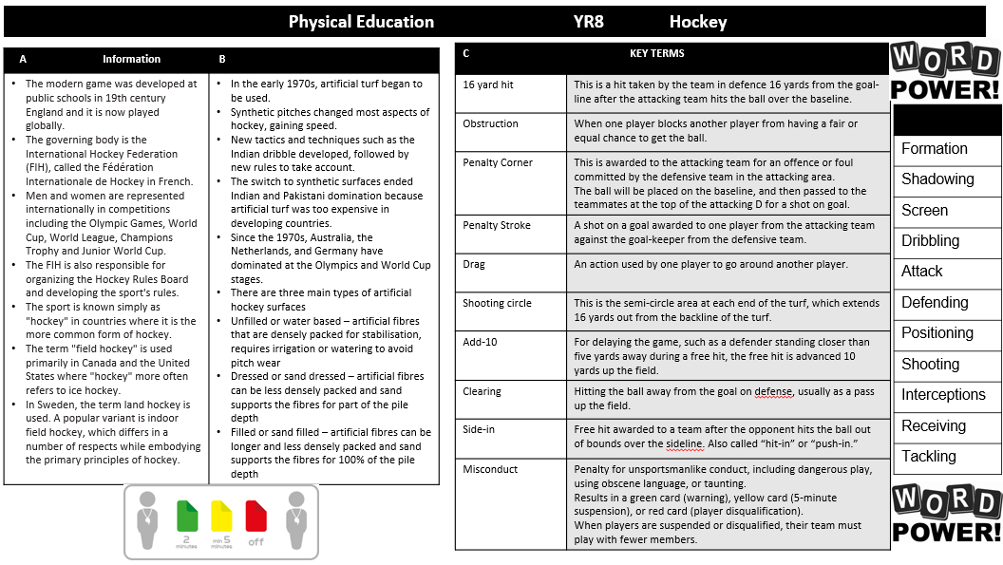
Physical Education

Slide 30
Physical Education

Slide 31
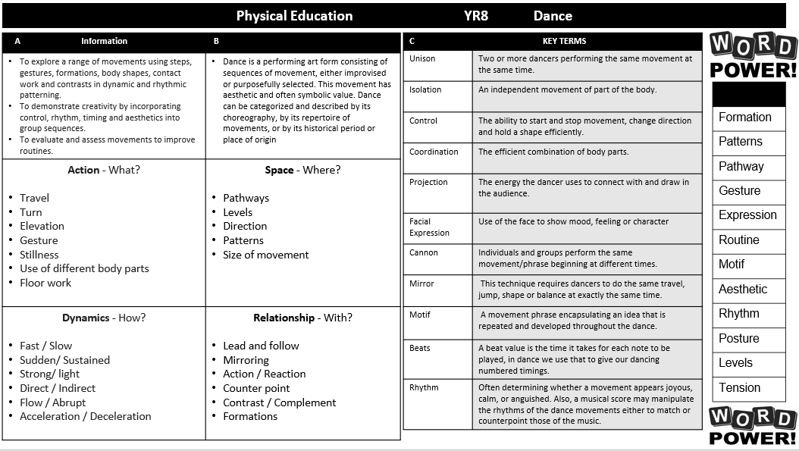
Physical Education

Slide 32
Physical Education

Slide 33
Engineering

Slide 34
Product Design

Slide 35
Food Technology

Slide 36
Textiles

Slide 37
Graphic Design

Slide 38
Numeracy
Here are some activities that will help develop your numeracy skills and link the numeracy you are doing in all of your lessons to the numeracy you see every day in the real world.

Slide 39
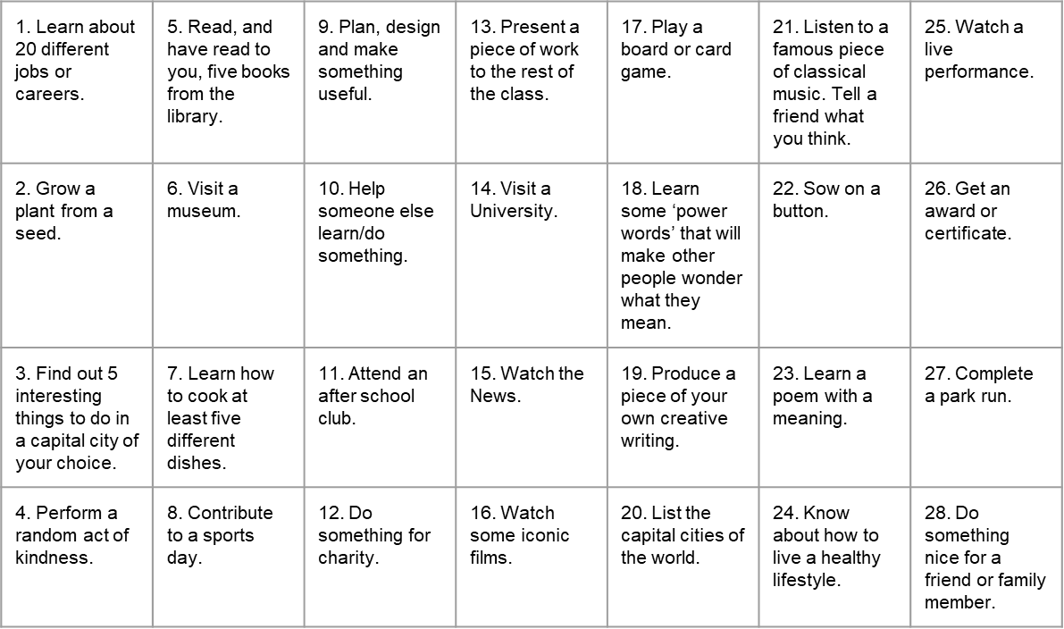
Things to do whilst at Wilsthorpe

Slide 40
Notes and Reminders

Slide 41
Notes and Reminders

Slide 42
Notes and Reminders

Slide 43
Notes and Reminders

