Slide 1
‘Spend each day trying to be a little wiser than you were when you woke up.’
Charlie Munger
Preparation for Learning - Knowledge Organisers
Year 8 Autumn Term

Slide 2
What is a knowledge organiser and why do we use them?
Here at Wilsthorpe School, all subject leaders produce knowledge organisers to support you whilst you are in Years 7, 8 and 9, but what is a knowledge organiser?
Knowledge organisers present the key knowledge and skills for a particular topic. We call this the most ‘powerful’ knowledge.
They contain the key vocabulary for the topic that you need to understand and use.
We know that if we do not regularly revisit this powerful knowledge, we forget some or most of what we have learned. Our lessons are designed so that we regularly revisit prior learning but knowledge organisers allow you to also revisit this knowledge at home.
Using this booklet at home will help you to understand and remember all of the knowledge you will be taught each term. This will allow you to connect and strengthen your learning, allowing you to thrive in your lessons and beyond.

Slide 3
How to use a knowledge organiser (1)
Using your knowledge organiser at school
You will be given a knowledge organiser at the start of each term (September, January and April). You need to bring your knowledge organiser and exercise book with you every day to school. This will be a key piece of equipment and will be regularly referred to in lesson.
In lessons, there will be fortnightly low-stakes retrieval quizzes based on the knowledge contained in the knowledge organiser. Your knowledge organiser and exercise book will be checked regularly during tutor time.
Using your knowledge organiser at home
You should spend 40 minutes per evening completing your knowledge organiser work. On Monday, Tuesday, Wednesday and Thursday evenings, you should be studying two sections of your knowledge organiser. On Friday you should study one section.
The timetable on the following pages tells you which subjects you should be studying on which days. Your subject teacher will explain which Design and Technology page to study and which Languages page to study.
You should use your exercise book to show the work you have done. Each evening you should start a new page and put the date clearly at the top.
Every night you should also read for 15 minutes as a minimum and fill in your ‘Reading Log’. Parents should sign your reading log by initialling the relevant column.

Slide 4
How to use a knowledge organiser (2)
There are many different methods you can use to revise the information in the knowledge organiser and to test yourself. Here are some ideas of things you can do:
Clocks - divide a page into 12 sections (like a clock) and add information about a topic in each section
Spelling tests - write a spelling test for yourself based on the key vocabulary
Fact sheets - produce a fact sheet that contains key words, diagrams and information about a topic
Posters - produce of poster that contains the key images in a topic
Flowcharts – produce a diagram that sequences the key steps in a process or key events in a time period
Quizzes - write a quiz based on what you have learnt about a topic and get others to test you
Mind maps - produce a mind map to logically organise key concepts
Flash cards - create a set of flash cards that contain key pieces of information and vocabulary for a topic
Read, cover, say, write and check – read 3 pieces of information, cover it over, say it aloud, write it down correctly then check it against your knowledge organiser. Repeat until to you say and write it perfectly

Slide 5
How to use a knowledge organiser (3)
There are many different methods you can use to revise the information in the knowledge organiser and to test yourself. Here are some ideas of things you can do:
Mnemonics - take the first letter of each key word to be remembered and write it in to a down in to a memorable word or sentence i.e to remember the planets you could use My Very Educated Mother Just Served Us Nuts (Mercury, Venus, Earth, Mars, Jupiter, Saturn, Uranus, Neptune.)
3D models - make a 3D model (with labels) relating to a topic
Comic strip/storyboard – produce a visual representation of a topic or concept in a storyboard or comic
Poem/song - create a poem or song about a topic you’ve studied, remember to include key terms
Creative writing – write a fictional story that contains the key terms from a topic
For more details on each of these methods and how to use them, visit the following page on the school website:
https://www.wilsthorpe.ttct.co.uk/wp-content/uploads/sites/6/2021/10/Using-the-Knowledge-Organiser.pdf
You will also be taught how to use each of these methods during our revision sessions in tutor time.

Slide 6
Knowledge organiser timetable
Week A
Week B
Day | Subject 1 | Subject 2 | Reading
Monday | English | Design Technology | 15 minutes minimum
Tuesday | Maths | Physical Education | 15 minutes minimum
Wednesday | Science | Geography | 15 minutes minimum
Thursday | Grammar | Music | 15 minutes minimum
Friday | Drama |  | 15 minutes minimum
Day | Subject 1 | Subject 2 | Reading
Monday | English | History | 15 minutes minimum
Tuesday | Maths | MFL | 15 minutes minimum
Wednesday | Science | Computing | 15 minutes minimum
Thursday | Grammar | Art | 15 minutes minimum
Friday | Maths |  | 15 minutes minimum

Slide 7
Reading log
Week Beginning | M | T | W | T | F | S | S | Book(s) Read | Pages Read | Parent Initials | Librarian Initials
 | Record the number of minutes you read for each day

Slide 8
Year 8 reading list
Subject Wider Reading Lists for every subject are available on the school website subject pages at: https://www.wilsthorpe.ttct.co.uk/curriculum/subjects/

Slide 9
Maths

Slide 10
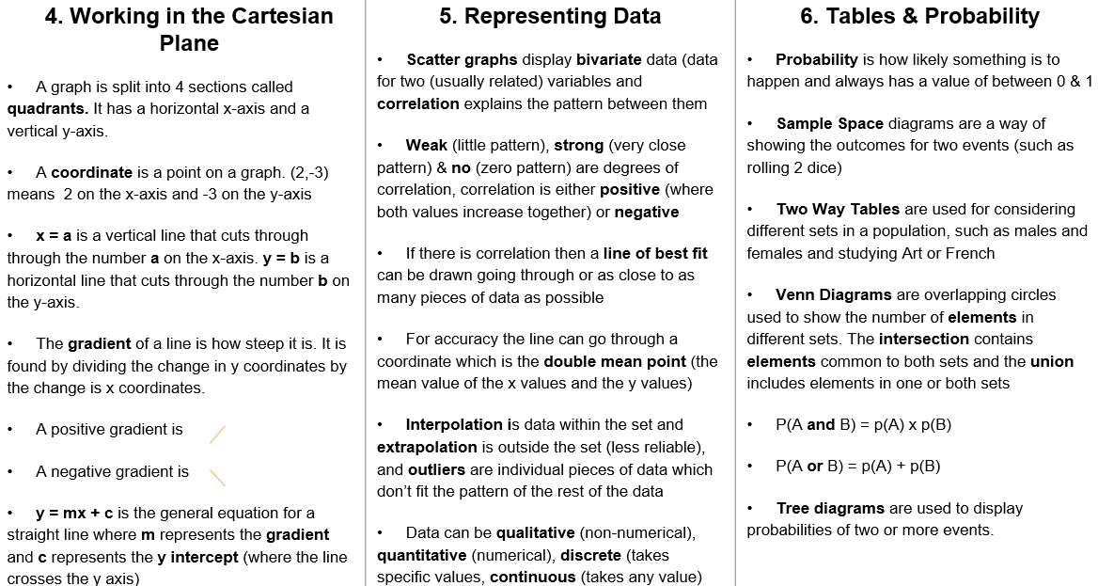
Maths

Slide 11
English

Slide 12
Grammar

Slide 13
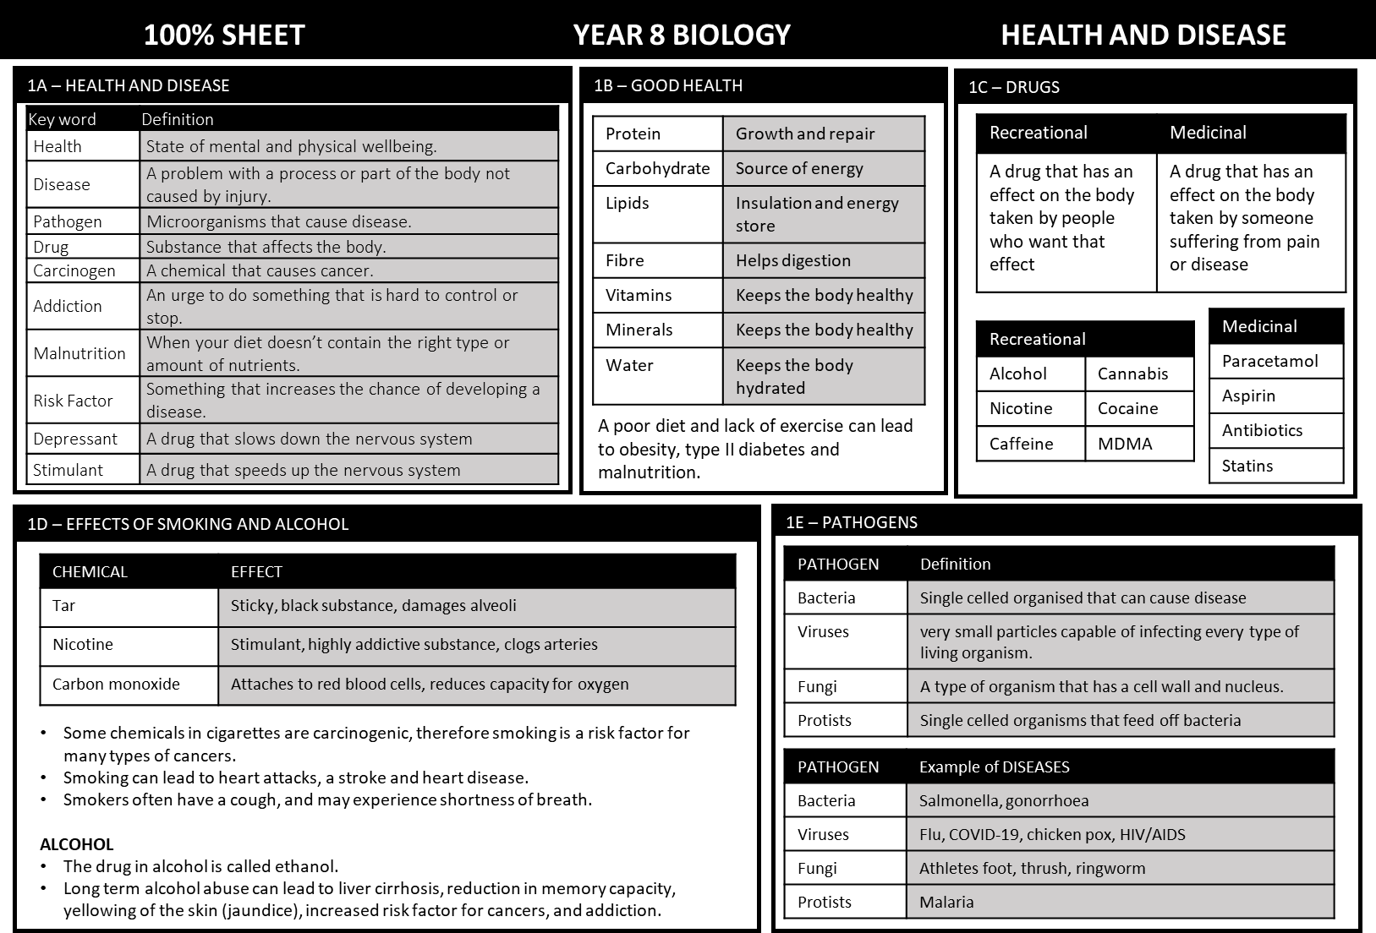
Science

Slide 14
Science

Slide 15
Science

Slide 16
Science

Slide 17
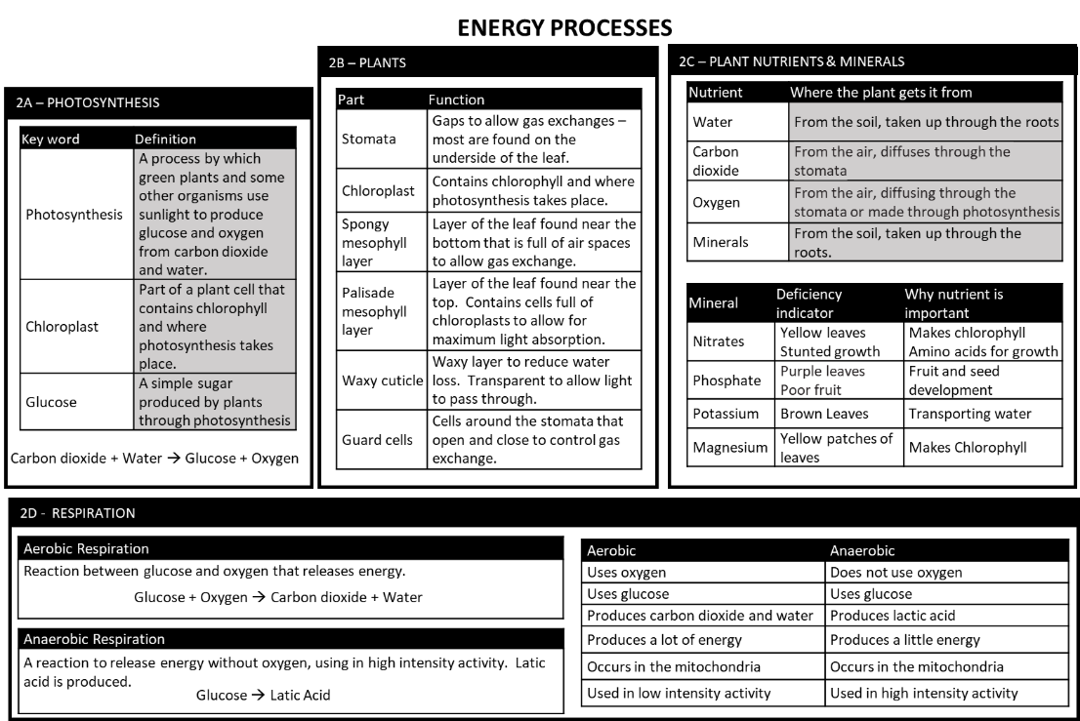
Science

Slide 18
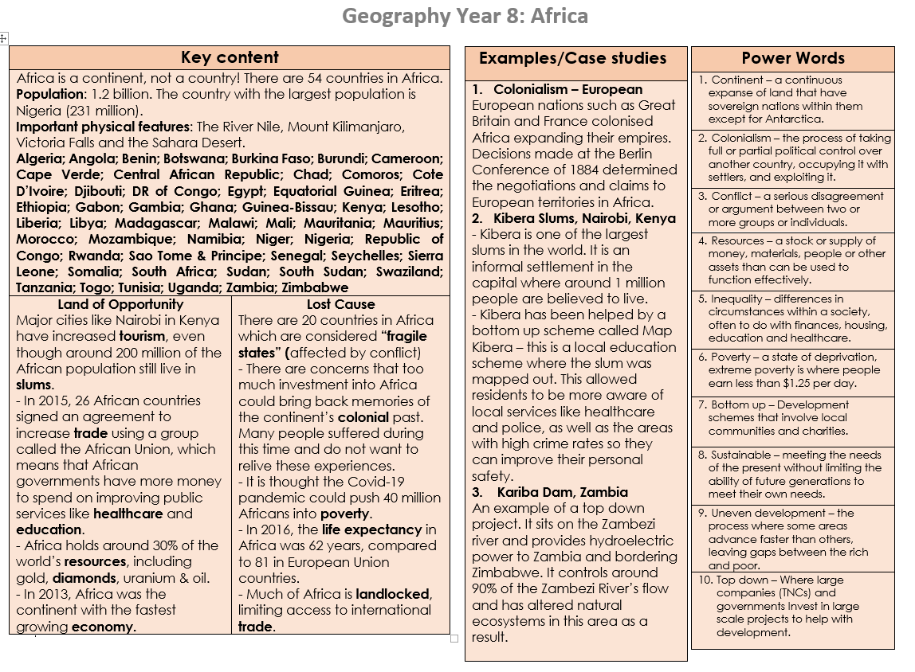
Geography

Slide 19
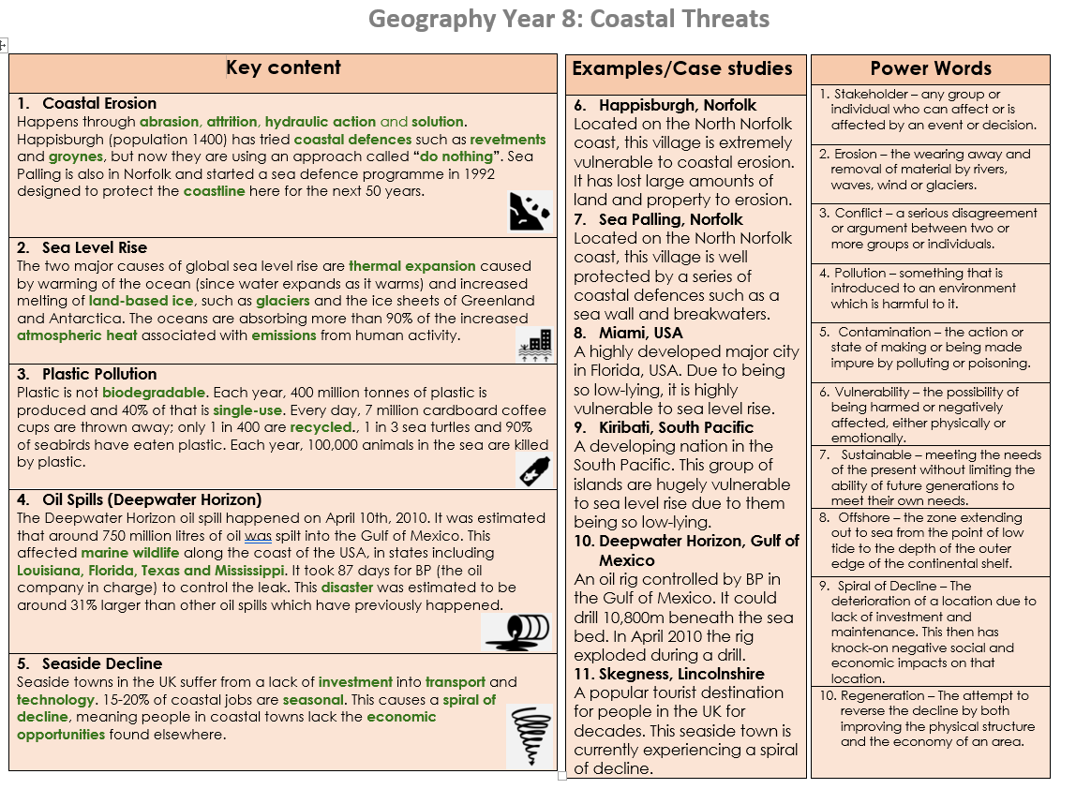
Geography

Slide 20
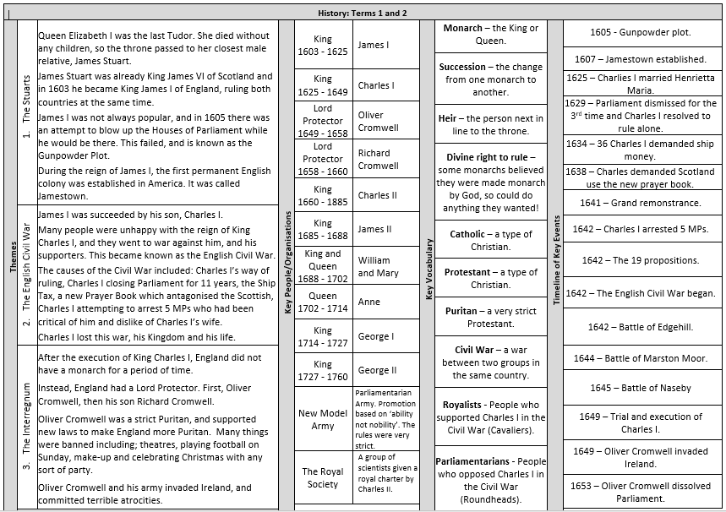
History

Slide 21
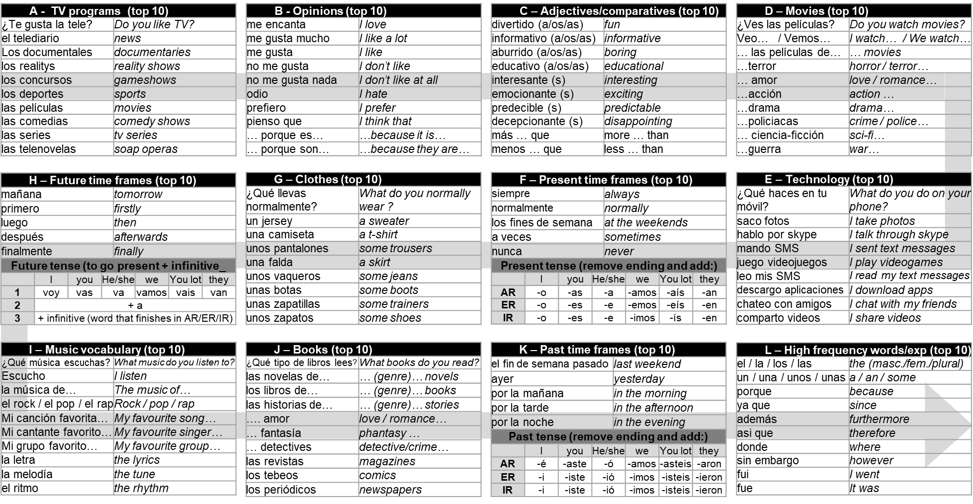
Spanish

Slide 22
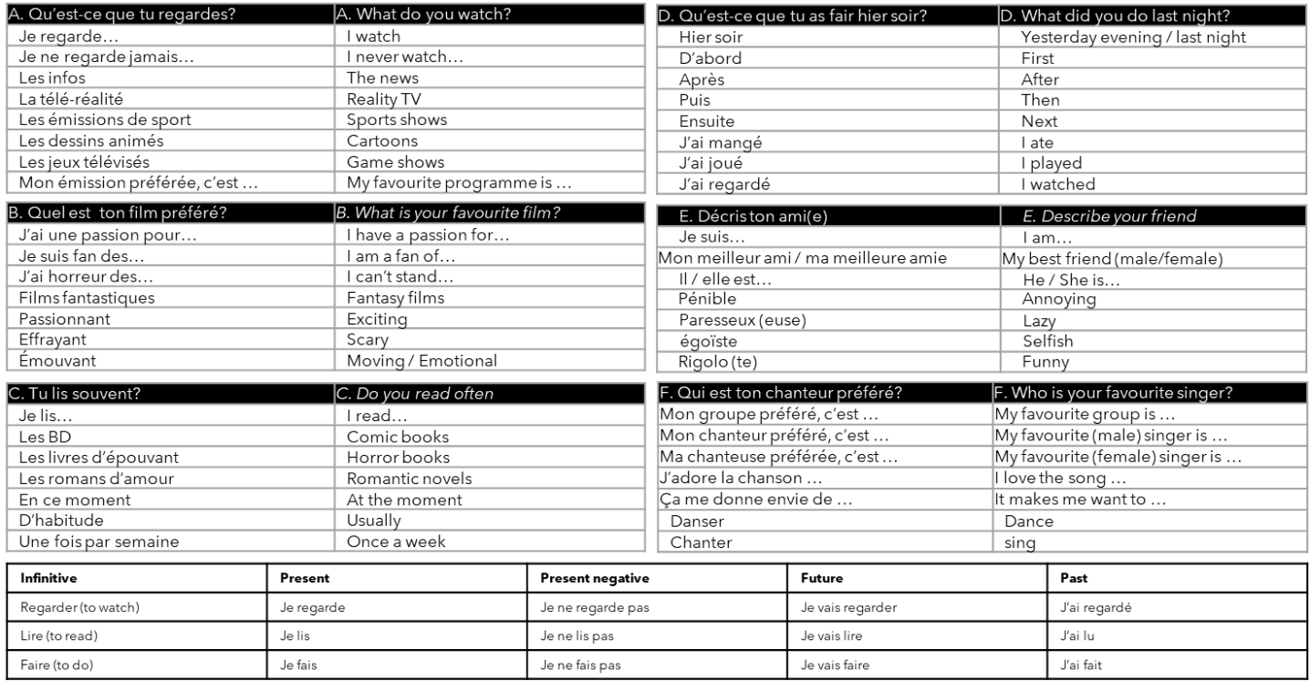
French

Slide 23
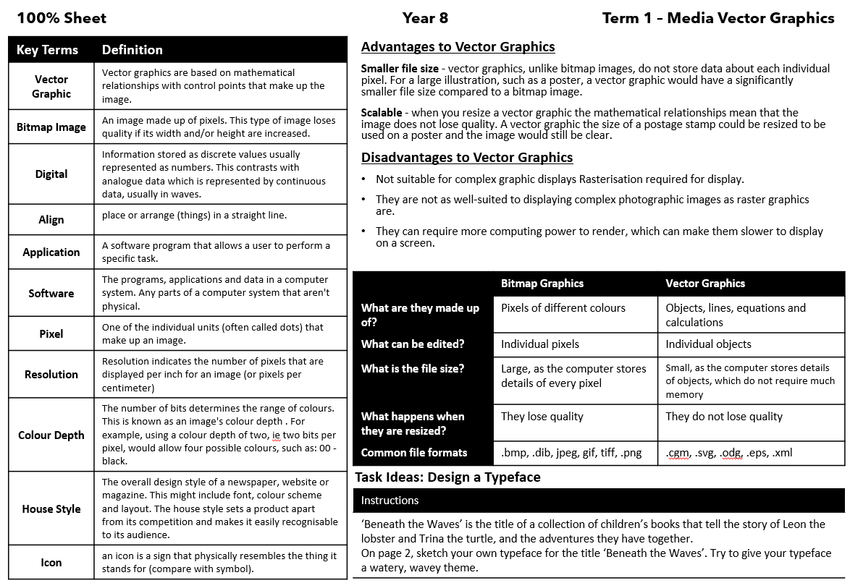
Computing
Term 2 - Media ‘Vector Graphics’

Slide 24
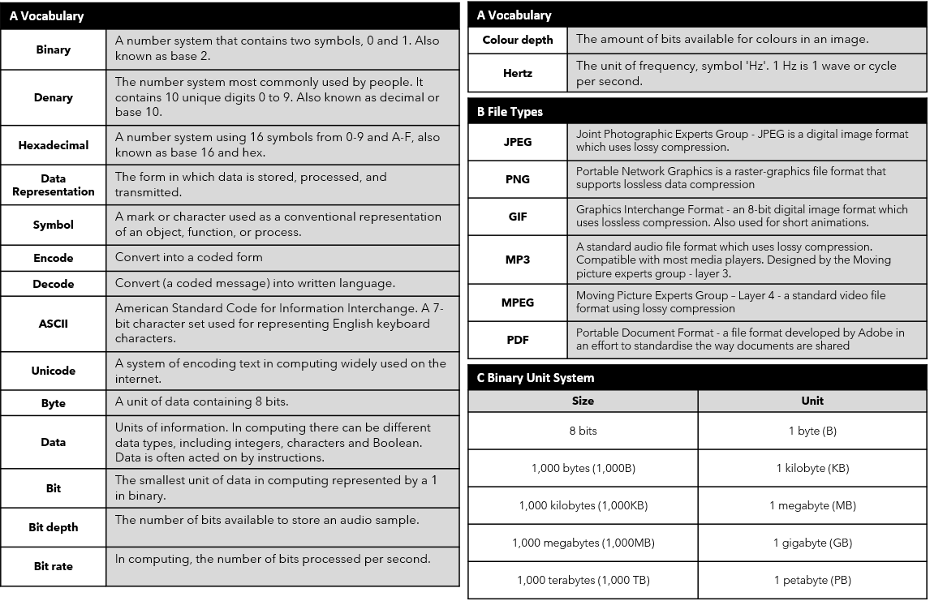
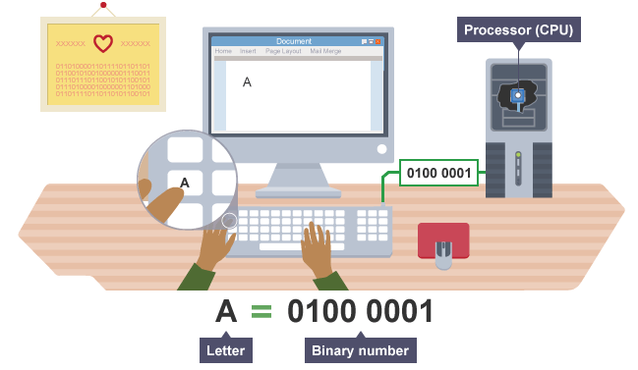
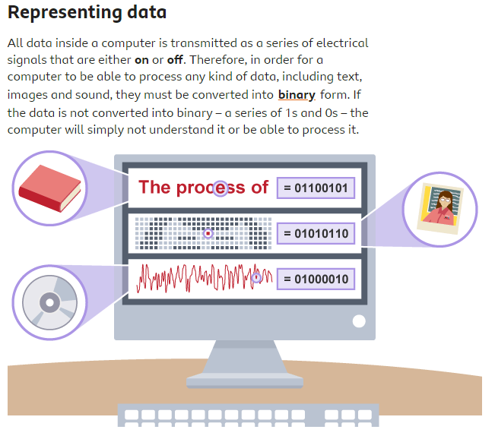
Computing
Term 3 - AudioVisual Data Representation

Slide 25
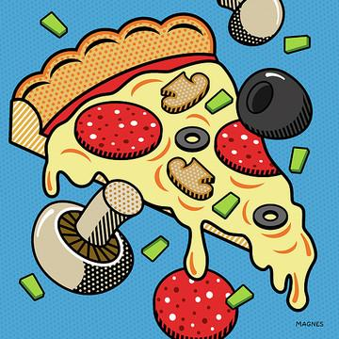
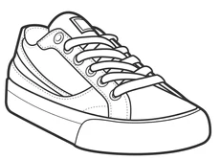
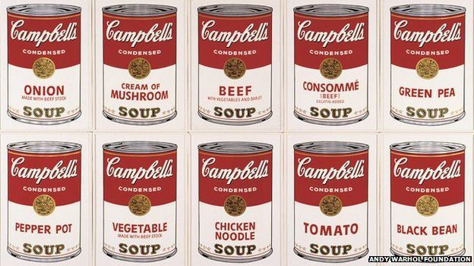
Art
Ron Magnes, American illustrator and animator with a pop art style.
Key Words – POP ART
Pop Art (Popular Art) | Artwork based on simplified commonplace images/objects e.g. Coke bottles, comic strips and soup cans.
Composition | The way objects/images are arranged in artwork.
Sketch | A rough/unfinished drawing often made to prepare for a final design.
Observation | Looking at something carefully.
Contour line | Outlines of the shapes in an object – no shading.
Collage | Different papers, images or materials glued onto a background to form an artwork
Mixed Media | Artworks composed from a combination of different media or materials.
Benday Dots | Small coloured dots, typically in cyan, magenta, yellow, and black, spaced and combined to create shading and complete images
Still life | An artwork of an arrangement of objects.
Johnny Romeo
Australian painter
Claes Oldenburg & Coosje van Bruggen ‘Dropped Cone’ 2001, 10m high
Patrick Caulfield, English painted associated with pop art.
Pop Art - An Art movement which began in the 1950’s in both the UK and America, by a group of artists who wanted to rebel against traditional art. Their work is characterised by the use of bold flat colours, shapes and lines. These artists included Roy Lichtenstein, Patrick Caulfield, David Hockney, Peter Blake, Claes Oldenburg and Andy Warhol.
Yayoi Kusama Japanese artist sometimes called the princess of polka dots.
Michael Craig Martin, American artist ‘Untitled (with suitcase)’ 2020
Andy Warhol American artist and leading figure in pop art. ‘Cambell’s Soup’ 1968. Photographic Screenprint
Roy Lichtenstein ‘Whaam..’ 1963. He often used Benday Dots in his work.
Peter Blake, The first British pop artist. Creating work full of 1960’s icons.
Remember: to watch the linked videos before beginning the work and check Google Classroom for more handouts/guidance
W/B 4 Sep: Task 1 - Write out the keywords. ‘look, cover, write and check’ to learn the definitions.
W/B 18 Sept: Task 2 - https://youtu.be/kZV8eubKEYc – use the suggestions in the video or look at the to create your own Pop Art Inspired Comic Book.
W/B 2 Oct: Task 3 - https://youtu.be/FWK2D6nJ1-I Create your own Lichtenstien inspired artwork.
W/B 16 Oct: Task 4 - https://youtu.be/DhEyoDCTSDQ Enlarge the trainer above by drawing out a grid with 3cm squares. Then enlarge each square of this version onto the same 3cm square on your grid.
W/B 6 Nov: Task 5 – https://youtu.be/BRkNntry7tI – Watch the video and then use the framework to write about the work of Oldenburg. Extension: create your own sculpture.
W/B 20 Nov: Task 6 https://youtu.be/vTYOqFNIZlI – use tracing to produce your own Craig Martin inspired artwork.
W/B 4 Dec: Task 7 https://youtu.be/BM34JysCI_s – Create an artists research digital or paper information guide aimed at teaching primary school children about Pop Art.

Slide 26
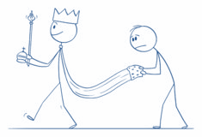
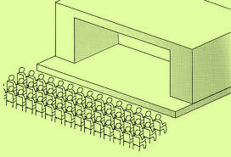
Drama
How to communicate STATUS on stage
Term 1 - Script Work Key words
Backstory | A character’s backstory is their past experiences, influencing their actions and opinions.
Subtext | The underlying message being communicated in a sentence. It’s not what you say, it’s how you say it.
Prologue | An introduction in which a narrator summarizes the main action of the work. Explaining what you are about to see happen without giving too many details away.
Empathy | The ability to understand and relate to another person's thoughts and feelings.
Status | Level of character importance on stage.
Term 2 - Masked Theatre Key words
Clocking the Audience | Looking at the audience to focus the audience's attention on that character and communicate what they may be thinking
The Rule of 3 | Setting up patterns in the audience's expectations
Slapstick | Exaggerated physical or violent comedy
Stage Combat | Fighting on stage
Exaggeration | More extreme or bigger
Internal Monologue | The expression of a character's thoughts so that the audience can witness what is going on inside that character's mind
Gait | The manner in which you walk
Stock Characters | Familiar / recurring characters that appear in a variety of different performances, similar to pantomime characters
Facal Expressions
Showing emotion on face
Levels
High or Low
Language
Chosen words to suit character / situation
Posture
How we hold our bodies
Eye-line
Where actors look
Gesture
Hand signals to communicate
Gait
Way of walking
Voice:
Use of accent to show where a character is from
Articulation- pronouncing all words correctly
Proxemics
Use of space to communicate relationships
Costume
Clothes a character wears
STAGING Types
End-On
In-the-round
Traverse
Thrust
Arena

Slide 27
Music

Slide 28
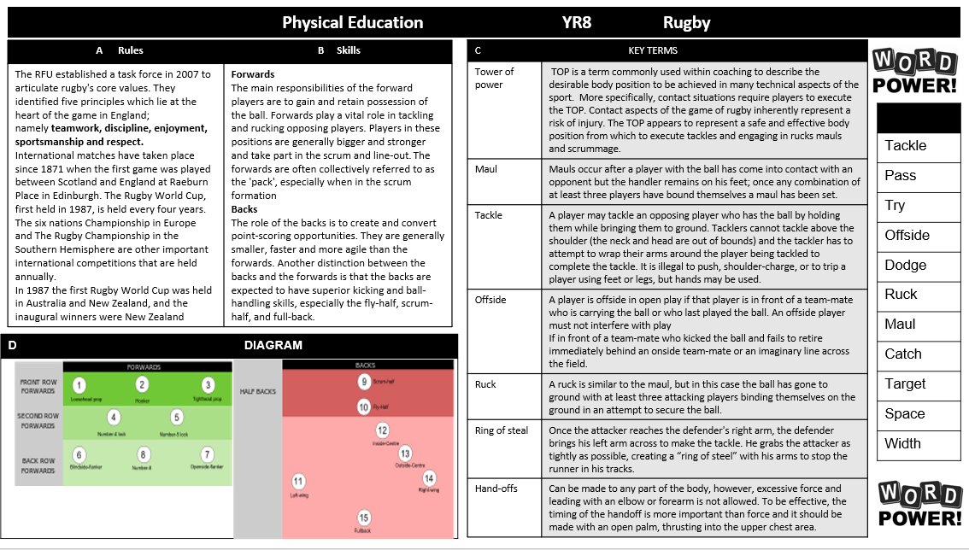
Physical Education

Slide 29
Physical Education

Slide 30
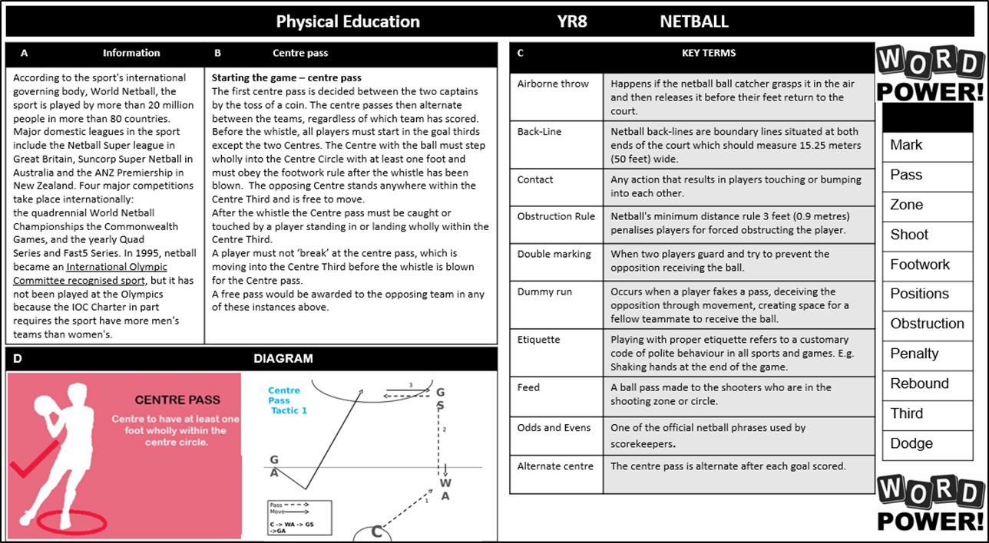
Physical Education

Slide 31
Physical Education

Slide 32
Physical Education

Slide 33
Physical Education

Slide 34
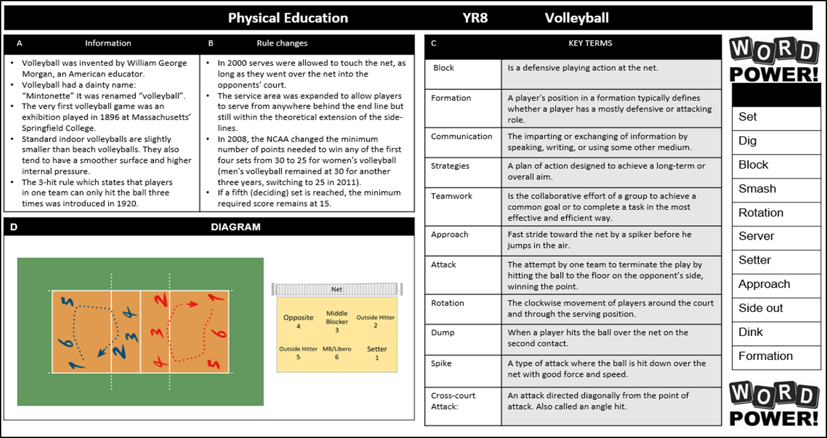
Physical Education

Slide 35
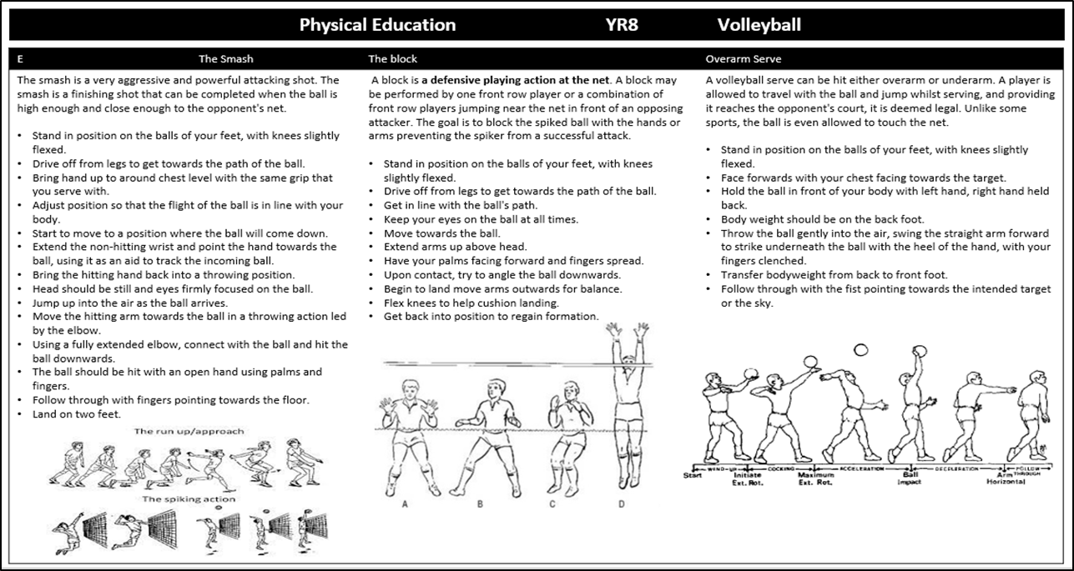
Physical Education

Slide 36
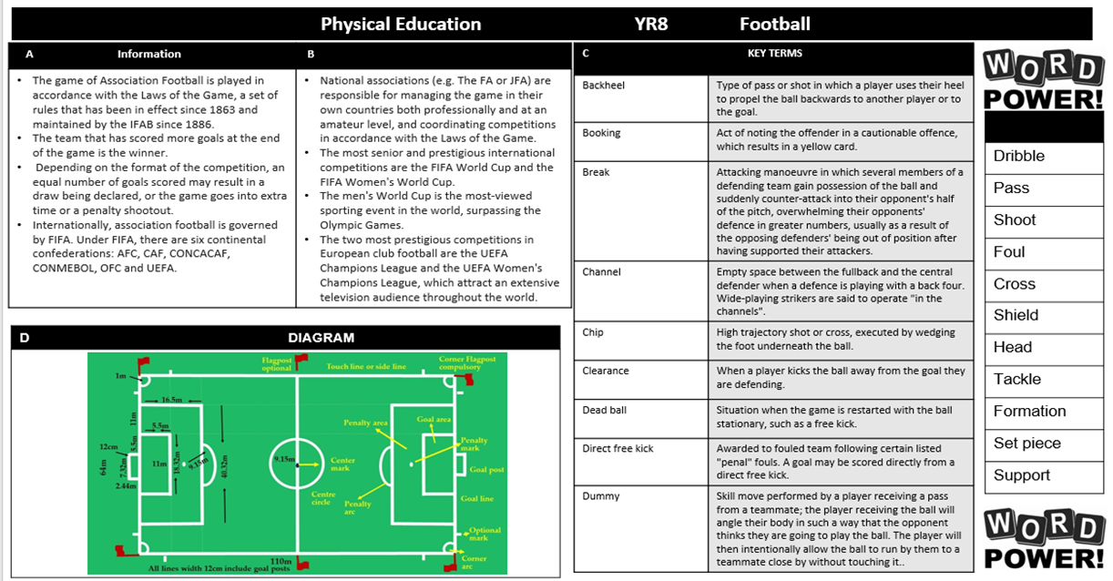
Physical Education

Slide 37
Physical Education

Slide 38
Engineering

Slide 39
Product Design

Slide 40
Food Technology

Slide 41
Textiles

Slide 42
Graphic Design

Slide 43
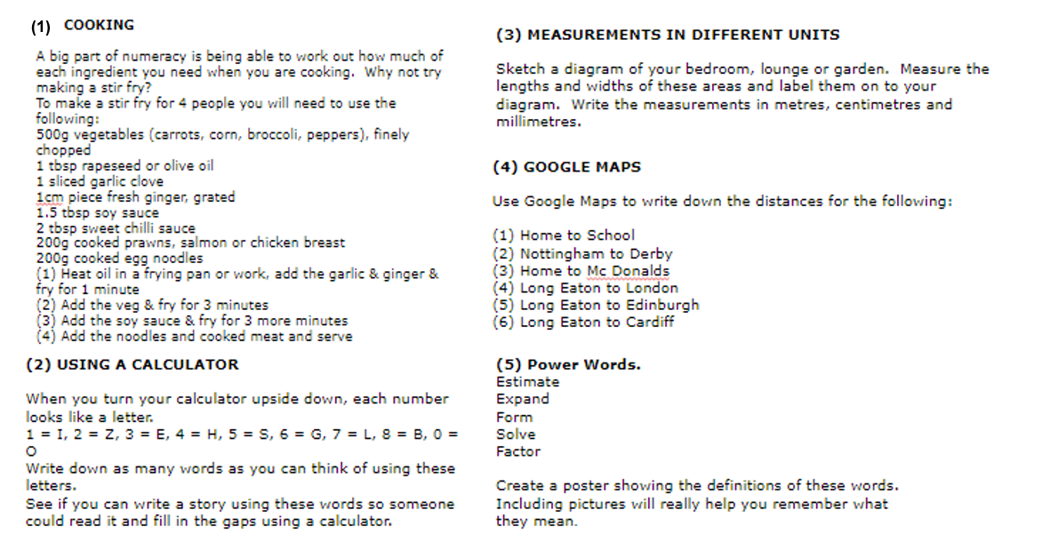
Numeracy

Slide 44
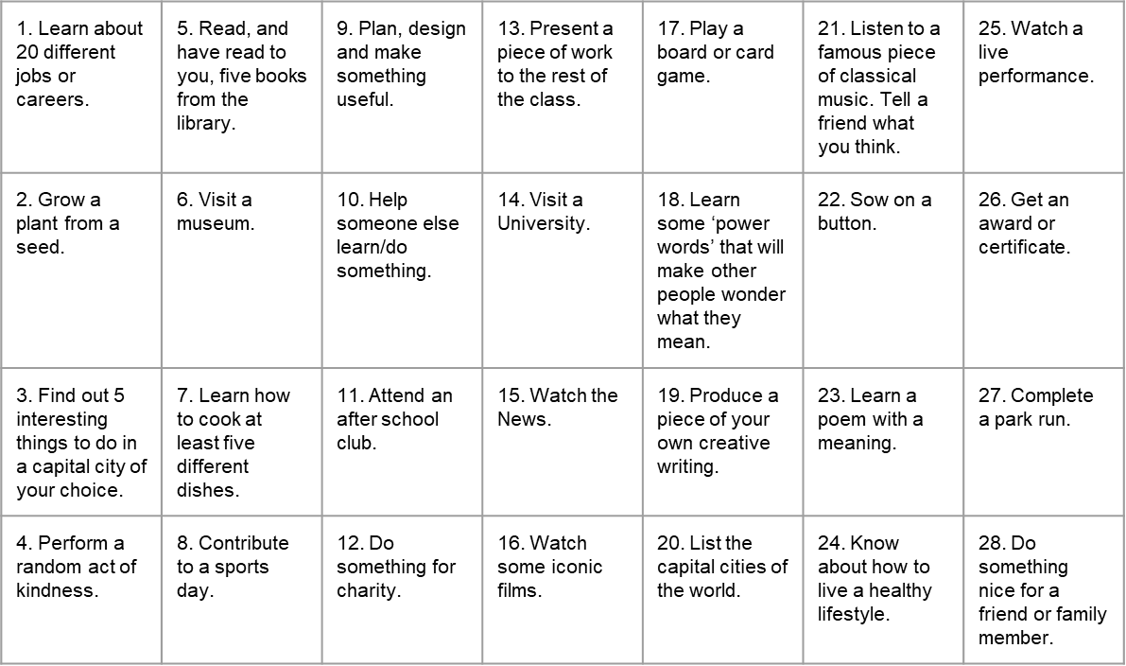
Things to do whilst at Wilsthorpe

Slide 45
Notes and Reminders

Slide 46
Notes and Reminders

Slide 47
Notes and Reminders

Slide 48
Notes and Reminders

