Slide 1
“Education is the most powerful weapon which you can use to change the world.”
Nelson Mandela (Anti-apartheid activist and former President of South Africa)
Preparation for Learning - Knowledge Organisers
Year 7 Summer Term

Slide 2
What is a knowledge organiser and why do we use them?
Here at Wilsthorpe School, all subject leaders produce knowledge organisers to support you whilst you are in Years 7, 8 and 9, but what is a knowledge organiser?
Knowledge organisers present the key knowledge and skills for a particular topic. We call this the most ‘powerful’ knowledge.
They contain the key vocabulary for the topic that you need to understand and use.
We know that if we do not regularly revisit this powerful knowledge, we forget some or most of what we have learned. Our lessons are designed so that we regularly revisit prior learning but knowledge organisers allow you to also revisit this knowledge at home.
Using this booklet at home will help you to understand and remember all of the knowledge you will be taught each term. This will allow you to connect and strengthen your learning, allowing you to thrive in your lessons and beyond.

Slide 3
How to use a knowledge organiser (1)
Using your knowledge organiser at school
You will be given a knowledge organiser at the start of each term (September, January and April). You need to bring your knowledge organiser and exercise book with you every day to school. This will be a key piece of equipment and will be regularly referred to in lesson.
In lessons, there will be fortnightly low-stakes retrieval quizzes based on the knowledge contained in the knowledge organiser. Your knowledge organiser and exercise book will be checked regularly during tutor time.
Using your knowledge organiser at home
You should spend 40 minutes per evening completing your knowledge organiser work. On Monday, Tuesday, Wednesday and Thursday evenings, you should be studying two sections of your knowledge organiser. On Friday you should study one section.
The timetable on the following pages tells you which subjects you should be studying on which days. Your subject teacher will explain which Design and Technology page to study and which Languages page to study.
You should use your exercise book to show the work you have done. Each evening you should start a new page and put the date clearly at the top.
Every night you should also read for 15 minutes as a minimum and fill in your ‘Reading Log’. Parents should sign your reading log by initialling the relevant column.

Slide 4
How to use a knowledge organiser (2)
There are many different methods you can use to revise the information in the knowledge organiser and to test yourself. Here are some ideas of things you can do:
Clocks - divide a page into 12 sections (like a clock) and add information about a topic in each section
Spelling tests - write a spelling test for yourself based on the key vocabulary
Fact sheets - produce a fact sheet that contains key words, diagrams and information about a topic
Posters - produce of poster that contains the key images in a topic
Flowcharts – produce a diagram that sequences the key steps in a process or key events in a time period
Quizzes - write a quiz based on what you have learnt about a topic and get others to test you
Mind maps - produce a mind map to logically organise key concepts
Flash cards - create a set of flash cards that contain key pieces of information and vocabulary for a topic
Read, cover, say, write and check – read 3 pieces of information, cover it over, say it aloud, write it down correctly then check it against your knowledge organiser. Repeat until to you say and write it perfectly

Slide 5
How to use a knowledge organiser (3)
There are many different methods you can use to revise the information in the knowledge organiser and to test yourself. Here are some ideas of things you can do:
Mnemonics - take the first letter of each key word to be remembered and write it in to a down in to a memorable word or sentence i.e to remember the planets you could use My Very Educated Mother Just Served Us Nuts (Mercury, Venus, Earth, Mars, Jupiter, Saturn, Uranus, Neptune.)
3D models - make a 3D model (with labels) relating to a topic
Comic strip/storyboard – produce a visual representation of a topic or concept in a storyboard or comic
Poem/song - create a poem or song about a topic you’ve studied, remember to include key terms
Creative writing – write a fictional story that contains the key terms from a topic
For more details on each of these methods and how to use them, visit the following page on the school website:
https://www.wilsthorpe.ttct.co.uk/wp-content/uploads/sites/6/2021/10/Using-the-Knowledge-Organiser.pdf
You will also be taught how to use each of these methods during our revision sessions in tutor time.

Slide 6
Knowledge organiser timetable
Week A
Week B
Day | Subject 1 | Subject 2 | Reading
Monday | English | Design Technology | 15 minutes minimum
Tuesday | Maths | Physical Education | 15 minutes minimum
Wednesday | Science | Geography | 15 minutes minimum
Thursday | Grammar | Music | 15 minutes minimum
Friday | Drama |  | 15 minutes minimum
Day | Subject 1 | Subject 2 | Reading
Monday | English | History | 15 minutes minimum
Tuesday | Maths | MFL | 15 minutes minimum
Wednesday | Science | Computing | 15 minutes minimum
Thursday | Grammar | Art | 15 minutes minimum
Friday | Maths |  | 15 minutes minimum

Slide 7
Reading log
Fifteen is fantastic! Remember to read for at least 15 minutes everyday.
Week Beginning | M | T | W | T | F | S | S | Book(s) Read | Pages Read | Parent Initials | Librarian Initials
 | Record the number of minutes you read for each day
15th April
22nd April
29th April
6th May
13th May
20th May
Half term
3rd June
10th June
17th June
24th June
1st July
8th July
15th July

Slide 8
Year 7 reading list
Fifteen is fantastic! Remember to read for at least 15 minutes everyday.
Alternative ‘Super Readable Reads’ are available in the library
Subject Wider Reading Lists for every subject are available on the school website subject pages at: https://www.wilsthorpe.ttct.co.uk/curriculum/subjects/

Slide 9
Maths

Slide 10
Maths

Slide 11
English

Slide 12
Grammar
Vocabulary Test - when you are tested on these words, you will be asked to write the word - spelt correctly - within a sentence that makes sense.
Your Grammar teacher will tell you which list to learn and when.

Slide 13
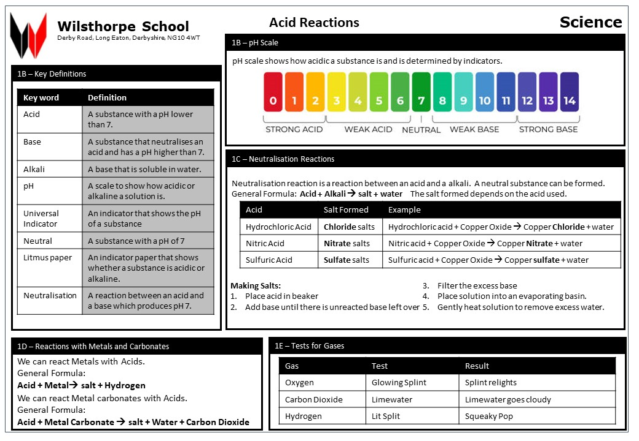
Science

Slide 14
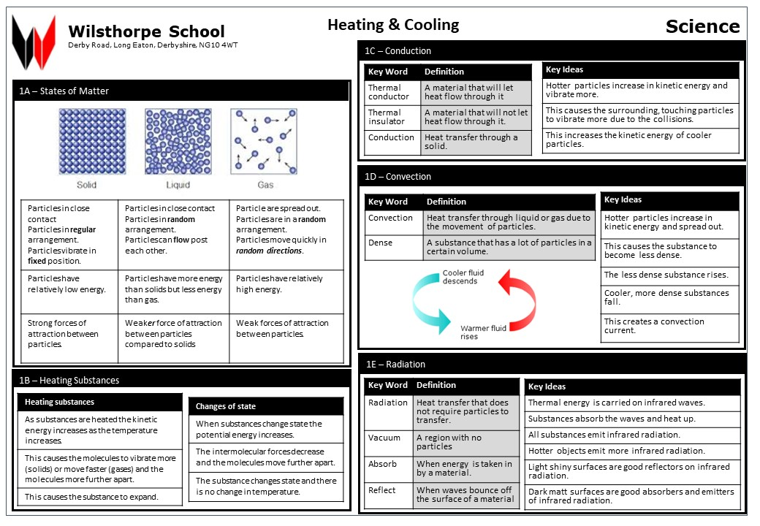
Science

Slide 15
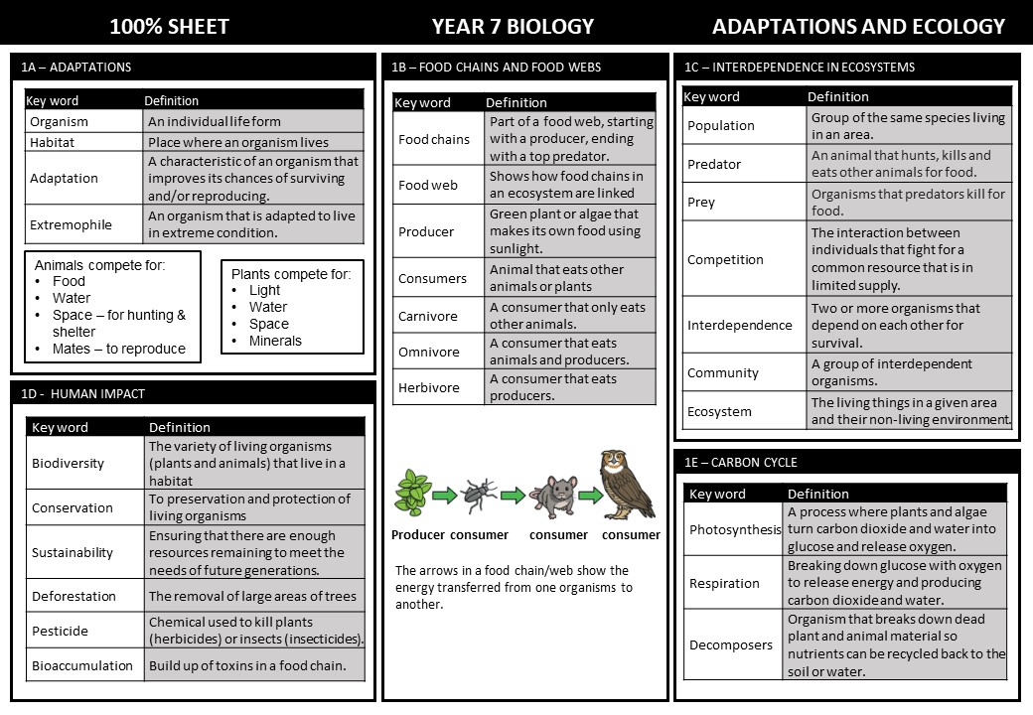
Science

Slide 16
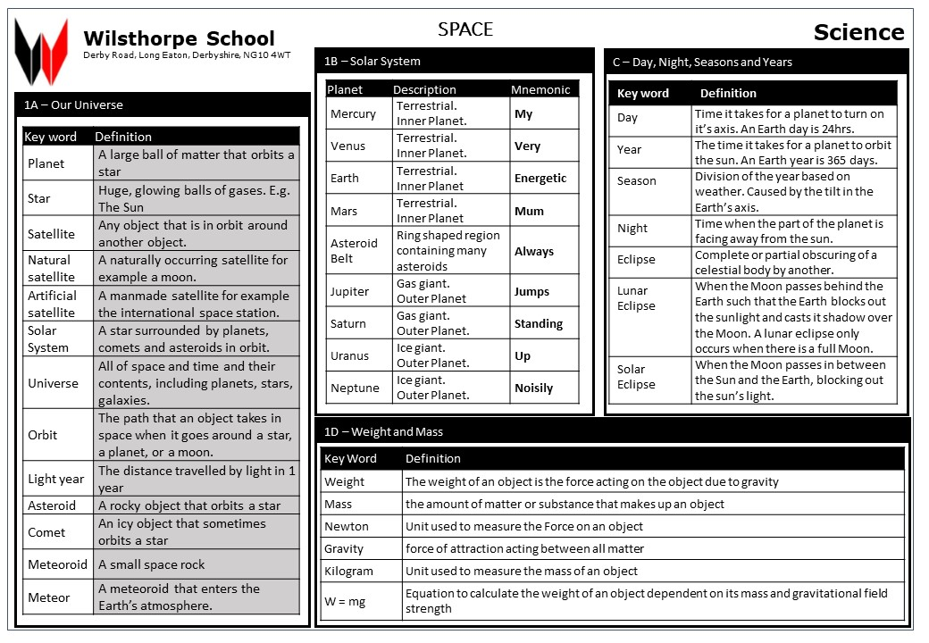
Science

Slide 17
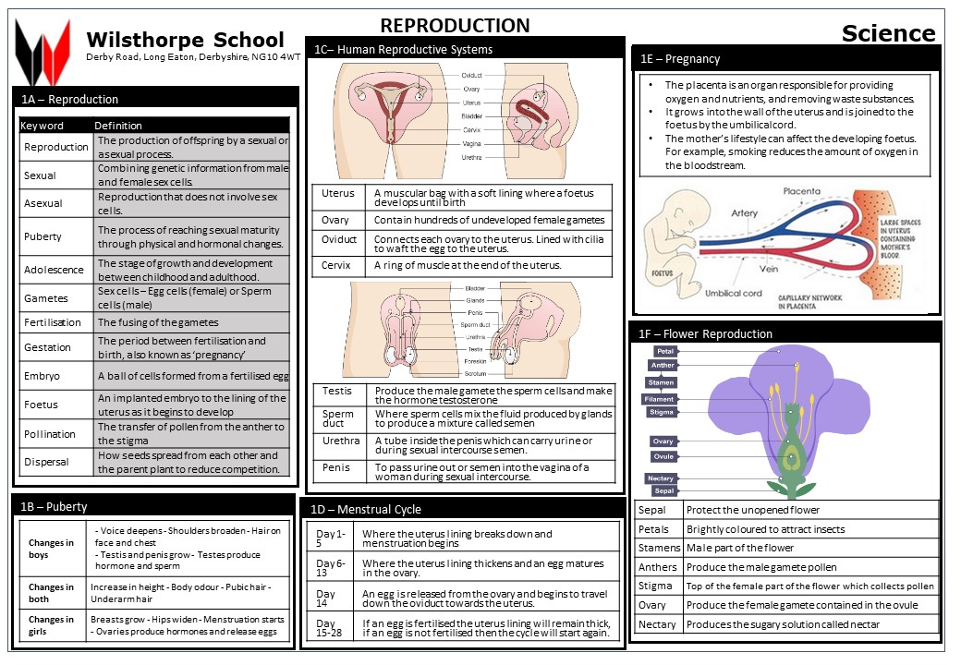
Science

Slide 18
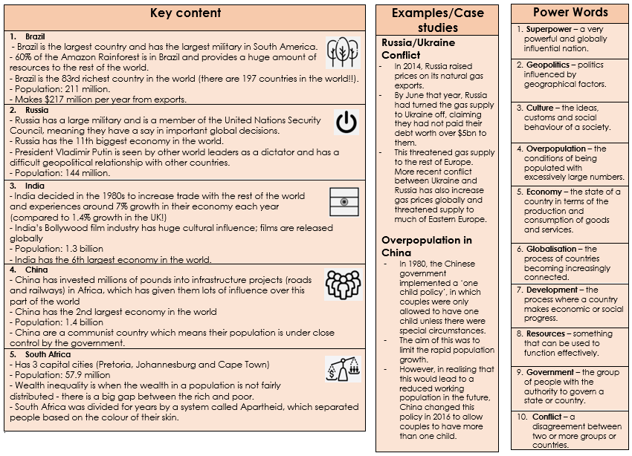
Geography

Slide 19
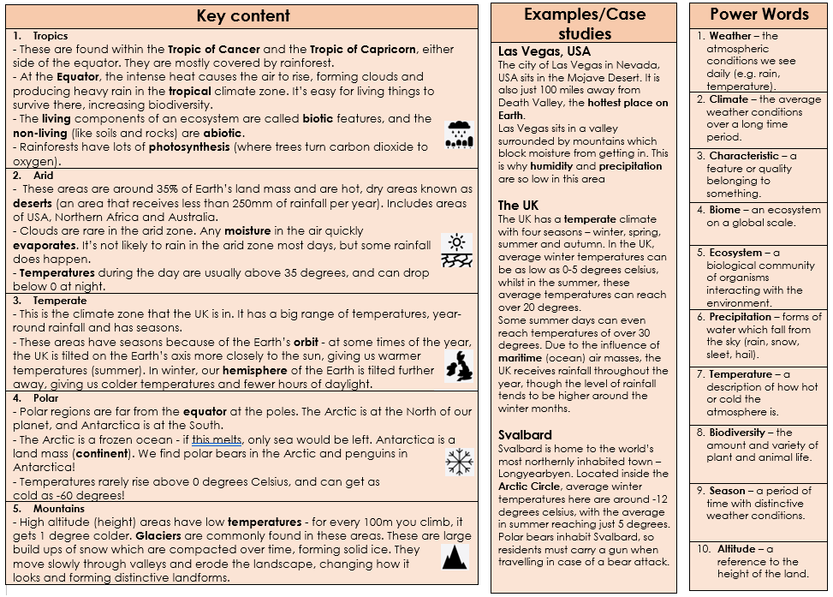
Geography

Slide 20
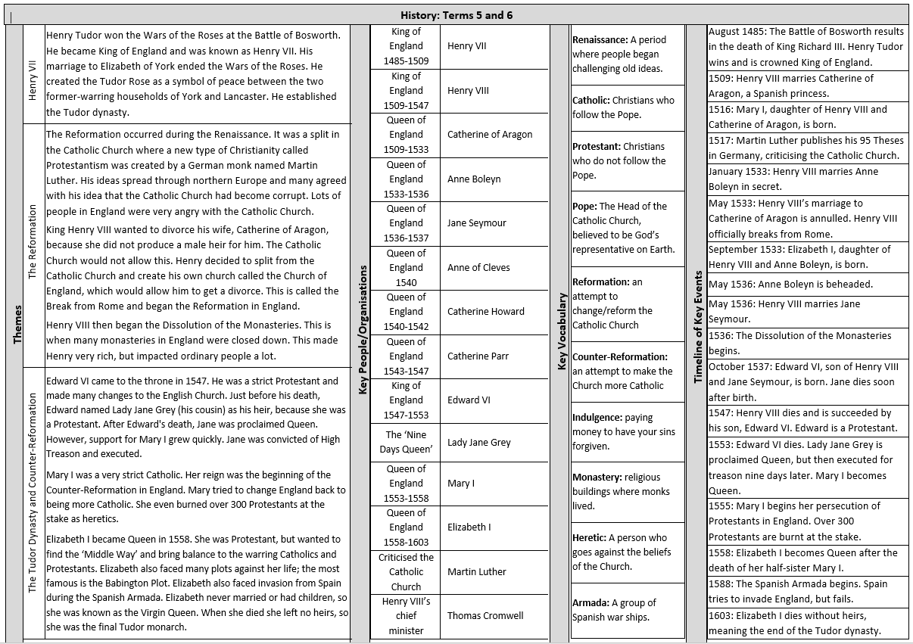
HISTORY
HISTORY

Slide 21
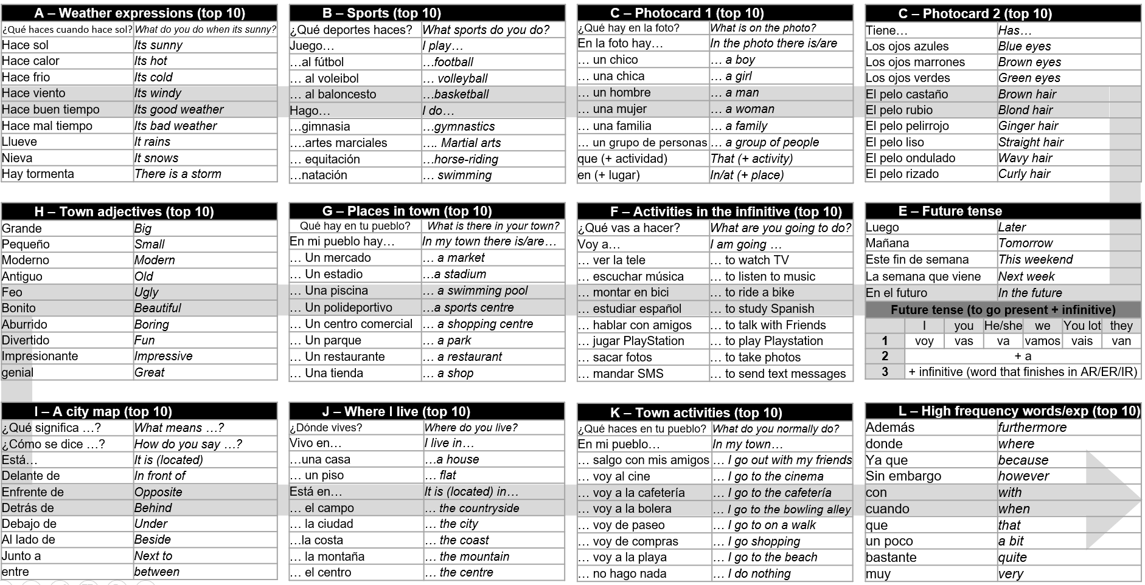
Spanish

Slide 22
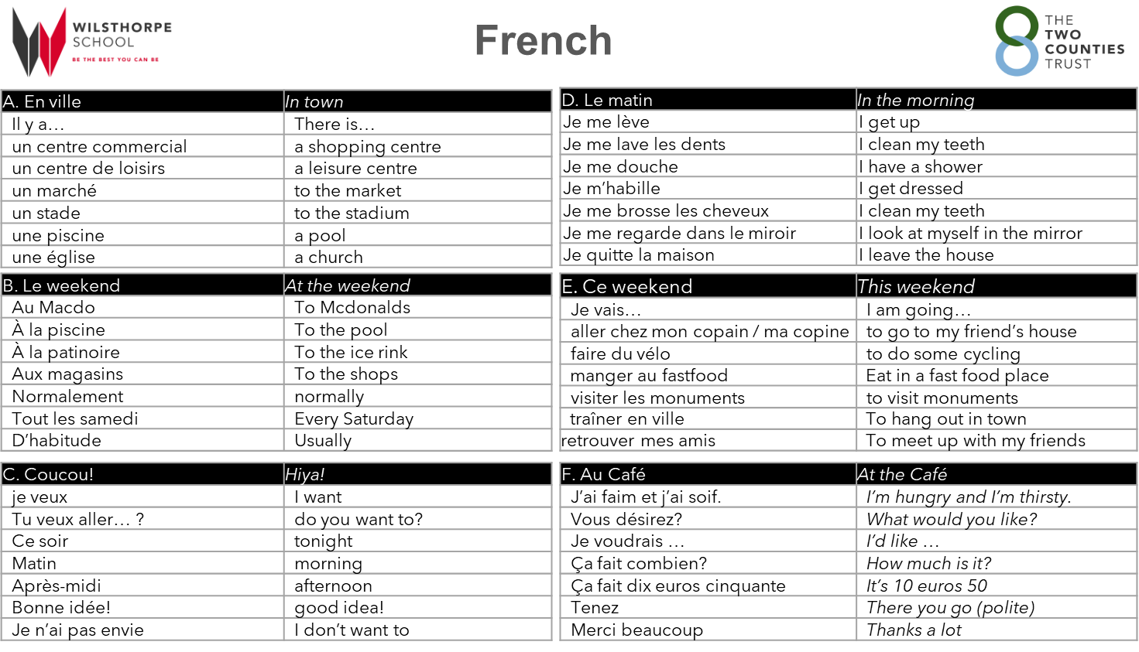

Slide 23
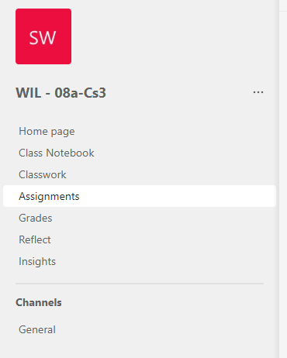
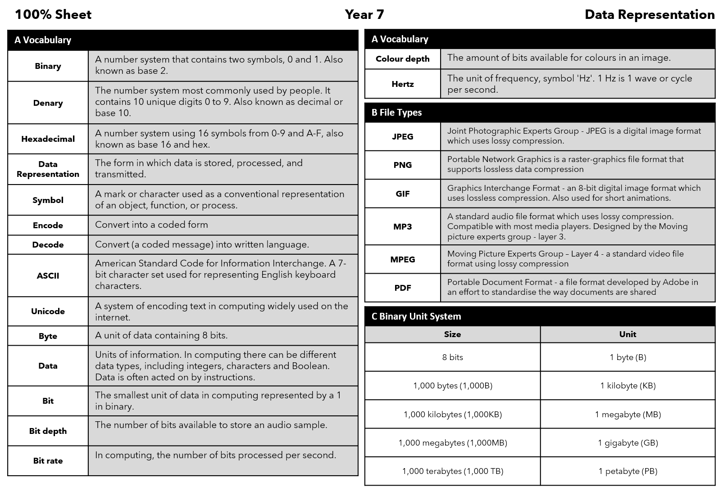
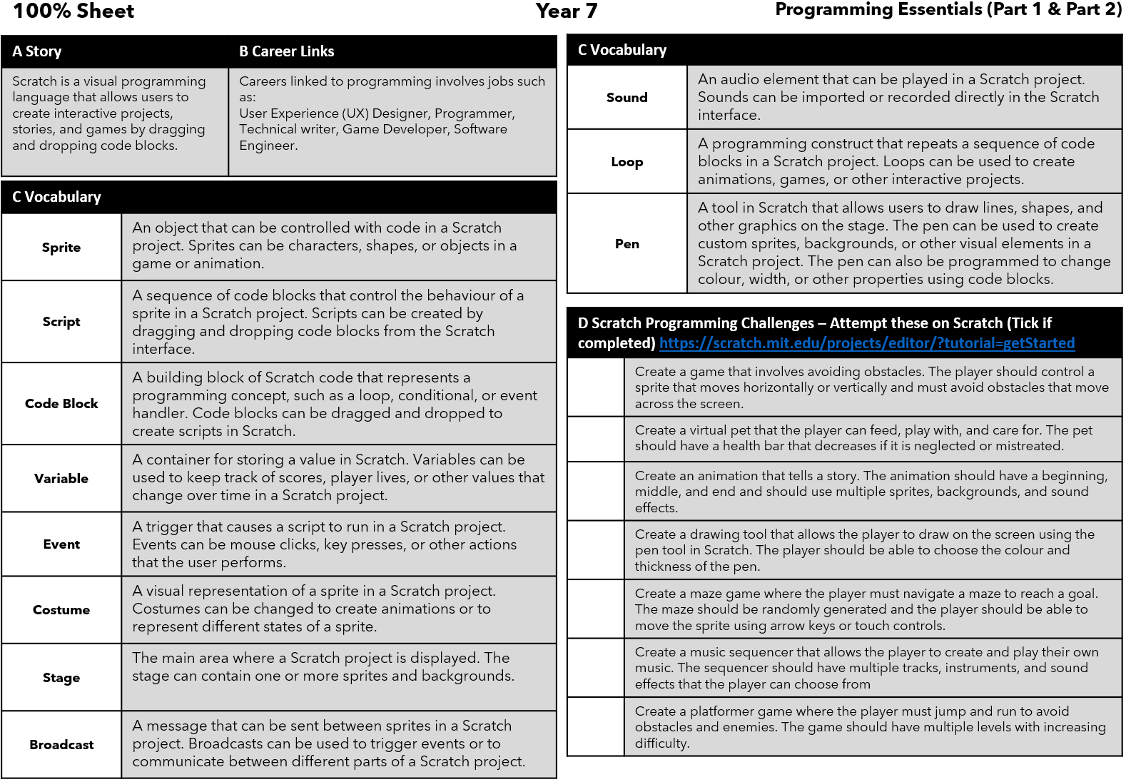
Accessing Teams
Computing
All Computer Science Lessons, Resources and Homework can be found on our Teams Platform. (This does not affect other subjects). To access the web platform for Teams - type into google the following link: https://www.microsoft.com/en-gb/microsoft-teams/log-in
You may not always get homework through teams. Revise the information below if you don't receive any from your teacher on the platform.
Then click on the top right and login using your school email and password.
You can also download the platform but this is optional.
On the Teams platform find your classroom and open it.
In your classroom go to assignments and scroll through until you find your homework posted by your teacher.
Term 5
Term 6

Slide 24
Art

Slide 25
Drama
Key Word | Definition
Inanimate | Not alive
Animate | Bring to life
Stimulus | Starting point
Intention | Goal / aim
Characterisation | The creation of a character
Vocal Techniques
Key Word | Definition
Tone | Emotion / mood
Volume | How loud or quiet your voice is
Pitch | Speaking in a high, low or natural voice
Pace | The speed at which lines are delivered
Pause | Where the characters are not speaking
Accent | Manner of speaking or pronunciation
Emphasis / Stress | Drawing attention to a particular word
Unison | When two or more people speak at the same time
Canon | Speaking one after the other
Echo / Repetition | Using a word or phrase for effect, two or more times
Stutter | Repetition of the same letter to communicate emotion
Movement Techniques
Key Word | Definition
Posture | The position of a person's body when standing or sitting
Eye Line | Where actors look while acting in a scene
Pace | The speed at which movement is performed
Balance | An even distribution of weight
Coordination | Use different parts of the body together smoothly and efficiently
Gesture | A sign that communicates a character’s action
Stance | The way in which someone stands
Gait | A person's manner of walking
Weight Placement | Placing weight in a different location to create different gaits
The Basics of Puppetry
The three principles of puppetry: BREATH – making the puppet breathe FOCUS – where the puppet is looking WEIGHT – considering gravity and avoiding floating
Hot seating can be used to understand a character more.
A variety of vocal techniques should be used to create a clear character for your puppet.
A puppets’ mouth needs to open on each syllable (beat) of a word to make the puppet look believable for an audience.
The puppeteer should make sure all parts of the puppet are being controlled at all times to make it look alive

Slide 26
Music

Slide 27
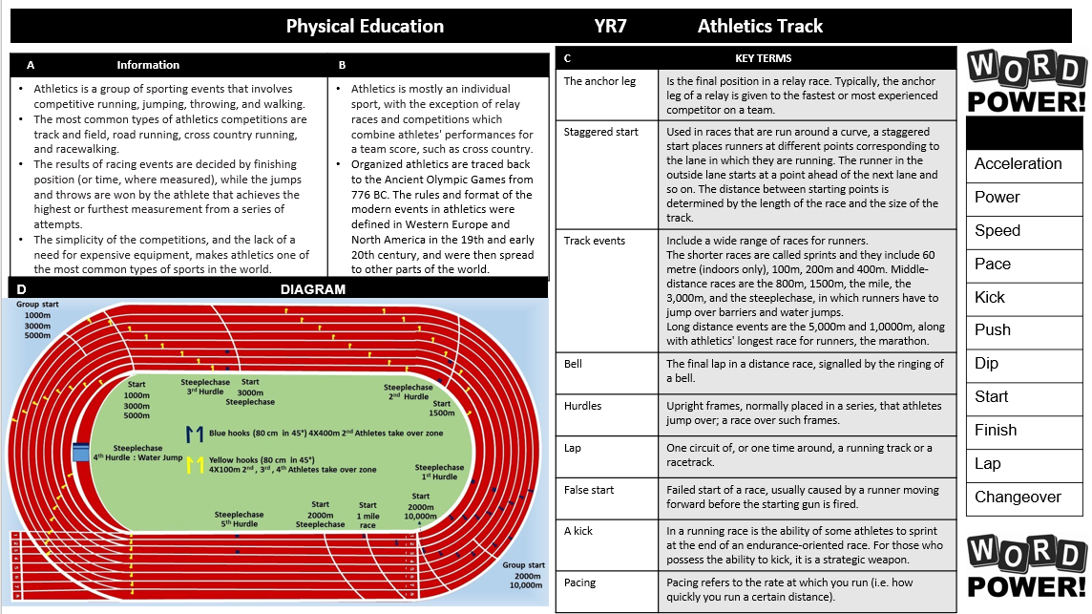
Physical Education

Slide 28
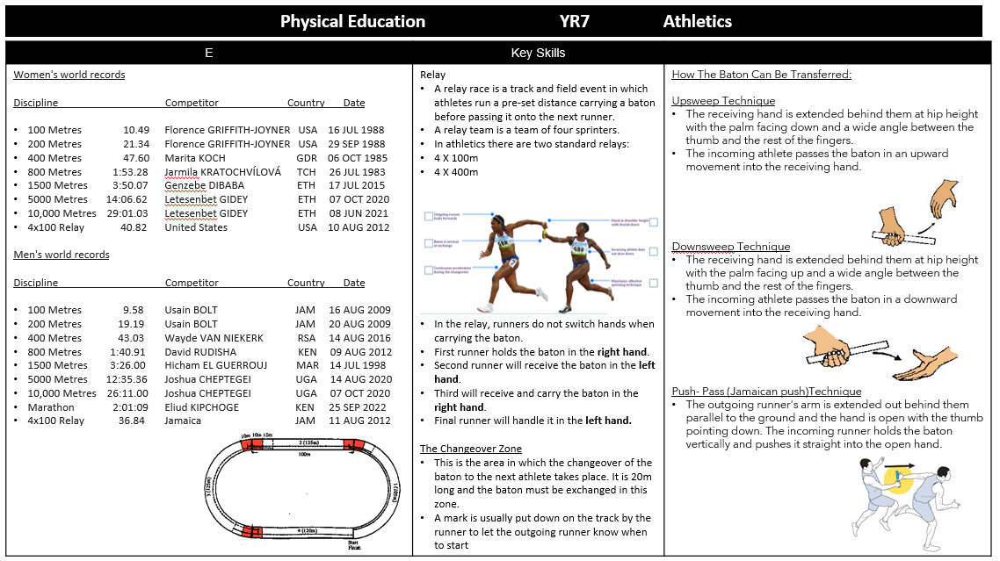
Physical Education

Slide 29
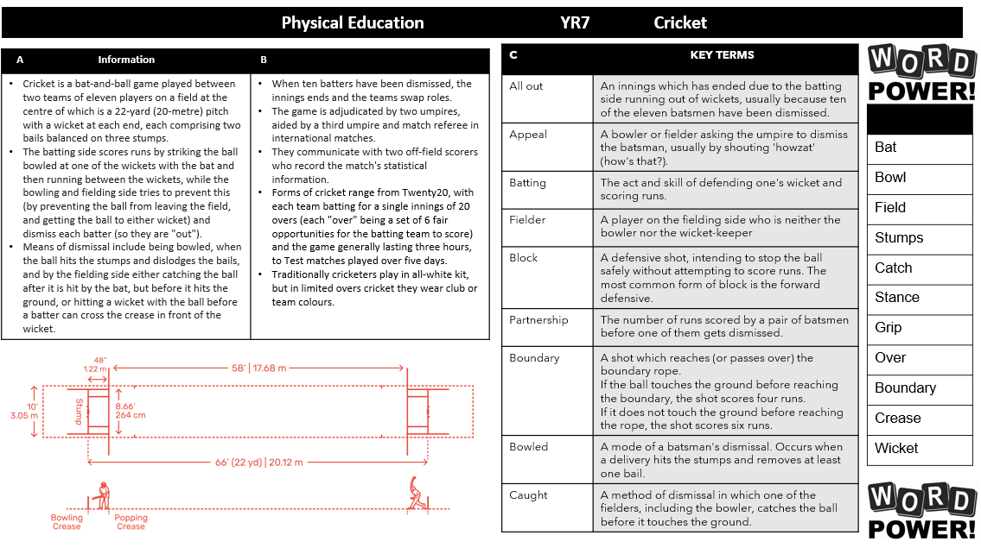
Physical Education

Slide 30
Physical Education

Slide 31
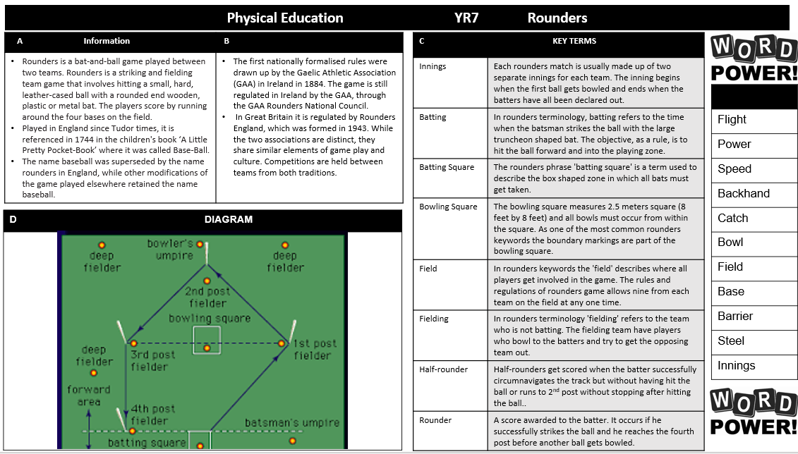
Physical Education

Slide 32
Physical Education

Slide 33
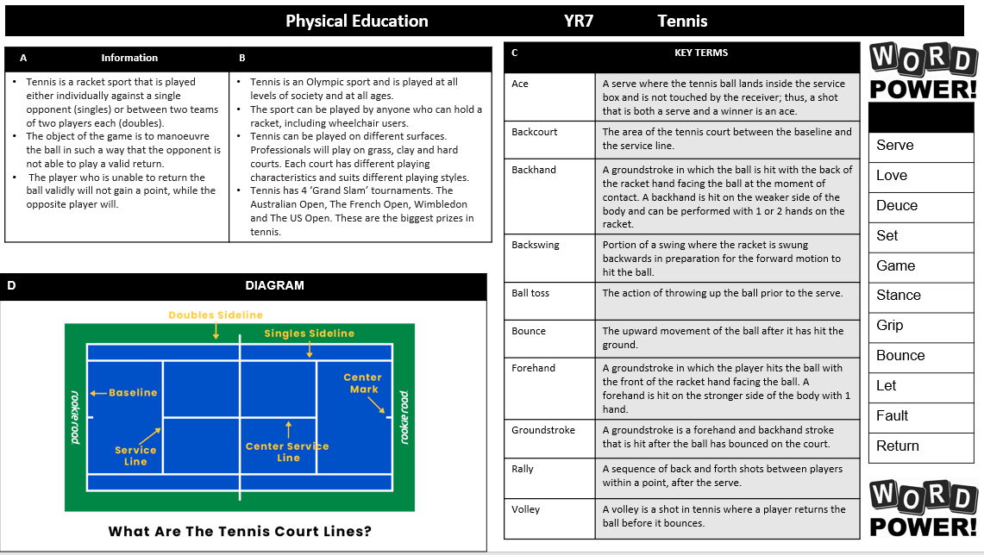
Physical Education

Slide 34
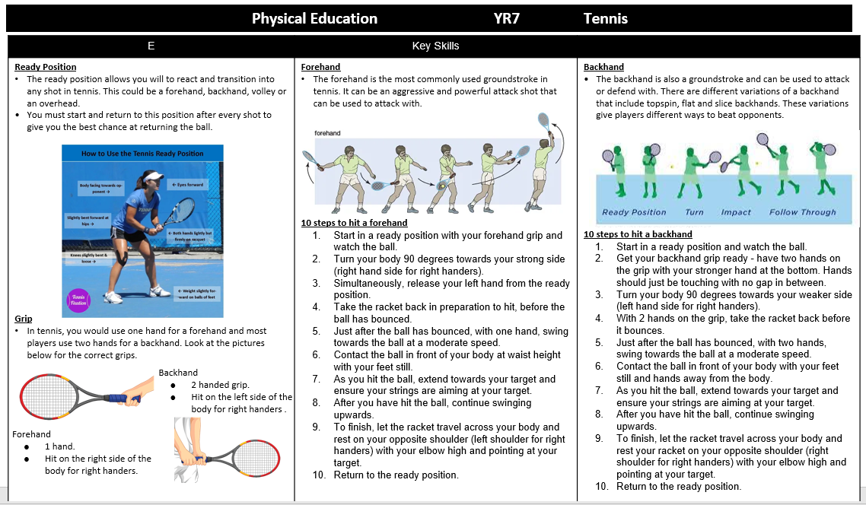
Physical Education

Slide 35
Engineering

Slide 36
Product Design

Slide 37
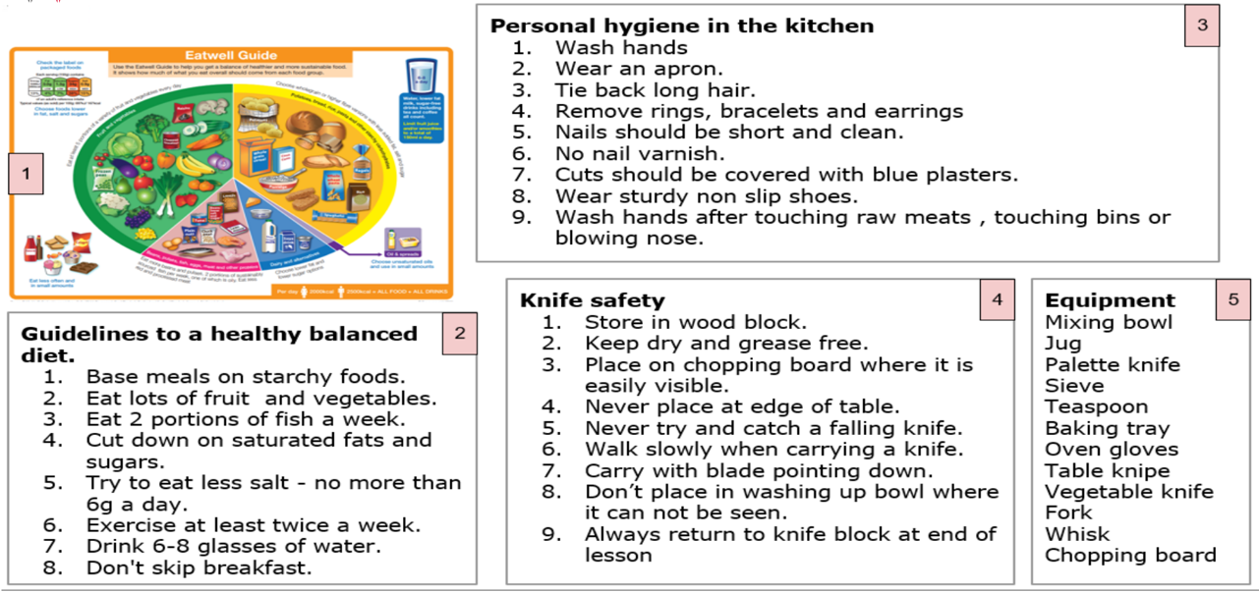
Food Technology

Slide 38
Textiles

Slide 39
Graphic Design

Slide 40
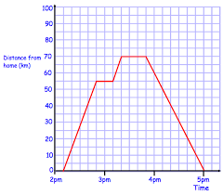
Numeracy
CURRENCY
Using www.xe.com look up the different amounts of currency you could get for £100.
Try for US Dollars, Euros, Australian Dollars and any others you want to.
Do this once a week for a month and see if there are any changes.
Make a poster to explain what you have found out.
REAL LIFE GRAPHS
This graph shows a journey that a person made one day.
They travelled 55km and then stopped for a short time.
They travelled another 15km and then stopped again.
They then returned back to their starting point without any breaks.
Draw a distance time graph to show your normal journeys on a school day. Try and do the same for someone else’s day.
Coordinate
Axis
Conversion
Proportion
Sequence
Create a poster showing the definitions of these words.
Including pictures will really help you remember what they mean.
TELLING THE TIME We live in a digital world and so are used to seeing a digital watch. It is really important that we are able to tell the time using a real clock face. Research and make a poster showing the difference between the 12 hour and 24 hour clock Draw 4 pictures of a digital clock and an analogue clock(shown here) and show the following times on them both:
7:30am 3:15pm 9:40pm 12:30am

Slide 41
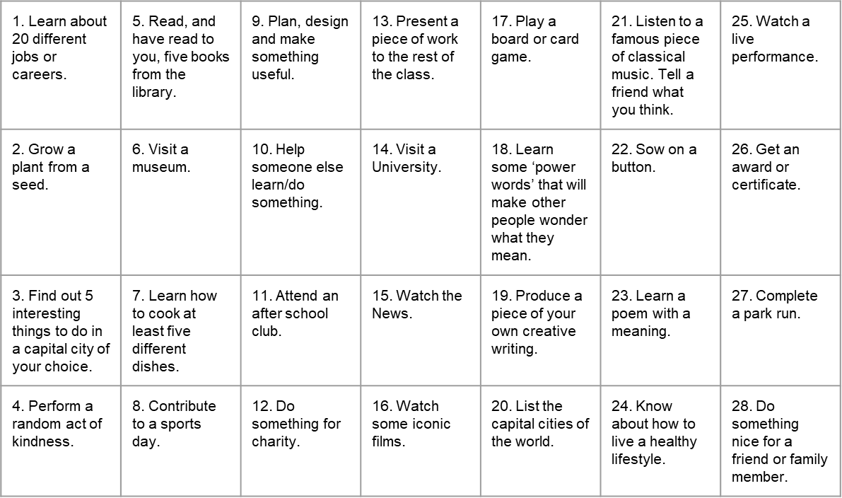
Things to do whilst at Wilsthorpe

Slide 42
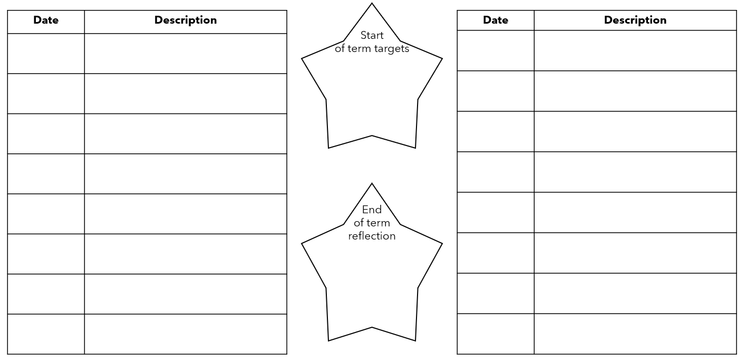
Out of lesson opportunities

Slide 43
Notes and Reminders

Slide 44
Notes and Reminders

Slide 45
Notes and Reminders

Slide 46
Notes and Reminders

