Slide 1
“An investment in knowledge always pays the best interest.”
Benjamin Franklin
Preparation for Learning - Knowledge Organisers
Year 7 Autumn Term

Slide 2
What is a knowledge organiser and why do we use them?
Here at Wilsthorpe School, all subject leaders produce knowledge organisers to support you whilst you are in Years 7, 8 and 9, but what is a knowledge organiser?
Knowledge organisers present the key knowledge and skills for a particular topic. We call this the most ‘powerful’ knowledge.
They contain the key vocabulary for the topic that you need to understand and use.
We know that if we do not regularly revisit this powerful knowledge, we forget some or most of what we have learned. Our lessons are designed so that we regularly revisit prior learning but knowledge organisers allow you to also revisit this knowledge at home.
Using this booklet at home will help you to understand and remember all of the knowledge you will be taught each term. This will allow you to connect and strengthen your learning, allowing you to thrive in your lessons and beyond.

Slide 3
How to use a knowledge organiser (1)
Using your knowledge organiser at school
You will be given a knowledge organiser at the start of each term (September, January and April). You need to bring your knowledge organiser and exercise book with you every day to school. This will be a key piece of equipment and will be regularly referred to in lesson.
In lessons, there will be fortnightly low-stakes retrieval quizzes based on the knowledge contained in the knowledge organiser. Your knowledge organiser and exercise book will be checked regularly during tutor time.
Using your knowledge organiser at home
You should spend 40 minutes per evening completing your knowledge organiser work. On Monday, Tuesday, Wednesday and Thursday evenings, you should be studying two sections of your knowledge organiser. On Friday you should study one section.
The timetable on the following pages tells you which subjects you should be studying on which days. Your subject teacher will explain which Design and Technology page to study and which Languages page to study.
You should use your exercise book to show the work you have done. Each evening you should start a new page and put the date clearly at the top.
Every night you should also read for 15 minutes as a minimum and fill in your ‘Reading Log’. Parents should sign your reading log by initialling the relevant column.

Slide 4
How to use a knowledge organiser (2)
There are many different methods you can use to revise the information in the knowledge organiser and to test yourself. Here are some ideas of things you can do:
Clocks - divide a page into 12 sections (like a clock) and add information about a topic in each section
Spelling tests - write a spelling test for yourself based on the key vocabulary
Fact sheets - produce a fact sheet that contains key words, diagrams and information about a topic
Posters - produce of poster that contains the key images in a topic
Flowcharts – produce a diagram that sequences the key steps in a process or key events in a time period
Quizzes - write a quiz based on what you have learnt about a topic and get others to test you
Mind maps - produce a mind map to logically organise key concepts
Flash cards - create a set of flash cards that contain key pieces of information and vocabulary for a topic
Read, cover, say, write and check – read 3 pieces of information, cover it over, say it aloud, write it down correctly then check it against your knowledge organiser. Repeat until to you say and write it perfectly

Slide 5
How to use a knowledge organiser (3)
There are many different methods you can use to revise the information in the knowledge organiser and to test yourself. Here are some ideas of things you can do:
Mnemonics - take the first letter of each key word to be remembered and write it in to a down in to a memorable word or sentence i.e to remember the planets you could use My Very Educated Mother Just Served Us Nuts (Mercury, Venus, Earth, Mars, Jupiter, Saturn, Uranus, Neptune.)
3D models - make a 3D model (with labels) relating to a topic
Comic strip/storyboard – produce a visual representation of a topic or concept in a storyboard or comic
Poem/song - create a poem or song about a topic you’ve studied, remember to include key terms
Creative writing – write a fictional story that contains the key terms from a topic
For more details on each of these methods and how to use them, visit the following page on the school website:
https://www.wilsthorpe.ttct.co.uk/wp-content/uploads/sites/6/2021/10/Using-the-Knowledge-Organiser.pdf
You will also be taught how to use each of these methods during our revision sessions in tutor time.

Slide 6
Knowledge organiser timetable
Week A
Week B
Day | Subject 1 | Subject 2 | Reading
Monday | English | Design Technology | 15 minutes minimum
Tuesday | Maths | Physical Education | 15 minutes minimum
Wednesday | Science | Geography | 15 minutes minimum
Thursday | Grammar | Music | 15 minutes minimum
Friday | Drama |  | 15 minutes minimum
Day | Subject 1 | Subject 2 | Reading
Monday | English | History | 15 minutes minimum
Tuesday | Maths | MFL | 15 minutes minimum
Wednesday | Science | Computing | 15 minutes minimum
Thursday | Grammar | Art | 15 minutes minimum
Friday | Maths |  | 15 minutes minimum

Slide 7
Reading log
Week Beginning | M | T | W | T | F | S | S | Book(s) Read | Pages Read | Parent Initials | Librarian Initials
 | Record the number of minutes you read for each day

Slide 8
Year 7 reading list
Subject Wider Reading Lists for every subject are available on the school website subject pages at: https://www.wilsthorpe.ttct.co.uk/curriculum/subjects/

Slide 9
Maths

Slide 10
Maths

Slide 11
English

Slide 12
Grammar

Slide 13
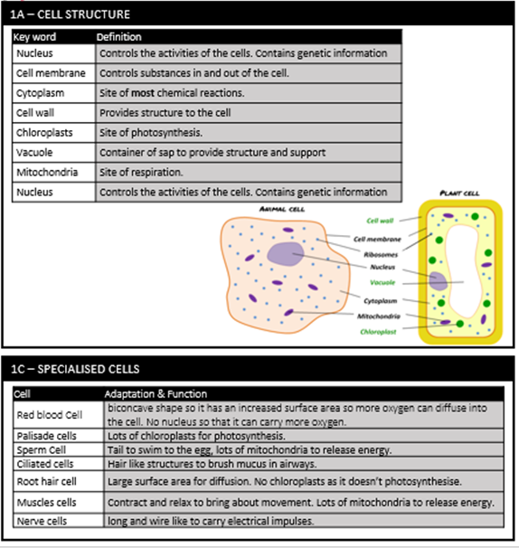
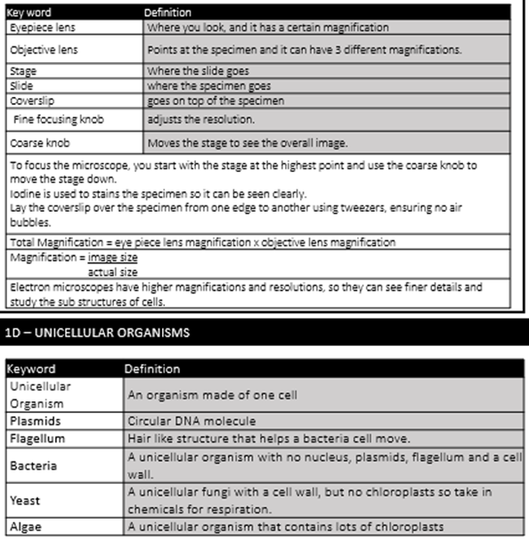
Science

Slide 14
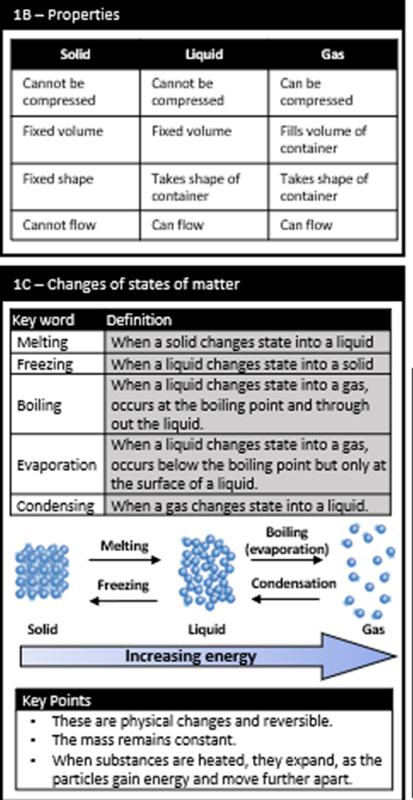
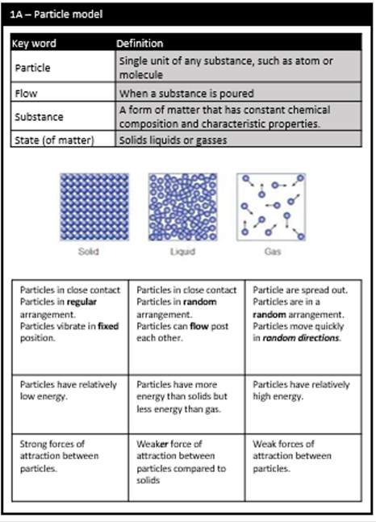
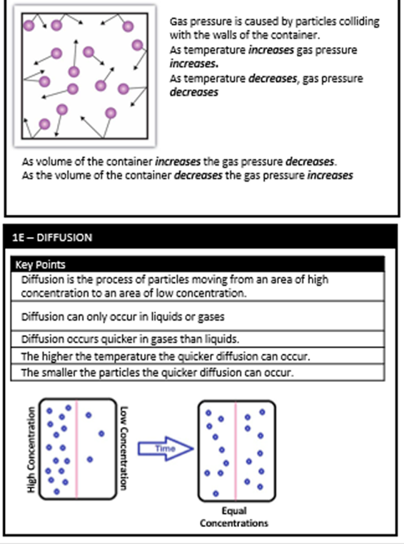
Science

Slide 15
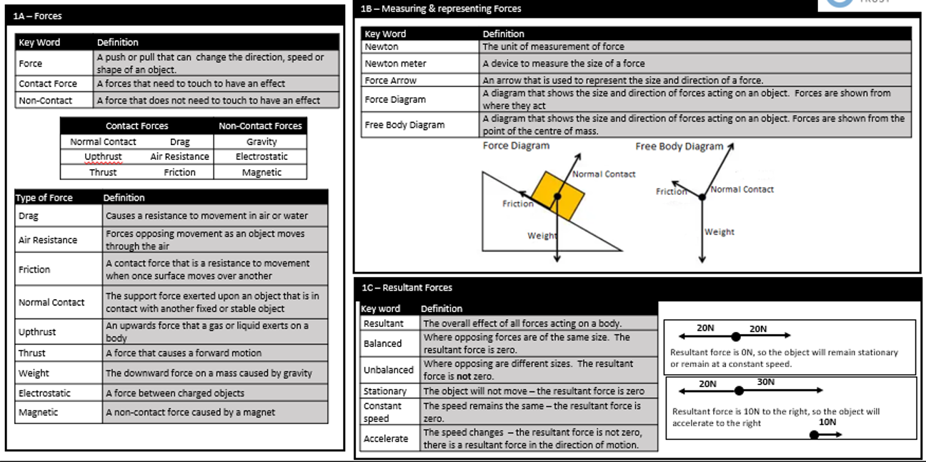
Science

Slide 16
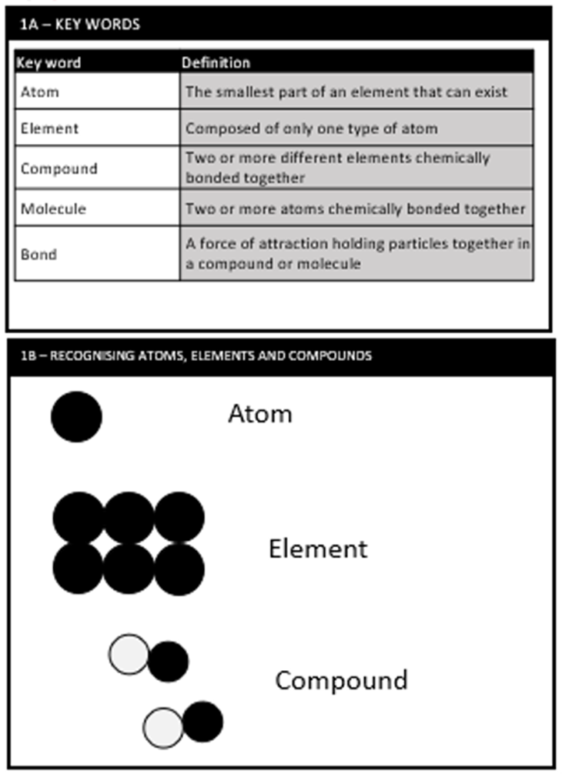
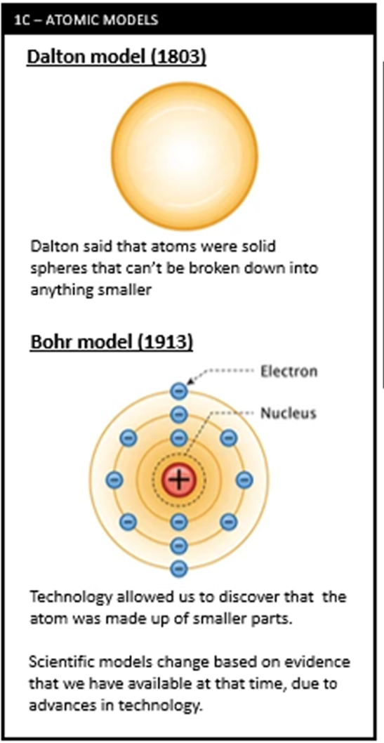
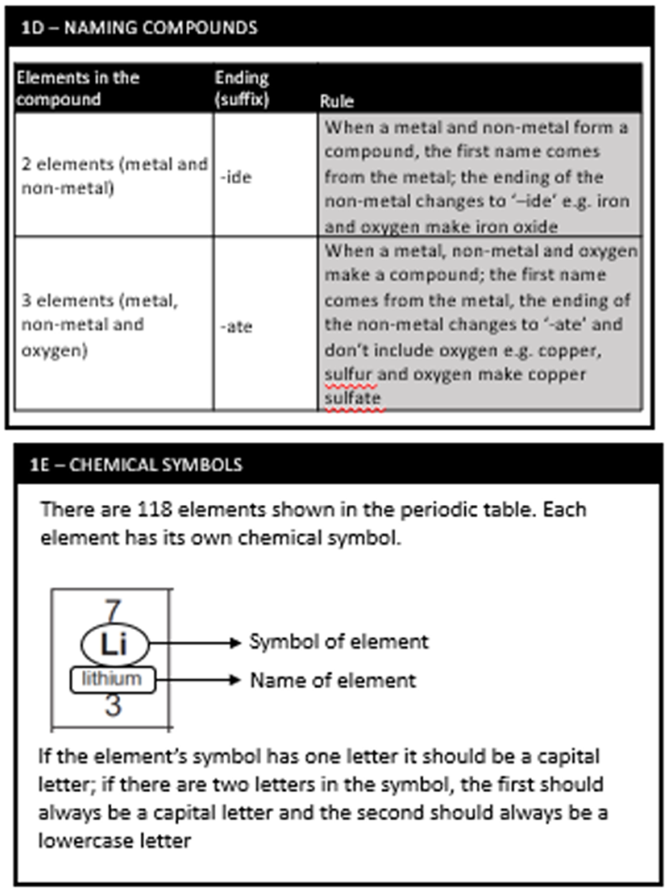
Science

Slide 17
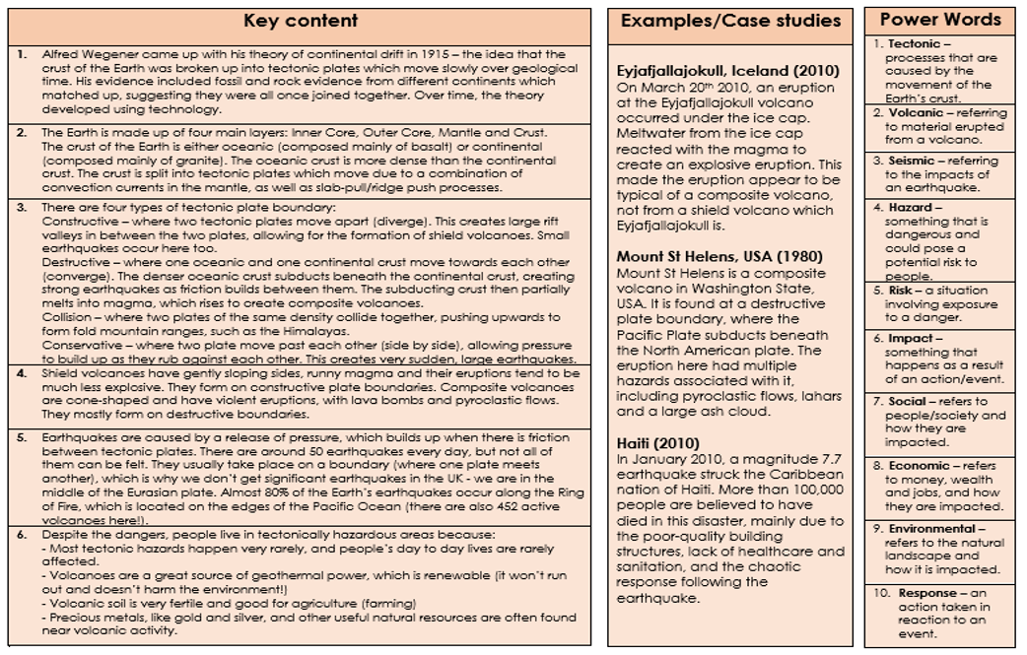
Geography

Slide 18
Geography

Slide 19
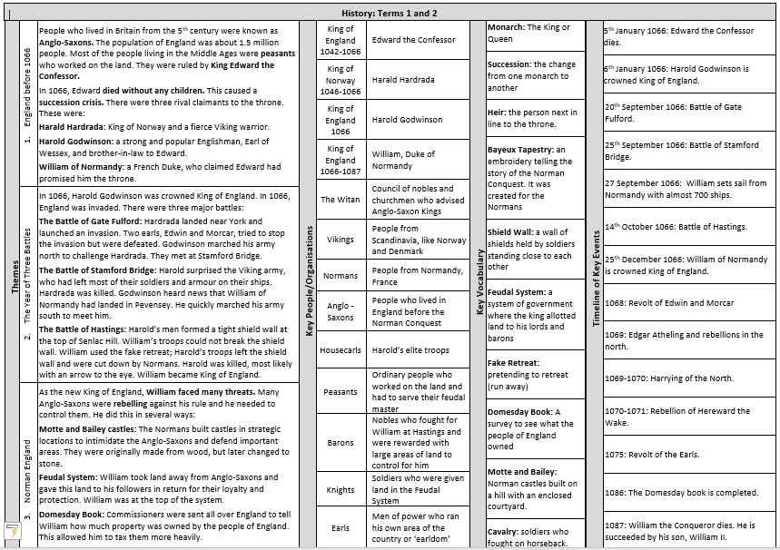
History

Slide 20
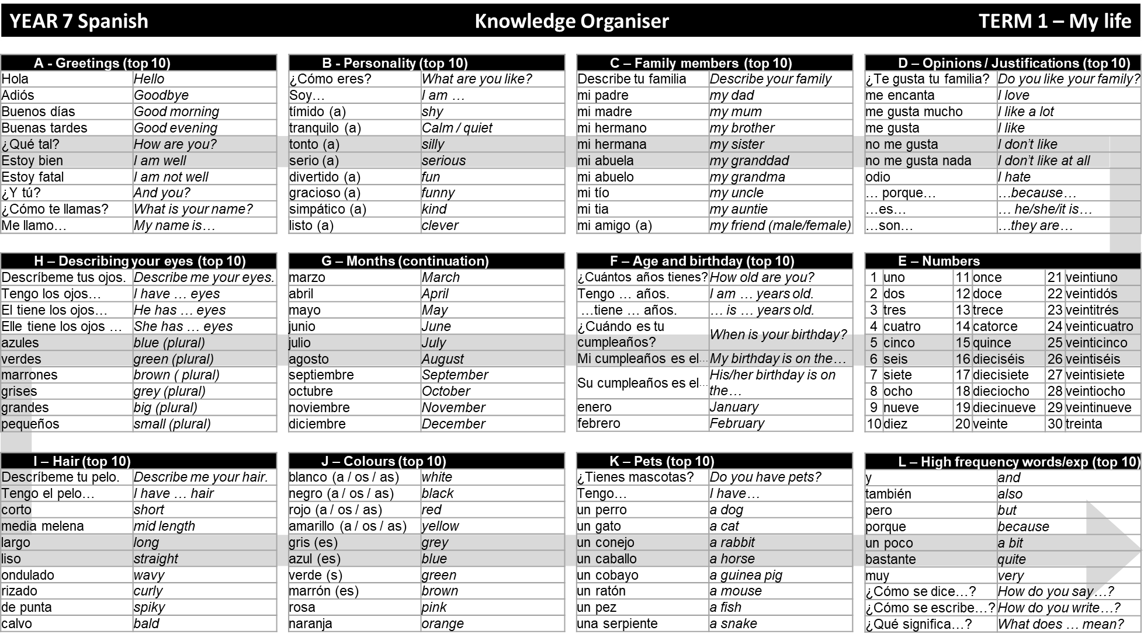
Spanish

Slide 21
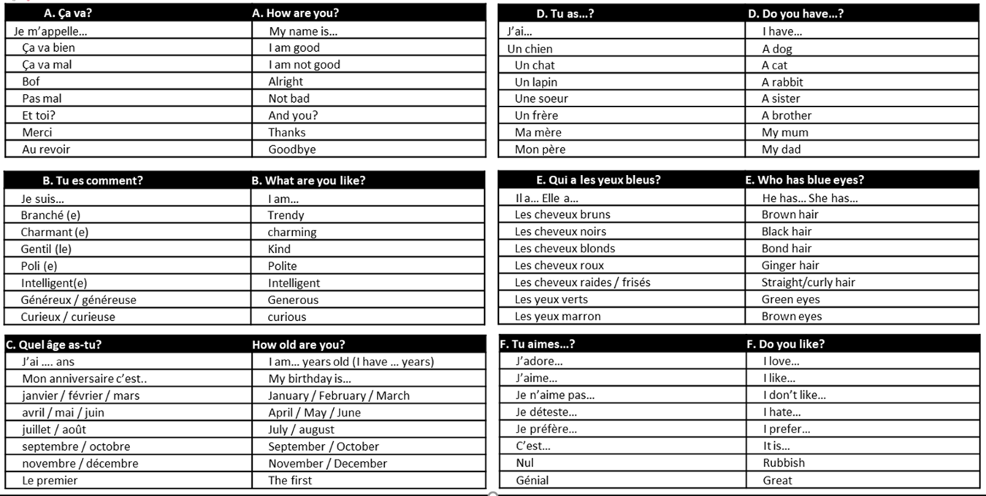
French

Slide 22
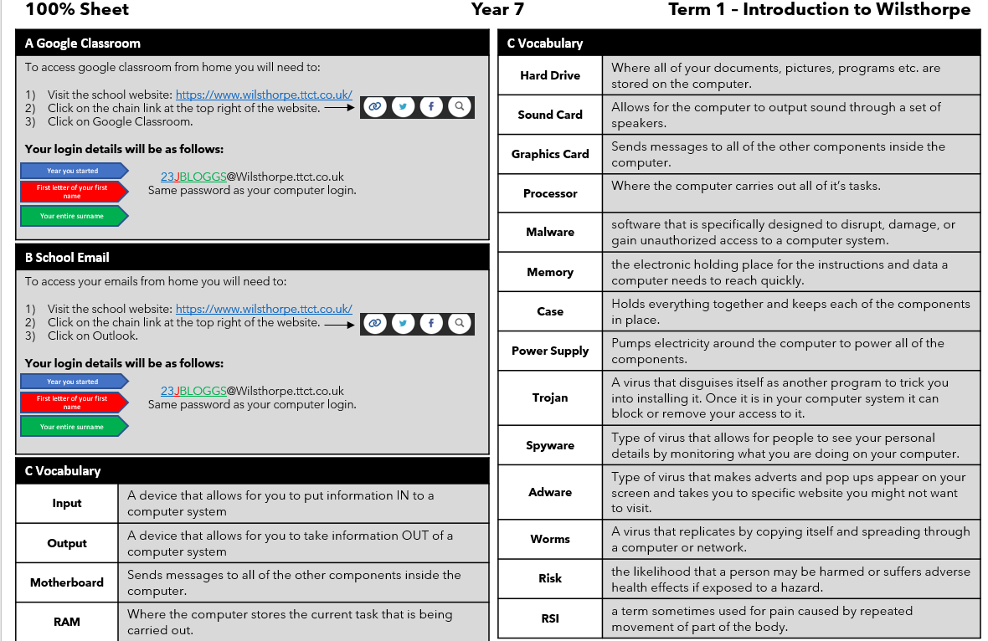
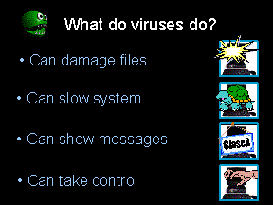
Computing

Slide 23
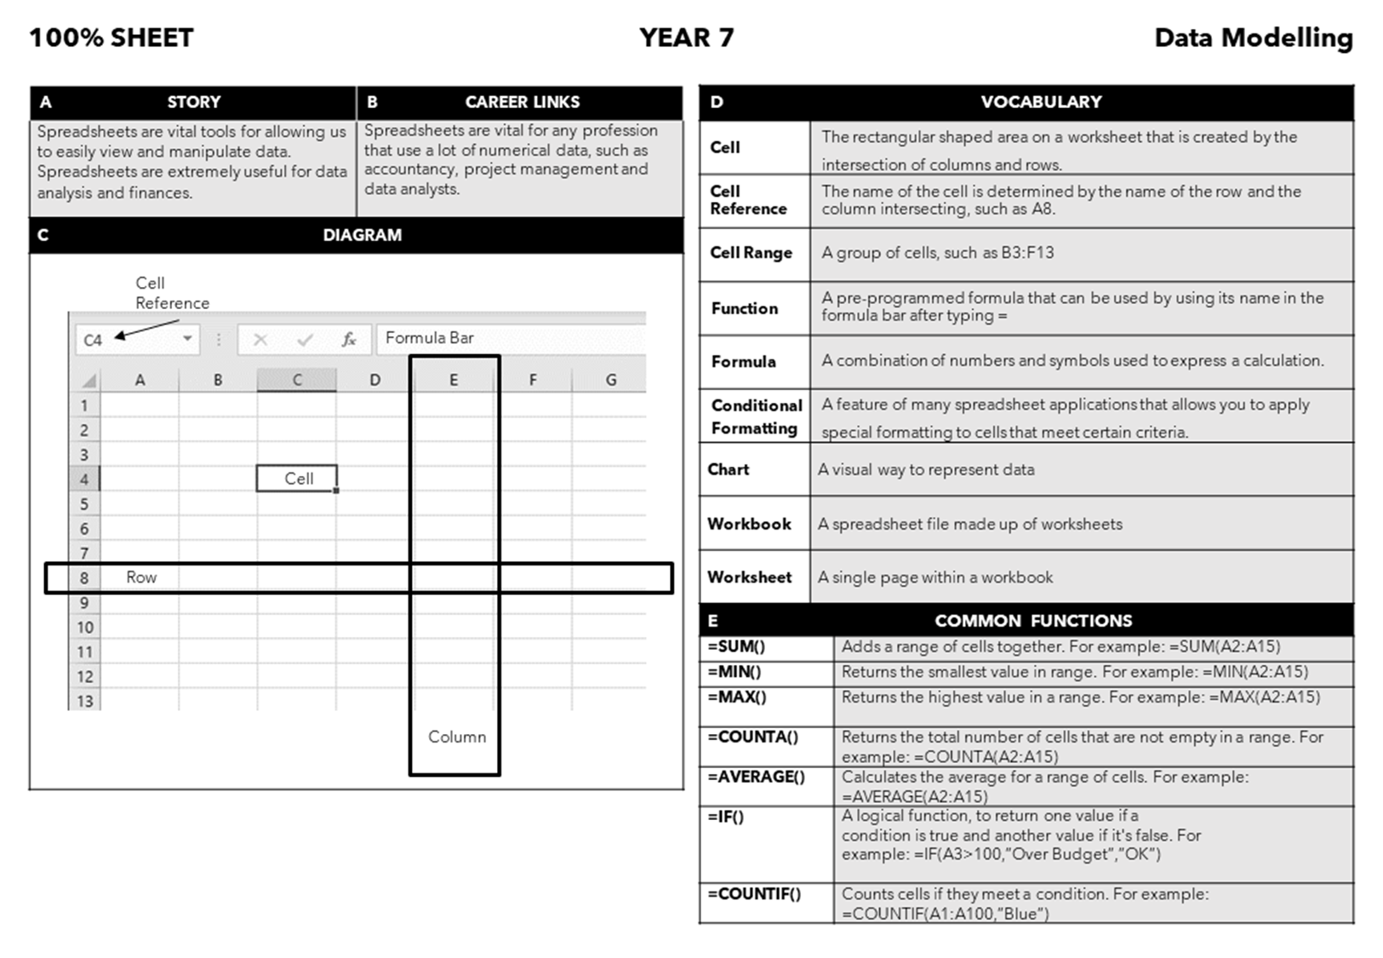
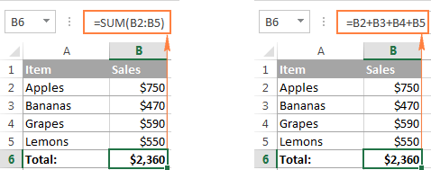
Computing

Slide 24
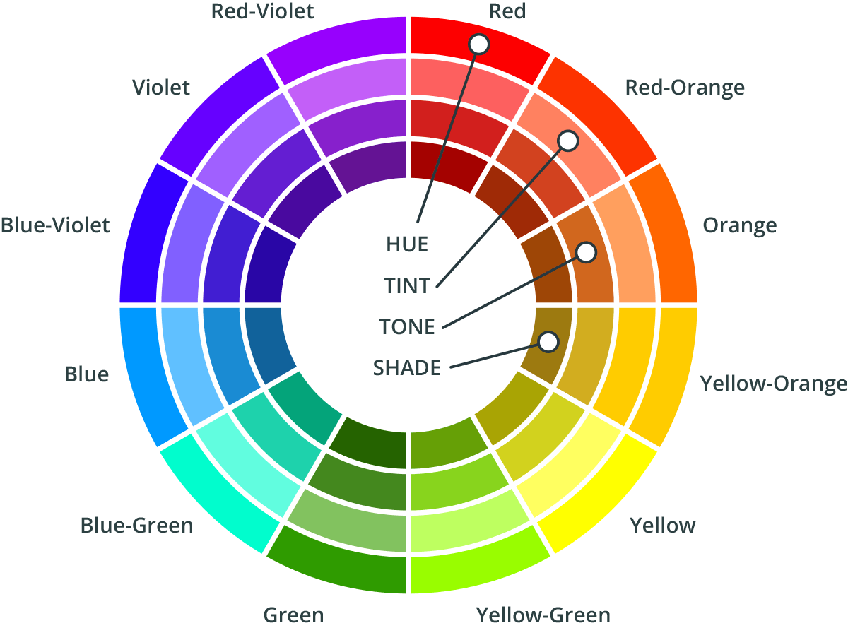
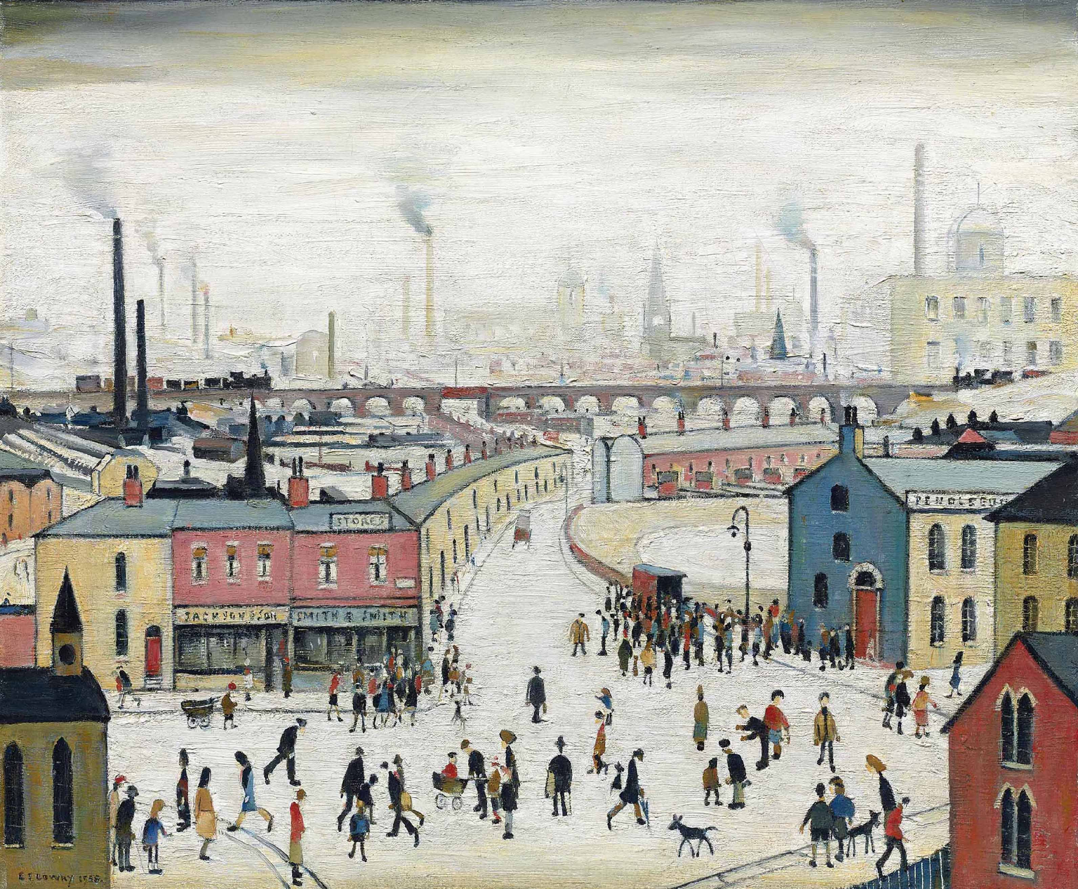
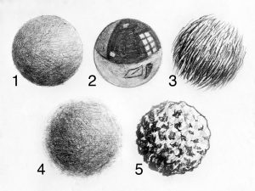
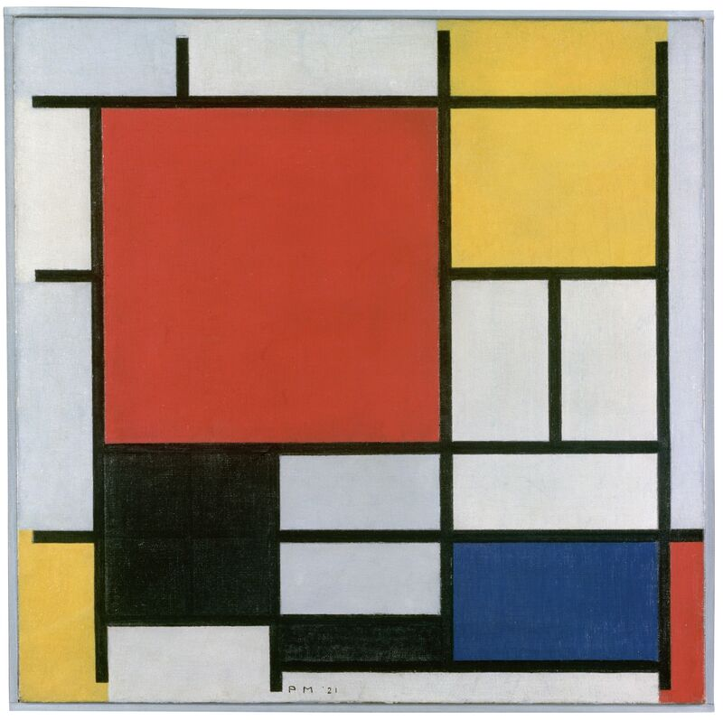
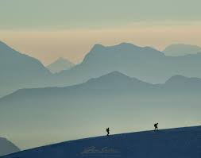
Art
Lines can show the subject's physical appearance: the outline of shapes and objects; details of features and patterns; surfaces and texture; tone, light and shade. Lines can suggest something more than just what can be seen: movement, mood and atmosphere, the subject's emotions, the artist's emotions and ideas
Key Words - Formal Elements
Colour | Colours are made up of mainly Primary, Secondary and Tertiary colours (Also known as pure colours).
Tone | Refers to the darkness or lightness of an object. You can use a range of different tonal values to create contrast in your work and give it depth.
Texture | Texture means how something feels. There are two types of texture: actual texture and visual texture. The appearance of texture is an important visual element. For example, smooth, coarse, soft, rough, etc.
Shape | A shape is a two-dimensional area. Shapes have height and width but not depth e.g. square, circle, triangle etc
Form | Form is a three dimensional shape e.g. cube, sphere, cone, cylinder etc.
Line | A line is a mark made on a surface that joins together different points. Lines can vary in length, width, direction and shape.
Pattern | A pattern is a design in which lines, shapes, forms or colours are repeated. The part that is repeated is called a motif. Patterns can be regular or irregular, manmade or natural
Tone is created by the way light falls on an object. The parts of the object on which the light is strongest are called highlights and the darker areas are called shadows.
Complimentary colours sit opposite each other on the colour wheel. Adding white to a colour creates a tint; adding grey to a colour makes a tone; adding black to a colour makes a shade.
Visual texture refers to the artist using their skill to create the illusion of an object's texture.
Actual or physical texture means the real surface of an artwork or design.
L S Lowry is best remembered his busy scenes of England’s industrial north,. The use of perspective was essential in his work, particularly when emphasising the scale of the towns and capturing the busy scenes of industrial life.
Perspective with tone
Tessellation
Piet Mondrian is a Dutch artist best known for his abstract paintings. Art that is abstract does not show things that are recognisable such as people, objects or landscapes. Instead artists use colours, shapes and textures to achieve their effect
Zentangle
Mandala
Check out Google Classroom for more handouts and help for the tasks
W/B 4 Sep: Task 1 Write up the key words for formal elements in your book
W/B 18 Sep: Task 2 Create a drawing in the style of Piet Mondrian. Add 5 facts about the artist
W/B 2 Oct: Task 3 Draw a robot and add tone to make it look 3D. Create core shadows and cast shadows
W/B 16 Oct: Task 4 Create a tonal drawing which shows objects fading into the distance. Place objects in the image to create a sense of scale for example trees, houses, animals. EBI- Create a perspective drawing.
W/B 6 Nov: Task 5 Create a 3-frame comic strip which uses line to create motion. Apply texture to your drawing to give it more detail and interest
W/B 20 Nov: Task 6 Create a Zentangle drawing which uses complex pattern.
W/B 4 Dec: Task 7 Pen portrait. Use Line, Tone and Texture to create a portrait of yourself, friends or family
2D Shape
3D Form

Slide 25
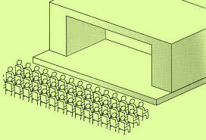
Drama
Term 1 – Storytelling Key words
Teacher-in- role | When the teacher takes on a performance role and performs to a class as a character
Atmosphere | The mood or feeling around you created by using a variety of different drama techniques.
Soundscape | A collection of sounds created either by the actors themselves or by other means like musical instruments. A soundscape is used to create the atmosphere of a scene through sound only, so for example if you were creating a ship you would expect to hear waves, maybe a ships horn, seagulls etc.
Climax | When tension builds and something happens
Anti-climax | When tension builds but then nothing happens
Mime | A wordless form of entertainment, in which movement and gesture are used to communicate rather than speech.
Tension | Keeping an audience wondering; not knowing something they want to know.
Term 2 – Introduction to Script Work Key words
Subtext | The underlying message being communicated in a sentence. It’s not what you say, it’s how you say it.
Intention | A thing that is intended, a purpose or goal
Proxemics | The use of space on stage to communicate character relationship
Backstory | A character’s backstory is their past experiences, influencing their actions and opinions.
Physicality | The use of movement skills to communicate character
Blocking | The initial positioning of actors and scenery on stage. This is done prior to polishing a performance
STAGING Types
End-On
In-the-round
Traverse

Slide 26
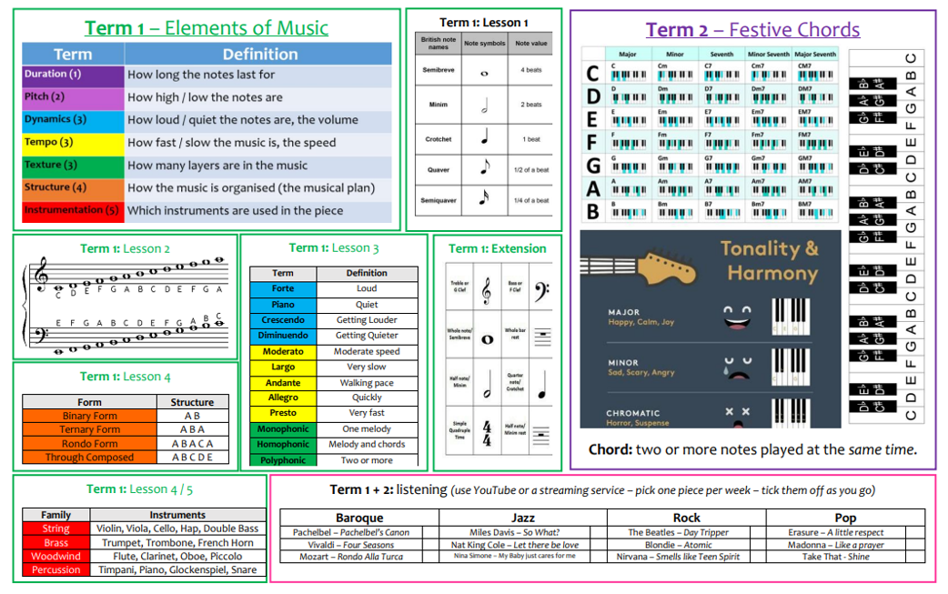
Music

Slide 27
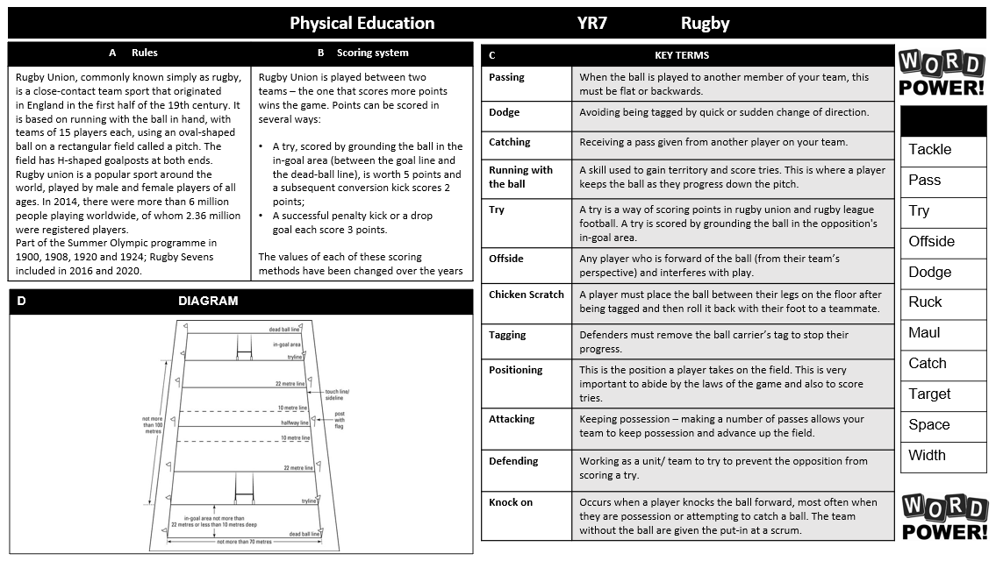
Physical Education

Slide 28
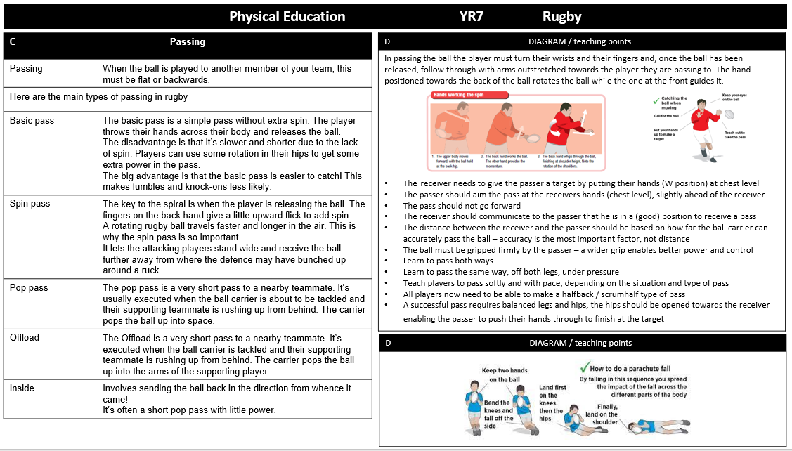
Physical Education

Slide 29
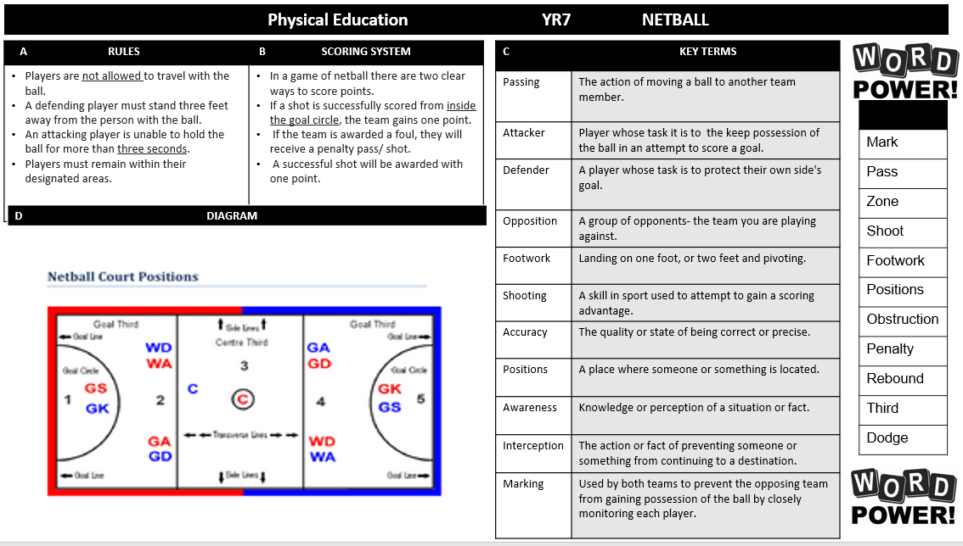
Physical Education

Slide 30
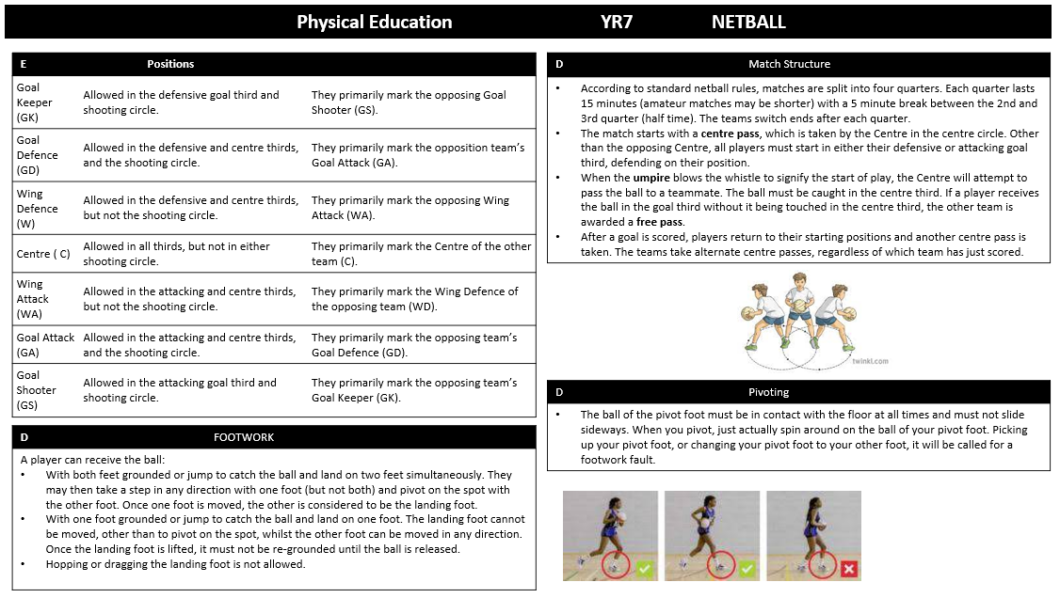
Physical Education

Slide 31
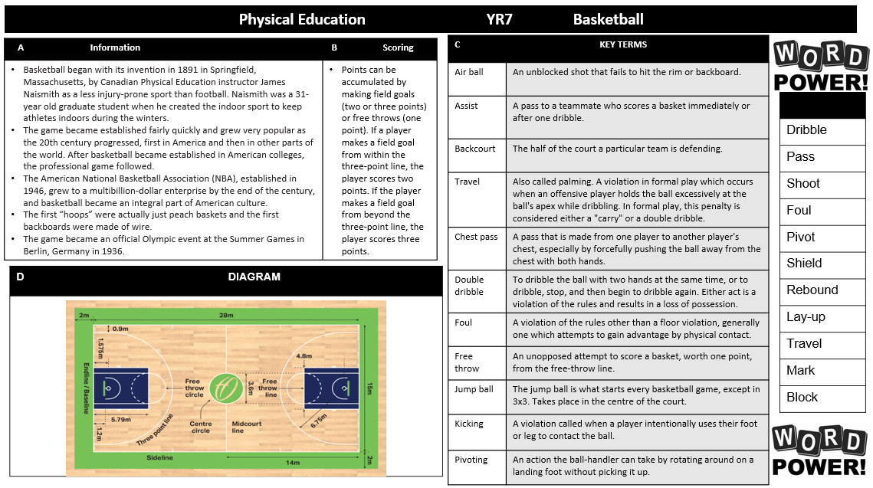
Physical Education

Slide 32
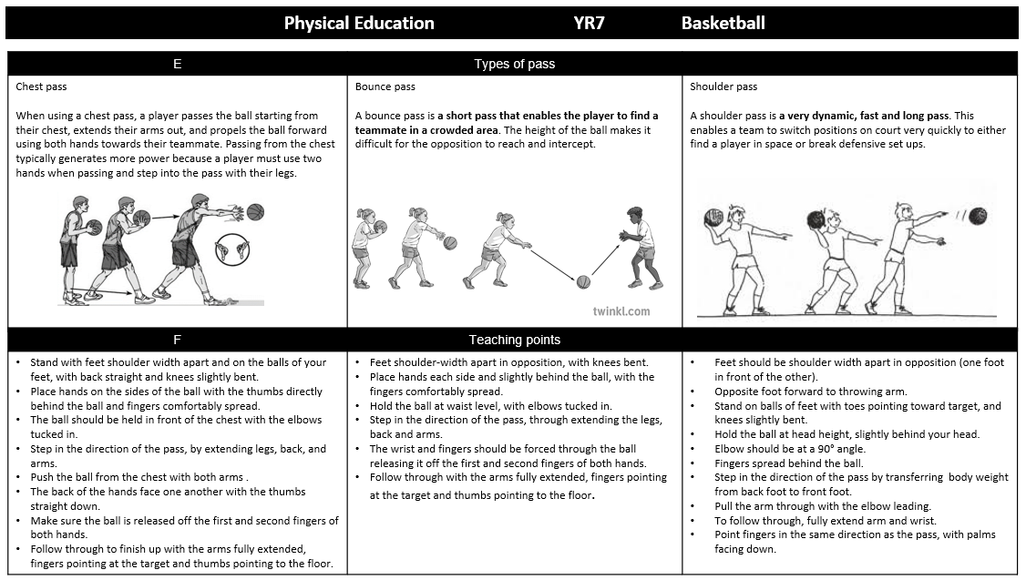
Physical Education

Slide 33
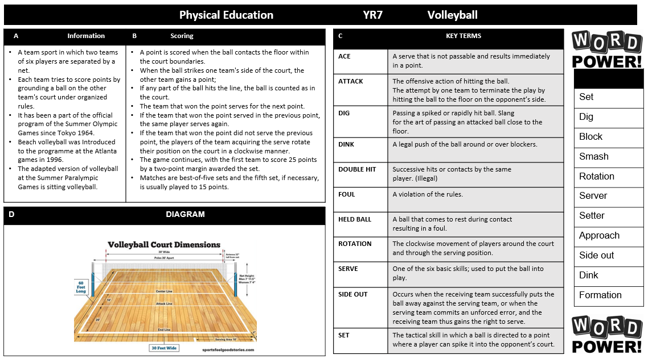
Physical Education

Slide 34
Physical Education

Slide 35
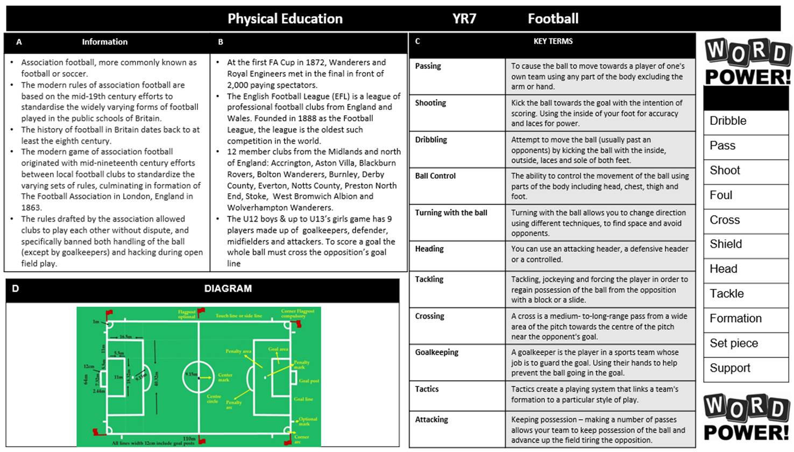
Physical Education

Slide 36
Physical Education

Slide 37
Engineering

Slide 38
Product Design

Slide 39
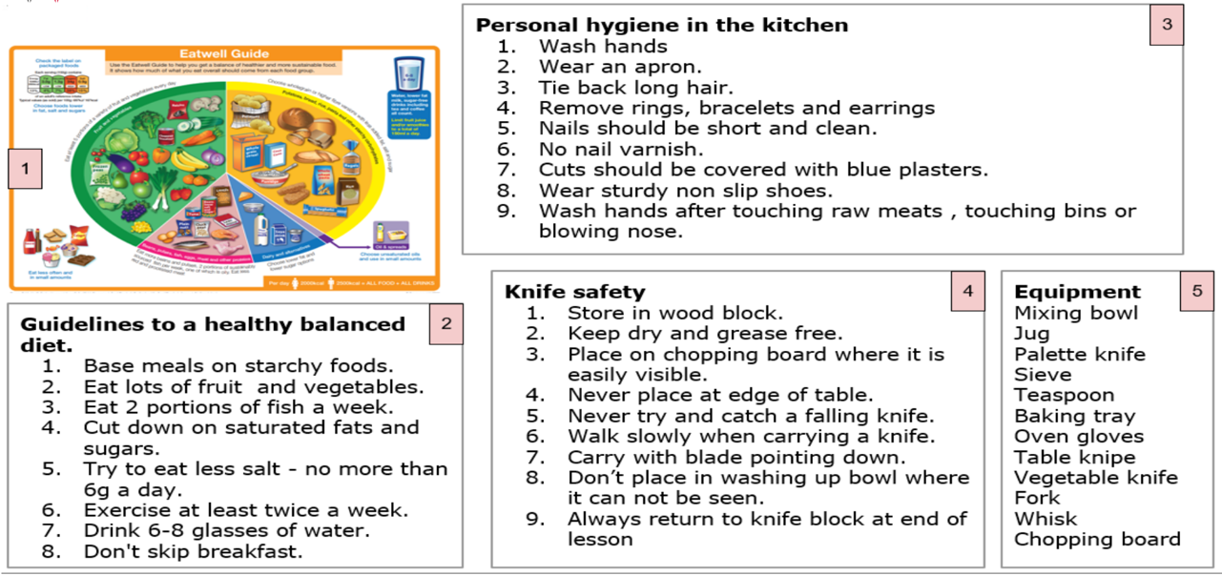
Food Technology

Slide 40
Textiles

Slide 41
Graphic Design

Slide 42
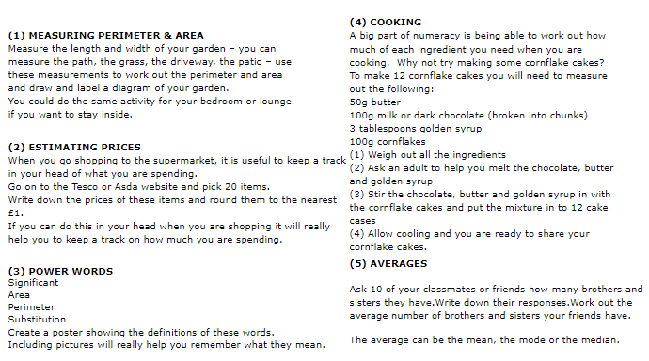
Numeracy

Slide 43
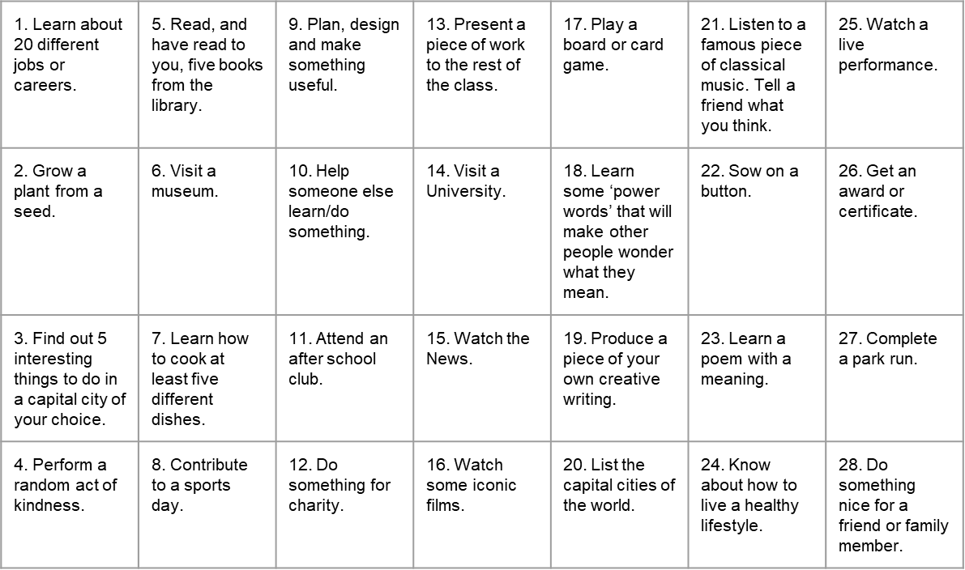
Things to do whilst at Wilsthorpe

Slide 44
Notes and Reminders

Slide 45
Notes and Reminders

Slide 46
Notes and Reminders

Slide 47
Notes and Reminders

