Slide 1
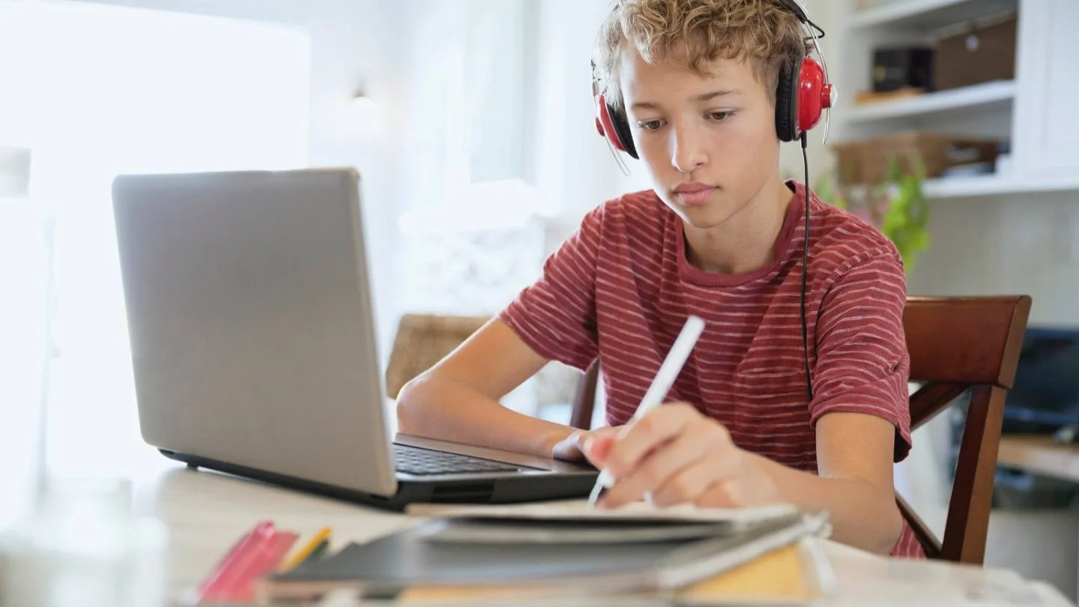
Homework at Wilsthorpe

Slide 2
Year 7, 8 and 9:
Subject | Homework Set | Homework Due | Online Platform
Maths | 4 pm on Tuesday | 8am on the following Tuesday | Sparx Maths
Science | 4 pm on Wednesday | 8am on the following Wednesday | Seneca
English | 4 pm on Thursday | 8am on the following Thursday | Century Learning
Reading | A minimum of 15 minutes reading of your reading book every day (recorded on the reading log in the student handbook)

Slide 3
Year 7, 8 and 9:
Maths, English & Science will all set 40 minutes of homework each week.
Homework should be completed on the online platform that subject uses (Maths – Sparx, Science – Seneca, English – Century).
You log in to all online homework platforms using your normal school email address and password.

Slide 4
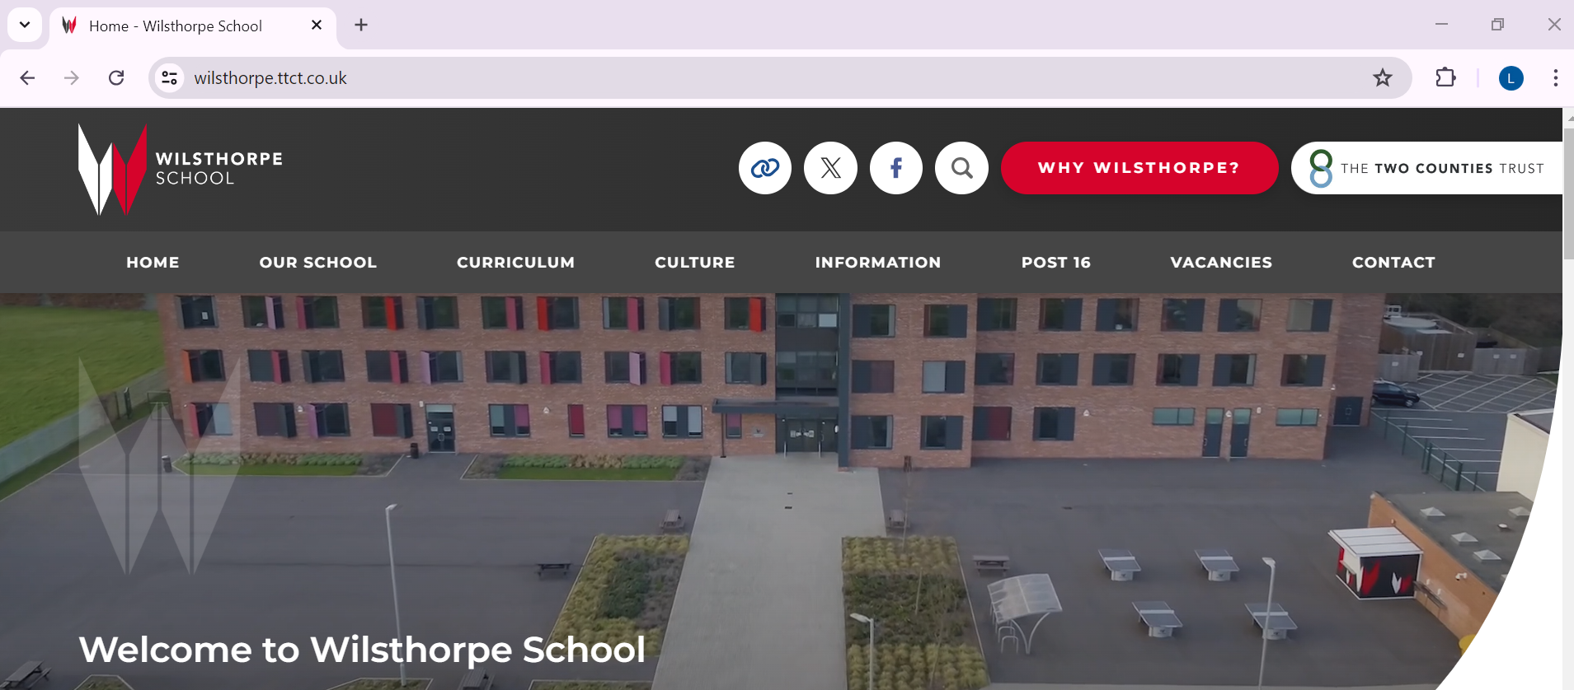
Year 7, 8 and 9:
You can access the online platforms (Sparx, Seneca and Century) via the quick links button at the top of the school website:

Slide 5
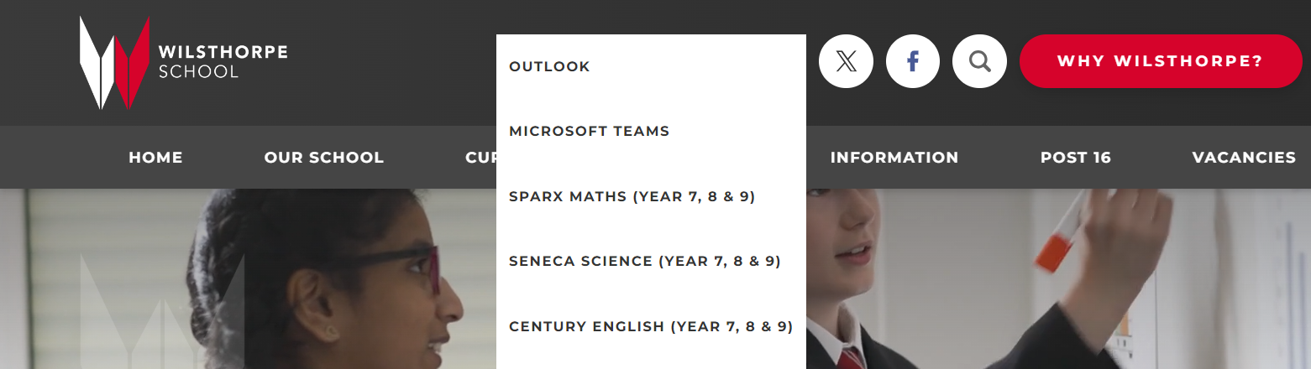
Year 7, 8 and 9:
You can access the online platforms (Sparx, Seneca and Century) via the quick links button at the top of the school website:

Slide 6
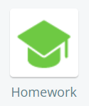
Year 7, 8 and 9:
You’ll be awarded positive points for the completion of homework.
Negative points and an after-school correction will be given for
failure to complete homework. The correction will be set for the day
the homework was due. Corrections will be set from October half
term to allow a few weeks to get used to the new system and to ask
for help if needed.
The library is available every day after school until 4pm to access computers to support you in completing your homework.
You should attempt your homework well in advance of the day it is due so that you can ask your teacher for help if you need it.

Slide 7
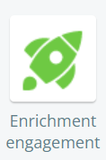
Year 7, 8 and 9:
All other subjects will run subject specific enrichment sessions to widen
your understanding of the subject and to develop a love for the subject.
You will receive positive points for attendance at enrichment sessions.
You must also complete a minimum of 15 mins reading every night using your reading book. This should be logged on the reading log in the student handbook. This will be checked during your library lesson.

Slide 8
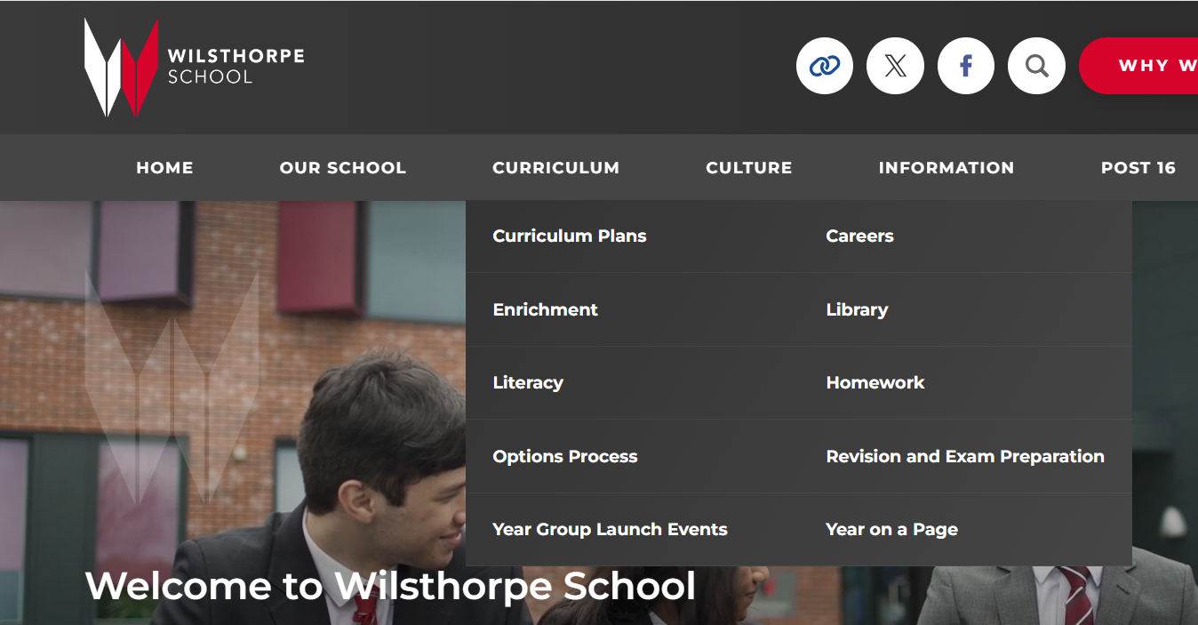
Year 7, 8 and 9:
During lessons in the first two weeks of September, your Maths, English and Science teachers will show you how to complete your homework on Sparx, Seneca and Century.
On the ‘homework’ page of
the school website, you will also
find step by step guides to remind
you of how to complete your
homework on these platforms.

Slide 9
Year 7, 8 and 9:
A reminder of where to find the homework tasks for Maths, English and Science will be posted on your class group on Microsoft Teams.
The details of the enrichment sessions for all other subjects will also be posted under the ‘Classwork’ tab on Microsoft Teams.

Slide 10
Year 10 and 11:
You will be set a minimum of 1 piece of homework each week for every subject you study.
You are also expected to complete a minimum of 15 minutes reading every night using your reading book. This should be logged on the reading log in the student handbook. This will be checked by your tutor.
Staff will record all of your homework tasks and
dates for submission under the ‘Assignments’ tab
on Microsoft Teams.

Slide 11
Year 10 and 11:
You will be awarded positive points for the completion
of homework.
Negative points and an after-school correction will be given for
failure to complete homework.
The library is available every day after school until 4pm to
access computers to support you in completing your homework.
You should attempt your homework well in advance of the day it is due so that you can ask your teacher for help if you need it.

Slide 12
Year 12 and 13:
You will be set approximately 60 minutes of homework/independent study for every 1 hour lesson completed in Sixth Form.
Staff will record all of your homework tasks and dates for submission under the ‘Assignments’ tab on Microsoft Teams.

Slide 13
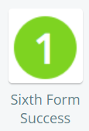
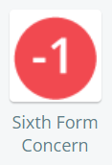
Year 12 and 13:
You will be awarded a positive for the successful
completion of homework. This will be logged under
the ‘Sixth Form Success’ button.
Non-completion of homework will be logged under
the ‘Sixth Form Concern’ button and your teacher
will either arrange a time for you to come and complete
the work or set a new submission date.

Slide 14
Using Microsoft Teams
to access your homework tasks

Slide 15
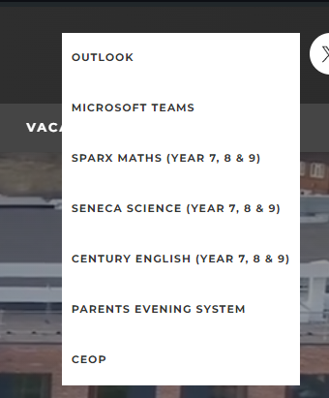
Logging in on a computer / laptop from home
To access Microsoft Teams from home using a computer or laptop you must go to the school website: https://www.wilsthorpe.ttct.co.uk/
1) Move your mouse over the quick links button
2) Click on Microsoft Teams and log in using your school username and password

Slide 16
Logging in on a computer / laptop from home
3) Once you are on the online platform, you will need to click on Teams on the left side.
Next click on the Class Team of the subject that has posted your homework
Then click on Classwork (Y7-9) or Assignments (Y10-13) to see your homework.

Slide 17
Logging onto Teams on a mobile phone
To access Microsoft Teams from your mobile phone, you will need to download from your respective app store the Teams app.
Open the Teams App and click on Teams
Click on the Class Team of the subject that has posted your homework.
3) Just like on the computer or laptop version, you must
now click on Classwork (Y7-9) or Assignments (Y10-13)
to see your homework.

Slide 18
Accessing Assignments on Microsoft Teams
At school you’ll automatically be logged into Teams on school computers.
Click on the Class Teams of the subject that has posted your homework.
2) Click on Classwork (Y7-9) or Assignments (Y10-13) to see your homework.
3) Click on the homework task
for more details/resources.
*The homework assignment on this video is not real and it’s only an example

