Slide 1
Socio-cultural issues and sports psychology 1
Characteristics and classification of skills

Slide 2
2.2 Sports Psychology: Characteristics and classification of skills

Slide 3
Do it now!
Change exam questions

Slide 4
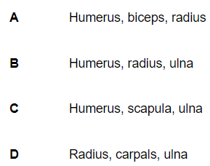
1.
Draw the revision aid for Mental Preparation techniques and list the 4 techniques which can be used
(5 marks)
2.
A sprinter focusing on the finishing line and not worrying about the runner in the next lane is an example of which mental preparation technique?
(1 mark)
3.
4.
(1 mark)
(1 mark)

Slide 5
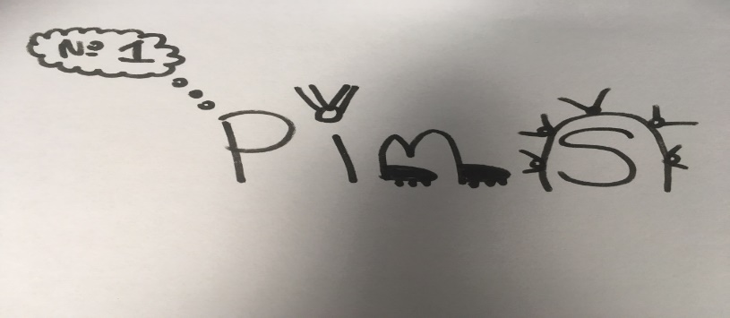
1.
2.
Selective attention – blocking out irrelevant information
Positive thinking, Imagery, Mental rehearsal and selective attention
4.
3.

Slide 6
Motor Skills
A motor skill is ‘An action or task that has a target or goal that requires voluntary body and/or limb movement to achieve this goal’
Two ways to use the word skill
To see a specific task e.g. A drop shot in badminton is a skill
To describe the quality of an action e.g. They showed great skill when performing a somersault/Messi is a skilful player
Task - What are the characteristics of a skilful movement? Could you break this down into 5 specific areas necessary in a skilful movement?
Skills video…..
Watch the video and write down your 5 keywords on your whiteboards….

Slide 7
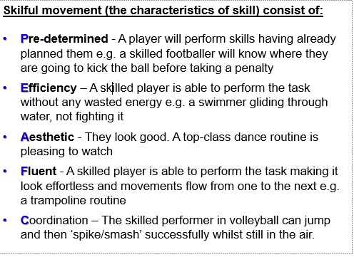
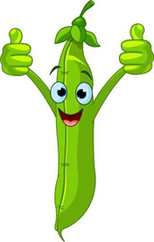
Characteristics of a skilful movement

Slide 8
Characteristics of a skilful movement – PEA FC!
Task: for each of the PEA FC characteristics, list your own example from your chosen sport
Sport chosen: _______________________:
Pre determined example: __________________________________________________________________________________________________________________________________________________________

Slide 9
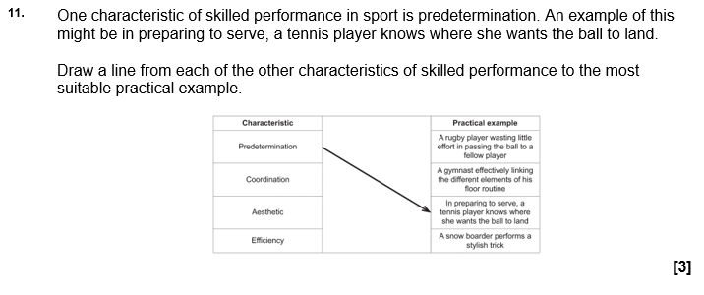
Exam Questions

Slide 10
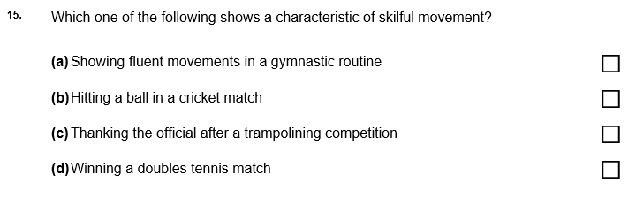
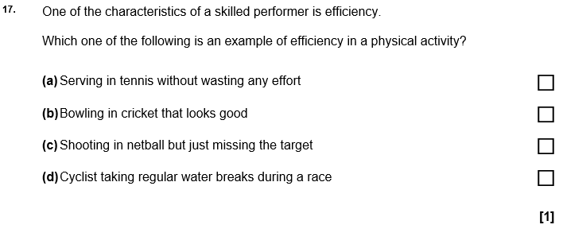
Exam Questions

Slide 11
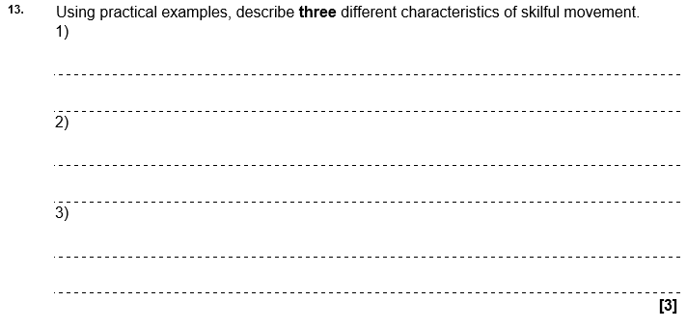
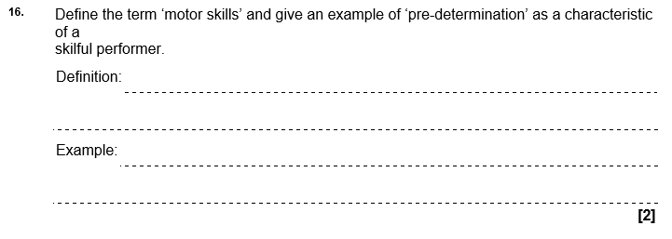
Exam Questions

Slide 12
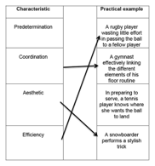
Exam Answers - Purple pen
11.

Slide 13
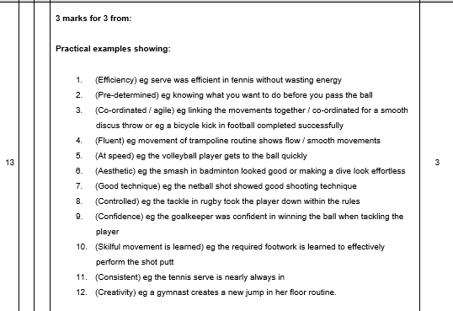
Exam Answers –Purple pen

Slide 14
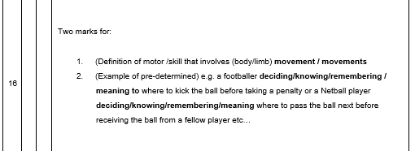
Exam Answers – Purple pen

Slide 15
2.2 Sports Psychology: Classification of skills

Slide 16
Give one practical example of using mechanical guidance when learning a motor skill
Change these!!!!(1 mark)
(1 mark)
Give two mental preparation techniques a sports performer might use to prepare themselves before a competition
(2 marks)

Slide 17
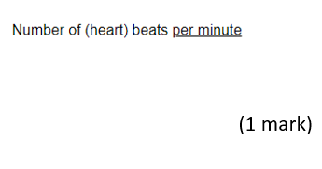
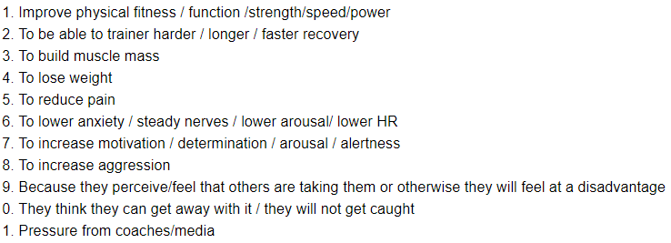

Slide 18
Classification of skills - Difficulty continuum
Simple skills:
Few decisions to make
Little information to process
Little feedback required
Taught as a whole in a repetitive way to ensure good memory simple skill
Examples?
Complex skills:
Many subroutines
Lots of information to process
Lots of feedback required
Taught in stages to allow the brain to remember each subroutine complex skill
Examples?

Slide 20
Classification of skills - Environmental continuum
Closed:
Self paced (you control the start and finish)
Predictable environment
Repeatable technique
Practices repeat the exact same movement
Examples?
Open:
Externally paced
Environment constantly changing
Varied practice in different situations
Movements have to be continually adapted
Examples?

Slide 22
Exam Questions

Slide 23
Exam Questions

Slide 24
Exam Answers – Purple pen

Slide 25
Exam Answers – Purple pen

Slide 26
2.2 Sports Psychology: Goal Setting

Slide 27
Goal setting
Why is it important to set goals?
Exercise/training adherence - Setting goals can help people stick to a plan
Motivate - Inspires or drives people to achieve their best
Improve performance - Goal setting often leads to higher performance levels

Slide 28
Reasons for goal setting - task
Can you come up with a practical example for each of the following reasons to use goal setting?
Help improve or be more skillful e.g.________________________________________________________
To work on specific fitness ___________________________________________________________
To know what to achieve ___________________________________________________________
To ensure to stick to a task/not give up ___________________________________________________________
To motivate or encourage you ___________________________________________________________
To control your stress ___________________________________________________________

Slide 29
Reasons for goal setting – Purple pen
Help improve or be more skillful e.g. goal setting can encourage a netball player to score as many points as possible.
To work on specific fitness e.g. strength
To know what to achieve e.g. timing a sprint run after training
To ensure to stick to a task/not give up e.g. to stick to the weekly exercise class
To motivate or encourage you e.g. you attend yoga class willingly
To control your stress e.g. make you calmer when training

Slide 30
SMART Targets
Setting goals using the SMART acronym is common in sport.
SPECIFIC - Targets must be concise
MEASURABLE - Use numbers in order to monitor progress
ACHIEVABLE - Make targets challenging yet reachable
RECORDED - Create a log/table/spreadsheet in order to make comparisons
TIMED - Make sure the target has an end point

Slide 31
Task!
Gives examples relating to your sport for each of the SMART steps.
Here’s one to start you off…..
Sport: Football
Specific - ‘To improve my non dominant foot shooting in football’

Slide 32
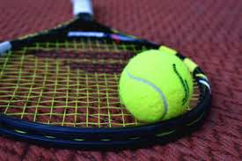
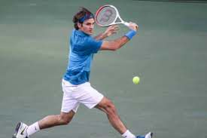
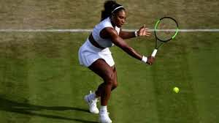
Example answer for Tennis
Specific - to improve the second serve in tennis
Measurable - to serve with a least 70% success rate in the service box
Achievable - to win 60% of points on second serve
Recorded - to write down the number of serves that are in (first and second serves)
Timed – to reach these goals over a 4 week period

Slide 33
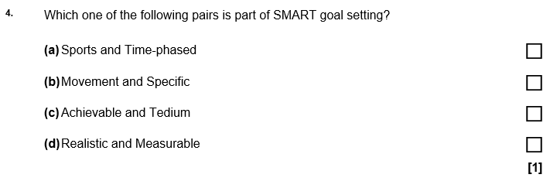
Exam Questions

Slide 34
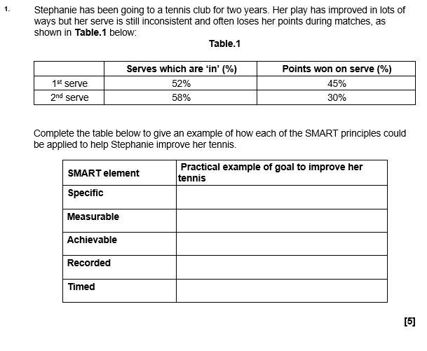
Exam Questions

Slide 35
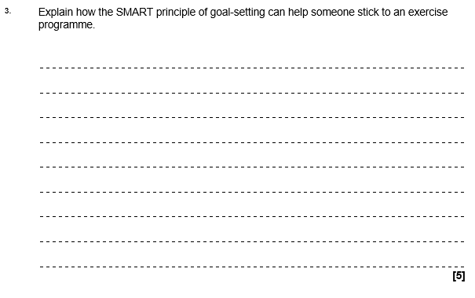
Exam Questions

Slide 36
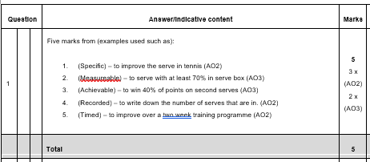
Exam Answers – Purple pen

Slide 37
Exam Answers – Purple pen

