Slide 1
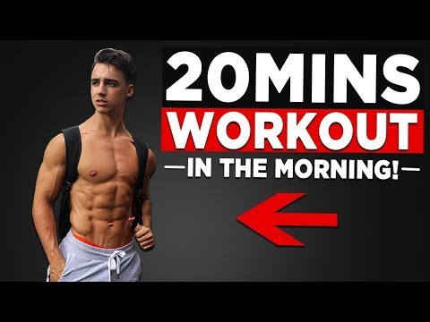
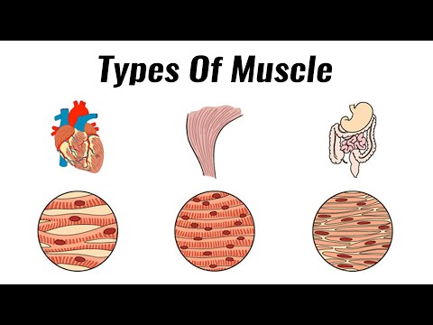
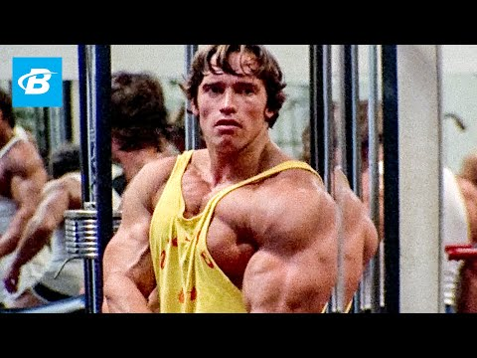
Effects of Exercise on 4 Body Systems

Slide 2
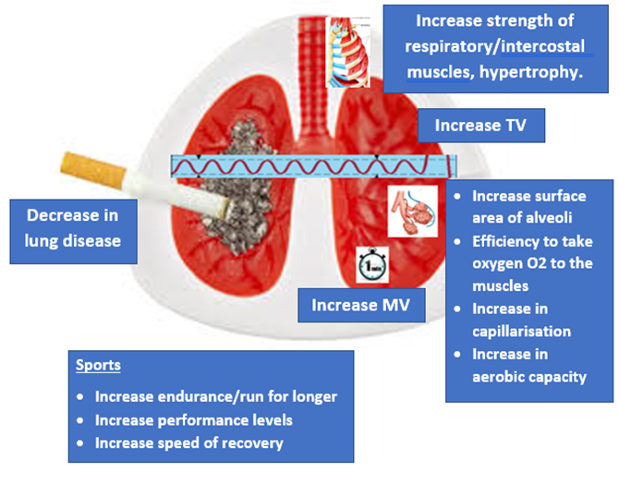
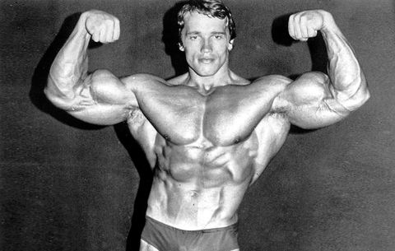
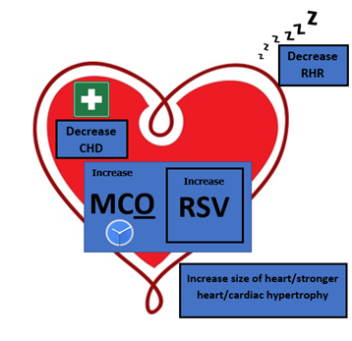
Skeletal System |  | Muscular System |  | Cardiovascular System |  | Respiratory System
Short term (effects of exercise)
 |  |  | 1.Temperature of muscles 2.Flexibility 3.Oxygen to muscles 4.Lactic acid production (anaerobic) |  | HR SV CO Redistribution of blood flow |  | Respiratory/breathing rate TV MV Oxygen to working muscles Lactic acid production
Long term (training effects of exercise)
 | Bone density |  | Muscular strength Hypertrophy of muscle Injury reduced Flexibility/stretch further Tolerance to lactic acid Muscular endurance Resistance of fatigue Speed of contraction Recovery rate Rate of removal of lactic acid |  | Hypertrophy of the heart (cardiac hypertrophy) The heart becomes bigger Resting SV Maximum CO Rate of recovery Heart becomes stronger/stronger contractions Capillarisation of the heart Decrease in likelihood of CHD/heart attacks Decrease resting HR Bradycardia |  | Aerobic capacity/ lung volume Respiratory muscles (diaphragm and intercostal muscles) TV Maximum MV Capillarisation Surface area of alveoli Aerobic capacity Decrease in lung disease / healthier lungs
SHIFTERS RR

Slide 3
Skeletal System |  | Muscular System |  | Cardiovascular System |  | Respiratory System
Short term (training effects of exercise)
Long term (training effects of exercise)

Slide 4
Revision Aids for Long Term Effects of Exercise on the Muscular System
Muscular Hypertrophy
Muscles will increase in size
Muscular strength (ligaments/tendons)
Hypertrophy of muscles
Injury prevention
Flexibility/stretch further
Tolerance to lactic acid
Muscular endurance
Resistance of fatigue
Speed of contraction
Recovery rate
Rate of removal of lactic acid
SHIFTERS RR

