Slide 1
Student Handbook. Everything you need to know for September 2023

Slide 2
Your first day at Wilsthorpe
Wednesday 6th September.
Form time
Register with your Form Tutor and re-connect with members of your tutor group.
Attend a welcome to Wilsthorpe Assembly delivered by Mr Hobbs.
Lesson 1
Get your timetable, Student Planner and Knowledge Organiser.
Find out about all the clubs and extra curricular activities available.
Tour of school.
Lesson 2
Go to lesson 2 on your timetable. Your class teacher will take you to the main hall to have your photograph taken and finger print scanned ready for lunchtime.
Breaktime.
Lesson 3 - your first Wilsthorpe lesson of the year.
Lunchtime.
Year 7 will go to lunch slightly earlier for the first term. Your class teacher will escort you to the diner at 12.05pm where you will eat your lunch. You must remain in the school diner until the bell goes at 12.15pm
Lesson 4 and 5
Year 7 will be dismissed at 14.50pm for the first term. Your period 5 teacher will dismiss you and accompany you to the front of school.
Don’t worry about getting lost; there will be lots of staff to help you find your way around.
Your first day at Wilsthorpe will be Wednesday 6th September.
On this day only Year 7 and Year 11 will be in school so it will quieter on your first day, with fewer people.
You can arrive at Wilsthorpe anytime after 8am. When you arrive, you will enter the school site by either the Briar Gate or Petersham entrances.
Your Form Tutor will be at the front of the school holding a sign so you know where to line up.
At 8.20am everyone will start to line up in form groups and you will walk into school with your Form Tutor.
You will not need your PE kit on your first day at Wilsthorpe.
Thursday 7th September
School is open to all students from 8am.
Students in the other year groups will all start back today. In the morning, you will have extended form time again.
Just like on the Wednesday, there will be lots of staff around to help you.
Remember you need to be at your form room for 8.25am ready for a prompt start at 8.30am

Slide 3
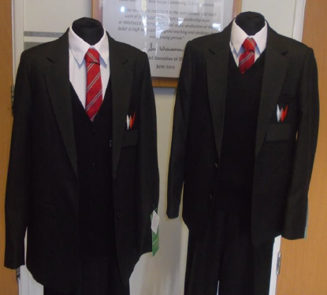
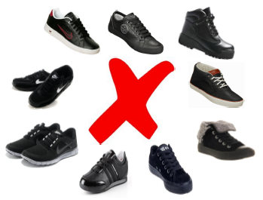
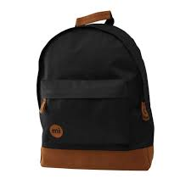
Getting Organised
Uniform
Blazer
White shirt and school tie
Knee-length black pleated skirt
Smart trousers (no skinny fit, ankle grazers or jeans)
Black V neck jumper with Wilsthorpe logo (optional)
Smart, polishable school shoes, not trainers
Black socks
School bag and stationery
Bag or backpack big enough to hold an A4 folder
A4 folder to keep work safe
Black pen
Pencil
Rubber
Ruler
Glue stick
Coloured pencils
Pencil sharpener
Scientific calculator
Other important uniform rules.
You are allowed to wear a wrist watch and a small (max 1cm) pair of earrings
No rings, necklaces or bracelets
No facial piercings
Hair colour must be natural
Hair should not be shaved any shorter than a grade 2
No coloured or acrylic nails or nail extensions
If you are having school dinners don’t forget to ask a parent or carer to top up your Parent Pay account with money.

Slide 4
What happens during form time
Form time is a really important part of the day as it will give you and your Tutor the opportunity to share with you important messages and information about the day ahead. Form time lasts 30 minutes and is a calming and positive start to your day to make sure you are ready for the day of learning ahead.
Your Form Tutor is a really important link between you, your school and your parents/carers. If you have a problem or a worry, your Form Tutor will be happy to help and support you. When people look back on their school experience, the first person they often think of is their Form Tutor.
Your Form Tutor will discuss attendance with you and your positive and negative points on Class Charts which is the school rewards system.
What you need to bring every day in your school bag
Student journal
Knowledge Organiser and work book
Subject books
Fully equipped pencil case
Mathematical calculator
Reading book
Water bottle
Attendance
Every term we will celebrate your attendance and there are rewards to be won for 100% attendance.
Year 7 Form Time
Monday | Assembly
Tuesday | Ready to Learn checks
Wednesday | Wilsthorpe Reads
Thursday | PSHE & Citizenship
Friday | PSHE & Citizenship

Slide 5
Employability Standards
It is important to remember that everyone is expected to behave in school. Everyone has the right to feel safe and have the education they deserve.
Disrupting the learning of others is not fair and won’t be tolerated.
Rewards you can be given in school by teachers, TA’s and Support staff. Each term Progress Managers and Curriculum Area Leaders will also celebrate your success by handing out different rewards.
Each term there will be reward assemblies where we will celebrate your success.
If your teacher has to remind you of the school rules and expectations you will be issued with a Correctional Conversation and your parents will be notified.
If you make poor choices in school you will receive a negative point. This will result in a 20 minute correction at the end of the day.

Slide 6
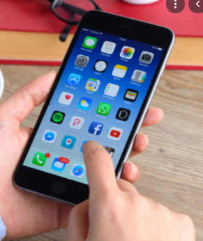
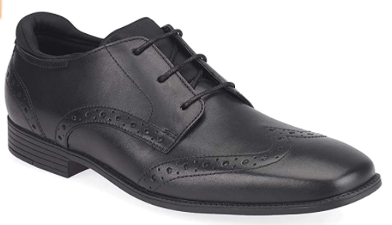
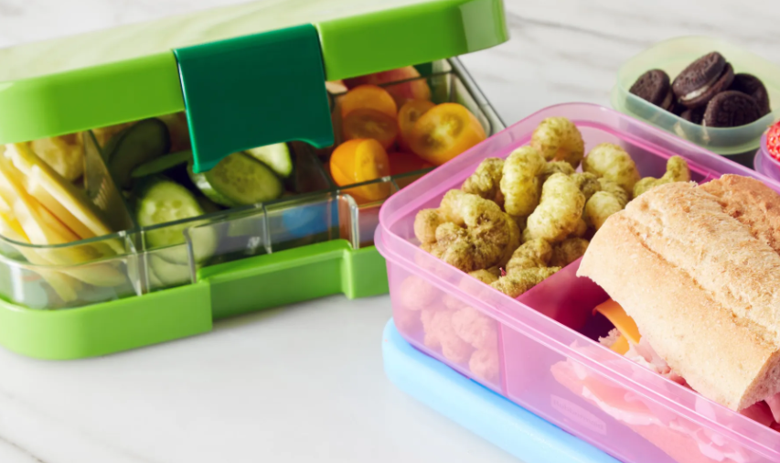
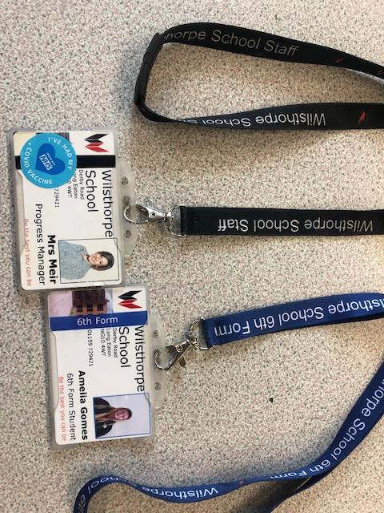
Students’ frequently asked questions
Do I need to bring all my books every day?
No. Check your timetable the night before to see what lessons you have the following day and then pack your bag ready for morning.
Can I bring my mobile phone to school?
Yes, but it must not be seen, heard or used. Keep it switched off and safe in your bag/pocket.
What happens if I lose my timetable?
Your form tutor will print a new timetable or you can ask at student reception.
Can I wear smart trainers to school?
No, school shoes only.
What do I do if I forget my equipment or book?
Tell your Form Tutor in the morning so they can help you sort out what you need before lessons start.
What happens if I get lost?
Firstly, don’t panic. Go and ask the nearest adult and they will help point you in the right direction. If there are no adults around, look out for the signs on the corridor walls or check the map in your planner.
Where can I eat my lunch?
In the Diner or outside. You must not eat in the corridors.
Top Tip
Staff wear black lanyards and 6th formers wear blue lanyards. So, if you are lost, or unsure where to go, you can always stop and ask someone wearing a blue or black lanyard.

Slide 7
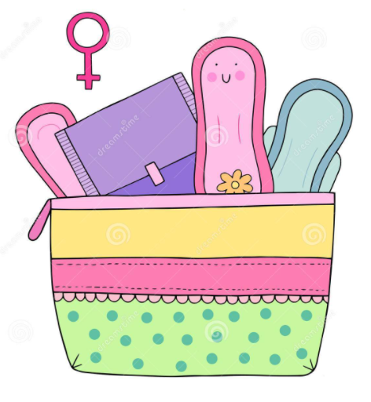
Students’ frequently asked questions
Can I go to the toilet during a lesson?
As much as possible you need to remember to use break and lunchtime to visit the toilet. However, if you do really need to go during a lesson you can ask the teacher.
Will I be put in a “set”?
You will be put in a set in English, Maths and Science based on the information we have received from your Primary school. Your English set will also inform your Humanities and Languages set. Your Maths set will inform your Science set. Once you have settled at Wilsthorpe, Curriculum Areas will do their own internal assessments which may result in some set changes.
What happens if I start my period while at school.?
Visit Student Support and they will be able to help you. There are always period products in school available for you to have.
What Languages can I study at Wilsthorpe?
Languages: We teach French and Spanish at Wilsthorpe. Students will find out which language they have been allocated in September and they will continue with this language until they choose their GCSE options in year 9.
Curriculum: Our curriculum in year 7 focuses on communication skills and the phonics of the language, giving a good foundation for students to express themselves and understand others. Prior knowledge of the language is not important as we start with the basics.
Deadline: We are not able to give students a choice of the language they study. However, if families have a compelling reason to prioritise a language, for example family members living in France or Spain, they can contact l.street@Wilsthorpe.ttct.co.uk by Wednesday 12th July at the latest. After this date, it will not be possible for students to switch
languages due to timetabling.
What happens if I feel unwell during the school day?
If you feel unwell during a lesson tell your teacher. At Wilsthorpe there are First Aiders and a medical room which you can visit if you are unwell.

Slide 8
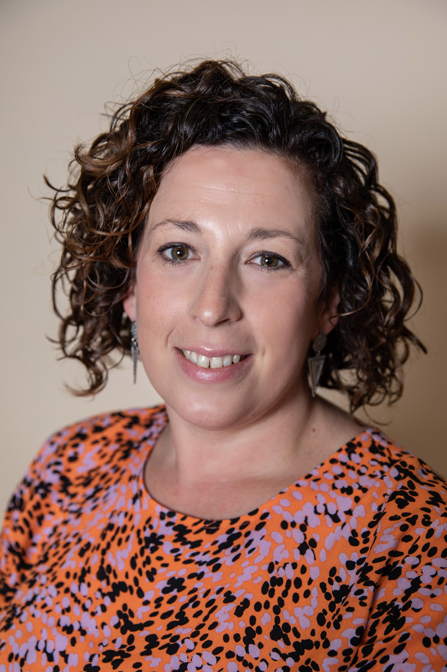
Meet the Year 7 Team
Favourite subject at school
I loved Art and English.
Favourite book
Matilda by Roald Dahl. It was the first book I bought myself with my pocket money and Miss Honey is the reason I wanted to become a teacher.
My biggest worry………
I always worry about getting lost and forgetting something. To help me overcome this you will find I always carry a notebook with me to write lists of what I need to do each day and I always wear a watch.
My role models
Mrs Nadin, my Year 1 teacher, who taught me reading was fun and not all teachers were scary. She always wore the best clothes and lots of animal print!
Mrs Todd, my GCSE and 6Th Form Art teacher, who always pushed me to work hard and constantly challenged me to do better.
My Nan who taught me to work hard and get stuck in!
At the weekend
When I am not taking my daughters to dance lessons, swimming lessons and hockey games, I enjoy cooking for my family and friends, having time to practise yoga and enjoying five minutes peace and quiet.
Favourite films
Toy story
Grease
Favourite quote
“Use your smile to change the world. Don’t let the world change your smile.”
Unknown
I am most proud of….
Completing the Couch to 5k challenge.
Mrs Meir
Senior Progress Manager & PSHE Co-Ordinator
Food and Textiles teacher
Favourite football team
Chesterfield Town
Important part of my job
Making sure you are all at school, happy and working hard.

Slide 9
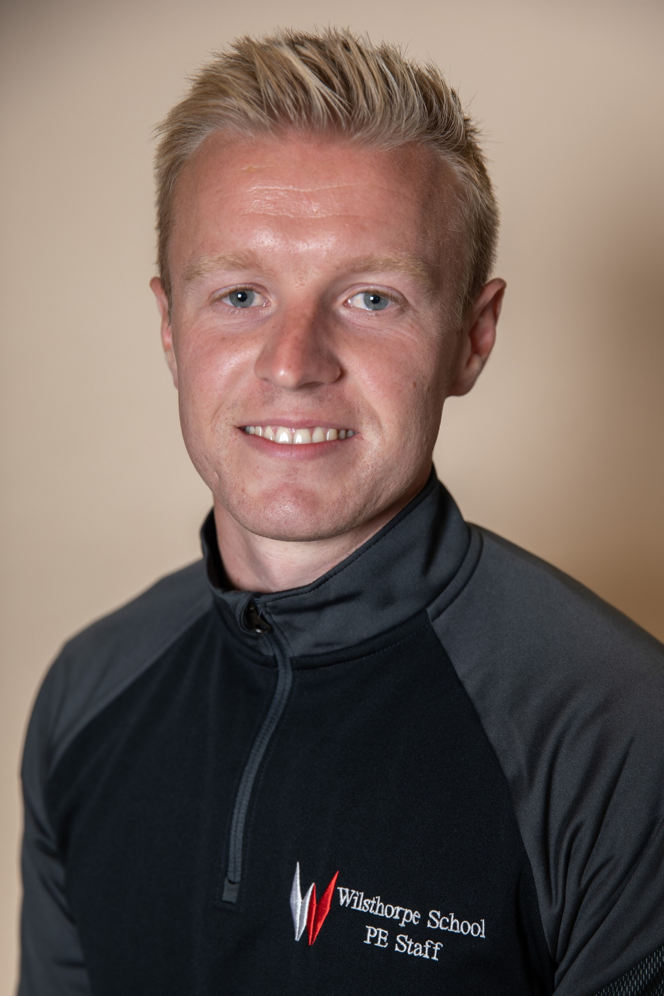
Meet the Year 7 Team
Favourite book
Tyson Fury: Behind the Mask
I am most proud of…
Coaching tennis in America for 3 years.
Favourite quote
‘’Good, better, best. Never let it rest. Until your good is better and your better is best.’’
Favourite football team
Leicester City
Important part of my job
Ensuring students are happy and achieving things they didn’t think they could.
Favourite film
The Lion King
My role models
Rafael Nadal because he has overcome many injuries and setbacks throughout his career and always gives 100%, even when losing.
Lewis Hamilton, because despite his incredible talent, he always shows his class off-track and respects his opponents.
My biggest worry..
Is being underprepared and not being ready to perform at my best.
Mr Redfern
Year 7 Assistant Progress Manager
PE Teacher
At the weekend:
I enjoy being outside, meeting friends and playing tennis. I frequently go to watch Leicester City play and follow the Formula 1.
Favourite subject at school
PE

Slide 10
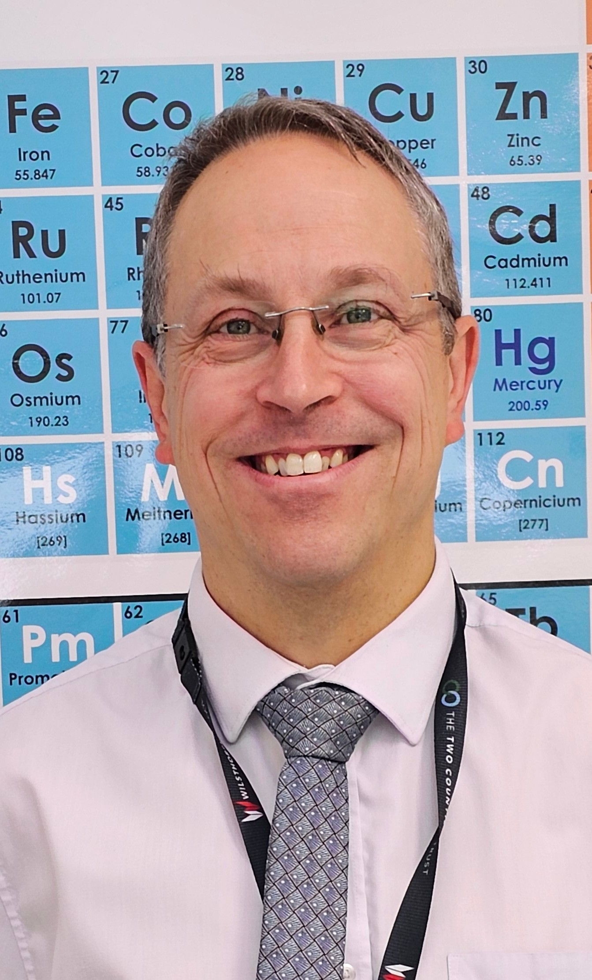
Meet the Year 7 Team
Favourite subject at school
Science, English, Geography
Favourite book
I like thrillers and exciting novels. My favourite author is Michael Crichton who wrote Science thrillers. For example, he wrote Jurassic Park which has a deeper meaning than the current Hollywood blockbusters!
My biggest worry………
I worry about many things but I do try to live by the philosophy to not take things too seriously and to make sure that I am as kind and helpful as possible.
My role models
Mr Kendall was my year 5 and 6 teacher. He was terrifying and wonderful at the same time. He told us ghost stories and put on the school play. He also had double jointed knees!
Mr Greene was my A level chemistry teacher. He was so passionate about chemistry and didn’t care if he did dangerous demos.
My Mum had the greatest integrity and taught me to have high values and always do the right thing – even if it was difficult.
At the weekend
My daughters both do athletics for Amber Valley and Erewash Athletics Club and a lot of time is used taking them to training or going to competitions.
I have some DJ decks and like to play on those. I also have all the kit to do mobile DJ parties!
Favourite quote
Mostly silly ones like “I’ll hit the brakes – he’ll fly right by” – Maverick in Top Gun.
“88.2% of statistics are made up on the spot” – Vic Reeves
Favourite films
Sci fi, action and thrillers!
Marvel, Star Wars and James Bond are my favourite films.
Mr Turner
You can call me Mr T
7P
Science Teacher
Important part of my job
Helping students to understand difficult concepts – seeing them have the ‘lightbulb moment’
I am most proud of….
My own children. They make me proud every day!
Favourite football team
Bolton Wanderers (home town)
Derby County (current town)
Liverpool (childhood favourite)

Slide 11
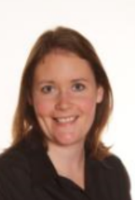
Meet the Year 7 Team
Favourite subjects at school
History, English & Textiles.
Favourite book
I love reading lots of different types of books. I particularly enjoy science fiction and historical novels, but I am always happy to try new genres.
My biggest worry is…getting lost. I do not have a very good sense of direction so I always plan my routes in advance and give myself plenty of time to make mistakes.
My role models:
We learn about so many wonderful people in History, that it is impossible to choose!
I admire people who are resilient and determined, people who help to make the world a better place. And people who share their knowledge with the world.
At the weekend…I spent time with my family and friends. Both my daughters dance, so I enjoy watching them perform in shows and competitions. I am in a book club and love talking about what we have read.
Favourite film
I love musicals but I can’t pick a favourite!
Favourite quote:
“Those that fail to learn from the past, are doomed to repeat it.”
Winston Churchill
I am most proud of… how many of our students continue to enjoy History after school.
Mrs Parker
7W
Deputy CAL Humanities
History Teacher
An important part of my job is…supporting students in enjoying school, especially their History lessons!
Favourite football team – I don’t have one!

Slide 12
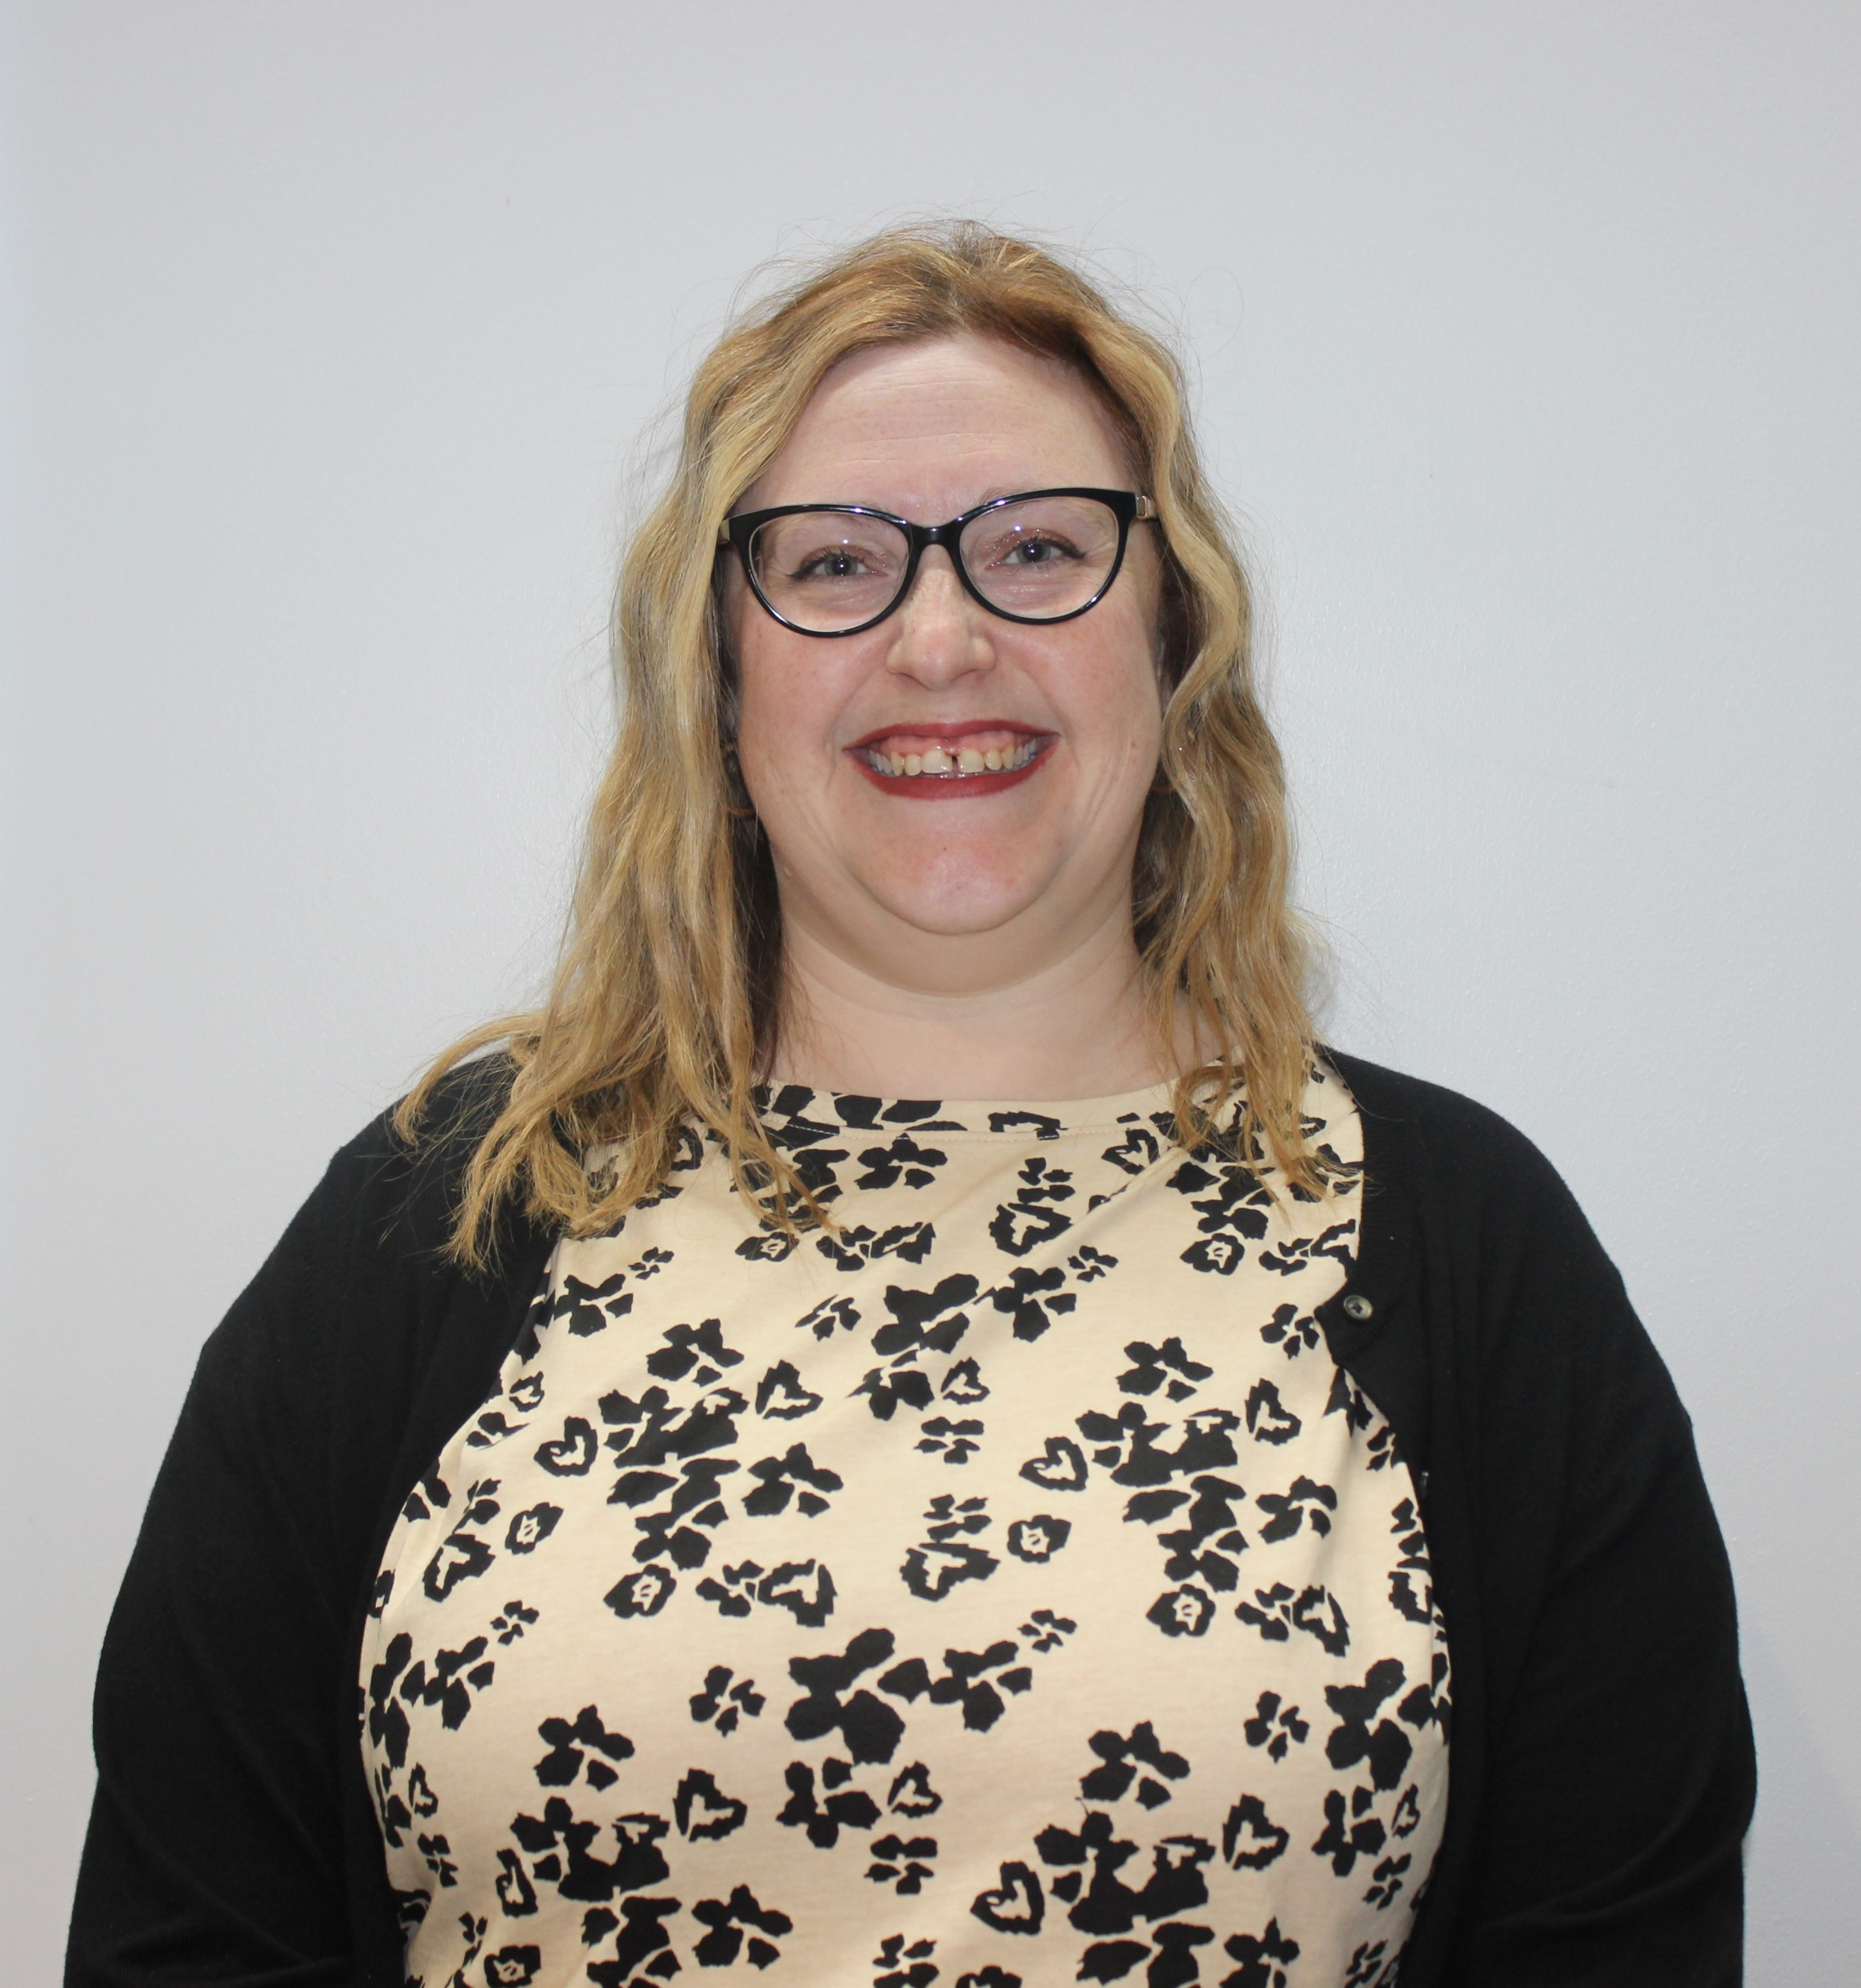
Meet the Year 7 Team
Favourite subject at school
RE, English and History
Favourite book
This is a tough one! Probably equally divided between the Millennium series (Girl with the Dragon Tattoo), The Count of Monte Cristo and Jane Eyre
My biggest worry………I am a perfectionist and I don’t like getting things wrong!
My role models
My Mum: she has always taught me to be kind, but to stand up for myself.
My husband: he is always so calm and zen. I am so jealous of his ability to keep his chill!
Mr Murphy: my RE teacher at school. I saw how lovely he was and I always wanted to be like him.
At the weekend
I will try and go back home to Barnsley to see my parents, or my husband and I go out to the theatre. Sometimes, we go to nice restaurants and eat fabulous food!
Favourite films
The Slipper and the Rose
Favourite quote
“I need not sell my soul to buy bliss.” – Jane Eyre
I am most proud of….
Achieving my Masters Degree during lockdown.
Mrs Giles
7W & 7H
RE Teacher
Important part of my job
Making sure that you are all happy and well and ready to learn.
Favourite football team
Barnsley FC (Come on you Reds!!)

Slide 13
Meet the Year 7 Team
Favourite subject at school
I liked Maths and Drama
Favourite book
Dune by Frank Herbert. This is one of the original Sci-Fi books and you can see it’s influence everywhere
My biggest worry………
I always worry about upsetting people. I can be very direct and honest and sometimes people take this as rude.
To overcome this I always think before I speak and I’m not afraid to say sorry if I do make a mistake.
My role models
Ada Lovelace
She is considered to be the first Computer Programmer. She was a great mathematician and wrote about computers creating music long before we had digital computers.
Marie Curie
She was the first woman to win a Nobel Prize, the first person to win a Nobel Prize twice and the only person to win a Nobel Prize in two Scientific fields. There were many times she was told ‘No’ because she was a woman, but she did it anyway
At the weekend
I play board games and computer games with my husband and daughter. I also manage a Comic Convention in London
Favourite films
Muppets Christmas Carol
Grease 2
Favourite quote
“Life is not easy for any of us. But what of that? We must have perseverance and above all confidence in ourselves. We must believe that we are gifted for something and that this thing must be attained.”
Marie Curie
I am most proud of….
Being able to become a teacher, despite my disabilities
Mrs McGarry-Thickitt
7R
Trust Lead for Computer Science
Computer Science Teacher
Important part of my job
Making sure students leave school with the digital skills they need to succeed.
Favourite sport
I love Field Archery

Slide 14
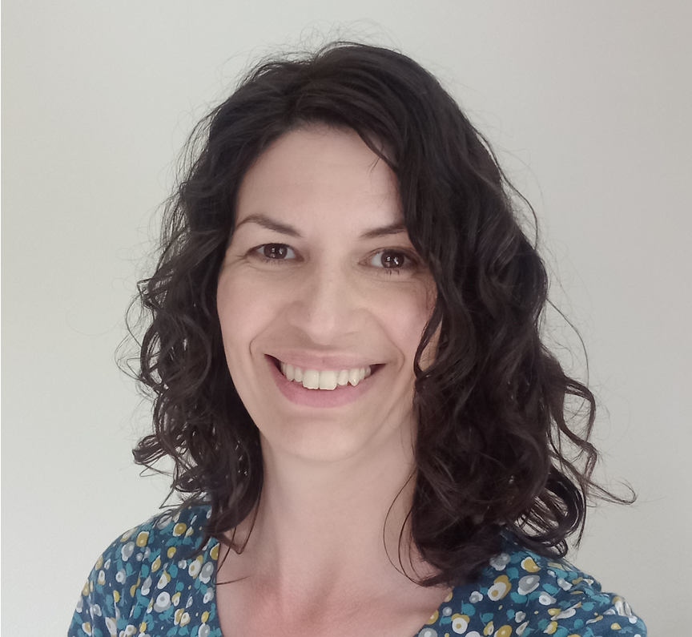
Meet the Year 7 Team
Favourite subjects at school English,
French and Music.
Favourite book
I have so many favourites, but I absolutely love "The Remains of the Day" by Kazuo Ishiguro.
My biggest worry is being underprepared. I also worry about not finding anywhere to park my car! I like to leave plenty of time to get to places and to use my planner and checklists to make sure I am organised.
My role models.
My incredible English teacher, Mr Henderson, who gave me a lifelong passion for the subject.
A lady at my church called Janette who has a life-limiting condition but who remains so funny, warm, positive and encouraging.
My friend Petra, who once dressed up as a giant daffodil and is the best teacher I've ever known.
At the weekend I spend a lot of time playing with (and cleaning up after) my children and our Golden Retriever puppy! When I can, I enjoy seeing live music and theatre. I absolutely love to crochet; it's so creative and relaxing! I'm also very happy reading recipe books and planning feasts for my family and friends.
Favourite films
Lord of the Rings and
Star Wars
Favourite quote
"I am no bird, and no net ensnares me; I am a free human being with an independent will." Jane Eyre by Charlotte Brontë
I am most proud of my two amazing children and of getting my degree.
Mrs Allister
7R
English Teacher
Favourite football team
Hmm...England? I only really watch the international games.
Important part of my job is encouraging you, being there for you and helping you to love reading.

Slide 15
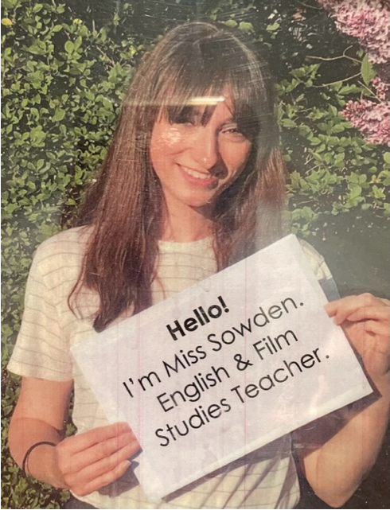
Meet the Year 7 Team
Favourite subject at school
English and Media Studies
Favourite book
Of Mice and Men
My biggest worry
Is not being ready for the day. Preparing the day before helps with this.
Favourite films
E.T
The Sound of Music
At the weekend
I love to spend time with my little girl, see friends and try lots of different foods in restaurants around Nottingham and Derby.
My role models
My Grandad who was a Headteacher. He has taught me lots of life lessons and he inspired me to be a teacher too.
Mrs White, my Maths teacher, was also a role model as she helped me through my GCSE Maths, a subject I found challenging.
Favourite quote
‘You never really understand a person until you consider things from his point of view’
Atticus Finch, To Kill a Mockingbird
Miss Sowden
7H
English and Film Studies Teacher
Important part of my job
Making sure you love English and are happy and progressing in lessons.
As a Tutor, supporting you through school.
I am most proud of
Climbing Machu Pichu in Peru!

Slide 16
7S

Slide 17
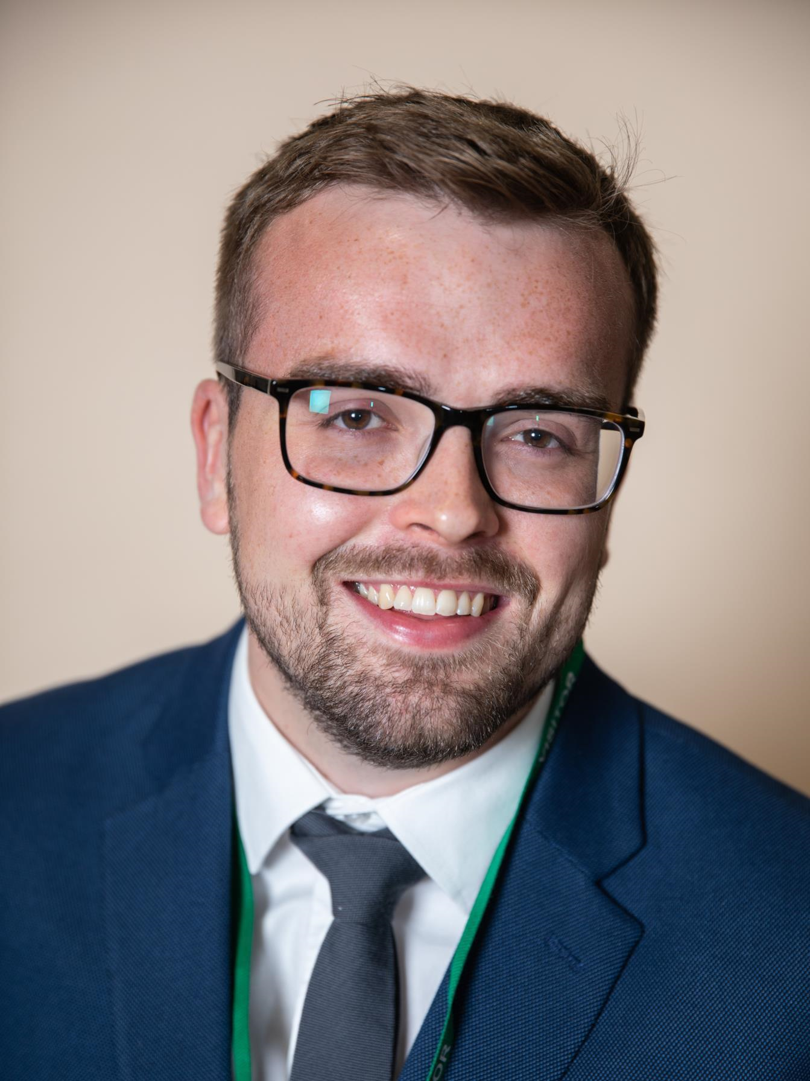
Meet the Year 7 Team
Favourite subject at school
Maths!
My biggest worry………
Accidentally saying something that makes someone else feel bad!
My role models
Andy Murray – Despite injury, he battled back from a hip operation at the age of 31 and is still playing at professional level in tennis.
My Dad – he is always there whenever I need help! He also seems to know how to do every DIY related task!
Favourite film
Semi-Pro
At the weekend
I enjoy being outside in the garden with my children.
Camping (if the weather is ok!).
I also enjoy going to watch DCFC (season ticket holder).
Favourite quote
“If opportunity doesn’t knock, build a door.” ―Kurt Cobain
I am most proud of….
My two children, Ewan (2) and May (6 months)
Mr Gotheridge
7L
Mathematics Teacher
Important part of my job
Making sure that students enjoy being at school and in class!
Making Maths enjoyable for everyone!
Favourite football team
Derby County

Slide 18
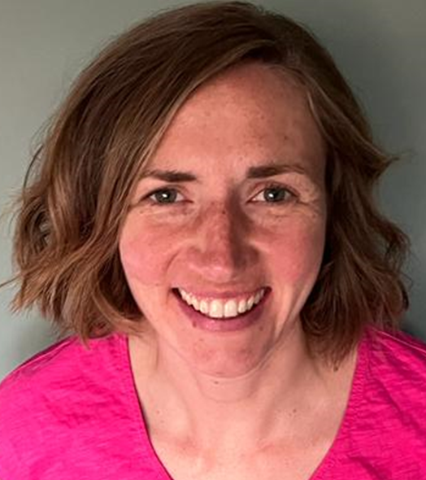
Meet the Year 7 Team
Favourite subject at school
I loved Maths and French
Favourite book
Surprised by Joy - C S Lewis
My biggest worry………
Not being prepared. I always try and prepare for things in advance to take the pressure off.
My role models
Marcus Rashford – I love how he uses his platform to bring about real positive change.
Mikaela Loach – she’s a climate campaigner who empowers young people.
At the weekend
I love to hang out with my family. We usually go to the allotment and the playground. I like to relax, read and eat nice food!
Favourite films
Matilda
Favourite quote
‘Be the change you wish to see in the world’.
I am most proud of….
learning new things.
Mrs Sarno
7L
Mathematics Teacher
Important part of my job
Helping open as many doors as possible for students.
Favourite football team
I’m sorry I don’t follow football!

Slide 19
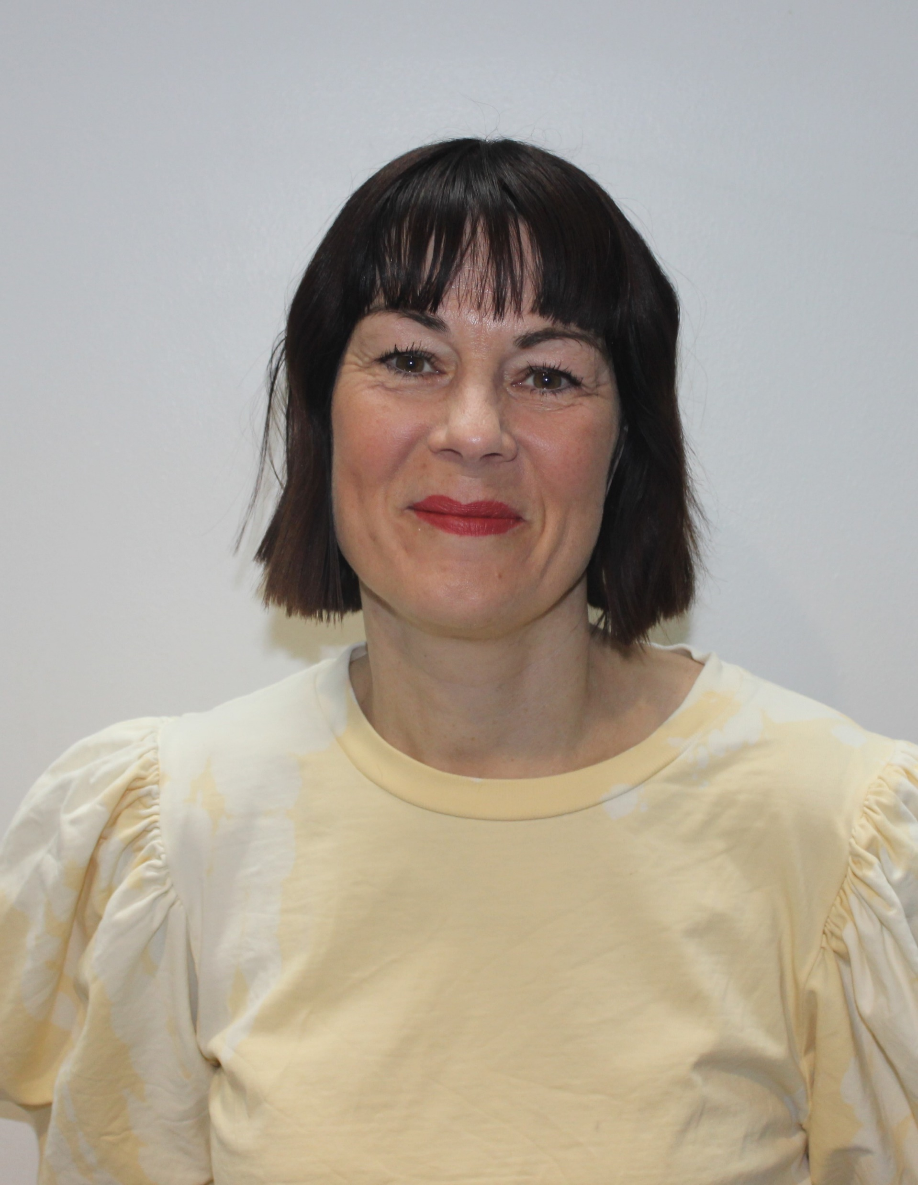
Meet the Year 7 Team
Favourite subject at school
English, Art and History
Favourite book
‘Wuthering Heights’ by Emily Bronte
My biggest worry………
Getting lost! I have no sense of direction!
Favourite films
Baz Luhrman’s ‘Romeo and Juliet’ and ‘Moulin Rouge’
At the weekend:
I love to read and go to the theatre. My Saturday morning routine is going to two dance classes followed by coffee and cake with friends!
Favourite quote
“I am no bird and no net ensnares me: I am a free human being with an independent will” Charlotte Bronte
My role models
The Suffragettes, because without them, my daughter and I wouldn’t have the freedoms we have today.
My Dad also inspired me to be the person I choose to be.
I am most proud of…
My children.
Miss Beirne
7T
English Teacher
Important part of my job
Inspiring a passion and love for literature.
Favourite football team
I’m more of a yoga kind of girl!

Slide 20
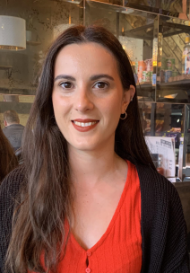
Meet the Year 7 Team
Favourite subject at school.
English, Spanish and French. I have loved languages from yr7
Favourite football team.
Liverpool FC
My biggest worry…
is not being organised and not knowing what I am doing. I like writing important things down on my calendar and knowing where everything I need is.
Favourite book.
This is such a difficult question because I love reading. I really like “Pillars of the Earth” by Ken Follett
At the weekend….
I like to spend time with my family and take lots of photos of my cat Brie. I enjoy spending time with friends and visiting new places.
Favourite quote.
“Do what you can, with what you have, where you are.” ―Theodore Roosevelt.
Important part of my job.
Getting to know my students and motivating them to achieve what they didn’t think was possible.
My Role Models.
My parents who have always taught me to work hard for what I want and to be myself.
My Primary school teacher Anabela, who was always kind and encouraged me in my love of reading.
I am most proud of….
Getting good grades in all my GCSEs having moved to the UK in yr10 not speaking English fluently
Mrs Cottee
7E
MFL Teacher
Favourite films.
-Beauty and the Beast
-The Holiday
-Thor Ragnarok

Slide 21
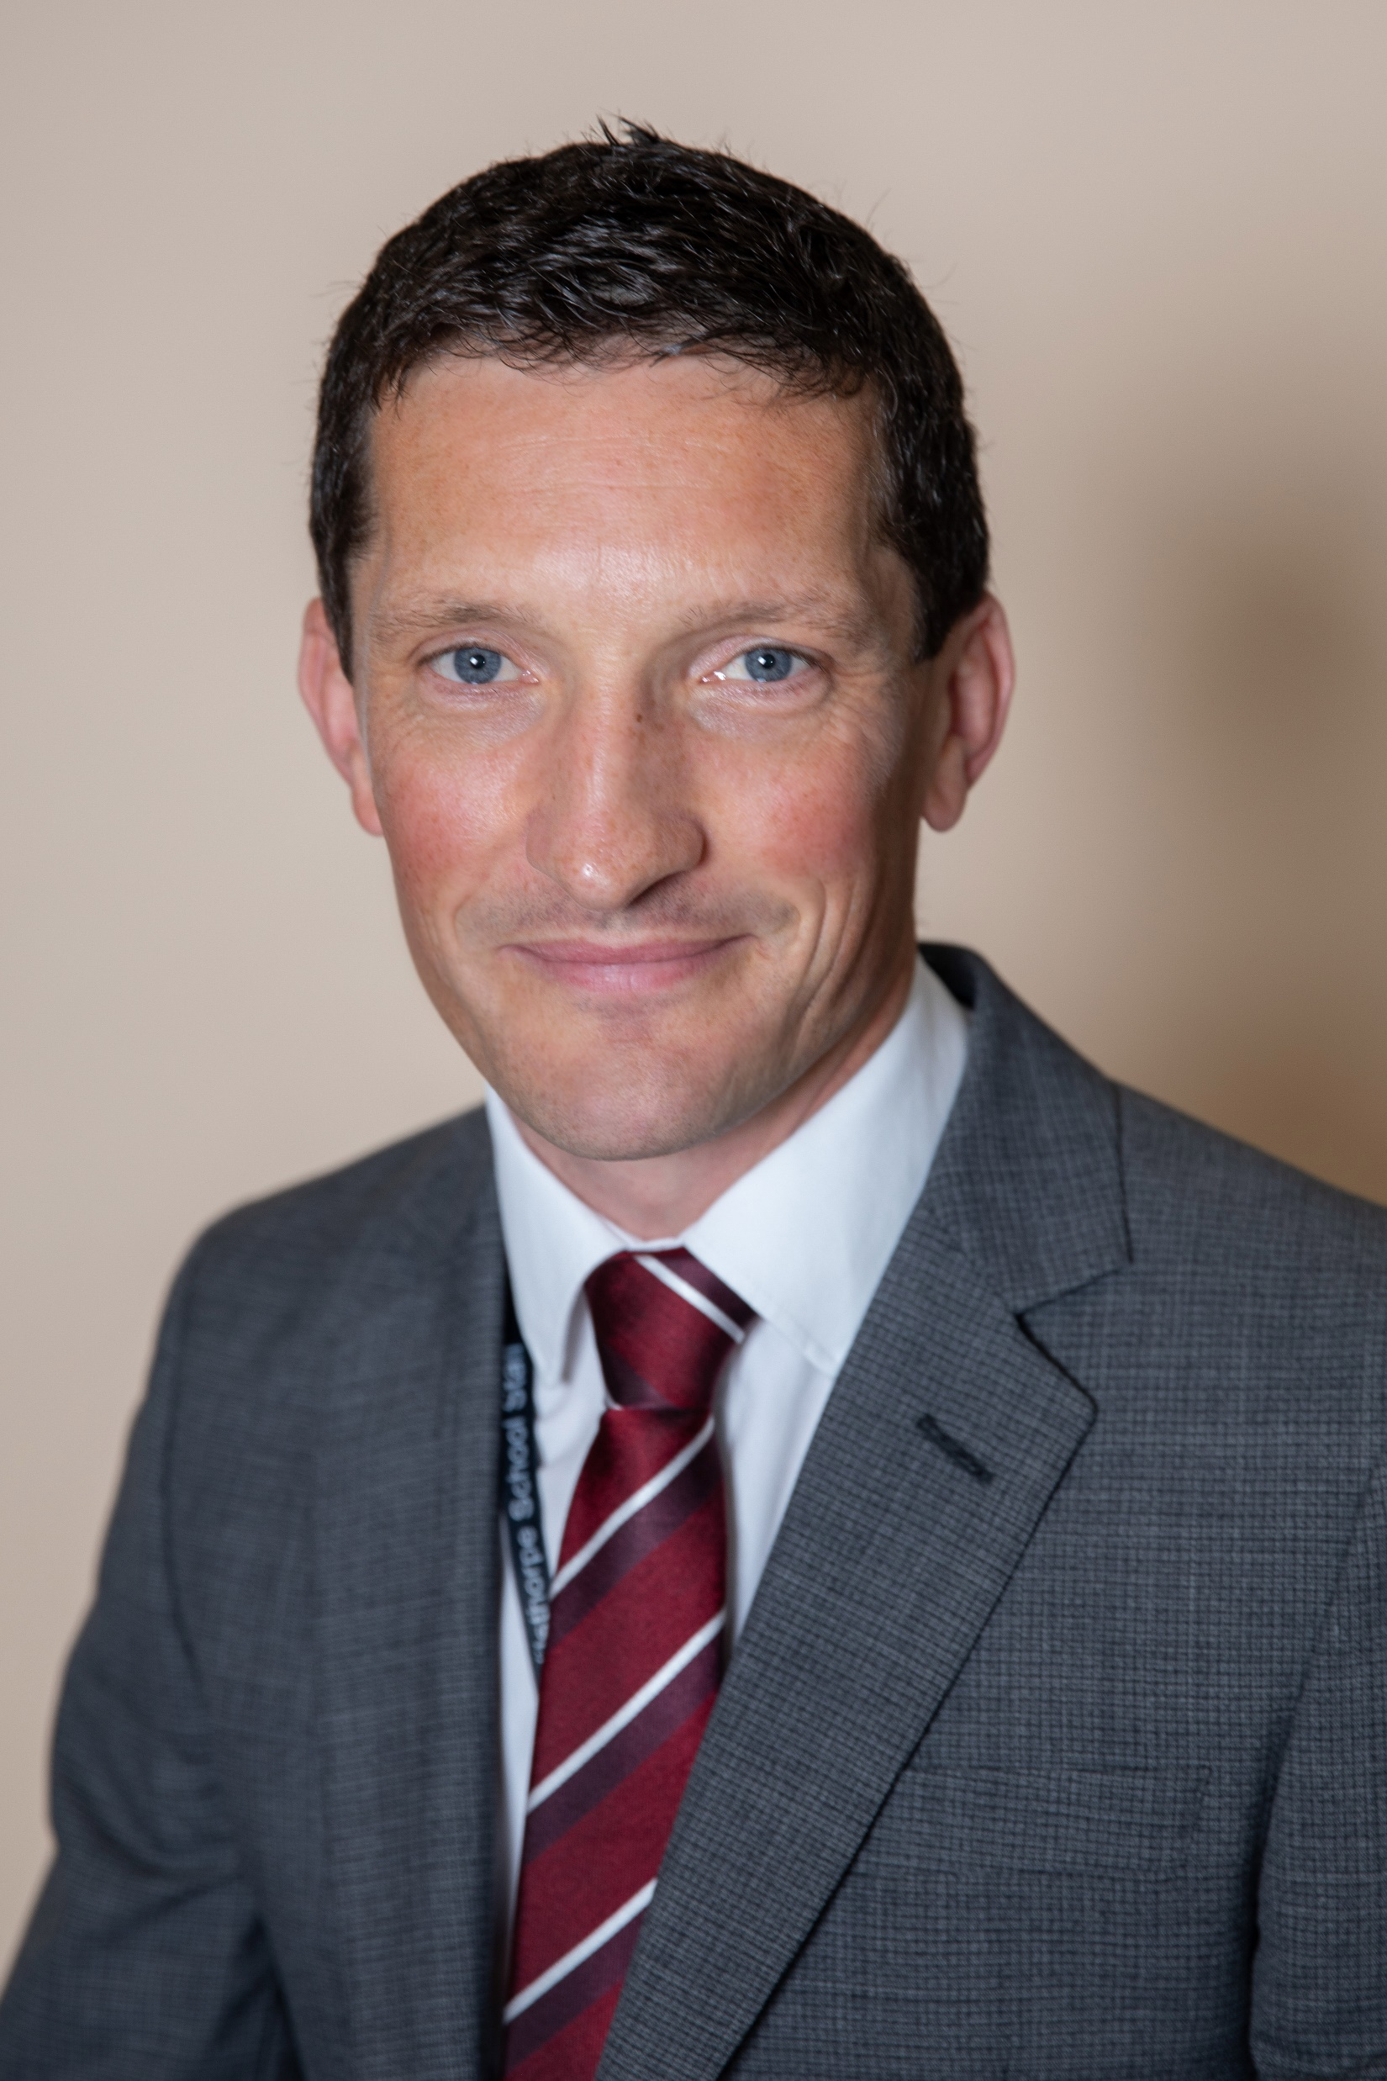
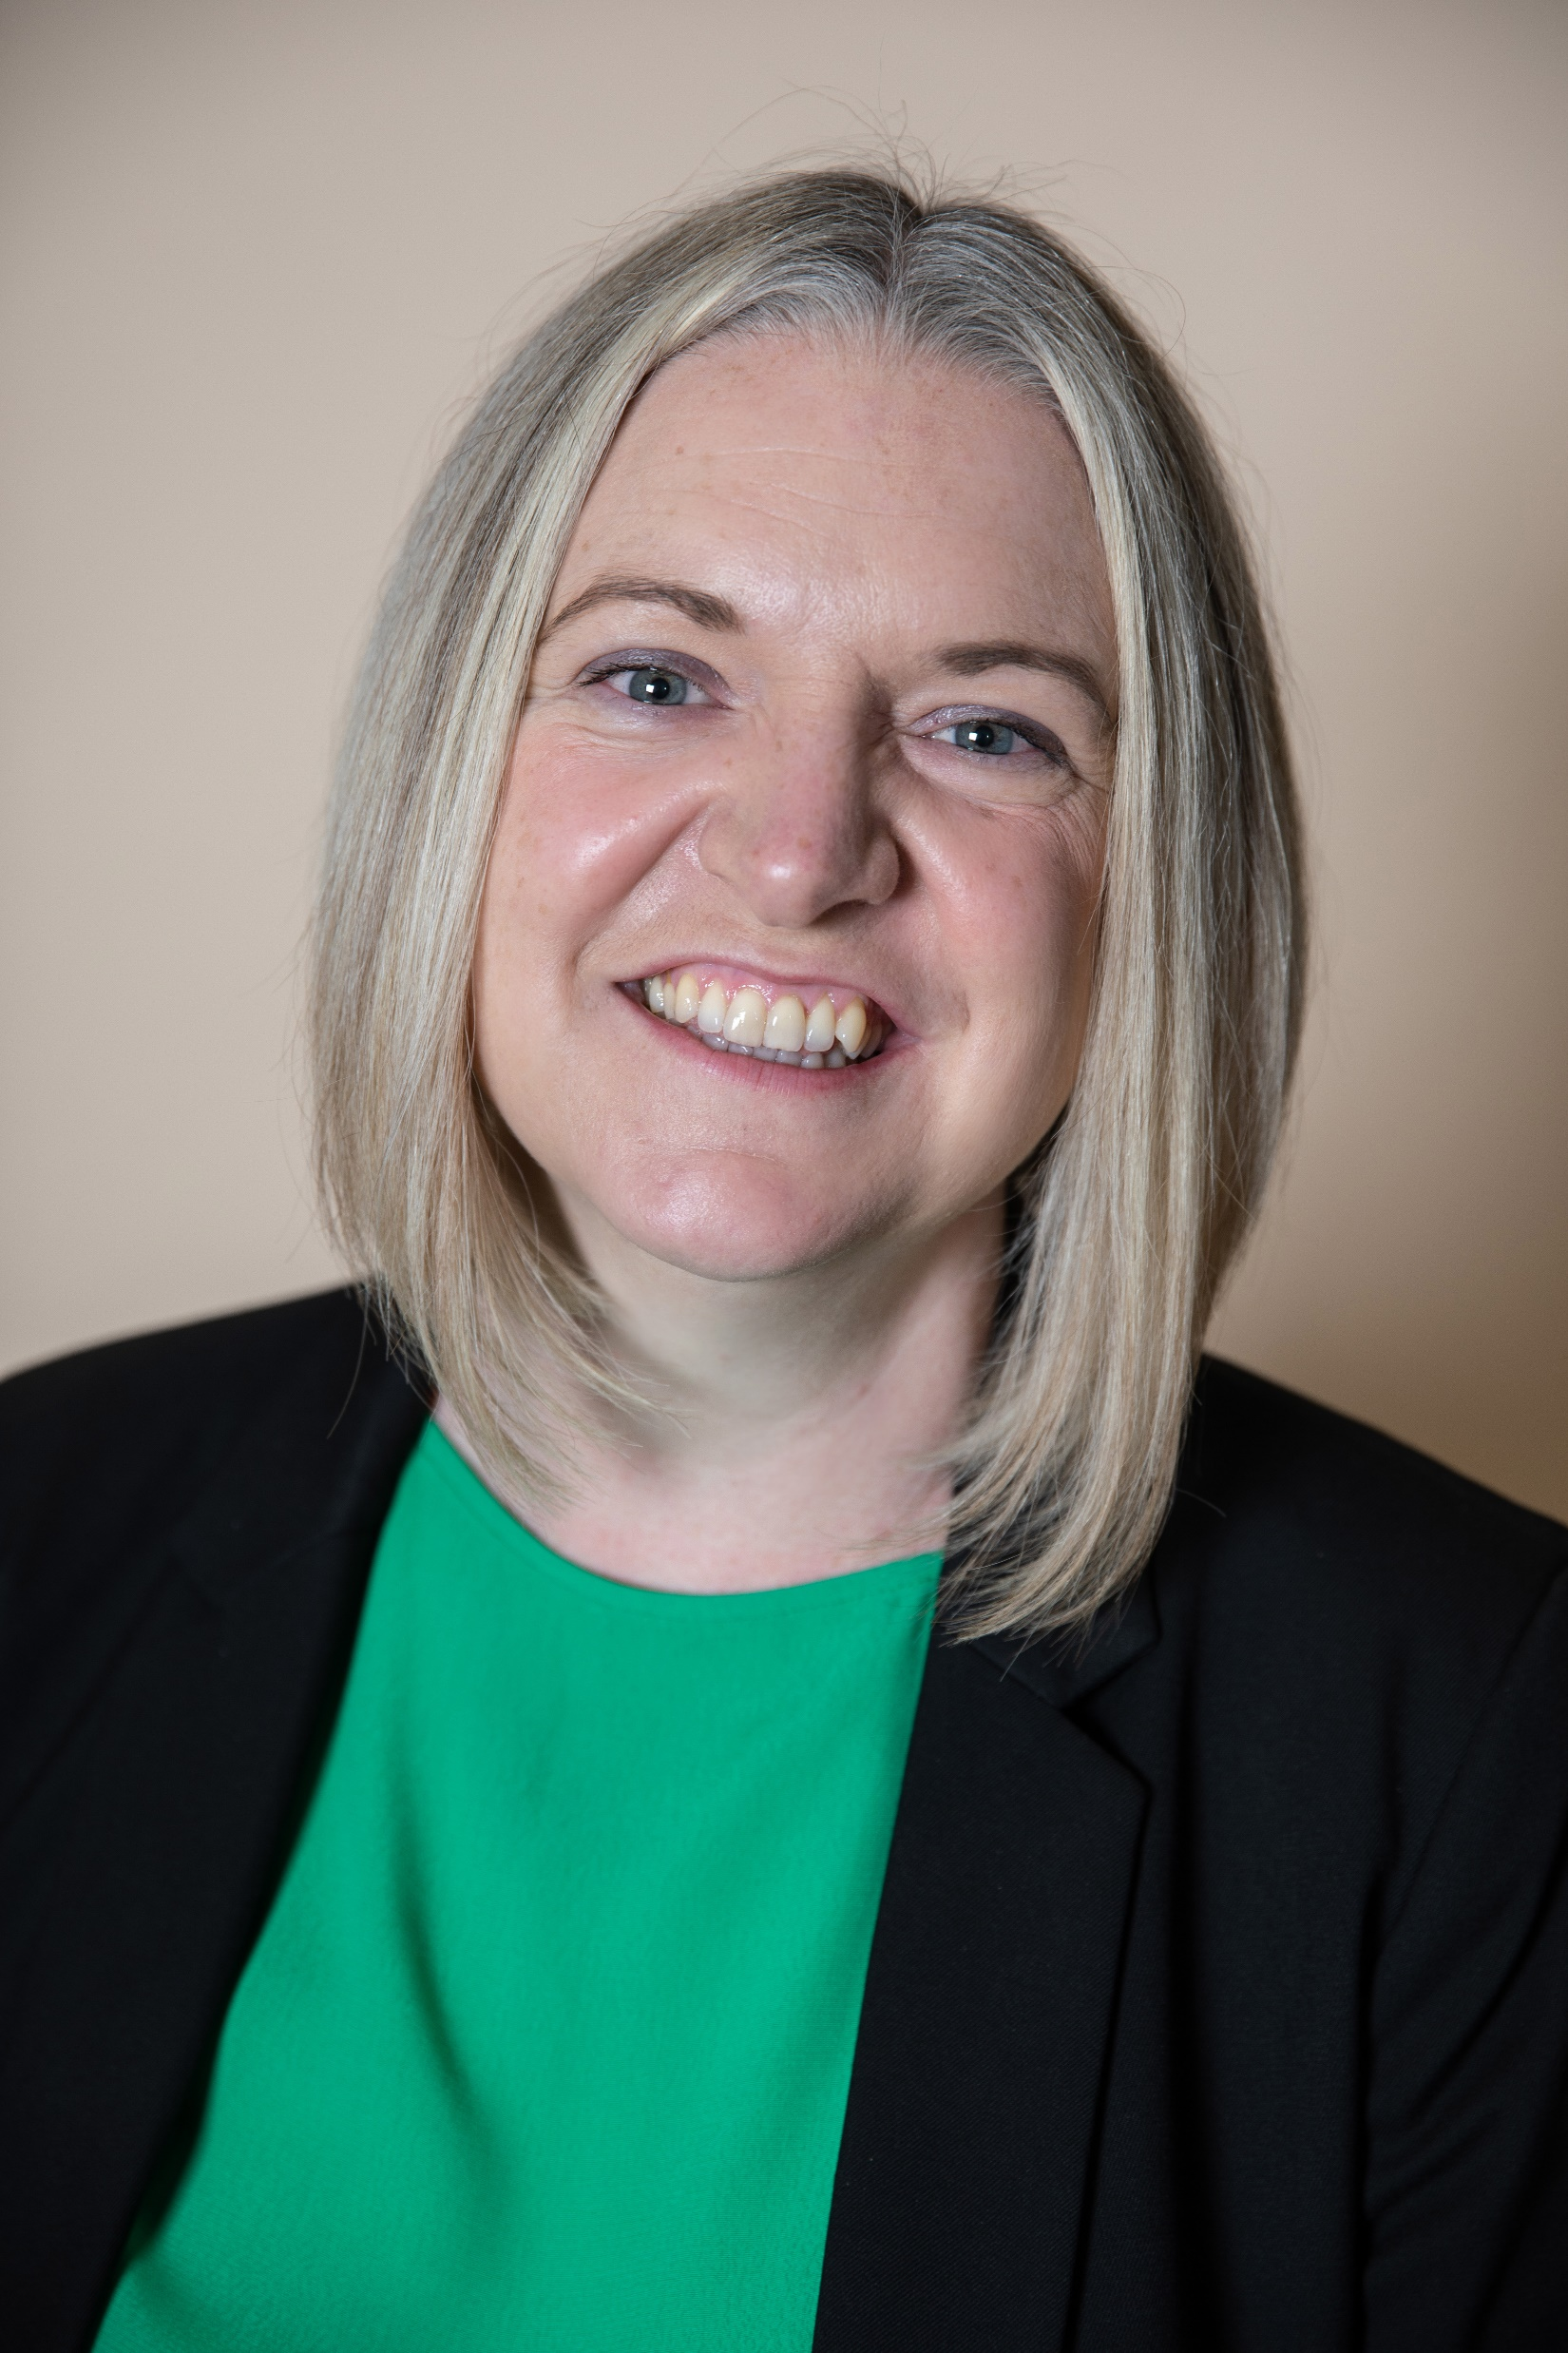
Senior Leadership Team
The Senior Leadership Team oversee the running of the school and you will see them every day in school so remember to say hello.
Mr Hobbs - Headteacher
The most important part of my job is helping all the staff and students to live up to our motto – ‘be the best you can be’ – and making sure that everyone is included as part of the Wilsthorpe community.
If I had a superpower … I think it would be apparating, as in Harry Potter, as I do walk at quite a pace and students often comment that I’ll appear at one end of the building, only to reappear in another part not long afterwards. Keeps everyone on their toes!
Mrs Tickle – Deputy Headteacher
The most important part of my role is trying to ensure that students feel safe and supported during their time at Wilsthorpe. I help to make sure that students develop not only academically but personally so that they leave Wilsthorpe with the confidence to succeed in life
If I had a superpower it would be to be able to give the students all the confidence and self belief that they need.

Slide 22
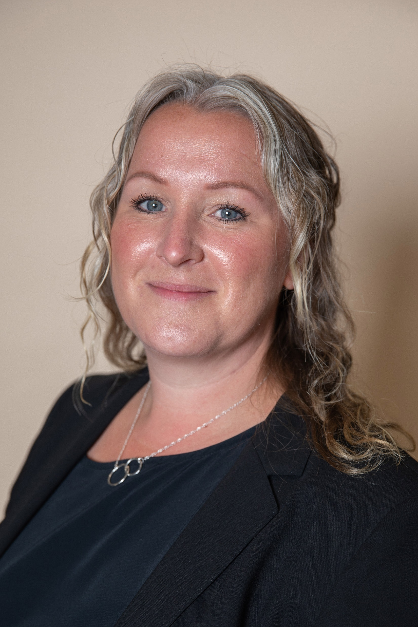
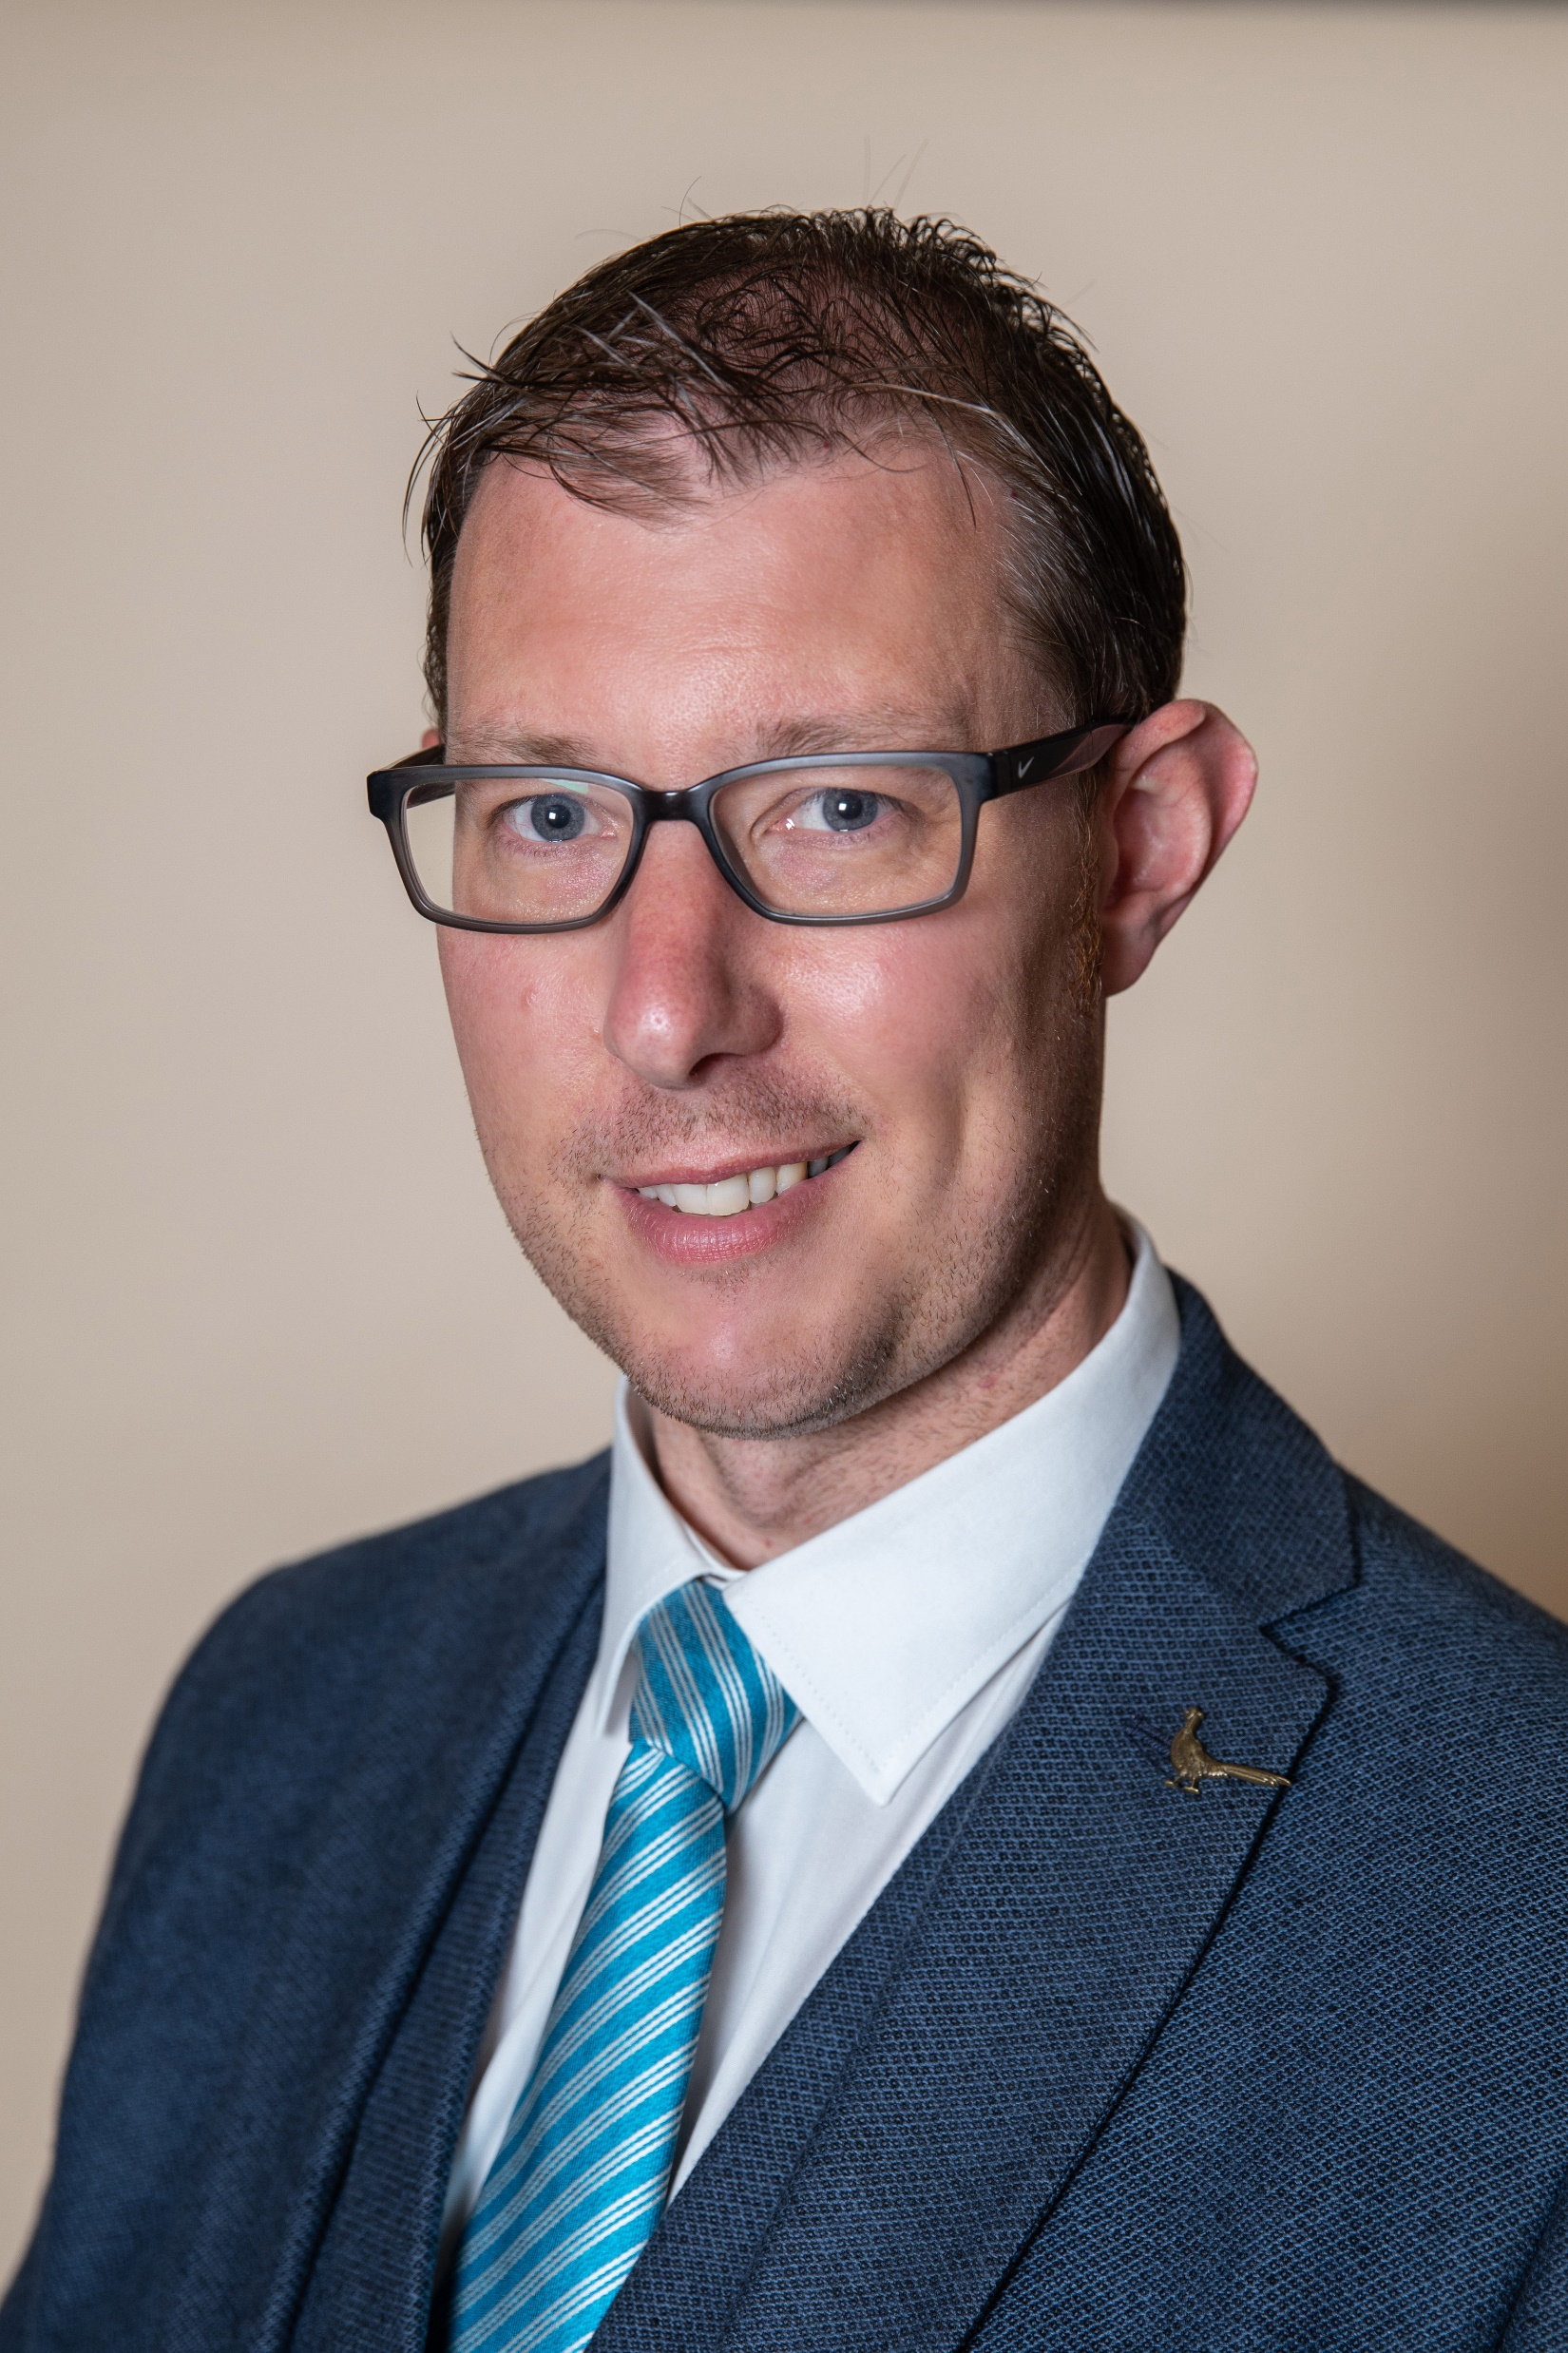
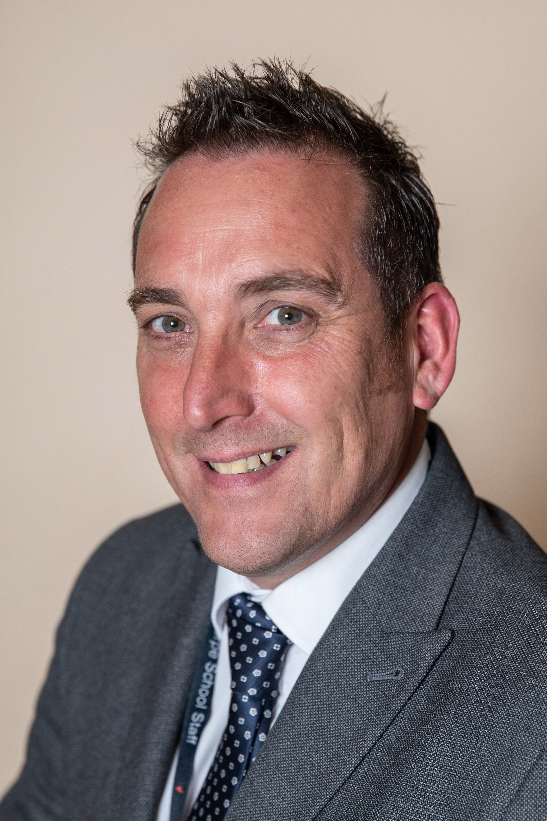
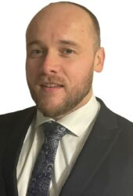
Senior Leadership Team
Mrs Scott
Assistant Headteacher
The most important part of my job is making sure everyone is in school every day and feels happy and safe in school. If you feel happy and safe, you will maximise your learning.
If I had a superpower I would wish to read minds. This may help me to understand everyone that little bit better.
Mr Parker
Assistant Headteacher
The most important part of my job is:
Having an overview of and supporting new teachers.
Ensuring Teaching and Learning is excellent.
Making sure students have an opportunity to voice their views
If I had a superpower it would be the power of premonition – to see things before they actually happen. This would allow me the chance to be in the right place at the right time to see all of the excellent things happen in school.
Mr Gray
Assistant Headteacher
The most important part of my job is working with students! This is because by helping students overcome the challenges of each school day, they develop the superpowers admired by employers and the exams results necessary to have options when they leave.
My dream superpower would be the ability to move at super speeds. This would allow me to visit every class each lesson and celebrate the brilliant things Wilsthorpe students do!
Mr Hunter
Assistant Headteacher
The most important part of my job is ensuring that the actions of others only have a positive impact on your time at Wilsthorpe and supporting students to do the right thing every day.
My dream superpower would be the ability to teleport to get to places instantly! That way I could move around school instantly to support and challenge students throughout the day!

Slide 23
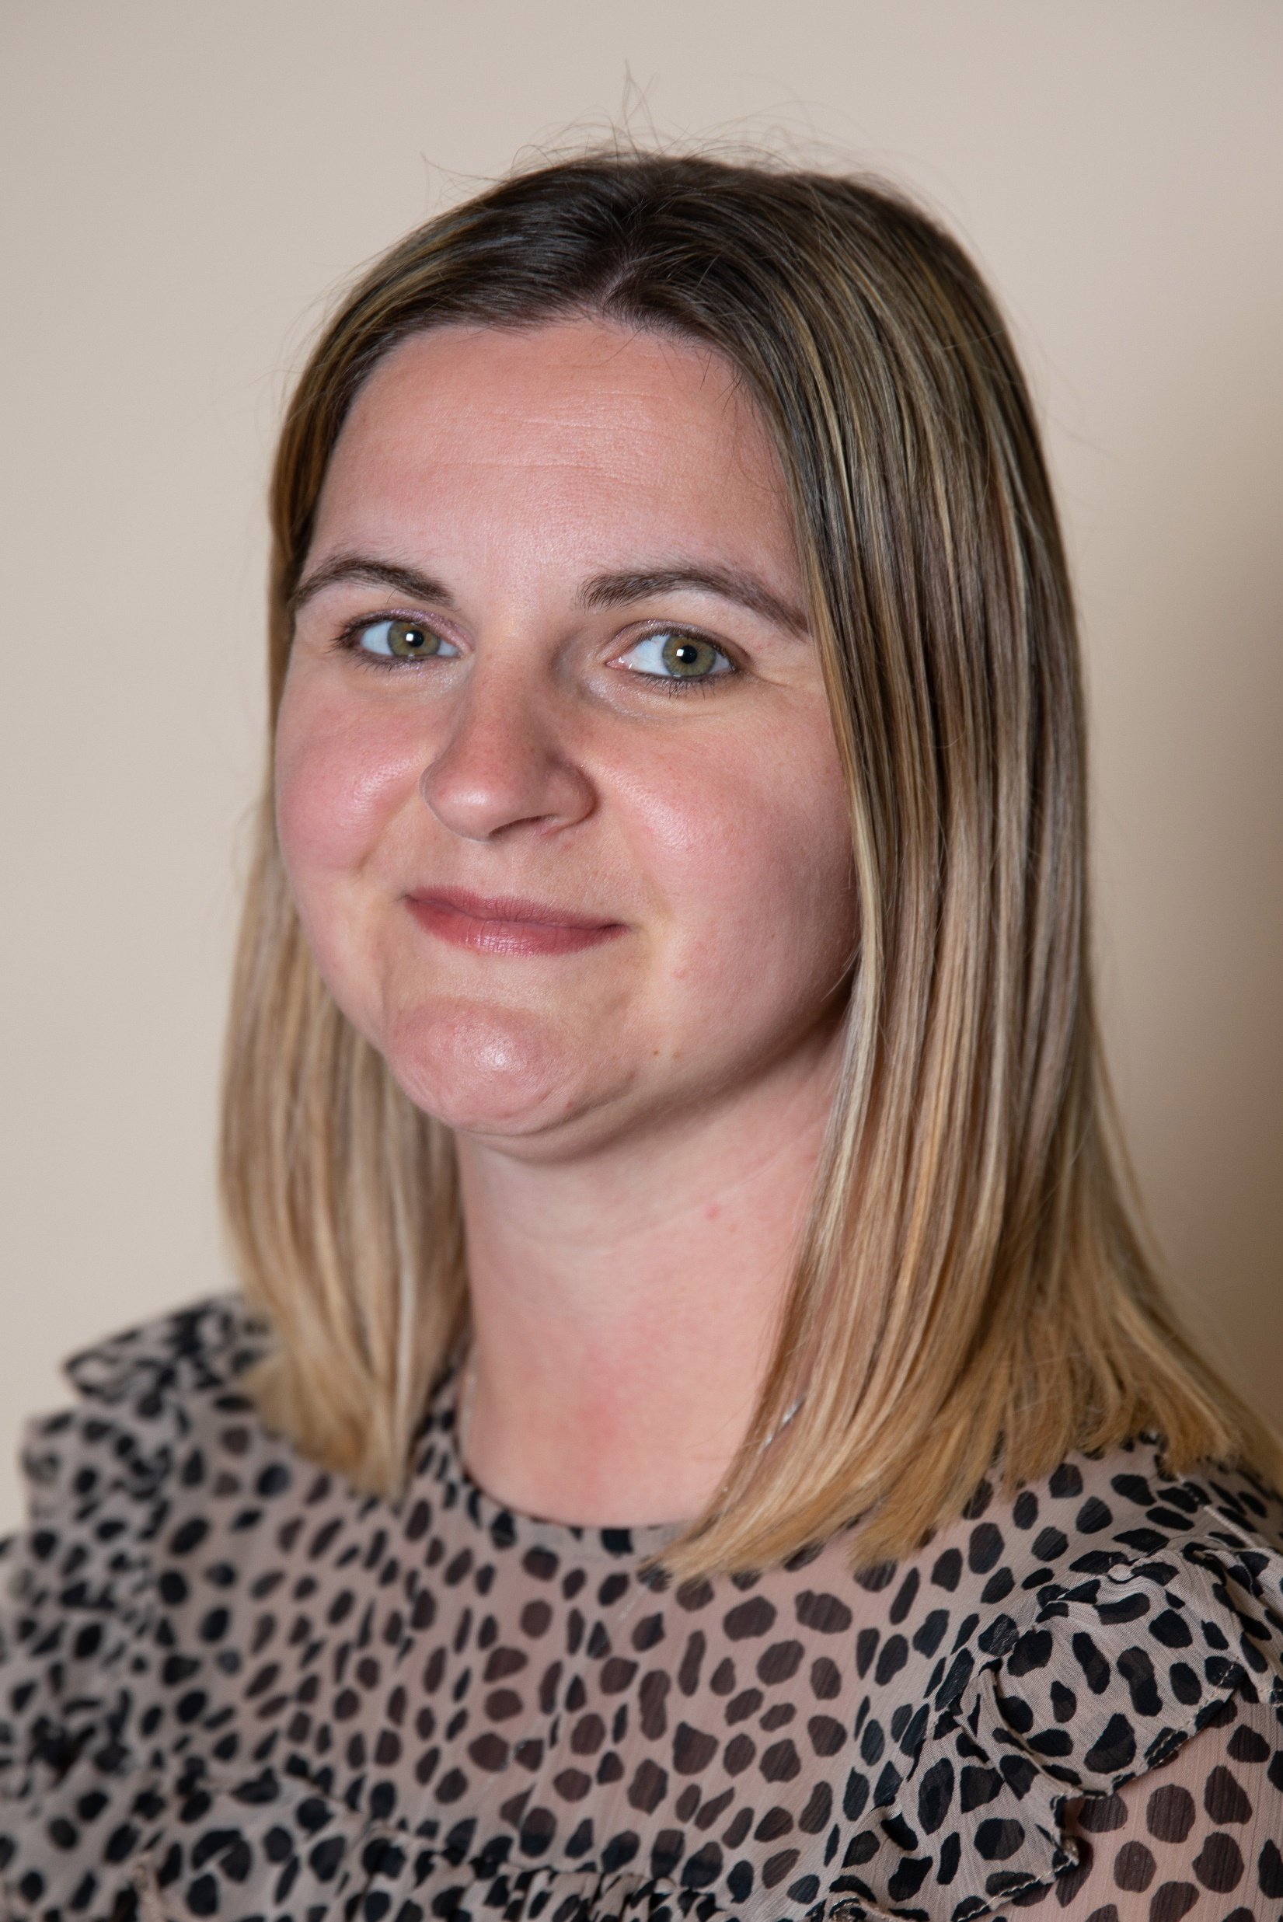
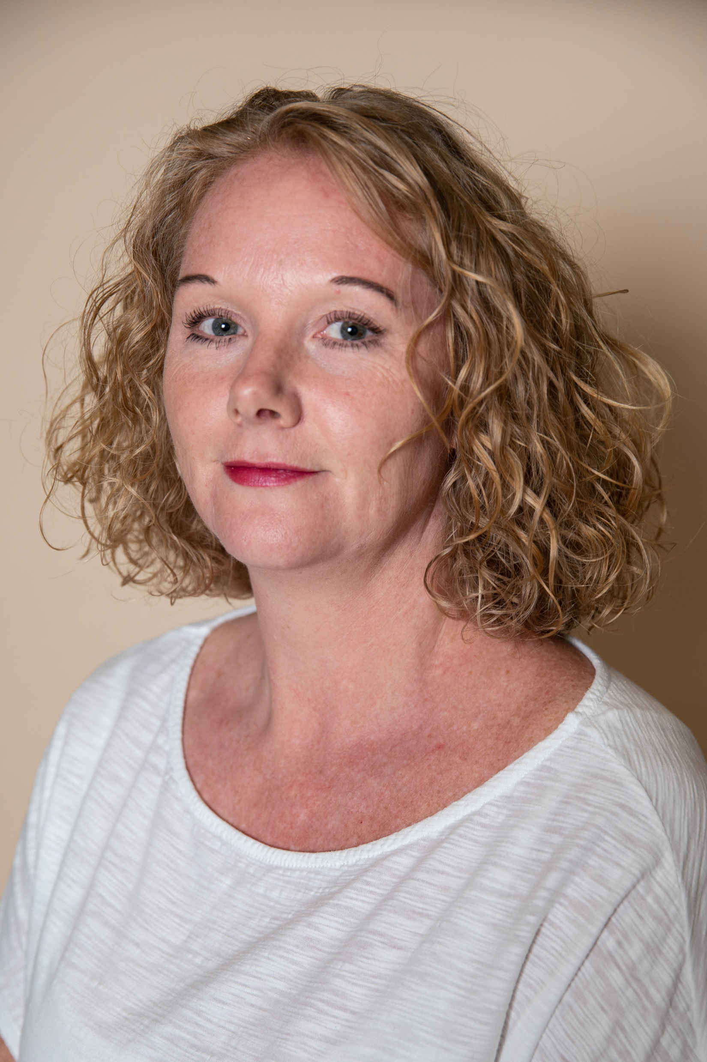
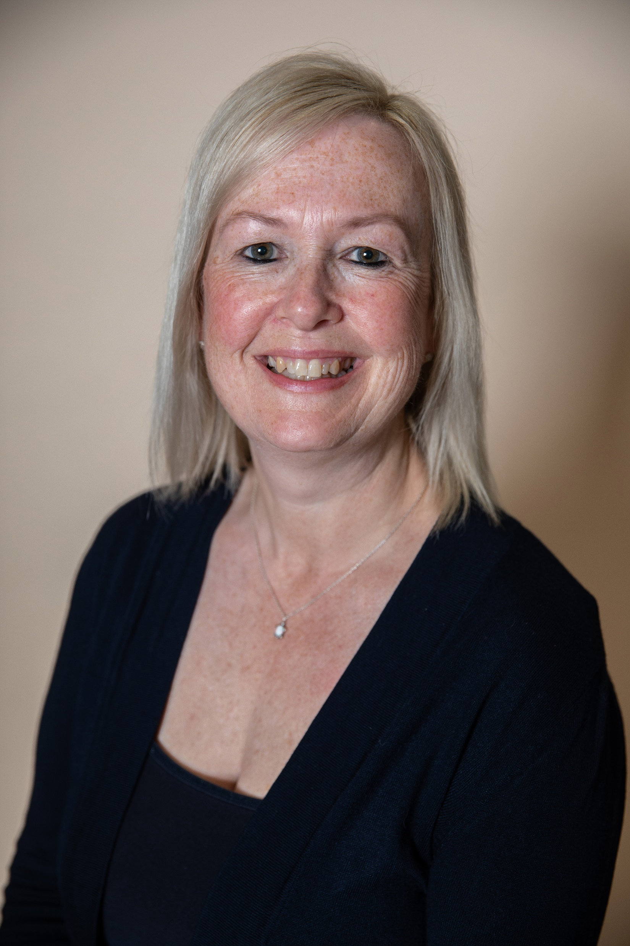
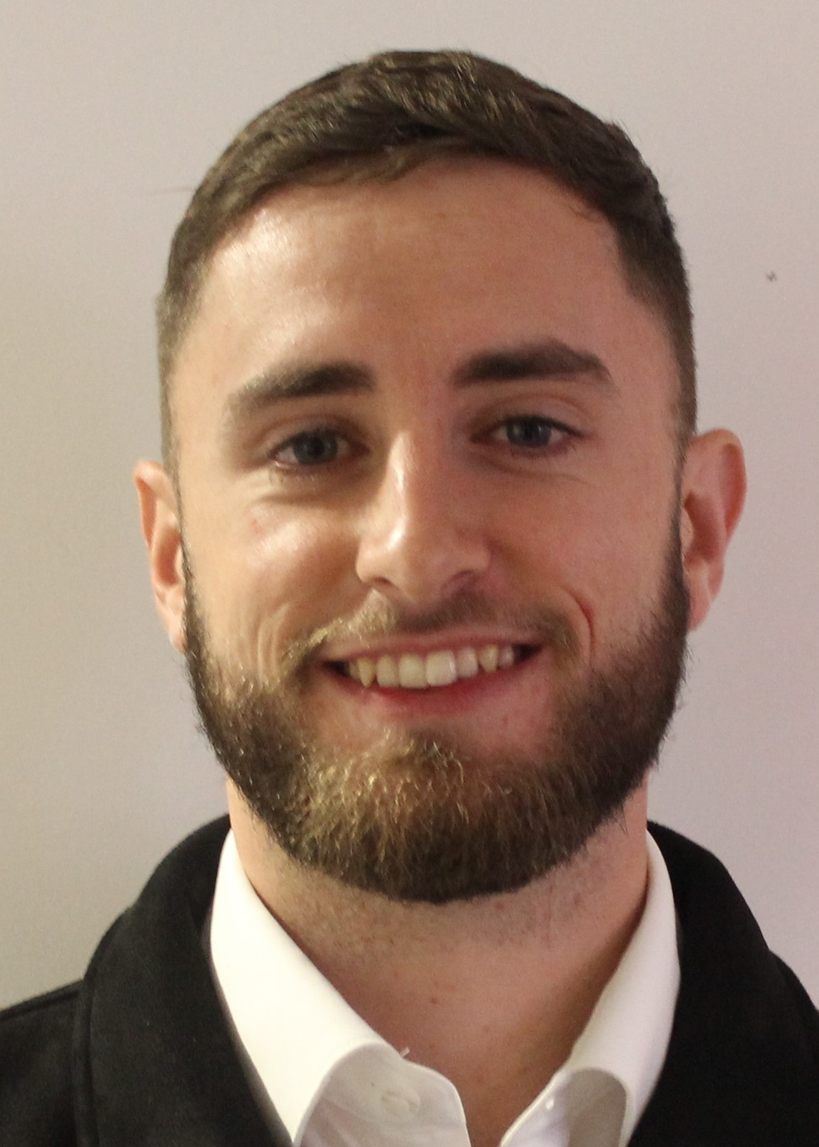
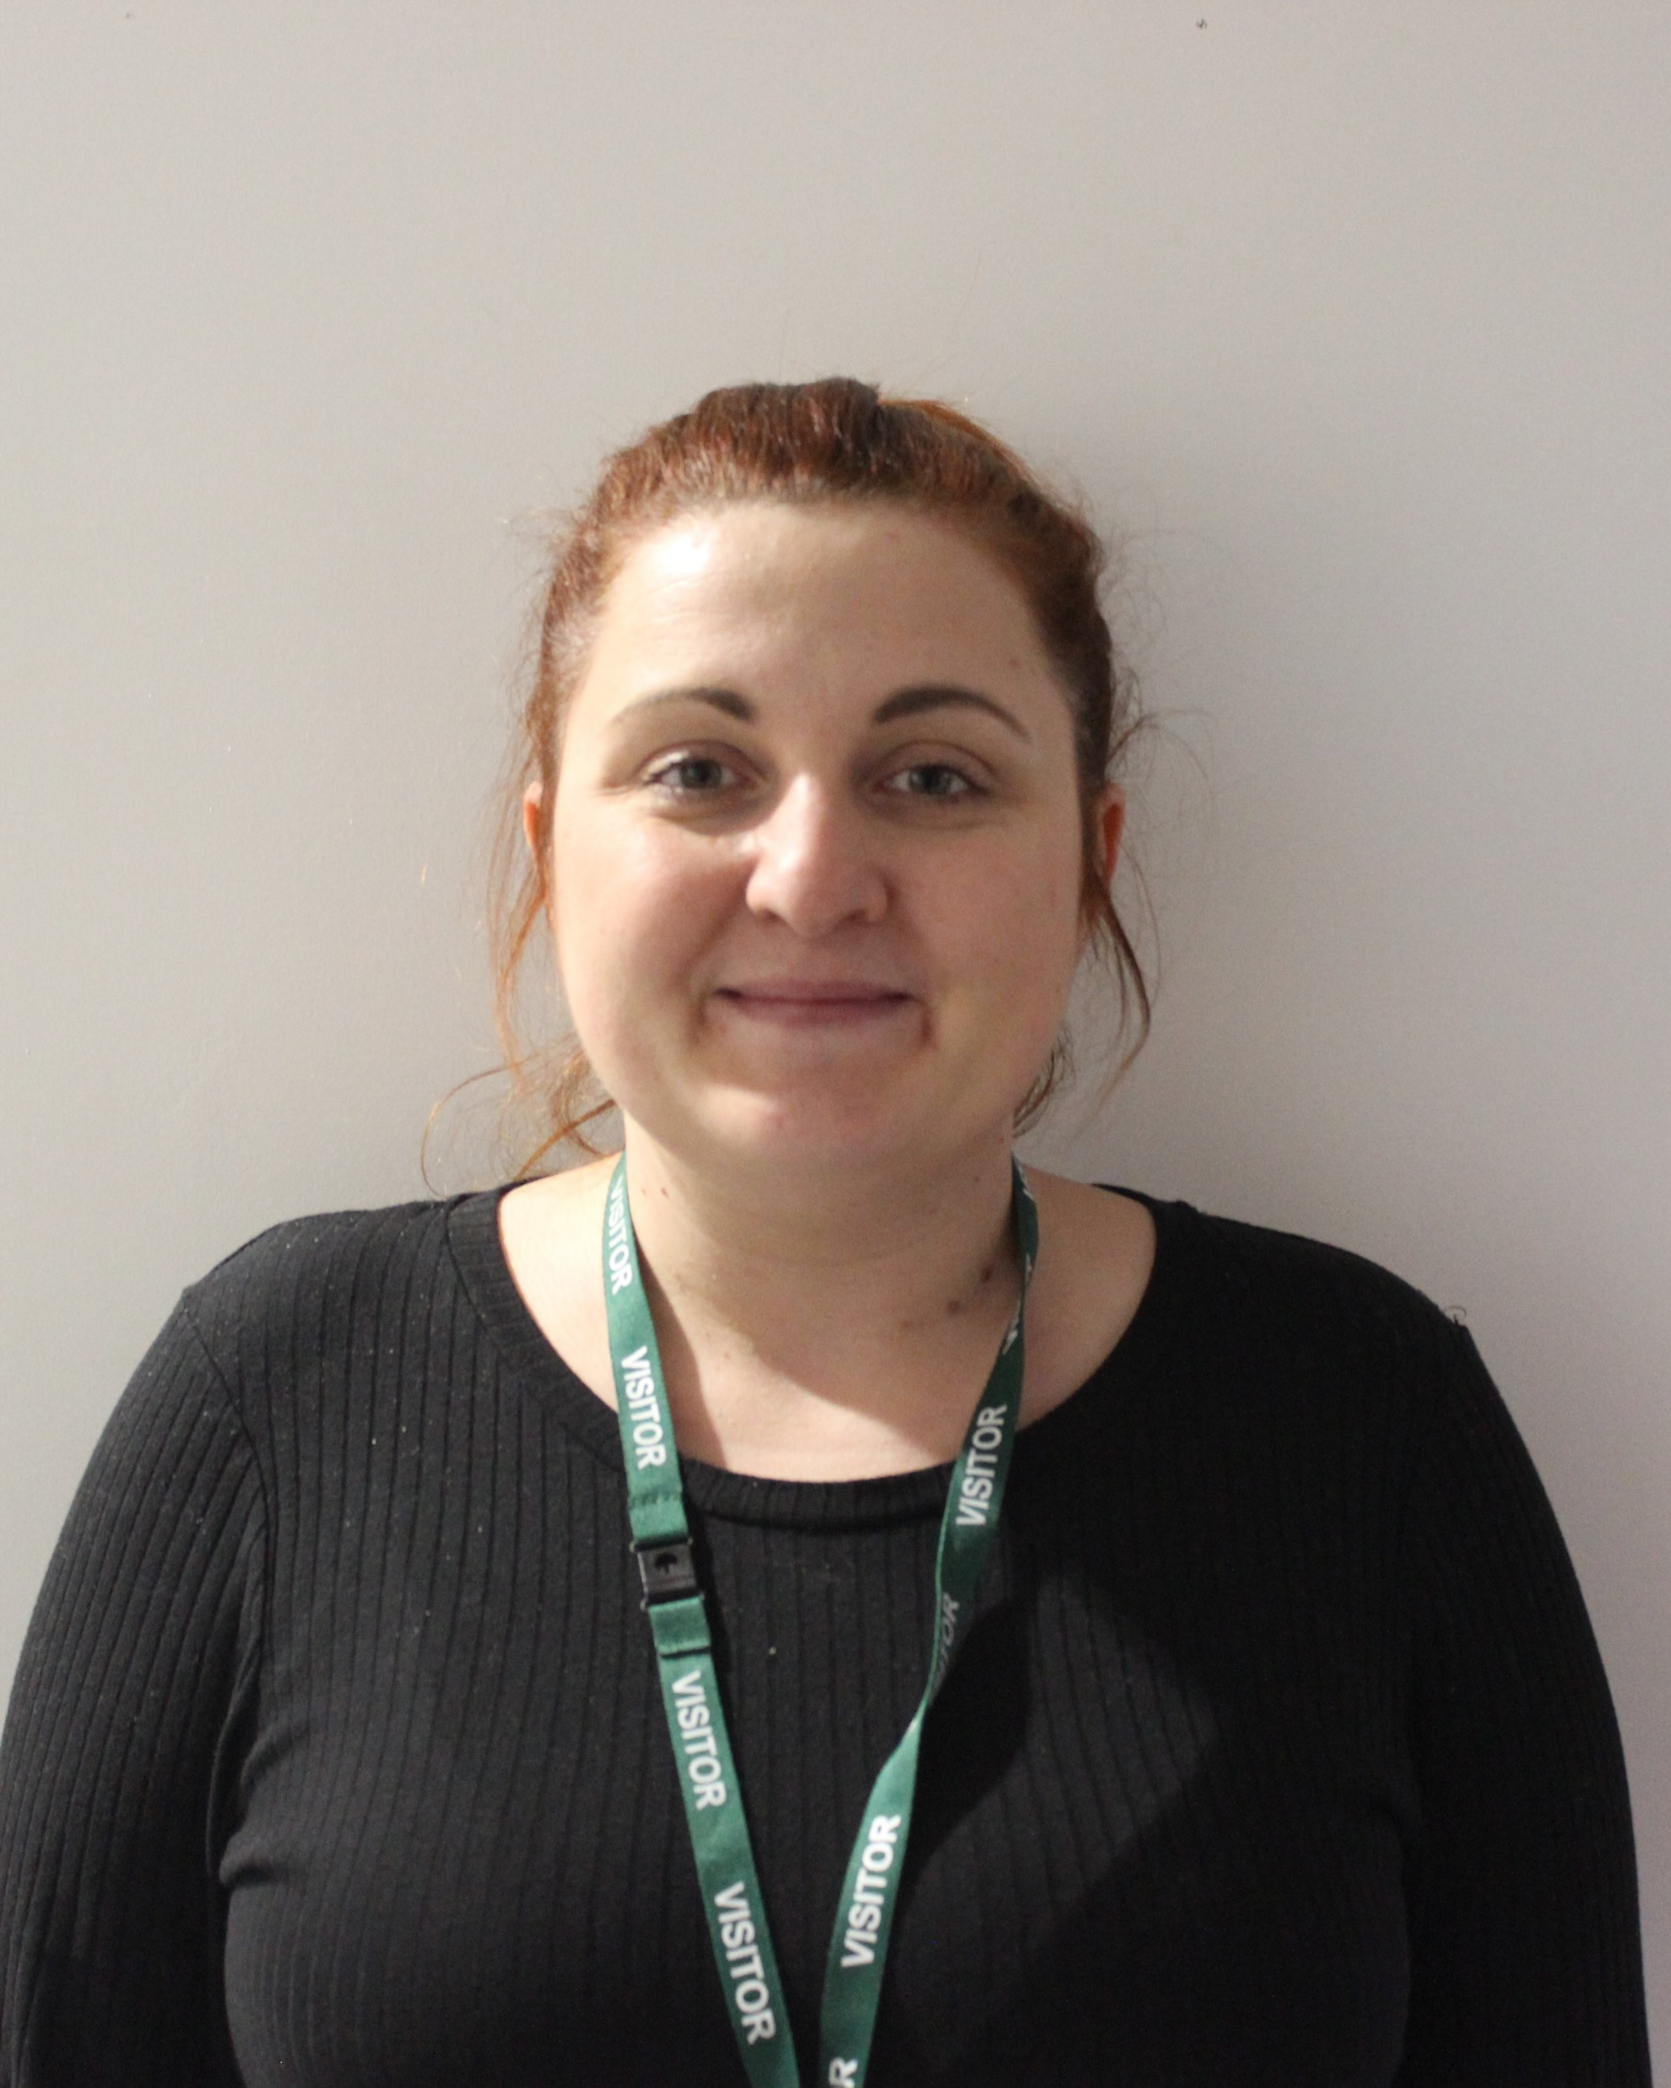
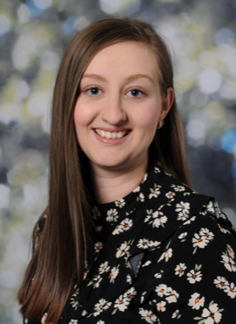
Student Support
The Student Support office can be found on the first floor between rooms 116 and 117.
The staff are always available to talk to you if you have a problem.
Mrs Kendrick
Senior Student Welfare Officer
Miss Bowman
Senior Family Welfare Officer
Mrs Rudkin
Student Welfare Officer
Mr Bundey
Student Welfare Officer
Mrs Bryant
Student Welfare Officer
Miss Whittaker
Attendance Officer
What makes me smile?
Lying by the pool in Tenerife
What makes me smile?
Chocolate!
What makes me smile?
Camping
What makes me Smile?
Making other people smile
What makes me Smile?
Spending time with my family .
What makes me smile?
Taking my dog for a walk

Slide 24
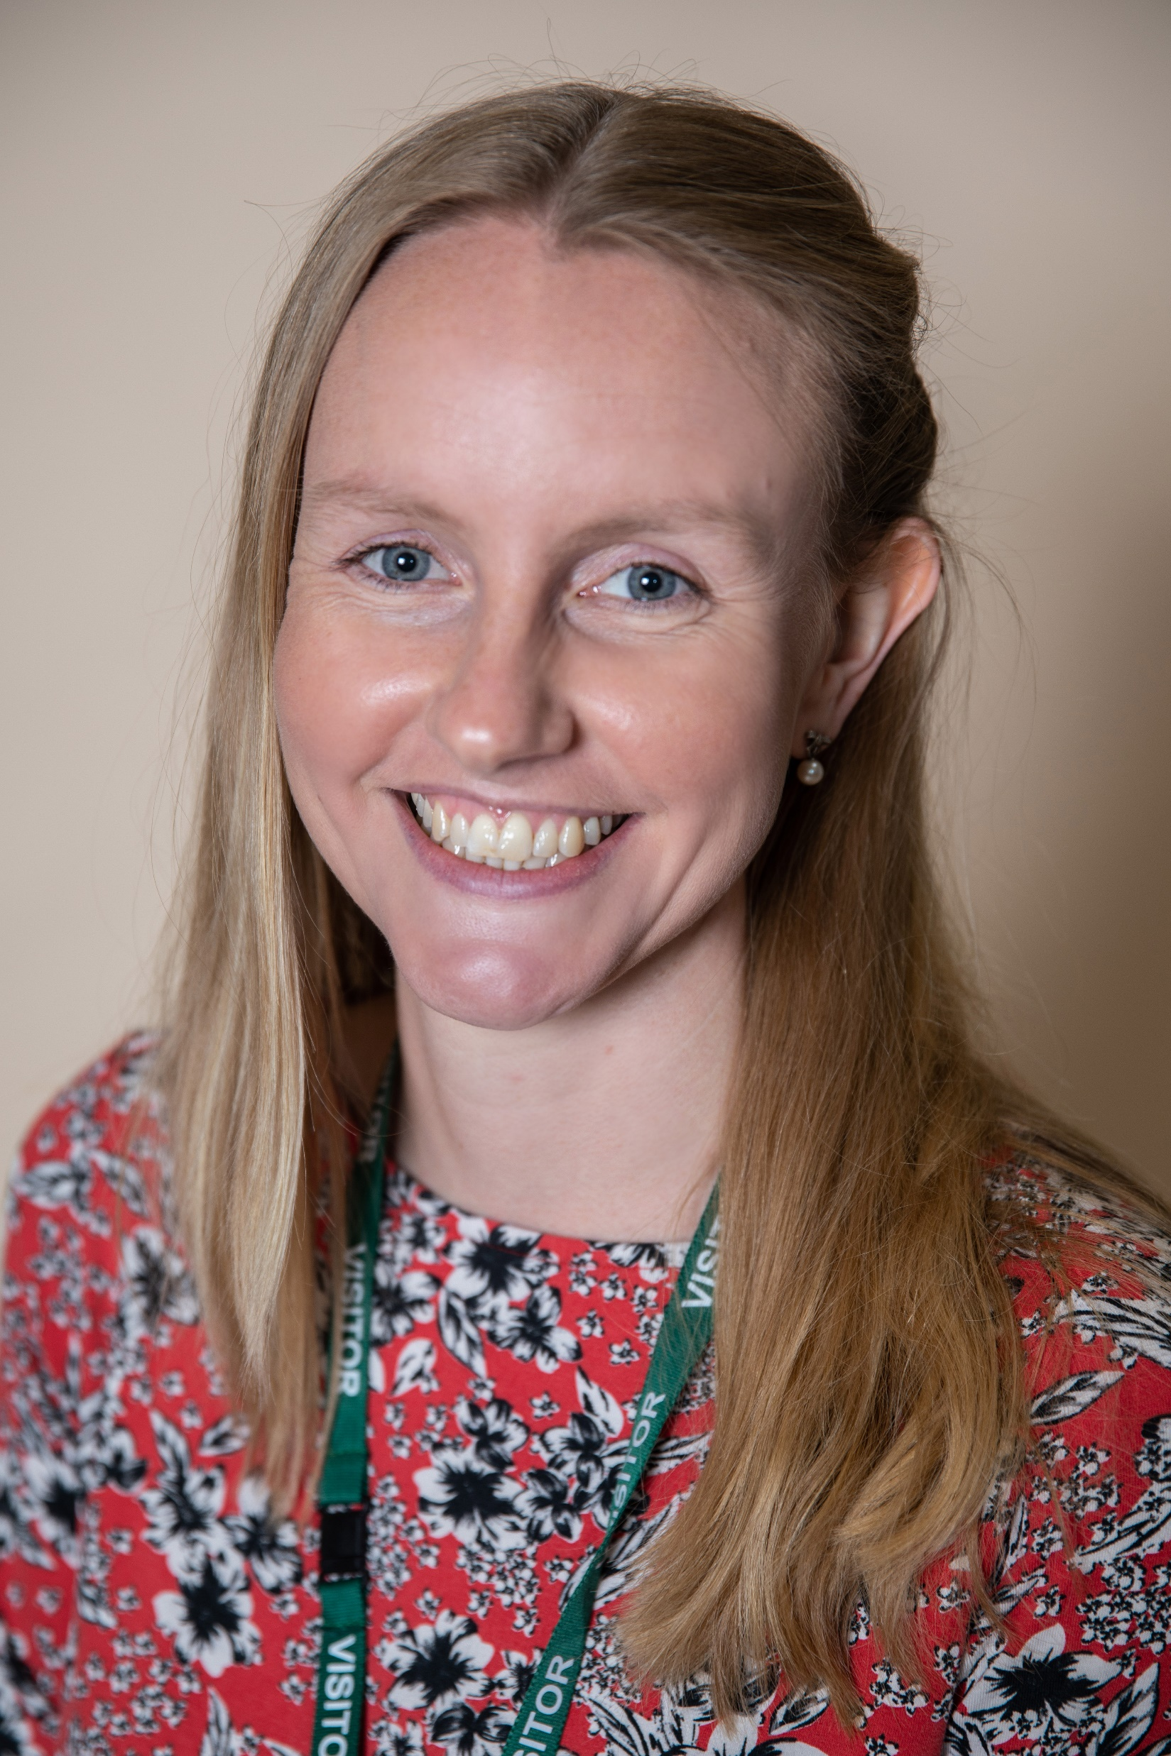
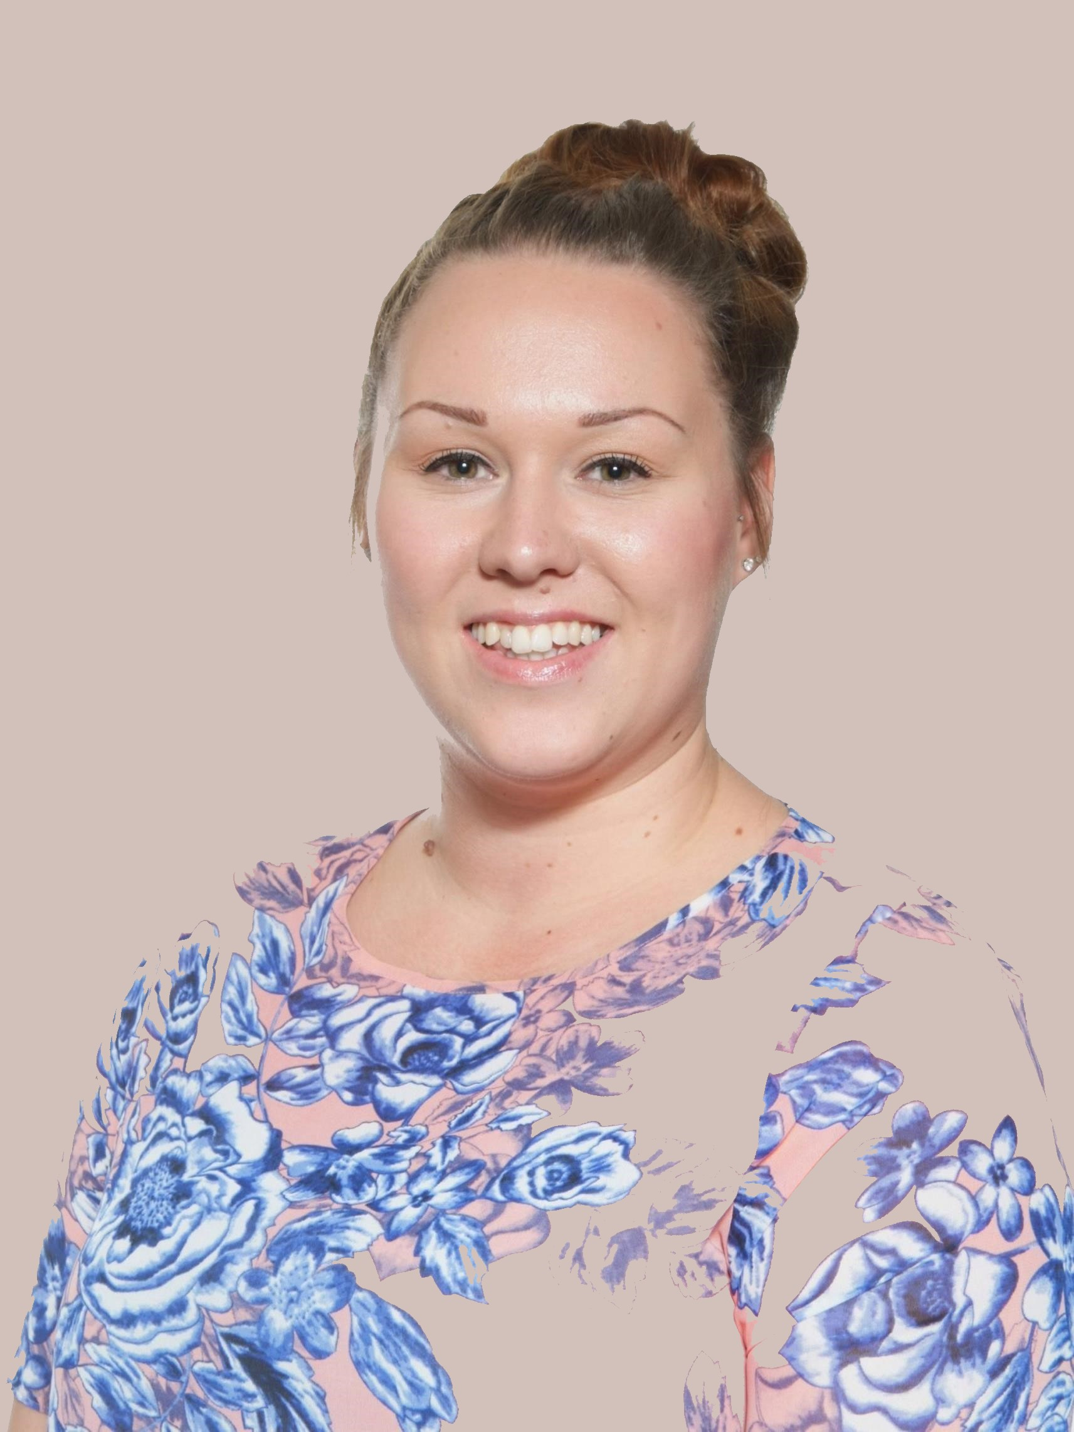
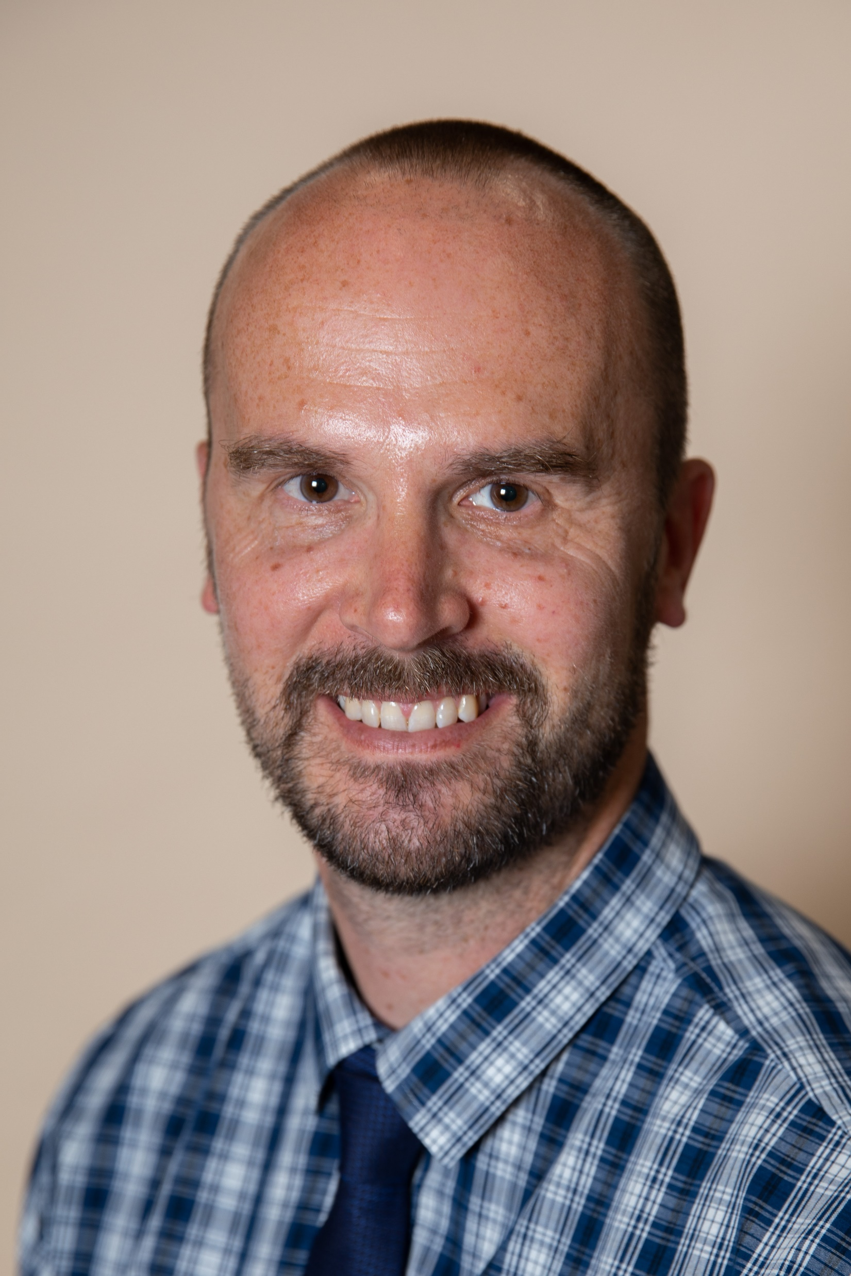
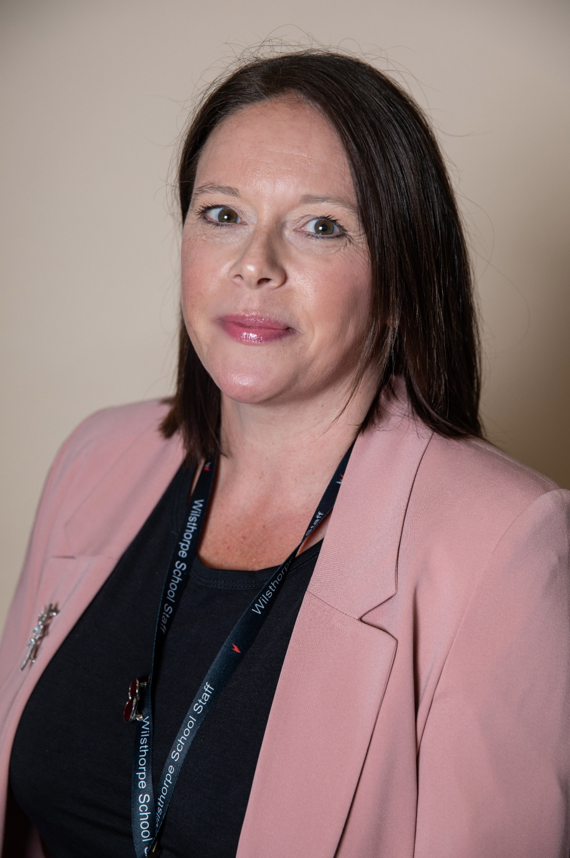
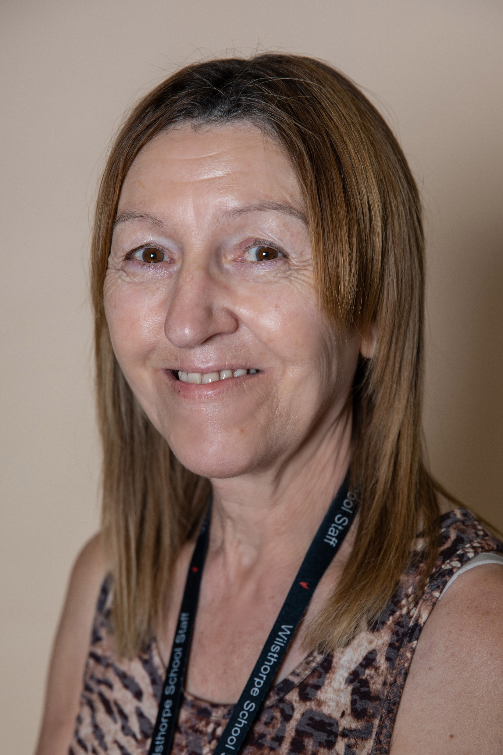
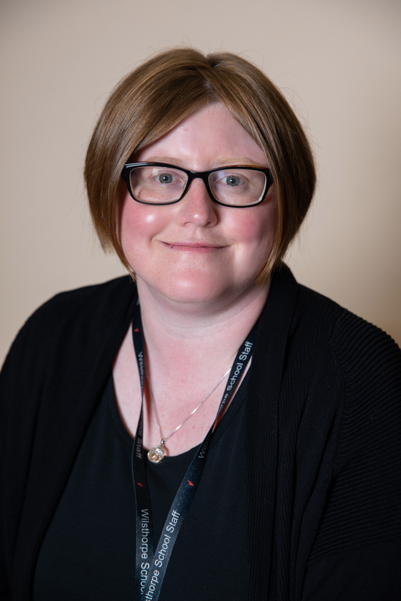
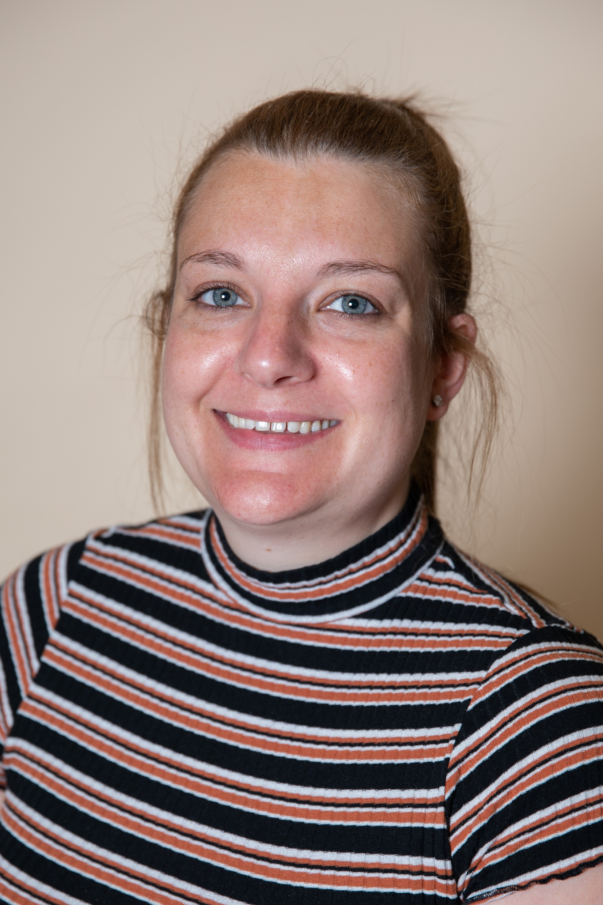
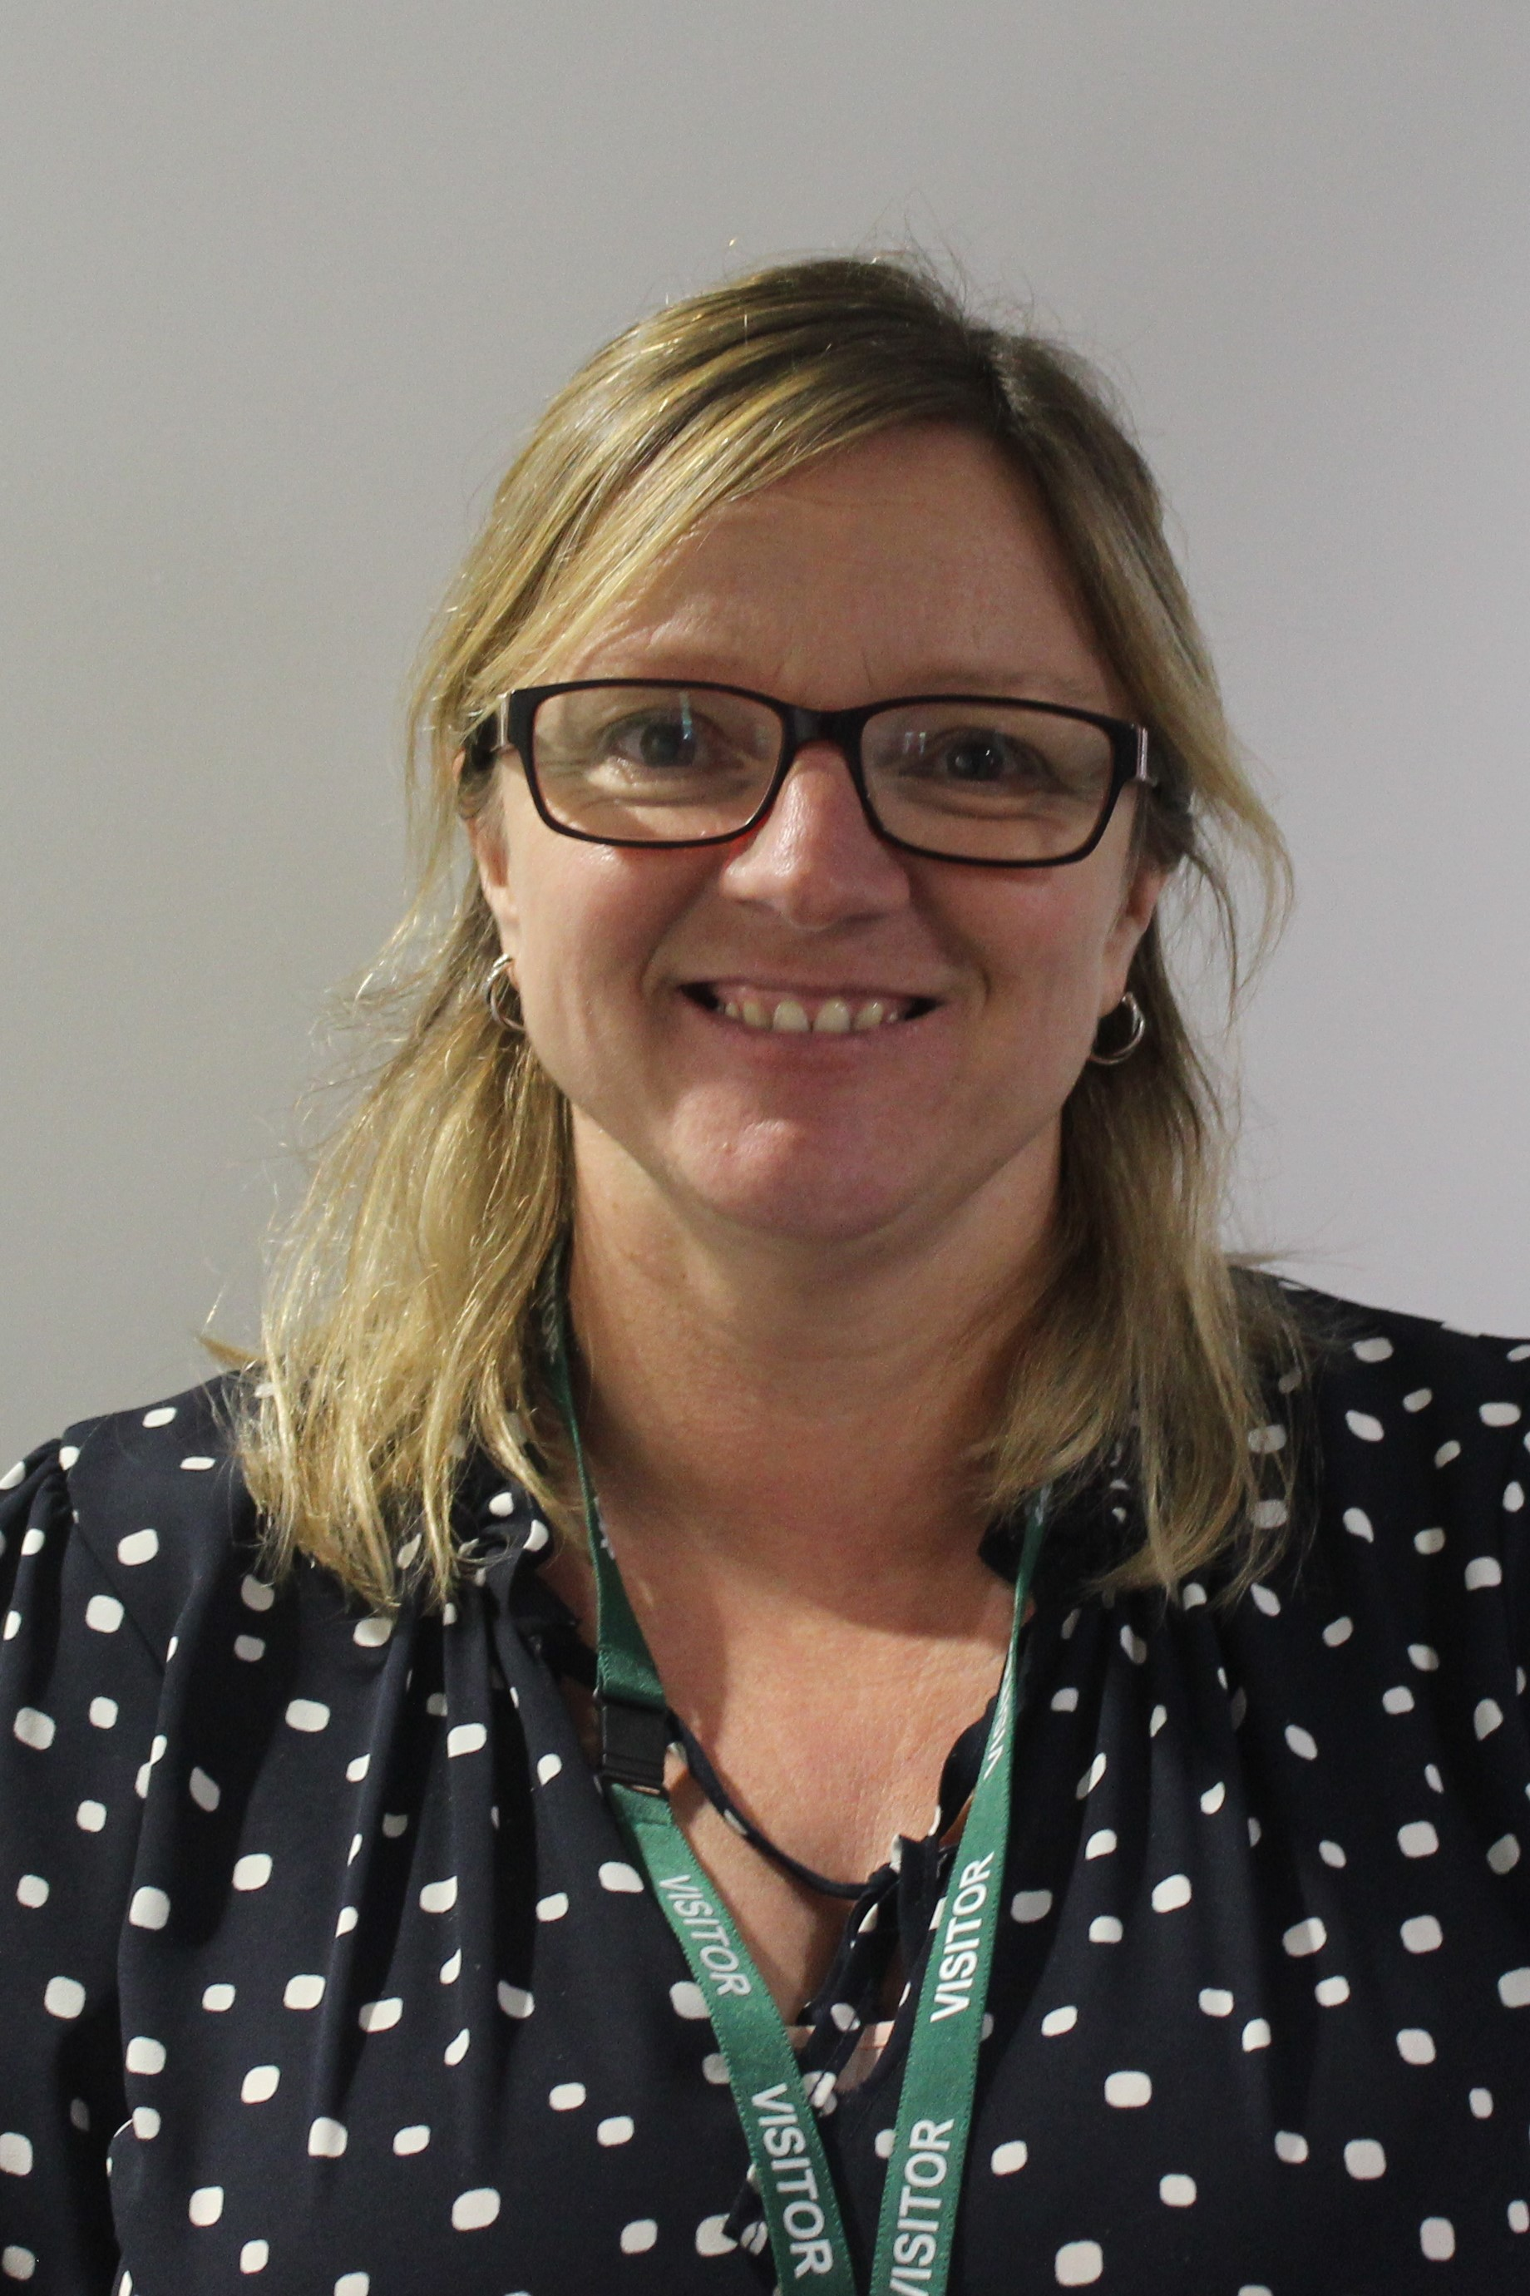
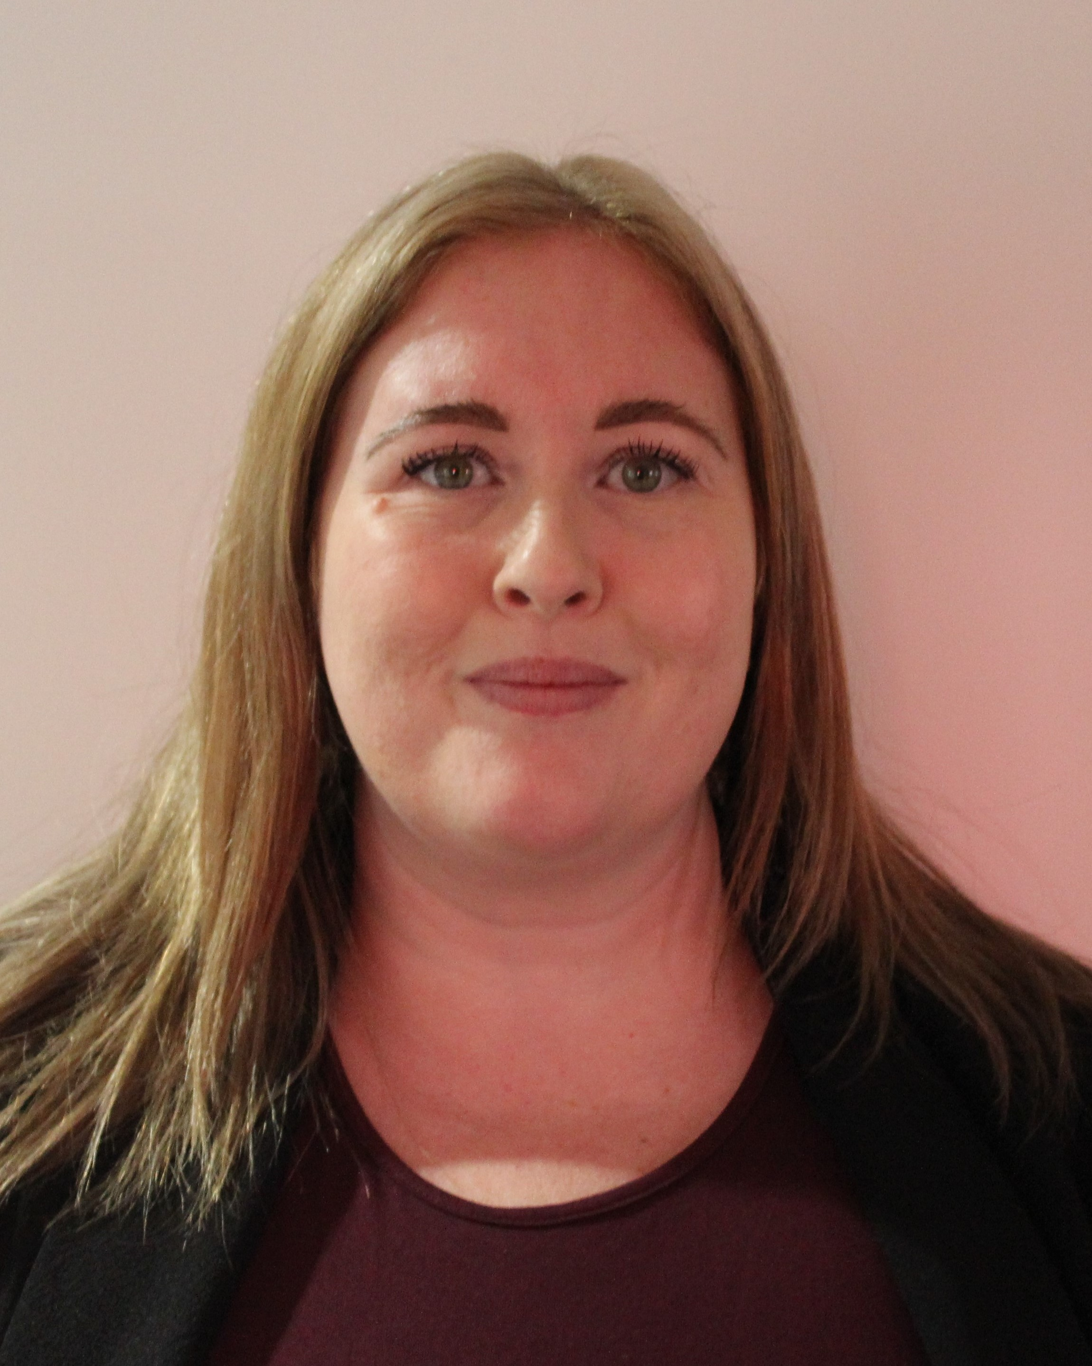
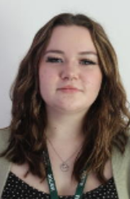
The Hub
The Hub can be found on the ground floor opposite the library and can be used at break and lunchtimes. The Hub is open before school and at the end of the day for Homework Club on Monday, Wednesday and Thursday. You might also visit The Hub for interventions.
Mrs Pickering - SENCo
The most important parts of my job are:
Giving students strategies so that they can be successful at school and thrive as young adults.
Working with teachers and teaching assistants to make sure that students have the support they need.
Identifying when students might need extra help with something and putting suitable interventions in place.
If I had a superpower it would be to be able to show students their future: to show them that their hard work will pay off when they’re older and to give them the self-belief that they will achieve their goals.
Miss Devlin Assistant SENCo
Mr Meir AEN Teacher
Mrs Scarborough TA
Mrs Smith TA
Mrs Redfern
TA
Mrs Duncanson TA
Mrs Tuttey
TA
The Hub staff are really supportive and always here to help. They are really kind and it is a nice place to go.
Miss Elliott TA
Miss Clay TA

Slide 25
Mrs Meir’s Summer challenge
Practise writing with a pen. | Test-run your route to school. Don’t forget to time how long it takes. | Read a book. | Have a go at making a packed lunch.
Learn how to tie your school tie and keep practising. | Pack your school bag and PE kit. | Practise your times tables. | Put on your cookery apron and practising tying it around the back.
Talk to a friend about starting at Wilsthorpe. What are you excited about or nervous about? | Visit the school website to find about the different Curriculum Areas. | Send a postcard to your Form Tutor | Play a board game with a friend or family member

Slide 26
If you have any questions over the next few weeks feel free to contact me on emma.meir@wilsthorpe.ttct.co.uk My final and most important message is to enjoy your summer holiday! All the Wilsthorpe Staff look forward to meeting you on Wednesday 6th September. Take care Mrs Meir

