Slide 1
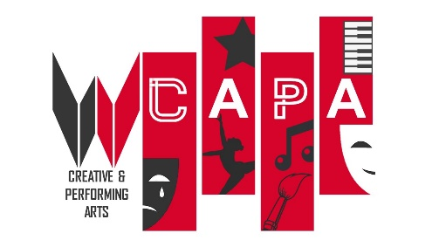
Unit 3: The Performing Arts Experience WRITTEN EXAM
NAME: _____________________________

Slide 2
Knowledge Organiser Expectations:
Bring to every single lesson and take home again – this is part of your equipment.
Revise from this resource regularly in order to be prepared for your exams and deepen your learning.
TOP TIPS FOR REVISING:
Read through your Knowledge organiser be sure to ask if you do not understand anything.
Record yourself reading your knowledge organiser out loud and then listen to it.
Read, re-read and highlight the key word / points to make sure you know what you have to do: e.g. explain, list, create etc.
Get someone to test you on your key words.
Little and often – break revision into 20-30 minute chunks and then take a short break.
Get creative – create your own flash cards, mind maps or posters to help embed your learning.
Revise with a friend and test each other!
Create a timetable of when you will revise and STICK TO IT!

Slide 3
Contents Page
Storyboard Narrative Development
Approaches to rehearsal
Approaches to rehearsal – Theatre companies
Approaches to rehearsal
Reviewing performances
Reviewing your own work
Unions
Recruiting processes, auditions, interviews, show-reels
Performing Arts in society
performing arts organisations- Birmingham REP Theatre
The REP theatre season programming
Management structure at the REP
Target Audiences
Venues and live performances
Different Types of Venues
Marketing
Marketing
Budget
Funding
Devising Tips
Rehearsal Techniques
Practitioners-Stanislavski
Practitioners – Brecht
Practitioners- Artaud
Practitioners – Frantic Assembly
Comparing Practitioner Theory
Modern & Post-Modern Theatre
Key Words
Top Tips for exam
Cover page
Expectations and tips for revising
Contents page
The basics
From Page to Stage
Narrative, genre and tension
Roles & Responsibilities
Roles & Responsibilities / Contract Types
What makes a performance, concert, film interesting?
The theatre space / Cross section of a theatre and terminology
Lighting
How to write a lighting plan
Set design
How to draw a ground plan
How to draw a ground plan
Sound
How to write a sound cue sheet
Costume
Creating a costume plot
Make-up
Props and the Props Table
The process of bringing a performance to an audience
Health and Safety
How to write a risk assessment
Script Narrative Development
Marking up a stage managers script (the book)

Slide 4
The Basics

Slide 5
Immersive theatre surrounds the audience with an experience, and they often interact directly with the actors and the space.
Promenade theatre allows the audience to move freely around the performance space, often guided by the actors.

Slide 7
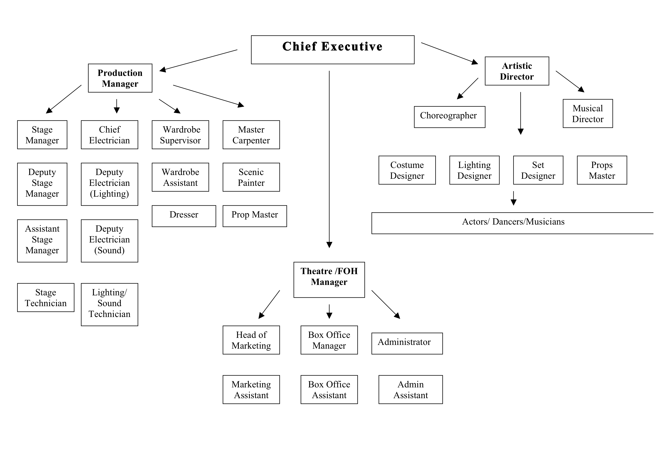
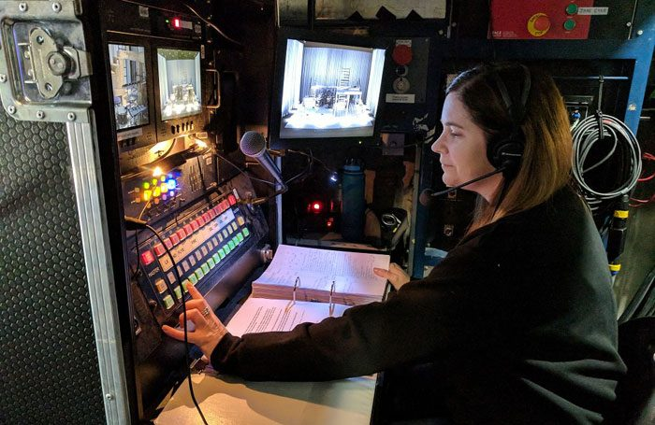
Roles and responsibilities
Creative
Technical / Production
Design
Performance
Admin / Front of House

Slide 8
Roles and responsibilities
Contract Types
Full-time:
Standard is 37-40 hours/week.
Contract may include pension, paid holidays, sick time.
Will usually be long-term.
Part-time:
A contract as above, but not full-time.
Can vary from one day – four days per week or hourly.
Will usually be long-term.
Freelance:
Self-employed & is not committed to a particular employer long-term.
No long-term contract!
Self-employed:
Working for yourself rather than for a business or someone else.
Permanent:
Offers guaranteed work for a certain length of time & job security.
Casual:
Not secure as it varies according to the work on offer, but it does give flexibility and choice as to organising your time.
Voluntary
where an individual provides services for no financial or social gain

Slide 9
What makes a performance, concert, film interesting?
What? | Why? YOU MUST GIVE A CLEAR EXAMPLE OF HOW THESE WERE USED IN THE PERFORMANCE
The acting | Voice: Pitch, accent, pause, volume, tone, emphasis, pace, dialect, articulation, diction, clarity, silence Movement: body language, facial expressions, gesture, gait, co-ordination, balance, eye contact, proxemics, status, posture, stance, timing, contrast, physical contact, stage combat
The lighting | Positioning of lights, colours, fades, cross-fades, variety of lights, higlighting a particular event/person, used to symbolise something, types of lights used, gobo,
The props | Multi-purpose (the same prop could be used to represent different items/objects), realistic,
The set / staging | Naturalistic, multi-purpose, unique, abstract, colours, scale, shapes, use of rostrum, simple yet effective, type of staging (end-on, traverse, in-the-round, thrust, promenade, site-specific)
The costumes , hair or make-up | Colours, textures, style, creation, structure, quick changes, eye-catching, unique, suits the style of the piece, prosthetics, artificial hair/beards,
The sound | Sound effects (SFX) realistic, emphasis key points, unique, create tension/atmosphere, show a certain time period, recorded music, live sound, soundtracking, incidental music used for transitions
The effects | Pyrotechnics, smoke, strobe, glitter ball, slight of hand (magic), making ‘impossible scenes’ happen,
The genre | Drama, comedy, action, western, science fiction, romance, horror, crime, adventure, fantasy, musical theatre, thriller, war, rom-com,
The style | Naturalistic, abstract, physical theatre, episodic, mise-en-scene, dialogue, monologue, flashbacks, flash-forwards, freeze frame, tableau, slow motion, narration, voice over, aside, mime, puppetry
The plot | Atmosphere, tension, character relationships, structure, climax, anti-climax, resolution/denouement, linear, non-linear (cross-cutting), subject matter, historical accuracy, social, cultural, political context, character’s personalities, backstory, character objective/goal/motivation,

Slide 10
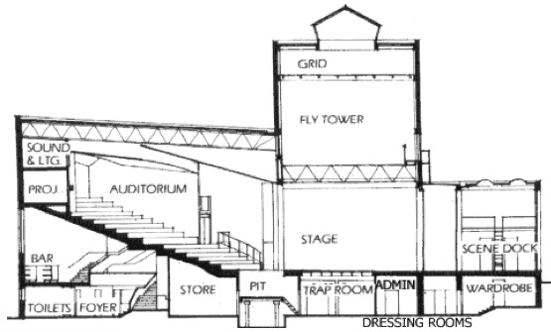
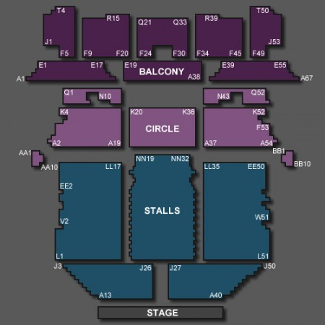
The Theatre Space
C: Theatre terminology
A: Cross section of a theatre
FRONT OF HOUSE
BACKSTAGE
LIGHTING RIG
AUDIENCE
ENTRANCE
STAGE DOOR
B: Theatre seating plan

Slide 12
Remember… You MUST state WHY you have chosen what you have and HOW it links to the brief / synopsis
Complete all boxes for full marks (1 mark for each row) State LX
Clearly identify the CUE!!! (When will it happen?)
What lighting state? (Which lights will you use?)
Complete the description. (What do you want the lights/sound to communicate?) LX state = intensity of light %,
Link to the script/extract/idea given to you
Complete the question!

Slide 13
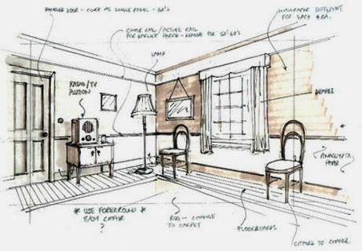
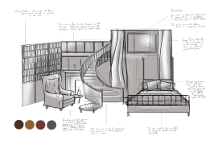
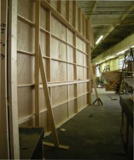
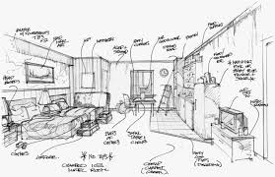
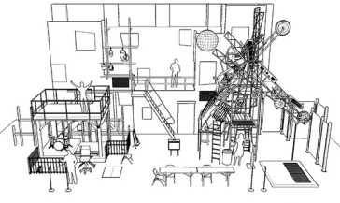
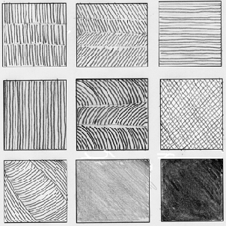
Set
C: What decisions does the designer make?
Colours | Can be used to reflect colours in real life, create an atmosphere or tell an audience about the mood of a place or the personality of a character.
Shapes | Different shapes can have a different effect on the audience or create a different atmosphere: lots of smooth curves look and feel very different to lots of jagged, pointed lines.
Scale | The size of individual items on stage. An audience can be told that an object is very important by making it slightly bigger and ‘out of scale’ or a strange atmosphere can be created by varying the scale of different parts of the stage.
Texture | Comes from the materials used to create the set (wood, metal, fabric) or it can be created using paint effects (for example a painted woodgrain effect). Different textures can give the audience information about the setting of the play or can help create an atmosphere on stage
Staging format | End-on, Traverse, In-the-round, Thrust, Promenade, Site-specific, Immersive
A: Purpose
Era | is the ‘when’ of the set design: when does the action take place?
Location | is the ‘where’ of the set design: what place does the design represent?
B: Style of set design
Naturalistic / Realism | realistic, incorporate elements that are meant to look like real life.
Abstract | not normal or everyday like but represents the same thing.
Simplistic | Simple yet effective
Symbolism | Symbolist sets are more interested in communicating an idea to the audience than in representing real life.
Multi-purpose | The set can be used in more than one way, e.g. a box could represent a seat or a TV.
Fantasy | Does not have the constraints of representing a world that is already known to the audience.
Minimalism | Minimalist sets use pieces of stage furniture or props to indicate a setting or location.
Remember that, even if a stage set looks realistic, it isn’t real. Total
D: Key words
Annotation | Description of what has been designed and why
Rostrum | A raised platform
Interior | Inside of a building
Exterior | Outside location

Slide 14
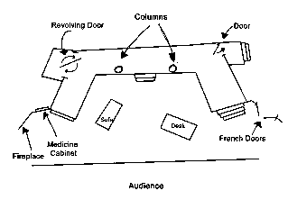
Set
A: Key words
GROUND
PLANS
Ground plan | Drawings of the stage from above that show the location of different parts of the set including furniture, entrances/exits and the position of the audience.
Model box | Detailed model of the set and scenery.
B: What to consider when creating a ground plan
C: Ground plan symbols
D: Top Tips
Draw simple designs and think about what colours will you use and why you have chosen them (to symbolise…)
Annotate = SAY WHY YOU HAVE CHOSEN WHAT YOU HAVE LINKING IT TO THE BRIEF.
Sets need to be designed to easily change between scenes and they need to be easy to move by the backstage crew.

Slide 15
Set
Remember… You MUST state WHY you have chosen what you have and HOW it links to the brief / synopsis
Top Tips
For set design, explain where the audience would be sat (staging format). Plot everything that is in the brief. Where would the actors enter/exit from? How would the set be taken on / off stage (wings, flown in, trapdoor etc)

Slide 16
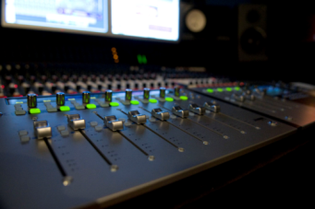
Sound
Think about… music, sound effect or soundscape?
Sound designers can use a range of different types of sound, including music, sound effects or soundscapes. Music can be used to accompany the action (called underscoring), or can be called for by the play text. It can be created live on stage (diegetic) or pre-recorded (non-diegetic). Sound effects are often called for by the play (for example a telephone ringing), but can also create a mood or comment on the action: a comedy might use a certain sound every time a character falls over, for example. Soundscapes either set location or create a mood.
A: What is the sound design doing?
Time and location | The ‘when’ and ‘where’ of a production. Consider the period and genre of a play, as well as the venue where the performance will take place.
Mood and atmosphere | The feeling that the production creates for the audience. Audiences will associate different sounds with different moods. Mood and atmosphere can be created through the use of music or through a soundscape or choice of sound effects.
Introduce a character | Sound can help to shape the audiences view of characters and relationships (e.g. powerful orchestral music can introduce a king or queen)
C: What decisions does the designer make?
Tip: Try not to choose songs that are too well known otherwise the audience will be focusing more on the music and not on what is happening on stage.
Sound levels | how loudly or softly the sound effects or music are played. The choice of volume can create an atmosphere for an audience. But remember, sound levels must always be set so that the actors can be heard.
Reverb / Echo | An effect added to a sound using editing software or occurring naturally in a performance space. Reverb (or reverberation) occurs when sounds bounce off the surfaces in a space. Adding reverb to a sound can help the audience understand the location or atmosphere of a performance
Fade | how the volume of a sound alters. Music, sound effects or soundscapes can be faded in (gradually made louder) or faded out (gradually made quieter) during a performance. Sounds can also be established at a higher volume, faded to a lower level when the action begins, and brought back up at the end of a scene, giving the impression that the sound has been played at the same volume throughout.
B: What style is the sound?
Realism | Represents real life. This means a production tries to seem as close to real life as possible, so sound designs for these productions need to mimic sound in real life.
Symbolism | Is more interested in communicating an idea to the audience than representing real life. Symbolism perhaps communicates through deliberately using certain sound effects or music for certain characters or using abstract sounds.
Minimalism | Sound is used to create an entire setting, or a location can be changed simply by changing the soundscape.
Fantasy | Creates a new world / a magical atmosphere. The audience must engage with the world however.
Remember: ‘read’ a stage
When an audience hears a sound design, they will believe that what they are listening to is important and significant. We say that audiences ‘read’ the design: they identify important elements of the sound and work out what they think these mean. When you interpret a sound design, you are also reading the production. Designers make decisions about what they think will ‘read best’ (that is, be most effective and clearest to understand) for an audience.
Remember: everything’s deliberate!
Good sound design is a series of deliberate decisions. Always assume that anything on stage has been put there for a reason and contributes to the audience’s experience.

Slide 17
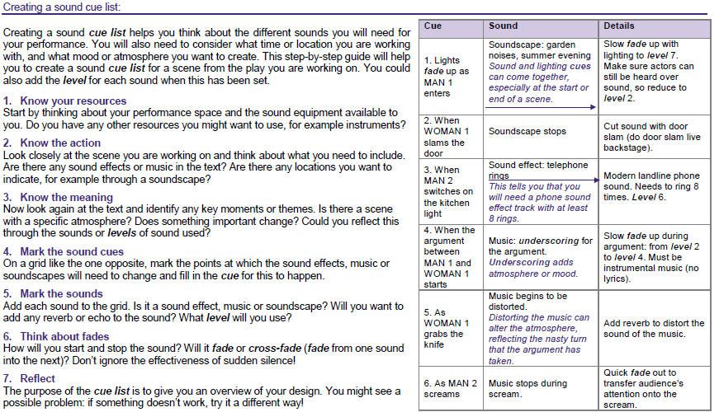
Sound
Complete all boxes for full marks (1 mark for each row) State SFX
Clearly identify the CUE!!! (When will it happen?)
What sound state? (Which lsound will you use?)
Complete the description. (What do you want the lsound to communicate?) SFX state = intensity / volume of sound %,
Link to the script/extract/idea given to you
Complete the question!

Slide 18
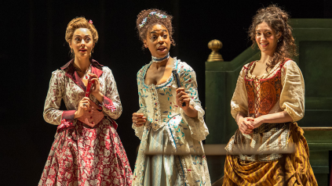
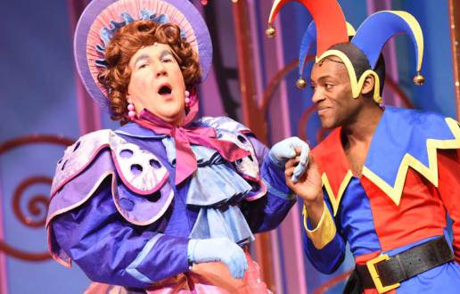
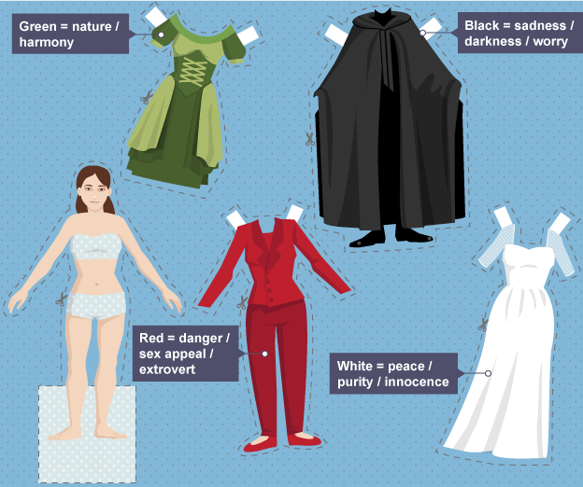
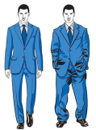
Costume
A: What is costume design?
Costume is what the actors wear when performing. Costume can show who a character is, when the play is set and the style of the production, eg naturalistic (realistic) or abstract (not realistic).
It’s important to consider the type of costume that best suits your work and also how easy it is to change from one costume to the next.
C: What decisions does the designer make?
Colours | Colours of clothing, jewellery, footwear, accessories, and make-up or masks on stage have many functions, for example, they can be used to create an atmosphere or tell an audience about the mood or personality of a character.
Shapes | the shape of any item of clothing, such as a skirt or jacket; any padding or shaping that needs to be added to give the actor the correct physical shape (fat suit or pregnancy pad); Different shapes can have a different effect on the audience or create a different impression of the character: a tailored, sharp cut suit is very different to a flowing skirt.
Fit | How the clothes hang on the actor’s body; which parts of the clothes are loose or tight; how the fit of the costumes reflects a certain era or period.
Texture | the choice of fabric, its weight and thickness; how coarse or smooth it is. Different textures create different feelings or moods for costumes, as well as indicating a character’s social or personal status.
B: Colours = Symbolism
Costume is often used to help communicate a character’s personality. A flamboyant character might wear brightly coloured clothing while a more sombre or serious character would dress in dark coloured clothes. Colour has its own language and can be used symbolically. White may represent innocence and purity, and red may represent danger.
In Shakespeare’s era an actor playing a king would dress in regal purple, symbolic of holiness, as kings were considered second only to God.

Slide 19
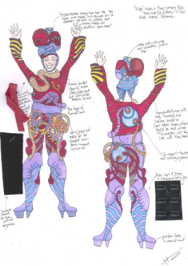
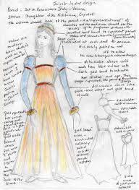
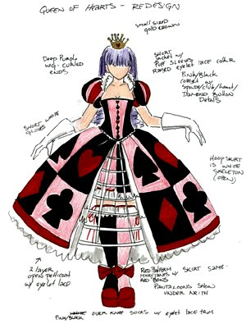
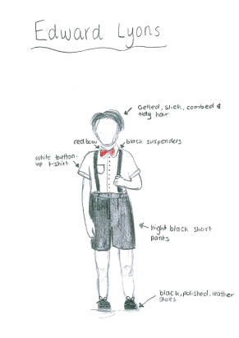
Costume
A: Creating a costume plot
Annotate your designs
Explain why you have used certain colours (symbolism)
B: Questions to consider
Can the actors move in this?
Is it sturdy enough?
Can the actors get changed quickly in and out of it?
Is the costume clear to the audience?
C: Where are the audience and what can they see?
How close the actors are to the audience can have an effect on the costume design. Audiences in immersive performances, for example, might be close enough to touch the costumes, meaning that the designer may need to include a higher level of detail and accuracy.
Audiences at a distance from the stage present a different problem: designers need to make sure that all the important details are visible for the audience members. Details in fabrics or accessories can give the audience important character information, but not if they can’t be seen from the auditorium.
Link back to stimulus or brief
This design does not have to be detailed or coloured in. As long as you explain your choices

Slide 20
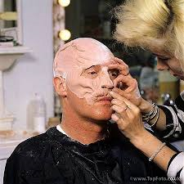
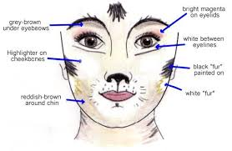
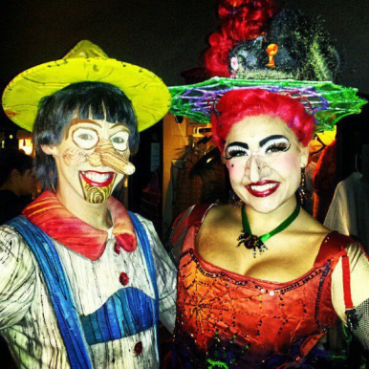
Make-up
Bright stage lighting can wash out facial features and make performers appear pale, so make-up is used to enhance features and make sure that the audience can see the actors’ facial expressions.
Make-up can also be used to age an actor who is playing an older character or to create fantasy characters, such as the fairies in Shakespeare’s A Midsummer Night’s Dream. At other times it can alter the gender of a character, or communicate a different style of theatre. It is sometimes designed with specific lighting in mind to achieve particular effects. Make-up can also be used symbolically.
Successful use:
If the actors need to look natural, then the make-up should ensure that the audience can clearly see the actors’ features but not draw attention to itself
If the make-up is to exaggerate a character, or to place them in a specific historical time, then it needs to be more obvious
The make-up may need to create an other-worldly impression by giving a distinctive, non-human colour and shape to the face (e.g. in Cats)
You must annotate the designs, explaining why you have chosen the costume/make-up and what this communicates to the audience. You can either do this on a PowerPoint slide or on paper.

Slide 21
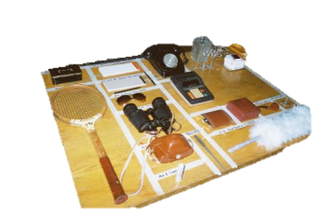
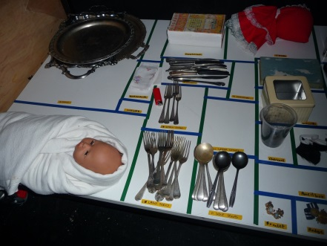
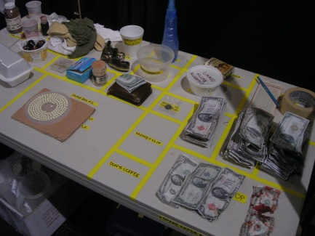
Props and the prop table
A: What is a prop table?
A properly placed and laid out prop table is an invaluable help to the cast of a show, as they often need to get on stage quickly and in the dark, and just don’t have the time to go looking for their props.
The table (or tables) is generally placed offstage where it will be out of the way of scene shifts and crowd movements.
C: Top Tips
If something is too big to fit on top of the table (i.e., a suitcase), it can go under the table, and label the edge of the table. Items like spears and flagpoles can go in a bin on the side of the prop table
Before First Tech starts, ask the actors which side of the stage they want their props to be on.
The Stage Manager asks the actors to check the prop tables before each performance to make sure their props were on them, and again after the performance.
Nothing should go on the table that’s not a prop used in the show: no personal items, water bottles, tools, or similar things.
Check the prop tables as soon as possible after the show, or the next morning. This way you’ll notice missing or broken items, or expendables that need to be replenished, and have time to deal with them before the next performance.
Items that get used, like cups and glasses, need to be washed before the next performance, and preferably just before show time. Real food items should be placed on the table just before the show starts, to keep them fresh and safe.
B: How to create a prop table?
Generally, the top of the table is covered with butcher paper and marked off in “blocks,” each one holding one prop. The name of the prop, and sometimes the act and scene, plus the name of the character, are then written clearly inside the block to make sure the prop always goes back in the same place. The blocks can be marked off in masking tape or with a thick marker, but the important thing is that they are clearly visible backstage during the show.

Slide 22
The process of bringing a performance to an audience
Performance Process:
Casting ]Rehearsals ] technical rehearsals ] dress rehearsals ] preview performances ] performance runs.
Skills Development: Skills are developed through practice, reflection and the application of relevant research and theory.
Key Words:
Libretto- Is the text in a script, also referred to as ‘lib’
Score - written music that shows all parts
Choreography- the sequence of steps and movements in dance
Character Track- The role an actor plays in a show, particularly an ensemble role, it encompasses all the characters, lines, blocking, dance choreography, prop placements
Rehearsal Report – After each rehearsal a report is written which evaluates how rehearsals went with actions to undertake moving forward to ensure that the performance deadline is met
It is important to create a series of schedules when putting on a production to ensure that you meet the deadline of opening night. Having a clearly laid-out schedule ahead of time will ease headaches and reduce conflict clashes, smoothing the overall process. There are different types of schedules including:
Cast Schedule
During a long run of a show the cast are given a schedule which states when they will be performing, their days off what time technical checks, sound checks and warm-ups happen. With touring shows this schedule will also state what time transport leaves and sometimes states which accommodation actors will stay in.
Rehearsal Schedule
A calendar of practice sessions leading up to a final performance. When creating a rehearsal schedule, it is always a good idea to start from the performance week and work backwards. You must consider how many times/hours per week you will be rehearsing, the location, who will be required and what the focus of the rehearsal is.
Production Schedule
Lists every single product that'll be manufactured, including where and when they'll be made. It includes every detail, from raw materials to logistics. The production schedule is a project plan of how the production budget will be spent over a given timescale, for every phase of a project.

Slide 23
Health & Safety
A: Performers / Backstage
Ensure all wires are taped down to avoid trip hazards
No glass and no running backstage
All water in a plastic bottle with a lid away and kept out of the way
Stage manager completes a ‘walk around’ with the performers and points out all hazards on stage.
Ensure performers have practiced walking up/down stairs and jumping from levels. All stairs should have a handrail where possible.
All cast/crew must be aware of the exit routes
Ensure dim backstage lighting is used for people to see
If set is flown in, ensure actors are out of the way
All performers should test out costumes / shoes prior to a performance to avoid slipping/tripping
Food allergies should be brought to the attention of the SM
Fight scenes on stage should be choreographed and rehearsed thoroughly
B: Audience
Sensitivity warnings: Flashing lights (strobe) loud noises etc. Displayed on theatre doors
Emergency exits pointed out (announcement before a show and clearly visible)
Access and safety - Obstacles appropriately lit/indicated (i.e. stairs)
Audience management. Flow of people in and out of venue, ensure ushers are aware of policy
There needs to be at least one member of staff who is first aid trained on duty at all times- all staff should be aware of who this is
D: Working practices backstage
Maintenance of specialist equipment, power tools, lighting, sound, pyrotechnics. PAT testing of electrical appliances to make sure they are safe to use
‘Asbestos’ – staff/workers aware of risks
Use protective equipment: shoes, Hard hats/ harnesses for working on ‘site’, gloves, safety glasses, dustmasks, ear defenders for ‘noise risks’ and Tie hair back when working
Complete fire inspections.
Lights must have safety cable attached
Emergency contacts of staff known
All set secure/screwed and tested
No flammable substances around harmful solvents, paints and dyes, store these in a metal container and wear a mask when using.
When using ladders these must have the correct safety feet on
Orchestra pit safety - when working near the edge a safety net must be set up over it
Ensure correct fog/smoke fluid is used
Make sure the appropriate fireproof curtains, props, sets and costumes are used to comply with fire plan.
C: Venue / Front of House
Heating, lighting & ventilation must be checked
Electrical equipment safe
Queue for toilets doesn’t block exits & drinking water is clean
First Aid kit stocked and made clear where it is stored
Adequate parking & parking arrangements for visitors in need
Secure ramps for disabled guests
Ensure there is no noise pollution and all rubbish is cleaned
Audience numbers-do not sell over the number of seats in the theatre
Security regulations-audience checked on way in
Front of House facilities, amenities clean and accessible
Fire exits clearly visible
E: In the event of an emergency
Report the accident. 2.Conduct an accident investigation to determine the cause or causes of the accident

Slide 24
Health & Safety
A: How to write a risk assessment
Go in to more detail about the hazard. Why is this a hazard?
List the general hazard
What can you do to reduce this hazard?
B: Top Tips
If the question asks you to write a risk assessment linking to a set/story/venue of your choosing then you MUST make specific links to this!
One mark is awarded for each different hazard with a description and the required action needed to prevent accidents.

Slide 25
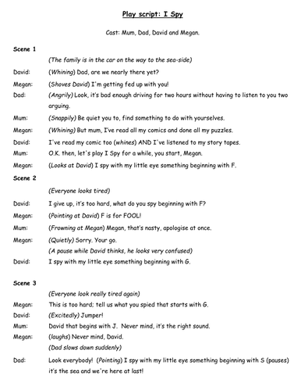
Script Narrative Development
A: Approaching a script
Look for the given circumstances (facts) – Who, where, what, why, when, how
Split script into units (each unit should start when a thought changes)
Give each unit an objective or ‘action’-what emotion? (To betray, To undermine etc)
B: How to write a script
A play script will include a list of characters (at the very beginning).
It may be divided into acts which are then divided into scenes.
Each scene will have a description of the setting at the start and then the characters' dialogue.
Dialogue is set out with the character's name on the left, then a colon then the dialogue (without speech marks).
Stage directions for the actors are written every now and again in italics and brackets. There may also be an emotion written in brackets before a character’s line.

Slide 26
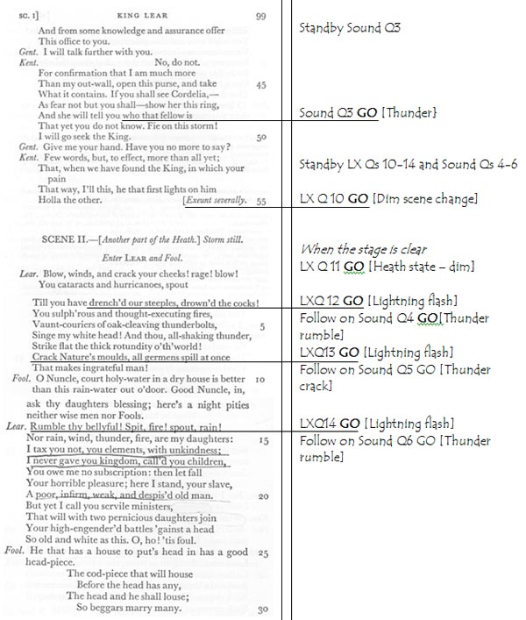
Marking up a script
A: The Stage Managers Book
The Prompt Book is the master copy of the script or score, containing all the actor moves and technical cues, and is used by the deputy stage manager to run rehearsals and later, control the performance.
It’s sometimes known as the ‘book’, Prompt Copy or Prompt Script. The member of stage management (often the DSM) cueing the show is said to be ‘On the Book’. (e.g. ‘Clare’s on the book for the next show’).
As well as the script and/or score of the show, the prompt book also contains contact lists for all concerned with the production, information about the venue(s), show reports, local amenities, emergency procedures and any other information that may be needed during the run of the show. It’s rightly known as the production ‘bible’.
The book is usually laid out so that the script is on one side of a folder, and the cues are on the opposite side, with a line between the cue word / line, and the cue itself.
B: Making up the book
Write technical cues on this side
You can also write when to call actors to the stage

Slide 27
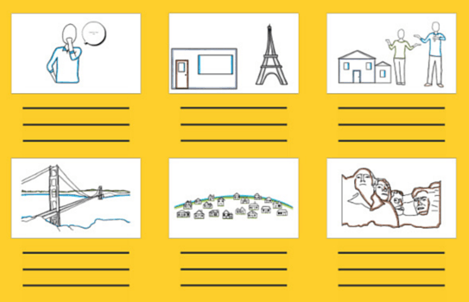
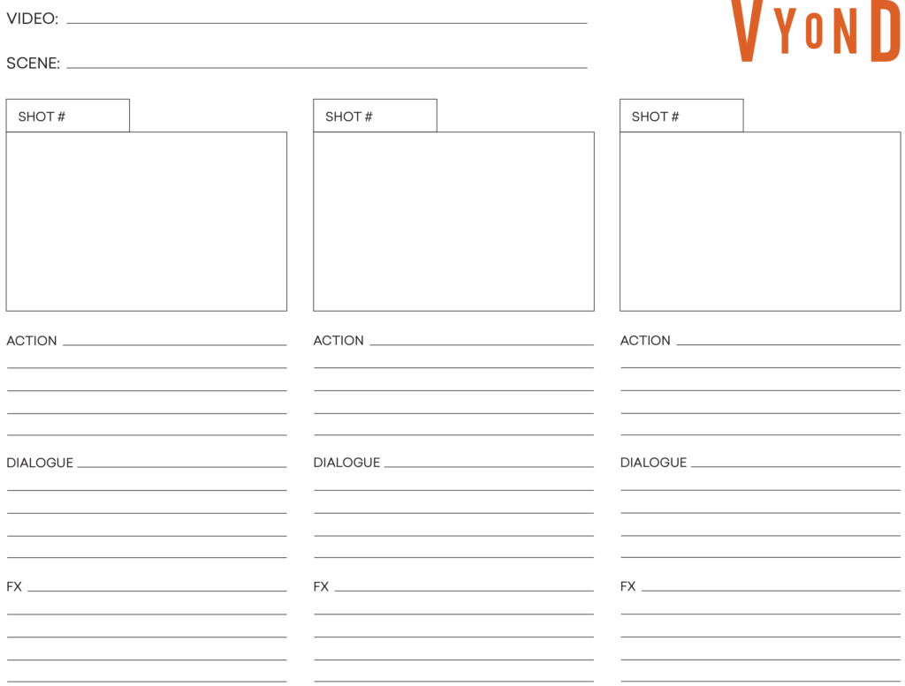
Storyboard Narrative Development
A: What is a Storyboard?
A storyboard is a graphic representation of how your video will unfold, shot by shot.
It’s made up of a number of squares with illustrations or pictures representing each shot, with notes about what’s going on in the scene and what’s being said in the script during that shot. Think of it as sort of a comic book version of your script.
D: Step-by-step instructions
Add your script. Beneath each picture, write the lines from the script OR the action that is happening
Sketch your story. Your storyboard doesn’t have to be incredibly detailed — you can draw stick figures and do not have to use colour. You can indicate movement with an arrow.
Add Notes. Finally, add in any notes about each scene. This might include a description of what’s happening, camera angles or movement, and any special effects. Don’t forget about audio like music or sound effects.
B: Why storyboarding can be a good idea
Best way to share your vision as it is visual
Makes rehearsals much easier
Saves you time
C: Helpful Storyboarding Tips
Annotate WHY you have chosen what you have
LINK your decisions to the brief/stimulus
Make sure it’s logical and makes sense
If you are writing a storyboard for a film you can include the shot (close up, medium shot, pan out, pan across etc)

Slide 28
Approaches to Rehearsal
A: Warm-ups
B: Rehearsal techniques
What is the purpose?
To prevent injury and to encourage focus. Vocal warm ups and games- to prevent damage to the voice and to experiment with sounds and voices.
What activities can you do in rehearsals based on a script or when devising?
Hotseating: one actor sits on the ‘hotseat’, the rest of the group asks them questions.
Role on the wall: (outline of your character, facts go around the outside, feelings/personality on the inside).
Given Circumstances: a Stanislavski technique which means looking at the facts the playwright has given you about your character.
Emotion Memory: the actor remembers a time when they experienced a similar emotion.
Actors speaking the stage directions: A Brechtian alienation technique.
Speed run: use just before a performance; checks that you know what’s coming next. Can increase the energy of the performance.
Freeze frames: breaking down the play into a series of freeze frames which tell the story. Capturing the essence of a scene in one freeze frame.
Forum theatre: Showing a scene to an audience who can stop/start the action, making suggestions which you act upon on the spot.
Status games: Experiment with levels to convey status- try using them to go against the obvious (i.e. low status placed higher than character of high status). Could give actors playing cards and improvise a scene where their character conveys a status according to how high or low the number on the card is.
Animalisation: actors play their role as an animal in order to experiment with physicality, temperament and status.
Modernising scenes: rehearse hostorical scenes in a modern concept.
Off text improvisation: fill in some of the gaps in the plot by improvising scenes to explore characters.
B: Warm-up examples
Clear the space- practical warm-up
Yoga- relaxation
Throw the facial expression
Count to 10/20 as a group: without a leader, no one to speak at the same time or you go back to 1.
Rubber chicken-energy & voice
Breathing-using diaphragm
Stretching-to prevent injury
Vocal-AEIOU etc –diction
Chewing gum-articulation

Slide 29
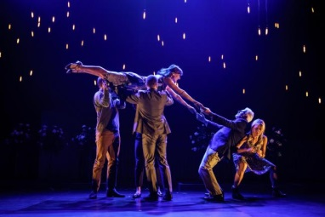
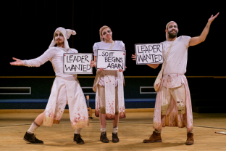
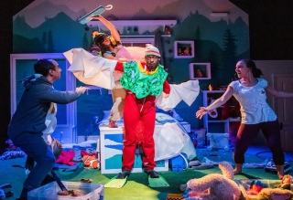
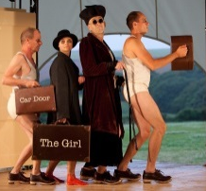
Approaches to Rehearsal
Theatre Companies
Company: Frantic Assembly
Style: Physical Theatre
Warm-Ups they use: Clear the space
Through/By/Round (Over/Under/Through)
Chair Duets
Performances they have created: John, Othello, Love song, The Curious
Incident of the dog in the
Night-time
Company: Splendid Productions
Style: Epic Theatre, modernising traditional plays
Warm-Ups they use: Archetypal (stereotypical) character improvisations, Lecoq 7 states of tension to develop characterisation
Inspired by Brecht
Performances they have created:
Macbeth, Metamorphosis,
Company: Kneehigh Theatre
Style: Multi-disciplined, storytelling, physical theatre, puppetry, Epic Theatre
Warm-Ups they use: They devise through playing childhood games such as Grandmother’s footsteps, use props as other things /puppetry
Performances they have created: Hansel & Gretel, Dead Dog in a Suitcase,
Brief Encounter, The Red Shoes
Company: Unicorn Theatre
Style: Children’s theatre
Warm-Ups they use: Any that focus on energy, co-operation and ensemble work.
Performances they have created: Gulliver’s Travels, Cinderella-A fairy-tale,
Magical Midnight Mischief
Sleepover

Slide 30
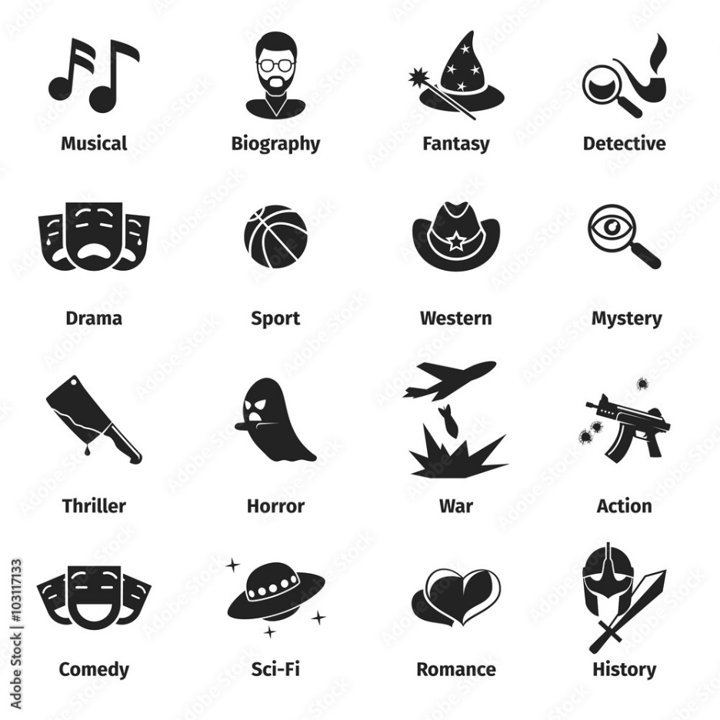
Styles & Genres
The genre of a performance refers to the type of story being told, and the style refers to how the work is presented on stage.
Naturalism | Representing real life on stage
Abstract | Does not follow the linear sequence of a story. It is more concerned about representing the underlying feelings, moods, themes and ideas. This kind of drama uses movement, sound and words.
Mime | suggesting action, character or emotion without words, using only gesture, expression and movement
Physical Theatre | encompasses storytelling primarily through physical movement.
Symbolism | Features represent a specific idea. It can be achieved through lighting, set, costume, props and colours. The sets and props in symbolic plays are often unrealistic and are used to symbolise emotions or values in society.
Site-specific | any type of theatrical production that is performed at a unique, specially adapted location other than a standard theatre
Classical | Classical theatre usually contains lofty, grand prose or free verse dialogue. Good examples are the Elizabethan dramatists William Shakespeare.
Masked Theatre | Use of masks and exaggeration to communicate meaning
Puppetry | involves the manipulation of puppets – inanimate objects, often resembling some type of human or animal figure
Pantomime | this theatrical form is passionately devoted to its audience. The sole purpose of Pantos is to make the audience laugh, dance and sing
Melodrama | Exaggerated characterisation and dramatic plots using stereotypical stock characters to appeal to the audiences emotions
Verbatim | a form of documentary theatre which is based on the spoken words of real people.

Slide 31
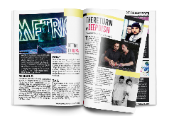
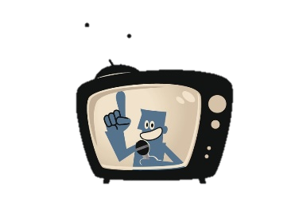
Reviewing performances
A: Top Tips for Reviewing Performances:
Avoid describing the story/plot
Make sure you analyse and evaluate what went well and what would make the performance better
Always justify your comments/decisions with clear examples (for example, if stating that an actor used their facial expressions effectively to communicate an emotion, describe what the actor actually did with their face such as raising their eyebrows etc)
Outline the important themes and issues of the play.
Discuss the director's interpretation of the play and how the style and form of the play communicates the play's themes.
Describe and analyse the characters.
Use drama vocabulary in your responses
Refer to the time in which the action is set (the historical context)
B: Effective Responding Sentence Structure:
C: Types of Theatre Reviews:
Newspapers
Magazines
Vlogs – YouTube, TikTok etc
Arts review TV programmes
Podcasts
Online Blogs

Slide 32
Reviewing your own performance

Slide 33
Unions
A: What is a union?
A union is an organisation established to support, protect, guide and further the rights and interests of artists and production workers.
B: What does a union do?
Wages and employment conditions (e.g. health and safety of work environment, not on equal pay to others in same job)
Disputes between employee and employer
Advice for freelancers on tax and national insurance
Networking opportunities
Information about insurance and pensions
Changes to legislation (e.g. working at height)
Benevolent funding (if you need financial support due to ill health)
Negotiate contracts on behalf of actors, stage crew, musicians
Tackle issues raised when there are employment disputes
Give advice & support regarding copyright protection or unpaid fees
Make sure working conditions are acceptable
Assist members throughout their careers by net-working with other actors/crew
C: Who do the following represent in the performing arts industry
Equity (the actors union:
Actors
Dancers
Stage managers
Choreographers
Directors
Backstage crew
BECTU (Broadcast Entertainment Cinematograph Theatre Union):
Media & entertainment trade union - representing broadcasting and film
Production staff, technical, box office and front of house
MU (Musicians’ Union):
Musicians
Music Teachers
Instrumental teachers
Other professional unions include: BAPAM (British Association for Performing Arts Medicine), NATKE (National Association of Theatrical and Kino Employees).

Slide 34
Working in the Performing Arts
Training opportunities include: professional drama schools such as RADA, GSA, Mountview, film and television schools, university courses including BA (hons) in Drama and Theatre, Performing Arts or specialising in areas such as Directing, Applied Theatre, Stage Combat etc.
Headshots: Headshots are actors' branding and marketing around the industry; it's the key toward getting
Letter of application: This is how actors (especially without agents) apply for roles. A letter of application should highlight why they are suitable for the position, discuss relevant past experience, training paths and requirements for the position. In addition, actors also have CVs which state their previous acting experience. This can be uploaded to sites such as Spotlight or Mandy.
noticed for the audition, and the best way for an agent or casting director to remember the actor for future work. A headshot is the first thing talent agents and casting directors will look at.
Agents: An acting agent represents professional actors working on behalf of their clients as the middle person between the actor and their employers. Agents take a percentage fee (commission) deducted from the actors earnings.
Show Reels: An actor usually puts together a short video showcasing their work, especially if they are hoping to work in the media rather than on stage. is there to give a moving, living impression of you as an actor.
Auditions & Casting: the people present at the audition will include you, the casting director, and maybe a handful of other complete strangers. ... At some auditions, someone may take your picture with a digital camera, so the casting director can review all the people who auditioned that day. Monologue – usually one classical and one contemporary
expect the unexpected, and be ready to work with unusual situations at a moment's notice. To help prepare for the unexpected, many actors take improvisation classes.

Slide 35
Performing Arts in Society
A: Benefits of a Performing Arts centre
D: Examples
Educate the audience on certain issues/topics
Entertain the community
Place for community to go / Engage youth (get youngsters off the streets)
People can learn new skills
Job opportunities
Community issues – can create work on issues that community are facing
Bring family together with performances that appeal (i.e. pantomimes etc)
Developing English language skills
Develop team-working, leadership, confidence through workshops
Learn about the theatre – backstage tours & post-show discussions
In the centre of Birmingham, attached to a park, has indoor and outdoor theatre venues, an art gallery, café/restaurant, lots of meeting rooms and rehearsal space, dance studios with mirrors and exercise rooms.
B: How to gain funds from a Performing Arts Centre
Selling food / drinks (add a café/restaurant)
Charging for workshops
Charging for theatre clubs
Selling advertising space in the programme
Charge for theatre tickets
Introduce more opportunities, such as film nights, networking events,
Charity events / fundraising events (i.e. sponsor a seat)
Merchandise
Get a company to sponsor the theatre / a rehearsal room
Room hire
C: Different activities that could take place in a Performing Arts Centre
Workshops – arts & craft, acting, dance, script-writing, film-making, costume design, textiles, stand-up comedy etc
Performances
Meetings
Rehearsals
Festivals
Parties / weddings
Theatre clubs
Summer schools
Film screenings
Community events (i.e. networking, speed dating, addiction meetings etc)

Slide 36
The Birmingham REP Theatre
C: How does the REP benefit the local community?
The REP offers a variety of ways for the local community to get involved and learn more about theatre.
Youth
Education department- workshops, post-show discussions, backstage tours, discounted rates for tickets to shows
Summer schools
Youth Theatre groups-meet every saturday
Adults
Adult Drama Company
Lightpost Theatre Company is made up of young black and dual heritage men aged 16 to 26.
Play-Reading Group
Play in a Day
Write away develops adults playwriting skills.
Community Casting - is composed of talented volunteer performers from the local area who are given the chance to perform alongside professional actors in a REP show
Job opportunities-front of house, backstage, onstage etc
A: What type of theatre is this?
The REP is predominantly a producing theatre as it creates pieces of work themselves, including casting, rehearsing, creating the set, costumes props etc.
However it does also receive shows from other theatres.
B: What different activities take place here?
Workshops / classes
Performances
Backstage tours
Internships
Summer schools
Rehearsals
Casting
Work experience placements
Meetings / conferences
Restaurant/café
Selling refreshments/ programmes
Weddings/parties
Press nights / launches
Props/costume hire
D: What business opportunities are there?
Artist Development- develop new artists, writers and theatre makers through The REP Foundry scheme, take theatre to the community through our Furnace programme, offer support and nurturing for emerging theatre directors in partnership with JMK Directors as well as running Introduction to Directing courses for new and emerging D/deaf and disabled directors.

Slide 37
The REP Theatre
Programming
Consider:
Range of performances offered
Target audience aimed at
Length of run
Family shows at specific periods
Rental to local amateur companies
Price range of tickets
What’s on? | Target Audience | Genre | Other opportunities
Peter Pan – modern adaptation of J.M. Barrie’s novel brings the classic Peter Pan story into the twenty-first century | 7+ - for all the family | Family Drama / musical | Post Show Discussions Backstage Tours Captioned performance-the actors words appear on a screen
Asking For It By Louise O’Neill Explores the impact of peer to peer sexual abuse | 14+ - created for a teenage audience | Docudrama – Theatre in Education | Discounted tickets for students Pupil workshops
Faustus: That Damned Woman – reimagining of Christopher Marlowe’s Dr Faustus. This devilishly provocative story about the 7 deadly sins is told from a female perspective and promises to thrill purists whilst captivating new audiences. | 18+ - mature themes | Thriller / Horror | Signed performance-for audience members who are deaf Audio Described Performances - use headphones and describe the action for blind people
First Stages - Puss In Boots With a host of puppets, a working windmill and an avalanche of fruit and nuts come and see this classic furry tail, it's the cat's whiskers! | 4+ - to introduce young children to the theatre | Puppetry Comedy Fairy-tale | Early morning performances
Cirque Berserk -includes over thirty jugglers, acrobats, aerialists, dancers, drummers and daredevil stuntmen | Family | Circus | Relaxed performance- for audience members with a learning disability or sensory and communication conditions

Slide 38
Birmingham REP
Management Structure

Slide 39
Target Audiences
A: What is a target audience?
A target audience is an identifiable group of people at whom a drama is aimed. When justifying a target audience you must state why that group would like it and not why it is not suitable for other groups.
C: Examples
“The appropriate target audience for my drama would be teenagers aged between 17-19. This is the age bracket where most young people will learn how to drive. The drama will therefore be easily relatable to them and will enable them to be educated on important issues.”
“The target audience is teenagers because the mature themes would suitable and interesting to them and the content is specifically aimed at young people who are like to go through similar experiences”
B: Target audience categories
Concession = children / old age pensioners (OAPs)
Gender
Class
Interests
Age
Ethnicity / creed
Marital status
Job (skilled/ professional /unemployed)
Income
D: Top Tips
If you want to identify an age group be specific about their age!
Avoid general terms such as “Old people.” Instead you could write “the older generation between 65-80 years old”
Avoid giving a negative answer to a target audience question (stating who would not enjoy watching your drama).
You will be expected to give reasons for your answer.

Slide 40
Venues & live performance
A: Small & medium local venues
Examples: | Advantages: | Disadvantages:
Pub School stage Small theatre Studio theatre Museums | Intimate atmosphere Close to audience More accessible for local bands Caters for the community | Poor sound quality & technical facility Limited audience Less publicity/ promotion
B: Large multi-use spaces
Examples: | Advantages: | Disadvantages:
Sports’ Arena West End Theatre Outdoor festival (Glastonbury) Birmingham Hippodrome | Excellent sound & technical facilities Huge publicity & promotion Higher fee from tickets sold | You have to be already famous to perform at a large venue (less easily accessible) The cost of hiring a large venue Less intimate interaction with audience.

Slide 41
Different Types of Venues
Type of venue | Description
Receiving Theatre (e.g. Birmingham Hippodrome, The Alexandra) | A theatre which does not produce its own repertoire but instead receives touring theatre companies, usually for a brief period such as three nights or a full week. The incoming company may receive a share of the box office takings or a minimum guaranteed payment.
Producing Theatre (e.g. The Birmingham REP) | Producing theatres combine a resident theatre company of actors, directors etc with a theatre building. Producing theatres ‘manufacture’ artistic product in-house, often as well as presenting other companies work.
Arts Centre (e.g. The MAC – Midlands Arts Centre) | An arts centre is a functional community centre with a specific remit to encourage arts practice and to provide facilities such as theatre space, gallery space, venues for musical performance, workshop areas, educational facilities, technical equipment, etc.
Arena | An arena is an enclosed area, often circular or oval-shaped, designed to showcase theatre, musical performances, or sporting events. It is composed of a large open space surrounded on most or all sides by tiered seating for spectators, and may be covered by a roof. Holds many people.
Studio | A small theatre where experimental and innovative productions are staged.
Multi-use spaces | Multi-purpose venues are usually the crème de la crème of event and conference space. Theatres, activity centres, sports stadiums, museums – they all provide a level of functionality which was once a rarity. Not only that but they offer something exceptional; repurposing their space, so that it appeals to more than just their ‘typical’ client.
Festival | An organized series of concerts, plays, or films, typically one held annually in the same place.

Slide 42
Marketing
A: Types of marketing
Social media – Facebook, Twitter etc
TV adverts, trailers,
Billboards, posters
Teaser campaign
Interviews – newspapers, TV, radio
Marketing: The action of promoting and selling a product
B: Logos
Logos are intended to be the "face" of a company: They are A VISUAL SHORTHAND of a company's unique identity, and through colors and fonts and images they provide essential information about a company that allows people to identify them.
C: Theatre Posters
The poster for a given show is about 2 things
Letting people know what’s happening
Information about times, costs, locations
Attracting people to book to see the show
who’s in it?
Attractive image that says something about the show.
Any reviews or awards?
It also needs to be able to translate to other media – tickets, programmes, merchandise etc
The 5 rules of a good logo are:
Simple. Simple logos are the ones people can recognize as soon as they see them. ...
Scalable. A great logo should be simple enough to be able to be scaled down or up and still look good.
Memorable / Impactful. It stands out and people remember them.
Versatile. You can use them in a variety of different ways.
Relevant. It relates to the theme/theatre etc
D: Alternate ways to advertise
Promo events, TV interviews, arts festivals
Flash mob events
Photoshoots

Slide 43
Marketing
A: 5 things marketing & distribution do:
1. Advertise the product and introduce new plays to audience
2. Connect with audience through video streams (i.e. publicity on YouTube)
3. Grow their sales
4. Target the appropriate audience
5. Promote your product via media (radio, online)
C: How productions are marketed and advertised
B: Distribution of flyers / posters:
Locally: numerous shops, restaurants, pubs, community centres etc will display flyers and posters – occasionally it can be helpful to offer a ticket or two in exchange for displaying posters.
London Off-west end/arts venues: most off-west end theatres and arts venues across the capital will display print
Door-to-door flyering- posting flyers through the letter boxes of people’s homes
Special interest: Is your show particularly relevant to a particular group? Eg if you are targeting a particular ethnic group, you could take your print to restaurants, shops and community centres that are of particular relevance to that group, or into areas that have a high percentage of that group living locally
Word of mouth

Slide 44
Budget
A: Why do performances need budgets?
Every show must have a budget that estimates the amount of money the show will make, whilst setting limits on the spending for the different areas of a show, to result in a profit.
B: Key words:
C: What to include in a theatre budget
Profit | A financial gain, especially the difference between the amount earned and the amount spent
Loss | The amount of money lost by a business or organisation
Income | Money received, Coming IN
Expenditure | The amount of money spent
Royalties | Royalty is a fee that pays the playwright for their creativity and hard work when putting on their piece of work. This tends to be taken out of the overall ticket sales
Pricing Policy | Referring to ticket prices -An effective pricing strategy must do two things: attract an audience for the show and raise sufficient income through ticket sales to break even and then make a profit.
Income | Expenditure
Ticket Sales (this will depend on how many shows you perform and how many audience your chosen venue holds) Merchandise (programmes, t-shirts etc) Sponsorship Arts Council Grants Refreshments | Hiring venues Wages (actors , director and technicians) Marketing (cost of printing flyers, tickets etc Transport Accommodation Props Set Costume Publicity Hiring lighting and sound equipment Costumes

Slide 45
Funding
A: Types of funding
Public Sector | Private Sector | Third Sector
Large regional and national funding bodies. They will monitor how the money is spent (ensure it is spent how the application stated) Money is given as a ‘grant’ meaning the venue/company don’t have to pay it back. | Sponsors or investors could be businesses or individuals They will give money or benefits in kind (this is called a benefactor) to an organisation but will want something in return e.g. advertising or use of facilities for their own use. You could also be giving a loan | Funding from trusts and charities The trust or charity decides how much money it will donate as a grant to an arts organisation They have separate grants for Performing Arts and Drama Many arts venues become charities- this means individuals can make donations to the venue.
B: Examples
Arts Council- money from the Government is distributed to arts organisations following application Local government funding The National Lottery funding- you can apply for a grant | For example the Theatre Royal Bath offers ‘Corporate membership’ to companies- including use of hospitality facilities and membership fees go towards to running of the building. Amateur theatre companies pay for their programmes by getting business to advertise in it. | An example is ‘The Wingate Foundation’-an independent grant giving charity which supports arts in Wiltshire. Sponsor a seat- members of the public can pay to have their name on a seat.

Slide 46
Devising Tips
The Stages of Devising:
1: Response to stimulus Consider and brainstorm your initial ideas and then create an aim/objective for your performance. “We are devising a performance for…” 2: Agree on a ‘general aim’ Agree on a general aim for your performance, this may change after initial research or later in the devising process 3: Research Conduct focused research that can be used specifically to enhance your performance. 4: Feeding back research Feedback your findings to the group and consider how this could be used to influence your performance and educate your audience. 5: Discussion Agree on group rules for discussion. Brainstorming and similar exercises will help you to explore everybody’s ideas. 6: Specific Aims Agree on a specific intention for your performance – everything you include should now work towards achieving this intention in performance. 7: Improvisation be open to experimentation and be on your feet, improvising and trying ideas out as often as possible. 8: Scripting or equivalent Get the dialogue down on paper, so that it is not improvised and everybody knows what they are doing. 9: Rehearsal this should be ongoing. Set specific rehearsal targets to ensure they are productive. 10: Technical Rehearsal/Final Performance Final run through with technical cues and costume, followed by your final exam.
TOP TIPS FOR YOUR DEVISING:
Keep on top of it – always write a diary entry whilst the lesson/rehearsal is fresh in your mind! If you don’t finish an entry in lesson time, complete it at home so that you are not chasing your tail!
Ensure you document all important decisions and moments from your rehearsals – your devising log must show a CLEAR journey from stimulus to final performance.
When explaining your ideas, or moments from rehearsals – BE SPECIFIC! Paint a picture with your words and ask yourself “would somebody that was not in the lesson be able to visualise this moment?” If the answer is no, you need to be more specific!
Always JUSTIFY your creative choices.
Evaluate throughout, not just at the end. WWW/EBI in each lesson for YOU or YOUR GROUP?
Set yourself clear targets and explain how you will work towards meeting them.
Identify any challenges faced and explain how you overcame them – be HONEST.
Refer to feedback given by peers or teacher.
TRY YOUR BEST!

Slide 47
Rehearsal Techniques
On-text Activities | Thought-Tracking. Act a scene but speak the thoughts inside the character’s heads.
 | Sub-text. Act a scene, but add in what the characters are really thinking. Useful for a scene where people are not saying what they really think or feel.
 | Emotion memory. Ask the actor to recall a situation when they felt the same emotion. Feed the emotion into the scene.
 | Swap roles in a scene. Observe how other people interpret the role. It often helps to hear some else saying the lines that you say.
 | Over- and under-playing. Experiment with exaggerating and under-playing a scene, to help find the right level.
 | Tension and intensity. Use cards (1 – 10) to experiment with different levels of tension, anger, intensity etc, to find the right level.
 | Status. Experiment with changing the status levels for the characters.
Off-text Activities | Hot-seat your characters to find out more about them.
 | Improvise around the characters. Take the characters from a scene, and get them to improvise a scene at a different time, and in a different situation, to explore their interaction and relationships.
 | Consider an animal that might be appropriate for the character you are exploring – using that as a basis for movement work
 | Magic if (Part 1). Ask the actors to discuss how they would feel if they were in the same situation. Magic if (Part 2). Ask the actors to discuss how their character would feel in various situations.
 | Conscience alley. The whole company form an alley for the character to walk down, and speak out loud all the possible thoughts the character might have at a particularly important moment.

Slide 48
Konstantin Stanislavski

Slide 49
Bertolt Brecht
Well known Facts;
· spent his life evolving a theory and practice of theatre as a forum for political ideas. Brecht aimed to appeal to less privileged classes
Epic Theatre is the term used generally to describe Brecht's theory and technique. His plays were 'epic' in that the dramatic action was episodic - a disconnected montage of scenes, non-representational staging, and the 'alienation effect'. All elements contribute to Brecht's overall purpose which was to comment on the political, social and economic elements that affected the lives of his characters.
Acting Techniques
Brecht believed that an actor should present a character in a way that wasn't an impersonation, rather, a narration of the actions of the character. He did this because he wanted to constantly remind his audience that they were watching a play.
Breaking the Fourth Wall
'The Fourth Wall' is an imaginary wall separating the audience from the action on the stage. In realistic productions this wall remains intact and the performers do not acknowledge that they are being watched. The audience are observers who are conditioned to believe that the world of the play is 'real'. It is a suspension of disbelief. Like most theories of realism, Brecht wanted to disrupt the notion of the fourth wall. 'Breaking the fourth wall' involves the characters directly addressing and acknowledging the audience, whether they break character or perform with an awareness of being watched.
Verfremdungseffekt/Alienation Technique.
It is a technique which 'estranges' the audience and forces them to question the social realities of the situations being presented in the play. Brecht achieved this by breaking the illusion created by conventional plays of the time. He believed that the 'suspension of disbelief' created by realistic drama was a shallow spectacle, with manipulative plots and heightened emotion.
Gestus is a theatrical technique that helps define the emotion within a character and the context they are in. It is the combination of a gesture and a social meaning into one movement, stance or vocal display.
Narration and Song
The purpose of song in his plays is not to heighten the emotion of the scenes but as a means to commentate or narrate what is going on.

Slide 50
Antonin Artaud
Artaud was a French Practitioner who wanted to push theatre to its limits; to wake up the audiences' hearts and nerves. He wanted them to believe they were in a dream/ waking nightmare so it would touch them on an inner level.
KEY WORDS and DEFINITIONS
Artaud: Practitioner we are studying today.
Artaudian: When something is “Artaudian” it reflects Artaud’s ideas and style of Theatre. Example: “The staging was Artaudian.”
Characterisation: How you develop and reflect a character, e.g. Voice, Movement, Walk, Mind-set.

Slide 51
Frantic Assembly
Who are Frantic Assembly? Frantic Assembly are an internationally renowned theatre company. The company was founded in 1994 by Scott Graham, Steven Hoggett and Vicki Middleton. At the time they were students at Swansea University, studying English Literature and Geography. There were untrained in any aspect of theatre or dance but they were willing to learn. They were inspired and encouraged to create their own theatre company. They have since said that ‘This reckless and terrifying leap was the best thing we ever did.’ As soon as the company learned something they tried to teach it and pass it on. This simple starting point of encouragement, learning and training has been at the heart of the company ever since.
The Aim Frantic Assembly creates thrilling, energetic and unforgettable theatre. The company attracts new and young audiences with work that reflects contemporary culture. Vivid and dynamic, Frantic Assembly's unique physical style combines movement, design, music and text.
Quick Fire Facts!
Physical Theatre company
They create work which reflects modern-day culture
Contemporary
Vivid and dynamic
Performances include movement, design, music & text
Led by Artistic Director, & co-founder, Scott Graham
Most famous production: ‘Curious Incident of the Dog in the Night-time’
The Company Frantic assembly are a company who use movement as an integral part of their practice. They can be seen as sitting under the wide and varied umbrella of physical theatre, though it is certainly not a term they themselves use to define their work. Frantic assembly are known for working from a starting place of text and through a collaborative devising process develop the ways in which they will present a text. The artistic director of the company does not come into the rehearsal process with a clear vison of the production, rather a few images, a list of song titles, descriptions of various physical images, quotations and text extracts. From this starting place the company works together to create moments within the production where movement may be used to express more
Dramatic Conventions ◻ Replacing text with movement sequences to engage the audience and make them think about the performance. ◻ High energy movement sequences. ◻ Total theatre—light, sound, set and costume surprising and engaging the audience ◻ Creative adaptation
Devising Strategies:
Chair Duets, Round, By, Through, Hymn Hands, Clear the space

Slide 52
Comparing Practitioner Theory
Stanislavski
Brecht
Artaud
Actors cast should be of the correct gender and age for their role.
They must try to imagine they are really in the character’s situation (The Magic If).
They must know the character’s back story (Given Circumstances).
They must know what their character wants to achieve (Objective).
Archetypal characters
Self conscious acting (the actors ‘show’ the characters, rather than pretending to become them)
Non-naturalistic set/props
Breaks the 4th wall/direct address
Humour
Music/song
Placards
Theatre of Cruelty
Visceral Emotion
Ritual
Shocking or unsettling the audience
Language not important
Awakens the audiences 5 senses
Physical Theatre Company
Use of a variety of actions and different uses of pace and stillness.
Very sharp and fluid movements.
They warm up and devise performances using activities such as ‘Clear the Space’, ‘Chair Duets’ and ‘Over, Under, Through’.

Slide 53
Modern & Post-Modern Theatre

Slide 54
Key Words
Actor
Antagonist
Audience
Auditorium
Aside
Apron
Audition
Act
Accent
Ad-Lib
Action
Articulation
Angel/Devil
Body Language
Blocking
Box-Set
Backstage
Blackout
Backdrop
Character
Centre Stage
Costume
Chorus
Climax
Conflict
Comedy
Cue
Cast
Characterisation
Classical Theatre
Conscience Alley
Special Effects
Slow Motion
Sound
Spatial Awareness
Sonnet
Scenery
Stimulus
Theatre in Education
Theatre in the Round
Tableau
Tone
Traverse(stage)
Theme
Thrust(stage)
Tragedy
Text
Theatre
Tech Rehearsal
Thought Track
Tension
Tabs
Upstage
Understudy
Verse
Voice
Voice-Over
Verbatim (Documentary)
Volume
Wings
Warm-Up
Workshop
Wash (lighting)
Gesture
Greek Chorus
Hot-Seating
Improvisation
Irony
Intonation
Juxtaposition
Kitchen-Sink
Language
Lighting
Lines
Levels
Monologue
Melodrama
Movement
Musical
Mime
Mood
Mask
Mannerisms
Mirroring
Marking the Moment
Montage
Masking
Narrator
Naturalistic
Non-Naturalistic
Off-stage
On-stage
Objective
Props
Proscenium Arch (stage)
Performer
Promenade Theatre Plot
Pause
Pace
Pitch
Practitioner
Producer
Production
Physical Theatre
Projection
Prompt
Rehearsal
Role-Play
Role on the Wall
Realism
Role
Rostra
Response
Stage
Script
Still Image
Stage Directions
Stage Left/Right
Set
Status
Scene
Cross Cutting
Crossfade (lighting)
Director
Dramatic Irony
Documentary Theatre
Dialogue
Diction
Duologue
Downstage
Duet
Entrance/Exit
Ensemble
Empathy
End-On (stage)
Exploration
Expression
Extract
Focus
Forum Theatre
Fourth Wall
Facial Expression
Flashback
Flash-forward
Freeze Frame
Flood(lighting)
Farce
Flats
Given Circumstance
Genre

Slide 55
Top Tips for exam:
READ the question!
Complete the highest marked questions first
Do not write in full sentences if it is not a review. Bullet points are fine for some questions.
Give examples where necessary
Use drama vocabulary when evaluating work (i.e. facial expressions, tone, pause, body language, status etc)
Annotate set/costume designs
LX & SFX-state what you want to use, give reason why & how it links to the task asked
Learn 3 health and safety and use in final exam
Complete all questions!
Revise!!!
Make sure all work can be clearly read

