Slide 1
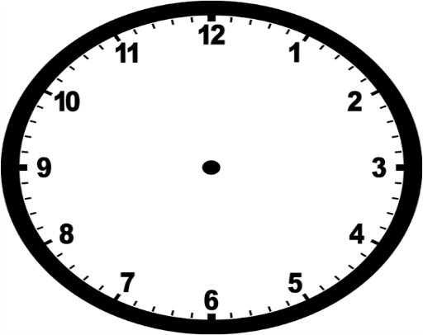
Sao Paulo: Management and Sustainability
Nottingham vs Sao Paulo Comparison
Global Urbanisation
Effects of High Rates of Urbanisation
Sao Paulo: Population and Quality of Life
UK Urbanisation
Changing Cities
Sao Paulo: Functions
Nottingham: Site and Situation
Nottingham: Functions
Sao Paulo: Site and Situation
Nottingham: Management and Sustainability
Nottingham: Population and Quality of Life
Notes:
Changing Cities

Slide 2
Deciduous Woodlands: Threats
Deciduous Woodlands: The New Forest
Biomes and Ecosystems
Climate and Local Factors
Deciduous Woodlands: Nutrient Cycle and Goods and Services
Goods and Services
Ecosystems, Biodiversity and Management
Deciduous Woodlands: Distribution and Characteristics
Distinct UK Ecosystems and Marine Ecosystems
Tropical Rainforests: Distribution and Characteristics
Tropical Rainforests: Costa Rica
Tropical Rainforests: Threats
Tropical Rainforests: Nutrient Cycle and Goods and Services
Notes:
Ecosystems, Biodiversity and Management

Slide 3
Sustainable Management: China
UK vs China Comparison
What is a resource?
Distribution of Natural Resources
Sustainable Management: UK
Consumption of Resources
Resource Management: Water Resources
UK Water Supply
Water Supply
Global Supply Variation
Different Views on Usage
Meeting Demand
Problems of Water Supply
Notes:
Resource Management: Water Resources

