Slide 1
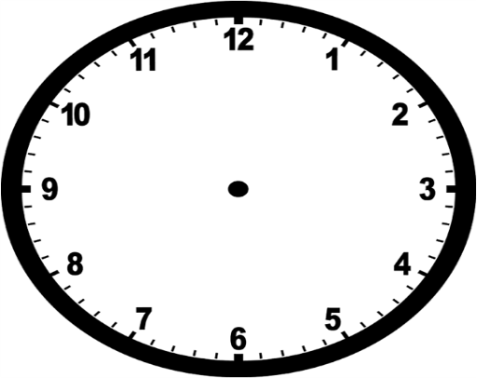
Typhoon Hagibis (Japan 2019)
Droughts (California and Namibia)
Global Atmospheric Circulation (GAC)
Oceanic Circulation
Cyclone Idai (Mozambique 2019)
Past Climate Change
Weather Hazards and Climate Change
Tropical Cyclones (Formation and Characteristics)
Natural Climate Change
Human Activities
Spatial Variations in the UK Climate
Climate of the UK (Past and Present)
Impacts of Climate Change
Notes:
Weather Hazards and Climate Change

Slide 2
India: Positives and Negatives of Development
India: Managing India’s Growth
Factors Affecting Development and Measuring Development
Uneven Development on a Global Scale and UK
India: Demographics and Geopolitics
Causes and Impacts of Global Inequality
Global Development
India: Trade, Aid and Investment
Trade and Fair Trade
Aid, Debt Relief and Remittances
India: Uneven Development and Economic Structure
India: Location and Context
Top-Down and Bottom-Up Approaches
Notes:
Global Development

Slide 3
Hard and Soft Engineering
Distinctive Landscapes: River Tees
Hydrological Cycle
River Processes: Erosion, Transportation and Deposition
The Responses of Flooding
Long Profile
Changing Landscapes of the UK: River Landscapes
The Effects of Flooding
Landforms from Erosion (Upper Course)
Landforms from Erosion and Deposition (Middle Course)
The Causes of Flooding, Frequency and Location
Factors Affecting Discharge
Landforms from Deposition (Lower Course)
Notes:
River Landscapes

Slide 4
Happisburgh
Sea Palling
Coastal Geology and Waves
Coastal Processes
Hard and Soft Engineering
Weathering
Changing Landscapes of the UK: Coastal Landscapes
Effects of the Coast on People and the Environment
Mass Movement
Erosional Landforms
Human Activity on the Coast
UK Coastline Threats
Depositional Landforms
Notes:
Coastal Landscapes

