Slide 1
Knowledge organiser
English Literature: Aspects of Tragedy

Slide 2
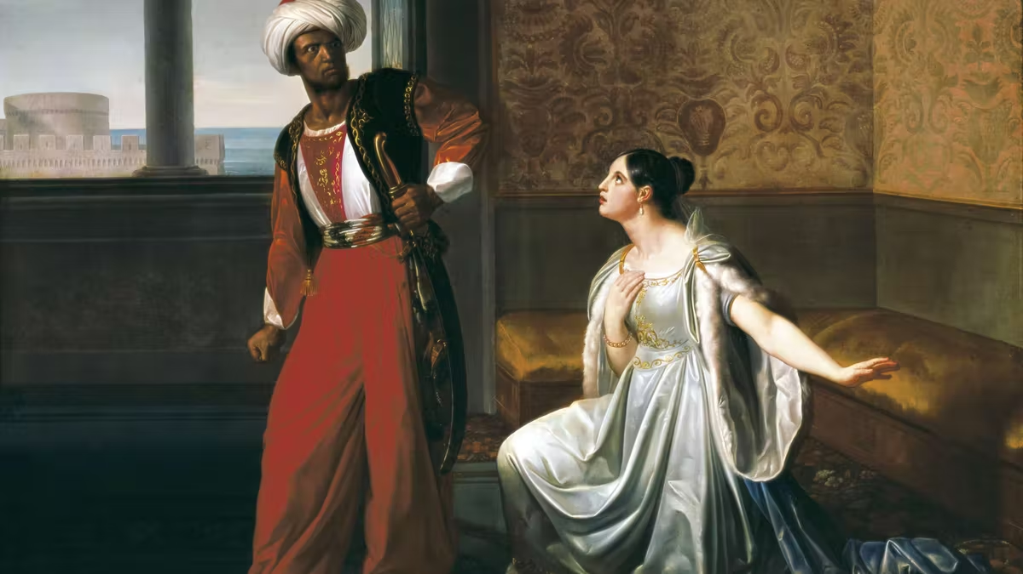
Othello Key Characters
Othello | Desdemona | Iago | Brabantio | Emilia | Roderigo | Cassio
A general in the venetian army. Tragic hero of the play. Husband of Desdemona. Black Man. | Of noble birth. Wife of Othello. Daughter of Brabantio. Tragic victim. | Tragic villian of the play. Not of noble birth. He believes he deserves more than he gets. | Father of Desdemona. Racist man who has prejudice views (tragic flaw). | Iago’s wife and servant of Desdemona’s. Becomes more confident throughout. Victim. | In love with Desdemona and is blind. Easily manipulated. | Suspected lover of Desdemona’s. Is used as a puppet by Iago.
Aristotle’s aspects of tragedy (AO4)
The tragic hero is noble, but with hamartia (fatal flaw) that leads to peripeteia (reversal of fortune). This flaw may be hubris (excessive pride) or blindness to the truth, and leads to the hero’s isolation, emptiness, and sense of loss. The hero has a moment of anagnorisis (realisation) before his downfall. This tragic trajectory evokes pathos (pity and fear) for the hero, which is eventually purged in a moment of catharsis (release) at the play’s denouement (resolution). There is often a sense that the hero is fated to meet his inevitable downfall.
Key themes in Othello
Prejudice
Jealousy
Manhood & Honour
Womanhood & Sexuality
Appearance VS Reality

Slide 3
Assessment Objectives (AO’s)
Key Quotes
AO2
AO2 is how writers “shape meanings” within their texts using devices such as:
Dramatic structure
Stage directions
Speech and Language
Stagecraft
Imagery
Metaphorical Language
Time & Place
Point of View etc
When writing an essay on Othello, the AO2 points can be made like so:
‘An old black ram is tupping your white ewe’ Shakespeares use of metaphorical and suggestive language implies that Othello, as a balck man, is bestial which in turn dehumanises Othello.
AO3
AO3 relates to the many possible contexts which arise out of the text, the specific task and the period being studied. These can be things such as:
Context of production
Context of reception
When writing an Othello essay it’s important to not forget AO3 is it can be hard to pick out from the text. Some examples of AO3 are:
The edwardian audience would have had strong views on interracial relationships.
The courtly love tradition and idealised vision of romance.
Patriarchal society - Male dominated hierarchy was a part of their belief system.
AO4
AO4 is the aspects of the genre you are studying (tragedy). Aspects of tragedy include:
Tragic villain
Tragic Victim
Tragic Hero
Hamartia
Hubris
Catharsis
Fate
Loss
Inevitability
Tragic Blindness
When writing an Othello essay AO4 is crucial as it is a key part of the text and the mark scheme for the essays. For example: ‘Your son in law is more fair than black’ Implies that Othello's job gives him status as if he was a white man. Shows that Othello's tragic flaw is his skin colour and his job/status.
She loved me for the dangers I had passed, And I loved her that she did pity them. (1.3.)
I know, Iago
Thy honesty and love doth mince this matter. (2.3.)
No, Iago, I’ll see before I doubt. (3.3.)
Therefore be double damned: Swear thou art honest. (4.2.)
I put out the light and then put out the light (5.2)
O, beware, my lord, of jealousy: It is the green-eyed monster which doth mock. The meat it feeds on. (3.3)
I kissed thee ere I killed thee: no way but this, Killing myself, to die upon a kiss. (5.2)
Even now, now, very now, an old black ram Is tupping your white ewe. (1.1)

Slide 4
Death of a Salesman- key characters
Willy Loman | Biff Loman | Happy Loman | Linda Loman | ‘The Woman’ | Charley | Bernard | Ben
Patriarch of the Loman family, tragic protagonist and salesman. | Oldest son of Willy and Linda Loman.tragic victim. | Second son of Willy and Linda Loman. Tragic victim. | Matriarch of the family, wife of Willy Loman and mother of Biff and Happy. Tragic victim. | Women Willy Loman has an affair with- symbol throughout the play of guilt. | Willy Loman’s neighbour and only friend. | Son of Charley and an important successful lawyer, friend of Biff. | Willy Loman’s older and more adventurous brother. Got rich quick- idolised by Willy, a symbol of the American dream.
Aristotle’s aspects of tragedy (A04)
The tragic hero is noble, but with hamartia (fatal flaw) that leads to peripeteia (reversal of fortune). This flaw may be hubris (excessive pride) or blindness to the truth, and leads to the hero’s isolation, emptiness, and sense of loss. The hero has a moment of anagnorisis (realisation) before his downfall. This tragic trajectory evokes pathos (pity and fear) for the hero, which is eventually purged in a moment of catharsis (release) at the play’s denouement (resolution). There is often a sense that the hero is fated to meet his inevitable downfall.
Key themes in Death of a Salesman
Blindness
Illusion of the American Dream
False dreams
False pride
Psychic vs Actual time

Slide 5
Assessment objectives (AO’s)
Key Quotes
A02
A02 is How writers ‘shape meanings’ within texts using structural and figurative devices such as:
Stage directions
Persistent motifs
Symbols
Figurative language
Dramatic structure
Features of dramatic texts
Psychic vs actual time
When writing a ‘Death of a salesman’ essay, A02 points can be included like this - ‘You blew me so full of hot air I could never stand taking orders from anybody!’ Through Millers depiction of Biff Loman- the tragic victims catharsis an overarching sense of dramatic irony is evoked to portray the impact of Willy’s parenting heightening the tragic experience
A03
A03 relates to the many possible contexts which arise out of the text, the specific task and the period being studied. These can be things such as:
Context of production
Context of reception
The American Dream
Political state of USA (capitalist society)
When writing a ‘Death of a salesman’ essay A03 is important as in the text it could be perceived as a crucial factor in the overall tragedy, some examples of A03 are:
The impact of the American dream in 1950s America
The impact of capitalism
The treatment of women at the time/ role of the patriarchy
A04
A04 is the aspects of the genre you study (Tragedy). Aspects of tragedy include:
Tragic Villain
Tragic Victim
Tragic hero
Hamartia
Hubris
Catharsis
Fate
Loss
Sadness
Suffering
Tragic blindness
Misjudgements
When writing a ‘Death of a salesman’ essay A04 is important as it is a key part of the texts and the mark scheme, for example ‘I’m not saying he’s a great man’ suggests that Linda is blinded by her love for Willy which is over-riding her clarity on the situation alluding to the final tragedy.
‘You blew me so full of hot air’
‘What you are, and what i am’
‘We never told the truth for 10 minutes in this house’
‘Would you stop mending stockings’
‘He had the wrong dream’
‘Now is no time for false pride Willy’
‘Only a little boat looking for a harbour’
‘Why am I trying to become what I don’t wanna be’
‘I’ve got to get some seeds’
‘I am not a leader of men, Willy, and neither are you.’

Slide 6
Feminist critical theory key aspects
Deconstructing the way that women characters are described in novels, plays etc, especially if the author is male
Deconstructing how one’s own gender influences how one reads and interprets a text
Deconstructing how women autobiographers of women treat their subjects, and how biographers treat women who are secondary to the main subject
Describing relationships between the literary text and ideas about power and sexuality and gender
Critique of patriarchal or woman-marginalizing language
Reclaiming women writers who are little known or have been marginalised or undervalued, sometimes referred to as expanding or criticizing the literary canon
Examples of feminist critical theory on novels
There are multiple narrator's in Mrs Dalloway, as the novella uses a stream of consciousness narrative structure. The novella's protagonist, Clarissa Dalloway, is one of these narrators, giving her a level of autonomy over the way in which she is portrayed to the reader. Clarissa Dalloway is the text's protagonist, or main character. She has a dominant role in the novella's narrative, with the story centering on the events of a single day, leading up to her party in the evening. Woolf utilises both feminine and masculine imagery in the text, a key example being Peter's 'pocket-knife'. The pocket-knife acts as a phallic symbol, Woolf employs it to allow the audience to infer Peter’s attraction and need for dominance. The pocket-knife becomes a symbol of masculinity during Peter and Clarissa's first exchange. Despite knives holding connotations with danger and Peter’s own pocket knife being large, Clarissa dismisses it. This indicates that she is not intimidated by Peter’s masculinity and presence. As he tilts his pen-knife towards her green dress, Clarissa simply responds by opening her scissors, a yonic symbol, the similar connotations with danger held by scissors allowing Clarissa to match Peter’s encroaching masculinity with her femininity.
Examples of feminist critical theory on poetry
In the Dickinson’s poem, “I ’m wife; I’ve finished that”, it showed the woman’s difference of freedom when they are married and have not married. It is not amazed if this poem is connected to feminism approach. Feminist scholars have examined Dickinson’s poems and letters in an effort to gain some insight into how the poet responded to the gender-restrictive values of the mid-nineteenth-century patriarchal society. These critics have concluded that while as a person Dickinson succumbed to a life of social marginality and seclusion, as a poet she opened a new frontier of feminine power and assertiveness through her transcendent and imaginative verse. Feminist scholars have identified a number of Dickinson’s poems which directly comment upon the role and experiences of women within a repressive patriarchal order. In addition, some of these critics have suggested that many more poems can be interpreted as the poet’s opinion of gender issues if one were to assume that the speaker in each verse is a female. For example, Poem 271 (“A solemn thing—it was—I said—”) presents the image of “a woman—white,” which may be a reference to a bride, a novice nun, or a female poet. At the conclusion, the speaker of the poem finds satisfaction in her “‘small’ life,” which some commentators have suggested is a rejection of conventional female roles in favor of pursuing those that she finds more fulfilling.

Slide 7
Assessment objectives (AO’s)
AO2
AO2 is how writers “shape meanings” within their texts using devices.
Within the coursework it is important to focus on how the authors have made conscious choices to portray women in a certain way.
It is also important to keep the literary genre in mind and ask yourself how this genre could affect the portrayal of women.
Try to acknowledge the text as a whole rather than relying on smaller extracts from the novel/poem.
ALways link your quotes and thoughts back to the text and back to the critical anthology given to you.
You can still use the ‘classic’ AO2 points such as
Dramatic structure
Stage directions
Speech and Language
Stagecraft
Imagery
Metaphorical Language
Time & Place
Point of View etc
However these need to be linked back to the anthology and back to how the novel/poem presents feminism.
AO3
AO3 relates to the many possible contexts which arise out of the text, the specific task and the period being studied.
Relevant background factors are good to know as they can help to learn how women are portrayed in the novel/poetry and how time periods affect the way authors write about women.
AO3 is important however it should be used to support points that have been made and used to reinforce AO1/AO2.
After making a point on AO3 it is important to go back to the point/task as it can be very easy to drift off into writing an essay about treatment of women in a specific time period, when this is not needed.
Things such as
Context of production
Context of reception
Are important to recognise within the coursework as they can be extremely relevant to the representation of women within the writing.
AO4
AO4 is the aspects of the genre you are studying, in your NEA this will be the literary criticism chosen to study (feminist).
In coursework it is important to make literary links and to focus on how the writer has presented the relevant aspects.
Exploring differences and similarities within the text and how women are presented is important when trying to make connections between the anthology and the novel.
AO4 is targeted by the requirement to refer to the critical anthology, which is itself another text. Making connections between the text and the critical anthology is important for establishing a good feminist critical theory of your chosen novel.
AO1/AO5
AO1:It is important to read over your chosen texts to be able to have a wider understanding of the novel/poetry and be able to start making links to feminist critical theory. It is good to start planning and writing about key points you have encountered within the novel so they can be refined and used within the coursework.
AO5: Reading others literary criticisms on the novel you have chosen can help to inform you and help you to create a more informed response. In addition to this, don’t rely too heavily on others criticism’s and don’t plagiarise.

Slide 8
Marxists critical theory key aspects
Deconstructing the way marxism may impact the works of an author subconsciously
Deconstructing the power balances between different classes of society
Deconstructing the different representations of different socio-economic backgrounds
Deconstructing the role of class within a prose/poem
Considering the socio-economic status of the author and the impacts of these contextual factors on writing
Examples of Marxist critical theory on novels
If you take a step back from the overarching plot of ‘pride and prejudice’ a marxist critical view can be applied, Austen provides underneath the centre of the prose an interesting depiction of the notable contrasts in relationships between higher and lower classes, insight is given into the different qualities of life during the time, giving insight into Austen’s own socio-economic status. As well as this, Austen provides a view into the real life struggles faced by those concerning livelihoods and economic success in the 1800s. The trajectory of Austen’s characters are impacted by the class as to which they are divided into, Austens choices regarding her characters socio-economic status’ could be perceived as deliberate to impact their own actions and plot. The most important theme in the novel is marriage as to which Austen portrays as being heavily dictated by the goal of avoiding oppression and a struggle for freedom as a women in their socio-economic position.
Examples of Marxist critical theory on Poetry
A Marxist critical approach can be taken to most texts despite not seeming explicitly like a marxist text at face value, for example- in Sylvia Plath’s poetry collection ‘ariel’ the poem ‘morning song’ can be observed through a marxist lens. PLath includes a line ‘I am no more your mother Than the cloud that distills a mirror to reflect its own slow Effacement at the wind’s hand.’ Rather than being about just the introduction to motherhood at childbirth, the phrase ‘I am no more your mother’ could be a symbol for how as soon as one is introduced to the world they are infiltrated by society- the phrase could be viewed to dehumanise Plath’s own child presenting them as instead as a slave to society who will grow up to work and become a product of capitalism. This view suggests Plath’s own criticism of marxism and gives insight into her own socio-economic background/ views. Pastoral imagery evoked in ‘wind’s hand’ juxtaposes the symbol of dehumanization potentially being presented representing the decline of natural society- what once was pure (childbirth/nature) has been replaced by a flawed system.

Slide 9
Assessment objectives (AO’s)
A02
A02 is how the writers ‘shape meanings’ within their texts using devices. Within the coursework it is important to focus on how the authors have made conscious choices to shape their meanings regarding Marxism. Keep the literary genre in mind and consider how this may impact a marxist critical view. Always link quotes and thoughts back to your novel and the genre as well as the critical anthology. Well known features of A02 are still valid here such as:
Dramatic structure
Stage directions
Speech and language
Imagery
Figurative language
Point of view
Time and place
Keep in mind to always link back to the novel and the critical lense genre
A03
A03 relates to the many possible contexts which arise from the texts , the specific task and the period being studied. Relevant background factors are good to know when analysing a text through a marxist critical lens. A03 is important however it should be used to support points that have been made and used to reinforce AO1/AO2. After making a point on AO3 it is important to go back to the point/task as it can be very easy to drift off into writing about marxism in this time period but this isn’t needed unless it serves your concept. Things such as:
Context of production
Context of reception
Are important to recognise within the coursework as they can be extremely relevant to the examples of marxism within the writing
AO4
AO4 is the aspects of the genre you are studying, in your NEA this will be the literary criticism chosen to study (Marxism). In coursework it is important to make literary links and to focus on how the writer has presented the relevant aspects. Exploring differences and similarities within the text and how marxist views are presented is important when trying to make connections between the anthology and the novel/poem. A04 is targeted by the requirement to refer to the critical anthology which is itself another text. Making connections between the text and the critical anthology is important for establishing a good marxist literary theory on your chosen novel/poem.
AO1/AO5
AO1:It is important to read over your chosen texts to be able to have a wider understanding of the novel/poetry and be able to start making links to marxist critical theory. It is good to start planning and writing about key points you have encountered within the novel so they can be refined and used within the coursework.
AO5: Reading others literary criticisms on the novel you have chosen can help to inform you and help you to create a more informed response. In addition to this, don’t rely too heavily on others criticism’s and don’t plagiarise.

