Slide 1
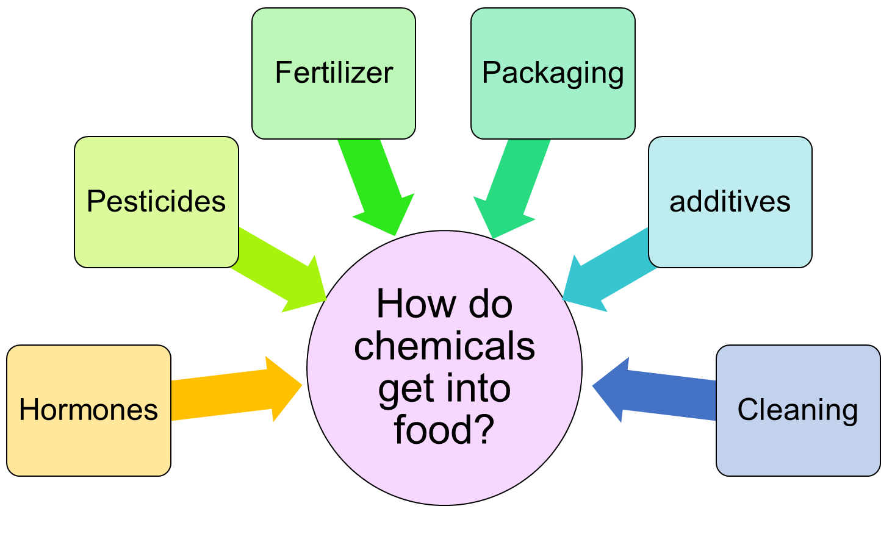
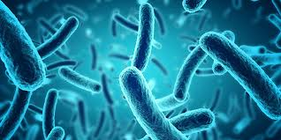
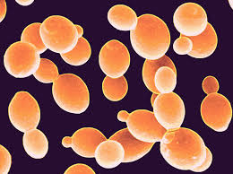
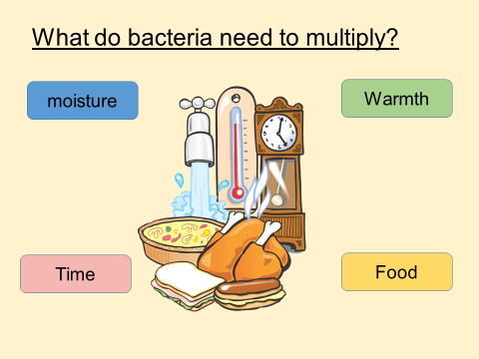
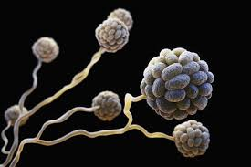
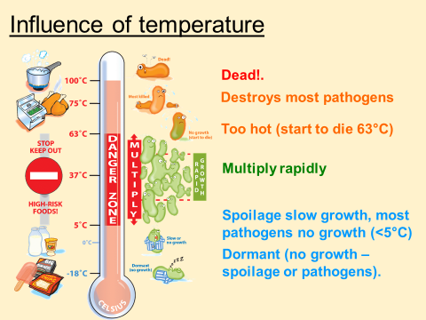
LO4 Know how food can cause ill health
Sources of bacteria
Raw food
Pests
People
Air and dust
Soil
Food waste
Water
Animals
Chemicals
Keywords
4.1 Food-related causes of ill health
Microbes- are tiny micro-organisms that can contaminate food and spoil it, casing ill health. The micro-organisms discussed on this page are bacteria, yeasts and moulds
Bacteria
Extended reading
Bacteria are single-celled micro-organisms. Bacteria can be found everywhere around you; on your skin, in food, in soil, in water and in the air.
Most bacteria are harmless, but some are pathogenic and can cause food poisoning. General food poisoning symptoms are vomiting (being sick) and diarrhoea.
Other types of bacteria cause food to decay; these are called food spoilage bacteria, which cause food to smell and lose its texture and flavour.
Metals
Aluminium
Aluminium is one of the most common metals used in cookware as it is lightweight and conducts heat well.
When aluminium surfaces are in contact with acidic foods, such as tomatoes and citrus fruits, the aluminium reacts and can leach (dissolve) into the food. This can give the food an unwanted metallic taste.
When aluminium has been associated with Alzheimer’s disease, there is no evidence that this causes the disease. The world health Organisation estimate that adults can consume more than 50 mg of aluminium daily without harm, so day to day exposure to aluminium from cooking is considered to be safe.
Aluminium cookware can be anodised (hardened through a process that makes it unreactive) or coated with a less-reactive material, such as stainless steel, so that it does not react with food.
Copper
Copper may be used in cups, pots and pans. It warms quickly and is he best conductor of heat.
Copper and copper-alloy surfaces react with acidic foods, such as tomatoes and citrus fruits, and can leach (dissolve) into the food. High doses of copper can be toxic, so most copper pans are lined with stainless steel to avoid this happening.
Yeasts
Exam question
Yeasts are a single celled fungi that reproduce by ‘budding’ – the yeast cell grows a bud, which becomes bigger until it eventually breaks off and becomes a new yeast cell.
Yeast can grow in acidic, sweet foods; for example orange juice can ferment if it is not stored correctly, and honey can ferment if not pasteurised.
Yeasts prefer moist, acidic foods.
Yeasts can grow in high concentrations of sugar and salt.
Yeasts grow best in warm conditions (around 25-29 ̊C) but can also grow at fridge temperatures (0-5 ̊C)
Yeasts are destroyed at temperatures above 100 ̊C.
Video links
Moulds
Moulds are tiny fungi; they produce thread like filaments that help the mould to spread around the food.
Moulds grow in warm and moist conditions.
Moulds grow easily on bread, cheese and soft fruits, and can grow on foods with high sugar and salt concentrations.
Moulds grow best between 20 ̊C and 30 ̊C, but can also grow in the fridge (0 ̊C- 5 ̊C)
Mould growth may be speeded up by high humidity and fluctuating temperatures
Moulds can grow on fairly dry food, such as hard cheese (for example Cheddar cheese)
Moulds often spoil food such as bread and other bakery products.
Revision Techniques

Slide 2
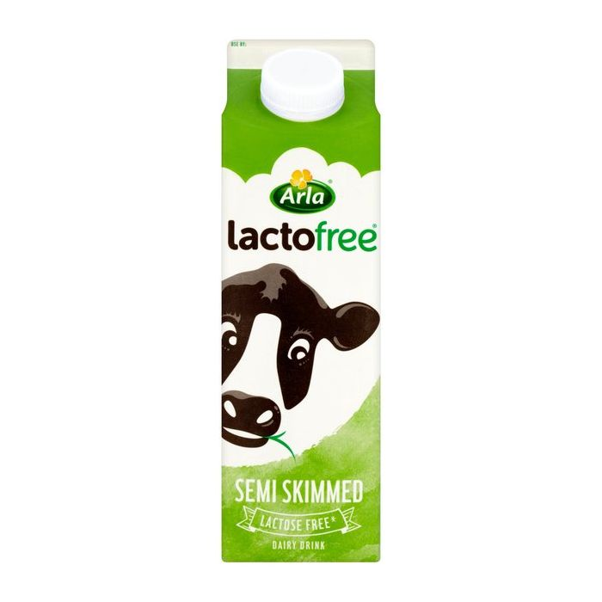
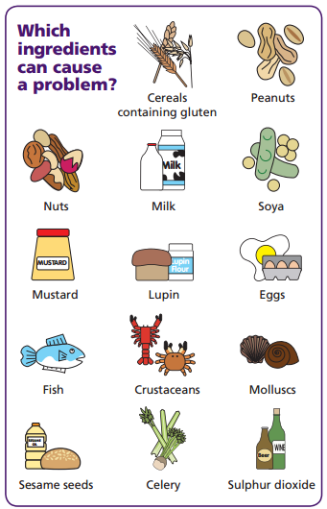
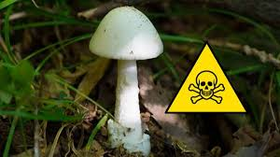
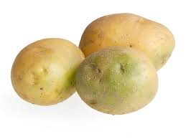
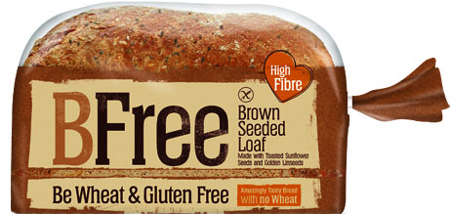
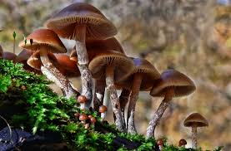
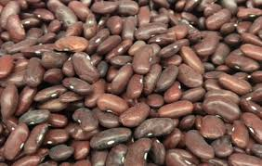
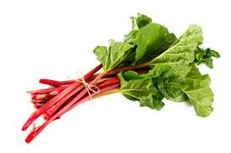
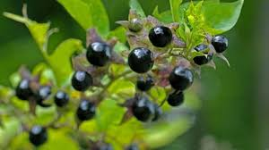
LO4 Know how food can cause ill health
Allergies
Intolerances
Keywords
A person with a food allergy experiences an allergic reaction when they eat or come into contact with specific foods.
Allergic reactions are caused by the body’s immune system reacting to the food and can be fatal.
Some people have sensitivity to certain foods. This is called a food intolerance. Eating these foods can cause symptoms such as nausea, abdominal pain, joint aches and pains, tiredness and weakness
4.1 Food-related causes of ill health
Poisonous plants
Some mushrooms are poisonous, so you should pick mushrooms to eat unless you are 100% sure of what they are. The death cap and autumn skullcap are two of the most poisonous. Consuming poisonous mushrooms can lead to pain in the area of the kidneys, thirst, vomiting, headache and fatigue.
Many berries that grow wild are poisonous and should not be eaten. Yew berries, deadly nightshade and unripe elderberries re all poisonous. Consuming poisonous berries can lead to nausea, vomiting, stomach ache and diarrhoea, but can also be fatal.
Rhubarb leaves contain oxalic acid, which shuts down the kidneys and can be fatal; the stalks are safe to eat how ever.
Glycoalkaloids are found in leaves, stems and sprouts of potatoes. They can build up in potatoes if they are left too long in the light, causing them to turn green. Eating glycoalkaloids can lead to cramps, diarrhoea and coma, and can prove fatal.
If nuts and cereals get damp when they are stored, they can develop a mould that produces a toxin that can damage the liver.
Dried kidney beans contain a toxin called lectin that makes them unsuitable for eating. Eating raw or inadequately cooked beans can lead to symptoms that indicate food poisoning. Kidney beans should be soaked and boiled for a t least ten minutes to destroy the toxin.
Lactose intolerance
A person with a lactose intolerance cannot digest the sugar in milk called lactose.
People with a lactose intolerance need to avoid all dairy products and foods that contain dairy products in their ingredients.
Extended reading
Gluten intolerance
Gluten is a protein present in a number of cereals including wheat, rye and barley.
Wheat is a nutritious staple food in the UK diet an dis found in a number of foods including flor, baked products, bread, cakes, pasta and breakfast cereals.
People with a gluten intolerance need to follow a gluten free diet.
It is important not to confuse gluten intolerance with coeliac disease which is an autoimmune disease caused by a reaction of the immune system to gluten. A person with coeliac disease is called a coeliac.
Exam question
Video links
Revision Techniques
Make sure you understand the difference between a food intolerance and an allergy. An intolerance is a sensitivity to some foods; a person with a food allergy can suffer a fatal reaction if that food is eaten.

Slide 3
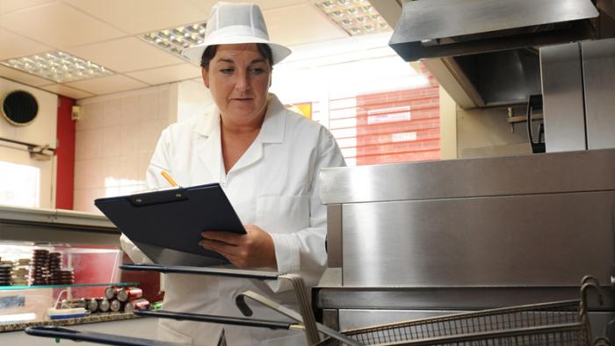
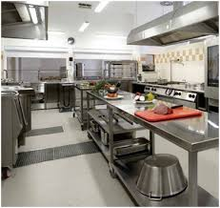
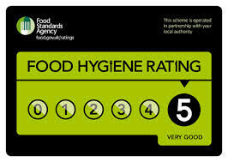
LO4 Know how food can cause ill health
Enforcement action
Keywords
Enforcement action is required by law following an inspection from an EHO.
Enforcement action can range from verbal advice, informal or formal letters, and notices through to prosecution.
Formal Inspection letters- tells the food business which issues must be addressed to comply with the law. The EHO may revisit the business to check that the issues have been resolved.
Hygiene Improvement Notices- An EHO can serve a Hygiene Improvement Notice when they believe that a food business is failing to comply with food hygiene regulations. This notice will specify what s going wrong and what needs to be done by which date. The EHO will visit again to see if the required work has been done. If it has not improved, it can lead to a fine or imprisonment.
Hygiene Emergency Prohibition Notices- If an EHO believes that there is a significant risk to health and injury, a Hygiene Emergency Prohibition Notice may be served. The notice stops the use of the unsafe equipment, processes or premises immediately. It can only be removed by an EHO once the issues have been addressed.
Voluntary closure- A food business may elect to close voluntarily to carry out improvements. However, should the business reopen before the improvements are completed, the EHO will serve a Hygiene Emergency Prohibition Notice.
Seizure and detention of food- EHOs have the power to inspect and seize food suspected of not meeting food safety regulations. Food is taken if there is suspicion that it is contaminated and is likely to cause food poisoning or disease. Seized food may undergo microbiological examination and testing.
Condemnation of food- In order to condemn or seize food, the EHO must present their findings to a court. They will consider the information and decide whether the food poses a risk to human health and whether or not to condemn it.
Voluntary surrender of food- The owner of a business may surrender unfit food to the EHO voluntarily. This would avoid the involvement of the court.
4.2 The role and responsibility of the Environmental Health Officer
Environmental Health Officers (EHOs) are responsible for carrying out measures to protect public health and to provide support to minimise health and safety hazards.
Extended reading
Role of EHOs
Responsibilities of EHOs
They look after the safety and hygiene of food through all stages of the manufacture or production from distribution to storage and service.
They help develop, co-ordinate and enforce food safety policies.
They have the right to enter and inspect food premises at all reasonable hours and can visit without advance notice.
They carry out routine inspections of all food premises in their area; the frequency of routine inspections depends on the potential risk posed by the type of business and its previous record- some high-risk premises may be inspected at least every six months, others much less often.
They visit premises as a result of a complaint.
They have powers of enforcement and can close businesses in extreme cases.
They check that food producers handle all food hygienically so as not to give customers food poisoning.
They check that food is being kept at the specific temperatures at which it should be stored or held.
They check that staff are properly dressed, with clean nails, no jewellery, hair covered or tied back, and showing good hygiene habits.
Thy review processes in the workplace, such as the handling of food, use of equipment, use of colour coded chopping boards, washing-up and disposal of waste.
They inspect food stores-fridges, freezers and dry stores.
They check stock rotation and temperature logs
They check that equipment is clean, well maintained and with safety notices if appropriate.
The check the temperature of the food when it is cooked with probes to ensure that it is at the correct temperature.
They ask questions to check compliance with the law or good practice
They identify potential hazards
They review safety management systems and plans
At the end of an inspection they give verbal feedback, discuss any problems and advise on possible solutions. They complete a report of inspection findings, which tells the business what enforcement action is to be taken.
Exam question
Video links
Revision Techniques

Slide 4
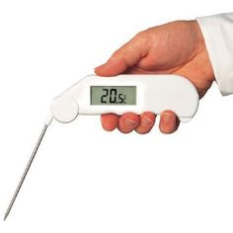
LO4 Know how food can cause ill health
Basic hygiene rules
Record Keeping
Keywords
Don’t cough or sneeze near food.
Don’t touch your head, especially your mouth, nose or ears.
Wear protective clothing and footwear provided by your employer.
Don’t brush your hair when wearing protective clothing or in any food areas.
Long hair should be tied back and covered.
Cuts and scratches should be covered with a coloured waterproof plaster.
Don’t prepare food if you are unwell with a stomach bug or cough and cold, as you could spread bacteria onto food.
Detailed records need to be kept of:
Food safety management procedures
Training records of staff and staff illness reporting procedures
Cleaning schedules
Pest control and waste disposal contracts
Records of checks, problems found and actions taken, for example a food temperature log book
List of suppliers
4.3 Food safety legislation
Food Safety Act 1990
This act is concerned with all aspects of food production and sale.
If affects everyone involved in the production, processing, storage, distribution and sale of food.
It ensures that all food produced is safe to eat.
The act states that it is an offence to make food sold for human consumption unsafe to eat.
A food producer or retailer may not add any substances to food, or subject food to any process or treatment, which will make it harmful to health.
An EHO may inspect any food intended for human consumption at any reasonable times. If the food is regarded as unfit for human consumption, it may be seized.
The legislation also provides a defence for foo producers, processors and retailers. They must prove that all reasonable precautions were taken to prevent a food safety incidence. This is called due diligence.
Failure to take reasonable precautions can result in prosecution.
Magistrates’ courts may impose a fine, prison sentence or both for offences committed.
Extended reading
Food safety plan
Hazard analysis and critical control points (HACCP)
The following information should be included in a written safety plan:
Purchase and delivery
Stock control
Storage and preparation
Chilled foods
Frozen foods
Cooking
Hot holding
Cooling
Reheating
Personal hygiene
Equipment and premises
Cleaning and maintenance
Pest control
Using this system can demonstrate the defence of ‘due diligence’ legally. To prove due diligence a business must be able to demonstrate that it took every possible reasonable step to achieve safe food. This may protect the owner of the business from prosecution.
It is likely that the court would demand written records to support the defence. These might include documents from the safety plans. Other relevant documentation may include staff training records, temperature logs, cleaning schedules, supplier specifications, traceability systems, remedial action where food safety problems have arisen, and pest control measures.
This is a process that is designed to help look at how you handle food and to put procedures in place to ensure that the food you produce is safe to eat.
Every business that produces, sells or serves food is required to have a HACCP plan in place with a written food safety plan. It is the responsibility of the owner of the business to develop an appropriate food safety management system based on HACCP.
HACCP systems should apply the following principles:
Create a flow chart or table showing each step in the preparation, making, serving and storing of each dish.
Each step should be analysed to identify the hazards. Hazards can be:
Physical- foreign materials can cause injury to the consumer; these might be metal or plastic, or natural hazards such as bones in fish.
Biological- food can become infected by bacteria, which might lead to food poisoning
Chemical- potentially dangerous chemicals such as cleaning fluids can contaminate food.
Identify what can be done to control (prevent) the hazard.
Set guidelines on how to ensure food is going to be safe to eat- these are known as critical limits- and keep a record of this.
When new dishes are made, there needs to be a HACCP review to ensure that they are safe to eat.
All the documentation relating to the HACCP needs to be kept safe.
Exam question
Food Safety (General Food Hygiene) Regulations 1995
Video links
These regulations apply to food businesses and cover all activities involving food. The legislation clearly sets out the responsibility of food businesses to:
Produce food safely and make sure it is consistently safe to eat; food is unsafe if it is harmful to health and unfit for human consumption
Keep records of suppliers so that food can be traced; businesses must withdraw food that does not meet food safety requirements.
The whole food chain, from farm to fork, is covered by legislation. Farm to fork means that food can be traced through all the stages of production, processing and distribution back to the original source.
The regulation require that food is stored, handled, cooked an served safely; that premises are clean and hygienic; and that people handling food follow basic hygiene rules.
Revision Techniques

Slide 5
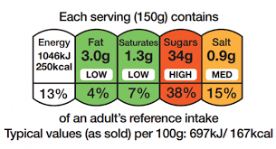
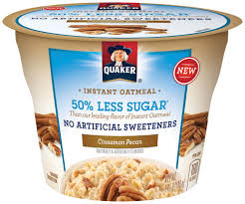
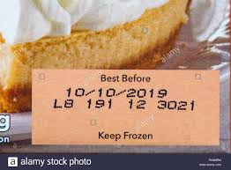
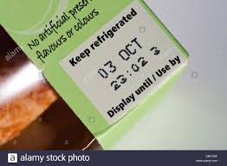
LO4 Know how food can cause ill health
Nutritional labelling
Traffic light labelling
Keywords
Nutritional information must be expressed per 100g or per 100ml, and it must be listed in the following specific order:
Energy-stated in kilojoules (kJ) and kilocalories (kcal) per 100g or 100ml
Fat
Saturated
Carbohydrates
Sugars
Fibre (not required by law)
Protein
Salt
Vitamins and minerals-these must also be expressed as a percentage of the reference intake (RI)
Traffic light labelling is a voluntary system that uses traffic light colours to indicate how healthy a product is at a glance in terms of fat, saturated fat, sugar and salt.
Red- the food is high in something that consumers should try to cut down on in their diet; such foods should be chosen less frequently and eaten in small amounts.
Amber- the food isn’t high or low in the nutrient, so this is an acceptable choice most of the time.
Green- the food is low in teat nutrient; the more green, the healthier the choice.
Consumers should choose foods with more greens and ambers and fewer reds to ensure healthier choices.
Traffic light labels also give the amount of fat, saturated fats, sugars and salt in grams, the manufacturer or retailer’s suggested ‘serving’ size, and information on the nutrient as a percentage of RI.
4.3 Food safety legislation
Food labelling regulations
Food labels are used by business to provide information about their products. They are needed to:
Enable consumers to make informed decisions and choices, and to educate them about the food they choose to buy
Help us to store, prepare and cook the food we buy correctly
Identify the ingredients used in food-if a consumer has a severe allergy to certain ingredients (for example nuts), they need to check if the food contains those ingredients.
Establish the nutrient content of the food- if a consumer has a health condition such as diabetes or high blood pressure, they may want to check the sugar, fat, carbohydrate or salt content of the food.
Identify where the food comes from- some consumers may prefer to buy local ingredients.
Extended reading
Mandatory information required on labels
Information that food labels must show
Name of the food
List of ingredients
Allergen inforamtion
Quantity of certain ingredients or categories of ingredients
Net quantity
Date of minimum durability (use by and best before dates)
Storage
Manufacturers name and address
Country of origin
Instruction for use
Alcoholic strength
Nutritional declaration
Exam question
Dates of minimum durability
Nutrition claims
Different types of dates are used to tell customers when food should be consumed by:
Use-by date- usually on high risk foods such as soft cheeses, chilled meats, salads and sandwiches, which can go off quickly; it states the date that the food should be used by.
Sell-by or display-until date- this date is aimed at shopkeepers rather than consumers; it is usually a few days before the use-by date to allow the consumer time to eat the food.
Best-before date- these are given on foods that keep for longer, for example biscuits; the food should be eaten before this date for quality purposes, but it is not usually harmful to eat it after this date.
There are strict rules about claims that can be made about food on its packaging so that consumers are not misled. For example, if the packaging says that the product is ‘fat free’, the product must not contain more than 0.5g of fat per 100g or 100ml.
Any health claim the manufacturer makes has to be reviewed to ensure it is accurate before it appears on the label.
Video links
Revision Techniques

Slide 6
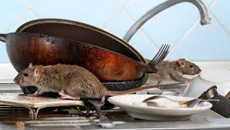
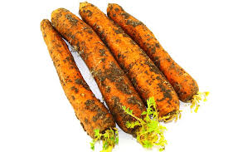
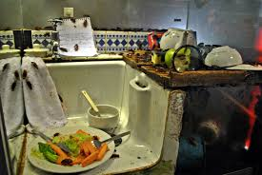
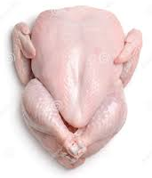
LO4 Know how food can cause ill health
Conditions necessary for food poisoning
Symptoms of food poisoning
A symptom is a sign or indication of a disease.
The body reacts to bacteria or toxins by developing symptoms such as diarrhoea, vomiting, stomach pains, headache and sweating.
Some of these symptoms are visible and some are non-viable
Keywords
4.4 Common types of food poisoning
Bacteria can grow rapidly in the correct conditions. A single bacterium can divide into two by the process called binary fission. A single bacterium can produce 16 million bacteria in only 12 hours.
Food poisoning bacteria have four essential requirements for growth:
Food- bacteria grow rapidly in high risk foods that are good sources of protein; such as cooked meat and poultry, shellfish, and seafood, undercooked or lightly cooked eggs, unpasteurised milk and cheeses, cooked rice and pasta, and salads.
Moisture- bacteria cannot multiply without moisture, which means that they do not usually affect dried foods or products with high quantities of salt or sugar, which absorb water.
Warmth- most bacteria multiply at ambient temperature -normal room temperature. This falls within the danger zone between 5 ̊C and 63 ̊ C. Below 5 ̊C most bacteria are unable to multiply rapidly, and below -18 ̊C they become dormant. Cooking food at high temperatures above 63 ̊C will destroy most bacteria; when cooked, the food should reach 75 ̊C for at least two minutes.
Time- in the right conditions the number of bacteria can double every 20 minutes.
The acidity and alkalinity of a food can influence the growth of bacteria. If conditions are too acidic or to alkaline, bacteria can not grow.
Food poisoning can be caused by pathogenic bacteria but it can also be caused by virus, chemicals and metals contaminating the food. Food can even be contaminated with poisonous plants and animals.
Visible symptoms | Non-visible symptoms
Shivering Diarrhoea Vomiting | Feeling tired or weak Stomach ache Headache Feeling nauseous (sick)
Extended reading
Symptoms of food allergies
A food allergy is a serious reaction to a food or ingredients in food. It is caused by the body’s immune system reacting to an allergen. If the reaction to a food is a bad one, it could give the following symptoms:
Skin rash
Itchiness of skin, eyes and mouth.
Swollen lips, face, eyes
Difficulties in breathing.
In severe cases, it can bring about anaphylactic shock- the person develops swelling in their throat and mouth, making it difficult to speak or breathe. This can lead to death if appropriate treatment, such as an EpiPen, is not used quickly.
Symptoms of food intolerances and coeliac disease
Some people have a sensitivity to certain foods, which can cause symptoms such as nausea, abdominal pain, joint aches and pains, tiredness and weakness. This is called a food intolerance- this is not an allergic reaction and it does not involve the immune system.
Coeliac disease is neither a food allergy nor a food intolerance but an autoimmune disease caused by a reaction of the immune system to gluten- a protein found in wheat, rye and barley. The symptoms of coeliac disease vary from person to person and can range from mild to severe.
Symptoms of coeliac disease include:
Severe diarrhoea, excessive wind and/or constipation
Persistent or unexplained gastrointestinal symptoms, such as nausea and vomiting.
Recurrent stomach pain, cramping or bloating.
Iron, vitamin B12 or folic acid deficiency.
Anaemia
Tiredness
Sudden or unexpected weight loss.
Symptoms of lactose intolerance include:
Abdominal pain
Nausea
Diarrhoea
flatulence
Exam question
Sources of food poisoning
Food can become contaminated during production, preparation and retailing. The main sources are:
Raw food-for example meat, poultry, shellfish and eggs.
People- food-poisoning bacteria are found on the skin, in septic wounds, in the nose and sometimes in the gut.
Pests- for examples rats, mice, cockroaches, ants, wasps and flies.
Animals- domestic pets and farm animals can carry E.coli in their intestines.
Air and dust- food must be covered as bacteria in the air can settle on the surface.
Water- bacteria such as Salmonella are carried in untreated water.
Soil- bacteria and spores can survive in soil, so can be found on unwashed vegetables.
Food waste-waste needs to be disposed of correctly as it could be a source of contamination and may attract pests.
4.5 Symptoms of food –induced ill health
Video links
How bacteria make you ill
Eating pathogenic bacteria- when bacteria enter the stomach and intestines they multiply. This is ow Campylobacter and Salmonella cause illness. Some types of food poisoning require the consumption of thousands of bacteria; others, such as E.coli, only require the consumption of a few to cause serious illness.
Eating a toxin- a toxin is a poison produced as a waste product by bacteria. Some bacteria, such as Staphylococcus aureus and Bacillus cereus, produce a toxin when they multiply. Eating the toxin makes you ill, not eating the bacteria.
Revision Techniques

Slide 7
Pathogenic Bacteria | Source | Special points | Average onset time and duration of symptoms | Typical symptoms
Campylobacter | Raw meat, raw poultry, animal contamination, milk and milk products. Found in the intestines of many types of animals and birds; birds can contaminate food by pecking it and with their droppings. Inadequate pasteurised milk and contaminated water supplies are responsible for larger outbreaks of het disease. | The most common form of bacterial food poisoning in the UK. Less than 500 Campylobacter bacteria are required to cause infection. Destroyed by heat. | 2-5 days after infection Usually lasts a week | Diarrhoea, vomiting, stomach pains and cramps, fever, generally feeling unwell
Salmonella | Eggs, poultry, cooked meats, unpasteurised milk, insects and sewage. Found in the intestines of farm animals and sometimes human beings. Pets and rodents can carry the bacteria. | AS Salmonella is infectious (it can be passed from person to person easily) make sure the toilet areas and personal bedding are kept clean Avoid drinking water from untreated sources. It is destroyed by cooking | 12-72 hours after infection Usually lasts for 4-7 days | Abdominal pain, diarrhoea, vomiting, headache and high fever. Salmonella causes dehydration and this can be particularly serious in young children, the sick and the elderly. Fatalities (deaths) from the disease are rare
Escherichia coli (E.coli) | Raw and undercooked meats; raw poultry; untreated milk, water and dairy products. Found in the intestines of animals and humans. | Only a small number of bacteria can produce sufficient toxin to cause an illness. The bacteria can survive refrigeration and freezer storage Thorough cooking of food and pasteurisation will destroy it. | 2 days Usually lasts 3-10 days | Abdominal pain, nausea, mild diarrhoea, bloody diarrhoea due to severe inflammation of the gut, vomiting, kidney failure Can be fatal
Clostridium perfringens | Healthy animals and people, raw meat, soil from root vegetables, dust and animal excreta, sewage and manure. | Can occur when food, usually meat, is prepared in advance and kept warm for several hours before serving. Clostridium perfringens can reproduce during slow cooling and unrefrigerated storage. Spores develop in the danger zone and can anaerobic conditions. Spores can survive low temperatures When consumed it produces a toxin that can cause illness. | Within hours of consuming the bacteria Usually lasts 24-48 hours | Abdominal pain, diarrhoea, nausea
Listeria | Cooked chilled foods (foods that have been cooked and then chilled and stored in the fridge), for example ready meals. Untreated dairy foods, pate, smoked fish, soil sewage, water, animals and people. | It can grow at low temperatures and will multiply in refrigerators at 5 ̊C. It is destroyed by cooking food thoroughly and by the process of pasteurisation. Pregnant women, babies, those with weakened immune system and the elderly are most at risk. Infections during pregnancy can cause miscarriage or premature delivery. Vulnerable groups should avoid eating unpasteurised dairy products. Salads and raw vegetables should be washed before eating | Can take up to 90 days for symptoms to appear, so identifying the source of infection can be a challenge Usually lasts a few days, but can last up to 2-3 weeks | Mild flu to serious complications- blood poisoning or meningitis Gastroenteritis Can cause miscarriage
Bacillus cereus | Cooked rice and pasta dishes, meat and vegetable dishes, dairy products, soups, sauces, sweet pastry products, cereals and cereal products, dust and soil. Usually these food products have not been cooled or stored correctly; food that has been inadequately reheated can also be the source. | During cooling time after cooking, the spores will produce bacteria; bacteria can multiply rapidly at these warm temperatures and produce heat-resistant toxins that are not destroyed by further reheating. Only a small number of bacteria are required to cause illness | 1-16 hours after infection Usually lasts 24-48 hours | Nausea, vomiting
Staphylococcus aureus | Raw milk, meat and meat products The human body- Staphylococcus aureus can live on the skin, in eh nose or on the fingers of some infected people. | Cross-contamination occurs when an infected person handles ready-to-eat foods; storage of infected foods at room temperature before consumption allows the bacteria to multiply and produce a harmful toxin. High standards of personal hygiene are essential Most strains of Staphylococcus aureus are destroyed effectively by antibiotic but some are resistant to the antibiotic methicillin- they are known as methicillin-resistant Staphylococcus aureus (MRSA) | 1-6 hours after infection Usually lasts 1-3 days | Abdominal pain, severe vomiting, low temperature, diarrhoea, stomach pain. An cause blood and wound infections if there is an opportunity for the bacteria to enter the body.

