Slide 1
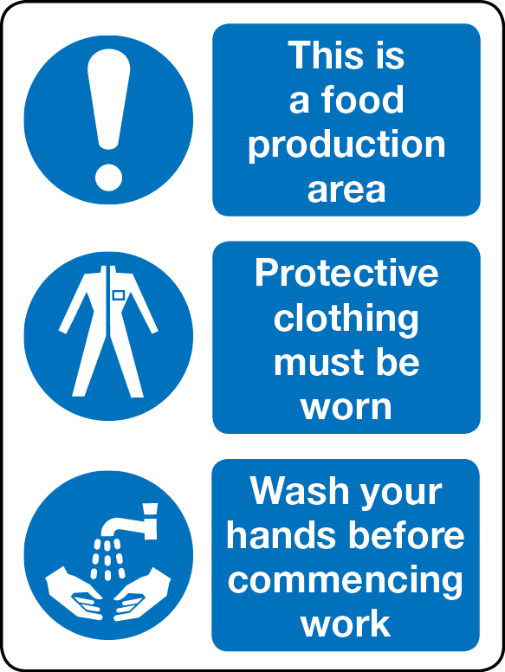
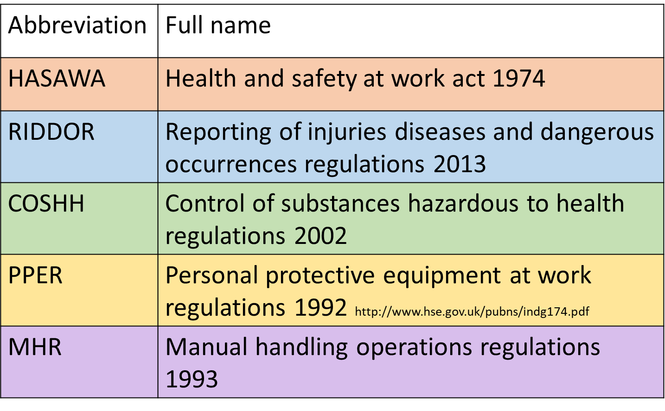
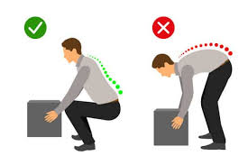
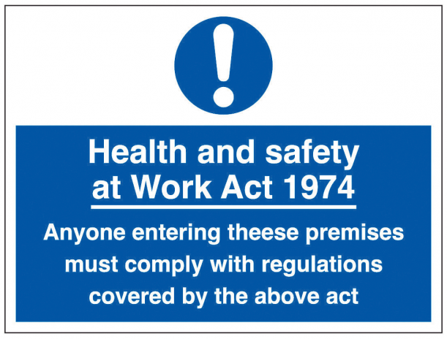
LO3 Understand how hospitality and catering provision meets health and safety requirements
RIDDOR 2013
PPER
Keywords
This regulation require employers to report certain workplace incidents to the Health and Safety Executive (HSE) such as:
Death and serious injury (for example serious burns)
Dangerous occurrences (for example near-miss events such as the collapse of equipment)
Work-related diseases (for example occupational dermatitis)
Flammable gas incidents (for example leaking gas)
Dangerous gas fitting (for example faulty gas cooker)
Employers must also keep a record of any injury, disease or dangerous accident.
An employee must ensure that:
They tell their line manager or union representative if they see any health and safety issue that concerns them
Any injury at work are recorded in an accident book
If nothing is done about a health and safety concern that an employee has reported, it can be reported to the HSE.
3.1 Personal safety responsibilities in the workplace
Personal Protective Equipment (PPE) is clothing or equipment designed to protect the wearer from injury. It is sometimes necessary when cleaning as the chemicals used in the workplace are often stronger that those we may use at home.
These regulations require employers to provide suitable high-quality protective clothing and equipment to employees who may be exposed to a risk to their health and safety while at work. This can include:
Gloves to protect hands from cleaning materials and metallic-style gloves to be used when cutting meat
Goggles to prevent eyes being splashed with chemicals
Facemasks to prevent inhalation of any chemicals or powder
Long sleeves to prevent contact with skin on arms
Waterproof aprons to be worn on top of clothing
Signs to remind employees what PPE to wear and when should also be visible.
Employees are expected to attend training sessions on how to wear PPE and to wear it in the workplace as instructed by the employer
It is both the employer’s and employee’s responsibility to make sure they follow health and safety rules at work because:
They help prevent accidents
They ensure the business is a safe place to work
They ensure food is safe to eat
Extended reading
Exam question
MHR
COSHH 2002
HASAWA 1974
The manual Handling Operations Regulations protect employees from injury or accident when they are lifting or moving heavy or awkward shaped boxes. Items that are hot, frozen or sharp may also need to be carried in the hospitality industry-this is also covered by these regulations.
Employers must complete a risk assessment whenever items need to be moved, and provide adequate training.
Employees must be trained in correct manual handling techniques and lifting; moving equipment should be provided when appropriate.
Lifting
When handling boxes, cartons and trays, there is a correct way to lift:
Always keep your back straight when lifting
Bend your knees and use the strength in your arms
Never reach forward
Keep the item close to your body and make sure you hold the item firmly
Use protective clothing if there are sharp edges to boxes or cartons
Never attempt to carry items that are too heavy-always get help.
Employers must ensure that:
Equipment is tested for safety and correctly maintained
Chemicals are stored and used correctly by trained staff
Risk assessments are completed
A health and safety policy statement is given to employees
Safety equipment and clothing are provided
Health and safety training is given and updated regularly
Employees must ensure that they:
Work in a safe way so they do not put others in danger
Follow the health and safety rules set by the employer
Wear safety clothing and equipment provided by the employer
Report anything that poses a health and safety risk, or something that could be a risk.
The control of Substances Hazardous to Health (COSHH Regulations covers substances that are hazardous to health, for example:
Chemicals, for example cleaning materials
Fumes, from machinery and cooking processes
Dusts, for example from icing sugar and flour
Vapours from cleaning chemicals, for example oven cleaner
Gases from cookers
Any substances hazardous to health must be:
Stored, handled and disposed of according to COSHH Regulations
Identified on the package or container
Shown in writing and given a risk rating
Labelled as toxic, harmful, irritant, corrosive, explosive or oxidising.
An employer should ensure that employee use of and exposure to these substances is kept to a minimum.
An employee should ensure that they are trained in the use of these substances. They should take note of the intentional symbols that are used to identify the different types of substances and how they can cause harm
Video links
Revision Techniques
Risk assessments : a way of identifying things that could cause harm to people in the workplace
Health and safety policy statement : a written statement by an employer of its commitment to health and safety for employees and the public

Slide 2
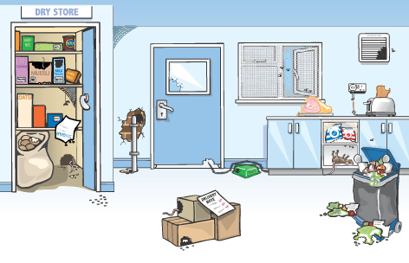
LO3 Understand how hospitality and catering provision meets health and safety requirements
Risks to health and personal safety
Levels of risks
Keywords
Risks to health and safety
Using equipment and electrical appliances
Inadequate flooring and trip hazards
Food poisoning and allergies
Using hazardous chemicals
Inadequate clothing worn
Lifting or moving objects
Fire or explosion
Injuries such as burns, scalds, cuts, muscle and back strain
Bullying, harassment, stress and fatigue
Inadequate ventilation causing dust and fumes
Inadequate signage and lighting
A risk assessment should be carried out to identify risks. It is a way of identifying things that could cause harm to people in the workplace. All workplaces must have the necessary risk assessments in place. In business there are five steps to risk assessment:
Identify the hazard
Decide who might be hard and how
Evaluate the risk and decide on controls (precautions)
Record the findings and implement them.
Review the assessment and update if necessary.
3.2 Risks to personal safety in hospitality and catering
Can you spot the 17 hazards in the image below. Write them down in your book
Extended reading
Calculating Risk
It is possible to calculate whether the level of risk is high, medium, or low. To do this, the hazard severity and the likelihood of it happening are given a score on a scale of one to five. They can then be multiplied together to give a level of risk. The overall aim is to reduce the risk to an acceptable level (as close to 1 as possible)
Scales used to calculate the level of risk:
Exam question
Hazard severity | Likelihood of occurrence | Scale
Trivial | Remote(almost never) | 1
Minor | Unlikely (occurs rarely) | 2
Moderate | Possible (uncommon) | 3
Serious | Likely (not frequent) | 4
Fatal | Very likely (frequently) | 5
Potential risks to employees, suppliers and customers
Risks to security
Security risks
Theft
Burglary
Robbery
Fraud
Assault
Vandalism
Arson
Undesirable people on the premises
Terrorist attack
Risk to employees
Stress, fatigue, Using equipment, Trip hazards, Food and drink spillages, Using hazardous chemicals, Inadequate clothing worn, Using electrical appliances, Moving and lifting objects, Fire and explosion, Bullying and harassment, Injuries, Inadequate lighting, Inadequate ventilation, Inadequate signage, Theft, Assault ,Undesirable people on the premises
Risk to suppliers
Using equipment, Trip hazards, Food and rink spillages, Inadequate clothing worn, Moving and lifting objects, Fire and explosion, Injuries, Inadequate lighting, Inadequate signage
Risk to customers
Food poisoning, Food allergies, Trip hazards, Food and drink spillages, Fire and explosion, Theft, Assault, Undesirable people on premises.
Video links
Level of risk = hazard severity X likelihood of occurrence
Low risk 1-8 | Medium risk 9-12 | High risk 15-25
Continue to review regularly to ensure controls remain effective | Continue but implement additional controls where possible and monitor regularly | Stop the activity ]Identify new controls Activity must not proceed until risks are reduced to a low or medium level
Revision Techniques

Slide 3
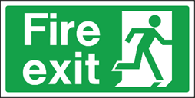
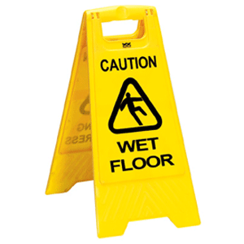
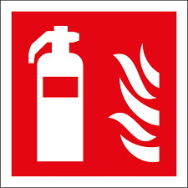
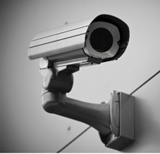
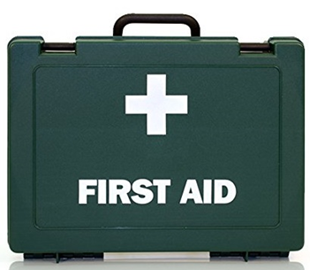
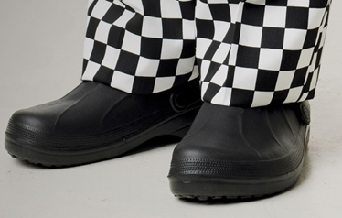
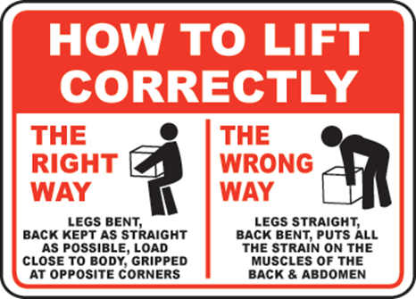
LO3 Understand how hospitality and catering provision meets health and safety requirements
Control measures for employees cont.
Control measures for customers
Keywords
Hazard | Control
Food poisoning | Hazard Analysis and Critical Control Point (HACCP) systems put in place to ensure food prepared, cooked and served is safe to eat
Food allergies | Detailed information must be given to customers on any allergens in the dishes
Trip hazards | Make sure areas where customers go are well lit and that there are no trailing wires or clutter on the floor
Food and drink spillages | Spillages must be cleared up straight away and appropriate signage used
Fire and explosions | Emergency exits must be well lit and signposted; fire extinguishers should be in place and staff should be trained in how to use them
Assault | Staff should be ensure the safety of customers if another person is aggressive
Theft/fraud | Ensure that card transactions are done in front of the customer; provide a secure place for their belongings
Undesirable people on premises | Any suspicious person should be challenged and not allowed to mix with customers
Hazard | Control
Fire and explosion | Under the Fire Safety Order 2005, employers must ensure there is a low risk of fire and explosion by: Having fire alarms and making sure they are tested regularly Making sure escape routes are clear and adequately signed Having suitable equipment such as fire extinguishers available
Bullying and harassment | Protocols and policies should be in place to ensure that this does not happen; there should be an open culture if anyone needs to report it.
Injuries | Kitchens and restaurants can be dangerous places- there should be a first aid kit and a trained first aider
Inadequate lighting | Lighting must be bright enough to work safely in; if a light is broken it should be fixed
Inadequate ventilation | Good ventilation is needed in a catering kitchen; this is normally provided by extractor fans, which remove steam, heat and smells; the kitchen may be hot so drinking water should be available
Inadequate signage | Signs need to be clear and visible; staff need to be made aware of what the signs mean
Theft | A secure area should be available for staff to leave personal belongings
Assault | Train staff on how to deal with aggressive customers and diffuse volatile situations
Undesirable people on premises | Have a security system to monitor who is entering the premises; any suspicious person should be reported; effective signage in and out procedures are required.
3.3 Personal safety control measures for hospitality and catering provision
Control measures for employees
Extended reading
The control measures outlined in the table can be put in place to help protect employee’s personal safety
Hazard | Control
Stress, fatigue | Employees need to be monitored closely and adequate rest breaks should be allocated
Using equipment | The instruction manual needs to be followed, with training given if needed
Trip hazards | Floors need to be clutter free; exits and entrances need to be clear
Food and rink spillages | Clear up spillages immediately and use warning signs
Using hazardous chemicals | Wear protective clothing where necessary; training should be given on use of chemical; chemicals should be stored correctly; COSHH regulations need to be followed
Inadequate clothing worn | The correct PPE should be worn at all times; wear aprons that are done up correctly; shoe laces should be tied up.
Using electrical appliances | The equipment should be maintained and cleaned regularly; training should be given if necessary; it should be given if necessary; it should be PAT tested regularly by a qualified electrician
Moving and lifting objects | Wear correct PPE; training on safe lifting techniques should be given
Exam question
Video links
Revision Techniques

