Slide 1
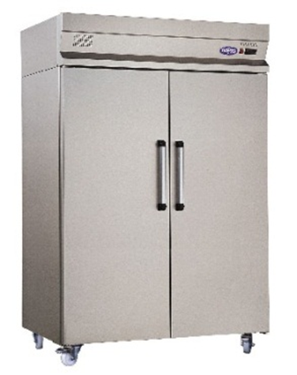
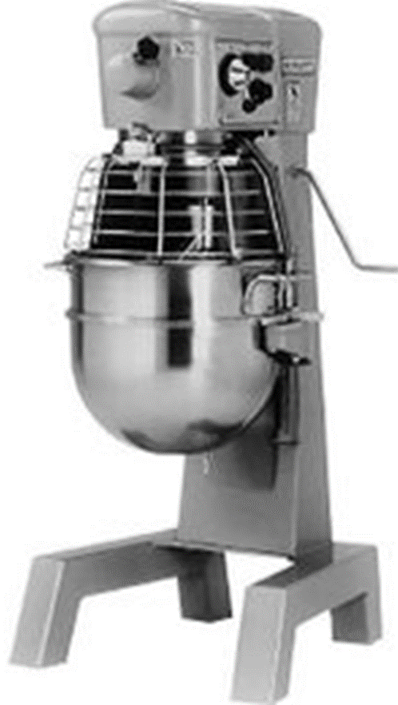
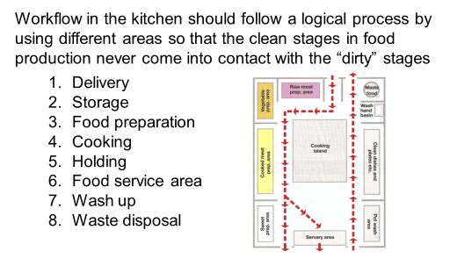
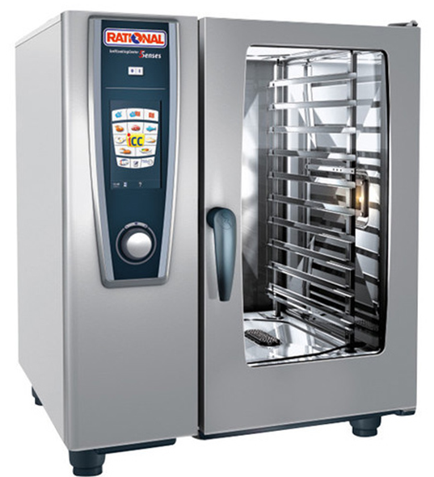
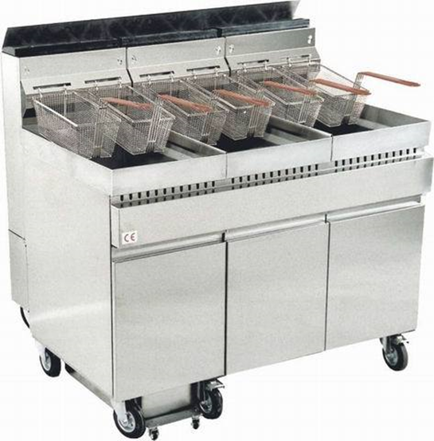
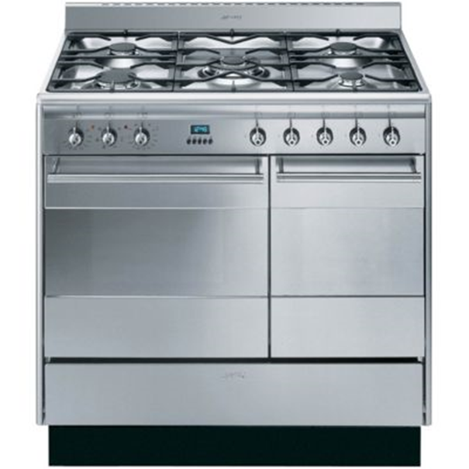
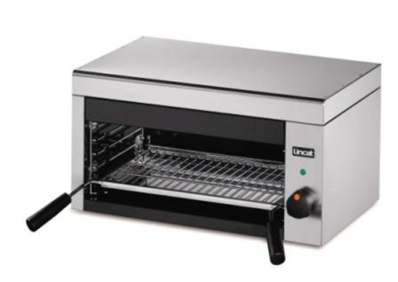
LO2 Understand how hospitality and catering provision operates
3. Operational activities
5. Large Equipment
Keywords
The operational activities that occur in a catering kitchen follow the efficient workflow:
Goods are received and stored
Food is prepared for cooking
The food is cooked.
The food is dished up and presented for service.
Service- serving the food to the customers.
Cleaning and maintaining the kitchen area.
Large Equipment | Use
Convention (fan assisted) oven | The fan circulates hot air, making it very efficient and cooking foods consistently Used for baking and roasting
Microwave oven | Cooks food quickly Useful for reheating food
Gas hob | These hobs have an exposed flame that is easy to regulate. Used for cooking food in saucepans, frying pans and griddles
Induction hob | These energy-efficient hobs only heat up when in contact with stainless steel pan; they turn off and cool down quickly once the pan is removed Used for cooking food in saucepans, frying pans and griddles
Deep fat fryer | A thermostatically controlled container filled with oil and heated with an electric element Used t deep fry food
Salamander | A grill heated from above by gas or electricity Used to grill food, for example steaks and bacon
Pressure steamers | Cook large quantities of food quickly by adjusting the pressure inside the steamer Used for cooking casseroles and vegetables
Under-heated grills | These grill food , such as steak and chicken, quickly from below Food can be moved on these grills to make a criss-cross pattern called a quadrillage
Refrigerator or chill room | To keep high-risk food such as meat, fish and dairy products chilled between 1 ̊C and 5 ̊C
Freezer | Keeps foods frozen at -18 ̊C
Blast chiller | Used to cool or freeze hot food quickly
1. The operation of the kitchen
Layout
The size and space of a kitchen should enable staff to work:
Safely
Efficiently
In comfort
The correct layout of a kitchen is crucial in maintaining high standards of food hygiene, and to ensure that there is enough space for everyone to work effectively and quickly to manage orders.
The man considerations are:
Design an efficient workflow
Provide adequate workspace so that staff do not get in each other’s way
Create appropriate sections to avoid the risk of cross contamination, for example vegetable preparation and washing up areas should be separate from food preparation and service
Ensure access to all areas
Determine the number, size and type of equipment required.
4. Equipment and materials
Extended reading
Large kitchen equipment-such as ovens, walk-in fridges and freezers, floor standing mixers, deep fat fryers and sinks-are expensive, so initial selection is important. The following questions should be considered before each item is purchased or hired:
Overall dimension-
Weight
Fuel Supply
Drainage
Water
Use
Capacity
Time
Exam question
Ease
Maintenance
Attachments
Extraction
Noise
Construction
Appearance
Spare parts
2. Workflow
5. Large Equipment
Video links
Revision Techniques

Slide 2
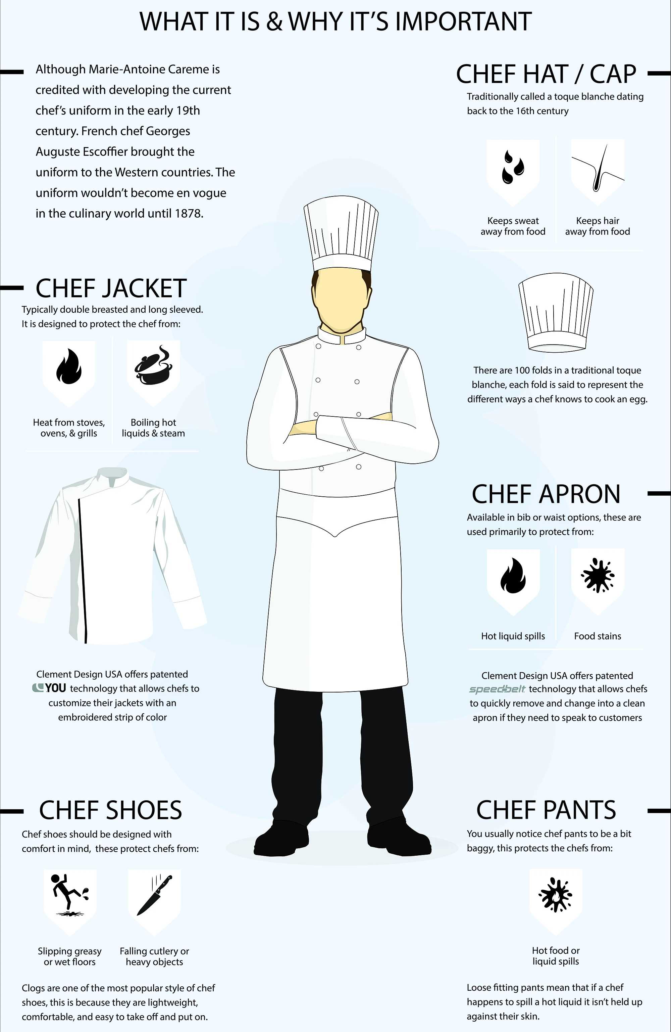
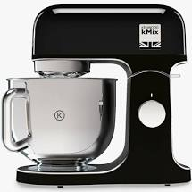
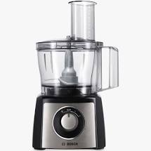
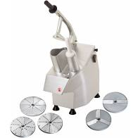
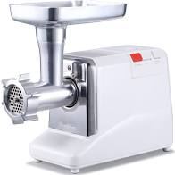
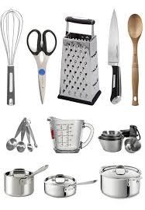
LO2 Understand how hospitality and catering provision operates
2.1 The operation of the kitchen
7. Materials
10. Dress code
Keywords
Materials that are frequently used in the a catering kitchen include:
Detergents- to remove dirt and grease
Disinfectant- to destroy bacteria
First aid kit
Hand wash and paper towels or hand driers
Kitchen cloths- disposable cloths are often used as they can be thrown away after use
Kitchen paper, foil, cling film, parchment paper, bin liners
Mops, dustpan and brushes, brooms, aprons
Oven gloves
Sanitiser-usually in the form of a spray for cleaning and disinfecting
Tea towels
6. Small Equipment
Small equipment | Use
Liquidiser or blender | Blends solid food into a liquid, such s soups and smoothies
Hand-held food mixer | Used to beat and whisk smaller amounts of food quickly such as batters, cakes and biscuits
Table-top mixer | Used to beat and whisk larger quantities of food They often have attachments such as dough hook to knead bread or mincer for meat
Mincer | A stand-alone piece of equipment that minces meat into small pieces
Food processor | Used to mix, chop, slice and grate
Peeler | Used to take the skin off fruit and vegetables
Extended reading
8. Stock Control
Exam question
All materials, ingredients and equipment used in catering kitchen are called stock.
Correct storage is important to ensure that ingredients remain in their best condition, and are therefore safe to eat.
All deliveries of food should be checked and moved to the most appropriate area within 15 minutes of delivery.
The first in, first out (FIFO) policy should always be used to ensure that the older stock is used up first. Dates on packaging need to be checked when deliveries ar placed into stores.
Factors affecting health, safety and security
Knives and sharp tools
Heat, open gas jets or flames
Mixing and cutting equipment
Staff need a secure place for personal belonging
Inhalation of flour dust
Monitoring well-being in a busy working environment
6. Utensils
9. Documentation and Administration
Video links
A range of utensils are used in a catering kitchen, including:
Baking tins | Frying pans | Saucepans
Bowls | Jugs | Sieves
Colanders | Knives | Spatulas
Colour-coded chopping boards | Ladles | Spoons
 | Rolling pins | woks
Bin card
Labels attached to stock items
Stock ledger
A detailed list of all the stock, usually kept on a computer
Requisition stock book
Issued to each department to draw stock out from the store to the kitchen
Order book
For ordering stock
Delivery notes
For checking all the necessary details when food is delivered, such as the amount delivered and the price of each item
Invoices
For goods ordered
Food safety documentation
Temperature charts, for example checking and recording fridge temperature. Food hygiene and safety regulations
Health and safety documentation
Health and safety certificates for staff. Accident book to record any accidents at work
Revision Techniques

Slide 3
LO2 Understand how hospitality and catering provision operates
13. Operational activities
15. Equipment and materials
Keywords
Operational activates that occur front of house include:
Reception- where customers check in and out, book tables and find out what facilities are offered both in the establishment and in the local area.
Lounge- there is usually a social area where guests can relax with a drink or wait for their table
Bar- an area where drinks can be ordered; there are usually bar stools, tables and chairs
Restaurant/ dining area- an area where guests can sit and eat a meal
Toilets and cloakroom- where guests can leave coats and use the facilities.
A range of equipment is needed in different areas of front of house:
11. The operation of front of house
Reception
IT facilities for checking in and out, telephones, paper and pens, information about facilities in the establishment and in the local area
Lounge
Furniture for the customers to use such as settees, chairs, tables, lamps and TVs.
Bar
Drinks measures, ice buckets, tongs, a range of glasses, coffee and tea making facilities, tills, menu, and a range of alcoholic and non-alcoholic beverages.
Layout
Front of house covers the following areas:
Reception (usually only present where there is overnight accommodation or conferences and events taking place)
Bar
Lounge
Dining area
Toilets and cloakroom.
Restaurants and hotels can be busy, with people moving around between different areas. There should be a logical layout so that people can move from one area to another easily. Reception should be clearly signposted, and ideally lead on to the bar, lounge, dining areas and toilets. Larger establishments my have dedicated floor for reception and another for dining.
Extended reading
14. Stock control
Stock for front of house use needs to be monitored in exactly the same way as stock for use in the kitchen, although it is likely that a different person will be in charge of monitoring it. Similarly, different people will be responsible for monitoring stock such as cleaning materials and beverages (wine, spirits and non-alcoholic drinks)
Restaurant and dining area
table-top equipment such as salt and pepper grinders, flowers, candles, coasters and table mats, cutlery and crockery.
Toilets and cloakroom
tissues, paper towels or driers, toilet roll, hand soap and hand cream
Exam question
12. Workflow
Workflow in front of house describes the flow of food and drinks from the catering kitchen and bar to customers in the dining areas, bars and lounges..
Meet and greet customers, show them to their table, issue a menu
Clear table, issue bill, take payment, customer leaves
Reset table for next customers
Take drinks order, take food order and send to the kitchen
When service is ready, serve meal to customers, check on them
Clear table when finished, offer dessert/ coffee, send order to the kitchen
When service is ready, serve dessert/ coffee
Video links
Materials are also needed for housekeeping and cleaners working behind the scenes, for example:
Cleaning equipment for cleaning rooms and restaurant
Mops, dustpan brushes, brooms, vacuum cleaners
Bin liners
Hand wash and paper towels or hand drier
First aid kit
Revision Techniques

Slide 4
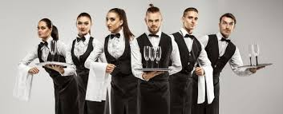
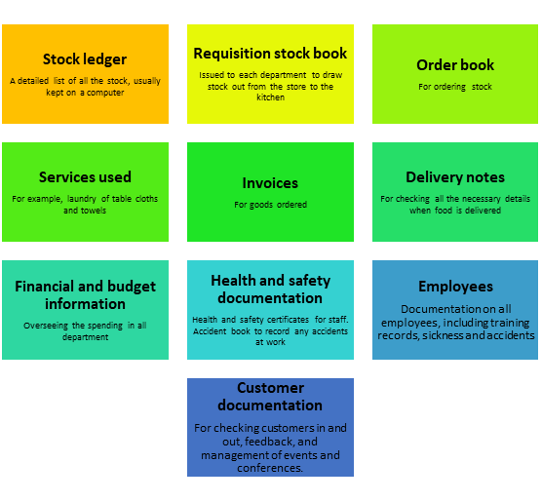
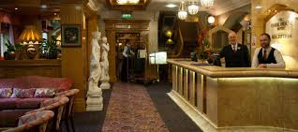
LO2 Understand how hospitality and catering provision operates
16. The operation of front of house
17. Materials
20. Dress code
Keywords
Materials that are frequently used in the a catering kitchen include:
Detergents- to remove dirt and grease
Disinfectant- to destroy bacteria
First aid kit
Hand wash and paper towels or hand driers
Kitchen cloths- disposable cloths are often used as they can be thrown away after use
Kitchen paper, foil, cling film, parchment paper, bin liners
Mops, dustpan and brushes, brooms, aprons
Oven gloves
Sanitiser-usually in the form of a spray for cleaning and disinfecting
Tea towels
Front of house staff have to look smart and clean to present a positive image. They often have a corporate uniform.
Room attendants have a uniform covered by an apron for cleaning duties.
Waiting staff and bar staff have a specific dress code, designed to look smart and be hygienic and safe:
Usually a black skirt/ trousers and a white blouse/ shirt
Long sleeves to cover arms in case of spillages and burns
Low heeled black shoes for comfort
Long hair ted back
Apron on top of uniform to protect from hot food/ drink spillages
Cloth tucked in waistband to use if carrying hot plates and dishes.
Extended reading
18. Staff allocation
Staff are allocated roles and responsibilities in front of house according to their qualifications and experience.
The manager of the hotel has overall responsibility for staff in front of house, but it is likely that staff would be allocated roles and responsibilities by the head housekeeper, head receptionist or head waiter
Exam question
Factors affecting health, safety and security
Theft of cutlery and glasses
Vandalism by customers
Trip hazards, slippery floors
Monitoring well-being in a busy working environment
Dealing with aggressive or drunk customers
Secure place to leave personal belongings
19. Documentation and Administration
Video links
Revision Techniques

Slide 5
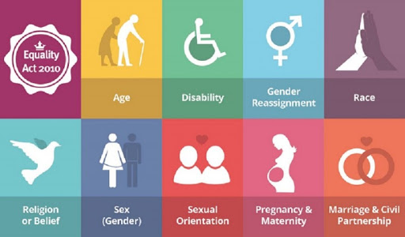
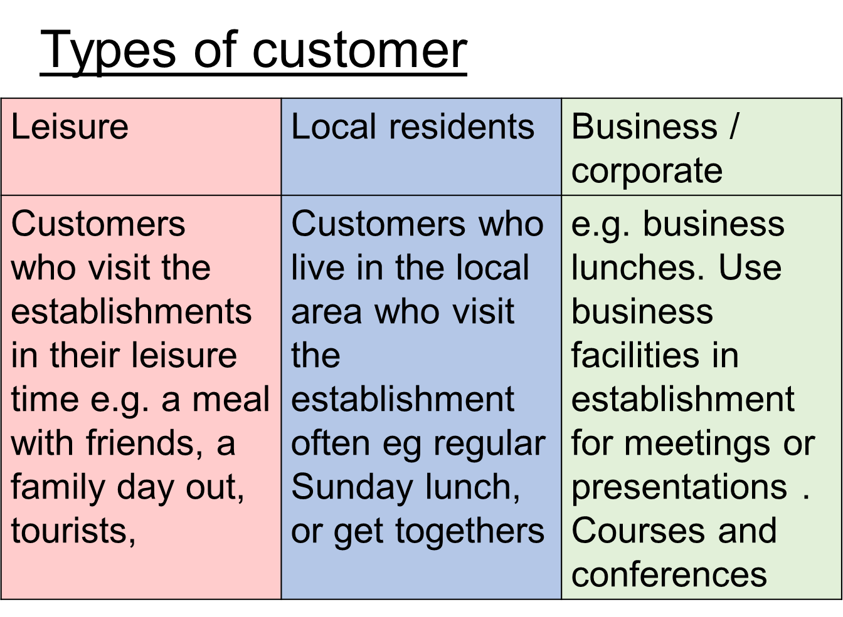
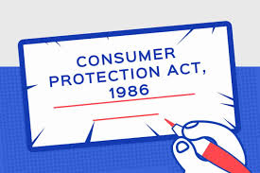
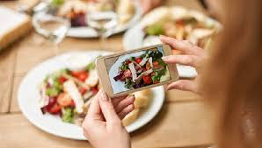
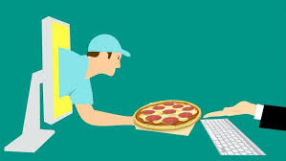
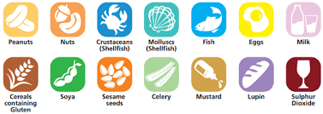
LO2 Understand how hospitality and catering provision operates
23. Equality
Keywords
Customer Expectations
Value for money
Reliability
Health safety and security
Complaints or problems dealt with correctly
Advice and help
Accuracy
The Equality Act of 2010 protects customers from direct discrimination on the basis of:
21. How hospitality and catering provision meet customer requirements
A hospitality and catering business cannot operate without customers, so meeting customers requirements is of the upmost importance. There are three main groups of customers.
Extended reading
24. Customer rights
Consumer Protection Act 1987
This act gives you the right to claim compensation against the producer of a defective product if it has caused damage, death, or personal injury. Manufacturers are legally obliged to put certain information on products, such as health and safety messages on equipment, that may be used by customers when eating out or staying in accommodation.
Consumer Rights Act 2015
This act states that all products must be:
Satisfactory quality- goods should not be faulty or damaged when receiving them.
Fit for purpose- goods should be fit for the purpose they are supplied for.
As described- the goods supplied must match the description given to you.
General Data Protection Regulation 2016
When you buy goods and services, stay at a hotel or sometimes even just visiting a website, the organisation you deal with may collect information and data about you, such as your name, address and date of birth.
Under the General Data Protection Regulation (GDPR) rules, businesses must now have a customer’s consent to store this information and use it for marketing purposes or to share it with other businesses
Exam question
Type of customer | Possible customer needs
Leisure | Facilities such as pools, gym or spa, sporting activities such as golf Local maps Tourist information Sightseeing information
Business or corporate | Pick up/ taxi from the airport Express check in and out Business centre or lounge with IT facilities and Wi-Fi Trouser press and laundry service Financial newspapers and magazines High level of food and beverage facilities, personalised service Fine dining options Conference rooms Access to leisure facilities
Local resident | Access to facilities such as pool, gym or spa, sporting activities such as golf Ability to book a table for lunch or dinner only.
22. Customer Trends
Video links
Revision Techniques

