Slide 1
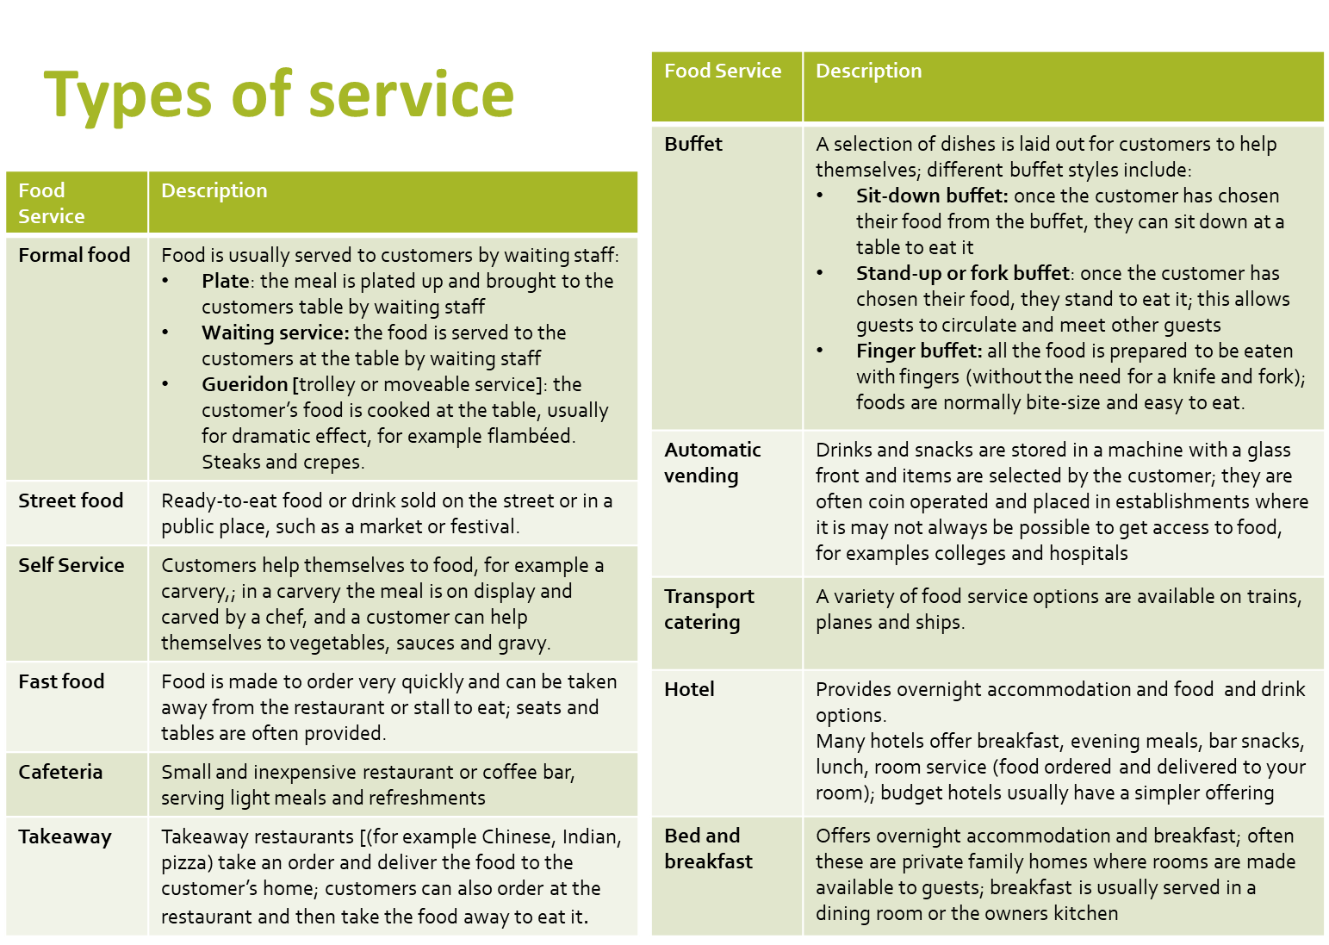
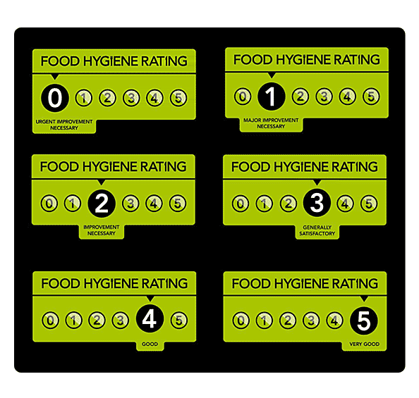
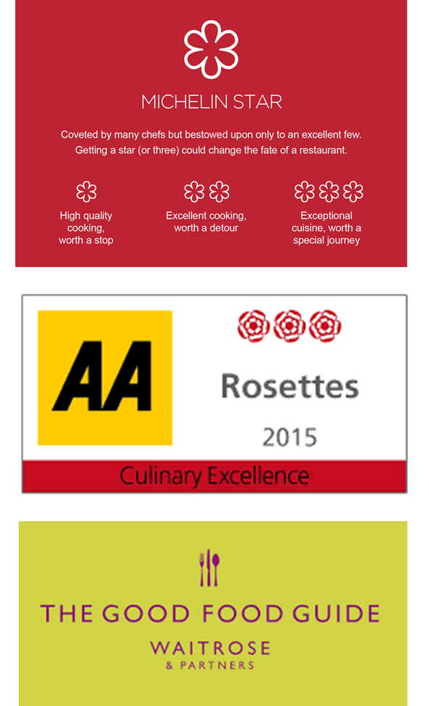
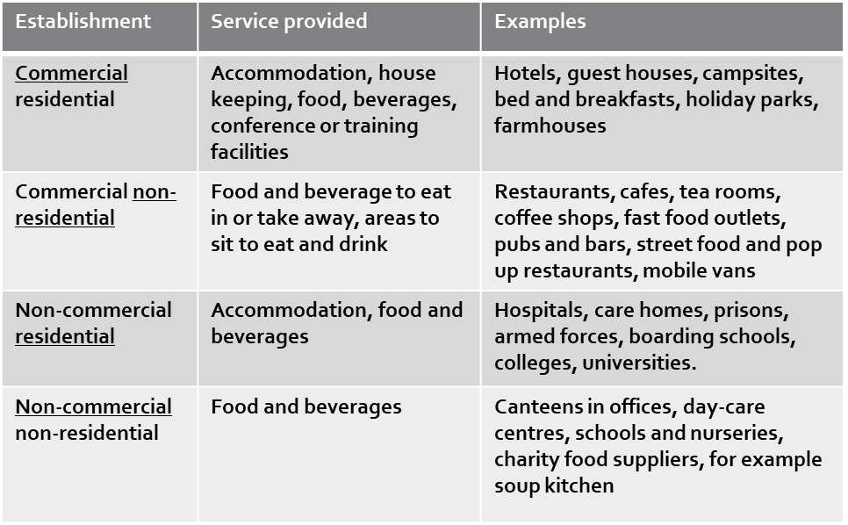
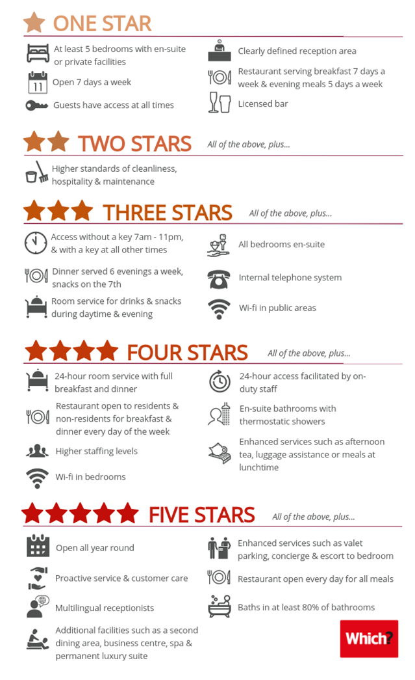
AC 1.1 The structure of the hospitality and catering industry
3. Standards and ratings
Keywords
Food hygiene standards
1. Types of Provider
The Food standards agency runs a scheme with local authorities where they score businesses on a scale from zero to five to help customers make an informed choice about where to eat. The rating is usually displayed as a sticker in the window of the premises. The scores mean:
Range of establishments
Non-residential commercial establishments
Residential non-commercial establishments
Residential commercial establishments
Non residential non-commercial establishment
Extended reading
Hospitality at non-catering venues Contract Caterers provide:
food for functions such as weddings, banquets and parties in private houses.
prepare and cook food and deliver it to the venue, or cook it on site.
They may also provide staff to serve the food, if required.
Complete catering solutions for works canteens etc
Restaurant standards
The three main restaurant rating systems used in the UK are Michelin stars, AA Rosette Awards and The Good Food Guide reviews:
Michelin stars are a rating system used to grade restaurants for their quality:
One star is a very good restaurant
Two star is excellent cooking
Three stars is exceptional cuisine
AA Rosette Awards score restaurants from one (a god restaurant that stands out from the local competition) to five (cooking that compares with the best in the world)
The Good Food Guide gives restaurants a score from one (capable cooking but some inconsistencies) to ten ( perfection)
Exam question
3. Standards and ratings
Video links
Environmental standards
2. Suppliers
Hotel and Guest house standards
Hotels and guest houses are often given a star rating. Star ratings help customers to know what services and facilities they can expect at a hotel or guest house. The quality of the service provided is rated on a scale of one to five stars
The Sustainable Restaurant Association awards restaurants a one-two-three star rating in environmental standards. To achieve this the restaurant has to complete an online survey about sourcing, society and the environment. It is then given an overall percentage for environmental standards:
One star: 50-59%
Two star: 60-69%
Three stars: more than 70%
Suppliers to the hospitality and catering industry
Specialist markets
Local supplier delivery
Independent suppliers
Large wholesalers
Equipment suppliers
Revision Techniques

Slide 2
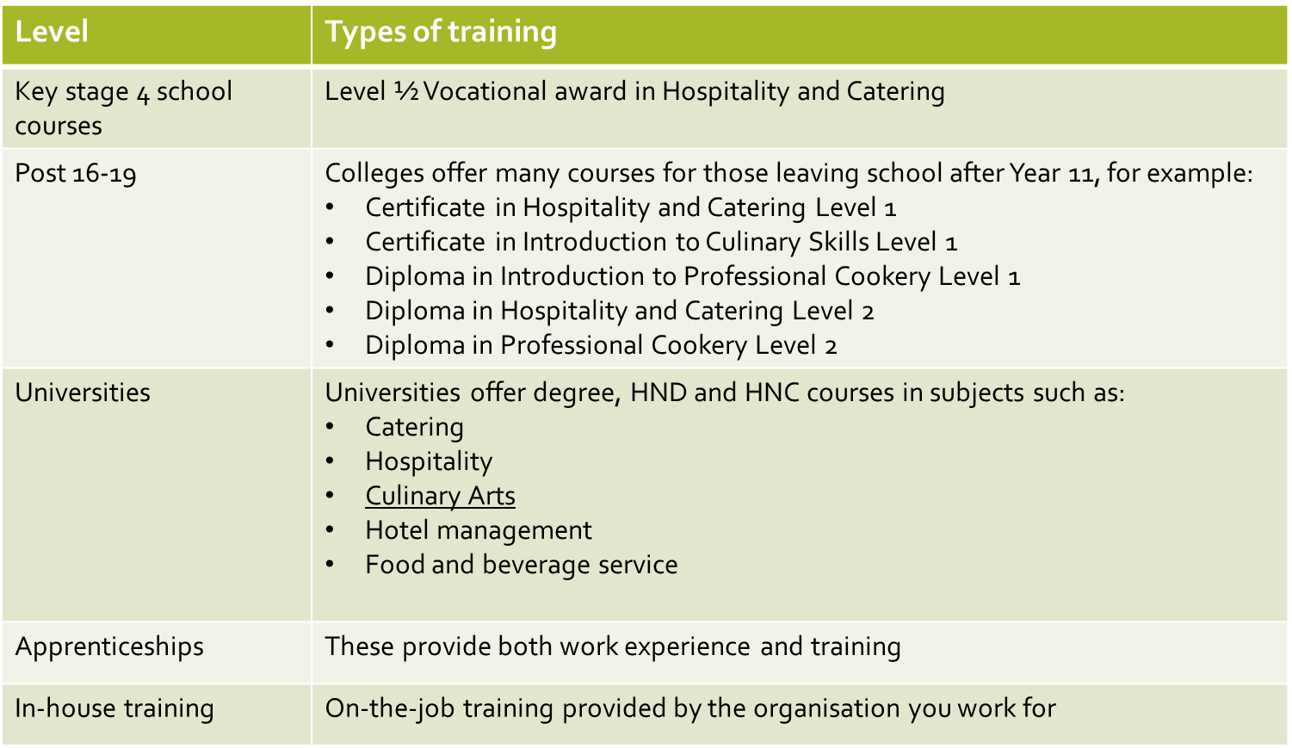
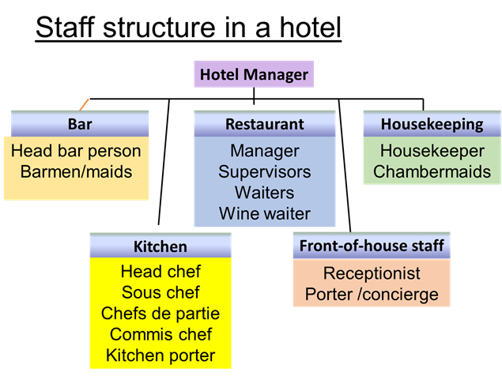
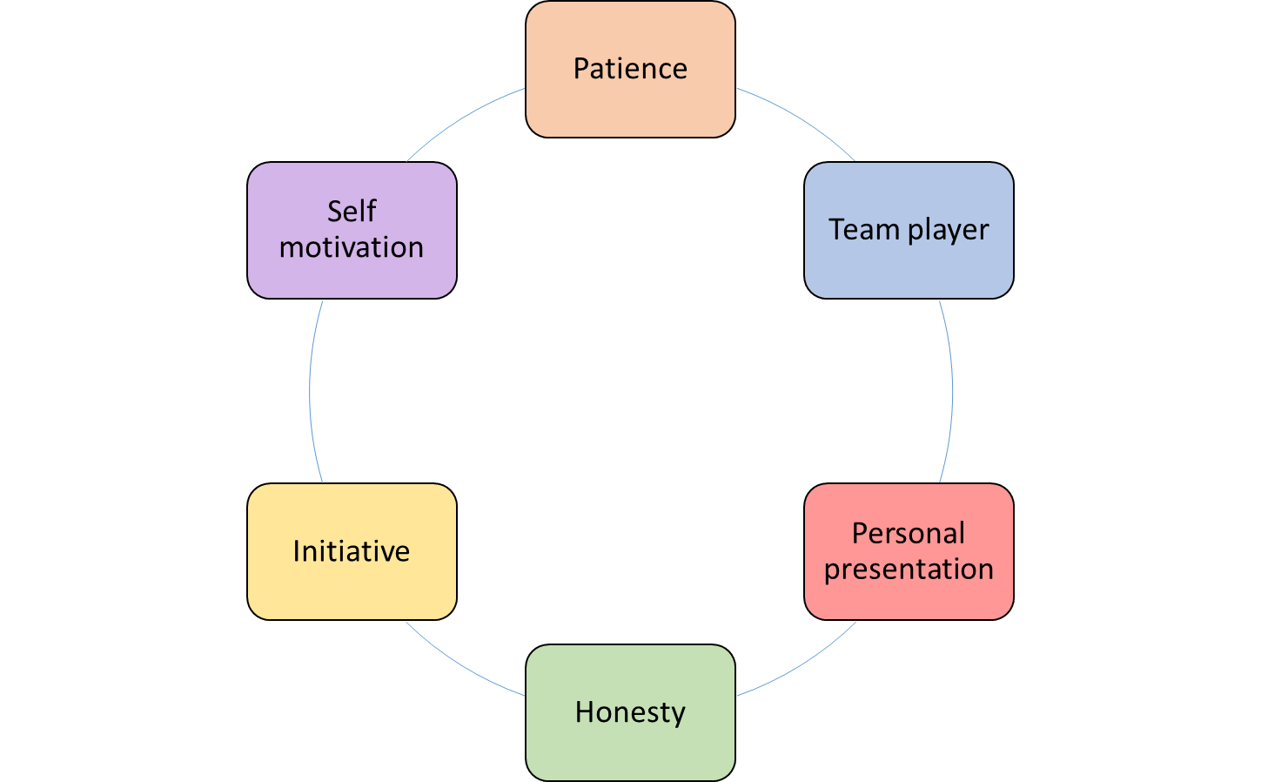
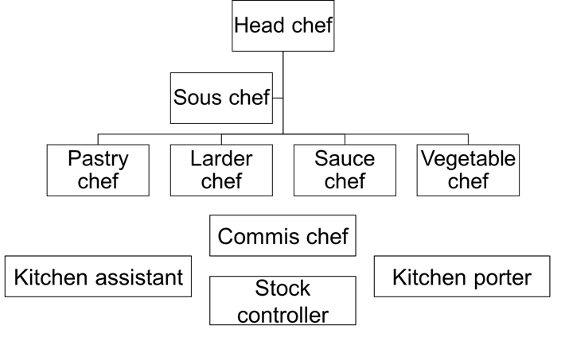
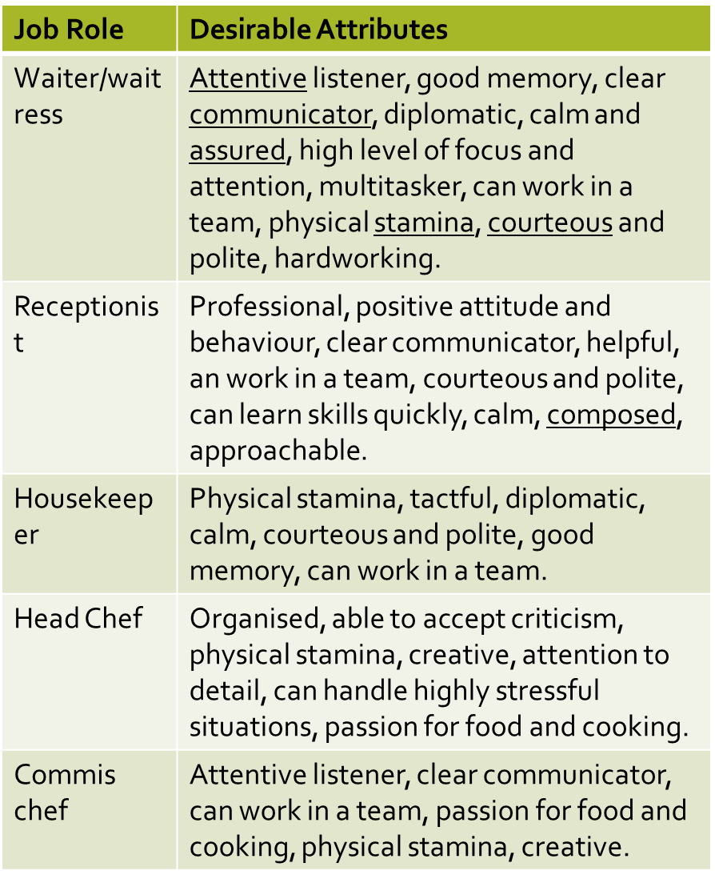
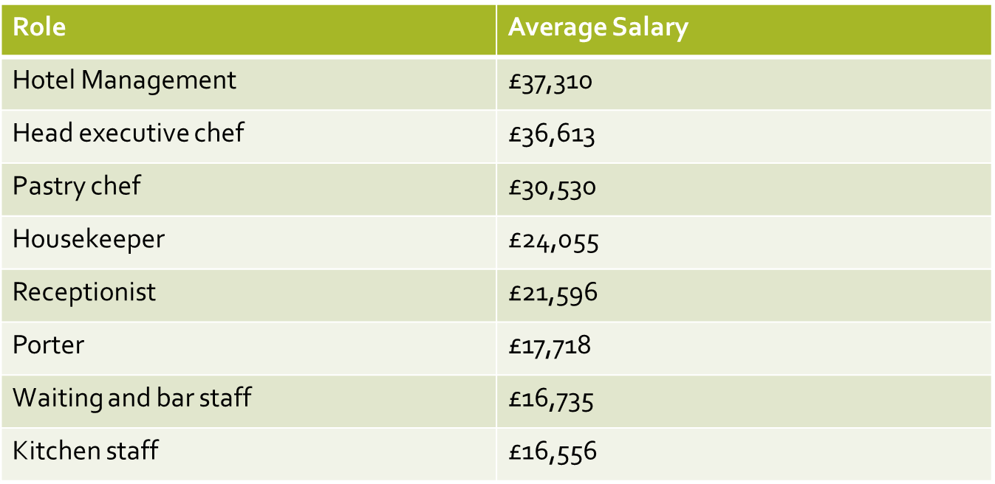
AC 1.2 Job roles in the Hospitality and Catering industry
6. Front of House roles
8. Training
Keywords
Reception
Receptionist: meet customers and direct them to the correct person or place; they manage visitor lists and booking systems
Porter/ Concierge; assist hotel guests by making reservations, booking taxis and booking tickets for local attractions and events.
Restaurant and bar
Restaurant manager (Maître d’Hote): The restaurant manager is in overall charge of the restaurant,; they take bookings, relay information to the head chef, complete staff rotas, ensure the smooth running of the restaurant
Head waiter (ess): Second in charge of the restaurant,. Greets and seats customers, relays information to the staff, Deals with complaints and issues referred by the waiting staff.
Waiting staff Serve customers, clear and lay tables, check the customers are satisfied with the food and service. May give advice on choices from the menu and special order foods
Wine waiter- Le sommelier: Specialises in all areas of wine and matching food, advises customers on their choices of wine, Wine waiters serve the wine to the customer and can advise customers on their choices as well
Bar staff serve drinks and take food orders , wash up, clear tables, change barrels and fill shelves.
Baristas make and serve hot and cold beverages, in particular different types of coffee such as espresso, cappuccino and latte.
4. Job roles in the industry
Extended reading
9. Personal attributes
Exam question
5. The Kitchen brigade- Back of House
Video links
7. Average salaries in the hospitality and catering industry
Most large establishments could have chefs de partie in the following areas:
Sauce chef- Le Saucier
Pastry chef- Le Patissier- baked goods and dessert
Fish chef- Le Poisonnier
Vegetable chef- L’entremetier
Soup chef- Le Potager
Larder chef- Le garde manger- cold starters and salads
The commis chef or assistant chef is a chef in training
The kitchen porter washes up and may do basic vegetable preparation
The stock controller is in charge of all aspects of store keeping and stock control.
Revision Techniques

Slide 3
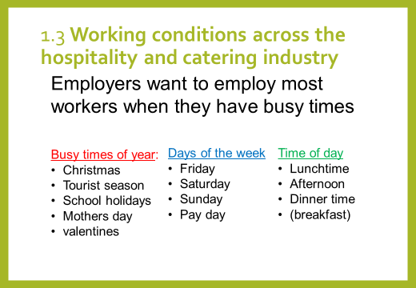
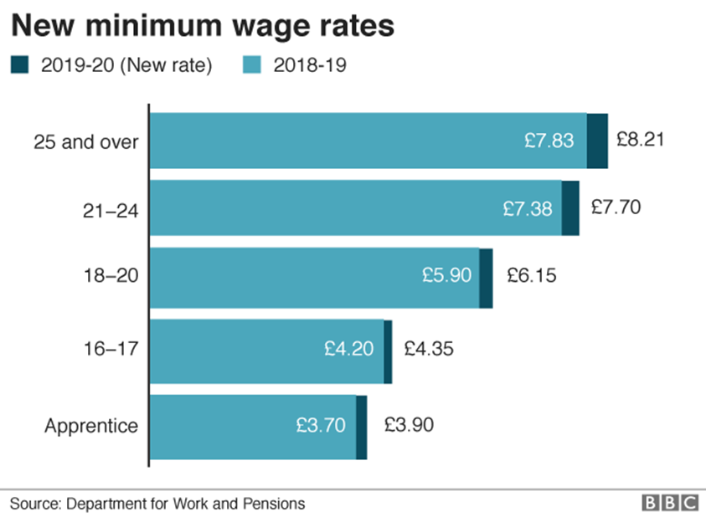
1.3 Working conditions across the hospitality and catering industry
12. Contracts of employment
13. Remuneration
Keywords
Remuneration is a term used for the reward that people receive from working somewhere. It includes their basic pay, plus extra money t top u their income from:
Tips and gratuities- money given to someone by a customer as a way of saying ’thank you’ for good service
Service charge- a percentage added to the customers bill to reward the employees who have provided the customer with a service
Bonus payments and rewards- given by some employers as a way of rewarding hard work throughout the year and helping make the business successful.
It is quite common for all he tips, gratuities and service charges to be divided equally amongst all the workers in, e.g. restaurant. This is known as a tronc arrangement, and the person who works out and distributes the extra money is known as a ‘troncmaster’.
Extended reading
10. Working hours
a written statement of employment or contract setting out their duties, rights and responsibilities
the statutory minimum level of paid holiday 28 days for full time workers
a pay slip showing all deductions, eg National insurance, tax . Earning above £166 a week
the statutory minimum length of rest breaks- one 20 min break for 6 hrs worked
Statutory Sick Pay (SSP) £94.25 pw for 28 weeks (some may get full wages for a limited amount of time)
Maternity, paternity and adoption pay and leave-90% of earnings for 6 weeks then ££148.68 for next 33 weeks
14. Paid annual leave
Exam question
Hospitality and Catering jobs tend to be long hours, early starts for breakfast in a hotel to late nights for dinner in a restaurant.
Staff will still get 2 days off a week but it will be quieter days instead of the weekend
Shifts could be 6-3. 11-6. 3-11 or other hours.
Monthly salaried staff may not have set hours eg Head Chef who might work from early morning to late night every day
All workers are entitled to 28 days paid leave annually
no legal right for employees to be given Bank and Public Holidays. Most hospitality staff would work these days
To calculate holiday entitlement,
Multiply the full-time entitlement (28 days) by the number of days worked and divide by the number of days full-time staff work
Entitlement for 3 days a week: 28 x 3/5 = 16.8 days
Casual staff / Agency staff
work for specific functions and can be employed through an agency.
They do not have a contract or set hours of work.
They are needed at busier times of the year e.g. at Christmas or for weddings, New years eve
Temporary staff
Employed for a specific length of time such as the summer tourist season or the month of December.
Temporary staff have the same rights as permanent staff for the duration of their contract.
Temporary staff employed for longer than 2 years become permanent by law
Zero Hours Contract
This type of contract is between the employer and a worker, where the worker may sign an agreement to be available to work when they are needed, but no specific number of hours or times to start or end work are given. The employer is not required to offer the person any work and the worker is not required to accept the work.
15. Compulsory Rest Breaks
Video links
11. The national Minimum Wage
Adult workers are entitled to 24 hours off in each 7 day period and young workers (15-18) are entitled to 2 days in 7.
Adult workers are entitled to at least 20 minutes uninterrupted rest if their working day is longer than 6 hours.
Young workers are entitled to 30 minutes rest if their working day is over 4.5 hours long.
Revision Techniques

Slide 4
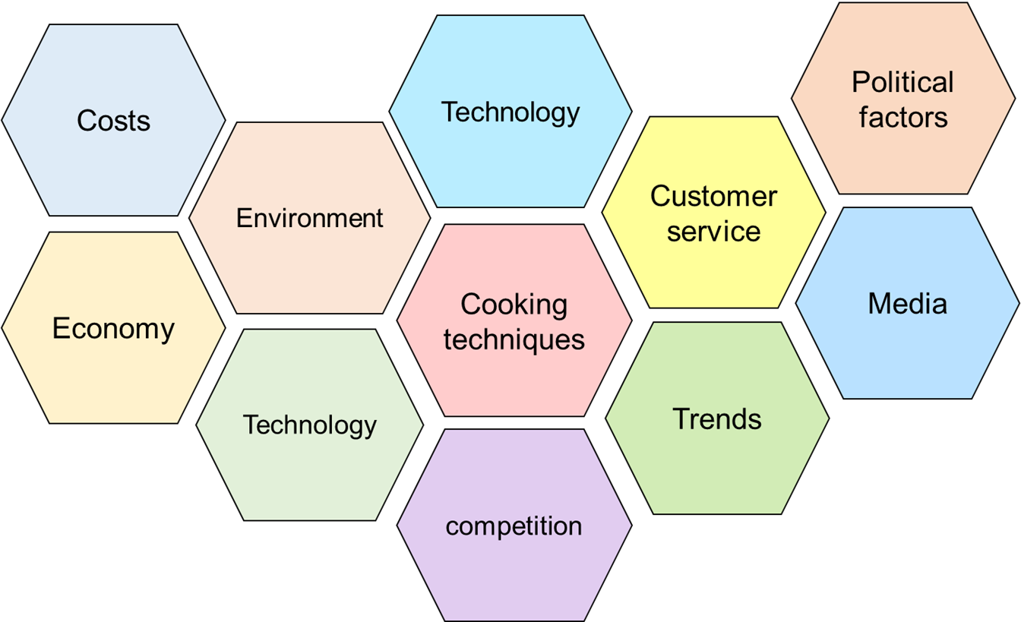
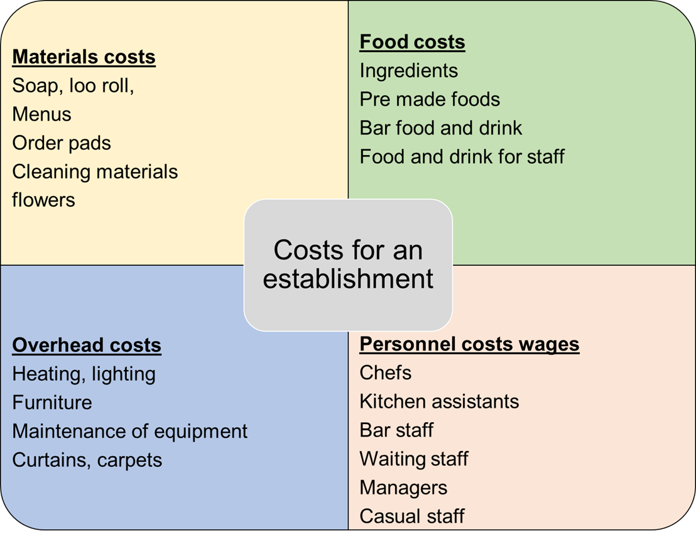
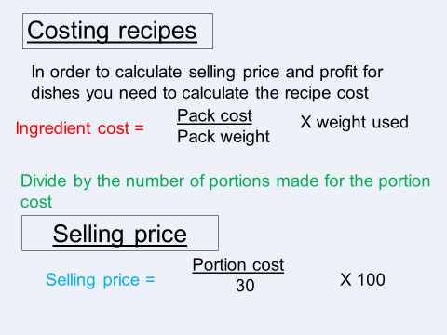
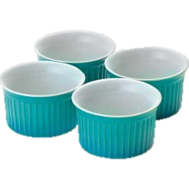
1.4 Factors that affect the success of Hospitality and catering providers
17. Factors affecting success
18. Costs for an establishment
Keywords
16. Reasons for failure
A saturated market – there is a fine line between competition & too many for the number of customers
General business incompetence – 46% of business fail due to lack of business knowledge
Lack of capital – not enough money to get through the first few months
Location – either not enough people walk past (foot-fall) live & work nearby
Quality of life - most restaurateurs work 60 hours a week – not the glamorous life they thought
Lack of industry experience – most successful restaurateurs tend to have previous industry experience
Failure to create a good enough brand – They did not incorporate the 12 Ps of restaurant branding,( Place, Product, Price, People, Promotion, Promise, Principles, Props, Production, Performance, Positioning and Press)
Name of the restaurant is too long- A restaurant with a name that is brief, descriptive and attractive is more likely to succeed.
Lack of differentiation -the brand is not different enough
Poor financial controls – Main costs – labour and food exceeded 60% of sales
Extended reading
Costs - need to make a profit. Consider cost of everything you buy and selling price.
Material - Anything involved in making product
Labour - Costs of staff
Overheads - Anything not connected with making products
Economy - when the economy slows down, business have lower sales as consumers eat out less because they have less disposable income
Environment – 3 R’s, packaging, food waste, global warming, carbon footprint, clean eating
Technology - Using technology to improve service, delivery and stock control – touch screen customer ordering, EPOS systems, stock management, apps for delivery services
Emerging and innovative cooking techniques – sous vide, clean eating, steaming, new restaurants,
Customer demographics and lifestyle
– delivery services Facebook Twitter
Customer service–customer satisfaction – free WiFi, order online
Competition - Low cost food ( £1 menu, coffee McDs espresso v Starbucks )
Trends healthy food options, pop-up bars, cafes and restaurants, cronut, clean eating, low carb, good fats,
Political factors - Increasing regulations – from government due to health issues, Brexit, use of migrant labour, migrants – ethnic foods
Media - Strong global brand, Good community reputation – children’s charities / Ronald McDonald House, celebrity chefs, celebrity endorsements, Masterchef,
19. Costing a recipe
Exam question
Video links
20. What is portion control?
Portion control is the amount of each menu item that is served to the customer.
It depends on the type of customer, the type of food served,
some foods are served in very small portions due to the high cost of the item eg caviar is served by the teaspoon
Revision Techniques

