Slide 1
KS4 Exam Preparation Evening: Revision Support
How to support your child through their GCSE exams

Slide 2
The Aim of this Session:
To provide you with information, advice and resources to help you support your child in their GCSE revision.
Structure of the session:
General Advice
Science
English
Maths
Mock Exams start 27th February

Slide 3
General Advice:
Quiet space to work in.
Have resources ready and easily available.
20-30 minute chunks with 5 minute breaks 3 times a evening.
Have a revision timetable (tutors have been supporting with this via a revision booklet, more to follow on this) – so that you can be fair to all your subjects, especially your weaker ones.
Consider their work/life balance – don’t burn out.
Well-being – sleep, eat well, talk to an adult if they are stressed.
Celebrate successes to maintain motivation.

Slide 4
What the Students said…
“Turn the internet off”
“I do feel stressed, especially when I have to do loads of jobs too.”
“Buy me resources – revision books, note books, flashcards.”
“Quiz me on work I have read/ask questions.”
“Make a timetable together and help me stick to it.”
“Trust me.”

Slide 5
After-school intervention:
Week A
Monday: Option 1 Block
Wednesday: Option 2 Block
Thursday: Option 3 Block
Week B
Monday: Maths
Wednesday: English
Thursday: Science

Slide 6
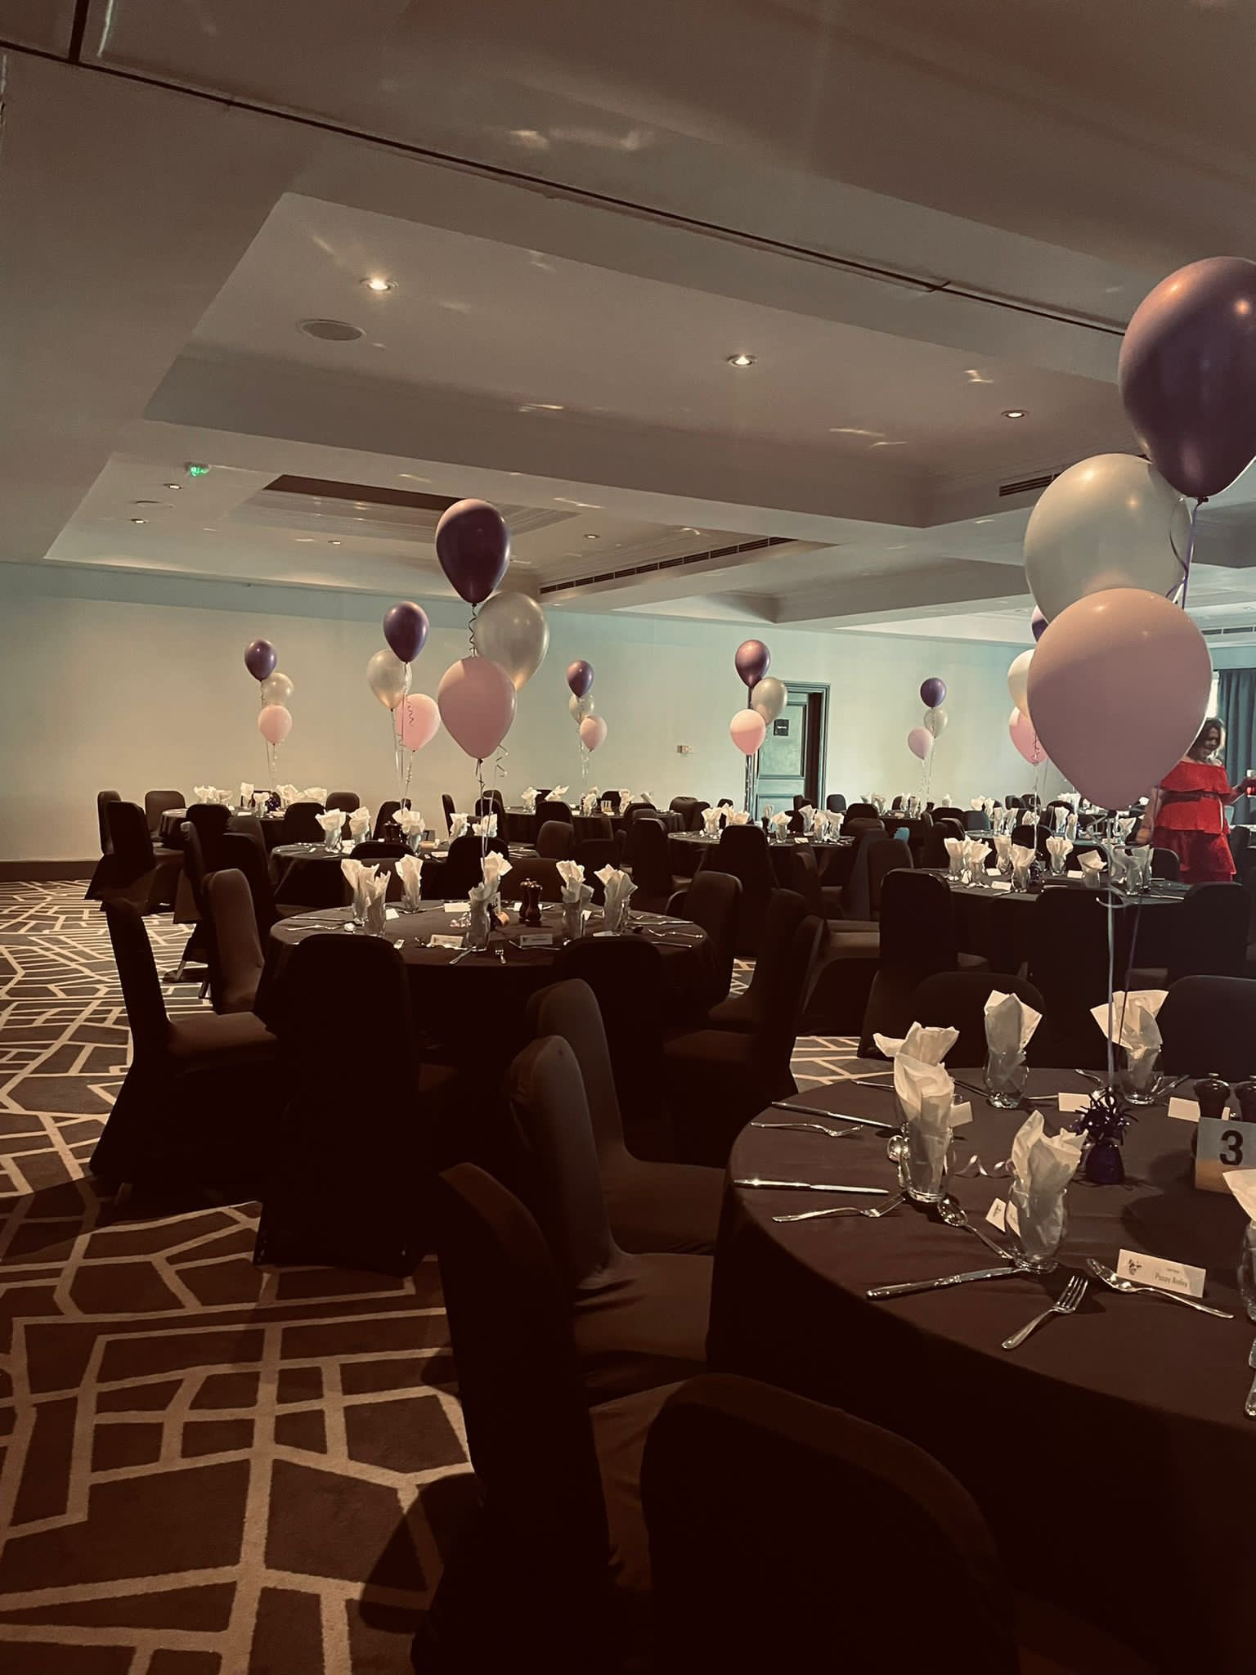
Prom / Hoodie:
Prom:
Friday the 7th July 2023.
The Village Hotel, Chilwell, Nottingham.
Invites to prom (with ticket information) will follow shortly, subject to the students’ attendance and attitude to learning figures.
Leavers’ Hoodies:
Leavers’ Hoodies are now available online until 23rd February. Please collect a letter after this presentation.

Slide 7
Science

Slide 8
All separate exams are 1hr45 long
Biology Paper 1 1hr15 70 marks Cell Biology; Organisation; Infection and response; and Bioenergetics. | Chemistry Paper 1 1hr15 70 marks Atomic structure and the periodic table; Bonding, structure, and the properties of matter; Quantitative chemistry; Chemical changes; and Energy changes. | Physics Paper 1 1hr15 70 marks Energy; Electricity; Particle model of matter; and Atomic structure.
Biology Paper 2 1hr15 70 marks Homeostasis and response; Inheritance, variation and evolution; and Ecology. | Chemistry Paper 2 1hr15 70 marks The rate and extent of chemical change; Organic chemistry; Chemical analysis; Chemistry of the atmosphere; and Using resources. | Physics Paper 2 1hr15 70 marks Forces; Waves; and Magnetism and electromagnetism

Slide 9
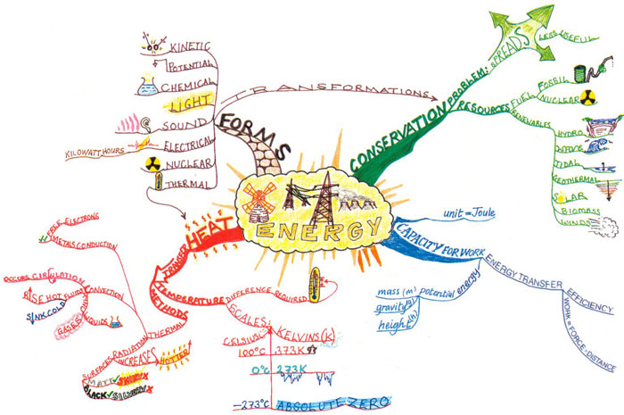
Use the revision guide…
… but don’t just read it!
Use active revision strategies.
Mind maps
Flash Cards
Look cover write check

Slide 10
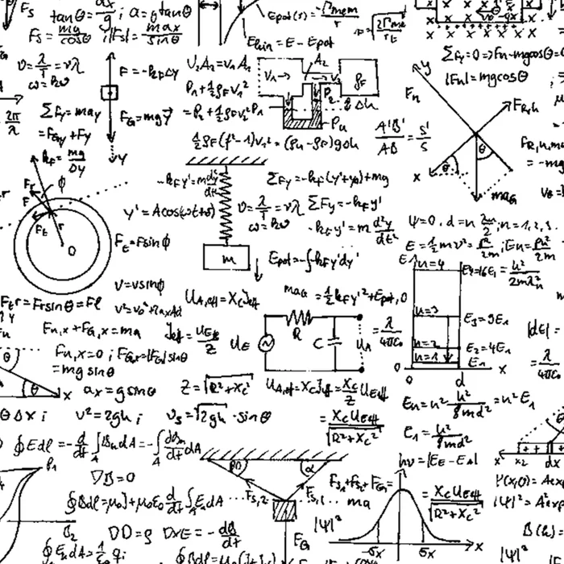
Equations….
There is no requirement for students to learn the equations this year.

Slide 11
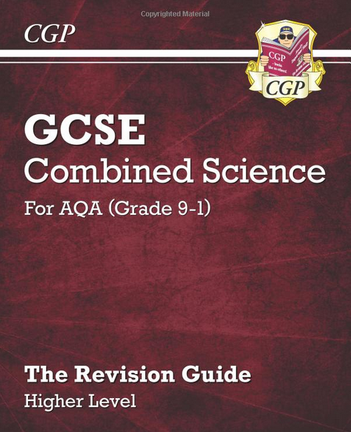
Formula Sheets
30 day challenges
Key knowledge books
Intervention - Thursday after school
How you can help:
Key knowledge
Exam practice
Seneca
Practicals

Slide 12
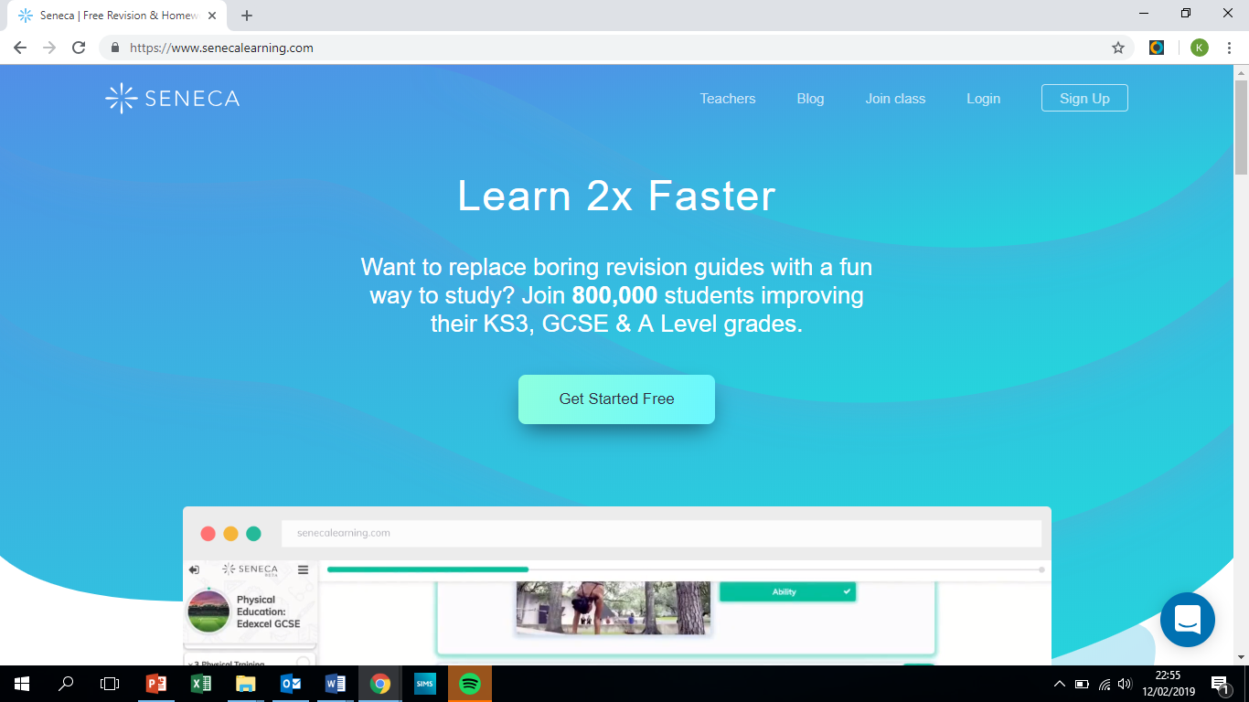

Slide 13
Other online bits….
Free Science Lessons
https://www.youtube.com/channel/UCqbOeHaAUXw9Il7sBVG3_bw
Primrose Kitten
https://www.youtube.com/c/primrosekittenscience

Slide 14
English

Slide 15
English: Language AND Literature
Paper 1 Wed 18th May | Paper 2 Fri 10th June
Section A Reading a Fiction Extract | Section A Reading 2 Non Fiction Extracts
Section B Creative Writing | Section B Viewpoint Writing
A Page a Day Revision Booklet

Slide 16
English Language: ways to revise
Practice makes perfect!
Writing is 50% of the Language GCSE.
Get your child to choose an image off the internet to describe or give them a topic to write persuasively about.
Time your child for 45 minutes.
Read through what they have done. Is it interesting? Have they structured their writing? Have they used ambitious vocabulary?

Slide 17
English Language: ways to revise
Read!
With all this revision reading will just seem like something extra to do…
However, exposing your child to short stories or articles online will really help with their Language GCSE.
And could be a stress relief too!
Your child can get practice Language exams
online or from their English teacher.

Slide 18
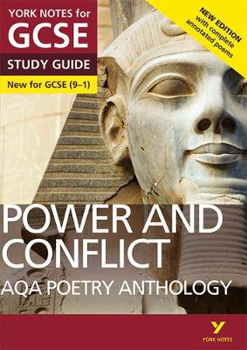
Literature
Paper One Wed 25th May | Paper Two Wed 8th June
Section A: Power and Conflict Poetry | Section A: Romeo and Juliet
Section B: Animal Farm | Section B: Unseen Poetry

Slide 19
Flash Cards
For each text your child needs to know:
Characters
Plot
Themes
Context
With the use of flashcard you can easily test them on these.
Information
Questions
Quotations
Students have lots of ‘notes’ or information. It is now time to start condensing these notes – active revision!
Bonus Revision:
Your child can plan (and even write) and exam answer. Again exam questions can be found online or from the classroom teacher.

Slide 20
Embrace their phone…
Youtube Poetry Mr Bruff
SENECA
BBC Bitesize
York/Spark Notes
Flash card apps

Slide 21
Maths

Slide 22
You don’t need to be good at maths to be able to help your child with their maths revision!
There are lots of things you can do to support them.

Slide 23
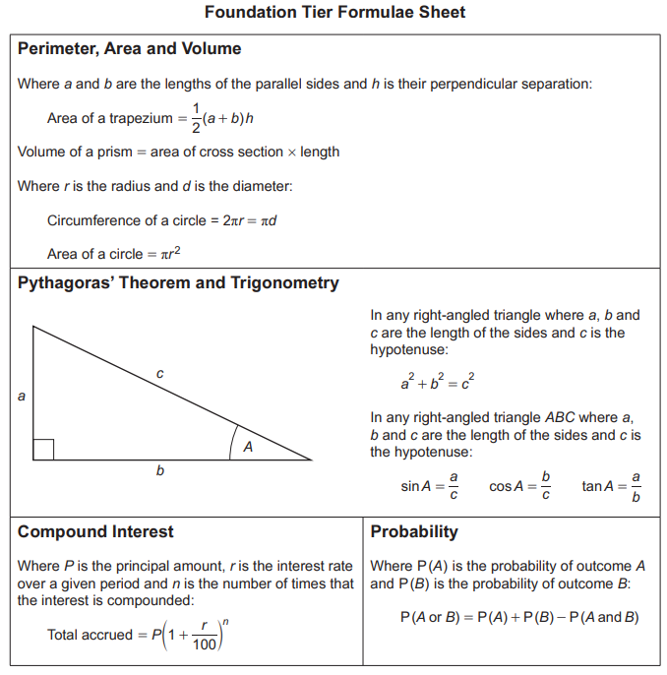
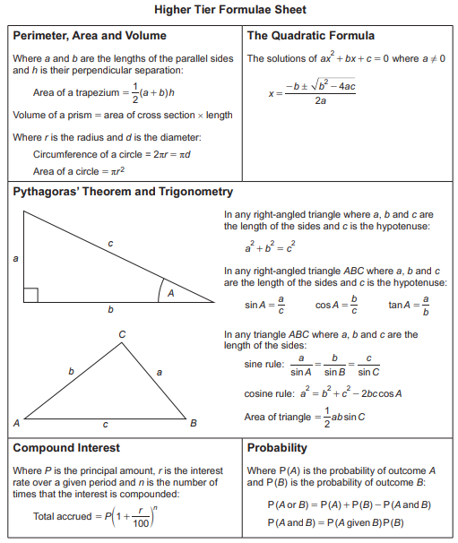
Maths students will receive a formula sheet this year

Slide 24
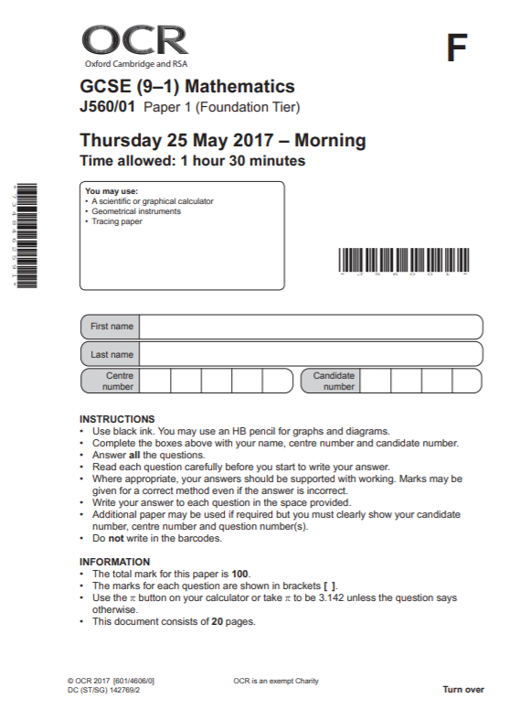
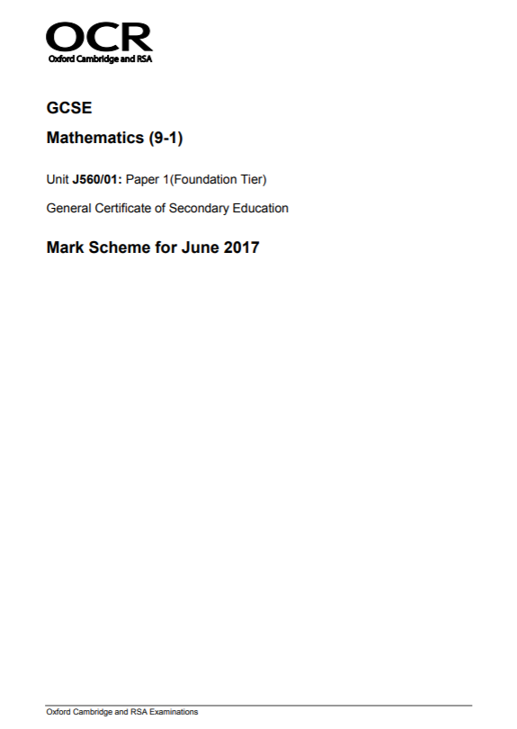
The most important thing to work on and to use are past exam papers:
They inform students where they are (using official grade boundaries)
They inform students which topics they need to revise
If students can get a grade 5 regularly on these then they will in the exam

Slide 25
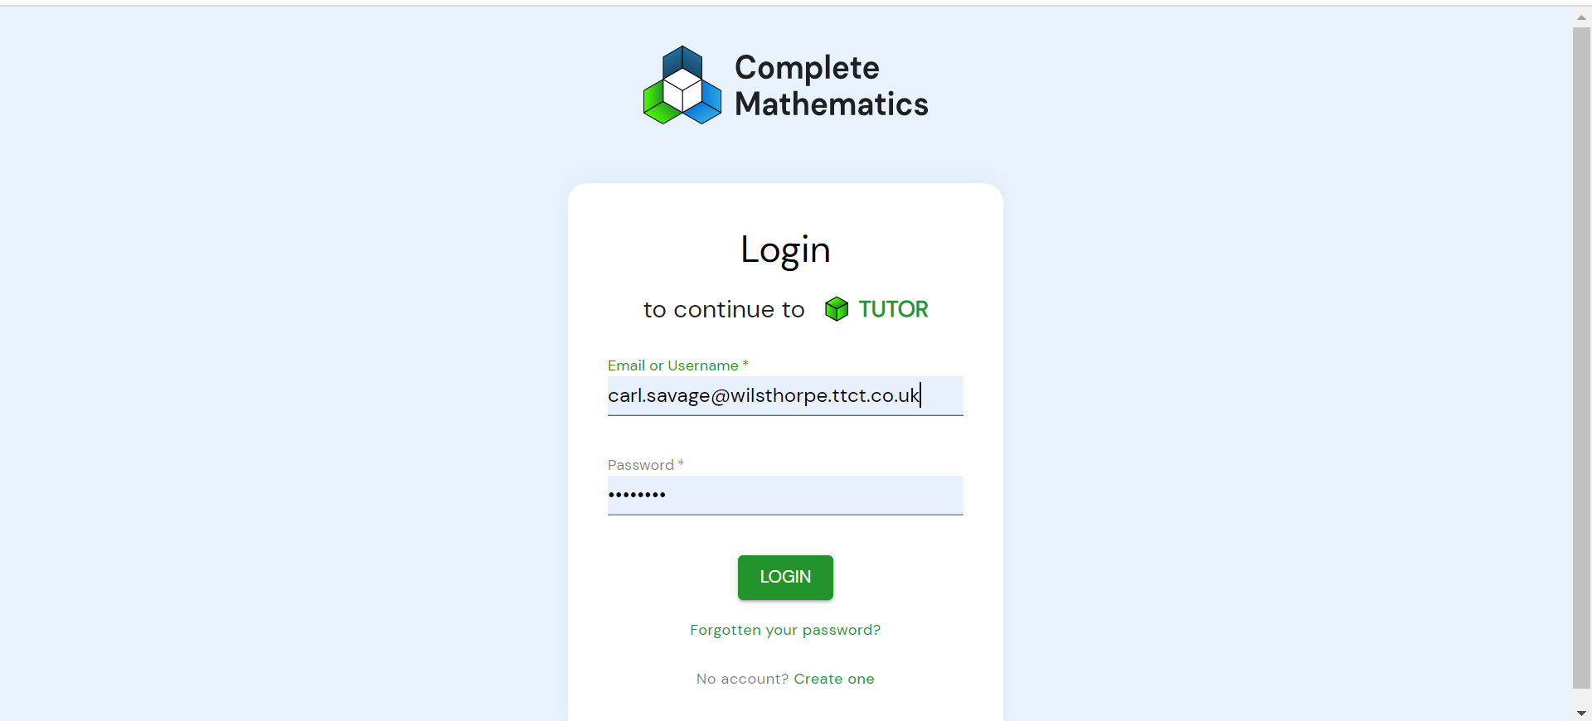
1. TUTOR - work on gaps in knowledge and/or target a particular grade

Slide 26
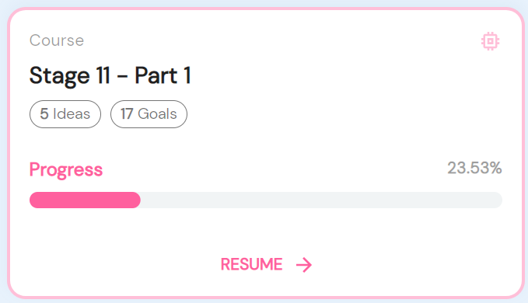
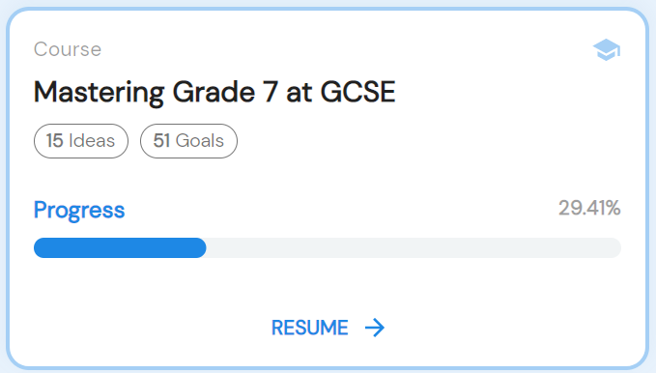
1. TUTOR - work on gaps in knowledge and/or target a particular grade
Work on your gaps
Target a grade

Slide 27
2. Corbett Maths - videos explaining topics plus questions and answers

Slide 28
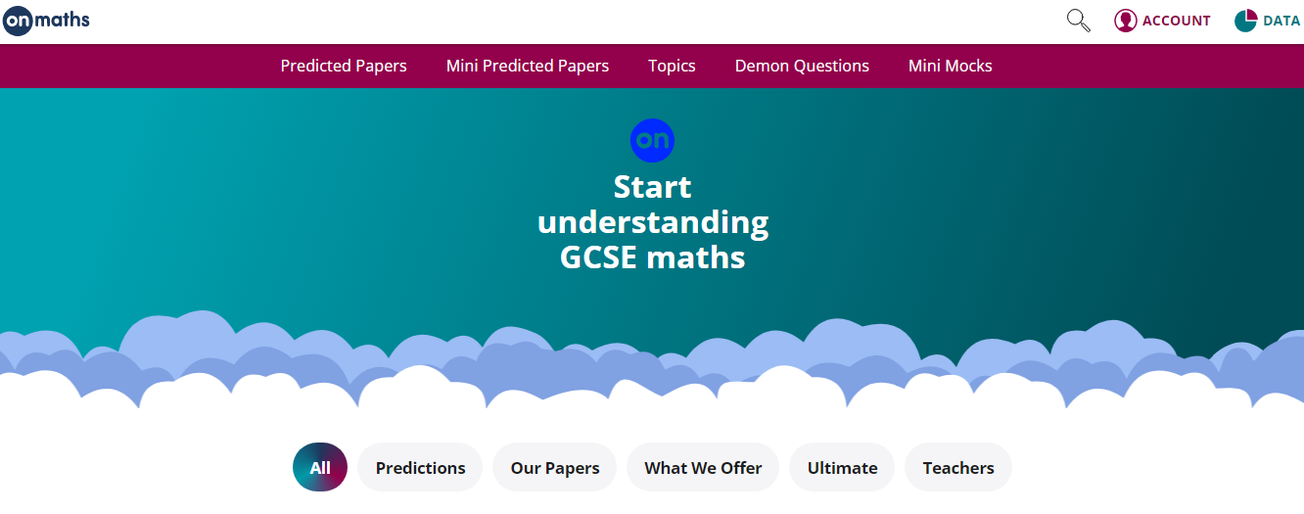
3. OnMaths - topic revision with increasingly difficult question plus predicted papers

Slide 29
4. PinPoint Learning - targeted questions on students’ weakest topics

Slide 30
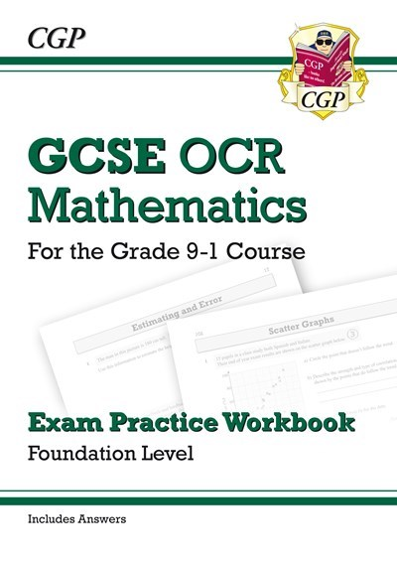
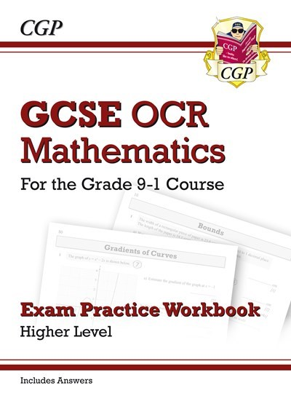
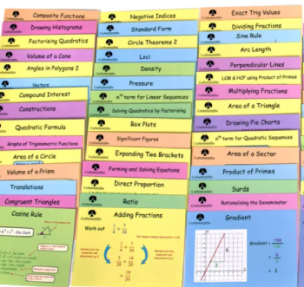
5. Revision cards/revision books and workbooks
£2.50 per set
£6.25

Slide 31
Please come and ask us any questions…

