Slide 1
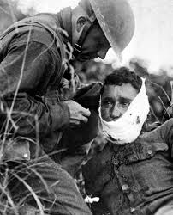
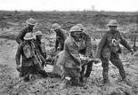
Edexcel GCSE 9-1 History
Medicine Through Time.
Key Topic 5:The British sector of the Western Front, 1914-18: injuries, treatment and the trenches
Medicine Through Time PLC |  |  | Page | Lesson | Date Revise
Key Topic 5: The British sector of the Western Front, 1914-1918: injuries, treatment and the trenches. | KT5.1 The historical context of medicine in the early twentieth century: | The understanding of infection and moves towards aseptic surgery; the development of x-rays; blood transfusions and developments in the storage of blood.
 | KT5.2 The context of the British Sector of Western Front and the theatre of war in Flanders and northern France | Ypres salient, the Somme, Arras and Cambrai. The trench system – its construction and organisation, including frontline and support trenches. The use of mines at Hill 60 near Ypres and the expansion of tunnels, caves and quarries at Arras. Significance for medical treatment of the nature of the terrain and problems of the transport and communication infrastructure.
 | KT5.3 Conditions requiring medical treatment on the Western Front | Including the problems of ill health arising from the trench environment. The nature of wounds from rifles and explosives. The problem of shrapnel, wound infection and increased numbers of head injuries. The effects of gas attacks.
 | KT5.4 The work of the RAMC and FANY. The system of transport: | Stretcher bearers, horse and motor ambulances. The stages of treatment areas: aid post and field ambulance, dressing station, casualty clearing station, base hospital. The underground hospital at Arras.
 | KT5.5 The significance of the Western Front fort Experiments in surgery and medicine | New techniques in the treatment of wounds and infection, the Thomas splint, the use of mobile x-ray units, the creation of a blood bank for the Battle of Cambrai.
Name:
Notes:
21.0 x 29.7 cm

Slide 2
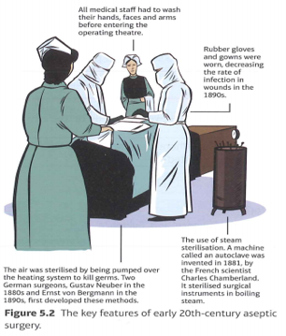
KT5.1 Historical context of medicine in the early 20th century
p.2
In the years before the outbreak of the First World War, many medical breakthroughs had occurred. These were used as the foundation for medical advancements in the British sector of the Western Front. These included aseptic surgery, x-rays and blood transfusions.
Understanding infection and the move towards aseptic surgery.
Joseph Lister first used carbolic acid to prevent infection in surgery in 1865, based on Louis Pasteur’s work on Germ Theory.
The development of x-ray machines
The development of x-rays was completely accidental. In 1895, Wilhelm Roentgen, a German physicist, was studying the effects of passing an electrical current through a glass tube covered in black paper. He noticed that although everything in the room was darkened, a screen about a metre from the equipment had begun to glow. He called these rays that could pass through glass ‘x’.
Further experiments led him to realise that these rays could penetrate many objects. He held a piece of lead in front of the tube and was able to see his own flesh glowing around his bones. He then placed photographic paper between the tube and his hand and created the world’s first x-ray image. Shortly after, he also took an x-ray of his wife’s left hand. It was possible to see not just her hand on this x-ray but also her wedding ring.
The importance of the use of x-rays was understood immediately.
AS early as 1896, radiology departments were opening in a number of British hospitals, contributing to advancing knowledge and applying the new science in a medical setting. At Glasgow Royal infirmary, a radiology department headed by Dr John Macintyre produced a number of interesting x-rays, including x-rays of a kidney stone, a penny in a child's throat, and even a frog’s legs in motion.
At Birmingham General Hospital, Dr John Hall-Edwards was one of the first doctors to make a diagnosis based on information from an x-ray, when he located a needle in a woman's hand. It was this potential for carrying out diagnosis before operations took place that would help medical treatments on the Western Front.
However, many problems emerged with the early use of x-rays.
The health risks associated with x-rays were not fully understood. The amount of radiation that was released in early x-rays was about 1,500 times the amount that is released today. Exposure to x-rays was harmful. Patients could lose hair or suffer burns.
Wilhelm Roentgen had used a table-top machine, but the glass tube used with this was very fragile, so could break easily.
Taking an x-ray of a hand using the table-top machine took about 9 minutes- which was a very long time to keep your hand still!
Larger x-ray machines were being developed, but were very difficult to move around.
However, these dangers and problems did not prevent the continuing use of x-rays.

Slide 3
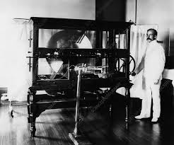
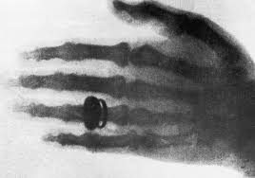
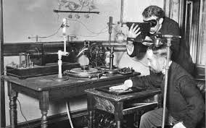
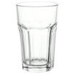
KT5.1 Historical context of medicine in the early 20th century
p.3
TASK: Answer the following questions.
List the 4 key features of aseptic surgery.
______________________________________________________________________________________________________________________________________________________________________________________________________________________________________________________
______________________________________________________________________________________________________________________________________________________________________________________________________________________________________________________
______________________________________________________________________________________________________________________________________________________________________________________________________________________________________________________
______________________________________________________________________________________________________________________________________________________________________________________________________________________________________________________
Who invented the first x-ray and in what year? ___________________________________________________________________________
What were the first and second x-rays he made of? ______________________________________________________________________________________________________________________________________________________________________________________________________________________________________________________________
What type of departments were being opened in hospitals by 1896? ______________________________________________________________________________________________________________________________________________________________________________________________________________________________________________________________
What did Dr John Macintyre do? ___________________________________________________________________________________________
TASK: These pictures, added up. form information regarding the problems with x-rays, but what do they mean?

Slide 4
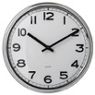
KT5.1 Historical context of medicine in the early 20th century
p.4
TASK: Highlight 1 fact in each of the following paragraphs
The development of blood transfusions and the storage of blood
An average adult body contains about five litres of blood. If somebody loses too much blood, then they are likely to go into shock and die. In the 19th centuries, blood loss was often the result of complex surgeries
With the development of aseptic surgery and x-rays in the late 19th century, it was possible to carry out more complex surgical operations safely. However, if the problem of blood loss could not be solved, then the success of these operations would be irrelevant.
James Blundell did the first experiments in human blood transfusion in 1818 to help women under his medical care who lost blood when they gave birth. Between 1818 and 1829, Blundell carried out ten transfusions, with up to half of the patients surviving. In these years, Blundell developed many o f the techniques and basic equipment which would continue to be used up to the First World War. As blood could not be stored - it had to be used as soon as it was available - transfusions were carried out with the donor ( the person giving the blood) being directly connect to the recipient (the person receiving the blood) by a tube.

Slide 5
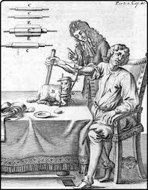
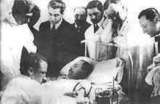
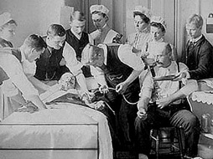
KT5.1 Historical context of medicine in the early 20th century
The understanding of infection and moves towards aseptic surgery; the development of blood transfusion.
p.5
TASK: Rewrite the 3 facts about blood transfusion from the previous page below in chav language.
_____________________________________________________________________________________________________________________________________________________________________________________________________________________________________________________________________________________________________________________________________________________________________________________________________________________________________________________________________________________________________________________________________________________________________________________________________________________________________________________________________________________________________________________________________________________________________________________________________________________________________________________________________________________________________________________________________________________________________________________________________________________________________________________________________________________________________________________________________________________________________________________________________________________________________________________________________________________________________________________________________________________________________________________________________________________________________________________________________________________________________________________________________________________________________________________________________________________________________________________________________________________________________________________________________________
TASK: Break the code using the information below. Find each coded letter on the top row, and read down to break the code.

Slide 6
KT5.1 Historical context of medicine in the early 20th century
The understanding of infection and moves towards aseptic surgery; the development of blood transfusion.
p.6
Problem with transfusion | Attempted solution to the problem
Blood coagulates (clots) as soon as it leaves the body. This meant that the tubes which transfused blood from one person to another could become blocked up. | There were attempts to find chemicals, such as sodium bicarbonate, to prevent clotting. In 1894, Professor Almroth Wright, a British scientist, concluded that the soluble solution of certain acids could prevent clotting, but he thought that side effects, such as convulsions, could not be prevented.
Rejection of the transfused blood because the blood of the donor and the blood of the recipient was not compatible. | In 1901, Austrian doctor Karl Landsteiner discovered the existence of three different blood groups – A,B and O. The following year a fourth blood group, AB, was also found. This information was used in 1907 by Reuben Ottenberd, an American doctor, who was the first person to match a donor and a recipient’s blood type before a transfusion. He also identified blood group O as a universal blood group.
Danger of infection from unsterilized equipment. | The introduction of aseptic methods of surgery had largely solved this problem in hospital conditions by the early 20th century.
Task: Rewrite the information from the table regarding the problems with transfusion into 15 words each
Problem with transfusion | Attempted solution to the problem

Slide 7
KT5.1 Historical context of medicine in the early 20th century
The understanding of infection and moves towards aseptic surgery; the development of blood transfusion.
p.7
TASK: Answer the following exam question.
Describe two features of blood transfusion on the Western Front during the Frist World War.
Feature 1
______________________________________________________________________________________________________________________________________________________________________________________________________________________________________________________________________________________________________________________________________________________________________________________________________________________________________________________________________________________________________________________________________________________________________________________________________________________________________________________________________________________________________________________________________________________________________________________________________________________________________________________________________________________________________________________________________________
Feature 2
________________________________________________________________________________________________________________________________________________________________________________________________________________________________________________________________________________________________________________________________________________________________________________________________________________________________________________________________________________________________________________________________________________________________________________________________________________________________________________________________________________________________________________________________________________________________________________________________________________________________________________________________________________________________________________________________________________________________________________________________________________________________________________________________________________
4 Marks
Remember that no mark will be given for information outside of the First World War so don’t mention the discovery of blood groups or aseptic surgery. Instead mention the methods that were used to deliver blood to wounded soldiers, the medical advances that made it possible and the impact that transfusions had.
You get 1 mark for mentioning a feature and 1 mark for some supporting information so 2-3 sentences max!

Slide 8
KT5.2 The context of the British sector of the Western Front
p.8
TASK: Recap Quiz
Give 3 features of Aseptic surgery:
____________________________________________________________________________________________________________________________
____________________________________________________________________________________________________________________________
____________________________________________________________________________________________________________________________
Give 2 problems with the early use of x-rays:
____________________________________________________________________________________________________________________________
___________________________________________________________________________________________________________________________
Give one problem and solution to blood transfusion:
Problem: _____________________________________________________________________________________________________________________
Solution: _____________________________________________________________________________________________________________________
Flanders and northern France
Britain declared ________ on Germany on August 4 1914, Germany invaded ________________ through Belgium. The British ______________________ sent the British Expeditionary Force (BEF) to northern France to try to stop the German advance through Belgium. The BEF was made up of 70,000 professional ____________________, fighting alongside a larger French army. Near Mons, close to the French-Belgian ____________________, the BEF face a German _____________ that was more than double their size – 160,000 soldiers. Although they stopped the German advance briefly, they were ordered to _______________ to the River Marne in order to prevent Paris falling to the Germans. After the Battle of the Marne, the German forces pulled back to the River Aisne.
soldiers | River | France | army
retreat | war | government | border
The trench system
By the end of 1914, much of Belgium and northern France had been occupied by the Germans, although they had been stopped from advancing into the heart of France. This meant that battles could not follow along the same lines as previous wars, which had involved much more movement of single armies. Instead, it became a static war based on trenches, which needed to be defended from the enemy, with attempts made to advance from the trenches to seize land from the enemy army. A line of trenches was eventually established all the way from English Chanel in the north, to Switzerland in the south.

Slide 9
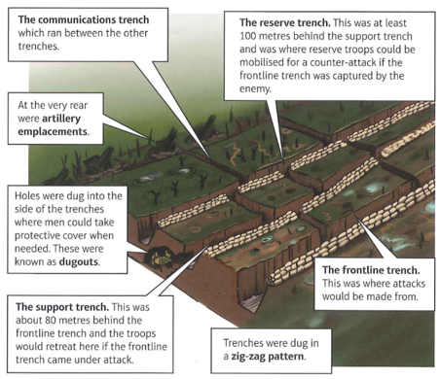
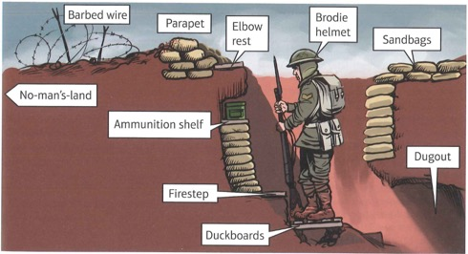
KT5.2 The context of the British sector of the Western Front
p.9
Construction and organisation
Although some basic trenches were dug in 1914, a more complex system began to evolve from 1915. The trenches were generally dug to a depth of about 2.5.m.
Trenches were easier to defend than attack. Machine guns could fire rapidly, and barbed wire was place in no-man’s-and (the area between two opposing lines of trenches) to slow down the progress of any attack.
New tactics were developed to try to deal with the advantages held by the defenders. Such tactics included the use of gas.
Cross section of a trench.
TASK: Unscramble these words related to the cross section of the trench
Brow lest - ________________________________________
Let me hide bro - __________________________________
Darko buds - ___________________________________________

Slide 10
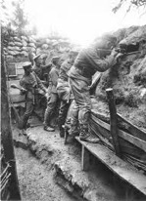
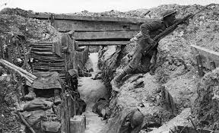
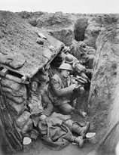
KT5.2 The context of the British sector of the Western Front
p.10
EXAM QUESTION
Describe two features of the trench system
Feature 1
___________________________________________________________________________________________________________________________________________________________________________________________________________________________________________________________________________________________________________________________________________________________________________________________________________________________________________________________________________________________________________________________________________________________________________________________________________________________________________________________
_____________________________________________________________________________________________________________________________________________________________________________________________________________________________________________________________
Feature 2
_________________________________________________________________________________________________________________________________________________________________________________________________________________________________________________________________________________________________________________________________________________________________________________________________________________________________________________________________________________________________________________________________________________________________________________________________________________________________________________________________________________________________________________________________________________________________________________________________________________________________________________________________________________________________________________________

Slide 11
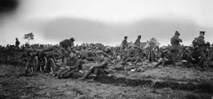
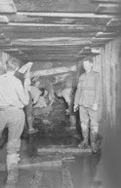
KT5.2 The context of the British sector of the Western Front
p.11
The Ypres Salient, the Somme, Arras and Cambrai
This section will outline the key battles in the British sector of the Western Front. It will be important to refer back to this section when looking at specific medical advancements on the Western Front.
TASK: Write one sentence that sums up each of the battles. You don’t need to know battles in detail but you will need to reference them in an answer.
1914: The First Battle of Ypres
During the first months of the war, the BEF had moved to the town of Ypres in western Belgium, in order to prevent the German advance towards the sea. In the autumn of 190914, the Germans launched an attack on the British positions to be east and north-east of Ypres. Although the British lost over 50,000 troops in this battle, which went on from 12 October to 11 November, they held on to Ypres. This meant they controlled the English Channel ports, so that supplies and reinforcements could be provided. By the end of the battle, the Germans had extended their control around the edge of the Ypres Salient as far as the village of Messines.
The use of mines at Hill 60
Hill 60 was a man-made hill to the south east of Ypres. The Germans had captured it in December 1914 and its height gave them a strategic advantage in this area. The British used the method of offensive mining to take it back in April 1915. This involved tunnelling into and under the hill. Five mines were placed in the tunnels. When they exploded they blew the top off Hill 60 and the British were able to take this strategically important position

Slide 12
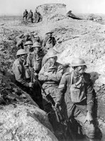
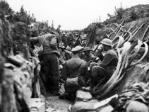
KT5.2 The context of the British sector of the Western Front
p.12
1915: The Second Battle of Ypres
As soon as the battle for Hill 60 was finished, the Second Battle of Ypres began. This took place as a sequence of battles over a period of about one month, from 22 April through to 25 May 1915. It is significant in the history of the First World War as it was the first time that the Germans used chlorine gas on the Western Front. British losses during this month totalled about 59,000 men. By the end of the battle, the Germans had moved about two miles closer to the town of Ypres on the eastern side of the salient.
1916: The Battle of the Somme
The British attack on the Somme aimed to take ground from the Germans and was launched on 1 July 1916. The casualties on both sides were enormous: on the first day alone, British casualties were over 57,000, with deaths totalling around 20,000 men. The British tried two new strategies, which would both eventually contribute to increased casualty rates:
The use of the creeping barrage, which saw artillery launched from the trenches towards the German lines just ahead of the British infantry as it advanced forwards.
The first use of tanks in warfare – however, the use of tanks had many technical problems and they were not very successful.
By the time the Battle of the Somme ended in November 1916, it is estimated that the British had suffered over 400,000 casualties.
List 3 facts about the battle of the Somme.

Slide 13
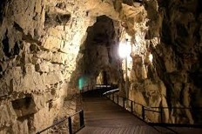
KT5.2 The context of the British sector of the Western Front
p.13
Tunnels, caves and quarries at Arras
The area around Arras is vey chalky, and so it is easy to tunnel through. Quarries and tunnels had been dug in the landscape since Roman times. In 1916, the British decided to link the existing tunnels, caves and quarries to create an underground network around Arras to act as shelters against German attacks. They were also built to enable safe underground movement. The work was carried out by Tunnelling Companies from Britain and New Zealand. In total, they dug more than 2.5 miles of tunnels in five months. Up to 25, 000 men could be stationed in the tunnels, which contained electric lights, running water, a light railway system and a fully functioning hospital.
1917: the Battle of Arras
In April 1917, 24,000 men who had been hiding in tunnels dug near the German trenches attacked. The aim of the offensive was to break through the German lines. In the first few days, it appeared that this aim was achieved, as the British advanced about eight miles. However, as the advance slowed, virtually no further progress was made by the end of the offensive in May, there was a large number of casualties (nearly 160,000 British and Canadians).
1917: the Third Battle of Ypres
The purpose of the Third Battle of Ypres in 1917 was for the British army to break out of the Ypres Salient. The British wanted to remove the German advantage of having the higher ground. Throughout June, the British had prepared for the main attack in the battle of Messines, where they had driven the Germans off the ridge that formed part of the Ypres Salient and which the Germans had occupied since October 1914.

Slide 14
KT5.2 The context of the British sector of the Western Front
p.14
The British launched their main attack on 31 July, marching east from Ypres towards Passchendaele. The army advanced about two miles on the first day. Soon though, the weather turned to rain and the ground became waterlogged – so much so that many men fell in the mud and drowned. This campaign lasted until November. By then, the British had moved the edge of the salient back by about seven miles. The cost of this advance was an estimated 245,000 British casualties.
1917: the Battle of Cambrai
The Battle of Cambrai was launched on 20 October 1917. The artillery barrage was change dos that less warning of the coming attack was given to the Germans. It was accompanied by the first large-scale use of tanks – nearly five hundred were used in this battle. They were able to move easily across the barbed wire and their machine guns were very effective.
TASK: Name that battle! Below is a list of statements that refer to the battles you have just read. You need to write the name of the correct box. Do they refer to: the First Second or Third Battle of Ypres, Hill 60, Somme, Arras or Cambrai.
Statement | Battle
The British mined underneath the man made hill.
The result of the battle meant Britain controlled the English Channel ports.
First time the creeping barrage tactic was used.
The British decided to link existing tunnels to create an underground network.
It was the first large-scale use of tanks.
It was the first time the Germans used Chlorine Gas.
Nearly 160,000 British and Canadian soldiers died.

Slide 15
KT5.2 The context of the British sector of the Western Front
p.15
Give a title to each paragraph
Highlight the key information
Reduce to 1-2 bullet points
Problem of transport and communication.
The constant shelling, and the type of terrain that soldiers were fighting on (similar to the conditions in the Third Battle of Ypres), left the landscape full of craters and hole and destroyed many roads. This led to major problems in transporting injured men away from the frontline. Before the war, this region had been used as farmland, and the use of fertiliser was extensive. This mean there was a lot of bacteria in the soil that could lead to infected wounds.
Men who were injured on the Western Front needed to be moved away from the frontline in stages, as soon as their condition was stable enough. Stretcher bearers, like Edward Munro, would carry away the large numbers of wounded form the frontline, both during the day and at night. This meant they often had to expose themselves to shelling and gunfire. Further away from the frontline, it was possible to carry out more advanced medical procedures, and also to provide some protection against shelling. The faster an injury could be treated, the more likely a person was to survive.
Horse-Drawn and motor ambulances
When the BEF was first sent to France in August 1914, the military leadership decided not to send any motor ambulances with them. It was soon realised that this was a mistake, as the horse-drawn ambulance wagons could not cope with the large number of casualties. Men who were transported in these wagons were shaken about, which often made their injuries even worse. This lack of transport actually led to soldiers being left to die or being taken prisoner by the Germans.

Slide 16
KT5.2 The context of the British sector of the Western Front
p.16
Give a title to each paragraph
Highlight the key information
Reduce to 1-2 bullet points
Problem of transport and communication.
When news of this reached Britain, The Times newspaper ran a public appeal for donations. By October 1914, after only three weeks, the appeal had raised enough money to buy 512 ambulance wagons, which would make transporting wounded soldiers much easier, and would prevent injuries being made worse from the move. The first motor ambulances were sent to the Western Front in October 1914, as a result of work by the Red Cross. However, motor vehicles could not operate in much of the muddy terrain of the frontline, so horse-drawn wagons continued to be used throughout the war. In worse terrain, six horses, rather than the usual two, pulled the ambulance wagons.
Train, barge and ship ambulances
Wounded men might also be transported by train or by canal in the final stage of their evacuation to the Base Hospitals on the French coast. In the first few months of the war on the Western Front, the Royal Army Medical Corps (RAMC), which was responsible for medical care in the army, had to use French goods trains. The first ambulance train designed for carrying wounded soldiers arrived in France in November 1914. It had spaces for stretchers fitted down both sides of the carriage.
Later, some trains sent to France even contained operating theatres. There were concerns that the numbers of wounded being moved on the railways damaged the war effort because they contributed to too many trains moving around on the rail network of northern France and Belgium.

Slide 17
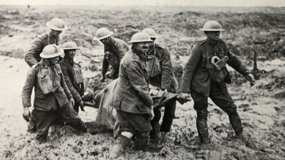
KT5.2 The context of the British sector of the Western Front
p.17
Give a title to each paragraph
Highlight the key information
Reduce to 1-2 bullet points
This led to the decision to also make use of canal barges as transport for the wounded to Base Hospitals. Although the journey was slow, it was comfortable, and some of the wounded bypassed the Base Hospitals to be transferred directly onto the ships that were transporting wounded men back to Britain.
TASK: Describe the photo Source A – what is happening?
________________________________________________________________________________________________________________________________________________________________________________________________________________________________________________________________________________________________________________________________________________________________________________________________________________________________________________________________________________________________________________________________________
Source A: Stretcher bearers carrying a wounded man to safety at the third battle of Ypres in August 1918. This photograph was taken by Lieutenant John Brooke, an official photographer for the British army on the Western Front.
TASK: What other sources would be helpful in considering the work and problems faced by stretcher bearers on the Western Front.
________________________________________________________________________________________________________________________________________________________________________________________________________________________________________________________________________________________________________________________________________________________________________________________________________________________________________________________________________________________________________________________________________________________________________________________________________________________________________________________________________________________________________________________________________________________________________________________________________________________________________________________________________________________________________________________________________________________________________________________________________________________________________________________________

Slide 18
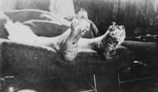
KT5.3: Conditions requiring medical treatment on the Western Front
p.18
TASK: Recap questions
Give 3 methods of transporting the wounded: __________________________________________________________________________
Give 2 features of the Trench System: ______________________________________________________________________________________________________________________________________________________________________________________________________________________________________________________________
Give 1 WW1 battle with 1 detail:
Battle name: ______________________________________
Detail of the battle:________________________________________________________________________________________________________
Main medical problems on the Western Front
Conditions in the trenches were very unpleasant. Sanitary or hygienic, conditions for such large numbers of people posed a problem. In summer, the combination of sewage and dead bodies made the smell dreadful, whilst in winter, bad weather gave rise to both flooding and frostbite. In November and December 1914, there were over 6,000 cases of frostbite. Rat infestation was normal. A number of medical problems were caused by these conditions.
The nature of wounds
Rifles and explosives
In a case study of over 200,000 wounded men admitted to Casualty Clearing Stations (CCS) on the Western Front, it was discovered that high-explosive shells and shrapnel were responsible for 58% of wounds. When a shells and shrapnel were responsible for 58% of wounds. When a shell exploded, it could kill or injure a soldier immediately. A shell explosion also scattered shrapnel (fragments of metal in the casing), which travelled at fast speeds over a wide area. This meant that anyone who was in the way of the shrapnel was likely to be wounded. About 60% of injuries were to arms and legs.
The case study also found that bullets were responsible for 39% of wounds. Machine guns could fire 450 rounds a minute, and their bullets could fracture bones or pierce organs. Rifles could fire accurately at up to 500m, but lacked the speed of machine guns.
 | Main Symptoms | Attempted solutions to deal with the problem
Trench foot | Painful swelling of the feet, caused by standing in cold mud and water. In the second stage of trench foot, gangrene set in. Gangrene is the decomposition of body tissue due to a loss of blood supply. | Prevention was key Rubbing whale oil into feet to protect them. Keeping feet dry and regularly changing socks. If gangrene developed, then amputation was the only solution to stop it spreading along the leg.

Slide 19
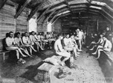
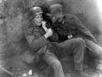
KT5.3: Conditions requiring medical treatment on the Western Front
p.19
 | Main Symptoms | Attempted solutions to deal with the problem
Trench Fever | Flu-like symptoms with high temperature, headache and aching muscles. This condition was a major problem because it affected an estimated half a million men on the Western Front. | By 1918, the cause of trench fever had been identified as contact with lice. Delousing stations were set up. After this, there was a decline in the numbers experiencing condition.
Shellshock | Symptoms included tiredness, headaches, nightmares, loss of speech, uncontrollable shaking and complete mental breakdown. It has been suggested that about 80,000 British troops experienced shellshock. | The conditions was not well understood at the time. In some cases this involved treatment back in Britain. However, some soldiers who experienced shellshock were accused of cowardice. Many were punished for this - some were even shot.
TASK: If this is the answer what is the question?
Sewage and dead bodies: _________________________________________________________________________________________________
58%: _____________________________________________________________________________________________________________________
60%: ________________________________________________________________________________________________________________________
Fracture bones: _____________________________________________________________________________________________________________
Painful swelling: ____________________________________________________________________________________________________________
Trench Fever: _______________________________________________________________________________________________________________
Tiredness, headaches and nightmares: ______________________________________________________________________________________________________________________________________________________________________________________________________________________________________________________________

Slide 20
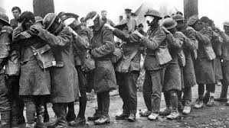
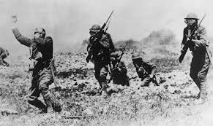
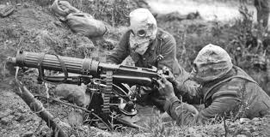
KT5.3: Conditions requiring medical treatment on the Western Front
p.20
Shrapnel, wound infection and head injuries
When men were injured, either by shrapnel or by bullets, the metal would penetrate their body, taking with it the fabric of the uniform the area surrounding the wound. The soil in the region, which had been intensively farmed with large quantities of fertiliser before the war, contained the bacteria for both tetanus and gas gangrene. Gangrene is an infection caused by a lack of blood to an area in the body. When wound were exposed to the soil the presence of these bacteria made infection much more likely. The impact of tetanus was reduced by the use of anti- tetanus injections from the end of 1914. However, there was no cure for gas gangrene. The bacteria for gas gangrene spread through the body quickly and could kill a person within a day.
At the start of the war, the headgear worn by soldiers was a soft cap. To protect against head injuries, a trial using the Brodie helmet was carried out in 1915. This was a steel helmet with a strap that prevented it being thrown off the head in an explosion. It was estimated that it reduce fatal head wounds by 80%, so the helmet was then provide to all soldiers fighting on the Western front.
TASK: Answer the following questions:
What happened to the fabric of the uniform when a bullet penetrated the body?
What was significant about the soil in the regions where fighting took place?
What did this cause?
What is gas gangrene?
How was the impact of tetanus reduced?
What type of headgear did soldiers wear at the beginning of the war?
What reduced the number of fatal head wounds by 80%?

Slide 21
KT5.3: Conditions requiring medical treatment on the Western Front
p.21
The effects of gas attacks
Gas attacks caused great panic and fear. It was not, however, a major cause of death, with only about 6,000 British soldiers dying as a result of gas attacks. The British army gave troops on the Western Front gas masks from 1915, which became more sophisticated over time. Still, gas attacks were greatly feared by soldiers on the Western Front.
Chlorine
First used by the Germans in 1915 at the second battle of Ypres. It led to death by suffocation.
The medical services had no experience in dealing with gas attacks, and so had to experiment with treatments. Gas masks were given to all British troops in July 1915.
Before this, soldiers developed their own system of gas masks. They soaked cotton pads with urine and pressed them to their faces to help stop the gas entering their lungs.
The British retaliated with their own chlorine attack later in 1915 at the Battle of Loos, but the wind changed direction and the gas blew back on the British Lines.
Phosgene
First used at the end of 1915 near Ypres. Its effects were similar to those of chlorine but it was faster acting, killing an exposed person within two days.
3 Types of Gas Attacks
Mustard
First used in 1917 by the Germans. It was an odourless gas that worked within 12 hours, causing both internal and external blisters and could pass through clothing to burn the skin.
Exam Question practice.
Describe 2 features of the treatment of battle wounds on the Western front. 4 marks
One key feature of the treatment of battle wounds on the Western Front was shrapnel. ________________________________________________________________________________________________________________________________________________________________________________________________________________________________________________________________________________________________________________________________________________________________________________________________________________________________________________________________________________________________________________________
Another key feature of the treatment of battle wounds on Western Front was ________________________________________________________________________________________________________________________________________________________________________________________________________________________________________________________________________________________________________________________________________________________________________________________________________________________________________________________________________________________________________________________

Slide 22
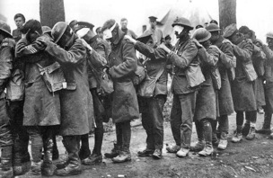
KT5.3: Conditions requiring medical treatment on the Western Front
p.22
TASK: How useful is source C to a historian studying the effects of gas on soldiers during WW1?
Source C From the notebook of Lance Sergeant Elmer Cotton, who served in the 5th Northumberland Fusiliers in 1915. He is describing the effects of a chlorine gas attacks.
It produces a flooding of the lungs. It is the equivalent to drowning, only on dry land. The effects are these – a splitting headache and a terrific thirst (but to drink water is instant death), a knife-edge pain in the lungs and the coughing up of a greenish froth off the stomach and the lungs, finally resulting in death. It is a fiendish death to die.
 | Comment on usefulness
Nature
Origin
Purpose
Own Knowledge
Source D: Photograph of British troops blinded by poison gas during the Battle of Estaires, 1918.

Slide 23
KT5.3: Conditions requiring medical treatment on the Western Front
p.23
Source D is useful because it shows _____________________________________________________________________________________________________________________________________________________________________________________________________________________________________________________________________________________________________________________________________________________________________________________________________________________________________________________________________________________________________________________________________________________________________________________________________________________________________________________________________
Although we don’t know why the photo was taken, it might have been taken to show the consequences of gas attacks and how they were treated.
From my own knowledge I know
______________________________________________________________________________________________________________________________________________________________________________________________________________________________________________________________________________________________________________________________________________________________________________________________________________________________________________________________________________________________________________________________________________________________________________________________________________________________________________________________________________________________________________________________________________________________________________________________________
The source may be considered limited because… (explain WHY this situation was not always typical)
_____________________________________________________________________________________________________________________________________________________________________________________________________________________________________________________________________________________________________________________________________________________________________________________________________________________________________________________________________________________________________________________________________________________________________________________________________________________________________________________________________

Slide 24
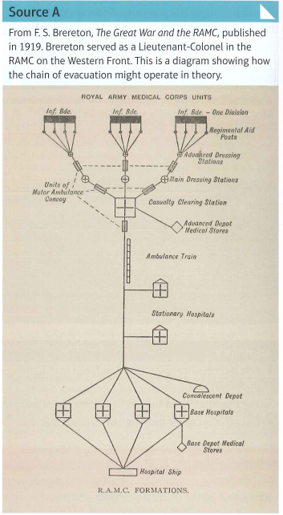
KT5.4 The work of the RAMC and FANY. The system of transport:
p.24
TASK: Recap questions
Give 3 Problems with early x-ray machines : __________________________________________________________________________
______________________________________________________________________________________________________________________________________________________________________________________________________________________________________________________________
Give 2 features of a problems faced in the transportation of the wound: ______________________________________________________________________________________________________________________________________________________________________________________________________________________________________________________________
Give one specific WW1 statistic ______________________________________
To deal with the large numbers of casualties in the First World War, the number of medical professionals needed to be increased dramatically.
The table below shows the number of medical professionals in 1914 and 1918.
More than half of Britain's doctors were serving with the armed forces and most of these were deployed to the Western Front.
 | 1914 | 1918
Medical Officers | 3,168 | 13,063
Other ranks | 16,331 | 131,099
Key Words
RAMC
Royal Army Medical Corps. This branch of the army was responsible for medical care and was formally founded in 1898.
FANY
First Aid Nursing Yeomanry. Founded in 1907, this was the first women’s voluntary organisation to send volunteers to the Western Front. it provided frontline support for the medical services, for example by driving ambulances and engaging in emergency first aid.

Slide 25
KT5.4 The work of the RAMC and FANY. The system of transport:
p.25
TASK: Reduce to 1-2 bullet point.
The system of transport and the stages of treatment
Because of the large numbers of casualties, it was essential that there was an efficient system to get the wounded from the frontline to a safe area where they could be treated. This system became known as the chain of evacuation.
The main stages in the chain of evacuation were Regimental Aid Posts (RAP), Dressing Stations (ADS and MDS), Casualty Clearing Stations and Base Hospitals. Remember - these were the main stages, but were not always followed in the same order for every casualty.
REGIMENTAL AID POST
The RAP was generally located within 200m of the frontline, in communication trenches or deserted buildings. It was made up of a Regimental Medical Officer, with some help from stretcher bearers with first-aid knowledge. Wounded men would either walk in themselves or be carried in by other soldiers. The purpose of the RAP was to give immediate first aid and to get as many men back to the fighting as possible. It could not deal with serious injuries. These had to be moved to the next stage in the chain of evacuation.
DRESSING STATIONS(ADS and MDS)
In theory, there should have been an Advanced Dressing Station (ADS) about 400m from the RAP and a and a Main Dressing Station (MDS) a further half a mile back. In practice, this was often not the case - and there may only have been one Dressing Station. Where possible, the Dressing Station were located in abandoned buildings, dug-outs or bunkers, in order to offer protection from enemy shelling. Where these were not available, tents would be used. Each dressing station would be staffed by ten medical officers, plus medical orderlies and stretcher bearers of the RA<C. From 1915, there were also some nurses available for this part of the chain of evacuation. To get to the Dressing Station, men would either walk, if they were able to do so, or be carried in by stretcher in stages.

Slide 26
KT5.4 The work of the RAMC and FANY. The system of transport:
p.26
TASK: Reduce to 1-2 bullet point.
Those working at the Dressing Stations belonged to a unit of the RAMC called the Field Ambulance. This should not be confused with the vehicles that carried the sick and wounded, which were known as ambulance wagons. In theory, each Field Ambulance unit could deal with 150 men, but when major battles were taking place, they would have to deal with many more. The Field Ambulance at Hooge in the Ypres Salient dealt with about 1,00 casualties on 10-11 August 1917 . The Field Ambulance units did not have the facilities to tend to wounded men for more than a week. Men who had been treated would either be returned to their units if they were fit enough to fight again, or they would be moved on to the next phase of the chain of evacuation by horse or motor ambulance.
CASUALTY CLEARING STATION
Casualty Clearing Stations were located a sufficient distance from the frontline to provide some safety against attack, but close enough to be accessible by ambulance wagons. Often the CCS closest to the frontline would specialise in operating on the most critical injuries, such as those to the chest. They were set up in buildings such as factories or schools and were often located near to a railway line to allow the next stage of the chain of evacuation to take place quickly.
When wounded soldiers arrived here, they were divided into three groups. This system was called triage, from the French word for sorting or selecting. Triage helped medical staff make decisions about treatment.
The three categories the wounded were divided into are:
The walking wounded. These were the men who could be patched up and returned to the fighting.
Those in need of hospital treatment. These men would need to be transported to a Base Hospital once they had been treated for any immediate life-threatening injuries.
Those who were so severely wounded that there was no chance of recovery. These men would be made comfortable, but the medical resources available were given to those who were more likely to survive their wounds.

Slide 27
KT5.4 The work of the RAMC and FANY. The system of transport:
p.27
Here are some useful statistics about the CCS during the Third Battle of Ypres in 1917.
There were 24 CCS in the Ypres Salient.
379 doctors and 502 nurses treated more than 200,000 casualties.
The medical staff operated on 30% of the men who were admitted.
In total, 3.7% of the men admitted died.
BASE HOSPITALS
Base Hospitals on the Western Front were located near the French and Belgian coast, so that the wounded men who were treated there would be close to the ports, from which they could be transported home to Britain. At the start of the War there were two types of Base Hospitals - the Stationary Hospital and the General Hospital. However, in practice, they worked in very similar ways. Men were treated in both types of hospital until they could be returned to Britain for further treatment or were fit enough to return to the fighting.
As the war progressed, Casualty Clearing Stations played an increasingly important role in dealing with wounds, instead of Base Hospitals. It had become clear that if contaminated wounds were not dealt with quickly, wounded men were more likely to develop gangrene. This meant that the CCS started doing operations that it was originally believed would be done in the Base hospital.
As the Base Hospitals were not carrying out their intended role, other important roles emerged for them. The experimented with new techniques which, once successful, were used in the CCS. For example, by dividing patients up into different wards according to their wounds, such as amputees, head wounds, chest wounds, and by allocating doctors to a specialised ward, it was possible for doctors to become expert in the treatment of particular wounds.
The Casualty Clearing Stations retained their role as the most important place for operations until the spring of 1918. The static nature of trench warfare had meant that the CCS had been relatively safe early on in the war, but in March 1918, the Germans launched the Spring Offensive. This was a last-ditch attempt to win the war before American troops arrived in Europe and joined the British. It resulted in many CCS having to move back so much of the surgery that was required for the wounded was now undertaken again in the base hospitals.
TASK: Reduce to 1-2 bullet point.

Slide 28
KT5.4 The work of the RAMC and FANY. The system of transport:
p.28
TASK: Fill in the flowchart showing the chain of evacuation. Write down what would happen to a casualty at each stage of the chain.
REGIMENTAL AID POST
DRESSING STATIONS
CASUALTY CLEARING STATIONS
BASE HOSPITALS

Slide 29
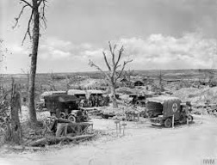
KT5.4 The work of the RAMC and FANY. The system of transport:
p.29
TASK: Exam question practice.
How useful are Sources C and D for an enquiry into the treatment of the wounded at ADSs on the Western Front?
Explain your answer, using Sources C and D and your knowledge of the historical context.
Source C: From the diary of E.S.B. Hamilton, 19 August 19166. Hamilton had been in France for over a year at this time, as part of the Field Ambulance. AT the time of this diary entry, he was working at an Advance Dressing Station on the Somme.
The dugout (of the ADS) is awfully overcrowded both night and day and it is impossible to get it cleaned or aired. (There were) something like 800 people through here in about thirty hours the day before yesterday. This is far too much work for the personnel (of) three officers and about 115 men. Result (is) a lot of the men are done up and the officers seedy and depressed.
Source D: A photograph of an Advanced Dressing Station. This was taken in August 1916 at Pozieres Ridge, which was part of the Somme campaign.
PLAN: Why is source C useful? Remember Nature (type of source), Origin (when and who), Purpose (why) and own knowledge. Why is it limited (think untypical or unrepresentative)?
Source C is useful because…
From my own knowledge I know….
Source C might be considered limited as it is...
PLAN: Why is source D useful? Remember Nature (type of source), Origin (when and who), Purpose (why) and own knowledge. Why is it limited (think untypical or unrepresentative)?
Source D is useful because…
From my own knowledge I know….
Source D might be considered limited as it is...

Slide 30
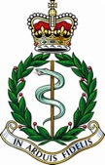
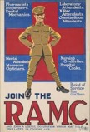
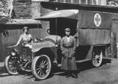
KT5.4 The work of the RAMC and FANY. The system of transport:
p.30
The Role of the RAMC and FANY
ROYAL ARMY MEDICAL CORE (RAMC)
The Royal Army Medical Core (RAMC) was the branch of the army responsible for medical care, it organised and provided medical treatment to the wounded and sick whilst being responsible for keeping men healthy.
Throughout the war, its numbers increased due to the amount of wounded:
In 1914, there were 9000 men and by 1918 and by 1918 they had 130,000 who were doctors, stretcher bearers etc.
Well trained nurses from Queen Alexandria were allowed to join, but only 300 of them in 1914. By 1918, there were 10,000 and many volunteer cooks, cleaners and washers.
THE FIRST AID NURSING YEOMANRY (FANY)
The First Aid nursing Yeomanry (FANY) was the first women’s voluntary organisation to send volunteers to the Western Front.
First 6 women went in 1914 and over 500 women volunteered to provide frontline medical support.
FANY help by driving ambulances, driving supplies to the front line and setting up a mobile bath units that could bathe up to 40 men an hour.
One unit ran the Calais ambulance unit, with 22 drivers and 12 ambulances.
FANY paved the way for VAD (Volunteer Aid Detachment ) nurses to help medical services.
TASK: Exam question
Describe two features of the Royal Army Medical Core. (Think RAMC and FANY. Think what they did, who was involved and numbers. All you have to do is give one detail and one supporting piece of information.)
One Key feature of the RAMC was _________________________________________________________________________________________________
_____________________________________________________________________________________________________________________________________________________________________________________________________________________________________________________________________________
______________________________________________________________________________________________________________________________________________________________________________________________________________________________________________________________________________
Another key feature of the RAMC was _______________________________________________________________________________________
____________________________________________________________________________________________________________________________________________________________________________________________________________________________________________________________________________________________________________________________________________________________________________________________________________________________________________________________________________________________________________________________________________________________

Slide 31
KT5.4 The work of the RAMC and FANY. The system of transport:
p.31
Source I: From The Daily Telegraph, a British newspaper, 29 April 1915.
POISON BOMBS: CANADIAN’S HEROIC CONDUCT
There appears little doubt that the material used by the Germans in the “poison bombs” is chlorine. This is the only conclusion one can arrive at after hearing the graphic narration of a Canadian who was enveloped in the fumes near Ypres.
The Canadian said, “Directly we opened fire the Germans rained shrapnel over us. We kept the guns going, wounded as some of us were. That we could stand. We had no complaints, because it was honest warfare. Then came the surprise. We saw bombs burst in the air and throw off a greenish-yellow vapour…”
At yesterday’s meeting of the London Education Committee, the chairman (Mr Gilbert) called attention to the request of the Government for respirators [gas masks] for the troops.
Using the range of sources
Following up an enquiry
In the examination, you are asked to suggest a possible question and a type of source that you could use to follow up another source. Read Source I, the framework of the question helps you through the four-stage process and I have given suggestions on what you could use in an answer. .
The detail you might follow up is the request for respirators
The question you might ask is ‘How many gas masks were given to Canadian troops after April 1915?’
There are lots of different types of source in this unit. You could suggest private diaries, local newspapers or official records.
Lastly, you have to explain the reason for your choice. For example, you could say that you would follow up Source I with a private diary because gas attacks would be a common event soldiers would write about in their diaries.
National Newspapers
Source I shows you some of the strengths and weaknesses of national newspapers as sources. The report refers to events that are going on in both the Western Front and at home in response to these events. The chairman of the London Education Committee is named, but the soldier is anonymous. He is only referred to as ‘the Canadian’. The article appears to give valid information, but it is also a form of propaganda.
TASK: What can you find out about the German attack at Ypres, the types of weapon used and the response at home?
____________________________________________________________________________________________________________________________________________________________________________________________________________________________________________________________________
How useful is this national newspaper for studying gas attacks?
____________________________________________________________________________________________________________________________________________________________________________________________________________________________________________________________________

Slide 32
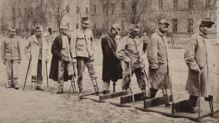
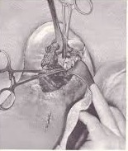
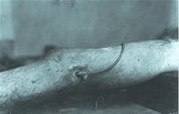
5.5 The significance of the Western Front for experiments in surgery and medicine.
p.32
RECAP
What were the stages of the chain of evacuation? ____________________________________________________________________
___________________________________________________________________________________________________________________________
What does FANY stand for and what did they do? _______________________________________________________________________________________________
What 3 illnesses could you get from being in a trench for extended periods of time?
___________________________________________________________________________________________________________________________
What were the 3 types of gas used?
___________________________________________________________________________________________________________________________
What was memorable about the battle of Cambrai in 1917?
___________________________________________________________________________________________________________________________
New techniques in the treatment of wounds and infection
A major problem that faced the RAMC at the start of the war on the Western Front was dealing with
infections caused by gas gangrene. It was not possible to perform aseptic surgery in Dressing Stations and Casualty Clearing Stations, due to the contaminated conditions and because of the large numbers of wounded men needing treatment.
Because of this, other methods of treatment had to be found. This led to much disagreement in the medical profession between those medics who were facing frontline conditions on a daily basis and those who were back in Britain, unfamiliar with what medics in the trenches were facing.
Amputation. . If neither wound excision nor the use of antiseptics succeeded in halting the spread of infection, the only way to deal with it was through the amputation of wounded limbs. By 1918, 240,000 men had lost limbs – many of them because it was the only way to prevent the spread of infection and death.
Wound excision or debridement. This was cutting away of dead, damaged and infected tissue from around the site of the wound. It needed to be done as soon as possible because infection could spread quickly. After excision, the wound needed to be closed by stitching. If any infected tissue had not been removed before the wound was stitched, the infection would spread again.
The Carrel-Dakin method. Antiseptics, such as carbolic lotion, were inefficient when treating gas gangrene. By 1917, it was agreed that the Carrel-Dakin method, which involved using a sterilised salt solution in the wound through a tube, was the most effective alternative. The solution only lasted for six hours and so had to be made as it was needed. This could be difficult, especially when large numbers of wounded men needed treatment at the same time.

Slide 33
5.5 The significance of the Western Front for experiments in surgery and medicine.
p.33
TASK: Do the following statements refer to Amputation, The Carrel-Dakin method or Wound Excision or Debridement?
If wound excision or antiseptics did not work in stopping the spread of infection, this method was used.
This was the cutting away of dead, damaged and infected tissue.
Involved using sterilised salt solution in the wound through a tube.
After the excision, the wound needed to be closed by stitching.
By 1918, 240, 000 men had this done. It was the only way to prevent the spread of infection.
If the wound was not stitched in time, the infection would spread again.
The solution only lasted for 6 hours and had to be made as it was needed.
TASK: Read the information about Thomas Splints and answer the questions regarding the paragraph in the box to the side.
The Thomas Splint
In 1914 and 1915, men with gunshot or shrapnel wound to the leg only had a 20% chance of survival. This was because these wounds created a compound fracture where the broken bone pierced the skin. It was particularly serious if the femur (thigh bone) was fractured, because a large amount of muscle would be damaged. This mean there was likely to be major bleeding into the thigh.
The splint that was in use as the wounded man was transferred from the frontline did not keep the leg rigid. By the time the wounded man arrived at the Casualty Clearing station. Where he could be operated on he would have lost a great deal of blood, was likely to be in shock and might already have developed gas gangrene in the wound. This combination of factors reduced his chances of surviving an operation to the wound. Many of those who survived did so because their wounded leg was amputated.
What were the survival rates of a gunshot or shrapnel wound to the leg? Why was this?
What would have happened by the time soldiers got to the CCS?
How come some soldiers survived?

Slide 34
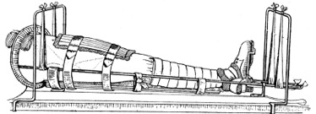
5.5 The significance of the Western Front for experiments in surgery and medicine.
p.34
The Thomas Splint
It was clear that a way of improving the survival rate for men with this type of injury was needed. In fact, the solution, which only came into use in 1916, had been available since well before the start of the war.
In the late 19th century, Robert Jones worked with his uncle, Hugh Thomas, in his medical practice, where his uncle had designed a splint to stop joints from moving. When the war broke out, Jones was 57 years old. He offered his services immediately to the war effort. He worked with disabled soldiers in a hospital in London and started to make use of his uncle’s Thomas splint.
As a result of this, in December 1915, he was sent to Boulogne to instruct medical practitioners on how to use the Thomas splint. The introduction of its use from this time increased the survival rate for this type of wound from 20% to 82%.
Who invented the Thomas splint?
What did Robert Jones do when the war broke out?
How did the survival rate change as the result of the Thomas Splint?
The use of mobile x-ray units
X-rays were used from the start of the war. Their main use was to identify shell fragments and bullets in wounds, which, if not removed when the person was wounded, could cause infection. Two x-rays would be taken from different angles and this helped the surgeon to identify quite accurately the location of shrapnel and bullets in the body.
Although a relative success, there were some problems with the use of x-rays for medical practitioners on the Western Front.
X-rays could not detect all objects in the body. For example, fragments of clothing that were driven into wounds with shrapnel would not show up on an x-ray. However, doctors soon realised that they need to look for these fragments in the same area as shrapnel when operating on the wounded.
The length of time that a wounded man had to remain still whilst the x-ray was taken was still several minutes, which could cause problems depending on the wound.
The tubes used in x-ray machines were fragile and overheated quite quickly. This meant that x-ray machines would only be used for about one hour at a time and then had to be left to cool down. This posed a problem when there was a major offensive going on and large numbers of wounded men were being brought in. The solution was to have three machines which would be used in rotation. When a machine became too hot to continue working, it would be replaced by another one. There had been an advance made in the technology of tubes in the USA by William Coolidge in 1913, but this was not available to the RAMC on the Western Front until the USA entered the war in 1917.

Slide 35
5.5 The significance of the Western Front for experiments in surgery and medicine.
p.35
The Base Hospitals and some of the larger Casualty Clearing Stations had static (unmoving) x-ray machines as part of their equipment. Those that did not have them could call on a mobile unit. There were six mobile x-ray units operating in the British sector on the Western Front. Setting up the equipment from the mobile unit took some time. A tent was attached to the back of the van with a table where stretchers could be placed. The x-ray machine was set up next to this table and linked to the engine of the van, which was used to power the x-ray machine. The equipment for processing the x-ray films was set up inside the van. Although the quality of the x-rays taken by the mobile units was not quite as good as that taken by static units, it was sufficient to identify shrapnel and bullets and prevent infection for many of the wounded soldiers.
TASK: Using the information on the previous page, add detail to each of the stems of this mind map to show the problems with x-ray machines.
COULD NOT DETECT SMALL OBJECTS
Problems x-rays
TOOK A LONG TIME
TUBES IN THE X-RAY MACHINE WERE FRAGILE

Slide 36
5.5 The significance of the Western Front for experiments in surgery and medicine.
p.36
TASK: Answer the following questions regarding mobile x-rays
What was the main use of the x-ray machine?
How many x-rays would be taken?
What type of x-ray machines did Base Hospitals and
How many mobile x-ray units were there in the British sector on the Western Front?
How did the mobile unit get set up?
TASK: Read through the model answer for the ‘source follow up’ question.
Source C
From Radiography and Radiotherapeutics by Robert Knox, published in 1917. This was a textbook on the use of x-rays written by a British doctor.
The need for portable outfits in connection with the war has led to a great development in the provision of motor wagons containing complete x-ray apparatus with all accessories. The mechanism used for driving the wagon i.e. the motor is coupled with a powerful dynamo which delivers a continuous current.
Detail in Source C that I would follow up
Question I would ask
What type of source I could use
How this might help answer my question

Slide 37
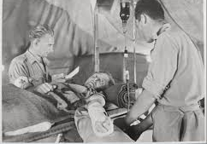
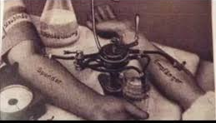
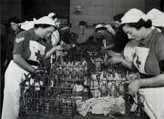
5.5 The significance of the Western Front for experiments in surgery and medicine.
p.37
Blood Transfusions
The use of blood transfusions from 1915 in the British sector of the Western Front was pioneered by a Canadian doctor, Lawrence Bruce Robertson, in the Base hospital at Boulogne. He used the indirect method where a syringe and tube was used to transfer the donor blood to the patient. The purpose of this was to stop the patient going into shock through blood loss before surgery. Even where a wound was relatively minor, shock could kill a soldier. Those who did not experience a negative reaction to the blood transfusion generally recovered. As blood transfusions proved so successful at the Base Hospital, it was decided to extend their use. Therefore, by 1917, blood transfusions were being administered in the Casualty Clearing Stations as a routine measure in the treatment of shock.
Geoffrey Keynes, a British doctor and lieutenant in the RAMC, designed a portable blood transfusion kit that was used to provide blood transfusion kit that was used to provide blood transfusions close to the frontline. Despite Roberson’s pioneering work, this kit did not use stored blood because of the difficulties in keeping the blood fresh when there was no refrigeration available. Keynes added a device to the blood bottle to regulate the flow of the blood which helped prevent clotting. In 1915, Keynes used the new method in a Casualty Clearing Station on the Western Front. By his own accounts, it saved countless lives.
What type of method did Lawrence Bruce Robertson use?
What was the purpose of this?
What happened to those that did not experience a negative reaction?
What happened by 1917?
What did Geoffrey Keynes design?
Why did it not use stored blood?
Why did Keynes add a device to the blood bottle?

Slide 38
5.5 The significance of the Western Front for experiments in surgery and medicine.
p.38
The Blood Bank At Cambrai
The identification of blood groups and the use of blood type O as a universal donor blood type meant that the risk of being transfused with the wrong blood group was reduced. The problem of clotting remained, and there was never enough blood on hand to meet demand. However, as the war continued, some advances were made in the storage of blood.
In 1915, American doctor Richard Lewisohn discovered that by adding sodium citrate to blood the need for donor-to-donor transfusion was removed. Blood transfusions could be done indirectly with patients not needing to be in the same room.
In the same year, Richard Weil discovered that blood with sodium citrate could be refrigerated and stored for up to two days.
In 1916, Francis Rous and James Turner found that by adding a citrate glucose solution to blood, it could be stored for much longer period - up to four weeks.
The use of stored blood was clearly demonstrated in 1917 at the Battle of Cambrai. Before the battle, Oswald Hope Robertson, a British-born American doctor, stored 22 units of universal donor blood in glass bottles. He built a carrying case for the bottles in ammunition boxes which he packed with i.e. and sawdust. He called this a ‘blood depot’. During the battle, he treated 20 severely wounded Canadian soldiers with the 22 units of blood, some of which had been collected 26 days before use. They were so badly affected by shock that none of them were expected to survive. In fact, of the 20 wounded men, 11 survived.
Robertson’s work at Cambrai was the first time stored blood was used to treat soldiers in shock, and, although it was only on a small scale, demonstrated its potential to save lives. This was important, because during times of heavy fighting, only the most severely wounded were taken to the casualty Clearing Stations. The less severely wounded, who were normally the men who gave blood for transfusions, would not be taken there. Therefore, the availability of blood stored in a number of blood depots made a huge difference to men’s chances of survival.

Slide 39
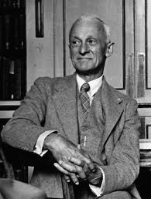
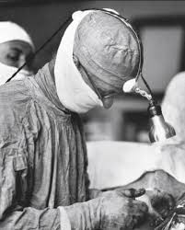
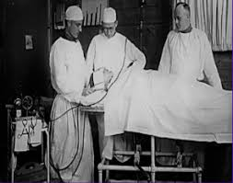
5.5 The significance of the Western Front for experiments in surgery and medicine.
p.39
TASK: Reread the text about the battle of Cambrai. List 5 facts that you want to remember. Write them down, read them, then get your partner to test you.
Fact 1
Fact 2
Fact 3
Fact 4
Fact 5
The attempts to deal with increased numbers of head injuries
About 20% of all wounds in the British sector of the Western Front were to the head, face and neck. This was the part of the body that was most exposed in the trench warfare of the Western Front. Injuries of this nature could be caused by both bullets and shrapnel.
BRAIN SURGERY
Injuries to the brain were very likely to prove fatal at the start of the war because:
The issue of infection applied just as much to head injuries as it did to wounds to other parts of the body..
There were difficulties involved in moving men with head injuries through the chain of evacuation, as they were often unconscious of confused.
There were very few doctors who had experience of neurosurgery (surgery carried on the nervous system) before the war.
Despite the inexperience of doctors in dealing with head wounds, observation quickly led to improvements in methods of treatment.
Harvey Cushing, an American neurosurgeon, developed new techniques in brain surgery on the Western Front. He experimented, for example, with the use of a magnet to remove metal fragments from the brain. He also used a local anaesthetic rather than a general anaesthetic when operating. The reason for this was that the brain swelled as a result of general anaesthetics and this increased the risks of operation. His methods became more effective as he learned more through observation. He operated on 45 patients in 1917 with an operation survival rate of 71% , compared to the general survival rate of 50% for brain surgery.

Slide 40
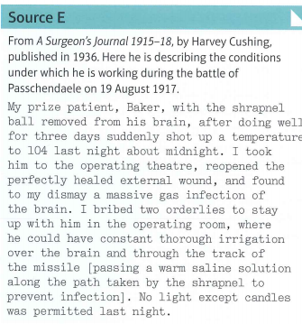
5.5 The significance of the Western Front for experiments in surgery and medicine.
p.40
Observation | New method of treatment
Men who were operated on quickly were more likely to survive. | Specific Casualty Clearing Stations became chosen as centres for brain surgery.
It was dangerous to move men too soon after an operation. | Patients remained at the Casualty Clearing station for three weeks after surgery.
Injuries that looked fairly minor could be hiding more severe injuries. | All head wounds were always carefully examined.
TASK: Study Source E and answer the following questions
Why do you think Baker was Cushing’s prize patient? _______________________________________________________________________________________________________________________________________________________________________________________________________________________________________________________________________________________________________________________________________________________________
What happened to make Baker’s temperature rise? _______________________________________________________________________________________________________________________________________________________________________________________________________________________________________________________________________________________________________________________________________________________________
What do you learn about the problems facing surgeons on the Western Front? _______________________________________________________________________________________________________________________________________________________________________________________________________________________________________________________________________________________________________________________________________________________________
TASK: How do the following pictures relate to the attempts to deal with increase numbers of head injuries?

Slide 41
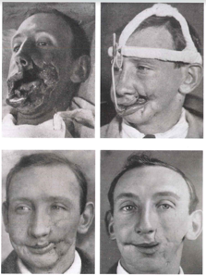
5.5 The significance of the Western Front for experiments in surgery and medicine.
p.41
PLASTIC SURGERY
The development of plastic surgery was largely the work of a New Zealand doctor called Harold Gillies. In civilian life, he was an ENT (ear, nose and throat) surgeon. He was sent to the Western Front in January 1915. There he met Charles Valadier, a French man who had been working for the British Red Cross as a dentist since October 1914. Head injuries that might not kill could cause severe disfigurement. This led Gillies to become interested in facial reconstruction - how to replace and restore those parts of the face that had been destroyed. As he had no background in this type of surgery, he devised new operations to deal with problems as they confronted him.
The intricate operations and recovery that were required in plastic surgery could not be carried out in France. Men who needed this surgery were returned to Britain. Form August 1918, the key hospital providing this type of surgery was the Queen’s Hospital in Sidcup, Kent. Gillies was involved in creating the design for the hospital so that it exactly matched his needs.
Source F - Four photographs documenting the facial reconstruction of a soldier whose cheeks was extensively wounded during the Battle of the Somme (July 1916).
By the time of the end of the war, just over a year after the hospital opened, nearly 12,000 operations had been carried out.
TASK: Read the above regarding plastic surgery and answer the following questions.
Who was the leading pioneer of the plastic surgery?
What was his job in civilian life?
What is facial reconstruction?
Where did plastic surgery take place?
How many operations had been carried out by the end of the war?

Slide 42
5.5 The significance of the Western Front for experiments in surgery and medicine.
p.41
Source H
From A Surgeon’s Journal 1915018, by Harvey Cushing, published in 1936. This work is made up of extracts from the journal kept by the American surgeon Cushing during the war. Here he is describing his first impressions of medical treatment on the Western Front soon after his arrival in France on 2 April 1915.
It is difficult to say just what are one’s most vivid impressions: the amazing patience of the most seriously wounded, some of them hanging on for months; the dreadful deformities (not so much in the way of amputations, but broken jaws and twisted, scarred faces); the tedious healing of infected wounds with discharging sinuses, tubes, irrigation and repeated dressings. Painful fractures are simply abandoned to wait for wounds to heal, which they don’t seem to do.
TASK: Read Source H, then work through these tasks.
Record at least two ways in which Cushing’s memoir is useful for explaining the challenges with the treatment of injuries on the Western Front according to its CONTENT. .
___________________________________________________________________________________________________________________________________________________________________________________________________________________________________________________________________________________________________________________________________________________________________________________________________
What are the strengths and limitations of the source according to its PROVENANCE (nature and origin)?
___________________________________________________________________________________________________________________________________________________________________________________________________________________________________________________________________________________________________________________________________________________________________________________________________
Considering the strengths of the CONTENT (what the source says) and the strengths and limitations of the PROVENANCE (the nature and origin of the source) how useful would you consider it overall.
Look at the source again. What if the source was used to answer the question: ‘How useful is Cushing’s memoir for explaining the work done by surgeons and doctors on the Western Front?’. Write down any ways in which the source is useful for answering this new question and the limitations.
Quite limited
Somewhat useful
Very Useful
Extremely useful
Useful
Limitations
Quite limited
Somewhat useful
Very Useful
Extremely useful

Slide 43
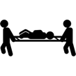
What makes a source useful?
p.43
A source can be useful for a number of different reasons. There are two things that you must look at when analysing how useful a source is. Provenance and content. You must talk about both when explaining how useful the source is.
When approaching a source question, the first thing you need to do is look at the provenance. This is usually found above a piece of text if it is a written source or below if it is a painting/photograph. Once you have read this, you must underline the nature (type of source, letter, journal, photo, diary) and origin (when and who wrote it). This is to help you remember what you need to write about in the answer.
The second thing you need to do is read the actual content of the source. As you read it, underline any information that is useful to the focus of the question. If the question is about problems with transportations of the wounded, then underline or highlight the information that talks about this.
The last thing you need to do is annotate with own knowledge. Does what the source tell you agree with what you have learnt? You must include own knowledge into you answer that supports or disagrees with what the source is telling you.
TASK: Read the following types of sources and explain why they might be useful to a historian. You may repeat yourself.
Letter
Diary
Journal
Painting
Poster
Photograph
Memoir
Last Years Exam Question
Study Sources A and B in the Source Booklet
How useful are Sources A and B for an enquiry into the work of the stretcher bearers on the Western Front?
Explain your answer, using Sources A and B and your knowledge of the historical context.
TASK: Highlight the focus of the question.

Slide 44
What makes a source useful?
p.44
Source A: From a letter written by a captain in the Royal Army Medical Corps (RAMC) to his family in 1915. He was in charge of a group of stretcher bearers. Here he is describing the work of his group of stretcher bearers after a German attack on the British trenches.
At 2 am a terrifying bombardment began and at 5 am the first batch of wounded began coming down the communication trench.
It was evening by the time I got out of the trench to look for more wounded. I went off with another man to search for the wounded. We found most of them in a wooded area, so weak that they could not call out. They were so relieved at being found that I led a search for more wounded. It was awful work getting them out of the shell-holes. It was also hard to find enough men to carry them away because the stretcher bearers were so exhausted.
Finally, we got our last wounded to safety at 4 am the next morning. Altogether we had collected 18 men in a single day and were certain that no-one was left behind.
TASK 1: Look at the provenance and the content, underline and then annotate aspects that are useful to the focus of the question. (stretcher bearers).
TASK 2: Below are some statements. Some of them are relevant to the question and would get you marks, and some are either false or won’t get you marks. Decide with a tick or a cross whether you would include it in your answer.
HOT: Decide if the statement is referring to the provenance, content or own knowledge.
STATEMENT | TICK/CROSS | P/C/OK
It is from a diary of a captain in the RAMC. Therefore is it more likely to be truthful
As a personal letter to his family, it could be expected that this would be an honest account.
The source is useful because it shows how stretcher bearers were expected to search for the wounded.
The source is useful because it shows that 40 men were collected in a week.
It might not be useful as it is possible that some details might have been missed out because of censorship or because he did not want to upset his family.
It is from a letter written by a captain in the RAMC, as someone who was directing and participating the work of the stretcher bearers, his knowledge should be accurate.
It is useful because it shows that surgery was difficult to perform during enemy attacks.
The source demonstrates how physically tiring the work was and the long hours stretcher bearers worked during an attack.

Slide 45
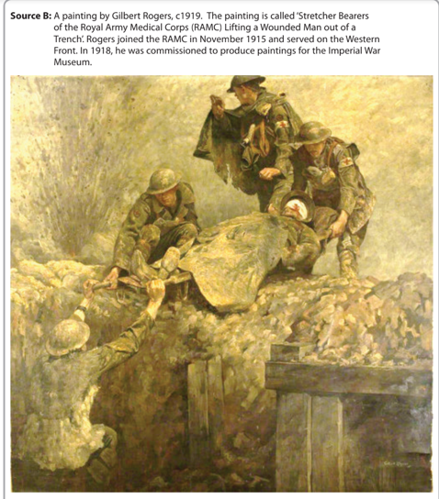
What makes a source useful?
p.44
STATEMENT | TICK/CROSS | P/C/OK
The source gives details of the amount of rescued men, showing the value of the work of the stretcher bearers.
It’s useful because it shows that soldiers would walk in with injuries which is true as soldiers with minor injuries could walk to the First Aid Posts or Dressing stations
It’s useful because it says that they didn’t leave anyone behind and I know that stretcher bearers would get all the wounded soldiers regarded of how injured they are.
Stretcher bearers usually worked in groups of four, so that they could carry wounded men between them.
Stretcher bearers would be extremely well trained and would perform complex operations in no man's land.
TASK: Annotate the drawing with reference to the question, why is it useful?

Slide 46
What makes a source useful?
p.46
TASK : Below are some statements. Some of them are relevant to the question and would get you marks, and some are either false or won’t get you marks. Decide with a tick or a cross whether you would include it in your answer.
HOT: Decide if the statement is referring to the provenance, content or own knowledge.
STATEMENT | TICK/CROSS | P/C/OK
Source B is useful because it depicts the physical difficulties involved in retrieving wounded soldiers.
Gilbert Rogers had served in the RAMC and therefore had accurate knowledge of the conditions and the work of stretcher bearers.
Source B is useful because it shows exactly how stretcher bearers were used in WW1 in every battle.
It’s useful because it shows a man with a head wound and would probably need plastic surgery.
From my own knowledge I know that the ground was often muddy and churned up by constant shelling - stretcher bearers sometimes had difficulty in carrying the injured through mud.
The painting was produced just after the war so it is likely to be a completely truthful interpretation.
As the painting was done as the war ended, it might have been intended to honour the work of the RAMC and therefore its focuses on portraying the difficulties face by the stretcher bearers and the horrors of war.
The sources shows a lot of mud and the mud in France had a lot of pesticides which would cause more infection.
The ground also looks muddy and soldiers would often suffer from trench foot.
There were only four stretcher bearers per company, so the injured sometimes had to wait a long time before they received attention.
As it was commissioned by the imperial war museum, it may not show an accurate interpretation of stretcher bearers in WW1.
The Source show an explosion happening in the background, highlighting the dangerous conditions in which they worked.
The explosions shows the that soldiers would suffer from shell shock and that it was misunderstood at the time.
Source B shows the injured man is already bandaged, suggesting that the stretcher bearers often performed first aid before moving the wounded.

Slide 47
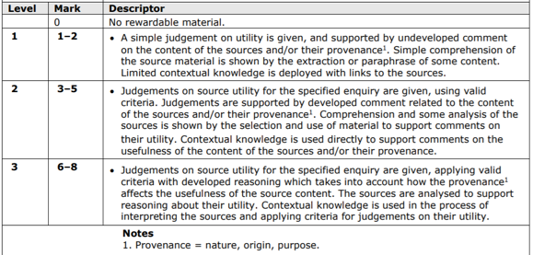
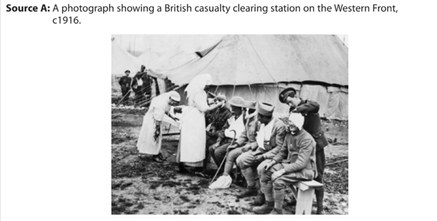
What makes a source useful?
p.47
Study Sources A and B
How useful are Sources A and B for an enquiry into the treatment of battle injuries by medical staff on the Western Front?
Explain your answer, using Sources A and B and your knowledge of the historical context.
TASK: Analyse the source using the skills you have learned so far.

Slide 48
What makes a source useful?
p.48
TASK: Using the indicative comments from the mark scheme, write your own paragraph using the provenance, content and own knowledge.
____________________________________________________________________________________________________________________________________________________________________________________________________________________________________________________________________________________________________________________________________________________________________________________________________________________________________________________________________________________________________________________________________________________________________________________________________________________________________________________________________________________________________________________________________________________________________________________________________________________________________________________________________________________________________________________________________________________________________________________________________________________________________________________________________________________________________________________________________________________________________________________________________________________________________________________________________________________________________________________________________________________________________________________________________________________________________________________________________________________________________________________________________________________________________________________________________________________________________________________________________________________________________________________________________________________________________________________________________________________________________________________________________________________________________________________________________________________________________________________________________________________________________________________________________________________________________________________________________________________________________________________________________________________________________________________________________________________________________________________________________________________________________________________________________________________________________________________________________________________________________________________________________________________________

Slide 49
What makes a source useful?
p.49
TASK: Now, without the mark scheme, write a paragraph answering the question for source B
___________________________________________________________________________________________________________________________________________________________________________________________________________________________________________________________________________________________________________________________________________________________________________________________________________________________________________________________________________________________________________________________________________________________________________________________________________________________________________________________________________________________________________________________________________________________________________________________________________________________________________________________________________________________________________________________________________________________________________________________________________________________________________________________________________________________________________________________________________________________________________________________________________________________________________________________________________________________________________________________________________________________________________________________________________________________________________________________________________________________________________________________________________________________________________________________________________________________________________________________________________________________________________________________________________________________________________________________________________________________________________________________________________________________________________________________________________________________________________________________________________________________________________________________________________________________________________________________________________________________________________

Slide 50
Notes
p.50
________________________________________________________________________________________________________________________________________________________________________________________________________________________________________________________________________________________________________________________________________________________________________________________________________________________________________________________________________________________________________________________________________________________________________________________________________________________________________________________________________________________________________________________________________________________________________________________________________________________________________________________________________
____________________________________________________________________________________________________________________________________________________________________________________________________________________________________________________________________________________________________________________________________________________________________________________________________________________________________
________________________________________________________________________________________________________________________________________________________________________________________________________________________________________________________________________________________________________________________________________________________________________________________________________________________________________________________________________________________________________________________________________________________________________________________________________________________________________________________________________________________________________________________________________________________________________________________________________________________________________________________________________________________________________________________________________________________________________________________________

