Slide 1
Topic Area 3: Postnatal checks, postnatal care and the conditions for development
Unit R057: Health and well-being for child development

Slide 2
The postnatal checks of the newborn baby
Physical checks
Feet
Fingers
Hips
Eyes
Heart
Testicles in boys
Fontanelle
Apgar score
5 vital signs:
Heartbeat
Breathing
Muscle tone
Reflex response
Colour
The postnatal checks of the newborn baby
Test
Heel prick test (blood spot test)
Skin
Vernix
Lanugo
Postnatal checks
Weight
Length
Head circumference

Slide 3
Postnatal checks - immediately after birth
Immediately after birth, the doctor or midwife will carry out routine checks to find out if the baby has any obvious physical problems.
Apgar score
This assesses the five vital signs:
Heartbeat
Breathing
Muscle tone
Reflex response
Colour
The score is used to assess how well the baby is doing outside of the womb and whether it needs medical assistance. This will happen 1 minute after birth and again 5 minutes after birth. If a problem is identified, reassessment may continue every 5 minutes.

Slide 4
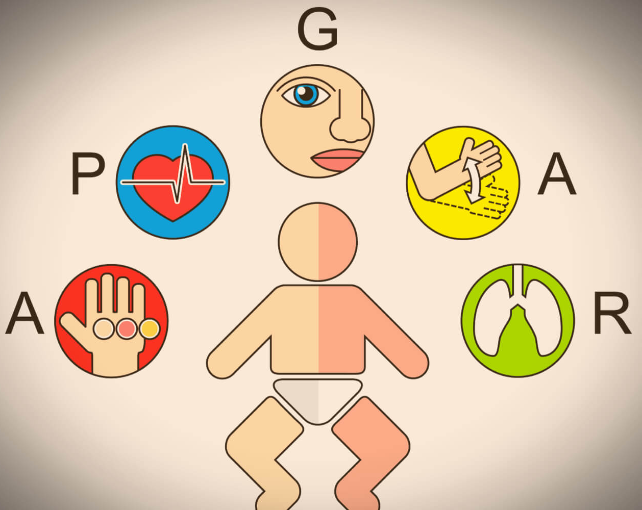
5 vital signs:
Appearance – colour
Pulse rate – heartbeat
Grimace – reflex response
Activity – muscle tone
Respiratory effort – breathing
https://www.youtube.com/watch?v=98ikG8a9JKs

Slide 5
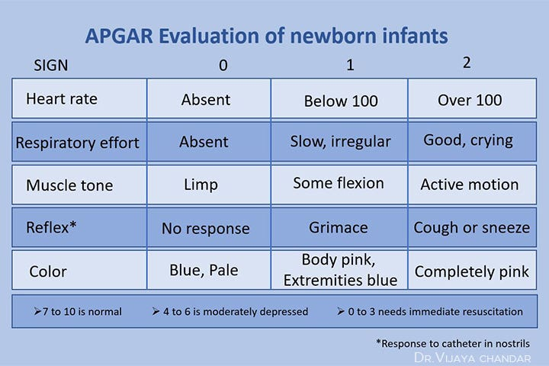
Recording APGAR results
Video on how to record scores:
https://www.youtube.com/watch?v=L8BnzIUDAd4
1 min | 5 mins | 10 mins

Slide 6
Apgar score
An Apgar score reveals how well the baby is doing outside of the mother’s womb and whether medical assistance is needed.
Scores are given out of 10 (each vital sign can score between 0 and 2).
Most healthy babies score 9 – many of them lose a point because they have blue extremities, which can last for several hours.
Low scores at one minute are not so concerning as many babies will score higher by 5 minutes.
A paediatrician will be informed if there is a score of 6 or under after 5 minutes.
Babies who score between 5 and 7 will be showing signs of mild asphyxia (lack of oxygen in the blood) and may need treatment.
A score of 3 or 4 indicates moderate asphyxia that will certainly need treatment.
A score between 0 and 2 indicates severe asphyxia and will need emergency resuscitation.

Slide 7
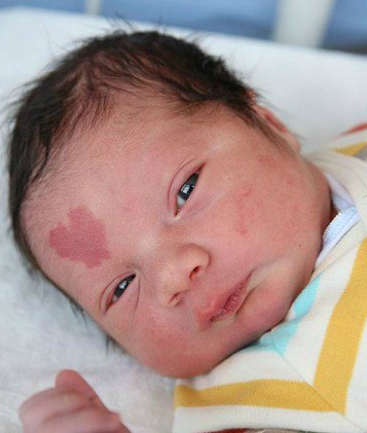
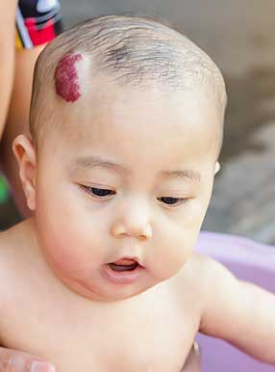
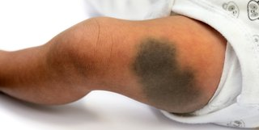
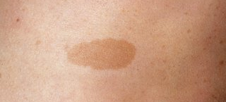
Skin
A baby’s skin will be checked for birthmarks. A newborn baby’s skin can be damaged easily because it is very thin. It will take a month or so for it to develop and mature into a protective barrier.

Slide 8
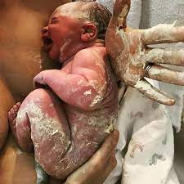
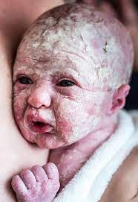
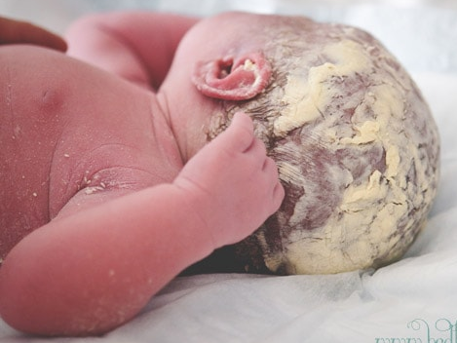
Vernix
This is a white, waxy substance that covers the baby’s skin while it is in the womb.
It is a natural moisturiser and provides a protective layer that helps to prevent infection, so it should be left to absorb naturally into the skin.
If a baby is overdue, the vernix may have been absorbed while in the womb, leading to dry and cracked skin.
The top layer of skin will peel off in its own over a few days, revealing perfectly healthy skin underneath (so avoid using creams as these can irritate the baby’s skin).

Slide 9
Lanugo
At around 22 weeks of pregnancy, a baby begins to become covered in soft, fine hair, which is usually unpigmented (without colour), and generally shed during 7 to 8 months of pregnancy.
It is thought to help keep the baby’s body at the right temperature.
It is sometimes present in newborns but disappears within a few days/weeks.

Slide 10
Weight
Full-term babies usually weigh 2.7 to 4.1kg
The baby’s weight is recorded in a Personal Child Health Record (the ‘red book’) which is then given to parents. An app is also available.
Weight is tracked on centile charts which show the expected pattern of growth for a healthy baby, so that comparisons can be made.
Babies tend to lose some of their birth weight in the first few days, although this is usually regained in 2 weeks.
Steady weight gain indicates that a baby is healthy and feeding well. Support will be given if this does not happen.

Slide 11
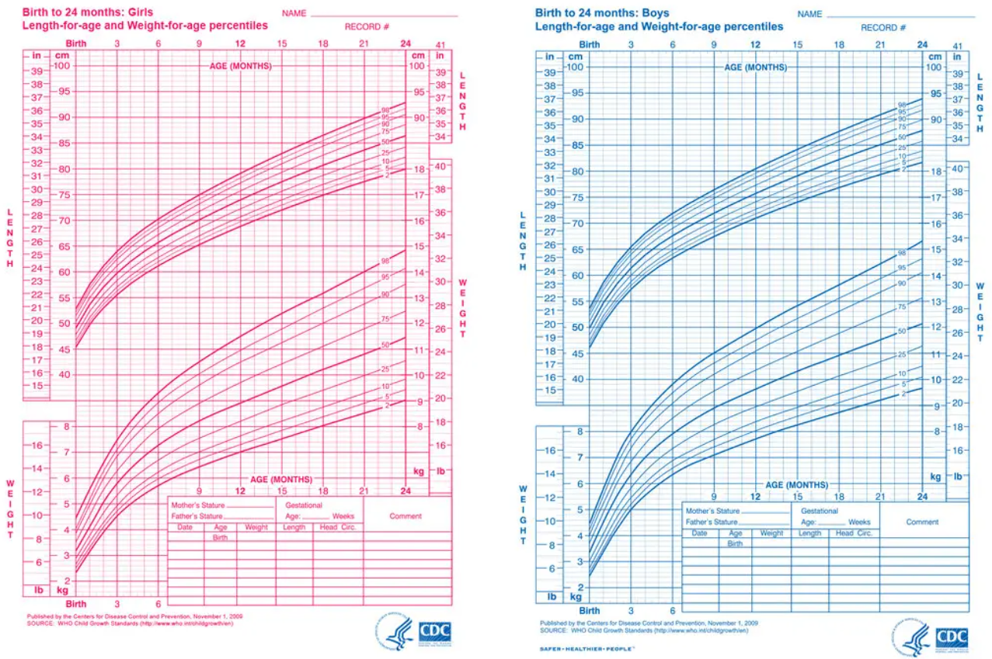

Slide 12
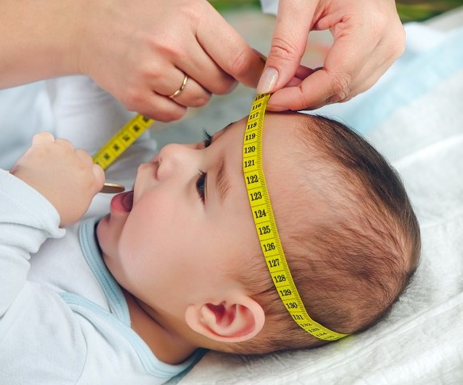
Length and Head circumference
The length of a full-term newborn is usually 50-53 cm.
The shape of the baby’s head is assessed and the circumference is measured.
A squashed appearance is common, as a result of the baby’s head being squeezed through the birth canal. This usually resolves itself within 2 days.
All results are recorded on the centile chart, so that health professionals can track how the baby is growing and developing.

Slide 13
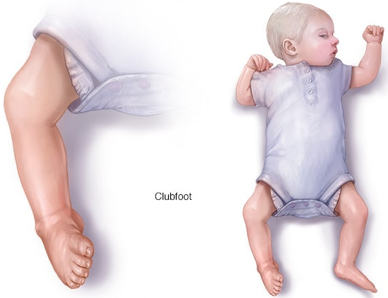
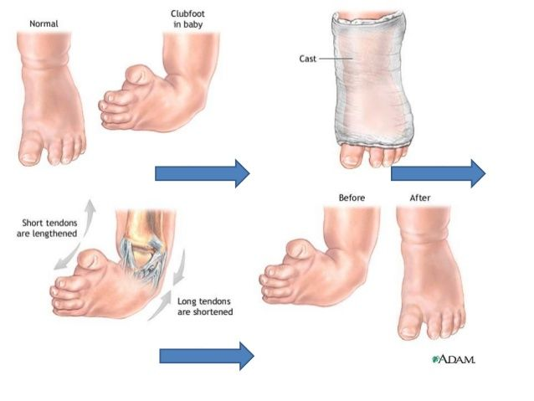
Physical checks – One to five days of birth
Feet
The toes will be counted and checked for webbing.
The natural resting position of the baby’s feet and ankles will be observed to check for talipes (clubfoot), although this may have already been identified in a previous ultrasound scan. This is a condition where the front half of the foot turns in and down.

Slide 14
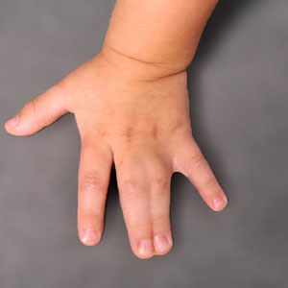
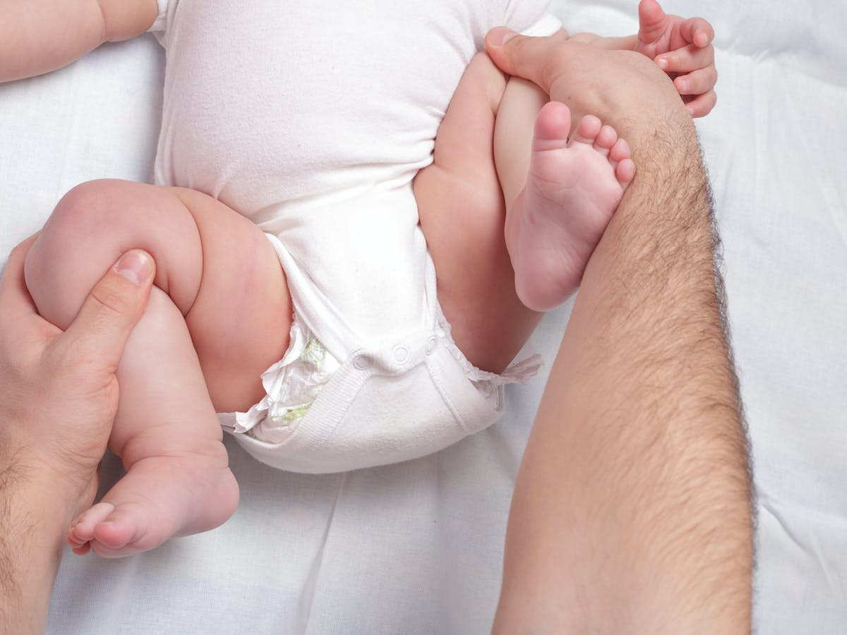
Fingers
Will be counted and checked for webbing.
The baby’s palm will be checked to see if two creases (palmar creases) run across them. A single palmar crease is sometimes associated with Down’s syndrome.
Hips
Checked for developmental dysplasia of the hip (affects 1 or 2 in 1000 babies). This is a condition where the hip joints have not formed properly and can result in problems or a limp if left untreated.

Slide 15
Eyes
Eye tests do not reveal how well a baby can see but, they allow conditions such as cataracts to be identified. A light is shined into the eyes to check a reflex. If a baby has cataracts, there will be a clouding of the transparent lens inside the eye. NHS report that 2 or 3 in 10,000 babies are born with problems with their eyes.
Heart
The baby’s pulse will be taken and the heart will be listened to using a stethoscope. A heart murmurs is where the heartbeat has an extra or unusual sound caused by a disturbed blood flow through the heart. Heart murmurs are common in babies however the heart is usually normal in almost all cases. NHS: 8 in 1000 babies have congenital heart disease that needs treatment.

Slide 16
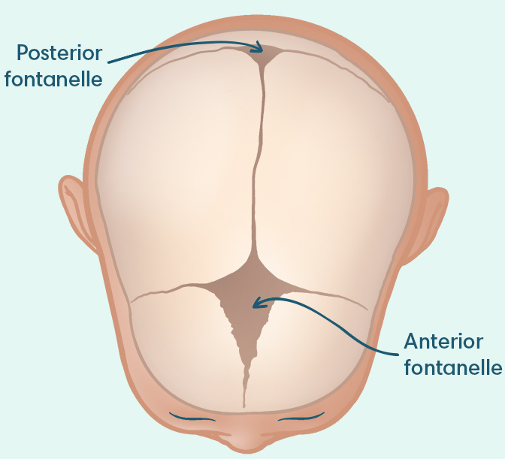
Testicles in boys
Testicles are checked to make sure they are in the right place. During pregnancy, the testicles form inside the baby’s body and may not drop down into the scrotum until a few months after birth.
Fontanelle
Part of a baby’s skull is not fused together when it is first born, creating a soft spot, called a fontanelle, between the two bones. These soft spots are covered by a tough protective membrane but the bones will not join together until a year or more.

Slide 17
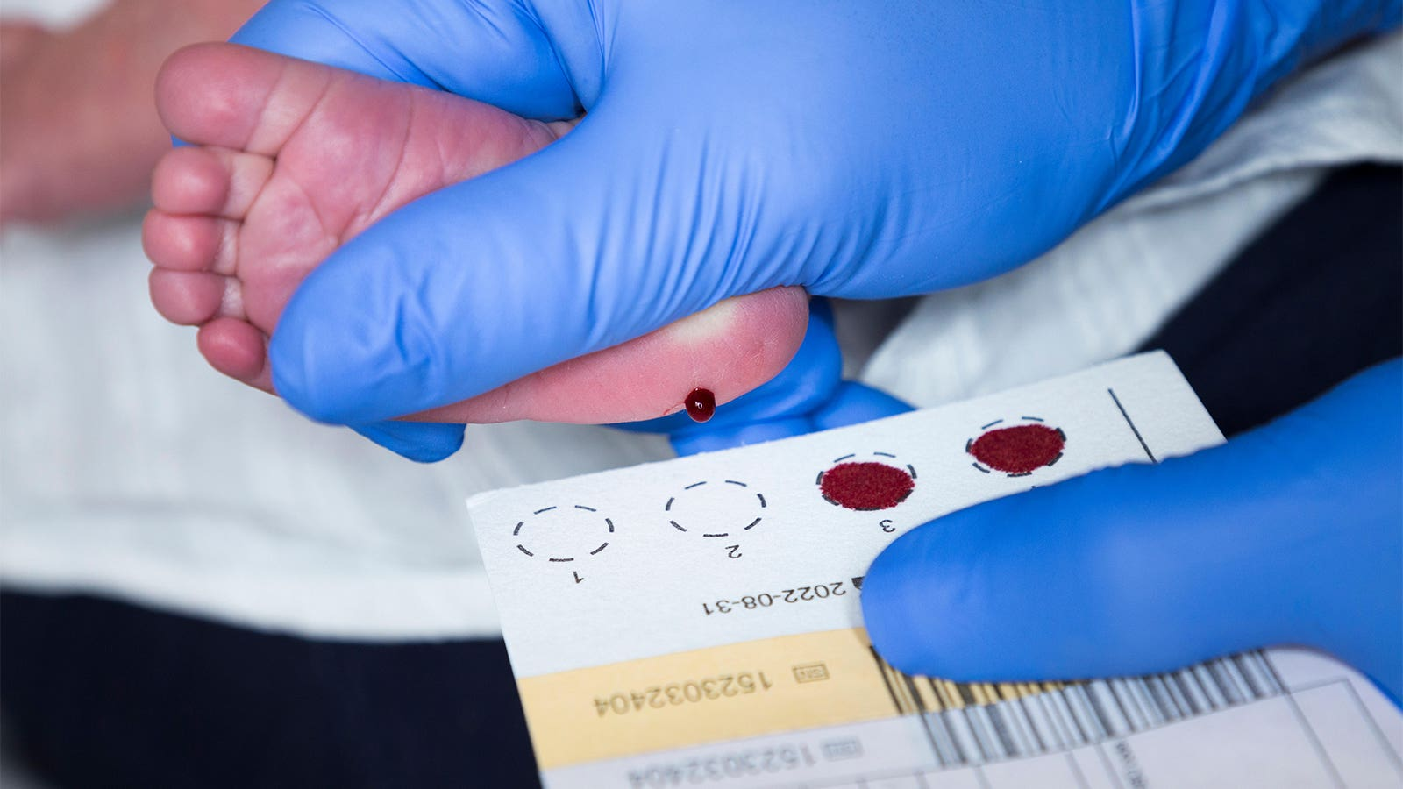
Heel prick test (blood spot test)
The heel prick test is a screening test that helps to identify several rare but serious diseases with a small blood sample. This includes cystic fibrosis (CF) and sickle cell disease.

Slide 18
TASK: Test My Progress Answer the following questions in full sentences in your assessment books: 1. What does the Apgar score evaluate? 2. Why is a low Apgar score after 1 minute not very concerning? 3. Why do most healthy babies score 9 on the Apgar test? 4. What is vernix? 5. What is lanugo? 6. What three measurements does a centile chart track? 7. What two things are a baby’s feet checked for? 8. What is a fontanelle?

Slide 19
TASK: Create a leaflet which explains to the mother of a newborn the postnatal checks and physical examinations that are carried out on a baby. Information you should include: - What specifically will be checked - What is looks like or how it will be measured/recorded - The reasons why the check is carried out - The key words and terms that may be used by health professionals

Slide 20
Postnatal care of the mother and baby
The arrival of a baby will impact close family members, especially siblings. Parents will need to make lots of adjustments to their usual lifestyle, so postnatal provision is very important for everyone’s well-being.
TPS:
Can you think of ways that the arrival of a baby may impact or change a families lifestyle, particularly siblings?

Slide 21
The role of the health visitor
A health visitor is a qualified nurse or midwife who has had extra training. Their job is to support families from pregnancy, up until children are aged five.
Watch the video ‘What healthcare will we get from the NHS after birth?’:
https://www.nhs.uk/conditions/baby/support-and-services/your-6-week-postnatal-check/

Slide 22
Information, advice and support
Health visitors often:
Provide advice on baby care, childcare, feeding, safe sleeping, sleep routines and development.
Run clinics baby health and development reviews and vaccinations.
Give advice on where to find help with mental health.
Put parents in touch with groups where they can meet other parents.
Offer support and advice for any child-related issues.

Slide 23
Safe sleeping
SIDS: Sudden Infant Death Syndrome
Research has found that sleeping position and bedding (including mattresses) may be a factor in cases of SIDS. SIDS occurs when a seemingly healthy baby or toddler dies unexpectedly in their sleep, with no medical explanation.
This affects around 300 babies in the UK each year. The NHS advise that to prevent SIDS, babies should sleep on a mattress that is:
Firm
Waterproof
Flat
In good condition

Slide 24
To prevent SIDS
Always place a baby on their back to sleep.
The baby should be breastfed (if possible).
The baby should not be allowed to get too hot or too cold. A room temperature of 16-20 degrees Celsius, with light bedding or a lightweight sleeping bag is ideal.
Place the baby in the ‘feet to foot’ position (feet touching the end of the cot).
The baby should sleep in a cot or Moses basket, in the same room as the mother/adult for the first six months.
The mother should not smoke during pregnancy or be allow anyone to smoke in the same room as the baby before or after birth.
Keep the head uncovered. Blankets tucked in no higher than their shoulders.
People should not sleep on a bed, sofa or armchair with the baby (especially if the person holding the baby smokes, takes drugs or has been drinking alcohol).
A mattress that is firm, flat, waterproof and in a condition should be used.

Slide 25
Physical and emotional support
Support from the partner
The father/partner needs time to bond with the new baby, alongside the mother.
The father/partner has a very significant role and should help and support the mother through difficult early days/weeks of motherhood; as taking care of a newborn baby requires a great deal of time and energy.
The father/partner can support the mother to take the time to take care of herself too, to stay fit and healthy and to recover by the birth.
TPS: Can you think of any specific ways that the partner could support the mother once the baby has arrived?

Slide 26
Physical and emotional support
Support from family and friends
Support from other family and friends can be a huge help to new parents, as this will help them to adjust to their new responsibilities and also help them to cope with the new pressures they may experience on their relationship.
Practical help and advice is valuable (e.g. helping with shopping, sharing childcare tips) and some new parents may need a lot of support from those more experienced in childcare.
TPS: Why do you think mothers and parents may benefit from help from family and friends after the birth of a baby? Do you think it is ok to rely on others for support?

Slide 27
6 week postnatal check with the GP
Mothers are offered a postnatal check with a GP 6-8 weeks after giving birth to make sure they are feeling well and are recovering properly.
Mothers are asked how they are feeling as part of a general discussion about their mental health and well-being.
If the mother was due a cervical screening test whilst pregnant, this should be rescheduled 12 weeks after birth.
Blood Pressure is often checked.
Mothers will be asked about contraception.
Mothers are asked if they still have any vaginal discharge and whether they have had a period since birth.
Offered an examination to see if stitches have healed (episiotomy or C section).
If a mother is overweight or obese with a BMI of 30 or more, they may be weighed and given guidance on healthy eating, physical activity and weight loss.

Slide 28
6 week postnatal check with the GP
The NHS advises mothers to make a list of any questions they would like to ask in advance, to take along to the appointment with them.
Tell your doctor if…
You’re feeling sad or anxious – looking after a baby can sometimes feel overwhelming. Do not feel you have to struggle alone or put on a brave face. It is not a sign that you are a bad mother. You need to get help, as you may have postnatal depression. Your doctor or health visitor can provide help and support.
You’re having trouble holding your pee or wind, or you’re soiling yourself with poo.
Having sex is painful.
You’re not sure if you’ve had two doses of the MMR vaccination.

Slide 29
TASK: Test My Progress Complete the following in full sentences in your books: 1. Write one sentence explaining the role of a health visitor. Be specific. 2. Explain 2 things a parents should do and 2 things they should not do, to prevent SIDS. 3. Explain one way the father or partner could provide emotional support to the mother after birth. 4. Explain one way friends a family could provide physical support to the mother after birth. 5. State 3 things that happen at the mothers 6 week postnatal check up. 6. State 1 thing a mother could discuss with or ask the GP about at her 6 week postnatal check up.

Slide 30
The developmental needs of children from birth to five years
For children to successfully thrive, develop and grow, their basic development needs must be met by parents and carers.
Warmth
Fresh air
Routine
You need to know:
the importance of each developmental need
how these needs can be met
Feeding
Exercise
Shelter/ home
Love and emotional security
Cleanliness/ hygiene
Socialisation/ play
Stimulation
Acceptable patterns of behaviour
Opportunities for listening and talking
Rest/ sleep

Slide 31
Warmth
Parents and carers must ensure that children are kept warm enough by providing:
Sufficient indoor and outdoor clothing for all weathers and temperatures
Adequate bedding, central heating or other safe heaters

Slide 32
Feeding
It is the responsibility of parents and carers to provide food and drink that contains the right nutrients for the baby/child at each stage of development.
Providing children with regular meals and snacks ensures they have the energy that they need to grow, learn and play. Healthy food options should be chosen over less healthy ones, which means making time to shop for, prepare and cook for.

Slide 33
Love and emotional security
All children need and deserve to be loved and brought up in a nurturing environment. Parents should be loving, kind, have the child’s best interests at heart, meet their needs and devote time to them.
Feeling loved, wanted, nurtured and being kept safe from harm makes a child feel emotionally secure.
A child who does not receive love and emotional security may be unhappy and experience social and emotional difficulties at home and in the wider world e.g. with their peers at school. This can continue to impact children as they grow up and may continue into adulthood.

Slide 34
Rest/sleep
Ensuring children get enough rest and sleep is crucial to their well-being, learning, growth and development.
While young children should be allowed to rest and sleep whenever they need to, good routines are helpful such as a warm bath, a story and then bedtime at the same time each evening.
It is important to build in plenty of time for quiet, restful activities after busier or physical ones and remember that activities which require concentration can be tiring.

Slide 35
Fresh air
Fresh air is good for a child’s physical health and well-being. It can help children feel more energised, improve their mood and help them sleep better.
While it is important to protect their skin, being outside in the sun can increase vitamin D levels and help the body to absorb calcium, which results in stronger bones.
Time outdoors promotes physical activity and nature can be soothing and restful. It is also beneficial for children’s eyesight to spend time away from artificial light and screens.

Slide 36
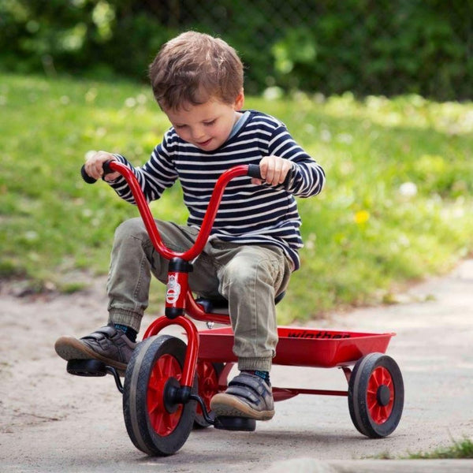
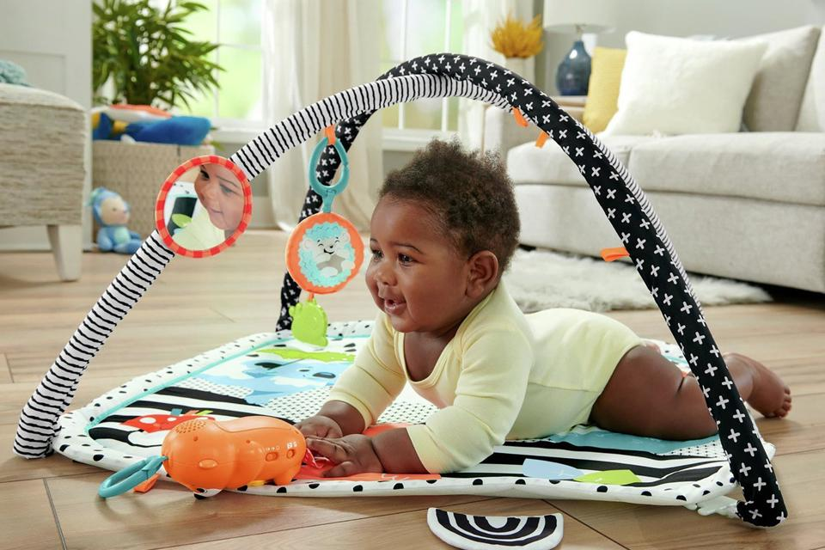
Exercise
The NHS: being physically active everyday is important for healthy growth and development.
Examples of physical exercise include tummy time for babies, crawling, going for a walk, running around, dancing, playing on rides toys and trikes, playing on a slide or climbing frame etc.

Slide 37
Cleanliness/hygiene
Children’s immune systems are less mature, so it is much easier for them to pick up an infection.
Cleanliness in the kitchen is especially important.
The child must be bathed daily and kept clean and fresh.
Their clothing and bedding should be regularly laundered.

Slide 38
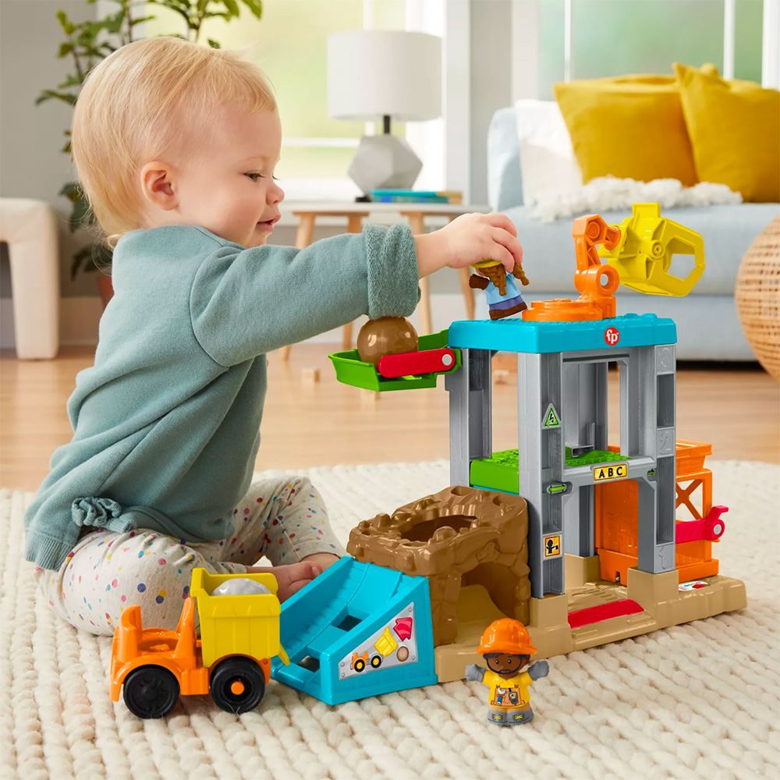
Stimulation
Babies and children need stimulation in order to feel energised and interested in the world. It helps them to learn about the world and to develop their social, intellectual, language and communication skills.
Interaction and play are the key ways in which young children are stimulated. It is crucial for parents to talk and play with babies and children, frequently throughout the day.
Providing interesting toys, playthings, sharing rhymes, singing, stories, games, imaginary play and new experiences are all important.

Slide 39
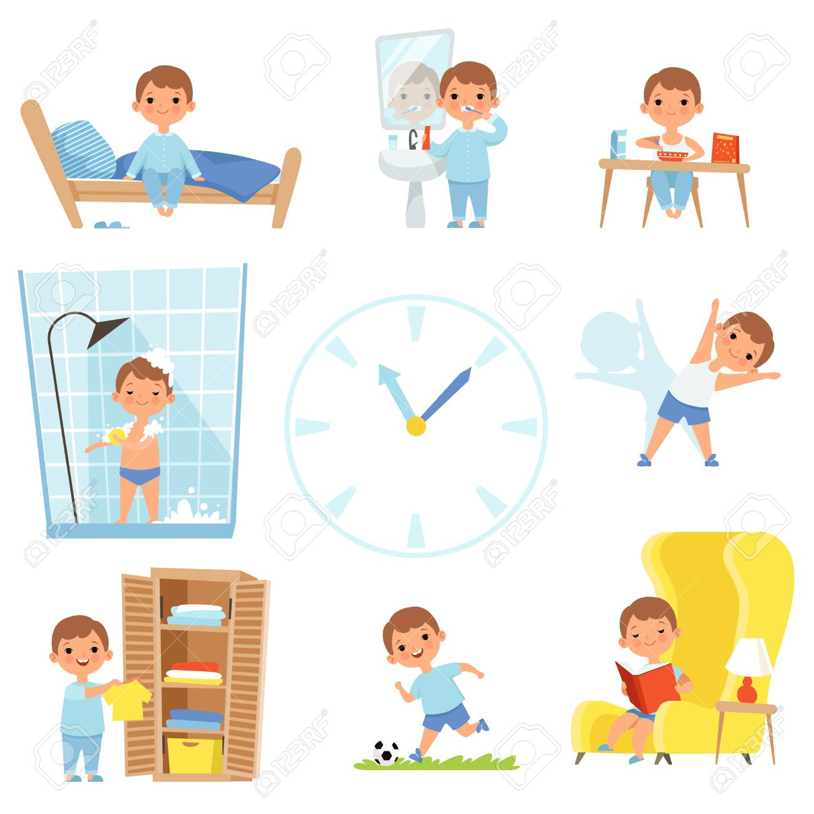
Routine
Routines help young children to feel safe and secure. Routines also help adults ensure that all of a child’s care needs are met effectively every day.
Feeding needs to be spread out across the day to ensure that children have the nutrition they need to keep them going.
Children need a bath every 24 hours and most parents often choose to bathe them every evening, before putting them into their nightclothes as part of their pre-bed routine.

Slide 40
Shelter/home
At the most basic level, every child needs a shelter/home that will keep them safe and secure in all environments and weathers. This will support their other basic needs; safe and sufficient sleep, a clean and hygienic environment, to be fully met.
Parents and carers should ensure the home is healthy for children to live in e.g. not damp as this can cause asthma/chest infections.

Slide 41
Socialisation/play
All children need opportunities to play in ways that are appropriate to their stage of development. Under the UN Convention on the Rights of the Child (UNCRC) all children have a fundamental right to play.
It is very important that children socialise with their peers and play is the perfect way to achieve this. Children learn how to interact with others and form relationships through their play, allowing them to develop qualities such as empathy and fairness.

Slide 42
Opportunities for listening and talking
Listening and talking with a child shows that you care about them and are interested in them.
This is very important for their social and emotional development.
It is also vital for their intellectual and language development.

Slide 43
Acceptable patterns of behaviour
Children need to learn how to behave in socially acceptable ways and adults should always strive to be positive role models.
Adults should have a consistent approach to discipline, or a child may become confused or worried about the reaction their behaviour will cause.
Need for boundaries
Children need to be aware of the boundaries set for their behaviour; what they can and cannot do, and these should be consistent.
By explaining why a particular behaviour is unacceptable will help a child to think through a situation and moderate their own behaviour in similar circumstances in the future.

Slide 44
Promoting positive behaviour
Promoting positive behaviour is the best way to limit inappropriate behaviour (positive reinforcement).
When adults notice and praise specific positive behaviours, a child tends to feel proud of themselves, enjoy the approval they receive, which encourages them to repeat the socially acceptable behaviour. The behaviour will eventually become and ingrained, normal part of what they do.
Verbal praise is most effective and the easiest to give however, using a reward chart is an effective, visual reward system.

Slide 45
TASK: Test My Progress In your assessment books: 1. List the 13 developmental needs of a child. 2. Now choose 3 developmental needs to explain how they can be met by parents.

Slide 46
TASK: Create a leaflet which explains the importance of the 13 developmental needs of a child and how they can be met by parents.

