Slide 1
Topic Area 2: Antenatal care and preparation for birth
Unit R057: Health and well-being for child development

Slide 2
The purpose and importance of antenatal clinics
Key term:
Antenatal care is the care given to a pregnant mother and her unborn baby during pregnancy and ahead of the birth. The first appointment should take place before week 10 of a pregnancy but, most occur between weeks 8 and 12.
Antenatal clinics prepare the mother for a safe pregnancy and delivery by:
Carrying out routine tests/checks
Carrying out screening and diagnostic checks
Providing antenatal (parenting) classes

Slide 3
The roles of the different health professionals
Obstetrician
Only involved for high risk pregnancies and births e.g. if the mother has a health condition or had complications with a previous pregnancy.
Carry out interventions such as a caesarean.
Become involved in the delivery of complicated births e.g. distressed baby.
General practitioner
Confirm the pregnancy, estimate the due date and enrol in maternity system.
Refer to a hospital or private midwife in preparation for appointments and health checks.
Treat conditions throughout pregnancy and provide postnatal care.
Midwife
Provide advice and care throughout pregnancy, labour and after the birth.
Help the woman to make decisions about the options available throughout pregnancy.
Provide clinical examinations and teach new mothers how to feed and care for their baby.

Slide 4
General practitioner (GP)
The doctor will confirm the pregnancy, estimate the due-date and enrol the woman in the maternity system, so that she is referred to a hospital or private midwife, to receive all appointments for all routine health checks.
The GP will answer any initial questions the mother may have and will discuss any medical conditions that may affect the pregnancy and will make referrals to other health professionals as necessary.
The GP will also treat the mother for any non-pregnancy related medical problems during pregnancy, respond to emergency concerns such as abdominal pains, and will provide postnatal medical care including advice on contraception following birth.

Slide 5
Midwife
Three categories
Hospital midwives: based in hospitals, birth centres and midwife-led units
Community midwives: see pregnant women at home, attend home births and provide postnatal care
Independent midwives: work privately outside of the NHS
Midwives are experts in normal pregnancy and birth (vaginal birth without the need of interventions) and provide antenatal care to women throughout their pregnancy, labour and for up to 28 days after the baby is born.
They are the lead health professional for the pregnant woman and provide advice to help the mother make informed choices about the options and services available throughout pregnancy.
They provide clinical examinations, identify high-risk pregnancies, support during and after labour, teach new mothers how to feed, bathe and care for their babies.
Watch the following videos to learn about the role of a midwife:
https://www.youtube.com/watch?v=tvzUbYRwcTk&t=34s
https://www.youtube.com/watch?v=Yr7sObI8XGw

Slide 6
Obstetrician
Obstetricians manage complex or high-risk pregnancies and births. They are skilled in performing caesareans and interventions during labour.
Obstetricians are not always necessary; they usually become involved if the pregnant woman experienced complications with a previous pregnancy, if they have a pre-existing health condition or if there are any risks associated with their current pregnancy.
They provide medical care and advice to women during and after their pregnancy (antenatal and postnatal care) however, sometimes they may only become involved during the delivery of a baby; due to unforeseen complications such as the baby becoming distressed during labour.
* If a pregnancy is progressing as expected or is considered low-risk, then a pregnant woman will receive all of her care from a midwife.

Slide 7
TASK: Design a question for each health professional to ask the person next to you or your peers in the class. *Instruction: For any question answered incorrectly, copy out the correct answer into your books.

Slide 8
TASK: Make a leaflet to explain the three health professionals involved during pregnancy, labour and after- birth to a pregnant mother. Information you should include: - The role of the health professional - Three things they do or specialise in

Slide 9
Routine checks carried out at antenatal clinics
Baby’s heartbeat
Blood pressure
Blood tests
Examination of the uterus
Urine test
Weight check
These tests can reveal potential problems or dangers to a mother and baby during pregnancy. Early recognition of conditions can allow treatments to be given, to prevent any problems from developing or having prolonged, harmful effects.
“Big Beautiful Bunnies Eat Under Water”

Slide 10
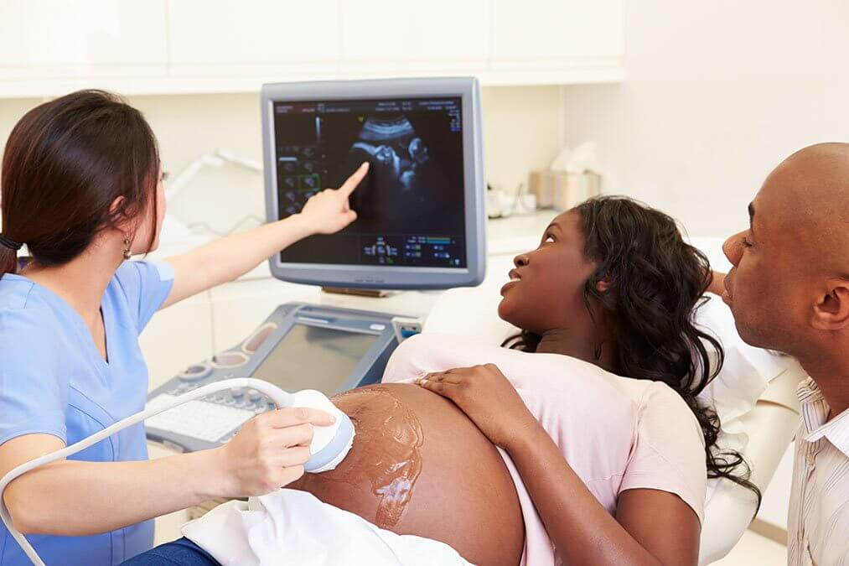
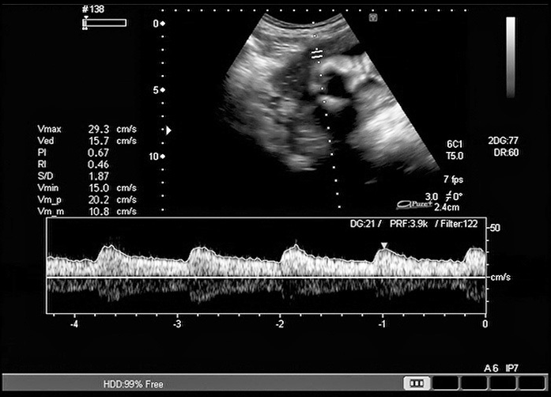
Baby’s heartbeat
The heartbeat is checked and monitored to confirm that the baby is alive.
The midwife/ doctor will also listen to hear if the heartbeat is normal/healthy.
The expected heartbeat of an unborn baby is 110 – 160 beats per minute.

Slide 11
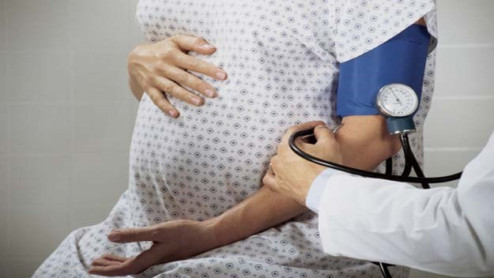
Blood pressure
A baseline BP measurement is taken and this will be compared to other measurements taken during pregnancy.
The average healthy BP range for a mother under 35 years old is 110/70 – 120/80.
Blood pressure above 140/90 can indicate pre-eclampsia (a condition causing high BP and can be serious if not treated).

Slide 12
Blood tests
Blood tests are carried out to check for a variety of conditions that could effect the health of the mother and baby.
Anaemia | a lack of iron leading to tiredness – folic acid and iron tablets may be needed.
High blood sugar | a sign of gestational diabetes which can develop during pregnancy and stop afterwards.
Blood group | this is checked in case a blood transfusion is needed during labour, which could be necessary if the mother has excessive bleeding
German measles (rubella) | a blood test will show whether the mother is immune to this disease, which is important as it can be harmful to a developing baby; as it can cause brain damage, deafness and blindness.
Hepatitis B and C | without treatment, these conditions can cause liver disease.
HIV | his can be passed from mother to baby via the placenta in pregnancy or via breastfeeding after birth.

Slide 13
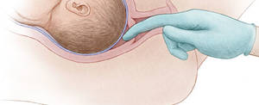
Examination of the uterus
Examinations of the uterus occur throughout pregnancy to check for abnormalities or infections. This can indicate whether there is a risk of the pregnancy leading to a miscarriage or premature birth.
Uterus examinations are performed by a doctor whom will insert a gloved index and middle finger into the vagina, up to the cervix to assess:
How soft the cervix is.
Whether there is any thinning or opening of the cervix.
The position of the cervix (posterior; facing the tailbone, anterior; facing the front).
How far into the pelvis the baby has descended.
Which way the baby is facing (presentation).

Slide 14
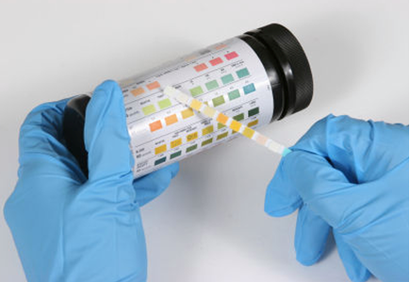
Urine test
Urine tests can reveal potential problems during pregnancy.
Protein: could be the result of an infection or could indicate the onset of pre-eclampsia.
Glucose (sugar): could indicate diabetes. This can be controlled by diet and/or insulin.
Ketones: can be present when there has been excessive vomiting (hyperemesis), which requires hospitalisation as without treatment a condition called ketosis can occur. This could mean the developing baby is not receiving adequate sources of energy, which are essential for their growth and development.
STI’s: can be very harmful to an unborn baby and can be passed onto the baby through the placenta or as it passes through the birth canal. Some STI’s can be treated, whilst others cannot be cured.

Slide 15
Weight check
Pregnant women are weighed to first establish their baseline weight. This means their weight can be tracked throughout their pregnancy. Women are expected to gain 10-12.5kg during a healthy pregnancy.
If a pregnant woman gains more weight than expected, it could be a sign of pre-eclampsia.
Weight loss could indicate an illness in the mother or that the baby has stopped growing.
Pre-eclampsia: a condition where high levels of protein are found in the urine and it can also cause swelling in the feet, legs and hands. If left untreated, it can lead to seizures which can be dangerous and harmful to the mother and baby.

Slide 16
TASK: Now test yourself:
1. Explain why checking for STI’s is important.
2. Name three checks that can be made during a blood test.
3. Identify three checks that are made during an examination of the uterus.
4. Explain what pre-eclampsia is.
Can you create 3 questions to ask someone else?
How many questions can you answer correctly from your peers in the classroom?

Slide 17
Screening and Diagnostic tests
KEY TERMS
Screening test: identifies whether and unborn baby is more or less likely to have certain conditions at birth.
Diagnostic test: used to diagnose certain medical conditions in an unborn baby but carries a risk of miscarriage.
Screening tests:
Ultrasound scan (dating and anomaly)
Nuchal fold translucency (NT) test
Triple test
Non-Invasive Prenatal Testing (NIPT)
Diagnostic tests:
Amniocentesis
CVS (chorionic villus sampling)

Slide 18
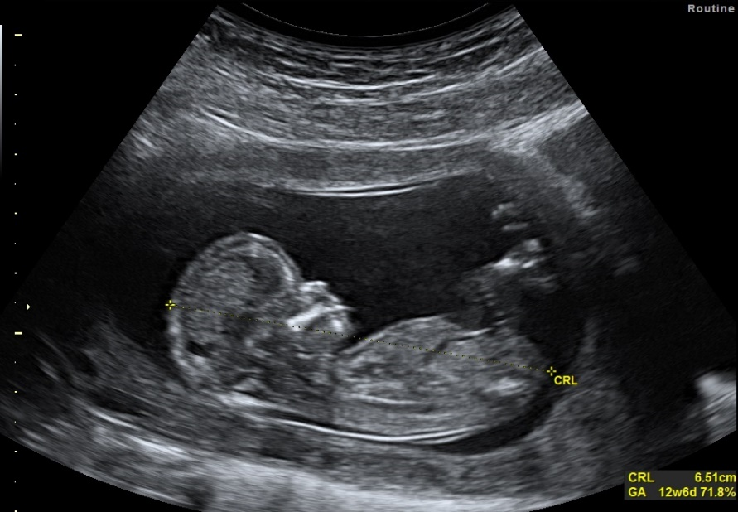
Ultrasound Dating scan
A sonographer will offer an ultrasound dating scan to the mother around 8 -14 weeks of pregnancy.
This scan checks for:
How far along the pregnancy is to work out the baby’s due date
The baby’s development
Whether more than one baby is expected
That the baby is growing in the right place
Defects such as spina bifida

Slide 19
Ultrasound anomaly scan
Task: Discuss why some women might choose to have a scan and some might not.
The scan looks at the baby’s: | 11 conditions are looked for:
Bones Heart Brain Spinal cord Face Kidneys Abdomen | Anencephaly Open spina bifida Cleft lip Diaphragmatic hernia Gastrochisis Exomphalos Serious cardiac abnormalities Bilateral renal agenesis Lethal skeletal dysplasia Edwards’ syndrome or t18 Patau’s syndrome or t13
An ultrasound anomaly scan is carried out in weeks 18–21 of pregnancy to check for major physical abnormalities in the baby.
Some problems could mean that the baby will need treatment or surgery after birth.
In rare cases, the baby will die during pregnancy or soon after birth.

Slide 20
Nuchal fold translucency (NT) test
The Nuchal fold translucency scan tests for Down’s syndrome by measuring the amount of fluid present under the skin at the back of the unborn baby’s neck (babies with Downs often have an increased amount of this fluid).
Pregnant women are offered this test between weeks 11 and 13 of pregnancy by an obstetrician.
Screening estimates the level of risk, but cannot determine whether a baby definitely has Downs syndrome, however it will indicate whether a diagnostic test should be offered.
A diagnostic test will enable a diagnosis of Downs syndrome to be confirmed however, it carries a small risk of miscarriage; therefore not all mothers will choose to have the NT test/further diagnostic test.

Slide 21
Triple test
The triple test is carried out between 10 and 14 weeks of pregnancy and assesses the chance of having a baby with any of the following conditions:
Down’s syndrome
Edwards’ syndrome
Patau’s syndrome
If a screening test shows a higher chance of any of these conditions, the mother will be offered further tests (such as NIPT) or diagnostic tests (such as CVS or amniocentesis) to confirm if the baby has, or does not have, one of the conditions.

Slide 22
Non-Invasive Prenatal Testing (NIPT)
NIPT is a screening test, carried out from week 10 of pregnancy, that assesses the likelihood of having a baby with Down’s syndrome, Edwards’ syndrome or Patau’s syndrome.
It involves taking a blood sample from the mother’s arm, where fragments of the baby’s DNA will be found and tested for chromosomal abnormalities.
It is more accurate and does not carry the risk of miscarriage however, NHS hospitals do not generally offer this test, therefore mothers wanting this test will need to pay to have it done privately.
Some mothers choose to have an NIPT before deciding to have a diagnostic test, to avoid the risk of miscarriage. If the risk of abnormality is high from an NIPT test, then diagnostic tests such as CVS or amniocentesis will be offered.
When a high-risk NIPT result is given, it is likely that diagnostic results will also be positive. If the NIPT is negative, parents may decide against a diagnostic test.

Slide 23
Reasons for diagnostic tests
Diagnostic tests are only offered if there is a high risk of a baby having a genetic condition, for example:
an earlier antenatal screening test has indicated a problem
the mother has had a previous pregnancy with there problems
there is a family history of a genetic condition

Slide 24
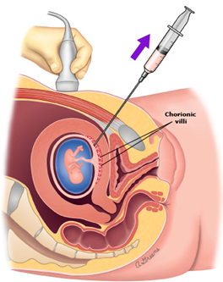
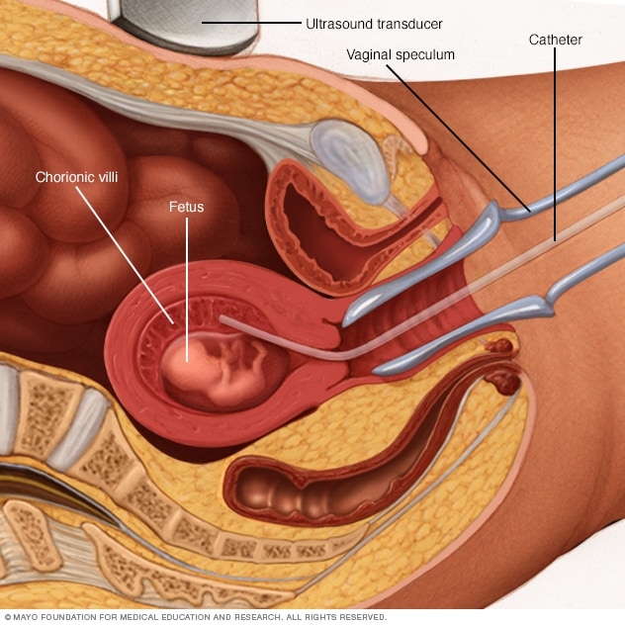
CVS (chorionic villus sampling)
* A diagnostic test with the risk of miscarriage
CVS involves removing cells from the placenta; either by inserting a needle through the mothers abdomen or, by inserting a tube or small forceps through the cervix.
This test is carried out between weeks 11 and 14 of pregnancy to check for genetic disorders and conditions such as Downs’ syndrome.
There is no cure for the majority of conditions detected by CVS. The mother may decide to continue with the pregnancy, while gathering information about the condition so that she is fully prepared, or she may consider a termination.

Slide 25
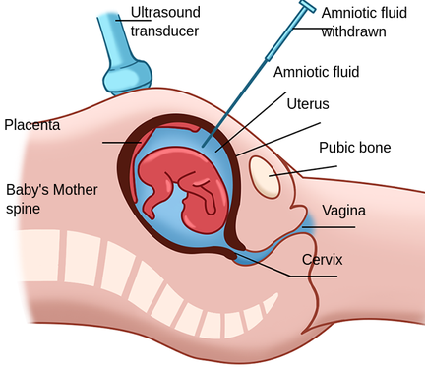
Amniocentesis
Amniocentesis involves removing a small sample of amniotic fluid to test for genetic disorders such as Down’s syndrome, Edwards’ syndrome, Patau’s syndrome, cystic fibrosis, muscular dystrophy, sickle cell disease and thalassaemia.
This test may be offered as an alternative to CVS, although it is usually carried out between weeks 15 and 18 of pregnancy (1 to 3 weeks after CVS is usually carried out).
The risk of causing a miscarriage with amniocentesis is slightly reduced in comparison to CVS.
Results from this test cannot be given until a later stage of pregnancy, which has implications for the possibility of terminating a pregnancy if a problem is discovered later on – (the normal deadline for a termination is 24 weeks).

Slide 26
TASK: Write a short paragraph to discuss why a mother might choose for or against a diagnostic test. Information you should include: - The circumstances a diagnostic test is offered - The risks and factors the mother may consider - The factors that may influence the mothers decision after a positive and negative result

Slide 27
TASK: 1. Copy the table on the next slide into your books. 2. Draw a timeline of the points in pregnancy when each test is carried out.

Slide 28
*Normal deadline for a termination is 24 weeks
TEST | POINT IN PREGNANCY | TYPE | TESTS FOR
Ultrasound Dating scan | 8 – 14 weeks | Screening | How far along the pregnancy is to work out the baby’s due date, the baby’s development, whether more than one baby is expected, that the baby is growing in the right place, defects such as spina bifida
Ultrasound Anomaly scan | 18 – 21 weeks | Screening | Physical abnormalities and conditions such as: anencephaly, open spina bifida, cleft lip, diaphragmatic hernia, gastrochisis, exomphalos, serious cardiac abnormalities, bilateral renal agenesis, lethal skeletal dysplasia, Edwards’ syndrome or t18, Patau’s syndrome or t13
Nuchal fold translucency (NT) test | 11 – 13 weeks | Screening | Down’s syndrome
Triple test | 10 – 14 weeks | Screening | Down’s syndrome, Edwards’ syndrome or t18, Patau’s syndrome or t13
Non-Invasive Prenatal Test (NIPT) | From week 10 | Screening | Down’s syndrome, Edwards’ syndrome or t18, Patau’s syndrome or t13
Chorionic villus sampling (CVS) | 11 – 14 weeks | Diagnostic | Down’s syndrome
Amniocentesis | 15 – 18 weeks | Diagnostic | Down’s syndrome, Edwards’ syndrome, Patau’s syndrome, cystic fibrosis, muscular dystrophy, sickle cell disease and thalassaemia

Slide 29
TMP HOMEWORK:
Name 3 parts of the baby’s body than an ultrasound anomaly scan looks at.
Name 3 conditions that an ultrasound anomaly scan tests for.
Name 3 things an ultrasound dating scan tests for.
State the condition that the nuchal fold translucency test checks for.
Explain the difference between a screening test and a diagnostic test.
State the risk of a diagnostic test.
Explain what the implication of an amniocentesis test has regarding a termination.
Explain why some mothers might choose to have an NIPT test before deciding to have a diagnostic test.
State the normal deadline for a termination
Name the weeks of pregnancy each of the following tests are carried out: dating scan, anomaly scan, NT test, triple test, NIPT, CVS, amniocentesis.

Slide 30
TIF QUESTIONS:
Which test checks for 11 different conditions?
Which 2 tests carry the risk of miscarriage?
Which two screening tests check for Down’s syndrome, Edwards’ syndrome or t18, Patau’s syndrome or t13?

Slide 31
The purpose and importance of antenatal (parenting) classes
Prepares both parents for labour and parenthood
Promotes healthy lifestyle and diet
Provides advice on feeding and caring for the baby

Slide 32
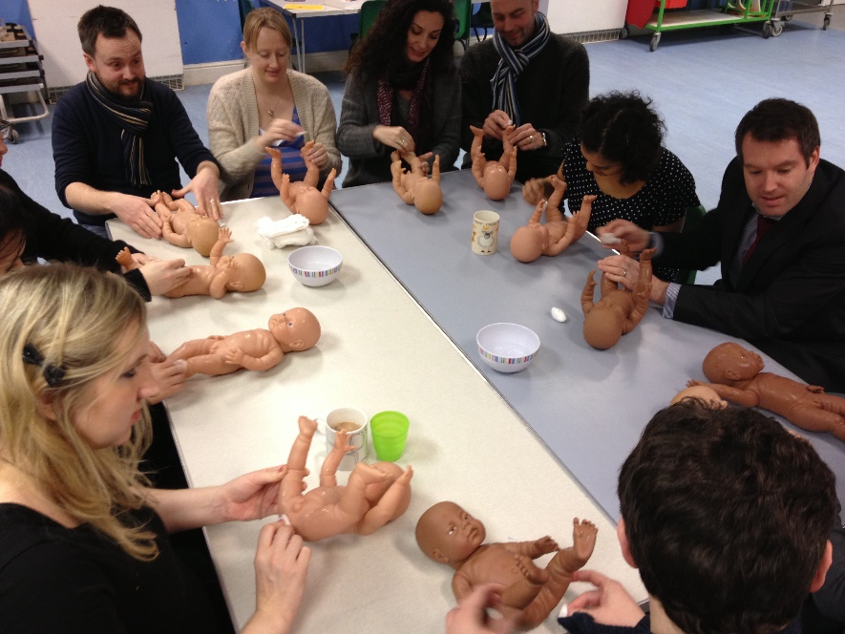
Antenatal classes
Most mothers will start attending antenatal classes, once a week, around weeks 30-32.
Those expecting twins will begin in week 24 as their babies are likely to be born earlier than 40 weeks.
NHS classes are free to attend, however mothers can pay for additional private classes from a provider such as the National Childbirth Trust (NCT).
NCT classes video (5mins): https://www.youtube.com/watch?v=8TxmxfonS0I
The benefits of Antenatal classes (2 mins): https://www.youtube.com/watch?v=C72uZIe85VI

Slide 33
Antenatal classes help to prepare the mother and partner for pregnancy, labour, birth and caring for their newborn baby as parents after.
Classes can help expecting parents to feel more confident with the delivery process and reassured about caring for their baby afterwards.
Classes also allow expecting parents to meet others in similar situations to them; meaning they can share experiences, knowledge and concerns to form a support group.

Slide 34
Antenatal classes prepare both parents for labour and parenthood by covering:
what happens during labour and birth and what to expect
how to cope with labour e.g. types of pain relief, relaxation methods and breathing techniques
different types of labour and birth e.g. home birth, hospital birth, so the mother can create a birthing plan
types of birth interventions e.g. ventouse or forceps delivery
caring for a baby e.g. feeding, sleeping, bathing
the mother’s health after birth
giving parents the chance to talk over any concerns and meet key professionals
discussions of emotions and feelings to give parents realistic expectations
how the father/partner can plan their participation in the birth and how to support the mother
refresher classes for those who have already had a baby

Slide 35
Antenatal classes promote healthy lifestyle and diet
NHS: https://www.nhs.uk/pregnancy/keeping-well/exercise/
The more active and fit you stay during pregnancy, the easier it will be for you to adapt to your changing shape and weight gain. It will also help you to cope with labour and get back into shape after the birth.
Antenatal classes:
Pregnant women are advised to follow the Eatwell guide for a balanced diet.
Parents learn about the negative impact of smoking, alcohol and recreational drugs during pregnancy and after the birth
Mothers learn about the benefits of breastfeeding

Slide 36
Foods to avoid during pregnancy | Foods to limit during pregnancy
Unpasteurised milk and soft goats’ cheese Mould-ripened soft cheese e.g. brie and soft blue cheeses Raw or undercooked meat Liver, pate and game meats Raw or partially cooked eggs that are not stamped British Lion Duck, goose or quail eggs unless cooked through Swordfish, marlin, shark, raw shellfish Alcohol Liquorice root | No more than 2 portions of oily fish per week No more than two tuna steaks our four medium sized cans of tuna per week Caffeine should be limited to 200mg per day No more than 4 cups of herbal tea per day High-dose multivitamin supplements and any vitamin A supplements must be avoided Women are also advised to ensure that fruit, vegetables and salad do not have soil in them

Slide 37
Advice on feeding and caring for the baby
This will include: feeding, sleeping and bathing.
Breast feeding is encouraged for at least the first two weeks after birth because the mother produces a concentrated form of milk called colostrum.
A few days after birth, the mother will produce actual milk which contains the exact quantities of fat, protein, carbohydrates and nutrients needed by the baby. This ‘mature milk’ also contains immune factors but at lower concentrations.
Breastfeeding also helps mothers and babies to bond.
Colostrum milk:
is high in protein
contains high levels on antibodies and immunoglobulins, which protect newborns from viruses and bacteria
contains concentrated immune boosters
is thick and usually a golden colour

Slide 38
Benefits to breastfeeding
Highly nutritious; containing vitamins, proteins and fats – all essential for baby growth and development.
More easily digested in comparison to formula milk.
Breast milk contains antibodies which help to fight off viruses and bacteria.
Research has shown that breastfeeding babies lowers their risk asthma, respiratory illnesses and hospitalisations.
Breast milk prevents Sudden Infant Death Syndrome (SID).
Helps to build a strong, emotional bond between the baby and mother
Breast feeding also has benefits to the mother as it decreases the risk pf breast cancer, ovarian cancer, osteoporosis, cardiovascular disease and obesity.

Slide 39
TASK: Imagine a pregnant mother has told you that she is not planning to attend antenatal classes because she has already read books on birth and parenting.
Write a paragraph or role play with a partner to explain and discuss what you would say to the mother to encourage her to attend.
Think about:
The importance of antenatal classes.
What will be learned by the mother and father/partner attending.
Why this information will be beneficial to them.

Slide 40
The choices available for delivery
A mother can choose between a hospital birth or a home birth.
The GP will be the first to provide information explaining the options.
The mother can also talk the options over with her midwife and with the leader of the antenatal and parenting classes she may attend.
Scroll down to video ‘Where can I give birth?’:
https://www.nhs.uk/pregnancy/labour-and-birth/preparing-for-the-birth/where-to-give-birth-the-options/
Scroll down to video ‘Giving birth at home or at the birth centre’
https://www.nhs.uk/pregnancy/week-by-week/1-to-12/12-weeks/

Slide 41
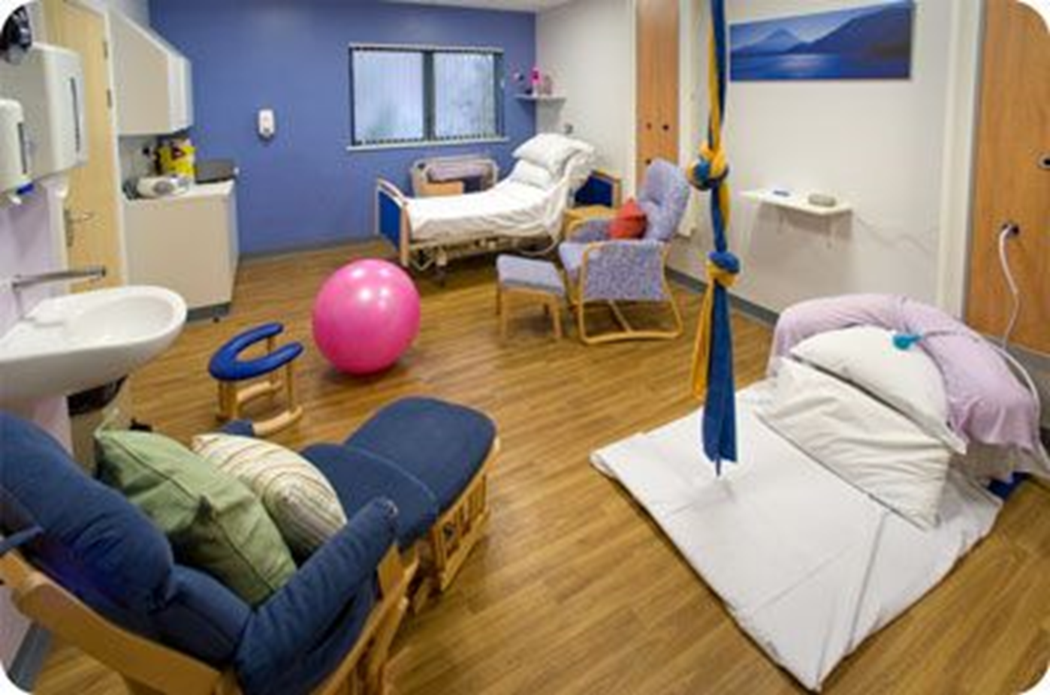
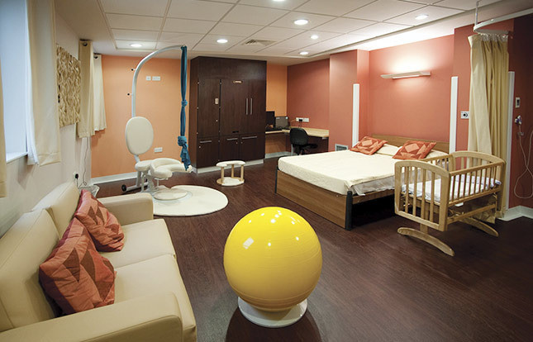
Hospital birth
Hospital births are considered to be the safest place to give birth, especially for pregnancies with known complications or conditions. This is due to the specialist equipment available and the access to trained health professionals in all different areas e.g. obstetricians, paediatricians.
There are 3 main types of hospital provisions: consultant-led units, midwife or GP-led units and birthing centres.

Slide 42
Consultant led units:
Hospitals with high technology and specialist equipment
Both doctors (obstetricians) and midwives available to support during labour
The best option for high-risk pregnancies e.g. multiple births, caesarean sections or women with complex health needs
Midwife or GP led units:
Are more comfortable and homely
When they are part of a hospital maternity unit, they have immediate obstetric, neonatal or anaesthetic care
Suitable for women who have no known complications associated with the pregnancy or health conditions
Birthing centres:
Delivery rooms are becoming increasingly home-like and comfortable; with soft chairs, bean bags and a double bed for the father to stay overnight with the mother
The mother giving birth will already know the midwife and so the care tends to be more personal
Water births are an option, along with warm baths and showers to soothe the pain of labour

Slide 43
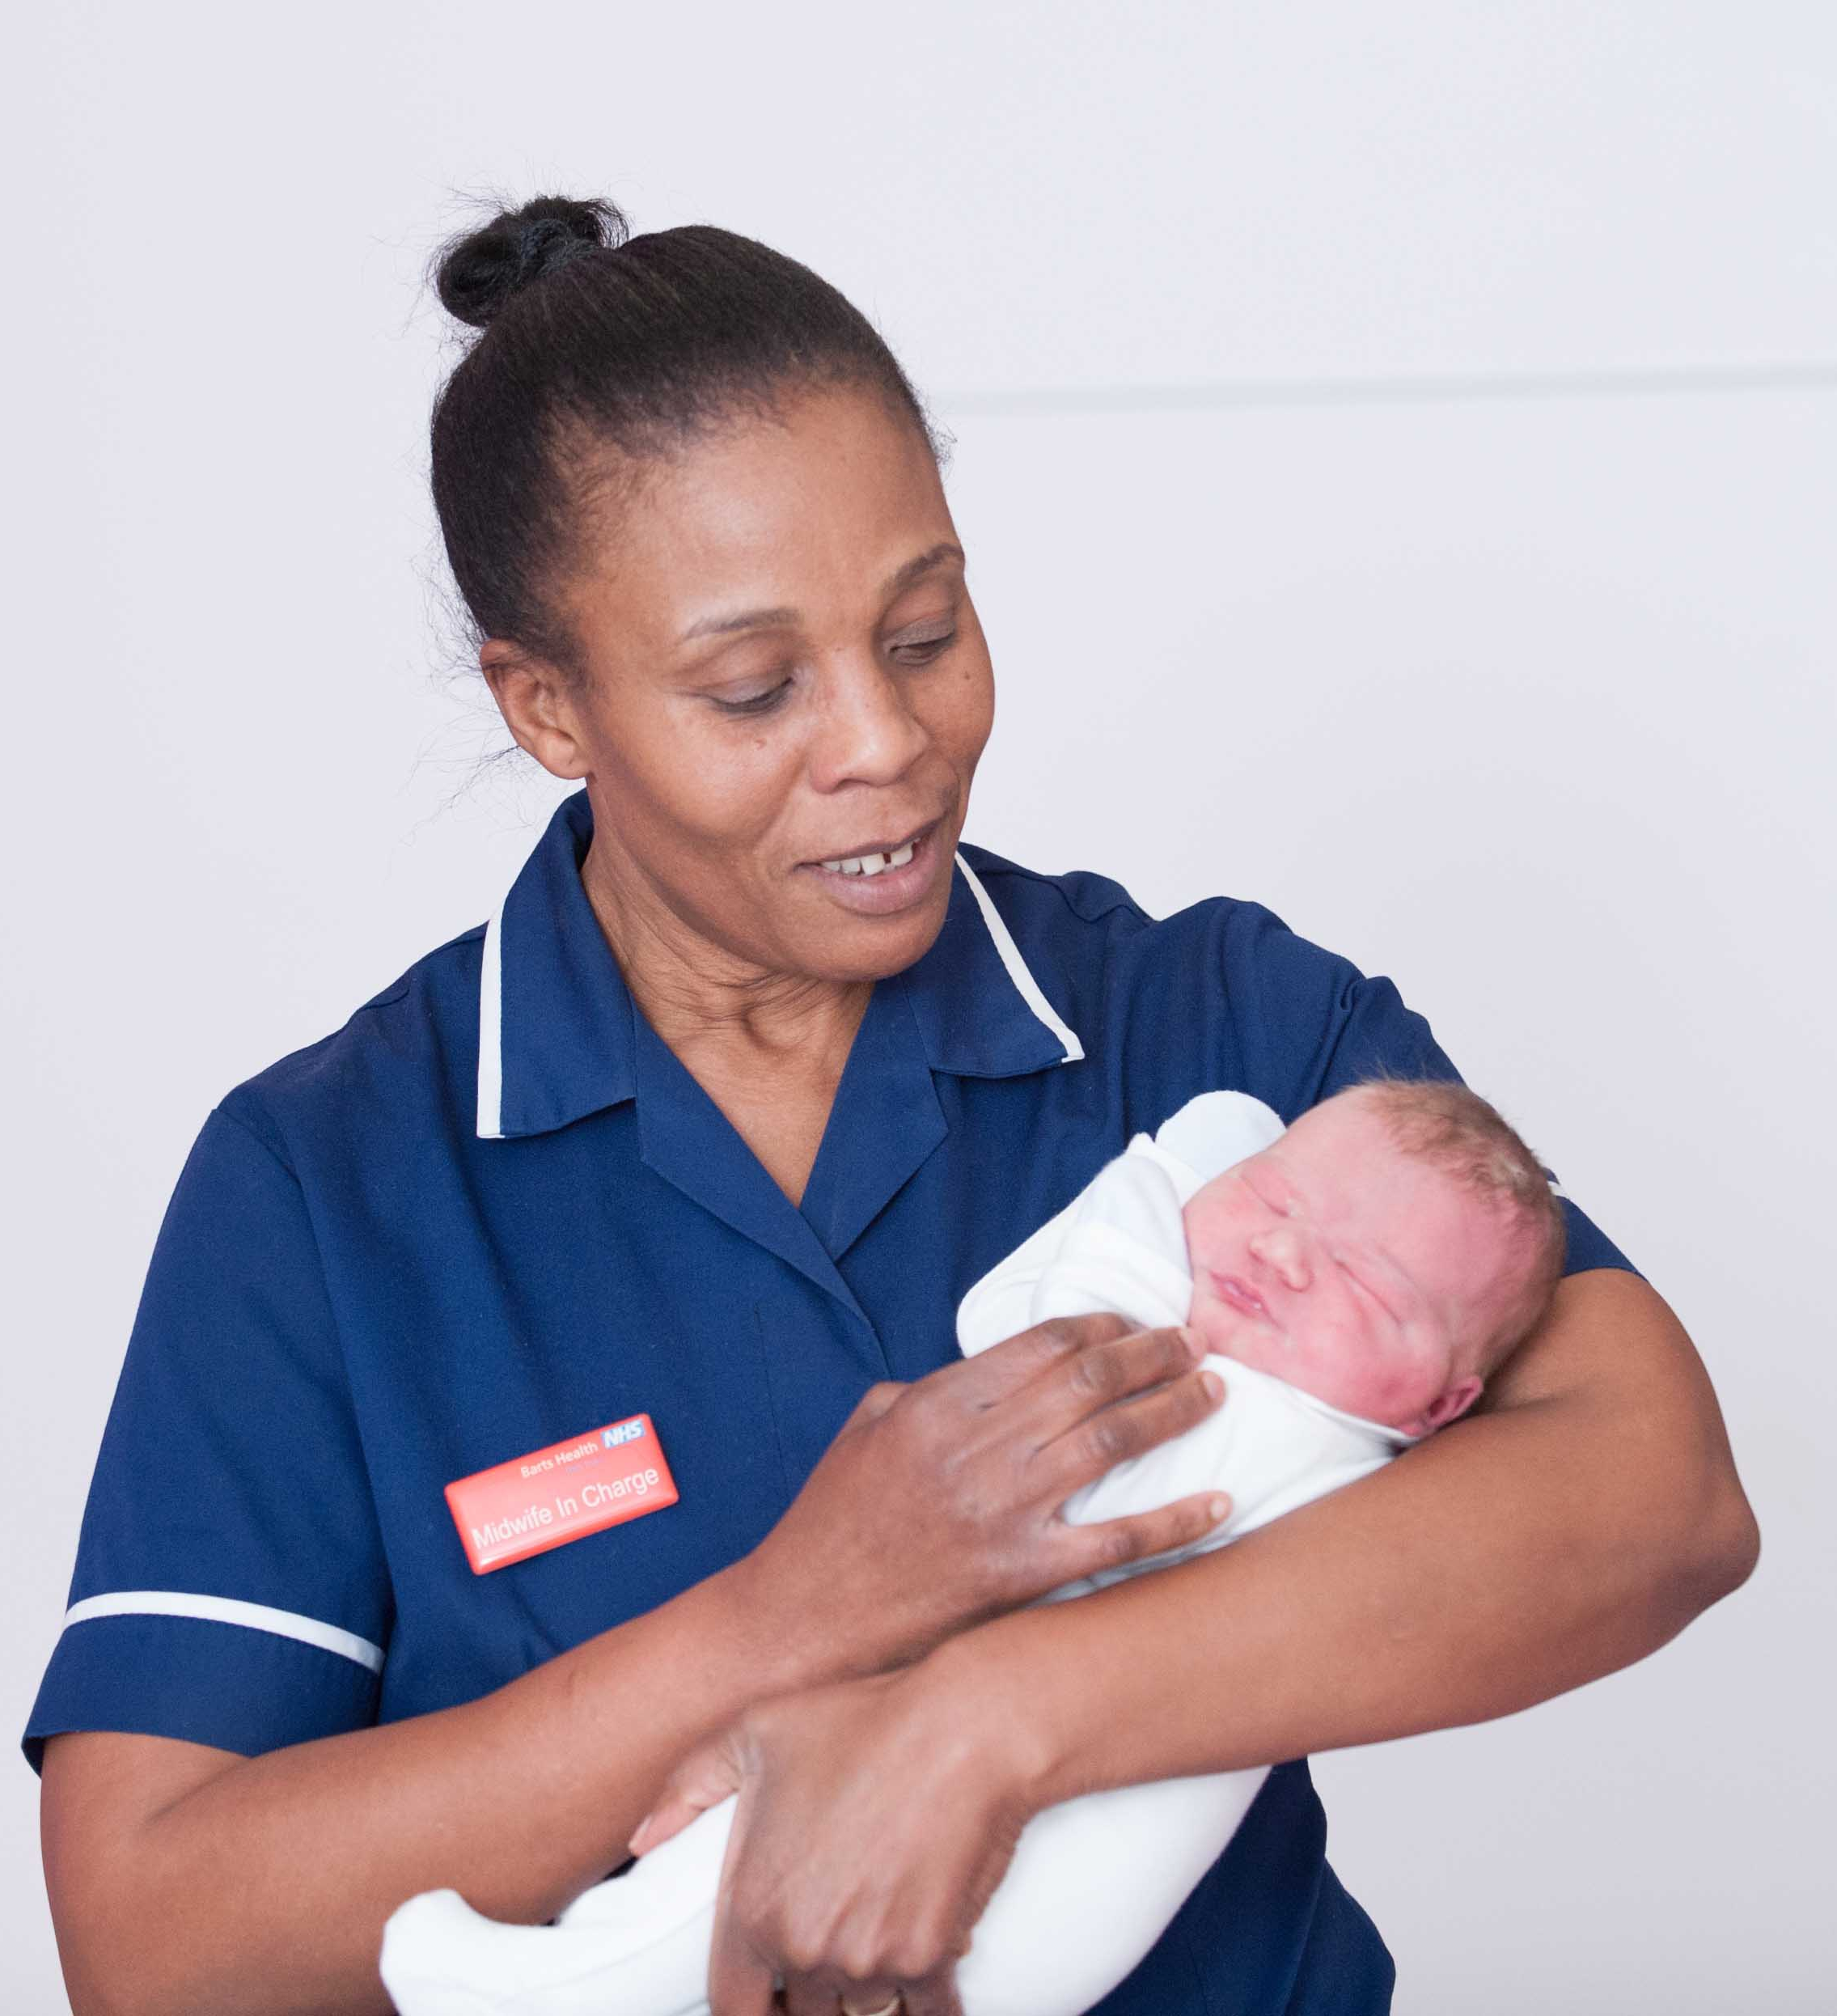
Delivery room are becoming more home-life and comfortable, with furniture such as soft chairs and bean bags. These enable the mother to change position, which can help with pain management. Warm baths and showers may also be available (most commonly in birthing centres) and these can also soothe and ease pain during early labour.
Maternity units offer birthing pools, which offer comfort and pain relief, and water births. Birthing pools are limited so this will need to be arranged in advance.

Slide 44
ADVANTAGES | DISADVANTAGES
Highly trained staff (obstetricians, paediatricians) and equipment are available in emergencies – this could save a baby’s life and is reassuring to the mother. Certain types of pain relief such as an epidural can only be administered in a hospital. Forceps, ventouse and caesarean section deliveries can only be carried out in a hospital. Midwives are able to help with feeding after the birth and can take newborn babies into the nursery, which supports the mother and allows her time to rest. The demands of home life are left behind. | A mother may be more relaxed at home - hospitals can be a stressful environment which may impact on the mothers labour and experience. The mother will not know the midwife delivering the baby. Mothers in labour are only allowed 2 birthing partners so older siblings will not be part of the birthing experience. Interventions such as forceps or ventouse are more likely in a hospital. There is little privacy in a hospital –mothers will be sharing a room and bathroom with several others on a ward. A limited number of birthing pools are available which means the mother may not be able to have the birth they had wanted/planned.

Slide 45
Home birth
Home births are only an option for normal pregnancies; where there are no complications and when both the mother and baby are well.
A midwife will attend the home during labour to support the delivery of the baby. If labour does not progress as expected or if problems occur where the mother and baby need help, the midwife will arrange for the mother to be transferred to a hospital.
The NHS reports that it is safer for women having their first baby to do so in a hospital, as a home birth will increase the risk of a poor outcome for the baby, however women having their second or subsequent baby are just as safe to have a home or hospital birth.

Slide 46
ADVANTAGES | DISADVANTAGES
Mothers may feel more relaxed and comfortable in their own homes; more likely to have a stress-free birth. Mothers can have as many birthing partners/ family members present as they want so older siblings can be involved in the labour/birth. Labour is not interrupted by travelling to the hospital. The mother is likely to be looked after by the same midwife that she has had throughout pregnancy; meaning she will feel more safe and reassured. Medical intervention such as forceps or ventouse are less likely to be used as home births are only offered to low-risk pregnancies. | If any problems occur during labour, there is no access to emergency equipment or specialist staff such as obstetricians etc. A transfer to a hospital may be needed in complications or issues arise. Poor outcomes from a home birth (that could be prevented through a hospital birth) can include death of the baby and problems that might affect the baby’s quality of life. Epidurals are not able to be administered at home; meaning the mother could experience a painful and stressful labour. Home births are not recommended for a mother’s first baby and a midwife or doctor might advise that a hospital birth is safer for mother and baby in some circumstances.

Slide 47
ASSESSMENT TASK:
Copy and complete in your books.
TIF: Complete the same question but, for a home birth.
[8]

Slide 48
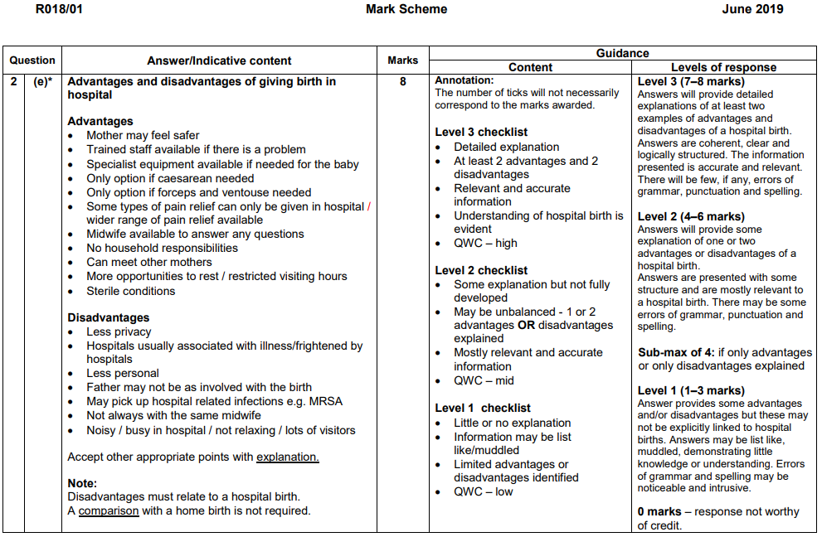

Slide 49
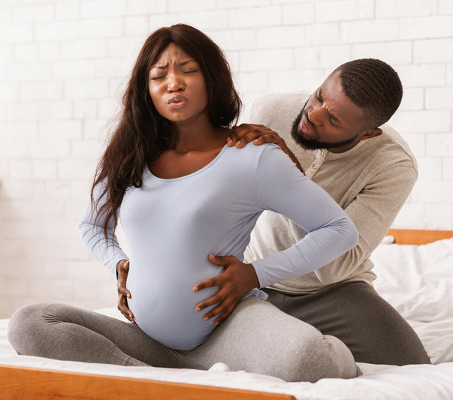
The role of the birth partner in supporting the mother through pregnancy and birth
Birth partner: is someone who supports the mother through pregnancy, by attending antenatal classes, and being present during labour and birth. This could be the father of the baby, the mothers partner, a family member or friend.
During pregnancy, the mother may experience tiredness, sickness and feel emotional, therefore it is beneficial for her to have someone there to help her with daily tasks and offer physical and emotional support.

Slide 50
Physical support the birthing partner can provide to the mother
Help the mother during pregnancy by providing practical support with tasks if the mother is feeling tired, such as the grocery shopping, household chores (cooking the dinner, washing the dishes).
Help the mother during labour and birth by massaging the back, shoulders or legs, supporting the mother’s body, timing the contractions, offering drinks, snacks or ice cubes, sponging the mother down and helping the mother to find a comfortable position.
Learning relaxation and breathing techniques alongside the mother. They can encourage the mother to use the techniques by participating alongside her during labour and birth.

Slide 51
Emotional support the birthing partner can provide to the mother
Be emotionally supportive if the mother is anxious about coping with birth.
Help the mother during labour and birth by giving encouragement, talking or finding ways to pass the time and making sure health professionals are aware of the birthing plan.
Helping with arrangements at home such as arranging childcare for older siblings when a mother goes into labour.

Slide 52
Pain relief
There are different types of pain relief that a mother can receive during labour and the birth of the baby.
Each method has its advantages and disadvantages so the mother should learn about these options during pregnancy, so that she can make decisions about pain relief in her birthing plan.

Slide 53
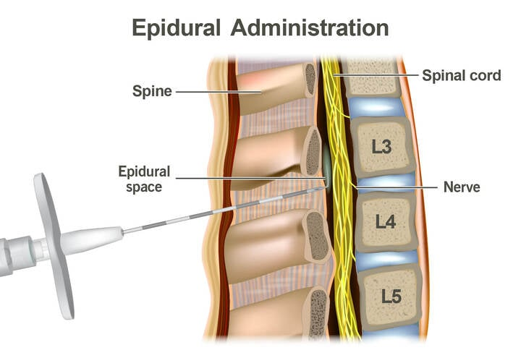
Epidural anaesthetic
An epidural is a local anaesthetic that numbs the nerves that carry the pain impulses from the birth canal to the brain.
It can provide total pain relief, but it is not always 100% effective.
It is often used when a mother is experiencing a very long or painful labour, or when a mother becomes distressed.

Slide 54
Epidural
An epidural can only be given by an anaesthetist in hospital:
The mother lies on her side or sits curled up.
Local anaesthetic is used to numb the back, then a needle is inserted.
A tube passes through the needle into the back, near the nerves that carry pain impulses from the uterus.
Drugs, usually a mixture of local anaesthetic and opioid, are administered through this tube.
It takes about 10 minutes to administer an epidural and up to another 15 minutes for it to work. It can then be topped up if necessary.

Slide 55
Epidural
An epidural does not usually cause sickness or drowsiness, but the mother’s contractions and the baby’s heart rate will need to be continuously monitored.
Possible side effects include:
Legs feeling heavy
BP dropping (this is rare)
Prolonged second stage of labour as contractions may not be felt, leading to increased likelihood of assisted delivery
Difficulty passing urine
A headache (this can be treated)
A sore back for a day or two afterwards

Slide 56
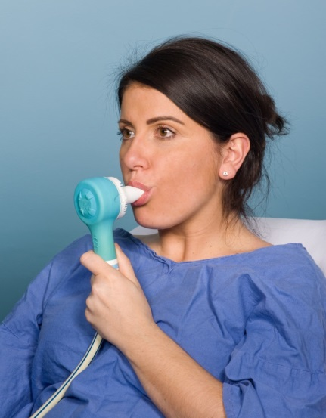
Entonox (gas and air)
This is a mixture of oxygen and nitrous oxide gas. It does not remove all the pain, but it can help to reduce it.
Mothers breathe in the gas and air through a mask or mouthpiece which they hold themselves – this gives them a sense of control.
It works within about 20 seconds, so a deep slow breath will be taken as a contraction begins.
There may be a light-headed sensation and some mothers decide to stop using it as they may feel sick, sleepy or unable to concentrate.
A painkilling injection can be given alongside if this pain relief is not sufficient.

Slide 57
Pethidine
Pethidine is an opiate-based drug which is given via an injection into the thigh or buttock. It quickly makes the mother feel relaxed because it causes the muscles to relax.
This makes pain more tolerable, but it does not take it away altogether. It tends to be used in early labour because it can help the mother to settle and rest.
It cannot be used too close to birth because the mother might not be alert enough and it could also cause the baby to become sleepy. This could negatively affect feeding and even breathing. It can also cause some mithers to feel sick or disorientated.

Slide 58
TENS
TENS stands for ‘transcutaneous electrical nerve stimulation’. A TENS machine is a small device that has leads connected to sticky pads called electrodes.
The electrodes are attached to the mother’s skin which deliver small electrical impulses. This gives a tingling sensation.
The impulses reduce the pain signals going to the spinal cord and brain, which relieves the pain and relaxes the muscles.
It is possible that the electrical impulses also stimulate the production of endorphins – the body’s natural painkillers’.
It should not be used if the mother has: a pacemaker, type of electrical or metal implant, epilepsy, heart problem or in early stages of pregnancy.

Slide 59
The signs that labour has started
Uterus
Cervix
Signs that labour is beginning include:
Show: This is when a plug of mucus that has sealed off the uterus during pregnancy comes away from the cervix as it dilates (gets wider). This will be stained with blood, but no blood should be lost. Not all women experience a ‘show’.
Waters break: The bag of amniotic fluid around the baby bursts; causing anything from a trickle to a gush of liquid from the vagina. When this happens, it indicates that it is time to go to hospital (or other chosen birth method) as there is a risk of infection for the baby.
Contractions: The uterus muscles start to contract and release and these contractions gradually become stronger and occur closer together.

Slide 60
The stages of labour
Stage one: labour - neck of the uterus opens
Stage two: the birth of the baby
Stage three: delivery of placenta and membranes

Slide 62
Stage one: neck of uterus opens
As the neck of the uterus continues to open:
More pain relief is required as the contractions become stronger, more regular and longer lasting - (a warm bath can help).
Mothers are encouraged to move around in an upright position.
The cervix gradually dilates 8 – 10 cm wide.
If the head of the baby is not already engaged in the mother’s pelvis, it will move into position.
As the end of this stage approaches, intense contractions can cause the mother to feel agitated, vomit, sweat or shiver. Due to pressure from the baby’s head, bladder and bowel control can be lost.

Slide 63
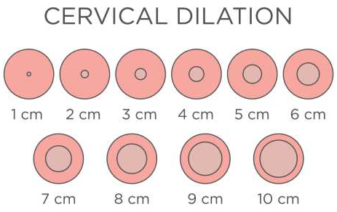
Transition stage
* Transition stage: when contractions get even closer, stronger and more intense, this signals that the mother is entering the transition stage; this links the end of the first stage of labour and the beginning of the second stage of labour.
* Stage two starts when the cervix becomes fully dilated at 10cm.

Slide 64
Stage two: the birth of the baby
Starts when the cervix becomes fully dilated at 10cm and ends when the baby has been born.
The vagina and the open cervix now form a single passage known as the birth canal.
The head of the baby moves into the birth canal, the mother begins to push with each contraction, to move the baby further down the birth canal. (This can be exhausting so the mother will rest between contractions).
When the baby’s head can be seen (crowning), the mother stops pushing, and instead controls her breathing, so that the head is born gradually and safely; to avoid tearing of the perinium (the skin between the vagina and rectum). Instead, the mother will pant or blow out to control her breathing.
An episiotomy (where the perinium is cut) may be needed if the perinium does not stretch enough to allow the head to be born.

Slide 65
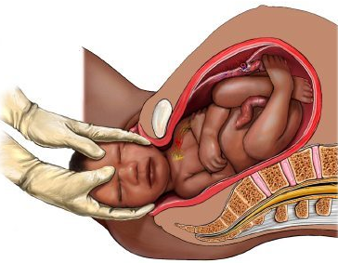
Stage two: the birth of the baby
The most difficult part of labour is birthing the head; as the body can be turned so that the shoulders are delivered one at a time. The rest of the body slides out easily.
If the baby needs mucus removing from its airways, or to be given oxygen, this can be done as soon as the head has been born, before the rest of the body has been delivered.
The umbilical cord is clamped and cut (the father or partner might cut the cord).
The baby is generally placed on the mother for skin-to-skin contact.
Some blood from the birth and a protective layer of oily vernix are likely to be present on the baby’s skin.
* Vernix: A white, waxy substance covering the baby’s skin whilst in the uterus, which acts as a natural moisturiser and protective layer to help prevent infection.

Slide 66
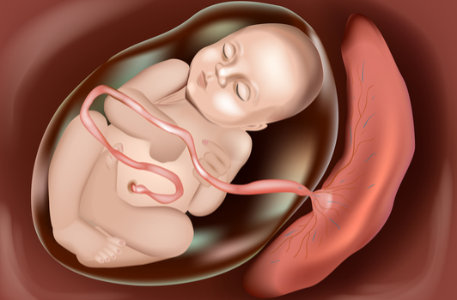
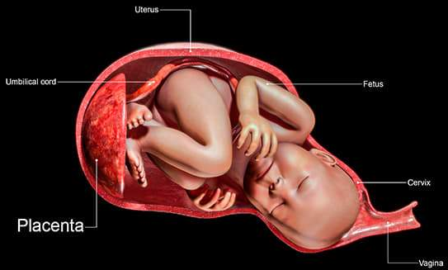
Stage three: delivery of placenta and membranes
The shortest stage of labour, which follows the birth.
After the baby has been born, contractions begin again to push out the placenta.
An injection of the hormone syntocinon may be given, to stimulate contractions and speed up the process. This helps to prevent the loss of blood and is helpful if the mother is exhausted.
If a tear occurred in the perinium or if an episiotomy was made, it will be sewed up under local anaesthetic.

Slide 67
TASK:
Create a storyboard or flowchart to show and explain what happens through the three stages of labour.

Slide 68
The methods of assisted birth
Some methods of delivery are planned in advance, however some become necessary if issues occur during labour or, if help is needed with birthing the baby.
* All procedures are safe, but only used when necessary.
The NHS reports that approximately 1 in 8 women have an assisted birth; where forceps or a ventouse suction cup are used to help deliver a baby’s head.
This could be because:
there are concerns about the baby’s heart rate
the baby is in an awkward position
the mother is too exhausted

Slide 69
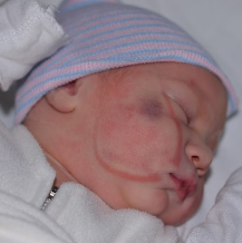
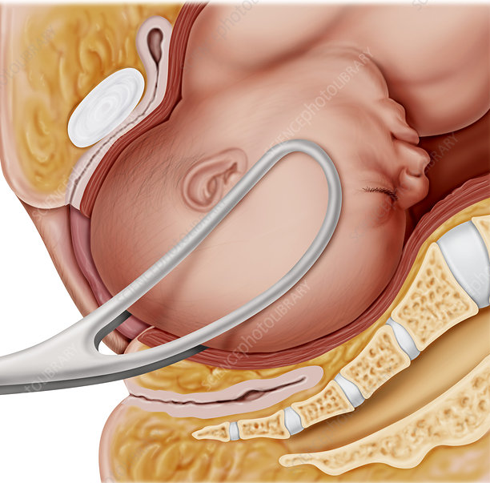
Forceps
Forceps are a curved metal instrument that are carefully positioned around the baby’s head, then joined at the handles.
As the mother pushes with a contraction, an obstetrician gently pulls to help deliver the baby.
Some forceps are designed to turn the baby to the right position to be born.
* Forceps are usually more successful than ventouse, but are more likely to result in vaginal tearing.

Slide 70
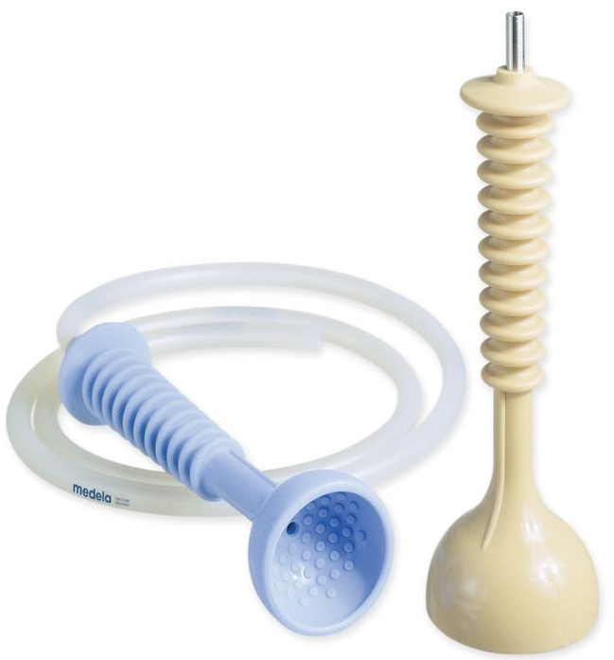
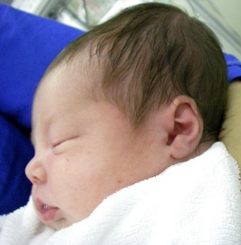
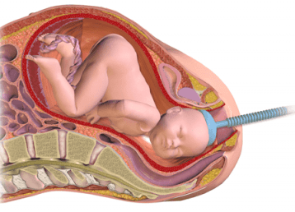
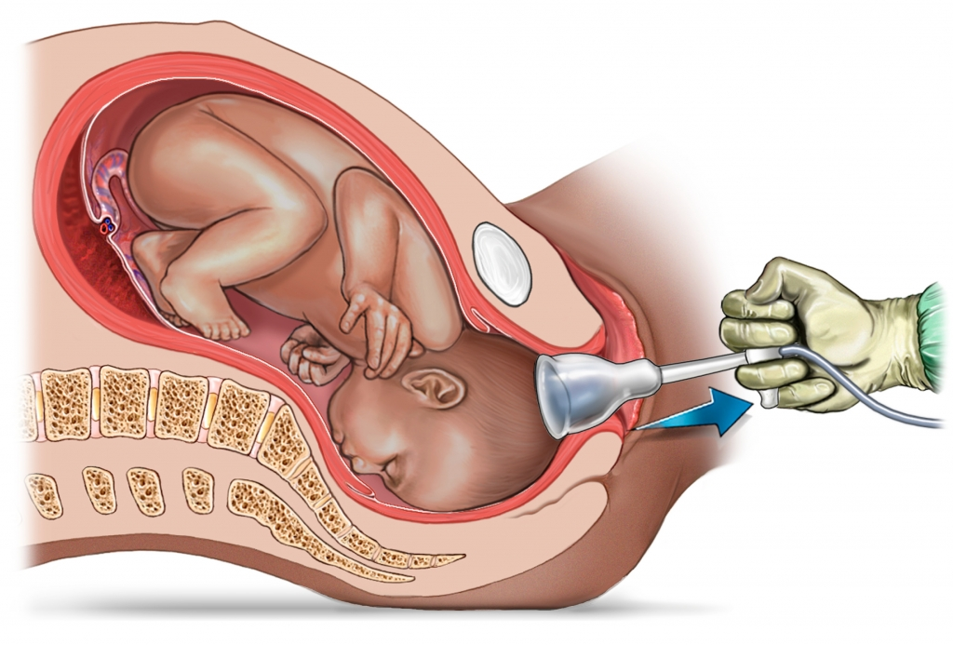
Ventouse
A ventouse (vacuum extractor) is a plastic or metal cup that fits firmly on the baby’s head and is attached by suction.
As the mother pushes with a contraction, an obstetrician gently pulls to help deliver the baby.
The process leaves a small swelling on the baby’s head, however this disappears soon after the delivery, and the cup may also leave a temporary bruise.
* A ventouse is not used with babies born before 34 weeks or pregnancy because the head is too soft.

Slide 71
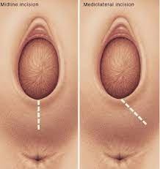
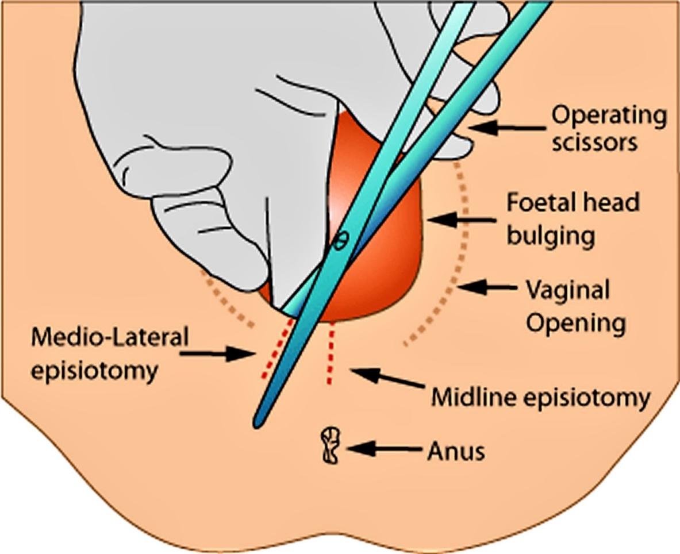
Episiotomy
Episiotomy: an incision or cut made in the perineum (the tissue between the vaginal opening and the anus). The perineum will sometimes tear ‘naturally’ when giving birth however, in circumstances when it is necessary to quickly enlarge the opening for the baby to pass through, an incision is made.

Slide 72
Risks of assisted birth
Vaginal tearing or episiotomy
A higher chance of having a vaginal tear that involves the muscle or wall of the anus or rectum
Higher risk of blood clots, leaking urine and anal incontinence
A catheter is a small tube that is inserted through the urethra into the bladder to remove urine. It is used to empty the bladder so that a doctor can examine the mother to confirm that an assisted birth is necessary. A catheter is also used during an epidural when a mother might be numb to the sensation that her bladder is full and when she has to stay in bed so cannot get up to urinate. A catheter is uncomfortable when it is inserted and some women find it difficult to urinate once it is removed.

Slide 73
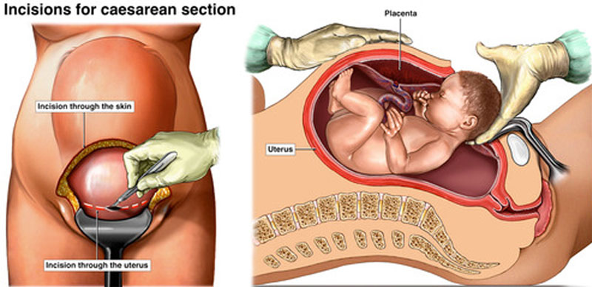
Elective/ emergency caesarean section
A caesarean is an operation to deliver a baby through a cut made in the abdomen and womb.
It may be recommended as an elective (planned) procedure or it may be done in an emergency, if a vaginal birth becomes unsafe.
Reasons for a caesarean include:
The baby being in the breech position (feet first)
A low-lying placenta (placenta praevia)
Pre-eclampsia
Infections such as STI’s and untreated HIV
The baby not getting enough oxygen and nutrients so needs to be delivered immediately
Labour is not progressing
Excessive vaginal bleeding

