Slide 1
Topic Area 1: Pre-conception health and reproduction
Unit R057: Health and well-being for child development

Slide 2
Factors which affect the decision to have children
Genetic counselling for hereditary diseases
(e.g. Down’s syndrome, cystic fibrosis, sickle cell anaemia, muscular dystrophy).
Relationship between partners
Factors which affect the decision to have children
Parental age
Peer pressure/ social expectations
Finance
Starter activity: List as many reasons why these 5 factors might affect the decision to have children.
* Not tested in exam but included in textbook

Slide 3
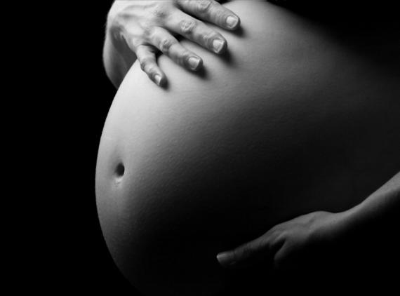
Pre-conception health
Pre-conceptual health is the health of couples before they conceive.
Both partners should try to address lifestyle choices and reduce known risks at least 12 weeks before trying to conceive.
Why is this important?
It gives couples the best chance of conception.
It increases the likelihood of a healthy embryo up to the point of a baby at delivery.
It reduces the possibility of complications during the pregnancy.
It decreases the risk of miscarriage or foetal abnormalities.

Slide 4
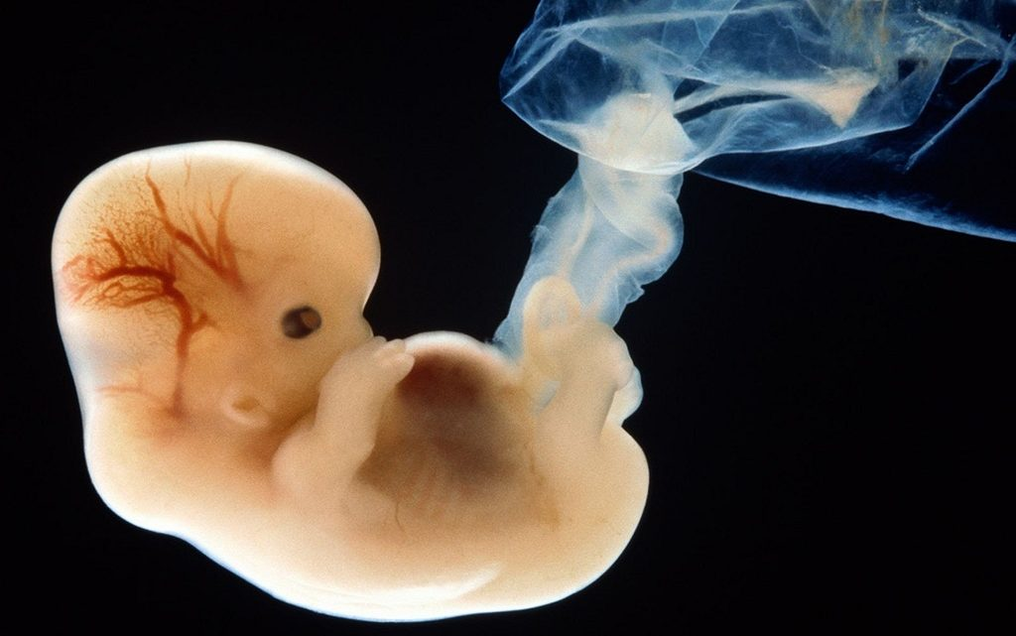
The first 12 weeks of a foetus’ life is the most important.
This is also known as the first trimester.
In this time, the liver, lungs, heart and brain are forming.
At the end of the 12 weeks, these organs will be formed and
working.
A woman may not know she is pregnant for several weeks in which time it could be too late – the damage may already be done.

Slide 5
Interesting facts
Health can impact on levels of fertility for both males and females.
Around 1 in 7 couples may have difficulty conceiving (3.5 million people in the UK).
About 84% of couples will conceive naturally within a year if they have regular unprotected sex (every 2 or 3 days).
Health can impact on risks to the pregnant mother and baby.
Around 50 per cent of pregnancies are not planned. Unplanned pregnancies are at greater risk of preterm birth and low birthweight babies.
Around 1 in 8 babies are born too early.
Before trying to conceive a baby, women and men should try to ensure their health is the best it possibly can be.

Slide 6
Factors affecting pre-conception health for men and women
Parental age
Weight
Factors affecting pre-conception health for men and women
Smoking
Taking recreational drugs
Drinking alcohol

Slide 7
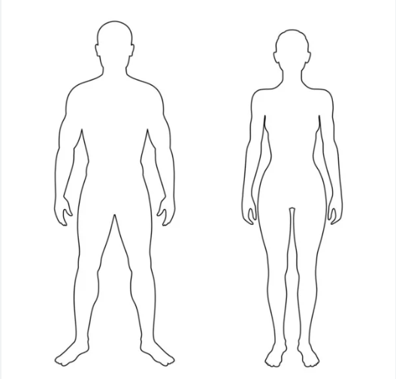
Drinking Alcohol
Taking Recreational Drugs

Slide 8
Weight
Smoking

Slide 9
Parental Age

Slide 10
Weight
 | Women | Men
Overweight or obese | Can affect ovulation because the quality of eggs produced is reduced. This makes it harder to conceive. Fertility treatments (such as IVF) less likely to work. | Can affect the quality and quantity of sperm.
Underweight | Can cause periods to stop or become irregular, which can make it harder to predict ovulation. Can also cause ovulation to stop altogether; meaning no egg is released. | Can reduce the quality of sperm and fertility.

Slide 11
Smoking
Infertility rates in both male and female smokers are twice the rate of infertility found in non-smokers. The risk for fertility problems increases with the number of cigarettes smoked each day.
Women: smoking disrupts ovarian function, reduces the number of mature eggs that can be fertilised, introduces toxic substances to the ovaries which kills the eggs (reducing their overall number) and can cause early menopause.
Men: smoking can cause a lower sperm count and may also produce a higher proportion of abnormal sperm.

Slide 12
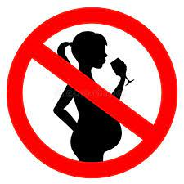
Drinking alcohol
Women: drinking alcohol decreases fertility in women, although the exact cause for this unknown. Drinking alcohol during pregnancy increases the risk to the baby, therefore it is recommended to not drink alcohol at all during pregnancy or when planning pregnancy.
Men: drinking excessive amounts of alcohol can cause men to have lower sperm counts and can also affect the quality of sperm.

Slide 13
Taking recreational drugs
Recreation drugs affect fertility and when taken over a long period of time, they can cause permanent problems with the reproductive systems in men and women.
Many recreational drugs cause fertility issues including; cannabis, anabolic steroids, ecstasy, cocaine, heroin.
Women: hormonal production, ovulation and menstrual cycles can become erratic.
Men: sperm quality and quantity can be damaged.
Unborn child: very serious damage can be caused to an unborn child by smoking (including passive smoking), drinking alcohol and using recreational drugs during pregnancy. It is extremely important to protect a foetus from these factors throughout its development in the womb.

Slide 14
Parental age
The age of the couple can affect the likelihood of conception.
Age of the mother: as a woman ages, her ability to conceive and the quality of her eggs decline (over the age of 35).
Age of the father: men produce sperm all of their adult life, including into old age. As long as they are physically capable of sexual intercourse, men can father children.
Parental age: can increase the chances of a baby being born prematurely and has been linked to increased chances of a baby being born with certain neurological conditions.

Slide 15
NHS
One-third of couples in which the woman is over 35 have fertility problems.
This rises to two-thirds when the woman is over 40.
When a woman stops having a reproductive cycle (known as menopause), she will no longer be able to get pregnant.
In recent years, figures have shown more mother are waiting to have their first child until the ages of between 35 and 45 years old.
Why do you think this could be?
Women are settling down and getting married later in life
Couples may be waiting until they are financially secure
Couples may build careers, gain qualifications and/or training for work

Slide 16
Show me what you have learned ☺
In your assessment books…
Explain one of the factors affecting pre-conception health for men and women.
Choose from:
Weight
Smoking
Drinking alcohol
Taking recreational drugs
Parental age

Slide 17
TASK:
Create a leaflet for a couple planning to have a baby which explains the factors affecting their preconceptual health.
You should explain:
The affects each factor has on both men and women.
Factors affecting pre-conceptual health:
Weight
Smoking
Drinking alcohol
Taking recreational drugs
Parental age

Slide 18
Other factors affecting pre-conception health for women
Folic acid
Taking folic acid during pregnancy can help prevent birth defects such as spina bifida; a condition where the baby’s spine and spinal cord do not develop properly.
Women who are pregnant or are planning pregnancy should take 400 micrograms of folic acid supplement per day, before conception and up to week 12 of pregnancy. They should also eat folate-rich foods e.g. green vegetables, brown rice and fortified breakfast cereals, to consume 6000 mcg of folate in total, per day.
Up-to-date immunisations
This keeps the woman healthy before and during pregnancy, which also benefits the baby.

Slide 19
Roles and responsibilities of parenthood
* Not tested in exam
Definition of a family:
a group of people who are linked by birth, marriage or living together.
Starter activity: List as many different types of families that you can think of

Slide 20
* Not tested in exam
Defining different types of families
Nuclear | A couple and their children
Extended | A family which extends beyond to include grandparents and /or other relatives
Foster | A family that provides custody for children whose parents are unable to look after them.
Single parent | A family with children and only one parent – can be male or female.
Shared Care | Children are brought up by both parents but in different homes.
Same sex | A couple of the same gender raising a child.
Looked After Children | children who are cared for away from their family and are the responsibility of the local authority. These children are often referred to as being in care.
Adoptive | A family who has provided a permanent home for a child / children through a legal process.
Step/reconstituted or blended | A couple, the children they have together / /their children from previous relationships.

Slide 21
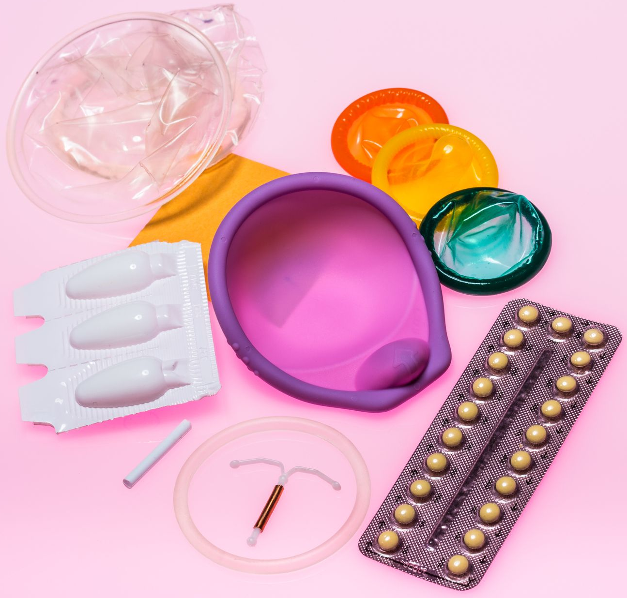
Methods of contraception
Contraception is the deliberate prevention of pregnancy and used for protection against STIs (contra = against, ception = conceiving).

Slide 22
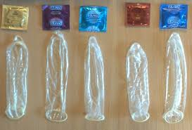
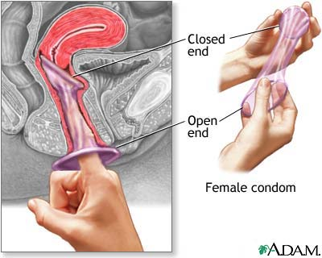
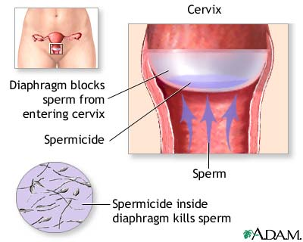
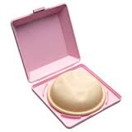
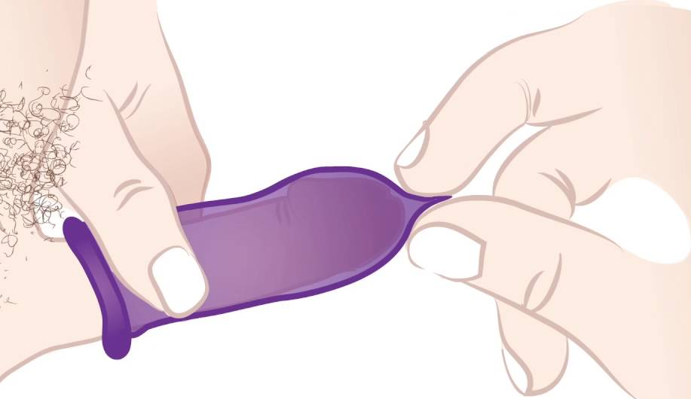
Barrier methods
Barrier methods: A device used to prevent semen from passing through the cervix, entering the uterus, and coming into contact with an egg (ovum).
Male and female condoms
Diaphragm or cap

Slide 23
Male and female condoms
Male condom
Condoms work by keeping semen (the fluid that contains sperm) from entering the vagina. The male condom is placed on the penis when it becomes erect. It is unrolled all the way to the base of the penis while holding the tip of the condom to leave some extra room at the end.
Has to be inserted into the vagina, using the closed-end ring, before it comes into contact with the penis
The other ring creates the open end of the condom
It lines the walls of the vagina, creating a barrier between the sperm and the cervix
Prevents the sperm from entering the uterus and fertilising an egg
It should be removed immediately after sex and before standing up
Female condom (femidom)

Slide 24
Male condoms
Advantages | Disadvantages
98% effective (2 out of 100 people will become pregnant in 1 year using male condoms). | You cannot re-use a condom – a new one is needed every time sexual intercourse takes place.
Condoms are free from family planning clinics and are also widely available from chemists, supermarkets, pubs, clubs and garages. | It is possible for a condom to slip off or split during sex.
Effective method of protection against STI’s. | Putting the condom on interrupts sex.
Polyurethane condoms are available for those with a latex allergy.
Condoms allow the man to take responsibility for contraception.

Slide 25
Female condoms
Advantages | Disadvantages
95% effective if used correctly. | Cannot be reused– a new one is needed every time sexual intercourse takes place.
Free from family planning clinics and are widely available in chemists and supermarkets. | It is possible for the female condom to be pushed too far into the vagina.
Effective method of protection against STI’s. | Inserting the female condom interrupts sex.
Can be used at any time following a birth.

Slide 26
Diaphragm or cap
A Diaphragm or cap is a dome-shaped piece of latex or silicone that is inserted into the vagina before sex, to prevent sperm passing through the cervix to the entrance of the uterus.
It is used with a spermicidal gel or cream (spermicide kills sperm). It is only used during sex but it must be left in for at least 6 hours after the last time having sexual intercourse.
A doctor or nurse will carry out an examination to advise each individual on the correct size diaphragm suitable for them.

Slide 28
Advantages | Disadvantages
It is reusable and small so is discreet to carry and transport. | Needs washing every time after-use (more maintenance).
The user is in control of their own contraception. | Users may find it difficult to insert and they also need to make sure it is used with enough spermicide each time.
Only needs to be used when deciding to have sex and it can be inserted at a convenient time before having sex (hours in advance), so that sex is not interrupted. | Not suitable for everyone e.g. women whom have; an unusually shaped or positioned cervix, vaginal muscles that cannot hold the diaphragm in place.
There are no serious associated health risks or side effects. | Does not protect against STI’s, cannot be used during a period and can cause cystitis.
Can be used from around 6 weeks after giving birth. | May need to get a different size if more or less than 3kg (7lbs) in weight is gained/lost.
 | Only 92% effective at preventing pregnancy when used correctly.

Slide 29
Hormonal methods of contraception
Prevents ovulation (the releasing of an egg)
Causes the mucus on the cervix to thicken so sperm cannot get through easily
Thins the womb lining (endometrium) so that the egg cannot implant
Copy these three bullet points into your books. They will appear on all proceeding slides about hormonal methods of contraception; there will be no need to copy them down every time.

Slide 30
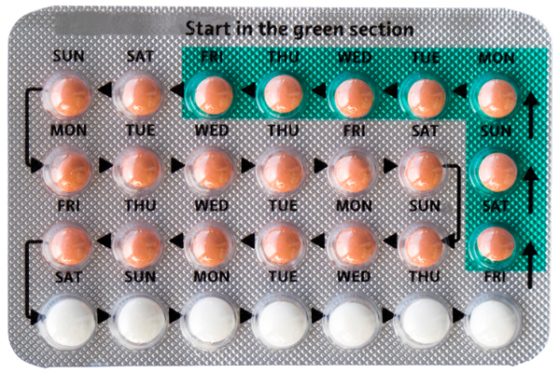
Contraceptive pill
A hormonal method of contraception which:
Prevents ovulation (the releasing of an egg)
Causes the mucus on the cervix to thicken so sperm cannot get through easily
Thins the womb lining (endometrium) so that the egg cannot implant
Combined pill
Contains two hormones; oestrogen and progestogen.
Involves a 7 day break to allow for a period (21 active pills:7 inactive).
Progestogen-only pill (mini pill)
Contains only progestogen.
Taken every day at the same time, without a break (although contains a number of inactive pills to allow for a period).

Slide 31
Combined pill
Advantages | Disadvantages
Can help regulate periods and make bleeding lighter and less painful. | May not be as effective if not taken around the same time each day or if the individual experiences vomiting or diarrhoea.
It reduces the risk of cancer in the ovaries, uterus and colon, and can sometimes reduce acne. | It can cause side effects such as weight gain, headaches, mood swings or depression, raised blood pressure and blood clots.
Does not interrupt sex and gives the user control over their own contraception (may provide reassurance). | Advised not to be taken by women who are breastfeeding or who are at risk of blood clots, until at least 6 weeks after giving birth (otherwise can be taken 3 weeks after birth).
99% effective when taken correctly. | Does not protect against STI’s.

Slide 32
Progestogen-only pill
Advantages | Disadvantages
Does not interrupt sex and gives the user control over their own contraception (may provide reassurance). | Individual needs to remember to take the pill every day and within a specified three-hour period of time.
Women who cannot take oestrogen may be able to take this pill. | Side effects can include spot-prone skin, tender breasts and periods may be irregular.
Can be used immediately after giving birth.
99% effective when taken correctly. | Does not protect against STI’s.

Slide 33
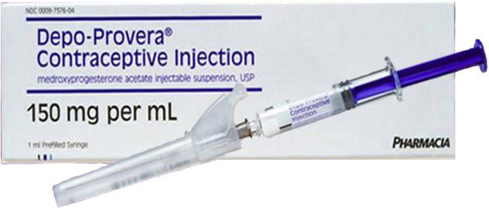
Contraceptive injection
The contraceptive injection steadily releases the hormone progestogen into the bloodstream, which prevents the release of an egg each month (ovulation).
It also thickens the cervical mucus, which makes it difficult for sperm to move through the cervix, and thins the lining of the womb so a fertilised egg is less likely to implant itself.
Injections are usually administered every 12 weeks, into the bottom, but can also be given in the arm. Some injections can be administered into the abdomen or thigh and the individual would learn to do this themselves.

Slide 34
Contraceptive injection
Advantages | Disadvantages
It is more than 99% effective. | It can take up to one year for fertility to return to normal after the injection wears off so it may not be suitable for women who plan to have a baby in the near future.
There is no responsibility of remembering to take contraception each day, at the same time. | Individuals must remember to take a repeat injection before their previous injection expires and becomes ineffective. Appointments should be booked in advance to avoid delays around this.
It can protect against some cancers and infections. | Side effects can include weight gain, headaches, mood swings, breast tenderness and irregular periods.
Can be used immediately after birth. | It does not protect against STI’s so condoms may also be needed.

Slide 35
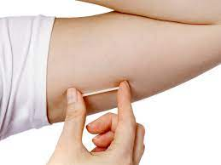
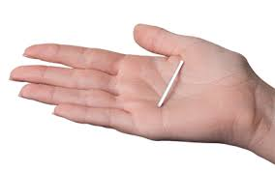
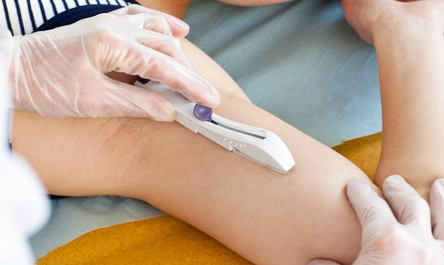
Contraceptive implant
The implant (Nexplanon) is a small flexible plastic tube that's placed under the skin in your upper arm by a doctor or nurse.
Local anaesthetic is used to numb the area when it is fitted and removed.
It releases the hormone progestogen into your bloodstream to prevent pregnancy and lasts for 3 years.
On removal, a tiny cut is made in the skin to gently pull the implant out.

Slide 36
Contraceptive implant
Advantages | Disadvantages
99% effective at preventing pregnancy. | A procedure involving local anaesthetic and a cut is involved for the fitting and removal of the implant.
Lasts for 3 years and is still effective during episodes of sickness or diarrhoea. | Side effects after it is inserted can include swelling, tenderness or bruising.
Fertility returns quickly once the implant has been removed. | It does not protect against STI’s.
It can be used immediately after giving birth. | Periods can become lighter or oppositely, irregular, heavier or longer.
Removes pressure of remembering to take contraception each day. | Some medicines can make the implant ineffective; not preventing pregnancy.

Slide 37
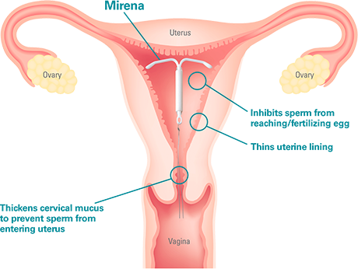
Intrauterine device and intrauterine system
An IUD or IUS is a small, T-shaped plastic device that is inserted into the uterus by a doctor or nurse and can last anywhere between three to ten years.
It releases progesterone, which thickens the mucus in the cervix; making it difficult for sperm to pass through or enter the uterus, and also thins the womb lining; making it difficult for an egg to implant.
The IUD and IUS both release the hormone progesterone however, the IUD also contains copper which acts as a spermicide by killing sperm.
Copper

Slide 38
Intrauterine device and intrauterine system
Advantages | Disadvantages
A good alternative for individuals whom cannot take the hormone oestrogen; which is used in other forms of contraception such as the combined pill. | Insertion can be uncomfortable and the copper IUD can cause spotting and heavier, prolonged bleeding and pain within the first 6 months of use.
Long-term method; it lasts for three to five years, depending on the brand chosen, which means maintenance is low. | An internal pelvic examination is needed prior to insertion, to check that it is suitable. It has to be inserted by a nurse or doctor.
Periods become lighter, shorter and less painful. | Periods can stop or become irregular which may not be suitable for some individuals.
99% effective if used correctly | It does not protect against STI’s.
 | Possible side-effects include mood swings, skin problems, breast tenderness, infections after insertion.

Slide 39
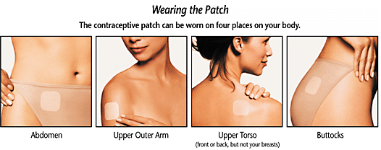
Contraceptive patch
The patch releases a daily dose of hormones through the skin into the bloodstream to prevent pregnancy. A new patch is applied each week, with a one week break in a month to allow for a period.
It contains the same hormones as the combined pill – oestrogen and progestogen – and works in the same way by preventing the release of an egg each month (ovulation).
It also thickens cervical mucus, which makes it more difficult for sperm to move through the cervix, and thins the womb lining so a fertilised egg is less likely to be able to implant itself.

Slide 40
Contraceptive patch
Advantages | Disadvantages
99% effective in preventing pregnancy. | It is not suitable for women who smoke and who are 35 or over, or who weigh 90kg (14 stone) or more.
Effective during episodes of sickness or diarrhoea. | If the patch falls off or becomes loose in week 3 of the patch cycle, a new patch cycle needs to be started and additional contraception will need to be used until the new patch has been on for 7 days in a row. This may cause inconvenience and effect the level of protection against pregnancy if not followed carefully.
It can be worn in the bath, when swimming and playing sports. | It does not protect against STI’s and can make some medicines less effective.
It helps with heavy or painful periods and with regulation. | Side effects can include headaches, raised blood pressure and blood clots.
May protect against some cancers and infections. | The patch may be visible and it can cause skin irritation, itching or soreness where it is applied.

Slide 41
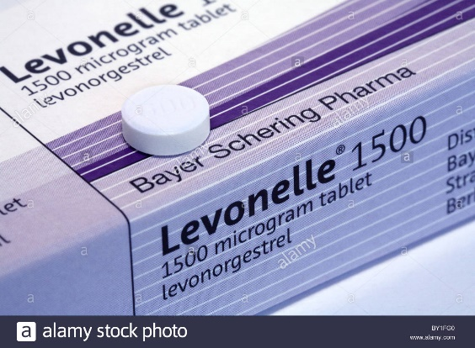
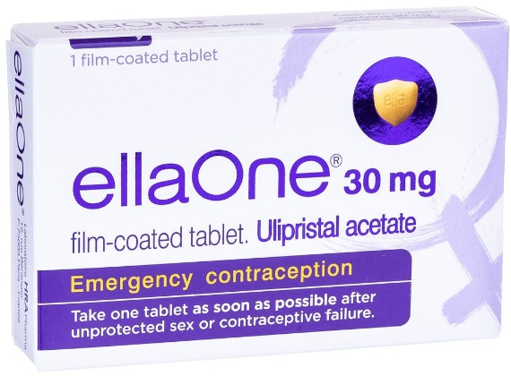
Emergency contraceptive pill
The emergency contraceptive pill (also known as the morning after pill or plan B) or the copper IUD can be used after unprotected sex or after sex where a method of contraception may have failed or been ineffective e.g. split condom, missed pill or sickness after taking a pill.
The sooner it is taken after unprotected sex, the more effective it will be but, it must be taken within either 72 hours (3 days) for the Levonelle pill or 120 hours (5 days) for ellaOne.
*The emergency pill should not be used as a method of contraception. It is only for use in an emergency where there may be a chance of unwanted conception.

Slide 42
Emergency contraceptive pill
Advantages | Disadvantages
An effective method in circumstances where an unwanted pregnancy may be likely. | It is only effective if taken before the release of an egg and it becomes less effective after 24 hours.
Allows up to 120 hours for the individual to make a decision and take action. | Does not protect against or treat any STI’s that may have been contracted.
It can be purchased from a pharmacy (by those aged 16 and over) and is also available free of charge from some GP surgeries, family planning and sexual health clinics, NHS walk-in centres and hospitals. | Women are not recommended to breastfeed for 1 week after taking ellaOne (they can continue to breastfeed after taking Levonelle).

Slide 43
Natural family planning
The natural family planning method involves the woman monitoring and recording different fertility signals:
basal body temperature
cervical secretions
the dates in her menstrual cycle (calendar method)
This allows the woman to work out which days during the menstrual cycle she is most fertile, meaning she can abstain from sexual intercourse on those days to avoid pregnancy.

Slide 44
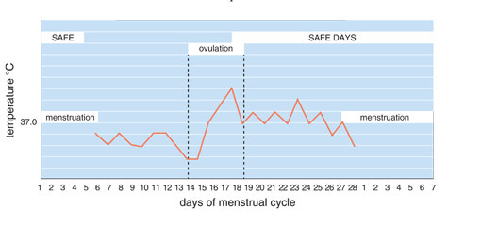
How it works
Cervical mucus increases and becomes clear, stretchy, wet and slippery (like raw egg white) when fertile:
Women not wanting to get pregnant should abstain from sexual intercourse when they notice this change in their cervical mucus.
Basal body temperature rises after ovulation:
Women can track their body temperature throughout their menstrual cycle to predict when they will ovulate and therefore when they will be most fertile.

Slide 45
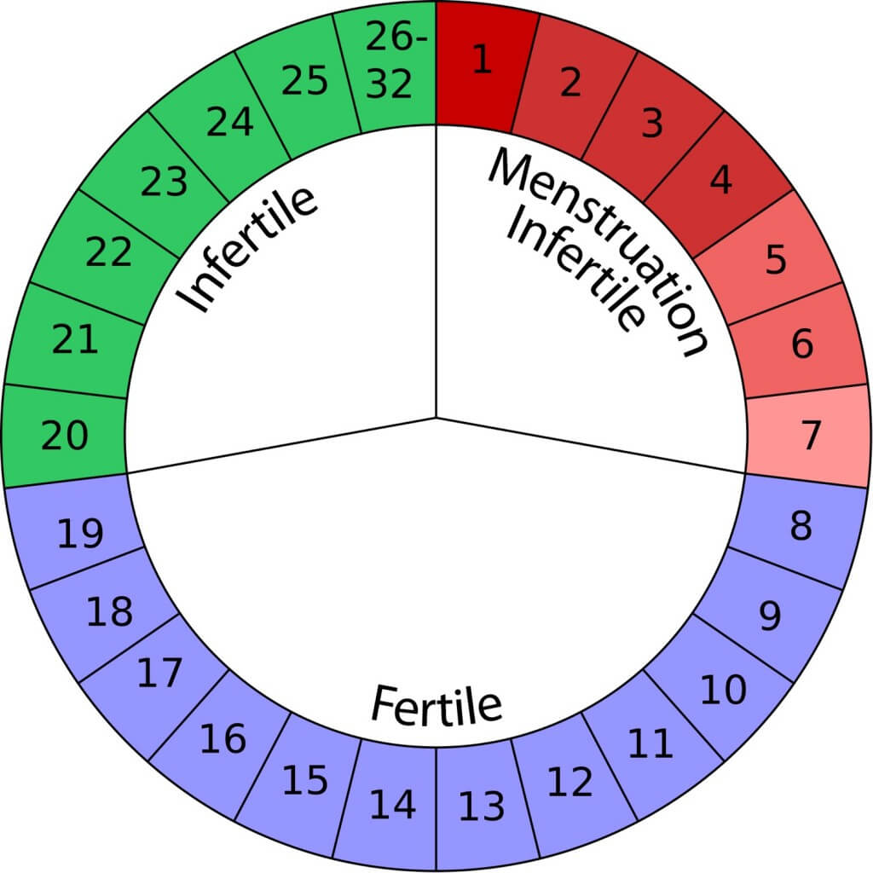
How it works
The ovaries usually release an egg around the same time each month (day 14). The egg moves through the fallopian tubes towards the uterus.
*An unfertilised egg can live for up to 24 hours.
*Sperm can live for up to 7 days; meaning that if sexual intercourse takes place 7 days before ovulation occurs, the egg could still become fertilised; resulting in conception.
Sex on day 8 could result in conception, even if the egg isn’t released until day 14.

Slide 46
Natural family planning
Advantages | Disadvantages
Beneficial for women who do not agree with the use of contraception due to religious beliefs. (It is acceptable to all faiths and cultures). | Not entirely accurate as there are lots of variables and factors which can affect body temperature and secretions e.g. illness and infection.
Allows the woman to take responsibility of her contraceptive method and get to know her body’s own, natural cycle. Individuals whom become aware of their fertility will be better able to plan or avoid pregnancy. | The calendar method is only reliable for women who have regular menstrual cycles. It also takes 3 – 6 menstrual cycles to learn effectively so this method cannot be used straight away.
A beneficial option for women whom do not respond well to hormonal or barrier methods of contraception due to side effects or allergic reactions. | Require rigorous tracking and relies on the individual consistently monitoring and taking accurate daily records of their body temperature and secretions.
There are no physical side effects and can be used when breastfeeding. | Does not protect against STI’s. Requires abstinence during periods of fertility or the use of condoms.
98% effective if used correctly.

Slide 47
TYPE | HOW IT WORKS | EFFECTIVENESS | ADVANTAGES | DISADVANTAGES
Condoms – male and female
Diaphragm or cap
Contraceptive pill – hormonal and mini pill
Contraceptive injection
Contraceptive implant
IUD/ IUS
Contraceptive patch
Emergency pill
Natural planning method
Copy and complete in your books.

Slide 48
Contraception case studies
Notes:
Print this slide for assessment books

Slide 49
Contraception case studies

Slide 50
Contraception case studies

Slide 51
Assessment task
Choose one case study to complete in your assessment book.
Information you should include about the contraception you have chosen to recommend:
How it works to prevent pregnancy
The effectiveness
The availability
The suitability (based on the case study)

Slide 52
Test my progress
Outline the choices available for couples who want to use barrier methods of contraception.
What is the main difference between the functions of the contraceptive pill and the emergency contraceptive pill?
Explain the factors to consider when choosing a method of contraception e.g. effectiveness, protection against STI’s, actions to remember/complete etc.

Slide 53
TASK: Choose a method of contraception and create a suitable case study for your chosen contraceptive method. Information you should include: - age - relationship status - key facts which indicate why your chosen contraceptive method is the most suitable for your case study.

Slide 54
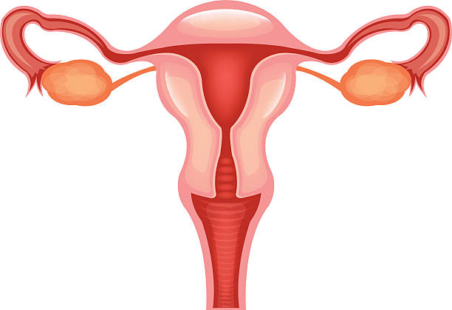
Female reproductive system
Ovaries
Fallopian tubes
Uterus
Endometrium
Cervix
TASK: Draw the diagram into your books and label correctly.
Vagina

Slide 55
Function of the female reproductive system
Vagina: A canal that joins the cervix to the outside of the body (also known as the birth canal). It is here that the man’s penis enters during sex. Folds of skin called labia meet at the entrance, altogether forming the vulva.
Cervix: A strong ring of muscles, between the uterus and vagina, which allows sperm to enter the uterus and menstrual blood to exit. It dilates during labour.
Uterus: The uterus is a hollow, pear-shaped muscular organ where the foetus grows and develops. The lining of the uterus walls is referred to as the endometrium, which thickens in preparation for ovulation and sheds, in the form of a period, when an egg is not fertilised.
Ovaries: Small, oval-shaped glands that are located on either side of the uterus. The ovaries produce eggs and the hormones progesterone and oestrogen which are responsible for regulating the menstrual cycle.
Fallopian tubes: These are narrow tubes that are lined with cilia (minute hairs) and serve as pathways for the ova (egg cells) to travel from the ovaries to the uterus. An egg is usually fertilised by a sperm in the fallopian tubes. The cilia help to waft the egg (ovum) along to the uterus, where it implants in the uterine lining.

Slide 56
Menstrual cycle
The menstrual cycle is controlled by hormones. In each cycle, rising levels of the hormone oestrogen cause the ovary to release an ovum (egg) – this is known as ovulation.
The womb lining also starts to thicken and the hormones progesterone helps the womb to prepare for implantation of a developing embryo.
The egg travels down the fallopian tubes. If pregnancy doesn't occur, the egg is reabsorbed into the body. Levels of oestrogen and progesterone fall, and the womb lining comes away and leaves the body as a period (the menstrual flow).
Once the endometrium has fully shed, it will begin to build up and rethicken. The cycle then repeats itself.
https://www.youtube.com/watch?v=vXrQ_FhZmos

Slide 57
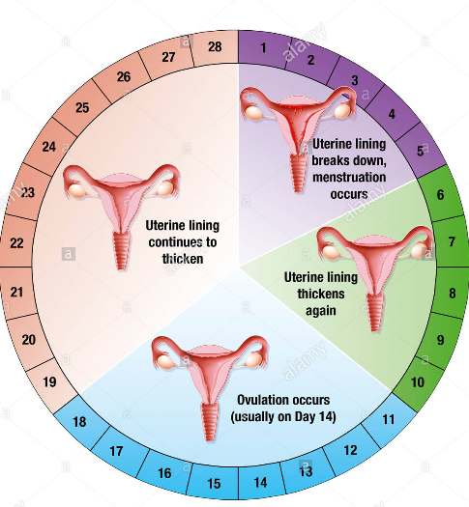
Menstrual cycle
On days 1-7: the menstrual cycle begins with a period, where blood flows from the uterus and leaves the body through the vagina. The female is not considered to be fertile and can have unprotected sex.
On days 8-19: Ovulation usually occurs on day 14 however sperm can live for up to 7 days; so if sexual intercourse occurred on day 8, it could still be around to fertilise the ovum released on day 14. The female is fertile, so should avoid unprotected sex to avoid pregnancy.
On day 20 through the end of your cycle:
if an egg is fertilised by sperm, a foetus will start to grow. If fertilisation does not occur, the egg will be reabsorbed into the body and the female will no longer be fertile, so can have unprotected sex.

Slide 58
TASK: Create a flow chart to explain what happens at all 4 stages of the menstrual cycle. Information you should include: - what happens during menstruation - what happens to the endometrium at each stage - which day ovulation occurs on - what happens during ovulation - what happens if an egg is and is not fertilised - the number of days each stage lasts - when the female is most fertile and when conception could happen

Slide 59
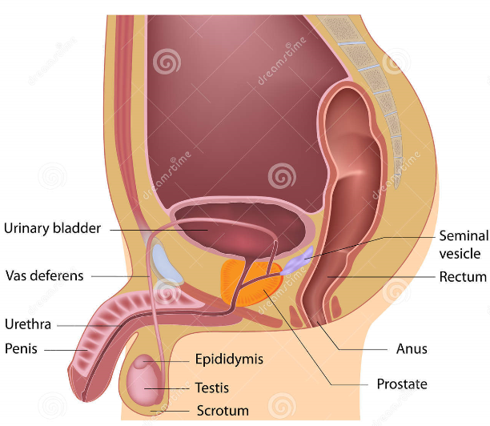
Male reproductive system
Seminal vesicles – a pair of glands found in the male pelvis which produce many of the ingredients of semen. During ejaculation, the smooth muscle layer of the seminal vesicles contracts, releasing the seminal vesicle fluid.
Penis – this consists of the shaft (that enters the vagina) and the glans (the tip) which has a small opening (the urethra) where the fluids leave the body from.
Urethra – this tube inside the penis carries urine and sperm but not at the same time. A ring of muscles controls this.
Sperm duct system/epididymis – the sperm duct system consists of the epididymis (which contains the sperm) and the vas deferens (which are the sperm ducts/tubes where sperm travel from the testes to the urethra). Glands produce the fluid semen which mixes with the sperm and carries it.
The testes are in a bag of skin (scrotum) – they make millions of sperm and produce testosterone which develops the male body.

Slide 60
Quick-fire questions
What is ovulation?
Which day of the menstrual cycle does ovulation usually occur?
How many days can sperm live for?
How long does an unfertilised egg live for?
Between which days in the menstrual cycle is a woman most fertile?
At which point does conception happen?
What is the correct term for the lining of the uterus?
What two parts of anatomy are part of the sperm duct system?
What part of the male anatomy carries urine and sperm?
When do the seminal vesicles release their fluid?

Slide 61
TASK: Create a poster which explains the structure and function of the male and female reproductive systems to explain to children. Female parts to include: - ovaries - fallopian tubes - uterus - endometrium - cervix - vagina
Male parts to include:
- testes - sperm duct system/epididymis - vas deferens - urethra - penis - seminal vesicle

Slide 62
How reproduction takes place
Ovulation
Birth
Conception/
fertilisation
Implantation
Development of embryo to foetus

Slide 63
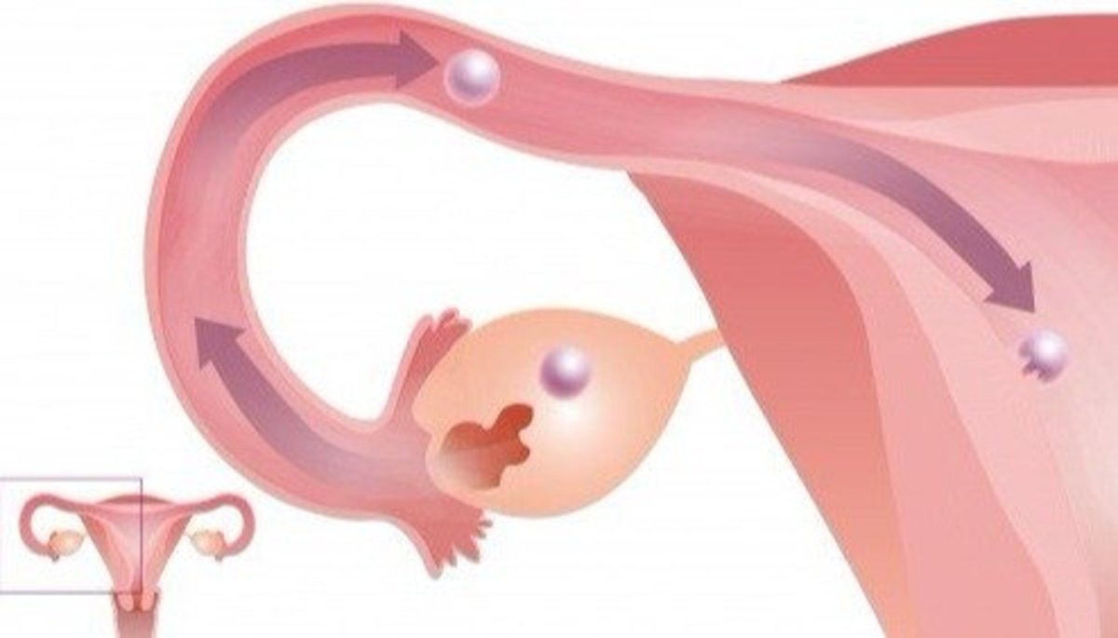
1. Ovulation
An egg/ovum is released from alternative ovaries each month, around day 14 of the menstrual cycle. The fallopian tubes are lined with cilia (microscopic hair-like filaments) which help to waft the egg along the tube, towards the uterus. The egg is also coated in a jelly substance to prevent it from sticking to the walls of the tube.

Slide 64
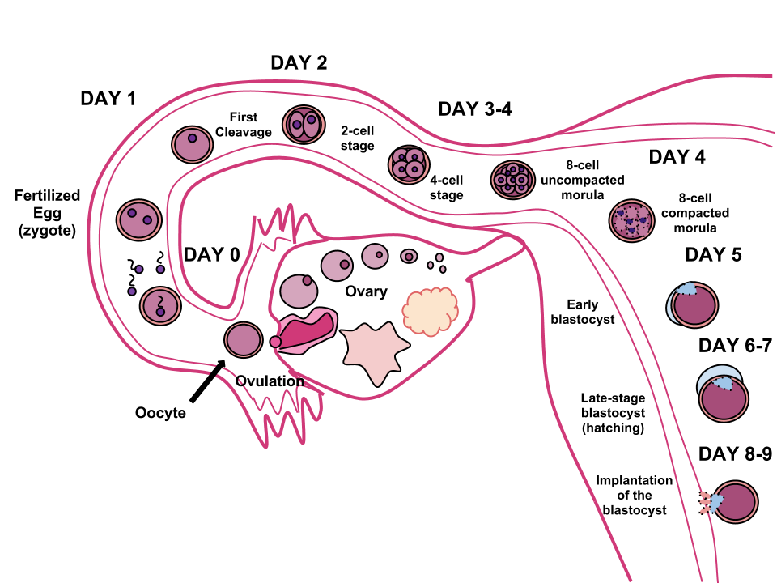
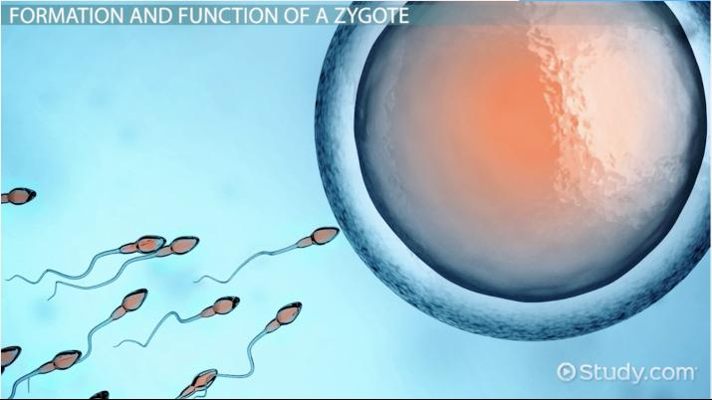
2. Conception/ fertilisation
A sperm meets the egg in the fallopian tube and loses its tail as they fuse together to become one cell. The fertilised egg is called a zygote and it continues to move along the fallopian tube towards the uterus over 3 to 5 days. The zygote divides to form a ball of 16 cells called a blastocyst. (The inner group of cells will become the embryo, the outer group of cells will become structures and membranes which nourish and protect the embryo).

Slide 65
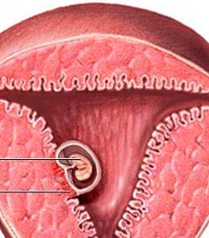
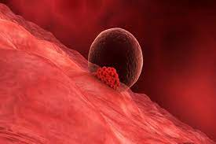
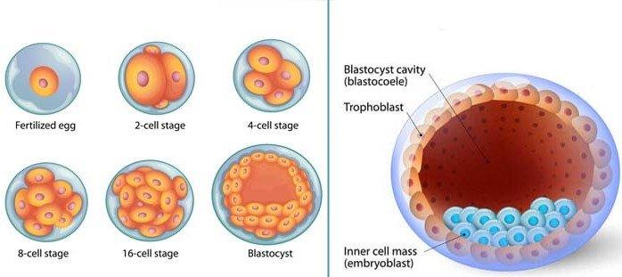
3. Implantation
The blastocyst reaches the uterus approximately 7 days after fertilisation, where it implants itself into the thickened lining of the uterus (endometrium). Once the blastocyst is firmly attached in the uterus, conception is complete and it is then referred to as an embryo.
https://www.youtube.com/watch?v=fMsPakRvBuM
https://www.youtube.com/watch?v=9AX1XwKCYQE

Slide 66
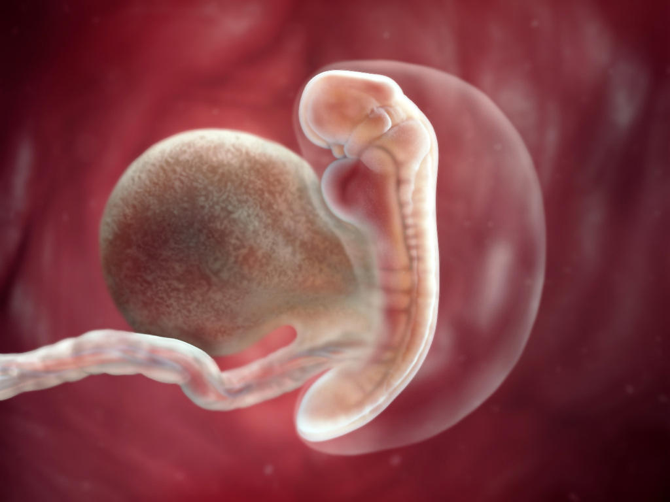
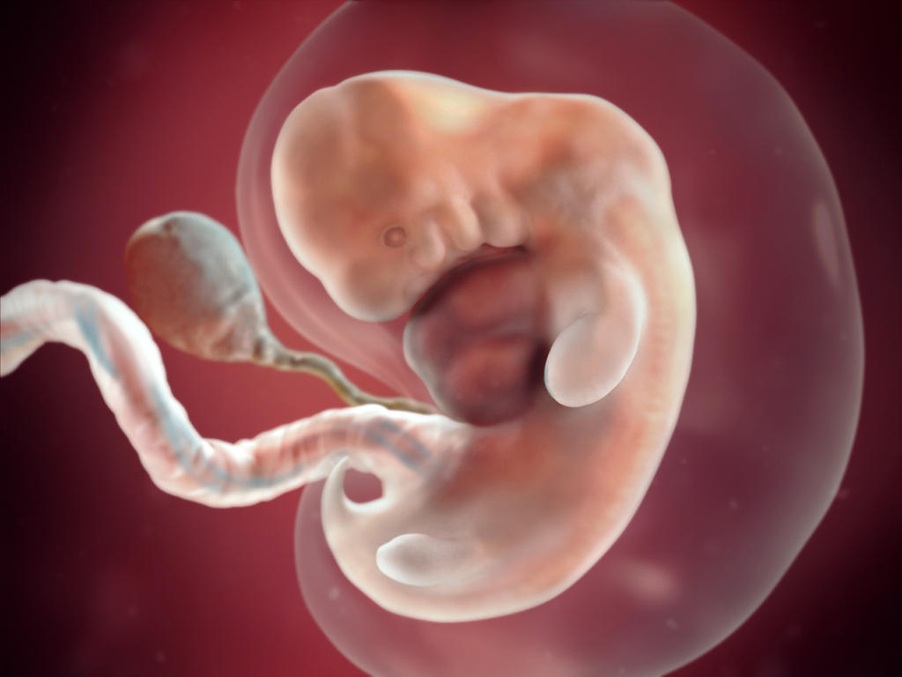
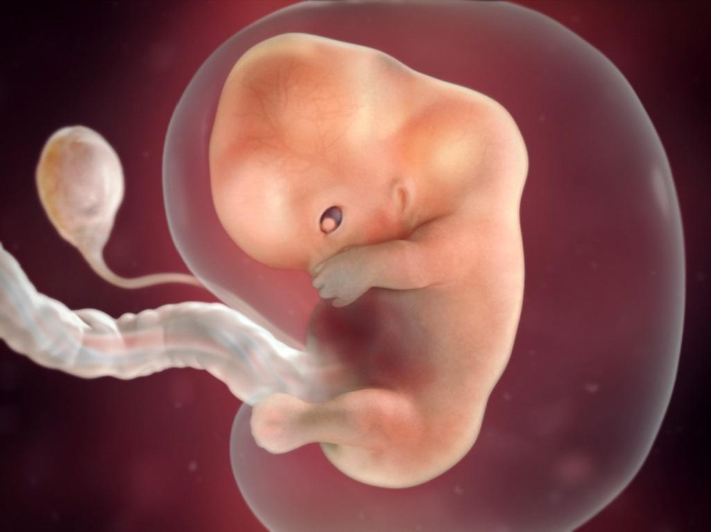
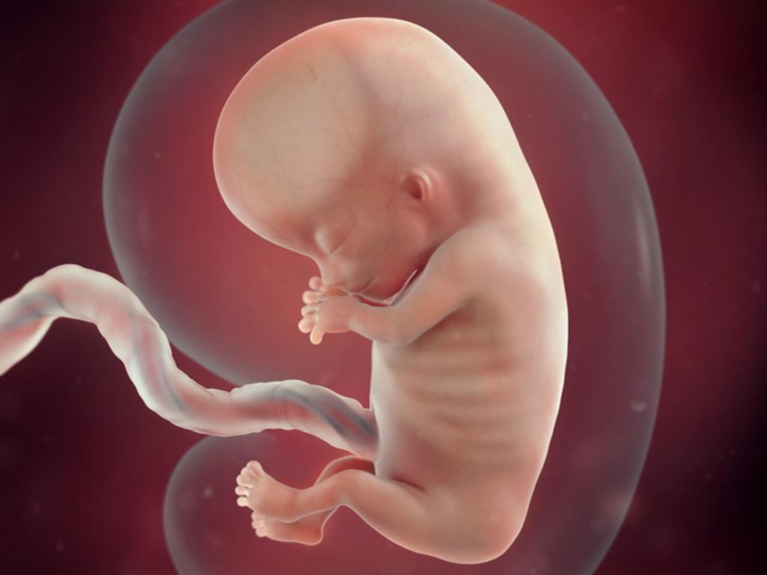
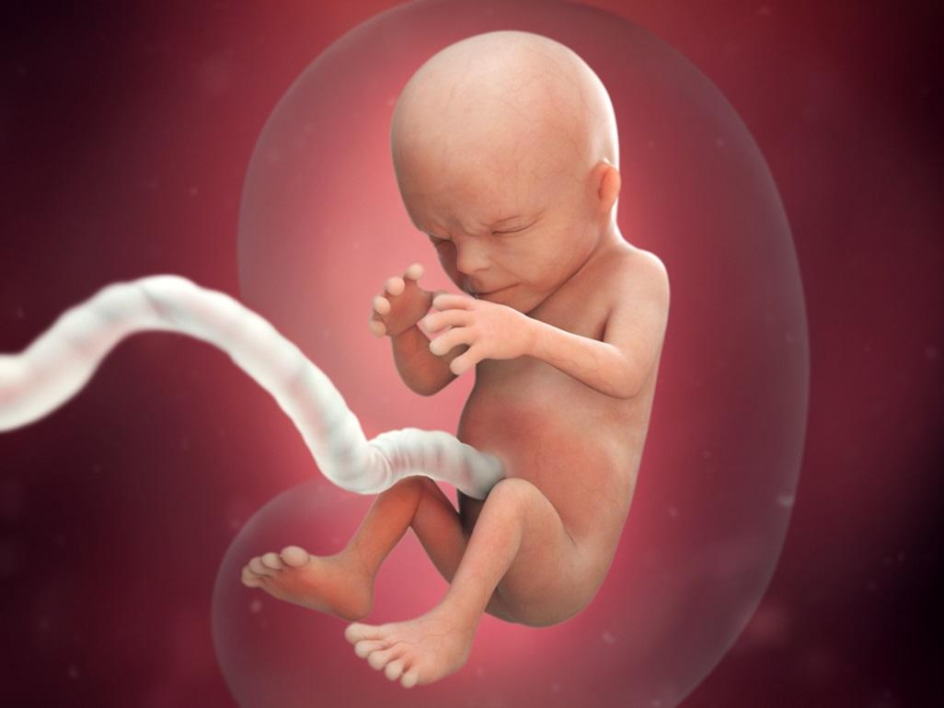
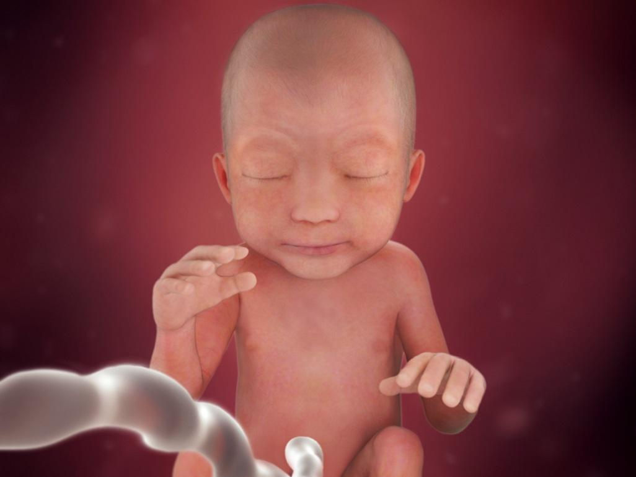
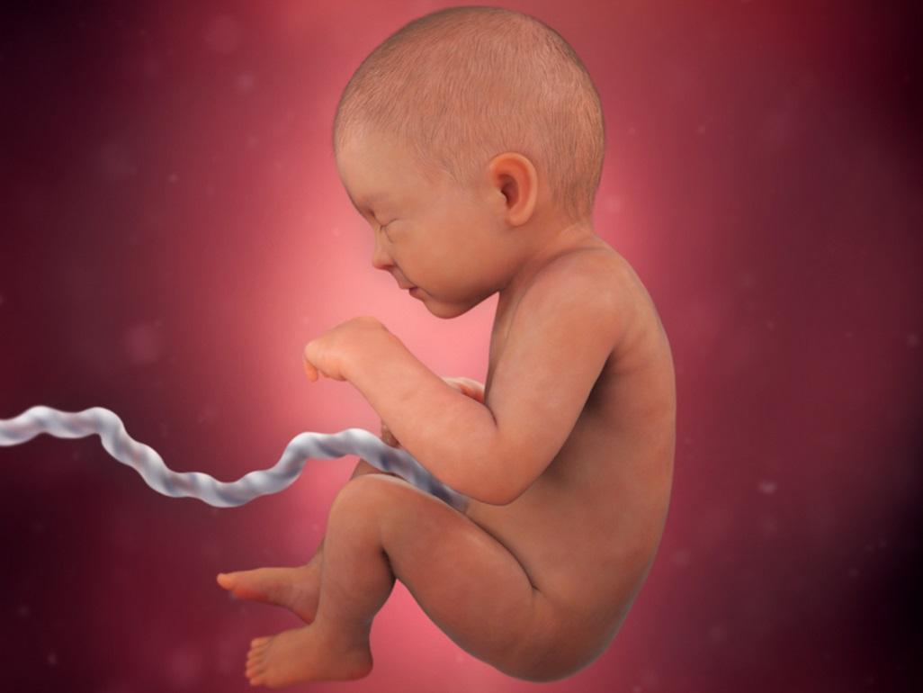
4. Development of embryo to foetus
5 weeks
7 weeks
9 weeks
11 weeks
14 weeks
24 weeks
27 weeks
33 weeks
*At the age of 8 weeks, the embryo becomes a foetus. The foetus will be 1 inch long and weigh 1/30 of an ounce.

Slide 67
Development of the embryo and foetus
The outer cells of the embryo link with the mother’s blood supply through the umbilical cord, amnion and placenta.
Amniotic fluid
This is the protective liquid contained in the amniotic sac. It provides a cushion for the foetus, helping to keep it safe from bumps and injury. It also contains nutrients, hormones and antibodies. At first, the fluid consists of water from the mother’s body. As the foetus grows, it is also made up of the baby’s urine.
Umbilical cord
This is a tube that connects the foetus to the mother during pregnancy. It has a vein that takes food and oxygen from the placenta to the baby, and two arteries that carry waste from the baby to the placenta.
Placenta
This is an organ that develops in the uterus during pregnancy. The placenta supplies oxygen and nutrients to the baby and removes waste products from the baby, through the umbilical cord.

Slide 68
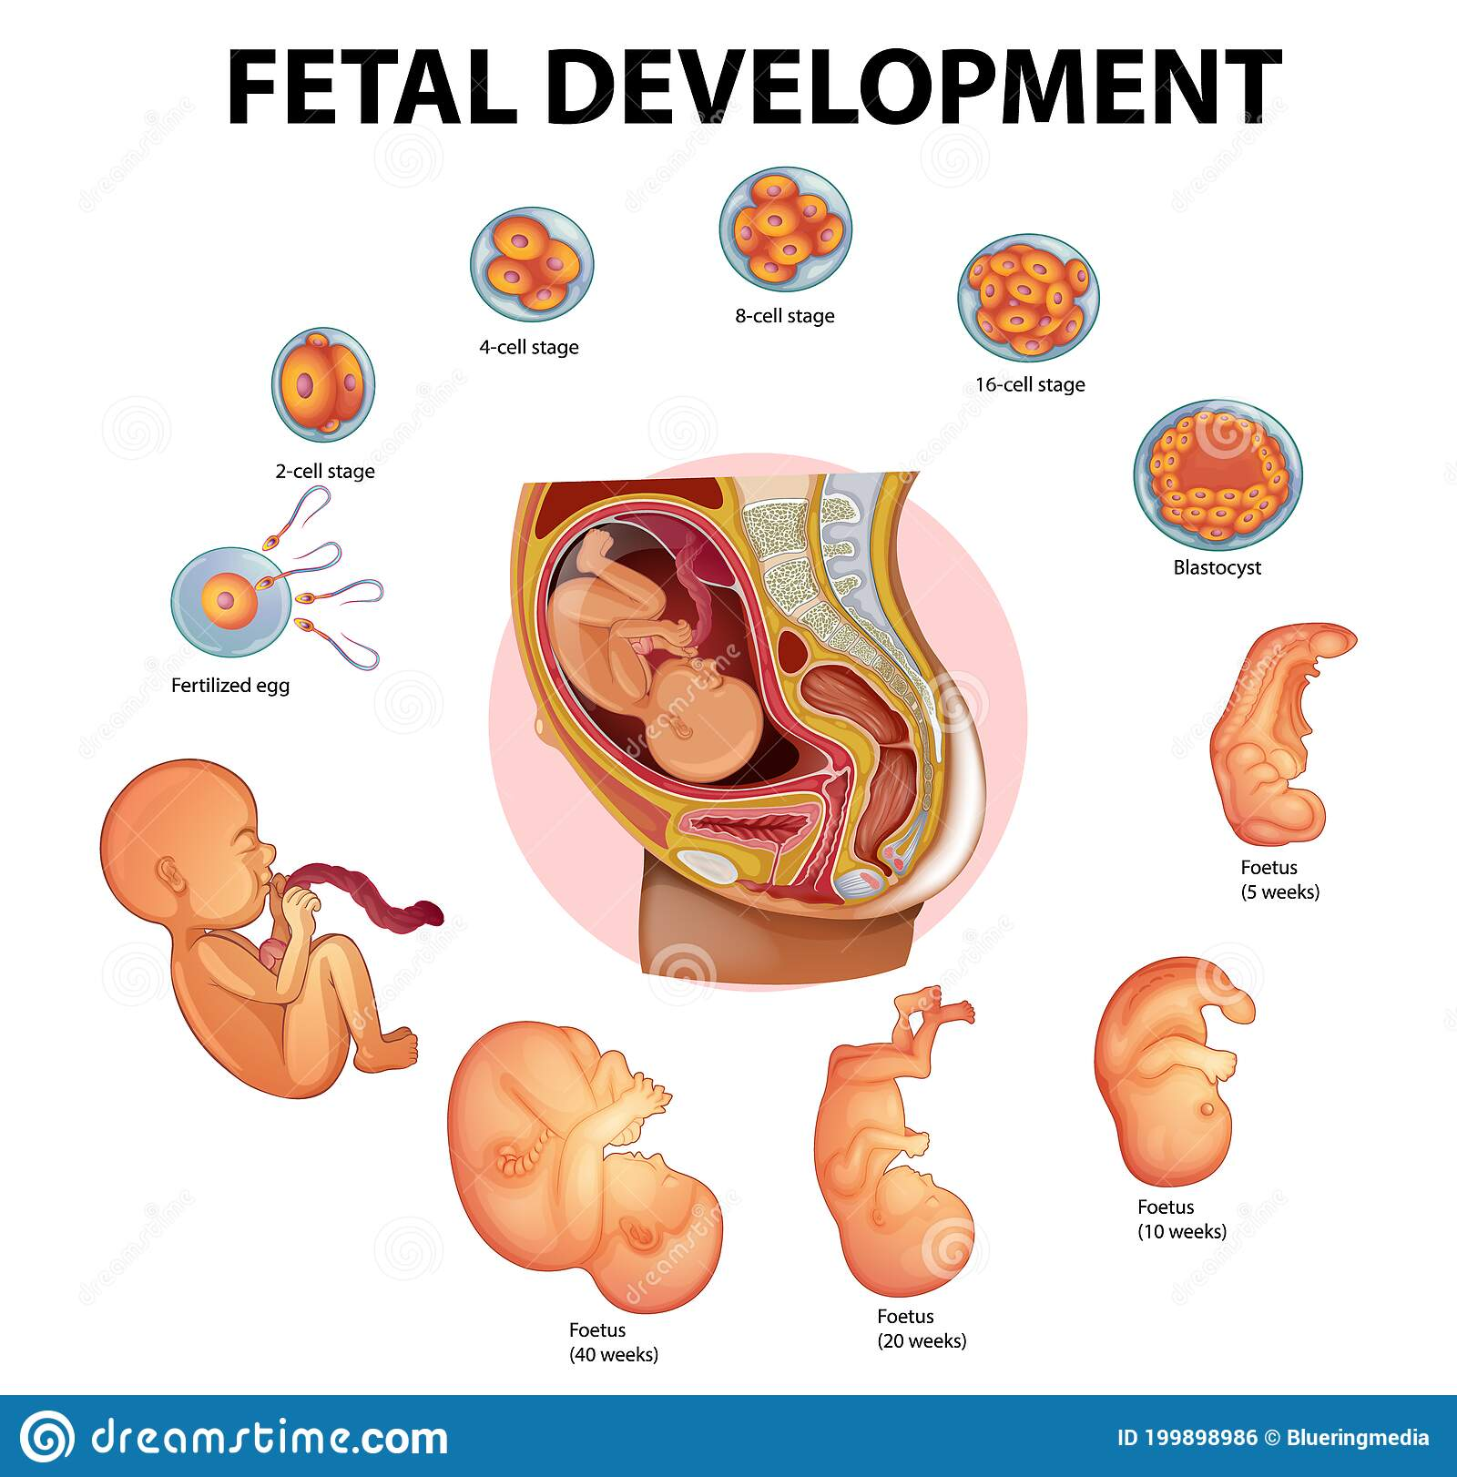
TASK: Create a timeline to show the development of an embryo to a foetus. Include images and the key features at each stage e.g. grows limbs, ears formed etc.
https://www.youtube.com/watch?v=EhUOkTPW7L0

Slide 69
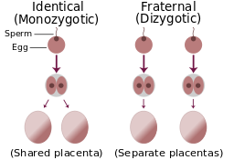
Multiple pregnancies
A multiple pregnancy is where more than one baby grows in the uterus at a time e.g. twins.
Identical twins (monozygotic): this is where one zygote splits to form two separate embryos. Both embryos share once placenta.
Non-identical twins (dizygotic or fraternal): this is where two eggs are released during ovulation and both eggs become fertilised by a separate sperm. Both embryos have their own placenta.
In rare cases, twins can have the same mother and different fathers.

Slide 70
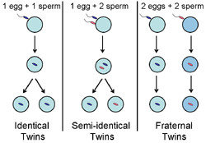
Multiple pregnancies
Semi-identical twins: this is where one egg becomes fertilised by two separate sperm. The mother’s DNA is identical in both babies but the father’s DNA varies in each twin.
They may share a placenta but it is particularly obvious that they are not identical twins when the babies are of two different genders (one male, one female).
https://www.reuters.com/article/us-health-reproduction-mosaic-twins-idUSKCN1QG2YH

Slide 71
TASK: Explain how the cycle of reproduction takes place to a couple wanting to try for a baby. Information you should include: - Ovulation: when it happens and when a female is most fertile - Conception: how an egg becomes fertilised, when a zygote becomes a blastocyst and how multiple pregnancies occur - Implantation: how the blastocyst implants, when it becomes an embryo - Embryo to foetus development: the changes and development that occur throughout the weeks of pregnancy up to the point of birth

Slide 72
The signs and symptoms of pregnancy
Breast changes: The breasts and nipples become larger, veins may become more visible and the nipples and areola may also darken. The breasts may feel more tender and the skin may become itchy or dry as it stretches to accommodate their growing size.
Missed period: A missed period, or a very light period, is often the first sign of pregnancy. Once conception has happened, the body produces hormones that stop ovulation and the shedding on the uterus. The menstrual cycle is stopped and menstruation will not happen again until after the baby is born.
Nausea: The increase in hormones needed to form a healthy baby is thought to play a role in ‘morning sickness’ and this usually begins around six weeks after the last period and clears by weeks 16 to 20 of pregnancy. Extreme and prolonged nausea during pregnancy can be dangerous due to a lack of fluids or nutrients in the body.

Slide 73
The signs and symptoms of pregnancy
Passing urine frequently: Hormones stimulate the kidneys to expand and produce more urine, to help the body dispose of extra waste more quickly. As the baby gets bigger, its weight may also add pressure to the bladder. There may also be constipation and an increase of vaginal discharge.
Tiredness: Hormonal changes can cause the woman to feel extremely tired during the first 12 weeks of pregnancy. After this, the woman may still experience tiredness due to carrying extra weight and difficulty sleeping due to the bump causing discomfort. The hormonal changes can also cause a woman to feel emotional or upset.

Slide 74
Revision
2. Can you write down an advantage and disadvantage for all 5 factors?
3. What is genetic counselling?
4. What are the 4 hereditary diseases and 1 genetic condition we have looked at?
Cystic fibrosis
Sickle cell anaemia
Huntington’s disease
Muscular dystrophy
Downs syndrome
5. For each disease, can you explain what it is, what the symptoms are and how it affects a persons life?
6. What 5 factors need to be considered for pre-conception health?
Diet
Exercise
Healthy weight
Up-to-date immunisations
Dangers of smoking, alcohol, recreational drugs
1. What are the 5 factors which affect the decision to have children?
The relationship between partners
Parental age
Finance
Peer pressure/social expectation
Genetic counselling for hereditary diseases

Slide 75
Revision
10. What are the hormonal methods of contraception?
Combined or mini pill
IUD or IUS
Injection
Patch
Implant
Natural family planning method
11. What are 2 advantages and disadvantages of each method of contraception?
12. How do identical and non-identical twins happen?
13. What happens during the menstrual cycle?
14. What are the stages of the reproduction cycle?
15. What are the 5 signs and symptoms of pregnancy?
Missed period
Breast changes
Passing urine frequently
Tiredness
Nausea
7. What is foetal alcohol syndrome, how does it affect the features of a person and what are the symptoms of the condition?
8. What are 5 primary needs that parents need to meet?
9. What are the barrier methods of contraception?
Male & female condom
Diaphragm or cap

Slide 76
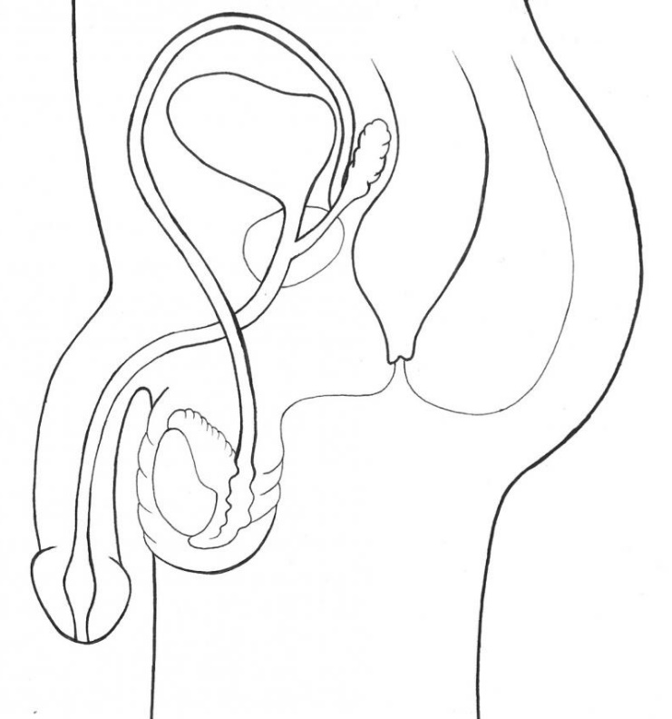
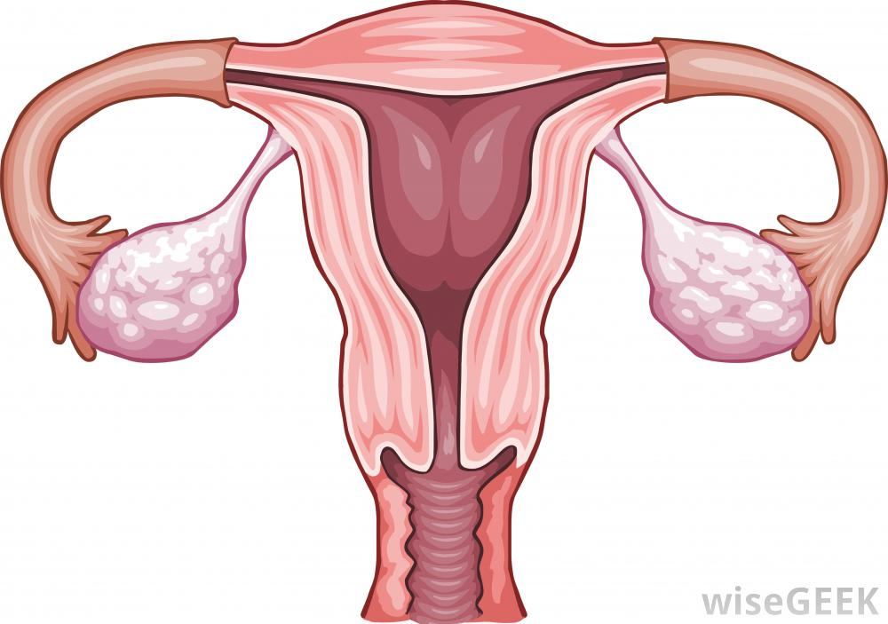
Label correctly
Fallopian tube
Uterus
Penis
Urethra
Sperm duct system
Ovary
Endometrium
Epididymis
Cervix
Vagina
Scrotum
Testes

Slide 77
Exam question

Slide 78
Exam answer

Slide 79
Exam question

Slide 80
Exam answer

