Slide 1
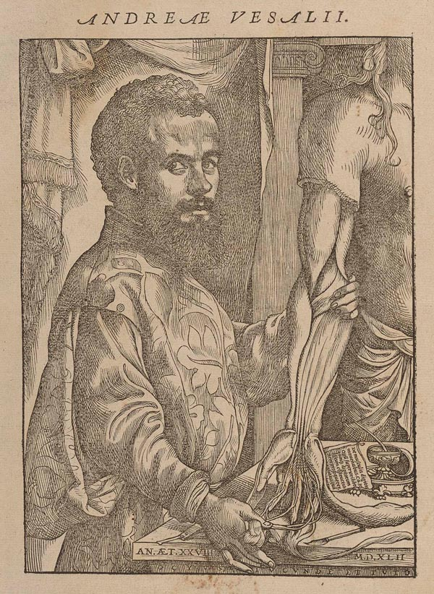
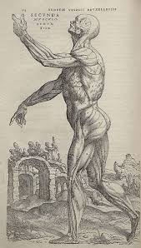
Edexcel GCSE 9-1 History
Medicine in Britain, c1250 to present workbook
Key Topic 2
c1500–c1700: The Medical Renaissance in England
version 3
Edexcel 9-1 GCSE History Medicine in Britain, c1250 – present PLC |  |  | Lesson date | Date revised
Key topic 2: c1500–c1700: The Medical Renaissance in England | Key topic 2.1 Ideas about the cause of disease in the Renaissance | A. Continuity and change in explanations of the cause of disease and illness. A scientific approach, including the work of Thomas Sydenham in improving diagnosis. The influence of the printing press and the work of the Royal Society on the transmission of ideas.
 | Key topic 2.2 Approaches to prevention and treatment | A. Continuity in approaches to prevention, treatment and care in the community and in hospitals.
 |  | B. Change in care and treatment: improvements in medical training and the influence in England of the work of Vesalius.
 | Key topic 2.3 Case Study - Harvey / Great Plague | A. Key individual: William Harvey and the discovery of the circulation of the blood.
 |  | B. Dealing with the Great Plague in London, 1665: approaches to treatment and attempts to prevent its spread.
Notes:
21.0 x 29.7 cm

Slide 2
Contents Page
p.2
Topic | Page
KT1 Recap Quiz | 3-5
Renaissance Key Words | 6-7
KT2.1 Ideas about the cause of disease in the Renaissance A scientific approach, including the work of Thomas Sydenham in improving diagnosis. | 8-18
12 mark exam practice question | 19
Key Topic 2.1 Quiz | 20
KT 2.2A Approaches to Prevention and Treatment in the Renaissance Continuity in approaches to prevention, treatment and care in the community and in hospitals. | 21-28
KT 2.2B Approaches to Prevention and Treatment in the Renaissance Change in care and treatment: improvements in medical training and the influence in England of the work of Vesalius. | 29-32
Key topic 2.3A Case Study Key individual: William Harvey and the discovery of the circulation of the blood. | 33-38
16 mark exam question practice - I Do. We Do, You Do. | 39-40
Key topic 2.3B Case Study B. Dealing with the Great Plague in London, 1665: approaches to treatment and attempts to prevent its spread. | 41-45
Renaissance Review | 46-53
Middle Ages and Renaissance Quiz | 54
Notes | 55-56

Slide 3
Key Topic 1 Quiz - Middle Ages Medicine
p.3
1) What did people pay to the Church to ensure that they were ‘good Christians’ and thought it would prevent disease?
____________________________________________________________________________________________
2) What does it mean that Middle Ages people had a conservative attitude ?
____________________________________________________________________________________________
3) What did the Church teach about sin and disease?
____________________________________________________________________________________________
4) What was leprosy and what were lepers required to do to prevent the spread of the disease?
____________________________________________________________________________________________
5) What was astrology and how was this connected to the treatment of disease?
____________________________________________________________________________________________
6) What does supernatural mean? How is this different than natural?
____________________________________________________________________________________________
7) What does rational mean? ____________________________________________________________________________________________
8) What were the 4 humours? ____________________________________________________________________________________________
9) Who created this idea and did he say that had to happen with each person’s humours?
____________________________________________________________________________________________
10) How did Galen develop the Theory of the Four Humours in Roman times?
____________________________________________________________________________________________
11) Why was the Theory of the Four Humours so popular in the Middle Ages?
____________________________________________________________________________________________
12) What was the Articella?
____________________________________________________________________________________________
13) Why did the Catholic Church support Galen’s ideas?
____________________________________________________________________________________________

Slide 4
Key Topic 1 Quiz - Middle Ages Medicine
p.4
14) When physicians witnessed a rare autopsy in university, what was being read during the dissection? ___________________________________________________________________________________________
15) What was the theory of miasma?
____________________________________________________________________________________________
16) How was a urine chart used for diagnosis?
____________________________________________________________________________________________
17) What were the 3 factors that meant there was continuity in the cause of disease?
____________________________________________________________________________________________
18) Give 3 religious or supernatural treatments for disease.
____________________________________________________________________________________________
20) Name the 3 types of bloodletting.
____________________________________________________________________________________________
21) Besides bloodletting, how else were the humours balanced?
____________________________________________________________________________________________
22) What were the issues with blood-letting?
____________________________________________________________________________________________
22) What was an emetic?
____________________________________________________________________________________________
23) Name 2 others ways people could purge
____________________________________________________________________________________________
24) What was the theriaca?
____________________________________________________________________________________________
25) Why did bathing help balance peoples humours?
____________________________________________________________________________________________

Slide 5
Key Topic 1 Quiz - Middle Ages Medicine
p.5
26) What was the Regimen Sanitatis?
____________________________________________________________________________________________
27) Give 2 pieces of advice as part of the Regimen Sanitatis.
____________________________________________________________________________________________
28) Write 3 facts about Middle Ages physicians.
____________________________________________________________________________________________
29) Write 3 facts about Middle Ages apothecaries.
____________________________________________________________________________________________
30) Write 3 facts about Middle Ages barber-surgeons.
____________________________________________________________________________________________
31) What percentage of hospitals were owned and run by the church in England?
____________________________________________________________________________________________
32) What happened to a an ill person when they went to a church hospital?
____________________________________________________________________________________________
33) Record 3 ideas behind the cause of the Black Death.
________________________________________________________________________________________
34) Name 2 symptoms of the Black Death.
____________________________________________________________________________________________
35) Explain 2 treatments of the Black Death.
____________________________________________________________________________________________
36) Explain 2 ways in which people tried to prevent the Black Death.
____________________________________________________________________________________________
Total ___ / 36
Three things you need to remember:

Slide 6
Medicine Key Topic 2 Renaissance Key Words p1
p.6
1 | apothecary | Affordable chemists from Middle Ages through the Renaissance who made herbal remedies and medicines. Often a cheap alternative to a doctor they did not swear to the Hippocratic Oath and would often prescribe poison in addition to helpful herbal cures. (MA, RE)
2 | Catholic Church | Also known simply as ‘The Church’. Controlled medical training in Middle Ages universities and promoted Galen’s teaching and superstition in medicine. Also funded hospitals in monasteries that would give the sick a clean place to recover and encouraged hospitality for the poor. The Church lost influence in the 16th century due to the Reformation and the Renaissance. (MA, RE)
3 | Dissolution of the Monasteries, 1541 | Between 1536 and 1541 Henry VIII closed monasteries and convents to obtain their land and wealth. Destroyed the network of Church hospitals open to the poor and invalid. (MA)
4 | English Reformation | A series of events in 16th century England by which the Church of England broke away from the authority of Catholic Church. (RE)
5 | Great Plague, 1665 | Lasting from 1665 to 1666, was the last major epidemic of the bubonic plague (Black Death) to occur in England and killed an estimated 100,000 people—almost a quarter of London's population—in 18 months. On a far smaller scale than the earlier Black Death pandemic. Physicians recommend a variety of cures including prayer, fasting, smelling perfume, quarantine, smoking tobacco and visiting plague doctors dressed as birds. Local authorities (government) took actions including plague searchers to look for the sick, quarantining the ill for 28 days, banning public events, lighting fires and killing 40,000 dogs and 200,000 cats. (RE)
6 | Harvey, William | English doctor who wrote "The Motion of the Heart and Blood in Animals" in 1628 and discovered that blood circulated around the body instead of being burnt up like fuel as Galen taught. Also proved the existence of veins in bringing blood back to the heart. (RE)
7 | humanism | Humanism is a cultural movement that emerged during the Renaissance from the 14th through 16th centuries that emphasized the value of human beings and generally prefered critical thinking and evidence over acceptance of dogma or superstition. Lead to the increased emphasis on education and the reduction in Church authority in Europe. (RE)
8 | king's touch (royal touch) | A form of laying on of hands, whereby English monarchs touched their subjects, regardless of social classes, with the intent to cure them of various diseases and conditions. Most commonly used to treat scrofula (tuberculosis) (MA, RE)
9 | medical chemistry / iatrochemistry | The increased use of scientific chemistry to create medicines and treatments as opposed to herbs. Starting in the 17th century by Paracelsus, doctors commonly used metals, salts and minerals to attempt to cure minor ailments. The Pharmacopoeia Londinensis published by the College of Physicians described 2,140 remedies based upon 122 different chemical preparations including the use of mercury which was poisonous. (RE)
10 | miasma / miasmata | Theory that disease is produced from bad smells or pollution. Caused many to try and clean up the streets during epidemics like the Black Death, bathe, and generally avoid pungent odors. (MA, RE, IR)
11 | New World | The ‘discovery’ of North America by Europe after 1492 which led to the increase in herbs and medicines available for treatment and prevention. (RE)

Slide 7
Medicine Key Topic 2 Renaissance Key Words p2
p.7
12 | pest houses | A hospital for people suffering from severe infectious diseases, especially the plague. Also known as plague houses or poxhouses, these new locations would attempt to treat those rejected by typical Medieval hospitals. (MA, RE)
13 | Printing Press | Created by Johann Gutenberg in 1440, the press allowed for the wide distribution of texts, books and pamphlets. It dramatically increased the literacy rates in Europe leading to increased scientific inquiry, communications and medical progress. (RE)
14 | quack doctors | Fake doctors who would sell ‘cure-all’ remedies preying on people’s superstitions and ignorance (MA, RE)
15 | quarantine | The act of isolating a person in their home or closing off a town to fight the spread of an epidemic. Used during both the Black Death (1348) and the Great Plague (1665-66) as people who contracted the disease were locked in their homes to die and a red cross was put above their door to warn others. (MA, RE)
15 | Royal Society | Founded in November 1660, it was granted a royal charter by King Charles II and included famous members such as Isaac Newton, Robert Hooke, Christopher Wren and Robert Boyle. The group of scientists were responsible for establishing the scientific method in England and promoting scientific knowledge and argument in the 17th through the 19th centuries. (RE, IR)
17 | Scientific Revolution | A concept used by historians to describe the emergence of modern science during the 16th through 18th centuries, when developments in mathematics, physics, astronomy, biology, anatomy and chemistry transformed the views of society about nature. (MA, RE)
18 | scrofula | A form of tuberculosis common in the Middle Ages and Renaissance. Many believed it could be cured by touching a King. (MA, RE)
19 | Sydenham, Thomas | English physician who wrote Observationes Medicae in 1676 which theorised that illness was caused by external factors rather than the Four Humours. He encouraged clinical observation and stated that the nature of the patient had little to do with disease. Sydenham also pioneered new treatments such as successfully using cinchona bark from Peru, which contains quinine, to treat malaria. (RE)
20 | transference | Mistaken 17th century belief that an illness or disease could be transferred onto something else. People would commonly rub inanimate objects on warts or boils in the attempt to transfer them away from their body. (RE)
21 | Vesalius, Andreas | Belgian physician who wrote "The Fabric of the Human Body" in 1543 with detailed illustrations of anatomy and correcting around 300 mistakes of Galen. These included the fact the human jawbone was one part and not two and that men did not have fewer ribs than women. Vesalius’ work promoted the understanding of anatomy and encouraged physicians to challenge old Galenic ideas although it did not overthrow the Theory of the Four Humours as not alternative causes for illness were found. (RE)

Slide 8
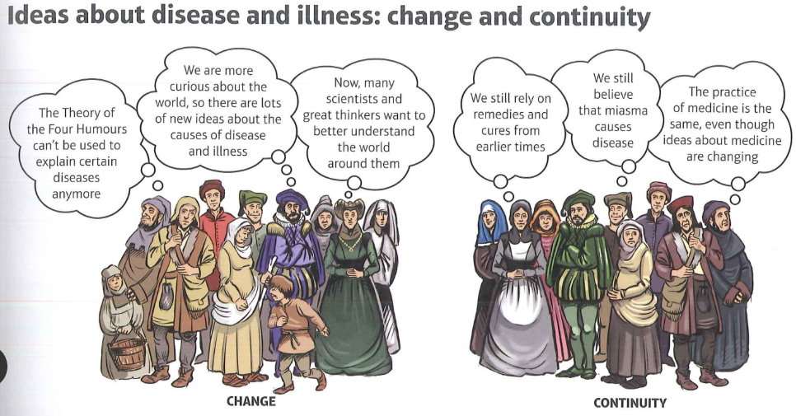
KT 2.1 - Ideas about the cause of disease and illness in the Renaissance
p.8
C1500-c1700: The Medical Renaissance in England
‘Renaissance’ is a French word that means rebirth. The Medical Renaissance refers to a period when new ideas were beginning to influence medicine. These new ideas were slowly breaking down old beliefs and rethinking the way the world worked. At this time, Protestantism challenged the teachings of the Catholic Church - this made the Catholic Church much less able to promote its preferred beliefs about science and nature.
Scientists provided evidence that the Greek and Roman teachings about how the world worked were incorrect. Vesalius, a doctor working in Padua, proved through dissection that Galen’s work on anatomy was wrong. Although these ideas took a long time to become widespread, the new printing presses meant that they could be published and spread even though they went against the teachings of the Church.
Between the years 1500 and 1700, there were certainly a lot of new, exciting ideas. However, as you will see, the impact that these ideas had on medical treatments during this period was minimal. It took a long time for people to let go of their old trusted beliefs about the Theory of the Four Humours. Therefore, this period was more about laying the foundations for changes in medicine to come, rather than changes in medicine at the time.
TASK - Highlight the one sentence you feel is the most important in each of the above paragraphs.Rewrite the sentences below in the order you think is the most important.
________________________________________________________________________________________________________________________________________________________________________________________________________________________________________________________________________________________________________________________________________________________________________________________________________________________________________________________________________________________________________________________________________________________________________________________________________________________________________________________________________________________________________________________________________________________________

Slide 9
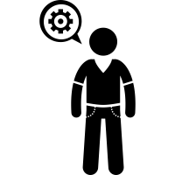
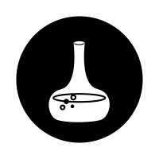
KT 2.1 - Ideas about the cause of disease and illness in the Renaissance
p.9
Add a title for each paragraph
Highlight the KEY information in each paragraph, be brief.
Summarise each paragraph in 1-2 bullets.
People who fell ill during the period 1500 to 1700 were likely to believe the same things about the cause of their illness as their medieval ancestors. Very little really changed in the practice of medicine during this period. However, all across Europe, enormous shifts were taking place in other areas of daily life. Beautiful art was being created in new styles and with new techniques; beliefs were changing, with new forms of Christianity and a more secular society developing; and understanding of the surrounding world was increasing with scientific discoveries.
Because of these changes, medical knowledge grew with the changing attitudes of ordinary people. The general population of Europe wanted better answers to the questions about what caused disease. Epidemics of the plague and other killer diseases, such as smallpox, the Great Pox (syphilis) and sweating sickness, could not be easily explained by the Theory of the Four Humours. They affected everybody in the same way and were not cured by traditional humoural treatments, like bloodletting and purging.
There was still widespread belief in miasmata (miasma) as a cause of humoural imbalance and disease. A miasma could be the product of rotten vegetables, decaying bodies of humans or animals, excrement or any swampy, smelly, dirty place. However, even this did not provide a satisfactory explanation for the spread of disease when people took such care to avoid miasma.
Some people came up with new ideas about the causes of disease and illness. They included new ideas based on alchemy and new discoveries about the body. Some of these new ideas are listed in the table on the next page, together with the name of the scientist or doctor who discovered them.
Keywords
Secular - Not religious or in any way connected with spiritual beliefs.
Alchemy - This was an early form of chemistry. Alchemists tried to turn one material into another: mostly, they were trying to discover a way of making gold.

Slide 10
KT 2.1 - Ideas about the cause of disease and illness in the Renaissance
p.10
TASK - Rank the new ideas about disease and illness in order of importance. 1 being the most important idea. Explain why you give the most and least important below.
________________________________________________________________________________________________________________________________________________________________________________________________________________________________________________________________________________________________________________________________________________________________________________________________________________________________________________________________________________________________________________________________________________________________________________________________________________________________________________
New ideas about disease and illness. | Influential individual. | Rank
In the 16th century, the Theory of the Four Humours was rejected by some radical physicians. Disease was seen as something separate from the body, which needed to be attacked. New chemical treatments started to appear, influenced by the increasing popularity of alchemy. | Paracelsus, a Swiss scientist and medical professor.
In 1546, a new text called On Contagion theorised that disease was caused by seeds that spread in the air. | Girolamo Fracastoro, an Italian physician.
In 1628, a new theory was published in Britain, which suggested that blood circulated around the body instead of being made in the liver, as taught by Galen. | William Harvey, an English scientist.
A better understanding of the digestive system developed. This meant that people gradually stopped believing disease was caused by eating the wrong things. Urine was no longer seen as an accurate way of diagnosing illness. | Jan Baptiste van Helmont, a Flemish physician.
New microscopes were being developed, which allowed for a much clearer magnification. A new book, Micrographia published in 1665, showed many detail images, including a close-up drawing of a flea, copied from a magnified image. | Robert Hooke, an English scientist and head of experiments at the Royal Society.
In 1678, the medical textbook Observationes Medicae was published. This theorised that illness was caused by external factors, rather than the Four Humour. | Thomas Sydenham, an English physician.
By 1683, more powerful microscopes had been developed to allow for the observation of time “animalcules” or little animals in plaque scraped from between the teeth. The images were not very clear, but they were visible. This was the first recorded observation of bacteria but they did not connect germs to causing disease. | Antony van Leeuwenhoek, a Dutch scientist.

Slide 11
KT 2.1 - Ideas about the cause of disease and illness in the Renaissance
p.11
So, due to all these new discoveries and ideas, by c1700:
The Theory of the Four Humours had been discredited - however, it was still being followed by the general population of Britain.
People began to explore the human body through detailed anatomy charts
Few new ideas about causes of disease had been discovered
Even though some of these ideas were very close to what we now know as the truth, they had very little impact at the time. This was due to several reasons. A better understanding of human anatomy (the makeup of the body) was developing all the time. However, there was no point studying correct drawings of the internal organs when it was impossible to diagnose or treat internal problems on a living patient as dissection was still forbidden in most places.
Also, the lack of quality medical instruments, such as microscopes, prevented any rapid change in people’s beliefs about the causes of disease. The new theories might have been very convincing, but without scientific proof they were just that - theories. Because the general public believed in the Theory of the Four Humours, most physicians stuck to the old methods. They were in the business of healing the sick, not coming up with better methods of doing it. Even those who did look for new ideas still needed to work, and patients did not want to pay physicians to experiment on them.
Changing Ideas
The key point to note here is that, while the practice of medicine did not change much at this time, ideas were starting to change. Scientists like Galileo and Copernicus were challenging the authority of the Church in other areas of scientific understanding like astronomy. This encouraged medical scientists to start looking beyond the works of Galen and Hippocrates. By the end of the 17th century, doctors and scientists had lots of new ideas about the causes of illness and disease - it just wasn’t applied to everyday medical practice.
TASK - Look at the statements below, do they suggest: Ideas that changed a lot, ideas that changed a little or ideas that stayed the same. Colour code or form a key and colour code the statements.
Ideas that changed a lot | Ideas that changed a little | Ideas that stayed the same.
Supernatural. Although astrology was much less popular from 1500, in times of epidemics people still wore charms to ward off the disease. | Miasma. The idea that disease was spread by bad smells and evil fumes was constant throughout this period - and even became more widespread during epidemics. | The Theory of the Four Humours. Very few physicians believed this by the end of the 17th century, though it was still used when diagnosing disease, because patients understood it.
The Human Body. There was a much better understanding of anatomy. | Diagnosis Using Urine. Physicians now understood that urine was not directly related to a person’s health. | Supernatural. Although astrology, was much less popular from 1500, in times of epidemics people still wore charms to ward off the disease.
The Influence of the Church. Most people now recognised that God did not send disease. However, intimes of epidemics, such as during the Great Plague, religious causes were still considered.

Slide 12
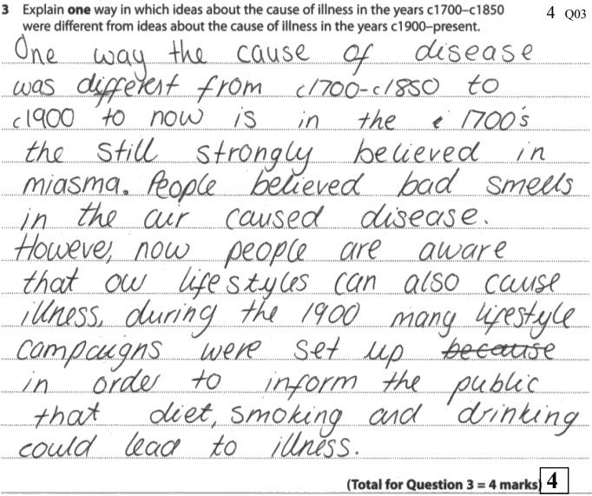
KT 2.1 - Ideas about the cause of disease and illness in the Renaissance
p.12
Exam Question
Explain one way in which ideas about the cause of disease and illness were similar in the 14th and 17th centuries 4 marks.
Mark Scheme:
Top Tips
Q3: 4 mark question – Difference/Similarity over two time periods
A brief but knowledge rich answer is required. For each time period give specific examples. Make sure you compare both periods explicitly. For example, ‘XXX was similar, because in the Middle Ages…and similarly in the 16th century…’.
You need to make sure you specifically explain what the difference is and to be specific with the historical detail.
This answer should not be very long, but it does need to have specific information for each time period. Try to make a general point that covers both time periods - for example. the idea of miasmata - and then give a specific example for each time period.
TASK - Copy out the question into your orange book and answer it.
Level 1 (1-2) | Simple/generalised comment about similarity/difference. Generalised information. Limited knowledge and understanding of periods.
Level 2 (3-4) | Features of period analysed to explain similarity/difference. Specific information added to support comparison. Good knowledge and understanding of periods.
Student example from 2019 Medicine exam showing 4/4 marks on similarity question across two time periods.

Slide 13
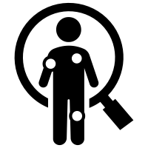
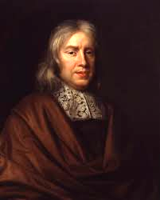
KT 2.1 - Ideas about the cause of disease and illness in the Renaissance
p.13
A scientific approach to diagnosis
One of the key changes during the Renaissance was the rise of Humanism. Humanism was characterised by a love learning, a new interest in classical scholars and the belief that human beings could make up their own minds when it came to discovering the truth of the world around them.
Humanism also represented a break with some of the old medieval traditions. Humanism rejected the Christian view that God was responsible for everything that happened, but they hadn’t yet figured out an alternative explanation. People returned to the original texts of ancient scholars such as Galen and Hippocrates. New translations of the works of Hippocrates and Galen started to appear. During the 16th century, 590 editions of Galen’s writings were published.
During the 17th century, more experimentation began to take place in the field of medicine. This, in part, was because the church had less authority in everyday life. Proof that Galen had been wrong about the human anatomy was becoming more widespread, thanks to the work of Vesalius. New ideas were starting to gain more support, although it would be a long time before this had an impact on everyday medical treatment.
Thomas Sydenham
Thomas Sydenham was nicknamed ‘the English Hippocrates’. He was a well-respected doctor in London in the 1660s and 1670s. The Theory of the the Four Humours was still being used at this time, but was starting to lose popularity. Sydenham’s work was very important in moving medicine in Britain away from the classical ideas of Galen and Hippocrates, and into the new era.
Sydenham refused to rely on medical books when diagnosing a patient’s illness. Instead, he made a point of closely observing the symptoms and treating the disease causing them. This was a change from the medieval method of treating each of the symptoms separately, instead of seeing them all as side effects of one cause.
One of Sydenham’s most controversial ideas was that diseases were like plants and animals, in that they could be organised into different groups. According to the Theory of the Four Humours, a patient’s disease was personal to them: it was caused by any number of individual factors, including the weather, diet and the patient’s particular balance of humours, which differed from person to person. This meant that treatment also varied from person to person.
Sydenham did not believe this. He encouraged his students to observe their patients, note down their symptoms in detailed descriptions and then look for remedies to tackle the disease. He theorised that the nature of the patient had little to do with the disease.
This was a very modern idea and laid the foundations for a more scientific approach to medicine from the 18th century onwards. Sydenham was not able to isolate and identify the various microorganisms that caused disease that he was observing. However, he was able to identify that measles and scarlet fever were separate disease.
Summarise what I think about the causes of disease and illness.

Slide 14
KT 2.1 - How significant was Thomas Sydenham?
p.14
3 Key Points:
1.
2.
3
Causing Change
Accepted by others
Relevance Today
Spreading Ideas
Area | Score | Explanation using specific facts and examples
Causing Change | /10
Spreading Ideas | /10
Accepted by others | /10
Relevance today. | /10

Slide 15
Renaissance Quiz - Ideas about the causes of illness and disease ____/7
p.15
What was the idea of Humanism? __________________________________________________________________________________________________________________________________________________________________________
How was Humanism a break from old medieval traditions? __________________________________________________________________________________________________________________________________________________________________________
Why were people able to do more experiments in the field of medicine? __________________________________________________________________________________________________________________________________________________________________________
Who was Thomas Sydenham? __________________________________________________________________________________________________________________________________________________________________________
What did Sydenham refuse to do? __________________________________________________________________________________________________________________________________________________________________________
What did he do instead? __________________________________________________________________________________________________________________________________________________________________________
What does ‘Renaissance’ mean? __________________________________________________________________________________________________________________________________________________________________________
HOT - How do these symbols relate to what you have read about the cause of disease and illness?

Slide 16
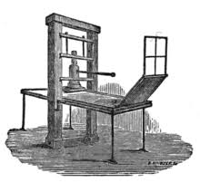
KT 2.1 - Ideas about the cause of disease and illness in the Renaissance
p.16
Improved Communications
The printing press also took book copying out of the hands of the Church. This meant that a much wider variety of subjects were written about, whereas, before this time, most books were about religious topics The Church was no longer able to prevent ideas they disapproved of being published. For example, physicians could now publish works criticising Galen.
TASK - On a scale of 1-10, how important do you think the influence of the printing press was for the ideas about the case of disease and illness. Explain your answer.
____________________________________________________________________________________________________________________________________________________________________________________________________________________________________________________________________________________________________________________________________________________________________________________________________________________________________________________________________________________________________________________________________________________________________________________________________________________________________________________________________________________________________________________________________________________________________________________________________________________________________________________________________________________________________________________________________________________________________________________________________________________________________________________
Keywords
Printing press- A machine for printing text or pictures. It had movable letters so that many copies of the same text could be printed.
Royal Charter - A document from the monarch, granting a right or power to a particular person or group. A Royal Charter shows that the monarch is supportive of a particular project.
One of the changes across Europe during the Medical Renaissance was the improvement in literacy: more people than ever before were able to read and write. This meant new ideas could spread further and more quickly.
THe influence of the printing press
In around 1440, Johannes Gutenberg, a German goldsmith named Johann Gutenberg, created the world’s first printing press. It didn’t take long for the popularity of his new inventions to grow: by 1500, there were hundreds of presses in Europe.
The new printing press enabled press information to be spread accurately and quickly. Text no longer had to be copied by hand, meaning there were fewer inconsistencies in the same version of a text. It also meant that scientists could publish their work and share it across Europe much faster than hen the work had to be copied by hand.
1 | 2 | 3 | 4 | 5 | 6 | 7 | 8 | 9 | 10

Slide 17
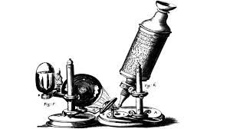
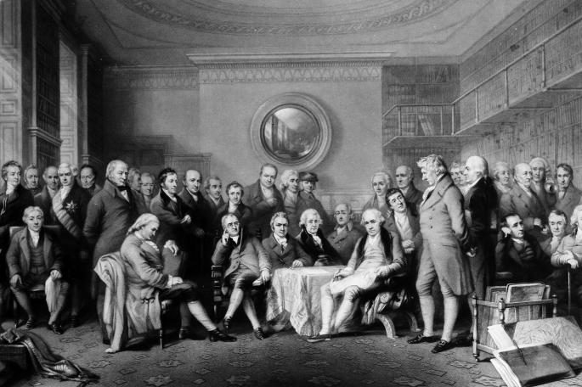
KT 2.1 - Ideas about the cause of disease and illness in the Renaissance
p.17
The work of the Royal Society
The desire to explain the world in secular terms led to a big increase in the number of experiments being carried out. Scientists wanted to talk to each other about their new discoveries and share new ideas. This led to the founding of the Royal Society.
The Royal Society met for the first time at Gresham College in London, in 1660. Its aim was to promote and carry out experiments to further the understanding of science. They also heavily promoted the sharing of scientific knowledge and encouraged argument over new theories and ideas. In 1662, the society received its royal charter from Charles II, who had a keen interest in science.
The support of the king gave the Royal Society credibility: if the king approved of and supported them, clearly hey were doing something right. It also raised their profile. More people sent their work in to be published, or were willing to donate money supporting the scientific work of the Royal Society.
In 1665, the Society began publishing their scientific journal, called Philosophical Transactions. It was the world’s first scientific journal, and it continues to be published today, celebrating its 350th anniversary in 2015.
When it was first published, the journal consisted of letters, book reviews and summaries of experiments and observation carried out by European scientists. Philosophical Transactions provided a vitally important platform from which scientists could share their work, and therefore contributed a great deal to the spread of medical ideas. For example, they published several letters from Leeuwenhoek, in which he described his observations of ‘animalcules’.
The Royal Society offered funding for translations of European scientific texts. It encouraged its members to write their reports in English instead of Latin, and in straightforward language, to make it accessible for everyone. It also requested that members provide a copy of any of their submissions, which would be put into a reference library and made available for anybody to study.
The Royal Society made it possible for physicians and scientists to access and study each others’ research. It was therefore very important in the development of new medical ideas. When Leeuwenhoek’s work was received by the Royal Society, they gave it to their microscope enthusiast, Robert Hooke. Hooke used his own microscope to confirm what Leeuwenhoek had seen. Because it was published in Philosophical Transactions, news of the new discovery spread quickly and widely.
TASK: Add a title for each paragraph

Slide 18
KT 2.1 - Ideas about the cause of disease and illness in the Renaissance
p.19
TASK - On a scale of 1-10, how important do you think the work of the Royal Society was for the ideas about the case of disease and illness. Why might it be considered limited in causing change? Explain your answer.
__________________________________________________________________________________________________________________________________________________________________________________________________________________________________________________________________________________________________________________________________________________________________________________________________________________________________________________________________________________________________________________________________________________________________
HOT - Did the printing press or the Royal Society have more influence on the progress of medicine?
______________________________________________________________________________________________________________________________________________________________________________________________________________________________________________________________________________________________________________________________________________________________________________________________________________________________________________________________________________________________________________________________________________________________________________________________________________________________________________________________________________________________________________________________________________________________________________________________________________________________________________________________________________________________________________________________________________
HoT Task - If you could travel back to the 17th century, what would you tell the Royal Society about the real causes of disease and illness that we’ve discovered in the 21st century?
______________________________________________________________________________________________________________________________________________________________________________________
1 | 2 | 3 | 4 | 5 | 6 | 7 | 8 | 9 | 10

Slide 19
12 mark exam question - Ideas about disease and illness in the Renaissance
p.19
Explain why there were changes in the ideas about the causes of disease and illness in the period c1500-1700. 12 marks
You may use the following in your answer:
The printing press
The Royal Society
You must also use information of your own
Top Tips
TOP TIP 1
This question type expects you to be able to give reasons why something happened. The two bullet points are a guide of relevant information but you must elaborate to show the extent of your knowledge. It is essential that you also include further relevant knowledge of your own. You should aim to give at least THREE explained reasons in a 12 mark question. Always try to elaborate on both bullet points, and add at least one further well explained point of your own (2 is better, if you can!) If you don’t go beyond the points given, you will be limited to 8 marks. Always try to refer back to the question, how does the point that you make relate to the question that is being asked.
Add specific facts and examples in the table below to help you plan the essay so you don’t have to keep switching pages. The last column free for you to fill in yourself. .
The printing press | The Royal Society | The decline in the power of the Church | Rise of Humanism

Slide 20
KT2.1 Quiz - Ideas about the cause of disease in the Renaissance ___ / 10
p.20
Why did the Catholic Church decline in power during the Renaissance? __________________________________________________________________________________________________________________________________________________________________________
What did people think about the Theory of the Four Humours from 1500-1700? __________________________________________________________________________________________________________________________________________________________________________
What medical ideas stayed the same from the Middle Ages to the Renaissance? __________________________________________________________________________________________________________________________________________________________________________
What did the invention of the printing press enable? __________________________________________________________________________________________________________________________________________________________________________
What did Thomas Sydenham do that was new and unique in medicine? __________________________________________________________________________________________________________________________________________________________________________
What was the Royal Society and why were they a positive force for change in medicine? __________________________________________________________________________________________________________________________________________________________________________
What was Humanism? __________________________________________________________________________________________________________________________________________________________________________
How did the decline of the Catholic Church allow progress in medical discoveries? __________________________________________________________________________________________________________________________________________________________________________
How did the lack of quality medical instruments affect change? __________________________________________________________________________________________________________________________________________________________________________
Why did physicians keep using bloodletting and purging even after the Theory of the Four Humours was discredited? __________________________________________________________________________________________________________________________________________________________________________

Slide 21
KT 2.2A Approaches to Prevention and Treatment in the Renaissance
p.21
Treatment: Change and continuity
Herbal remedies continued to be popular, although their use changed slightly. In c1500-c1700, often remedies were chosen because of their colour or shape. For example, yellow herbs, such as radish, were used to treat jaundice (which turns the skin yellow). Smallpox which had a red rash as one of the symptoms was treated with the ‘red cure’ - drinking red wine, eating red foods and wearing red clothes.
Since this was the age of exploration, new herbal remedies started to appear from other countries. New plants started to appear from the New World. Some physicians believed that within each country were herbal remedies which would cure the disease that came from that country: the appearance of new remedies opened up a huge number of new possibilities for treatments and cures.
New remedies that started to appear included sarasparilla from the New World, used to treat the Great Pox, and ipecacuanha from Brazil, later known just as ipecac, which was effective as a cure for dysentery. Thomas Sydenham popularised the use of cinchona bark, from Peru, in treating malaria. This was an effective remedy as long as patients continued to take it for some time after it seemed as though the disease had gone. Physicians also tested other new arrivals like tea, coffee, nutmeg, cinnamon and even tobacco to see if they had any impact on diseases.
TASK - Highlight/underline one sentence in each paragraph. Copy them out below in the order you think is the most important.
______________________________________________________________________________________________________________________1___________________________________________________________________________________________________________________________________________________________________________________________________________________________________________________________________________________________________________________________________________________________________________________________________________________________________________________________________________________________________________________________________________________________________________________________________________________________________________________________________________________________________________________________
Keywords
New World- North and South america. Europeans were only aware of their existence from 1492.
Dysentery - A stomach bug that causes severe diarrhoea. .
Since belief in humoural imbalances persisted through to the end of the 17th century and beyond, the old treatments, which were aimed at rebalancing humours continued as well. Bleeding, purging and sweating were all popular ways of removing too much of a particular humour.
A new popular theory in this period was the idea of transference - which meant that an illness or a disease could be transferred to something else. For example, people believed that if you rubbed an object on an ailment (such as a boil), the disease would transfer from you to the object. There was also a popular theory that you could get rid of warts by rubbing them with an onion - through transference, the warts would ‘transfer’ to the vegetable.

Slide 22
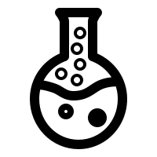
KT 2.2A - Approaches to Prevention and Treatment in the Renaissance
p.22
Chemical Cures
The growth of alchemy, which laid the foundations for the modern science of chemistry, had an impact on medical treatments. People began to look for chemical cures for diseases instead of relying on herbs and bloodletting. This new science was known as iatrochemistry, or medical chemistry, and it was extremely popular in the 17th century.
Inspired by Paracelsus, the scientist who experimented with chemical treatments, medical chemists experimented with metals as cures for common ailments. The Pharmacopoeia Londinensis, published in the College of Physicians in 1618 as a manual of remedies, included a chapter on salts, metals and minerals. Among it 2,140 remedies were 122 different chemical preparation, including mercury and antimony. In small doses, the antimony promotes sweating, which cools the body down.
This fitted in in with the idea of purging the body of disease. Patients would leave wine in the antimony cup overnight and drink the contents in the morning. I larger doses, antimony was used to encourage vomiting - another type of purge. Although it is poisonous in its pure form, a compound of it , known as antimony potassium tartrate, was said to have cured Louis XIV of France of typhoid fever in 1657, and became widely popular afterwards.
Prevention: Change and Continuity
Preventing disease was still considered to be the best way to avoid dying from it: since treatments had not moved on from medieval times, there was still no certainty that a person would recover. The only sure way to avoid dying from a disease therefore, was not catching one at all.
People believed you could avoid disease by practising moderation in all things, as well as avoiding draughts, exhaustion, rich and fatty foods, too much strong alcohol and being too lazy. Condition at the birth was also important - being born small or weak might be used to explain death from an illness in adulthood. This idea of a person’s ‘constitution’ was related to the medieval idea of a person’s humours and personality being influenced by the season in which they were born.
Reduce each paragraph on this page to one sentence and one symbol.
Medical chemistry became popular as people looked for chemical cures for disease.

Slide 23
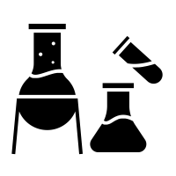
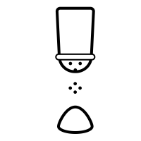
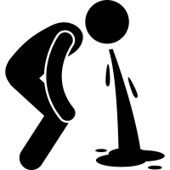
KT 2.2A- Approaches to Prevention and Treatment in the Renaissance
p.23
Cleanliness was also still important - both the home and the body needed to be kept clean and free from bad smells. However, bathing had become a lot less fashionable in England since the arrival of syphilis. Syphilis had spread so quickly among people who regularly visited the stewes, or bathhouses, in London that Henry VIII had been forced to close them down in the early 16th century.
The spread of syphilis at these places was probably, in part, due to the fact that many bathhouses were also brothels. However, the link between syphilis and bathhouses was not easily forgotten, and it was thought that bathing led to people catching the disease. People in the 16th and 17th centuries were far more likely to keep themselves clean by rubbing themselves down with linen and changing their clothes regularly than by going to public baths.
People continued to try to avoid catching diseases by practising regimen sanitatis. However, by the end of the 17th century, avoidance methods were as much about changing your surroundings (moving away from an are with a disease) as they were about looking after yourself. The idea that certain weather conditions, or the surrounding atmosphere, spread disease was becoming more popular. New instruments like barometers and thermometers were used to measure and record weather conditions over a long period of time, to see if there was a link between the weather and outbreaks of disease.
TASK: From what you have just read, how do these symbols relate to what you have read? Use specific detail.

Slide 24
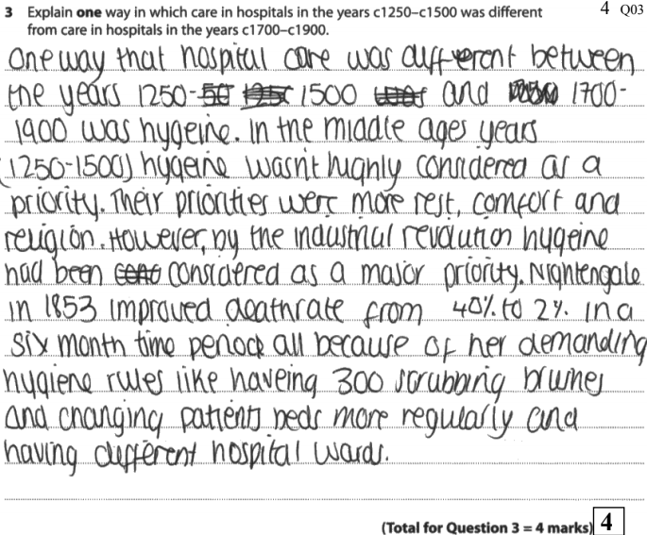
KT 2.2A - Approaches to Prevention and Treatment in the Renaissance
p.24
More steps were also taken to remove miasma from the air. Homeowners in English towns were fined for not cleaning the street outside their house. Projects were set up to drain swamps and bogs. Removing sewage and picking up rubbish from the streets was a punishment given to minor criminals.
Exam Question
Explain one way in which ideas about the treatment of disease were different in the 17th century from ideas in the 13th century. 4 marks.
Preventing disease: things that were the same (continuity) | Preventing disease: things that were different (change)
People still believed that there were many factors that could prevent disease,including superstitions and prayer... | … but people also started to believe that other things could help avoid disease, such as practising moderation and your condition at birth.
Cleanliness was still very important… | … but bathing had become a lot less fashionable in England since the arrival of syphilis. People now kept clean by changing their clothes more often.
People continued to practise regimen sanitatis... | … but, by the end of the 17th century, people also began to think that disease was also related to other factors (for example, the weather).
Miasma was still believed in… | … but more steps were now taken to remove miasma from the air (for example, removing sewage and picking up rubbish from the streets).
Exam Tip
The difference between half marks and full marks on this question is how precise your knowledge is. Make sure you give a fact that relates to each time period.
Record the question and answer in your orange book giving yourself 6 minutes to write.
Student example from 2018 Medicine exam showing 4/4 marks on similarity question across two time periods.

Slide 25
KT 2.2A - Approaches to Prevention and Treatment in the Renaissance
p.25
Task: Highlight the text in two colours, one colour symbolises aspects of change and another that shows continuity.
Medical Care: Change and continuity
The same range of professionals offered treatment from c1500 as in the period c1250-c1500: trained physicians, apothecaries and surgeons. However, there were some changes.
Apothecaries and Surgeons
Apothecaries continued to mix remedies and surgeons continued to carry out simple operations during the medical Renaissance. In the period c1250-c1500, apothecaries were organised into guild systems. This meant that men would carry out an apprenticeship, and then spend several years practising as journeyman under the supervision of a master, before becoming a master surgeon or apothecary himself.
Education for both types of medical professional increased considerably between 1500 and 1700. With wars being fought with new technology, new wounds on the battlefield meant that more surgery was necessary while the introduction of iatrochemistry introduced new ingredients into the stores of apothecaries. Both surgeons and apothecaries had to possess licences to be able to practice their trade. Surgeons and apothecaries continued to provide services to those unable to afford physicians.
Physicians
Physicians continued to be trained at universities in the period c1500-c1700. Training courses changed very little during this period: there were some new ideas emerging, but as with diagnosis and treatment, they were slow to take effect.
Although new subjects were introduced into the medical curriculum, like iatrochemistry and anatomy, most learning was still from books and not from practical experience. Lectures were dictated in Latin. However, as new ideas about human anatomy and iatrochemistry started to be shared, doctors were inspired to challenge the old teachings and investigate for themselves. This was particularly the case in the 17th century, when the Hippocratic focus on observation became more popular.
However, there was still very little practical, hands-on training. Dissection which had once been banned by the Church, was legalised due to the decline in the power of the Church, but it was still very difficult to get a supply of fresh corpses to dissect. Very few universities had an anatomy theatre, because most of them didn't think it was necessary to train a physician in anatomy - after all, he would only need it if he was supervising a lowly surgeon.
Luckily, trainee doctors had much better access to medical textbooks and there were a wider variety of these books than ever before. The newly-invented printing press made books easier to find and and a lot cheaper. Protestantism rejected highly-decorated churches, so many artists found themselves with hours to spare and in need of work. This meant that they were available to create detailed drawings for these new medical textbooks. For medical students who couldn't afford a whole book, individual copies of pictures were available.

Slide 26
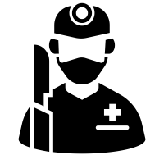
KT 2.2A - Approaches to Prevention and Treatment in the Renaissance
p.26
TASK: Complete the table below, highlighting the change and continuity through professional treatment. You need to make sure you select specific information from the reading on the previous page.
 | Change | Continuity
Apothecaries and Surgeons
Physicians
HOT: Ultimately, do you think there was more change or continuity? Explain your answer using specific detail.

Slide 27
KT 2.2A - Approaches Care in the Renaissance
p.27
Caring for the sick: change and continuity
Hospitals
Some changes had begun to take place in English hospitals by the early 16th century. Whereas before, travellers, pilgrims, the elderly, and a few sick people would have attended hospitals for food, shelter and prayer, this had begun to change. Patient records suggest that many people went to hospital with wounds and curable diseases such as fevers and skin conditions. They didn’t spend very long in the hospital before being discharged: this suggests that they got better.
A patient in a 16th-century hospital could expect:
A good diet - the restorative effects of food were still important, as many people didn’t have access to a lot of food that was good for them.
A visit from a physician - hospitals had contracts with doctors, who would visit the patients sometimes as often as twice a day, to observe the symptoms and prescribe treatments.
Medication- many hospitals had their own pharmacies and an apothecary to mix the medicines.
However, the dissolution of the monasteries in England in 1536 dramatically changed the availability of hospital care in England.
Since the vast majority of hospitals were connected to the Church, very few were able to stay open after the dissolution of the monasteries. As hospitals were attached to abbeys, monasteries and convents, it was the nuns and monks who administered the medical care. With the convents and monasteries gone, the hospitals also went. Saint Bartholomew’s hospital in London, which was founded in 1123, only survived because Henry VIII re-founded it himself in 1546.
Some smaller hospitals opened to fill the gap left by the dissolution of the monasteries, funded by charities, but there was a big change in the amount of medical treatment provided by hospitals.
Many hospitals reopened without their religious sponsors. However, it took a long time for the amount of hospitals to return to what they it had been before the dissolution of the monasteries.
TASK: Reduce each paragraph into 12 words.

Slide 28
KT 2.2A - Approaches to Care in the Renaissance
p.28
p.32
Pest houses
One change in hospital care in this period was the appearance of hospitals that specialise in one particular disease. Versions for these existed in the Middle Ages, when there was lazer houses for people suffering from leprosy. There was a growing understanding that disease could be transmitted from person to person (even though people didn’t understand how or why this happened). This meant that new types of hospital began to appear that catered only for people suffering from plague or pox. These were known as pest houses, plague houses or poxhouses.
These new types of hospital provided a much-needed service. Traditional hospitals would not admit patients who were contagious, but people suffering from serious contagious diseases had to go somewhere or risk infecting their family.
Community care
In spite of changes to hospitals, most sick people continued to be cared for at home. Local communities were very close-knit, which meant that there were plenty of people around to give advice and even mix remedies.
Women continued to play an important role in the care of the sick. This included rich and well-born ladies like Lady Grace Mildmay (1552-1620), who kept detailed notes of the healing and treatment she carried out. It also included poor women working in big cities to support their families. We don’t know a great deal about these women, but we know that a lot of them were prosecuted by the London College of Physicians for practising medicine without a licence. They usually mixed and sold simple herbal remedies to purge the body or cure a particular ailment. Records suggest that they were very popular, probably because they were cheaper than going to a licensed physician or apothecary.
TASK: Explain it as if I’m 5, what is a pest house?
________________________________________________________________________________________________________________________________________________________________________________________________________________________________________________________________________
TASK: Explain it as if I’m 5, what is community care?
____________________________________________________________________________________________________________________________________
_________________________________________________________________
____________________________________________________________________

Slide 29
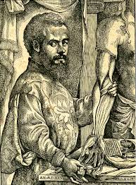
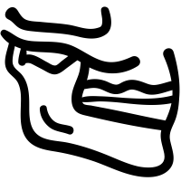
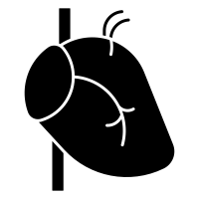
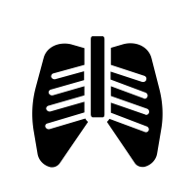
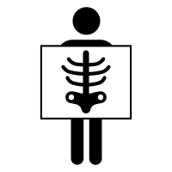
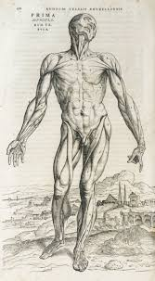
KT 2.2B - Discoveries and impact of Andreas Vesalius
p.29
Andreas Vesalius
The most famous anatomist of this period was Andreas Vesalius. He studied medicine in Paris in 1533. Paris was a centre for the new humanist ideas about medicine. From there he went to Padua, which had a very famous university, where he became a lecturer in surgery. Vesalius had a deep interest in the human body and was keen to share his discoveries with the rest of the world.
His first publication in 1537, Six Anatomical Tables, showed the different parts of the human body, labelled in Latin, Greek, Hebrew and Arabic. Three of the six drawings showed a human skeleton, which Vesalius himself had assembled. He used the publication in his lectures: they were very popular with his students and colleagues
Six years later, in 1543, Vesalius published the book for which he is most famous: De Humani Corporis Fabrica or On the Fabric of the Human Body. He had been able to carry out a large number of dissections, thanks to a local magistrate who allowed him to use the bodies of executed criminals.
Vesalius noted that Galen had made some errors in his original theory on the human body. He put this down to the fact that Galen dissected animals instead of people. In all, Vesalius found around 300 mistakes in Galen’s original work on anatomy. These included:
The human lower jaw was in one part, not two.
The main vein (vena) leading out of the heart did not lead to the liver.
Men did not have one fewer ribs than women.
The human liver did not have five separate lobes.
The human breastbone was in three parts, not seven.
As well as correcting these mistakes, Vesalius encouraged other doctors to base their work on dissection rather than believing old books. Ge wrote that it was vital that anatomy professors carry out dissections themselves, and claimed that this was really important if further advances in medical knowledge were to be made. Because of this, Vesalius laid the foundation for others to investigate the anatomy of the human body in more detail.

Slide 30
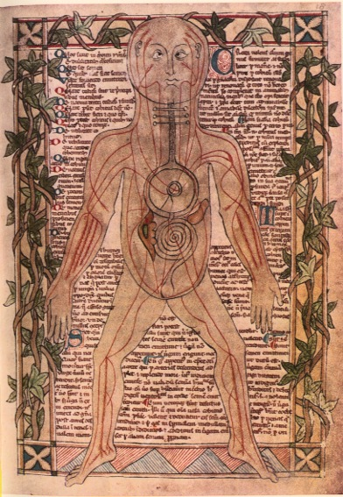
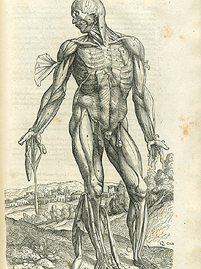
KT 2.2B - Discoveries and impact of Andreas Vesalius
p.30
Middle Ages anatomy chart
Causes
Consequences
14th century to 16th century
Renaissance anatomy book
Causes
Consequences

Slide 31
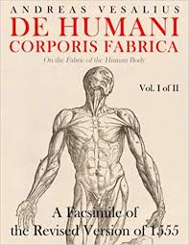
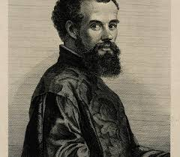
KT 2.2B - Discoveries and impact of Andreas Vesalius
p.31
Vesalius’s book was richly illustrated was richly illustrated with incredibly detailed drawings of the human body in various stages of dissection. By including so many pictures, Vesalius hoped to present the ideal version of the human body. To which other dissected corpses could be compared.
It was not difficult to find artists will to do this work: Renaissance artists were keen to study anatomy so that they could pain the human form more accurately and secure more work.
TASK: If this is the answer, what is the question?
On the Fabric of the Human Body. ___________________________________________________
300 ____________________________________________________________________________
Base their work on dissection._______________________________________________________
Lower Jaw ______________________________________________________________________
William Harvey __________________________________________________________________
HOT: Create your own answer and question.
_____________________________________________________________________________________
Made the study of anatomy not only acceptable but fashionable. Anatomy became a central part of the study of medicine. Doctors and medical professors now carried out dissections themselves rather than a surgeon.
His work was heavily copied and even plagiarised. Versions of the drawings from the Fabrica appeared in other medical texts and as fugitive sheets.
He caused a huge controversy. A lot of traditional physicians were angry that he had criticised Galen. They said that the differences Vesalius had found were down to the fact that there had been changes in human body since the time of Galen.
Inspired other anatomists, some of whom went on to correct his own mistakes in Fabrica.
He was a trailblazer. After he died, Fabricius discovered valves in human veins. Fabricius shared this work with his students at Padua - one of whom was William Harvey who went on to discover the circulation of the Blood.

Slide 32
KT 2.2B - How significant was Andreas Vesalius?
p.32
3 Key Points:
1.
2.
3
Causing Change
Accepted by others
Relevance Today
Spreading Ideas
Area | Score | Explanation using specific facts and examples
Causing Change | /10
Spreading Ideas | /10
Accepted by others | /10
Relevance today. | /10

Slide 33
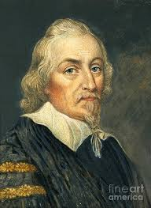
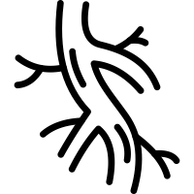
KT 2.3A - Discoveries and impact of William Harvey
p.33
William Harvey was born in 1578. He studied medicine at Cambridge, and then at the famous medical school in Padua. In 1615, he became a lecturer of anatomy at the College of Physicians, and by 1618 he was one of the royal doctors for James I.
Harvey had a keen interest in dissection and observing the human body, in order to improve his knowledge of the human anatomy. Carrying out public dissections was part of his job. He taught his students that it was important to observe the body and believe what they saw, rather than believing what had been written in classical texts. This idea was also followed by Thomas Sydenham, who would work on this theory later that century.
Harvey’s research
Harvey was particularly interested in blood. During his studies at ________, his __________ had taught him Vesalius’s theory that the veins of the body contained _________, which was proof that the blood in those veins flowed towards the _________. Using ____________ bodies, Harvey saw evidence to prove this theory. When he tried to pump liquids through the ___________ the other way, it did not work. This proved that the blood only flowed towards the heart, contradicting what Galen had taught about the blood.
________ looked in more detail at the old Galenic theory. It stated that blood was made in the ________ as a product of what a person ate, then flowed through the body to provide energy and was burned up. Harvey worked out that if Galen’s theory was correct, the liver would have to make ______ litres of blood a day for a person to survive!
Harvey was influenced by new ___________ that had appeared during the ______________. Fire engines now used ____________ pumps to provide water to put out fires: perhaps the human body worked in the same way.
HOT: List 2 ways in which William Harvey and Andreas Vesalius were similar.
________________________________________________________________________________________________________________________________________________________________________
Padua | professors | valves
heart | dissected | veins
Harvey | liver | 1,800
Renaissance | inventions | mechanical

Slide 34
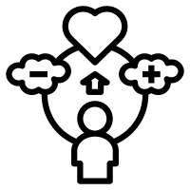
KT 2.3A - Discoveries and impact of William Harvey
p.34
Discovering the circulation of the blood
Harvey’s theory was that blood must pass from arteries to veins through tiny passages that were invisible to the naked eye. Today, we know about these blood vessels - they are called capillaries.
Galen had suggested that blood flowed from one side of the heart to the other through invisible pores in walls of the ventricles. He also said that veins carried both blood and pneuma, which was picked up in the lungs, while arteries carried just blood. Harvey’s theory criticised both these ideas, He showed that the veins carried only blood. He proved that the heart acted as a pump just as the new mechanical fire pumps did.
Factors enabling Harvey’s Discoveries
TASK - Match the factor with the picture.
Harvey’s research involved dissecting human corpses and cutting open cold=blooded animals, which had a much slower heartbeat, to observe the movement of their blood while they were still alive. Through his research, he famously proved that arteries and veins were linked together into one system. This was done by trying a tying a tight cord around somebody’s arm and cutting of the blood flow in the artery leading into the arm. Because the artery in the arm is deeper than the veins, loosening the cord a little bit allowed blood to flow into the arm but stopped it from flowing out and the veins swelled with blood.
Keywords
Pneuma- Means ‘breath of life’. Galen thought it was both the air that you breathe and your life force, or sould.
Institutions such as the Government (King Charles I)
Individuals Harvey’s own abilities
Scientific Breakthroughs such as dissections becoming more common place
Attitudes in society - the ‘Medical Renaissance’
Technology such as mechanical firefighter pumps.

Slide 35
KT 2.3A - Discoveries and impact of William Harvey
p.35
Factors that made Harvey’s research possible
Individuals and institutions
Individuals such as Vesalius had previously proved parts of the work of Galen wrong, which made it easier for other scientists and physicians to do the same. Harvey was employed by Charles I as his personal physician. This gave him credibility, in the same way the royal charter gave credibility to the Royal Society. More people heard of Harvey’s theory about the circulation of blood. The decline of the power of the Church also enabled Harvey to be critical of Galen’s teachings.
Science and Technology
Newly popular technologies, like the pump used when fighting fires, inspired Harvey to look again at how the heart worked.
Attitudes in society
There was more interest in science and in solving some of the puzzles of the human body. People had begun to search for rational explanations for things.
TASK: Ultimately, which factor was the most significant in enabling Harvey’s discoveries?
____________________________________________________________________________________________________________________________________________________________________________________________________________________________________________________________________________________________________________________________________________________________________________________________________________________________________
Write a short poem, rap or speech honoring the work of William Harvey in the Renaissance.

Slide 36
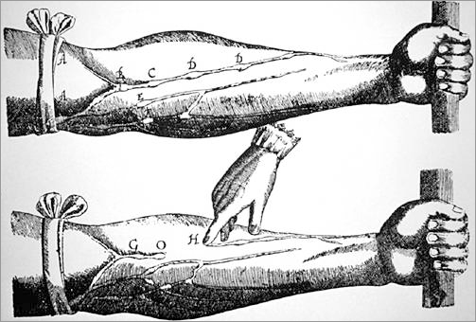
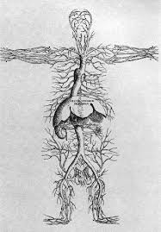
KT 2.3A - Discoveries and impact of William Harvey
p.36
The Impact of Harvey
Harvey’s arguments relied on careful observations of human and animal anatomy. Many people consider his book, An Anatomical Account of the Motion of the Heart and Blood in Animals, to be the beginning of modern physiology. However, Harvey did not consider himself to be a ‘modern’ scientist. He didn’t believe many of Galen’s theories, but he did follow the teachings of another classical thinker: Aristotle. Like Aristotle, he believed that the body was designed by a higher power, and thought that the soul was responsible for how the body worked.
The most immediate impact that Harvey’s theory had was to encourage other scientists to experiment on actual bodies. For example, Harvey had proved that the liver did not digest food to create blood. If the liver didn’t make blood, what did it do? Harvey had proved that blood circulated, instead of being absorbed to provide nourishment for the body - how, then, was the body nourished?
However, understanding the circulation of the blood had little practical use in medical treatment. This meant that the impact of Harvey’s discoveries on treatment during the 17th century was quite limited. He may have paved the way for a modern understanding of anatomy and how the human body functions, but a lot of doctors at the time ignored him. Some even openly criticised him. Nobody liked to be told that they had been doing their job incorrectly. They also reasoned that nobody recovered from disease by simply knowing that the blood flowed to the heart. To many, it had not practical application. English medical textbooks continued to give Galen’s account until 1651; Harvey’s ideas only began to appear in universities from 1673.
TASK: Answer the following questions.
What was the name of Harvey's book? _____________________________
Which classical thinker did he follow? _____________________________________________
What did they believe? __________________________________________________________________
What was the immediate impact? _____________________________________________________
Why did people not accept his ideas for such a long time? ____________________________________
HOT - Reduce the impact of Harvey’s work to 20 words. _______________________________________
________________________________________________________________________________________________________________________________________________________________________________________________________________________________________________________________________________________________________________________________________________________

Slide 37
KT 2.3A - How significant was William Harvey?
p.37
3 Key Points:
1.
2.
3
Causing Change
Accepted by others
Relevance Today
Spreading Ideas
Area | Score | Explanation using specific facts and examples
Causing Change | /10
Spreading Ideas | /10
Accepted by others | /10
Relevance today. | /10

Slide 38
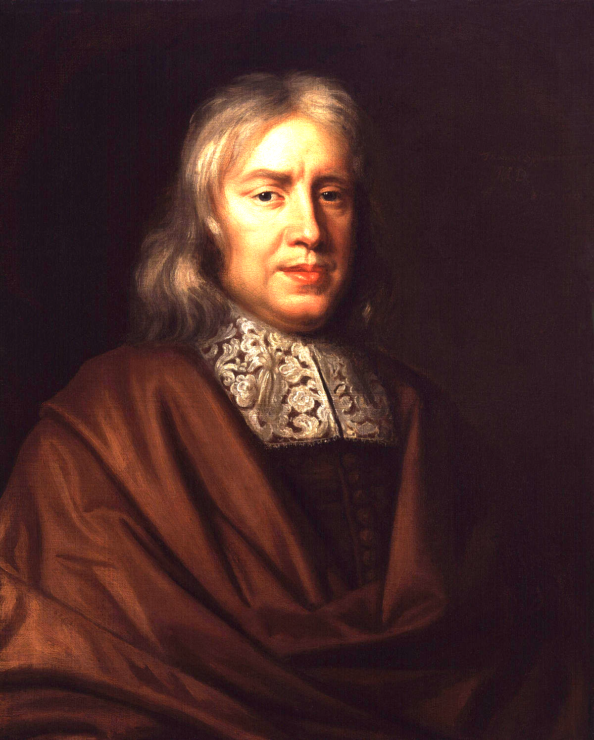
Review: Medical heroes of the Medical Renaissance c1500-c1700
p.38
Name, dates and info | Andreas Vesalius (p. 52-54) 1515-1564 Belgian professor of medicine at age 23. Worked at Padua Uni and for French emperor Charles V. | William Harvey (p. 58+60) 1578-1657 English Physician Discovered circulation | Thomas Sydenham (p. 44-46) 1624-1689 English Physician Laid foundation for a more scientific approach to medicine.
Area of medical discovery | Human Anatomy | Circulation and the Heart | Causes of disease
Books | ‘On the Fabric of the Human Body’ (1543) | ‘An Anatomical Study of the Motion of the Heart and the Blood in Animals’ (1628) | ‘Observationes Medicae’ (1676)
Related practices before their time? | Galen and other ancient doctors were accurate and contained all the discoveries needed to practice medicine. No need for true dissection – physicians might observe a dissection with someone reading Galen’s texts to prove how he was right. Illustrations of anatomy were very basic and often wrong. Little was known about different systems of the body (circulatory, muscular, respiratory etc. | Physicians believed blood was made by the liver and burnt up like fuel No understanding of the fact that blood circulates away from the heart via arteries and returns through veins. People in England still trusted Galen for medical knowledge and anatomical truth although respect was dropping due to the scientific work of Vesalius and others.
Discoveries? Impact? Importance? | Stole and dissected bodies before it was legal in order to start with the skeletal system. Created accurate descriptions of human skeleton and body systems (muscular, circulatory, respiratory) Widely published his work on human anatomy and was quickly adopted in medical universities. Encouraged students to question knowledge instead of accepting it. Proved Galen wrong on jawbone and septum. Pointed out 200 of Galen’s mistakes and set a precedent for further criticism. | Performed dissections to calculate the amount of blood the heart pumps. Concluded there way no way body manufactures that much new blood in a day Did experiments to prove that blood travels AWAY from the heart via arteries and returns to veins thus making a circular route = CIRCULATION. Drew diagrams to prove his theories so people could learn easily. Published books proving Galen wrong on blood and the heart setting a further precedent for others to criticise and experiment. (science) Became physician to James I and Charles I | Known as the ‘English Hippocrates’

Slide 39
16 mark exam question practice
p.39
TASK: Below is an exam style question which asks how far you agree with a specific statement. Below this are a series of general statements which are relevant to the question. Using your own knowledge and the information throughout this key topic, decide whether these statements support of challenge the statement in the question and tick the appropriate box.
‘Individuals had the most significant impact on medical training between c1500 and c1700.’ How far do you agree? Explain your answer.
(16 marks, with a further 4 marks available for spelling, punctuation and grammar.)
You may use the following in your answer:
Vesalius
The Royal Society
You must also use some information of your own.
Statement | Support | Challenge
More powerful microscopes were being developed and, in 1683, one allowed for the observation of tiny ‘animalcules’.
The Royal Society first met in 1660 to share scientific knowledge and encourage new ideas.
The Theory of the Four Humours was starting to be rejected by physicians.
Doctors and anatomists were starting to observe the human body themselves rather than relying on old books.
Thomas Sydenham encouraged doctors to observe their patients and note down their symptoms.
The newly developed printing press allowed for medical information to be spread quickly and accurately.
Vesalius dissected human corpses and proved around 300 ideas of Galen incorrect.
Harvey discovered that blood circulated around the body and that the heart acted as a pump.
Without a microscope, Harvey was unable to prove that capillaries existed and so many physicians ignored his ideas.

Slide 40
16 mark exam question practice - I Do. We Do, You Do.
p.40
‘Individuals had the most significant impact on medical training between c1500 and c1700.’ How far do you agree? Explain your answer.
(16 marks, with a further 4 marks available for spelling, punctuation and grammar.)
I DO - introduction with judgement
I somewhat disagree with the statement that the most significant impact on medical training between c1500 and c1700. Even though individuals like Vesalius and Harvey discovered groundbreaking advances in medical training that disproved hundreds of common beliefs at the time, these discoveries were not accepted by the majority of the physicians till the end of the 17th century so therefore had a limited impact on medical training. What clearly caused the biggest impact was technology of the printing press which allowed more freedom to share ideas and was the catalyst for medical progress.
We do - On one hand, I the idea that individuals had an impact of medical training is valid.
_______________________________________________________________________________________________________________________________________________________________________________________________________________________________________________________________________________________________________________________________________________________________________________________________________________________________________________________________________________________________________________________________________________________________________________________________________________________________________________________________________________________________________________________________________________________________________________________________________________________________________________________________________________________________________________________________________________________________________________________________________________________________________________________________________________________________________________________________________________________________________________________________________________________________________________________________________________________________________________________________________________________________________
You may use the following in your answer:
Vesalius
The Royal Society
You must also use some information of your own.
Copy out the above two parts into your orange assessment book and YOU DO the rest.

Slide 41
KT 2.3B - Dealing with the Great Plague in London 1665
p.31
p.41
In 1665, a serious outbreak of the plague swept across the whole of England. Lasting from June until November, the rate of infection of the Great Plague peaked in September, when 7,000 deaths from the disease were recorded in one week. Across the whole outbreak, 100,000 Londoners died – one in five people. It was the last serious outbreak of the disease in England, but people were as helpless to resist it as they had been 300 years earlier. As with previous epidemics, the disease was spread by fleas carried on rats.
Ideas about the causes of the Great Plague
Although fewer people believed in the Theory of the Four Humours by 1665, it had not been replace with any proven alternative. Still, nobody knew for certain what caused disease in general. Therefore, most people blamed the same things for the Great Plague in 1665 as they had during the Black Death in 1348.
Astrology
There had been an unusual alignment between Saturn and Jupiter in October 1664, and between Mars and Saturn on 12 November. These were seen as unlucky combinations that suggested there was trouble ahead. Worse still, a comet had been spotted, too.
Punishment from God
Many people believed the Great Plague was a result of mankind’s wickedness and that God had sent it to clean up his kingdom.
Miasma
In contrast to the Black Death outbreak in 1348, by far the most popular theory about the spread of the Great Plague in 1665 was that it was caused by a miasma. People believed this miasma had been created by the stinking rubbish and dunghills that were a feature of 17th century city life. The vapour was present in soil, where it would stay as long as the weather stayed cold. When the weather turned warmer, however, the vapour would pour out of the earth as a plague-carrying miasma. This fitted the pattern of the infection: plague outbreaks generally appeared when the weather began to turn warmer.
Other People
By 1665, many people believed the correct idea that disease could be spread from person to person, although, as there was no proof that this was the case it was not the most popular theory. However, plague victims were still quarantined. Even people who believed a miasma caused the disease believed that, once people had caught it, they could pass it on to others.
TASK: On the next page create a mind map with 4 branches about the causes of disease. You need to make sure:
That each branch is a different colour
The writing is capitalised
It contains 1 symbol/picture that represents each of the causes.

Slide 42
KT 2.3B - Dealing with the Great Plague in London 1665
p.42
Ideas about the causes of the Great Plague.

Slide 43
KT 2.3B - Dealing with the Great Plague in London 1665
p.43
Approaches to treatment of the Great Plague
We don’t know a great deal about treatments that were given to plague victims in 1665. This is partly because so many of them were shut up with family members in quarantine, so there are not many records of the methods they attempted to keep people alive.
We do know that some of the new ideas about treatment of disease had an impact on plague treatments in 1665. As was the fashion at the time, physicians advised that patients be wrapped in thick woollen cloths and laid by a fire so that they could sweat the disease out. Transference was also a popular idea –methods such as strapping a live chicken to a bubo, or lancing it with a feather plucked from a live chicken, were meant to draw poison and help the patient to recover.
Recipes for herbal remedies continued to be extremely popular. These took the form of the medicines, poultices or rubs. Quack doctors (somebody who did not have any medical qualifications but who sold their services as a doctor or apothecary) took advantage of the general panic. They mixed remedies and advertised them as fabulous cures, hoping to make some easy money.
People still did not understand the cause of the Great Plague and therefore could not treat it effectively. The best advice was the same as it had always been: make sure you don’t catch it in the first place.
Approaches to preventing the Great Plague
Advice from Physicians
The College of Physicians recommended a variety of preventative measures that could be taken to avoid catching the Great Plague.
Prayer and repentance
Quarantine anybody who had the plague
Carrying a pomander was a way to drive away miasma. A pomander was a ball containing perfumed substances.
Various diets were suggested, from eating almost nothing (fasting) to eating a diet heavy with garlic and sage fried in butter.
Plague doctors wore special costumes to avoid catching the plague from their patients. They had hooked, birdlike masks, with sweet-smelling herbs to ward off the miasma. Birds were meant to attract disease, so it was thought that the disease might be attracted to the bird shape and leave the patient. More practically , the physician’s cloak would be treated with wax to make sure that none of the pus of blood from the patient soaked into it.
Advice from other healers
Most people turned to local healers for help in warding off the plague. Recipes for plague water, a ‘treatment’ for the plague, were popular among apothecaries. Some relied on native herbs that would have been used in England for centuries, such as mint and rosemary, while others contained new, exotic ingredients such as nutmeg and sugar. Smoking tobacco was encouraged to ward off the miasma.

Slide 44
KT 2.3B - Dealing with the Great Plague in London 1665
p.44
Some people thought that, because buboes were symptoms of both syphilis and the Great Plague, catching syphilis would prevent a person from catching the Great Plague. They weren't out of their way to become infected with syphilis – though this of course did not prevent them catching the Great Plague.
Government Action
Local governments also tried to prevent the plague from spreading. Unlike the first large outbreak of the plague, this time they did more, and so did the king. Charles II decreed that people should fast regularly and made a list of actions to try to stop the spread of the plague. These were carried out by local government officials of each city including the mayor. Public meetings, fairs and even large funerals were banned. Theatres were closed. Streets and alleyways were swept and cleaned. Fires were st to burn on street corners, often in barrels of tar or strewn with sweet-smelling herbs, to drive away the evil miasma. Cats, dogs and pigeons were killed if they were seen on the street. Around 40,000 dogs and 200.000 cats were slaughtered because people thought they were helping to spread the disease.
The mayor also appointed searchers and wardens to monitor the spread of the disease. Searchers would go from house to house, checking to see if there were any plague victims in each one. If a household was infected, the inhabitants were either taken to the pest house or quarantined inside the house for 28 days. The house was painted with a red cross together with the words, ‘Lord have mercy on us’. The parish officials were in charge of bringing them food and other necessities. Every day, carts would travel through the city to collect the bodies of the dead.
Many people believed the best way to avoid the Great Plague, but they realised that this ignorance could kill them. Since there was no known cure for the disease, people focused on prevention, since methods of prevention had been successful in the past. Rather than attempt wild treatments, they put their energy into stopping the disease from spreading or into escaping it completely.
TASK: Revise what you have learned about the Black Death and fill in the table looking at the similarities and difference between the Black Death and the Great Plague.
Similarities | Differences
Ideas about the cause of disease | Ideas about the cause of disease
Prevention and Treatment | Prevention and Treatment

Slide 45
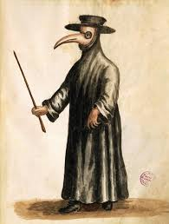
KT 2.3B - Great Plague of 1665 -
Continuity or Change in preventions and treatments?
p.44
1. Circle prevention or treatment for each of the reactions.
2. Circle – ‘old’ ideas, ‘new’ ideas and ‘developed’ ideas (old ideas that have changed slightly or been used for different reasons than before).
3. Make a decision on whether the reactions to the Great Plague of 1665 is more evidence of continuity or change when it comes to prevention and treatment during the Renaissance.
Sweating the disease out 1. prevention or treatment 2. ‘old’ ideas, ‘new’ ideas or ‘developed’ ideas | Live chicken on buboes 1. prevention or treatment 2. ‘old’ ideas, ‘new’ ideas or ‘developed’ ideas | Lancing buboes 1. prevention or treatment 2. ‘old’ ideas, ‘new’ ideas or developed’ ideas
Herbal rubs 1. prevention or treatment 2. ‘old’ ideas, ‘new’ ideas or ‘developed’ ideas | Herbal suppositories 1. prevention or treatment 2. ‘old’ ideas, ‘new’ ideas or ‘developed’ ideas | Prayer and repentance 1. prevention or treatment 2. ‘old’ ideas, ‘new’ ideas or ‘developed’ ideas
Quarantine 1. prevention or treatment 2. ‘old’ ideas, ‘new’ ideas or ‘developed’ ideas | Pomanders to drive away miasmas 1. prevention or treatment 2. ‘old’ ideas, ‘new’ ideas or ‘developed’ ideas | Fasting and special diets 1. prevention or treatment 2. ‘old’ ideas, ‘new’ ideas or ‘developed’ ideas
Plague costumes 1. prevention or treatment 2. ‘old’ ideas, ‘new’ ideas or ‘developed’ ideas | Plague water 1. prevention or treatment 2. ‘old’ ideas, ‘new’ ideas or ‘developed’ ideas | Smoking tobacco 1. prevention or treatment 2. ‘old’ ideas, ‘new’ ideas or ‘developed’ ideas
Catching syphilis 1. prevention or treatment 2. ‘old’ ideas, ‘new’ ideas or ‘developed’ ideas | Public meetings and fairs banned 1. prevention or treatment 2. ‘old’ ideas, ‘new’ ideas or ‘developed’ ideas | Cats and dogs slaughtered 1. prevention or treatment 2. ‘old’ ideas, ‘new’ ideas or ‘developed’ ideas
Searchers appointed 1. prevention or treatment 2. ‘old’ ideas, ‘new’ ideas or ‘developed’ ideas | Regular collection of the dead 1. prevention or treatment 2. ‘old’ ideas, ‘new’ ideas or ‘developed’ ideas | Running away 1. prevention or treatment 2. ‘old’ ideas, ‘new’ ideas or ‘developed’ ideas
Preventions | Treatments
More continuity or more change | More continuity or more change

Slide 46
Key Topic 2 Medicine in the Renaissance review
p.46
Events or historical change?
Change is an alteration is an alteration in a situation. Events are when something happens.
Sometimes a situation can be very different before and after an event - this even marks a change.
However, sometimes a situation is the same before and after an event, and sometimes a situation changes without a specific event taking place at all.
TASK study the following events and their changes:
TASK:
Sort the above into ‘events’ and ‘changes’ using two colours or symbols.
Match each even to the change that it marks and write them out below.
________________________________________________________________________________________________________________________________________________________________________________________________________________________________________________________________________________________________________________________________________________
HOT: Can you identify three changes and three continuities between the case studies of the Black Death and the Great Plague?
____________________________________________________________________________________________________________________________________________________________________________________________________________________________________________________________________________________________________________________________________________________________________________________________________________________________________________________________________________________________________________________________________________________________________________________________________________
The English Reformation reduced the power of the Church. | Vesalius published on the Fabric of the Human Body. | The Royal Society was founded in 1660. | The ideas of Galen slowly became discredited.
Careful observation of patients became more important when diagnosing disease. | Most people now recognised that God did not send disease. | Thomas Sydenham published Observationes Medicae | Improved communications enabled scientists to study each other’s research.

Slide 47
Key Topic 2 Review: Ideas about causes of disease in the Renaissance
p.47
TASK: Place the following ideas about the causes of disease in the correct section of the venn diagram
Miasma | Imbalance of Four Humors | God causing disease | Witches | seeds spread in the air
Poor diet | astrology | evil spirits | Jews | lack of exercise
Middle Ages
Both
Renaissance
TASK: Colour the thermometer to show show how much change there was with the ideas about the causes of disease between the Middle Ages and the Renaissance. The hotter the the temperature, the greater the change.
TASK: Explain why you have given this rating using specific historical detail and examples.
________________________________________________________________________________________________________________________________________________________________________________________________________________________________________________________________________________________________________________________________________________________________________________________________________________________________________________________________________________________________________________________________________________________________________________________________

Slide 48
Review: Approaches to prevention and treatment
p.48
TASK: Place the following ideas about approaches to prevention and treatment in the correct section of the venn diagram
Bloodletting | Purging | Plants from the new world | transference to animals | Changes in diet
Rest | Quarantine during plagues | confession | amulets | bathing
Middle Ages
Both
Renaissance
TASK: Colour the thermometer to show show how much change there was with the ideas about the causes of disease between the Middle Ages and the Renaissance. The hotter the the temperature, the greater the change.
TASK: Explain why you have given this rating using specific historical detail and examples.
________________________________________________________________________________________________________________________________________________________________________________________________________________________________________________________________________________________________________________________________________________________________________________________________________________________________________________________________________________________________________________________________________________________________________________________________

Slide 49
Key Topic 2 Review - Correct the mistakes:
Why didn’t medical developments during the Medical Renaissance make people healthier?
p.49
One reason why developments made during the Rennysause didn’t positively affect people’s health was that they had to do with onatomy and physiology and not the nature of disease, prevention, or trotment.
For instance, Andreas Harvey discovered exactly how the human body worked through multiple illegal dissections and recorded his discoveries in his book, “On the Fabric of the Human Brain”. He noticed that Hippocrates made many mistakes including the facts that the human jawbone is one piece instead of two and that the septum in the lungs has no holes in it. Galen had come to these conclusions through dissections of otters and monkeys. Although Vesalius did medicine a great service by making his anatomical discoveries available, his knowledge could not be used to improve treatment or prevention because people still believed in the Five Humours concept of illness and the idea of bad air called momosa.
Another development was the work of Billy Harvey in discovering how blood circulated through the body instead of being burnt up in the soul as Galen had said. He also published his work in “On the Motion of the Heart and Ocean” and also specifically pointed out Galen’s mistakes but these developments had little impact on finding the true reasons for illness. It wouldn’t be until 1861 with Burn Theory that we would understand the true nature of disease.
Yet another development was the invention of the printing press in the 11th century and the forming of the Royal Brotherhood. These developments combined sparked a scientific revolution in which ideas were shared and improved and saw the telescope and microscope be used for greater science discovery. These developments had little impact because they did not change our ideas about disease but did cause people to grow more skeptical about scientific discovery.
In conclusion, the amazing developments of Vesalius, Harvey, and the Royal Society set a precedent for questioning Henry VIII, improving science, and even some universities started teaching new ideas but without a comprehensive understanding of the nature of disease there would be no improvements to people’s mind.

Slide 50
p.50
 | Medicine c1250-1500 (end of the Middle Ages to start of Renaissance) | Medicine c.1600-1750 (End of the Renaissance + Scientific Revolution + start of Industrial Revolution) | Progress level: (1-10) (Think: change, continuity, improvement, stagnation, attitudes (conservative vs. enquiry), continuity vs. change
Knowledge of human anatomy | - Doctors knew about Greek and Roman discoveries but did not learn any more. - Dissection was carried out to illustrate what Galen had said, not to make new discoveries. | - Doctor’s started to question Galen’s theories after he was proved wrong 200 times by Vesalius. - Vesalius produced detailed anatomical works (Fabrica) -Dissection became more common in Europe in the 18th century
Ideas about causes of disease and illness | - Many believed that illnesses were sent by God - Doctors said that many illnesses had natural causes. They followed Hippocrates’ theory that illness was caused when the body’s humours were out of balance. | No replacement was found for older theories: - 4 humours - Miasma - God (Great Plague 1665)
Everyday treatments | a) Herbal Remedies b) Prayers, charms and rhymes. c) Bleeding, purging and other methods to restore the proper balance of the humours, following Galen’s methods d) Rest, exercise and diet. | - Bloodletting and purging common - New plants and herbs from exploration of the New World - Religion declining as a factor for disease - medical chemistry - transference
Preventions | - Religious preventions - (confession and living a sin free life) - Natural preventions - bathing, laxatives, diet, rest, bloodletting | - Less emphasis on prayer except during the Great Plague - God not seen to be huge factor for disease in everyday life - Quarantine and Isolation used during Great Plague 1665
Growth of science | - There was no understanding of the modern scientific method of asking questions and testing hypotheses through experiment and observation. - Physicians simply learned the writings of Galen and others and were not expected to question traditional ideas. | - Printing Press (1440) allowed communication of ideas - Galen proven wrong through ‘scientific method’ by Vesalius, Harvey and Sydenham - Royal Society formed ( ) and met to discuss weekly in England (Hooke, Boyle, Newton) - New texts (Fabric + Motion) caused many to question old theories
Physicians and their training | -Physicians trained at universities by reading the books by Hippocrates and Galen and some Arab medical writers. - Mothers and family members treated most illnesses. - Barber surgeons were trained as apprentices to a master. | - Less reliance on urine charts for diagnosis and astrology - Practical training started to be carried out in a few hospitals - Training still heavy on the academic (book study)
Hospitals | - Hospitals run by monks and nuns provided warmth, food and prayer for the poor. - There were hundreds of small hospitals but they did not admit people with infectious diseases in case the disease spread among residents. | - Church Hospitals closed during Henry VIII’s English Reformation - A few opened by town councils and wealthy patrons - No real treatment centres for infectious diseases

Slide 51
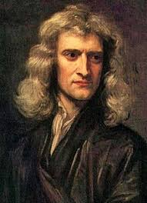
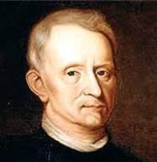
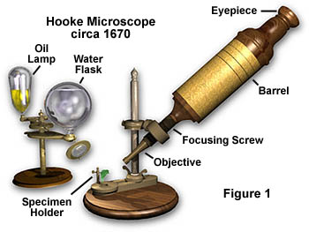
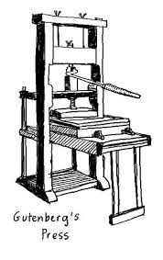
p.51
New discoveries
- Chemical treatments to replace some herbal ones (iatrochemistry or medical chemistry)
- sarsaparilla (Brazil) - helps treat the Great Pox (syphilis)
- cinchona (Peru) - helps treat malaria
New ideas
- Thomas Sydenham theorised that disease came from outside the body instead of inside (4 humours)
- Urine was disregarded as a way to diagnose illness
- Microbiology born as Hooke’s microscope opened up an invisible world
- Animalcules (germs) discovered by Leeuwenhoek but not connected to disease
- Humanism - a love of learning and independent thinking.
- Dissection legalised due to declining power of the Church but still not always common in training
- More focus on training physicians and apothecaries formally.
The Royal Society
- Met for the first time in 1660 and had King Charles II backing which gave it credibility.
- Group of scientists meeting to talk about new discoveries and ideas.
- Promoted the sharing of ideas and questioning everything
- Published ‘Philosophical Transactions’, a scientific journal that still runs today that makes it possible for scientists to share ideas.
- Set the stage for a Scientific Revolution and attitude change away from ‘conservatism’ towards ‘enquiry’
Community care
Pest houses
New technologies
- Robert Hooke’s microscope (not common until 18th century)
- barometers and thermometers to measure and record weather conditions
- Printing Press allows new medical textbooks to spread widely and criticism of Galen increased
Care
p. 55-56
The medical Renaissance in England c1500 -c1700
p.40-65
Hospitals
Important
Individuals
Events
- Exploration of the New World leads to new herbs and plants
- Far less Church authority over people’s lives and education
- 1400 Gutenberg's printing press
- 1660 Birth of the Royal Society
- 1665 Great Plague
- 1665 ‘Micrographia’ published
- 1683 - Leeuwenhoek discovered animalcules (germs)
Additional notes
Andreas Vesalius
Thomas Sydenham
William Harvey

Slide 52
“There was little improvement in medicine in the years c.1350 – c.1750”.
How far do you agree? Explain your answer.
You may use the following in your answer:
• Galen’s ideas
• The Royal Society
You must also use information of your own. (16 marks)
p.52
Read the question carefully and find command word(s). Ask yourself what the examiner wants to know.
Paragraph 1: Write a large paragraph (1+ pages) agreeing with the statement:
- Discuss the complete lack of new ideas for the cause of disease to replace the four humours. No new theories = no new methods to treat disease
- Although church declined there was still religious reactions during the Great Plague 1665
- Treatments (bloodletting, purging) largely remained ineffective. Transference was new but equally incorrect.
- Preventions did not advance as they were limited by the lack of new ideas about cause of disease
Paragraph 2: Write a large paragraph (1+ pages) disagreeing with the statement:
- Anatomical understanding increased exponentially due to the work of Vesalius and Harvey
- Galen was criticised openly through the works of Vesalius, Harvey and Sydenham
- Hospitals and community care showed limited improvements
- Real science and investigation was born with the Royal Society
- New technology would allow for the transformation of medical knowledge and understanding
- Physician training became marginally more practical (although still very academic)
LVL | Marks
4 | 16
 | 15
 | 14
 | 13
3 | 12
 | 11
 | 10
 | 9
2 | 8
 | 7
 | 6
 | 5
1 | 1-4
Paragraph 3: Write a smaller paragraph on any other context you want to add:
- Change in attitude from conservatism to enquiry
- Factors promoting change: decline of church power, birth of science, communications
Paragraph 4: Judgement / Conclusion
- You choose this time. :)
Student Mark scheme
A01 Own Knowledge | L1 | L2 | L3 | L4
 | Limited knowledge and understanding | Some knowledge and understanding of the period. | Good knowledge and understanding | Wide-ranging knowledge and understanding of the required (Accurate and relevant information is precisely selected)
A02 Argument for change or continuity. | L1 | L2 | L3 | L4
 | Generalised. lacking development and organisation. | Some development and organisation of material, but a line of reasoning is not sustained. | Reasoning that is generally sustained, (some analysis) | Showing a line of reasoning that is coherent, sustained and logically structured.
A02 Judgement on ‘how far’ you agree | L1 | L2 | L3 | L4
 | No judgement on ‘how far?’ | Weak judgement on ‘how far?’ that is not well developed or supported. | Some justification for judgement on ‘how far?’ | Clear judgement using on how far with enough support or criteria to be convincing.

Slide 53
p.53
Middle Ages Britain
1250-1499
13th through 15th centuries
Renaissance 1500-1699
16th - 17th centuries
- imbalance of the 4 humours (Galen)
- urine charts for diagnosis
- God’s punishment (Catholic Church)
- evil spirits
- miasma
- astrology (planets alignment)
- diet and hygiene (not common)
- imbalance of the 4 humours (discredited and questioned but widely followed)
- God’s punishment (reducing in validity)
- miasma
- diet and hygiene
ideas about the cause of disease and illness
- Christian (prayer, penance, pilgrimage)
- amulets for evil spirits
- natural (bathing, laxatives, diet, rest)
- Humours: bloodletting, purging, enemas
- Herbal remedies: plants and spices
- Bathing
- Christian treatments (less common)
- natural (bathing, laxatives, diet, rest)
- Humours: bloodletting, purging, enemas
- Herbal remedies: plants and spices
- Bathing
- transference
treatment of disease and illness
prevention of disease and illness
- religious (confession, righteousness)
- natural (bathing, laxatives, diet, rest)
- bloodletting
- Regimen Sanitatis (for wealthy)
- religious (confession, righteousness)
- natural (laxatives, diet, rest)
- bathing less popular
- bloodletting
- Regimen Sanitatis
public health
- Government action rare
- Rich had access to spring water
- Rare except for towns that had a wealth patron who paid for clean water
- Some steps to remove rubbish /sewage
hospitals
- Religious hospitals run by monks and nuns
- Care not cure
- Religious hospitals closed in 1541 by Henry VIII as part of the Dissolution of the Monasteries
(The English Reformation)
major diseases and reasons for illness
- Black Death 1348-49
- Leprosy
- dysentery
- Great Plague 1665
- Great Pox (syphilis)
- Smallpox
- sweating sickness

Slide 54
Middle Ages and Renaissance Medicine Review ____26
p.54
When does the Middle Ages begin and end for our exam
What is dissection and why is it so important for physician training?
What is the Theory of the Four Humours and who created it?
What is the Theory of Opposites and who created it?
Name 4 different kinds of medieval healers.
List 4 ideas people had about the cause of disease in the Middle Ages
List 3 kinds of treatments used in the Middle Ages in order of popularity
When did the Black Death arrive in England and what percentage of people did it kill?
Give 3 reasons why it was hard to keep medieval towns clean.
List 3 reasons why people continued to believe the ideas of Hippocrates and Galen well into the 17th century.
Which 3 factors were most important in inhibiting (preventing) change in medicine in the Middle Ages?
When does the Renaissance period begin and end?
What discovery did Harvey make and in which century did he make it?
List 3 ideas people had about the cause of disease in the Middle Ages that carried over to the Renaissance.
List 3 kinds of treatment used during the Renaissance period of 1500 and 1700.
Why was Vesalius important in the history of medicine and in which century did he do his work?
What was the name of Vesalius’ book and when was it published?
Give two preventions used to prevent plague spreading in 1665.
Why was Thomas Sydenham’s work important to the development of ideas about disease?
List 3 reasons why some physicians still believed the ideas of Hippocrates and Galen in the 1600s.
Name 3 reasons why some changes were taking place in medicine by 1700.
Why did the power of the Catholic Church decline in the Renaissance period?
What impact did the printing press have on medicine during the Renaissance?
What changed in Medicine during the Renaissance period?
Was there more change or continuity during the Renaissance period?
Was the reaction to the Great Plague 1665 more similar or different than the reaction to the Black Death in 1348?

Slide 55
Notes
________________________________________________________________________________________________________________________________________________________________________________________________________________________________________________________________________________________________________________________________________________________________________________________________________________________________________________________________________________________________________________________________________________________________________________________________________________________________________________________________________________________________________________________________________________________________________________________________________________________________________________________________________________________________________________________________________________________________________________________________________________________________________________________________________________________________________________________________________________________________________________________________________________________________________________________________________________________________________________________________________________________________________________________________________________________________________________________________________________________________________________________________________________________________________________________________________________________________________________________________________________________________________________________________________________________________________________________________________________________________________________________________________________________________________________________________________________________________________________________________________________________________________________________________________________________________________________________________________________________________________________________________________________________________________________________________________________________________________________________________________________________________________________________________________________________________________________________________________________________________________________________________________________________________________________________________________________________________________________________________________________________________________________________________________________________________________________________________________________________________________________________________________________________________________________________________________________________________________________________________________________________________________________________________

Slide 56
Notes
________________________________________________________________________________________________________________________________________________________________________________________________________________________________________________________________________________________________________________________________________________________________________________________________________________________________________________________________________________________________________________________________________________________________________________________________________________________________________________________________________________________________________________________________________________________________________________________________________________________________________________________________________________________________________________________________________________________________________________________________________________________________________________________________________________________________________________________________________________________________________________________________________________________________________________________________________________________________________________________________________________________________________________________________________________________________________________________________________________________________________________________________________________________________________________________________________________________________________________________________________________________________________________________________________________________________________________________________________________________________________________________________________________________________________________________________________________________________________________________________________________________________________________________________________________________________________________________________________________________________________________________________________________________________________________________________________________________________________________________________________________________________________________________________________________________________________________________________________________________________________________________________________________________________________________________________________________________________________________________________________________________________________________________________________________________________________________________________________________________________________________________________________________________________________________________________________________________________________________________________________________________________________________________________

