Slide 1
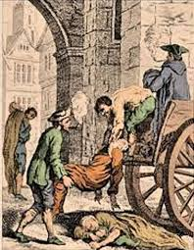
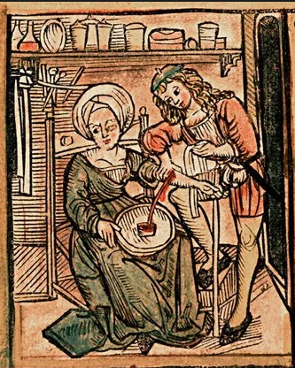
Edexcel GCSE 9-1 History
Medicine in Britain, c1250 to present workbook
Key Topic 1
c1250–c1500: Medicine in Medieval England
version 2
Edexcel 9-1 GCSE History Medicine in Britain, c1250 – present PLC |  |  | Lesson date | Quiz score | Date revised
Key topic 1: c1250–c1500: Medicine in Medieval England | Key topic 1.1 Ideas about the cause of disease and illness in the Middle Ages | A. Supernatural and religious explanations of the cause of disease.
 |  | B. Rational explanations: the Theory of the Four Humours and the miasma theory; the continuing influence of Hippocrates and Galen.
 | Key topic 1.2 Approaches to prevention and treatment | A. Approaches to prevention and treatment and their connection with ideas about disease and illness: religious actions, bloodletting and purging, purifying the air, and the use of remedies.
 |  | B. New and traditional approaches to hospital care in the thirteenth century. The role of the physician, apothecary and barber surgeon in treatment and care provided within the community and in hospitals, c1250–1500.
 | Key topic 1.3 Case study - The Black Death | A. Dealing with the Black Death, 1348–49; approaches to treatment and attempts to prevent its spread.
Notes:
21.0 x 29.7 cm

Slide 2
Contents Page
p.2
Topic | Page
Key Topic 1 Key Words | 3-5
Life In Medieval England | 6-8
KT1.1A Supernatural and religious causes of disease | 9-11
KT1.1B Rational explanations: the Theory of the Four Humours and the miasma theory; the continuing influence of Hippocrates and Galen. | 12-19
KT 1.1 Quiz | 20
KT 1.1 Exam Question 12 Marker + Tips. | 21-25
KT1.2A. Approaches to Treatment. | 26-31
KT1.2 A. Approaches to Prevention. | 32-34
KT1.2 B. Hospital care and the role of Physicians + Apothecaries and Barber Surgeons. | 35-39
KT 1.2 Exam Question 16 Marker + Tips. | 40-41
KT1.3 A. Case Study - Dealing with the Black Death, 1348–49; approaches to treatment and attempts to prevent its spread. | 42-46
KT1.4 Review | 47-54
Student Notes | 55-58

Slide 3
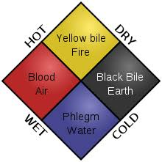
Medicine Key Topic 1 Key Words - Part 1
p.3
1 | amulet | Charm worn in the Middle Ages to ward off (give protection) from disease (MA)
2 | apothecary | Affordable chemists from Middle Ages through the Renaissance who made herbal remedies and medicines. Often a cheap alternative to a doctor the did not have university training but were trained through apprenticeship. (MA, RE)
3 | astrology | Superstitious study of how the position of planets influence people’s lives and health. Used in the form of ‘Zodiac Man’ charts to decide when and how to treat people. The Black Death was blamed on the positioning of the planets which caused the earth to discharge miasmic odors. (MA)
4 | barber surgeons | Uneducated but skilled medical practitioners who would provide amputation, broken bone setting, bloodletting and urine examination to help balance the humours. Identified by the red and white striped barber pole they could also cut hair. (MA, RE)
5 | Black Death (1348) | Bubonic and pneumonic plague. Killed 30% of England’s population and blamed by many on supernatural causes such as God or the position of the planets. Treatments ranged from the natural herbal cures and bloodletting to the supernatural with prayer and flagellation. Some preventative measures were taken with the local authorities (government) enacting quarantine laws for the sick, banning large gathering and setting up quarantine houses. (MA)
6 | blanc mangier | Medieval dish recommended to the sick made of chicken and almonds. (MA)
7 | bloodletting | Treatment of removing blood by cutting, cupping or leeches in order to balance out the humours. Also known as phlebotomy or simply bleeding. (MA, RE)
8 | Catholic Church | Also known simply as ‘The Church’. Controlled medical training in Middle Ages universities and promoted Galen’s teaching and superstition in medicine. Also funded hospitals in monasteries that would give the sick a clean place to recover and encouraged hospitality for the poor. The Church lost influence in the 16th century due to the Reformation and the Renaissance. (MA, RE)
9 | cesspit | A large pit for collecting and storing sewage that often overflowed creating unhygienic conditions and spreading disease. (MA, RE, IR)
10 | change | An act or process through which something becomes different / the opposite of continuity where things essentially stay the same.
11 | clyster | Middle Ages hollow enema tube to relieve constipation, feed people and deliver medicine to the ill through the anus. (MA)
12 | contagious | A disease that can be spread from person to person such as the pneumonic plague or cholera.
13 | continuity | When something basically stays the same or similar / opposite of change
14 | diagnosis | Identification of the nature of an illness or other problem by examination of the symptoms.
15 | dissection | Cutting up and examination of a body. Generally forbidden in the Middle Ages and Renaissance which led to ignorance about the human body until the 1832 Anatomy Act made bodies of criminals available to doctors to practice on. (MA, RE)
16 | endowment | A gift from a wealthy individual. Some Medieval and Renaissance era hospitals for paid for by endowments. (MA, RE)
17 | epidemic | Widespread occurrence of an infectious disease in a community or nation.
18 | flagellants | Religious extremists who publicly whipped themselves during the Black Death to beg for God’s forgiveness for their sins in hopes of being spared from the epidemic. (MA)
19 | Four Humours | Theory founded by Hippocrates (Greek) and promoted by Galen (Roman) which stated that a balance of blood, yellow bile, black bile, and phlegm promoted good health. Continued to be taught and applied to medicine well into the 17th century as no other theory was found to explain why people got ill. (MA)

Slide 4
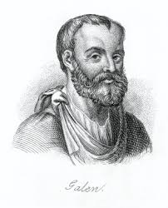
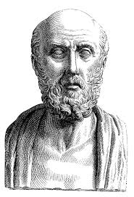
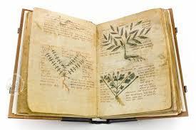
Medicine Key Topic 1 Key Words - Part 2
p.4
20 | Galen, Claudius | Roman doctor from Greece who developed the Theory of Four Humours by adding his Theory of Opposites which prescribed balancing out the humours by giving the opposite of their effect. Also wrote over 350 medical texts and eventually adopted by the Church as the leading medical authority during the Middle Ages. (MA)
21 | germ | Microorganism that causes disease. No idea about Germ Theory in Middle Ages.
22 | herbal manuals | Materia Medica and Circa Instans were often referred to in the Middle Ages as textbooks for classic herbal remedies. (MA)
23 | herbal remedy | Medicines made from a mixture of plants often containing beneficial ingredients such as honey, cinnamon, mint, rose oils and chamomile.
24 | Hippocrates | Greek doctor who popularised the Theory of the Four Humours but also recommended "clinical observation" in which the doctor would observe the patient and recommend rest, exercise, and small changes in diet before heal them. The Four Humours theory lasted over 1,700 years and only began to die out in the 17th century. (MA)
25 | hospitals (Middle Ages) | Monks and nuns ran many religious hospitals for the poor and invalid but would only provide comfort, food, a clean environment and hospitality instead of a range of medical care. Church hospitals would not take people with contagious diseases. Other cities had endowments from the wealthy to run public hospitals but many places had none. Pest and Lazar houses were constructed during epidemics to quarantine the truly ill. By 1700, England only had 5 hospitals left after Henry VIII dissolved the monasteries in 1540. (MA)
26 | infection | Formation of disease-causing germs or microorganisms in a person’s body.
27 | king's touch (royal touch) | A form of laying on of hands, whereby English monarchs touched their subjects, regardless of social classes, with the intent to cure them of various diseases and conditions. Most commonly used to treat scrofula (tuberculosis) (MA, RE)
28 | laxatives | Medicines which would causes bowel movements (pooping)
29 | lazar houses | Middle Ages hospital for persons with infectious diseases such as leprosy. (MA)
30 | leeches | Blood sucking worms used to bleed patient during bloodletting. (MA, RE)
31 | Materia Medica | A book with the collected knowledge about the therapeutic properties of any substance used for medicine. The term materia medica was used from the period of the Roman Empire until the 20th century, but has now been generally replaced in medical education contexts by the term pharmacology. (MA, RE)
32 | miasma / miasmata | Theory that disease is produced from bad smells or pollution. Caused many to try and clean up the streets during epidemics like the Black Death, bathe, and generally avoid pungent odors. (MA, RE, IR)
33 | natural vs. supernatural treatments | Natural involves the use of medicine, bloodletting and four humours treatments while supernatural involves Christian practices, charms and astrology to fight disease. (MA)
34 | observation | The act of watching the patient’s symptoms develop before attempting any major treatment. Also known as clinical observation.
34 | pandemic | A disease prevalent over a whole country or the world. (eg - Black Death)
36 | pathogen | A bacterium, virus, or other microorganism that can cause disease.
37 | penance | Punishment inflicted on oneself as an outward expression of religious repentance for wrongdoing. Flagellants were known to publically whip themselves during the Black Death outbreak in 1348 and public prayers were offered up during the Great Plague of 1665-66. (MA, RE)
38 | pest houses | A hospital for people suffering from severe infectious diseases, especially the plague. Also known as plague houses or poxhouses, these new locations would attempt to treat those rejected by typical Medieval hospitals. (MA, RE)

Slide 5
Medicine Key Topic 1 Key Words - Part 3
p.5
39 | phlebotomy | The process of making an incision in a vein. The procedure itself is known as a venipuncture or bloodletting. (MA, Renaissance)
40 | physician | A doctor formally trained at university. Before the 17th century training would be little more than learning from Galenic and other ancient texts with little practical experience or dissection. From the 17th century onwards doctors were inspired by anatomical drawings of Vesalius and Harvey to reject Galen and learn how human physiology actually worked. Human bodies were not widely available for dissection in medical universities in England until the 1832 Anatomy Act.
41 | pilgrimage | A journey to a spiritual location used by some Christians as a way to prevent or treat diseases. (MA)
42 | prevention | Steps taken to avoid catching a disease such as regular bloodletting or prayer. Do not confuse with treatment which is performed after catching a disease.
43 | purging | Making someone sick (throw up) through the use of herbal remedies using mixtures of mustard, aniseed and parsley. Also refers to the practice of using enemas and laxatives to cause people to make them poop. (MA)
44 | quack doctors | Fake doctors who would sell ‘cure-all’ remedies preying on people’s superstitions and ignorance (MA, RE)
45 | quarantine | The act of isolating a person in their home or closing off a town to fight the spread of an epidemic. Used during both the Black Death (1348) and the Great Plague (1665-66) as people who contracted the disease were locked in their homes to die and a red cross was put above their door to warn others. (MA, RE)
46 | Regimen Sanitatis | A prescription for daily healthy living which included hygiene recommendations given to a patient by a physician. (MA)
47 | remedy | A drug or treatment that cures or controls the symptoms of a disease
48 | scrofula | A form of tuberculosis common in the Middle Ages and Renaissance. Many believed it could be cured by touching a King. (MA, RE)
49 | stewes | Medieval bathhouses common in cities like London where middle class and wealthy individuals would bathe to stay clean and free of miasmas (MA)
50 | supernatural | Something spiritual or not natural. Disease in the Middle Ages were often believed to have supernatural causes and cures. (MA)
51 | superstition | An unreasonable belief based on ignorance.
52 | symptoms | a physical or mental feature which is regarded as indicating a condition of disease,
53 | Theory of Opposites | Proposed by Galen to balance out the Four Humours by providing the opposite of the symptom. For an excess of blood something cold was prescribed like a cucumber. For a cold, a chili was thought to balance out the phlegm. (MA, RE)
54 | theriaca | Common herbal remedy that could contain up to 70 ingredients such as ginger, cardamom and pepper that was believed to treat many different illnesses. (MA)
55 | treatment | Methods used to try and stop an illness or disease once a person has it. (Not prevention)
56 | trend | A general direction in which something is developing or changing. For example, the trend towards teaching Galen in the Middle Ages vs. the trend of questioning Galen in the late Renaissance period.
57 | turning point | A radical moment or breakthrough where a great deal of change happens. Usually in the form of a new invention, technology, method, inquiry or type of thinking. Examples include Vesalius’ Fabrica, the printing press in 1440 and the introduction of Salvarsan 606 as the first magic bullet (antibiotic).
58 | urine chart | Used by physicians in the Middle Ages to balance a patient's humours. Physicians or barber surgeons would check the colour, thickness, smell and taste before making a diagnosis. (MA)
59 | Wise women | Women in the Middle Ages who would give a range of services in a local town or village such as bone setting, herbal remedies, childbirth support and medical advice. (MA)
60 | witchcraft | The practice of dealing with magic and/or evil spirits. Sometimes used in the Middle Ages as treatment for diseases. (MA)

Slide 6
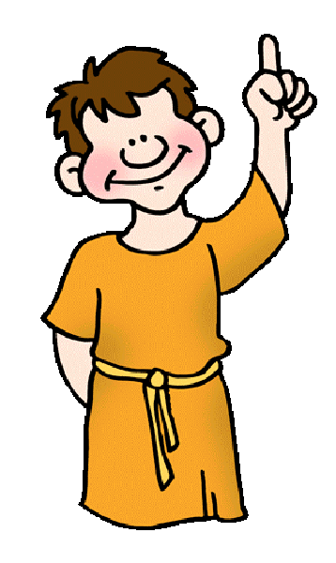
Life in Medieval England
p.6
To understand medieval medicine you need to understand medieval life and thinking. These questions will diagnose any misunderstandings you have.
1. True or false?
People did not wash or try to keep clean.
People threw rubbish into the street.
There were underground sewers in every town and city.
People believed God sent diseases.
2. Who controlled education?
The king and his council
The Catholic Church
The schools
4. Which of these statements best fits people’s attitudes?
We must respect traditional ideas, especially what is written in the Bible.
We must seek out new ideas. It is important to challenge old ideas.
Target 6-9 - Read the source below.
An extract from the Book of Customs (1321) - a book of court-cases brought against people in London in the Middle Ages.
Next case heard by the wardmen of the city of London: the lane called Ebbegate was a right of way for all men until it was blocked by Thomas at Wytte and William de Hockele, who got together and built latrines which stuck out from the walls of the houses. From these latrines human filth falls on the heads of the passers-by.
Is the source primary or secondary? ______________________
Looking at who wrote it and when it was written (origin) why is this source useful to a historian studying life in the Middle Ages? ________________________________________________________________________________________________________________________________________________________________________________________________________________________________________________________________________________________________________________________________________________________________________
What can you learn from the source itself (content) about peoples attitudes towards health and medicine? (use a quote) ________________________________________________________________________________________________________________________________________________________________________________________________________________________________________________________________________________________________________________________________________________________________________
3. What were the king’s two main duties?
Defending the country.
Improving people’s health.
Keeping law and order.

Slide 7
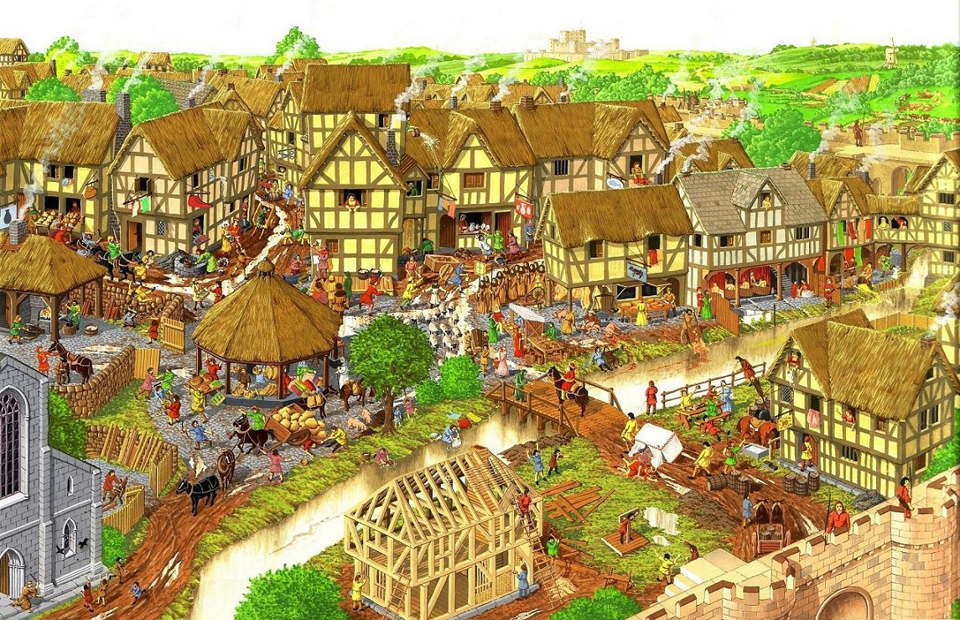
Life in Medieval England
p.7
Look at the drawing of a Middle Ages town in England. Annotate the picture to explain aspects would be dangerous to health or reduce life expectancy?
Summarise: What are the reasons that life expectancy in the Middle Ages was between 30-40 years old?
__________________________________________________________________________________________________________________________________________________________________________________________________________________________________________________________________________________________________________________________________________________________________________________________________________________________________________________________________

Slide 8
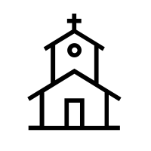
Life In Medieval England
p.8
TASK: If this is the answer, what is the question:
90% - _____________________________________________________________________________
10% - ____________________________________________________________________________
Every village had a priest. - ___________________________________________________________
Local councils - ____________________________________________________________________
People went hungry - _______________________________________________________________
What were the 4 main reasons that progress in medicine was slow in the Middle Ages?
____________________________________________________________________________________________________________________________________________________________________________________________________________________________________________________________________________________________________________________________________________________________________
The Church
The Christian Church was an organistion which spread all over Europe and was headed by the Pope. In England, the head of the Church was the Archbishop of Canterbury. Every region had a bishop and every village had a priest. This gave the Church great influence over everyone's ideas.
The King and his Government
The King’s main task was to defend the people at wartime and to keep the country peaceful. Taxes were only raised to pay for wars. Keeping streets clean and towns healthy were the work of local councils but they had little money to pay for this.
Communication
Printing came to England in the 1470s but until then books had to be written out by hand. This meant there were not many books and knowledge was slow.
Key features of medieval life c.100-c1500
Work and Harvest
90% of people worked as farmers to grow the food everyone needed. This was hard back-breaking work. This constant hard work meant there was little time for education or reading. There were years when poor harvest meant that people went hungry.
Education
The Church controlled education, especially in the universities where physicians were trained. By the end of the 15th century up to 10% of people in large towns could read. The books most commonly read were prayer books and other religious books.
Attitudes
People were taught to respect what was written in the Bible and other ancient books. They were not encouraged by the Church to think for themselves or challenge traditional ideas.

Slide 9
Key Topic 1.1A. Supernatural and Religious Causes of Disease
p.9
Religious Explanations of the Causes of Disease
The period of 1250-1500 is known as the Middle Ages or the medieval period and the majority of the people living at this time were extremely religious. Most of the people in England followed the teachings of the Catholic Church. They would attend services regularly and would be expected to give sums of money to the Church each month, this was called a tithe. The Church also owned large amounts of land in England where it built churches, monasteries and convents. These became important centres of the community: as well as praying, monks and nuns of the Church provided basic medical care, looking after people who were not able to care for themselves. The Church used the tithes to pay for the care of the community.
Illness was not uncommon. Malnutrition, particularly in times of famine, made people more likely to fall ill. A lack of scientific knowledge at this time meant that the causes of disease and illness were a mystery. The Church used religion to answer the questions people had about illness and disease.
Ordinary people received most of their teaching from the Church, as they didn’t receive any formal education. The majority of people at this time could not read or write, instead, they learned from the stories they heard, or the paintings they saw on the wall of their church. One thing they learned was that sin was very dangerous. The Church taught that those who committed a sin could be punished by God. They also taught that the devil could send disease to test someone’s faith.
The Church often explained famine by saying that God had sent it as a punishment for sin. Therefore, it was logical also to blame people’s sins for their illnesses. Blaming sickness on God acted as ‘proof of the divine’: it provided evidence of God’s existence.
Keywords
Malnutrition - An illness caused by lack of food.
Famine - food shortage, usually due to bad harvests.
Supernatural - Something spiritual or not natural. Disease in the Middle Ages were often believed to have supernatural causes and cures.
Monasteries - Buildings run by monks. People could get treatment here.
Paralysis - Being unable to move either all or part of your body as a result of illness, poison or injury.
TASK - Read the through the information above and think about whether the Church helped or hindered the understanding and treatment of disease? Summerise your ideas in the table and explain your overall verdict.
Ways the Church helped the understanding and treatment of illness | Ways the Church hinder the understanding and treatment of illness
Overall, I think that the Church helped/hindered the understanding and treatment of illness because… ________________________________________________________________________________________________________________________________________________________________________________________________________________________________________________________________________________________________________________________________________________________________________

Slide 10
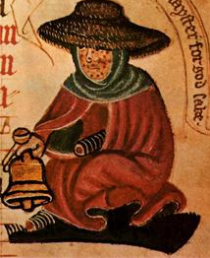
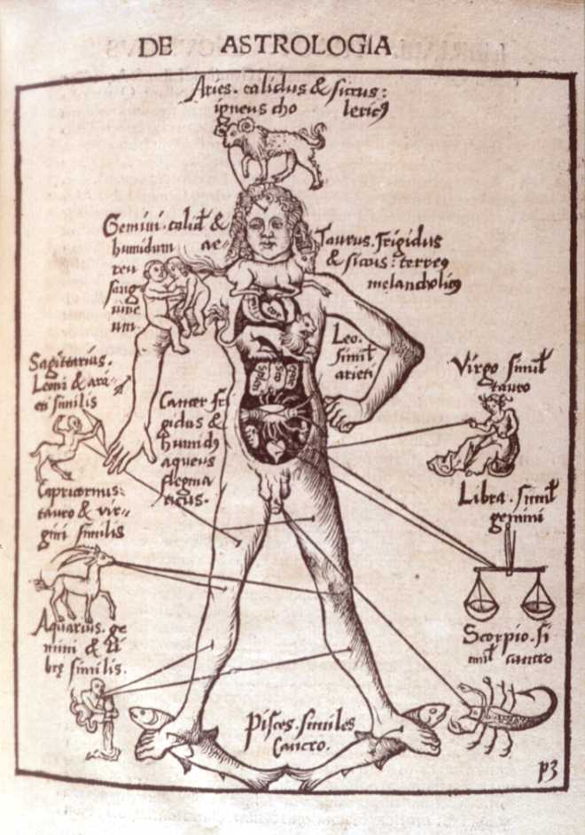
Key Topic 1.1A. Supernatural and Religious Causes of Disease
p.10
TASK: Carefully read the following account of leprosy in the Middle Ages. Can you see any evidence that, even in the Middle Ages, people also looked for rational (scientific/logical observations made from the real world rather than supernatural/otherworldly) causes of disease?
Leprosy
The Bible tells stories about how God sent disease as a punishment, leprosy in particular was included in the Bible. It was a painful skin disease that led to paralysis and eventually death. There was no cure, so lepers were banished from communities. If they were allowed to stay they had to wear a cloak and ring a bell to announce their presence. They were also banned from going down narrow alleys, where it was impossible to avoid them. This was because it was believed that their breath was contagious. Although this was not true, it does show that medieval people had some correct ideas about how some diseases were transmitted. Although there was no formal care for lepers, a few lazar houses did help people suffering from leprosy. Lazar houses were more commonly known as leper colonies.
Evidence that people in the Middle Ages had rational ideas about and treatment of disease:
__________________________________________________________________________________________________________________________________________________________________________________________________________________________________________________________________________________________________________________________________________________________________________________________________________________________________________________________________________________________________________________________________________________________________
Explain how the illustration on the left is connected to medicine and supernatural ideas.

Slide 11
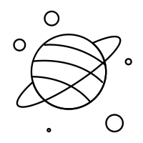
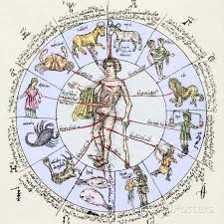
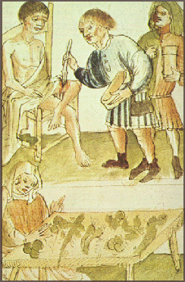
Key Topic 1.1A. Supernatural and Religious Causes of Disease
p.11
TASK - Read the following passage on astrology. Was astrology a rational or supernatural explanation of disease?
Astrology
The alignment of the planets and stars was also considered very important when diagnosing illness. A physician would consult star charts, looking at when the patient was born and when they fell ill, to help identify what was wrong. Traditionally, the Church frowned upon the idea of using astrology in diagnosing illness, as it seemed only one step away from predicting the future or fortune telling. However, after the Black Death arrived, astrology became more popular and the Church became more accepting of it. Many people believed the Black Death was caused by a bad alignment of the planets.
Astrology is a rational/supernatural explanation of disease because…
___________________________________________________________________________________________________________________________________________________________________________________________________________________________________________________________________________________________________________________________________________________________________
Keywords
Diagnosing - Deciding what is wrong with a patient by considering different symptoms. In medieval England, physicians could also consider star chats to diagnose an illness.
Physician - Someone who practices medicine. A medieval physician did not have to have the same level of training as a modern physician.
HOT - Write 2 sentences using all the keywords on page 12 and 1 sentence using all the keywords on page 13. Highlight the keywords after you have completed.
_____________________________________________________________________________________________________________________________________________________________________________________________________________________________________________________________________________________________________________________________________________________________________________________________________________________________________________________________________________________________________________________________________________________________________________________________________________________________________________________________________________________________________________________________________________________________________________________________________________

Slide 12
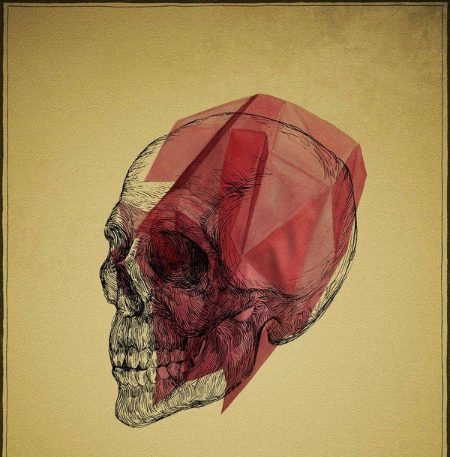
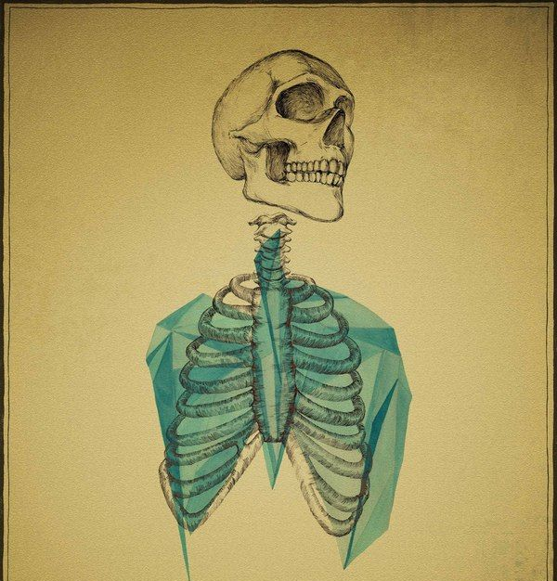
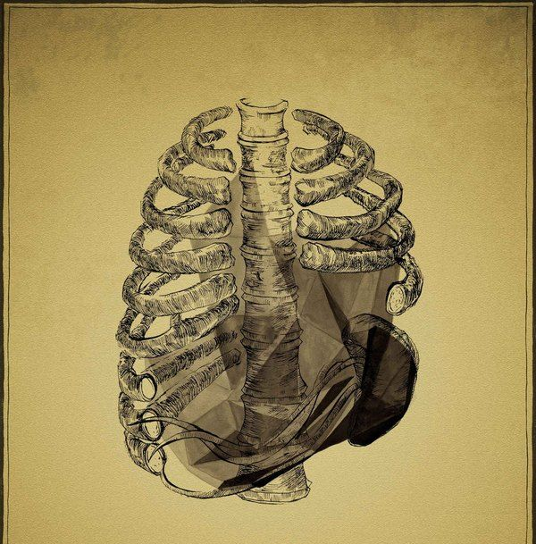
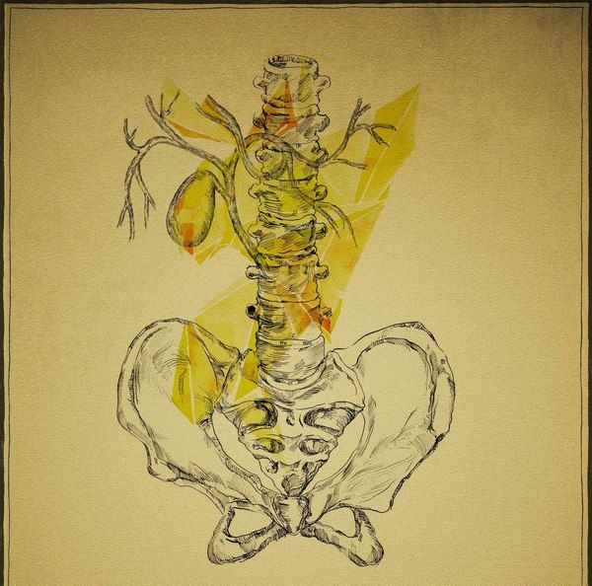
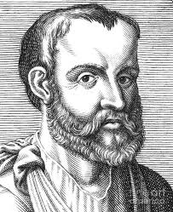
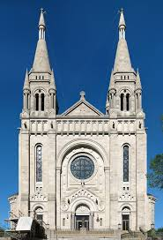
Key Topic 1.1B - Rational Explanation: Theory of the Four Humours
p.12
The theory stated that as the universe was made up of the four basic elements - fire, water, earth and air - the body must also be made up of four humours, which were all created by digesting different foods. The four humours were:
There was a belief that all the humours must be balanced and equal. If the mix became unbalanced, you became ill.
According to the theory, each humour was linked to certain characteristics that physicians would look for when carrying out their diagnosis. For example, a person suffering from a fever had a temperature, causing the skin to go hot and red, physicians believed, they had too much blood. This was a hot and wet element. Meanwhile, a person suffering from a cold had too much phlegm, which was cold and wet. They would shiver and the excess phlegm would run out their nose. The humours were linked with the seasons as seen in the table above. Along with this, the star signs for each season were associated with its humour. Astrology was considered an important part of the Theory of the Four Humours, as the humours were connected with star signs and seasons, and each one had its own ruling planet.
The Origins of the Theory.
The Theory of the Four Humours was created by the Ancient Greek physician named Hippocrates in the 5th century BC. The word “humour” comes from the Greek word for fluid- humon. Hippocrates was very careful to observe all the symptoms of his patients and record them. The Theory of the Four Humours fitted what he saw.
Blood
People may cough blood.
Phlegm
The watery substance coughed up or sneezed out.
Black Bile -
Probably referred to clotted blood, visible in excrement or vomit.
Yellow Bile
Appeared in pus or vomit.
Humour | Season | Element | Qualities
Blood | Spring | Air | Hot and Wet
Yellow Bile | Summer | Fire | Hot and Dry
Black Bile | Autumn | Earth | Cold and Dry
Phlegm | Winter | Water | Cold and Wet
1. Hippocrates created the theory of the Four Humours in Ancient Greece. 400 BC
2. Galen developed the theory by adding the theory of opposites (treatment) to balance the humours. 200 AD
3. The Catholic Church respected both and demanded their ideas be taught in medical universities in the Middle Ages

Slide 13
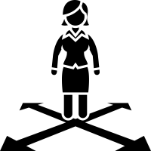
Key Topic 1.1B - Rational Explanation: Theory of the Four Humours
p.13
Galen, a physician in Ancient Rome during the 2nd century AD, liked the ideas of Hippocrates and developed them further. He had been a physician in a gladiator school and later became the personal physician of the Roman Emperor. This meant that he had lots of time to experiment, ponder philosophy and write. By the time he died, he left behind a very large body of work- more than 350 books.
Galen developed the Theory of the Four Humours to include the idea of balancing the humours by using the Theory of Opposites. For example, he suggested that too much phlegm, which was linked to water and the cold, could be cured by eating hot peppers. Galen also theorised that the circulatory system circulated blood generated in the liver, and the blood was distributed around the body.
The Theory of the Four Humours was very popular because it was very detailed and could be used to explain almost any kind of illness – physical or mental. It was important that the theory covered almost every type of illness that occurred, because there was no other scientific explanation for the cause of disease. Often physicians twisted what they saw to fit in with the logic of the theory.
Keywords
Vivisection - Criminals sent to death had their bodies cut open by physicians to examine.
Barber Surgeon - Barbers worked with knives, so as well as giving haircuts, they would carry out medical procedures and later on, smaller surgeries.
Galen’s Influence
Classical texts like those of Galen continued to be very influential in the Middle Ages for three reasons: the influence of the Church, the importance of book learning and the lack of alternative theories.
The influence of the Church
Galen wrote that the body was clearly designed for a purpose and that the different parts of the body were meant to work together in balance, as first proposed by Hippocrates. Galen also believed in the idea of the soul. This theory fitted in very well with the ideas of the Church, who believed that God created man in his image, and so they promoted Galen’s teaching and, by extension, those of Hippocrates. Since books were produced in monasteries, and libraries were maintained by the Church, their choice of texts were the ones that were widely read, preached and believed. In the early Middle Ages, the church controlled medical learning in universities, too.
The importance of book learning
Many people could not read in the Middle Ages. This meant that being widely read was a sign of intelligence. A good physician was considered to be one who had read many books, rather than one who had treated a lot of patients. Having read the works of Hippocrates and Galen was proof that a physician was worth the money he was being paid. The authority of these classical texts was so strong that people believed them even when there was actual, physical evidence that suggested they were wrong.
The lack of alternatives
There was a lack of scientific evidence to support any other kind of theories of the causes of disease. Dissections were mostly illegal, because the church taught that the body needed to be buried whole in order for the soul to go to heaven. Very occasionally, physicians were able to dissect executed criminals, or criminals who had been sentenced to death by vivisection. When this happened, the physician would sit far away from the body, reading from the works of Galen, while the actual cutting and examining was done by a barber surgeon. This meant that Galen’s ideas were preserved: anything in the body that didn’t agree with Galen’s writings could be explained away, since the body was that of a criminal and therefore imperfect, and the physician himself never did any examinations.

Slide 14
Key Topic 1.1B - Rational Explanation: Theory of the Four Humours
p.14
Who was Hippocrates? _______________________________________________________________________
What was the name of his theory? _______________________________________________________________________
How did Galen adapt this theory? _______________________________________________________________________
What element was each of the humours linked to? ______________________________________________________________________________________________________________________________________________________________________
Summerise the three reasons why Galen’s ideas had such a great influence on medicine. _____________________________________________________________________________________________________________________________________________________________________________________________________________________________________________________________________________________________________________________________________________________________________________________________________________________________________________________________________________________________________________________________________________________________________________________________________
Hot - Explain why and how the Church had an impact on medieval medicine.
_____________________________________________________________________________________________________________________________________________________________________________________________________________________________________________________________________________________________________________________________________________________________________________________________________________________________________________________________________________________________________________________________________________________________________________________________________

Slide 15
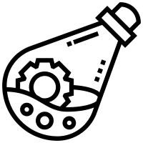
Key Topic 1.1B - Rational Explanation: Miasma and other Causes
p.15
Miasma
A miasma (plural= miasmata) was bad _______ that was believed to be filled with harmful fumes. Hippocrates and ___________ both wrote about miasmata and suggested that swamps, corpses and other _____________ matter could transmit disease. Smells and vapours like miasmata were also, unsurprisingly, associated with God. A clean and sweet-smelling home was a sign of spiritual _______________ , and incense was burned in churches to purify the air. Homes that smelled badly suggested _________________ and corruption and, if a person was unwashed, other people would ___________ them, in case they breathed in the bad miasma and contracted a disease.
Urine charts
Although medieval physicians didn’t _________ people’s urine for making them ill, they did carefully examine the urine in order to make their _______________. It was thought to be one of the best ways to check on the balance of the _____________ inside the body. Samples of a patient’s urine could be sent to a physician, where it would be examined and compared with a urine ___________. The physician would carefully check the colour, thickness, smell and even __________ of the urine before making his diagnosis.
sinfulness Galen taste blame avoid diagnosis cleanliness
chart humours rotting air
Influence on ideas about the causes of disease
The Middle Ages was a time when there was continuity in ideas about the causes of disease. There were only a few small changes. For example, the use of astrology became more widespread, which meant it was adopted by many people, but did not expand upon Galen’s original theories. On the whole, ideas remained the same.
Individuals and the Church
The Church was very important in maintaining the status quo at this time. This means that they did not like change, and wanted to keep things the way they were. The Church controlled medical learning. It chose which books were copied and distributed. The Church liked the Theory of the Four Humours because it fitted with their teachings, so it promoted this theory. The Church strongly discouraged anybody from criticising the theory.
HIppocrates and Galen were important individuals in the Middle Ages, Even though they lived many years before this time. Their books had been preserved by Arabic scholars and Latin translations were available in Europe by the Middle Ages. Galen in particular was popular with the Church, which meant that his work was widely promoted.
Science and Technology
During the Middle Ages, a lack of scientific understanding meant that new knowledge was limited. Physicians and medical students tried to make new discoveries fit into the old theories, rather than experimenting to explain the discoveries.
One important piece of technology invented near the end of the Middle Ages was the printing press. It was invented around 1440 by Johannes Gutenberg in what is now Germany. Although this was not directly related to advancing medieval medicine, it eventually led to much faster and easier sharing of medical texts. However, it did not have a huge impact during the medieval period.

Slide 16
Key Topic 1.1B - Rational Explanation: Miasma and other Causes
p.15
Miasma
A miasma (plural= miasmata) was bad _______ that was believed to be filled with harmful fumes. Hippocrates and ___________ both wrote about miasmata and suggested that swamps, corpses and other _____________ matter could transmit disease. Smells and vapours like miasmata were also, unsurprisingly, associated with God. A clean and sweet-smelling home was a sign of spiritual _______________ , and incense was burned in churches to purify the air. Homes that smelled badly suggested _________________ and corruption and, if a person was unwashed, other people would ___________ them, in case they breathed in the bad miasma and contracted a disease.
Urine charts
Although medieval physicians didn’t _________ people’s urine for making them ill, they did carefully examine the urine in order to make their _______________. It was thought to be one of the best ways to check on the balance of the _____________ inside the body. Samples of a patient’s urine could be sent to a physician, where it would be examined and compared with a urine ___________. The physician would carefully check the colour, thickness, smell and even __________ of the urine before making his diagnosis.
sinfulness Galen taste blame avoid diagnosis cleanliness
chart humours rotting air
Influence on ideas about the causes of disease
The Middle Ages was a time when there was continuity in ideas about the causes of disease. There were only a few small changes. For example, the use of astrology became more widespread, which meant it was adopted by many people, but did not expand upon Galen’s original theories. On the whole, ideas remained the same.
Individuals and the Church
The Church was very important in maintaining the status quo at this time. This means that they did not like change, and wanted to keep things the way they were. The Church controlled medical learning. It chose which books were copied and distributed. The Church liked the Theory of the Four Humours because it fitted with their teachings, so it promoted this theory. The Church strongly discouraged anybody from criticising the theory.
HIppocrates and Galen were important individuals in the Middle Ages, Even though they lived many years before this time. Their books had been preserved by Arabic scholars and Latin translations were available in Europe by the Middle Ages. Galen in particular was popular with the Church, which meant that his work was widely promoted.
Science and Technology
During the Middle Ages, a lack of scientific understanding meant that new knowledge was limited. Physicians and medical students tried to make new discoveries fit into the old theories, rather than experimenting to explain the discoveries.
One important piece of technology invented near the end of the Middle Ages was the printing press. It was invented around 1440 by Johannes Gutenberg in what is now Germany. Although this was not directly related to advancing medieval medicine, it eventually led to much faster and easier sharing of medical texts. However, it did not have a huge impact during the medieval period.

Slide 17
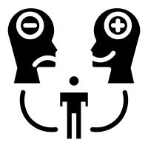
Key Topic 1.1B - Rational Explanation: Miasma and other Causes
p.16
Attitudes in Society
Medieval people had a strong belief in God and did not want to risk going to hell by being critical of the Church. Physicians who did not follow the old ideas found it hard to get work, because everybody knew a ‘good’ physician would follow Theory of the Four Humours. A famous 13th-century military surgeon, Henri de Mondeville, was among those who questioned the old ways of practising medicine. Mondeville is even quoted as stating that classical figures like Hippocrates and Galen were like an old dog that need to be put down, but whose owners could not face replacing it with a younger, healthier dog. However, even he continued to practise medicine in the same way as everybody else - he probably wouldn't have found employment otherwise. Many people believed that , since medicine had always been done this way, there was no need to change it.
TASK - 3-2-1 quiz
You need to create/write 6 questions from page 12-13. 3 true of false statements, 2 multiple choice and one factual recall e.g. what is miasma. Once you have written your questions, hand your workbook to your partner and get them to answer them!
3 True or false
_____________________________________________________________________________________
_____________________________________________________________________________________
_____________________________________________________________________________________
2 Multiple Choice
1 Factual recall
__________________________________________________________________________________________
___________________________________________________________________________________________
__________________________________________________________________________________________
Question | Option 1 | Option 2 | Option 3 | Option 4

Slide 18
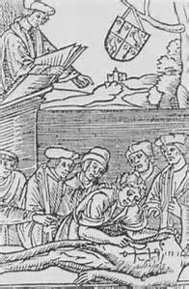
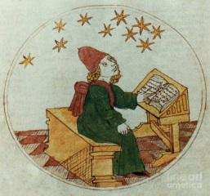
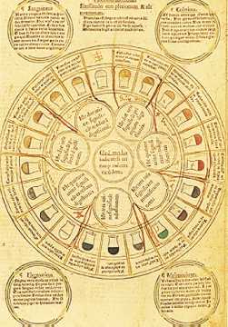
Medieval – Religious and Supernatural causes of disease and illness
p.17
Religious Explanation - God’s punishment of sinners: Church controlled what was taught and taught people that God made them ill either because: God was displeased with them e.g. in the Bible disease like leprosy were used to punish sins. God was testing their faith People believed that there was no need to search for other rational explanations for disease – which held back medical research and meant few new ideas about the causes of disease.
Supernatural Explanation: Astrology The alignment of planets and stars was thought to cause some diseases. A physician would use astrology by consulting star charts, when the patient was born, fell ill to help diagnose what was wrong with a patient. Use of astrology was not new in 1250 but it increased through this period, especially after the Black Death and the Church became more accepting.
Medieval – Rational and natural causes of disease and illness
Rational Explanation: The Theory of the Four Humours Hippocrates (Ancient Greek) created the Theory of Four Humours – the universe was made up of the 4 elements (fire, water, earth and air) so the body was too, created by eating foods. If one was out of balance it made people ill: Blood Phlegm (coughed, sneezed, tears) Black bile (e.g. clotted blood, excrement, vomit) Choler or yellow bile (pus, vomit) To get better the balance had to be put right. Galen (Ancient Rome) developed Hippocrates work further by developing the Theory of Opposites. Besides bleeding and purging to get rid of excess humours the treatment of opposites aimed to treat and balance the humours with an ‘opposite’ of their symptoms e.g. too much phlegm, linked to water and the cold = eat hot peppers.
Rational Explanation: Miasma (bad air) carried disease Miasma was bad air that was believed to be filled with harmful fumes. This was related to God because bad smells indicated sin. Hippocrates and Galen had even suggested that swamps, corpses and rotting matter could transmit disease – so the idea came from the ancient world.
Medieval Urine Chart
How accurate would diagnosis be using a urine chart? Explain.

Slide 19
Imbalance of the 4 humours
Miasma
God’s punishment
evil spirits
Alignment of the planets (astrology)
p.18
Diet and hygiene (not common)
natural causes (rational)
supernatural causes
witches
foreigners
Middle Ages: ideas about the cause of disease and illness (1250-1500)
only during Black Death
Jews
cats and dogs
academic training (not practical)
Why so little progress?
Catholic Church
Poor communications
Ignorance
Controlled medical universities that taught Galen and 4 humours
95% illiteracy
Blamed God for illness
Attitudes: conservatism
No formal education system
No scientific method
Forbade dissection

Slide 20
Key Topic 1.1 Recap Mind Map
p.19
God
Four Humours
Medieval Ideas about the cause of disease
Astrology
Miasma

Slide 21
p.20
Quiz - KT1.1 - Causes of Disease
1. What dates were the Middle Ages (according to our exam spec)
2. What period of time comes after the Middle Ages?
3. Three adjectives to describe the Middle Ages? Why was life expectancy so low?
4. What MA institution (organisation) had immense power of people’s lives?
5. Name of Greek doctor who came up with the Theory of the Four Humours?
6. What did the Roman Doctor Galen add to this?
7. About how many years did the 4 humours theory remain accepted?
8. Three supernatural causes of disease in MA?
9. Three natural causes of disease?
10. Two large reasons why there was so little progress in the medical understanding during the period.
Red | Amber | Green
Fails to adequately explain the ideas of the causes of disease in the Middle Ages with accuracy or detail and does not understand the role of factors of religion and context of the period. | Can explain the ideas behind the causes of disease in the Middle Ages with sufficient detail and understanding but struggles to explain the role of Hippocrates, Galen, the Church and Medieval context. | Fully understands and can explain the rational and supernatural ideas behind the causes of disease in the Middle in the Middle Ages including the role of Hippocrates and Galen and the influence of the Church and ignorance of the period.

Slide 22
Key Topic 1.1B - Rational Explanation: Miasma and other Causes
p.21
Below are the the three main factors to understanding change and continuity in early diagnosis of disease. You need to:
Annotate the mind map with factual information from the previous pages.
Draw a symbol that represents each of the factors
HOT - Number the factors 1-3 with one being the most significant
Explain which one you think is the most significance influencing beliefs about the causes of disease.
I think the most significant factor for ignorance regarding the causes of disease in the Middle Ages is…
_________________________________________________________________________________________________________________________________________________________________________________________________________________________________________________________________________________
Individuals and institutions including the Church and government.
Influencing beliefs: the causes of diseases.
Science and technology
Attitudes in society

Slide 23
KT 1.1 - 12 mark exam question
p.22
Explain why there was continuity in the idea about the cause of disease during the period 1250 - 1500
The following statements are pieces of evidence that you can use to answer this question. You need to choose 3 colours and and place them in the correct factor. There are boxes for you to consider your own evidence from previous lessons
Physicians tried to fit new discoveries into old theories.
Printing Press was not invented until the end of the Middle Ages
Factor | Number
Attitudes in Society
Science and Technology
Individuals + Institutions.
Many people believed that since medicine had always been done this way, there was no need to change it.
‘Good’ Physicians followed the ideas of the Four Humours. There was a belief that as it had always been done in a certain way, there was no reason to change it.
The Church controlled medical learning in universities.
Medieval society had a strong belief in God and did not want to risk hell by criticising the Church.
Galen’s theory and ideas of the soul linked well into the beliefs of the Church.
Books produced in monasteries and libraries were maintained by the Church.
Galen’s theories
The fact that many couldn’t read or write meant they relied on the Church’s teachings of disease that it was a punishment by God or a way to cleanse your soul.
Hippocrates theories

Slide 24
KT 1.1 - 12 mark exam question
p.23
Copy this question into your orange books:
Explain why there was continuity in the idea of cause of disease between 1250 - 1500.
You may use the following information in your answer:
The Church
Galen
You must also use information of your own 12 marks
This question is essentially a PEEL answer. Point, Evidence, Explain and Link
TOP TIP 1
This question type expects you to be able to give reasons why something happened. The two bullet points are a guide of relevant information but you must elaborate to show the extent of your knowledge. It is essential that you also include further relevant knowledge of your own. You should aim to give at least THREE explained reasons in a 12 mark question. Always try to elaborate on both bullet points, and add at least one further well explained point of your own (2 is better, if you can!) If you don’t go beyond the points given, you will be limited to 8 marks.
Point Write the main idea you want to talk about (e.g a factor)
Evidence Prove your point using facts/ figures/ examples.
Explain Tell me why you make this point.
Link Use a connective to link/refer back to the question.
This is because...
Student friendly Mark scheme
L2 4-6 | - Weak explanations - Some understanding but lacking
L3 7-9 | - Points are explained with good development. - Good focus on topic - Understanding is demonstrated by clear use of facts, key words and details. - Maximum 8 marks for Level 3 answers that do not go beyond aspects prompted by the stimulus points.
L4 10- 12 | - Points are explained with analysis supported by strong development and linked to wider understanding of the topic. - Excellent focus on topic and command word - Understanding is demonstrated by clear use of wide ranging facts, key words and key details about the period. - At least three different reasons given for the ineffectiveness of reactions.

Slide 25
KT 1.1 - 12 mark exam question
p.24
For this question, you don’t need an introduction or a conclusion in this answer, you are just explaining why something happened.
TASK - Highlighter Marking
Below is a sample paragraph. It is a good paragraph but there are 5 factual inaccuracies. You need to highlight them and correct the mistake in the margin.
Start each paragraph with a point that rephrases the question.
One reason why there was continuity in the ideas about the causes of disease between 1250-1500 was because of the Church. Even though the majority of people at this time were not religious, the Protestant Church held a lot of power and influence. For example, they controlled the education, and with the king, decided which books were copied and distributed. This led to continuity in the ideas of the cause of disease because even though the Church liked change, they discouraged anybody from criticising their beliefs. Furthermore, they only taught ideas that fitted their ideas, like Galen's Theory of Four Humours, which led to continuity as all medical professionals learnt from the Church’s teachings.
When referring back to the question, use the question to help you focus your explanation.
TASK
Identify the following on the model paragraph:
Point
Evidence
Explain
Link
Once complete, write 2 additional paragraphs into your orange exam book.

Slide 26
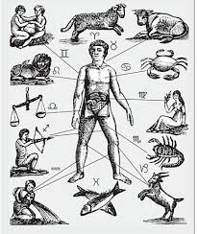
KT1.2A Approaches to Treatments
Supernatural Treatments
p.25
Christianity
(priests)
Astrology
(physicians)
Forbidden
(healers)
prayer
repentance
confession
fasting
penance
Physicians used star charts to coordinate the timing of bloodletting, purging and surgery.
amulets
incantations
spells
Wealthy
Special Mass
pilgrimage
relics
Black Death Only
flagellants
public prayers
Natural Treatments
4 humours
(physicians, barber surgeons)
Herbal Remedies
(apothecaries)
Bloodletting (phlebotomy)
- Cutting a vein
- Leeches
- Cupping
Sniff, drink or bathe in
Therica: a mixture of
- mint
- chamomile
- rose
- ginger
- aloe vera
Theory of Opposites
- Galen taught in 200AD
- still used in Middle Ages
Purging
- Emetics (vomiting)
(aniseed, mustard)
- Laxatives (pooping)
(linseed)
Manuals included:
- Materia Medica
- Circa Instans
Enemas
Clyster was used to deliver medicine designed to clear the stomach
Bathing:
- Remove blockages in humours
- Herbs, metals and even foxes

Slide 27
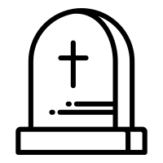
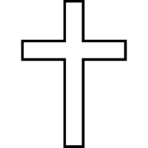
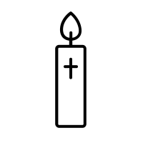
KT1.2A Approaches to Treatments
p.26
Religious and supernatural treatments
As the Church taught that disease was sent by God as a punishment for sin, it followed the that the cure should also involve the supernatural. As well as looking for medical treatment for disease, it was important to undergo a course of spiritual healing. Religious treatments included:
Healing prayers and incantations (spells)
Paying for a special mass to be said
Fasting (going without food)
Pilgrimages to the tombs of people noted for their healing power also became extremely popular. Once the pilgrimage was complete, there were a few suggested actions with diseases could take. (see pictures below)
Keywords
Mass - Roman Catholic service where bread and wine is given. Catholics believe that this involves a miracle: the bread and wine is turned into the body and blood of Christ.
Pilgrimage - A journey to an important religious monument, shrine or place.
Presenting an offering at a shrine, usually an image of the body part to be healed.
Touching holy relics, such as a piece of the ‘true’ cross on which Jesus was crucified or the bones of a saint
Lighting a candle proportionately as tall as you (or as long as the body part you wanted to heal).
Praying to God to help heal your ailment (illness).
If prayers and offerings did not work, there were other supernatural remedies available, although the church did not approve of them. Chanting incantations and using charms or amulets to heal symptoms and ward off diseases were fairly common throughout this period.
Sometimes the sick were discouraged from seeking cures. After all, if God had sent the disease to purge the soul, it was important for the disease to run its course. Taking medicine to cure the disease might keep you alive, but it would mean that your soul would still be stained with sin. That meant risking not being admitted into heathen when you died.
Explain three reasons why religious treatments were so common in the Middle Ages
1.
2.
3.

Slide 28
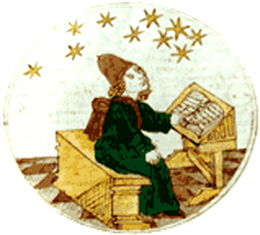
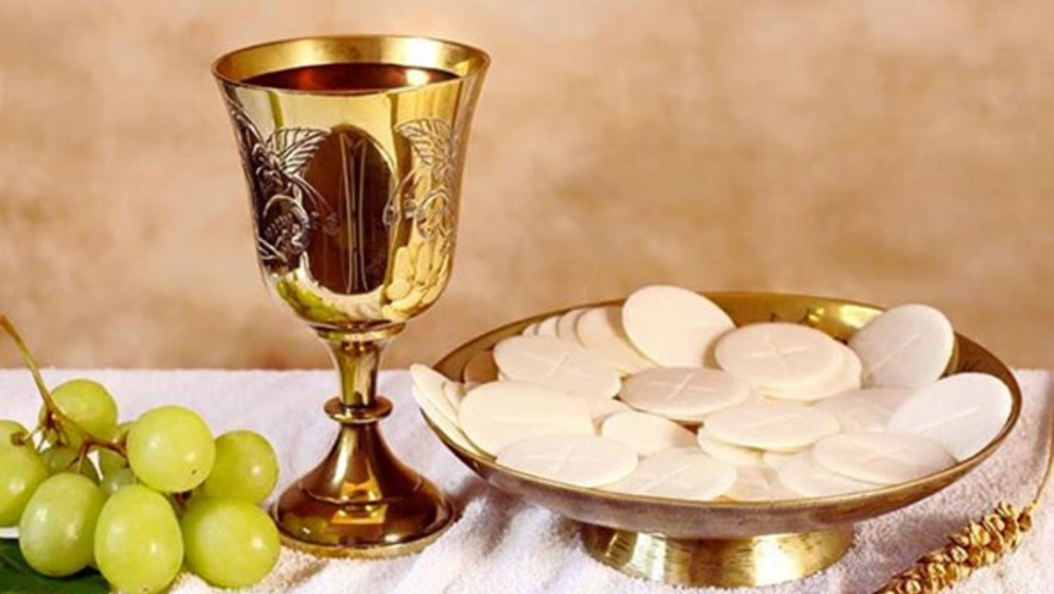
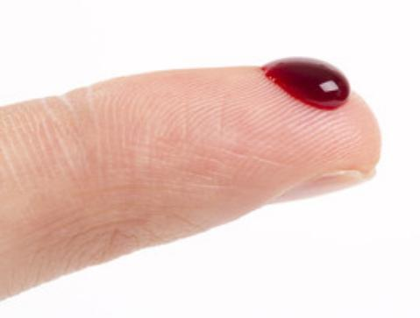
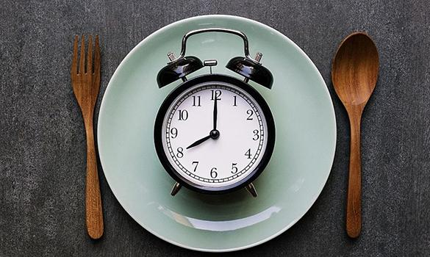
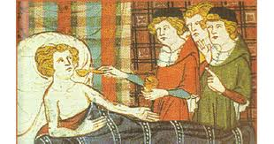
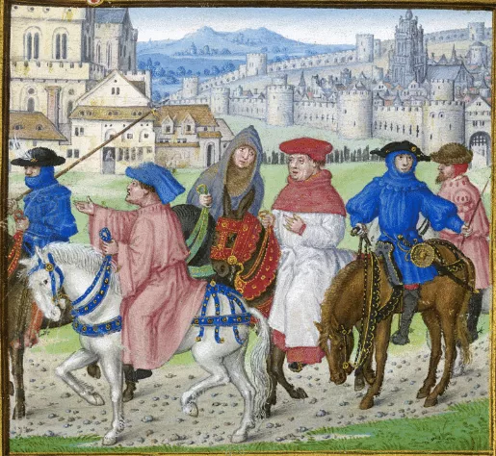
KT1.2A. Approaches to Treatments
p.27
Astrology
Physicians consulted star charts when diagnosing illness. These were also important when prescribing treatment. Treatments varied according to the horoscope of the patient. The alignment of the planets was then checked at every stage of the treatment prescribed: herb gathering, bleeding, purging, operations and even cutting hair and nails all had to be done at the right time.
Task - How do these pictures relate to the treatments illness?

Slide 29
KT1.2A. Approaches to Treatments
p.28
Humoural Treatments
Today, when we fall ill, doctors assess the symptoms, make a diagnosis and treat the infection. For example, if a patient catches a chest infection, the treatment prescribed will be to attach the germ, rather than to stop the patient from coughing. This is because modern medicine recognises that treating the cause of the illness will eventually treat the symptom.
Medieval physicians did not work in the same way. Each symptom was broken down and treated separately, as they believed each symptom represented an imbalance in the humours. Therefore, conflicting remedies might be provided.
TASK - look at Source A below, underline/highlight the treatments that are suggested.
HOT -Explain why this sources is useful for a historian studying treatments in the Middle Ages?
_____________________________________________________________________________________________________________________________________________________________________________________________________________________________________________________________________________________________________________________________________________________________________________________________________________________________________________________________________________________________________________________________________________________________________________________________________________________________________________________________
Source A
Advice from John of Gaddesden’s medical book, the Rosa Anglica. John, a very well - respected English physician, wrote this very popular medical text in the 14th century. Here, he explains how to cure lethargy [extreme tiredness]
It is necessary for lethargics that people talk loudly in their presence. Tie their extremities lightly and rub their palms and soles hard; and let their feet be put in salt water up to the middle of the shins, and pull their hair and nose, and squeeze the toes and fingers tightly, and cause pigs to squeal in their ears; give them a sharp clyster [an enema] at the beginning… and open the vein of the head, or nose, or forehead, and draw blood from the nose with the bristles of a boar. Put a feather, or a straw, in his nose to compel him to sneeze, and do not ever deist from hindering him from sleeping and let human hair or other evil-smelling thing be burnt under his nose…

Slide 30
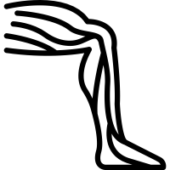
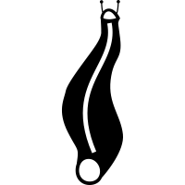
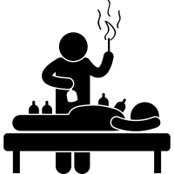
KT1.2A. Approaches to Treatments
p.29
Phlebotomy, or bloodletting/bleeding, was the most common treatment for an imbalance in the humours. The idea behind it was that bad humours could be removed from the body by removing some of the blood. Phlebotomy was so common that most physicians didn’t even bother to carry out the procedure themselves and monks were forbidden from bleeding their patients. Instead, it was usually done by barber surgeons and wise women. Demand was so high that even some people with no medical background offered the service.
Bleeding was carried out in several different ways.
Sometimes patients were bled for too long and died as a result. Evidence suggests that this was quite common and it was probably seen as a necessary hazard.
Purging
Because it was believed that the humours were created from the foods eaten, a common treatment was purging the digestive system to remove any leftover food. This was done by giving the patient either something to make them vomit (an emetic), or a laxative or enema to clear out anything left over in the body.
Emetics usually consisted of strong and bitter herbs like scammony, aniseed and parsley. Sometimes they contained poisons like black hellebore, so it was best to vomit them up quickly.
Type | Method | Uses
Cutting a vein | This involved cutting open a vein with a lancet or other sharp instrument. Blood was usually let from a vein near the elbow, because it as easy to access. | The most straightforward method of bleeding. Phlebotomy charts like the vein man were used to show points in the body where bleeding was recommended for specific illnesses.
Leeches | Freshwater leeches were collected washed and kept hungry for a day before being placed on the skin. Bleeding might continue for up to 10 hours after the leech was full. | Used for people whose age or condition made traditional bleeding too dangerous.
Cupping | The skin was pierced with a knife or a pin or even scratched with fingernails until it was bleeding. A heated cup was placed over the cuts to create a vacuum. This drew blood out of the skin. | Used for women, children and the very old. People believed different illnesses. For example, people believed that cupping on the back of the neck was good for eye trouble, bad breath and facial acne.
Explain three reasons why bloodletting was so commonly used as a treatment in the Middle Ages?
1.
2.
3.

Slide 31
KT1.2A. Approaches to Treatments
p.30
Laxatives were very common. Some well- known examples included mallow leaves stewed in ale, and linseeds fried in hot fat. Linseeds are still used today a s digestive aid. Sometimes people needed a bit more help to purge, and the physician would administer a clyster or enema.
Highlight the KEY information in each paragraph, be brief.
Add a title for each paragraph
Remedies
Sick people in the period c1250-c1500 were also treated with remedies - usually herbal infusions to drink, sniff or bathe in. Some of these are still in use today. For example aloe vera was prescribed to improve digestion. Other ingredients featured regularly included mint, camomile and rose oils, tamarind, almonds, saffron, butter, absinth, turpentine and coral. Sometimes the ingredients were expensive and difficult to find.
A common remedy mixed and sold at this time was theriaca. This was a spice-based mixture that could contain up to 70 ingredients, including quite common things like ginger, cardamom, pepper and saffron, but also some unusual ingredients like viper flesh and opium. Galen had written a book on tehiracas, looking particularly at their use in treating snake bites and poisons. Over time, they became widely popular and were used for many different illnesses.
Different foods were prescribed to encourage the balance of the humours-remember that the humours were thought to be created from the digestion of food. A dish called blanc mangier, made from chicken and almonds, was regularly recommended for medieval invalids because the ingredients were warm and moist.
Bathing
Warm baths were regularly prescribed to help the body draw in heat to help dissolve blockages in the humours. This gave the body the opportunity to steam out impurtities and ease aching joints. Herbal remedies could also be given this way. Various plants and herbs were added to the bath water to help. For example, people suffering from bladder stones were advised to stir in mallow violets.
Some of the remedies were less pleasant and were based purely on superstition:those suffering from paralysis were advised to boil a fox in water and then bathe in it! This was because it was thought that the quick and nimble properties of the fox would be transferred to the patient through the bath water
Summarise each paragraph in 2-3 bullets.
Remedy Ingredients
Remedies were herbal.
Drank, sniffed or bathed in.
Mint, rose oils and almonds.

Slide 32
Medieval – treatments
p.31
Religious: Healing prayers and incantations Paying for a special mass (church service) to be said Fasting (going without food) Use of charms and amulets Pilgrimages e.g. to tombs of people noted for healing powers and then take an action e.g.: Touching holy relics, presenting an offering to a shrine (usually an image of the body part to be healed), Lighting a candle proportionately as tall as you (or as long as the body part needing healing).
Supernatural – e.g. hanging a magpie’s beak around your neck to cure toothache Sometimes the sick were discouraged from finding cures as the disease had been sent to purge the soul so the disease should run its course.
Humoral treatments: Bloodletting (phlebotomy) - most common treatment for humoral imbalance – usually done by barber surgeons or wise women. Methods: cutting a vein, leeches and cupping (skin pierced until bleeding and a heated cup placed over to create a vacuum and draw the blood out). Purging - involved making someone remove food from the body by using mixtures from an apothecary to cause: vomiting – emetics to make someone sick e.g. bitter and strong herbs like scammony, aniseed and parsley. go to the toilet –laxatives e.g. mallow leaves stewed in ale and linseeds. An enema (clyster) – water and herbs were squirted into the anus to purge the body and clear blockages ( water mixed with honey, oil and wheat bran, soap and herbs e.g. camomile – squirted using a greased pipe fixed to a pigs bladder)
Traditional remedies: often made from herbs – to drink, sniff of bathe in. Theriaca = a spice-based mixture (up to 70 ingredients e.g. ginger, cardamom, pepper and even viper flesh or opium) – used for a wide variety of illnesses. Warm baths were prescribed to help the body draw in heat. Herbs and plants were added. One treatment for paralysis = boil a fox in water and then bathe in it!
Research 3-5 ingredients used in Middle Ages herbal remedies and make an advertisement for YOUR herbal remedy below (HOT - explain which disease or ailment your remedy would help solve)

Slide 33
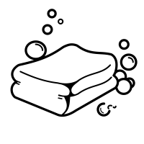
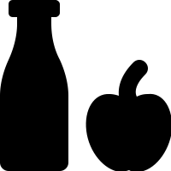
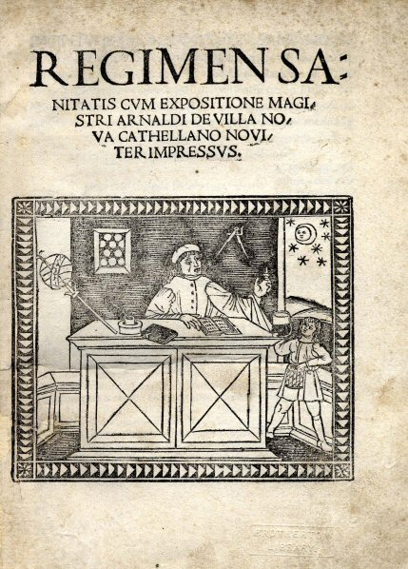
KT1.2A Approaches to Preventions
p.32
The Church
Most people believed that the best, and most important, way of preventing disease was to lead a life free from sin. Regular prayers, confessions and offering tithes to the Church worked together to ensure that any minor sins were quickly forgiven.
Hygiene
Once your spiritual health was taken care of, it was important to concentrate on your bodily health, too. Guidance on doing this was contained in a set of instructions known as the regimen sanitatis.
Purifying the Air
Medieval people attempted to keep the air free from miasmata by purifying it. They did this by spending sweet herbs, such as lavender. Sometimes this might be carried as a bunch of flowers, or placed inside a decorative piece of jewellery called a pomander (a large locket).
Local authorities put measures in place to keep towns clean. For example, they tried to make sure there were no rotting animals left lying around and pulled down or cleaned smelly public toilets.
Diet
Since the humours were thought to be produced by digestion, what and when you ate were both considered very important in preventing an imbalance. Eating too much was strongly discouraged. Fear of digestive problems leading to death was so great that many people purged themselves, either by vomiting or using laxatives, as a way of preventing disease as well as treating it.
Preventing Disease
Regimen Sanitatis
The regimen sanitatis was a loose set of instructions provided by physicians to help a patient maintain good health. It first appeared in the work of Hippocrates, where it was later picked up by Galen and Arabic scholars like Avicenna. This meant that the advice was widespread and very common by 1250.
Ideally, a physician would provide a regimen sanitatis written especially for their patient. However, in practice, this service was only used by the very rich, because it took a long time to write such a detailed set of instructions for a every patient. Bathing was an important treatment for disease. It was also used as a preventative measure: bad smells indicated a miasma. The wealthy could afford a private bath of hot water. Public baths were available for a fee. Poorer people swam in rivers where possible. They believed that cleanliness was next to godliness, so it was important to stay clean. People also tried to make sure their homes smelled sweet and fresh, too. Floors were swept regularly and rushes were laid down to soak up any mess. Sometimes sweet smelling herbs, like lavender, were spread with the rushes to keep air free of miasmata.

Slide 34
KT1.2A. Approaches to Preventions
p.33
The Church
Hygiene
Purifying the Air
Diet
Task
Reduce the information from page 23 into 10-15 words for each category.
Transform the words into 1 picture.
Regimen Sanitatis
HOT - Which method do you think was the most effective and why?

Slide 35
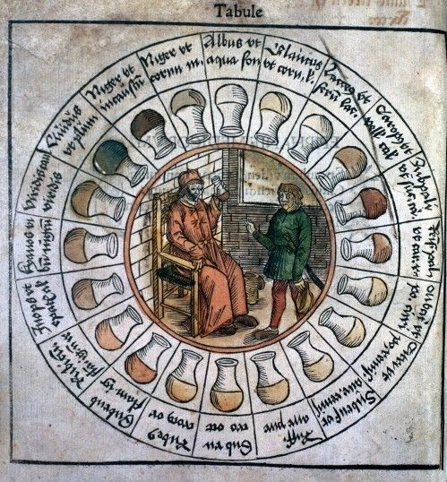
Medieval Diagnosis
p.34
Theory of the Four Humours
Astrology
Urine Charts: Medieval doctors used people’s urine to diagnose illness. They could check the colour, look at the thickness, smell and even taste the urine.
Medieval – prevention
Prevention and treatment of disease in the Middle Ages was based on rational and religious methods as well as traditional remedies.
Religious and supernatural: Living a Christian life e.g. pray, go to church and obeying the 10 Commandments Chanting incantations Use of charms and amulets Self punishment (so God won’t) – such as flagellation.
Rational methods: Trying to keep the streets clean Purifying the air e.g. with sweet herbs like lavender Exercising Not over eating Bleeding and purging Regimen Sanitatis – loose set of instructions provided by physicians to help a patient maintain good health: - Bathing and washing Public baths were available for free, the poor swam in rivers, only the wealthy bathed regularly. Keeping your home clean
TASK: Record 5 statements about Middle Ages prevention but make 2 of them incorrect. Then swap with partner and correct each others mistakes.

Slide 36
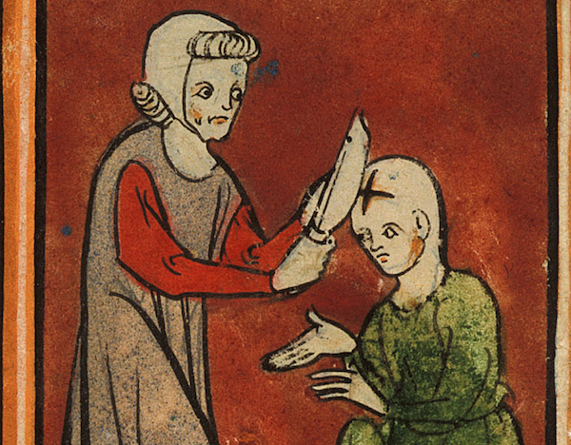
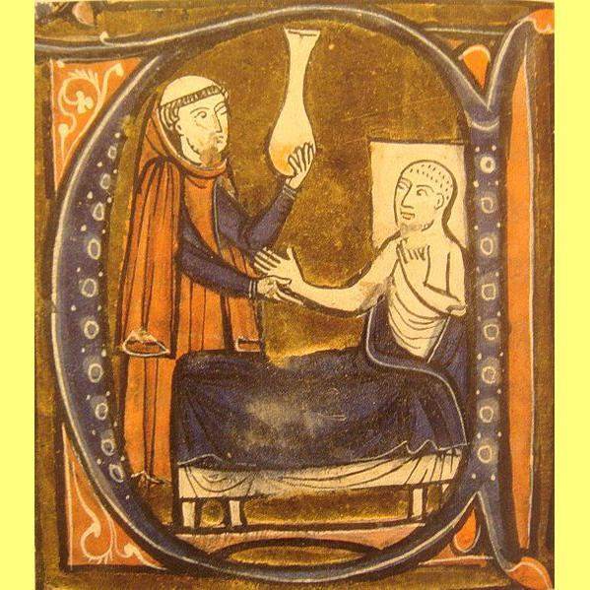
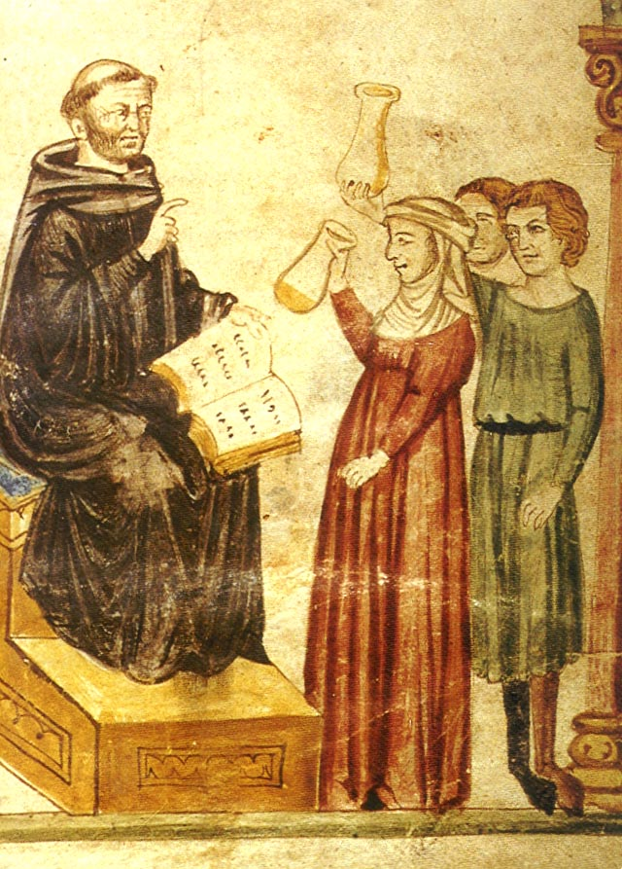
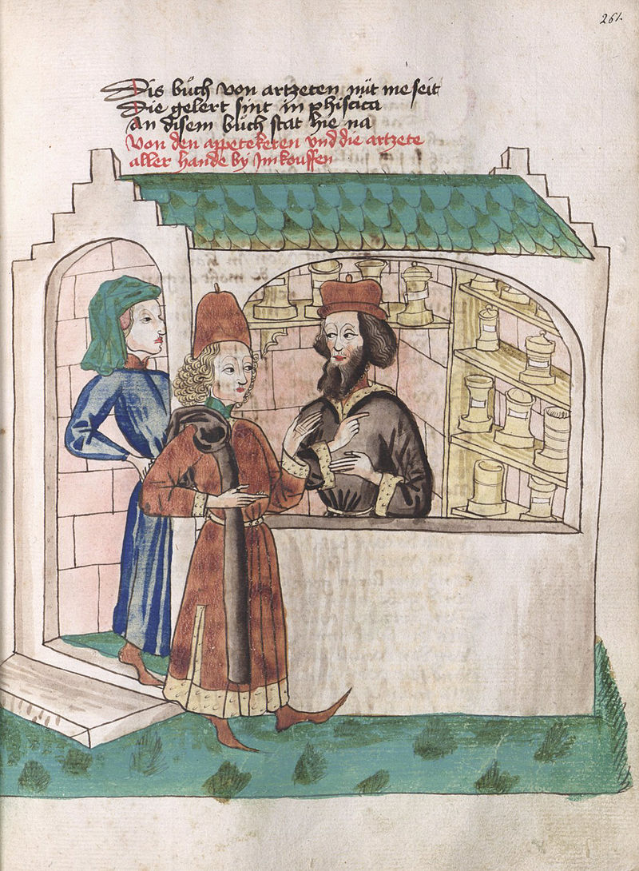
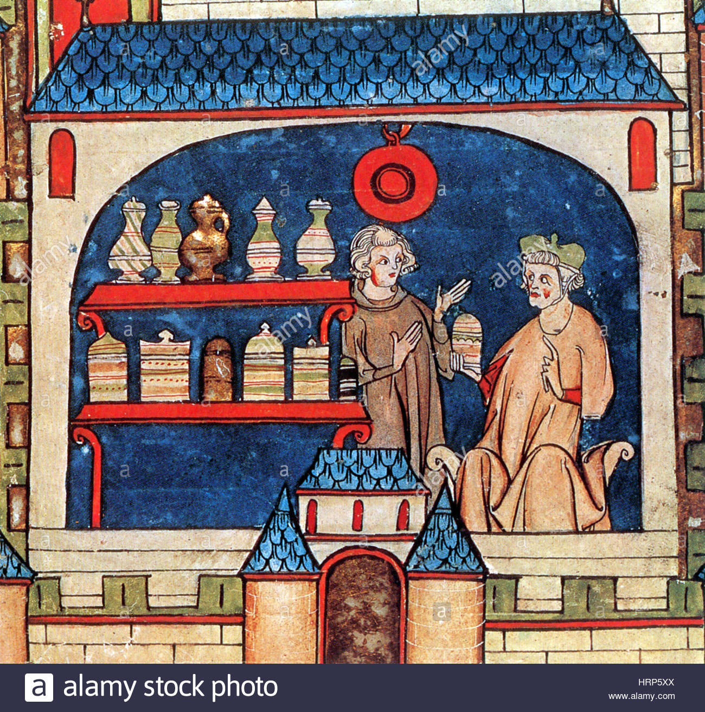
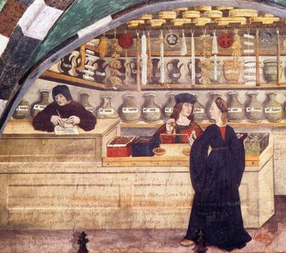
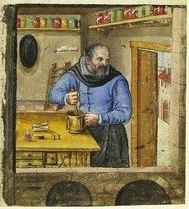
KT1.2B Role of Middle Ages Medics
p.35
Wise Women
Most people in the Middle Ages would have been treated at home by a female family member. Women did most of the treatment at home, caring for the sick and mixing remedies themselves. Women also acted as midwives: evidence from medieval sources suggests that only women attend births. Asking for medical advice cost a lot of money. Since the treamtents weren’t guaranteed, most people were not willing to spend this money even if they had it. However, there were other treatment options for people willing to pay.
Physicians Medicine became more professional during the Middle Ages and a medical degree took between 7-10 years. Doctors were known as physicians - the word ‘doctor’ did not become common until the 17th century. The main role for of a physician was to diagnose illness and recommend treatment, they rarely got involved in treating the patients themselves. He would: 1. look at samples of the patient’s urine, faeces and blood. 2. Consult astrological charts under which the patient was born and at the time they fell sick. 3. Based on this, they would create a course of treatment. Treatment would be carried out by less trained and lower paid professionals as many physicians were clergymen and were forbidden from carrying out procedures such as bleeding. During this time however, new universities were established without religious sponsorships so foreign physicians who had no connection to the Church were able to both diagnose and treat patients. Physicians were very expensive because there weren’t many of them mainly due to the training being so long.
Apothecaries Apothecaries mainly mixed herbal remedies. They had a good knowledge of the healing power of herbs and plants thanks to studying herbal manuals such as Materia Medica. They usually had a good amount of knowledge from their own experience, or passed down from family members. Apothecaries were not considered as skilled or knowledgeable as physicians. Physicians prescribed the medication and apothecaries were just there to mix the remedy. However, since doctors were expensive and apothecaries were comparatively cheap, lots of people would see an apothecary as an alternative to a doctor. This meant that doctors saw them as a threat to their livelihood. Apothecaries did not just create remedies, they also prescribed poison. This went against an idea fundamental to physicians - that they should do no har. This rule went all the way back to Hippocrates and still exists today. Apothecaries were not bound by this rule, so they could not be trusted to do the best for their patient. Nor did they need to attend universities. Finally, many apothecaries also dabbled in alchemy and the supernatural, providing amulets and charms for patients who wanted something extra to cure a disease. This was frowned upon by the Church and, since many physicians were also priests, this meant that the gap between physicians and apothecaries became even wider.

Slide 37
KT1.2B. Role of Middle Ages Medics
p.36
TASK - Which of the Medieval ‘medic’ do these statements relate to?
I trained at a university for 10 years. _________________________
I mainly mixed herbal remedies. ________________________
I would consult astrological charts. ________________________
I do most the treatment at home. _________________________
I’m considered the least qualified medical professional. _________________________
I dabbled in the supernatural. _________________________________
HOT - Why do you think there was so much friction between the different types of medics in medieval England?
____________________________________________________________________________________________________________________________________________________________________________________________________________________________________________________________________________________________________________________________________________________________________________________________________________________________________________________________________________________________________________________________________________________________________________________________________________________________________________________________________
Barber Surgeons Barber surgeons were probably the least qualified medical professionals in England. Since good barbers had sharp knives and a steady hand, they regularly performed small surgeries as well, such as pulling teeth and bleeding patients. Some surgeons were highly trained: in Europe, some physicians were encouraged to study surgery alongside medicine, so many learned their skills at university. In fact, the quality of surgery was arguably higher than the quality of medical advice, because it was usually based on experience rather than knowledge learned from books. In medieval England, a skilled surgeon could set a broken limb, remove an arrow or even successfully remove cataracts from the eyes.

Slide 38
Medieval ‘Medics’ Top Trumps
p.37
Knowledge & Training:
Treatment:
Cost of Treatment:
Likely success rate: /10
Knowledge & Training:
Treatment:
Cost of Treatment:
Likely success rate: /10
Medieval Healer: Wise Women
Medieval Healer: Apothecary
Knowledge & Training:
Treatment:
Cost of Treatment:
Likely success rate: /10
Knowledge & Training:
Treatment:
Cost of Treatment:
Likely success rate: /10
Medieval Healer: Physician
Medieval Healer: Barber Surgeon

Slide 39
KT1.2B Approaches to Hospital care
p.38
Caring for the sick: hospitals and the home
Hospitals
The number of hospitals in England was on the rise during the Middle Ages. By 1500, there were an estimated 1,100 hospitals, ranging in size from just a few beds to hundreds. Bury St Edmund’s, for example,had at last six hospitals to cater for lepers, the infirm and the old. The city had a shrine famous for its healing powers and therefore attracted a lot of sick people. However many hospitals did not actually treat the sick. Instead they offered hospitality to travellers and pilgrims, which is how hospitals got their name.
About 30% of the hospitals in England were owned and run by the Church in the Middle Ages. These were run by the monks and nuns who lived in nearby monasteries. The rest were funded by an endowment, where a wealthy person had left money in their will for the setting up of a hospital. Since charity was a foundation of religion and the Church taught that charitable donations could help to heal disease, it is not surprising that there were so many. The Church was in charge of running many of the hospitals, too.
Medieval hospitals that did treat the sick were not the same as the hospitals we have today. Medieval hospitals were good places to rest and recover The space would have been kept very clean and the bed linens and clothing of the patients changed regularly. It was a large part of the nuns’ duties to do the washing and make sure everywhere was kept clean. This is meant that, for people not suffering from terminal disease, hospitals were probably quite successful.
Naturally, this is what the Church wanted: a recovery was further proof of the existence of God and the importance of prayer. Many european hospitals employed physicians and surgeons, but there is not evidence to suggest that English hospitals did the same. Since religious men were forbidden from cutting into the body, treatment was very limited. Infectious or terminal patients were often rejected from hospitals, as prayer and penance could do nothing for these people. However, patients who had a chance of recovery were able to see the altar and even participate in Church services from their beds, to help with the healing of their souls.
The Home
Although many hospitals were established in medieval England, the vast majority of sick people were cared for at home. It was expected that women that women would care for their relatives and dependents when needed. This care would have involved making the patient comfortable preparing restorative foods and mixing herbal remedies. Women would also be responsible for the garden, in which they were expected to grow various plants known for their healing properties, such as marigolds and clover.Some historical sources hint that women in the home were well-respected for their healing skills.
HOT - Why would Henry VIII’s Dissolution of the Monasteries in 1541 have a negative impact of medical care?
____________________________________________________________________________________________________________________________________________________________________________________________________________________________________________________________________________________

Slide 40
KT1.2B. Approaches to Hospital care
p.39
TASKS
1. Prioritise - Underline the three most important sentences from page 41 and copy them here. Rank them 1-3 and explain Number 1.
__________________________________________________________________________________________________________________________________________________________________________________________________________________________________________________________________________________________________________________________________________________________________________________________________________________________________________________________________________________________________________________________________________________________________
2. Annotate the illustration of a Middle Ages hospital:
3. HOT - Extend: Write down three questions you’d like to ask an expert in this subject.
__________________________________________________________________________________________________________________________________________________________________________________________________________________________________________________________________________________________________________________________________________________________________________________________________________________________________________________________________________________________________________________________________________________________________

Slide 41
KT 1.2 - 16 Mark exam question
p.40
‘The main reason why medical care and treatment was ineffective during the medieval period, c1250-c1500, was because medical knowledge was based on Galen’s ideas.’
How far do you agree? Explain your answer. 16 marks
You may use the following in your answer:
Theory of Opposites
Hospitals
You must also use information of your own.
This question gives 16 marks for knowledge and 4 marks for use of correct terminology, spelling, punctuation and grammar. It is worth nearly 50% of the total marks available, so you may prefer to start the exam with this question to ensure you maximise your time available. You should NOT spend longer than 26 minutes on it though, as you’ll jeopardise losing the other available marks.
This type of question expects you to be able to identify the concept of the statement being given, for example, is it about significance; cause; consequence; change; continuity; similarity, or difference?
You will also be expected to look at both sides of the possible argument before reaching an overall judgement. It is essential to look at how to agree and how to disagree.
A good opening statement is ‘I agree to a limited/partial extent…’. This allows you to look at both sides effectively before summing up your main verdict. Another good tip, for showing both sides of the argument, is to use phrases such as ‘On one hand/On the other hand’ – to indicate you are considering the whole picture.
You should consider at least three points of evidence (more if you can) and ensure you try to use both of the bullet points. It is ESSENTIAL to include at least two more points from your own wider relevant knowledge. The easiest way to decide if you agree or disagree overall is to see which side you have more evidence for.
If you spot points which link, make that link explicit in your writing. Ensure you refer back to the question regularly, to show the examiner you are fully focused on analysing the statement.
TASK - Use the planning sheet on the next page to help you answer the question.
L2 5-8 | - Partial explanation of points but not really developed. - Moderate focus on topic but can wander. - Understanding is demonstrated by some use of facts, key words and details. -Weak judgement that doesn’t take much of a stand.
L3 9- 12 | - Points are explained with good development. - Good focus on topic with both sides of argument explored. - Understanding is demonstrated by clear use of facts, key words and details. - Good and balanced judgement that acknowledges both sides but takes a stand.
L4 13-16 | - Points are explained with analysis supported by strong development and linked to wider understanding. - Excellent focus on topic with both sides of argument explored and weighed up. - Understanding is demonstrated by clear use of wide ranging facts, key words and key details about the period.. - Strong and balanced judgement that acknowledges both sides and is justified in its final decision.

Slide 42
KT 1.2 - 16 Mark exam question
p.41
Introduction
Here you need answer the question and make a judgement. How far do you agree? Strongly, somewhat or do you not agree? Make sure you explain why, whats the ultimate reason you agree or disagree with this statement?
Paragraph 1
List here factual information that will agree with the statement. You need to refer to why Galen's ideas were the main reason for ineffective medical care and treatment. Think about what treatments were related to Galen’s ideas and how effective they were. Furthermore, think about the type of training doctors had.
Remedies based on Galen’s Theory of Opposites were unlikely to be effective in treating illness since they did not treat the actual cause of the disease, only its symptoms.
Paragraph 2
List here factual information that will disagree with the statement. You need to refer to other ideas about medical care and treatment and explain how they were not effective. Think about what they thought caused disease and what they used for treatments. Remember to explain how they are ineffective.
Treatment in hospitals were ineffective because they were mainly run by religious institutions who provided care but often did not attempt to cure illness because they saw it as God’s will.
Conclusion
Here you need to make a judgement on the question. Make sure you refer to the question and support it with the key factual information. Here, you are not expected to address any new ideas.

Slide 43
KT1.3 Case Study: The Black Death, 1348–49
p.42
In 1348, a new disease reached the shores of England. It had spread from the Far east along trade routes, arriving in Sicily in 1347, quickly spreading across the whole of Europe. The Black Death, as it eventually became known, was new plague that was unfamiliar to the ordinary people of England, as well as English physicians. Within months, it had spread the length and breadth of England, killing thousands of people. It was absolutely devastating: it didn’t matter if you were rich, poor, a city dweller or a country farmer - the plague did not discriminate. Those who caught it could expect to die within a matter of days.
There were two types of the Black Death in 1348. Bubonic plague which is transferred from the blood of a rat to the humans via flea bites. This would cause large buboes (swellings) to appear on the victims bodies and a range of other ailments and usually result in death within 5 days. The other type, pneumonic plague, was spread by air and would normally kill between 24-48 hours. Death was almost assured with the pneumonic plague.
Keywords
Scourge - A person or thing that causes great suffering.
TASK - Match the symptom with the pictures below by putting a number below the picture.
Chest pains and breathing troubles
Fever
Sneezing and coughing up blood
Boils and black buboes appearing in the groin and armpits.
Ideas behind the causes of the Black Death
Religious and supernatural
Many believed that the Black Death was the result of God deserting mankind - that is, the Black Death was a punishment for the sin in the world. In 1345, there was an unusual positioning of the planets Mars, Jupiter and Saturn, which astrologers interpreted as a sign that something wonderful or terrible was about to happen.
Natural causes
The main natural cause attributed to the Black Death was impure air. Breathing in this miasma caused corruption to the body’s humours. People believed that this impure air may have originated from poisonous fumes released by an earthquake or a volcano.
Common Beliefs
For the everyday people living in the cities and countryside, the spread of the black Death was terrifying and they would have heard many conflicting ideas about what cause it. In Europe, many people blamed the Jewish population, but the JEws had been expelled from England in the 13th century, so this was not the case in England.

Slide 44
KT1.3 Case Study: The Black Death, 1348–49
p.43
TASK - Reduce the information for each factor about what people thought caused the Black Death into 12 words.
Religious and supernatural - _____________________________________________________________________________________________________________________________________________________________________________________
Natural causes _____________________________________________________________________________________________________________________________________________________________________________________
Common beliefs _____________________________________________________________________________________________________________________________________________________________________________________
Treatments of the Black Death
Supernatural
The main recommendation to treat the Black Death was to confess your sins, and ask God for forgiveness through prayer. However, there was an air of inevitability about the disease: once caught, people believed it was clearly God’s will; if it was his will that the patient should die, there was no cure that would work.
Natural
To begin with, physicians tried bleeding and purging - the same things they would usually do to correct a humoral imbalance. Unfortunately, that didn't work and, in fact, seemed to make people die more quickly. As well as this, physicians recommended strong-smelling herbs like aloe and myrrh, which were believed to have cleansing properties. They often prescribed theriaca, as it was believed to work for lots of ailments. Lighting a fire and boiling vinegar could also drive off the bad air. Physicians or surgeons sometimes lanced the buboes - occasionally, people whose buboes burst survived.
Common Beliefs
Everyday people were willing to try anything to survive the Black Death. They held strong Christian beliefs, and so would have gone to confession and prayed, as well as seeking traditional cures like bleeding. However, it quickly became clear that neither priests nor physicians were capable of curing the disease. Apothecaries sold remedies and herbs were mixed in the home, based on old recipes, but they had uncertain and unpredictable results. Nobody came up with a cure that definitely worked in all cases.
The lack of medical knowledge about what caused the disease meant it was impossible to know how to cure it.

Slide 45
KT1.3 Case Study: The Black Death, 1348–49
p.44
TASK - Highlight each specific treatment of the of the Black Death on page 41.
Preventing the Black Death
Supernatural means
The main advice given by priests was for people to:
Pray to God and fast.
Go on a pilgrimage and make offerings to God.
Show God how sorry you are by self-flagellation (whipping yourself). Large groups of flagellants wandered the streets of London, chanting whipping themselves.
Natural Means
Escaping the plague was the best advice for prevention. Guy de Chauliac, who was the physician to the Pope, advised people to: ‘Go quickly, go far, and return slowly’. It was essential to escape the foul air to stay healthy. If this kind of movement was impossible, people believed it was essential to carry a posy of flowers or fragrant herbs and hold it to your nose. This helped to avoid breathing in the miasma. Unlike the usual advice on preventing disease, people were advised to avoid bathing. It was believed that water would open the skin’s pores to the corrupted air.
Common Beliefs
One physician in Italy recommended doing joyful things, listening to cheerful music and avoiding anything sad as a protection against the disease. This is a clue as to just how desperate most physicians felt - they were willing to suggest anything to prevent their patients from catching the disease. Much like the physicians, people did not know how to prevent the disease. However, they did stop visiting family members who had caught the plague - the common belief of the need to avoid those with the disease was so great that even their houses were avoided.
Government Action
Local authorities attempted to take action to prevent the plague from spreading. New quarantine laws were put in place to try to stop people from moving around too much. People new to an area had to stay away from everybody else for 40 days, to ensure they were not carrying the disease. Authorities also started to quarantine houses where the plague had broken out. They considered banning preaching and religious processions, to stop large crowds of people gathering.

Slide 46
prayer
repentance
confession
flagellants
fasting
charms
p.45
Supernatural
Some confessed but many thought that if you got the plague it was God’s will and you would die unless God healed you.
supernatural
treatments
Black Death reactions
preventions
quarantine of towns
killing cats and dogs
ringing bells
burning tar
burying plague victims
isolating the infected
covering oneself in poo
smelling a toilet / sewer
bloodletting
killing Jews
NATURAL
lancing the buboes
wash with vinegar and rose water
bloodletting
purging
shave a chicken’s butt and tie to buboes
diet changes ( fruit, vegetables)
smelling herbs
drinking wine (reduces fear)
therica (herbal remedy)
natural
Put a smile next to the preventions and treatments that were effective and a frown next to the ones that would make the plague worse.
Four Humours
Miasma (bad smells)
Jews and foreigners
Volcanoes
Rubbish on streets
Cats and Dogs
- Quarantining the infected for 40 days with a red cross on their door
- Killing cats and dogs
- Ordered people to clean up rubbish to drive away bad smells (miasma)
- Paid plague searches to put people in plague pits
Black Death causes
Government actions (prevention)
God punishing for sin
Astrology (Mars, Jupiter and Saturn aligned)
Witches
supernatural causes
natural causes

Slide 47
KT1.3 Case Study: The Black Death, 1348–49
p.46
TASK - Use the information on page 45-46 to complete the table below to show the links between cause, treatment and prevention of the Black Death.
Factors
Government
Individuals
Attitudes in society
The Church / religion
Science and technology
Black Death | Rational / Natural | Supernatural
Beliefs about cause
Treatment
Prevention

Slide 48
KT1.4 Middle Ages Medicine Review
p.47
TASK - You need to understand the role that factors had on the medieval ideas about the cause of disease and the treatments and preventions that they used. Look at the concentric circles, rank order the factors from page 49 in the box that explain the ideas that existed about cause, treatment and prevention, beginning with the most important in the middle to the least important on the outside. Explain your decisions by annotating the diagram.
For example, if you believe that the religious ideas about cause, treatment and prevention were the most influential, write ‘The Church’ in the centre circle. You can then annotate this with details of the religious ideas, such as it was believed that God sent the black Death as a punishment for sins.

Slide 49
Odd One Out – Middle Ages
p.48
A | Disease | Injury | Childbirth | Malnutrition
B | Black bile | Yellow bile | Blood | Water
C | Bloodletting | Purging | Changes in diet | Prayer
D | Sin | Jews | Witches | Curses
E | Pope | God | Pilgrimage | Priest
F | Cats and Dogs | Quarantine | Flagellants | Plague Pits
G | Enema | Clyster | Therica | Rest
Word | Meaning | Timing (short, medium, long)
motivated
precondition
precented
impeded
catalyst
developed
accelerated
led to
enabled
influenced
allowed
triggered
exacerbated
influenced

Slide 50
Key Topic 1 Middle Ages Medicine Quiz
p.49
Answer these quick fire questions to test your understanding
Who came up with the theory of the Four Humours?
What were the Four Humours?
How would you treat somebody that had a temperature because of too much blood?
Arguably, what was the most important institution in the medieval period?
How did MA people use religion to explain the causes of disease and illness?
How was astrology used to treat disease?
What was miasma?
What did physicians do with urine samples?
What common Middle Ages disease was often talked about in the Bible?
What were Medieval universities like?
Who controlled education during the Middle Ages and how did this impact medical training?
How else did the Church cause continuity in medicine c1250-c1500?
What would happen if you challenged the Church’s teaching?
Why did the Church support Galen’s ideas?

Slide 51
KT1.4 Middle Ages Medicine Quiz
p.50
15.How long did Doctors train for and what did they study?
16. What does it mean to have ‘conservative’ ideas and how did this impact the Middle Ages?
17. Why was there no medical breakthroughs during the Middle Ages?
18. Why were Galen’s ideas followed more than Hippocrates during the Middle Ages? What did Galen say needed to happen in order to have an understanding of the body?
19. What year did the Black Death hit Britain and what was its impact?
20. Give three ideas of the causes of the Black Death in the Middle Ages.
21. Give two treatments of the Black Death
22. How did people try and prevent the Black Death?
23. What role did the government play in helping with the Black Death and why was it so limited?

Slide 52
Medieval Medicine revision: ‘Find someone who knows’
p.51
Collect answers from the class to complete the table below. You cannot complete any answers yourself. You cannot collect more than two answers from one person.
What does the word ‘miasma’ mean? Name: | What was the difference between a physician and an apothecary? Name: | What does purging mean and how could people do it? Name: | How did hospitals help people? Name:
Give 3 beliefs about the causes of the Black Death. Name: | What were the 4 Humours and who came up with the idea? Name: | Give 3 supernatural methods of preventing disease. Name: | Give 2 ways physicians carried out bloodletting. Name:
What did Medieval people believe about astrology? Name: | What does quarantine mean, and when was it used? Name: | Give two reasons why the Church was important. Name: | Give 3 rational methods of preventing disease. Name:
Give another name for Medieval period and what years was it? Name: | How would wise women and barber surgeons help people? Name: | What year did the Black Death arrive in England? Name: | Describe the living conditions for people at this time. Name:
Give 2 ways people dealt with miasma. Name: | Who ran hospitals and why? Name: | What is a pilgrimage and why would people do it? Name: | Describe the theory of opposites and who came up with it. Name:

Slide 53
p.52

Slide 54
p.53
What’s this an example of and why did they use it?

Slide 55
p.54

Slide 56
Notes
________________________________________________________________________________________________________________________________________________________________________________________________________________________________________________________________________________________________________________________________________________________________________________________________________________________________________________________________________________________________________________________________________________________________________________________________________________________________________________________________________________________________________________________________________________________________________________________________________________________________________________________________________________________________________________________________________________________________________________________________________________________________________________________________________________________________________________________________________________________________________________________________________________________________________________________________________________________________________________________________________________________________________________________________________________________________________________________________________________________________________________________________________________________________________________________________________________________________________________________________________________________________________________________________________________________________________________________________________________________________________________________________________________________________________________________________________________________________________________________________________________________________________________________________________________________________________________________________________________________________________________________________________________________________________________________________________________________________________________________________________________________________________________________________________________________________________________________________________________________________________________________________________________________________________________________________________________________________________________________________________________________________________________________________________________________________________________________________________________________________________________________________________________________________________________________________________________________________________________________________________________________________________________________________

Slide 57
Notes
________________________________________________________________________________________________________________________________________________________________________________________________________________________________________________________________________________________________________________________________________________________________________________________________________________________________________________________________________________________________________________________________________________________________________________________________________________________________________________________________________________________________________________________________________________________________________________________________________________________________________________________________________________________________________________________________________________________________________________________________________________________________________________________________________________________________________________________________________________________________________________________________________________________________________________________________________________________________________________________________________________________________________________________________________________________________________________________________________________________________________________________________________________________________________________________________________________________________________________________________________________________________________________________________________________________________________________________________________________________________________________________________________________________________________________________________________________________________________________________________________________________________________________________________________________________________________________________________________________________________________________________________________________________________________________________________________________________________________________________________________________________________________________________________________________________________________________________________________________________________________________________________________________________________________________________________________________________________________________________________________________________________________________________________________________________________________________________________________________________________________________________________________________________________________________________________________________________________________________________________________________________________________________________________

Slide 58
Notes
________________________________________________________________________________________________________________________________________________________________________________________________________________________________________________________________________________________________________________________________________________________________________________________________________________________________________________________________________________________________________________________________________________________________________________________________________________________________________________________________________________________________________________________________________________________________________________________________________________________________________________________________________________________________________________________________________________________________________________________________________________________________________________________________________________________________________________________________________________________________________________________________________________________________________________________________________________________________________________________________________________________________________________________________________________________________________________________________________________________________________________________________________________________________________________________________________________________________________________________________________________________________________________________________________________________________________________________________________________________________________________________________________________________________________________________________________________________________________________________________________________________________________________________________________________________________________________________________________________________________________________________________________________________________________________________________________________________________________________________________________________________________________________________________________________________________________________________________________________________________________________________________________________________________________________________________________________________________________________________________________________________________________________________________________________________________________________________________________________________________________________________________________________________________________________________________________________________________________________________________________________________________________________________________

Slide 59
Notes
________________________________________________________________________________________________________________________________________________________________________________________________________________________________________________________________________________________________________________________________________________________________________________________________________________________________________________________________________________________________________________________________________________________________________________________________________________________________________________________________________________________________________________________________________________________________________________________________________________________________________________________________________________________________________________________________________________________________________________________________________________________________________________________________________________________________________________________________________________________________________________________________________________________________________________________________________________________________________________________________________________________________________________________________________________________________________________________________________________________________________________________________________________________________________________________________________________________________________________________________________________________________________________________________________________________________________________________________________________________________________________________________________________________________________________________________________________________________________________________________________________________________________________________________________________________________________________________________________________________________________________________________________________________________________________________________________________________________________________________________________________________________________________________________________________________________________________________________________________________________________________________________________________________________________________________________________________________________________________________________________________________________________________________________________________________________________________________________________________________________________________________________________________________________________________________________________________________________________________________________________________________________________________________________

