Slide 1
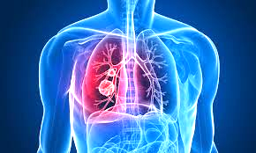
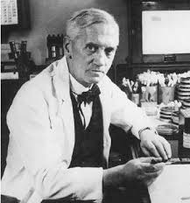
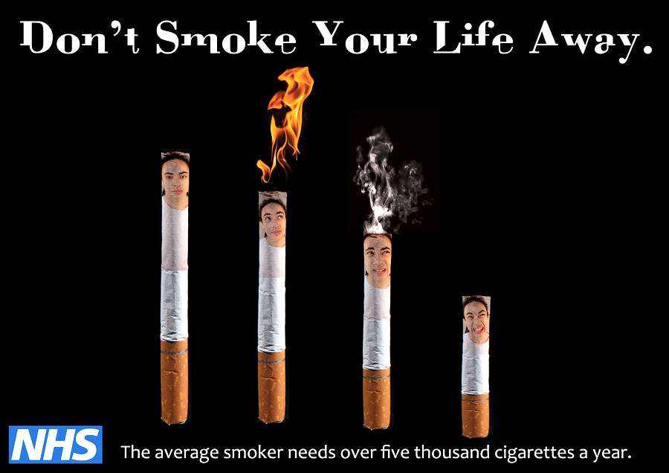
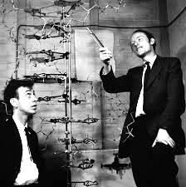
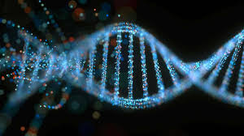
Edexcel GCSE 9-1 History
Medicine in Britain, c1250 to present workbook
Key Topic 4
c1900–present: Medicine in modern Britain V2
Name:
Edexcel 9-1 GCSE History Medicine in Britain, c1250 – present PLC |  |  | Lesson date | Date revised
Key topic 4: c1900–present: Medicine in modern Britain | Key topic 4.1 Ideas about the cause of disease and illness p. 5-14 | A. Advances in understanding the causes of illness and disease: the influence of genetic and lifestyle factors on health.
 |  | B. Improvements in diagnosis: the impact of the availability of blood tests, scans and monitors.
 | Key topic 4.2 Approaches to prevention and treatment p 15-26 | A. The extent of change in care and treatment. The impact of the NHS and science and technology: improved access to care; advances in medicines, including magic bullets and antibiotics; high-tech medical and surgical treatment in hospitals.
 |  | B. New approaches to prevention: mass vaccinations and government lifestyle campaigns.
 | Key topic 4.3 Case studies p. 27-33 | A. Key Individuals: Fleming, Florey and Chain’s development of penicillin.
 |  | B. The fight against lung cancer in the twenty-first century: the use of science and technology in diagnosis and treatment; government action.
Notes:
21.0 x 29.7 cm

Slide 2
Review on the Industrial Revolution
p.2
1. What disease did Edward Jenner help to prevent towards the end of the 18th century? _______________________________________________________________________________________________________________________________
2. What was his method called? ___________________________________________________________________________________________
3. Who opposed him? ______________________________________________________________________________________________________
4. Why was it a revolutionary discovery but also a limited one? _____________________________________________________________________________________________________________________________________________________________________________________________________________________________________________________________________________________________________________________________________________________________________________________________
5. What were the new ideas about the cause of disease in the 19th century? (one is correct and one incorrect) _______________________________________________________________________________________________________________________________
6. What disease was John Snow seeking to find the origin of during an 1854 outbreak?
_______________________________________________________________________________________________________________________________
7. How did he discover that this disease was water based? ______________________________________________________________________________________________________________________________________________________________________________________________________________________________________________________________
8. What was his recommendation for the Broad Street Pump and the immediate result? ______________________________________________________________________________________________________________________________________________________________________________________________________________________________________________________________
9. What did Parliament start to build after 1875? ______________________________________________________________________________________________________________________________________________________________________________________________________________________________________________________________
10. What mid 19th century chemist was inspired by the work of Edward Jenner? ______________________________________________________________________________________________________________________________________________________________________________________________________________________________________________________________

Slide 3
Medicine Key Topic 4 - Modern Medicine Key Words
p.3
1 | 20th century technology: diagnosis and prevention | Modern technologies have allowed doctors and hospitals to improve the treatment and prevention of disease including: blood tests, blood sugar monitoring, blood pressure monitoring, endoscopes, ECG’s (heart rate). A range of scans allow us to quickly diagnose a person which often leads to more effective treatment: x-rays, MRI, CT and ultrasounds. (20th)
2 | 20th century treatments | New treatments from the advancements of technology became available throughout the 20th century: x-rays for radiotherapy, cheaper machines for home dialysis, robotics prosthetic limbs, microsurgery to allow for transplants, keyhole surgery that allows for quicker healing and less trauma to the body and robotic surgery for more precise operations on a tiny scale such as brain surgery. (20th)
3 | biopsy | A medical procedure that involves taking a small sample of body tissue so it can be examined under a microscope. Often used to identify cancerous tumours. (20th)
4 | chemotherapy | Treating cancer with chemicals. (20th)
5 | chromosomes | Found in every cell and contain genetic information. (20th)
6 | Clean Air Act, 1956 | Introduced a number of measures to reduce air pollution. By shifting homes' sources of heat towards cleaner coals, electricity, and gas, it reduced the amount of smoke pollution and sulphur dioxide from household fires. (20th)
7 | compulsory vaccinations | Government sponsored vaccination campaigns. 1853 - Smallpox and 1955 - Polio (IR, 20th)
8 | DNA | Molecule that makes up genes / genetic instructions passed from parents to children. The double helix structure discovered by Watson and Crick in 1953 using the work of Rosalind Franklin’s x-ray photographs. (20th)
9 | electron microscope | Microscope with high magnification and resolution, employing electron beams in place of light and using electron lenses. Can produce a clear image at 10,000,000 times magnified. (20th)
10 | endoscope | Instrument used to view inside the body. Often times a camera inserted to aid diagnosis or carry out surgery. (20th)
11 | Fleming, Alexander | Discovered penicillin in 1923 and published materials showing antibacterial properties in medical journals but could not get funding for human trials. Later awarded a joint Nobel Prize after Florey and Chain helped to mass produce in 1945. (20th)
12 | Florey and Chain | Used Alexander Fleming’s research to grow and test penicillin in England in the 1940’s to prove its effectiveness in stopping internal infections and petitioned the US government for funding to mass produce during WWII. (20th)
13 | genetics | Study of genes, genetic variation, and heredity in living organisms. (20th)

Slide 4
Medicine Key Topic 4 - Modern Medicine Key Words
p.4
13 | genetics | Study of genes, genetic variation, and heredity in living organisms. (20th)
14 | hereditary diseases | Any disease that is caused by an abnormality in an individual's genome, often inherited from parents, such as Parkinson’s disease or cystic fibrosis. (20th)
15 | hospitals (20th century) | Hospitals now offer a range of preventative measures to accurately diagnose patients, provide care from nurses and doctors, delivery accurate and safe surgery, cover people from cradle to grave (NHS) and train new doctors in practical care. (20th)
16 | Human Papilloma virus (HPV) | Name for a group of viruses that can lead to genital warts and cervical cancer. A vaccine has been created and widely administered with over 205 million doses of the distributed worldwide 2016. (20th)
17 | Human Genome Project | An international scientific research project with the goal of identifying and mapping all of the genes of the human genome. It remains the world's largest collaborative biological project. The project formally launched in 1990 and was declared complete in 2000. Has allowed scientists to identify the gene that is sometimes present in women who develop breast cancer which can lead to preventative measures like mastectomy but the knowledge of the genome currently offers NO way to treat diseases. (20th)
18 | Landsteiner, Karl | Identified blood groups (A, B, O, AB) in 1901 which allowed for direct blood transfusions from person to person. (20th)
19 | lifestyle and health campaigns in the 20th century | Doctors are now have a much better understanding of how lifestyles choices impact health including the connection between: smoking and lung cancer, sugar and type 2 diabetes, alcohol abuse and liver disease, unprotected sex and STIs, obesity and heart disease and tanning and skin cancer. Campaigns have been sponsored by the government to make people aware of the consequences of smoking (Stoptober), binge drinking, unprotected sex,recreational drug use and to encourage more healthy eating and exercise (Change4Life). (20th)
20 | lung cancer | Cancerous tumours in the lungs often resulting in painful death and brought about by smoking and pollution. (20th)
21 | magic bullets | Compounds that would have a specific attraction to disease-causing microorganisms in the body, and that would target and kill them. Paul Ehrlich reasoned that, if certain dyes could stain bacteria, perhaps certain chemicals could kill them. By 1914, Ehrlich’s team had discovered several 'magic bullets' including Salvarsan 606 which targeted syphilis. (20th)
22 | MRSA | A drug resistant bacteria that is responsible for several difficult-to-treat infections in humans. (20th)
23 | NHS (National Health Service) | Formed in 1948, it gave ‘cradle to grave’ coverage for a range of medical services including ambulance, GP’s and prenatal care. Largely successful due to the work of Minister for Health, Aneurin Bevan in getting doctors to believe in the system of nationalised health. (20th)
24 | penicillin | Antibiotic drug produced from mould to treat infections. Discovered by Alexander Fleming in 1928 and tested by Florey and Chain in the 1940's before becoming widely available in 1945 due to US government funding during WWII. (20th)
25 | polio | Infectious disease that can lead to paralysis. A polio vaccine was produced in 1950 and has been a create success in making millions immune to the disease. (20th)

Slide 5
Medicine Key Topic 4 - Modern Medicine Key Words
p5
26 | Prontosil | Prontosil is an antibacterial drug discovered in 1932 that is one of the sulfonamide class of ‘magic bullets’ for treating blood poisoning. (20th)
27 | public health | Refers to projects and infrastructure that benefit the well being of the whole community such as sewers, clean water, and hospitals. By 1900 the government was willing to take steps to prevent disease and ended their laissez faire attitude. The NHS in 1948 can be seen as radical progress in the realm of public health. (20th)
28 | radiotherapy | Cancer treatment through radiation to destroy tumours. (20th)
29 | Rontgen, Wilhelm | A German physicist, who produced and detected electromagnetic radiation in a wavelength range known as X-rays or Röntgen rays in 1895, an achievement that earned him the first Nobel Prize in Physics in 1901. (20th)
30 | Salvarsan 606 (1909) | The first "magic bullet" that was designed to destroy one disease causing microbe(syphilis). The world’s first true antibiotic although it could not target a range of infections like penicillin. (20th)
31 | smoking bans | 2005 - ban on cigarette advertisements 2007 - Smoking banned from workplaces, cafes and pubs 2007 - raised legal age from 16-18 for tobacco 2012 - tobacco products removed from display 2015 - banned in cars, increased taxes to raise prices Anti-smoking campaigns now standard in schools. (20th)
32 | sulfonamides | A class of "magic bullet" antibacterial drugs such as Prontosil (20th)
33 | virus | Tiny microorganism responsible for infections such as flu, polio and chicken pox
34 | Watson and Crick | Used prior crystallography research by Rosalind Franklin to describe the "double helix" structure of DNA in 1953. (20th)
 | Odd one out? |  |  |  | Why?
1. | Black bile | Yellow bile | Blood | Water
2. | Bloodletting | Purging (inducing vomiting) | Changes in diet | Prayer
3. | Urine chart | Zodiac man | Bleeding bowl | Astrology
4. | Buboes | Temperature | Diarrhoea | Rash
5. | Germ Theory | Chicken Cholera vaccine | Identifying microbes with chemical dyes | Pasteurisation
6. | Infectious disease | Respiratory disease | Heart disease | Obesity
7. | Government | Religion | War | Science and technology
8. | Kidney dialysis machine | X-rays | MRI scan | Blood tests
9. | Herbal remedies | Prayers | Flagellation | Pilgrimage
10. | Disease | Injury | Childbirth | Malnutrition

Slide 6
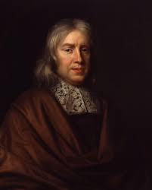
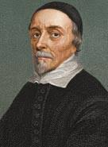
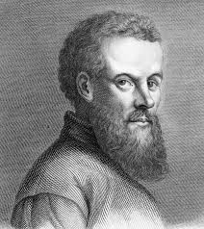
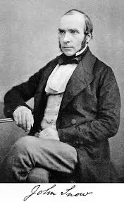
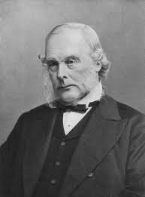
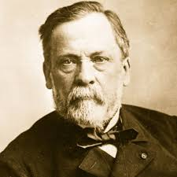
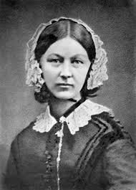
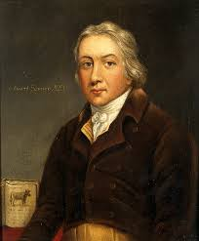
Guess Who: Key Individuals so far...
p.6
TASK: Read the following statements and decide if they belong to the following people:
William Harvey, Andreas Vesalius, Thomas Sydenham, Louis Pasteur, John Snow, Florence Nightingale, Joseph Lister or Edward Jenner.
Statement | Key Individual
1. He gathered evidence of over 1,000 cases where smallpox inoculation failed.
2. Found around 300 mistakes in Galen's work.
3. He gave Queen Victoria chloroform during the birth of Prince Leopold.
4. He saw a pattern. The number of deaths seemed to be centred around the water pump on Broad Street.
5. He sprayed carbolic acid in the air during operations.
6. Published his results called ‘germ theory’ in 1861.
7. She wrote a book on nursing and made being a nurse a respectable profession.
8. He infected a boy called James Phipps with cowpox. Later, he tried to infect him with smallpox.
9. He had no scientific proof that cholera was spread in water but got the water pump handle removed. .
10. Discovered the circulation of blood.
11. Made a point of closely observing symptoms and treating the diseases causing them.
12. There was a great deal of opposition from vaccination but from 1872, the government enforced compulsory vaccinations.
13. He started to look for a chemical that would kill bacteria in wounds.
14. Some Victorians believed that pain relief was interfering with God’s plan and fought against anathetic.
15. Proved the idea of spontaneous generation was wrong.
16. Promoted ‘pavilion style’ hospitals.
17. Wrote the book ‘an anatomical account of the motion of the heart and blood in animals.’
18. Encouraged doctors to base their work on dissection rather than believing in old books.
19. Argued that diseases were like plants and animals and that they could be oragnised into different groups.
20. First to categorise diseases and claim that disease came from outside the body.

Slide 7
4.1 Ideas about the cause of disease and illness
p.7
By 1800, Germ Theory had been around for nearly 40 years, and microbes had been clearly linked to outbreaks of disease. People finally understood what caused common disease, such as cholera and diphtheria.
Because of this, throughout the 20th century Doctors no longer referred to miasmata, the Four Humours or the supernatural when diagnosing illness. This is the first period in which doctors were working solely with solid scientific discoveries. For the first time, they had more than just ideas about what caused diseases and illnesses - they had solid, evidence-based, knowledge.
At the start of the 20th century, diagnosis was something that happened between a doctor and a patient. The doctor would observe the patient and consider the symptoms. He would consult medical textbooks and diagnose the disease based on this knowledge.
During the 20th century, there was a move towards laboratory medicine. With more examination of samples. These samples might include skin or blood, or more detailed samples of flesh gathered from the patient in a procedure called biopsy. The samples would be examined by medical scientists in a laboratory, using microscopes and other technology. In addition, the patient might be x-rayed to allow doctors to see what was going on inside the body, and the pictures produced would be examined by doctors looking for the cause of the disease or illness. All of this additional information meant that diagnosis was, and is, now more accurate. The exact microbe causing a disease can be identified and targeted
Therefore, the biggest change in diagnosis in the 20th century was that instead of being based on symptoms, and the experience and knowledge of the doctor, it was now based on medical testing.
TASK: Answer the following questions
What caused common disease? ____________________________________________________________________________________
What did doctors no longer refer to?_______________________________________________________________________________
Doctors were now working with what? ___________________________________________________________________________
What was diagnosis like at the start of the 20th century? ________________________________________________________________________________________________________________________________________________________________________________________________________________________________________________
How did this change? ________________________________________________________________________________________________________________________________________________________________________________________________________________________________________________
What is biopsy? ______________________________________________________________________________________________________
As a result, what happened to diagnosis? _________________________________________________________________________
What was the biggest change in diagnosis during the 20th century? ________________________________________________________________________________________________________________________________________________________________________________________________________________________________________________

Slide 8
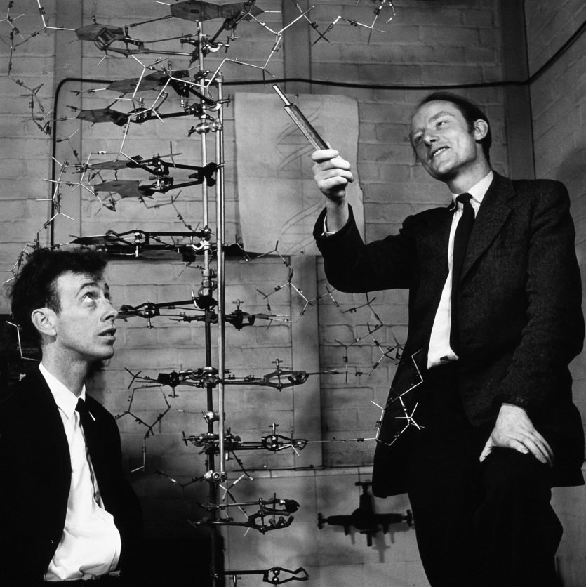
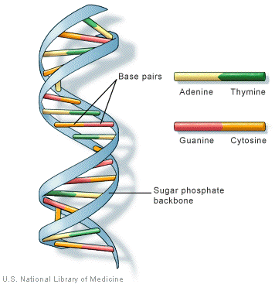
4.1 Ideas about the cause of disease and illness
p.8
By 1951, scientists knew that characteristics were passed down from parents to children, as children often look like their parents. They theorised that a substance in human cells passed on this information from one person to the next. This substance also passed on a variety of hereditary disease. However, it was not until 1953 that technology finally made it possible for scientists to find the missing piece of the puzzle: DNA.
Watson, Crick and the discovery of the human gene.
James Watson was an American biologist. Francis Crick was an English Physicist. In 1953, they were both working at Cambridge University where they shared an office. Even though neither men were investigating DNA, they both had a strong interest in researching and finding out more about human biology.
Crick and Watson saw the x-rays provided by Franklin and Wilkins. They built their model of DNA and shared it with Franklin, who made a correction based on her x-rays. Wilkins also shared clearer photographs that they had managed to take of the DNA. Due to this addition input, Crick and Watson were able to solve the puzzle of the structure of DNA. They discovered that it was shaped as a double helix, which could ‘unzip’ itself to make copies.
Watson and Crick published their paper in April 1953. Crick suggested that they had discovered the secret of life. Understanding the shape of DNA meant that they could now begin to look at its structure and identify the parts that caused hereditary disease.
TASK: Illustrate the discovery of the structure of DNA in 4 steps

Slide 9
4.1 Ideas about the cause of disease and illness
p.9
TASK: Decide if the statements below are causes or DNA being discovered or consequence of DNA being discovered. Use two separate colours and create a key.
Francis Crick trained as a physicist then changed direction to molecular biology and genetics. James Watson went to Chicago University at the age of 15. He was only 24 when he made his discovery. Both experts in their area. Prepared to work in different areas of science to get answers. | Creating new varieties of plants and animals. E.G developing a tomato that is frost resistant. In theory this could also be used with humans. With parents deciding on their child’s gender, appearance and intelligence.
Money came from two sources, government and private industry. It was an incredibly expensive process. | Identifying the illnesses people could suffer from and preventing them from getting them. E.G identifying who is likely to get cancer and so help them avoid activities that might trigger it.
Designing drugs for an individual person. So designing drugs that deal with a particular gene in a particular person. This could be more effective with less side effects. | For hundreds of years scientists knew that some illnesses were inherited. Scientists using microscopes also discovered how cells in the body were made up. Crick and Watson built on this earlier work.
Curing sick people by taking genes from healthy people. Diseases such as a cystic fibrosis or sickle cell anaemia are caused by a single abnormal gene. The theory is to take normal genes from a healthy person and put them into someone suffering from an illness. Not yet in practice. | At each stage of the discovery of DNA scientists made use of the latest developments and technologies. Using new knowledge in science like genetics and new technology like x-rays and photography.
Francis Crick and James Watson had different but supportive skills. They inspired each other. They were not held back by politeness-if one was wrong they would tell them. This saved energy and time. They both also worked with Maurice Wilkins and Rosalind Franklin. This brought together a team of with a wide range of skills and knowledge. | Key Causes: Consequences:
HOT: Which was the most significant cause and consequence? Why?
TASK: Which fact, from the above, do these images represent?

Slide 10
4.1 Ideas about the cause of disease and illness
p.10
Understanding that information - mapping the DNA’s code - was vital to helping scientist understand the cause of genetic diseases, such as haemophilia.
The Human Genome Project was launched in 1990. It was originally led by James Watson himself. For a decade, 18 teams of scientists all over the world worked together to decode and map the human genome. Even though hundreds of scientists were working towards this goal, they did not complete the first draft until 2000.
Once the human genome was mapped, it then became possible for scientists to use this blueprint of human DNA to look for mistakes or mismatches in the DNA of people suffering from hereditary diseases.
For example, scientists have now been able to identify a gene that is sometimes present in women who suffer from breast cancer. Although they cannot use this knowledge to treat breast cancer, women now have the opportunity to prevent this disease by identifying their risk of developing the disease and then having a mastectomy. A famous example of this is the actress Angelina Jolie who had herself tested for the gen because her mother had died of breast cancer.
Factors helping the development of genetics
TASK: Reduce each factor to one sentence and convert to one symbol.
Technology Discovering the shape of DNA, understanding how it works and then mapping the individual genes has been made possible through improvement in technology. Advances in microscopes and the ability to produce higher-powered images enabled scientists to identify the DNA and then start to examine how it formed. The electron microscope was first developed in 1931 by a german physicist, Ernst Ruska, and electrical engineer Max Knoll. Within two years, they had built a model that was able to magnify more than any of the optical microscopes that scientists had been using up to that point. Electron microscopes work by using a beam of electrons to illuminate the sample being examined, instead of regular light. This allows for a much more powerful magnification. An optical microscope that uses visible light can clearly magnify a sample up to 2,000 times; an electron microscope can produce a clear image up to 10,000,000 times magnified. | Reduced Sentence | Image
Science Understanding DNA required a lot of collaboration on the part of the scientific community. The Human Genome Project was an example of a new kind of ‘big science’ - thousands of scientists from all over the world collaborating to solve the same puzzle. All the data produced from the study was made public, so that it could benefit as many people as possible. | Reduced Sentence | Image

Slide 11
4.1 Ideas about the cause of disease and illness
p.11
The Impact of the science of genetics A better understanding of DNA and how each part of the genome affects the body has helped scientists to recognise genetic disorders, such as Huntington's and Down’s Syndrome. These disorders are caused by missing information in the genome: These disorders are caused by missing information in the genome: if that information can be put back in by scientists, this could theoretically lead to a treatment in some cases. However, this is not a current treatment. A good understanding of genetics has helped doctors to better understand what causes disease and illnesses, but the science is not yet at the stage where treatments of this nature are widely available for many diseases. | Reduced Sentence | Image
Lifestyle and health During the 20th century, we have gained a better understanding of the impact of lifestyle choices on the body and how these are linked with diseases and illnesses. | Reduced Sentence | Image
Smoking Smoking became more popular from the 1920s. It was associated with being young and free. By the 1950s doctors had started to notice a worrying rise in the number of men suffering from lung cancer, and this was linked with smoking. Doctors now recognise that smoking is associated with an enormous variety of disease, including high blood pressure, a wide variety of cancers (including lung, throat and mouth,), heart disease, and even gum disease and tooth decay. Smoking is the biggest cause of preventable disease in the world. It is even dangerous to people who inhale the smoke second-hand. Studies show that children exposed to second-hand smoke are more likely to develop asthma than those who do not. | Reduced Sentence | Image

Slide 12
4.1 Ideas about the cause of disease and illness
p.12
Diet Due to the Theory of the Four Humours, our medieval ancestors believed that what we ate had a huge impact on our health. Although nobody believes this theory anymore, we now recognise that what you eat (and how much of it) has a huge impact on your health - but in very different ways to what was suggested in the Middle Ages. Most people are probably familiar with the usual advice about a healthy diet: plenty of fresh fruits and vegetables, and most other things like in moderation. Two particularly important substances when it comes to health are sugar and fat. Too much sugar can cause the body to develop type 2 diabetes. This is an incurable condition where the body is not able to process sugar in the bloodstream. Too much fat can lead to heart disease. Not getting the right amount of nutrients or not eating enough at all can also cause health problems. | Reduced Sentence | Image
The influence of other lifestyle factors
Drinking too much alcohol, either through binge drinking or drinking a lot over a long period of time, can lead to liver diseases and kidney problems.
People now recognise that sharing bodily fluids with other people, either through intravenous drug taking (in vein with needles) or unprotected sex, can lead to the spread of certain diseases.
The fashion for tanning, either naturally or using sung eds, has led to a rise in the number of cases of skin cancer worldwide
TASK: If the is the answer, what is the question?
1900: _________________________________________________________________________________________________________________
2000: _________________________________________________________________________________________________________________
Electron Microscope: _______________________________________________________________________________________________
‘Big science’: _________________________________________________________________________________________________________
Missing information in the genome: _______________________________________________________________________________
1950s: ________________________________________________________________________________________________________________
Too much sugar: _____________________________________________________________________________________________________

Slide 13
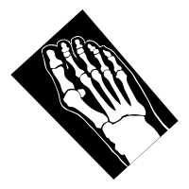
PEOPLE THAT SUFFER FROM DIABETES CAN CHECK THEIR BLOOD SUGAR
HELP TO SEE INSIDE THE HUMAN BODY.
p.13
HELP DIAGNOSE PROBLEMS SUCH AS BROKEN BONES.
BLOOD SUGAR MONITORING
(FROM THE 1960S)
USE BLOOD SAMPLES TO TEST FOR AN ENORMOUS NUMBER OF CONDITIONS.
X-RAYS
(FROM THE 1890S)
USE MAGNETS AND RADIO WAVES TO CREATE AN INTERNAL IMAGE OF THE BODY
BLOOD TEST
(FROM THE 1930S)
MRI Scans
(FROM THE 1970s)
NO NEED FOR INVASIVE DIAGNOSIS METHODS
Common technologies we use to make a diagnosis
THEY ARE BETTER SUITED TO DIAGNOSING SOFT TISSUE INJURIES LIKE LIGAMENT DAMAGE
BLOOD PRESSURE MONITORS
(FROM THE 1880’S)
CT SCANS
(FROM THE 1990S)
HELP TO DIAGNOSE HIGH AND LOW BLOOD PRESSURE.
ENDOSCOPES
(FROM THE 1900’S)
ULTRASOUND SCANS
(FROM THE 1940’S)
MORE ADVANCED THAN X-RAYS, THEY CAN BE USED TO DIAGNOSE TUMOURS.
USE A CAMERA ON THE END OF T THIN TUBE TO SEE INSIDE THE HUMAN BODY.
ECGs
(FROM THE 1990S)
COULD BE USED TO CARRY SMALL SURGICAL INSTRUMENTS INTO THE BODY.
USE SOUNDWAVES TO BUILD UP A PICTURE OF THE INSIDE. CAN DIAGNOSE GALL AND KIDNEY STONES.
USE ELECTRICAL IMPULSES TO TRACK HEART ACTIVITY.
USED TO INVESTIGATE DIGESTIVE SYMPTOMS SUCH AS VOMITING BLOOD.

Slide 14
4.1 Ideas about the cause of disease and illness
p.14
Improvements in diagnosis: the impact of the availability of blood tests, scans and monitors
New methods of diagnosis
The development of machines and computers has enabled doctors to have a better understanding of a patient's symptoms than in any previous time. For example, x-rays and CT scans. Mean that doctors no longer have to use surgery to diagnose all diseases.
The impact of technology
The enormous leap forward in technology since 1900 has made diagnosing disease much more accurate. This has, in turn, had a huge impact on doctor’s ability to treat patients.
Ne methods of diagnosing disease are being developed all the time.
Exam-style questions
Explain one way in which understanding of the causes of disease and illness was different from c1750-1900 to the present day. 4 marks.
______________________________________________________________________________________________________________________________________________________________________________________________________________________________________________________________________________________________________________________________________________________________________________________________________________________________________________________________________________________________________________________________________________________________________________________________________________________________________________________________________________________________________________________________________________________________________________________________________________________________________________________________________________________________________________________________________________________________________________________________________________________________________________________________________________________________________________________________________________________________________________________________________________________________________________________________________________________________________________________________________________________________________________________________

Slide 15
4.1 Ideas about the cause of disease and illness
p.15
TASK: Place the common technologies used to make a diagnosis in chronological order.
1. _________________________________________________________________________________________________________________________
2. __________________________________________________________________________________________________________________________
3. __________________________________________________________________________________________________________________________
4. __________________________________________________________________________________________________________________________
5. __________________________________________________________________________________________________________________________
6 .__________________________________________________________________________________________________________________________
7. __________________________________________________________________________________________________________________________
8. __________________________________________________________________________________________________________________________
TASK: Which 3 advancements of technology had the greatest impact on diagnosis? Think about how many people use them and the types of illness they help detect.
___________________________________________________________________________________________________________________________
___________________________________________________________________________________________________________________________ ___________________________________________________________________________________________________________________________ ___________________________________________________________________________________________________________________________ ___________________________________________________________________________________________________________________________ ___________________________________________________________________________________________________________________________ ___________________________________________________________________________________________________________________________ ___________________________________________________________________________________________________________________________ ___________________________________________________________________________________________________________________________ ___________________________________________________________________________________________________________________________ ___________________________________________________________________________________________________________________________ ___________________________________________________________________________________________________________________________ ___________________________________________________________________________________________________________________________ ___________________________________________________________________________________________________________________________ ___________________________________________________________________________________________________________________________ ___________________________________________________________________________________________________________________________ ___________________________________________________________________________________________________________________________

Slide 16
4.1 Ideas about the cause of disease and illness
p.16
TASK: In your summary pyramid note the following using a separate level of the pyramid for each question.
The 1 year that DNA was discovered.
The 2 doctors that discovered DNA.
3 Influences of ‘other lifestyle choices.
4 Factors that helped in the development of genetics.
5 Common technologies used to make a diagnosis.
TASK: Complete the table below showing the change and continuity of ideas regarding the cause of disease. Draw an arrow from where the belief starts and where it ends and draw a symbol to represent that cause. One is done for you.
Middle Ages | Renaissance | Industrial | Modern
God

Slide 17
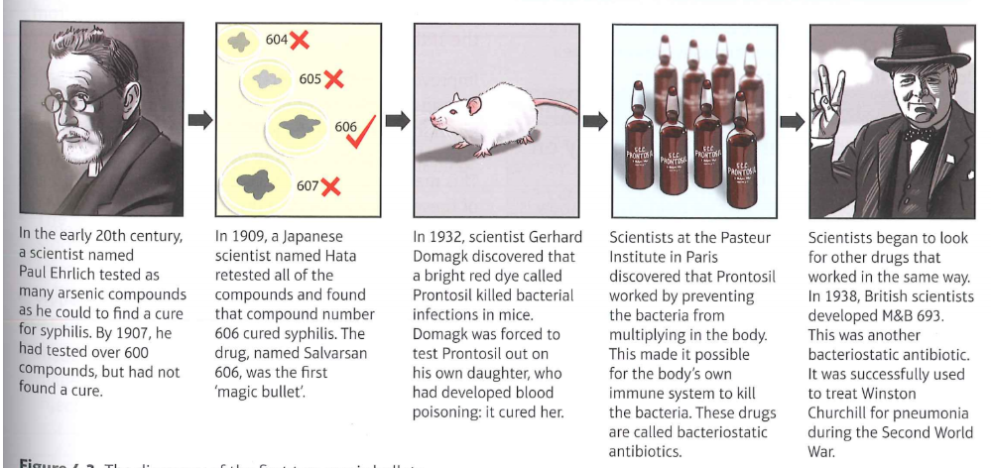
4.2 Approaches to prevention and treatment
p.17
TASK: Read the following and highlight each different drug that was developed.
Medical treatments
The first chemical cures: magic bullets
The term ‘magic bullet’ was used to describe a chemical cure that would attack the microbes in the body causing disease, whilst at the same time leaving the body unharmed. In the late 19th century, more microbes responsible for specific diseases were being discovered. This meant that scientists could begin to search for substances to attack and destroy these microbes.
Doctors now understood that the body produced antibodies to fight disease that had previously infected it - this is how vaccines work. The hunt was on for artificial or chemical antibodies that would work in the same way, attacking the infection without harming the body.
The first big breakthrough was made in the treatment of syphilis. Syphilis continued to be a problem throughout the 19th and 20th centuries, and treatment of it had not really improved since mercury treatments of the 16th century. There had been some success with arsenic compounds. However, it was very difficult to find a form of arsenic that attacked the disease and not the body, as arsenic is poisonous.
The development of antibiotics
The term antibiotic is used to describe any treatment that destroys or limits the growth of bacteria in the human body. The first true antibiotic was penicillin. Penicillin was different to Salvarsan 606 and Prontosil as it was created using microorganisms, not chemicals. Penicillin was isolated from a mould sample by Alexander Fleming in 1928 and developed into a usable treatment by Florey and Chain in 1940.
Inspired by the discovery of penicillin, other scientists investigated moulds and fungi in the search for more antibiotics. Streptomycin was discovered by American scientists Selman Wakston in 1943. This antibiotic was so powerful that it was even effective against tuberculosis which had previously been thought to be incurable. During the 1950s and 1960s, even more antibiotics were discovered.

Slide 18
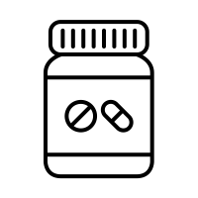
4.2 Approaches to prevention and treatment
p.18
The development of antibiotics
Research into the development of new antibiotics has not stopped. In the 21st century, pharmaceutical companies continue to test substances to develop a resistance to the antibiotics. This is because some bacteria have developed a resistance to the antibiotics we already have. If new treatments are not developed, scientists fear that the old antibiotics will become totally ineffective against diseases that against diseases that we think we have beaten, such as septicaemia (blood poisoning).
Therefore, in the short term, antibiotics have been a miracle cure for a variety of disease. However, their long-term impact has yet to be measured.
The impact of science and technology on advances in medicines
As with diagnosis, the way that we treat diseases now is almost unrecognisable from the way that people treated them before 1900. This is largely due to huge advances in science and technology.
Scientists have now developed medicines that pinpoint and treat specific diseases. Even if they are unable to cure some diseases, such as diabetes and lung cancer, treatments have been developed to help patients manage their illness. Scientists are now able to identify the causes of disease in most cases, because they know what they are looking for example, a microbe, a tumour or an unusual gene. This is a huge change from the 19th century.
Improved scientific understanding has also led to better testing and trialling of new treatments before they are given to patients. In the past, drugs did not have to go through the process before being used to treat disease. This meant that mistakes were made. The most famous of these mistakes was the use of the drug thalidomide in the 1960s to treat pregnant women suffering from morning sickness. The drug caused birth defects.
Now, it takes several years for a new drug to be trialled thoroughly before being used. This slows down progress but ensures drugs are safe for everybody.
New technology has made it easier to create and provide drugs to treat diseases:
Mass production of pills has made the distribution of drugs much easier.
The development of capsules, which dissolve in the stomach to release the drug, means taking drugs to treat disease is easier.
Hypodermic needles allow the precise dose to be introduced directly into the bloodstream.
Insulin pumps for young people suffering from diabetes deliver insulin without the need for injections.
TASK: Draw a timeline on the next page to show when the different drugs described in this section were developed. Label each one with details, such as who was responsible for its development and which diseases the drug fights.

Slide 19
4.2 Approaches to prevention and treatment
p.19

Slide 20
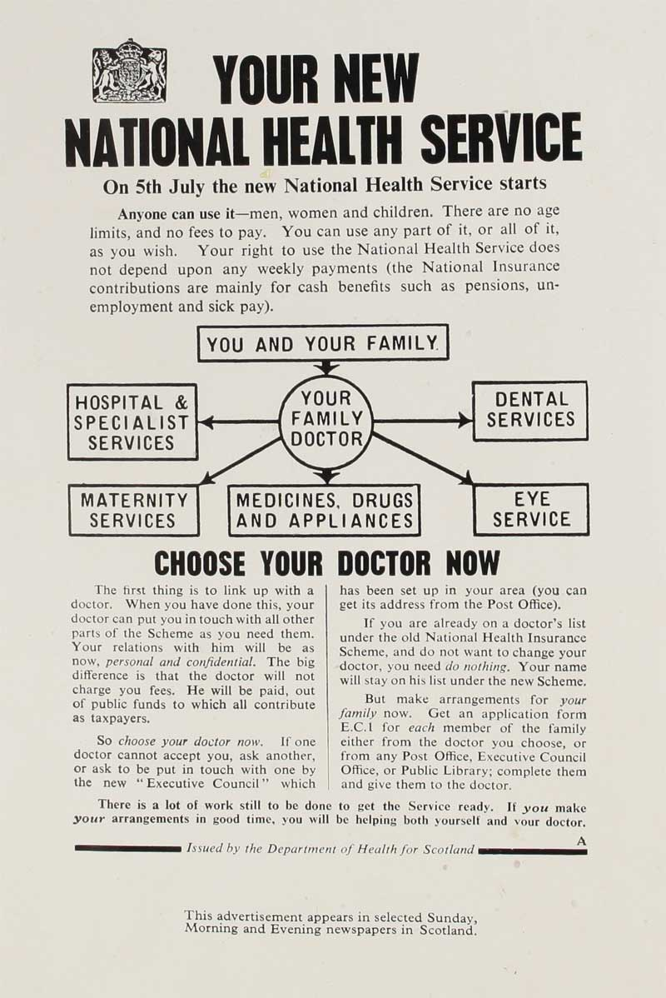
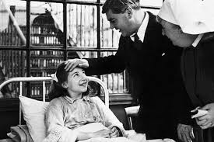
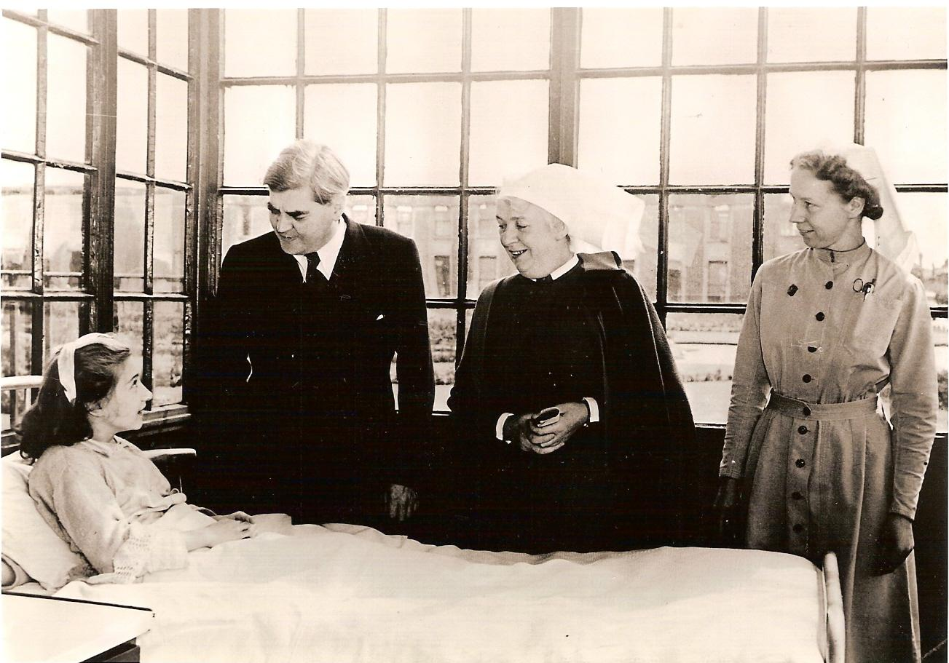
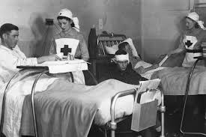
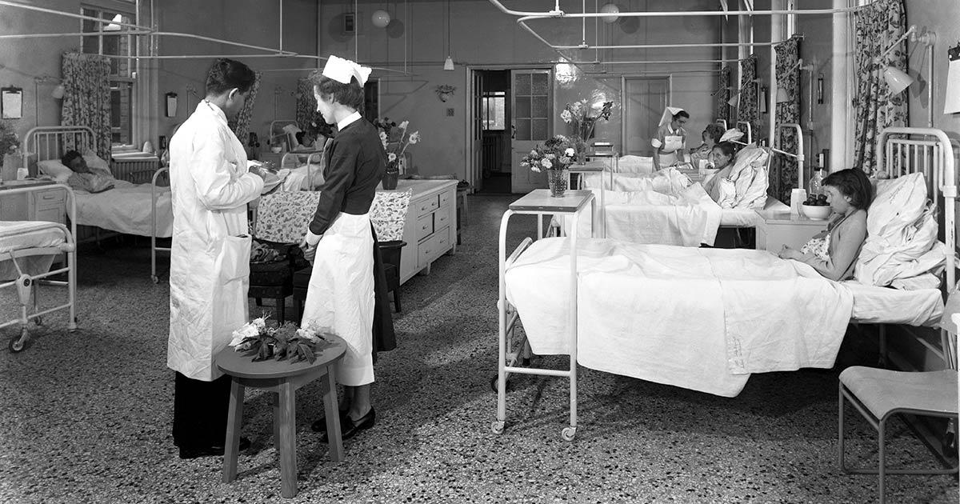
4.2 Approaches to prevention and treatment
p.20
TASK: Highlight key information in the development of the NHS.
Phase one: Improved access to care
The National Health Service (NHS) was launched in 1948 by the government. Its aim was to provide medical care for the entire population of Britain. It was paid for by National Insurance contributions, taken from wages in the same way as tax. It was the largest government intervention in medical care. The new NHS took over existing hospitals and medical services.
There are three parts of the NHS in 1948:
Hospitals, managed by regional hospital boards
General Practitioners (GPs) and dentists, otherwise known as primary care.
Additional services, such as the ambulance service and health visitors.
The government aimed to provide the same level of service for everybody in the country, no matter how rich or poor they were.
For example, workers earning under a certain amount were already entitled to medical care through the 1911 National Insurance act. However, this did not extend to women who were at home raising their families. After 1948, women were able to get treatment for painful conditions like varicose veins, which might previously have been left untreated. Similarly, children could be treated for minor problems before there was any lasting damage.
To begin with, hospitals were not much changed by the launch of the NHS. Post-war Britain did not have a lot of money to spend on medical care. The government was now responsible for 1,143 voluntary hospitals and 1,545 city hospitals, which was a huge undertaking. Many of the hospitals had been built in the 19th century and desperately needed updating. There were also more hospitals in London and South East than there were across the rest of the county.
Similarly, many GP surgeries were in need of modernisation, as well as the standards of the GPS themselves. Studies in the 1950s suggested that up to a quarter of GP were not satisfactory. With little time or opportunity to keep up-to-date with medical developments, many GPs were behind the times. The problem was made worse by the NHS, because more and more people began visiting GPs. Waiting times increased and appointment times decreased.
Therefore, access had improved because the NHS was available to all. However, provision had not improved in the short term. During the 1960s, however, the government implemented changes to improve the NHS. Plans were made to ensure that hospitals were even spread across the whole country. In 1966, a GP’s charter was introduced, which encouraged GPs to work in group practices and gave them incentives to keep up with medical developments. The government had to manage the NHS rather than just fund it. This led to improvements in standards in care.

Slide 21
4.2 Approaches to prevention and treatment
p.21
TASK: Read the previous page and list the problems that the NHS initially had and how the government overcome them.
Problems | Solutions
TASK: Revisit prior learning and list facts regarding the approaches to care in that time period.
Time Period | Facts about care.
Middle Ages
Renaissance
Industrial
Phase 2: High-tech medical and surgical treatments in hospitals
Hospital treatments have changed a lot since 1900. Treatments that we consider routine today, like hip replacements and blood transfusions, did not exist before 1900. Patients benefit from high-tech treatments that would have been unimaginable in previous centuries. Once the three major problems of surgery - pain, infection and blood loss - had been solved, doctors were able to carry out more daring and intrusive surgeries than ever before. The development of new machinery to treat the body and even replace parts of it that had stopped working also improved treatment in hospitals.
There are hundreds of examples of new high-tech medical and surgical treatments being carried out. The flow diagrams on the next couple of pages show a few of the most famous examples.

Slide 22
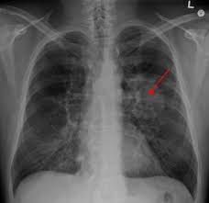
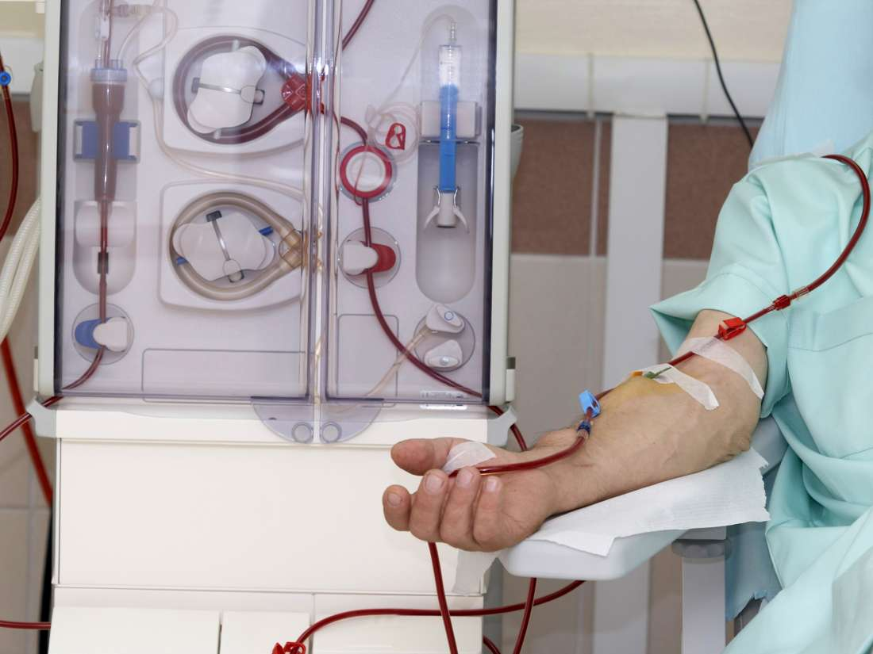
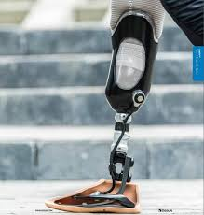
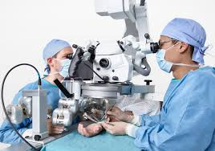
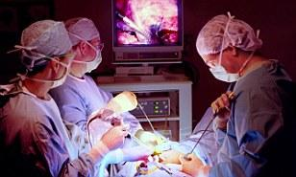
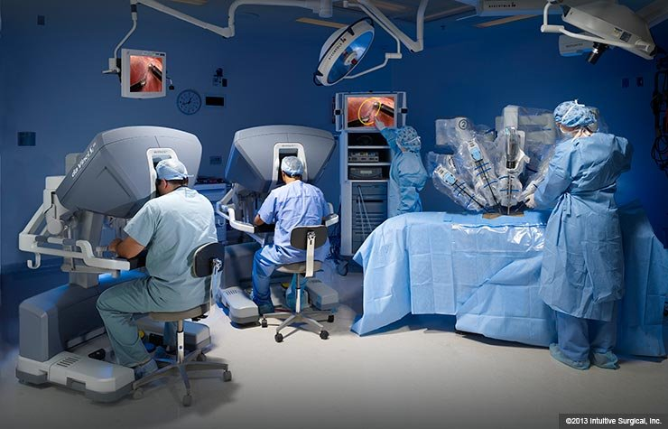
4.2 Approaches to prevention and treatment
p.22
Medical Treatments
Advanced x-rays
Smaller, cheaper machines
Robotics
Doctors can now also use x-rays to target and shrink tumours growing inside the body, using a treatment known as radiotherapy. Combined with chemotherapy, this is an effective treatment for many types of cancer.
Process like dialysis, where the blood of patients with kidney failure is ‘washed’ by a machine, and heart bypasses, where a machine performs the functions of the heart, have become more widely available as machines have become smaller and more portable.
Better prosthetic limbs are now produced. This is partly in response to the number of soldiers surviving bomb attacks in recent wars in Iraq and Afghanistan.
Surgical Treatments
Mircosurgery
Laparoscopic (keyhole) Surgery
Robotic Surgery
The first successful kidney transplant was performed between identical twins in the USA in 1956. This paved the way for transplants of other organs, including lungs (from 1963), and livers and hearts (from 1967). These were made possible by improved surgical techniques, including the use of microsurgery to reattach tiny nerve endings and blood vessels.
Using tiny cameras and narrow surgical instruments, surgeons can now operate inside the body through tiny incisions some distance away from the area to be operated on. This allows for quicker healing and less trauma to the body.
Surgeons can now use computers to control instruments inside the body, allowing for more precise surgery with smaller cuts. Operations can be performed on a tiny scale where precision is of vital importance - for example, in brain surgery.

Slide 23
4.2 Approaches to prevention and treatment
p.23
TASK: Highlight one sentence in each paragraph that you think is important.
The Extent of change in care and treatment
Treatment
Looking back to the 17th century, when Thomas Sydenham imagined a world in which each disease would have its own treatment, the change in the way diseases have been treated is immense.
In the 20th century, medical science made a huge leap forward towards Sydenham’s dream. In 1900, 255 of deaths were caused by infectious diseases. By 1990, that number had fallen to less than 1%.
In c1900, most people were still taking herbal remedies or patent medicines, such as Beechams, bought from the chemists to treat their illnesses. Now thanks to advances in science after 1900, there are a wide variety of specific, effective medicines matched with the disease that they treat.
However, scientists continue to face problems when developing treatments.
It is very difficult to develop a vaccine against some viruses. A different flu vaccine is available every year, as scientists develop it in response to the most common strain of the flu virus at that time.
New diseases keep appearing, which do not respond to any chemical treatments that we currently know about. Scientists have to go back to the lab and continue testing compounds in the hope that they might find one that is effective.
Lifestyle factors have caused an increase in illnesses such as heart disease and cancer, for which there are no certain cures.
Microbes are living organisms and they have evolved to beat some of the cures doctors have been using. This led to drug-resistant bacteria, such as MRSA. Tuberculosis cases are once again on the rise in the UK.
We may not be facing all the same problems as our ancestors when researching treatments for illness and disease, but we face many new ones. Therefore, alternative remedies, such as herbal medicines, acupuncture and homeopath, are still popular treatments for disease.
Improved access to care
In C1900, most sick people were still cared for in the home by women. Doctors had to be paid and so were only used for serious illnesses.
The situation improved slowly during the first half of the 20th century. In 1919, the government set up the Ministry of Health to help determine the level of health care across the country.
There was rapid improvement in the availability of care outside the home from 1948 onwards. The NHS made medical services free at point of service. This gave everybody access to medical care and treatment.
However, the introduction of the NHS made it clear once and for all, that hospitals were just for treating the sick. In earlier periods, hospital had been places for the elderly to rest. This change left a gap in services. Up until the end of the Second World War, elderly people with no family had often lived on the last days of their life in hospitals. This was no longer possible.

Slide 24
4.2 Approaches to prevention and treatment
p.24
TASK: From the reading on the previous page, decide if the following statements are true or false. If the statement is false, write the correction in the end column.
Statement | True | False | Correction
William Harvey imagined a world in which each disease would have its own treatment.
In 1900, 15% of deaths were caused by infections disease.
By 1990, less than 1% had fallen to less than 1%.
People stopped taking herbal remedies by c1900.
It was difficult to develop a vaccine against viruses because there weren’t enough doctors.
New disease keep appearing, which do not respond to any chemical treatments.
Lifestyle factors have caused an increase in illnesses such as heart disease and cancer.
In c1900 most sick people were cared for in hospitals.
Doctors were paid for all illnesses that they treated.
The situation improved slowly during the first half of the 20th century.
There was rapid improvement in the availability of care outside the home from 1938.
The introduction of the NHS made it clear, once and for all, that hospitals were just for treating the sick.
Score: /

Slide 25
4.2 Approaches to prevention and treatment
p.25
TASK: Reduce each paragraph to one sentence.
Preventing disease
By c1900, many different approaches to preventing disease had been put in place. The government now took responsibility for providing clean water and removing waste. The public understood the importance of these factors, due to the development of Germ Theory. As more people were given the vote, the government paid more attention to what its citizens wanted.
The government has taken significant action to improve the public's health since the beginning of the 20th century. The laissez-faire attitude was now behind them. There are two reasons for this.
1 Increased understanding of cause
Now that we understand what causes disease, the government recognsies that its intervention can have an impact. WIthout this understanding, the British government would not have acted in the same way, because they did not know that their intervention could change things.
2 Increased understanding of methods of prevention
Once the causes of disease and health problems was understood, methods of prevention could be tested and introduced. These have included:
Compulsory vaccinations: inspired by the positive impact of the smallpox vaccination, other campaigns were launched in the 20th century.
Passing laws to provide a healthy environment: these include the Clean Air Acts and adding the chemical fluoride to the water supply to help prevent tooth decay.
Communicating health risks: lifestyle campaigns help people to identify and tackle health risks. During times of global epidemics, such as during the 2014-15 outbreak of ebola in West Africa, the government tracked travellers from affected regions and put quarantine measures in place to stop the spread of disease. Communicating risks to the population has become key in preventing disease.
Charities also contribute to healthy lifestyle campaigns. For example, he British Heart Foundation creates adverts encouraging people to protect their heart by giving up smoking, eating less fat and exercising.
The national vaccination campaign against diphtheria was launched in 1942 - the first of its kind. Before this, local governments were responsible for vaccination campaigns that were not funded by the central government, which meant they were not widespread. Around 2,000 children died each year of diphtheria.
During the Second World war, the government put a national campaign in place to immunise all children against diphtheria. There were fears that the cramped conditions of air-raid shelters during the war might lead to an epidemic. Because of this, infection rates plummeted. By the middle of the century, diphtheria was seen as a disease of the past.

Slide 26
4.2 Approaches to prevention and treatment
p.26
TASK: Reduce each paragraph to one sentence.
Another significant vaccination campaign was against poliomyelitis (polio). Polio is a very contagious disease that causes paralysis. In the early 1950s, there were as many as 8,000 cases reported every year in Britain. The vaccination was developed in the USA by Jonas Salk and was introduced to the UK in 1956, followed by a more effective vaccination in 1962. As with diptheria, the number of infections dropped very rapidly. The last case of a person contracting polio in the UK was in 1984.
Some vaccines are aimed at protecting future generations. Rubella, or German measles, is not a life threatening disease for most people - however, it can be very dangerous if a pregnant woman catches it because it will affect the unborn child.
Other vaccines target disease that can lead to other disease. The HPV vaccine, for example, protects women against infection from a sexually transmitted disease that has been linked to cervical cancer.
There continues to be controversy surrounding vaccinations. Many people resent government intervention and choose not to vaccinate their children. A lack of trust in the medical profession has led to fears that vaccines are unsafe. While vaccination is the best way to prevent the spread of dangerous epidemic disease, there is still freedom of choice to reject this method.
New approaches to prevention: government legislation
The government has passed laws to provide a healthy environment for the population. Examples of these were the Clean Air Acts of 1956 and 1968. They were triggered by bad episodes of smog in London in 1952.
Smog is very heavy fog caused by air pollution. In an era a time when everybody burned coal to heat their homes, there was a great deal of smoke and soot in the air, particularly in London, where a lot of people lived. SOmetimes there was so much pollution that smog would cover the city for days at a time.
Smog si no longer a significant problem in the UK. However, the government continues to pass laws to protect the population from air pollution. An example of this is by limiting car emissions.
New approaches to prevention: government lifestyle campaigns.
As well as providing direct intervention to prevent disease, the government also aims to help people prevent disease themselves, by promoting healthier lifestyles. Some examples of their work include:
Advertising campaigns warning against dangers to health, such as smoking, binge drinking, recreational drug use and unprotected sex. .
Events such as Stoptober, which encourage people to stop smoking for a month
Initiatives encouraging people to eat more healthily and get more exercise, such as the Change4Life campaign.

Slide 27
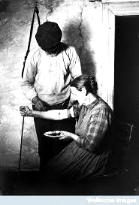
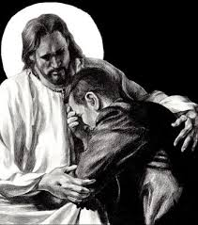
4.2 Approaches to prevention and treatment
p.27
TASK: Look at the table below and all the different methods of prevention, circle/highlight the which time period these methods were used in. They may fall into more than one time period.
Prevention Method | Middle Ages | Renaissance | Industrial | Modern
Confession
Bloodletting
Laxatives
Smallpox vaccinations
Government funding public vaccines
Diet
Hygiene in hospitals
NHS
Rest
Vaccines developed by Pasteur.
Regimen Sanitatis
Pollution laws
Public smoking ban

Slide 28
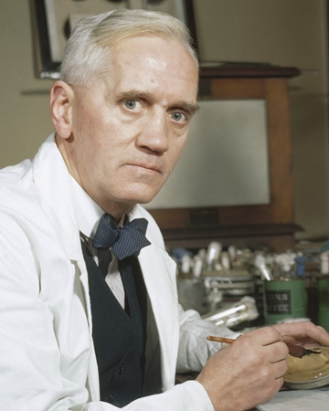
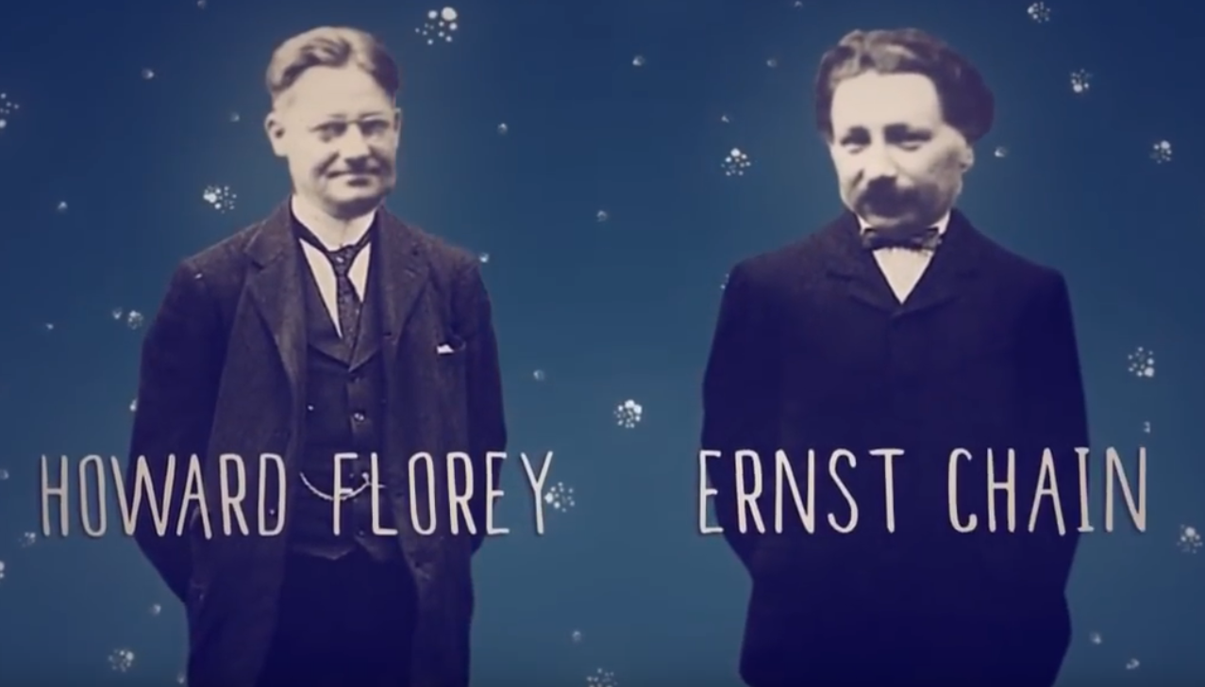
4.3 Fleming, Florey and Chain’s development of penicillin
p.28
Following the development of the first ‘magic bullet’ in 1909, the search for effective treatments continued throughout the 20th century. The development of penicillin into a usable drug revolutionised the way that infections were completed and has saved countless lives.
Alexander Fleming and the discovery of penicillin
Alexander Fleming was a British doctor working at St Mary’s Hospital in London. He had a particular interest in bacteriology and had been one of the first doctors to use the first ‘magic bullet’ to treat syphilis. During the First World War, Fleming had worked in battlefield hospitals trying to improve treatments for wounded soldiers. He was dismayed at the number of men who died from simple infections.
During the 1920s, Fleming research substances that might be effective in combating these simple infections. In 1928, he noticed something unusual about his dirty petri dishes,.: one of them had developed some mould. THis mould appeared to have killed off the harmful staphylococcus bacteria that had been growing in the dish.
Fleming tested the mould and identified it as penicillin. He was not the first person to notice what it could do: in the Middle Ages, people were aware that mouldy bread had healing properties, and Joseph Lister used it to treat a patient in 1871. However, Fleming published his findings at a time when scientists were actively looking for chemical treatments for disease, and so more notice was taken of it.
Unfortunately, Fleming did not believe that penicillin could work to kill bacteria in living people. His first experiments with the mould showed that it became ineffective when mixed with blood in test tubes in the laboratory, so he did not pursue funding to perform further tests on the mould.
Florey and Chain and the development of penicillin
Howard Florey was an Australian pathologist working at Oxford medical school. His colleague, Ernst Chain, had escaped Nazi Germany, where he had been a biochemist.
Florey and Chain were conducting research in the field of antibiotics. As part of this, they were looking for neglected
research that might be worth investigating. They came across Fleming’s findings and decided that the mould should be tested further. Chain grew the mould in his laboratory and used extracts of it in tests for treatment.
In 1940, Florey and Chain tested their extracted penicillin on infected mice. The results were promising: it looked as though the penicillin was killing the infection. Unfortunately, it was very difficult to produce penicillin in large quantities. The active ingredient in the liquid produced by the mould only represented one part per two million - that meant growing a great deal of mould before it was possible to get started on a human trial.
The scientists set about growing as much penicillin as possible. They used whatever they could to grow the mould: milk churns, bedpans and even a bathtub. By 1941, Florey and Chain had a human patient on whom to try the drug: a local policeman who had developed an infection. He had been scratched by a rose bush and had developed septicaemia - fatal blood poisoning.

Slide 29
4.3 Fleming, Florey and Chain’s development of penicillin
p.29
Florey and Chain only had a very small amount of penicillin, but they gave it to the policeman anyway. He showed signs of recovery almost straight away. However, there had not been enough penicillin to cure him completely and there was no more available. Florey and Chain collected the patient’s urine and extracted leftover penicillin from it. This was then given to the patient and, again, he showed signs of getting better. Unfortunately, this could only be done so many times and the patient eventually died.
Nethertheless, penicillin had proved to be effective in fighting infection in the human body.
Mass production of penicillin
Florey and Chain proved that penicillin was effective in treating infections, but they were still struggling to mass produce it. They need a large-scale factory where the penicillin could be grown and extracted on an industrial scale.
Florey first approached British pharmaceutical companies for assistance. Unfortunately, this was during the Second World War and the companies were busy producing materials for the war effort.
However, the USA had not yet joined the war. In July 1941, Florey visited the USA and convinced pharmaceutical companies to begin penicillin production. THe companies started growing penicillin in beer vats. Itw was a very slow process - after a year, the US companies only had enough penicillin to treat ten people.
However, once this had begun, the impact of penicillin could be shown. The US government, observing the benefits of the drug, fundeed 21 pharmaceutical companies to begin mass producing it. British pharmaceutical companies became involved in 1943, when they too stated to mass produce the drug. By D-Day, in June 1944, there was enough penicillin available to treat all Allied casualties.

Slide 30
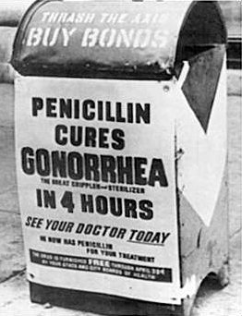
4.3 Fleming, Florey and Chain’s development of penicillin
p.30
Use of penicillin
Penicillin is effective in treating diseases caused by a certain family of bacteria.
Penicillin is also used to prevent infection, particularly with patients who have had teeth extracted.
The development of penicillin also encouraged scientists to look for other moulds that could be used to fight bacterial infections - such as streptomycin, which was the first drug found to be effective against tuberculosis. Once Dorothy Hodgkin had mapped the chemical structure of penicillin, scientists were able to begin working on synthetic versions of it that were slightly modified to treat specific disease.
Now that doctors could offer treatments that worked against a wide range of illnesses, confidence in medical treatments began to rise. Patients were more willing to to seek out medical treatments from Doctors.
Unfortunately, some bacteria are now resistant to penicillin. Bacteria can mutate to resist attack from penicillin mould. The first penicillin - resistant strain of bacteria appeared in 1942. Pharmaceutical companies continue to work hard to develop new forms of penicillin and other antibiotics that will kill ff the bacteria.
In 1928, Alexander Fleming… | In 1929, Fleming… | From 1938-40, Florey and Chain… | However, the UK government…
In 1941 the USA … | In 1942, the US government | Finally, by 1944, during D-Day… | Penicillin was later developed in to a range of similar antibiotics such as amoxicillin which have saved countless lives but also led to the rise of drug-resistant bacteria and other superbugs such as MRSA.

Slide 31
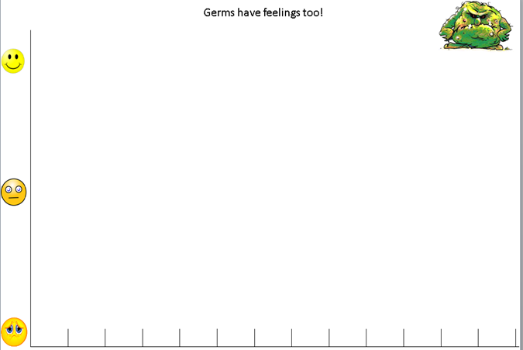
p.31
MRSA more common
NHS introduced 1945
Penicillin mass produced- 1943
Aseptic Surgery - 1910
Magic Bullets - 1910
Lister used carbolic acid - 1865
Pasteur develops
rabies vaccine 1881
Koch identifies
bacteria - 1876
“Germ Theory”
1861
Industrial Revolution 19th century
London 1665
“Great Plague”
Renaissance
England 1600 AD
Medieval England
1348 AD
“Black Death”

Slide 32
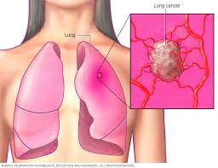
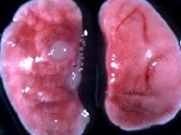
4.4 Case Study: The fight against lung cancer in the 21st century
p.32
TASK: Reduce each paragraph to one sentence.
Lung cancer was extremely rare 150 years go. Its frequency increased greatly in the early 1900s and today it is the second most common form of cancer. Over 40,000 people are diagnosed with it each year. Medical evidence has proved conclusively that cigarette smoking (which first became common in the early 1900s and especially during the First World War) is the major reason for contracting lung cancer. Nearly 90 per cent of cases are the result of smoking, in the some cases of passive smoking.
Lung cancer is particularly deadly because it is extremely difficult to diagnose in its early stages. It is usually diagnosed once symptoms have developed which means cancer may have spread. Only one in three people live for as long as a year after diagnosis. Only 10 percent live for more than five years. This compares very badly with survival rates from other cancers where 50 per cent live for at least ten years after diagnosis.
The devastation caused by lung now means that huge efforts are made in prevention, diagnosis and treatment. Governments have launched major campaigns to prevent people developing lung cancer. Campaigns warn people of the extreme dangers of smoking , through advertising the dangers, banning advertisements for cigarettes and making them as invisible as possible in shops. New laws have made public places such as cages, cinemas, sports grounds, workplaces and pubs smoke free, aiming both to reduce the effects of passive smoking and to help people give up smoking. Other campaigns, aim to improve rates of early diagnosis.
Governments have also, through the NHS, invested large sums of money in improved treatments which in turn are dependent on developments in science and technology on research undertaken by scientists. However, there is at this stage (2015) not national screening programme because the technology does not exist to pick up the earliest signs of lung cancer. As a step towards this, the screening of high-risk individuals is being developed.

Slide 33
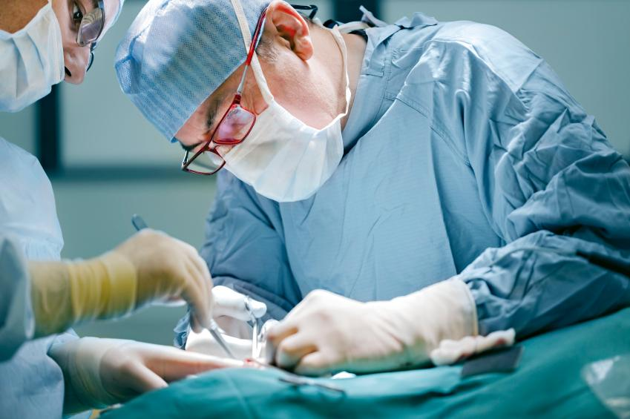
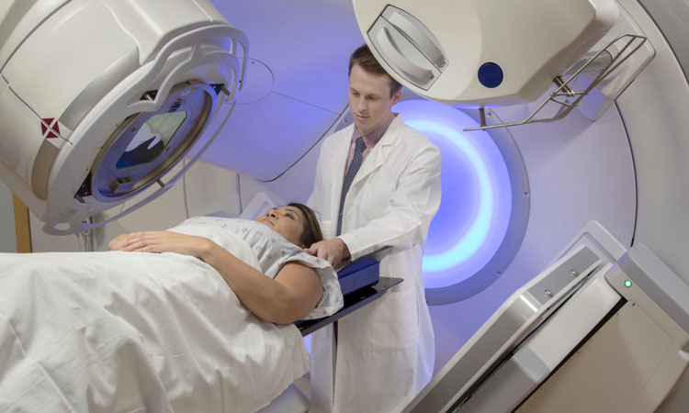
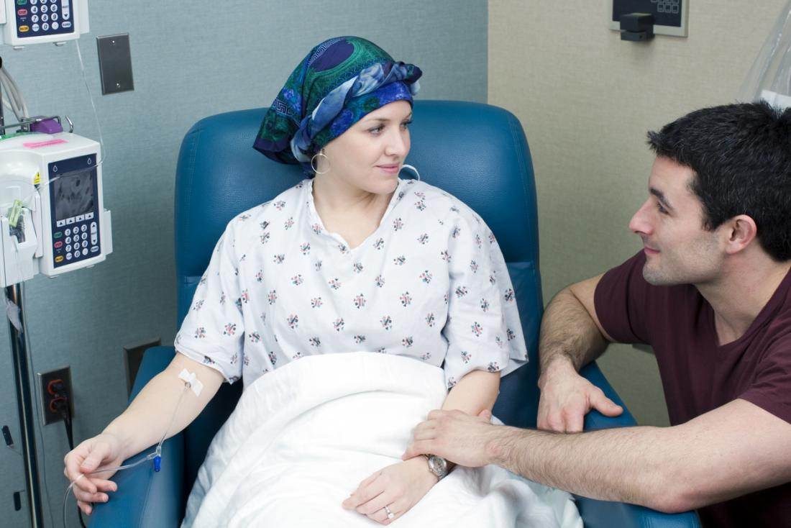
4.4 Case Study: The fight against lung cancer in the 21st century
p.33
Treatments
Surgery has been used since the 1930s but the majority of lung cancer sufferers have had other smoking-related health problems that have meant that surgery was too dangerous to use. New surgery techniques using remote-controlled micro-instruments and cameras have far less impact on the body and speed recovery.
Radiotherapy aims to kill the cancer cells using beams of radiation. Techniques have improved to target cancers more precisely.
Chemotherapy has been used since the 1970s if the cancer has developed so far that surgery and radiotherapy are not successful. Chemotherapy involves using particularly powerful chemical medicines to attack the cancer cells, although it can have significant side effect. New combinations of chemotherapy medicines are constantly being used and the results recorded.
Immunotherapy. Cancers are able to resit the body’s immune system’s attempts to block their growth. Trials have been taking place to boost the immune system and so stop the cancer cells from resisting it.
The fight against lung cancer therefore shows how interdependent the various factors are that help to improve medicine and health. Today the roles of government and science and technology overlap considerably and behind them are the many individuals who make significant contributions to preventing and treating such illness.
TASK: How has the government's focus on dealing with lung cancer changed?
Encouraging current smokers to quit | Preventing people from becoming smokers | Protecting non-smokers from dangers of secondhand smoke

Slide 34
Review
p.34
1) What was the biggest change that took place in diagnosing disease and illness in the modern period? What was diagnosis now not based on?
__________________________________________________________________________________________________________________________________________________________________________________________________________________________________________________________
2) What had German scientists theorised by 1900 about genes?
__________________________________________________________________________________________________________________________________________________________________________________________________________________________________________________________
3) What was discovered in 1953 that helped explain hereditary diseases?
__________________________________________________________________________________________________________________________________________________________________________________________________________________________________________________________
4) Which pair of individuals claimed they had discovered the secret of life?
__________________________________________________________________________________________________________________________________________________________________________________________________________________________________________________________
5) How does lifestyle and health factors contribute towards causing diseases and illnesses?
__________________________________________________________________________________________________________________________________________________________________________________________________________________________________________________________
6) What is a magic bullet?
__________________________________________________________________________________________________________________________________________________________________________________________________________________________________________________________
7) Which individual experimented with petri dishes and discovered penicillin by chance?
__________________________________________________________________________________________________________________________________________________________________________________________________________________________________________________________
8) Which pair of individuals then tried to mass-produce penicillin?
__________________________________________________________________________________________________________________________________________________________________________________________________________________________________________________________
9) What year was the NHS launched?
__________________________________________________________________________________________________________________________________________________________________________________________________________________________________________________________

Slide 35
p.35
10) Why was this a significant breakthrough in the treatment and care of the population?
_________________________________________________________________________________________________________________________________________________________________________________________________________________________________________________________
11) In what ways have the government helped prevent disease? Give two examples
__________________________________________________________________________________________________________________________________________________________________________________________________________________________________________________________
12) What is the second most common cancer in the UK?
__________________________________________________________________________________________________________________________________________________________________________________________________________________________________________________________
13) How is this cancer diagnosed?
__________________________________________________________________________________________________________________________________________________________________________________________________________________________________________________________
14) How have the government tried to change people’s behaviour with regards to preventing this cancer?
__________________________________________________________________________________________________________________________________________________________________________________________________________________________________________________________
15) What similarities are there between cholera and this case study with regards to how the government
Reacted?
__________________________________________________________________________________________________________________________________________________________________________________________________________________________________________________________
16) What are the three strands of care available from the NHS?
__________________________________________________________________________________________________________________________________________________________________________________________________________________________________________________________
17) Name two diseases that can now be prevented by immunisation
__________________________________________________________________________________________________________________________________________________________________________________________________________________________________________________________

Slide 36
4.4 Summary of Causes of disease through time
p.36
Medieval ideas c.1250—c.1500
Medieval ideas were so different from ours that it is easy to think that they were just based on superstition or magic, that people were ignorant and even stupid. That is case. Most medieval ideas about what caused disease were rational and logical, fitting people's ideas about how the world worked. They believed that God controlled everything so God must send disease and illness. Ideas that blamed bad air and the movement of planets were also linked to God because it was God who made the planets move or sent the bad air to spread disease.
Physicians continued to believe in the theory Four Humours which had been developed by Hippocrates in Ancient Greece and continued by Galen. This too was a rational theory because the Humours, such as blood and phlegm, were often seen when someone was sick.
Renaissance ideas c.1500-c1700
Ideas about the causes of disease and illness did not change in the Renaissance period. People's lives were still dominated by religion, so they continued to believe that God sent sickness. Bad air was still a common explanation because the increasingly crowded towns were dirty and full of human and animal waste which created awful smells which made the air seem 'bad'. Physicians were still trained by reading the work of Hippocrates and Galen, so they continued to accept the Theory of the four Humours. Therefore, the Plague of 1665 was explained in the same ways as the Black Death of 1348-49.
Changing ideas c.1700—c.1900
The first major breakthrough came with Louis Pasteur's germ theory which he published in 1861. His later experiments proved that bacteria (also known as microbes or germs) cause diseases. However, this did not put an end to all earlier ideas. Belief that bad air was to blame continued, which is not surprising given the conditions in many industrial towns. In addition, Pasteur's theory was a very general one until scientists began to identify the individual bacteria which cause particular diseases. So while this was one of the two most important breakthroughs in ideas about what causes disease and illness it did not revolutionise medicine immediately. Scientists and doctors were the first to be convinced of this theory, but it took time for most people to understand it. It is also important to remember that bacteria do not cause all illnesses. Many have other causes which you can read about in the next paragraph.
Changing ideas c.1900-present
One idea which has become more central since 1900 goes back a long way - that is the idea that lifestyle affects health. However, in the twentieth century considerable research was undertaken to identify exactly how things such as lack of exercise and smoking lead to particular diseases. More dramatic was the discovery of DNA, which may turn out to be an even more important discovery than germ theory. From the initial discovery the HUman Genome Project developed. This has identified the ext purpose of each gene in the human body, compiling a complete map of human DNA.
DNA is so important because many illnesses have genetic causes, i.e. they are inherited in the sufferer’s genes. Since DNA was first described, scientists have identified the specific genes which pass on particular conditions and illnesses such as Down’s syndrome, cystic fibrosis and some forms of cancer. This work has already eld to the development of treatments and to ways of preventing genetic illness and more will follow. This is why the discovery fo DNA may be an even more important breakthrough than germ theory.

Slide 37
4.4 Summary of Methods of Treatment through time
p.37
Medieval treatments c.1250—c.1500
The Theory of the four Humours led directly to bleeding and purging which were carried out to rebalance the Humours and so restore health. Physicians also recommended more exercise, changes in diet, and rest. They treated the wealthy who could afford to pay their fees, but these ideas did reach more people by the fourteenth century because they were written down in books summarising how to be healthy.
Most illnesses were treated by mothers, wives and local women with specialist knowledge. Herbal remedies were widely used and often contained ingredients such as hone and plantain that we now know do help cure infections. Many herbal ingredients are used i modern medicines. However, there were also many magical attempts at cures, and people prayed to God to help them recover or wore a carving of a saint who might help them. Simple surgery was carried out on the exterior of the body and some surgeons became very skilful.
Renaissance treatments c.1500—c.1700
Continuities in ideas about causes meant that there was a great deal of continuity in treatments. The discoveries of Vesalius (in anatomy) and Harvey (in physiology) did not lead to changes in treatments either. Physicians continued to bleed and purge, although, i the late 1600s, doctors such as Thomas Sydenham challenged the use of these treatments and were more likely to prescribe rest and good food, after taking great care over diagnosis. People continued to pray, wear charms, recite rhymes and, far more helpfully, use herbal remedies that they knew from experience did lead to recovery. Some new remedies were introduced as a result of overseas contacts. Some, such as tobacco, did more harm than good, but others proved helpful, such as the bark of the cinchona tree from South America — known as quinine — which was a good remedy for fevers.
Treatments in industrial England c.1700-c1900
Treatments in this period were an incredible mix of improved new ideas and very unhelpful old methods! There were important breakthroughs in surgery with james Simpson’s use of Chloroform as an anesthetic and Joseph Lister’s use of carbolic acid to kill infections. These laid the basis for the wonders of modern surgery. Hospitals influenced by Florence Nightingale, became cleaner and place much more emphasis on the importance of good food and sanitation to help patients recover. However, at the same time, ‘cure-all’ tablets were sold in their millions, making fortunes for men such as Thomas Holloway. These tablets were at first made of lard, wax, turpentine and other items until the government in the 1880s introduced laws controlling the use of such ingredients. Herbal remedies continued and many continued to do good, such as the use of mashed turnips to ease the pain of chilblains, a remedy that had been used since the Romans.
Modern Treatments c.1900-present
‘Vinegar and brown paper’ helped Jack mend his head when he tumbled down in the nursery rhyme but this wasn’t a ‘pretend’ cure. This was still used to treat headaches in the 1930s. This example shows that treatment from earlier periods continued to be used during the 1900s, partly because people had to pay to see a doctor and have their illness diagnosed. However, changes in treatments have in many ways been truly revolutionary and miraculous from medicines such as aspirin, to ‘macic bullets’ which killed bacteria, to antibiotics such as penicillin. In surgery, improvements came with the identification of blood groups and the development of transfusions, followed by many technical developments, such as plastic, transplant and keyhole surgery. Other high-tech methods such as radiotherapy and chemotherapy became common treatments. More recently still, genetic medicine has created drugs to tackle illnesses created by particular genes.

Slide 38
4.4 Summary of Preventions through time
p.38
Medieval prevention c.1250—c.1500
Reactions to the Black Death exemplify most methods of preventing disease. People prayed for God to put an end to the pestilence, they went on pilgrimage and took part in religious processions. The king demanded that the streets of towns be cleaned to get rid of bad air and local town councils made great efforts to clean up, employing more people to cleanse the streets. People used herbs to try to keep away the bad air.
At other times great efforts were made to prevent illness or diseases. Physicians recommended regular bleeding and purging to prevent the Humours becoming unbalanced and causing illness. Town councils and many individuals spent money on way of improving conditions — building public toilets, cleaning water supplies, cleaning the streets — but there was never enough money to deal with the many problems in towns.
Renaissance prevention c.1500—c.1700
We have more evidence about how people tried to prevent the spread of the plague in 1665 than we do about how they tried to prevent the Black Death in 1349, but essentially the methods were the same. People tried to keep bad air moving or to overcome it with other smells by creating bonfires in the streets or carrying bunches of herbs which they hoped would keep plague at bay. Victims of plague were quarantined in their homes and pest houses although it was not possible to stop some escaping or to make sure all victims were quarantined. Prayer was still an important part of prevention for individuals and for the government which ordered special days of prayer for forgiveness.
Prevention in industrial England c.1700-c1900
The first breakthroughs came in the battle against smallpox. Inoculations was useful but Edward Jenner’s development of vaccination was the first major triumph over an infectious disease, even if it took decades for governments to enforce the use of vaccination. Other vaccines were not developed until Pasteur had published his germ theory and even then it was several decades before effective vaccines for individual disease were widely available. In the meantime governments were beginning to take action to clean up conditions in the industrial towns. The 1848 Public Health Act was a start, though a small one, permitting local councils to collect taxes to pay for cleaning water supplies and sewerage, but it was the 1875 Act that made such improvements compulsory. At the same time improvements in technology led to the building of much safer and more effective sewerage and water systems such as Bazalgette's immense scheme in London. A critical change had taken place in that governments were now beginning to become involved in protecting health and preventing disease, but this development remained a slow process.
Modern prevention c.1900-present
Pasteur’s germ theory continued to have an impact on methods of prevention. New vaccines against infectious diseases continued to be discovered and made available. Government involvement in prevention has increased through, for example, lifestyle campaigns to encourage people to live healthier lives and to use vaccines. This involvements had developed hugely since the creation of the NHS, which introduced free consultations with doctors and hospital treatment. Developments in science and technology have also played their par, most dramatically in the development of genetic screening to identify health problems of babies while still in the womb and to correct those problems.

Slide 39
Medicine – Odd one out TASK: Circle the odd one out and write your reason for circling it in the last column.
p.39
 | A | B | C | Explanation
1 | Hippocrates | Thomas Sydenham | Edward Jenner
2 | Cholera | Smallpox | Cancer
3 | Miasma | Four Humours | Micro Organisms
4 | Robert Koch | Louis Pasteur | Andreas Vesalius
5 | Microscope | Printing Press | X-ray
6 | Florence Nightingale | William Harvey | John Snow
7 | Alexander Fleming | Florey and Chain | Watson and Crick
8 | Joseph Lister | James Simpson | Ignaz Semmelweis
9 | Blood Loss | Infection | Four Humours
10 | Blood Transfusion | Plastic Surgery | Penicillin
11 | Edwin Chadwick | William Beveridge | Edward Jenner
12 | Galen | Theory of Opposites | Black Death
13 | Robert Koch | Magic Bullet | Cowpox
14 | Phlegm | Pus | Blood
15 | Church | Luck | Communication

Slide 40
Notes
______________________________________________________________________________________________________________________________________________________________________________________________________________________________________________________________________________________________________________________________________________________________________________________________________________________________________________________________________________________________________________________________________________________________________________________________________________________________________________________________________________________________________________________________________________________________________________________________________________________________________________________________________________________________________________________________________________________________________________________________________________________________________________________________________________________________________________________________________________________________________________________________________________________________________________________________________________________________________________________________________________________________________________________________________________________________________________________________________________________________________________________________________________________________________________________________________________________________________________________________________________________________________________________________________________________________________________________________________________________________________________________________________________________________________________________________________________________________________________________________________________________________________________________________________________________________________________________________________________________________________________________________________________________________________________________________________________________________________________________________________________________________________________________________________________________________________________________________________________________________________________________________________________________________________________________________________________________________________________________________________________________________________________________________________________________________________________________________________________________________________________________________________________________________________________________________________________________________________________________________________________________________________________________________________________________________________________________________________________________________________________________________________________________________________________________________________________________________________________________________________________________________

Slide 41
Notes
______________________________________________________________________________________________________________________________________________________________________________________________________________________________________________________________________________________________________________________________________________________________________________________________________________________________________________________________________________________________________________________________________________________________________________________________________________________________________________________________________________________________________________________________________________________________________________________________________________________________________________________________________________________________________________________________________________________________________________________________________________________________________________________________________________________________________________________________________________________________________________________________________________________________________________________________________________________________________________________________________________________________________________________________________________________________________________________________________________________________________________________________________________________________________________________________________________________________________________________________________________________________________________________________________________________________________________________________________________________________________________________________________________________________________________________________________________________________________________________________________________________________________________________________________________________________________________________________________________________________________________________________________________________________________________________________________________________________________________________________________________________________________________________________________________________________________________________________________________________________________________________________________________________________________________________________________________________________________________________________________________________________________________________________________________________________________________________________________________________________________________________________________________________________________________________________________________________________________________________________________________________________________________________________________________________________________________________________________________________________________________________________________________________________________________________________________________________________________________________________________________________________

Slide 42
Notes
______________________________________________________________________________________________________________________________________________________________________________________________________________________________________________________________________________________________________________________________________________________________________________________________________________________________________________________________________________________________________________________________________________________________________________________________________________________________________________________________________________________________________________________________________________________________________________________________________________________________________________________________________________________________________________________________________________________________________________________________________________________________________________________________________________________________________________________________________________________________________________________________________________________________________________________________________________________________________________________________________________________________________________________________________________________________________________________________________________________________________________________________________________________________________________________________________________________________________________________________________________________________________________________________________________________________________________________________________________________________________________________________________________________________________________________________________________________________________________________________________________________________________________________________________________________________________________________________________________________________________________________________________________________________________________________________________________________________________________________________________________________________________________________________________________________________________________________________________________________________________________________________________________________________________________________________________________________________________________________________________________________________________________________________________________________________________________________________________________________________________________________________________________________________________________________________________________________________________________________________________________________________________________________________________________________________________________________________________________________________________________________________________________________________________________________________________________________________________________________________________________________________

