Slide 1
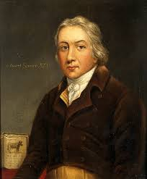
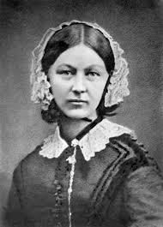
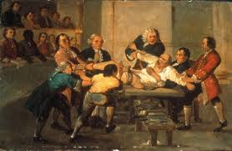
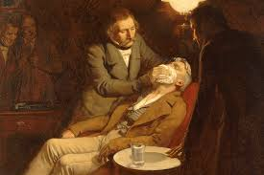
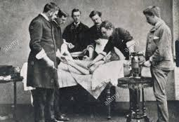
Edexcel GCSE 9-1 History
Medicine in Britain, c1250 to present workbook
Key Topic 3
c1700–c1900: Medicine in 18th and 19th century Britain v2
Name:
Edexcel 9-1 GCSE History Medicine in Britain, c1250 – present PLC |  |  | Lesson date | Date revised
Key topic 3: c1700–c1900: Medicine in 18th and 19th century Britain | Key topic 3.1 Ideas about the cause of disease and illness | A. Continuity and change in explanations of the cause of disease and illness. The influence in Britain of Pasteur’s Germ Theory and Koch’s work on microbes.
 | Key topic 3.2 Approaches to prevention and treatment | A. The extent of change in care and treatment: improvements in hospital care and the influence of Nightingale. The impact of anaesthetics and antiseptics on surgery.
 |  | B. New approaches to prevention: the development and use of vaccinations and the Public Health Act 1875.
 | Key topic 3.3 Case studies | A. Key individual: Jenner and the development of vaccination.
 |  | B. Fighting Cholera in London, 1854; attempts to prevent its spread; the significance of Snow and the Broad Street Pump.
Notes:
21.0 x 29.7 cm

Slide 2
Contents Page
p.2
Topic | Page
Key words: historical terminology | 3-6
3.1 Ideas about the cause of disease and illness in the Industrial Revolution period (c1700-c1900) | 7-19
Explain why the development of the Germ Theory was successful in the 19th century? (12 marks) | 20
3.1 - 16 mark question | 21
3.1 Summary Quiz | 22
3.2A - The extent of change in care and treatment in the Industrial Revolution period c1700-1900 | 23-35
KT 3.2B -Case Study - Jenner and the development of the vaccination | 36-40
KT 3.3A - New Approaches to prevention: the development of vaccinations. | 41-45
B. Fighting Cholera in London, 1854; attempts to prevent its spread; the significance of Snow and the Broad Street Pump. | 46-52
Exam Questions | 53-54
Notes | 55-58

Slide 3
Medicine Key Topic 3 - Industrial Revolution Key Words
p.3
1 | anaesthetics | A substance that numbs or dulls pain or puts the patient in a state of unconsciousness so they can be operated on. (nitrous oxide, ether, chloroform) (IR)
2 | antibodies | Produced by the immune system to fight against foreign pathogens that caused disease. Discovered by accident by Louis Pasteur when investigating chicken cholera in 1879.
3 | antiseptic surgery | Surgery which fights against infection pioneered by Joseph Lister (clean sheets, carbolic acid, sterilised equipment, face masks) (IR)
4 | antiseptics | A powerful substance that kills microbes on contact. Good for sterilising surgical equipment, operating rooms, and wounds during surgery. Carbolic Acid used by Joseph Lister to sterilise operating theatres in 1875 and give birth to antiseptic surgery which reduced the death rate from 50% due to infection to less than 10%. (IR)
5 | aseptic surgery | Literally: "without sepsis" The condition of an operating room that has been completely sterilised and is designed so that the patient cannot get infected during surgery. (Clean operating theatre, rubber gloves, full sterilized equipment, etc) (IR)
6 | bacteria | Disease causing microorganism (microbe)
7 | Bazalgette, Joseph | 19th-century English civil engineer and chief engineer of London's Metropolitan Board of Works. Created (in response to the Great Stink, 1858) of a sewer network for central London which was instrumental in relieving the city from cholera epidemics. (IR)
8 | ‘black period of surgery’ | Period of time ( 1847-1880) from the discovery of anesthetics (chloroform) to the adoption of antiseptics (carbolic acid) in which more patients died due to complex operations brining disease deeper into the body. Often wrongly blamed on chloroform, this period saw mortality rates for patients rise above the standard 40% due to infection after the surgery. (IR)
9 | carbolic acid | First used in Paris sewers, Joseph Lister started to use during surgical operations as well as surgeons hands and saw the death rate drop from 42% to less than 10%. Later used with a carbolic acid sprayer thus developing antiseptic surgery. (IR)
10 | Chadwick, Edwin | English social reformer and leader of the movement to improve conditions of public health. He published a series of reports on unsanitary conditions. In his Report on the Sanitary Condition of the Labouring Population of Great Britain (1842) Chadwick compiled a grim record of slum housing, unclean water, and undrained streets.The Public Health Act of 1848, passed by Parliament in the wake of a threat of a cholera epidemic, fell far short of Chadwick's proposals, but a Board of Health was created which Chadwick headed from 1848 to 1854. Later a Second Public Health Act in 1875 made many of his recommendations mandatory. (IR)
11 | chloroform | General anaesthetic discovered by James Simpson in 1847 as an alternative for ether. Ended pain for major operations allowing surgeons to often take their time to perform more accurate and complex operations. Also led to greater infection from 1847-1880 (black period of surgery) as surgeons not understanding germ theory and often refused to wash their hands and clothes.
12 | cholera | Waterborne disease that spread in dense urban environments such as London in 19th century. Outbreaks in 1831-32 (21, 882) and 1848-49 (53,293) and 1853-54 (20,097). John Snow proved it was in the water supply in 1854 through removing the handle on the Broad Street Pump. The last public outbreak of cholera in Britain was 1866-67 (14,378) due to preventative measures put in place after the First Public Health Act. (IR)
13 | compulsory vaccinations | Government sponsored vaccination campaigns. 1853 - Smallpox and 1955 - Polio (IR, 20th)
14 | contagious | A disease that can be spread from person to person such as the pneumonic plague or cholera.
15 | diphtheria | An infection that attacks the throat and was commonly fatal for children in the 19th century. (IR)
16 | epidemic | Widespread occurrence of an infectious disease in a community or nation.

Slide 4
Medicine Key Topic 3 Industrial Revolution Key Words
p.4
17 | First Public Health Act, 1848 | Largely the work of Edwin Chadwick: the Central Board of Health was created and also encouraged local Boards of Health to be set up to appoint a Medical Officer, provide sewers, inspect lodging houses and check food quality. All of this was voluntary and not compulsory so many towns simply ignored the recommendations. From the 1860’s the government took small steps to improve people’s living conditions and support disease prevention including: building 1,300 miles of sewers in London by 1865, demolishing slums in Birmingham and passing laws against dumping sewage in rivers. (IR)
18 | Garrett Anderson, Elizabeth | First British woman to qualify as a physician and surgeon in 1865. Her determination paved the way for other women, and in 1876 an act was passed permitting women to become physicians. (IR)
19 | germ theory (1861) | Louis Pasteur’s theory that germs are in the air and cause decay. In 1878, germ theory was connected to human infection. Ended belief in spontaneous generation and miasma as causes of disease. Joseph Lister in Britain was inspired to use carbolic acid for antiseptic surgery as the result of germ theory. (IR)
20 | Great Stink, 1858 | Parliament had to be closed due to summer heat causing the sewage in the Thames to reek. The miasma thought to transmit contagious diseases, and three outbreaks of cholera prior to the Great Stink were blamed on the ongoing problems with the river. (IR)
21 | hospitals (18th century) | New hospitals were opened in the 18th century due to donations from the wealth and became more focused on care instead of just resting and praying. Poor people were offered doctors and minor medical care for the first time but conditions soon became unsanitary due to the influx of patients. Doctors would move between patients without hygienic precautions thus diseases spread quickly. Rich people were still treated in their homes and would call a doctor or surgeon when necessary. By 1900, because of germ theory, hospitals were antiseptic, focused on treating the patient and a place were junior doctors could be trained practically. (IR)
22 | hospitals (19th century) | Largely due to the work of Florence Nightingale, hospitals in the late 19th century improved dramatically. She established nursing as fundamental to the recovery of the patient and set up the Nightingale School for Nurses in 1860 at St. Thomas Hospital. She also recommend hospital design changes to allow for improved ventilation, larger rooms, more windows and separate wards to stop diseases spreading.
23 | hypodermic needles, 1844 | A very thin, hollow tube with a sharp tip that contains a small opening at the pointed end. It is commonly used with a syringe, a hand-operated device with a plunger, to inject substances into the body (e.g., various drugs or liquid medicines) in correct proportions or extract fluids from the body. (IR)
24 | immunise | Process of giving protection from disease through the body's own defences or immune system.
25 | infection | Formation of disease-causing germs or microorganisms in a person’s body.
26 | inoculation / inoculators | Putting a low dose of a disease into the body to help it fight against a more serious attack of the disease. Before smallpox vaccination, inoculation was a popular prevention and would charge money to put the puss of a smallpox victim into a cut on an uninfected person. Sometimes immunity would be given but it was particularly dangerous for children who often got full blown smallpox. The inoculators resisted Edward Jenner’s cowpox vaccination in 1798 and the practice was later banned by the British government in 1840. (IR)
27 | Jenner, Edward | English doctor who promoted the use of cowpox to give immunity to smallpox (vaccination) in 1798. Opposed by inoculators who would lose business and some in the church who felt it was wrong to give humans an animal disease. Even the Royal Society refused to publish his work as Jenner could not explain how cowpox provided immunity to smallpox. By 1800, 100,000 people around the world had been vaccinated and and by 1803, 12,000 in Britain alone after the founding of the Royal Jennerian Society. By 1840 the government outlawed inoculation and paid for children to receive free vaccination and by 1852 smallpox vaccination became mandatory. Jenner was publicly praised by Napoleon, American President Thomas Jefferson and even the Emperor of Japan for his work on preventing disease. Although this was a turning point in medicine as it confirmed that humans could be made immune to a disease it was a one-off prevention and could not be replicated with other diseases. Would inspire Pasteur and Koch to look for ways to weaken disease causing microbes which they would later name vaccines in Jenner’s honor. (IR)

Slide 5
Medicine Key Topic 3 Industrial Revolution Key Words
p.5
28 | Koch, Robert | German doctor, and rival of Pasteur, who used industrial dyes to identify microbes such as tuberculosis (1882) and cholera (1883) that cause specific diseases and created vaccines for anthrax and rabies. Considered the father of Bacteriology and his rivalry with Louis Pasteur in France helped make vaccines possible for a range of diseases. (IR)
29 | laissez-faire | Belief that governments should not get involved in people's lives. Prevented progress in public health schemes in the early 19th century but progress was made under the First (1848) and Second Public Health Acts (1875). By 1900, the Victorian laissez-faire attitude was over and the government was much more keen to spend money on preventative measures improve living conditions. (IR)
30 | Lancet (medical journal) | Respected medical journal founded in 1823 and often reported on new discoveries and progress in medicine although was also used to attack new methods such as the use of chloroform and carbolic acid in surgery. (IR)
31 | Lister, Joseph | English surgeon and father of antiseptic surgery. Inspired by Pasteur’s germ theory he performed an amputation in 1865 and further tested and published his success at minimising infection after surgery. Some surgeons rejected his methods until late 1880’s as carbolic acid irritated the skin and many refused to believe that they had been causing the infection all along through unhygienic conditions. His work with antiseptic surgery led to the development of aseptic surgery and by 1900 all operating theatres were steam sterilising their tools, wearing gloves, surgical gowns and face makes. (IR)
32 | Nightingale, Florence | English nurse who advocated the idea of hygiene in hospitals during the Crimean War dropping the death rate of wounded soldiers from 42% to 2%, wrote several books including "Notes on Nursing" and “Notes on Hospitals”, petitioned the government for funding for improved hospitals, and raised the status of nursing and women in medicine. (IR)
33 | Pasteur, Louis | French chemist who discovered germ theory in 1861 after researching why wine was going sour and in 1868, inspired by Jenner, would later present his germ theory of infection tying microorganisms to human illness. In 1879 he was able to produce a vaccine for chicken cholera, by chance accidentally leaving a petri dish exposed to the air, and later went on to produce vaccines for anthrax and rabies using the work of Robert Koch who identified the microbes responsible. By weakening the culture of microbes it created an immune response with the release of antibodies that would prevent the person vaccinated from suffering the disease the next time. (IR)
34 | patent medicine | 19th century medicine sold for profit, sold under a brand name and often in pill form. (IR)
35 | pathogen | A bacterium, virus, or other microorganism that can cause disease.
36 | Queen Victoria | Used chloroform for the birth of her 8th child in 1853 and praised its effects at reducing pain. As Queen of England her authority essentially ended opposition to anaesthetics although many found it unwise to use on a monarch.
37 | Royal Jennerian Society | A group formed in 1803 with the goal to promote the eradication of smallpox through vaccination. Jenner was supported by his colleagues and the King in petitioning Parliament, and was granted £10,000 in 1802 for his work on vaccination. In 1807, he was granted another £20,000 after the Royal College of Physicians confirmed the widespread efficacy of vaccination. (IR)
38 | Second Public Health Act, 1875 | Ended the government laissez-faire attitude of the 19th century after the work of John Snow, Louis Pasteur and Edwin Chadwick. Brought together a range of Acts covering sewage and drains, water supply, housing and disease. Local authorities had to appoint Medical Officers in charge of public health. Local sanitary inspectors were appointed to look after slaughterhouses and prevent contaminated food being sold. Local authorities were ordered to cover sewers, supply fresh water to their citizens, build public toilets, collect rubbish and provide street lighting to avoid accidents. (IR)

Slide 6
Medicine Key Topic 3 Industrial Revolution Key Words
p.6
39 | Simpson, James | Scottish surgeon who discovered chloroform through self experimentation in 1847 and promoted its use in England as an alternative to ether which hurt the lungs and was flammable. A 14 year old girl named Hannah Greener died of an overdose during an operation on an infected toenail igniting public fears over the use. More opposition came from Victorian society who feared being asleep during an operation, the increased death rate from infection (black period of surgery and blood loss) and some even believed that it was God’s will for childbirth to be painful. Queen Victoria promoted chloroform after the painless birth of their 8th child in 1853 and Simpson became the first person knighted for his services to medicine. (IR)
40 | smallpox | Epidemic viral disease that killed many in the 18th and 19th centuries especially children. Some could be made immune by inoculation (dangerous) and later Jenner’s vaccination after 1798. (IR)
41 | Snow, John | English surgeon (and well respected anaesthesiologist who invented the chloroform inhaler) in Soho area of London who created the ‘ghost map’ (spot map) to track the outbreak of cholera in 1854 which lead to 53 deaths. He later concluded that the workers were being infected by the sewage from a cesspit buried less than a meter away that was leaking into the water supply through the Broad Street Pump. His discovery was initially dismissed by the General Board of Health, as they believed in miasma theory, he was successful at getting the pump handle removed and the cholera infections cleared up thus proving cholera was water-borne. In 1855 he presented his findings to a House of Commons committee advocating for massive improvements to London sewer systems. Snow’s work, combined with the Great Stink of 1858 pushed the government into funding new sewers in 1860 under the direction of Joseph Bazalgette. (IR)
42 | spontaneous generation theory | Popular but incorrect 19th century theory that decaying matter (dead animals and rotting vegetables) caused disease or bacteria. Disproven by germ theory in 1861. (IR)
43 | sterilise | To destroy all living microorganisms from surfaces and medical instruments using antiseptics or heat. The steam steriliser was invented in 1881 and supported the development of antiseptic surgery. (IR)
44 | tuberculosis | Respiratory infection that caused widespread public concern in the 19th and early 20th centuries as the disease became common among the urban poor. In 1815, one in four deaths in England was due to "consumption". (IR)
45 | Tyndall, John | English physicist who discovered small organic particles on the air and made lectures in 1877 linking Pasteur’s germ theory and Lister’s success with antiseptic surgery. (IR)
46 | vaccination | The use of cowpox to make one immune to smallpox. First coined by Edward Jenner as Vacca is Latin for cow in his published work in 1798. (IR)
47 | vaccine | The injection into the body of weakened organisms to give the body immunity against disease (prevention). Made possible by the work of Koch (identifying microbes) and Pasteur (weakening microbes) in order to activate an immune response and create resistant antibodies in a person’s body that would prevent the disease. (IR)

Slide 7
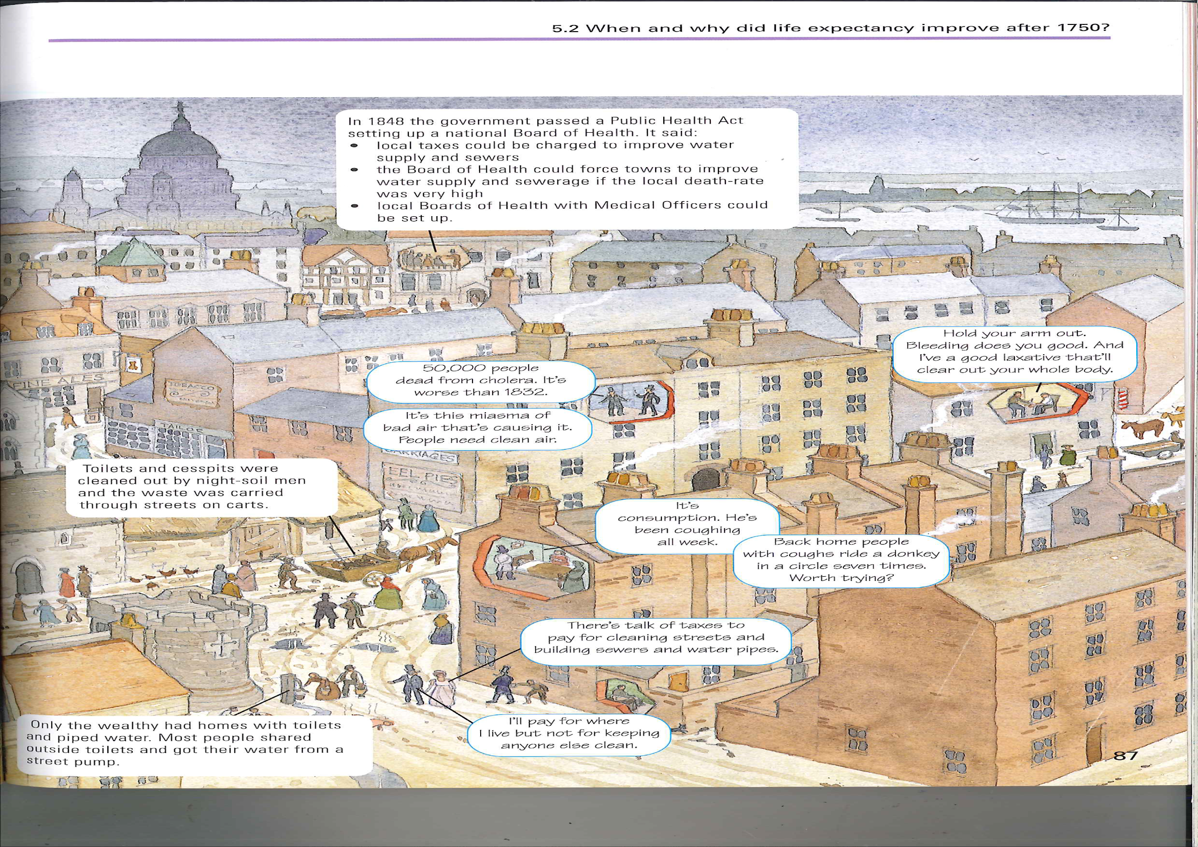
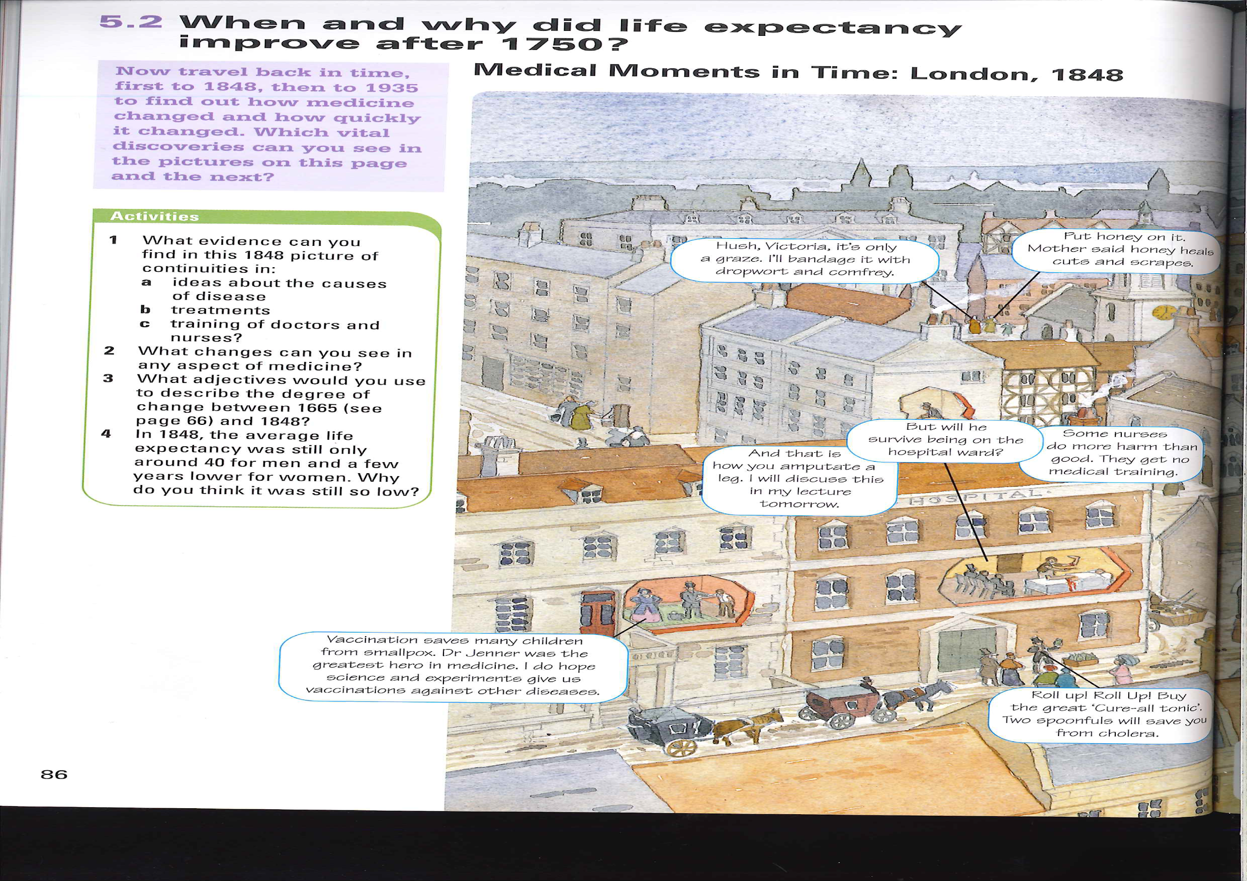
p.7

Slide 8
3.1 Ideas about the cause of disease and illness in the Industrial Revolution period (c1700-c1900)
p.8
The 18th century was a very exciting time in the world of science. In 1700, the influence of the Church was not as great as it once was. Many people no longer believed that God was responsible for all worldly events. Instead, they focused on developing scientific explanations. Intellectual movements such as the Enlightenment* made it fashionable to seek answers to questions about the world - including disease and illness.
This fashion for rational explanations touched every part of life - politics, philosophy, history, economics and, of course, science. In fact, the 'Age of Enlightenment' was happening at the same time as the Scientific Revolution during which developments across all branches of science completely changed the way people lived and the ways they understood the world around them. Some historians suggest that there were two halves to the Scientific Revolution.
In the first half, starting with the Renaissance in the 16th century, old theories were discredited.
In the second half, new ideas began to replace the old. This half of the Scientific Revolution began in c1700
Society itself was also changing. Cities began to grow as people moved there in search of jobs. The new cities were not well planned and quickly became dirty and disease-ridden. Disease like tuberculosis, typhus and smallpox were a big threat to this new working population. Therefore, understanding the causes of disease and illness became even more important.
Keywords
The Enlightenment- A movement in Europe during 18th century that promoted the idea that people could think for themselves and that traditional authorities, like the nobility and the Church, should not be able to control everyday life.
Microbes - A microbe is any living organism that is too small to see without a microscope. Microbes include bacteria.
Decaying Matter - Material, such as vegetables or animals, that has died and is rotting.
Continuity and Change
There were not a lot of new ideas about the causes of disease in the 18th century. Ideas such as the Theory of the Four Humours had been discarded. People still believed in miasma, although this theory was also becoming less popular.
Scientists in the early 18th century developed the theory of spontaneous generation as an alternative to theories like the Four Humours. Improvements in the quality of the glass lenses used in microscopes meant that scientist could see microbes. Present on decaying matter. Most people believed that these microbes were the product of decay, rather than the cause of it.
In the 18th century, this was just a theory, and scientists were unable to prove that spontaneous generation was correct. It took until the 19th century for scientists to make a solid link between these microbes and disease.
Task: How do these pictures relate to what you have just read? Add specific detail.

Slide 9
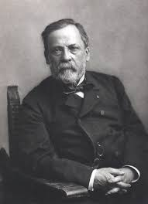
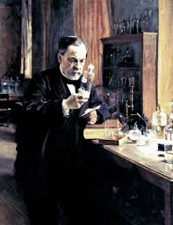
3.1 Ideas about the cause of disease and illness in the Industrial Revolution period (c1700-c1900)
p.9
TASK: Answer the following questions.
How did people's view of God change? _________________________________________________________________________________________________________________________________________________________________________________________________________________________________________________________________
What was the Enlightenment?
__________________________________________________________________________________________________________________________________________________________________________________________________________________________________________________________________
How was society changing?
__________________________________________________________________________________________________________________________________________________________________________________________________
What changed and what stayed the same in terms of cause of disease?
___________________________________________________________________________________________________________________________________________________________________________________________________________________________________________________________________________________________________________________________________________________________________________________________________
Medical breakthrough: Germ Theory
Louis Pasteur and the development of Germ Theory
In 1860, the French Academy of Science challenged scientists to come up with evidence to either prove or disprove the theory of ________________________.
By the middle of the _________________, microscopes had improved even more - it was now possible to magnify substances to a much higher level and keep the image clear enough to see. Because of this, Louis Pasteur, a ____________ scientist, was able to observe unwanted microbes in wine and vinegar, which turned both liquids ‘bad’.
Pasteur published the results of his ________________ 1861. He called his discovery Germ Theory.
Pasteur proved that the ideas of spontaneous generation was ____________ because decay did not happen to sterilised matter that was left undisturbed. Instead, something in the air was causing the ___________.
Pasteur also theorised that, as germs were causing decay, they might also be causing disease in the human body. He observed one particular type of microorganism killing off France’s silkworm population, which seemed to prove this theory. However he did not publish this germ theory of infection until 1878.
spontaneous generation | experiments | French
wrong | 19th Century | decay

Slide 10
3.1 Ideas about the cause of disease and illness in the Industrial Revolution period (c1700-c1900)
p.10
TASK: Add an image to each of the 4 basic principles of Germ Theory.
The air contains living microorganisms
Microbes are not evenly distributed in the airy
The four basic principles of Germ Theory
Microbes can be killed by heating them
Microbes in the air cause decay
Pasteur's influence in Britain
To begin with, Pasteur's work had almost no impact on British ideas about the causes of illness and disease. He was not a doctor, and his work focused on decay and spoiled food, not disease.
In Britain, the theory of spontaneous generation continued to be important until the 1870s. It was promoted by Dr Henry Bastian, who was one of the most powerful doctors in the country. Because he was so well respected, few people disagreed with him.
However, some scientists did start to look for a link between the microbes and disease. One of these was Joseph Lister, who read Pasteur's germ theory and linked it to the infection problems his surgical patients had experienced.
Another scientist who promoted the link between microbes and disease was John Tyndall. He had discovered that there were small organic particles in the air. In January 1870, he gave a lecture, linking his discovery with Pasteur's germ theory and Lister's work on wound infection. Tyndall theorised that dust particles carried the germs that caused disease.
However, Tyndall was not a doctor: he was a physicist. The medical world trusted Bastian's beliefs rather than Tyndall's theory.
Lister's ideas were also doubted, as he could not prove his theory. Although microscopes meant that microbes were visible, there were lots of them present in the blood or in a wound. Doctors could not yet identify what they were and what role they played The gut is a good example of why they had problems: when examined under the microscope, scientists saw hundreds of microbes, even in healthy people. It seemed impossible to people that these microbes caused disease, too.

Slide 11
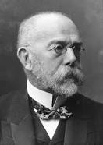
3.1 Ideas about the cause of disease and illness in the Industrial Revolution period (c1700-c1900)
p.11
Therefore, Pasteur’s theory had limited impact in Britain, because attitudes among doctors meant people refused to recognise the link between germs and disease - even though the link was correct.
Old Ideas
The SPONTANEOUS GENERATION theory closed rotting matter CREATED microbes.
This theory claimed that microbes spread through MIASMATA.
New Ideas
Pasteur’s GERM THEORY claimed that microbes CAUSED DECAY and were not created by rotting matter.
This theory claimed that microbes spread through air.
Decaying Matter
Figure 3.2 Germ Theory vs. spontaneous generation.
Robert Koch’s work on microbes
Pasteur had been the first scientists to identify microbes and their role in decay. However, it was the German scientist Robert Koch who successfully identified that different germs cause many common disease.
Koch discovered the bacteria that caused tuberculosis, in 1882. He then published his ideas on the methods that could be used to identify disease-causing microbes.
The microbe is present in every case of the disease.
Once taken from the body, the microbe can be reproduced into a pure culture.
The disease can be reproduced in test animals using that culture.
The microbe can be taken out of the test animals and used to start a fresh culture.
Koch continued to look for the microbes causing different disease. In 1993, he discovered cholera, and in 1884 he proved that it was spread in water supplies when he found it in the drinking water in India, where a cholera epidemic had broken out. This also provided proof for John Snow’s theory (we will learn about him later on.
Koch made it easier for future scientist to study bacteria by developing a new method of growing them, using agar jelly in a petri dish. This made it easier to study the bacteria under a microscope. Later, Koch also developed a method for staining them with industrial dyes, to make them easier to see.
Koch's research inspired other scientist. Over the next decades, they went on to discover the microbes responsible for other disease, such as diphtheria, pneumonia, meningitis, the plague, tetanus and various other infections. Koch received the Nobel Prize for Medicine in 1905. He is considered to be the father of bacteriology and his methods are still used when seeking out the microbes responsible for disease today.
Keywords
Culture - Bacteria grown under controlled conditions.
Bacteriology - The study of bacteria.

Slide 12
3.1 Ideas about the cause of disease and illness in the Industrial Revolution period (c1700-c1900)
p.12
TASK: Highlight 1 key sentence in each paragraph then create an image or a symbol to represent the information in the paragraph.
Koch's influence in Britain
The identification of microbes that caused particular diseases was an enormous breakthrough in the diagnosis of disease. Whereas before, doctors had studied and treated symptoms, now they studied the disease itself. The medical profession had begun to recognise that the microbe created the symptoms of the disease, and it was the microbe that needed to be removed.
For example, in 1883, the microbe that caused diphtheria was found. Diphtheria was a horrible disease that mostly affected children. It caused a painful cough and a fever A leathery skin would grow over the tonsils and the back of the throat, which meant that the sufferer could not breathe. By studying the microbe, scientists were able to observe that it produced a poison. The poison, when breathed, stayed in the throat and caused the painful symptoms. Since the microbe had been identified, scientists were able to seek ways of attacking it directly, rather than just treating the symptoms.
Summary: the impact of Germ Theory in Britain
Progress in treatment and prevention using Germ Theory was slow. Once Pasteur, Koch and other scientists had found the specific disease-causing microbes, cures and vaccines could be tested. Only after this did Germ Theory begin to have a direct impact on medical treatment.
Even the British government rejected the Germ Theory of disease at first. When Koch travelled to Calcutta in 1884 to study an outbreak of cholera, he proved that it was caused by microbes in the supply of drinking water.
However, this was ignored by the British government. Instead, they kept to the idea that the disease was present in the soil, and the miasma was brought out by the weather. This seemed to make sense, since there was more cholera a und during the rainy season.
Despite these setbacks, in the 20th century Germ Theory and the new study of bacteriology had an enormous impact on our understanding of the causes of disease and illness. It is now recognised that many diseases are caused by a microorganism - bacteria, virus or fungus. When diagnosing disease, doctors now look for symptoms and try to match them to a disease caused by a specific microbe.
By the end of the 19th century, the mystery around what caused illness and disease had been solved. It took a little more time for this to be accepted by the medical profession, but the evidence had been found. Now it was time to start looking for new treatments based on this new science.

Slide 13
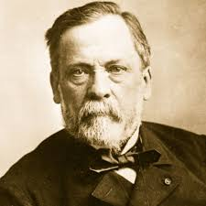
3.1 Ideas about the cause of disease and illness in the Industrial Revolution period (c1700-c1900)
p.13
TASK: Create 3 images that would appear on Louis Pasteur’s instagram
HOT: Include the caption below the image and a hashtag. What stories would this page have?
Follow
...
Louis Pasteur
87
posts
1.7m
followers
12k
following
You think I can’t see you, but I can! 😄😎🙈
Oui oui, bonjour bonjour. ✌👋
Who would Joseph Lister follow and why?
__________________________________________________________________________________________________________________________________________________________________________________________________________________________________________________________________
Who would follow Lister and why?
__________________________________________________________________________________________________________________________________________________________________________________________________________________________________________________________________
TASK: How are the following dates related to the development of germ theory?
1860
1861
1878
1882
1883

Slide 14
3.1 Ideas about the cause of disease and illness in the Industrial Revolution period (c1700-c1900)
p.14
TASK: 3-2-1 quiz. Create your own quiz about the development of germ theory. 3 multiple choice, 2 true or false and 1 factual recall.
3 multiple choice questions
2 True or false questions
1 factual recall question
________________________________________________________________________________________________________________________________________________________________________________________________________________________________________________________________________________________________________________________________________________________________________________________________
Questions | Option
 | True | False
 | True | False
HOT: How do these images relate to the development of germ theory?

Slide 15
3.1 How significant were Pasteur and Koch?
p.15
3 Key Points:
1.
2.
3
Causing Change
Accepted by others
Relevance Today
Spreading Ideas
Area | Score | Explanation using specific facts and examples
Causing Change | /10
Spreading Ideas | /10
Accepted by others | /10
Relevance today. | /10

Slide 16
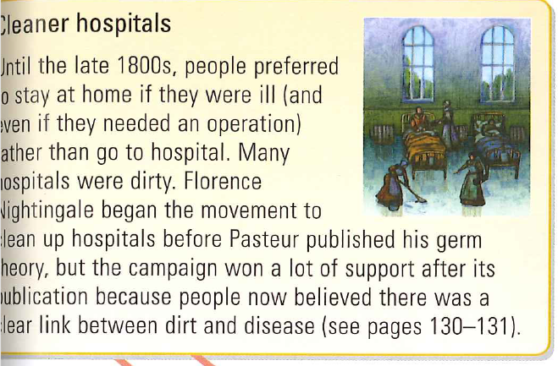
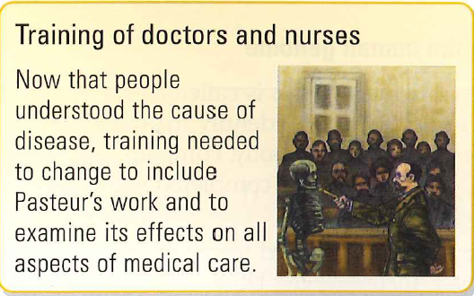
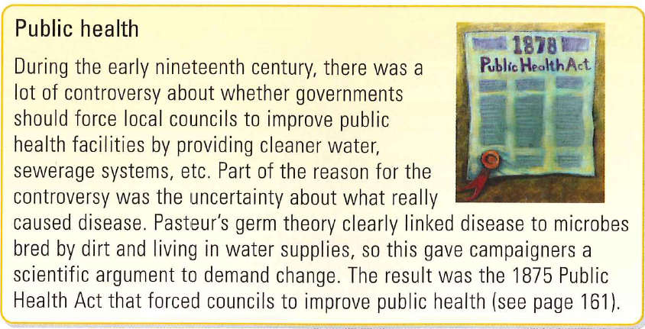
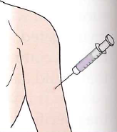
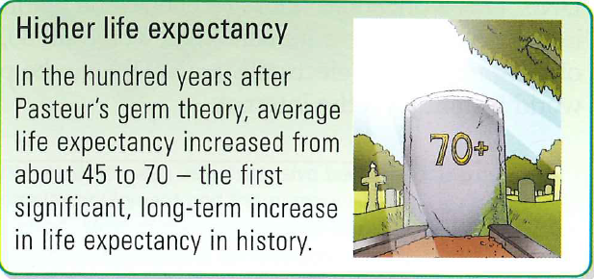
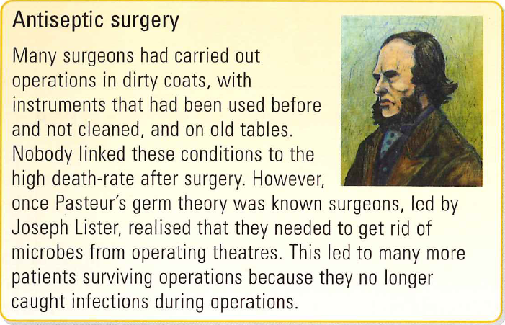
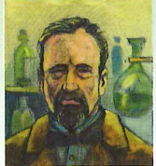
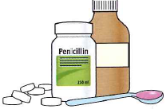
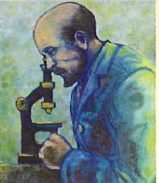
p.16
Vaccines - Once scientists had identified microbes causing individual diseases, they could create vaccines using weakened microbes. These vaccines would make people immune to the disease. Began with rabies vaccine in 1885 and led to a range of others soon after.
Magic Bullets - chemical cures that destroy bacteria in the human body without harming tissue. The first MB (Salvarsan 606) cured syphilis and the second Prontosil helped to cure blood poisoning in the 1930’s.
Germ Theory - Pasteur convinced other scientists that diseases are caused by microbes
Identifying Bacteria - Koch was the first scientist to identify specific microbes that caused individual diseases
Antibiotic medicines - Antibiotics are cures that use one type of microbe to kill other microbes that cause illness. The first antibiotic medicine was penicillin which became publicly available after 1945.

Slide 17
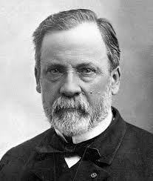
After 1700… the ideas of the causes of disease were:
p.17
Dead beliefs:
Supernatural ideas and the Four Humours theory had dominated ideas for thousands of years, but by 1700 these ideas were invalid.
Bad air/Miasma:
People thought that because rotting food and flesh and even faeces gave off bad smells that these smells spread and caused disease. These fumes were called Miasma and made sense because early 1800s towns were filthy and overcrowded!
The Microscope – a key development:
The first microscope that magnified things 300 times was developed in the 1600s. The inventor wrote down what he saw – tiny living organisms that were called ‘animalcules.’ Then in the 1800s Lister developed a more powerful microscope, so scientists could study them in more detail!
change!
The latest theory – SPONTANEOUS GENERATION
The new microscopes were used to study the micro-organisms on rotting food to try and work out where they came from. The decided that they were spontaneously (automatically) generated (created) by the process of decay and then they spread disease.
Louis Pasteur 1857-1865:
1. Pasteur concluded that micro-organisms (or germs) in the air were turning the alcohol sour.
2. He proved his Germ Theory by using the Microscope to show different shaped microorganisms in the sour and not sour liquids and by conducting the experiments on an earlier slide.
3. Whilst working with silk worms he was able to prove that disease was being spread through the air by the germs. This made him curious about the spread of human diseases.
FACTORS: Technology, Government,
Enquiry.
Robert Koch 1873-1880:
1. Koch investigated anthrax (which affected people and animals) and identified the specific germ causing it! This was a first – Pasteur had failed to do this!
2. He went on to develop ways of staining germs so they could be photographed and studied in greater detail and proving which bacterium caused which diseases.
FACTORS: Technology, War.
Louis Pasteur 1881-1885:
Pasteur used his success with animal vaccines to help him work on human diseases. He used his work on rabies in dogs to cure a young boy of the disease. Fighting disease was now possible and had been done! Scientists were spurred on to cure a wider range if diseases.
Robert Koch 1881-1882:
1. Koch was angry that Pasteur had beaten him, and he felt
that he had stolen his research!
2. He vowed to be the first to cure tuberculosis – he did this by staining the bacterium causing the disease.
3. He then used this method to identify several other bacteria causing a wide range of disease.
Louis Pasteur 1879-1881:
1. Pasteur wanted to match and improve upon Koch’s work, so he built up a large team to ensure his work was faster!
2. He worked with the farming industry to solve the problem of chicken cholera (see next slide.)
3. Pasteur then knew how Jenner’s vaccination worked and was able to create other vaccinations! He even beat Koch to an Anthrax vaccination!

Slide 18
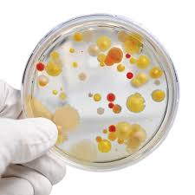
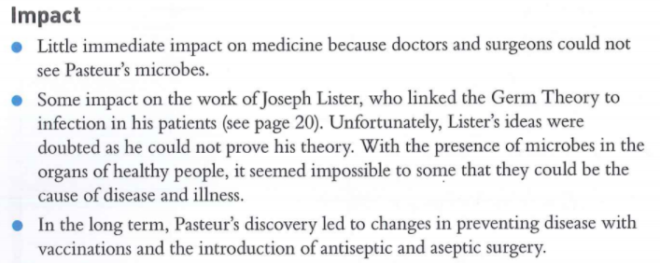
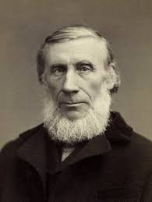
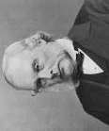
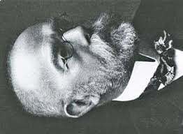
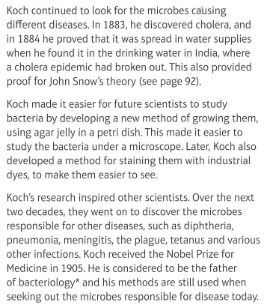
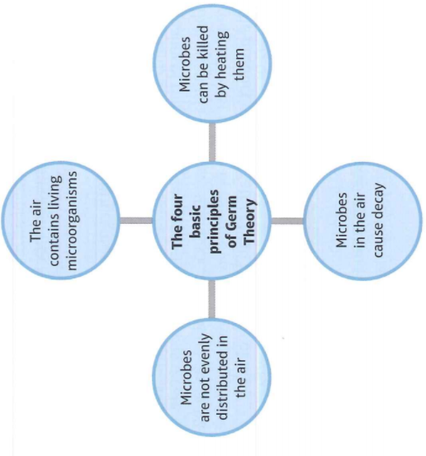
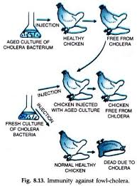
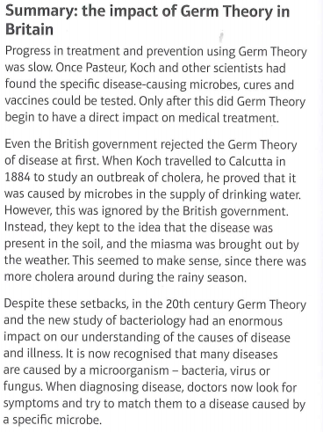
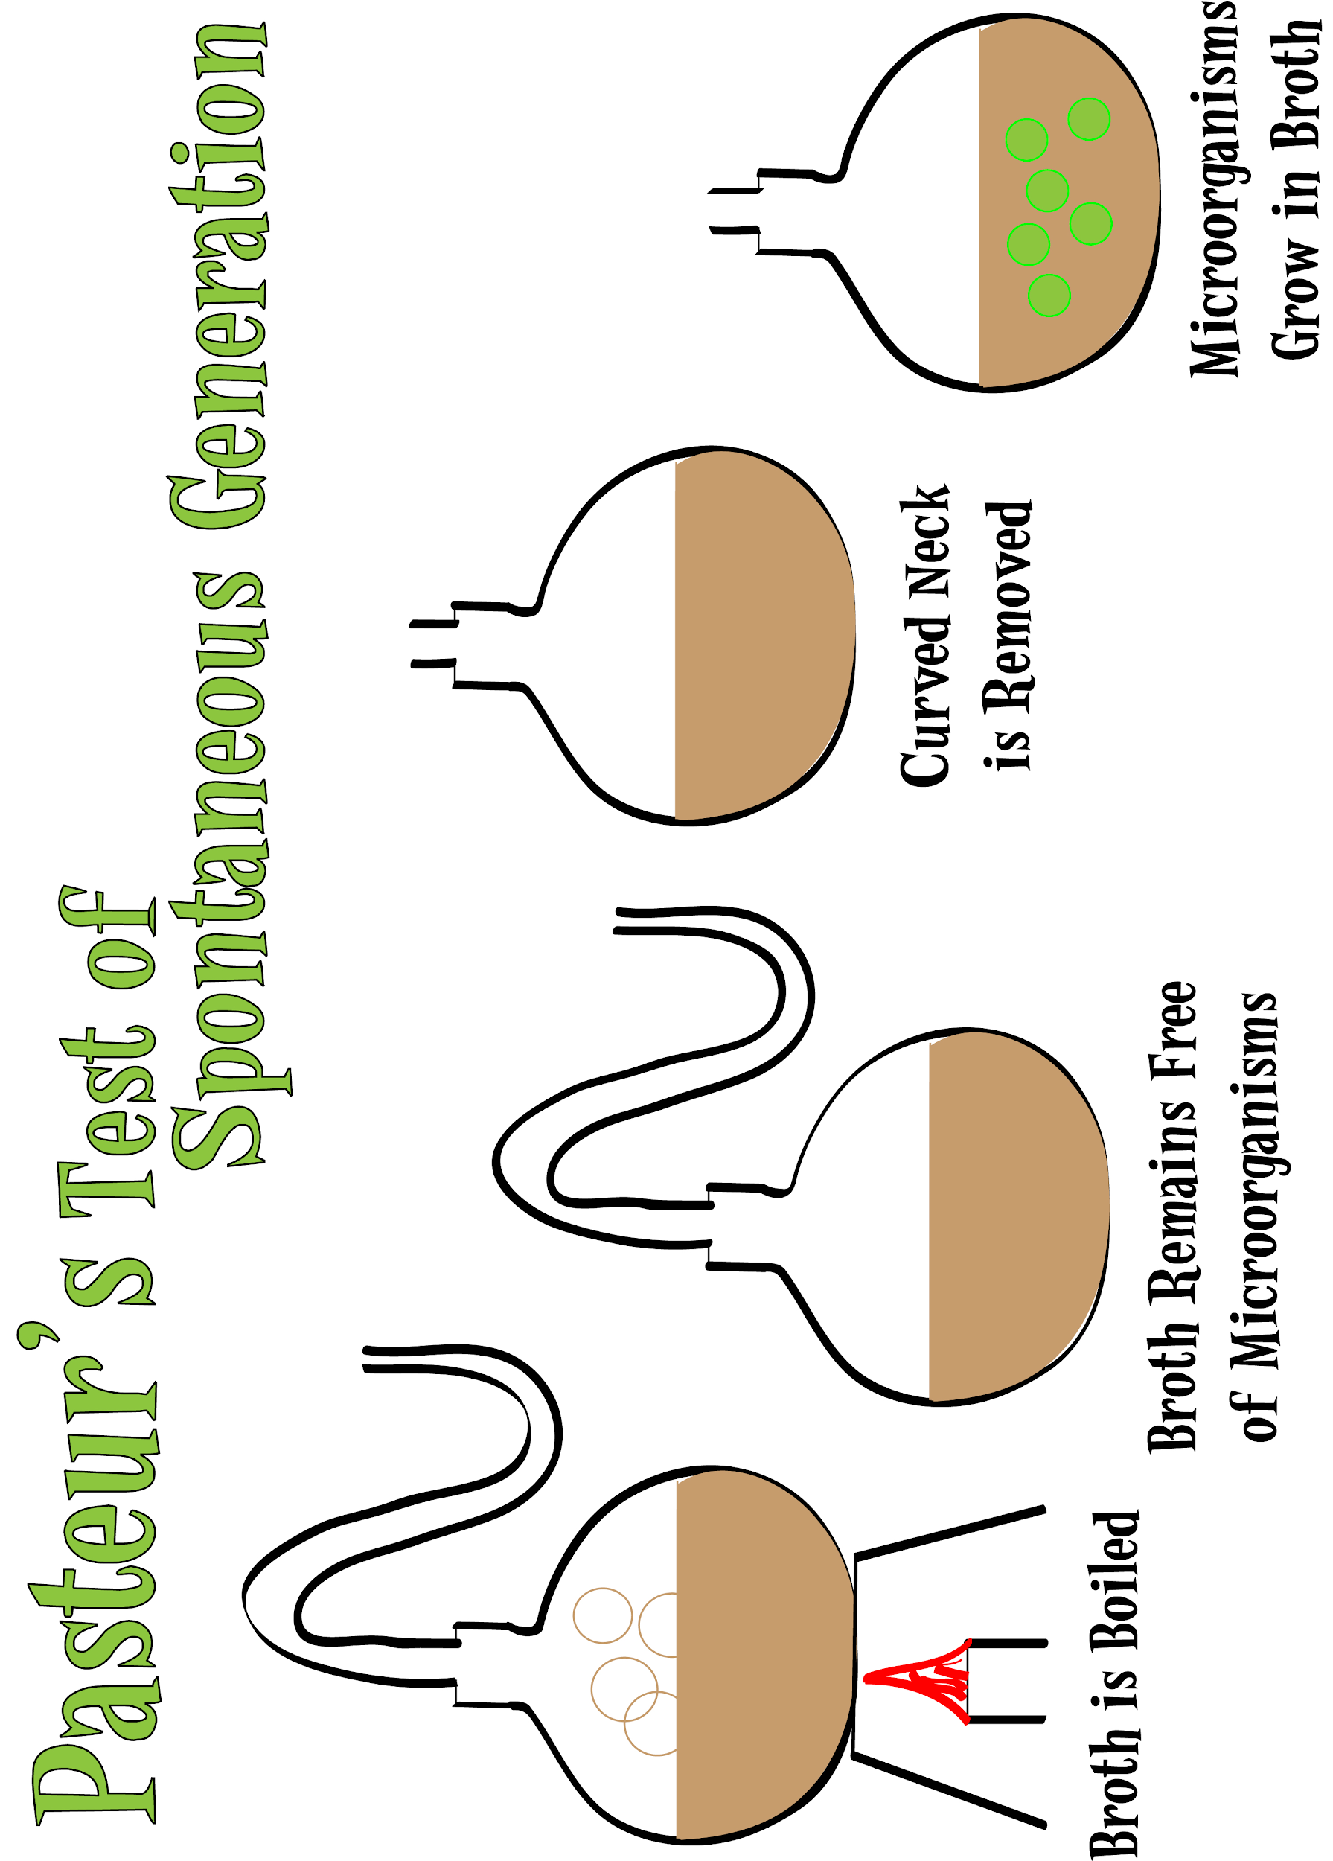
p.18
Joseph Lister
Germs cause infection in surgery (1875)
John Tyndall
Germs that cause disease carried by dust particles (1870)
Resistance in Britain: many refused to believe that microbes cause disease as they could be found in the human gut and so many believed in spontaneous generation (attitudes)
Robert Koch
German Doctor
Father of bacteriology
identification of microbes
1861
Louis Pasteur
French Chemist
Father of Germ Theory
Inventor of Vaccinations

Slide 19
Explain why the development of the Germ Theory was successful in the 19th century? (12 marks)
p.19
Science and technology (use of scientific method in discovery)
Individuals (role of Pasteur and Koch)
War (German French rivalry after the Franco-Prussian War)
Government (well funded teams)
Attitudes - Enquiry / Science
Copy the factors for the development of Germ Theory into a pyramid based on their significance.
MOST SIGNIFICANT
VERY SIGNIFICANT
SOMEWHAT SIGNIFICANT
A01 Own Knowledge | L1 | L2 | L3 | L4
 | Limited knowledge and understanding | Some knowledge and understanding of the period. | Good knowledge and understanding | Wide-ranging knowledge and understanding of the required (Accurate and relevant information is precisely selected)
A02 Argument for change or continuity. | L1 | L2 | L3 | L4
 | Generalised. lacking development and organisation. | Some development and organisation of material, but a line of reasoning is not sustained. | Reasoning that is generally sustained, (some analysis) | Showing a line of reasoning that is coherent, sustained and logically structured.

Slide 20
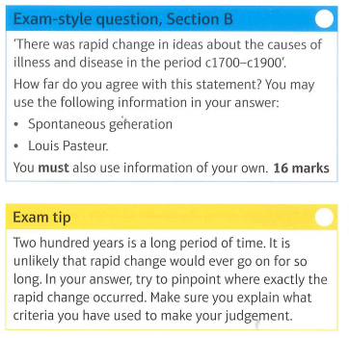
p.20
P1 - On one hand, there was rapid change towards the middle and end of the 19th century with the advent of Pasteur’s Germ Theory and Koch’s identification of microbes.
P2 - On the other hand, even after the discovery of Germ Theory there was opposition from medical professionals.
P3 - There was very little change in understanding during the 18th century even after Jenner’s discovery of vaccination
P4 - Judgement - It is undeniable that there was rapid change that fundamentally changed our ideas about the causes of disease and illness in the later part of the 19th century. So much so that….
A01 Own Knowledge | L1 | L2 | L3 | L4
 | Limited knowledge and understanding | Some knowledge and understanding of the period. | Good knowledge and understanding | Wide-ranging knowledge and understanding of the required (Accurate and relevant information is precisely selected)
A02 Argument for change or continuity. | L1 | L2 | L3 | L4
 | Generalised. lacking development and organisation. | Some development and organisation of material, but a line of reasoning is not sustained. | Reasoning that is generally sustained, (some analysis) | Showing a line of reasoning that is coherent, sustained and logically structured.
A02 Judgement on ‘how far’ you agree | L1 | L2 | L3 | L4
 | No judgement on ‘how far?’ | Weak judgement on ‘how far?’ that is not well developed or supported. | Some justification for judgement on ‘how far?’ | Clear judgement using on how far with enough support or criteria to be convincing.

Slide 21
Quiz - KT 3.1 - Causes of Disease in the Industrial Revolution
p.21
1. What was the date Germ Theory was discovered?
______________________________________________
2. Why were Pasteur and Koch rivals?
____________________________________________________________________________________________________________________________________________________________________________________
3. What was Spontaneous Generation?
____________________________________________________________________________________________________________________________________________________________________________________
4. How did Pasteur prove spontaneous generation wrong?
____________________________________________________________________________________________________________________________________________________________________________________
5. How did Koch identify the microbes that causes specific diseases?
____________________________________________________________________________________________________________________________________________________________________________________
6. How did Pasteur accidentally make a vaccine?
____________________________________________________________________________________________________________________________________________________________________________________
7. What is Germ Theory in two short sentences?
____________________________________________________________________________________________________________________________________________________________________________________
8. Germ Theory of disease helped to kill off what causes of disease?
____________________________________________________________________________________________________________________________________________________________________________________
9. Why did people resist Pasteur at first?
____________________________________________________________________________________________________________________________________________________________________________________
10. What is a vaccine? Name one early example.
____________________________________________________________________________________________________________________________________________________________________________________
Bonus: Why did it take so long for Germ Theory to be discovered?
Score ___ / 10

Slide 22
3.2A - The extent of change in care and treatment in the Industrial Revolution period c1700-1900
p.22
TASK: Using 2 highlights/colours, underline or highlight every example of change and continuity in approaches to treatment.
The extent of change in care and treatment
By 1900, the way that sick people were treated and cared for had changed almost completely since 1701. However, there was some continuity in treatment because it took a while for medical science to catch up to new ideas about the of illness and disease. By 1900, most people accepted that germs caused disease and that treatment needed to be focused on removing the germ. Unfortunately, there was still no a great deal of understanding about how best to do this. Scientists were working incredibly hard to come with treatments for everyday diseases such as syphilis and tuberculosis, but it was not until after 1900 that these were successfully developed. Therefore, old herbal remedies continued to be popular.
Similarly, by 1900, the old belief that prevention was the most important aspect became even more widespread. People began to realise that infection was everywhere: on dirty clothes, medical instruments and unwashed hands, and in the air and water The old idea of avoiding disease by keeping clean and following a sanitary regime suddenly made sense, because people really did need to protect themselves against something invisible.
Perhaps the biggest change by 1900 was in the willingness of the government and the population to take steps to prevent disease from spreading.
Improvements in hospitals and the influence of Florence Nightingale
Hospitals in the 18th century
We discovered in Chapter 2, most of England's hospitals had closed down when Henry Viii dissolved the monasteries in the 1530s. By 1700, there were only five hospitals left in the country - and they were all in London. The country did not invest in new hospitals.
However, new hospitals did begin to appear in other cities in the 18th century, founded using donations from wealthy people and from members of the new middle classes such as lawyers and businessmen. Some doctors offered their services, free of charge to these new hospitals so that they could practise their skills.
Attitudes towards the role of hospitals were changing, too. Hospitals increasingly became places where sick people were treated, as opposed to places where people could rest and pray. Doctors visited patients regularly and there was a surgeon or apothecary on site for daily treatments. A small staff of untrained nurses cared for patients.
However, hospitals were still not places that people often chose to be treated. The rich received medical treatment, and even surgery, in their own homes, which was much safer.
Hospitals were still quite particular about who they treated. Generally patients admitted were ‘the deserving poor’ - respectable, working class people who could not afford to pay 'their medical bills. This change in the types of people hospitals were willing to treat was very important in the history of medical treatment, because it gave poor people access to trained doctors for the first time.

Slide 23
3.2A - The extent of change in care and treatment in the Industrial Revolution period c1700-1900
p.23
Unfortunately, as more people started to attend, hospitals became less sanitary. They became less strict about turning away infectious patients. Although they often had separate wards for infectious patients. However, doctors went from patient to patient and war to ward without washing their hands or changing their clothes. Disease spread quickly. People did not understand that germs caused disease, so they did not take steps to avoid spreading the gems .
By the middle of the 19th century, there were a lot more hospitals. However, hospital conditions were very poor.
Change
Hospital Care in the Industrial Revolution
Continuity
HOT: How much had treatment changed by c1900?
________________________________________________________________________________________________________________________________________________________________________________________________________________________________________________________________________________________________________________________________________________________________________________________________________________________________________________________________________________________________________________________________________________________________________

Slide 24
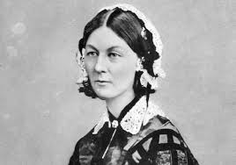
3.2A - The extent of change in care and treatment in the Industrial Revolution period c1700-1900
p.24
TASK: Underline/highlight examples of how Nightingale changed treatment.
Florence Nightingale
In 1854, Britain went to war with Russia in the News reports said that the hospitals there were not fit for the soldiers to be treated in, and there was a national outcry at the rumours that there were ho nurses or even bandages available to the soldiers. Because of this outcry, and her position in society, Nightingale was able to convince the government to send her to improve the hospitals in the Crimea, along with 38 other nurses.
While Nightingale was in the Crimea, she made changes to the care of the wounded soldiers in many different ways.
Nightingale and her nurses demanded 300 scrubbing brushes to get rid of any dirt near patients being treated.
Nurses were organised to treat nearly 2,000 wounded soldiers.
Clean bedding and good meals were provided.
Nightingale's efforts had a very positive effect on the mortality rate within six months, it had dropped from 40% to only 2%. By the time Nightingale returned to Britain in 1856, she was a national hero. There had been a great deal of bad publicity about the conditions in War hospitals, and Nightingale was famous for having made a big difference. This gave her credibility and helped her to make changes to hospitals in Britain, too.
Hospitals in 1900
Hospitals by 1900 looked very different from the few in Britain in 1700. MAny different wards split up infectious patients from those requiring surgery. Operating theatres and specialist departments for new medical equipment provided separate spaces for certain procedures.
Cleanliness was now of the utmost importance: hospitals first focused on cleaning up germs using antiseptics, and by 1900 they were focused on preventing the germs from getting in to begin with. Doctors were a common sight, particularly junior doctors who were training and getting more hands on experience. Trained nurses lived in nearby houses provided for them.
New ideas about hospitals were adopted quickly. Everybody wanted to have the most modern hospital designs, to help them attract donations and new student doctors.
The function of hospitals had completely change. Instead of being for the sick to rest, hospitals had become a place where the sick were treated. This fundamental change in the role of hospitals had forced a change in the way they were built and run.
It was in these dirty hospital conditions that Florence Nightingale found herself when she began nursing. Nightingale was born into a wealthy family in 1820. When she was 17, she experience a religious vision telling her that her mission was to save mankind. She eventually convinced her parents to train as a nurse, first in Germany then in Paris. In 1853, she became the superintendent of nurses at King’s College Hospital in London.

Slide 25
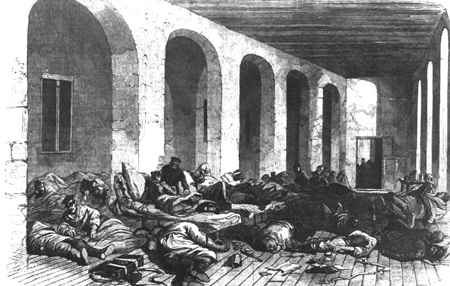
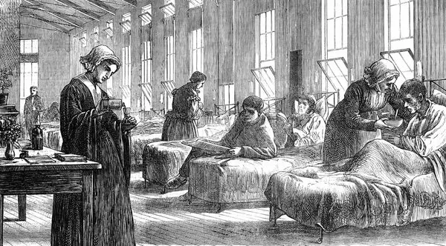
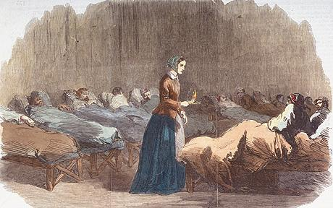
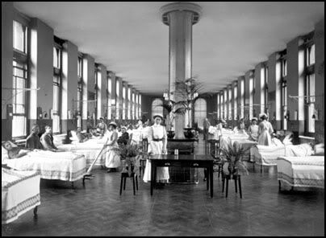
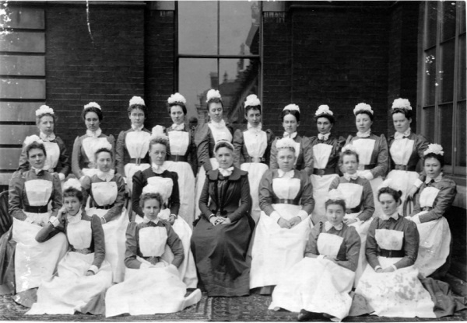
p.25
Pre- Nightingale
Scutari Hospital during the Crimean War in 1850’s
Nightingale’s work at Scutari
Impact of Nightingale on nursing and hospitals

Slide 26
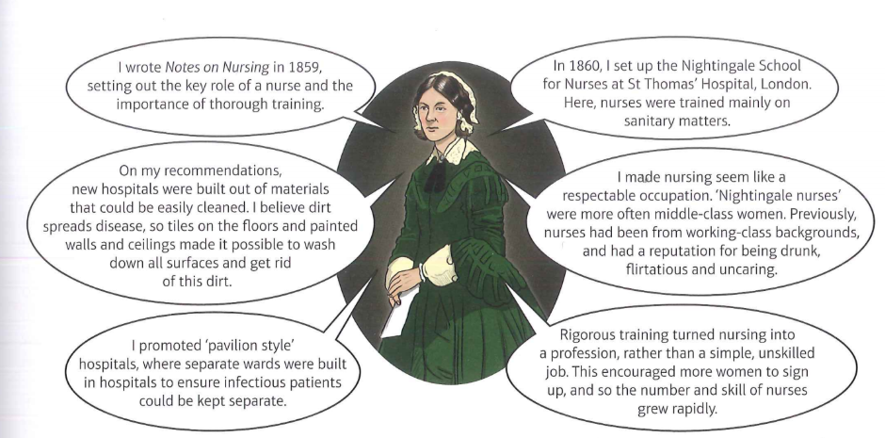
3.2A - The extent of change in care and treatment in the Industrial Revolution period c1700-1900
p.26
TASK: Make a list of the changes that had occured in hospitals by c1900.
______________________________________________________________________________________________________________________________________________________________________________________________________________________________________________________________________________________________________________________________________________________________________________________________________________________________________________________________________________________________________________________________________________________________________________________________________________________________________________________________________________________________________________________________________________________________________________________________________________________________________________________________________________________________________________________________________________________________________________________________________________________________
HOT: Explain the impact of more people attending hospitals.
__________________________________________________________________________________________________________________________________________________________________________________________________________________________________________________________________________________________________________________________________________________________________________________________________________________________________________________________________________________________________________________________________________________________________________________________________________________

Slide 27
3.2A - The extent of change in care and treatment in the Industrial Revolution period c1700-1900
p.27
3 Key Points:
1.
2.
3
Causing Change
Accepted by others
Relevance Today
Spreading Ideas
Area | Score | Explanation using specific facts and examples
Causing Change | /10
Spreading Ideas | /10
Accepted by others | /10
Relevance today. | /10

Slide 28
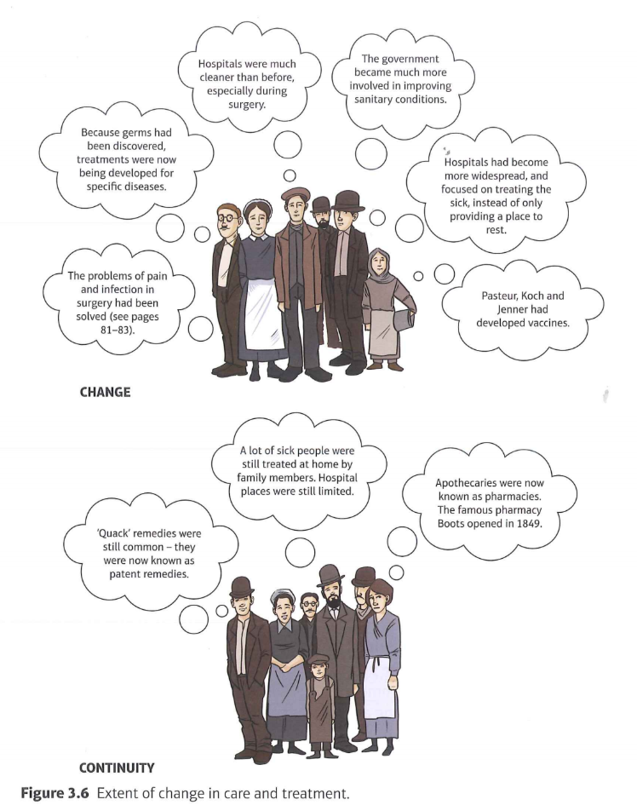
3.2A - The extent of change in care and treatment in the Industrial Revolution period c1700-1900
p.28
TASK: Add a symbol to each of the thought bubbles. Then, Number the changes 1-6, 6 being the greatest change and explain which one you put as number 1.
__________________________________________________________________________________________________________________________________________________________________________________________________________________________________________________________________________________________________________________________________________________________________________________________

Slide 29
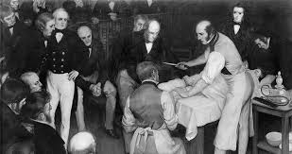
3.2A - Approaches to treatment
p.29
Improvements in surgical treatment
In the 18th century, surgery was a dangerous and
usually fatal business. The three big problems that
surgeons face were:
Bleeding
Pain
Infection
ALthough substances like opim had been used for some time to calm patients with severe injuries, without anaesthetic there was no way of preventing the excruciating pain that they went through - which sometimes sent them into shock. SUrgeries had to be performed quickly, before the patient bled to death on the operating table, as blood transfusions had not yet been developed. Bleeding continued to be a problem during surgery throughout the 18th and 19th centuries.
The most talented surgeons were able to operate extremely quickly, which improved their patients’ chance of survival. However, even if the patient survived, often infection set in as surgeries were not performed in germ-free environments. In fact, they were usually performed in the patient’s home, with the surgeon wearing the same clothes he had arrived in.
For these reasons, surgical treatments were quite limited. The most common type of surgery was amputation, which was often necessary due to accidents or complications relating to tuberculosis. Other types of surgeries were rare because the danger of death was so great. However, surgeons were becoming more respected.
In the 19th century, significant developments occurred that tackled two of the three problems of surgery. Firstly, anaesthetics were developed to enable surgeons to put patients to sleep before operating on them - which helped with the pain. Secondly, the development of Germ Theory led to an understanding of the importance of cleanliness in the operating room, and antiseptic surgery was developed - this helped to stop infection.
Annotate illustration identifying reasons why 19th century surgery was ineffective:

Slide 30
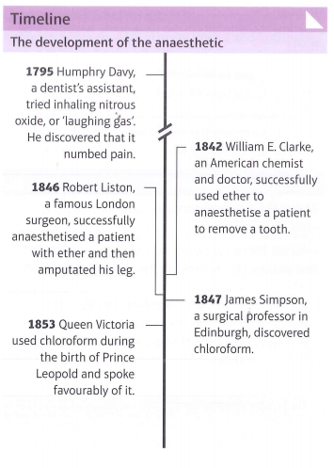
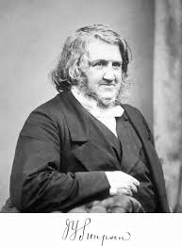
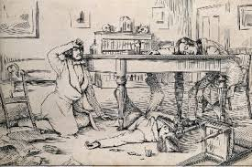
3.2A - Approaches to treatment
p.30
Tackling Pain: the development of the anesthetic
Doctors had been experimenting with pain relief for their patients for many centuries, in an attempt to keep them still and quiet for long enough to perform operations. Early experiments with laughing gas proved quite successful and small operations such as pulling teeth. When the chemical ether was discovered and used in America, it caused great excitement among surgeons. However, there were some problems with ether. IT often made patients vomit, and gas irritated the lungs which caused coughing, even while the patient was unconscious. Worse still, it was very flammable, which meant it was a dangerous chemical to keep around, given that operating room were lit with candles of gas lamps.
James Simpson and chloroform
James Simpson, a young surgeon from Edinburgh, was convinced that there were better anesthetics tan laughing gas to be discovered. He gathered a group of friends together and they inhaled the vapours of various chemicals to see what might work. After sniffing chloroform, the entire party passed out and were discovered some time later by Mrs Simpson. Clearly, chloroform was an effective anaesthetic.
Although they weren’t detected during Simpson’s experiments, chloroform did have some negative side effects
The dose had to be carefully controlled, as it was easy to overdose a patient and kill them.
The chemical sometimes affected the heart, which caused some healthy and fit young people to die shortly after inhaling.
In spite of this, however, chloroform began to be used as a solution to one of the problems of surgery: pain. After it was administered to queen Victoria during the birth of her son in 1953, chloroform became even more popular in Britain.
James Simpson was the first person to be knighted for services to medicine. This was because of the positive impact that regular use of anaesthesia had on surgery. More surgeries took place and deeper, more complex surgeries became possible.
Some historians suggest that the use of anesthetics made it possible for doctors to attempt lengthier and more-complex operations. However, because of anaesthetics allowed for deeper surgery to be attempted, infection and bleeding became an even bigger problem.

Slide 31
3.2A - Approaches to treatment
p.31
TASK: Read the above and answer the questions on the following page.
What were the 2 early methods of anaesthetics?
__________________________________________________________________________________________________________________________________
What were the problems with using ether?
__________________________________________________________________________________________________________________________________
Who discovered chloroform and how did he discover it?
__________________________________________________________________________________________________________________________________
What was the problem with Chloroform?
__________________________________________________________________________________________________________________________________
Why did chloroform become popular in Britain after 1853?
__________________________________________________________________________________________________________________________________
Ironically the use of chloroform led to the ‘black period of surgery’, a 20 year period saw death rate go up. Why was this?
______________________________________________________________________________________________________________________________________________________________________________________________________________________________________________________________________________________________________________________________________________________________________________________________________
TASK: How do the following pictures relate to what you read on the previous page.?

Slide 32
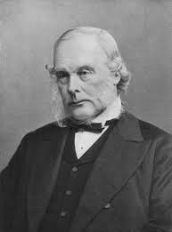
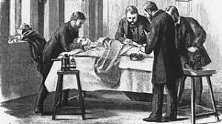
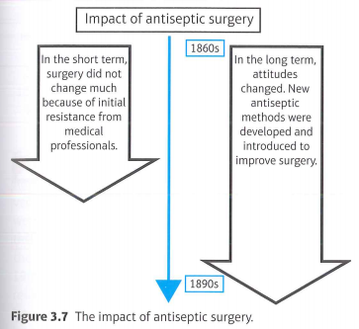
3.2A - Approaches to treatment
p.32
Joseph Lister and carbolic acid
Joseph Lister was an English surgeon. By studying infected wounds, he realised that the flesh was rotting. Lister compared his results with the recently-published work of Pasteur, who had identified germs as being responsible for decay. Lister theorised that, if microbes in the air caused wine and vinegar to go bad, perhaps microbes also caused flesh to rot.
Lister started to look for a chemical that would clear bacteria from wounds. He was aware of the use of carbolic acid in sewage treatments. So, in 1865, he operated on a patient with a broken leg and added a bandage soaked in carbolic acid. The wound healed cleanly.
From this, Lister developed a series of steps to ensure that wounds did not become infected. These included spraying carbolic acid in the air during operations.
Lister published his results in The Lancet, a medical journal. He detailed 11 different cases where carbolic acid had been used successfully in surgery.
In spite of its success, antiseptic surgery did not cat on quickly.
News of Lister’s success spread more quickly than Germ Theory. However, this meant that the science behind the new method wasn’t fully understood. Consequently, not all surgeons were willing to use the carbolic spray. They still did not believe that the air was full of germs.
Carbolic spray dried out the skin and left behind an odd smell. Some surgeons argued that, since it made their hands sore, it certainly could not be doing the patient any good.
Lister focused on encouraging his colleagues to use the carbolic spray instead of scientifically proving his theory. He was a ‘doer’ rather than a ‘thinker.
The key change here wasn’t that doctors started using carbolic acid - although it was a great improvement, carbolic spray was only popular for a short amount of time, and even Lister himself stopped using it in 1890. What is important is that the attitude of surgeons towards antiseptic and aseptic surgery changed. Surgeons finally understood that performing safe surgery was not only possible - was their duty.
Other surgeons began to look for different methods of preventing infection. By 1900, instruments were steam cleaned, operating theatres were scrubbed spotless, rubber gloves and surgical gowns were introduced and surgeons used face masks during operations.
Aseptic surgery: Surgery where microbes are prevented from getting into a wound in the first place, as opposed to being killed of with an antiseptic.

Slide 33
3.2A - Approaches to treatment
p.33
Opposition to change
Although developments in anaesthetics and antiseptics helped to improve the effectiveness and availability of surgery, not everybody welcomed the changes.
Anaesthetics allowed for deeper surgeries to be attempted. Before the introduction of carbolic spray, infection and bleeding became even bigger problems. The death rate actually increased, which seemed to suggest that anaesthetics were bad. People did not trust the technique.
The Victorians believed that pain relief was interfering with God’s plan, particularly in childbirth, which was meant to be painful.
Some doctors believed that patients were more likely to die if they were unconscious during the operation, rather than awake and screaming.
It took a long time for doctors to accept that germs caused infection. Surgeons did not want to believe that they might have been responsible for infections that killed their patients.
TASK: Create a flowchart showing the development of surgery during the 19th century. You need to include: the process of how chloroform was discovered, how carbolic acid was used in surgery and opposition to the changes.

Slide 34
3.2A - Approaches to treatment
p.34
Explain why there was rapid change in surgical treatments in the period c1700-c1900
You may use the following in your answer:
Chloroform
Joseph Lister
You must also use information of your own. 12 marks
Example Paragraph
The second half of the 19th century saw rapid change in surgery due to two out of the three problems (blood loss, Pain and infection) being solved: these previously made surgery so dangerous.
The discovery of a more effective anaesthetic had solved the problem of pain. Before the 19th century, alcohol and opium had been used to try and numb the pain during operations but they weren’t that successful and patients still felt pain during surgery. This meant it was necessary for the surgeons to be extremely fast and also that the patient moved during the operations which meant that surgeons were likely to make mistakes. On top of this, ether was discovered though this proved to be flammable and was dangerous to keep around operating rooms which were lit with candles.
However, James Simpson was one of the reasons why there was change in surgical treatment. In 1847, Simpson discovered chloroform, an effective anesthetic. Even though there were some negatives as it was possible to overdose a patient and kill them, it grew in popularity after Queen Victoria used it to give birth to her son in 1853. Additionally, there was negative change due to anesthetics as it actually led to the black period of surgery whereby death rates increased. It was only till the end of the century that surgeons and doctors understood germ theory and aseptic surgery that survival from surgery increased.
Exam Tips
Remember this type of question is about causation: this means you are looking for relevant reasons.
There are 12 marks in total for this question. You don’t have to use the prompts in the question in your answer but you must include your own information to answer the question fully.
You need to give more than one reason and the best answers will show how different factors combined to prevent or bring about change.
Your explanations need to stay focussed on answering the question. Although you might remember lots of detail, you need to focus on providing reasons why, not descriptions.
TASK: In your assessment book, complete a final paragraph looking at Joseph Lister and antiseptics.
You may also want to talk about the fact that blood loss was still a problem from surgery.

Slide 35
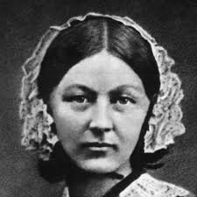
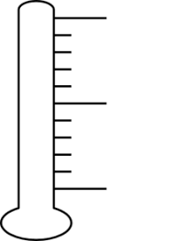
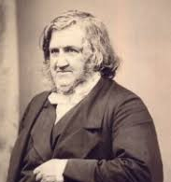
3.2A Change, Progress and Improvement - Industrial Revolution Treatment 1750-1900
p.35
Problems / need for change / context | What they did / Key Features of work | Impacts on treatment ( short & long term)) | Extent of Change + why?
19th c hospitals were often crowded and unhygienic with patients sharing beds and infection spreading rapidly. Nurses were seen as a minor part of the recovery process
No general anaesthetic means that few patients had surgeries till the last minute (too late) and surgeons had to rush operations leading to mistakes and poor quality surgery. Patients often struggled and a few would die from shock.
Infection after surgery had around 50% mortality rate as surgeons would reuse instruments and or wash hands or clothes. Poor reputation and known as ‘butchers’ due to failure rate. Many patients avoided surgery.
Florence ‘naughty’ Nightingale
Area of treatment
Patient Care
Nursing
Hospitals
James ‘feelgood’ Simpson
Area of treatment
Surgery
Patient experience
Complexity of surgeries
Joseph ‘so fresh and so clean clean’ Lister
Area of treatment
Surgery
Infection rate
Survival rate
Surgeon’s reputations

Slide 36
Quiz - KT3.2 - Nightingale, Simpson, Lister
p.36
1. What was the name of the hospital where Florence Nightingale was stationed in Turkey?
2. What was her nickname?
3. What were the names of her two books?
4. What hospital did she help redesign?
5. What institution did she help create that trained nurses?
6. What did James Simpson discover in 1847?
7. Why did some people initially oppose anaesthetics?
8. What did anesthetics allow surgeons to now do?
9. What did Joseph Lister discover and invent?
10. What type of surgery did he create and how effective was it?
Score ___ / 10

Slide 37
Target 5-6 | Explain why treatment of disease and illness changed during the 19th century. (12 marks)
- Quick mention of Germ Theory in 1861 and ending of Spontaneous Generation and miasma - Role of Florence Nightingale in Scutari Hospital during Crimean War, Lady with the Lamp, St. Thomas Hospital, Notes on Hospitals, Notes on Nursing, Nightingale School for Nursing. - Discuss work on James Simpson in discovering chloroform and testing its effects. Publishing and promotion despite opposition. Impact in making surgery more accurate and safer despite more germs being spread. - Discuss work of Joseph Lister in promoting use of carbolic acid to reduce infection rate during surgery. Inventing carbolic acid sprayer and pioneering antiseptic surgery with his refined methods. - Can also discuss improvements and regulation of pharmaceutical industry in making more accurate and easy to obtain medicine in pill form.
p.37
Target 7-9 | 16 mark question - Treatment of disease and illness saw little improvement during the 19th century. How far do you agree?(16 marks)
On one hand, I agree with the interpretation. - Germ Theory resisted by many from 1861-1890 - Hospitals and surgeons slow to adopt new methods to fight infection - Anaesthetics saw wide ranging opposition due to fear and religion - Surgeons were slow to adopt antiseptic methods due to complications and varied results - Most change saw in prevention with vaccines and public health On one hand, there is evidence for a counter interpretation. - Nightingale’s work in hygiene was adopted quickly with improved patient experience and care in hospitals. - She raised profile of nurses and women in medicine. - New hospitals like St. Thomas saw addition of clean wards, windows and much more consideration for patient wellbeing - Surgery became essentially painless due to Simpson’s work with chloroform - allowed greater range of surgery and more accurate - Lister’s work with antiseptics dropped mortality rate from infection from 50% to below 10% saving thousands of lives. - Antiseptic methods, although receiving opposition, were widely accepted by the end of the 19th century with clean sheets, washing hands, uniforms and sanitised surgical tools becoming common. Judgement - how far?
A01 Own Knowledge | L1 | L2 | L3 | L4
 | Limited knowledge and understanding | Some knowledge and understanding of the period. | Good knowledge and understanding | Wide-ranging knowledge and understanding of the required (Accurate and relevant information is precisely selected)
A02 Argument for change or continuity. | L1 | L2 | L3 | L4
 | Generalised. lacking development and organisation. | Some development and organisation of material, but a line of reasoning is not sustained. | Reasoning that is generally sustained, (some analysis) | Showing a line of reasoning that is coherent, sustained and logically structured.
A02 Judgement on ‘how far’ you agree | L1 | L2 | L3 | L4
 | No judgement on ‘how far?’ | Weak judgement on ‘how far?’ that is not well developed or supported. | Some justification for judgement on ‘how far?’ | Clear judgement using on how far with enough support or criteria to be convincing.

Slide 38
3.2B - New approaches to prevention: the development and use of vaccinations
p.38
People still generally believed that the best way to avoid dying from a disease was not catching it at all. People had begun to have new ideas about cures - however, most of these were still not effective on patients who were suffering from a disease. Therefore, scientists continued to focus on prevention and developed the idea of the vaccination.
Pasteur presented his case for the germ theory of infection in 1878, after publishing his Germ Theory in 1861. He theorised that microorganisms were responsible for disease. He admired the work of Jenner and started to look for vaccines that would tackle lots of disease. However, Jenner’s work had been the result of observation and experiments, rather than tackling the specific microbe. It would not be possible for other vaccines to work the same way. Pasteur realised that vaccines could only be developed once the germs causing the specific disease had been identified.
Pasteur's first effort at a vaccine was for chicken cholera. He identified the germ causing the disease and set about developing a vaccination against it.
In 1879 Pasteur proved that a weakened strain of the disease worked to vaccinate the chickens. He continued with his work, also creating a vaccine for anthrax, another devastating disease affecting animals. He then developed a vaccine for rabies.
Pasteur’s work on vaccines involved producing a weakened version of the culture and then treating patients with it. This created immune response, where the body fought off the weakened disease and, in doing so, created antibodies that prevented the individual form suffering from that disease if the microorganism was encountered again. Pasteur did not know that this was why the vaccine worked, because science had not progressed far enough for him to investigate the method properly yet. However, his methods were clearly effective.
Until this point, Pasteur’s focus had been on animal disease that caused problems for farmers. His work on vaccinations had little direct impact on disease in humans. However, it inspired research among other scientist, who wanted to find other vaccines for a wide range of human diseases.
Koch’s work isolating the microbes that caused specific diseases was very important in developing new vaccines. For example, in 1890, Emil von Behring developed a vaccine against tetanus and diphtheria.
By 1900 scientists all over the world were busy isolating microbes and developing vaccines, thanks to the work of Pasteur and Koch. This was a significant breakthrough in prevention of disease.
TASK: If this is the answer what is the question?
Not catching it at all - _________________________________________________________________________________________________________
Jenners results were based on observations and experiments - ___________________________________________________________
__________________________________________________________________________________________________________________________________
Chicken cholera - ______________________________________________________________________________________________________________
Immune resposne - ___________________________________________________________________________________________________________
Emil von Behring - ____________________________________________________________________________________________________________

Slide 39
3.2B - New approaches to prevention: the development and use of vaccinations
p.39
TASK: Draw a storyboard to explain how vaccines were developed.
TASK: As a method of prevention, vaccination were more effective than anything that had been tried in previous centuries. What factors made the development of new vaccinations possible?
____________________________________________________________________________________________________________________________________________________________________________________________________________________________________________________________________________________________________________________________________________________________________________________________________________________________________________________________________________________________________________________________________________________________________________________________________________________________________________________________________________________________________________________________________________________________________________________________________________________________________________________________________________________________________________________________________________________________________________________________________________________________________________________________________________________________________________________________________________________________________________________________________________________________________________________________________________________________________________________________________________________

Slide 40
3.2B - Changes in prevention and public health in the 19th century
p.40
Government laissez-faire attitude - up until the early 19th century`
Government in Great Britain had minimal involvement in anything related to public health. This laissez-faire (hands off) attitude combined with increasing urbanisation led to incredible pollution, overcrowding, filth, poor housing conditions and recurrent epidemics such as cholera and tuberculosis.
Failure to address common needs of its citizens:
- disease preventions schemes
- adequate sewers systems - provision for clean water
- hospitals - affordable and quality housing
- overcrowding - rubbish collection
Cholera outbreaks strike England in 1832, 1849 and 1854 kill thousands.
Events that caused change - mid 19th century
Edwin Chadwick, an English social reformer, writes ‘ A Report on the Sanitary Conditions of the Labouring Classes’ in 1842 and begins to petition the government for more public health intervention.
First Public Health Act - 1848
- recommended health improvements to local councils but it was not compulsory
John Snow proves cholera is waterborne by removing the handle off the Broad Street pump in Soho in 1854.
Great Stink in 1858. A particularly hot summer makes the Thames River, which is full of human waste and sewage, smell so bad that Parliament has to close down.
Reform Acts of 1832 and 1867 meant more than 2.5 million out of a population of 30 million could vote. (8% of population)
Pasteur discovered Germ Theory in 1861. By 1880 everyone agrees that Germs cause disease.
Writers like Charles Dickens highlighted the problems with the poor.
IMPACTS on public health and prevention
Second Public Health Act, 1875
Due to change in attitude the government passed the act requiring:
- Access to public toilets - - increased quality of housing
- provision for clean water -- improved sewers
- street lighting to reduce accidents -- regulation of food quality
AFTER 1860:
- Joseph Bazalgette builds 1,300 miles
of London’s sewers in 1865
- Birmingham slums demolished
- Declared illegal to dump sewage into water
Government became more responsive to the needs of the people as they have to win elections and choose to invest in public health schemes to improve wellbeing and end disease epidemics.

Slide 41
3.2B - New approaches to prevention: the Public Health Act 1875
p.41
The Public Health Act, 1875
Alongside the new scientific methods of __________________, a great deal was also being done to improve living conditions in Britain, particularly in the _____________cities. In c1700, the ____________________had little interest in improving conditions in cities. They had a laissez-faire attitude and believed that it was not their responsibility or right to interfere in the way that people lived.
During the ___________, this attitude began to change. More men now had the right to _____________, so the government began passing laws that appealed to masses. The government knew that if they appealed to normal people, they would be voted into power in future elections.
As well as this, cholera arrived in Britain. The epidemic led to the deaths of thousands of people. The work of John Snow led people to believe that cholera was spread in dirty _____________, and this theory was backed up by pasteur’s discovery of microorganisms in _____________.
prevention | 1800s | 1861 | responsibility
government | water | larger | vote

Slide 42
New approaches to prevention: the Public Health Act 1875
p.42
From the 1860s, the government began to take more action to improve living conditions for people in cities.
In London, 1300 miles of sewers were built by 1865.
In Birmingham, slums were demolished.
In leeds, a local business obtained a court order to prevent sewage from being drained into the river from which they got their water.
There had been a change in the way people felt about public health. More people began to recognise that it was now everybody’s responsibility.
In response to this change in attitude, the government passed the second Public Health Act in 1875. City authorities had to follow the rules it set out. The responsibilities included:
Providing clean water to stop diseases that were spread in dirty water
Disposing of sewage to prevent drinking and washing water from becoming polluted
Building public toilets to avoid pollution
Employing a public officer of health to monitor outbreaks of diseases
Ensuring new houses were of better quality, to stop damp and overcrowding
Providing public parks for exercise
Inspecting lodging houses to make sure they were clean and healthy
Creating street lighting to prevent accidents
Checking the quality of the food in shops to make sure that it didn’t contain anything that could cause somebody harm. For example, some bakers mixed chalk into flour to make bread whiter.
The government had taken solid steps to prevent the spread of disease - and it worked. The last cholera epidemic in Britain was in 1866-67, and it had a lower mortality rate than previous epidemics, due to some of the new measures that had been put in place.

Slide 43
There are 6 mistakes the paragraph, underline them and correct them in between the lines.
p.43
One of the reasons why public health and prevention improved in the 18th century was The Great Stink of 1862. After a particularly cold winter the Thames River, which was filled with waste and sewage, which created a smell so bad that Parliament had to close down. The government, already being very active in prevention and public health, made it illegal to dump sewage into water whilst also building a new sewage system. Leading this was Joseph Baguette who built 1300 metres in London in 1865. This was a big improvement in prevention as the government updated all the sewers to the best specification.
What can we learn from the source about how the public felt about public health provision in the mid-19th century?

Slide 44
New approaches to prevention: the Public Health Act 1875
p.44
TASK: Annotate the timeline using information from the previous pages showing the development of public health.
c1700
1800s
1842
1861
1865
1875

Slide 45
3.3A - Case Study - Jenner and the development of the vaccination
p.45
Add a title
Highlight key information
Reduce to 1-2 sentences.
Smallpox in 18th-century Britain
At the start of this period, smallpox was a terrible threat to the health of the population of Britain. There were nationwide epidemics in 1722, 1723 and 1740-42. The problem was particularly bad in London, where there were 11 epidemics in the 18th century. The worst of these occurred in 1796 when 3,548 people died. By this time, the population of the city was approaching one milion, so the disease spread quickly and easily from person to person.
At this time, people were still unaware of the cause of the disease, but they did have some ideas about how to avoid catching it. It had been noticed that people who caught a mild form of smallpox and then recovered from it did not catch it again. This would later form the basis for vaccination, which works in the same way. However, in the 18th century there was not enough scientific knowledge for people to understand how this worked.
Therefore, some people attempted to inoculate (deliberately infecting oneself with a disease, in order to avoid a more severe case of it later on) themselves against smallpox by catching a mild dose of the disease, so that they would avoid catching a more severe form of it later on. Pus from a smallpox scab would be rubbed into a cut on the patient being inoculated by a doctor. Unfortunately, this did not always work: some patients died of the smallpox they were given, as the disease did not affect everyone in the same way.
In spite of this, inoculation was seen by many as the best chance of surviving smallpox. However, the procedure was very expensive and so only the very rich could afford it. Many doctors made a fortune carrying out inoculations for wealthy people. One doctor, Thomas Dimsdale, was made a baron, pain £10,000 and awarded an annual salary of £500 after he inoculated Catherine the Great and her children in 1768. He was one of the most successful inoculators of his time.
Jenner discoveres the vaccination for smallpox
Edward Jenner was a Gloucestershire doctor in the late 18th century. He had trained as an apprentice to a surgeon-apothecary and then practised medicine at St George’s Hospital in London, before returning to Gloucestershire, where he became a general practitioner (GP). Jenner was particularly interested in inoculations. He gathered evidence of over 1,000 cases where smallpox inoculation had failed.
There were a lot of dairy farms in the area where Jenner worked. He regularly treated dairy maids for cowpox (a disease causing red blisters on the skin, similar to smallpox. It can be transmitted from cows to humans) and noticed that, when there was a smallpox epidemic, those who had previously suffered from cowpox did not catch smallpox. He decided the two must be somehow connected.

Slide 46
3.3A - Case Study - Jenner and the development of the vaccination
p.46
Add a title
Highlight key information
Reduce to 1-2 sentences.
Smallpox in 18th-century Britain
Jenner need to test this theory and so, in 1796, he infected a local boy, James Phipps, with cowpox. Six weeks later he attempted to infect James with smallpox, but James did not catch it. Jenner infected more local people with cowpox to further test his theory. In 1798, he wrote up his findings in An Enquiry into the Causes and Effects of the Variola Vaccinae. He named the technique ‘vaccination’ after the Latin word for cow, vacca.
Jenner made sure that the instructions for his new method were very detailed, so that other doctors would be able to follow them. He wanted other people to use the vaccination to prevent smallpox from spreading.
Reactions to the new vaccination
As with so many medical discoveries, it took some time for people to accept vaccinations. Although Jenner knew that the system worked, he was not able to explain how or why it worked - and this made people suspicious. The ideas of infecting someone with an animal disease was seen as extremely stranger, and a lot of people were against it.
Although certain groups of people were against vaccinations, there was another very powerful group that were in favour of them: parliament. As you can see from the timeline below, the British government favours the new method of vaccination from the first half of the 19th century. This was because it was a safer and more reliable alternative to inoculation. It was also cheaper, because recipients of vaccines did not need to be put into quarantine, whereas those receiving the inoculation were in danger of spreading smallpox to other people.

Slide 47
3.3A - Case Study - Jenner and the development of the vaccination
p.47
The impact of the smallpox vaccine
Short term
In the short term, the smallpox saved many lives. It quickly became very popular overseas and by 1800, 100,00 people around the world had been vaccinated. The French commander Napoleon had his entire army vaccinated in 1805.
The vaccination was slower to become popular in Britain, thanks to the anti-Jenner propaganda promoted by inoculators. Sometimes people still contracted smallpox or died of infection, because the doctors carrying out the procedure mixed up smallpox and cowpox samples or reused needles, and this discouraged people as well. However, after the Royal Jennerian Society had been founded in 1803, 12,000 British people were vaccinated in the space of two years.
Long term
By the end of the 19th century, vaccination against smallpox had become normal. Opposition continued throughout the century, but the number of people saved made it clear that the method worked. The number of smallpox case fell dramatically from 1872, when the government started to enforce compulsory vaccinations- this meant that everyone had to be vaccinated for smallpox.
Jenner had shown that a vaccine could be used to stop smallpox from spreading. His work inspired other scientists, like pasteur and Koch, to search for vaccinations for other disease. However, there were no other vaccinations discovered that worked in the same way as the smallpox vaccine. This was a one - off, so scientists were unable to develop other vaccines based on Jenner’s method.
Exam-style question
Explain why there was rapid change in the prevention of smallpox after 1798.
You may use the following information in your answer:
Inoculation
The government
You must also use information of your own. 12 marks
Exam Tip
As well as explaining medical breakthroughs in your answer, in order to show what changed you should compare with the situation before Jenner’s research.

Slide 48
3.3A - Case Study - Jenner and the development of the vaccination
p.48
A Dr Edward Jenner was surprised that farmers in Gloucestershire did not want to be inoculated – they told him that, if they had had cowpox, they were immune to smallpox. | B However, the Royal Society refused to publish his report about his experiments and his findings, so Jenner himself paid for it to be published in 1798.
C The technique of inoculating someone with smallpox in order to develop immunity from the disease in the future was used in China and Turkey and it became widespread in Britain after Lady Mary Wortley Montague had her children inoculated in 1721. | D James Phipps was slightly unwell but quickly recovered. When Jenner inserted some smallpox matter into a cut on Phipps’ arm, James did not develop the illness – he had developed immunity to smallpox.
E Towards the end of 1802, the Jennerian Society was set up in London to provide free vaccinations against smallpox – within two years over 12,000 people had been vaccinated. | F Jenner spent a lot of time supplying cowpox matter to other doctors and therefore, in 1802, the British government awarded him £10,000 in recognition of the importance of his work and a further £20,000 in 1807.
G Jenner received worldwide recognition for his achievement: honours from a number of cities and universities; a special medal from Napoleon, the ruler of France, who had his armies vaccinated; the gift of a ring from the Empress of Russia; a letter from Thomas Jefferson, the President of the USA; statues of him erected in various cities, including London and Tokyo. | H In 1852 the British government made vaccination against smallpox compulsory, although it was not strictly enforced until 1872. In 1980 the World Health Organisation officially declared that smallpox had been eradicated and it has been estimated that Jenner’s work has saved more human lives than the work of any other individual.
I Jenner vaccinated another 23 people in the same way in order to check his findings. | J Smallpox killed more children than any other disease in the 1700s. Survivors of smallpox were often severely disfigured by scars from the scabs that formed on the skin
K In 1796, Jenner decided to test the idea that cowpox created immunity to smallpox and took some cowpox matter from a sore on the arm of Sarah Nelmes and inserted it into a cut on the arm of a young boy, James Phipps. | L In the mid 18th century inoculation became big business with inoculators charging a heavy fee. The were some problems such as inoculated patients could get a strong dose of smallpox and die or pass on the disease to others. Many could not afford inoculation.
TASK: List the letters in the correct chronological order below and rewrite each box into one sentence.
_________________________________________________________________________________________________________________________________________________________________________________________________________________________________
__________________________________________________________________________________________________________________________________________________________________________________________________________________________________________________________________________________________________________________________________________________________________________________________________

Slide 49
3.3A - Case Study - Jenner and the development of the vaccination
p.49
_____________________________________________________________________________________________________________________________________________________________________________________________________________________________________________________________________________________________________________________________________________________________________________________________________________________________________________________________________________________________________________________________________________________________________________________________________________________________________________________________________________________________________________________
Understanding the chronology
The events of the eighteenth and nineteenth centuries that led to a change in the prevention and treatment of disease and illness are very complex. Place these events listed below in the correct chronological sequence in the timeline.
Nightingale set up the Nightingale School of Nurses.
Koch identified the microbe for anthrax.
Simpson discovered that chloroform was an anesthetic.
Jenner developed the smallpox vaccine.
Queen Victoria used chloroform during childbirth.
The British government made the smallpox vaccine compulsory.
Nightingale wrote Notes on Nursing.
Koch identified the microbes in tuberculosis and typhoid.
Lister used the carbolic spray in the operating theatre.
Nightingale went to the Crimea to improve hospitals.
Louis Pasteur published his Germ Theory.
Date | Event
1796
1847
1852
1853
1854
1859
1860
1861
1865
1876
1882

Slide 50
3.3B - Fighting cholera in London, 1854 - the significance of Snow and the Broad Street Pump
p.50
Cholera was a waterborne disease that spread in dense urban environments such as London in 19th century and killed within hours. Outbreaks in 1831-32
(21, 882) and 1848-49 (53,293) and 1853-54 (20,097) terrified the nation.
John Snow
mid 19th c. English Doctor
After the first epidemic in 1831 the government encouraged people to clean up filth on the streets thinking the origins were miasmic in nature.
Snow, who was also a successful doctor and the anaesthesiologist who gave chloroform to Queen Victoria in 1851, wrote in 1848 that cholera must be waterborne as it affects the guts and not the lungs and hypothesised that it must be spread by the faeces that leaked into the public drinking water.
During the 1854 outbreak in Soho he did a survey and created the ‘ghost map’ which proved that the infected were centered around the Broad Street pump. He challenged the local authorities to remove the handle and the cases cleared up. It was proved that miasma had nothing to do with cholera which was spread by water.
There was some opposition from the government at first who refused to remove the handle but his evidence proved overwhelming.
- Those who lived close to the pump died in greater numbers
- A local workhouse which had its own water supply had only 5 deaths
- Those who worked at a brewery and drank beer all day had no deaths
- Upon further inspection it was revealed that a cesspit had broken and was leaking straight into the source for the Broad Street Pump.
- The Board of Health for London rejected his findings and held onto miasma theory as the cause.
Immediate:
-In 1855 Snow presented findings to a House of Commons committee and suggested immediate government action.
- Nothing was done (Laissez- Faire) until 1860 when sewers were funded by the government but the work was slow
- He could not prove what caused the disease, just how it was spread.
Long:
- In 1875 when Joseph Bazalgette was commissioned to build thousands of miles of London sewers but this is largely credited to the Great Stink of 1858.
- Added weight to Germ Theory of disease after 1861
- Helped to bring about the Second Public Health Act in 1875 which forced local authorities to take action of a range of public health issues.
Factors:
Individual Genius Government Scientific Method

Slide 51
3.3B - Fighting cholera in London, 1854 - the significance of Snow and the Broad Street Pump
p.51
TASK: Look carefully at the cartoon. List all the threats to health you can see in the picture.
_______________________________________________________________________________________________________________________________________________________________________________________________________________________________________________________________________________________________________________________________________________________________________________________________________________________________________________________________________________________________________________________________________________________________________________________________________________________________________________________________________________________________
Fighting Cholera
Cholera was a terrible disease. It caused diarrhoea and sickness that became so bad, the victim would become dehydrated. It was usually fatal: sufferers would die between two and six days after falling sick. As the sufferers would die between two and six days after falling sick. As the sufferer became dehydrated, their blood would become thicker, rupturing blood vessels under the skin. This turned the skin blue, so cholera was nicknamed ‘the blue death’. It was spread through person to-person contact, or water contaminated with faeces of a sufferer.
Cholera did not arrive in Britain until 1831. It spread quickly across the county. It arrived in London in February 1832 and there were 5,275 deaths in the city by the end of the year. Cholera mainly affected the poorest people. There were lots of cases in slum dwellings, as well as in workhouses, prisons and asylums. However, wealthier districts were not immune. As had been the case with the plague two centuries earlier, doctors found it impossible to treat. There were three further severe epidemics across the country in the following decades.
Attempts to prevent the spread of cholera
Some steps were taken to try to clean up the filthiest areas of the cities so prevent the spread of cholera. The belief that miasmata and rotting material caused disease was still widespread, so local councils and populations turned their attentions to the mess in which they were living. The government encouraged cities to set up boards of health and provide clean water supplies. However, this did not have a great effect on people’s living conditions.
Year of epidemic | Total cholera-related deaths in England and Wales
1831-32 | 21,882
1848-49 | 53,293
1853-54 | 20,097
1865-66 | 14,378

Slide 52
3.3B - Fighting cholera in London, 1854 - the significance of Snow and the Broad Street Pump
p.52
John Snow
John Snow was a surgeon who had moved to Soho in 1836 and had become London’s leading anaesthetist. It was Snow who gave Queen Victoria chloroform during the birth of Prince Leopold in 1851. He was popular and well-respected.
Snow observed cholera during the epidemic of 1848-49. He wrote up his theories in On the Mode of Communication of Cholera. IN it, he suggested that:
Cholera could not be transmitted by a miasma, because it affected the guts, not the lungs
Drinking water was being contaminated by the cholera-ridden faeces being disposed of in the city’s drains.
Snow concluded that cholera was transmitted by dirty drinking water.
The 1854 epidemic
In August of 1854, cholera broke out in Soho, where Snow lived. . This prompted Snow to investigate the 93 deaths deaths in his local area. Snow created a spot map to show where the deaths had occurred in the area around Golden Square and Broad Street. He took a street map and drew spots onto it to represent the deaths that had taken place.
After looking at the map, John Snow realised that there was a pattern: the number of deaths seemed to be centred around the water pump on Broad Street.
To Snow, it was clear that the water pump was the source of the infection. He removed the handle from the pump, preventing locals from pumping water, and the cholera outbreak went away as quickly as it had arrived.
Later inspections of the well underneath the water pump revealed that it was extremely close to a cesspit - less than one metre away. Although the cesspit had a brick lining, it had cracked, meaning waste from the cesspit was seeping into the well and spreading cholera.
The impact and significance of John Snow and the broad Street Pump
In 1855, Snow presented his findings to a House of Commons committee. He showed the evidence that he had gathered, which proved that cholera was transmitted by dirty water. He recommended that the government start making massive improvements in the sewer systems of London. By doing this, Snow argued, another cholera outbreak could be avoided.

Slide 53
3.3B - Fighting cholera in London, 1854 - the significance of Snow and the Broad Street Pump
p.53
The government did eventually agree to invest in a new sewer system, which was planned by joseph Bazalgette and completed in 1875. However, this was not just due to the work of John Snow. An unusually hot and dry summer in 1858 had caused ‘The Great Stink’. The Thames was low and the stench of the exposed sewage on the riverbanks heating up and steaming gently in the sun became terrible. This nudged the government into action and the work on the new sewers was begun in 1860.
Many people rejected Snow’s work. Other scientists pointed out that cases would still occur among people who lived further away form the pump, even if they were drinking less of the water. The General Board of Health clung to the theory of miasma and rejected Snow’s findings. Admitting that cholera was present in the water would mean having to take steps to provide clean water, which was going to be very costly - and, the Board argued, there was no scientific proof that it would work.
Although Snow had plenty of practical evidence to show that cholera was spread in water, he had no scientific evidence to show what caused the disease. It would be another seven years before Pasteur published his Germ Theory - three years after Snow had died - and another 30 years before Koch finally isolated the bacterium that caused the disease.
Therefore, in the short term, Snow’s work had an immediate impact on the residents of Soho Square, many of whom avoided cholera thanks to his removal of the pump handle. However, his impact outside of this area was very limited. It was not until much later that the importance of clean water was accepted.
TASK: Create a 5 question quiz regarding ing the fight against cholera.
Role of the Government | Role of the individual: John Snow
ENcouraged local councils to clean up their cities and provide clean water. | Observed the pattern of cholera cases.
Listened to John Snow’s evidence about cholera. | Designed an experiment to prove that cholera was caused by dirty water.
Arranged for a new sewer system to be built in London. | Prevented residents from drinking the water.
Eventually passed the 1875 Public Health Act to force other cities to clean up. | Presented his findings to the government.
___________________________________________________________________________________________________________________________________________________________________________________________________________________________________________________________________________________________________________________________
_________________________________________________________________________________________________________________________________________________________________________________________________________________________________________________________________________________________________________________________________________________________________________________________________

Slide 54
Task: to create a visual storyboard of the story of how John Snow solved the mystery of the Cholera outbreak in 1854 and proved cholera was waterborne.
Should include references to:
- Effects of cholera
- conditions in Soho
- his investigation
- the ‘ghost map’
- removing the Broad street pump handle
- the discovery of the origin
- reaction of the government
- why Snow should be considered a hero
p.54
John Snow and the Cholera outbreak in 1854 - Storyboard

Slide 55
p.55
Explain why public health and prevention improved in the 19th century.
You may use in your answer
The Great Stink 1848
Edwin Chadwick
You must use information of your own. (12 marks, 18 min)
Read the question carefully and find command word(s).
Ask yourself what the examiner wants to know.
Paragraph 1: Write a very short paragraph explaining a little about the laissez-faire attitude of the government toward public health before 1850. (1-3 sentences)
Paragraph 2: Write a short paragraph explaining about the impact of the Great Stink and how it revealed the extent of pollution and lack of hygiene in the rivers and drinking water and forced MP’s to take public action by building London’s first comprehensive sewer system. (3-4 sentences)
Paragraph 3: Write a short paragraph explaining how the work of Edwin Chadwick passed the bill for the First Public Health act which was not mandatory but laid the foundation for the Second Public Health Act in 1975 which had changed that would be enforced. (3-6 sentences)
Step 5: Write a short paragraph explaining how Germ Theory in 1861 helped to establish the need for public health schemes to avoid outbreaks like cholera. (1-3 sentences)
Step 6: Time permitting, explain how John Snow’s removing the handle off the Broad Street pump in 1854 proved government intervention could save lives and that cholera was not miasmic in nature. (1-3 sentences)
FACTOR ALERT: - Government - Science - Attitudes -Individuals
A01 Own Knowledge | L1 | L2 | L3 | L4
 | Limited knowledge and understanding | Some knowledge and understanding of the period. | Good knowledge and understanding | Wide-ranging knowledge and understanding of the required (Accurate and relevant information is precisely selected)
A02 Argument for change or continuity. | L1 | L2 | L3 | L4
 | Generalised. lacking development and organisation. | Some development and organisation of material, but a line of reasoning is not sustained. | Reasoning that is generally sustained, (some analysis) | Showing a line of reasoning that is coherent, sustained and logically structured.

Slide 56
p.56

Slide 57
3.3 Fighting cholera in London, 1854
p.57
Significant to whom?
Historians are interested in different aspects of the past, and ask different questions. The interest of the historian is a very important factor in their decision about what is significant and what is not.
Historian’s focus | Social historian | British historian | Scientific historian
Title of investigation | How did medical developments change living standards in Britain during the 19th century? | How did British scientists change our understanding of the causes of disease? | What role did science and technology play in the development of medicine.
Changes and events during the 19th century
In 1861, Pasteur identified that germs caused decay. | The British government passed laws to make cities cleaner and protect people’s health. | In 1865, LIster developed a carbolic spray to make surgery safer.
In 1854, John Snow made a link between cholera and dirty water. | Better microscope enables scientist to see microbes and link them with diseases. | In 1797, Edward Jenner developed a vaccination against smallpox.
Robert Koch developed methods to allow bacteria to be grown and observed more easily. | The Enlightenment meant that people were more interested in looking for rational explanation for disease. | In 1870., John Tyndall theorised that dust particles carried germs that caused disease.
TASK: For each historian, make a diagram to show the relative significance of the changes and events that would interest them. Write the historian in the middle of the page and then add the events and changes that would interest them: the more significant, the closer to the historian.
Look at the change or event of most interest to the social historian. How important is it to the other historians?
Why would the work of Joseph Lister be interested to the social historian and the scientific historian?
Would the British historian include the work of Pasteur or ignore it? Explain your answer.

Slide 58
Notes
________________________________________________________________________________________________________________________________________________________________________________________________________________________________________________________________________________________________________________________________________________________________________________________________________________________________________________________________________________________________________________________________________________________________________________________________________________________________________________________________________________________________________________________________________________________________________________________________________________________________________________________________________________________________________________________________________________________________________________________________________________________________________________________________________________________________________________________________________________________________________________________________________________________________________________________________________________________________________________________________________________________________________________________________________________________________________________________________________________________________________________________________________________________________________________________________________________________________________________________________________________________________________________________________________________________________________________________________________________________________________________________________________________________________________________________________________________________________________________________________________________________________________________________________________________________________________________________________________________________________________________________________________________________________________________________________________________________________________________________________________________________________________________________________________________________________________________________________________________________________________________________________________________________________________________________________________________________________________________________________________________________________________________________________________________________________________________________________________________________________________________________________________________________________________________________________________________________________________________________________________________________________________________________________

Slide 59
Notes
________________________________________________________________________________________________________________________________________________________________________________________________________________________________________________________________________________________________________________________________________________________________________________________________________________________________________________________________________________________________________________________________________________________________________________________________________________________________________________________________________________________________________________________________________________________________________________________________________________________________________________________________________________________________________________________________________________________________________________________________________________________________________________________________________________________________________________________________________________________________________________________________________________________________________________________________________________________________________________________________________________________________________________________________________________________________________________________________________________________________________________________________________________________________________________________________________________________________________________________________________________________________________________________________________________________________________________________________________________________________________________________________________________________________________________________________________________________________________________________________________________________________________________________________________________________________________________________________________________________________________________________________________________________________________________________________________________________________________________________________________________________________________________________________________________________________________________________________________________________________________________________________________________________________________________________________________________________________________________________________________________________________________________________________________________________________________________________________________________________________________________________________________________________________________________________________________________________________________________________________________________________________________________________________

Slide 60
Notes
________________________________________________________________________________________________________________________________________________________________________________________________________________________________________________________________________________________________________________________________________________________________________________________________________________________________________________________________________________________________________________________________________________________________________________________________________________________________________________________________________________________________________________________________________________________________________________________________________________________________________________________________________________________________________________________________________________________________________________________________________________________________________________________________________________________________________________________________________________________________________________________________________________________________________________________________________________________________________________________________________________________________________________________________________________________________________________________________________________________________________________________________________________________________________________________________________________________________________________________________________________________________________________________________________________________________________________________________________________________________________________________________________________________________________________________________________________________________________________________________________________________________________________________________________________________________________________________________________________________________________________________________________________________________________________________________________________________________________________________________________________________________________________________________________________________________________________________________________________________________________________________________________________________________________________________________________________________________________________________________________________________________________________________________________________________________________________________________________________________________________________________________________________________________________________________________________________________________________________________________________________________________________________________________

