Slide 1

Understanding “command words” and how to use them to help you answer exam questions
PART 1: COMMAND WORDS

Slide 2

PART 1: COMMAND WORDS
Put simply, understanding exam technique is not about what you know, but how you apply your knowledge under exam conditions.

Slide 3

PART 1: COMMAND WORDS
Whilst revision is a vital part to getting good exam results, examination technique is also important.
Key to this is the importance of understanding “Command Words”.

Slide 4
PART 1: COMMAND WORDS
What are command words?
Command Words are guides in the question which identify how the question should be answered.
They are carefully chosen to make it clear what the examiner is looking for and how they want the question answered.

Slide 5


PART 1: COMMAND WORDS
It is important to always read the whole question and to understand what the question is getting at, as the command word on its own will need reinforcing with the remainder of the question.
Top tip: ALWAYS HIGHLIGHT THE COMMAND WORDS IN EACH QUESTION

Slide 6
PART 1: COMMAND WORDS
Typical command words used in exam questions:
GCSE question grades: 1, 2, 3, 4
AS/A level question grades : E, D, C
Define Name
Describe Outline
Explain State
Give What is meant by
Identify

Slide 7
PART 1: COMMAND WORDS
Typical command words used in exam questions:
GCSE question grades: 4, 5, 6, 7
AS/A level question grades : D, C, B
Apply Identify What would be the benefit / costs of
Demonstrate Name Which
Describe How Why
Explain Show how
Give Using
Give an example Using examples

Slide 8
PART 1: COMMAND WORDS
Typical command words used in exam questions:
GCSE question grades: 6, 7, 8, 9
AS/A level question grades : B, A, A*
Advise Critically assess Organise
Analyse Discuss Show how
Assess Evaluate What
Assess the relative Explain What factors
Importance Explain why Which
Compare & contrast Identify Why
Consider Justify

Slide 9

PART 1: COMMAND WORDS
What did you notice about the words in the lists?
Certain words appeared in more than one category.
This is where the rest of the question is important in giving you the full picture of what is required

Slide 10
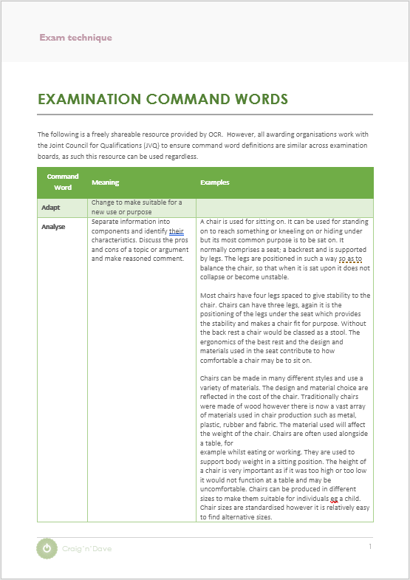
PART 1: COMMAND WORDS
Make sure you understand what the commands words are asking you to do:
Do not explain if you are being told just to identify
Do not simply identify if you are being asked to explain
Do not just explain if you are being asked to analyse!

Slide 11

Guidance for the actual exam
PART 2: EXAM GUIDANCE

Slide 12

PART 2: EXAM GUIDANCE
When you hear those magic words “You may now begin”:
Avoid the temptation to rush in.
Adopt a calm, methodical approach.
Read the instructions carefully
Make sure you understand what you have to do.
“You may now begin”

Slide 13
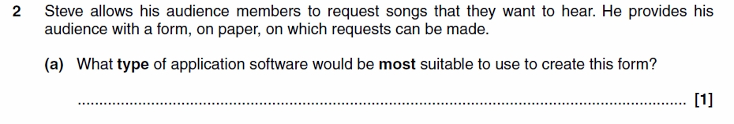
PART 2: EXAM GUIDANCE
Spend the right amount of time on each question:
The GCSE exams are 80 marks and 90 minutes long.
The AS exams are 70 marks and is 75 minutes long.
The A Level exam is 140 marks and is 150 minutes long.
Therefore as a rough guide you should look to spend 1 minute on each question per mark.

Slide 14

PART 2: EXAM GUIDANCE
Look for the questions that relate to those parts of the course you have revised the most.
Read the question carefully before you attempt to answer it.
What exactly is it asking?
Does the question have more than one part?
Make sure to underline or highlight key words. (look for those command words)
Having done all this, is the question about what you think it is?
Make sure to relate your answer to the scenario.

Slide 15

PART 2: EXAM GUIDANCE
If your mind goes blank DON’T PANIC!
If you have a plan you’re less likely to go blank in the middle of a question.
If this happens go on to the next question and come back later to the one you were tackling.

Slide 16
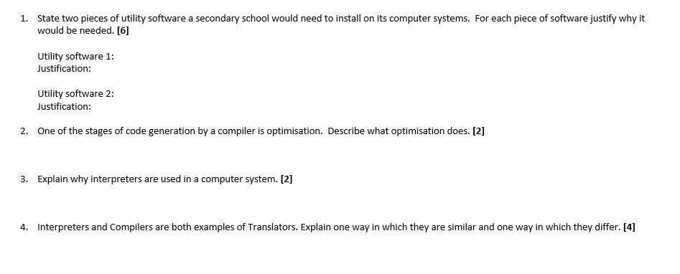
Exam paper tips
PART 3: EXAM PAPER TIPS

Slide 17

PART 3: EXAM PAPER TIPS
Tip 1
Your exam papers are scanned before being marked online by examiners. Therefore make sure to keep your answers written on the lines provided only.
If you can’t do this (maybe because you have crossed out an answer) then:
In the first instance use the continuation pages provided at the back of the exam paper.
If you can’t do this write your answer in any other space provided and note to the examiner on the lines where to find the answer. Even if it looks obvious!
Answer on bottom of page 4

Slide 18

PART 3: EXAM PAPER TIPS
Tip 2
Don’t scridfhj out h wong anser
Don’t scribble out answers you think you got wrong.
Simply cross out the answer neatly so it is still readable.
Examiners can award you marks for crossed out answers if it’s correct and the only one there.
So scribbling it out could end up costing you marks.

Slide 19
PART 3: EXAM PAPER TIPS
Tip 3
It might sound obvious but…
Make sure your handwriting is readable!
Examiners will try hard to read your answers, but if they unable to they can’t award you marks.
Your handwriting can accidently get very scruffy when you are under stress. Pay extra attention to carefully form letters.

Slide 20

PART 3: EXAM PAPER TIPS
Tip 4
Computing exams aren’t English exams.
Examiners don’t really want to have to hunt for marks within rambling paragraphs.
Bullet points are the best way of presenting your answers unless the quality of your written answer is specifically stated as being assessed.
Use a new bullet for each new point you are making, it will help to keep you focused.
Put each bullet point on a new line.

Slide 21
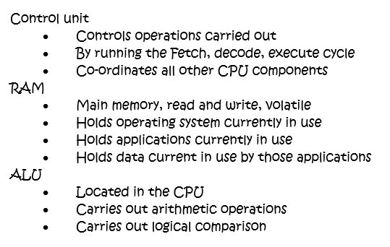
PART 3: EXAM PAPER TIPS
Tip 5
In order to use the bullet point method make headings out of the main parts of the question and then list your points under those headings to answer the question.
So if question asked you to…
Explain the purpose of the Control unit, RAM and the ALU [6]
…you could do this:

Slide 22
PART 3: EXAM PAPER TIPS
Tip 6
Try not to use words that are in the question.
So if a question said:
State the purpose of the arithmetic logic unit.
Don’t then write:
It’s a unit for arithmetic and logic.
You won’t get marks.
Instead you should write:
Performs addition. E.g. x = x +1
Evaluates conditions. E.g. If x>6
Performs binary shifts.

Slide 23

PART 3: EXAM PAPER TIPS
Tip 7
Most questions are presented as part of a scenario.
Make sure your answer and examples are related to that scenario.
You won’t get marks for generic points not related to the scenario.

Slide 24

PART 3: EXAM PAPER TIPS
Tip 8
You can’t simply write down everything you know on a topic in response to a question in hope of getting the marks.
This is called a ‘shopping list’
E.g. List two input devices. [2]
The question is only worth 2 marks.
At least 2 input devices have been listed.
However there are also output and storage devices listed.
This shows a lack of understanding.

Slide 25
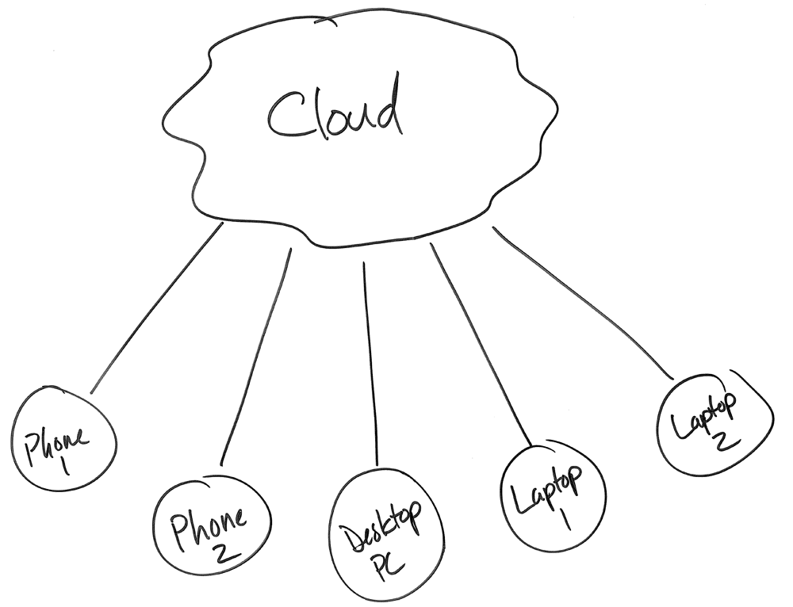
PART 3: EXAM PAPER TIPS
Tip 9
Don’t be afraid to use a diagram instead of text to help explain a concept if you feel it is relevant and you can make all the points you need to gain the marks.
Annotated diagrams can be an excellent way to show your understanding.

Slide 26

PART 3: EXAM PAPER TIPS
Tip 10
If a question has multiple sub parts marked like this i) ii) iii) then you are allowed follow-through.
This means that part ii) will need information from part i)
You might get the answer to part i) incorrect, as long as the method you use in part ii) is correct you will get the marks for using the incorrect answers from part i) in your answer.
This is common in binary based arithmetic questions.

Slide 27
PART 3: EXAM PAPER TIPS
Tip 11
Include examples in your answer that are relevant to the question and scenario.
They demonstrate your understanding.
Examples are often worth an additional mark.
Describe a situation that can cause the processor to stop execution of a current task. [2]
When an interrupt is received on the control bus from another device. E.g. when a file has finished being transferred to RAM.

Slide 28
PART 3: EXAM PAPER TIPS
Tip 12
Don’t repeat the question in your answer.
You are using up valuable time and space for words that will not gain marks.
State one characteristic of random access memory. [1]
One characteristic of random access memory is that it is volatile.

Slide 29

How to tackle those 8+ mark questions
PART 4: TACKLING EXTENDED QUESTIONS

Slide 30
PART 3: EXAM PAPER TIPS
Most exam papers will have extended answer questions worth 8 or more marks.
Don’t get thrown by these questions, they are designed to test higher understanding and to provide you with an opportunity to really demonstrate your knowledge.
In at least one extended question in each paper the quality of your written communication (spelling, punctuation, grammar & technical terms ) will be assessed, these questions are clearly marked.
OCR mark these questions with an asterisk. (*)
AQA state it clearly in the question.

Slide 31
PART 3: EXAM PAPER TIPS
STEP 1: Highlight the command words
STEP 2: Highlight other parts which are important
STEP 3: Identify the scenario
STEP 4: Split the question into multiple parts
Step 1: Highlight the command words
The Internet has had a major effect on society.
Discuss the social and ethical effects on young people of allowing unrestricted
access to The Internet. [8]
Make sure you know what the command words mean.
Command words are guides in the question which identify how the question should be answered.
Discuss means: “Give an account that addresses a range of ideas and arguments.”

Slide 32
PART 3: EXAM PAPER TIPS
STEP 1: Highlight the command words
STEP 2: Highlight other important words
STEP 3: Identify the scenario
STEP 4: Split the question into multiple parts
Step 2: Highlight other important words
The Internet has had a major effect on society.
Discuss the social and ethical effects on young people of allowing unrestricted
access to The Internet. [8]
The question is asking you to talk about the “effects” on young people
So make sure to talk about this.
However, check carefully, it is not that simple, you could still get side-tracked if your answer just becomes about the effects of The Internet on young people.
This question is asking you to be more specific, you must isolate your answers to talking about the effects unrestricted access to The Internet has had on young people.

Slide 33
PART 3: EXAM PAPER TIPS
STEP 1: Highlight the command words
STEP 2: Highlight other parts which are important
STEP 3: Identify the scenario
STEP 4: Split the question into multiple parts
Step 3: Identify the scenario
The Internet has had a major effect on society.
Discuss the social and ethical effects on young people of allowing unrestricted
access to The Internet. [8]
Don’t forget that your arguments and examples must directly relate to the scenario you are given and not just everything you know about a topic.

Slide 34
PART 3: EXAM PAPER TIPS
STEP 1: Highlight the command words
STEP 2: Highlight other parts which are important
STEP 3: Identify the scenario
STEP 4: Split the question into multiple parts
Step 4: Split the question into multiple parts
The Internet has had a major effect on society.
Discuss the social and ethical effects on young people of allowing unrestricted
access to The Internet. [8]
There are actually two questions here:
A discussion of the social effects
A discussion of the ethical effects
The examiner will expect you to divide your response equally between these two parts, so you can’t focus to heavily on one over the other. This has now become two slightly less daunting four-mark questions instead of one eight-mark one.

Slide 35
PART 3: EXAM PAPER TIPS
This four-step process in reality will only take you a minute and will be well worth it in order to make sure you keep your answer focused and on track. So what have we ended up with?
The Internet has had a major effect on society
Discuss the social and ethical effects on young people of allowing unrestricted access to The Internet. [8]
In our head we should now be seeing the following two questions:
1. Give an account that addresses a range of ideas and arguments on the social effects on young people having unrestricted access to The Internet. [4]
2. Give an account that addresses a range of ideas and arguments on the ethical effects on young people having unrestricted access to The Internet. [4]
This is the same question as was presented in the exam paper, however now it is much easier to tackle, you are more likely to keep on point and to make sure you answer all aspects of the question.

Slide 36
PART 3: EXAM PAPER TIPS
We can even take this one step further. Notice how each question asks you for the “effects”.
Effects come in two forms, Positive and Negative.
So we now we have 4 two-mark questions instead of one eight-mark one.
The Internet has had a major effect on society
Discuss the social and ethical effects on young people of allowing unrestricted access to The Internet. [8]
1. Give an account that addresses a range of ideas and arguments on the positive social effects on young people having unrestricted access to The Internet. [2]
2. Give an account that addresses a range of ideas and arguments on the negative social effects on young people having unrestricted access to The Internet. [2]
3. Give an account that addresses a range of ideas and arguments on the positive ethical effects on young people having unrestricted access to The Internet. [2]
4. Give an account that addresses a range of ideas and arguments on the negative ethical effects on young people having unrestricted access to The Internet. [2]

Slide 37

PART 3: EXAM PAPER TIPS
Positive Social Effects:
The Internet has had a major effect on society
Discuss the social and ethical effects on young people of allowing unrestricted access to The Internet. [8]
You can create a writing frame to make it easier to answer all parts of the question.
This will really help show the examiner you have understood the question and make it easier to mark!
It will help you focus and stay on point.
Negative Social Effects:
Positive Ethical Effects:
Negative Ethical Effects:
[8]

Slide 38
PART 3: EXAM PAPER TIPS
Positive Social Effects:
● First positive social effect on young people
The Internet has had a major effect on society
Discuss the social and ethical effects on young people of allowing unrestricted access to The Internet. [8]
Each of these are two-mark questions.
So make sure to make at least two valid points under each heading.
Again, it is ok to use bullet points to help spilt out your points You don’t have to write in paragraphs.
However remember that some of these questions are marked on the quality of your written communication.
Make sure to write in full sentences, and check that spelling and grammar!
● Second positive social effect on young people
Negative Social Effects:
● First negative social effect on young people
● Second negative social effect on young people
Positive Ethical Effects:
● First positive ethical effect on young people
● Second positive ethical effect on young people
Negative Ethical Effects:
● First negative ethical effect on young people
● Second negative ethical effect on young people
[8]

Slide 39
PART 3: EXAM PAPER TIPS
And finally! Don’t panic when you see these extended questions. Be confident:
Take your time to break the question down.
Make a writing frame.
Address all the important key words in the question.
Use subject specific terminology.
Use examples related to the scenario.
Be concise, don’t repeat the question.
Check your spelling, punctuation and grammar.
Make sure your handwriting is easy to read!

