Slide 1

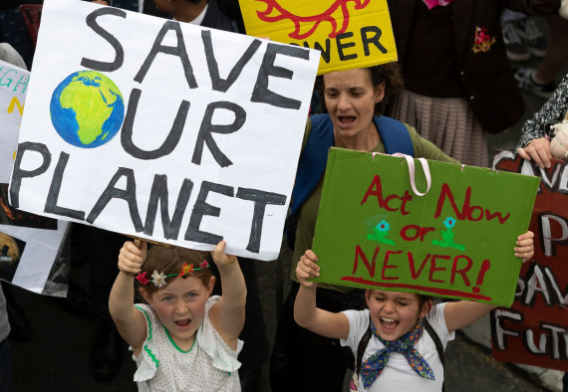
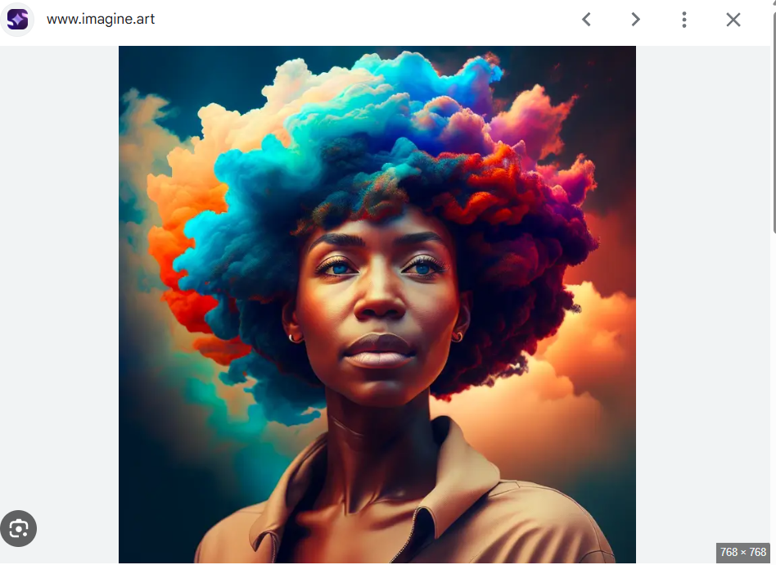



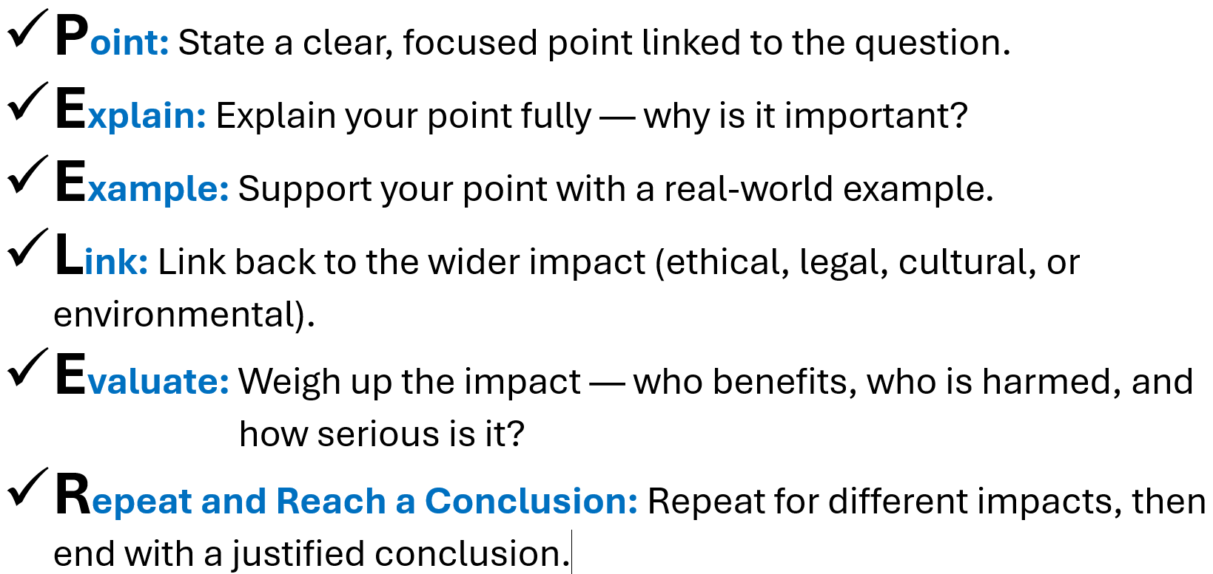

Do Now
Which of these is an example of a legal, ethical, cultural or environmental issue?
“Discuss the environmental impact of increased use of digital devices.”
_______________________________________________________________________________________
_______________________________________________________________________________________
_______________________________________________________________________________________
_______________________________________________________________________________________
_______________________________________________________________________________________
_______________________________________________________________________________________
_______________________________________________________________________________________
_______________________________________________________________________________________
_______________________________________________________________________________________
_______________________________________________________________________________________
_______________________________________________________________________________________
_______________________________________________________________________________________
_______________________________________________________________________________________
_______________________________________________________________________________________
_______________________________________________________________________________________
_______________________________________________________________________________________
_______________________________________________________________________________________
_______________________________________________________________________________________
_______________________________________________________________________________________
_______________________________________________________________________________________
_______________________________________________________________________________________
_______________________________________________________________________________________
_______________________________________________________________________________________
_______________________________________________________________________________________
_______________________________________________________________________________________

Slide 2
12-Mark Planning Grid – Use PEELER to Build Your Extended Response
Question: “Discuss the cultural impact of widespread access to the internet.”
What is one key issue or impact?
_______________________________________________________________________________________
_______________________________________________________________________________________
_______________________________________________________________________________________
What do you mean by that?
_______________________________________________________________________________________
_______________________________________________________________________________________
_______________________________________________________________________________________
Add a real-world case or example.
_______________________________________________________________________________________
_______________________________________________________________________________________
_______________________________________________________________________________________
How does this connect to society, law, culture or the environment?
_______________________________________________________________________________________
_______________________________________________________________________________________
_______________________________________________________________________________________
Is this positive or negative? Who benefits or loses out?
_______________________________________________________________________________________
_______________________________________________________________________________________
_______________________________________________________________________________________
Reach a conclusion. Which impact is most significant and why?
_______________________________________________________________________________________
_______________________________________________________________________________________
_______________________________________________________________________________________

Slide 3
Mark Scheme: Discuss the cultural impact of widespread access to the internet
Use this mark scheme to assess written answers using the PEELER structure. This is designed to support OCR J277 12-mark extended response questions.
Mark Scheme (12 Marks)
0-3 marks: Basic response. One or two simple points made. Little or no explanation. No evaluation or conclusion. May not link to 'cultural impact'.
4-6 marks: Some structure. A few points are made with some explanation. May include a general example. Limited evaluation. Some relevance to the question.
7-9 marks: Good structure. Clear use of PEELER. At least two cultural impacts explored with explanation and examples. Balanced view attempted. A basic conclusion is included.
10-12 marks: Excellent structure and clarity. Detailed explanation of multiple cultural impacts. Good examples used. Clear evaluation with multiple viewpoints considered. Strong, reasoned conclusion linked to the question.
PEELER Checklist
Use this checklist to self-assess or peer-mark:
Clear Point made about a cultural impact
Explanation supports the point
Relevant example included (real or realistic)
Link to cultural change or society shown
Evaluation includes a different perspective or debate
Final Reasoned conclusion included

Slide 4
12-Mark Planning Grid – Use PEELER to Build Your Extended Response
Question: “Discuss the cultural impact of widespread access to the internet.”
What is one key issue or impact?
_______________________________________________________________________________________
_______________________________________________________________________________________
_______________________________________________________________________________________
What do you mean by that?
_______________________________________________________________________________________
_______________________________________________________________________________________
_______________________________________________________________________________________
Add a real-world case or example.
_______________________________________________________________________________________
_______________________________________________________________________________________
_______________________________________________________________________________________
How does this connect to society, law, culture or the environment?
_______________________________________________________________________________________
_______________________________________________________________________________________
_______________________________________________________________________________________
Is this positive or negative? Who benefits or loses out?
_______________________________________________________________________________________
_______________________________________________________________________________________
_______________________________________________________________________________________
Reach a conclusion. Which impact is most significant and why?
_______________________________________________________________________________________
_______________________________________________________________________________________
_______________________________________________________________________________________

Slide 5
Mark Scheme: Evaluate the ethical, legal, and environmental impacts of driverless cars
Use this mark scheme to assess written answers using the PEELER structure. This is designed to support OCR J277 12-mark extended response questions.
Mark Scheme (12 Marks)
0-3 marks: Basic response. One or two simple points made. Little or no explanation. No evaluation or conclusion. May not link clearly to ethical, legal, or environmental impacts.
4-6 marks: Some structure. A few impacts are identified with some explanation. May include a vague or general example. Limited or one-sided evaluation.
7-9 marks: Good structure. Clear use of PEELER. At least two of the three impact areas are discussed with explanation and examples. Balanced view attempted. Basic conclusion is present.
10-12 marks: Excellent structure and clarity. Detailed explanation of all three impact areas. Realistic examples used. Clear evaluation with multiple viewpoints. Strong, reasoned conclusion directly linked to the question.
PEELER Checklist
Use this checklist to self-assess or peer-mark:
Clear Point made about one of the impacts (ethical, legal, or environmental)
Explanation supports the point with specific detail
Relevant example included (real or realistic)
Link made to the wider impact on people, society, or the world
Evaluation includes both benefits and concerns
Final Reasoned conclusion included that answers the question

Slide 6
Evaluate the ethical and legal issues associated with the use of facial recognition technology.
You should refer to:
Possible uses of facial recognition
How data is collected and used
Relevant legal and privacy concerns
[12 marks]
_______________________________________________________________________________________
_______________________________________________________________________________________
_______________________________________________________________________________________
_______________________________________________________________________________________
_______________________________________________________________________________________
_______________________________________________________________________________________
_______________________________________________________________________________________
_______________________________________________________________________________________
_______________________________________________________________________________________
_______________________________________________________________________________________
_______________________________________________________________________________________
_______________________________________________________________________________________
_______________________________________________________________________________________
_______________________________________________________________________________________
_______________________________________________________________________________________
_______________________________________________________________________________________
_______________________________________________________________________________________
_______________________________________________________________________________________
_______________________________________________________________________________________
_______________________________________________________________________________________
_______________________________________________________________________________________
_______________________________________________________________________________________
_______________________________________________________________________________________
_______________________________________________________________________________________
_______________________________________________________________________________________
_______________________________________________________________________________________
_______________________________________________________________________________________
_______________________________________________________________________________________
_______________________________________________________________________________________
_______________________________________________________________________________________
_______________________________________________________________________________________
_______________________________________________________________________________________
_______________________________________________________________________________________
_______________________________________________________________________________________
_______________________________________________________________________________________
_______________________________________________________________________________________
_______________________________________________________________________________________
_______________________________________________________________________________________
_______________________________________________________________________________________
_______________________________________________________________________________________
_______________________________________________________________________________________

Slide 7
Evaluate the environmental and cultural impacts of cloud storage services.
You should refer to:
The energy use of cloud data centres
How cloud storage affects how people access or share data
Possible long-term effects on global culture and the environment
[12 marks]
_______________________________________________________________________________________
_______________________________________________________________________________________
_______________________________________________________________________________________
_______________________________________________________________________________________
_______________________________________________________________________________________
_______________________________________________________________________________________
_______________________________________________________________________________________
_______________________________________________________________________________________
_______________________________________________________________________________________
_______________________________________________________________________________________
_______________________________________________________________________________________
_______________________________________________________________________________________
_______________________________________________________________________________________
_______________________________________________________________________________________
_______________________________________________________________________________________
_______________________________________________________________________________________
_______________________________________________________________________________________
_______________________________________________________________________________________
_______________________________________________________________________________________
_______________________________________________________________________________________
_______________________________________________________________________________________
_______________________________________________________________________________________
_______________________________________________________________________________________
_______________________________________________________________________________________
_______________________________________________________________________________________
_______________________________________________________________________________________
_______________________________________________________________________________________
_______________________________________________________________________________________
_______________________________________________________________________________________
_______________________________________________________________________________________
_______________________________________________________________________________________
_______________________________________________________________________________________
_______________________________________________________________________________________
_______________________________________________________________________________________
_______________________________________________________________________________________
_______________________________________________________________________________________
_______________________________________________________________________________________
_______________________________________________________________________________________
_______________________________________________________________________________________
_______________________________________________________________________________________
_______________________________________________________________________________________

Slide 8
OCR-Style Mark Schemes (12-Mark Questions)
Question 1:
Evaluate the ethical and legal issues associated with the use of facial recognition technology.
[12 marks]
Mark Scheme:
Level 1 (1–3 marks): Basic response
- One or two simple points made - May identify an ethical or legal issue but lacks depth - Little or no use of examples or analysis - May not link clearly to the context of facial recognition
Level 2 (4–6 marks): Limited response
- Some relevant points made with limited explanation - At least one ethical or legal concern described with some clarity - May include a general example - Some awareness of impact or consequence
Level 3 (7–9 marks): Good response
- Clear explanation of ethical and/or legal issues - Relevant examples used - Balanced argument attempted with different perspectives - Some analysis of the impact of facial recognition on individuals or society
Level 4 (10–12 marks): Strong response
- Detailed discussion of both ethical and legal issues - Well-chosen examples clearly support points - Clear evaluation and reasoning with different stakeholder views - Judgement or conclusion directly related to the question

Slide 9
OCR-Style Mark Schemes (12-Mark Questions)
Question 2:
Evaluate the environmental and cultural impacts of cloud storage services.
[12 marks]
Mark Scheme:
Level 1 (1–3 marks): Basic response
- One or two simple points made - May identify an environmental or cultural impact with little explanation - Little or no evaluation or examples
Level 2 (4–6 marks): Limited response
- Some explanation of one or more impacts - May mention data centres or global data access - Limited evaluation, possibly one-sided
Level 3 (7–9 marks): Good response
- Good explanation of both environmental and cultural impacts - Includes relevant and realistic examples - Some evaluation with reference to different perspectives
Level 4 (10–12 marks): Strong response
- Well-developed explanation of both impacts with clear structure - Effective use of examples - Balanced evaluation showing understanding of positive and negative effects - Clear conclusion or judgement

Slide 10
Plenary – PEELER Jungle
Match each sentence below to the correct PEELER step.
Use a line to match them up.
1️⃣ This links to wider environmental concerns, like climate change and sustainable energy use.
2️⃣ Self-driving cars require a lot of energy and data processing, which increases electricity demand.
3️⃣ However, others argue that driverless cars could reduce emissions in the long term by reducing traffic congestion.
4️⃣ One environmental impact of driverless cars is their potential to increase electricity usage.
5️⃣ An example is Tesla’s autopilot vehicles, which rely on constant internet connectivity and sensors powered by electricity.
6️⃣ Overall, while the environmental impact is a concern, future developments in clean energy may help reduce the damage.

