Slide 1
Exam Technique Computer Science Unit 1 - J277
Ethical, Moral, Cultural and Environmental
Essay Practice

Slide 2


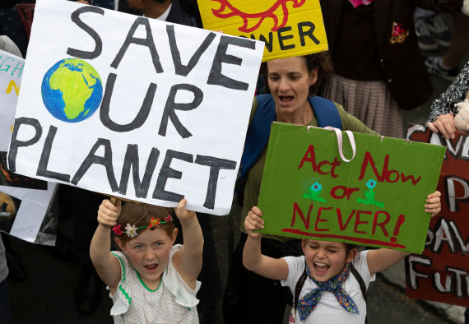

Do Now
Which of these is an example of a legal, ethical, cultural or environmental issue?
Legal
Ethical
Environmental
Cultural

Slide 3
Lesson Objectives
Recall key ethical, legal, cultural, and environmental concerns related to technology
Explain real-world examples of how these issues affect individuals, organisations, and society
Structure a 12-mark extended response using the PEELER method
Evaluate different viewpoints and provide a reasoned conclusion
Improve my exam technique by reviewing and refining my written answer

Slide 4

AO1 – Knowledge and Understanding
Explain clearly. Define accurately.
What it means:
Demonstrating factual knowledge
Explaining concepts and terminology clearly
Showing understanding of how things work

Slide 5

AO2 – Application
Apply what you know to a scenario or problem.
What it means:
Using knowledge in context
Linking theory to real-world systems or examples
Answering scenario-based questions properly

Slide 6
AO3 – Analysis and Evaluation
Think critically. Weigh up pros and cons. Justify your points.
What it means:
Making judgments or comparisons
Evaluating effectiveness or efficiency
Giving reasoned arguments

Slide 7
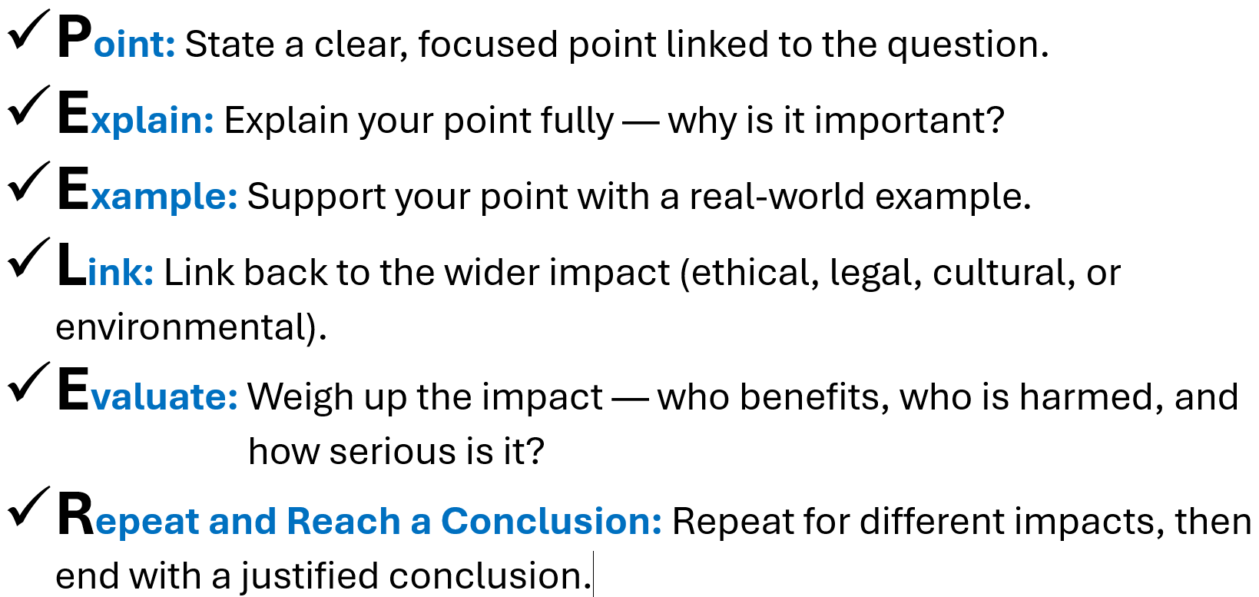
PEELER Method – Essay Technique

Slide 8
PEELER | Explanation | AO Link
P – Point | Make a clear, relevant point | AO1 or AO2
E – Explain | Explain the concept or how it works | AO1
E – Example | Give a relevant, specific example | AO2
L – Link | Link it back to the question or scenario | AO2
E – Evaluate | Weigh up pros/cons, compare, or justify | AO3
R – Repeat | Repeat for another point (if needed) | All

Slide 9
Example PEELER
“Evaluate the ethical, legal, and environmental impacts of driverless cars.”
Point: An ethical concern about driverless cars is how they are programmed to make decisions in dangerous situations.
Explain: Unlike human drivers, autonomous vehicles follow pre-programmed algorithms. In a situation where a crash is unavoidable, the car must decide who to protect — the passengers or someone outside the car.
Example: For example, if a child runs into the road, the car might choose to protect its passengers by not swerving, even if it means hitting the child. This raises serious moral questions.
Link: This links to wider ethical issues around artificial intelligence and whether machines should be allowed to make life-or-death decisions without human input.
Evaluate: Some argue that autonomous vehicles will reduce overall accidents and deaths because they remove human error. However, others believe it's unethical to give full control to machines in situations involving moral judgement.
Repeat and Reach a Conclusion: Overall, while driverless cars could make roads safer, the ethical implications of their decision-making must be addressed. Without clear rules or accountability, the public may not trust or accept the technology.

Slide 10



We now will build a PEELER paragraph together.
“Discuss the environmental impact of increased use of digital devices.”

Slide 11

Task – Using PEELER (Exam Technique) complete the questions on your worksheet.

Slide 12
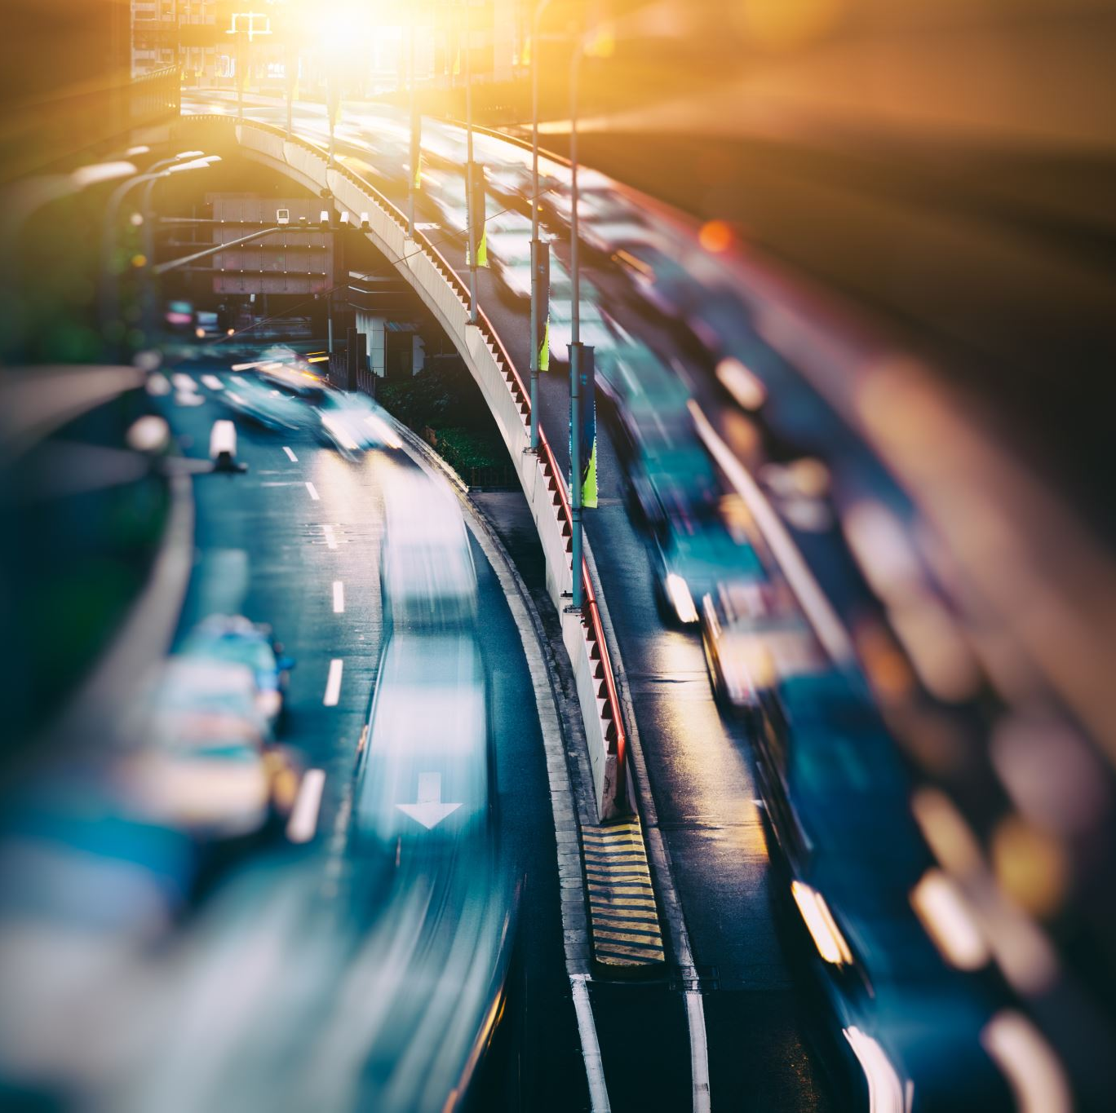
Plenary – PEELER Jumble
1️⃣ This links to wider environmental concerns, like climate change and sustainable energy use.
2️⃣ Self-driving cars require a lot of energy and data processing, which increases electricity demand.
3️⃣ However, others argue that driverless cars could reduce emissions in the long term by reducing traffic congestion.
4️⃣ One environmental impact of driverless cars is their potential to increase electricity usage.
5️⃣ An example is Tesla’s autopilot vehicles, which rely on constant internet connectivity and sensors powered by electricity.
6️⃣ Overall, while the environmental impact is a concern, future developments in clean energy may help reduce the damage.
Notes:
Sentence #PEELER Part 4️⃣🟩 P – Point 2️⃣🟨 E – Explain 5️⃣🟦 E – Example 1️⃣🟥 L – Link 3️⃣🟧 E – Evaluate 6️⃣🟪 R – Reach a conclusion

Slide 13
Plenary – PEELER Jumble
4️⃣ One environmental impact of driverless cars is their potential to increase electricity usage.
2️⃣ Self-driving cars require a lot of energy and data processing, which increases electricity demand.
5️⃣ An example is Tesla’s autopilot vehicles, which rely on constant internet connectivity and sensors powered by electricity.
1️⃣ This links to wider environmental concerns, like climate change and sustainable energy use.
3️⃣ However, others argue that driverless cars could reduce emissions in the long term by reducing traffic congestion.
6️⃣ Overall, while the environmental impact is a concern, future developments in clean energy may help reduce the damage.
Notes:
Sentence #PEELER Part 4️⃣🟩 P – Point 2️⃣🟨 E – Explain 5️⃣🟦 E – Example 1️⃣🟥 L – Link 3️⃣🟧 E – Evaluate 6️⃣🟪 R – Reach a conclusion

