Slide 1
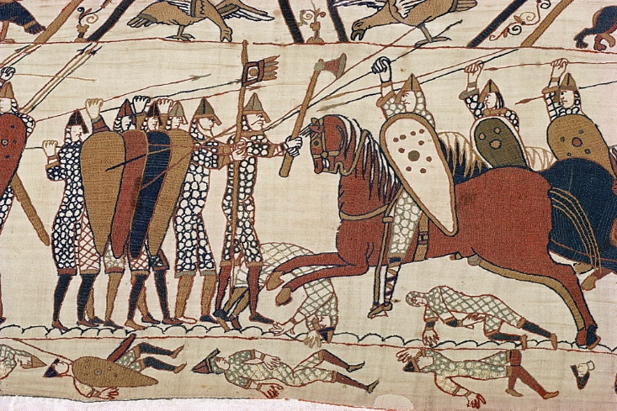
Anglo-Saxon and Norman England, 1060-1088
Key Topic 1: Anglo-Saxon England, 1060-1066
Key Topic 2: William Secures Control, 1066-1087
Key Topic 3: Norman England, 1066-1088
Name:

Slide 2
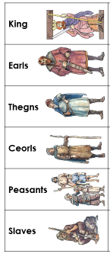
Key Topic 1: Anglo-Saxon England
Anglo-Saxon Society
This was a strict hierarchy, however people could move up or down.
King – defend the country from attack, pass good laws and make sure people obeyed them, control tax, grant and take away land, control earls, power over the Church.
Earls – powerful lords who owned huge areas of land e.g. Wessex, Northumbria, advisors to the king, raised men for king’s army, collected taxes and kept 1/3.
Thegns – noble warriors with small areas of land, local duties such as repairing roads and bridges.
Ceorls – freemen who owned their own small area of farmland.
Peasants – 70% of the population, had to work on the lord’s land every week, on other days they farmed their land.
Slaves – 10% of the population, no freedom and no land.
Villages and Towns
Villages had 12-15 houses; 90% of people lived in villages. Village houses would be one room with a fire in the centre, made from wattle and daub. Villagers would be peasant farmers and there were large numbers of sheep and pigs. Animals would go inside in poor weather. The Church was the most important building.
Towns were surrounded by a burh, a large wall so people could retreat if there was a Viking attack. There was a mint where coins were made, and a marketplace. Markets sold items such as jewellery.

Slide 3
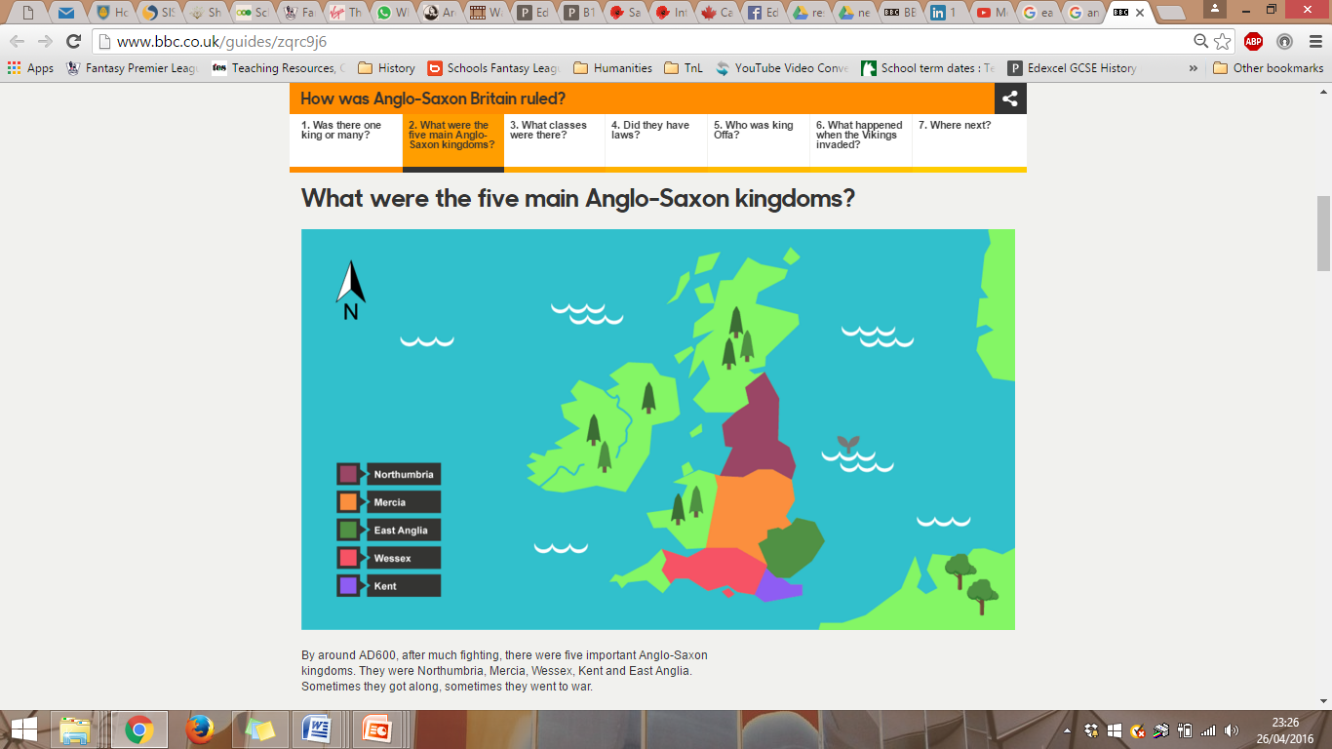
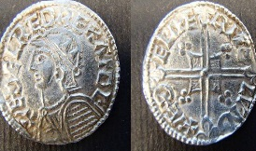
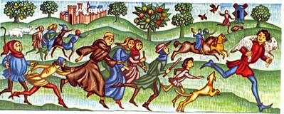
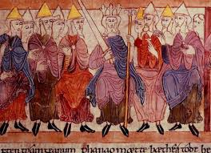
Key Topic 1: Anglo-Saxon England
Local Government
The top layers of government were the earls. The main earldoms were Wessex, East Anglia, Mercia and Northumbria.
Earldoms were divided into shires, and then hundreds. There was a thegn in each shire known as a sheriff who collected taxes, dealt with courts and raised soldiers. Each hundred had about 12 villages.
The Witan
When the king needed advice he would call a meeting of the Witan, this meant Wise Men. It included: earls, thegns, archbishops and bishops. It meant the powerful earls were more likely to support the king.
The Witan’s most important role was in choosing a new king.
The Economy
Most people only grew what they needed. If there was any spare, it would be exchanged and bartered.
Most goods were exchanged using the bartering system, however silver coins did exist but were only used by the wealthy.
Legal System
Wergild – fine paid to the victim of crime of their families. The fine was greater for a nobleman.
Capital Punishment – for a small number of serious crimes e.g. treason.
Corporal Punishment – repeat offenders would be mutilated e.g. hand, ear or nose cut off, eyes put out.
Tithings – groups of 10 men aged over 12 responsible for bringing each other to court.
Hue and Cry – all villagers had to pursue a criminal or face a fine.
Trial by Jury – local villagers would hear both sides of the case.
Trial by Ordeal – if the local jury could not decide then God would decide with either hot water, hot iron, cold water or blessed bread.

Slide 4
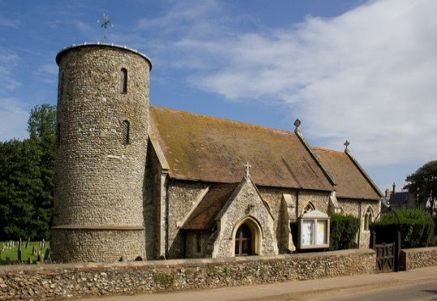
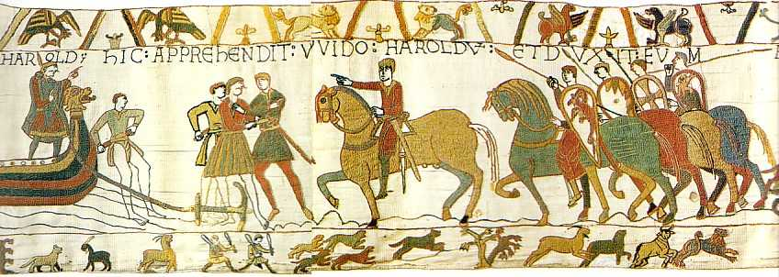
Key Topic 1: Anglo-Saxon England
The Church
There were two archbishops, the Archbishop of York, and the Archbishop of Canterbury called Stigand. They were in charge of the Church.
The Church was very influential as it was rich and powerful, part of government (Witan) and played a big role in everyday life. It owned 25% of the land in England.
Anglo-Saxons believed in Heaven and Hell; this meant the village priest was very important as he would help the villagers get to heaven. Holy Days (holidays) were days off from work, and were looked forward to.
Archbishops
Bishops
Priests
Harold’s Trip to Normandy
In 1064 Harold went to Normandy. Anglo-Saxon and Norman sources disagree on events.
Norman sources state that Harold was sent by Edward to promise William the throne. Harold made a promise on holy relics.
Anglo-Saxon sources rarely mention the trip. If they do they state Harold was asking for the release of family members.
Tostig Godwinson
Tostig had been given Northumbria but this was a difficult area to control. He had to defend against the Scottish and Vikings. He over-taxed the northern people, and was heavy handed in his punishments e.g. murder.
October 1065 thegns rebelled against Tostig. Harold is sent by Edward to look into what is happening and agrees that Morcar (Edwin of Mercia’s brother) will be the new earl. This shows the trust Edward had in Harold but the brothers were enemies.

Slide 5
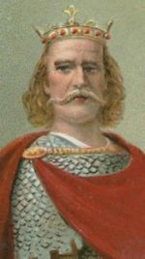
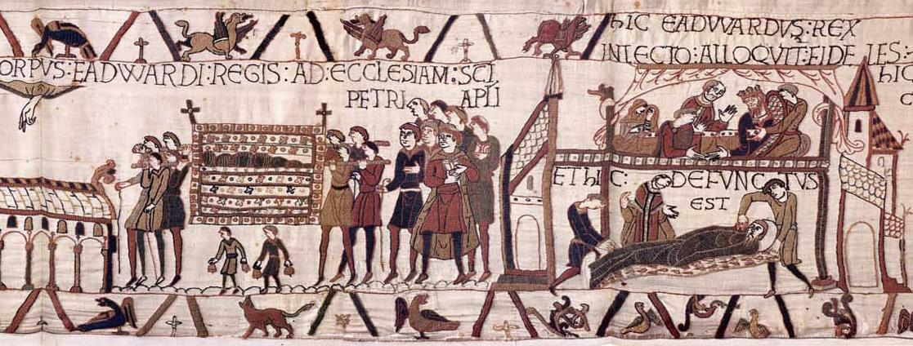
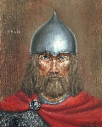
Key Topic 1: Anglo-Saxon England
Power of the House of Godwin
The House of Godwin was very powerful in Anglo-Saxon England.
Allies: Edward the Confessor was married to Edith Godwin. Harold married Edith Swanneck to get influence in the east, but this was unofficial. He later officially married Edith who was Edwin’s sister (Mercia).
Land: Harold owned Wessex, the largest and richest earldom with the capital Winchester. Tostig Godwinson owned Northumbria. Gyrth and Leofwine owned Kent and East Anglia.
Wealth: Wessex produced an income of £8500 a year, Edward the Confessor only received £6000.
Military: Tostig and Harold put an end to rebellions in Wales during the 1060s. Thegns supported them due to this.
Religion: Harold founded an abbey, and received support from bishops winning the support of the Church.
Claimants for the Throne
Edward the Confessor died in January 1066. He had no strong heir however Harold Godwinson was at his bedside when he died and Edward chose him to be the next king. The Witan also chose Harold Godwinson as their next king, and he was crowned the day after Edward died. There were other people who wanted the throne however:
Edgar Aethling: Great-nephew of Edward; no support from earls; only 14 years old.
Harald Hardrada, King of Norway: Promise made to his father, huge amount of military experience, huge wealth, support of Tostig.
William, Duke of Normandy: Experience soldier and ruler, King Edward had promised him the throne in 1051 and Harold promised again in 1064.

Slide 6
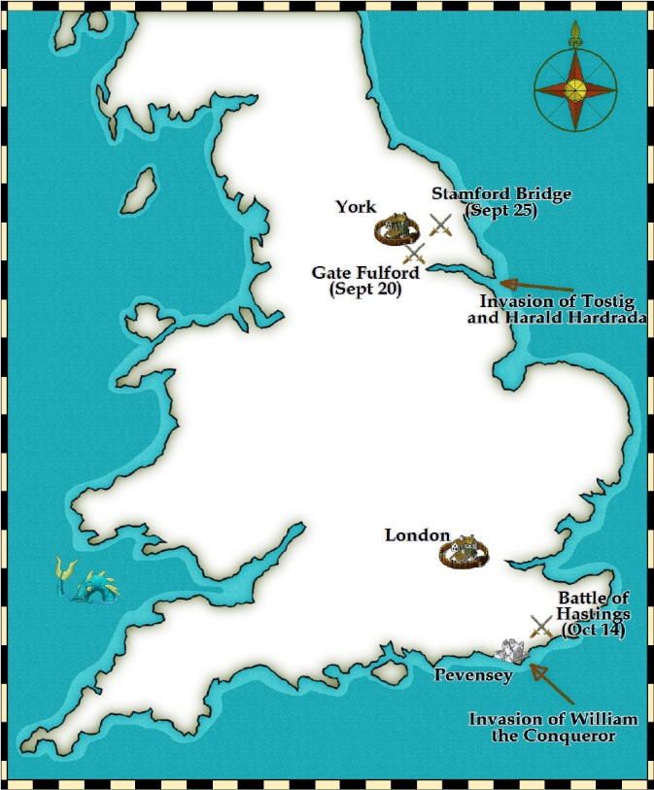
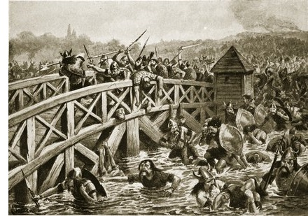
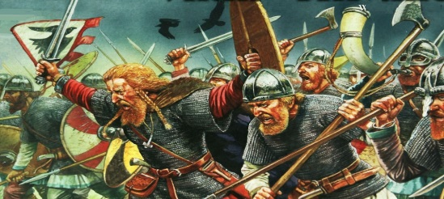
Key Topic 1: Anglo-Saxon England
Battle of Gate Fulford, 20 September 1066
Harald Hardrada and Tostig sailed up the River Humber. Earls Edwin and Morcar gathered an army of 5000 men. They formed a shield wall in a strong position with marsh protecting them to the side and a ford in front.
Hardrada had 10,000 men. The Saxons pushed the Vikings into the marsh to begin with, however Hardrada ordered his men around the Saxons and they were driven into the river or the marshland. The Saxon army was destroyed.
The people of York agreed to hand over money, soldiers and hostages,
Battle of Stamford Bridge, 25 September 1066
Hardrada was waiting for his hostages from York at Stamford Bridge so the Vikings did not have their full army or armour. King Harold attacked after marching north. The Vikings formed a shield wall, and a single Viking warrior held the bridge between the Saxons and Vikings for a long time. It was a savage hand to hand battle. Harold won, and the Vikings only needed 24 of the 300 ships they arrived in. Hardrada and Tostig died.

Slide 7
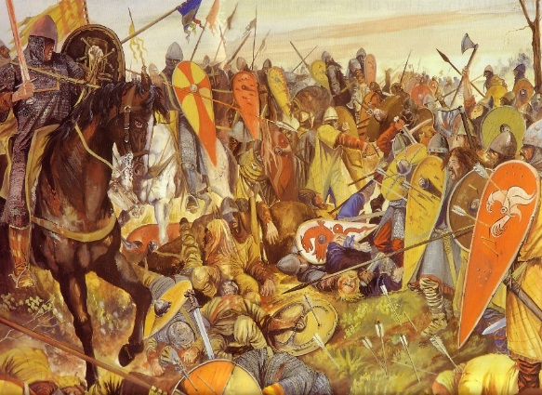
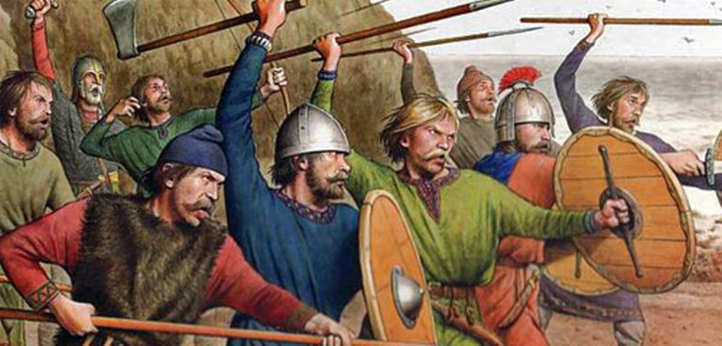
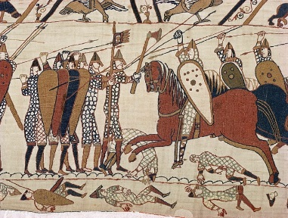
Key Topic 1: Anglo-Saxon England
Battle of Hastings, 14 October 1066
William won the Battle of Hastings for three reasons:
Chance and Luck:
The wind suddenly changed direction allowing William to sail while Harold was fighting in the North.
Harold had to march his tired army south, and had also lost some of his best fighters. Harold was able to form a strong defensive shield wall in a good position at the top of the hill however.
Leadership:
William had kept a huge army fed for many months in Normandy while preparing for the battle.
William got backing from the Pope to further support and gave a strong speech before the battle to prepare his troops. When they believed he was dead he rode through them.
William knew if he did not win before nightfall he would be attacked and so ordered one last strong push focusing on Harold. His archers succeeded in shooting Harold through the eye.
Norman Tactics:
Before the battle the Normans marched inland building motte and bailey castles, plundering the local area. This forced Harold to march south.
The Normans had three types of soldier, archers, foot soldiers and cavalry; in contrast the Anglo-Saxons had the housecarls, but many more general fyrd.
The Normans had 7,500 to Harold’s 6,000 men.
The Normans also used the feigned retreat to trap Anglo-Saxons and make them leave their strong position.

Slide 8
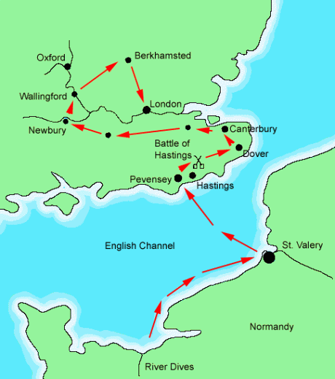
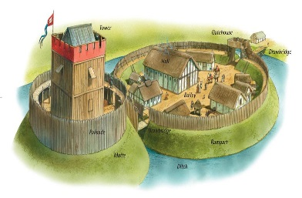

Key Topic 2: William Secures Control
Submission of the Earls, 1066
William had won the Battle of Hastings but was not king yet.
He was expecting the Witan to come and declare him the next King of England but they did not. He went on a slow march to London building motte and bailey castles and harrying the landscape along the way. The Witan, including Stigand, Morcar and Edwin, eventually met him at Berkhamsted where they declared him king.
Motte and Bailey Castles
William built motte and bailey castles to help keep control of the Anglo-Saxons.
They provided a place to keep cavalry safe; horses gave William a huge advantage.
They were placed in strategic positions e.g. at river crossings.
They were intimidating to the English. and could be built very quickly.
Homes were destroyed to make way for castles.
They provided a base to attack and defence from.
Treatment of the English
William wanted the English to believe he was the chosen ruler. Therefore, he did the following:
Allowed thegns to buy back land if they did not fight at Hastings.
Kept Archbishop Stigand in place.
Kept the Witan.
Edwin and Morcar were allowed to keep their land and titles.
Edwin was promised marriage to William’s daughter.

Slide 9
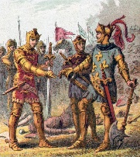
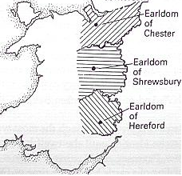
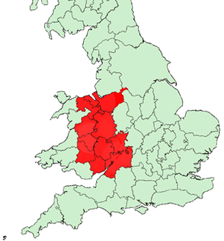
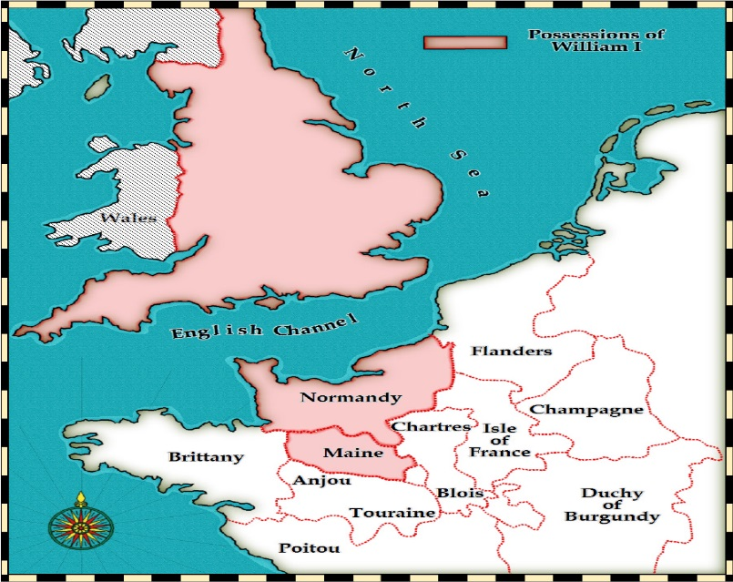
Key Topic 2: William Secures Control
Rewarding Followers
William had to reward his loyal followers who had fought with him at Hastings, therefore he gave them the land of the dead Englishmen. For example, William fitzOsbern received a large amount of Wessex.
Marcher Earldoms
Harold and Tostig had put an end to fighting in the Welsh borderlands in the 1060s. After Hastings, the Welsh started attacking the borderlands.
William created three earldoms, called the Marcher earldoms. These were given to his loyal followers e.g. William fitzOsbern. They were different because:
Tax went directly to the baron.
Barons could build castles.
Sheriffs reported to the barons, not the king.
Control in Normandy
William now had two kingdoms to control, Normandy and England.
To remind the Normans how strong and powerful he was, he took Edwin, Morcar, Edgar Aethling and Stigand on a ‘tour’ of Normandy as his ‘guests’ in 1067.
Odo was left as regent in England.

Slide 10


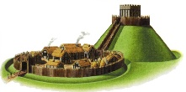
Key Topic 2: William Secures Control
Revolt of Earls Edwin and Morcar, 1068
Edgar Aethling, Northern Rebellions, Early 1069
Causes?
William had promised to marry his daughter to Edwin. This had not happened.
Morcar’s earldom was reduced in size.
There was a huge tax to pay.
Dead nobles’ land had been given away.
English people hated castles.
Causes?
Edgar the Aethling believed that he should be king.
Hatred of the Norman takeover.
Fear of losing land to the Normans.
Hated new Norman leader – Cumin – in the North.
Key events?
Normans were murdered and their leader Cumin was burnt to death.
The new Norman castle in York was attacked.
Key events?
Morcar and Edwin left William’s court. They gathered allies against William.
William’s actions?
Marched his army north.
Took control of Warwick and Nottingham. Built castles in these places.
Destroyed houses and crops called ‘harrying’.
William’s actions?
Marched his army north.
Destroyed homes, farmland and animals in the north.
York destroyed and castles built there.
What happened to the rebels?
The rebels ran away, and Edgar went back to Scotland.
What happened to the rebels?
Edwin and Morcar surrendered quickly. William made them return to court as ‘guests.’

Slide 11
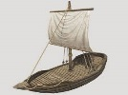
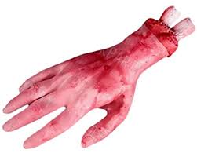

Key Topic 2: William Secures Control
Edgar Aehtling, Northern Rebellions, Summer 1069
Hereward the Wake, Isle of Ely, 1069-1071
Causes?
Edgar the Aethling believed that he should be king.
Hatred of the Norman takeover.
Fear of losing land to the Normans.
Danish support looked likely as the king sent a large invasion force.
Causes?
Lands lost to Norman lords.
Family members murdered by Normans.
Danish returned and set up a base near Ely.
Raided the abbey taking much gold and silver. Hereward had hoped to protect it from the Normans.
Key events?
Danish force met Edgar Aethling.
Anglo-Danish attack on York, 3000 Normans dead.
Rebellions spread.
Key events?
Morcar joined Hereward at Ely, as did other English rebels. They held the island as it was protected by marshland.
William’s actions?
Marched his army north.
Destroyed the north by ‘harrying’ everywhere. Huge amounts of destruction.
Paid the Danish gold to leave.
William’s actions?
William firstly relied on his men in the area, but then marched to Ely.
He paid the Danes off.
A bridge was built but it collapsed.
William then either built a second bridge or locals showed him to the Isle of Ely.
What happened to the rebels?
Edgar the Aethling returned to Scotland.
What happened to the rebels?
Hereward escaped, Morcar was imprisoned. Some rebels had their hands or feet cut off to make sure they did not rebel again.

Slide 12

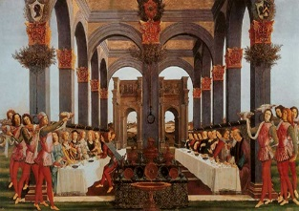
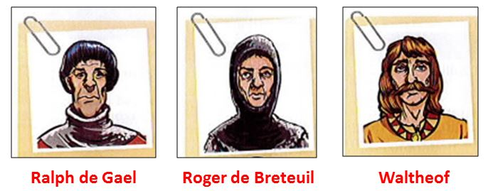
Key Topic 2: William Secures Control
Harrying of the North
William ordered the North to be harried between 1068 and 1070.
100,000 people dead, either through murder or famine.
Livestock killed, crops burnt down, homes burnt down, salt sown into ground.
People ate horses, cats, dogs, even each other.
Thousands of people travelled south.
William was exceptionally cruel.
Value of land in the north dropped as revealed in the Domesday Book.
The Harrying of the North was carried out here due to the constant rebellions William was facing. In Summer 1069, there was the triple threat of Anglo-Saxons, Danish and Scottish.
Revolt of the Earls, 1075
Roger, Ralph and Waltheof (the last Anglo-Saxon earl) plotted to rebel against William at a wedding feast.
They hoped the Danish would support them as they had attacked previously in 1069 and 1071.
They planned their rebellion for when William was away in Normandy. Lanfranc was acting as regent.
Waltheof became scared, and went to Lanfranc and confessed all!
Roger and Ralph continued with the rebellion. They were angry they did not have as much land or power as their fathers.
Odo led troops against Roger and Ralph, and they were defeated. Danish support arrived too late.
Roger was imprisoned, Ralph escaped but Waltheof was executed for the plot!
This event showed William’s strong control, and was the last involvement of the Vikings in England.

Slide 13
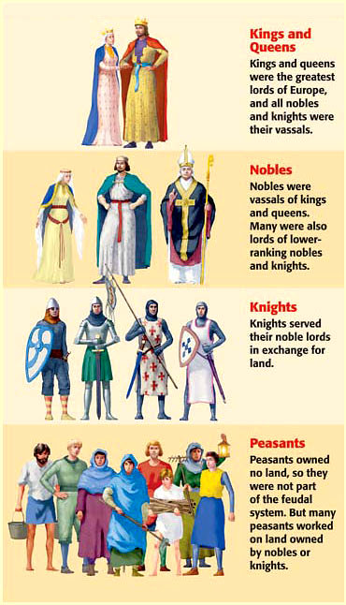
Key Topic 3: Life in Norman England
The Feudal System
The King
William kept 20% of the land in England for himself and 25% of what was left to the church. What was left was given to 190 followers.
The Barons
The King’s followers were called barons, or tenants in chief. They held land directly from the king. In return for their land they took oaths of loyalty to William and promised to give his army money or soldiers. They would also pay tax. They kept some land for themselves and split up the rest into manors, which they gave to their followers, the knights. Anyone who held land in the Feudal system was called a vassal.
The Knights
Knights were also known as under-tenants. In return for their land they took an oath of loyalty to the baron and promised to serve as a knight in the army (on horseback), known as knight service for 40 days a year. They kept some land for themselves and shared the rest between the Saxon peasants, who lived on their manor. The peasants had to farm the knights’ land too.
The Villeins
Saxons became known as villeins. In return for their land they had to obey the lord and give him part of their crops. They also worked without pay on the lord’s land. This was known as labour service. Villeins were not free men – they could not leave the knight’s land without permission. They even needed permission for their sons and daughters to get married!
Homage: A formal ceremony declaring loyalty to the king.
Relief: Money paid to king to keep land.
Forfeiture: Land taken away if a lord was not loyal.

Slide 14
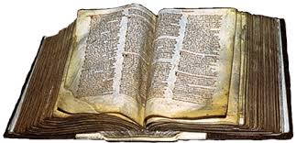
Key Topic 3: Life in Norman England
The Feudal System
Economic Control
William was able to use the feudal system to tax his barons. This meant he had a continuous supply of funds in case of a war.
Military Power
Each lord had to provide knights for William for 40 days a year. William had 4000 knights in total he could call upon.
Political Power
William held all land in the feudal system. Tenants-in-chief had to declare loyalty through homage, pay relief or be punished with forfeiture if they were not loyal.
The Domesday Book
What was it?
1085 William ordered an investigation into land ownership.
Men investigated what taxes were paid.
William was worried about a Danish invasion so wanted to make sure he could collect enough tax.
Written into a book in August 1086, just 8 months after the survey started.
Probably written by an Anglo-Saxon as the spellings are correct.
England’s population to be 2 million.
It showed just 5% of land was held by Saxons.
Significance
Economic Significance - William was extremely powerful and wealthy. He had the power to tax people effectively.
Legal Significance - It includes cases of Anglo-Saxons claiming their land had been taken from them leading to legal disputes being heard.
Military Significance - It was used to see how many knights each tenant-in-chief could provide if the Danes invaded.

Slide 15
Key Topic 3: Life in Norman England
The Church
Why was the Church important?
It helped control society by teaching the king was in charge, and was central to society. It was the place where marriages were held and people would go to on the weekend.
The government needed the Church as they were the only people who could read and write.
Bishops and archbishops provided the king with advice.
The Church owned a lot of land, collected taxes and paid taxes.
Why did William want to change the Anglo-Saxon Church?
Archbishop Stigand had crowned Harold King of England.
Stigand help two positions, Archbishop of Canterbury and Bishop of Winchester. This was not allowed. Many priests and bishops did this.
Church posts would be given to family members.
Church posts would be sold.
Therefore, William replace Stigand with Lanfranc as Archbishop of Canterbury.
Archdeacons were bought in to control parish priests. This added layer of control.
After Stigand was removed, only one Anglo-Saxon bishop remained.
William decided to remove Anglo-Saxon bishops during the rebellions. He wanted loyal people.
Priests had to be celibate. Marriage for priests was banned. Those who worked in cathedrals were told to give up their wives or their job!
Lanfranc made the Council of Bishops meet more regularly and used them to make sure his rules were followed.
The king appointed new bishops. Under the Feudal System Church leaders could lose their land if they disobeyed him.
Lanfranc wanted Church members to be spiritual, and hated the Anglo-Saxon Church for its corruption.
Every church and cathedral was rebuilt in the Norman style. These were glorious buildings to the Anglo-Saxons.
The number of monasteries increased. Monks no longer mixed with ordinary people.

Slide 16
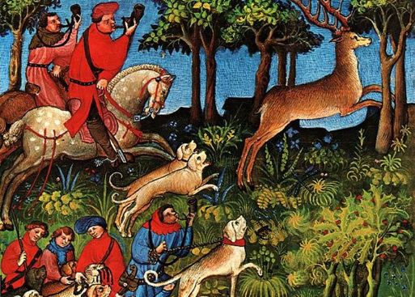

Key Topic 3: Life in Norman England
Changes and Continuities
Changes
As William held land in two countries, he had to appoint regents (Odo, Lanfranc, fitzOsbern).
Trade grew with Normandy, and declined with Scandinavia.
New French communities in Southampton and Nottingham.
Slavery disappeared.
Language slowly adopted French words.
Many villages in the north were destroyed during the harrying.
Forest Laws were introduced. These were areas reserved for hunting. Villagers were moved out (e.g. New Forest) and had harsh punishments if they were caught hunting or chopping down wood (e.g. eyes put out).
Trial by combat introduced.
Wergild no longer paid to victim’s families but to William.
Introduction of Church courts which were more lenient.
William held all the land in England, known as the Royal Demense. This gave him huge amounts of power.
Changes
The power of the earls was reduced. They were given much less land.
Sheriffs could keep part of what they taxed, so many created larger taxes. English sheriffs were replaced with Norman ones.
Continuity
William kept the title of earl for the nobles.
Trial by ordeal remained (hot iron, cold water and hot water).
Harsh punishments were used including execution.
The hue and cry and tithings continued as previously.
Sheriffs, the official in each county carried out the king’s instructions. He collected taxes and fines, punished criminals and raised soldiers.

Slide 17
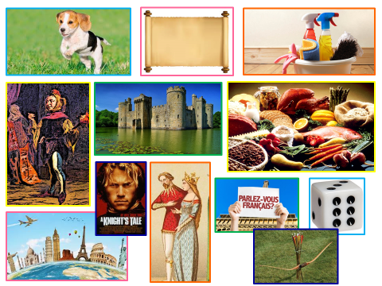
Key Topic 3: Life in Norman England
The Norman Aristocracy
Lords were generous to their knights, giving them gifts of war horses and dogs.
Lords did not write but they would read important documents, written in Latin.
Children were taught good manners, and the importance of being clean.
Jesters sand and played music in the castles.
Lords built huge stone castles and cathedrals to show their wealth.
Lords believed they were superior. They showed off their wealth with furs and silks.
Lords only ate the best foods, and were served first at meals.
Lords only spoke French.
Chess and dice were common games.
Norman lords travelled between England and Normandy.
Boys were trained to be knights from the age of 7. Being knighted was hugely important.
Hunting was the nobles favourite activity. It was good preparation for war.
Land: Norman lords would try and pass their land onto one heir, so it was kept together ensuring strength and power.

Slide 18
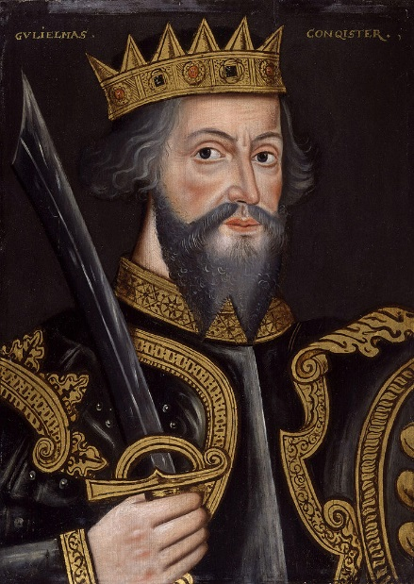
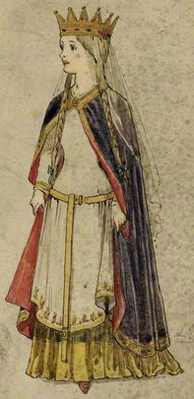
Key Topic 3: Life in Norman England
Bishop Odo
Successes
Half-brother to William, so given the position of Bishop of Bayeux. This was an important role.
Ordered the Bayeux Tapestry to be sewn after the Battle of Hastings.
Paid for 100 ships to bring over Norman troops before Hastings.
Experienced military leader.
Given land worth £3000 after Hastings; only William richer.
Earl of Kent; an important area that needed defending against the Danish.
Appointed regent.
Led an army to defeat the Revolt of the Earls, 1075.
Failures
Treated the people of Kent unkindly, taking land and giving heavy taxes.
Did a poor job of being regent between 1068 and 1071, rebellions broke out.
Planned a military trip to Italy as he hoped to be made Pope. William ordered him to stop but he did not so was imprisoned.
Planned a rebellion against William Rufus that failed in 1088.
Died on his way to a crusade.
Key Characteristics of William
William loved his wife Matilda very much, and trusted her leaving her to be regent in Normandy.
William became Duke of Normandy when he was 7.
William had to fight for control of Normandy, and won age 20.
William was very harsh on rebels, even in France e.g. chopping off villagers feet.
Deeply religious, building cathedrals.

Slide 19
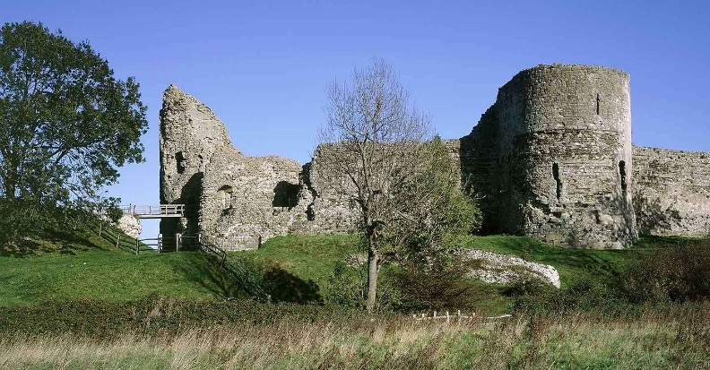
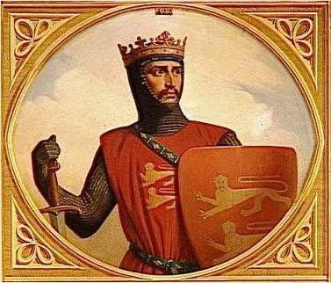
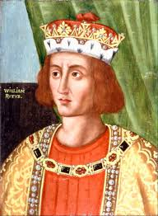

Key Topic 3: Life in Norman England
Robert’s Revolt in Normandy, 1078-1080
Causes
William I had mocked Robert his whole life, calling him ‘Curthose’ meaning short-pants.
William favoured his second son, William Rufus,
There was tension between Rufus and Robert; Rufus weed on Robert’s head.
William I left Matilda as regent in Normandy.
Robert wanted more land and power than he had.
Key Events
Robert tried to take one of William’s castles and failed.
Robert was then given control of a castle over the border in France.
From this castle Robert launched raids into Normandy.
William I lay siege to the castle. He fought with Robert, but was wounded and Robert won.
William Rufus
Robert Curthose
Consequences
Robert was named heir of Normandy.
William looked like a weak leader.
Robert out down the Scottish rebellion.
In 1087, when William died, Robert became Duke of Normandy, and Rufus King of England.
Reasons for Peace
Matilda wanted peace be-tween her husband and son.
The Scottish invaded England.
Robert had rebelled with young Norman nobles; families wanted to be reunited,

Slide 20
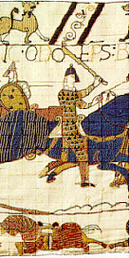
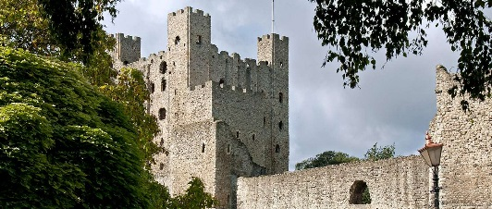
Key Topic 3: Life in Norman England
Disputed Succession
By 1087 William was very fat. He injured himself whilst fighting, and slowly passed away in Normandy. He wanted Rufus to rule England, so gave him a letter addressed to Lanfranc telling him to crown Rufus. Rufus travelled to England, took control of the money kept at Winchester, and was crowned King of England. In 1088, there was a rebellion against Rufus!
Causes
William did not trust Robert to lead England after their fight in 1080.
William’s favourite son was Rufus.
Nobles were concerned that Rufus looked like he would be a powerful leader threatening them.
The nobles hoped to control Robert, who was weaker.
The nobles wanted England and Normandy under the same king. Many owned land in both countries.
Why did Rufus succeed?
The English barons supported Rufus.
The English fyrd fought for Rufus.
Rufus marched directly to Odo forcing him to surrender.
Robert failed to invade from Normandy.
Rufus treated the rebels generously to ensure future support.
Key Events
Odo was released from prison and led a rebellion against Rufus in support of Robert.
There were areas of rebellion around the country.
Rufus marched directly to Rochester where Odo was and captured him. He was banished.

