Slide 1
A Level English Language
Paper 2 Revision
Diversity and Change
Change Related Revision

Slide 2
Language Change

Slide 3
Useful Theorists
Language Change
Name | Year | Background | Brief Overview of Study
Jean Aitchison | 1997 | Linguist | Progress or Decay? 3 Metaphors = Castle / Damp Spoon / Disease
Braj Kachru | 1982 | Linguist | 3 Circles Model of World English - Inner / Outer / Expanding
David Crystal | 1997 | Linguist | 3 Futures of English - Disintegration / Uniformity / Bidialectalism
Tom McArthur | 1987 | Linguist | McArthur's Circle of World Englishes Model
M.A.K. Halliday | 1961 | Linguist | Language changes to suit the needs of its users - Functional Theory
Charles Hockett | 1958 | Linguist | Random Fluctuation Theory - No pattern / happens by accident
Peter Strevens | 1980 | Linguist | Distribution of English from the BrE and AmE branches - 'Family Tree'
Edgar Schneider | 2007 | Linguist | Dynamic Model: P1: Foundation P3: Nativisation P5: Differentiation
Donald Mackinnon | 1996 | Linguist | Attitudes towards change: pleasant or ugly / correct or incorrect etc.
Charles Bailey | 1973 | Linguist | Wave Theory - Further away change spreads from source the weaker
Matthew Chen | 1972 | Linguist | S' Curve - Change rapidly rises and then speed of change slows
Wilhelm Von Humboldt | 1836 | Philosopher | Language never truly stands still…continous process of development
Sarah Thomason | 2001 | Linguist | Substratum - Language changes primarily through contact with countries

Slide 4
Cycle of Change:
Language is in a permanent state of flux. Language Change is inevitable.
Words are created or repurposed and used by a small group of people. Perhaps they appear in social media. E.g. slang terms.
Words become more ‘vogue’ (heard everywhere) and are used by a wider range of social groups – perhaps seen in the media.
Words become officially validated and are recognised formally in the dictionary and other official sources.
Words begin to fall out of common usage. They may become archaic and removed from the dictionary. Alternatively, they may acquire a new meaning and begin the cycle all over again.
4
1
3
2

Slide 5
Reasons for language change:
Individuals – Chaucer and Shakespeare
Technology – Internet etc needing new lexis
Society – Cultural changes and shifts in attitudes requiring new lexis e.g. Political Correctness
Foreign Influence – e.g. America through film or trade
Science – new inventions requiring new lexis
Travel, trade and colonisation – require new lexis and shared lexis to barter and trade
Globalisation – English becoming language of trade and business – new forms created (Spanglish / Hinglish)

Slide 6
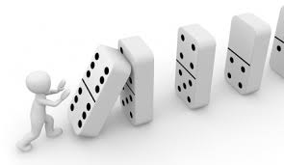
Causes of language change:
Ease of Articulation – Some words change to make them physically easier to say. Usually such changes involve either omission or assimilation.
Standardisation – This occurs when we change language in order to make it more consistent.
Social Influences – Language change often reflects changes in society. There may be a need for new meanings e.g. new inventions or ideas. Words that are no longer needed fall out of use. Some changes are motivated by the wish to be different or fashionable e.g. slang expressions.
Influence of other languages – Contact with other languages can bring about language change. Contact can take many forms: military invasion, immigration, trading links, cultural products (films and television), social and economic power.

Slide 7
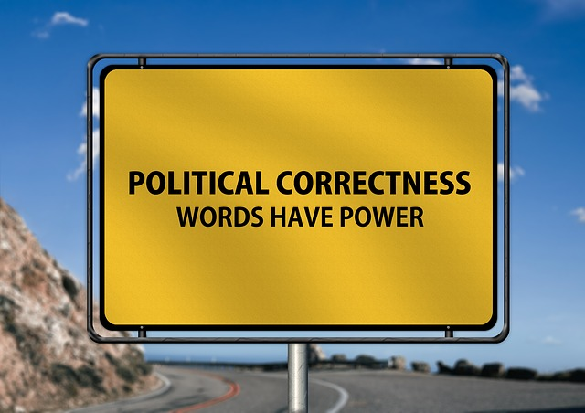
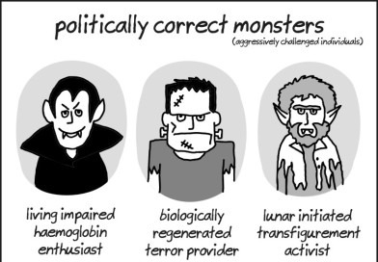
Political Correctness:
Refrain from causing emotional harm
Fit into society free of isolation
Well intentioned
However… gone too far? - ‘vertically challenged’ for short

Slide 8
Attitudes towards language change:
Prescriptivism – dictate how language should be used
(Want language to remain same and refrain from change)
Descriptivism – accept language change is inevitable and accept change
Progress or Decay? Is language in decline (declinism) or is it becoming more accurate and efficient? Jean Aitchison wrote a whole book on this issue.

Slide 9
Taboo
Used for comedic effect
Convergence or divergence – conform to more dialectical lexis to fit in or show separate from others
Used as filler or to show pain and displeasure
Negative views towards taboo
Too much on TV
However, shows reality to modern language in Britain

Slide 10
Lexical Change
Neologisms
Completely new words

Slide 11
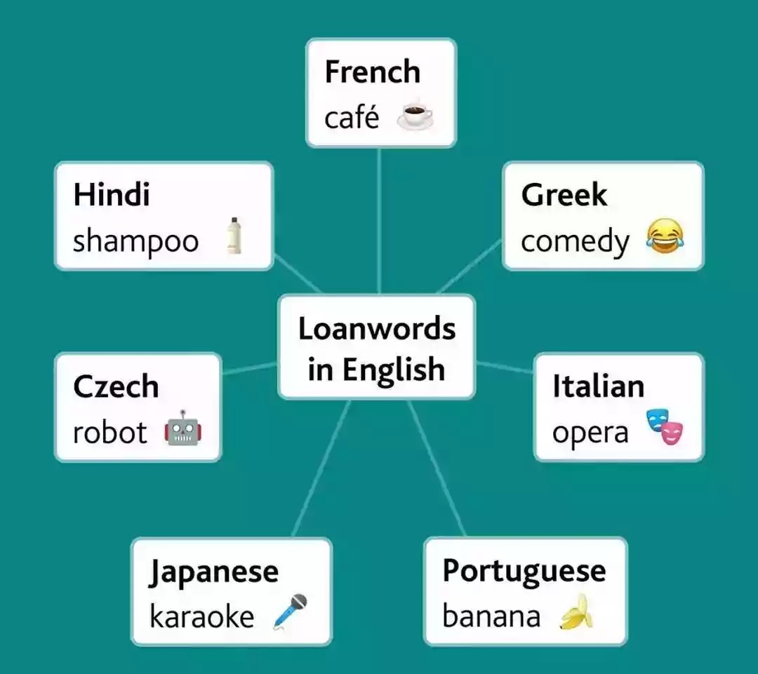
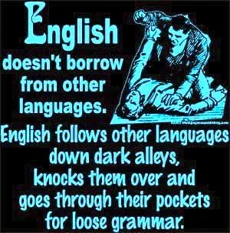
Lexical Change
Words from other languages - Borrowings
Loans taken from foreign languages
E.g. ‘Judge’ from French

Slide 12
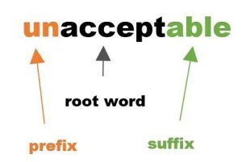
Lexical Change
Words formed from existing words - Affixation
Adding affix (prefix [beginning] or suffix [end]) to an existing word - e.g. ‘Racism’ and ‘sexism’ or ‘international’ and ‘unhappy’
Words formed from existing words - Conversion
Changing of word class - e.g. Noun to verb – ‘Text’ was noun now verb of ‘to text’ or ‘Google’ (n) to ‘Google’ (v)

Slide 13
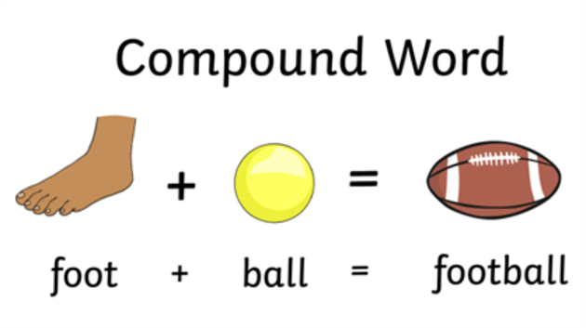
Lexical Change
Words formed from existing words - Compounding
Two words are combined in their entirety to make a new word
e.g. ‘Lap-top’ and ‘Happy-hour’
Words formed from existing words - Blending
Two words parts are moulded together to form a new word, usually by adding the start of one word and the end of another
e.g. ‘Smog’ – smoke and fog and ‘Motel’ – motor and hotel

Slide 14
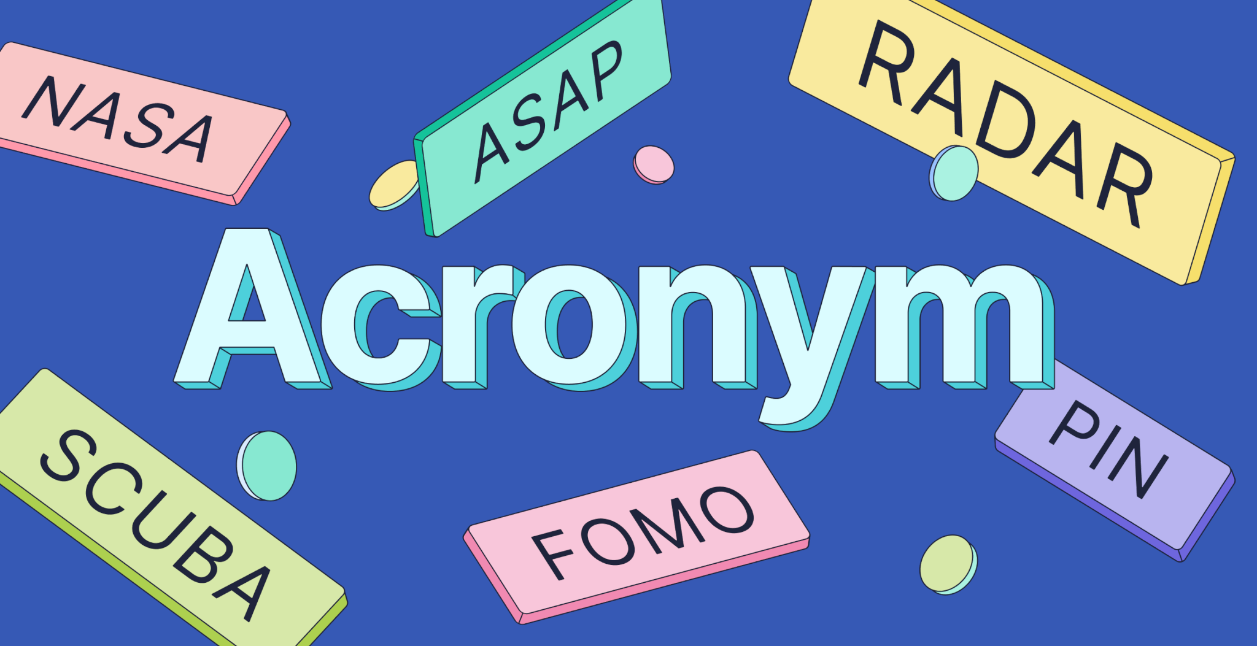
Lexical Change
Words formed by shortening – Shortening or abbreviation
Clipping part of a word
e.g. television to ‘tele’ or refrigerator to ‘fridge’
e.g. Omnibus to ‘bus’ and Public house to ‘pub’
Words formed by shortening - Acronym
Taking initial letters of words and making them into a combination of pronounceable as a new word
e.g. NATO, NASA, AIDS, WAG, Scuba, Laser

Slide 15
Lexical Change
Words formed by shortening – Initialism
Words abbreviated to initial letter - E.g. B.B.C., F.B.I., U.S.A.
Words formed by shortening – Eponyms (Words from names)
Derived from names or places synonymous with the product
e.g. ‘Hoover’ instead of saying Vacuum Cleaner.
Denim – place in France – ‘De Nimes’
Sandwich – after Earl of Sandwich

Slide 16
Lexical Change
Words formed by shortening – Back Formation
A particular kind of shortening in which a word of one type (usually a noun) is shortened to form a word of another type (usually a verb)
e.g. ‘edit’ came to exist from ‘editor’ / ‘donate’ from ‘donation’ / ‘burgle’ from ‘burglar’

Slide 17
Semantic Change
Broadening / Generalisation
Meaning of a word broadens so as it retains old meaning but takes on new meanings as well
e.g. ‘Mouse’ – was animal now computer equipment also
or ‘Holiday’ used to refer to days taken off as ‘holy days’ only

Slide 18
Semantic Change
Narrowing / Specialisation
Is the opposite of broadening
Applies when word becomes more specific in its meaning, but again can retain the original meaning as well
e.g. ‘Meat’ – meant all food, now flesh of animals
‘Girl’ – Middle Ages meant all young people, now just females

Slide 19
Semantic Change
Amelioration
Word has taken on a more pleasant or positive meaning than originally held
e.g. ‘Wicked’ – still means evil, but is now modern slang of good
‘Pretty’ – Middle Ages meant sly or cunning now beautiful
‘Sick’ – means vomit, but also now apparently is slang for good

Slide 20
Semantic Change
Pejoration
Opposite to amelioration
Words original meaning becomes less favourable
E.g. ‘awful’ – originally 'worthy of awe' now 'exceedingly bad’
‘Cowboy’ – originally a hero character, now someone who conducts a task badly i.e. cowboy builder

Slide 21
Semantic Change
Weakening
When a word loses emphasis and impact over time
E.g. ‘soon’ – originally meant ‘immediately’ now just ‘anytime with no fixed limit’
You may be waiting a while is you asked – “Please can you pass the salt soon?” ☺

Slide 22
Semantic Change
Figurative Language - Metaphors
Words take on new meanings when begin to be used metaphorically
E.g. ‘Cow’ – bitchy female and ‘Catty’ – female
Figurative Language - Idioms
Formed from existing words but assume new meanings often as fixed frame forms
Can only be properly interpreted by learning what the whole frame means. Very difficult for those learning English as a Second Language
E.g. ‘In the dog house’, ‘under the weather’ and ‘Over the moon’

Slide 23
Semantic Change
Euphemism
Polite way of describing something unpleasant, embarrassing or socially undesirable
More politically correct
E.g. ‘Friendly fire’, ‘Collateral damage’, ‘Letting you go’ and ‘Passed away’
Dysphemism
A blunt and uncaring way of describing something unpleasant, embarrassing or socially undesirable
Less politically correct
E.g. ‘Murderous massacre’, ‘You’re fired!’ and ‘Kicked the bucket’

Slide 24
Phonological Change
Great Vowel Shift (1400-1600)
Dramatic and important example of sound change.
Happened over a 200 year period (approximately)
The pronunciation of long vowel sounds changed, being replaced into what have today
Thousands of words affected. Examples include:
Modern English word: | Middle English pronunciation:
to | toe
wife | weef
mouse | moos
been | bayn
her | heer

Slide 25
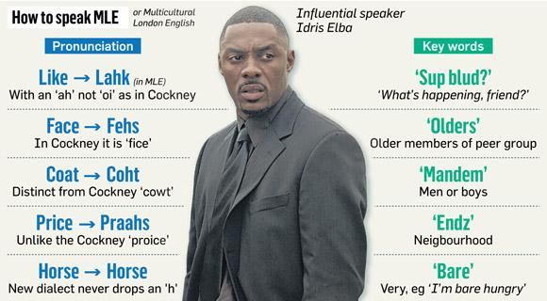
Phonological Change
Recent British Examples
Spread of Estuary English (1990s+)
e.g. ‘waaw’ (wall), ‘auwfuw’ (awful), ‘cauwt’ (caught) and ‘miwk’ (milk)
Spread of Multicultural London English (beyond London)

Slide 26
Phonological Change
William Labov – Martha’s Vineyard (1963)
Research carried out at Martha’s Vineyard (Island north-east coast of the United States).
Island has a small resident population, but also a popular holiday resort visited by thousands of Americans.
Labov found that the pronunciation of certain vowel sounds was subtly changing, shifting away from the standard American pronunciation.
The source seemed to be the island’s fishermen.
The local accent had always differed slightly from mainland U.S.
However, in the speech of the fishermen the differences were becoming stronger.
After the fisherman, the people whose speech was most affected were resident islanders aged 30-45.

Slide 27
Phonological Change
William Labov – Martha’s Vineyard (1963) continued…
Labov believed that the inhabitants of the island were speaking differently to distance themselves from the ‘outsiders’ who holidayed on the island.
The fishermen (a tightly knit social group) were especially resentful of the summer influx of visitors.
The 30-45 year olds imitated their speech (fishermen) in order to show that they too regarded themselves as true, loyal islanders.
Labov found that the islanders were apparently not conscious that their speech was changing. They were not altering their pronunciation deliberately.
Labov refers to this unconscious change as ‘change from below’ (the level of consciousness – you don’t know you are doing it).
‘Change from above’ (the level of consciousness – you do know you are doing it) is the opposite.

Slide 28
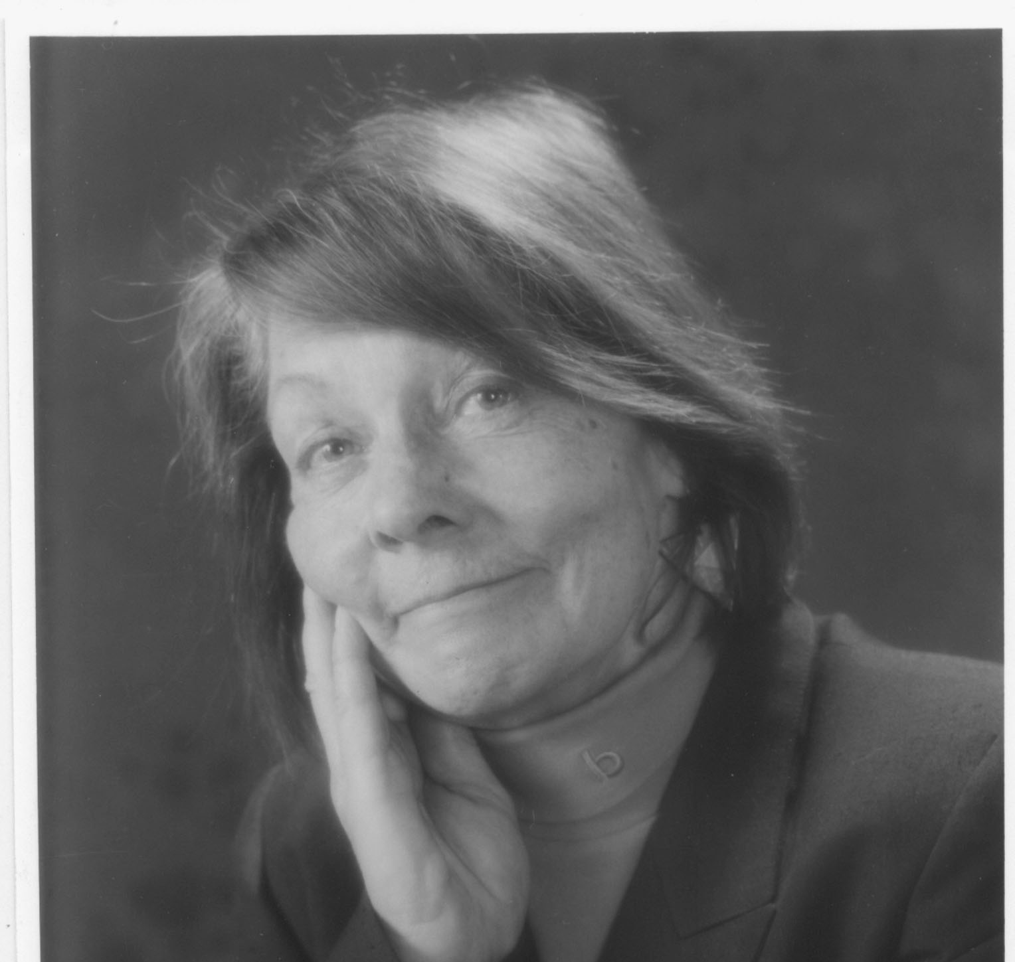
Phonological Change
Jean Aitchison – Stages of Phonological Change (1991)
Stage 1 = The speech of a particular social group differs in some way from the usual pronunciation of the area in which they live.
Stage 2 = A second social group begins – possibly unconsciously – to imitate the speech of the first group.
Stage 3 = The new pronunciation becomes established among the second group – it is now part of their usual accent.
Stage 4 = A third social group now begins to model itself on the second group, and the process repeats itself.

Slide 29
Grammatical Change
General Points
Grammar in the last few hundred years has been relatively stable – although it can and does still happen.
It has changed considerably since the Old English period, but these changes occurred before the end of the Middle Ages.
In the 18th and 19th centuries vigorous attempts to ‘fix’ the rules of grammar e.g. Dr Robert Lowth 1762 – A Short Introduction to English Grammar.
The above explains why grammar is more resistant to change than vocabulary and phonology.

Slide 30
Grammatical Change
Word Endings (Inflections)
One of the most important developments in language since Old English has been the loss of inflections.
Inflections indicate the grammatical form of a word.
Most inflections involve the ends of words.
There used to be many more inflections than there are now.
Nowadays majority of nouns change from singular to plural by the simple addition of ‘-s’ e.g. ‘pen’ to ‘pens’
Examples below:
Present Day English | Old English
Hand | Handa
Early Modern English
‘-st’ ending e.g. ‘dost’
‘-th’ ending e.g. ‘doth’
Present Day English | Middle English
Eye | Eyen

Slide 31
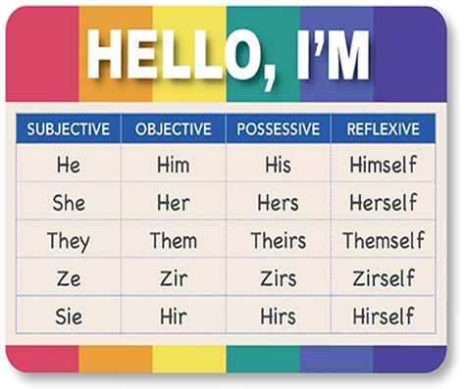
Grammatical Change
Pronouns
We still use these in Present Day English e.g. ‘I’, ‘Me’, ‘You’, ‘Them’
However, the pronouns ‘thou’, ‘thee’ and ‘thine’ have generally disappeared from English.
In some regional dialects a distinction still exists between singular and plural second person pronouns e.g. ‘youse’ (scouse – Liverpool) as a plural word.

Slide 32
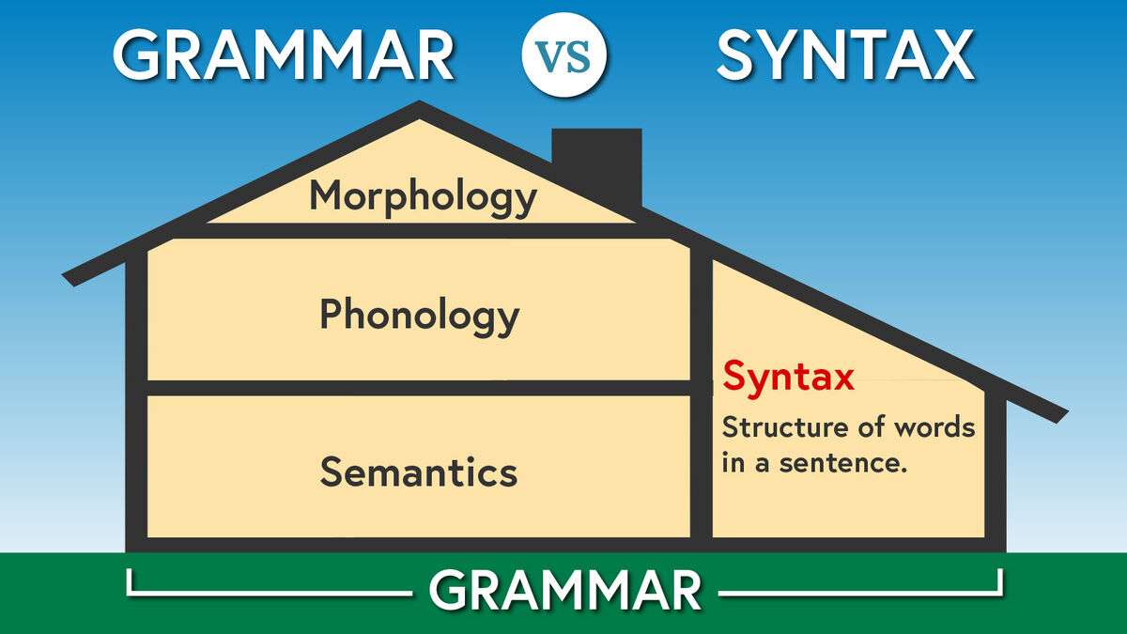
Grammatical Change
Word Order (Syntax)
In Old English the construction of sentences was freer and word order showed more variation.
Due to grammatical functions of words being mainly indicated by inflections, expression of meaning was less dependent on word order.
In Present Day English word order is less flexible (Subject, Verb, Object), but there is still some variation. For example, some might say: “she gave me it”, others might say: “she gave it me”.

Slide 33
Grammatical Change
Negative Constructions
Today, multiple negatives (as in the double negative “I don’t want nothing”) are considered incorrect grammar.
However, in the past they were considered quite acceptable and used for emphasis.
For example, they were used in Chaucer’s The Canterbury Tales, written in the 14th Century: “Ther nas no man nowher so vertuous” (“Ther nas” = There was not).
An informal negative construction that originated in the United States in the 1990s was the addition of ‘not’ at the end of a positive statement so that the earlier part of the sentence becomes ironic.
For example: “Your hair really suits you… not!”.

Slide 34
Graphological Change
How has what texts look like changed?
The appearance of letters has changed over time – 200 years ago many letters looked different. The letter ‘s’ was written as ‘∫’. Typefaces have also changed.
Newspaper layout has changed in terms of design over the last 100 years. More images and larger text are a couple of advancements.
Magazine layouts have also changed – there is far less texts these days in favour of glossy full page images.
The graphology of modern books typically has one column of text, whereas in the past books had two columns to a page.
Electronic media has changed the appearance of written communication – publishers are far more creative using animated text, links and embedding videos. Different fonts are far easier to select.

Slide 35
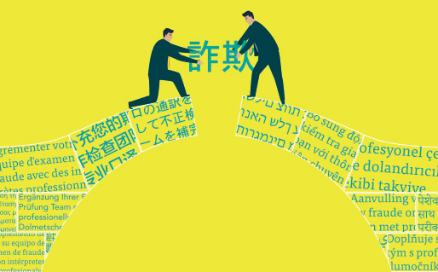
World Englishes
Key Terms
Lingua Franca – a language that is adopted as a common language between speakers whose native languages are different. English is known as the Lingua Franca of the world.
L1 Language -
L2 Language -
Hybrid World Englishes
Hinglish – Hindi (Indian) + English
Singlish – Singapore + English
Spanglish - Spanish + English

Slide 36
World Englishes
American English vs. British English
“England and America are two countries separated by the same language” – George Bernard Shaw.
Many Americanisms are actually an earlier form of English that later changed in England e.g. ‘fall’ for ‘autumn’. (Many people left England and settled in America – Mayflower Pilgrimage 1620 onwards)
Due to the media and internet, many feel that in the last 50 years or so there has been an influx of Americanisms entering (even invading) the English Language. For example: ‘trash’, ‘sidewalk’ and ‘candy’.
We often fail to recognise that American English also has had an influx of Britishisms. For example: ‘cheeky’, ‘bum’, ‘loo’ and ‘bloody’.
Areas of difference include: Pronunciation, Spelling, Grammar and Vocabulary.

Slide 37
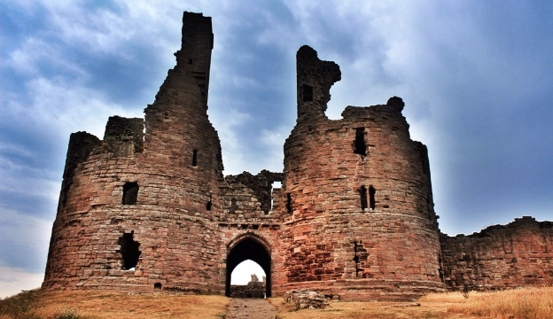
Jean Aitchison’s Language Change
Metaphors
Crumbling Castle
This model treats language as an old beautiful castle and presumes that at some point in time the language was perfect.
This model looks at how the language needs to be preserved to prevent more language change from occurring.
Overtime, some words or phrases may fall out of use due to those not doing anything to evolve language.
This model has prescriptive approach and is seen as negative because of the fact that the language at some point in time was seen as perfect and is now not.

Slide 38
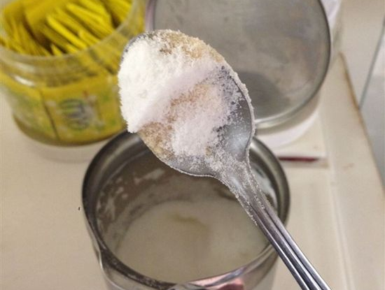
Jean Aitchison’s Language Change
Metaphors
Damp Spoon
This model looks at language change being 'distasteful' and 'lazy' and described it as putting a damp spoon into a sugar bowl due to peoples’ laziness of not finding another spoon to use.
An example of this would be dropping an apostrophe and contracting words incorrectly.
This model is seen to have a prescriptive approach and is seen as negative due to language being used ‘incorrectly’.

Slide 39
Jean Aitchison’s Language Change
Metaphors
Infectious Disease
This model looks at how language is changing.
Aitchison looks at language change happening in terms of people 'catching' it from other then spreading that language 'like a disease’.
It continues to change through social contact and people pick it up from others and then apply it to their own speech.
This model has a descriptive approach and the language change is not seen as negative.

Slide 40
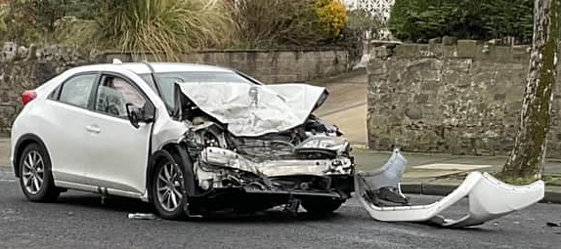
Jean Aitchison’s Language Change
Metaphors
Car Crash
“A car crash is only rarely caused by one overriding factor, such as a sudden steering failure, or the driver falling asleep”
Just like the aforementioned car crash, language change is exactly the same.
In her book, ‘Progress or Decay’ Aitchison suggests that Language Change occurs due to a multitude of reasons. It is rarely due to one significant event.

Slide 41
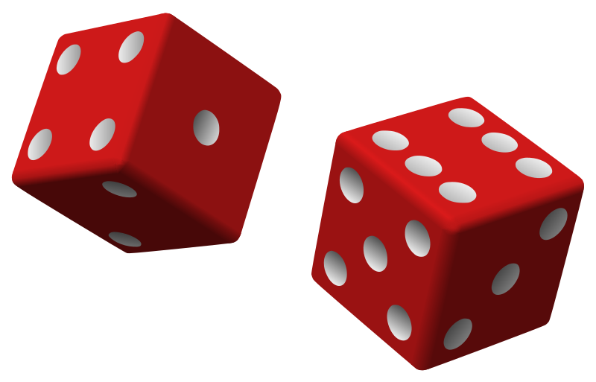
Other Theories of Language Change
Charles Hockett / Paul Postal – Random Fluctuation Theory
Random Fluctuation Theory was supported by two linguists.
Charles Hockett proposed that random ‘mistakes’ lead to language changing. For example, in gaming where ‘pwned’ means getting ‘owned’.
Paul Postal proposed a different angle, that language is as unpredictable as fashion and changes that occur are totally random.
A limitation of both theories would be that if they were true it would lead to linguistic chaos.

Slide 42
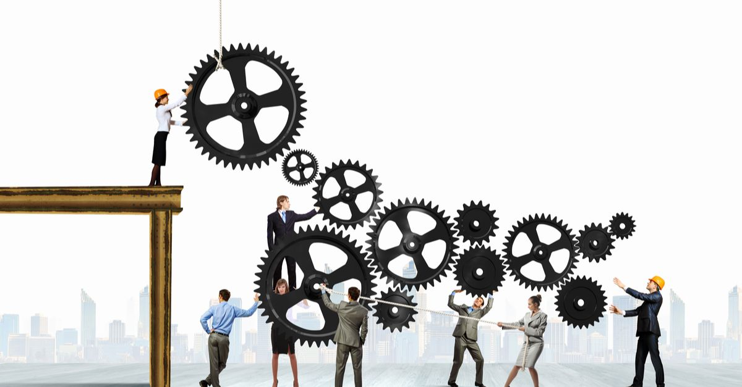
Other Theories of Language Change
M.A.K. Halliday – Functional Theory
The idea that language changes due to the needs of its users. This mainly relates to lexical change.
This ‘functional’ change tends to take the form of:
New discoveries/learning/inventions
Technological words
Slang

Slide 43
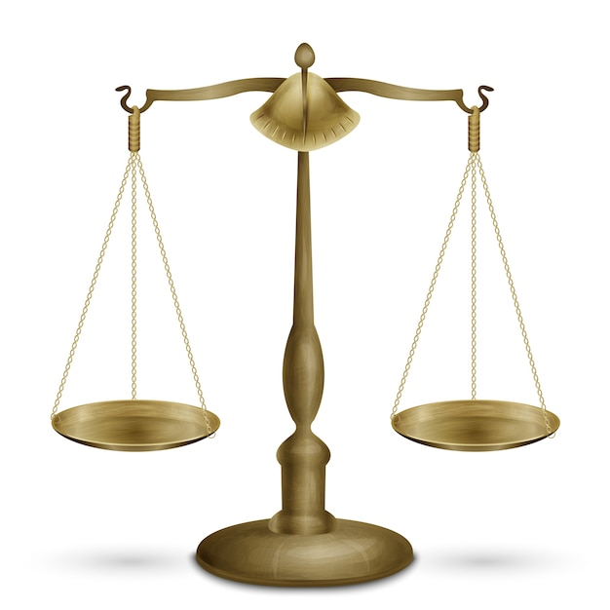
Other Theories of Language Change
Donald Mackinnon – Attitudes Towards Change (1996)
Donald Mackinnon suggested a way to look at attitudes towards language over time was by placing views on a scale / spectrum in terms of can language be seen as:
Correct or Incorrect
Pleasant or Ugly
Socially Acceptable or Socially Unacceptable
Morally Acceptable or Morally Unacceptable
Appropriate or Inappropriate in their context
Useful to us or Useless

Slide 44
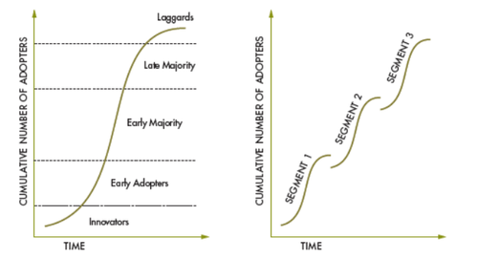
Language Change Spread Models
Chen – S-Curve (1968 & 1972)
This model is based on Chen who asserted that users would pick up a language change at a certain rate before spreading into wider language usage and then slowing.

Slide 45
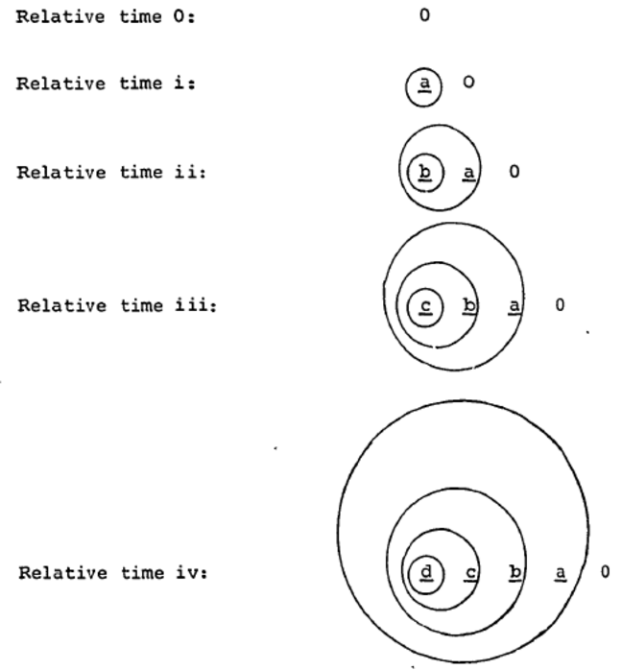
Language Change Spread Models
Bailey – Wave Theory (1973)
Just as someone who is close to the epicentre of an earthquake will feel the tremors, a person or group close to the epicentre of a language change will pick it up whereas a person or group further away from the centre of change is less likely to adopt it.

Slide 46
Language Change Spread Models
Aitchison – PIDC Model
Potential – Implementation – Diffusion - Codification
Potential – A need for a new word arises because of something new in the world.
Implementation – A few people start to use the new language.
Diffusion – The innovation spreads and is used more widely.
Codification – The new language enters the dictionary and is used as a standard form of the language.

Slide 47
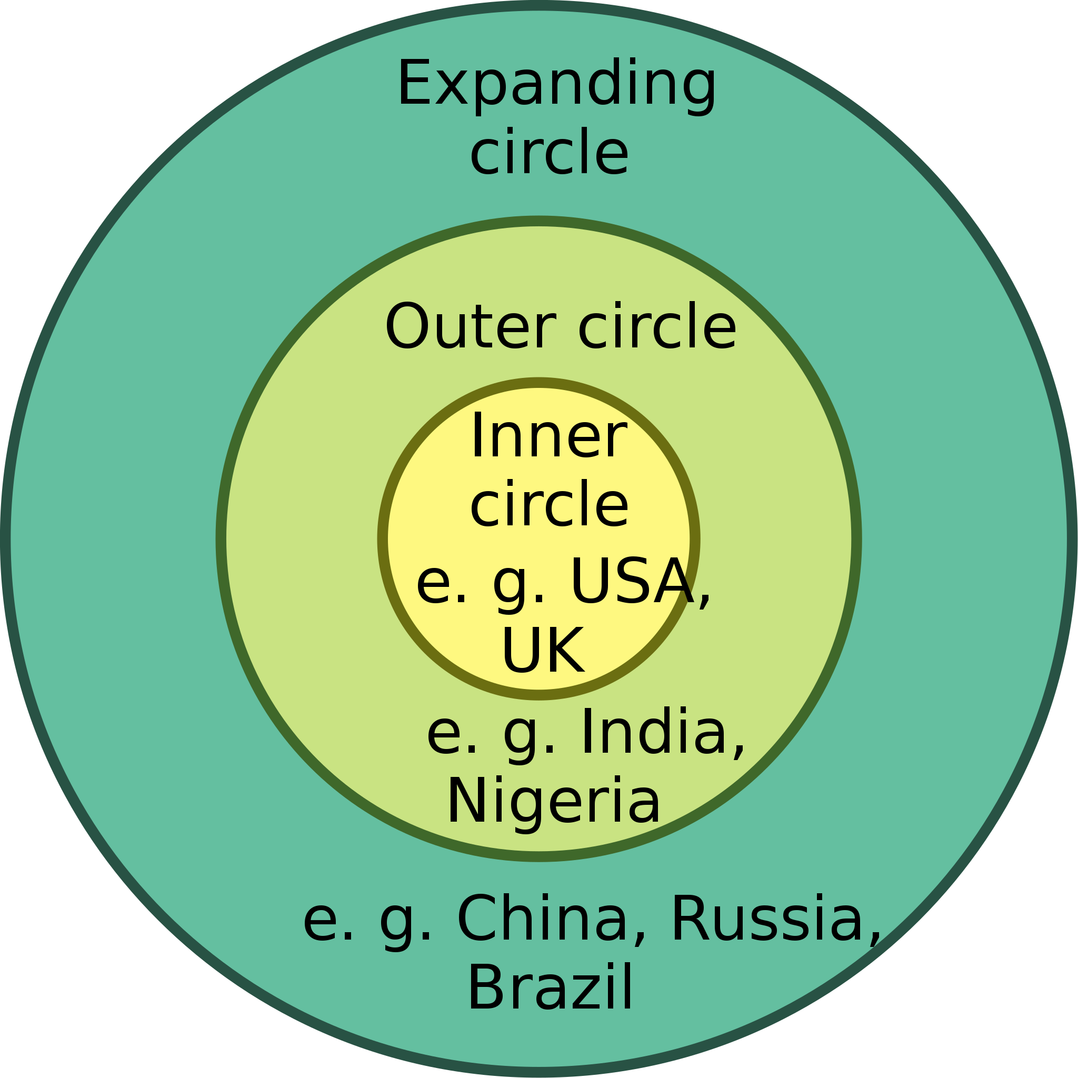
World English Models
Braj Kachru – 3 Circles Model (1982)

Slide 48
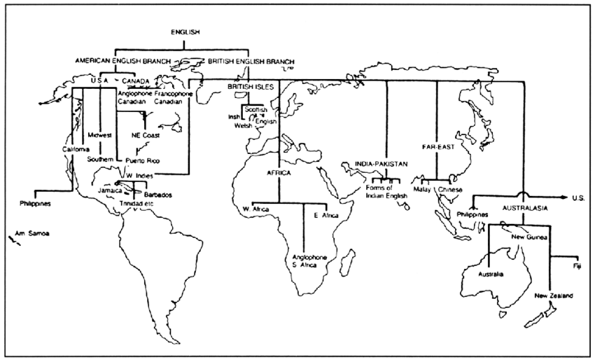
World English Models
Peter Strevens – ‘Family Tree’ Model [Br. & Am. English Beginnings] (1980)

Slide 49
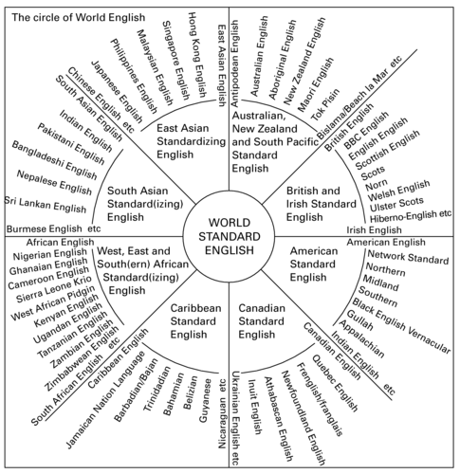
World English Models
Tom McArthur – Circle of World Englishes Model (1987)

Slide 50
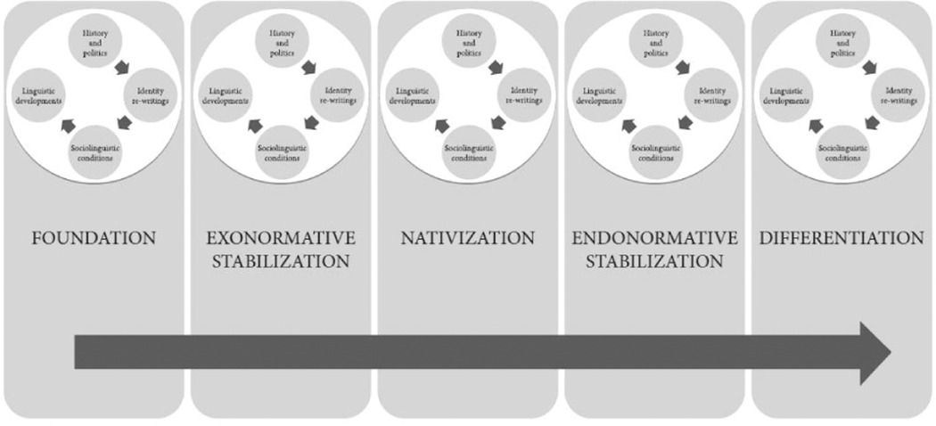
World English Models
Edgar Schneider – Dynamic Model (2007)

Slide 51
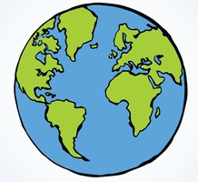
Future of English?
As a World Language
English is today the global language and is more widely used than any other language.
It is the recognised international language of business, technology (internet too!), politics and popular culture.
Jean-Paul Nerrière → Globish = International Business English consisting of just 1,500 words required to successfully communicate.
English is spoken as a first language on every continent – except South America.
The political strength of Britain may have declined, but the emergence of the United States as a world power has meant the continued spread of English (as a language).

Slide 52
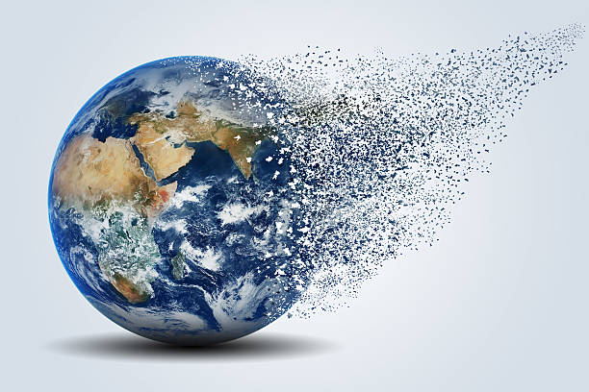
Future of English?
Potential Future 1: Disintegration
Each country around the world that speaks the English Language has its own variety. For example, important differences (such as phonology and lexis) exist between British English and American English.
Over time, the language used in each country adapts itself to the local needs and conditions – perhaps even a desire to develop a distinct version of English to promote national identity occurs.
This has, therefore, led some to speculate that eventually the English Language will DISINTEGRATE into a collection of related, but largely separate dialects.
Latin would be a comparison of this ‘potential fate’ – French, Italian and Spanish all developed from Latin originally.

Slide 53
Future of English?
Uniformity
A contrasting vision to disintegration predicts that development will move in the opposite direction… instead a world standard English will form instead.
The differences between varieties of English will decrease rather than increase.
Due to TV, internet, films, music and so on – a common culture is emerging and encouraging the growth of a common language.
The number of languages in the world is diminishing and the global spread of English can be viewed as being destructive.
In Australia it has been estimated that over 200 languages have been lost. In England, regional dialect vocabulary is also in decline.

Slide 54
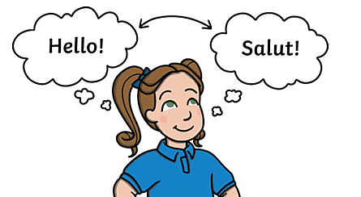
Future of English?
Bidialectalism
Some believe that the most likely future of the English Language won’t entail disintegration nor absolute uniformity – but instead a compromise between the two.
David Crystal (and others) support the view that bidialectalism – the ability to use two dialects of the same language – will persist and develop.
People will adapt their language to suit the needs of the situation they are in – whether that be professional or personal.
Speakers might use a local variety of English in their own community, but a different, more international, variety when speaking with speakers from other communities. Like a type of codeswitching.

Slide 55
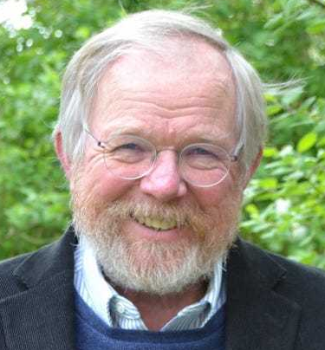
Future of English?
Final Thought
“If we should be worrying about anything to do with the future of English, it should not be that the various strands will drift apart but that they will grow indistinguishable. And what a sad, sad loss that would be”
Bill Bryson, 1990 (Travel Writer)

