Slide 1
100% SHEET 3. Understand how the impact of sports development can be measured
Content
3.1 Possible measures, i.e. • levels of performance • levels of participation • impact on society (e.g. in context of a specific social policy such as reducing obesity) 3.2 Methods, i.e. • for measuring performance, i.e. o benchmarks and quality schemes (e.g. Clubmark) o self-assessment o external assessment • for measuring participation, i.e. o surveys (e.g. Active People) o uptake of NGB schemes (e.g. SwimMark) • for measuring impact on society (e.g. against the policy or initiatives target such as obesity levels) 3.3 Purpose of measurement (e.g. demonstrate success, justify funding, identify areas to improve, illustrate best practice)
 | Self assessment
Clubmark is the universally acknowledged cross sport accreditation scheme for community sports clubs. It stands for: Higher standards of welfare, equity, coaching and management in community sports clubs. | (Quest Uk Quality scheme) Quest is a scheme based on impact and outcomes that stretches the sector generally, and high performing sites. five key areas of working with impact and outcomes, national governing bodies of sport, people development, legacy health and wellbeing.
advantages of using surveys
Cost effective/cheap to do Can reach a large number of people/saves travelling to ask questions Can be done electronically/data can be analysed/compared Easy to do/can be done quickly Can be shared on social media Can be done online/phone/paper
Benefits of a benchmark or quality scheme status like Clubmark
Attract funding Investment in new equipment/facilities/allows the club to grow Increase membership/amount of people in the club Parents aware that it is a safe club/safeguarding is in place/will take their child there Develop coaches Leading to better quality provision/ success/ improved player performance Helps the club run more effectively/more organized systems/allows for continued improvement
measuring the impact of sports development is important.
To demonstrate success of the initiative/event / increase in participation To justify the funding given to the initiative/event To identify areas to improve To illustrate best practice
disadvantages of using surveys
You may not get accurate valid responses / results May not get honest answers / they can lie People completing the survey may not feel comfortable answering some questions / provide partial answers People completing the survey may not understand the question Closed questions /Yes-No / limited in the questions you can ask Respondents can get bored / may not take seriously Data errors occur if questions are missed out

Slide 2
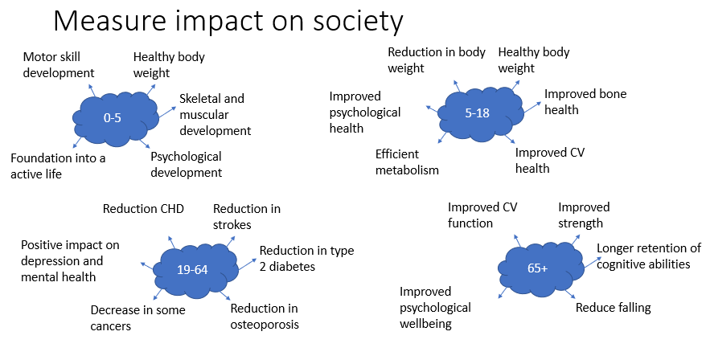
100% SHEET 3. Understand how the impact of sports development can be measured
success of this initiative could be measured
Participation – possible effects Increased numbers taking part overall, including at grassroots level Increased numbers taking part in target groups Greater frequency/regularity of participation More uptake/use of the activity in schools Increased level of demand on providers/increase in hire of equipment/facilities Increased membership/number of registrations with the NGB More popularity/demand for NGB events | Performance – possible effects Increasing numbers in performance programmes Improved outcomes achieved in age–group levels Improved performance at events at different levels/increase in elite performers Increased number of coaches required at different levels Increased standard of coaches required at different levels
success of this initiative could be measured
The number of people attending the events Increased on-going participation following the initiative… …could be at local or national level New members gained Feedback from participants Enquiries/hits on websites Use of social media (trending hashtags) Court bookings/usage | More satisfaction amongst participants A positive impact on local priorities/campaigns Improved behavior in schools/links to inner city Levels of performance increased Created opportunities to volunteer

