Slide 1
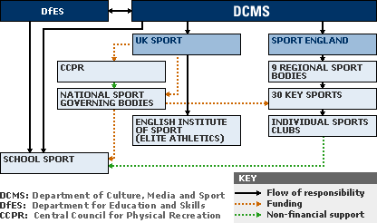
UNIT 3 (LO1) Understand how sport in the UK is organised.
A Introduction | B Content
The organisation of sport in the UK can be quite complex with multiple agencies and organisations, both inside of and outside of the UK, working together at different levels on different agendas. One of the key areas which most, if not all, of the organisations involved in sport in the UK are concerned with is sports development and the increase of participation. in sport and physical activity, both to improve the health of the nation but also to aid the development of elite athletes who can compete and achieve on an international level. | • Government, o Department for Culture, Media and Sport o Department of Health o Department for Education • National Governing Bodies o Rugby Football Union (RFU), Badminton England, Rounders England, Lawn Tennis Association (LTA)) • National Disability Sports Organisations (NDSOs) • National Lottery • Sport England • UK Sport • Sport and Recreation Alliance • Active Partnerships • local councils • other organisations (e.g. Youth Sports Trust, Association for Physical Education (AfPE), Chartered Institute for the Management of Sport and Physical Activity (CIMSPA), Activity Alliance)
D | KEY TERMS
Department for Culture, Media and Sport | helps to drive growth, enrich lives and promote Britain abroad.
Department of Health | We support ministers in leading the nation's health and social care to help people live more independent, healthier lives for longer.
Department for Education | Is the British government department responsible for child protection, child services, education, apprenticeships and wider skills in England
National Governing Bodies | Making up 100 of our members, our national governing bodies, also known as NGBS, are the custodians of sport and help clubs and activity to run across the country.
National Disability Sports Organisations (NDSOs) | They provide advice, support and opportunities for people of all ages with specific impairments.
National Lottery | The National Lottery is the state-franchised national lottery established in 1994 in the United Kingdom.
Sport England | Is a non-departmental public body under the Department for Digital, Culture, Media and Sport, vision is to transform lives and communities through sport and physical activity
UK Sport | Is the government agency responsible for investing in Olympic and Paralympic sport in the United Kingdom. It is an executive non-departmental public body sponsored by the Department for Digital, Culture, Media & Sport
Sport and Recreation Alliance | is the umbrella body for sport and recreation in the UK and represents 320 members to tackle the challenges and take advantage of opportunities. We are the voice of the sector with Government, policy makers and the media. We help get the nation active at the grassroots by providing advice, support and guidance.
Active Partnerships | There are 42 Active Partnerships across England who use the power of sport and physical activity to transform lives. We collaborate with local partners across all sports, activities, providers, and audiences, focused on the needs of our local communities to create the conditions for an active nation. We focus our efforts on inactive people and under- represented groups who will benefit the most from an active lifestyle.
C Structure of UK sport

Slide 2
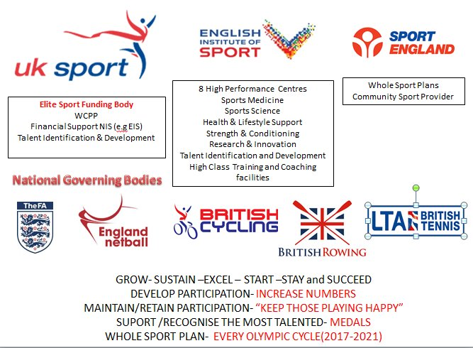
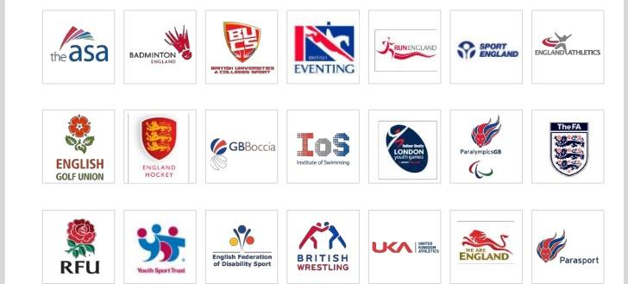
UNIT 3 (LO1) Understand how sport in the UK is organised
D | KEY TERMS
Youth Sports Trust | is the UK's leading charity improving every young person's education and development through sport and play.
Association for Physical Education (AfPE) | The Association for Physical Education (afPE) is the PE Subject Association in the UK. They promote and maintain high standards and safe practice in all aspects and at all levels of physical education, school sport and physical activity, influencing developments at national and local levels that will impact on pupils’ physical health and emotional well-being.
Chartered Institute for the Management of Sport and Physical Activity (CIMSPA) | is the professional development body for the UK’s sport and physical activity sector, committed to supporting, developing and enabling professionals and organisations to succeed and, as a result, inspire our nation to become more active.
Activity Alliance | The national charity and leading voice for disabled people in sport and activity
local councils | Local authorities have a central role to play in the provision of community sport and recreation facilities. From the local parks to leisure centres, local councils enable a huge range of leisure activities and sport to happen
C Structure of UK sport

Slide 3
UNIT 3 (LO1) Understand how sport in the UK is organised.
D | KEY TERMS
Department for Culture, Media & Sport (DCMS) | The DCMS states its roles are to improve the quality of life for all through cultural and sporting activities and through strengthening of the creative industries. Sport is one area in which these aims are pursued. As a result, the DCMS promotes the government’s policies, for example, the Sporting Future strategy, aiming to widen access to sport and physical activity. It therefore has two main agendas: promoting mass participation and developing sporting excellence. The DCMS develops policies aimed at fulfilling these two agendas. It also supplies the funding to achieve the policy aims. The actual implementation of these policies is then in the hands of other organisations, such as UK Sport and Sport England. These organisations are directly accountable to the DCMS. The DCMS was responsible for the delivery of the 2012 Olympic Games and Paralympic Games.
Department for Education (DfE) | The DfE is responsible for education and children’s services in England. In terms of sport, the DfE has responsibility for many of the government’s policies and strategies aimed at using physical education and school sport to achieve many educational aims. For example, the DfE was responsible for the delivery of the very successful PE, School Sport and Club Links (PESSCL) strategy in 2002. More recently, the DfE works alongside other key governmental departments in delivering the Primary PE and Sport Premium. This initiative aims to use £150 million per annum to improve the provision of physical education and sport in primary schools in England.
English Institute of Sport (EIS) | This organisation helps athletes to improve their sporting performance through the delivery of science, medicine, technology and engineering support. It is an owned subsidiary of UK Sport and receives over £60 million from them every four years to provide world class services to elite athletes and their coaches. Support is delivered through a network of nine high-performance centres across England. Loughborough University and Holme Pierrepont are examples of these centres.
International Olympic Committee (IOC) | The IOC is an international, non-profit, non-governmental organisation. It is the supreme authority of the Olympic movement. The IOC organises the modern Olympic Games and Youth Olympic Games, held in summer and winter, every four years.
Sport England | This organisation is responsible for increasing the number of people participating in sport and physical activity. In contrast to UK Sport, it therefore focuses very much on mass participation as opposed to elite level sports development. Sport England is a key organisation responsible for delivering the government’s Sporting Future strategy.
UK Sport | Founded in 1997, this organisation is responsible for the development of elite level sport in the UK. It uses over £100 million every year of public taxes and National Lottery funding to support the nation’s Olympic and Paralympic athletes in their pursuit of medals on the international stage. UK Sport works very closely with NGBs of sport to ensure that the support given operates as effectively as possible. It is accountable to the Department for Culture, Media & Sport (DCMS).
World Class Programme | UK Sport created the World Class Programme to provide world class support to elite level athletes in this country. It covers all funded summer and winter Olympic and Paralympic sports and is delivered by the NGBs for sport. It operates at two levels: Podium – supports athletes with a realistic medal winning chance at the next Olympic/Paralympic Games (four years away); Podium Potential – supports athletes who have a realistic chance of winning a medal at the subsequent Olympic and Paralympic Games (eight years away).
Whole sport plans | Sport England is investing over £400 million of public money and National Lottery funding into 46 NGBs of sport between 2013 and 2017. In order to receive this funding, each NGB is required to produce and submit whole sport plans detailing how they would use this money to help them increase the number of people playing their sport and how they would nurture and develop talent. Sport England then assesses the plan, and if the NGB meets the criteria, they receive funding

Slide 4
UNIT 3 (LO1) Understand how sport in the UK is organised
C 1.1 ORGANISATIONS INVOLVED
Governmental departments. | Department of Health Department for Education Department for Culture, Media and Sport
Role of the Department of Health in Sport in the UK. | They want to encourage people to be more active
Sports development initiative. | Sport Relief Couch to 5k This Girl Can Street Games
Role of DCMS. | Works with DfE and/or DoH Increases participation/gets people involves Funds Sport England/UK Sport Promotes lifelong involvement amongst 14-25 year olds Contributes to the ‘school games programme’ Provides more opportunities to play competitive sport Promotes major sporting events throughout the UK
How the Department for Education (DfE) is involved with the organisation of sport in the UK. | Determine amount of Physical Education in the national curriculum/What is included in the PE curriculum Funding for school PE / PE and Sport Premium Support initiatives such as the school games programme Protect school playing fields (Works with Sport England to) train teachers/organise CPD 6. Encourage healthy lifelong participation
UK NGB’s | Football Association (FA) Rugby Football Association (RFU) England and Wales Cricket Board (ECB) Lawn Tennis Association (LTA) English Basketball Association (EBBA)
Role of Sport England | Increases participation/gets more people involved/reduces dropout/more involved at grassroots Launches campaigns/initiatives Supports governments targets Provides/distributed lottery/government targets Promotes/encourages volunteers/coaches/leadership/officials Targets priority groups e.g. disabled Works with other organisations e.g NGB’s, YST, National Lottery Responsible for funding some elite performers Provides information and expertise Protects community playing fields/provides community facilities
Role of UK sport | Develop strategies to help excellence/elite/medal hopefuls Manages lottery funding Manages the world class programme Promotes ethical behaviour/runs anti-doping programme Attracts major events e.g. London 2012 Enhances the organisation and administration of sport Works With NGB’s. Top coaches Provides Performance Lifestyle Advice (PLA) Launches Talent ID campaigns, looks for high performance athletes
Positive impacts which lottery funding has on sport. | Provides economic benefits eg urban regeneration Improves elite level sport Supports the generation of more full-time jobs in sport Improves health By providing opportunities to take part in initiatives/events/comps 6. To increase participation Improvements in attainment in schools/increased progression to higher education/ Improve self-esteem of people playing in sport Reduce crime rates/Anti-social behaviour Improves facilities/equipment

Slide 5
UNIT 3 (LO1) Understand how sport in the UK is organised
C 1.2 ROLES & RESPONSIBILITIES OF ORGANISATIONS
How sport development is funded in the UK | Government National Lottery NGB Princes Trust Membership subscriptions Sponsorship
How CSP attempt to increase participation in sport | Provide a single contact point for a variety of sporting events and activities Through promotional campaigns / coordinated marketing Interpret & mould policies (national/regional/local) to best suit communities By providing networking opportunities e.g. working with NGBs/schools / sharing best practice By implementing school / community games By making best/efficient use of facilities /equipment By subsidising events By putting on free taster days Training volunteers Implement promotional campaigns to raise awareness Organise networking groups/conferences Share good practice and case histories Help to implement School Games Programmes/comps Implement community games Create a legacy from London 2012 Support young workers to volunteer Sport Makers/satellite centres Works with target groups
UK Sport | UK Sport invests National Lottery and government funding into both Olympic and paralympic sport. UK Sport aims to support athletes in order to maximise their chance of medal success. They run a World Class Programme which helps athletes by providing top
Roles or responsibilities of an NGB | Sports development Setting of rules and regulations Organising competitions/tournaments/initiatives/events 4. Increasing participation rates Involvement with target groups Talent development Raising awareness/increased publicity/promote sport Develop grassroots (e.g. Just Play) Providing ethics/education to athletes and performers Eg Anti-doping/nutrition/equality Training coaches/officials providing the framework for coaches (e.g. FA Level 1) Providing/distribute funding
How the DCMS and DFE help other sports organisations to develop sports participation. | Secure funding from treasury for investment in sport Distribute/receive funding to sports organizations Help to attract sponsorship Promote initiatives to improve participation levels Organise events/comps with other organisations Fund education/training Promote roles in sport Retention of PE as part of core school curriculum Policies which affect sport such as selling school playing fields Use of sporting role models to back government initiatives
How NDSO’s develop and promote sporting opportunities (Jan 2017) | Work with NGB’s to deliver an inclusive programme Work with EFDS to ensure all disabled people are active for life Organise sports events & competitions for all ages Support gifted and talented athletes to train and compete in national & international comps Provide opportunities to learn new skills, meet others, participate Provide funding for facilities/equipment
UK Sport | The primary role of UK Sport is to invest money to maximise the performance of UK athletes in the Olympic and Paralympic Games and other global events. To achieve this UK Sport invests some of its income through central funding for sporting National Governing Bodies (NGBs), enabling them to operate a World Class Programme (WCP) and ensuring athletes have access to outstanding support personnel and training environments to ensure they are among the best prepared in the world.
The Prince's Trust | Is a charity in the United Kingdom founded in 1976 by King Charles III to help vulnerable young people get their lives on track. It supports 11-to-30-year-olds who are unemployed or struggling at school and at risk of exclusion

Slide 6
UNIT 3 (LO1) Understand how sport in the UK is organised
C 1.2 ROLES & RESPONSIBILITIES OF ORGANISATIONS
The School Games, which is funded by Sport England and delivered by the Youth Sport Trust, is a sports initiative which provides chances for young people to take part in different sports events within their schools and between schools, at local, regional and national level. | Provides more opportunities/new experiences for those not engaged in competitive sport Provides access to a range of competition formats Develops a young person’s skills/values Develops active/healthier lifestyles Allows young people to challenge themselves/be competitive Allows young people to have fun/enjoyment Develops leadership skills through volunteer roles e.g. officials Develops experience of emotions linked to winning and losing May improve attainment/engagement in school Compliments other school initiatives/improves extra-curricular clubs/improves school networks Increases the reputation/standing of the school
UK Sport provides strategic support for its world-class coaches when working with elite performers. One way that they do this is through investment in performance analysis. | Allows focus on strengths and weaknesses of players /What the performer needs to improve on Uses video platforms e.g. Dartfish/slow motion replay Support the training environment through use of video/data monitoring-statistical data e.g.s GPS trackers/amount of successful passes made/tackles made Enhances performance / Helps them progress . Understand where performers are in terms of their performance Uses video/data in real-time to provide improved feedback during performance Allows focus on strengths and weaknesses of opposition player Provides post event analysis
The Department for Health funded the Youth Sports Trust to run the ‘Change 4 Life’ sports clubs, which encourage less active children to take part in more physical activity. Describe the values developed and physiological benefits for a child participating in regular physical activity through a Change 4 Life club. | Physiological benefits: Increased bone density/ Make bones stronger/ reduces Osteoporosis Increased tendon strength/increased flexibility Greater pliability/extensibility of muscle tissues/ Stronger Muscles 4. Increased vital capacity Increased strength of respiratory muscles Cardiac hypertrophy / Stronger Heart / Improved cardiovascular fitness / Reduce Blood Pressure Decreased resting heart rate Decreased recovery time/Be able to participate in the activity without getting tired Control body weight/Prevent obesity Reducing the chances of Chronic diseases (CHD Diabetes) Values gained Fair play/honesty/By adhering to the rules and spirit of the game / Discipline Sportsmanship Teamwork /or examples of teamwork. Develop communication skills Develop leadership skills (e.g. Captain) Tolerance, Respect, Equality. Appreciate other people/may participate with those who have a disability Opportunity to play with others outside friendship group Life-long participation/ Opportunity to try something new and become a new hobby Resilience/Determination/courage
Examples of actions taken by NGB linked to the role or responsibility shown. | Enable members to gain insurance for their club = admin and funding Updating anti-doping policy for the sport = setting rules and regs Reviewing progression pathways in the sport = sports development Run inter-school competitions in the sport = organising competitions Primary and junior school sessions introducing young people to the sport = sports development

Slide 7
UNIT 3 (LO1) Understand how sport in the UK is organised
1.3 INTERNATIONAL & EUROPEAN ORGANISATIONS
International governing bodies in sport | FIFA (Football) FINA (Swimming) IAAF (Athletics) IOC (Olympics)
International governing body and describe the role of that organisation | Promotes the game/event/increases participation Organises tournaments/events decide on host nation Creates and amends the laws of the game (FIFA) Uses the game to unite people/remove barriers Uses the game to improve education Uses the game to improve ethics and fair play Tackles drug problems Promotes equality in sport and the participation of women
European governing bodies in sport. | UEFA (Football) European Boxing Union (EBU) European Cricket Council (ECC) European Athletic Association/European Athletics Badminton Europe Rugby Europe Netball Europe
International sports organisation impacts sport in the UK | Provide administrative and promotional support Coordinate events/comps/tournaments Agree and amend the rules of the game/doping policy Uses sport to unite/remove barriers Uses sport to improve education Uses sports to improve health and quality of life Provides financial support/distributes resources
International organisation and how its work impacts on sport in the UK. | Increase participation Sets rules and regulations Uniting people, removing barriers, improving education / Promote youth education improving health and the quality of life Using the success of major events (e.g. World Cup/Olympics) to distribute resources to develop sport in the UK. Sets international and European fixtures dates Promote values ethics and fair play Help with the organisation, development and planning of competitions Promote the Involvement of different target groups Challenge of drug use in sport Promote (environmental and sustainable) sports development Implementation of new technology

Slide 8
UNIT 3 (LO1) Understand how sport in the UK is organised
1.4 HOW THE DIFFERENT ORGANISATIONS INTERACT WITH EACH OTHER
How NGB’s work with UK sport organisations. | NGBs and Sport England – Sport England invests significant funds into individual NGBs and provides financial support to NGB elite development programmes NGBs and EFDS – EFDS work in partnership with NGBs to promote inclusion and improve provision and participation amongst disabled people in the relevant sport/activity NGBs and Government – e.g. UK athletics, DCMS and British Olympic Association working together to win bidding process and deliver London 2012
How does national governing body (NGB) and Sport England work together. | Improve provision/opportunity/increase participation/eg set up competitions/events Meet government recommendations for physical activity for 14-25 year olds Reducing barriers for under-represented groups (e.g. Female) /more accessible for target groups Develop projects aimed at disabled people to increase participation Provides funding for NGB elite development programmes Improves coaching standards (through The Coaching Plan) Help support the delivery of Whole Sport Plans Provides safeguarding and support resources to the NGB’s Deliver ‘The High Performing NGB programme. Develop grassroots provision to identify and develop talent.
Unit 3 Sports organisation and development
LO1 Understand how sport in the UK is organised
LO2 Understand sports development
LO3 Understand how the impact of sports development can be measured LO4 Understand sports development in practice

