Slide 1
A guide to preparing for end of year assessments

Slide 2
A Revision Timetable – Week A
Times | Monday | Tuesday | Wednesday | Thursday | Friday | Times for the weekend | Saturday | Sunday
3.30 – 4.00
4.00-4.30
4.30 – 5.00
5.00-5.30
5.30 -6.00
6,30 – 7.00
7.00 – 7.30

Slide 3
A Revision Timetable – Week B
Times | Monday | Tuesday | Wednesday | Thursday | Friday | Times for the weekend | Saturday | Sunday
3.30 – 4.00
4.00-4.30
4.30 – 5.00
5.00-5.30
5.30 -6.00
6,30 – 7.00
7.00 – 7.30

Slide 4
Top revision tips!
Make the best use of every moment in your lessons. Lesson time is the most important time to embed learning and developing news skills and knowledge.
Make use of the online platform Seneca and the Useful websites recommended by each subject area on the school website.
Attend every intervention session and give your best.
Do not bury your head in the sand. If you are struggling then speak to your Subject Teacher or your Progress Manager.

Slide 5
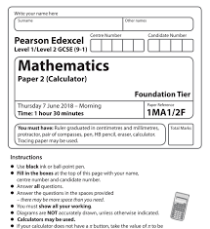
Revision Strategy 1:Past paper questions.
You should begin trying past paper questions as far in advance of your exam as possible.
Ask your subject teacher the exact name of the exam board and specification.
Look out for the exam verbs (describe, explain and evaluate) and try and picture the mark scheme.

Slide 6
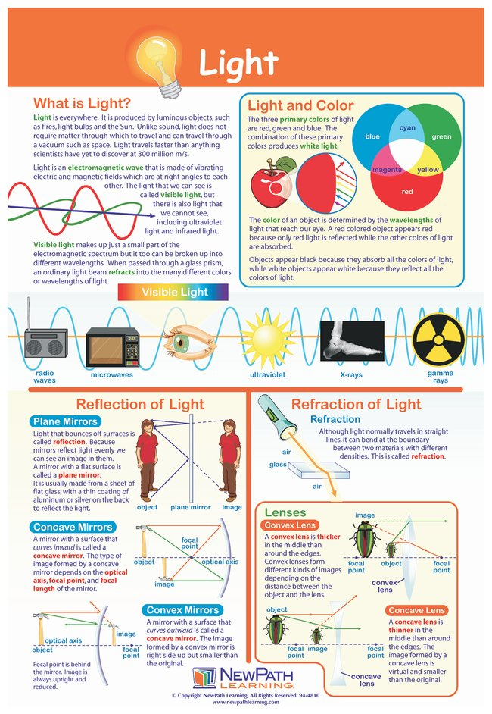
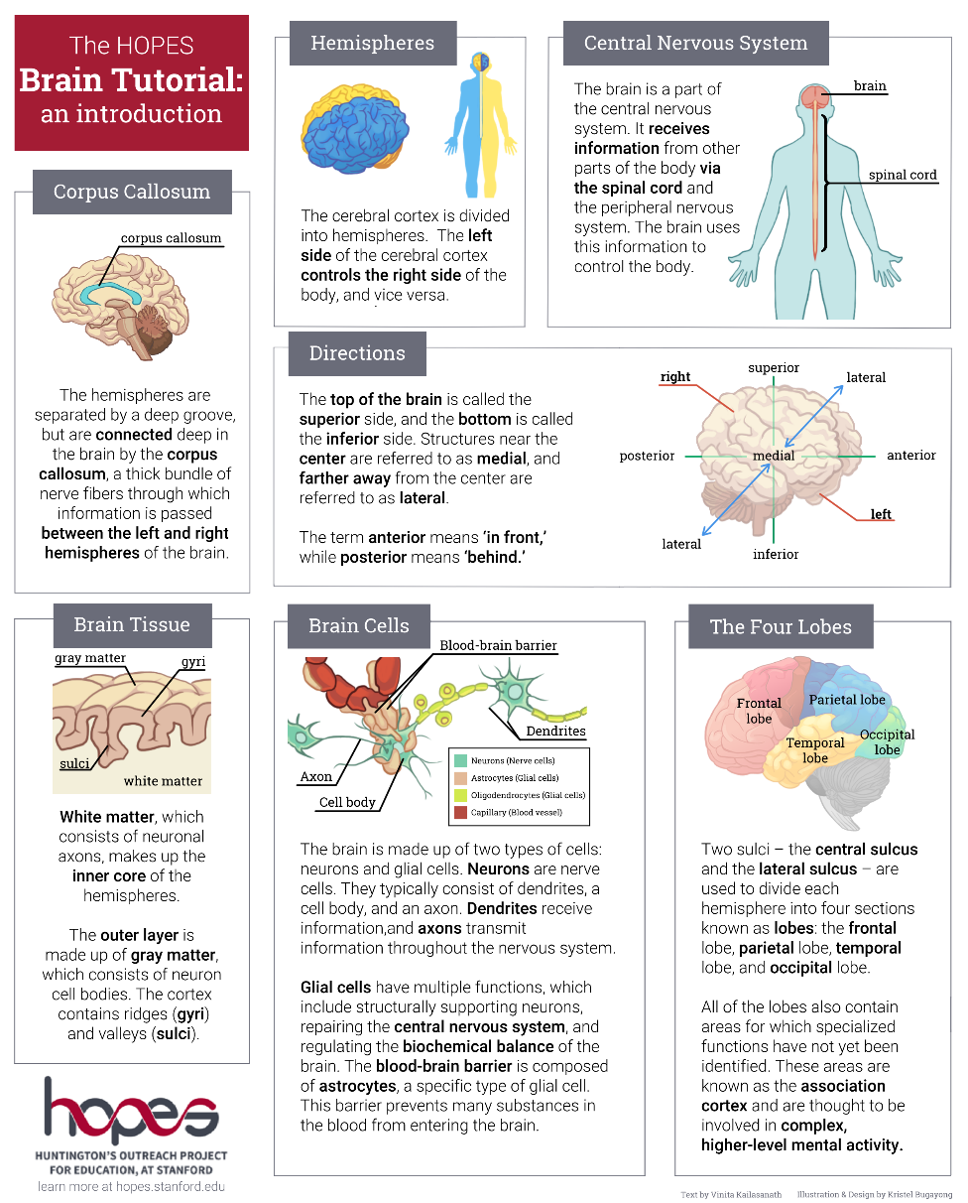
Revision Strategy 2:Fact sheet.
Compile a fact sheet that has key words, diagrams, information and images about a topic

Slide 7
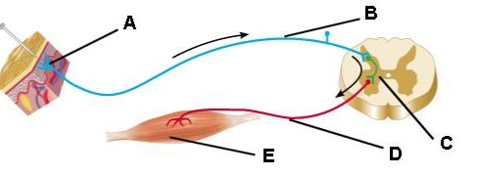
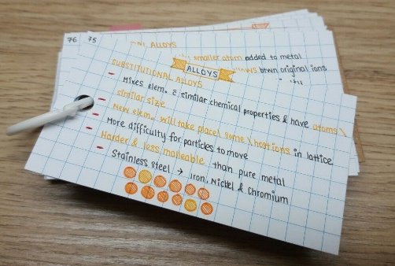
Revision Strategy 3: Flash Cards.
How does the reflex arc work?
Create a set of flash cards that contain key pieces of information and vocabulary for a topic
What are the main parts of the reflex arc?
A – Receptor (reacts to a stimulus)
B – Sensory Neuron (carries message to the co-ordinator/CNS)
C – Relay Neuron Gaps between neurons are called SYNAPSES
D – Motor Neuron (carries message away from co-ordinator/CNS
E – Effector (a muscle or gland)

Slide 8
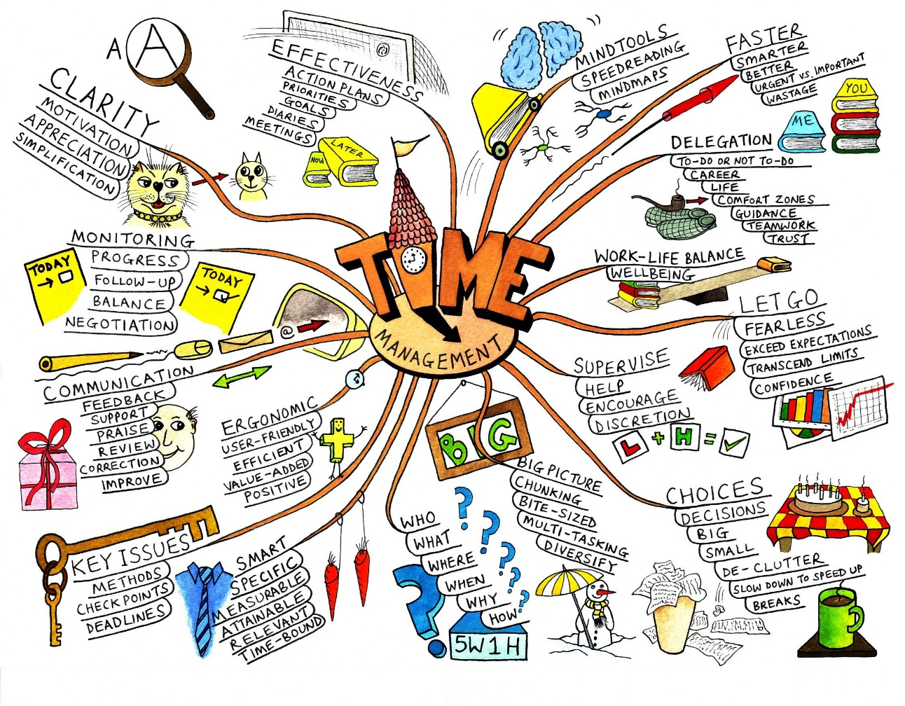
Revision Strategy 4: Mind Maps.
Produce a mind map to logically organise key concepts – perhaps even add illustrations

Slide 9
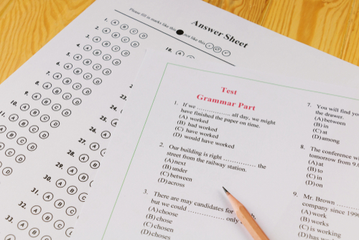
Revision Strategy 5:Quizzes.
Compose a quiz on what you have learnt about a topic and test a family member or friend

Slide 10
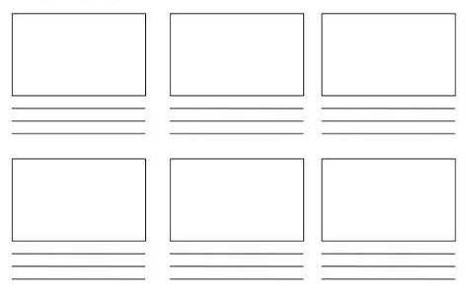
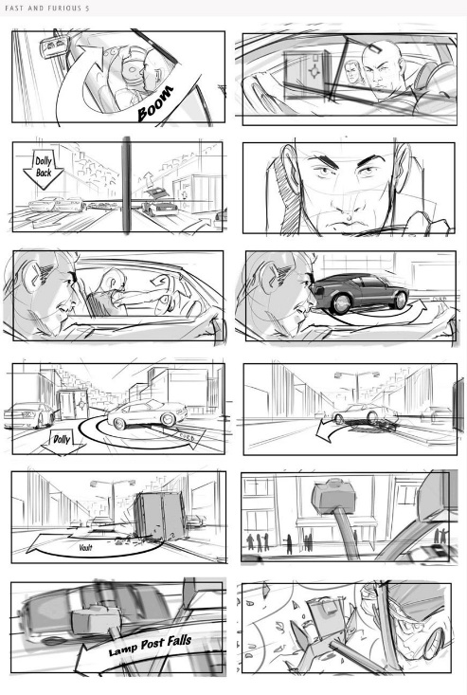
Revision Strategy 6:Comic Strip/Storyboard.
Construct a graphical representation of a topic, event or concept in a storyboard or comic

Slide 11
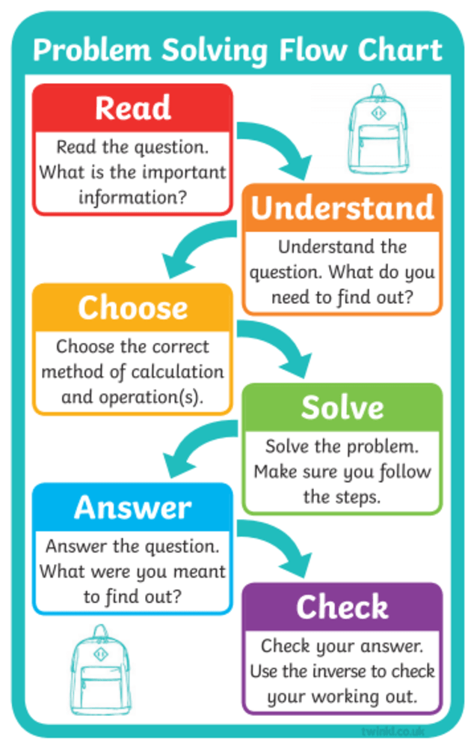
Revision Strategy 7:Flow Charts.
Demonstrate your understanding of topics or processes with the production of a flow chart

Slide 12
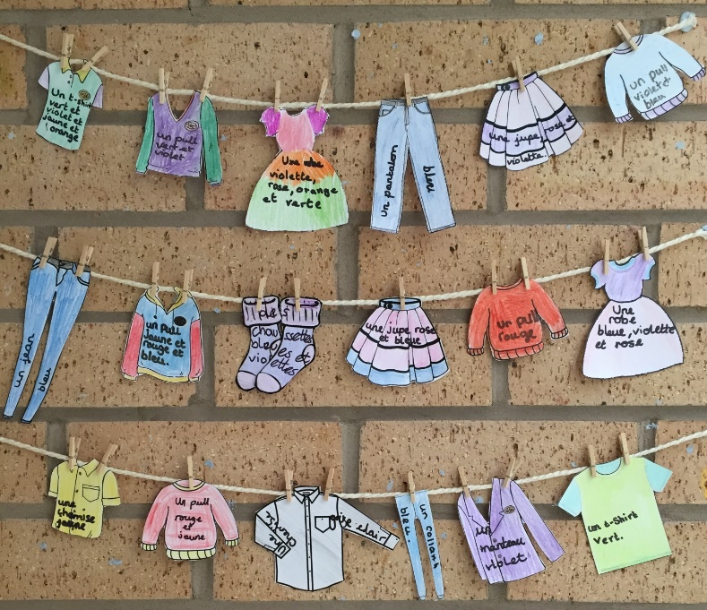
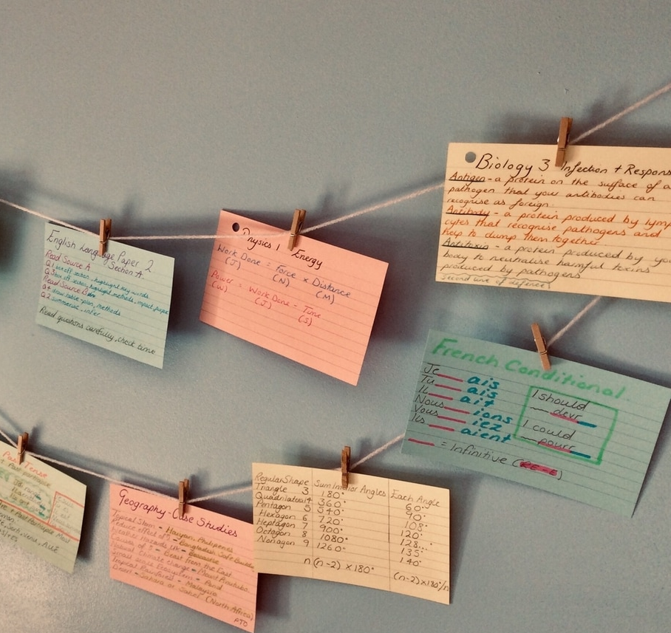
Revision Strategy 8:Washing line learning.
Cut out key vocabulary terms into the shape it represents and peg to a washing line

Slide 13
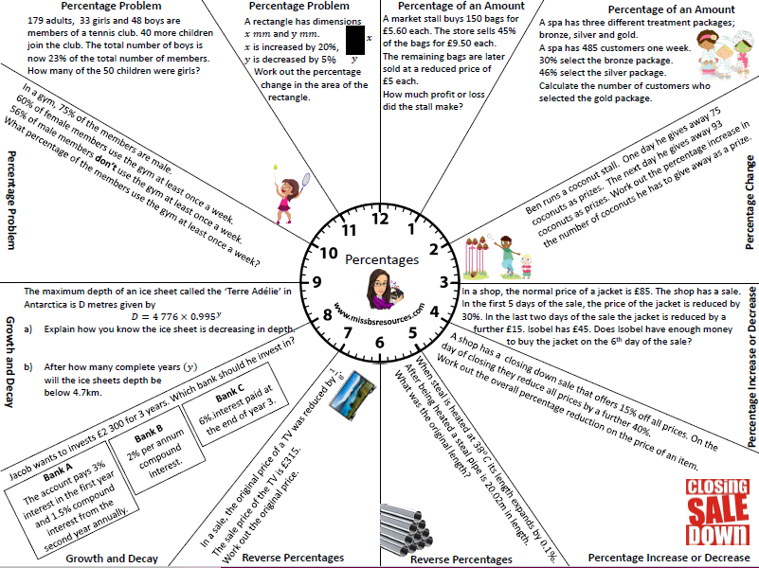
Revision Strategy 9:Clock Learning.
Divide a page into 12 sections (like a clock) and add information about a topic in each section

Slide 14
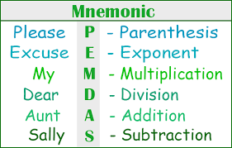
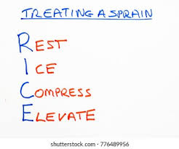
Revision Strategy 10:mnemonics.
A mnemonic is a pattern of letters that help us to remember something.

Slide 15
Revision Strategy 11:Test yourself.
1)Silent revision – READ (3 minutes) You could read the resource You could draw out the resource You could make notes https://www.online-stopwatch.com/countdown-timer/ | 2)Test yourself (In silence) (3 minutes) Turn the resource over and test yourself Try to re-write what you can remember. definitions/explanations Try to re-draw the spider diagram Think Hard
3)Silent revision Go back over your notes… CHECK (2 minutes) You could re-read the resource You could add to the resource You could continue to write notes | 4)In silence (Re-Test) (3 minutes) Test each other Turn the resource over and test yourself Try to re-write what you can remember. definitions/explanations Try to re-draw the spider diagram Think Hard

Slide 16
Revision websites.
MFL:
https://senecalearning.com/en-GB/
Geography:
https://www.bbc.co.uk/bitesize/examspecs/zsytxsg
https://timeforgeography.co.uk/
https://app.senecalearning.com/classroom/course/c25820ce-c6f1-436f-b33b-917b620631dc/section/8683454e-9aed-45af-b4ff-5f6272fe6a46/session
History:
https://www.bbc.co.uk/bitesize/examspecs/zw4bv4j
https://www.bbc.co.uk/teach/class-clips-video/medicine-through-time/zdcy8xs
https://www.youtube.com/playlist?list=PLcvEcrsF_9zLBPrC0QDfASQ1MDqYzedVj
https://www.historylearningsite.co.uk/
Sport and Recreation:
https://www.bbc.co.uk/bitesize/examspecs/ztrcg82
https://www.bbc.co.uk/teach/gcse-national-5-physical-education/zh92vk7
https://www.brianmac.co.uk/
https://www.topendsports.com/
Computer Science https://www.youtube.com/c/craigndave/playlists?view=50&sort=dd&shelf_id=1 https://www.youtube.com/c/ComputerScienceTutor/playlists?view=50&sort=dd&shelf_id=2 https://www.codecademy.com/
Science:
https://www.bbc.co.uk/bitesize/subjects/zrkw2hv
https://senecalearning.com/
https://www.youtube.com/channel/UCqbOeHaAUXw9Il7sBVG3_bw
Maths:
https://www.mathseffect.co.uk/
https://www.mathsgenie.co.uk/
https://www.onmaths.com/
https://www.drfrostmaths.com/login.php?url=%2Fdashboard.php
English:
https://drive.google.com/drive/folders/1AWgsx6aBeZjG-_UTIsTpajMeEopnMkMk
https://www.bbc.co.uk/bitesize/levels/z98jmp3
www.senecalearning.com
https://www.youtube.com/channel/UCM2vdqz-7e4HAuzhpFuRY8w
Expressive Arts:
https://www.bbc.co.uk/bitesize/guides/z39x34j/revision/1

